Slide 1
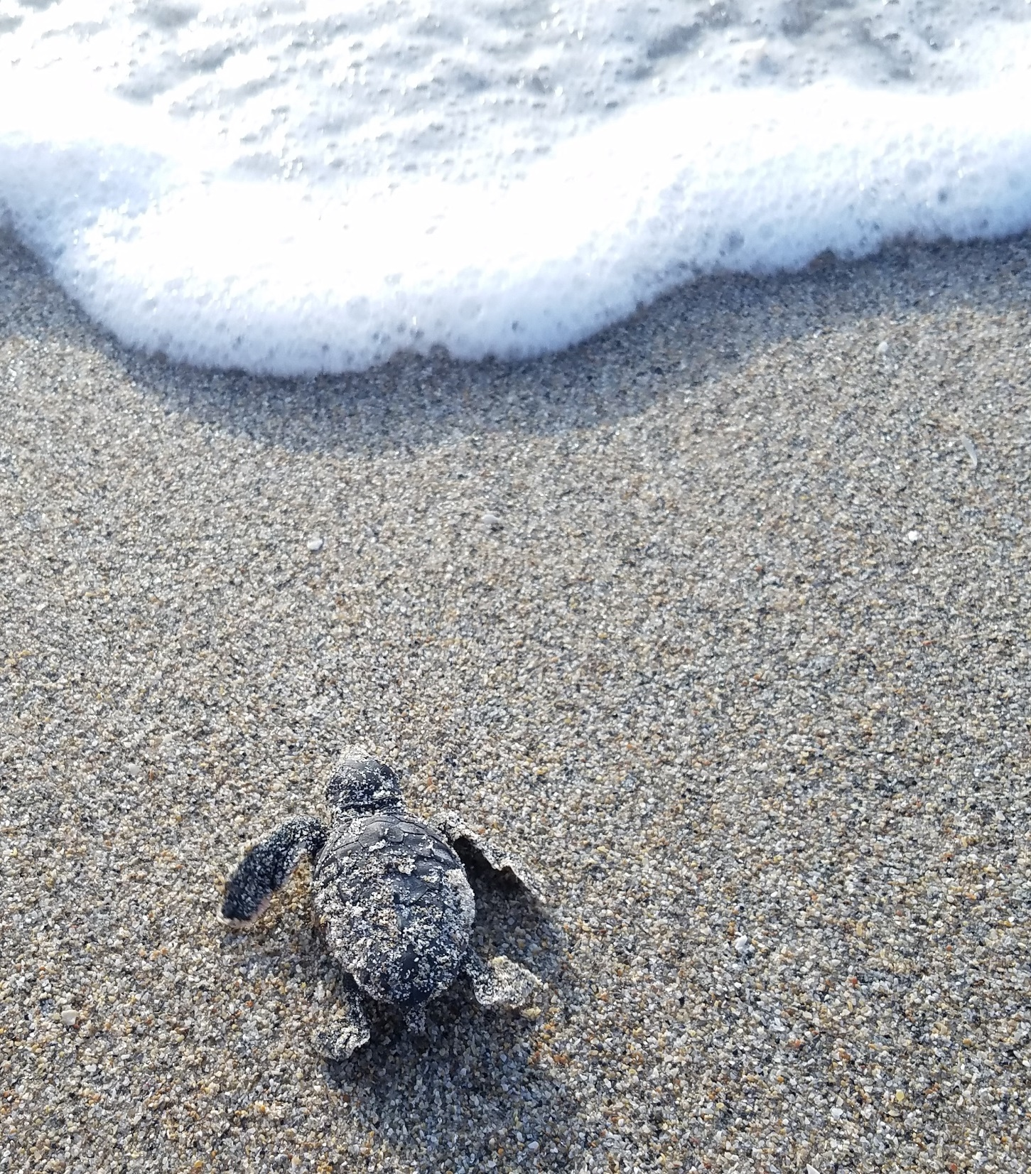


Sea Turtles and Lights
Balancing Property Rights, Safety, and Sea Turtle Survival
Tonya Long, Luke Davis, Rachael Stevenson
Imperiled Species Management
Florida Fish & Wildlife Conservation Commission
Photo: T. Long, FWC

Slide 2
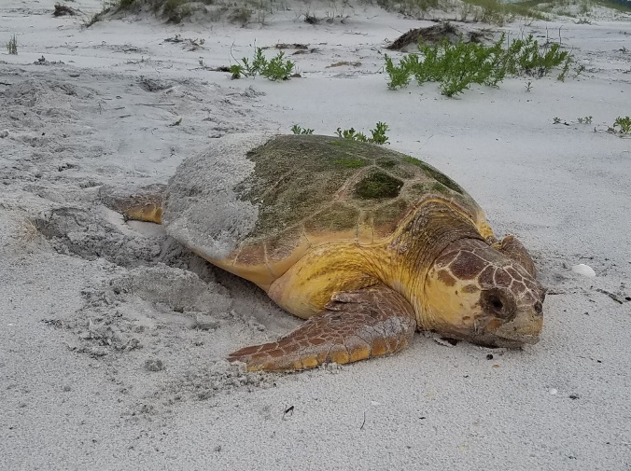
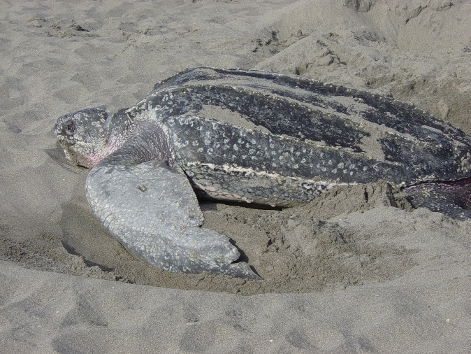
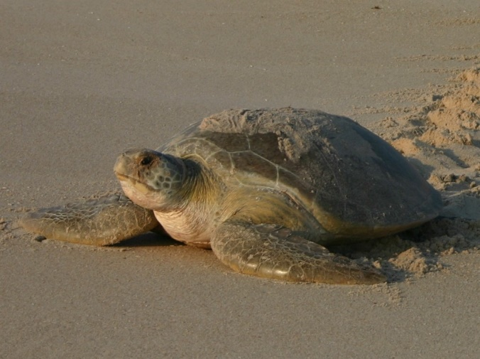
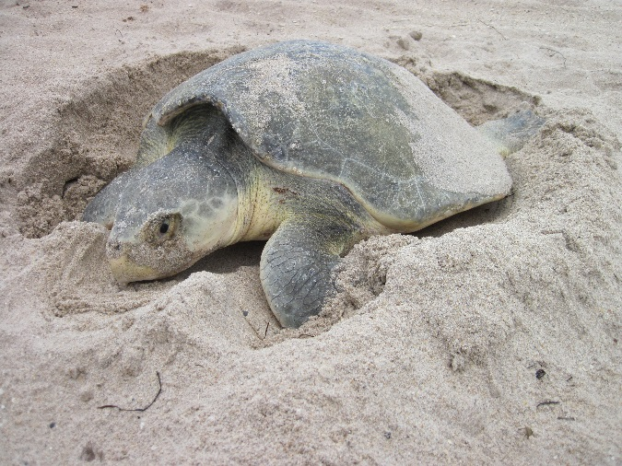
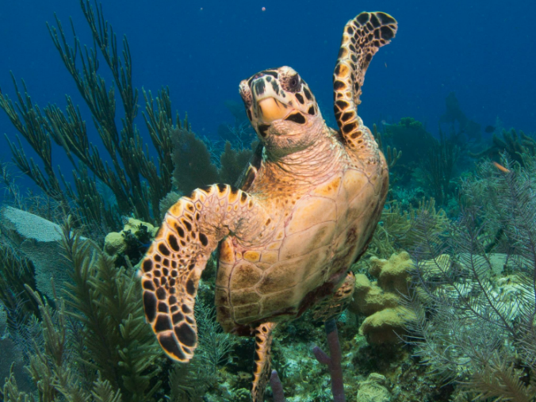
Sea Turtles Nesting in Florida
Photo: M. Nicholas, Gulf Islands National Seashore, MTP #032
Photo: FWC
Photo: B. Witherington, FWC
Loggerhead
(Caretta caretta)
Status: Threatened
Leatherback
(Dermochelys coriacea)
Status: Endangered
Green
(Chelonia mydas)
Status: Threatened
Photo: T. Hirama, FWC
Photo: N. Brockhoff
Kemp's Ridley
(Lepidochelys kempii)
Status: Endangered
Hawksbill
(Eretmochelys imbricata)
Status: Endangered
Notes:
*Stars indicate the most common species nesting in FL.
There are 5 species of sea turtles found in and around Florida. They are the Loggerhead, Green, Leatherback, Kemp’s Ridley, and Hawksbill. All of these species are listed as threatened or endangered.

Slide 3
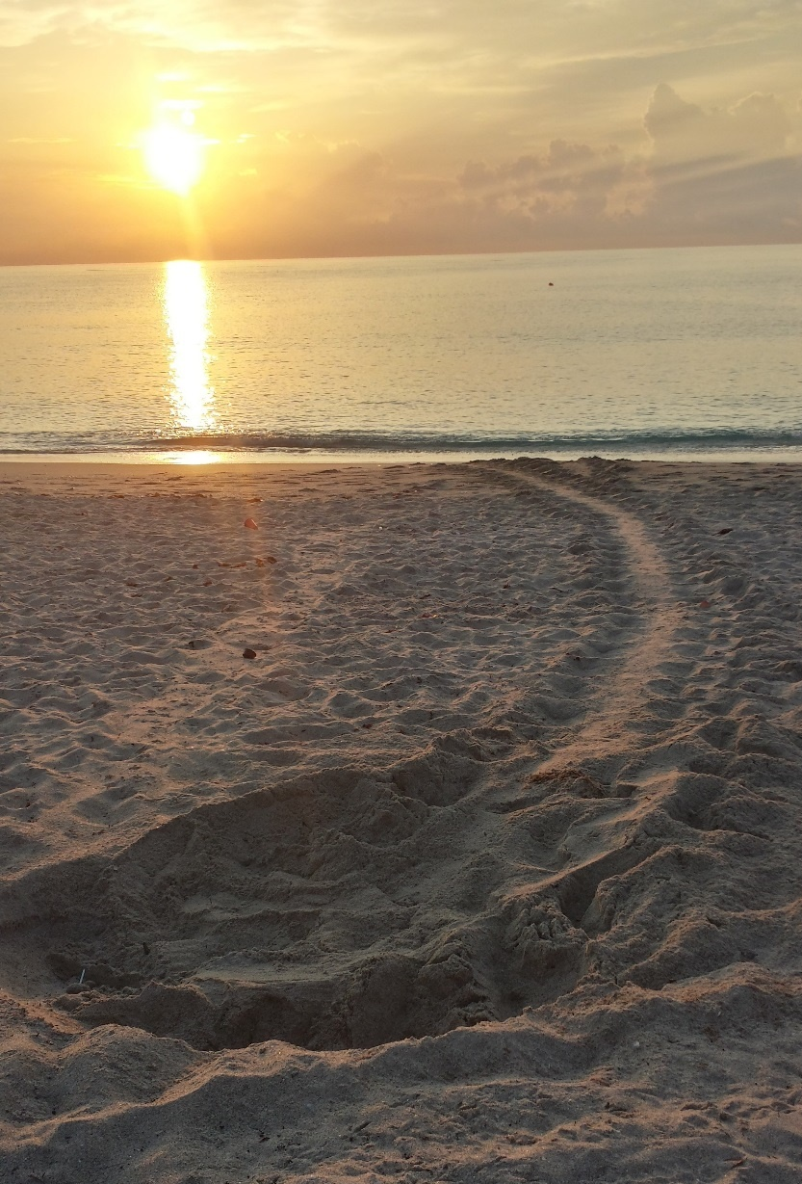
Sea Turtle Nesting 101
Nesting season is May 1 – October 31 (March 1 – October 31 in Brevard through Broward)
Nesting and hatching both occur at night.
Nests contain ~100 eggs and incubate ~2 months
Females return to nest in the same areas where they hatched.
About 40% of worldwide loggerhead nesting occurs in Florida – more than anywhere else in the world!
Photo: T. Long, FWC
Notes:
During the summer months, sea turtles nest most often at night and prefer dark beaches with the right kind of sand. Sea turtles lay approximately 100 eggs per nest. After about 2 months, hatchlings emerge from the nest. The majority of hatchlings come out at night with goal to get to sea as quickly as possible. They hatch out together to try and limit risk of predation.
Females typically return to nest in the same general area where they emerged as hatchlings. In addition, Florida is the most important nesting beach for loggerheads in the world and hosts over 40% of the word’s nesting. This means we have an important responsibility to maintain good nesting habitat, as the health of the global population relies on Florida.

Slide 4
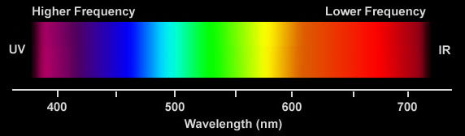
Why is artificial lighting such a problem?
Hatchlings rely on multiple visual cues to find the water
TOWARD bright open areas/horizons
AWAY from dark silhouettes i.e. dunes and vegetation
Attracted to SHORT wavelength light
Less disturbed by LONG wavelength light
ATTRACTION
INDIFFERENCE
AVERSION
Witherington et al. 2014
Notes:
4
Sea turtle hatchlings use multiple cues to orient towards the ocean. They are crawling not only towards the brightest horizon but also away from dark silhouettes. So large structures with good lights actually can act as a large silhouette and cue the turtles towards the ocean.
Hatchlings also discriminate between colors of light. They are highly attracted to short wavelengths (the purple to green part of the spectrum) but are less attracted to long wavelengths (the amber to red part of the spectrum). Keep in mind that white light contains the full spectrum, making it highly attractive to hatchlings.

Slide 5
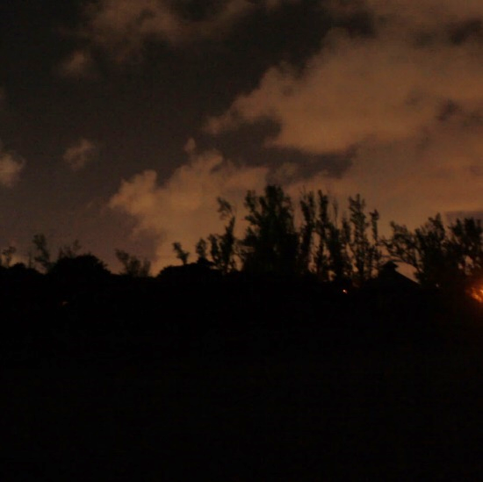
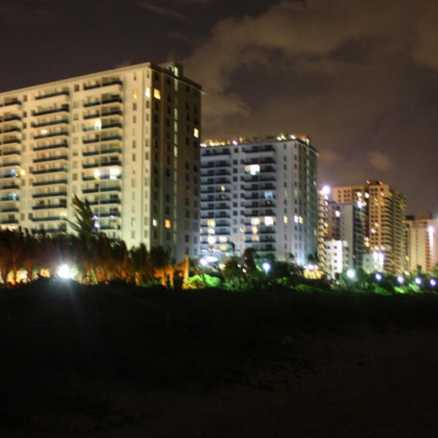
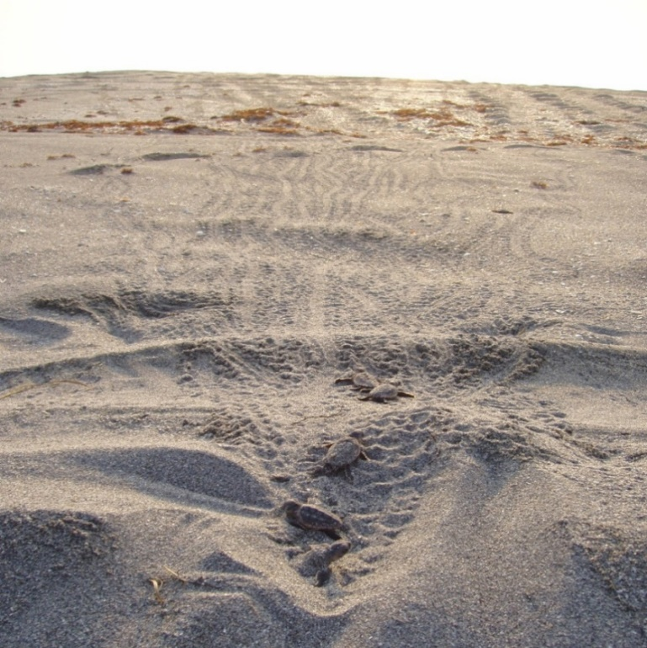
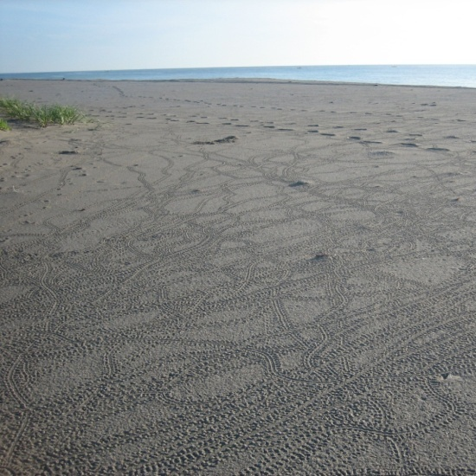
Conflicting cues often lead to disorientation.
Undisturbed
hatchlings:
seaward orientation
in a “V” formation
Disoriented
hatchlings:
circular orientation or
not towards the ocean
Photo: K. Schanzle, FWC
Photo: K. Schanzle, FWC
Ocean
Ocean
Photo: FWC
Photo: Sea Turtle Conservation League of Singer Island, MTP #058
Notes:
When artificial lighting conflicts with natural lighting cues, hatchlings aren’t able to properly navigate toward the water and instead head toward landward lights, crawl up and down the beach, or just wander in circles. This is known as a disorientation.
How do we know a disorientation has occurred? The evidence is left for morning surveyors as tracks in the sand, much like the tracks left by nesting females. The tracks from undisturbed hatchlings go straight toward the ocean in a “V” formation, while tracks from disoriented hatchlings may go toward the land, up and down the beach parallel to the water, or in circles all over the beach. Disoriented hatchling tracks usually go everywhere except where they’re supposed to – toward the water.

Slide 6
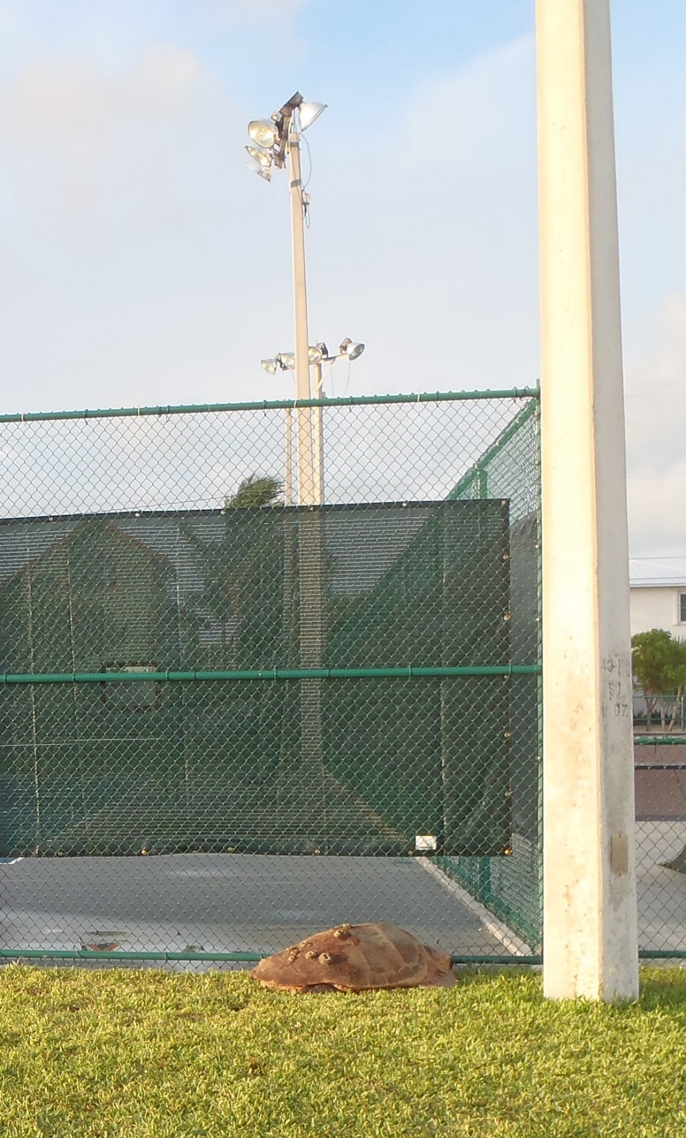
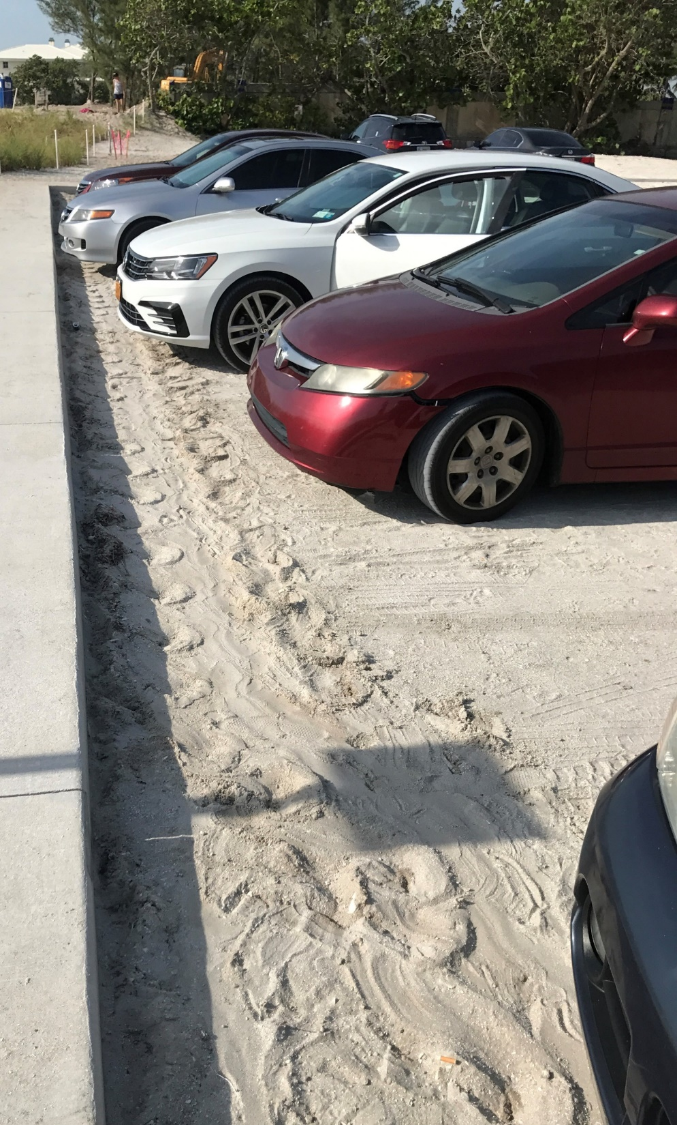
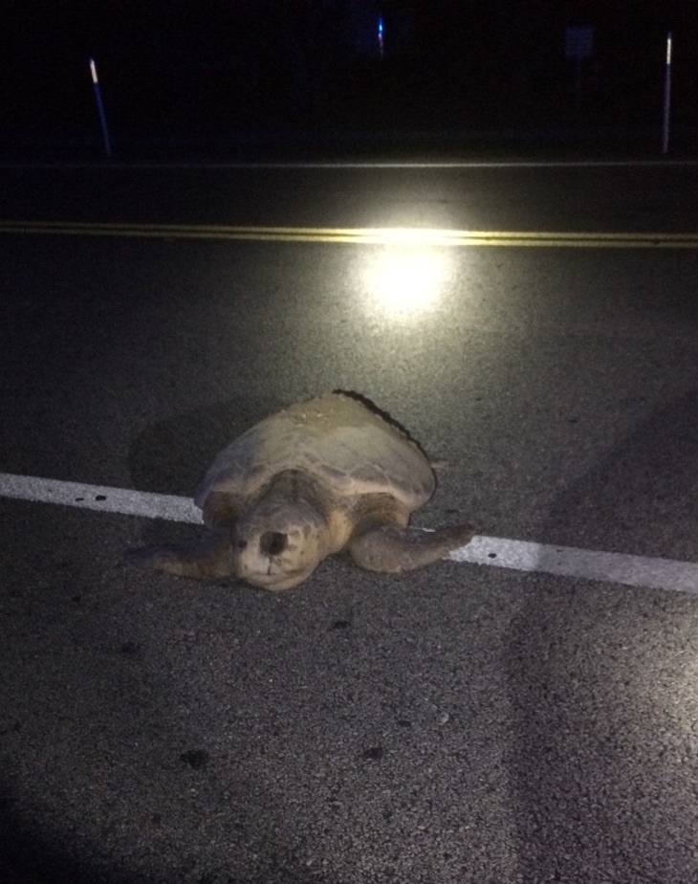
Nesting females can disorient too!
Photo: S. Schaf, FWC
Photo: FWC LE
Photo: Ecological Associates, MTP #010
Notes:
Although hatchlings are more sensitive to artificial lighting, nesting females can also be attracted to very bright lights. Unfortunately, this can sometimes lead them into dangerous situations, such as roadways or parking lots.

Slide 7
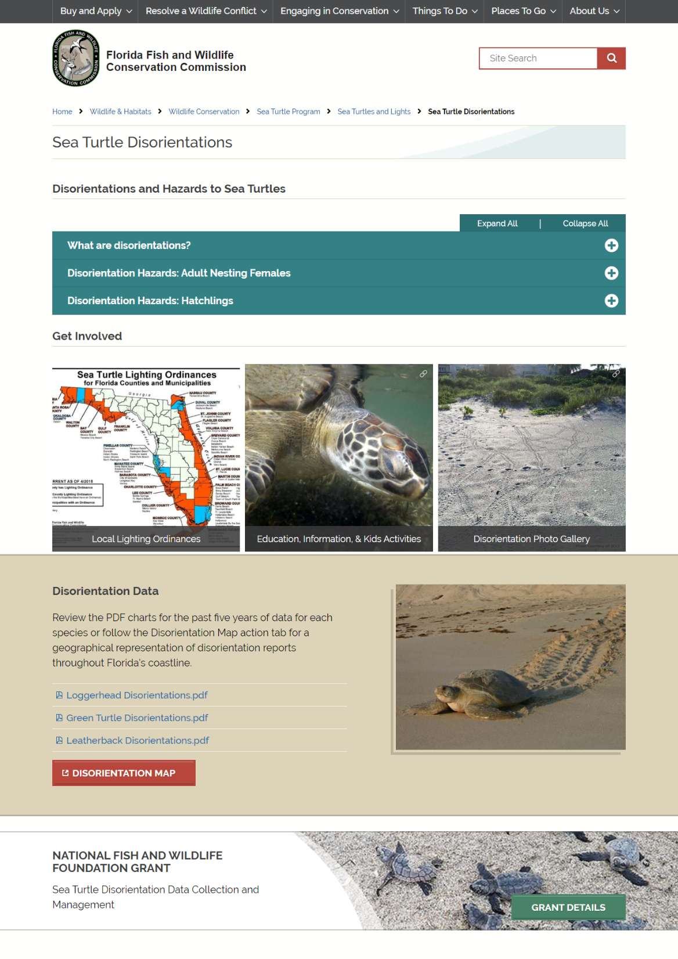
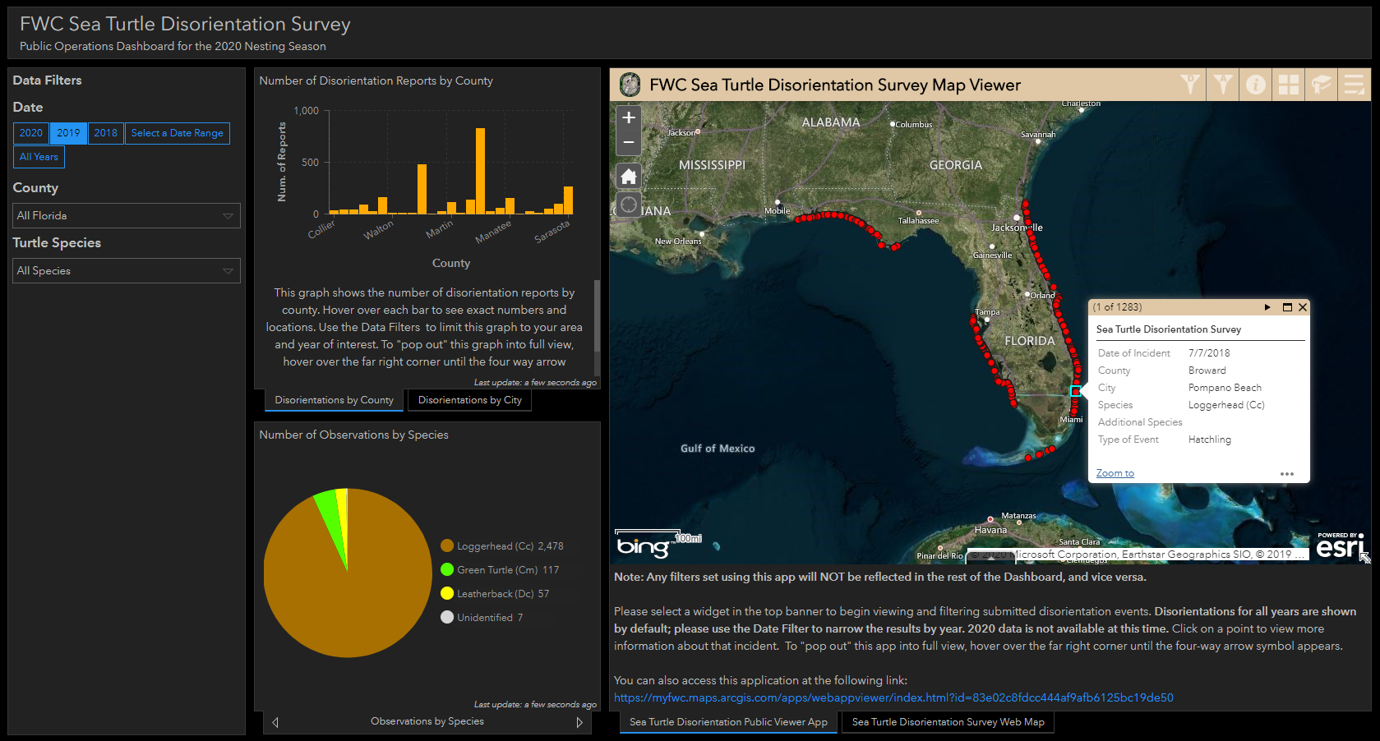
Tracking Disorientations
www.MyFWC.com
Search “disorientation”
Notes:
Disorientations are documented by morning nesting surveyors and submitted to FWC. Live data are now available on our website so you can easily see the status of lighting impacts anywhere in the state. Go to www.myfwc.com and search for “disorientation” – the first result is our disorientation information page. At the bottom, click on the red disorientation map button to view the live, interactive dashboard.

Slide 8
You’ve identified the problems – now what?
Lights should follow
FWC’s Three Golden Rules:
Keep it Low
Keep it Long
Keep it Shielded
Notes:
Now that we’ve talked about why improper artificial lighting is such a problem and how to identify it, what can we do to fix it? The sea turtle lighting guidelines are based on the following three principles which we refer to as FWC’s Golden Rules. All three must be used in combination to be effective as not one of them is more important than the other.

Slide 9
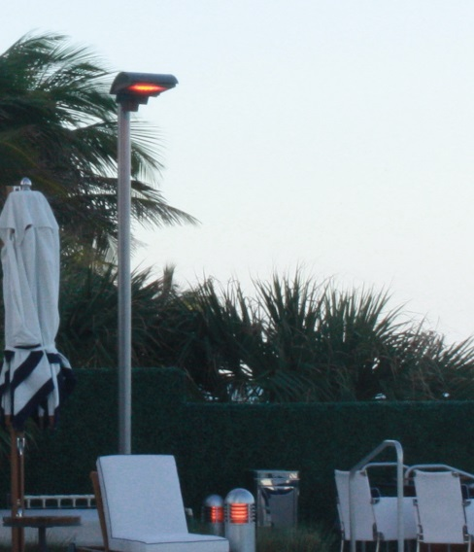
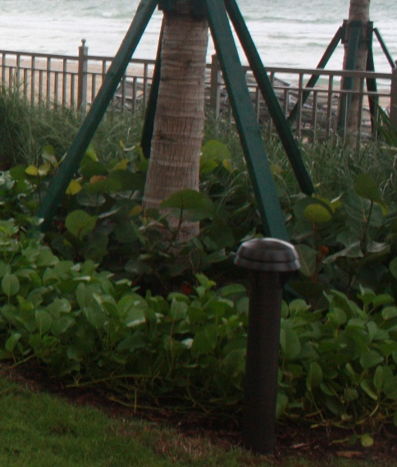
FWC Golden Rule Number 1
Keep it Low
Keep mounting heights low to minimize light trespass.
Keep it low also refers to lumens. Use only the lumen output needed. For most applications this can be minimal.
Photo: T. Long, FWC
Photo: T. Long, FWC
Notes:
First is Keep it Low. This means that the light should be mounted as low as possible to minimize the amount of light trespass.
Keep it Low also means to use only the lumens necessary for the application. Just as you wouldn’t use a 100 watt bulb in a night light you don’t want to use more light than is necessary outside.
If you read through the sea turtle lighting guidelines, you will see that there are specific recommendations for fixture mounting heights. There are several reasons for this: 1. Low mounted fixtures provide more light directly on the ground where it is needed for life safety and these fixtures are also easier to conceal from the adjacent beach 2. Fixtures mounted very high, especially on levels above the ground level, have a higher potential for becoming visible from the beach and can be very difficult to shield appropriately

Slide 10
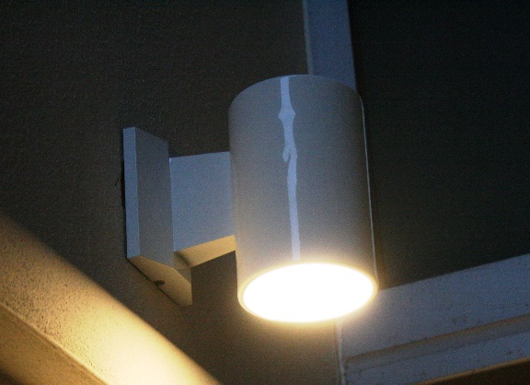
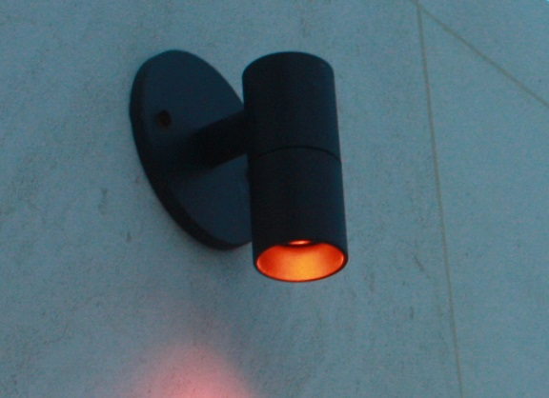
FWC Golden Rule Number 2
Keep it Low
Keep it Long (wavelength)
Use bulbs with wavelengths greater than 560 nm.
Photo: J. Higgins, FWC
Photo: T. Long, FWC
Notes:
The second rule is to keep it long. When we say long we aren’t referring to the fixture itself but rather to the wavelength of the bulb installed in the fixture.

Slide 11
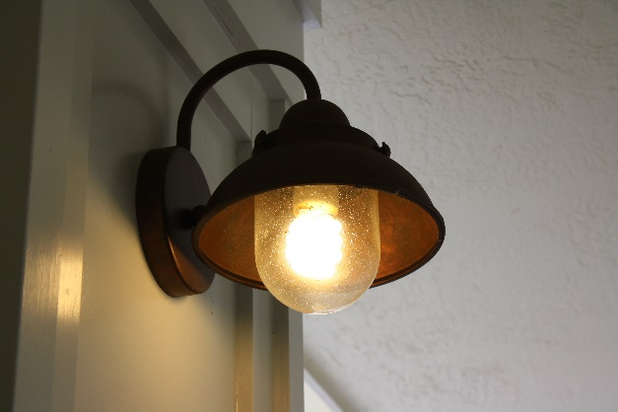
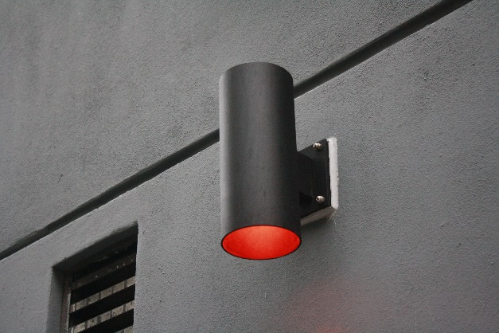
FWC Golden Rule Number 3
Keep it Low
Keep it Long
Keep it Shielded
Eliminate the point source of light.
  Use full cut-off or fully recessed fixtures.
  Use 180 to 270 degree external beachside shields when in proximity to the beach.
Photo: K. Schanzle, FWC
Photo: T. Long, FWC
Notes:
Golden Rule #3 is to Keep it Shielded. That means the filament, bulb or glowing lens MUST be shielded from direct view. We recommend installing full cut-off fixtures to achieve this type of shielding.
So what is full cut off? The definition from the Illumination Engineering Society or IES states that there is NO light being emitted above the 90° angle. The bulb is entirely recessed inside the fixture directing light downward.

Slide 12
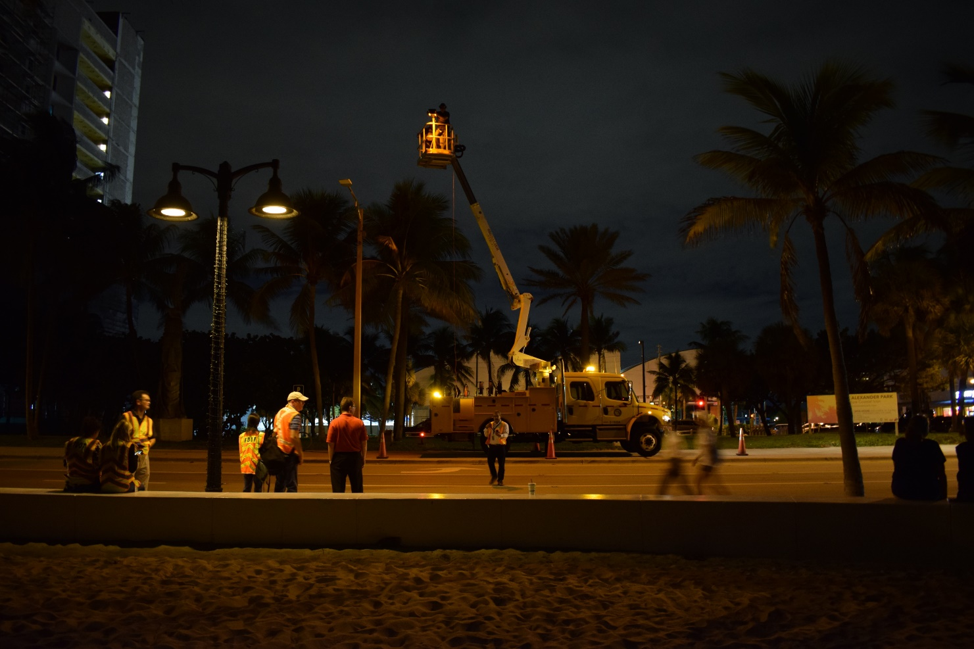
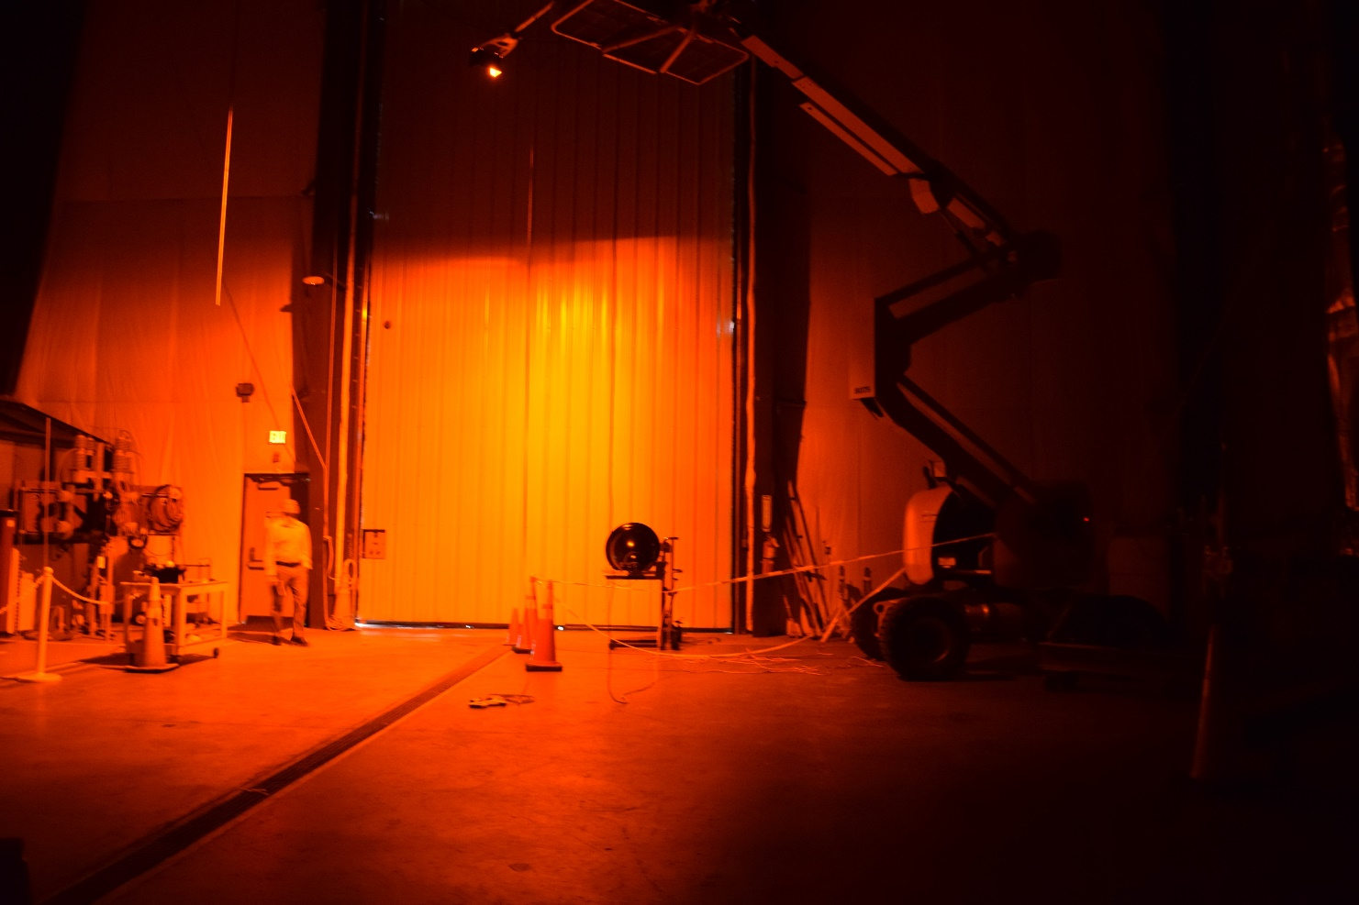
Can streetlights really meet the Golden Rules?
YES!
Synergy Streetlight demo with FDOT – now being installed in Fort Lauderdale
Cree RSW Series Streetlight demo with FPL – now on FPL approved products list
Photo: T. Long, FWC
Photo: T. Long, FWC
Notes:
Even streetlights can meet the Golden Rules. Several models of streetlight fixtures are available from multiple manufacturers that are fitted with true amber LEDs and external, drop-down shielding to prevent visibility from the beach. FDOT has approved the use of shielded, amber LED streetlights in Fort Lauderdale and Treasure Island, while FPL and Duke Energy now offer these fixtures on their approved products lists.

Slide 13

FDOT Wildlife-Sensitive Roadway Designs
PROSECUTION AND PROGRESS – LIMITATIONS OF OPERATIONS – NIGHT WORK ALONG COASTAL ROADS. (REV 4-8-19) (FA 7-22-19) (1-2020)
SUBARTICLE 8-4.1 is expanded by the following new Subarticle:
8-4.1.1 Additional Requirements for Night Work Along Coastal Roads: The project is located adjacent to sea turtle nesting habitat. Direct all work zone lighting away from the beach to avoid illumination of or direct visibility from the beach. Shield luminaires to avoid lighting areas outside of the immediate construction area.
FDOT Design Manual (1/2020)
231.2.1 Wildlife-Sensitive Conventional Lighting
For conventional lighting near a wildlife area of concern (as determined by the Office of Environmental Management), incorporate the following design requirements:
Where feasible, orient luminaires away from the wildlife area of concern.
Design lighting system using luminaires from the Wildlife-Sensitive Conventional Lighting category of the APL.
Use the criteria for Wildlife-Sensitive Conventional Lighting from Table 231.2.1 in accordance with the requirements of FDM 231.3.
Standard Specifications for Road and Bridge Construction (1/2020)
992-2.4.2 Luminaires for Wildlife-Sensitive Conventional Lighting: Luminaires must meet the following additional requirements:
The light source for the luminaires must be true red, orange, or amber light-emitting diodes (LEDs) with no more than 1.75% of the spectral power distribution below 560 nm. Submit testing report.
The optics must have an IP 66 rating. Submit testing report.
The luminaire mounting assembly must be a slipfitter type designed to accommodate a nominal 2 inch pipe size (2-3/8 inch O.D.) arm or a pole top mounting assembly designed to accommodate a 2-3/8 inch pole top tenon.
Luminaires must have a IESNA light distribution curve (IES LM-79) designated by an EPA-recognized laboratory. Submit testing report.
Luminaires must meet a minimum pole spacing of 50 feet using the AGi32 lighting optimization tool in accordance with the settings shown in 992-2.4. Submit IES file.
Notes:
To facilitate the incorporation of considerations for sea turtles into FDOT roadway projects, FWC recently coordinated with FDOT on updates to several guidance documents. These provide a more standardized way of designing roadway lighting near sea turtle nesting areas instead of considering each project on a case by case basis. For especially tricky areas, FDOT has also worked with FWC to allow a variance on certain projects.
There’s a lot shown here so don’t try to read it all now, but know that you can now find these standards in each of the referenced documents.

Slide 14
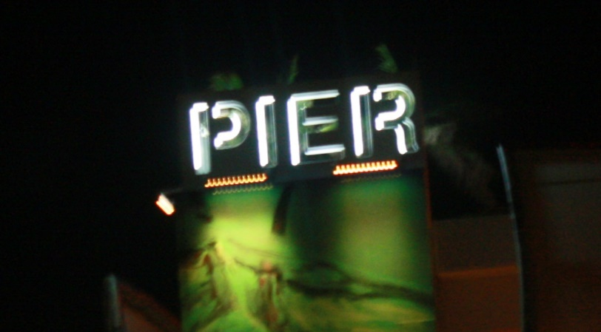
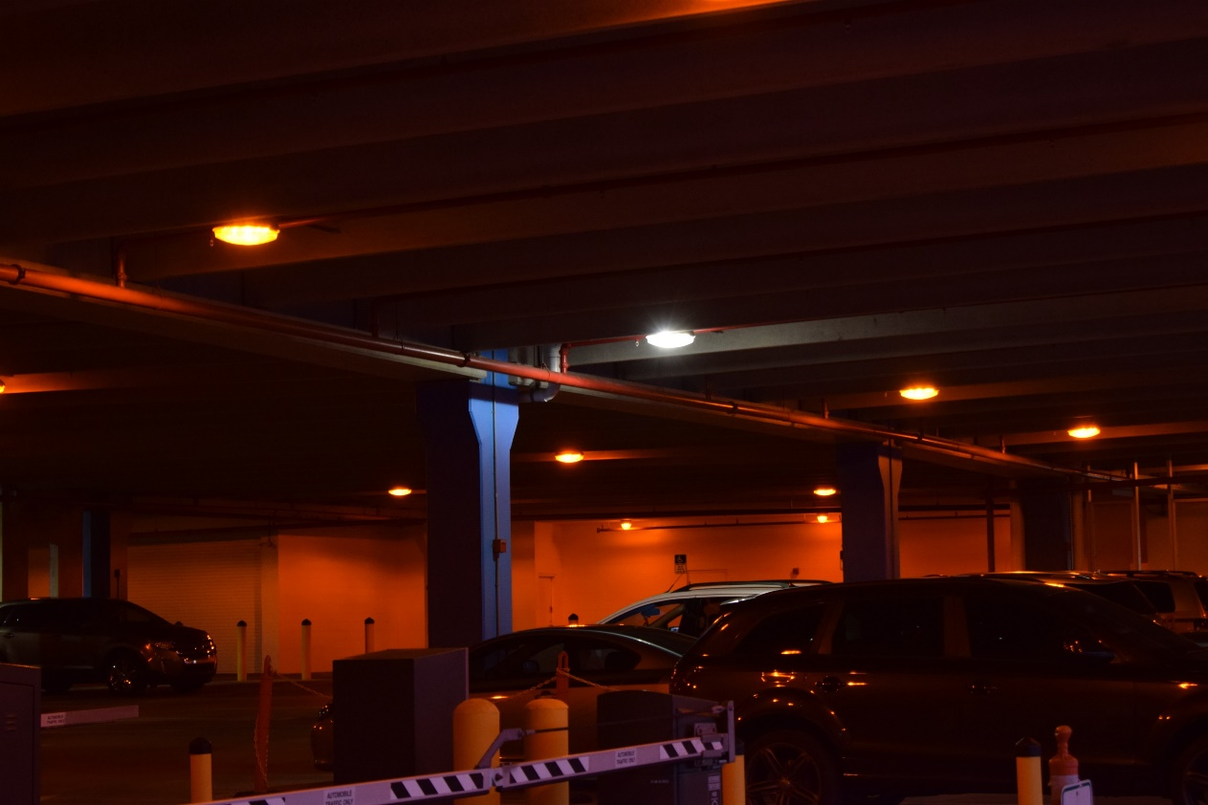
“Halfway” Solutions to Lighting Problems
Timers, switching off lights, or changing LED colors seasonally are NOT recommended long-term solutions.
But WHY?
Prone to malfunctions
Turning off lights may create unsafe situations for drivers/pedestrians
Switching colors fosters the perception that amber lighting is “less safe” than white lighting
Photos: T. Long, FWC
Notes:
Often, lighting designers will try to incorporate what I call “halfway solutions” into their roadway projects to try to account for being near the beach. These include things like putting lights on timers, using color-changing lights or turning lights off during the season. While these measures aren’t technically wrong, they’re not what we would recommend as best practices for a number of reason. Despite our best efforts, even the most technologically advanced timers can be prone to malfunctions, which could cause the lights to be visible from the beach. Lights that are turned off completely may create unsafe conditions for drivers or pedestrians, especially in highly populated areas with heavy vehicular and pedestrian traffic. Although well-designed amber lighting can be just as safe as white lighting, using color-changing lights fosters the idea that amber lighting is less safe than white. In areas that use amber lighting year-round, residents begin to feel comfortable with it as they realize they are just as safe as they were before.

Slide 15
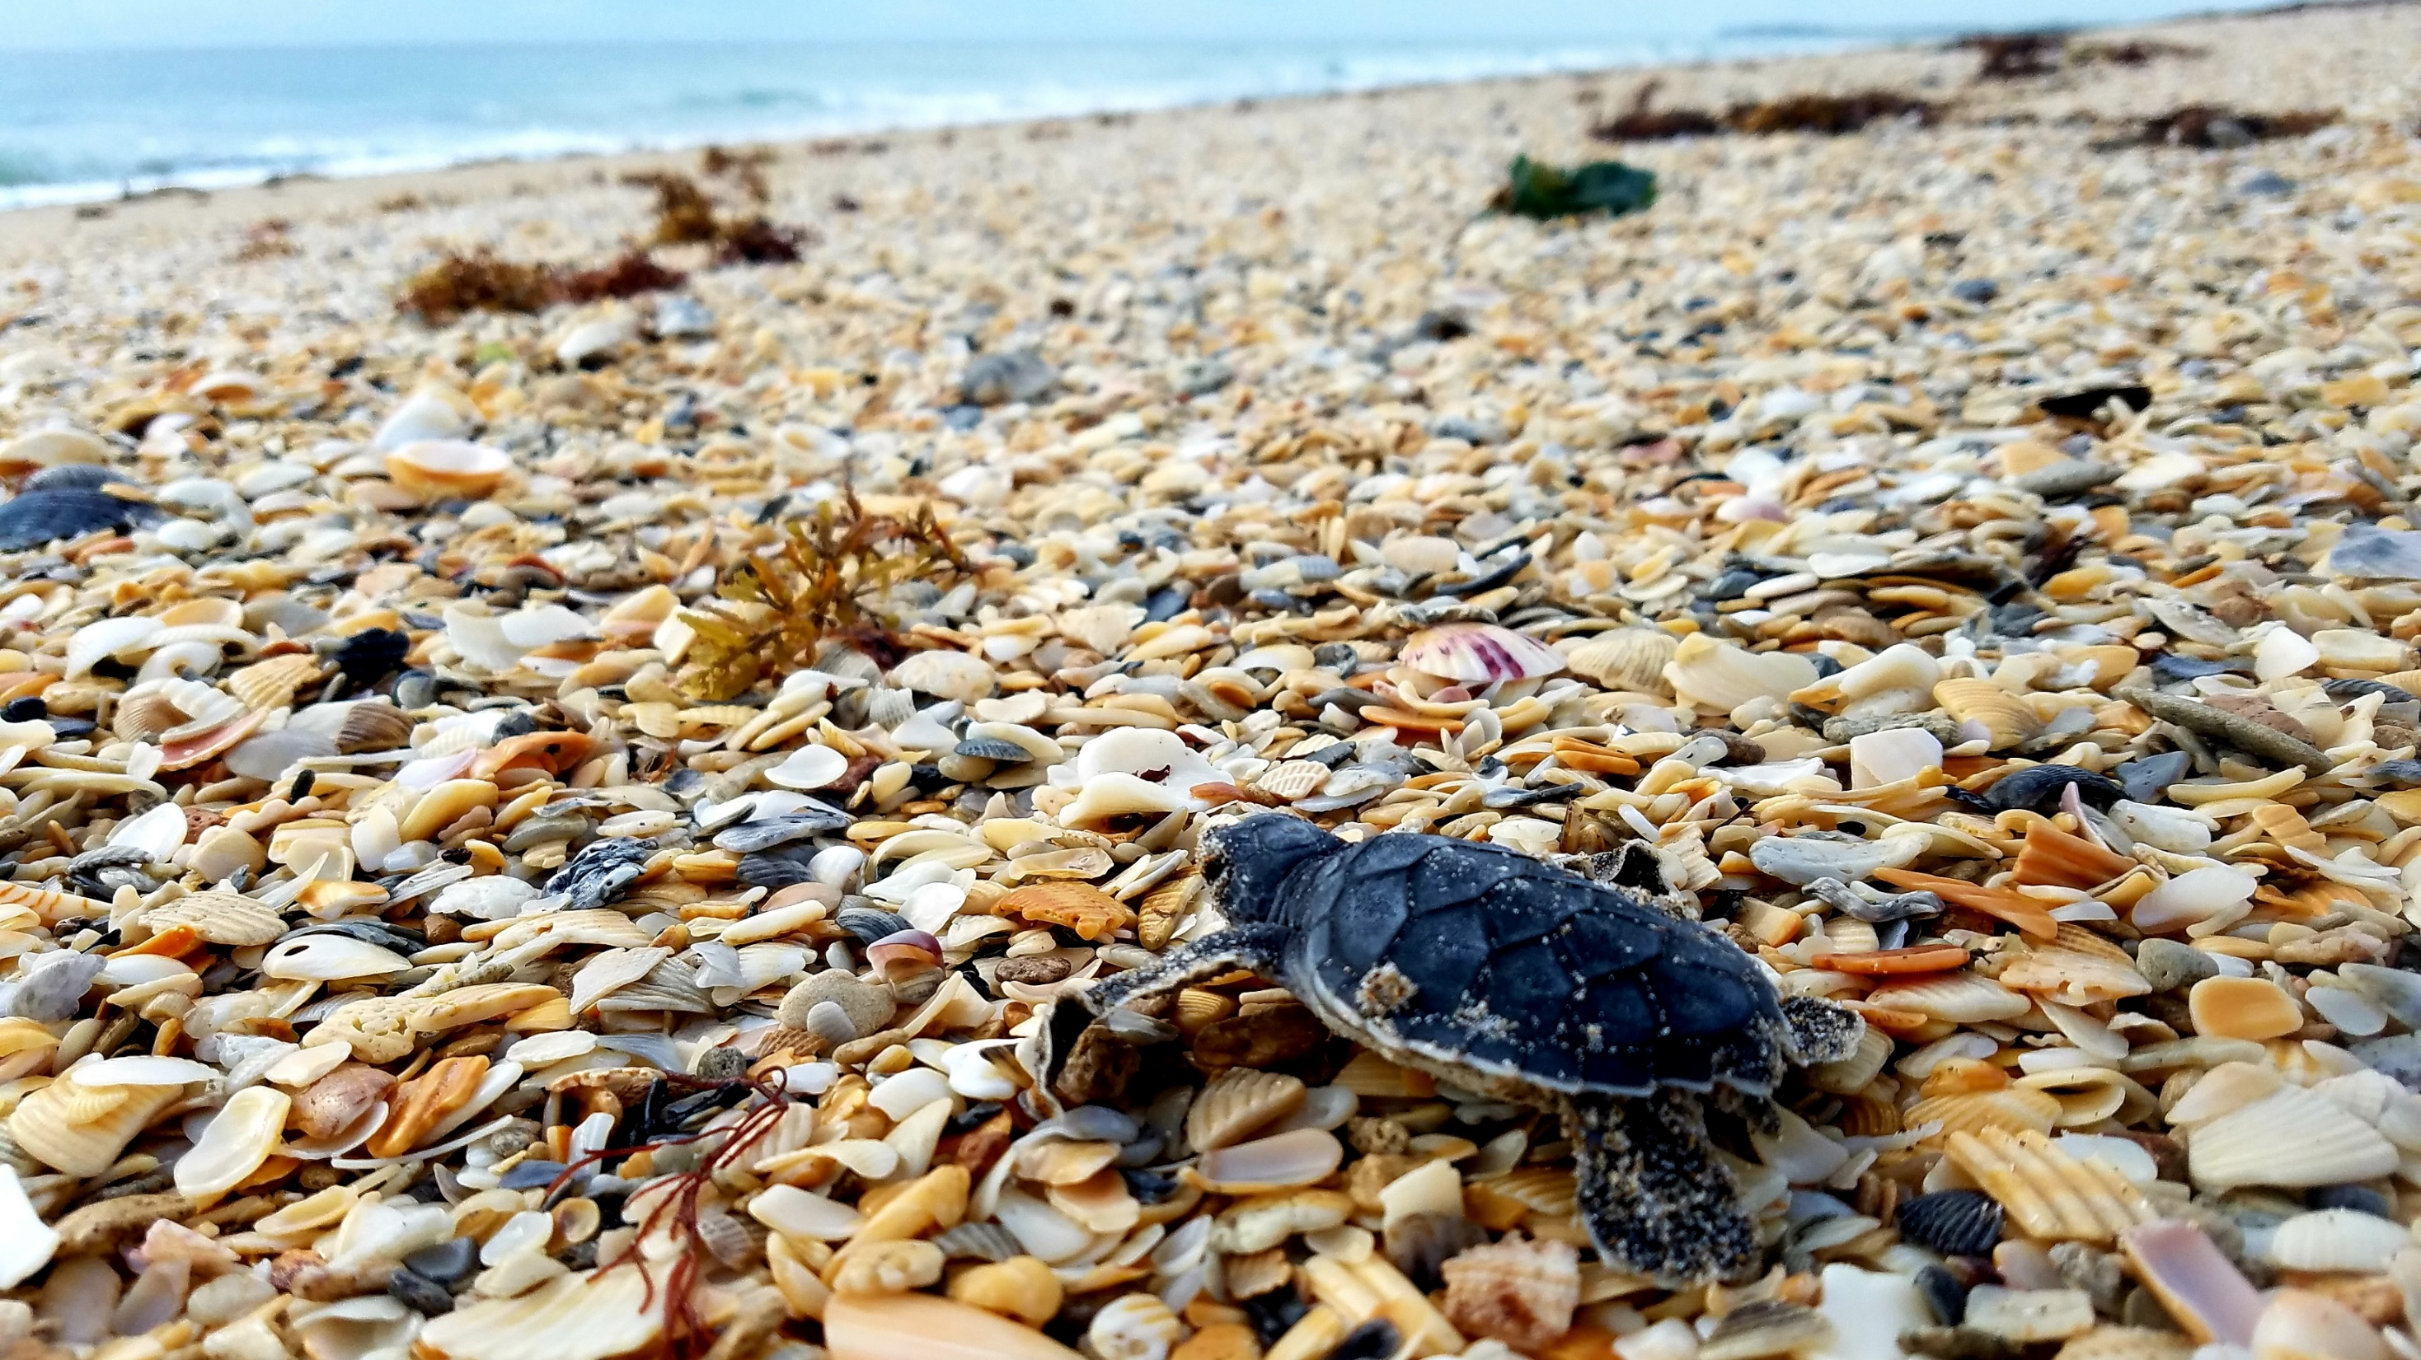
Thank you!
For questions, contact SeaTurtleLighting@MyFWC.com
Want more info?
www.MyFWC.com/seaturtle
Photo: T. Long, FWC

