Slide 1
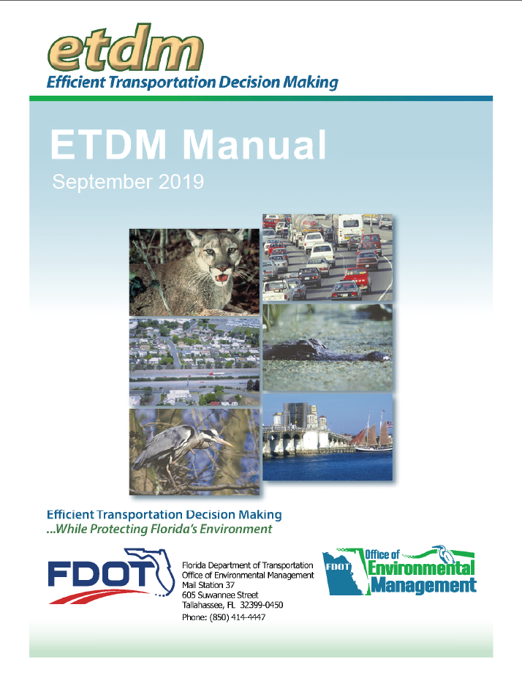
2020 PD&E and ETDM
Manual Revisions
Replace with image or photo
June 24, 2020
The environmental review, consultation, and other actions required by applicable federal environmental laws described in this training are carried out by FDOT pursuant to 23 U.S.C. § 327 and a Memorandum of Understanding dated December 14, 2016 executed by FHWA and FDOT.

Slide 2
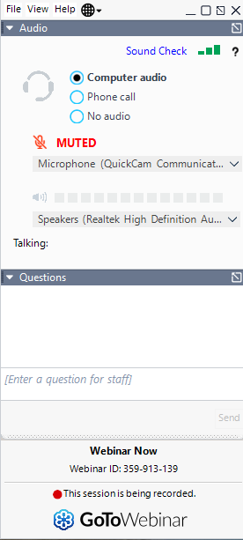
Housekeeping
Interactive Poll Questions
Recording and Materials
Questions
Notes:
First some housekeeping.
This webinar is being recorded and will be available for reference on OEM’s website after today.
If you are watching this webinar with others, please enter names of all attendees in the chat box so that their attendance can be captured.
Everyone is in listen only mode. If you have questions during the presentation, use the chat box to ask them. We will have staff monitoring the chat as we go along and may pause to answer questions or they will be addressed at the end of our presentation during our open Q&A session.

Slide 3
Which describes you best?

Slide 5
Minor Changes to All Chapters
Deleted form numbers for forms in SWEPT or in the EST
  Removed from the Forms Management System
  Edits and removal of the Forms section of some chapters
Issue name changes and chapter references
  Water Quality and Stormwater Water Resources
    References to Aquatic Preserves and Outstanding Florida Waters chapter to Water Resources chapter
  Class of Action Determination for Highway Projects Class of Action Determination for Federal Projects
Added references to new chapters
  Part 1, Chapter 16- United States Coast Guard Projects and Navigation
  Part 2, Chapter 23- Acquisition and Restoration Council (ARC) Coordination
Reference Section updated/hyperlinks checked
Updated History Sections

Slide 6
PART 1

Slide 7
Chapter 1- Introduction
MINOR CHANGES ONLY

Slide 8
Chapter 2- Class of Action Determination for Federal Projects

Slide 9
Chapter 2- Class of Action Determination for Federal Projects
Chapter name change:
  Class of Action Determination for Highway Projects Class of Action Determination for Federal Projects
Information on early acquisition of real property interests
  Added to actions listed in 23 CFR § 771.117(d)(12)(b) – b- list items
Minor Categorical Exclusion (MiCE) process
  Emphasis on coordination with OEM rather than findings
  Use of the Type 1 Categorical Exclusion Determination form to identify when coordination with OEM is needed
  Minor Categorical Exclusion Determination Key removed from chapter
Clarification of what a federal project is
Coordinate with OEM early if you anticipate an Environmental Impact Statement
Clarification on changing the Class of Action

Slide 10
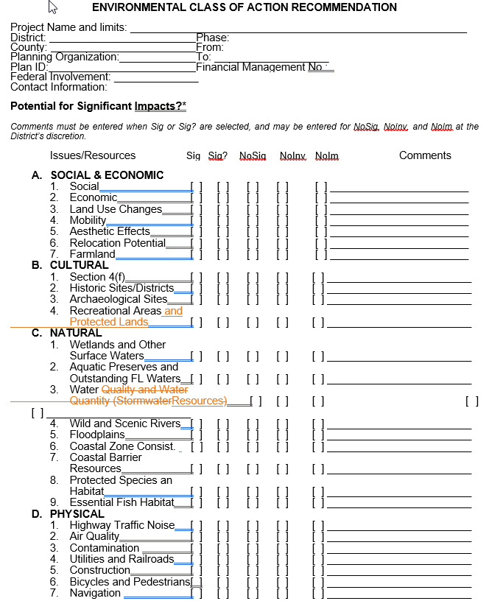
Chapter 2- Class of Action Determination for Federal Projects
Updated the Type 1 Categorical Exclusion Checklist
  Addition of an Acquisition and Restoration Council question
  Edited the Wild and Scenic Rivers question to match changes to Part 2, Chapter 12
  Addition of a Nationwide Rivers Inventory question
Minor changes to the Environmental Class of Action Recommendation Form

Slide 11
Chapter 3- Preliminary Environmental Discussion and Advance Notification

Slide 12
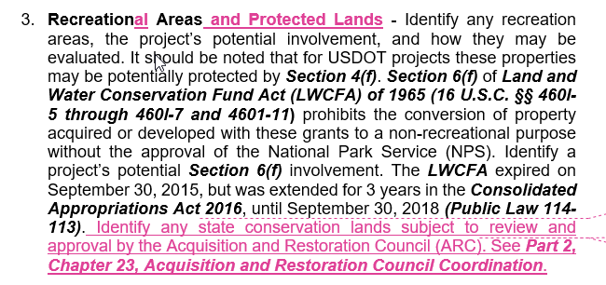
Chapter 3- Preliminary Environmental Discussion and Advance Notification
Reordered topics in the Preliminary Environmental Discussion (PED) to align more closely with the Environmental Document
  Reorganized and changed some issue titles
  Added Nationwide Rivers Inventory
Added information on identifying state conservation lands subject to review and approval by the Acquisition and Restoration Council

Slide 13
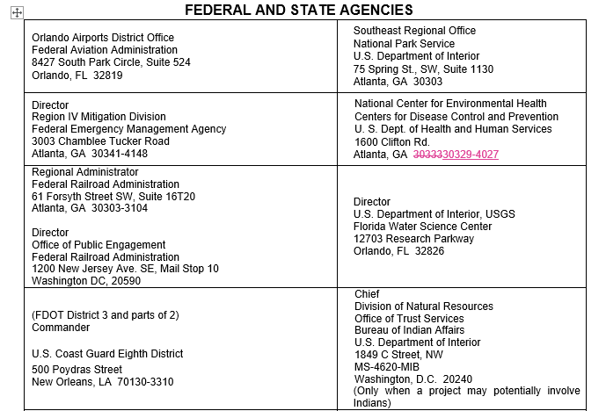
Chapter 3- Preliminary Environmental Discussion and Advance Notification
Updated the Transmittal List Figure
Updated Contact Information

Slide 14
Chapter 4- Project Development Process

Slide 15
Chapter 4- Project Development Process
New section on Environmental Review for Early Acquisition Projects
Link to the Alternatives Corridor Evaluation Report Template
Clarifications to the Interchange Access Request (IAR) review and approval process
Deleted Table 4-2 -Approval to Advance Preliminary Design Activities
Edits to Figure 4-5- Final Approval of Interchange Access Requests and the PD&E Study
  Removed Table reference

Slide 16
Chapter 5- Type 2 Categorical Exclusion

Slide 17
Chapter 5- Type 2 Categorical Exclusion
Guidance on when a public hearing is required
Guidance for Preparing a Type 2 Categorical Exclusion Determination Form
  Project Description
  Purpose and Need
  Wild and Scenic Rivers
  Public Involvement
  Changes to match the form in SWEPT
  Clarification on technical materials vs. attachments
Updated the Document Review Process
Removed Document Review Flowchart and referenced online diagram

Slide 18
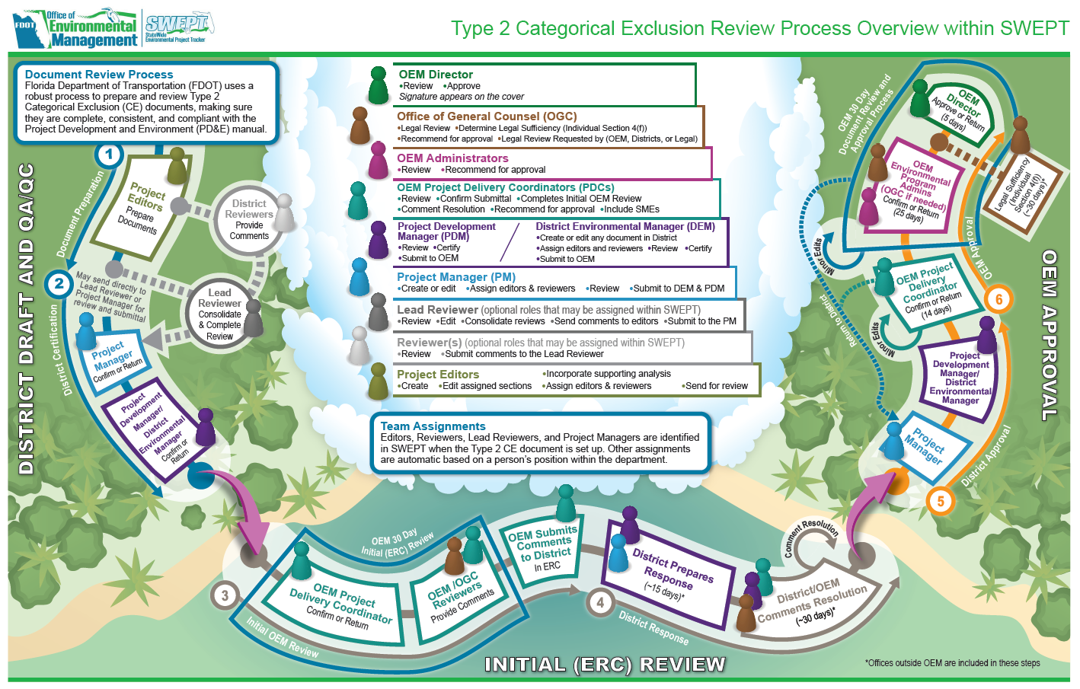
Chapter 5- Type 2 Categorical Exclusion

Slide 19
Chapter 6- Environmental Assessment

Slide 20
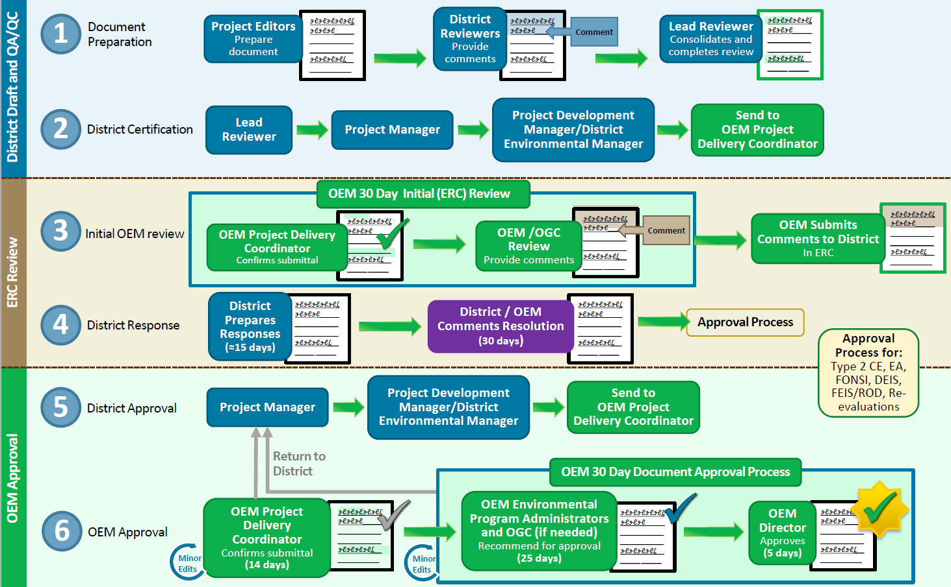
Chapter 6- Environmental Assessment
Guidance on entering project schedules into the Permitting Dashboard
Guidance added from the Interim Policy on Page Limits for NEPA Documents and Focused Analyses
Updated the Document Review Process
Removed Document Review Flowchart and referenced online diagram

Slide 21
Chapter 7- Finding of No Significant Impact

Slide 22
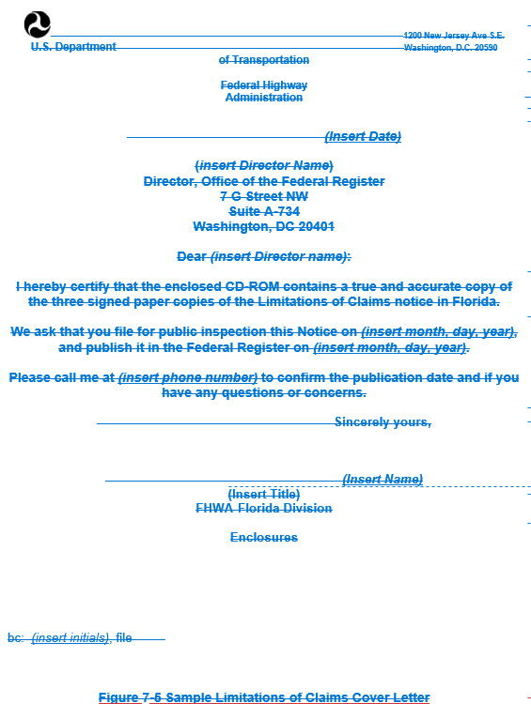
Chapter 7- Finding of No Significant Impact
Guidance on entering project schedules into the Permitting Dashboard
Updated the Document Review Process
Removed Document Review Flowchart and referenced online diagram
Limitations of Claims information updated
Removal of Limitations of Claims Cover Letter- reference new OEM guidance document

Slide 23
Chapter 8- Draft Environmental Impact Statement

Slide 24
Chapter 8- Draft Environmental Impact Statement
E.O. 13807 reference and goals
Explanation of the One Federal Decision (OFD) process and the types of projects it applies to
  Interim Policy on the Application of the OFD Process to DOT Projects
Guidance on entering project schedules into the Permitting Dashboard
Re-organized Pre-Notice of Intent list and added information to include OFD items
Notice of Intent (NOI) information updated
  OEM submittal of NOI to the Federal Register
  Minor edits to the NOI Cover Letter – Figure 8-3

Slide 25
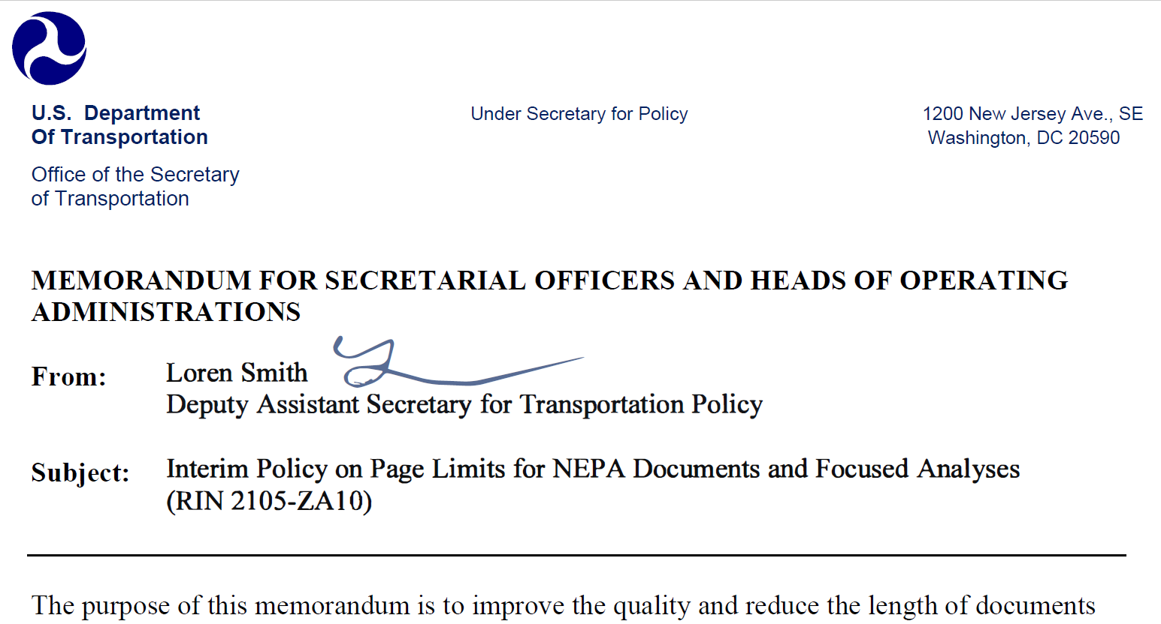
Chapter 8- Draft Environmental Impact Statement
Interim Policy on Page Limits for NEPA Documents and Focused Analyses
Updated FDOT Document Review Process
  Guidance for Major Infrastructure Projects (MIPs)
  Removed Document Review Flowchart and referenced online diagram
Notice of Availability in the Federal Register
    Updated e-NEPA guidance

Slide 26
Chapter 9- Final Environmental Impact Statement

Slide 27
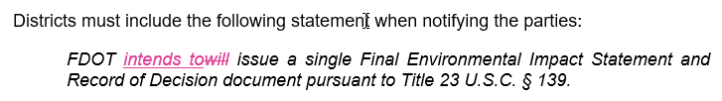
Chapter 9- Final Environmental Impact Statement
E.O. 13807 reference and goals – Same as DEIS chapter
Guidance on entering project schedules into the Permitting Dashboard
U.S. Department of Transportation (USDOT) Guidance on the Use of Combined Final Environmental Impact Statements/Records of Decision and Errata Sheets in NEPA Reviews
Interim Policy on Page Limits for NEPA Documents and Focused Analyses
Change to combined standard statement

Slide 28
Chapter 9- Final Environmental Impact Statement
Updated FDOT Document Review Process
  Removed Document Review Flowchart and referenced online diagram
Notice of Availability in the Federal Register
    OEM submitting through e-NEPA
    Updated e-NEPA guidance
Limitations of Claims information updated
Removal of Limitations of Claims Cover Letter- reference new OEM guidance document

Slide 29
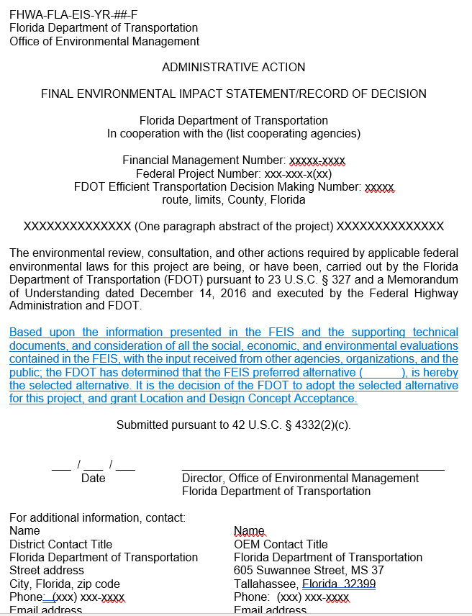
Chapter 9- Final Environmental Impact Statement
Deleted the Record of Decision Standard Statement from the ROD itself
Added it to the Cover Pages
  Language was modified
    Record of Decision
      If submitted separately from ROD
    Final Environmental Impact Statement/Record of Decision
    Final Environmental Impact Statement/Record of Decision - Section 4(f) Approval
    Final Environmental Impact Statement/Record of Decision -Section 4(f) de minimis Approval

Slide 30
Chapter 10- State, Local, or Privately Funded Project Delivery

Slide 31
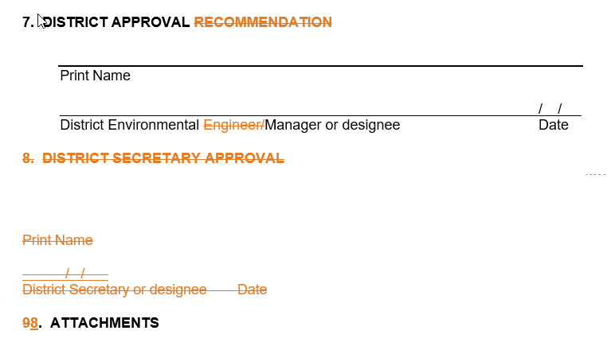
Chapter 10- State, Local, or Privately Funded Project Delivery
Guidance on the State Environmental Impact Report (SEIR) Re-evaluation Form
Renamed Section 7 of the SEIR Re-evaluation Form
Changed the District Approval signature to District Environmental Manager or designee
Removed the District Secretary signature

Slide 32
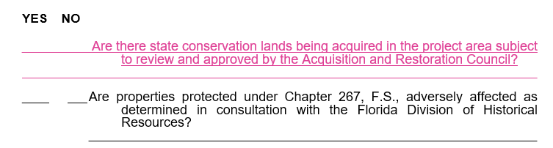
Chapter 10- State, Local, or Privately Funded Project Delivery
Edits to the Document Review Process
New question to the Non-Major State Action Checklist for state conservation lands subject to review and approval of the ARC
Changes to SEIR and PEIR Forms to incorporate issue name changes
All forms will be updated in SWEPT

Slide 33
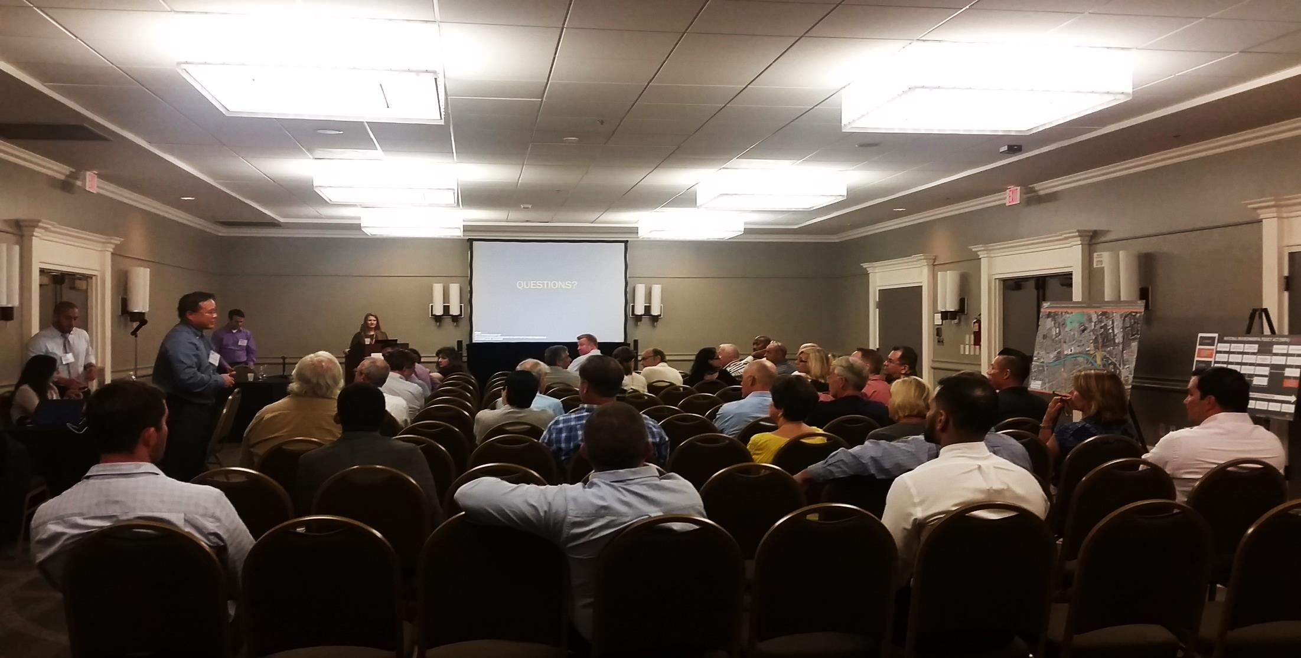
Chapter 11- Public Involvement
MINOR CHANGES ONLY

Slide 34

Chapter 12- Environmental Permits

Slide 35
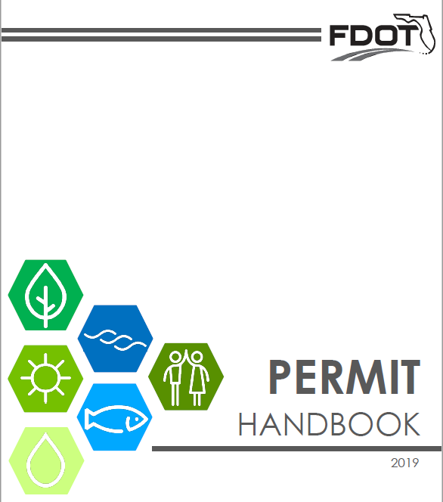
Chapter 12- Environmental Permits
Reference to the FDOT Permit Handbook
Updated -osprey is no longer listed in Florida
  Updated figures
Replaced USCG information with a reference to Part 1, Chapter 16
Minor clarification changes

Slide 36
Chapter 13- Re-evaluations

Slide 37
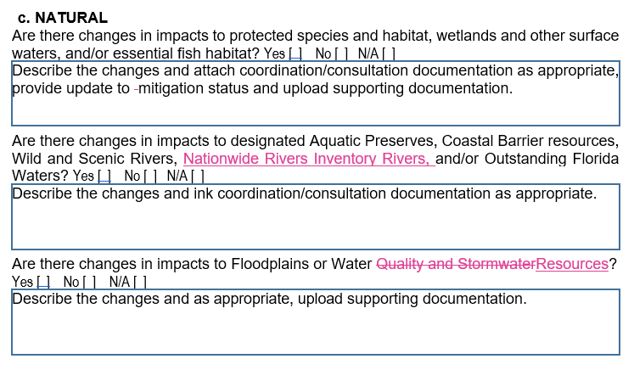
Chapter 13- Re-evaluations
NEPA Re-Evaluation Joint Guidance for Federal Highway Administration (FHWA), Federal Railroad Administration (FRA), & Federal Transit Administration (FTA)
  For clarification, no changes to the procedure
Updated the Document Review Process
Clarification on when Re-evaluations are needed
Minor edits to the Re-evaluation Form

Slide 38

Chapter 14- Transit Project Delivery

Slide 39
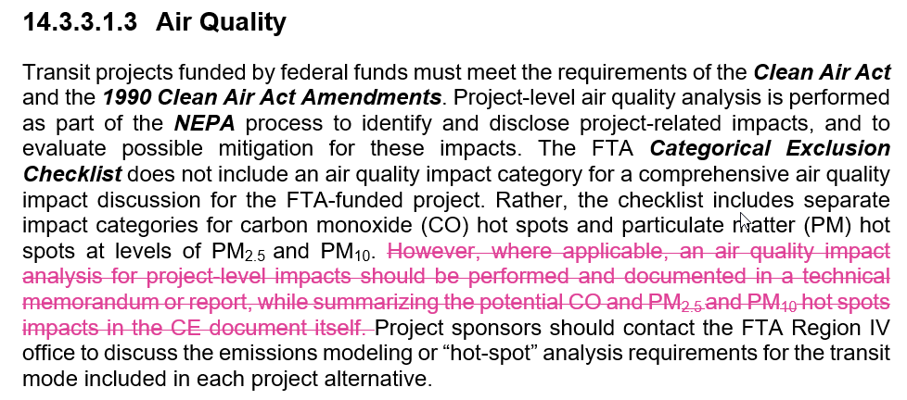
Chapter 14- Transit Project Delivery

Slide 40
Chapter 15- Project File and Records Management
MINOR CHANGES ONLY

Slide 41
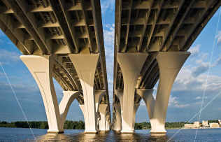
NEW Chapter 16 - United States Coast Guard Projects and Navigation

Slide 42
Chapter 16- U.S. Coast Guard Projects and Navigation
Guidance on the environmental review process for projects in which a USCG permit is required
Legislative Authority
  Background on laws and regulation relating to the protection, preservation and safety of navigable waterways and requirements of the USCG
Permit Eligibility
  Guidance on when a USCG bridge permit is necessary

Slide 43
Chapter 16- U.S. Coast Guard Projects and Navigation
Bridge Permit Exceptions and Exemptions
  Details 3 types of Exemptions:
    1982 Coast Guard Authorization Act
    Advance Approval Waterways
    Title 23 U.S.C. § 144(c)
      FHWA funded or eligible projects only

Slide 44
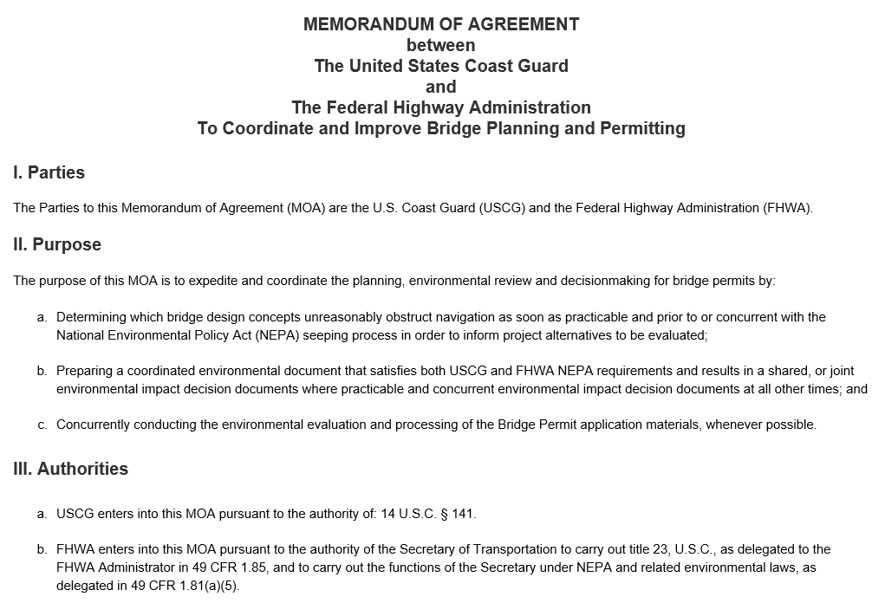
Chapter 16- U.S. Coast Guard Projects and Navigation
Synchronizing Federal Agency Reviews
  USCG permitting process and NEPA compliance coordination
  1986 MOU between USCG and FHWA
  2014 MOA between USCG and FHWA – to expedite and coordinate planning , environmental review, and decision-making
Lead Agency Options
Process Overview
  Process depends on Lead Agency

Slide 45
Chapter 16- U.S. Coast Guard Projects and Navigation
Divided into sections depending on Lead Agency
  FDOT as Lead Agency for FHWA Funded or Eligible Projects
  United States Coast Guard as Lead Agency
  FDOT as Lead Agency for State Funded Projects
Each section provides guidance on
  ETDM Process
  Project Development and Environment
  Design and Permitting
Coordination process differs between USCG Districts

Slide 46
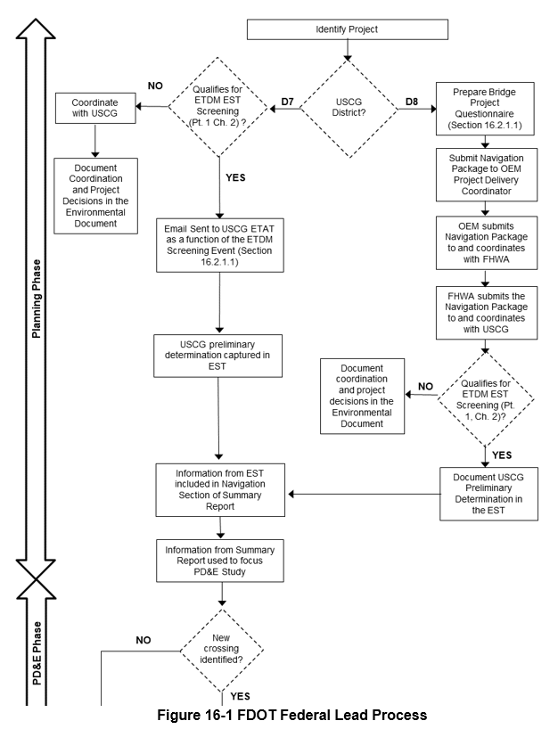
FIGURES
Flowcharts for each Lead Agency Process
Bridge Project Questionnaire
USCG Letter- D3 bridge repair information
Sample Letter for Preliminary Determination of Navigational Clearance

Slide 47
What is your area(s) of expertise?

Slide 48
PART 2

Slide 49
Chapter 1- Project Description and Purpose and Need

Slide 50
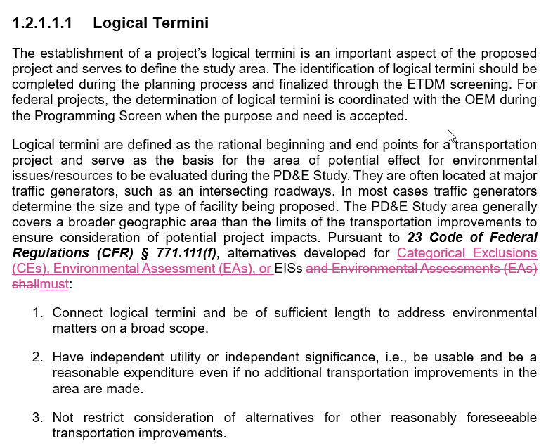
Chapter 1- Project Description and Purpose and Need
Categorical Exclusions added to logical termini requirements

Slide 51
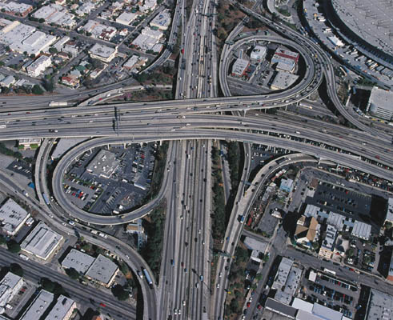
Chapter 2- Traffic Analysis
MINOR CHANGES ONLY

Slide 52
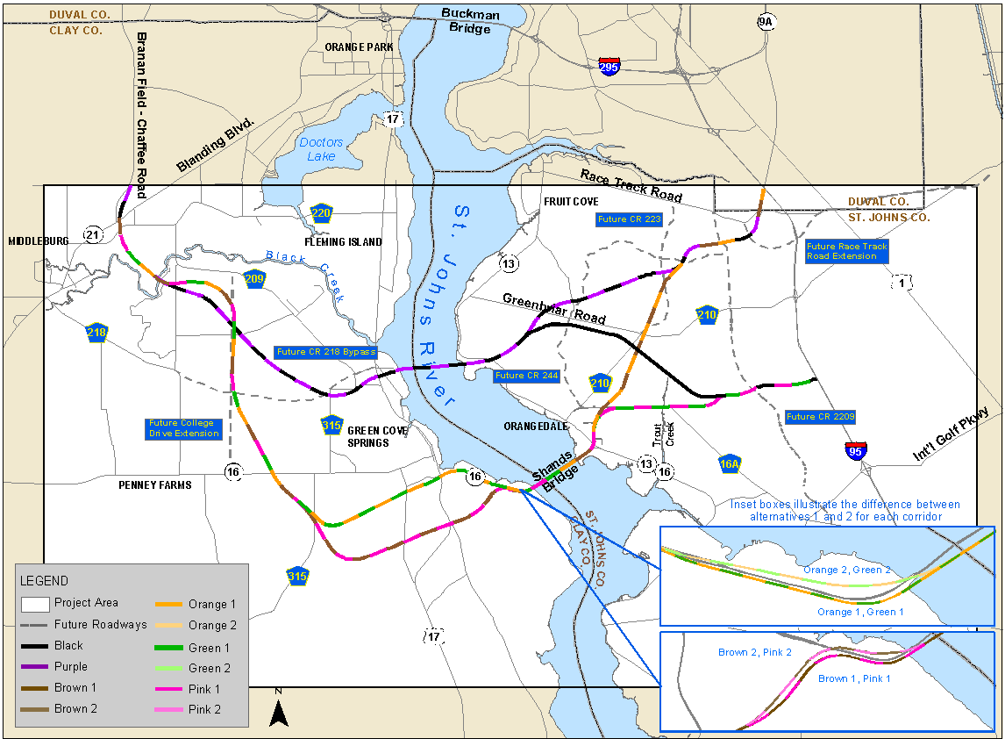
Chapter 3 – Engineering Analysis

Slide 53
Chapter 3- Engineering Analysis
Changes to aviation guidance
TSM&O alternative clarification
Reference to FHWA’s Bicycle and Pedestrian Planning, Program and Project Development guidance
Clarified the Managed Lanes process
  New policy
  Express Lanes to Managed Lanes
  Tolling to congestion pricing
Removed the Roundabouts section
Clarified the Interchange Access Request (IAR) process

Slide 54

Chapter 4 – Sociocultural Effects Evaluation

Slide 55
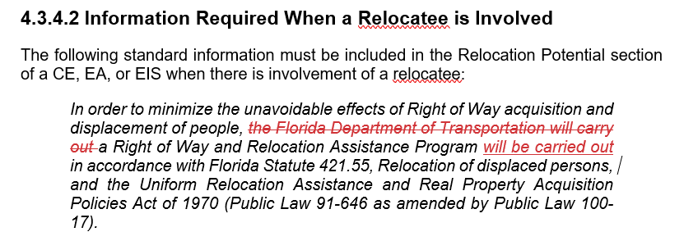
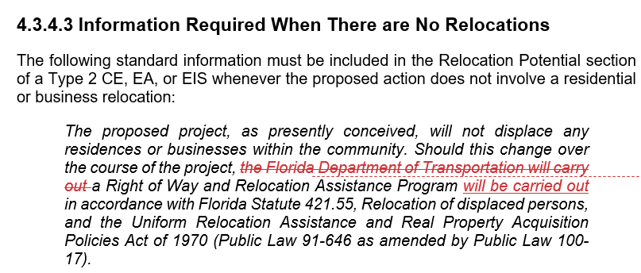

Slide 56
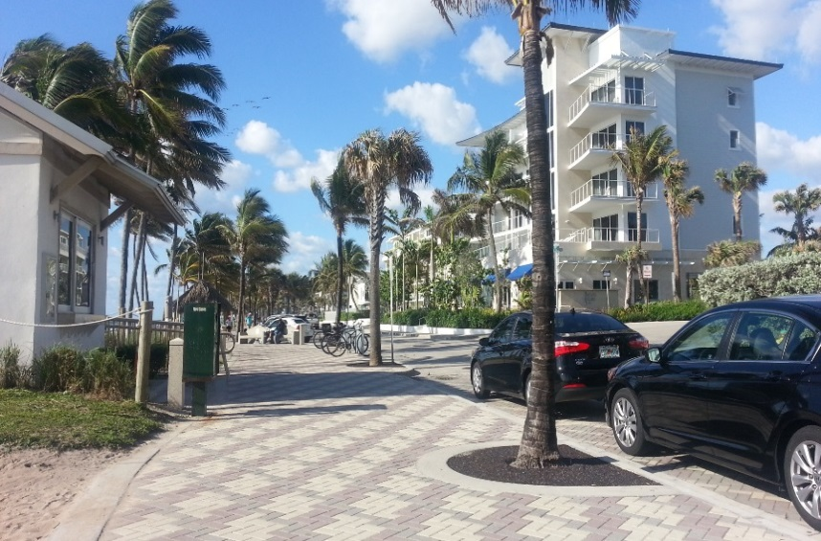
Chapter 5- Aesthetic Effects
MINOR CHANGES ONLY

Slide 57

Chapter 6- Farmland

Slide 58
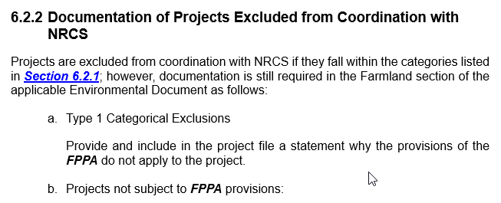
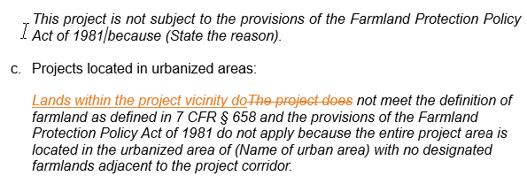
Chapter 6- Farmland

Slide 59
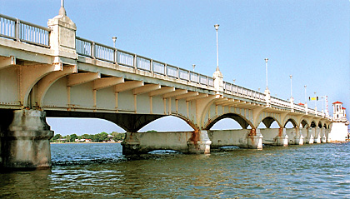
Chapter 7 – Section 4(f) Resources

Slide 60
Chapter 7- Section 4(f) Resources
Minor editorial corrections and edits
Removal of Section 4(f) Forms - Figures 2-12
    In Section 4(f) tool in SWEPT
Documentation for “No Use” Determinations
  Options for recording a No Involvement or a No Use decision
Archaeological Sites and Related Exemptions
  Excluded from late designation exemption in 23 CFR 774.11(f)
  Exempted from Section 4(f) when primarily important for research value

Slide 61
Chapter 7- Section 4(f) Resources
Clarification for Constructive Use Determinations
Guidance for emergency repairs
Consideration of changes to proximity impacts such as noise and vibrations during Re-evaluations

Slide 62
Chapter 8- Archaeological and Historic Resources

Slide 63
Chapter 8- Archaeological and Historic Resources
The District coordinates with OEM prior to initiating coordination for projects where adverse effects to historic or archaeological properties have been identified
Public involvement guidance
For a Type 2 CE any SHPO/THPO concurrence letters must be attached
Updated standard statement for
  No Involvement with Cultural Resources/No Historic Properties Affected
  No Adverse Effect or Adverse Effect to NRHP Properties
Deadline for completing Section 106 consultation after emergency repair

Slide 64
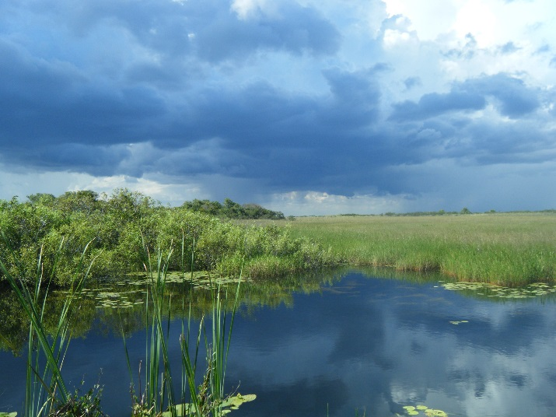
Chapter 9- Wetlands and Other Surface Waters
MINOR CHANGES ONLY

Slide 65
Chapter 10- Aquatic Preserves and Outstanding Florida Waters
CHAPTER DELETED

Slide 66
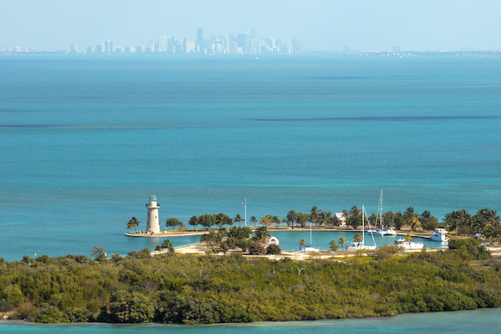
Chapter 11- Water Resources

Slide 67
Chapter 11- Water Resources
Incorporated information from the Outstanding Florida Waters and Aquatic Preserve chapter
Name change:
  Water Quality and Stormwater Water Resources
Reorganized to combine with existing information on
  Sole Source Aquifer
  Water Quality
  Stormwater Management
Incorporated changes to the Drainage Manual
Minor edits to Water Quality Impact Evaluation (WQIE) Form

Slide 68
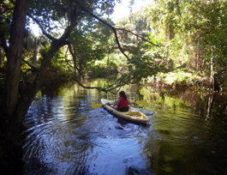
Chapter 12- Wild and Scenic Rivers

Slide 69
Chapter 12- Wild and Scenic Rivers
Updated to better clarify changes made last revision
Addition of State Wild and Scenic River information
  Myakka River
    FDOT District 1
Clarification of “Federally” Designated Wild and Scenic Rivers
Reorganized chapter- separating out Nationwide Rivers Inventory (NRI) rivers
Clarified how to determine involvement
Added guidance on analysis for NRI rivers

Slide 70
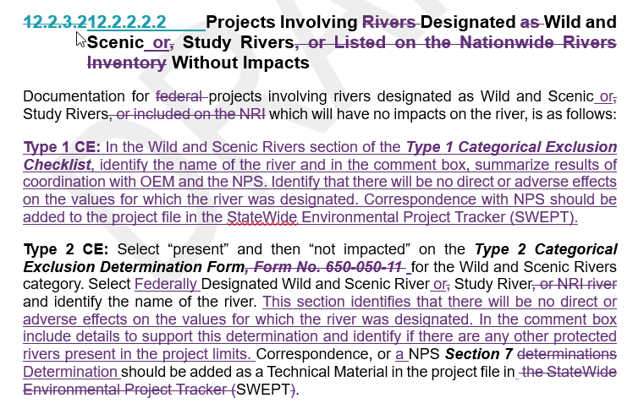
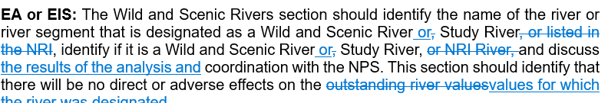
Projects Involving Designated Wild and Scenic or Study Rivers Without Impacts
New guidance on documentation on Type 1 CE Checklist
Updates to Type 2 CE Determination Form guidance

Slide 71
Chapter 12- Wild and Scenic Rivers
Nationwide Rivers Inventory (NRI) Rivers Documentation
  Changes to the Type 1 CE Checklist
    Separate question for projects on the NRI
    Add Myakka River
  Changes to the Type 2 Categorical Exclusion Determination Form
    Add Florida Wild and Scenic River option
    Modify standard statement

Slide 72
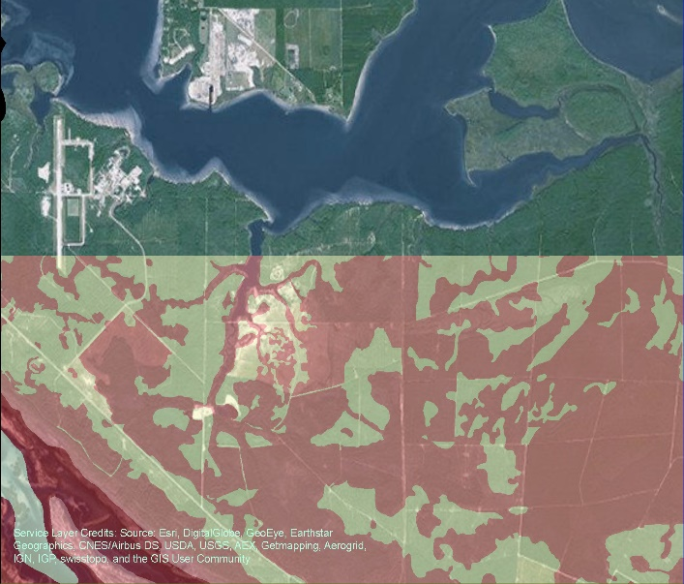

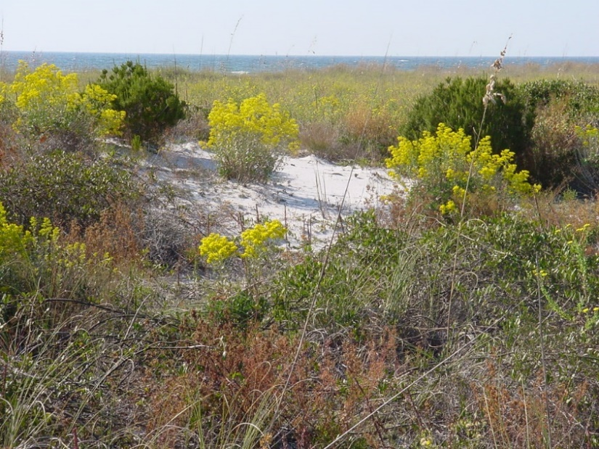
Chapter 13- Floodplains
Chapter 14- Coastal Zone Consistency
Chapter 15- Coastal Barrier Resources
MINOR CHANGES ONLY

Slide 73
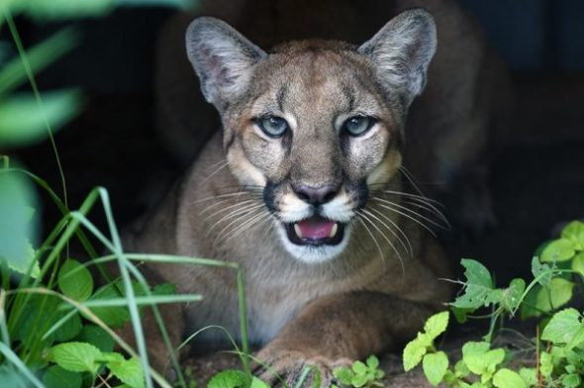
Chapter 16- Protected Species and Habitat

Slide 74
Chapter 16- Protected Species and Habitat
Revisions based on:
  Previous year’s FHWA audit
  Recent correspondence with regulatory agencies
  FHWA Memorandum: Management of the Endangered Species Act Environmental Analysis and Consultation Process, 2002
  Amendments to Section 7: Interagency Cooperation on federal Actions
    50 CFR Part 402 (both Services)
The U.S. Coast Guard requires Section 7 consultation when a bridge permit is needed
Some re-organization

Slide 75
Chapter 16- Protected Species and Habitat
Clarification on use of species keys
New timeframe for Informal Consultation
Clarified effect determinations
Clarification of requirements for when consultation cannot be completed during the PD&E phase
Guidance added on Design
Content of NRE updated to match Section 7 rule change and NRE Guidance Document
Clarified what information should be described in a Re-evaluation when considering changes in impacts to protected species and habitat

Slide 76
Chapter 16- Protected Species and Habitat
Changes in Type1 CE documentation
Updated permit information
  Edits to clarify the process based on Lead Agency agreement between USFWS, USACE, and USCG
  FDOT is lead agency for federal projects
Edited the Federally Listed Species process flowchart

Slide 77
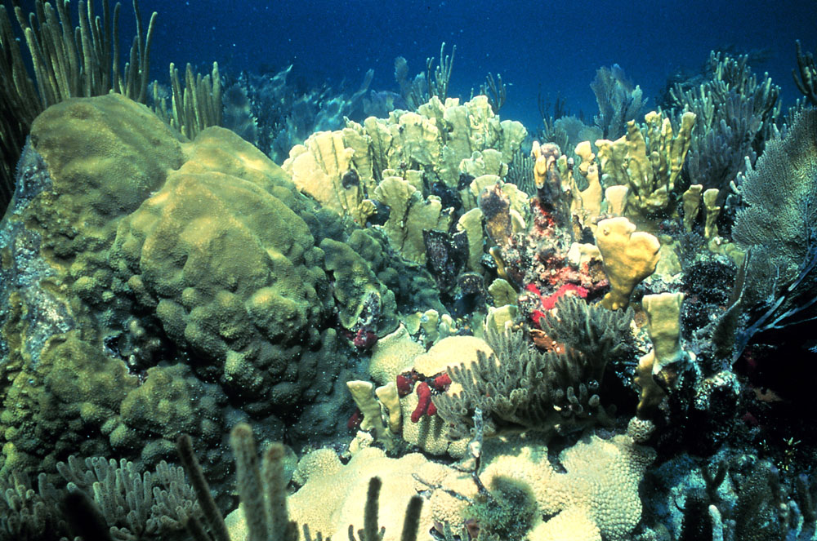
Chapter 17- Essential Fish Habitat

Slide 78
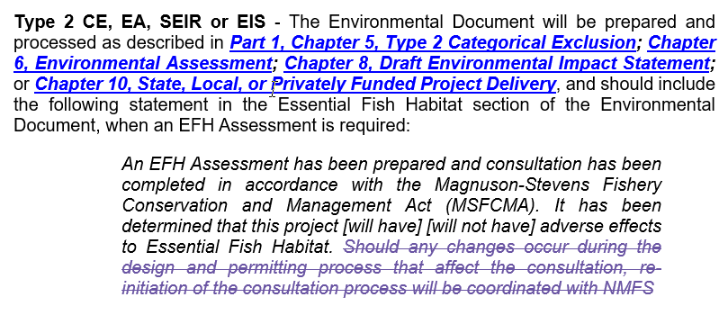
Chapter 17- Essential Fish Habitat
Removed Design and Permitting section
  Moved information to EFH Consultation Section
Added language on completing consultation and a new standard statement
Clarification for Type 1 CE and NMSA Documentation
Added Re-evaluation guidance
Edited statement documenting Type 2 CEs, EAs, EISs and SEIRs

Slide 79
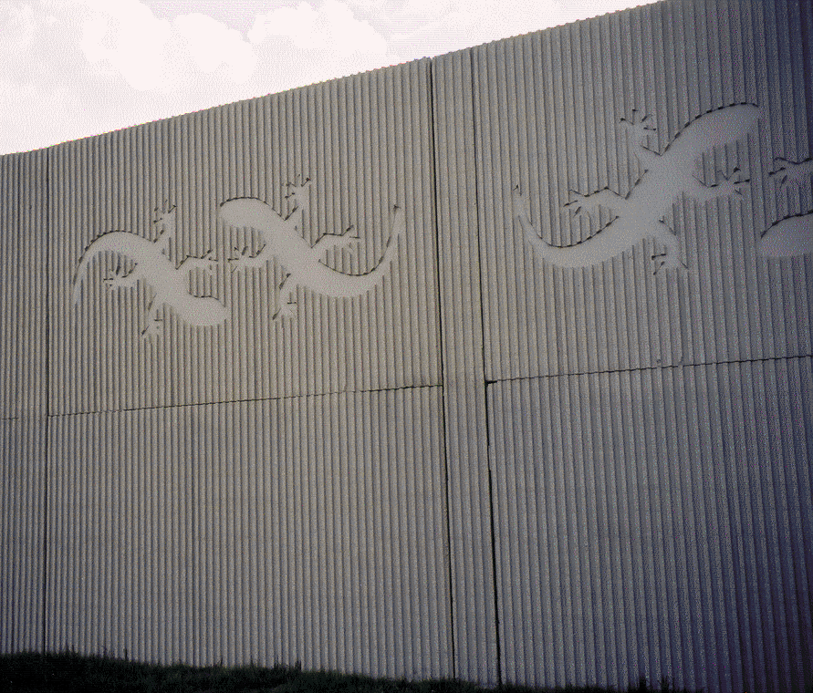
Chapter 18- Highway Traffic Noise

Slide 80
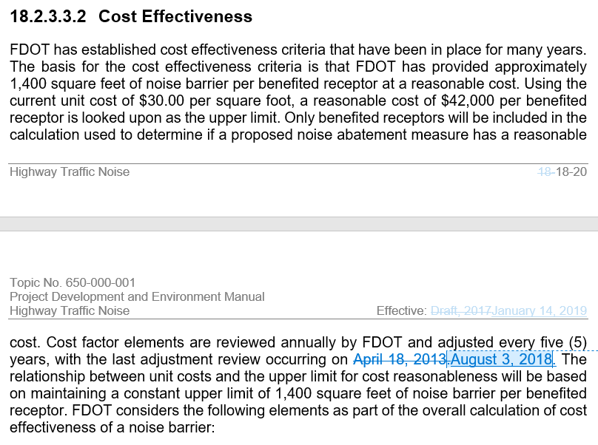
Chapter 18- Highway Traffic Noise
Only minor changes made in the 2020 version
FHWA approved changes
Changes to address District comments will be incorporated into the 2021 version

Slide 81
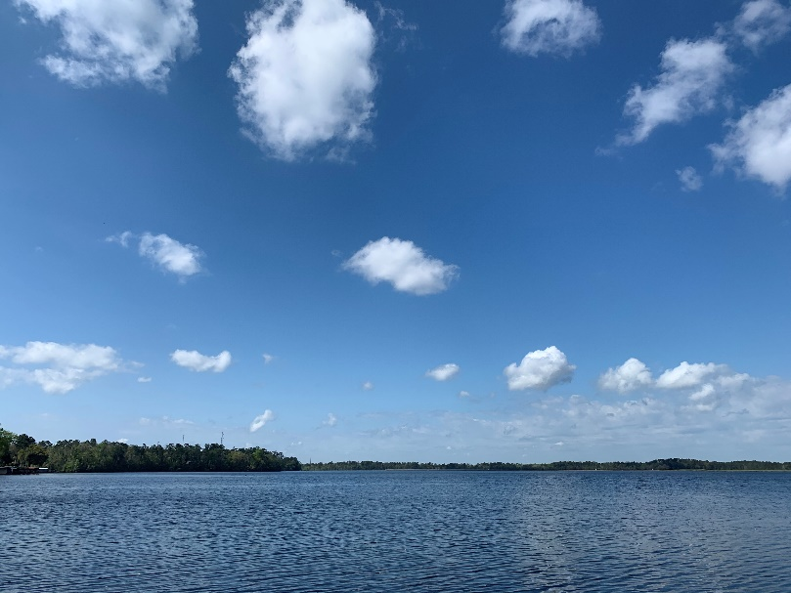
Chapter 19- Air Quality

Slide 82
Chapter 19- Air Quality
Chapter was re-written/ re-organized
Since Florida is in “attainment” for Carbon Monoxide and Particulate Matter National Ambient Air Quality Standards (NAAQS), removed information on “non-attainment” areas
  Information moved to a white paper in case Florida is in non-attainment in the future. Chapter would then be updated with this information
  Removed detailed information on State Implementation Plans and Transportation Conformity
Focused chapter on project level analysis
Guidance on MSAT quantitative analysis
Clarified language on how to conduct Air Quality Analysis

Slide 83
Chapter 19- Air Quality
Removed detailed information on NAAQS that were not pertinent to FDOT projects and focused the chapter on:
  Carbon Monoxide (CE)
  Particulate Matter (PM)
  Mobile Source Air Toxics (MSAT)
Combined these into one Air Quality Analysis section
Clarified that project level analysis is not required for CO (since in attainment), yet may be needed in certain circumstances
  Clarified the circumstances
Edits to clarify the CO Florida 2012 screening test

Slide 84
Chapter 19- Air Quality
Clarified that project level analysis is not required for PM (since in attainment), yet temporary construction impact impacts are minimized by:
  Adherence to applicable state regulations and
  The FDOT Standard Specifications for Road and Bridge Construction
Removed non-attainment documentation in the Air Quality Technical Memorandum and Environmental Document
Split the Documentation section into two separate Sections
  Air Quality Technical Memorandum
  Documentation in the Environmental Document

Slide 85
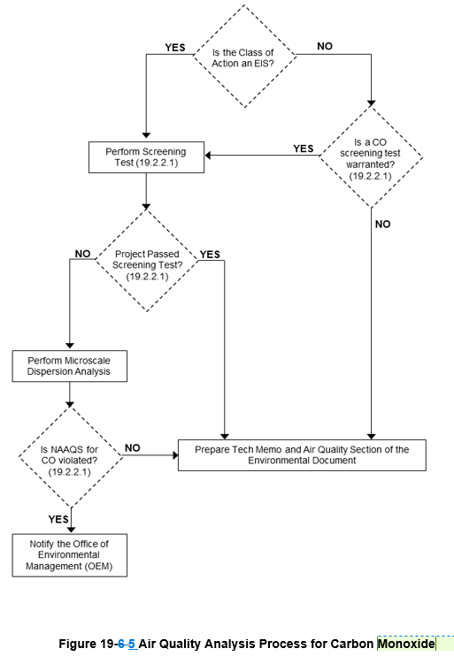
Chapter 19- Air Quality
Added 2 Flowchart Figures
  Air Quality Analysis Process for Carbon Monoxide
  Air Quality Analysis Process for MSAT
Removed Figure 19.2
  Will still be a form

Slide 86
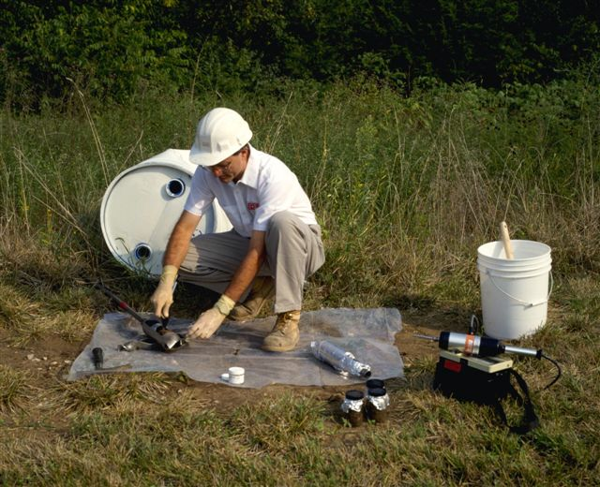
Chapter 20- Contamination
MINOR CHANGES ONLY

Slide 87
Chapter 21- Utilities and Railroads

Slide 88
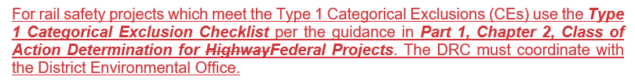
Chapter 21- Utilities and Railroads
Section 21.2.3 Railroad Procedure

Slide 89
Chapter 22- Commitments

Slide 90
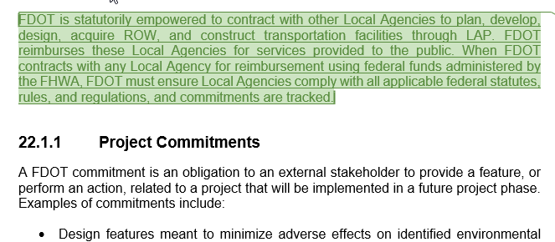
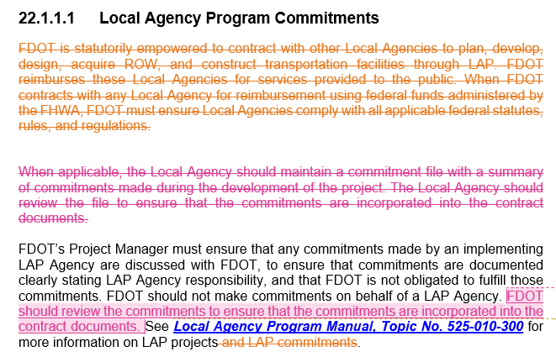
Chapter 22- Commitments
LAP projects- FDOT should review commitments

Slide 91
NEW Chapter 23- Acquisition and Restoration Council (ARC) Coordination

Slide 92
Chapter 23- Acquisition and Restoration Council Coordination
NEW chapter to the manual
Provides guidance for projects requiring the use of state-owned upland conservation lands which are managed for
  Conservation
  Outdoor resource-based recreation, or
  Archaeological or historic preservation
  These lands are held by the Board of Trustees of the Internal Improvement Trust Fund (TIITF), which is also referred to as the Board of Trustees (BOT).
Introduces Land Acquisition Funds, Special Programs, and Statutory Authority

Slide 93
Chapter 23- Acquisition and Restoration Council Coordination
Describes the policies established by the TIITF
Explains how to identify the applicability of state-owned lands
Explains Coordination
  Between FDOT and Land Management Agency
  Between FDOT, Land Management Agency, and Bureau of Public Lands Administration
  District Coordination with the OEM Director
  For mitigation

Slide 94
Chapter 23- Acquisition and Restoration Council Coordination
Explains preparation of:
  ARC Agenda Item Package
    Upland Easement Application
    Supplemental Information for the Upland Easement Application
    State Lands Impact Report
Process of scheduling ARC Meeting Agenda Item
ARC review of the ARC Agenda Item Package
ARC determination and development of an MOA
Signing of MOA and FDEP preparation of easement document for FDOT approval
Documentation in the Environmental Document
Other applicable laws and regulations

Slide 95
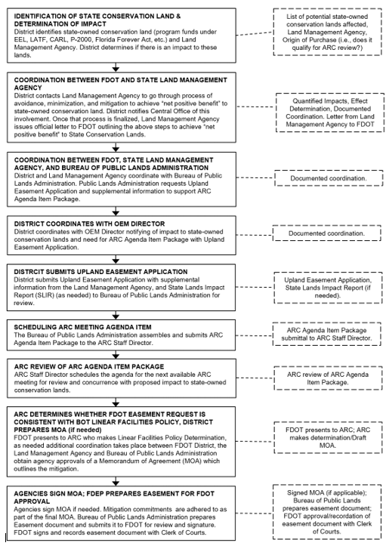

Slide 96
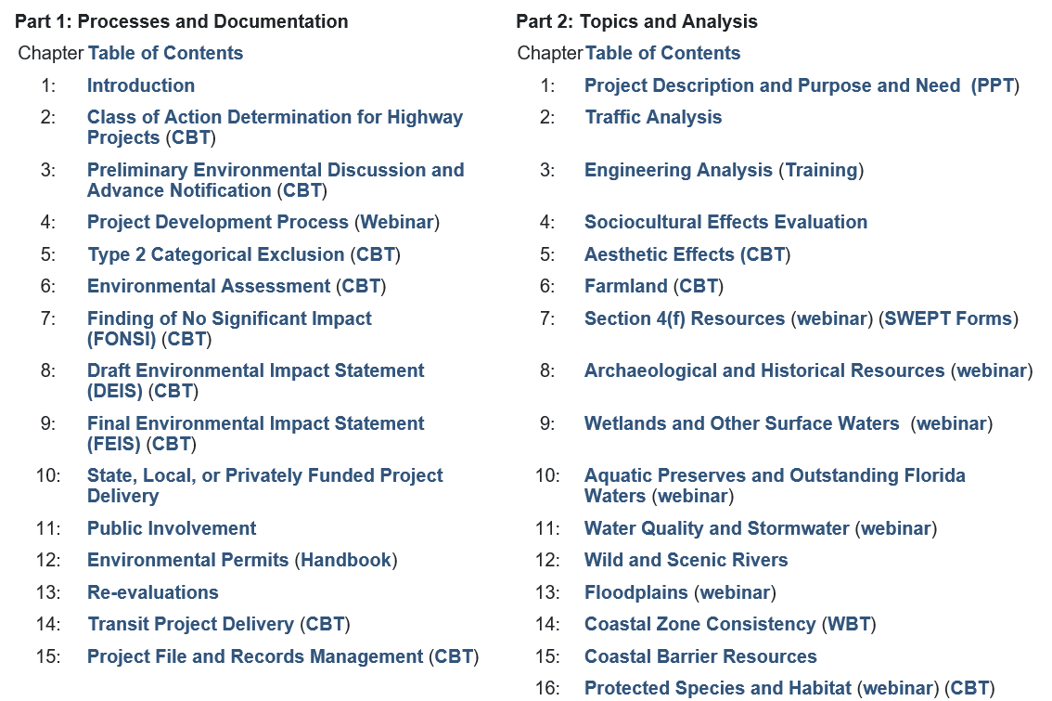
Computer Based Trainings- Learning Curve

Slide 97
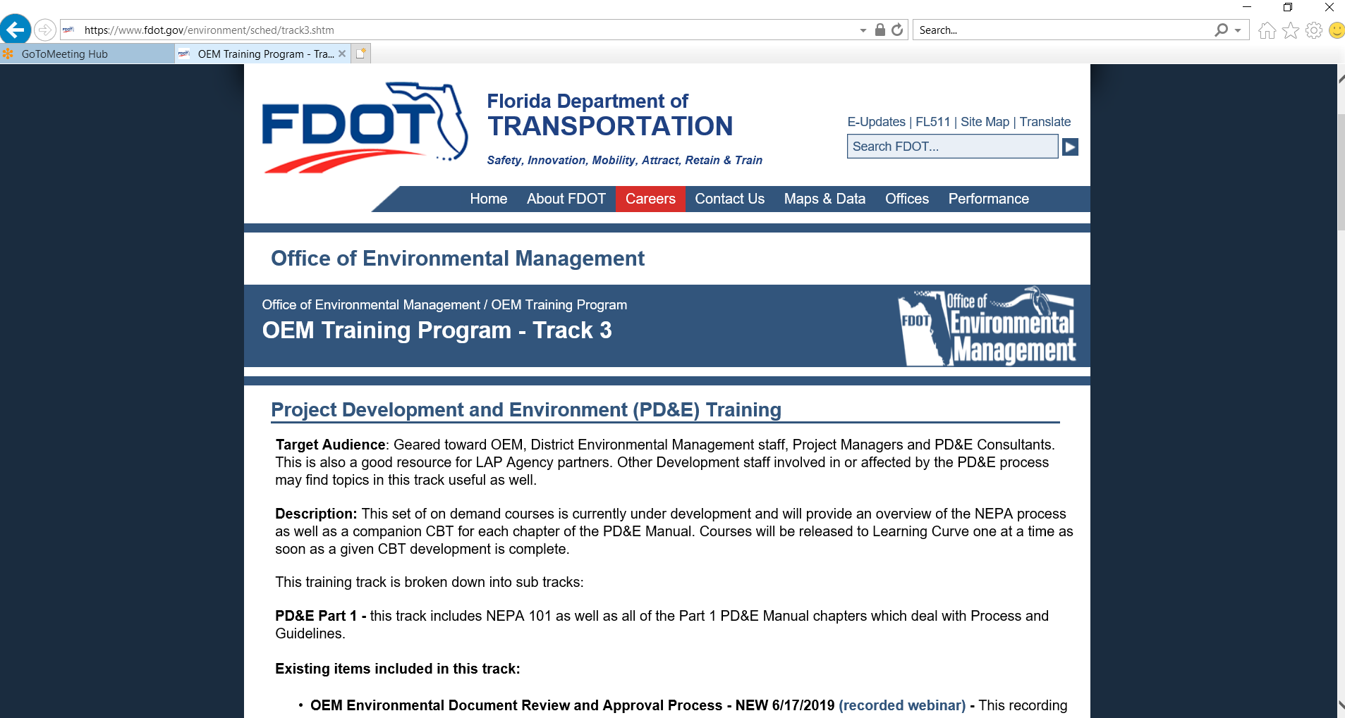

Slide 99
Summary of Edits
No major changes, substantive revisions, or additions (i.e. policy changes, new chapters) are recommended at this time
  Minor pen and ink changes
    Editorial corrections
    Changes to incorporate updates approved in the 2020 version of the PD&E Manual
    Word replacements

Slide 100
Highlights
Throughout Chapters 2, 3, 4, and 5:
  Incorporated updates made in 2020 to the PD&E Manual:
    Updated references to PD&E Manual chapters as needed
    Re-ordered and renamed PED and ETAT Review topics
    Consistent capitalization of “Cooperating and Participating Agencies” (should be title case)
  Changed “Dispute Resolution” to “Issue Resolution” (title change only)
  Text changes to eliminate confusion with “Issue” Resolution:
    Changed “issue” to “topic” when referencing environmental topics
    Changed “issue” to “comments” when related to comments that may require responses, but not to the level of the ETDM Issue Resolution process
  Updated revision date and history log
In Acronyms document, corrected typo in header (period in date changed to comma)
No changes to Chapters 1 and 6

Slide 101
Topics and PED Order
Social and Economic
  Social
  Economic
  Land Use Changes
  Mobility
  Aesthetic Effects
  Relocation Potential
  Farmlands
Cultural and Tribal
  Section 4(f) Potential
  Historic and Archaeological Sites
  Recreational and Protected Lands (previously Recreation Areas)
Natural
  Wetlands and Surface Waters
  Water Resources (previously Water Quality and Quantity)
  Floodplains
  Protected Species and Habitat (previously Wildlife and Habitat)
  Coastal and Marine
Physical
  Noise
  Air Quality
  Contamination
  Infrastructure
  Navigation
Special Designations
  Outstanding Florida Waters (OFW)
  Aquatic Preserves
  Wild and Scenic Rivers
  Sole Source Aquifers

Slide 102
Coordination Summary
10/8/2019 – ETDM coordinators meeting: discussed anticipated Pen & Ink changes
  Incorporating PD&E Manual updates, and editorial corrections
1/14/2020 – ETDM coordinators meeting: discussed anticipated Pen & Ink changes
  Incorporating PD&E Manual updates, editorial corrections, and changing “Dispute” to “Issue” Resolution per OGC
4/14/2020 – ETDM coordinators meeting: discussed Pen & Ink changes incorporated into the approved revision

Slide 103
Publication Date: July 1, 2020

Slide 104
How well does the information shared in this webinar help you with your job?

Slide 105
Questions?

Slide 106


