Slide 1



Lesson One
Highway Traffic Noise Legislation, Regulations and Policies
Source: www.keyclub.org
Notes:
Lesson 1 – Noise Legislation, Regulations, and Policies.

Slide 2
Lesson 1: Highway Traffic Noise Legislation, Regulation and Policies
Lesson Overview
This lesson presents information on:
Federal regulations
State regulations
  Florida Department of Transportation (FDOT) regulations and guidance
    PD&E Manual
    Traffic Noise Modeling & Analysis Handbook
Local regulations
Notes:
This lesson presents information on Federal noise regulations (including discussion of the Noise Abatement Criteria), State noise regulations, Florida Department of Transportation (FDOT) noise regulations and guidance, PD&E Manual noise chapter, Traffic Noise Modeling & Analysis Handbook, and local noise regulations.

Slide 3
Lesson 1: Highway Traffic Noise Legislation, Regulation and Policies
Federal Regulations
National Environmental Policy Act (NEPA) of 1969
2. Federal-Aid Highway Act of 1970
3. The highway traffic noise related aspects of each of these pieces of legislation are contained in Title 23 Code of Federal Regulations (CFR) Part 772
4. Congress passed the Noise Control Act of 1972, which put even more pressure on the Federal Highway Administration, or FHWA (read all letters), to address highway traffic noise.
Notes:
The National Environmental Policy Act, or NEPA (pronounced NEE-PAH) was passed in 1969. This law was one of the first laws to establish protection of the environment. The NEPA regulation helps to make sure that all branches of government have properly considered any environmental impacts that may occur as a result of a federal project or action.
Following the passage of NEPA in 1969, the Federal-Aid Highway Act of 1970 established the requirement for highway noise level standards.
In an effort to further focus on noise issues, congress passed the Noise Control Act of 1972, which put even more pressure on the Federal Highway Administration, or FHWA (read all letters), to address highway traffic noise.

Slide 4
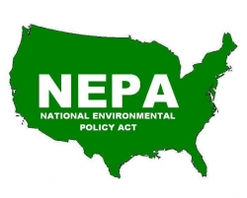
Lesson 1: Highway Traffic Noise Legislation, Regulation and Policies
National Environmental Policy Act (NEPA) of 1969
Declares a national environmental policy
  Applies to any project that has federal dollars or federal action
Incorporation of environmental considerations by Federal agencies
Oversight by Council on Environmental Quality (CEQ)
Categorical Exclusions (CE)/Environmental Assessments (EA)/Environmental Impact Statements(EIS)
Source: www.energy.gov
Notes:
NEPA applies to all projects with federal dollars or actions. It does not work through technology standards like other policies. It relies on information and forces agencies to consider the environment. By itself, it has no teeth. It is designed to educate decisionmakers. It relies on a belief that agencies will do the right thing if the proper issues are considered. This is where the Environmental Impact Statement, or EIS, comes from. The EIS looks at unavoidable adverse impacts as well as mitigatable impacts. In Transportation those are Cultural, Biological, and Physical. NEPA created the CEQ, which oversees the NEPA process, but does not enforce authority. Authority is enforced through lawsuits. These lawsuits often challenge “was the NEPA process fully followed?”

Slide 5
Lesson 1: Highway Traffic Noise Legislation, Regulation and Policies
Federal–Aid Highway Act of 1970
Section 136(b) of the Federal-Aid Highway Act of 1970, Section 109(i), Title 23 U.S.C. requires the establishment of standards for highway noise levels by the Federal Highway Administration (FHWA)
The 1st Federal legislation to address traffic noise and resulted in…..
Notes:
The Federal-Aid Highway Act of 1970 established the first federal requirement for highway noise level standards. This Federal legislation resulted in the development of…..(go to next slide).

Slide 6
Lesson 1: Highway Traffic Noise Legislation, Regulation and Policies
Title 23 Code of Federal Regulations (CFR) Part 772
Title: “Procedures for Abatement of Highway Traffic Noise and Construction Noise”
Simply known as “23 CFR 772”
July 13, 2010 (latest version)
Notes:
…Title 23 Code of Federal Regulations, or CFR, Part 772. In general, this CFR is simply referred to as “23 CFR 772”. 23 CFR 772 is titled “Procedures for Abatement of Highway Traffic Noise and Construction Noise”. Although this was developed in the 1970’s, July 13, 2010 is the most up to date and latest version of 23 CFR 772. The FDOT PD&E Manual, Part 2 Chapter 18 incorporates the requirements of 23 CFR 772, to be discussed later.

Slide 7
Lesson 1: Highway Traffic Noise Legislation, Regulation and Policies
Applicability of 23 CFR 772
Applies to all Federal or Federal-Aid Highway Projects authorized under Title 23 United States Code (USC).
Applies to any highway project by the Department, regardless of funding sources, including those which:
  Require FHWA approval, regardless of funding sources
  Are funded by Federal-Aid highway funds
  Under Florida Statute (FS) 335.17, state-funded projects must follow the process from 23 CFR 772
Notes:
23 CFR 772 regulations apply to all Federal or Federal-Aid Highway Projects that have been authorized under Title 23 of the United States Code. In short, these regulations apply to any highway project in Florida, regardless of funding. It applies to Federal-Aid highway funds as well as funding for all phases solely with Florida state funds according to Florida Statute, or FS, 335.17.

Slide 8
Lesson 1: Highway Traffic Noise Legislation, Regulation and Policies
More Applicability of 23 CFR 772
The state highway agency shall develop a noise policy in conformance with 23 CFR 772, and apply it uniformly
Applies to Type I, Type II & Type III Projects (to be defined
later)
Notes:
Specifically, 23 CFR 772 calls for each state highway agency to develop and uniformly apply a noise policy in conformance with 23 CFR 772. The regulation calls for feasibility requirements of the achievement of at least a 5 decibel highway traffic noise reduction at impacted receptors (i.e., a discrete or representative location of a noise sensitive areas for which there is a noise abatement criteria) and that each highway agency shall define (and receive FHWA approval for) the number of receptors that must achieve this reduction for the noise abatement measure to be acoustically feasible and explain the basis for this determination. Florida has adopted the requirement that two impacted receptors must achieve a 5 decibel reduction for noise abatement to be considered feasible. However, each state is different. For example, Georgia and South Carolina require one receptor to meet this. Other states like Texas and Ohio require a percentage. For example, in Texas, 50% of the first row of impacted receptors must achieve a 5 decibel reduction. In Ohio, 40% of the impacted receptors have to achieve a 5 decibel reduction.
Additionally, as previously mentioned, the FDOT has developed a noise policy (Part 2 Chapter 18 of the PD&E Manual) that incorporates the requirements of 23 CFR 772 and has been approved by FHWA, which is to be covered later.

Slide 9
Lesson 1: Highway Traffic Noise Legislation, Regulation and Policies
Key Elements of 23 CFR 772
Provide procedures for noise studies and abatement measures
Establish Noise Abatement Criteria (NAC)
If impacts are identified, abatement measures MUST be CONSIDERED
Notes:
23 CFR 772 provides procedures for evaluating highway traffic noise and recommending abatement measures.
It also provides impact criteria for considering noise abatement called the Noise Abatement Criteria, or NAC.
If impacts are identified according to the NAC, abatement measures such as noise barriers must be considered.

Slide 10
Lesson 1: Highway Traffic Noise Legislation, Regulation and Policies
Key Elements of 23 CFR 772 (Continued)
Identify feasible and reasonable noise abatement measures that are
likely to be incorporated into the project
Identify traffic noise impacts that can’t be reduced or eliminated (and
why)
Consider the viewpoints of the property owners and residents that
are benefited (i.e., receive a 5 dB[A] reduction) by the abatement
measure (done during design phase).
Notes:
One purpose of 23 CFR 772 is to identify feasible and reasonable noise abatement measures that are likely to be incorporated into the project’s Design. There are several requirements for feasibility and reasonableness that will be discussed in detail later in this training.
23 CFR 772 also serves to identify traffic noise impacts that can not be reduced or eliminated with abatement measures.
When determining abatement measures, it is very important to consider the viewpoints of the property owners and residents that are benefited by the abatement measure. This is very important in the eyes of FHWA and typically done during the Design phase.

Slide 11
Lesson 1: Highway Traffic Noise Legislation, Regulation and Policies
Key Elements of 23 CFR 772 (Continued)
FHWA will NOT approve project plans and specifications unless
feasible and reasonable noise abatement measures are included
  Notably, as of 2016, Florida has received NEPA assignment, which delegates
  review and approval to FDOT
Provide noise contours to local officials for land use planning in the final noise study report for PD&E
  Reminder – Contours do not identify impacts!
Third-Party funding not allowed to achieve abatement reasonableness
  Example: If a barrier for a school is $2,000 over the cost criteria the school can
  NOT provide $2,000 to meet the cost reasonable criteria
Notes:
Of note, FHWA will NOT approve project plans and specifications unless feasible and reasonable noise abatement measures are included.
23 CFR 772 also aims to provide noise contours to local officials for land use planning purposes in the final noise study report for Project Development and Environment, or PD&E. Of importance, these noise contours do NOT identify impacts, but rather are used for land use planning purposes only.
Additionally, 23 CFR 772 explicitly states that third party funding is NOT allowed to be included in the calculation of cost reasonableness to determine if a noise abatement measure is cost reasonable.

Slide 12
Lesson 1: Highway Traffic Noise Legislation, Regulation and Policies
Even More Key Elements of 23 CFR 772
The FHWA’s Traffic Noise Model (TNM) must be used
  TNM version 3.2 is the latest version. However, issues with the model need to be resolved.
  FHWA is accepting projects using TNM version 2.5 or 3.2, but the FDOT is currently recommended to use TNM 2.5 until issues can be resolved.
Identify land uses or activities that may be affected by noise from construction of the project and determine the measures that are needed to minimize construction noise
Notes:
23 CFR 772 also requires the use of FHWA’s Traffic Noise Model, or TNM. Of importance, as of 2020, there is new version of TNM, TNM 3.2. FHWA allows its use but does not require it. However, TNM 3.2 has issues that need to be worked out and, therefore, FDOT is not currently using TNM 3.2. Currently, the FHWA is accepting projects using TNM version 2.5 or 3.2. Once TNM 3.2 is required to be used, there will likely be a “grandfathering” period between TNM 2.5 and the expected new version, but it is unknown what the time period will be.
23 CFR 772 also requires to identify land uses that may be impacted by construction noise and to determine measures that could be utilized to lessen or eliminate construction noise.

Slide 13
Project Types
Lesson 1: Highway Traffic Noise Legislation, Regulation and Policies
Type I: A highway construction project (new location or physical alteration of existing highway) which substantially changes horizontal and vertical alignment, profile or adds through lanes (adds capacity).
Type II: A federal, federal-aid, or state funded highway project for noise abatement on an existing highway (not under construction). Type II projects are commonly referred to as retrofit projects and are allowed (but not mandatory) under 23 CFR Part 772. (Florida doesn’t have a Type II program, discussed later)
Type III: A project that does not meet the classifications of a Type I or Type II
Notes:
There are three different project types under 23 CFR 772.
A Type 1 project is a highway construction project (new location or physical alteration of existing highway) which substantially changes horizontal and vertical alignment, profile or adds through lanes (adds capacity).
A Type 2 project is a federal, federal-aid, or state funded highway project for noise abatement on an existing highway (not under construction). Type 2 projects are commonly referred to as retrofit projects and are allowed (but not mandatory) under 23 CFR Part 772. Of note, Florida doesn’t have a Type 2 program, which will be discussed later.
A Type 3 project is a project that does not meet the classifications of a Type 1 or Type 2. Type 3 projects do not require a noise analysis.
It should be noted that these project type designations of Type 1, Type 2 and Type 3 have nothing to do with the class of action for a project (CE, EA, etc.).

Slide 14
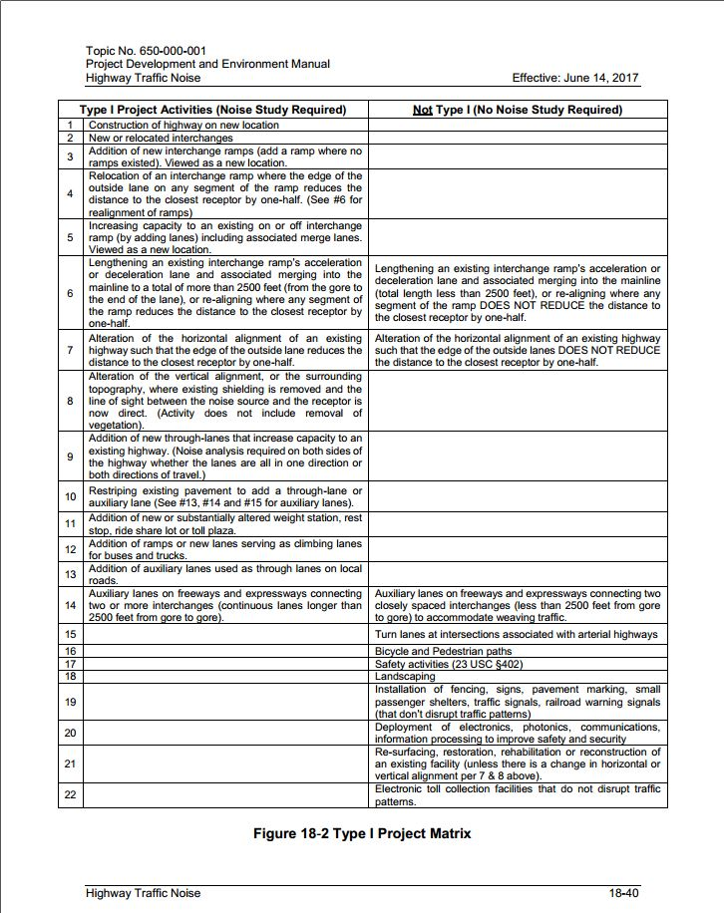
Figure 18-2
Part 2 Ch. 18
PD&E Manual
Lesson 1: Highway Traffic Noise Legislation, Regulation and Policies
Further defines what projects are Type I Projects
Notes:
This is Figure 18-2 from Chapter 18 of the PD&E Manual (Part 2). This figure helps to differentiate project types. Specifically, this provides a list of projects that would and would not be considered a Type 1 project. For example, construction of a highway at a new location is considered a Type 1 project, whereas adding a bicycle and pedestrian path is not considered a Type 1 project. This figure is an excellent reference if you are unsure if a noise analysis is needed.

Slide 15
Lesson 1: Highway Traffic Noise Legislation, Regulation and Policies
Type I, II and III Projects
Type I Project Examples:
Construction of a highway on a new location
Physical alteration of an existing highway, with either:
  Substantial horizontal alteration
  Substantial vertical alteration
Capacity expansion (e.g.: addition of through lanes)
Notes:
Examples of a Type 1 Project include the construction of a highway at a new location (i.e., a new alignment), a physical alteration of an existing highway with a substantial horizontal or vertical alteration, or a capacity expansion (e.g., the addition of through lanes).

Slide 16
Lesson 1: Highway Traffic Noise Legislation, Regulation and Policies
Type I Project Examples (Continued)
Addition of an auxiliary lane (except when functioning as a turn lane), including:
  Auxiliary lanes used as through lanes on local roads
  Auxiliary lanes on freeways connecting two or more interchanges (continuous lanes longer than 2500 feet)
Addition or relocation of interchange lanes or ramps added to a quadrant to complete an existing partial interchange
Increasing capacity to existing interchange ramp by adding lanes, including merge lanes
Notes:
Another Type 1 project example is any project with an addition of an auxiliary lane (except when functioning as a turn lane). This includes auxiliary lanes used as through lanes on local roads and auxiliary lanes on freeways connecting two or more interchanges (continuous lanes longer than 2,500 feet). Note that auxiliary lanes on freeways/expressways that connect 2 closely spaced interchanges to accommodate weaving traffic/movements do NOT require a noise study. However, a “closely spaced interchange” still needs to be defined.
Another Type 1 project is a project that includes the addition or relocation of interchange lanes or ramps added to a quadrant to complete an existing partial interchange.
Another Type 1 project is a project that is increasing capacity to existing interchange ramp by adding lanes, including merge lanes

Slide 17
Lesson 1: Highway Traffic Noise Legislation, Regulation and Policies
Type I Project Examples (Continued)
Lengthening or re-alignment of existing interchange ramp acceleration or deceleration lane and associated merging into mainline to a total of more than 2,500 ft., where any ramp segment reduces the distance to the closest receptor by one-half
Restriping existing pavement for the purpose of adding a through- traffic lane or auxiliary lane
The addition of a new, or substantial alteration of a weigh station, rest stop, ride-share lot or toll plaza
Addition of ramps or new lanes serving as bus/truck climbing lanes
Notes:
A Type 1 project is also a project where there is lengthening or a re-alignment of an existing interchange ramp, acceleration or deceleration lane and associated merging into mainline, or where any ramp segment reduces the distance to the closest receptor by one-half (Or, we just say “Halving the distance to the nearest receptor” ).
Restriping existing pavement for the purpose of adding a through-traffic lane or auxiliary lane is also considered a Type 1 project.
A Type 1 project is also a project that includes the addition of a new, or substantial alteration of a weigh station, rest stop, ride-share lot or toll plaza.
A project that includes the addition of ramps or new lanes serving as bus/truck climbing lanes is also considered a Type 1 project.
For a more comprehensive list of Type 1 project examples, please reference the aforementioned Figure 18-2 in Chapter 18 of the PD&E Manual.

Slide 18
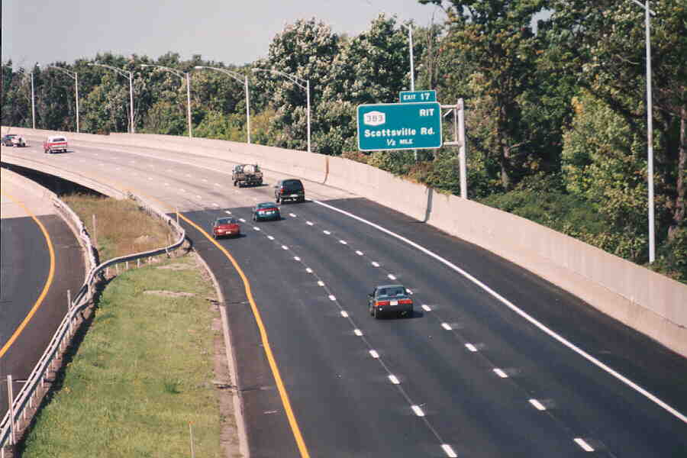
Lesson 1: Highway Traffic Noise Legislation, Regulation and Policies
Type I Projects – the “Kicker”
If any portion of a project is determined to be a Type I project under this definition, then the entire project area as defined in the environmental document is a Type I project and therefore requires a noise analysis to be performed.
Notes:
The most important thing to remember about determining if a project warrants a noise analysis is that if any portion of a project is determined to be a Type 1 project under this definition, then entire project area as defined in the environmental document is a Type 1 project and would require a noise analysis to be performed. The evaluation should not just focus on where improvements are being made, but within the entire defined project limits. The project limits should be identified carefully, as noise should be evaluated for the entire length of the project limits. Analysis and abatement could potentially be required in a segment of a project even if no capacity increase is being provided in a segment of the project.

Slide 19
Lesson 1: Highway Traffic Noise Legislation, Regulation and Policies
Type II Projects
A Type II project is a project for noise abatement on an existing highway (no improvements are being proposed).
Also known as “Retrofit” projects
Are optional
  The development and implementation of Type II projects are not mandatory requirements of Section 109(i) of Title 23, United States Code.
FDOT does not have a Type II program
Notes:
Let’s move on to Type 2 projects. A Type 2 project is a project for noise abatement on an existing highway where no improvements are being proposed. These projects can also known as “Retrofit” projects and are optional. FDOT receives a lot of noise complaints for existing roadways (like I-10 where some sections have not been widened since originally constructed but traffic noise along such highway sections has certainly increased since the roadway was constructed and noise is at 'impact' levels based on NAC); but because FDOT has no retrofit program (i.e., Type II Projects) because one is not required by 23 CFR 772, FDOT is not required to abate noise. A Type II program has never been funded in Florida. Other states which have a Type II program have learned that it is a very expensive program that requires implementation throughout several years.

Slide 20
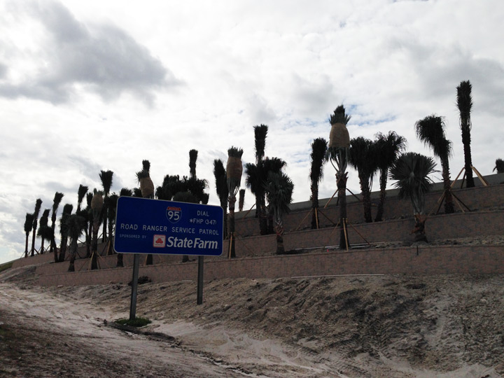
Lesson 1: Highway Traffic Noise Legislation, Regulation and Policies
Type III Projects
A project that does not meet classification of a Type I or Type II project. Type III projects do not require a noise analysis.
Notes:
Type 3 projects. A Type 3 project is a project that does not meet classification of a Type 1 or Type 2 project. Type 3 projects do not require a noise analysis.

Slide 21
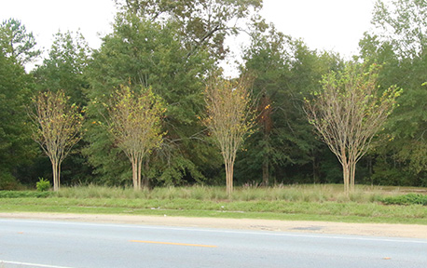
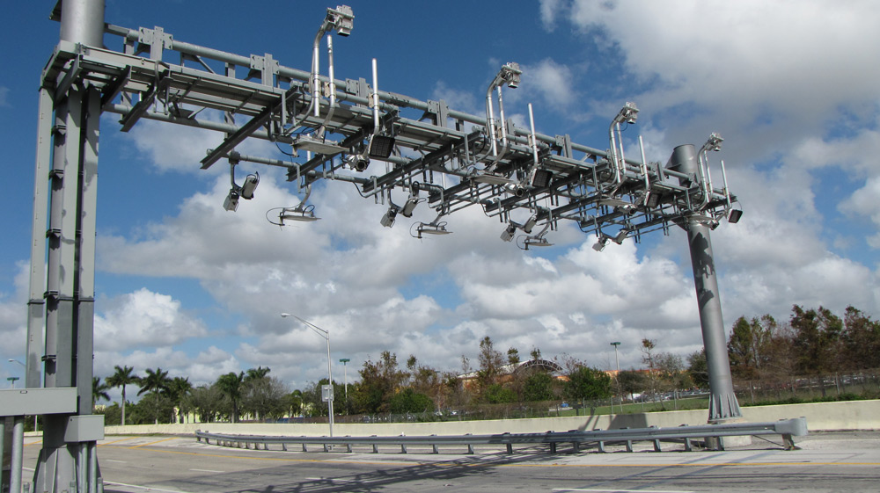
Lesson 1: Highway Traffic Noise Legislation, Regulation and Policies
Type III Project Examples:
Bicycle and pedestrian lanes/paths/facilities
Activities included in the FDOT highway safety plan
Landscaping (including the removal of existing vegetation)
Installation of fencing, signs, pavement markings, small passenger shelters, traffic signals and railroad warning devices
Deployment of electronics, photonics, communications, or information processing (ITS)
Resurfacing/restoration/rehabilitation/reconstruction
Placement of overhead gantries to collect tolls (as long as no disruption to existing traffic patterns)
Notes:
Examples of Type 3 Projects are: Bicycle and pedestrian lanes/paths/facilities; Activities included in the FDOT highway safety plan; Landscaping (including the removal of existing vegetation); Installation of fencing, signs, pavement markings, small passenger shelters, traffic signals and railroad warning devices; Deployment of electronics, photonics, communications, or information processing (ITS); Resurfacing/restoration/rehabilitation/reconstruction; and placement of overhead gantries to collect tolls (as long as no disruption to existing traffic patterns).

Slide 22
Lesson 1: Highway Traffic Noise Legislation, Regulation and Policies
FHWA Noise Abatement Criteria (NAC)
Activity Category | Activity Criteria |  | Evaluation Location | Activity Description
 | Leq(h) | L₁₀ (h)
A | 57 | 60 | Exterior | Lands on which serenity and quiet are of extraordinary significance and serve an important public need and where the preservation of those qualities is essential if the area is to continue to serve its intended purpose.
B | 67 | 70 | Exterior | Residential
C | 67 | 70 | Exterior | Active sports areas, amphitheaters, auditoriums, campgrounds, cemeteries, day care centers, hospitals, libraries, medical facilities, parks, picnic areas, places of worship, playgrounds, public meeting rooms, public or nonprofit institutional structures, radio studios, recording studios, recreational areas, Section 4(f) sites, schools, television studios, trails, and trail crossings.
D | 52 | 55 | Interior | Auditoriums, day care centers, hospitals, libraries, medical facilities, places of worship, public meeting rooms, public or nonprofit institutional structures, radio studios, recording studios, schools, and television studios.
E | 72 | 75 | Exterior | Hotels, motels, offices, restaurants/bars, and other developed lands, properties or activities not included in A-D or F.
F | -- | -- | -- | Agriculture, airports, bus yards, emergency services, industrial, logging, maintenance facilities, manufacturing, mining, rail yards, retail facilities, shipyards, utilities (water resources, water treatment, electrical), and warehousing.
G | -- | -- | -- | Undeveloped lands that are not permitted.
Notes:
Federal Highway Administration’s Noise Abatement Criteria, or NAC, are used to determine project impacts by land use type. Each land use type has been assigned an Activity Category with an Activity Criteria. Of note, FHWA states you can use either Leq or L10, but not both, as your descriptor. FDOT chooses to use Leq. Activity Categories range from A to G, with noise level criteria assigned to categories A through E. More details will be discussed in Lesson 3.

Slide 23
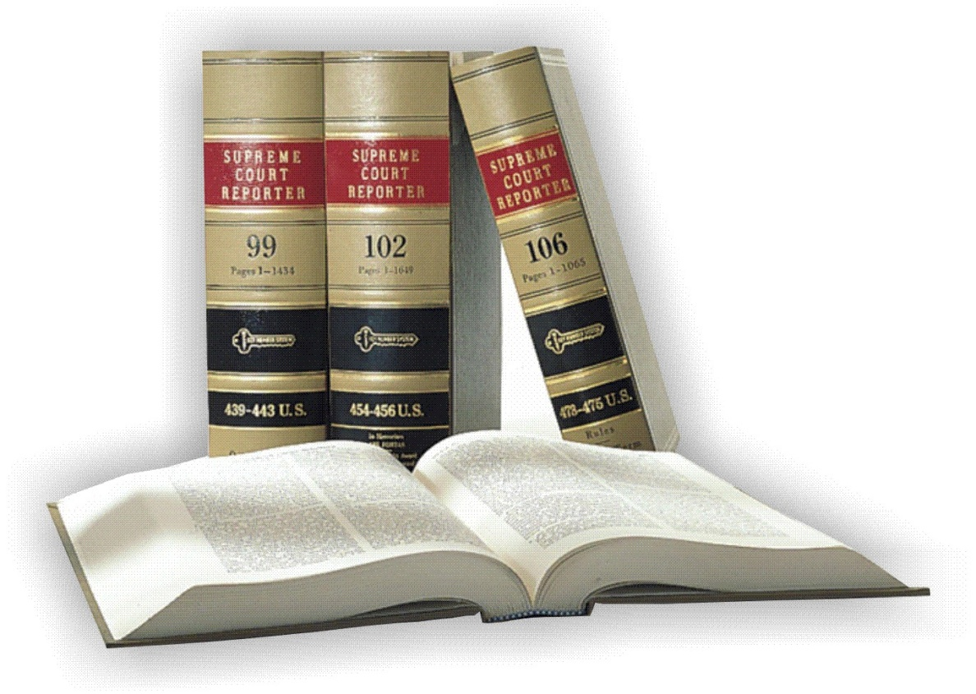
Lesson 1: Highway Traffic Noise Legislation, Regulation and Policies
Florida Regulations Related to Traffic Noise
Florida Statute (F.S.)§ 335.17
    State highway construction; means of noise abatement.
F.S. § 335.02(4)
    Local noise regulations/ordinances do not apply to FDOT projects
F.S. § 479.25
    Erection of noise-attenuation barrier blocking view of Outdoor Advertising sign
F.S. § 339.09(1)
    Transportation tax revenues may be used to construct and maintain noise mitigation
Notes:
There are several Florida regulations related to noise, including Florida Statute 335.17, 335.02(4), 479.25, and 339.09(1). Each of these statutes are discussed in detail in the following slides.

Slide 24
Lesson 1: Highway Traffic Noise Legislation, Regulation and Policies
FS 335.17
State Highway Construction; Means of Noise Abatement
1st law to address traffic noise and abatement in FL
Applies to all projects by FDOT regardless of funding
Follow requirements of 23 CFR 772
Notes:
Florida Statute 335.17 relates to State highway construction and means of noise abatement. This was the 1st law to address traffic noise and abatement in Florida. It applies to all project by FDOT regardless of funding. In addition, it follows the requirements of 23 CFR 772.

Slide 25
Lesson 1: Highway Traffic Noise Legislation, Regulation and Policies
FS 335.02
Application of Local Regulations
“Regulations of any county, municipality, or special district, including any instrumentality thereof, shall not apply to existing or future transportation facilities, or appurtenances thereto, on the State Highway System.”
Passed in 2003
Notes:
Florida Statute 335.02 was passed in 2003 and relates to the application of local regulations. It states that “Regulations of any county, municipality, or special district, including any instrumentality thereof, shall not apply to existing or future transportation facilities, or appurtenances thereto, on the State Highway System.”
Essentially, this means that local noise regulations/ordinances do not apply to FDOT projects – either from operation of such project or during construction.

Slide 26
Lesson 1: Highway Traffic Noise Legislation, Regulation and Policies
FS 479.25
Erection of noise-attenuation barrier blocking view of outdoor advertising sign
If a FDOT noise barrier will block a lawfully erected outdoor advertising sign; FDOT must perform the following:
  Conduct a survey of the benefited property owners
  Have a public hearing
  Coordinate with local government
Notes:
Florida Statute 479.25 relates to the erection of noise barriers which block views of outdoor advertising (or, ODA) signs (i.e., billboards). Notably, this statute states that if an FDOT noise barrier will block a lawfully erected outdoor advertising sign, the FDOT must conduct a survey of the benefited property owners, have a public hearing, and coordinate with local government

Slide 27
Lesson 1: Highway Traffic Noise Legislation, Regulation and Policies
FS 339.09(1)
Use of Transportation Tax Revenues; Restrictions
“……Funds available to the department shall not be used for any non-transportation purpose…..The department is encouraged and permitted to use funds to construct and maintain noise mitigation facilities or walls upon request of the proper authorities.”
Notes:
Florida Statute 39.09(1) relates to the use of transportation tax revenues and restrictions of use. Specifically, it states, “……Funds available to the department shall not be used for any non-transportation purpose…..The department is encouraged and permitted to use funds to construct and maintain noise mitigation facilities or walls upon request of the proper authorities.”. However, this has not been done or tested, nor is there a definition of “proper authorities” (and, furthermore, there is no legal opinion).

Slide 28
Lesson 1: Highway Traffic Noise Legislation, Regulation and Policies
Local Noise Ordinances
Local noise ordinances do not apply to FDOT projects per F.S. 335.02(4)
Local ordinances vary widely in their approach to noise control
Frequently have boundary limits
Often have different criteria for day and night noise levels
May or may not have provisions for variances
Notes:
In addition to Florida regulations, local ordinances also need to be considered. Local ordinances can vary widely in their approach to noise control and frequently have boundary limits. Oftentimes, local ordinances have different criteria for day and night noise levels and often limit construction noise. Local ordinances may contain varying criteria and may or may not have provisions for variances. Of importance, local noise ordinances do not apply to FDOT projects

Slide 29
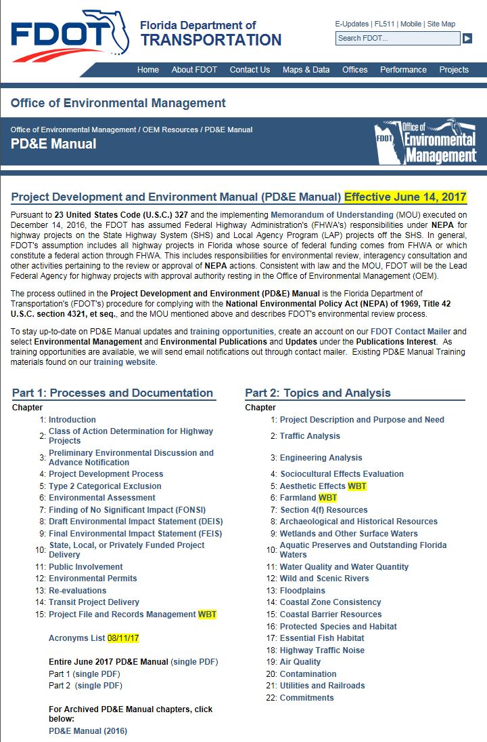
Lesson 1: Highway Traffic Noise Legislation, Regulation and Policies
FDOT Noise Abatement Policy
Part 2, Chapter 18 (Highway Traffic Noise) of the FDOT Project Development & Environment (PD&E) Manual is the FDOT noise policy, which contains procedures for the purpose of meeting the requirements of 23 CFR 772 and applicable state laws.
  Latest: July 1, 2020
FDOT has also published the Traffic Noise Modeling and Analysis Practitioner’s Handbook, which provides guidance on noise modeling procedures.
Notes:
Additionally, the FDOT has guidance on their noise abatement policy, found in Part 2, Chapter 18 (Highway Traffic Noise) of the Project Development and Environment (PD&E) Manual. This chapter of the PD&E Manual is the official noise policy and procedures for the purpose of meeting the requirements of 23 CFR 772 and applicable state laws. Additionally, the FDOT has published Traffic Noise Modeling and Analysis Practitioner’s Handbook, which provides guidance on noise modeling procedures and is a tool for producing consistent, predictable, and repeatable traffic noise studies. Consistency of noise study procedures and uniform application of regulations throughout the state is very important.

Slide 30
Lesson 1: Highway Traffic Noise Legislation, Regulation and Policies
QUESTIONS?
If you have any questions, please feel free to send an email to OEM@dot.state.fl.us
30
Notes:
If you have any questions, please feel free to send an email to OEM@dot.state.fl.us.

