Slide 1
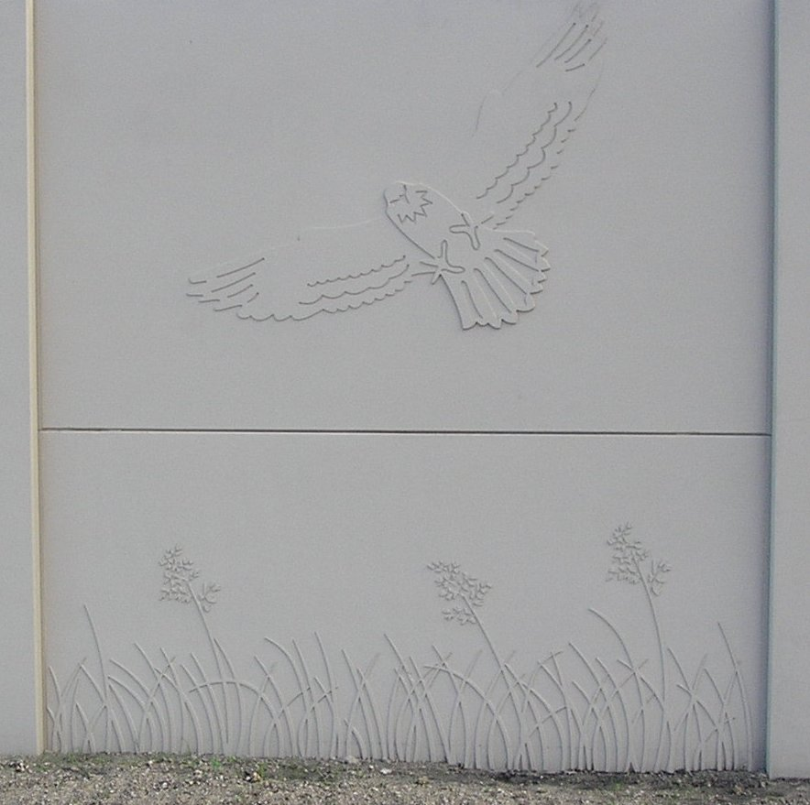


Lesson Two
Basic Acoustic and Traffic Noise Concepts
Notes:
Lesson 2 – Basic Acoustic and Traffic Noise Concepts. This lesson will cover the basics of acoustics and traffic noise concepts used in evaluating highway traffic noise.

Slide 2
Lesson 2: Basic Acoustic and Traffic Noise Concepts
This lesson presents information on:
Basic concepts of sound and noise
  Frequency
  Time
  Magnitude
Decibels
  A-weighting
  Adding decibels
Noise level descriptors
Sound propagation
Shielding
Noise barrier placement
Notes:
This lesson will cover the basics of acoustics and traffic noise concepts used in evaluating highway traffic noise, including information on basic concepts of sound and noise (frequency, time, magnitude), decibels (A-weighting, adding decibels), noise level descriptors, sound propagation, shielding, and noise barrier placement.

Slide 3
What is Noise?
Lesson 2: Basic Acoustic and Traffic Noise Concepts
Noise is unwanted sound
Notes:
What is noise? Noise can be defined as unwanted sound.

Slide 4
Lesson 2: Basic Acoustic and Traffic Noise Concepts
What is sound?
Sound is the sensation produced by stimulation of the organs of hearing by vibrations transmitted through the air or other medium. (From: www.dictionary.com)
Notes:
What is sound? Sound is the sensation produced by stimulation of the organs of hearing by vibrations transmitted through the air or other medium.

Slide 5
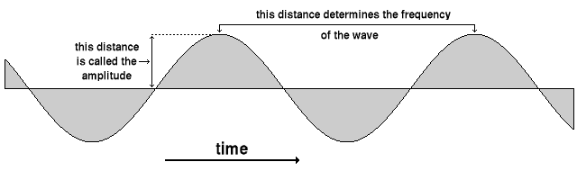
Lesson 2: Basic Acoustic and Traffic Noise Concepts
3 Basic Dimensions of Sound:
Magnitude/Amplitude (the “loudness”)
Frequency (the “pitch”)
Time (both duration and variation)
Notes:
There are three basic dimensions of sound:. They are the magnitude, the frequency, and time. The magnitude, also known as “amplitude”, is the “loudness” of the sound. This is represented in the graphic below by the distance the waves depart from the centerline.

Slide 6
Lesson 2: Basic Acoustic and Traffic Noise Concepts
Frequency is the number of cyclical crests\variations (wavelengths) per unit of time. Frequency is generally expressed in cycles per second, also denoted as Hertz (HZ).
Source: Noise Control Reference Handbook, 1989
Notes:
The frequency, also known as the “pitch”, is the number of cyclical crests/variations (or, wavelengths) per unit of time. The distance between the crests of waves determines the frequency. Generally, the frequency is expressed in cycles per second. The metric which expresses the frequency is known as Hertz.

Slide 7
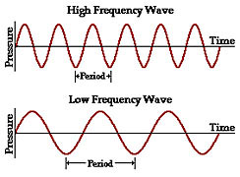
Lesson 2: Basic Acoustic and Traffic Noise Concepts
Wavelength (λ) is the distance, measured in the direction of propagation, between two points of the same phase in consecutive cycles of a wave.
Source: www.dictionary.com
λ
λ
Source: www.physicsclassroom.com
Notes:
A wavelengths is the distance between two points of the same phase in consecutive cycles of a wave. It is measured in the direction of propagation. Note the “Period” or distance in between waves is what determines the frequency. A high frequency has closely spaced waves. Conversely, a low frequency has waves further apart. Of importance, low frequency waves, which is depicted by the bottom of the two graphs, travel farther than high frequency waves, which is depicted by the graph on the top.

Slide 8
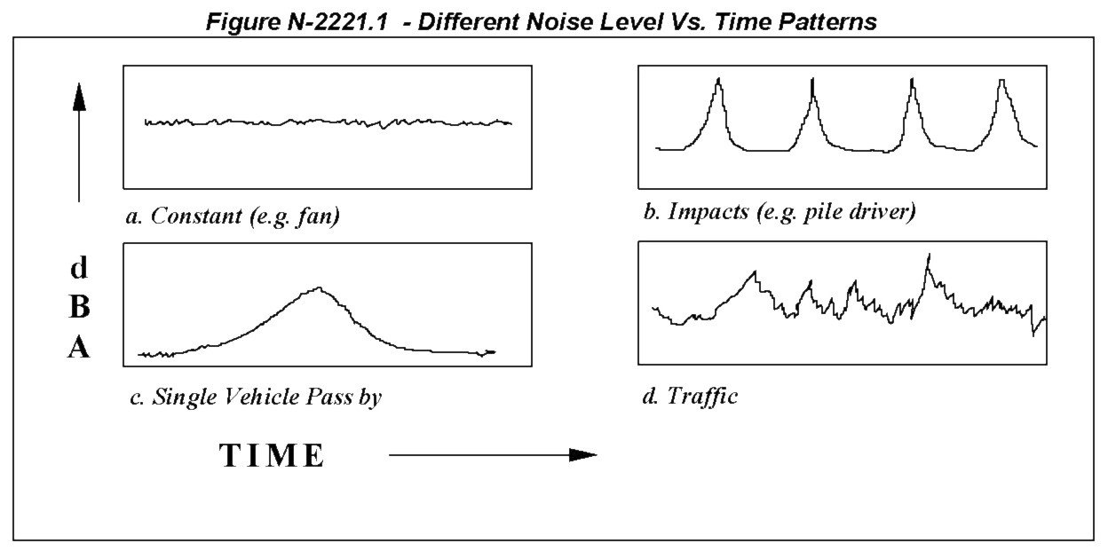
Lesson 2: Basic Acoustic and Traffic Noise Concepts
Noise is described based on its sound intensity over a given period of time.
This is illustrated here:
Source: CALTRANS Technical Noise Supplement, 1998
Notes:
The 2nd dimension of sound is time. Noise is described based on its sound intensity over a given span of time. The illustration shows four different types of noise: a constant noise such as a fan is depicted in the top left graph, a pile driver is depicted in the top right graph, a single vehicle pass by is depicted in the bottom left graph, and random traffic is depicted in the bottom right graph.

Slide 9


Lesson 2: Basic Acoustic and Traffic Noise Concepts
Magnitude is what can be measured – the “loudness”
Sound/Acoustic Power – The sound energy emitted per unit of time.
Sound Pressure – The sound measured at a point in space (x) distance from the source to a “receptor”.
Sound Power is the source – Sound Pressure is the effect
Notes:
The magnitude is the intensity, or the “loudness”, and is what can be measured. The sound energy emitted per unit of time is called the sound/acoustic power. It’s the sound measured at a point in space which is a certain distance from the source of the sound to a “receptor” or a recipient of sound. In other words, sound power is the source, and sound pressure is the effect.

Slide 10
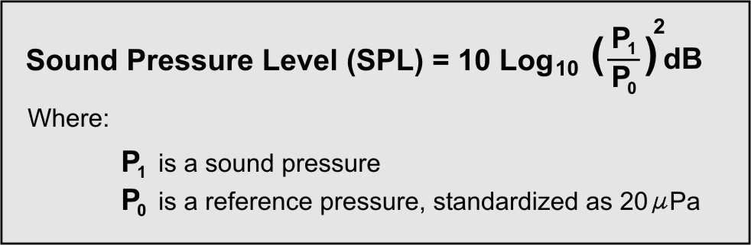
Lesson 2: Basic Acoustic and Traffic Noise Concepts
*Sound pressure is measured in sound pressure level (no units) – named bels
Log of the square of the ratio of pressures
Since a decibel is one tenth of a bel our equation is as follows in decibels (dB(A)):
*
◊
Source: CALTRANS Technical Noise Supplement (TENS), 1998
◊ Threshold of hearing
Notes:
Sound pressure is measured in sound pressure level – named bels. The sound pressure level is the Log of the square of the ratio of pressures. Since a decibel is one tenth of a bel, the resulting equation is what is displayed on this slide, where P₁ (pronounced “P sub1”) is a sound pressure, and P₀ (pronounced “P sub 0”) is a reference pressure, which is standardized as 20 micro pascals.

Slide 11
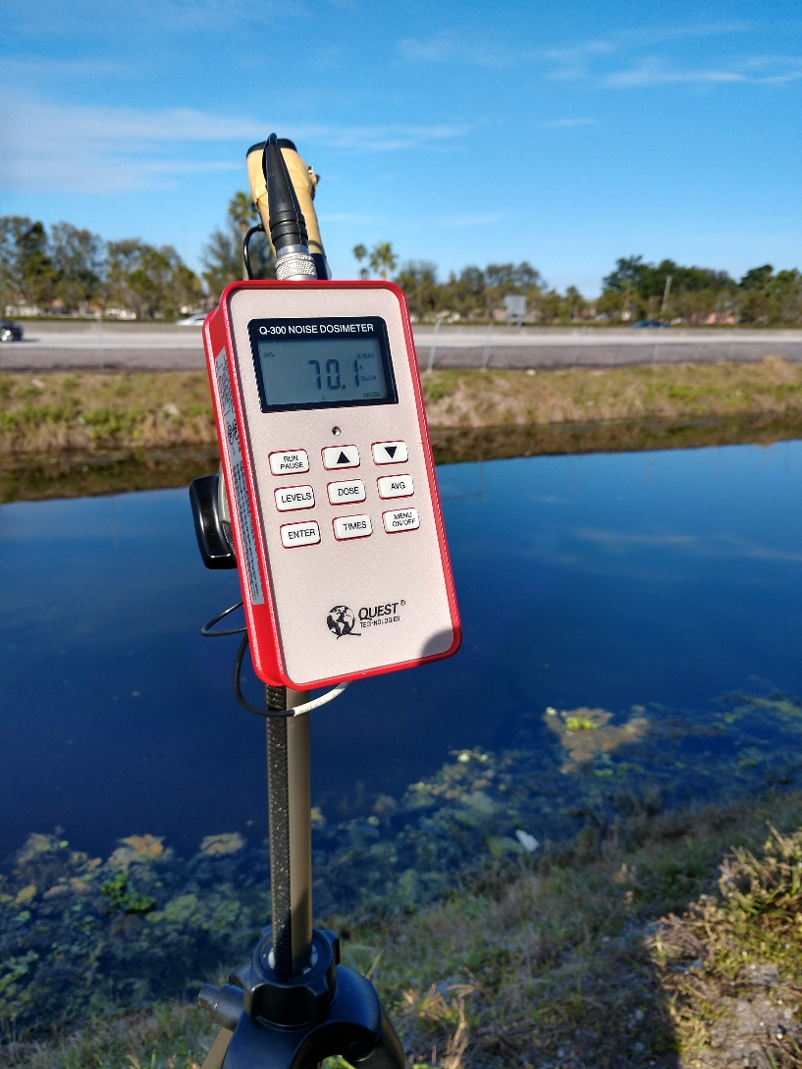
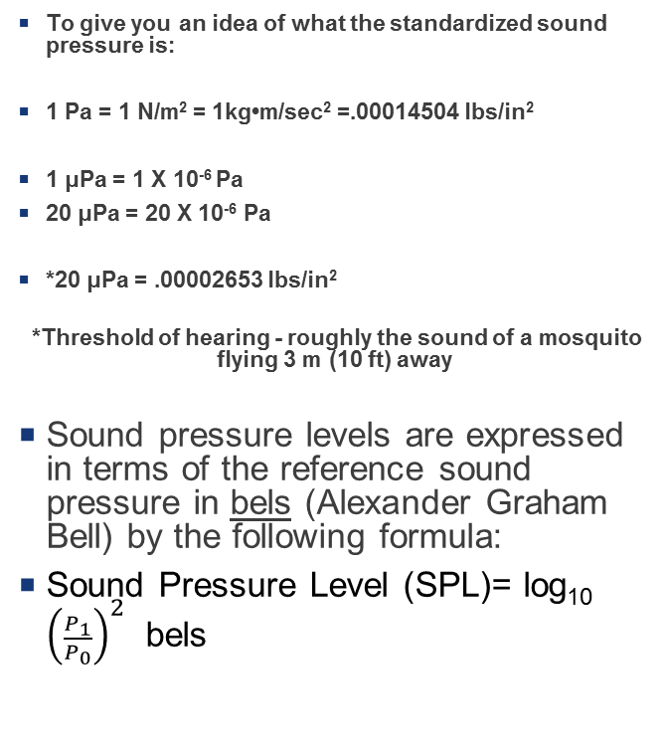
Lesson 2: Basic Acoustic and Traffic Noise Concepts
Sound is measured in decibels with a sound level meter (dosimeter)
To give you an idea of what the standardized sound pressure is:
1 Pa = 1 N/m² = 1kg•m/sec² =.00014504 lbs/in²
1 μPa = 1 X 10⁻⁶ Pa
20 μPa = 20 X 10⁻⁶ Pa
*20 μPa = .00002653 lbs/in²
*Threshold of hearing - roughly the sound of a mosquito flying 3 m (10 ft) away
Sound pressure levels are expressed in terms of the reference sound pressure in bels (Alexander Graham Bell) by the following formula:
Sound Pressure Level (SPL)= log₁₀ ${\left(\frac{P_{1}}{P_{0}}\right)}^{2}$ bels
Notes:
Sound is measured in decibels with a sound level meter called a dosimeter. To give you an idea of what the standardized sound pressure is, one Pascal equals 1 Newton per square meter. One Newton per square meter equals 1 kilogram meter per second squared, which is equal to 0.00014504 pounds per square inch. One micro pascal equals one times 10 to the negative 6 Pascal. 20 micro Pascals equals 20 time 10 to the negative 6 Pascals, which equates to 0.00002653 pounds per square inch. This is the threshold of human hearing. The use of micro pascals reduces the "large" numbers expressed in Pascals
Sound pressure levels are expressed in terms of the reference sound pressure in bels, named after Alexander Graham Bell, by the following formula shown on the slide.

Slide 12
Lesson 2: Basic Acoustic and Traffic Noise Concepts
Sound Level Meters – designed to give readings of sound pressure levels.
Sound Level Meters offer a selection of frequency weighting networks designated as A, B, C, D and Z.
The human ear is much more sensitive to midrange frequencies between 1,000 Hz and 6,300 Hz (although human hearing covers the frequency range of 20 Hz to 20,000 Hz) – less sensitive to very low or very high pitch sounds.
Depending on the weighting network, the meter calculates the measurements to ensure it is measuring what you actually hear.
Notes:
Sound Level Meters are designed to give readings of sound pressure levels and offer a selection of frequency weighting networks designated as A, B, C, D and Z. A-weighted is weighted for human hearing. B and D have fallen into disuse. C-weighted is the standard weighting of audible frequencies. Z weighting is the flat frequency from 10 Hertz to 20 kilohertz and is not weighted at all for the human ear. The human ear is much more sensitive to midrange frequencies between 1,000 Hertz and 6,300 Hertz, and less sensitive to very low or very high pitch sounds. However, human hearing covers the frequency range of 20 Hertz to 20,000 Hertz. Depending on the weighting network, the meter calculates the measurements to ensure it is measuring what you actually hear.

Slide 13
Lesson 2: Basic Acoustic and Traffic Noise Concepts
A decibel is a unit of sound pressure level which denotes the ratio between two quantities that are proportional to power.
A Decibel is……Not an Amount like:
A WEIGHT
OR
A DISTANCE
Notes:
A decibel is a unit of sound pressure level which denotes the ratio between two quantities that are proportional to power. A decibel is not an amount such as a weight or distance. Of note, it is possible to have “negative decibels”, which are those that are below the threshold of human hearing. This is possible since the reference level is the threshold of human hearing.

Slide 14
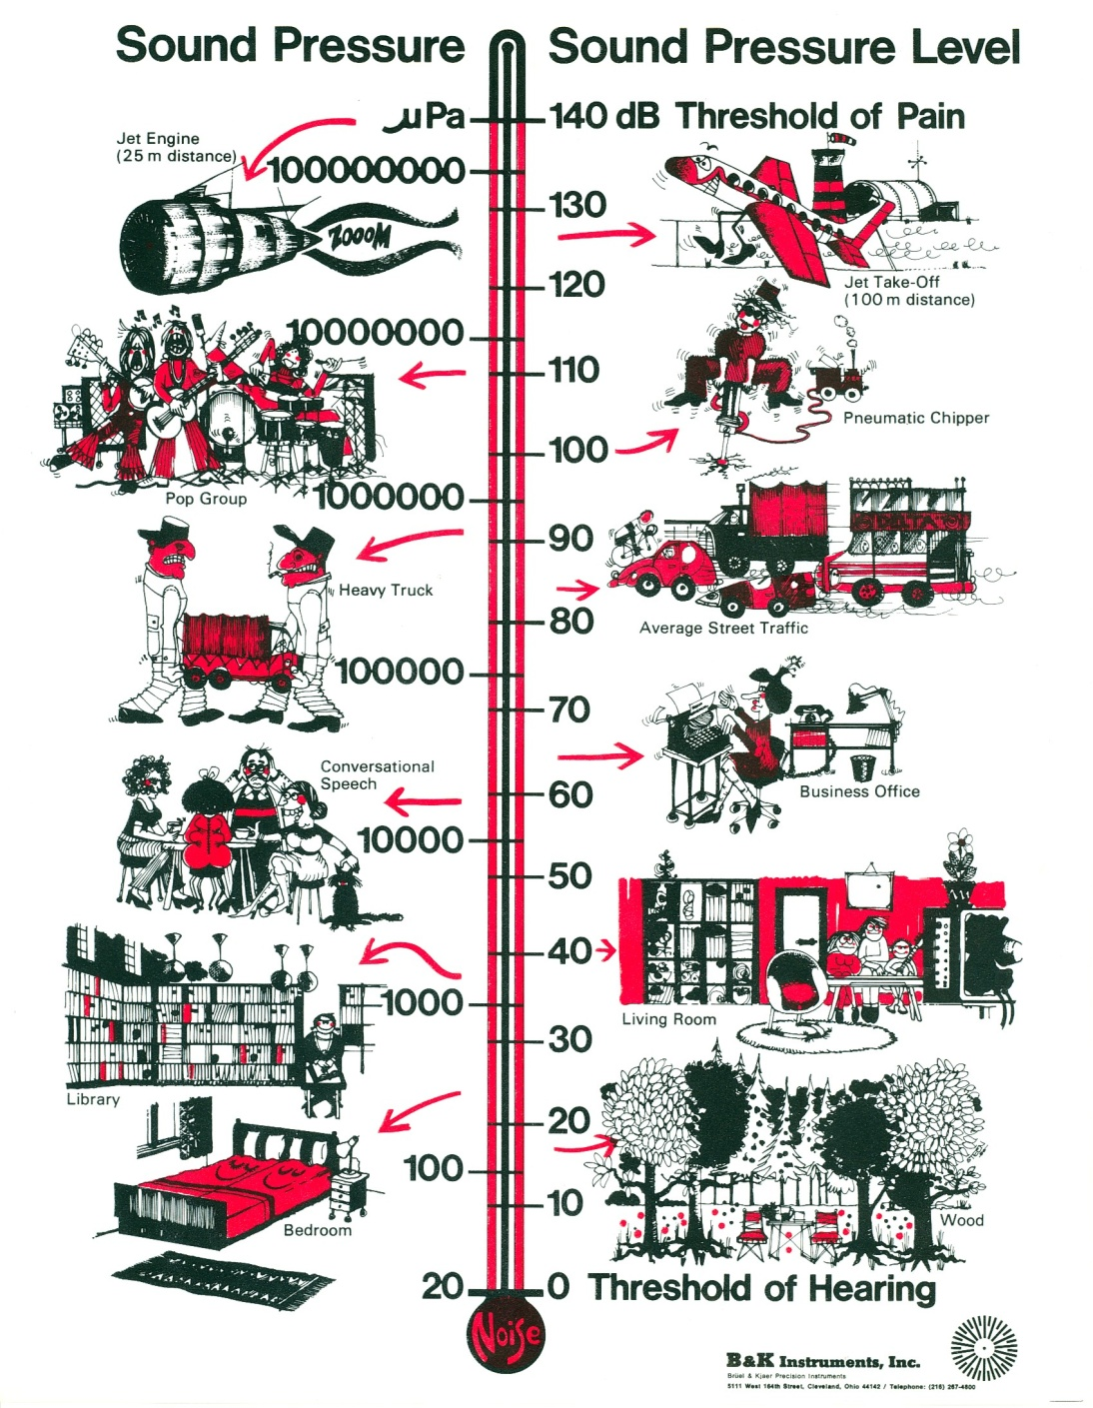
Lesson 2: Basic Acoustic and Traffic Noise Concepts
Notes:
This slide shows an illustration that uses sound pressure levels in micro-Pascal units on the left. The use of decibels on the right as a logarithmic expression of the sound pressure level allows the use of much smaller numbers. Note the threshold of human hearing of 20 micro Pascals at the bottom which is used as the reference point.

Slide 15
Lesson 2: Basic Acoustic and Traffic Noise Concepts
A-weighting is the frequency weighting network used to account for changes in sensitivity as a function of frequency. This weighting network most closely approximates the way the human ear perceives sound.
Notes:
A-weighting is the frequency weighting network used to account for changes in sensitivity as a function of frequency. This weighting network most closely approximates the way the human ear perceives sound.

Slide 16
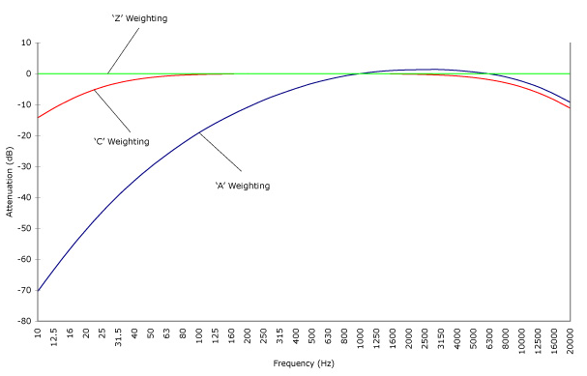
Lesson 2: Basic Acoustic and Traffic Noise Concepts
Comparison of A, C, and Z Weighting
The meter adjusts Sound Pressure Levels (SPLs) up or down based on the frequency (and weighting filter).
Notes:
This slide shows a comparison between A, C and Z weighting. Notice how Z weighting is a straight line because it is flat from 10 Hertz to 20 kilohertz. C-weighting follows the frequency sensitivity of the human ear at very high noise levels and is commonly used in workplace noise and/or OSHA requirements. A-weighting is weighted for the human thresholds of hearing. The meter adjusts Sound Pressure Levels up or down based on the frequency and weighting filter.

Slide 17
Lesson 2: Basic Acoustic and Traffic Noise Concepts
Comparison of Decibel Changes, Loudness, and Energy Loss
Sound Level Change | Relative Loudness | Acoustic Energy Loss
0 dB(A) | Reference | 0
+/-3 dB(A) | Barely Perceptible Change | 50%
+/-5 dB(A) | Readily Perceptible Change | 67%
+/-10 dB(A) | Half as Loud | 90%
+/-20 dB(A) | 1/4 as Loud | 99%
+/-30 dB(A) | 1/8 as Loud | 99.9%
Source: Highway Traffic Noise: Analysis and Abatement Guidance (FHWA, 2010)
Notes:
Due to the logarithmic nature, the amount of acoustic energy lost is not proportional to the sound level reduction. Remember, a logarithmic scale is used to express a wide range of numbers on a nonlinear scale, which means the difference between 3 and 5 is not the same as the difference between 20 and 23. Since we are dealing with pressure ratios, a 10 decibel increase actually represents a 10-fold increase in intensity. A 20 decibel increase is perceived as 4 times as loud, but is 100 times the acoustical energy. This table provides examples of the acoustic energy loss in relation to a sound level change and relative loudness perception. As shown, a 10 decibel decrease can be perceived as half as loud, but has a 90% acoustic energy loss.

Slide 18
Lesson 2: Basic Acoustic and Traffic Noise Concepts
How are decibels added?
(Because 50 dB(A) + 50 dB(A) DOES NOT = 100 dB(A))
When two decibel values differ by: | Add the following to the HIGHER value: | Example
0 or 1 dB(A) | 3 dB(A) | 70 dB(A) + 69 dB(A) = 73 dB(A)
2 or 3 dB(A) | 2 dB(A) | 74 dB(A) + 71 dB(A) = 76 dB(A)
4 to 9 dB(A) | 1 dB(A) | 66 dB(A) + 60 dB(A) = 67 dB(A)
10 dB(A) or more | 0 dB(A) | 65 dB(A) + 54 dB(A) = 65 dB(A)
Notes:
Furthermore, because of the logarithmic nature, decibels from multiple sound sources are not added together arithmetically. 50 decibels plus 50 decibels does not equal 100 decibels. This table provides guidance as to how to add decibels from multiple sound sources. For example, when two decibel values differ by 2 or 3 decibels, add 2 decibels to the higher value. 74 decibels plus 71 decibels is 76 decibels.

Slide 19
Lesson 2: Basic Acoustic and Traffic Noise Concepts
Now let’s try adding the following decibel levels together:
75 dB(A)
68 dB(A)
88 dB(A)
82 dB(A)
79 dB(A)
?? dB(A) Total
Notes:
Let’s try adding the following decibel levels together: 75 decibels, plus 68 decibels, plus 88 decibels, plus 82 decibels, plus 79 decibels equates to a noise level of how many decibels?

Slide 20
Lesson 2: Basic Acoustic and Traffic Noise Concepts
The first step is to put the decibels in order from lowest to highest as shown here:
68 dB(A)
75 dB(A)
79 dB(A)
82 dB(A)
88 dB(A)
?? dB(A) Total
Notes:
The first step is to arrange the decibels in order from lowest to highest.

Slide 21
Lesson 2: Basic Acoustic and Traffic Noise Concepts
Next, begin adding the values in pairs, beginning with the smallest two levels:
68 dB(A)
75 dB(A)
79 dB(A)
82 dB(A)
88 dB(A)
?? dB(A) Total
= 76 dB(A)
= 81 dB(A)
= 85 dB(A)
= 90 dB(A)
When two decibel values differ by: | Add the following to the HIGHER value:
0 or 1 dB(A) | 3 dB(A)
2 or 3 dB(A) | 2 dB(A)
4 to 9 dB(A) | 1 dB(A)
10 dB(A) or more | 0 dB(A)
Notes:
Next, the decibels should be added in pairs using the table as a reference guide and starting with the smallest two decibel levels.
You have to take into account that when two decibel values differ by 0 or 1 dB(A), you add 3 dB(A) to the higher value. When two decibel values differ by 2 or 3 dB(A), you add 2 dB(A) to the higher value. Between 4 to 9 dB(A) difference, 1 dB(A) is added to the higher value. For 10 dB(A) difference, you just use the higher value.
Therefore, 68 decibels plus 75 decibels equals 76 decibels. Then, 76 decibels plus 79 decibels equals 81 decibels. Following this pattern , 81 decibels plus 82 decibels equals 85 decibels, and finally, 85 decibels plus 88 decibels equals 90 decibels.

Slide 22
Lesson 2: Basic Acoustic and Traffic Noise Concepts
66 dB(A)
66 dB(A)
69 dB(A)
66 dB(A)
71 dB(A)
66 dB(A)
72 dB(A)
66 dB(A)
73 dB(A)
66 dB(A)
74 dB(A)
66 dB(A)
75 dB(A)
66 dB(A)
76 dB(A)
1 car
+1 car
How many cars at 66 dB(A) does it take to have a perceived doubling of sound?
+1 car
When two decibel values differ by: | Add the following to the HIGHER value:
0 or 1 dB(A) | 3 dB(A)
2 or 3 dB(A) | 2 dB(A)
4 to 9 dB(A) | 1 dB(A)
10 dB(A) or more | 0 dB(A)
+1 car
+1 car
+1 car
+1 car
Remember: An increase or decrease of 10 dB(A) is perceived as a doubling or halving of sound.
+1 car
76 dB(A) – 66dB(A) = 10 dB(A) increase
ANSWER = 8 cars total
Notes:
Let’s try another example. How many cars at 66 decibels would it take to double the sound? First, remember that an increase of 10 decibels is perceived as a doubling of sound. 66 decibels plus 10 decibels is 76 decibels. So, how many cars at 66 decibels does it take to reach 76 decibels, or a perceived doubling of the sound? 66 decibels plus 66 decibels is 69 decibels, plus 66 decibels is 71 decibels, plus 66 decibels is 72 decibels, plus 66 decibels is 73 decibels, plus 66 decibels is 74 decibels, plus 66 decibels is 75 decibels, plus 66 is 76 decibels. So, it takes a total of 8 cars at 66 decibels to double the sound. Additionally, note that if additional cars were to be added, 0 decibels would be added because the two decibels differ by 10 decibels or more.

Slide 23
Lesson 2: Basic Acoustic and Traffic Noise Concepts
Sound Level Descriptors
Descriptors are the various metrics (can also be called “measures”) used to describe noise under various conditions.
Notes:
Sound Level Descriptor are the various metrics that are used to describe noise under various conditions. These can also be called “measures”.

Slide 24
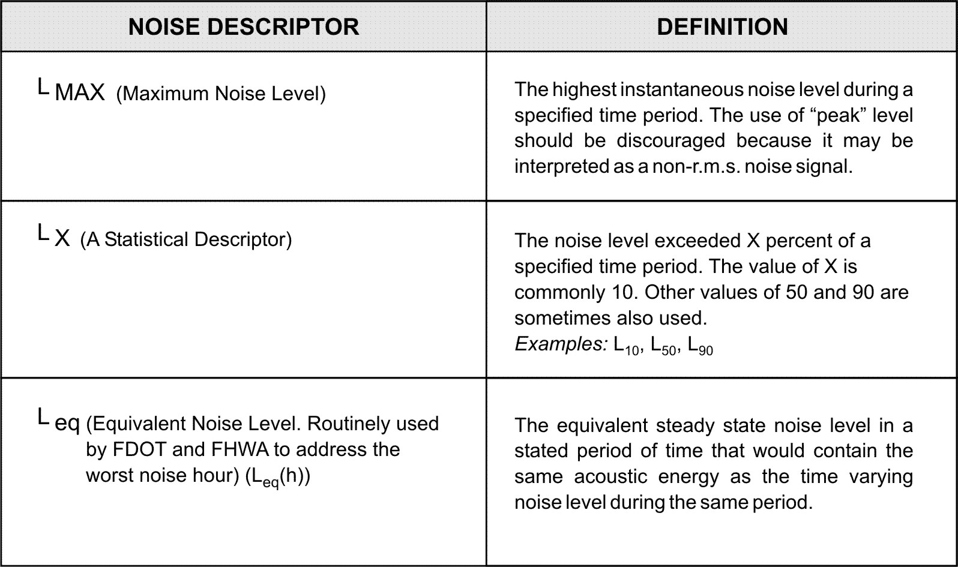
Lesson 2: Basic Acoustic and Traffic Noise Concepts
Source: CALTRANS Technical Noise Supplement, 1998
Notes:
This slide shows three different noise descriptors, L Max, L X (pronounces EL-EX), and L EQ (pronounced EL-E-Cue). The L Max, or Maximum noise level, is the highest instantaneous noise level during a specified time period. The use of “peak” level is discouraged because it may be interpreted as a non-r.m.s. noise signal. L X is a statistical descriptor where the noise level exceeded “X” percent of a specified time period. The value of “X” is commonly 10. Other values of 50 and 90 are sometimes also used. For Example, this could be L sub 10, L sub 50, and L sub 90. The L EQ is the equivalent noise level. This descriptor is routinely used by Florida Department of Transportation and the Federal Highway Administration to address the worst noise hour. The L EQ is the equivalent steady state noise level in a stated period of time that would contain the same acoustic energy as the time varying noise level during the same period.

Slide 25
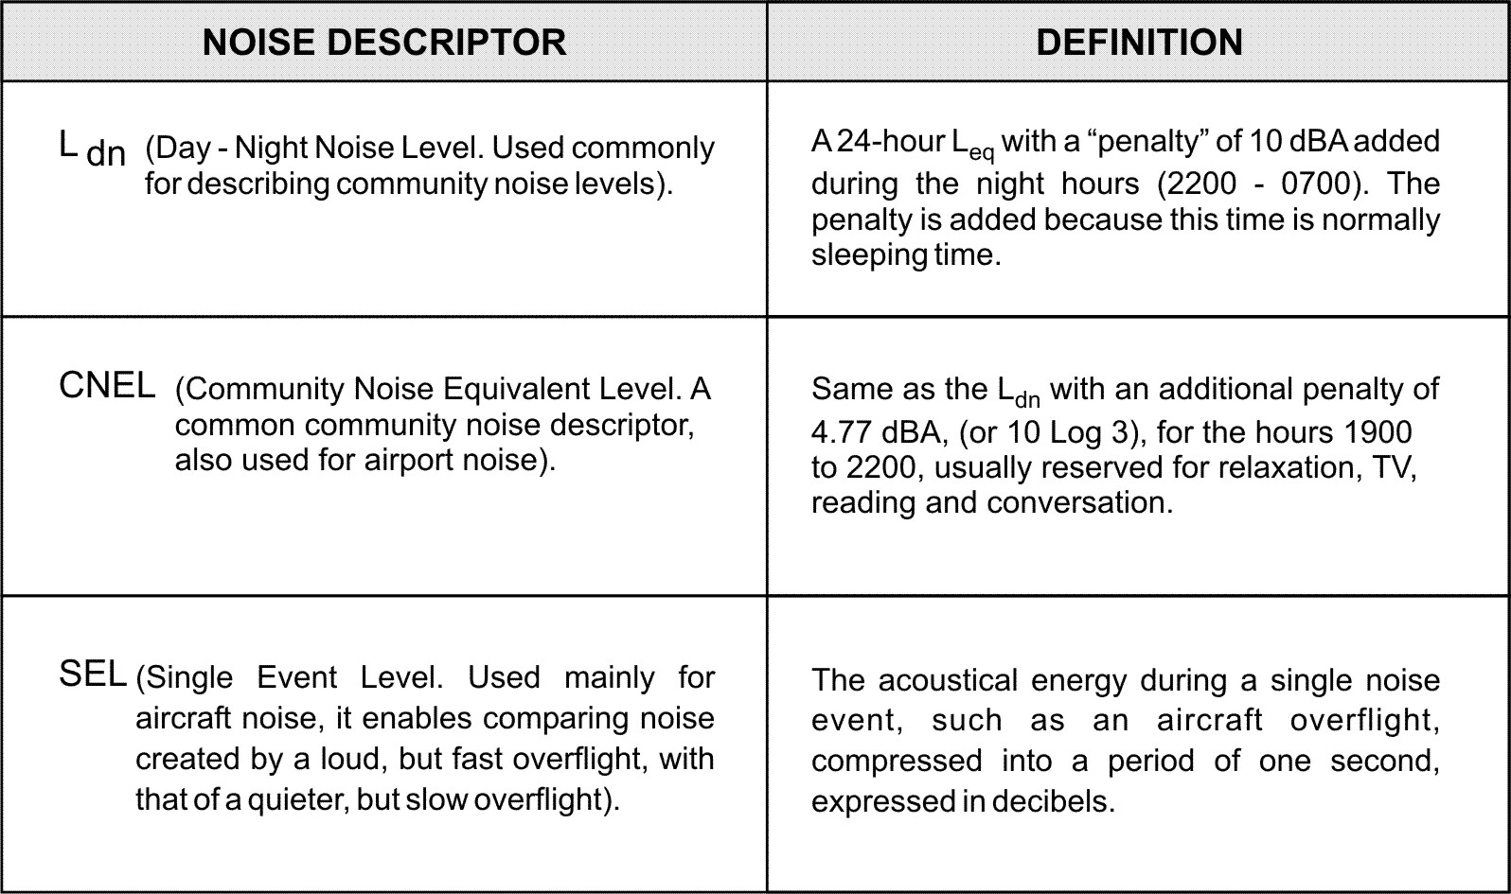
Lesson 2: Basic Acoustic and Traffic Noise Concepts
Source: CALTRANS Technical Noise Supplement, 1998
Notes:
Continuing on with more descriptors, this slide shows three more noise descriptors, the L DN (pronounced EL-DE-IN), the CNEL, and the SEL. The L DN is the Day-Night noise level. This is used commonly for describing community noise levels. The L DN is a 24 hour L EQ with a “penalty” of 10 decibels added during the night hours from 2200-0700. The penalty is added because this time is normally sleeping time. The CNEL is the Community Noise Equivalent Level. This is a common community noise descriptor and is also used for airport noise. The CNEL is the same as the L DN with an additional penalty of 4.77 decibels (or 10 Log 3) for the hours between 1900 and 2200, which are usually reserved for relaxation, TV, reading, and conversation. The SEL is the Single Event Level which is mainly used for aircraft noise. The SEL enables comparing noise created by a loud but fast overflight, with that of a quieter, but slower overflight. The SEL is the acoustical energy during a single noise event, such as an aircraft overflight, compressed into a period of one second and expressed in decibels.

Slide 26
Lesson 2: Basic Acoustic and Traffic Noise Concepts
So Which Descriptor Does the FDOT Use?
FDOT uses the descriptor Leq(h) to describe highway traffic noise.
Notes:
Which descriptor does the Florida Department of Transportation use to describe highway traffic noise? The L EQ (hourly). 23 CFR Part 772 specifies that either the L EQ (hourly) or L10(hourly) metric can be used, but not both. FDOT uses L EQ(hourly). L EQ is typically about 3 dB(A) less than L10 for the same conditions.

Slide 27
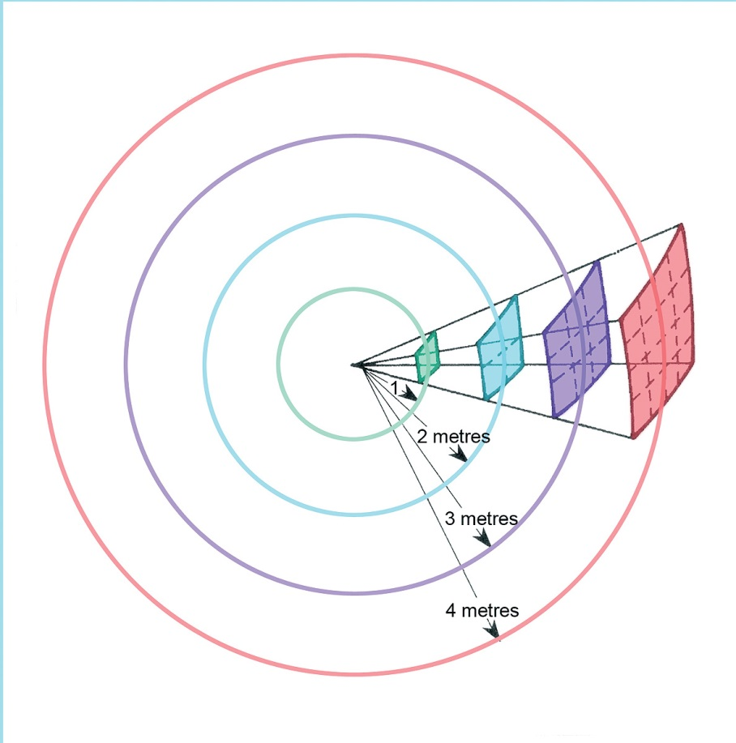
Lesson 2: Basic Acoustic and Traffic Noise Concepts
What is sound propagation?
The manner in which sound travels through a compressed medium (such as air)
  Propagation is Influenced By…..
  Geometric spreading from point and line sources
  Ground Effects
  Atmospheric Effects
  Shielding (by both natural and man-made features)
Source: www.performing-musician.com
Notes:
Let’s move on to sound propagation. What is sound propagation? It is the manner in which sound travels through a compressed medium, such as air. Propagation is influenced by a variety of factors, including geometric spreading from point and line sources, ground effects, atmospheric effects, and shielding (both by natural as well as man-made features). Note the increasing size of the wave as it move outward from the source in the center.

Slide 28
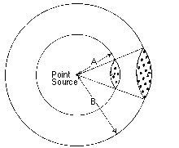
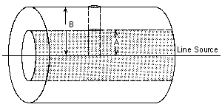
Geometric Spreading – 2 Primary Types:
Lesson 2: Basic Acoustic and Traffic Noise Concepts
Spherical Spreading (From a point source)
  Like pile driving
Cylindrical Spreading (From a line source)
  Like traffic
Source: Handbook for Acoustic Ecology
https://www.sfu.ca/sonic-studio-webdav/handbook/Sound_Propagation.html
Notes:
There are two primary types of geometric spreading. They are spherical spreading and cylindrical spreading. Spherical spreading originate from a point source such as pile driving. Cylindrical spreading originate from a line source such as traffic.

Slide 29
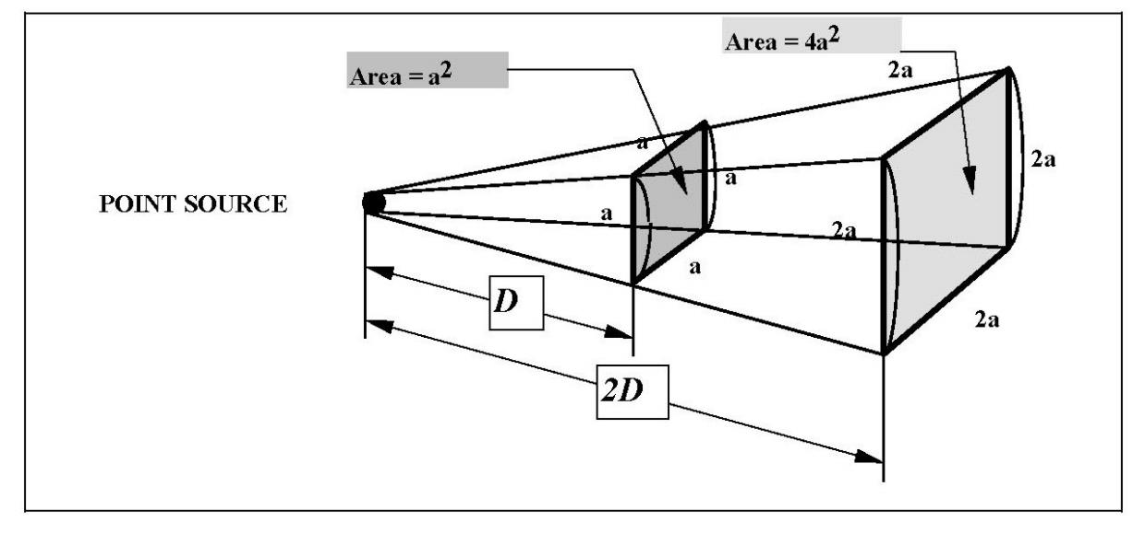
Lesson 2: Basic Acoustic and Traffic Noise Concepts
A point source radiates outward uniformly from the source in a spherical pattern. The sound level attenuates (decreases) at a rate of 6 dB(A) for each doubling of the distance from the source.
Source: CALTRANS Technical Noise Supplement, 1998
Notes:
Point sources are stationary. The sound propagation radiates outward uniformly from the source in a spherical pattern. The sound level attenuates, or decreases, at a rate of 6 decibels for each doubling of the distance from the source.

Slide 30
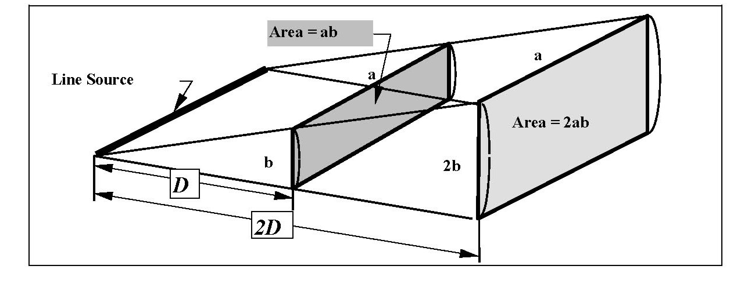
Lesson 2: Basic Acoustic and Traffic Noise Concepts
A line source (such as highway traffic) makes the sound appear to emanate from a line rather than a point, which results in cylindrical spreading. The sound level attenuates at a drop-off rate of 3 dB(A) for each doubling of distance.
Source: CALTRANS Technical Noise Supplement, 1998
Notes:
A line source, such as highway traffic, makes the sound appear to emanate from a line rather than a point, which results in cylindrical spreading. The sound level attenuates at a drop-off rate of 3 decibels for each doubling of distance. Note that a line source is a series of moving point sources, and the drop off rate is not the same as that for a point source.

Slide 31
Lesson 2: Basic Acoustic and Traffic Noise Concepts
Receptors vs. Receivers
RECEPTOR
A discrete or representative location of a noise sensitive area(s), for any of the land uses listed in FHWA’s NAC Table
A specific XY point in the Traffic Noise Model for which traffic noise is predicted for
RECEIVER
A physical real-life recipient of noise
A human or animal ear
Oftentimes, these two words are used interchangeably. Some instances require the use of one word or the other.

Slide 32
Lesson 2: Basic Acoustic and Traffic Noise Concepts
Ground absorption is how the ground surface tends to absorb or reflect traffic noise. There are two general classifications for the ground surface type:
Hard Sites
Soft Sites
Notes:
Ground absorption also effects noise. Ground absorption is how the ground surface tends to absorb or reflect traffic noise. In general, there are two types of classifications for ground surface types: hard sites and soft sites. Hard sites are typically more reflective. Soft sites are acoustically more absorptive. Additionally, the drop off rate depends on if it is a point source or a moving line source.

Slide 33
Lesson 2: Basic Acoustic and Traffic Noise Concepts
A “Hard Site” is a reflective ground surface between the source and the receptor, such as:
Parking Lots (Concrete, asphalt, etc.)
Water
The “Hard Site” drop-off rate is typically considered to be 3 dB(A) per doubling of distance.
Notes:
A “Hard Site” is a reflective ground surface between the source and the receptor, such as parking lots (which are made from concrete, asphalt, etc.) or water. The “Hard Site” drop-off rate for a moving line source is typically considered to be 3 decibels per doubling of distance.

Slide 34
Lesson 2: Basic Acoustic and Traffic Noise Concepts
A “Soft Site” is an absorptive ground surface between the source and the receptor, such as:
Grass/Lawn
Loose Soil
Snow
The “Soft Site ” drop-off rate is typically considered to be 4.5 to 6 dB(A) per doubling of distance.
Notes:
A “Soft Site” is an absorptive ground surface between the source and the receptor, such as grass or lawn, loose soil, or snow. The “Soft Site ” drop-off rate for a moving line source is typically considered to be 4.5 to 6 dB(A) per doubling of distance.

Slide 35
Lesson 2: Basic Acoustic and Traffic Noise Concepts
Calculate the noise level from a Point Source to a receptor 200 feet away if the noise level at 50 feet is 76 dB(A). Assume the ground surface is “soft”. (Assume a drop off rate of 6 dB(A) per doubling of distance).
100 feet = __ dB(A)
200 feet = __ dB(A)
70
64
Notes:
Let’s do an exercise together. Calculate the noise level from a Point Source to a receptor 200 feet away if the noise level at 50 feet is 76 decibels. Assume the ground surface is “soft” and assume a drop off rate of 6 dB(A) per doubling of distance. Just to be clear, we do not model point sources for traffic noise, only lines. (pause) At 100 feet away, the noise level is 70 decibels. At 200 feet away, the noise level is 64 decibels.

Slide 36
Lesson 2: Basic Acoustic and Traffic Noise Concepts
Let’s try another one…..
Calculate the noise level from a Line Source to a receptor 400 feet away if the noise level at 50 feet is 76 dB(A). (Assume this is a hard site with a drop off rate of 3 dB(A) per doubling of distance).
100 feet = __ dB(A)
200 feet = __ dB(A)
400 feet = __ dB(A)
73
70
70
64
67
58
What would you get if this were a soft site area? (Assume drop-off rate of 6 dB(A) per doubling of distance)
Notes:
Let’s try another problem. Calculate the noise level from a Line Source to a receptor 400 feet away if the noise level at 50 feet is 76 decibels. Assume this is a hard site with a drop off rate of 3 decibels per doubling of distance. (pause) At 100 feet, the noise level is 73 decibels. At 200 feet, the noise level is 70 decibels. And, at 400 feet, the noise level is 67 decibels. What would you get if this were a soft site area, assuming a drop-off rate of 6 decibels per doubling of distance? (pause) At 100 feet, the noise level is 70 decibels. At 200 feet, the noise level is 64 decibels. At 400 feet, the noise level is 58 decibels.

Slide 37
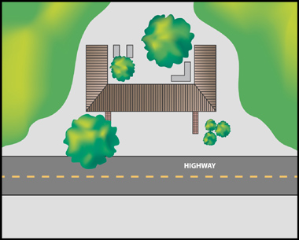
Lesson 2: Basic Acoustic and Traffic Noise Concepts
What is shielding?
Shielding is an object that exists between the noise source and the receiver that can reduce overall noise levels.
Source: FHWA
Notes:
What is shielding? Shielding is some object that exists between the noise source and the receiver that can reduce overall noise levels. Shielding from traffic noise can occur from single or multiple buildings, rows of homes, noise barriers, earth berms, etc.

Slide 38

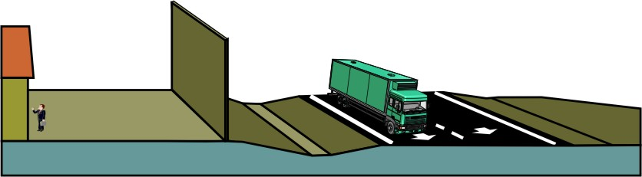
Lesson 2: Basic Acoustic and Traffic Noise Concepts
Examples of Shielding Include:
Buildings/Rows of Homes
Existing Barriers
IMPORTANTLY!
  FHWA does not consider the planting of vegetation to be a highway traffic noise abatement measure (see next slide)
Notes:
Examples of shielding include buildings or rows of homes, or existing barriers. Note that the reduction provided by each will vary. Vegetation and landscaping is not considered a form of abatement because it typically does not provide enough noise reduction.

Slide 39
Lesson 2: Basic Acoustic and Traffic Noise Concepts
Vegetation and Traffic Noise
To reduce traffic noise, vegetation must be:
200 feet wide (between source and receptor)
  According to FHWA – 10 dB(A) reduction
“Optically Dense” (You can’t see through it)
Notes:
A note about vegetation and traffic noise: to reduce traffic noise, according to the Federal Highway Administration, vegetation must be 200 feet deep and optically dense (as in, you must not be able to see through it) in order to provide a 10 decibel reduction. Typical vegetation, even though it may not measurably reduce the noise, may provide a visual block that provides a perceived psychological noise reduction. Typical Florida vegetation and FDOT landscaping do not do much to reduce noise levels, but provides the psychological benefit. Vegetation is more likely to provide 1 to 2 decibels of reduction, although it can vary considerably depending upon the thickness, the type of trees, and the type of leaves. To be considered acoustically beneficial, the leaves must remain throughout the year (evergreen). Removal of the trees can be expected to increase noise complaints even if you can’t measure the increase with a noise meter. This is because there may be some frequency shifts as a result of vegetation that cause the noise levels to be more acceptable with the trees present. Minimizing vegetation removal can be a positive step in reducing noise complaints.

Slide 40
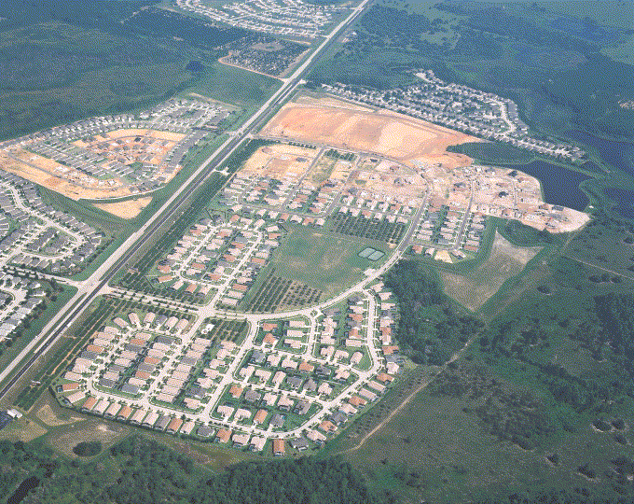
Lesson 2: Basic Acoustic and Traffic Noise Concepts
Shielding From Buildings and Rows of Homes
Provided by buildings or rows of homes
Will depend of the size of the structure(s) and the spacing between them
Notes:
Buildings and rows of homes can provide shielding. The shielding provided depends on the size of the structures and the spacing between them. Shielding values generally are on the order of 3 to 5 decibels per row of homes, up to a maximum of 10 decibels.

Slide 41
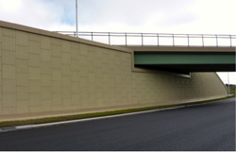
Lesson 2: Basic Acoustic and Traffic Noise Concepts
Shielding Can Also be Provided By Roadway Features, Such as:
  Elevated roadways on fill/embankment
  Elevated roadways on MSE/retaining walls
  The top edge of a depressed roadway (i.e., roadway in a “cut section”
Source: www.bigrbridge.com
Notes:
Shielding can also be provided by roadway features, such as elevated roadways on fill or embankment, elevated roadways on mechanically stabilized earth or retaining walls, and the top edge of a depressed roadway, or a roadway in a “cut section” such as the picture shown in the bottom right.

Slide 42
Lesson 2: Basic Acoustic and Traffic Noise Concepts
Shielding from Building Envelope (Exterior to Interior Reduction)
Will depend on the building construction
In Florida, open windows are not typically modeled in the noise model
…discussed in more detail in Lesson 3
Notes:
Shielding from building envelopes, or “exterior to interior reduction”, will depend on the building construction and the amount of open or closed windows. However, it should be noted that open windows are not modeled when modeling highway traffic noise.

Slide 43
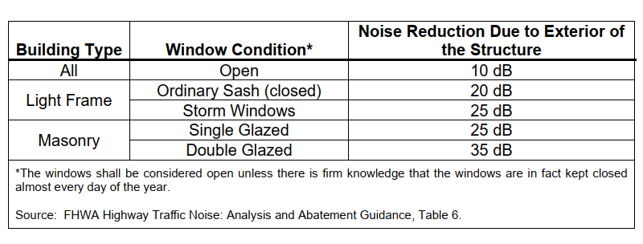
Lesson 2: Basic Acoustic and Traffic Noise Concepts
Noise Reduction Provided by a Building
*Windows are always considered closed in Florida*
Notes:
The amount of noise reduction that is provided by a building depends on the building type, window type, and whether the windows are open or closed. The reduction for interior levels is based on the surrounding walls, especially those directly between the source and receiver. For example, a masonry building with single glazed windows provides a 25 decibel noise reduction due to the building structure. Importantly, it is generally assumed in Florida that windows are kept shut most of the year.

Slide 44
Lesson 2: Basic Acoustic and Traffic Noise Concepts
Noise Barrier Basics
How do they work?
By interrupting the direct noise path between the source and the receiver
Notes:
Finally, noise barriers are the last type of shielding that will be discussed in this training. How do noise barriers work? By interrupting the direct noise path between the source and the receiver.

Slide 45
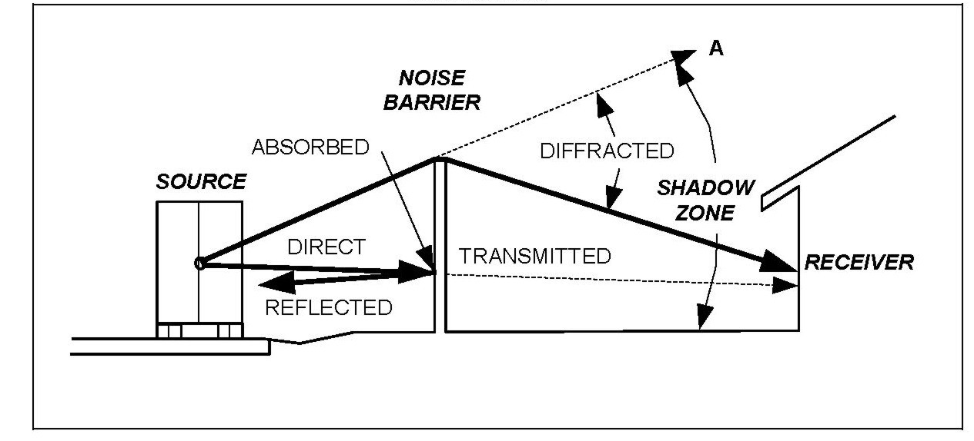
Lesson 2: Basic Acoustic and Traffic Noise Concepts
Source: CALTRANS Technical Noise Supplement, 1998
Notes:
There is a correlation between the shadow zone and diffraction. Diffraction is the bending of sound waves around an obstacle which causes the sound waves to take a longer path. The happens at the top and sides of a barrier. Higher frequencies are shorter wave lengths and therefore diffract to a lesser degree than the longer wavelength lower frequencies which go deeper into the shadow zone. Therefore, barriers are better at attenuating higher frequencies then they are lower frequencies.

Slide 46
Lesson 2: Basic Acoustic and Traffic Noise Concepts
“Insertion Loss” (IL) is the difference in noise levels from the “before barrier” and “after barrier” conditions. Also referred to as “noise reduction”
Includes all of the things we have discussed:
Ground attenuation
Reflected
Diffraction
Absorbed
Notes:
Insertion loss is the difference in noise levels from the “before barrier” and “after barrier” conditions. This is also referred to as “noise reduction” and includes all of the things we have discussed, including ground attenuation, reflection, diffraction, and absorption.

Slide 47
Lesson 2: Basic Acoustic and Traffic Noise Concepts
Noise Barrier Placement
As close to the receiver as possible
If not, then as close to roadway as possible
Avoid placing the noise barrier in the middle if at all possible.
Notes:
Noise barriers should be placed as close to the receiver as possible. If this is not possible, then a noise barrier should be placed as close to the roadway as possible. The noise barrier should not be placed in the middle between the roadway and the receiver. Keep in mind, if there is a large space between the source, or roadway, and the receiver, the sound waves will spread out.

Slide 48
Lesson 2: Basic Acoustic and Traffic Noise Concepts
If the roadway is depressed…
Noise barrier should be placed at the top of the cut slope, if possible
Notes:
If the roadway is depressed, the noise barrier should be placed at the top of the cut slope, if possible. Placing the barrier at the top of the slope reduces the required height and increases its effectiveness. The barrier is mostly ineffective if you can see the traffic. If there is a line of sight from the receiver to the traffic, there is little to no abatement. Blocking the view of the residents may become an issue and has resulted in the use of transparent barriers in some states. Additionally, placement at the top of the slope reduces safety issues.

Slide 49
Lesson 2: Basic Acoustic and Traffic Noise Concepts
If roadway is elevated…
Noise barrier should be placed as close to the road as possible on elevated ground or structure.
Notes:
If the roadway is elevated, the noise barrier should be placed as close to the road as possible. Placing a barrier near on elevated roadway can reduce the required height of the wall considerable compared to a ground-mounted barrier. Additionally, wall heights may be limited due to structural and safety issues. This will be discussed in a later lesson. Additionally, walls on structure may block a vista for the motorists.

Slide 50
Lesson 2: Basic Acoustic and Traffic Noise Concepts
How Tall Does the Noise Barrier Have to Be?
Many factors influence the height, but the general rule-of-thumb is…..
The noise barrier has to at least break the line-of-sight to achieve a 5 dB(A) reduction in traffic noise
    Line-of-sight is a straight line along which an observer has unobstructed vision to vehicles
For each 2 feet above the initial break in line-of-sight, you will achieve approximately an additional 1 dB(A) reduction in traffic noise
Notes:
How tall does a noise barrier have to be? Many factors influence the height, but the general rule of thumb is that a noise barrier has to at least break the line of sigh to achieve a 5 decibel reduction in traffic noise. Furthermore, for each 2 feet above the initial break in the line of sight, you will achieve approximately an additional 1 decibel reduction in traffic noise. Note that breaking the line of sight for traffic noise involves multiple sources, including the tire and pavement, engine, exhaust, and heavy truck exhaust, which is almost 12’ above pavement.

Slide 51

Lesson 2: Basic Acoustic and Traffic Noise Concepts
Not an Effective Noise Barrier Design….
Notes:
For example, this is not an effective noise barrier design. If you can see the source, there will not be much noise reduction, if any at all.

Slide 52
Lesson 2: Basic Acoustic and Traffic Noise Concepts
How Long Should the Noise Barrier Be?
As with the height, many factors will influence the length, but….
The general rule is that the barrier should extend “4D” beyond the last impacted receptor.
What is 4D??
Notes:
How long should a noise barrier be? As with height, many factors will influence the length. The general rule is that the barrier should extend “4D” beyond the receptor. What is “4D”?

Slide 53
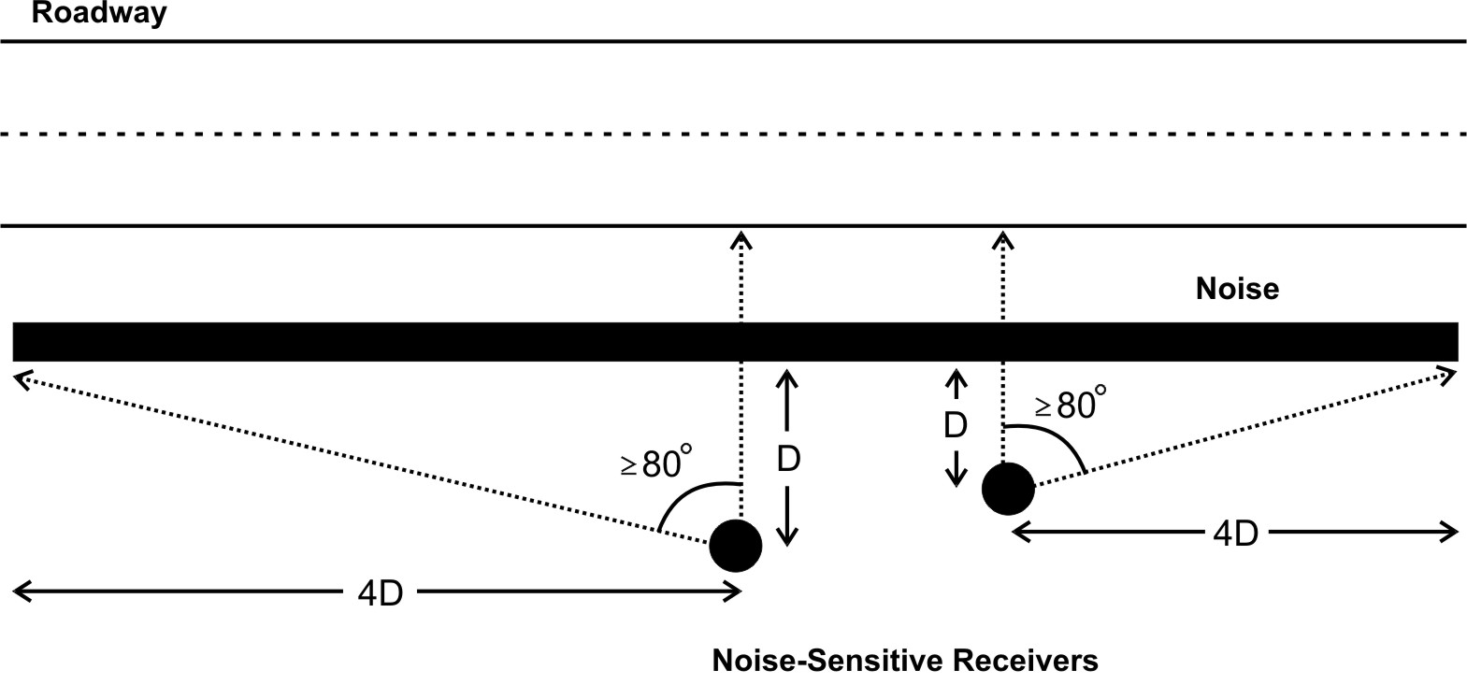
Lesson 2: Basic Acoustic and Traffic Noise Concepts
Noise Barrier Length
Noise Barrier
Noise Sensitive Receptors
SOURCE: FHWA Highway Noise Barrier Design Handbook, 2000
Notes:
“4D” refers to the distance between the end of the barrier and the last receptor. The end of the barrier should be at least 4 times the distance as the last receiver is perpendicular to the barrier, as shown in this figure. This is because of diffraction.

Slide 54
Lesson 2: Basic Acoustic and Traffic Noise Concepts
QUESTIONS?
If you have any questions, please feel free to send an email to OEM@dot.state.fl.us
Notes:
If you have any questions, please feel free to send an email to OEM@dot.state.fl.us.

