Slide 1


NEPA Assignment:
Preparation for the 2019 Federal Highway Administration Audit
Replace with image or photo
September 10, 2019
Replace with image or photo
The environmental review, consultation, and other actions required by applicable federal environmental laws described in this training are carried out by FDOT pursuant to 23 U.S.C. §327 and a Memorandum of Understanding dated December 14, 2016, executed by FHWA and FDOT.
Notes:
Welcome to our presentation on the 2019 FHWA Audit. To have a successful audit experience, preparation is most important. Over the next hour, we will cover the highpoints that will help you for the 2019 FHWA Audit so that we can highlight the excellent work FDOT is doing with NEPA Assignment.

Slide 2

Notes:
Jason intro of the team
Audit coming
Brief the team
Tell you what we know
Prepare for the interview portion of the audit
Practice
Remind you how awesome you all are and that you do great work.

Slide 3


Agenda
Pre-Audit
During Audit
Post Audit
Interview Preparation
Closing
Notes:
The Agenda will include a brief overview of the 2019 FHWA Audit activities before, during and after audit interview week.

Slide 4
Three Years of FHWA Audits
2019
Focus Topics – Environmental Documentation, Funding Authorizations, Interchange Access Request Policy, Emergency Repairs
2018
Focus Topics – Endangered Species Act, Essential Fish Habitat, Commitments, Environmental Documentation
Findings – 16 Successful Practices, Two Observations on ESA and Commitments, One Non-Compliance on Environmental Documentation
2017
Focus Topics – Planning Consistency, QA/QC, Section 106, Protected Species and Habitat, Environmental Documentation
Findings – 13 Successful Practices; Three Observations on Commitment Documentation, Program Level Coordination with FHWA, and QA/QC; and One Non-Compliance on Project File Documentation
Notes:
We have had 3 years of FHWA Audits and, as required by the MOU, we will have a 4th and final year in 2020.
2019
Focus Topics – Environmental Documents, Funding Authorizations, Interchange Access Request Policy, Emergency Repairs
2018
Focus Topics – Endangered Species Act, Essential Fish Habitat, Commitments, Environmental Documents
Findings – 16 Successful Practices, Two Observations on ESA and Commitments, One Non-Compliance on Environmental Documentation
2017
Focus Topics – Planning Consistency, Section 106, Protected Species and Habitat
Findings – 13 Successful Practices; Three Observations on Commitment Documentation, Program Level Coordination with FHWA, and QA/QC; and One Non-Compliance on Project File Documentation

Slide 5
2018 FHWA Audit

Slide 6

2nd FHWA Audit Report Findings (2018)
Version | # of Successful Practices | # of Observations | # of Non-Compliant Observations
Debriefing after Interviews | 11 | 1 | 4
Pre-Register Draft | 16 | 2 | 1
1-Non-Compliance Findings:
Some FDOT project files contain insufficient documentation to support the environmental analysis or decision. – FDOT has provided details responses on all project files and is actively coordinating with the FHWA audit team to remove projects from this non-compliance observation
2-Observations:
FDOT’s definition of “commitment” excludes necessary mitigation as required by Federal regulation – FDOT disagrees with this assertion and is actively working with FHWA audit team to resolve
ESA assessment was unsupported on certain projects. – FDOT has worked with USFWS and received approval to use their Species Key and make no-effect determinations as the lead federal agency

Slide 7


2nd FHWA Audit Report Findings (2018)
16 – Successful Practices (Grouped below into program elements):
  Five practices in Program Management covering good agency and district relations and communications, use of SWEPT, training promotion, PD&E updates, tracking of FHWA updates, District participation in QA/QC.
  Two practices in QA/QC covering new QA/QC enhancements and tools, and PD&E changes as a result of audit findings.
  Two practices in Legal Sufficiency including housing environmental counsel under General Counsel and close collaboration between Legal and OEM.
  Three practices under Training covering tracking, updating and mentoring.
  Four practices under Performance Measures covering addressing indicators, use of timeliness measure, streamlining reviews and monitoring of 30-day review period.
Notes:
FHWA found 16 FDOT successful practices, including:
Good District communications
Great working relationship with agencies
SWEPT enhancements – required files before approval – SMART forms
Tracking system for federal guidance – spreadsheet tracker with action captured
District review of NEPA documents – some additional reviews by individuals beyond what is required in the existing processes

Slide 8


Slide 9
2019 Self-Assessment

Slide 10
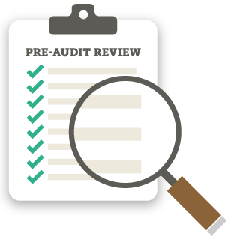
2019 FDOT Self-Assessment Target Topics
Noise
MOU Standard Statement
Relocation
Interchange Access Request Policy
Public Involvement
Sociocultural Evaluation
Notes:
The 2019 Self-Assessment Target Topics are Noise, MOU Standard Statement, Relocation, Interchange Access Request Policy, Public Involvement, and Sociocultural Evaluation

Slide 11
2019 FDOT Self-Assessment Overview
Successful Practices (10)
Effective documentation, public engagement
Opportunities for Improvement (11)
Conducting and documenting public hearings, uploading documents to SWEPT, quality of documentation

Slide 12

FDOT Addressing 2019 Self-Assessment Findings
  Action plan to address findings
  Lessons learned, statewide guidance, and possible policy and procedure revisions
  Statewide meeting with District leadership to review and discuss Self-Assessment Report findings and recommendations
Notes:
To address the 2019 Self-Assessment Findings, OEM put together or held:
Action plan to address findings
Lessons learned, statewide guidance, and possible policy and procedure revisions
Statewide meeting with District leadership to review and discuss Self-Assessment Report findings and recommendations

Slide 13
2019 FHWA PAIR and Project Reviews

Slide 14
2019 – FHWA PAIR
The 2019 PAIR had a total of 20 questions organized into the basic program elements of Program Management, Documentation, QA/QC, Legal Sufficiency, Training, and Performance Measures; Audit Report will be organized into these 6 elements
PAIR themes or focus areas included documentation of emergency relief permanent repair projects, public Involvement, Interchange Access Request Policy, and concurrence with USFWS/USACOE/USCG on use of ESA Keys and FDOT as ESA Lead Agency
Notes:
The 2019 PAIR had a total of 20 questions organized into the basic program elements of Program Management, Documentation, QA/QC, Legal Sufficiency, Training, and Performance Measures; Audit Report will be organized into these 6 elements.
PAIR themes or focus areas included cocumentation of emergency relief permanent repair projects, public Involvement, Interchange Access Request Policy, and concurrence with USFWS/USACOE/USCG on use of ESA Keys and FDOT as ESA Lead Agency.

Slide 15

2019 – FHWA Project Comments
FHWA provided file review comments to FDOT on July 22, 2019, which were submitted to Districts for review as necessary
Common Themes
  Environmental Documentation
  Project Funding Authorizations
  Interchange Access Request
  Emergency Repairs
Notes:
The themes of Interchange Access Request and Emergency Repairs from the PAIR and FHWA project file reviews overlapped. FHWA provided file review comments to FDOT on July 22, 2019, which were submitted to Districts for review as necessary
Common Themes
Environmental Documentation
Project Funding Authorizations
Interchange Access Request
Emergency Repairs

Slide 16


MOU Performance Measures
Compliance with NEPA, FHWA NEPA regulations and other federal environmental statutes and regulations
    Maintain documentation regarding compliance with responsibilities assumed under this MOU.
QA/QC for NEPA Decisions
    Maintain internal QA/QC measures and processes, including a record of:
      Completion of legal sufficiency reviews by FDOT’s Office of General Counsel (OGC)
      Compliance with FDOT’s environmental document content standards and procedures, including those related to QA/QC
Notes:
Performance measurement is common to our work at FDOT. Our NEPA (nee-pa) measures are based upon data and systems we currently have in place. Data compilation and reporting will happen in SWEPT and should not have an impact on the Districts as these measures are captured and reported on activities as they are completed.
The four performance measures from the MOU are Measure A, Compliance with NEPA, FHWA NEPA regulations and other federal environmental statutes and regulations, and Measure B, Quality Assurance and Quality Control for NEPA Decisions.
.

Slide 17

MOU Performance Measures
Relationship with agencies and the general public
    Maintain communication considering timeliness and responsiveness among FDOT, federal and state resource agencies, Indian Tribes, and the public
    Provide opportunities for public involvement and comment
    Use NEPA issue resolution process, as appropriate
Increased efficiency and timeliness in completion of the NEPA process
    Compare time of completion of environmental document (e.g. NEPA documents and technical reports) approvals before and after assumption of responsibilities
Notes:
The remaining measures from the MOU are Measure C, Relationship with agencies and the general public; and Measure D, Increased efficiency and timeliness in completion of the NEPA process.

Slide 18
Pre-Audit: Before FHWA Arrives

Slide 19
FDOT NEPA Role Refresh…
OEM is to provide oversight, policy direction, and programmatic support
OEM has final approval authority for NEPA documents
OGC provides legal sufficiency review as required and legal review as requested
OGC reviews policies and procedures, prepares the administrative record, handles all litigation, evaluates litigation risks and legal defensibility, and reviews all Interagency Agreements and Programmatic Agreements
Districts follow the PD&E Manual in developing and reviewing environmental projects and technical analysis, conducting quality control and quality assurance, and creating and maintaining project files in SWEPT
Districts work with OEM as Lead Agency for all NEPA policy guidance, and assigned Project Delivery Coordinators and Engineering Leads for project guidance
Notes:
FDOT NEPA roles include:
OEM is to provide oversight, policy direction, and programmatic support
OEM has final approval authority for NEPA documents
OGC provides legal sufficiency review as required and legal review as requested
OGC reviews policies and procedures, prepares the administrative record, handles all litigation, evaluates litigation risks and legal defensibility, and reviews all Interagency Agreements and Programmatic Agreements
Districts follow the PD&E Manual in developing and reviewing environmental projects and technical analysis, conducting quality control and quality assurance, and creating and maintaining project files in SWEPT
Districts work with OEM as Lead Agency for all NEPA policy guidance, and assigned Project Delivery Coordinators and Engineering Leads for project guidance

Slide 20
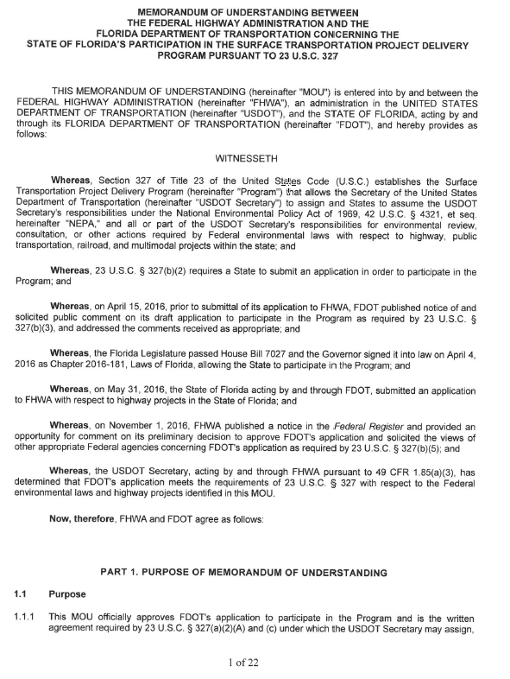
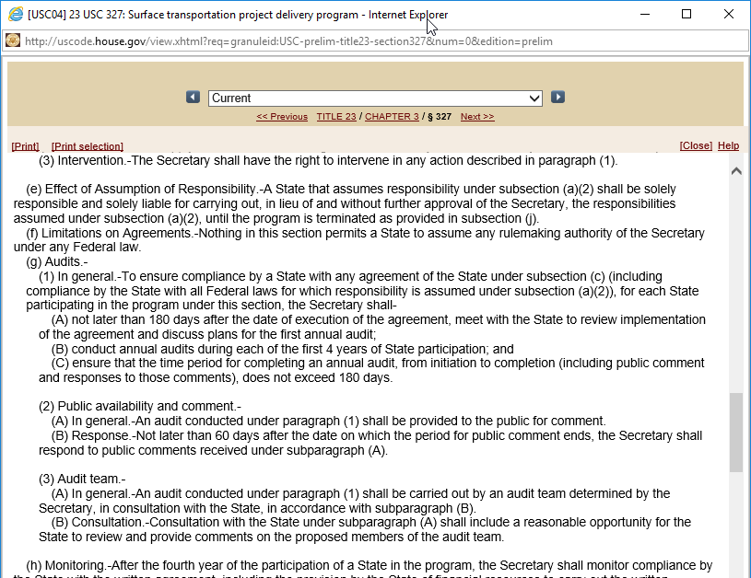
Audit Authority
Audits are required pursuant to 23 U.S.C. §327(g) and the NEPA Assignment MOU, Part 11
  FHWA is in 3rd year of four required annual audits (after that monitoring)
  Audits will be used for annual reporting to Congress
Notes:
Section 23 U.S.C. 327(g) and the MOU Part 11 require FHWA to conduct four annual audits of FDOT to evaluate compliance with federal environmental laws, adherence to the MOU, and achievement of the NEPA performance measures. FHWA is now in the 3rd year.
Audits will also be used for the United States Department of Transportation Secretary's annual report to Congress.

Slide 21

Scope of 2019 Audit
FHWA audits will include consideration of FDOT's staffing, technical competency and organizational capacity,
adequacy of the financial resources committed by FDOT to administer the responsibilities assumed,
quality control and quality assurance process,
attainment of performance measures, compliance with this MOU's requirements, and
compliance with applicable Federal laws and policies in administering the responsibilities assumed.
2019 focus topics include Environmental Documentation, Funding Authorizations, Interchange Access Request Policy and Emergency Repairs
Review period from May 1, 2018 to April 30, 2019
Notes:
FHWA audits will include consideration of FDOT's staffing, technical competency and organizational capacity,
Adequacy of the financial resources committed by FDOT to administer the responsibilities assumed,
Quality control and quality assurance process,
Attainment of performance measures, compliance with this MOU's requirements, and
Compliance with applicable Federal laws and policies in administering the responsibilities assumed
2019 focus topics include Environmental Documentation, Funding Authorizations, Interchange Access Request Policy and Emergency Repairs
Review period from May 1, 2018 to April 30, 2019

Slide 22

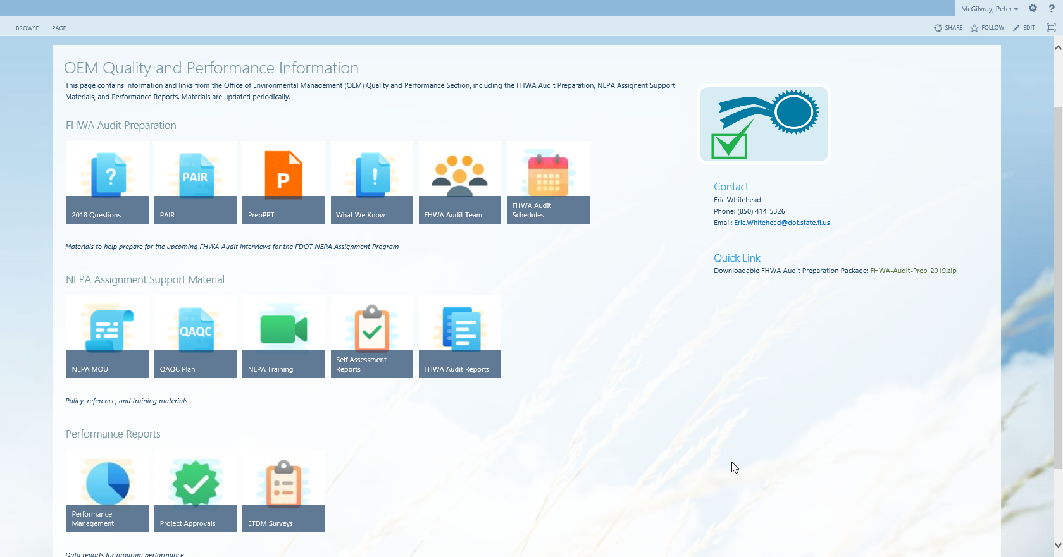
Prepare, Prepare, Prepare
National Environmental Policy Act (NEPA) Assignment Courses (Link http://wbt.dot.state.fl.us/ois/NEPA/index.html
Audit Support CBT (HTML5, 13:31) This CBT is designed to familiarize employees with FHWA NEPA Assignment Audit Support.
Performance Measures CBT (HTML5, 19:24) The NEPA Assignment Memorandum of Understanding (MOU), executed December 14, 2016, requires that FDOT have performance measures that assess our implementation of NEPA Assignment. This training provides an overview of those measures.
Quality Assurance and Quality Control CBT (HTML5, 13:39) This course will provide a high level overview of the QA/QC Plan, which is divided into the 3 parts of QA/QC Process, Self-Assessment Process, and FHWA Audit Support.
Self Assessment CBT (HTML5, 13:21) This CBT is designed to introduce you to the NEPA Self-Assessment process and the responsibilities of those involved.
OEM Audit Prep Sharepoint Site
http://fdotsp.dot.state.fl.us/sites/ISD/EMO/_layouts/15/start.aspx#/SitePages/OEM%20Quality%20and%20Performance%20Information.aspx

Slide 23
How do you Prepare for the Audit?
In addition to this statewide meeting and training courses from previous slide:
Be familiar with project specifics for any projects approved during this reporting period.
If you manage or support financial authorizations, interchange access requests or emergency management projects, expect questions on these processes.
Review supporting documentation for SharePoint (OEM SharePoint Site), including NEPA MOU, Self-Assessment Report (2017, 2018, and 2019), FHWA Audit Report, 2019 PAIR responses, and 2019 Project File responses.
Attend Practice Interview September 16th or 17th .
Notes:
In addition to this statewide meeting and training courses from previous slide:
Be familiar with project specifics for any projects approved during this reporting period.
If you manage or support financial authorizations, interchange access requests or emergency management projects, expect questions on these processes.
Review supporting documentation for SharePoint (OEM SharePoint Site), including NEPA MOU, Self-Assessment Report (2017, 2018, and 2019), FHWA Audit Report, 2019 PAIR responses, and 2019 Project File responses.
Attend Practice Interview September 16th or 17th .

Slide 24
2019 FHWA Audit - What to expect?
Interview questions based on
  Project File Review
  FDOT Self-Assessment findings
  FDOT PAIR responses
  Prior Non-Compliance Observations
  Performance Measure Results
*Interviews – Answer based on your knowledge and role
Notes:
Interview questions based on
Project File Review
FDOT Self-Assessment findings
FDOT PAIR responses
Prior Non-Compliance Observations
Performance Measure Results
*Interviews – Answer based on your knowledge and role

Slide 25
Audit Initiation Activities
FHWA has reviewed PD&E Manual, MOU and any other policy and procedure guidance; all previous audits, FDOT response to PAIR, and 2019 Self-Assessment Summary; FDOT project files covering period of May 1, 2018 to April 30, 2019; and scheduled interviews September 24th for Districts/ 23rd and 24th for OEM
FDOT has conducted 2019 Self-Assessment, responded to PAIR and file reviews, met every 2 weeks with District Contacts, provided schedule listing employees to be interviewed to Districts August 27th, is holding today’s meeting, and will conduct individual prep interviews September 16th and 17th
Notes:
Audit initiation activities include:
FHWA has reviewed PD&E Manual, MOU and any other policy and procedure guidance; all previous audits, FDOT response to PAIR, and 2019 Self-Assessment Summary; FDOT project files covering period of May 1, 2018 to April 30, 2019; and scheduled interviews September 24th for Districts/ 23rd and 24th for OEM
FDOT has conducted 2019 Self-Assessment, responded to PAIR and file reviews, met every 2 weeks with District Contacts, provided schedule listing employees to be interviewed to Districts August 27th, is holding today’s meeting, and will conduct individual prep interviews September 16th and 17th

Slide 26

During Audit: FHWA Interviews Are Occurring

Slide 27
FHWA 2019 Audit Team
Team Members:
Name | Title, Office | Role | Sub-Team
Karen Brunelle | Dir, Proj Develop, FL Div | Team Sponsor, Sub-team Lead | Legal Sufficiency
Joseph Sullivan | Env Specialist, FL Div | Team Co-Leader, Sub-team Lead | Documentation
Jorge Rivera | Transp Engineer, FL Div | Sub-team Lead | QA/QC
Luis Lopez | Sr. Env Specialist, FL Div | Team Co-Leader, Sub-team Lead | Training/Performance Measures
Marisel Lopez-Cruz | Env. Specialist, HEPE | Team Co-Leader, Sub-team Lead | Program Management
Owen Lindauer | Env. Specialist, HEPE | Team member | Training/Performance Measures
Cathy Kendall | Planning Team Lead, FL Div | Team member | QA/QC
Mark Clasgens | Transp Engineer, FL Div | Team member | Documentation
Gloria Hardiman-Tobin* | HCC-SO, Legal Staff | Team member | Legal Sufficiency
Tom Bruechert | Env Coordinator, Tx Div | Team member | Program Management
Michele Palicka | Resource Center | Team member | Program Management
*Scott Jones, HCC-SO, is an alternate Legal Staff participant.
Notes:
This table includes the 2019 Audit Team Members. Please note team has been reduced from 15 in 2018 to 11 for 2019. Any other changes will be shared as we receive them.

Slide 28
FDOT District Audit Contacts
2019 FHWA Audit FDOT Contacts
District | Contact Name/Role | E-mail Address | Phone Number
1 | Jennifer Marshall, Management Contact Gwen G. Pipkin, Backup MC Jonathon Bennett, Logistics Contact | Jennifer.Marshall@dot.state.fl.us Gwen.pipkin@dot.state.fl.us Jonathon.Bennett@dot.state.fl.us | 863-519-2239 863-519-2375 863-519-2495
2 | Terri Newman, Management Contact Susie Hetrick, Backup Management Contact Aja Stoppe, Logistics Contact | Terri.Newman@dot.state.fl.us Susie.Hetrick@dot.state.fl.us Aja.Stoppe@dot.state.fl.us | 386-961-7713 386-961-7524 386-961-7521
3 | Colby Cleveland, Management Contact Joy Swanson Pleas, Backup Management Contact Virgie Bowen, Logistics Contact | Colby.Cleveland@dot.state.fl.us Joy.SwansonPleas@dot.state.fl.us Virgie.Bowen@dot.state.fl.us | 850-330-1538 850-330-1505 850-330-1520
4 | Cesar Martinez, Management Contact Ann Broadwell, Backup Management Contact Molly Winn | Cesar.Martinez@dot.state.fl.us Ann.Broadwell@dot.state.fl.us Molly.Winn@dot.state.fl.us | 954-777-4368 954-777-4325 954-777-4342
5 | William G. Walsh, Management Contact Karen Snyder Kathaleen Linger, Logistics Contact | William.Walsh@dot.state.fl.us Karen.Snyder@dot.state.fl.us Kathaleen.Linger@dot.state.fl.us | 386-943-5411 386-943-5404 386-943-5413
6 | Dat Huynh, Management Contact Rosa Contreras, Logistics Contact Stephen Gue, Backup Contact | dat.huynh@dot.state.fl.us Rosa.Contreras@dot.state.fl.us Stephen.Gue@dot.state.fl.us | 305-470-5201 305-470-5163 305-470-5163
7 | Kirk Bogen, Management Contact Robin Rhinesmith, Back-up Contact Lisa Luberza, Logistics Contact | Kirk.Bogen@dot.state.fl.us Robin.Rhinesmith@dot.state.fl.us Lisa.Luberza@dot.state.fl.us | 813-975-6448 813-975-6496 813-975-6748
FTE | Rax Jung, Contact | Rax.Jung@dot.state.fl.us | 407-264-3870

Slide 29
Interview itself
Know your interview date, time, and location
In the District, these will be conducted over our Video Conference Equipment
We are anticipating project specific questions
We are also expecting questions on financial authorizations, emergency projects, and interchange access request processes
Once the interview is complete, please attend the debrief session
Notes:
For the interview itself:
Know your interview date, time, and location
In the District, these will be conducted over our Video Conference Equipment
We are anticipating project specific questions
We are also expecting questions on financial authorizations, emergency projects, and interchange access request processes
Once the interview is complete, please attend the debrief session

Slide 30
Audit Interview Tips and Questions

Slide 31

Tips for Audit Interview
Know your role & be prepared to talk about it
Listen carefully to the auditor’s questions and answer what is asked
  Take your time to respond
  Keep answers short, focused, and accurate
  If you do not understand the auditor’s question, ask for clarification
  Provide answers based upon your knowledge related to your experience & role
  If you cannot respond to a question, tell the auditor that you do not know the answer
Notes:
Audit interviews can be intimidating. This and the following slides provide interview guidelines to help alleviate some of the intimidation factor during the audit interview. These guidelines are from our OEM training course and the Ohio Department of Transportation Interview Guidelines.
You will need to cooperate with the auditors; listen carefully to the auditor’s questions and answer what is asked; keep your answers short, focused, and accurate; and provide answers based upon your expertise related to your specific job duties.
If you do not understand the auditor’s question, ask for clarification . Take your time to respond properly
If you cannot respond to a question, tell the auditor that you do not know the answer. Never feel pressured to answer a question you cannot answer.

Slide 32
Tip Takeaways
LISTEN—Hear the Question
  Don’t Guess
  Ask for Clarification
  THINK—Consider the Question
  Pause before answering
  It’s okay to say “I don’t know.”
ANSWER—Only the Question Asked
  Don’t volunteer information.
  Don’t think you know what they’re going for, answer the question asked.
ALWAYS be polite & answer truthfully.

Slide 33
Post Audit

Slide 34
Post Audit
FHWA will brief OEM at end of audit week
FHWA will create an initial draft of the audit report and share with FDOT, which has up to 30 days to respond
Several FHWA/FDOT meetings may occur to discuss findings and resolve issues
FHWA will publish draft report in the Federal Register (FR) for 30 day comment period
FHWA will publish final report in FR and FDOT will resolve any corrective actions identified; FHWA will monitor in the 2020 audit
Notes:
FHWA will brief OEM at end of audit week
FHWA will create an initial draft of the audit report and share with FDOT, which has up to 30 days to respond
Several FHWA/FDOT meetings may occur to discuss findings and resolve issues
FHWA will publish draft report in the Federal Register (FR) for 30 day comment period
FHWA will publish final report in FR and FDOT will resolve any corrective actions identified; FHWA will monitor in the 2020 audit

Slide 35

Questions
Notes:
If you have additional questions or need additional information, please contact the appropriate OEM Administrator or Eric Whitehead for Audit Support questions
Thank you for attending today.

