Slide 1
Local Agency Program:
Overview

Slide 2
Presentation Overview
Program Overview
  Local Agency Certification Process
  Responsible Charge
  Program Operations
Learning Resources
  Computer Based Trainings
  Program Manuals
  Challenges and Lessons Learned
  Intergovernmental Autonomy
  Reimbursement Activities
  Team Approach
  Streamline and Be Proactive
  Be Consistent, Be Innovative

Slide 3
Preconstruction Activities
Agency Certification
Local Agency takes Online LAP Certification Course
Full Certification
NO
Local Agency Pass Course
YES
YES
Local Agency Submits Application
Project
NO
District Approval

Slide 4
Basis of certification & responsible charge
  Supervising Agency (CFR 23: 635.106)
  FDOT is Ultimately Responsible
  Must Approve all Plans and Specifications
  Ensure Adequate Staff and Processes
  Responsible Charge
  Understand the Operations of the Project
  Be Responsible for the Work Product
  What About My Consultant?
Notes:
1) In the case of force account work, there is full compliance with subpart B of this part.
(2) When the work is to be performed under a contract awarded by a local public agency, all Federal requirements including those prescribed in this subpart shall be met.
(3) The local public agency is adequately staffed and suitably equipped to undertake and satisfactorily complete the work; and
(4) In those instances where a local public agency elects to use consultants for construction engineering services, the local public agency shall provide a full-time employee of the agency to be in responsible charge of the project.

Slide 5
Eligible phases
  Phase Coding
  Planning - 18
  Environmental - 28
  Design - 38
  Right of Way – 48
  Construction – 58
  Construction Engineering Inspection - 68

Slide 6
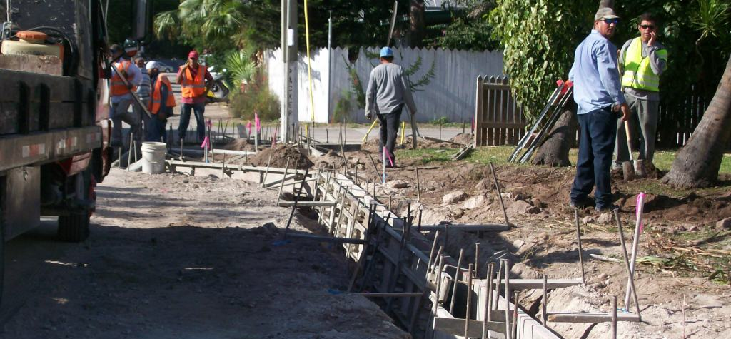
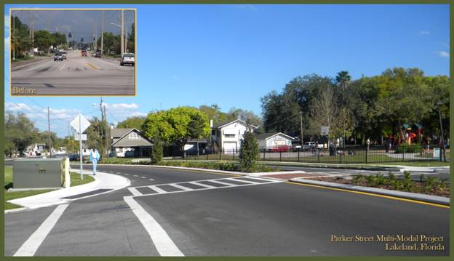

Slide 7
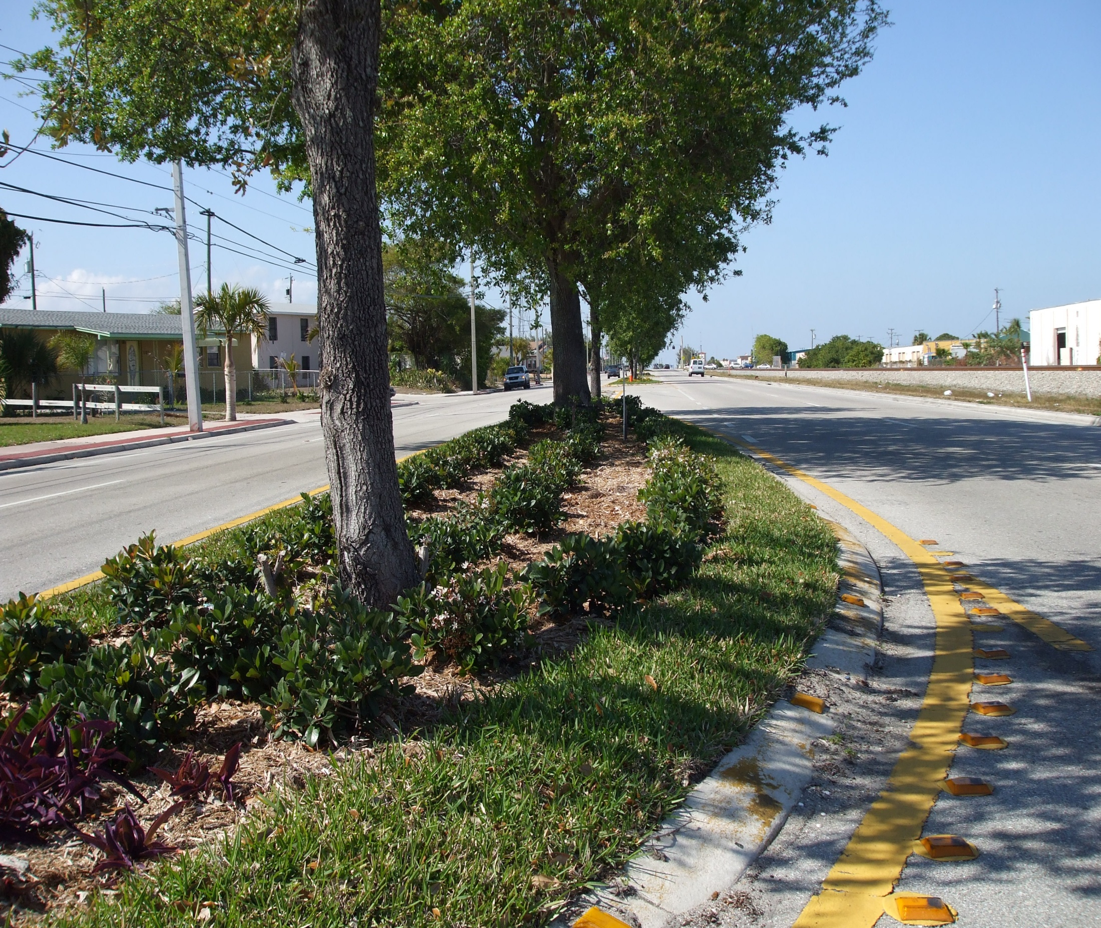

Slide 8
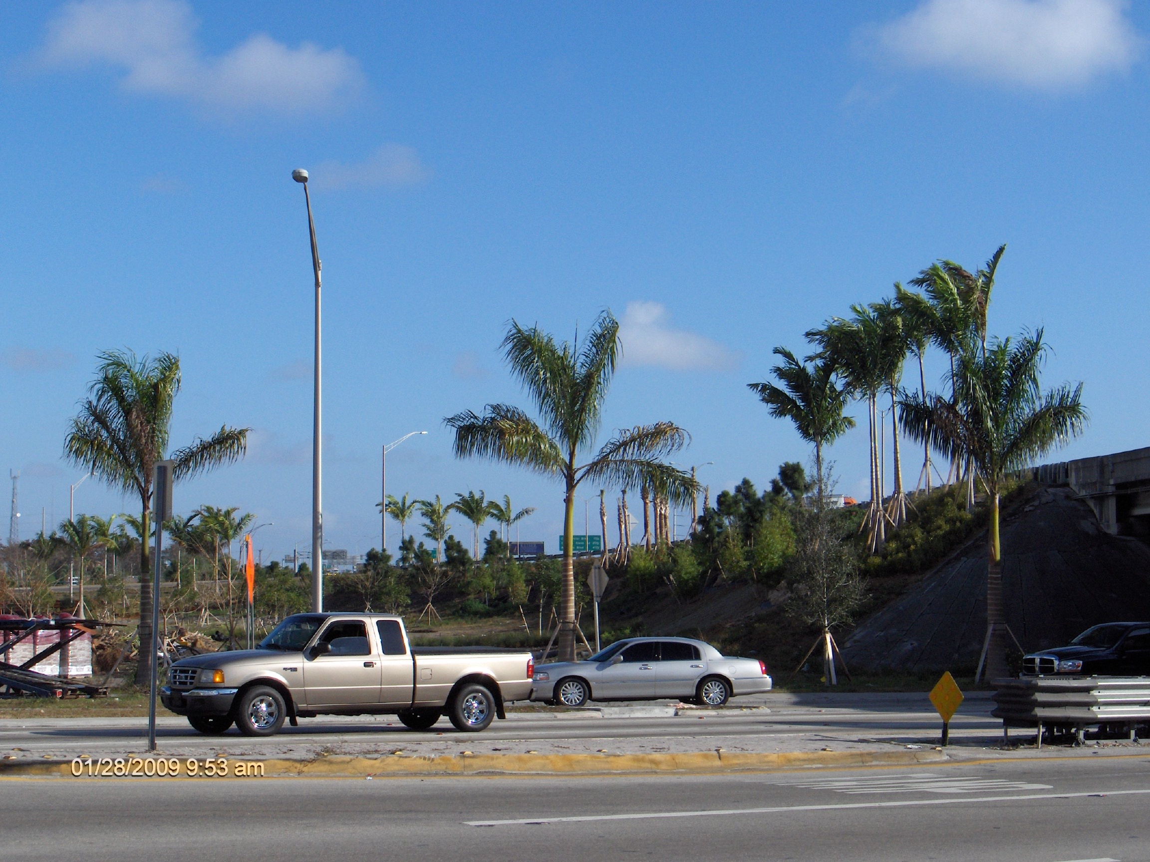

Slide 9
Approval of Checklist
Approval of Checklist
NO
Central Office Notifies District Federal Aid Coordinator
YES
NO
YES
PS&E Development Checklist Submission
District
Review
LAP Administrator Review
Central Office Federal Aid Review
FHWA Funds Requested for Construction
YES
YES
Approval of Checklist
Approval of Federal Aid
NO
NO

Slide 10
challenges
  Funded or Not?
  General Consultant Use
  Proprietary Items
  Liquidated Damages
  When is it Worth it?
  Plant City vs. City of Lakeland
  New Way of Doing Business

Slide 11
Streamlining Initiatives
  Local Agency Program Information Tool (LAPIT)
  Centralize Information and Electronic Documentation
  Automatic Email Notifications
  Streamlined Document Based Audits
  Simplified Professional Service Acquisition
  Category Five Services - $325,000 Construction value
  Professional Services Contract - $150,000
  LAP Community of Practice
  Evaluation and Development of Streamlining Processes
  Collaborative Effort

Slide 12
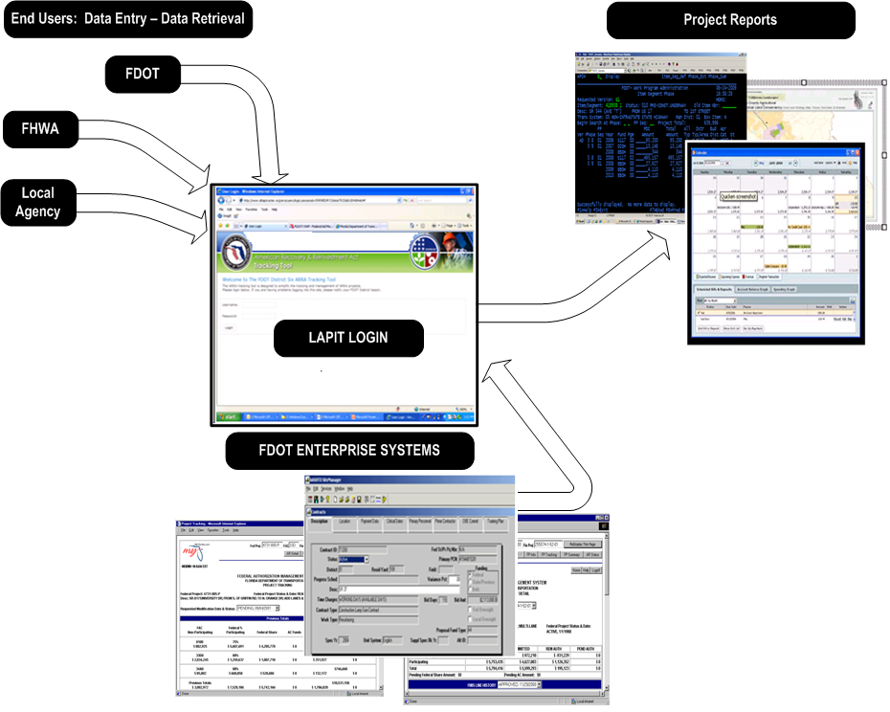
On the job training
What is LAPIT

Slide 13
LAPIT: Current Status
  https://www3.dot.state.fl.us/LocalAgencyProgram/Account.aspx/LogOn

Slide 14
Lessons learned
Communication: Early and Often
Hold Requirements Gathering Meetings
Train, Train, then Train Again.
Team Approach
A Good Consultant is Well Worth It!
Read the LAP Manual and Ask Questions

Slide 15
Thank You!

