Slide 1

WELCOME
THE PUBLIC MEETING PRESENTATION
WILL BEGIN AT X:XX P.M.
Notes:
[This slide should be on the screen as a screen saver before the start of the meeting.]

Slide 2

Welcome
Name
FDOT Project Manager
719 S. Woodland Blvd., MS 542
DeLand, FL 32720
name.name@dot.state.fl.us
386-943-xxxx
Notes:
TOPIC: WELCOME BY FDOT PROJECT MANAGER
[*on slide use icons, not real photos – may have less or more speakers but only need PM and moderator]
Good evening, everyone and welcome to the INSERT PROJECT NAME public meeting.
My name is PROJECT MANAGER NAME and I am the project manager with the Florida Department of Transportation.
During the meeting, we will present information on the Department’s plans to improve safety and enhance operations through this project.
We encourage your feedback and during the presentation, we will provide multiple ways you can submit your questions and comments to us about this project.
All comments and questions will be responded to after the meeting and will become part of the public meeting record.
I will now turn it over to our project team to begin the presentation.

Slide 3

About the Public Meeting
Hybrid meeting
This public meeting is being conducted in a hybrid format:
In-Person
Virtual
Dial-in
In-Person
Virtual
Dial-In
Dial-in attendees are “listen only”.
A copy of the presentation is available at CFLRoads.com/project/xxxxxx-x
Notes:
TOPIC: ABOUT THE PUBLIC MEETIING
This meeting is being conducted in a hybrid format to provide multiple ways for the public to receive information about the project and provide input.
This meeting is being conducted in-person, virtually through GoToWebinar, and over the phone.
If you dialed in today on a telephone line, the PowerPoint presentation is available on the project webpage at WEBPAGE URL (spell out).

Slide 4

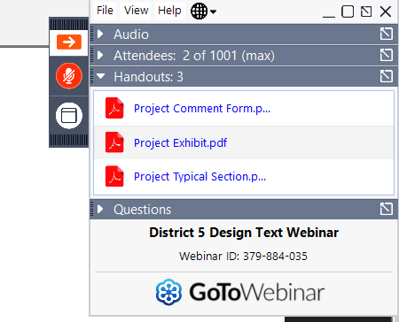
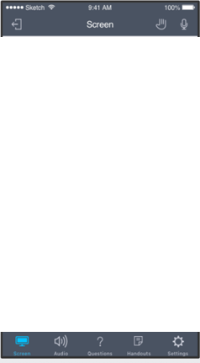
GoToWebinar Control Panel
Mobile
Desktop
Notes:
For online participants, the GoToWebinar Control Panel should be visible in the upper-right corner of your computer screen.
If joining GoToWebinar on your mobile device, simply tap the screen to display the same options.
The blue arrows in both images point to where you will find the Question box.
You can type a comment or question into the Question box.
Then click Send to submit your comment or question to staff.
The red arrows in both images point to where you can find handouts, documents and comment forms for this public meeting.
Click the handouts icon to see available handouts. Click on the file name to download.

Slide 5


To report a technical issue…
Type a message in the question box on the GoToWebinar control panel
Send an email to xxxx.xxxx@xxxx.com
Call ###-###-####
?
Notes:
TOPIC: TECHNICAL ISSUES (SELECT AS APPROPRIATE)
If you happen to experience a technical issue during this meeting, please:
Type the issue in the questions box on the control panel on GoToWebinar.
Or send an email to EMAIL ADDRESS – spell out to report it.
You may also call insert phone number
Staff will do their best to assist you.

Slide 6
Title VI of the Civil Rights Act of 1964
Title VI Compliance
Public participation is solicited without regard to race, color, national origin, age, sex, religion, disability, or family status. Persons wishing to express concerns relative to FDOT compliance with Title VI may do so by contacting:
Jennifer Smith
District Five Title VI Coordinator
719 S. Woodland Blvd.
DeLand, FL 32720
386-943-5367
Jennifer.Smith2@dot.state.fl.us
Jacqueline Paramore
State Title VI Coordinator
605 Suwannee St., MS 65
Tallahassee, FL 32399-0450
850-414-4753
Jacqueline.Paramore@dot.state.fl.us
All inquiries or concerns will be handled according to FDOT procedure and in a prompt and courteous manner.
Notes:
TOPIC: TITLE VI COMPLIANCE
This public meeting was advertised and is being conducted in accordance with state and federal requirements, including Title VI of the Civil Rights Act of 1964.
Public participation is solicited without regard to race, color, national origin, age, sex, religion, disability or family status.
Persons wishing to express their concerns about Title VI may do so by contacting Jennifer Smith, District Five Title VI Coordinator, by mail at 719 South Woodland Boulevard DeLand, Florida 32720, by phone at 386-943-5367, or email at jennifer.smith2@dot.state.fl.us (spell out). You may also contact Jacqueline Paramore, State Title VI Coordinator, by mail at 605 Suwannee Street, Mail Station 65, Tallahassee, Florida, 32399-0450 by phone at 850-414-4753 or email at jacqueline.paramore@dot.state.fl.us (spell out).
This information is shown on a sign at the in-person location, on the project website, and in the meeting notifications.

Slide 7
PROJECT SPECIFIC TECHNICAL SLIDES
AND SCRIPT
Notes:
TOPIC: TECHNICAL ISSUES

Slide 8


Share Your Comments and Questions
In-person
Virtually
Mail
By phone
Notes:
TOPIC: ABOUT YOUR COMMENTS AND QUESTIONS
We encourage your input and feedback about this project and there are multiple ways for you to participate.
All public comments and questions are part of the public meeting record and every method for providing public comments and questions carries equal weight.
While comments and questions will be accepted at any time, those submitted by DATE, NUMBER days after the public meeting, will become part of the project’s public meeting record.
All comments and questions will be responded to in writing following the meeting.

Slide 9
Ways to Submit Comments & Questions
In-person
  Submit Comment Form
Virtually
    GoTo Webinar: Type the comment in the Questions box
    Online at CFLRoads.com/project/xxxxxx-x
  Contact the FDOT Project Manager directly
Project Manager Contact Information
Name
719 S. Woodland Blvd., MS XX
DeLand, FL 32720
Email
386-943-XXXX
Notes:
TOPIC: WRITTEN COMMENTS AND QUESTIONS (SELECT AS APPROPRIATE)
To submit comments in person, you may speak to our project staff on the floor or complete a printed Comment Form and return it to project staff.
If you are participating online, you may submit written questions or comments in the Question box on the GoToWebinar Control Panel.
Written comments may also be submitted on the project website at WEBSITE URL.
You may also contact the project manager directly by email at EMAIL ADDRESS – spell out.
Or by U.S. Mail at the Florida Department of Transportation, 719 S. Woodland Boulevard, Mail Station XX, DeLand, FL 32720
You may also call the project manager at PHONE NUMBER to provide verbal comments during normal business hours.
The contact information is also available on the public meeting notification that you may have received by mail.

Slide 10


Thank you for participating.
Please submit comments and questions by Month, Day
Insert contact email address
Insert contact mailing address
Insert contact phone number
CFLRoads.com/project/xxxxxx-x
Notes:
TOPIC: THANK YOU FOR PARTICIPATING
On behalf of the Florida Department of Transportation thank you for attending this public meeting and providing your input on this project.
If you have comments or questions after the meeting, please submit them by [PUBLIC COMMENT PERIOD END DATE].
Contact information, a recording of this presentation, project documents and other exhibits displayed at the public meeting are posted on the project website at [PROJECT WEBSITE URL].
Have a good evening.

Slide 11

We are experiencing technical difficulties
Our team is actively working to fix the issue and hope to have this resolved soon.
Thank you for your patience.
Notes:
TOPIC: WE ARE EXPERIENCING TECHNICAL DIFFICULTIES (hidden contingency slide)

