Slide 1
Value Engineering
Bobby Bull, P.E.
State Value Engineer
2024 South Florida Symposium

Slide 2
Objectives
Background
What is VE?
Why, When, What, & How to VE?
References

Slide 3

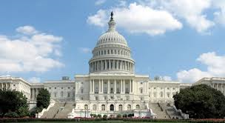


Background
1947 VE Process Established
1954 Adopted by US Navy
1959 SAVE International
1970 Highway Act
1978 FDOT VE Program
1995 National Highway Systems Act
1997 Federal Regulation (23 CFR 627)
2005 SAFETEA-LU
2012 Updated Federal Regulation
2012 MAP-21
2014 Updated Federal Regulation

Slide 4
Background
FHWA Requirements – 23CFR 627
  NHS Federal-Aid projects
  $50 million projects
  $40 million bridge projects
  Federal-Aid Major project on or off the NHS
  Not Design Build
  Any project FHWA determines appropriate

Slide 5
What is Value Engineering?
It is not cost reduction!!!
Value Engineering is the systematic application of function-oriented techniques by a multi-disciplined team to analyze and improve the value of a product, process or service.

Slide 6
What is Value Engineering?
It is not cost reduction!!!
Value Engineering is the systematic application of function-oriented techniques by a multi-disciplined team to analyze and improve the value of a product, process or service.

Slide 7
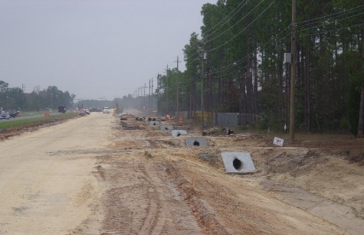
Why use VE?
Shrinking Resources
  Do More with Less
  Put more product on the street
Bold, Innovative & Inspirational

Slide 8


Why use VE?
Improve Project Schedule
Improve Constructability
Resolve Stakeholder Issues
Reduce Operating Costs
Reduce Overall Project Costs
Mitigate Risks
Introduce Innovation

Slide 9
When to apply VE
Scope/Concept
Development
Design
Opportunity for
Change
Operation &
Maintenance
VE Study
Construction
Project Life Cycle

Slide 10
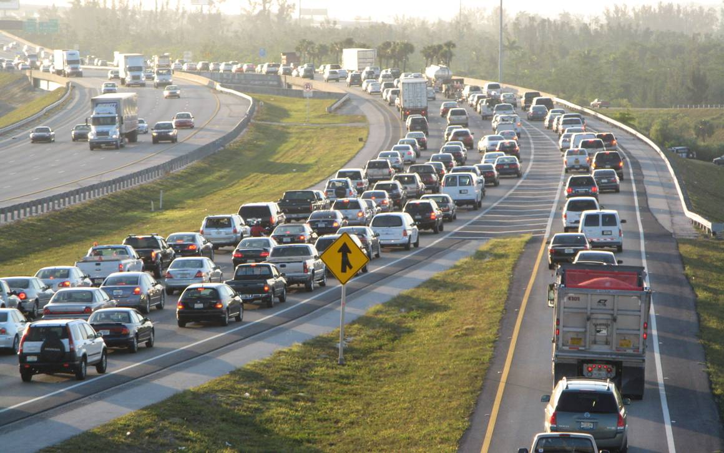
When to apply VE
Planning
Typical Information Required :
Traffic Information
Aerial Photo
ROW Information
Preferred Alternative

Slide 11
When to apply VE
Project Development & Environmental
Typical Information Required :
Construction Cost Estimates
ROW Cost Estimates
Business Damage Estimates
Traffic Analysis
Preliminary Plans
Environmental Impact Analysis
Summary of public Involvement

Slide 12
When to apply VE
Design
Typical Information Required :
Drainage Information
Typical Sections
Plan & Profile
Intersection & Interchange Layouts
PD&E Commitments
Cross Sections
Structure Info.
Traffic Control Plans
Preliminary Cost Estimate

Slide 13
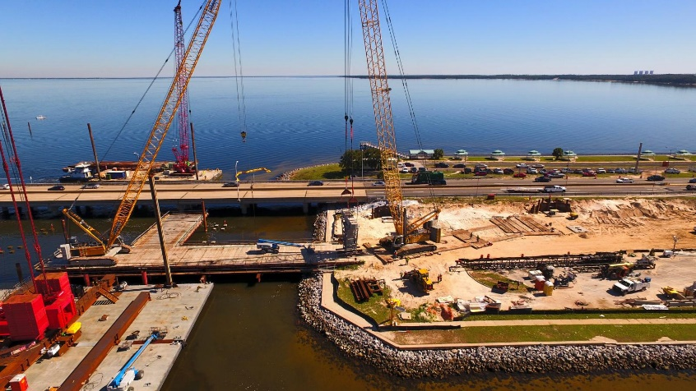
When to apply VE
Design/Build Projects
23 CFR 627.5 – FHWA Encourages
23 CFR 627.9 - Conducted prior to release of RFP document
Typical Information Required :
RFP Package

Slide 14

How is VE Done?
VE Job Plan
Project Selection
Pre-Study
Team Selection
Information Phase
Function Analysis
Creative
VE Team Study
Evaluation
Development
Presentation
Implementation
Post-Study
Report Results

Slide 15
Projects Selected for VE (What)
All projects over $50/$40 million
Large Right-of-Way Purchases
Major Bridges
Complex Projects
Large Corridor & Multi-modal Projects
Project Manager Requests

Slide 16

Team Selection (Who)
Team Leader
Consultant
In-house
Design
Construction
Maintenance
Specialized Expertise

Slide 17
Team Selection (Who)
Team Leader
Consultant
In-house
Design
Construction
Maintenance
Specialized Expertise

Slide 18
Pre-Study Activities
Team Notifications
Schedule room/platform
Distribute study material
Review study material
Develop project cost model/pareto chart
Reserve van/vehicles if performing field review
Schedule Design Team for presentation
Supplies (in person)– flipcharts, markers, post-its, masking tape
Virtual – templates.

Slide 19
How is VE Done?
VE Job Plan
Project Selection
Pre-Study
Team Selection
Information Phase
Function Analysis
Creative
VE Team Study
Evaluation
Development
Presentation
Implementation
Post-Study
Report Results

Slide 20
5 QUESTIONS
ASK DURING THE VE STUDY:
What is it?
What does it do?
What does it cost?
What else can do it?
What does that cost?

Slide 21
Stages of Team Development
Stage 1: Forming - Monday
Stage 2: Storming - Tuesday
Stage 3: Norming - Wednesday
Stage 4: Performing – Thursday/Friday
Perform
Norm
Storm
Form

Slide 22

Information Phase
Review Project Information
  Discuss Design/Estimate
  Develop Questions for Design Team
    Constraints ?
    Major issues?
    What keeps you up at night?
    Significant Risks?
  Identify any missing information
Team Briefing – Design Team contact info

Slide 23
Information Phase
Site Visit
  Meet at site and walk the site as a team
  Record any observations
  Take Pictures
Post Site Visit
  Collect group observations
  Review Cost Model
  Areas of Review

Slide 24
Cost Model Pareto
20% of functions contain 80% of cost

Slide 25
Function Analysis
What is Function?
Intent or purpose that a product or service is expected to perform.
Expressed in 2 words, active verb and measurable noun.
WHAT DOES IT DO?
WHAT DOES IT DO IT TO?

Slide 26
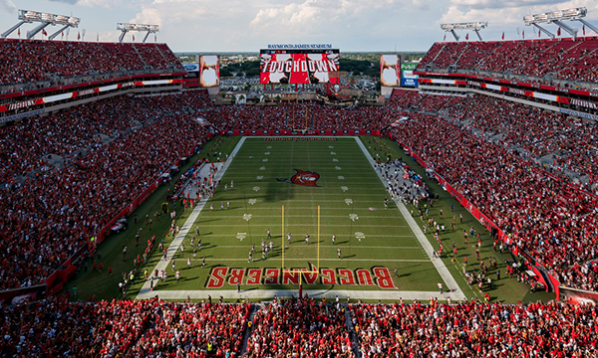

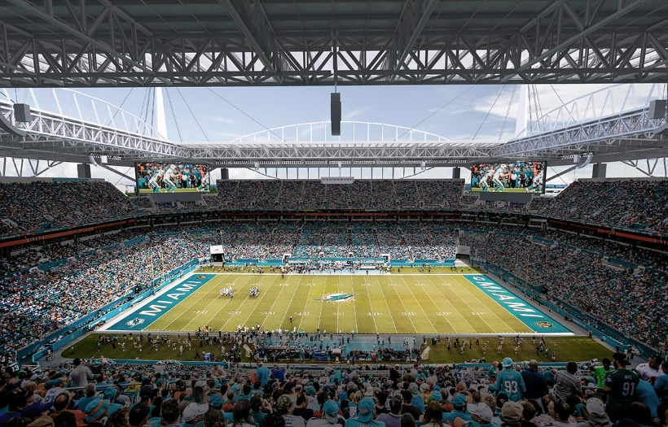
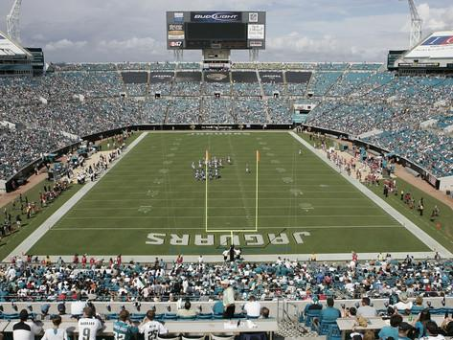
Function Analysis
Calling ‘timeout’ in football results in various actions.

Slide 27
Function Analysis
Time out
How many reasons (Functions) are behind any timeout call by either player, coach or officials?

Slide 28

Function Analysis
ACTION VS. FUNCTION
Stop Clock
Substitute Players
Change Play
Conserve Time
Convey Strategy
Avoid Errors
Modify Strategy

Slide 29
Function Analysis
Random Function Generation
ITEM | VERB | NOUN
Guardrail
Door
Electric Switch
Screwdriver
Column
Light
Fence
Landscaping
Re-direct
Vehicle
Control
Access
Interrupt
Current
Transmit
Torque
Transfer
Load
Illuminate
Area
Enclose
Area
Improve
Appearance

Slide 30
Function Analysis
What is the function of this pencil?
“make marks”
Band:
Secure Eraser
Barrel:
Support Lead, Accommodate Grip, Transmit Force
Eraser:
Remove Marks
Paint:
Protect Wood, Improve Appearance
Graphite:
Make Marks

Slide 31
Function Analysis
Function Analysis System Technique (FAST)
HOW
WHY
PROJECT OBJECTIVES
ALL THE TIME FUNCTIONS
HIGHEST ORDER FUNCTION
BASIC FUNCTION
SECONDARY FUNCTION
SECONDARY FUNCTION
SECONDARY FUNCTION
LOWEST ORDER FUNCTION
SECONDARY FUNCTION
SECONDARY FUNCTION
SCOPE OF PROBLEM UNDER STUDY

Slide 32
Function Analysis
Function Analysis System Technique (FAST)
Pencil
HOW
WHY
REMOVE MARKS
SECURE ERASER
RECORD INFORMATION
MAKE MARKS
TRANSMIT FORCE
APPLY FORCE
IMPROVE APPEARANCE
SUPPORT LEAD
ACCOMMODATE GRIP
PROTECT WOOD
SCOPE OF PROBLEM UNDER STUDY

Slide 33
Creative Phase
Brainstorming
A technique to get bigger and better ideas
Free flow of creative ideas not bound by barriers
Challenges traditional thinking
WHAT ELSE CAN DO IT?

Slide 34
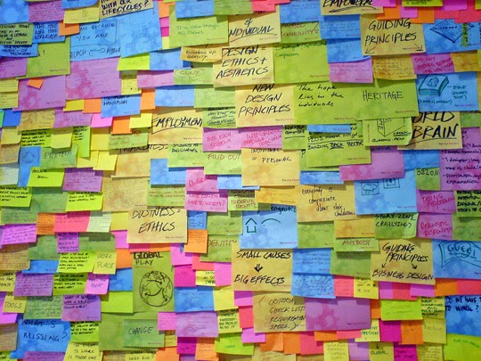
Creative Phase
Ideas flow freely
No debating or evaluating ideas
Build on other ideas
Think of new ways
Be humorous and creative
Everyone participates
There are no bad ideas

Slide 35

Evaluation Phase
Eliminate ideas
Combine ideas
Evaluate remaining ideas
  Weighted Matrix
  Multi-Voting
  Team Consensus

Slide 36
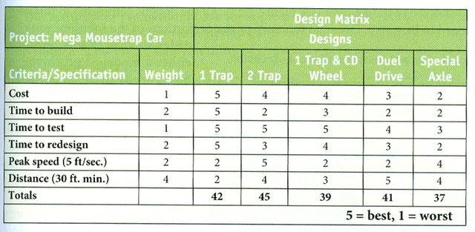
Evaluation Phase
What is an Evaluation Matrix?
Matrix used to evaluate ideas against the proposed design using the same criteria.

Slide 37
Evaluation Phase
Determine Evaluation Criteria
Use paired comparison to weight criteria.
Evaluate each alternative/idea based on criteria

Slide 38
Evaluation Phase
Typical Criteria:
  Costs
  Operations
  Constructability
  Maintenance
  Environmental
  Aesthetics

Slide 39
Evaluation Phase
Paired Comparison
Costs
Operations
Constructability
Maintenance
Aesthetics
(A)
(B)
(C)
(D)
(E)
Costs
(B)
(C)
(A)
(A)
(A)
Operations
(B)
(B)
(B)
(B)
Constructability
(C)
(C)
(C)
Maintenance
(D)
(D)
Aesthetics
(E)

Slide 40
Evaluation Phase
Criteria Weightings
Costs (A)
3 = (2)
Operations (B)
5 = (4)
Constructability (C)
4 = (3)
Maintenance (D)
2 = (1)
Aesthetics (E)
1 = (0)

Slide 41
Evaluation Phase
Weighted Matrix
RATINGS: EXCELLENT – 4 GOOD - 3 FAIR – 2 POOR - 1 | COSTS |  | OPERATIONS |  | CONSTRUCTABILITY |  | MAINTNANCE |  | AESTHETICS |  | TOTALS
ALTERNATIVES/ WEIGHTING | 3 |  | 5 |  | 4 |  | 2 |  | 1
AS PROPOSED | 4 | 12 | 3 | 15 | 2 | 8 | 1 | 2 | 5 | 5 | 42
VE ALTERNATIVE 1 | 3 | 9 | 5 | 25 | 2 | 8 | 3 | 6 | 2 | 2 | 50

Slide 42
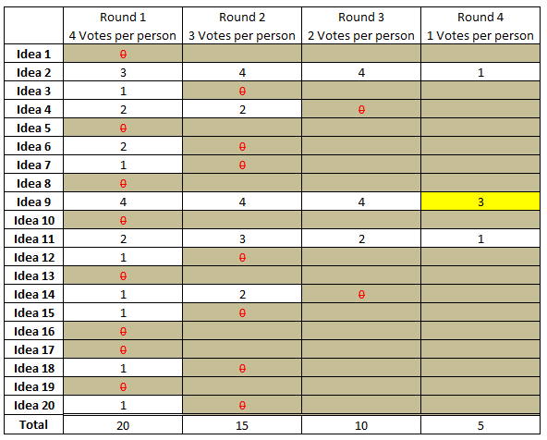
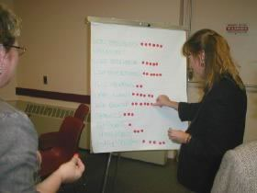
Evaluation Phase
Multi-Voting
What is it?
  A decision-making tool that enables a team to reduce a long list of ideas to a manageable number of ideas.

Slide 43
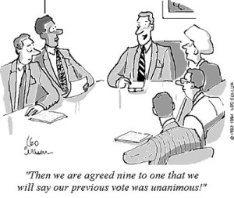
Evaluation Phase
Team Consensus
What is it?
  As a group decide:
    Which ideas to move forward for development
    Which ideas to combine
    Which ideas to eliminate

Slide 44

Development Phase
Write-up Ideas
Descriptions
Sketches
Calculations
Advantages & Disadvantages
Cost Analysis (Life Cycle Costs)

Slide 45
Development Phase
Write-up Ideas
Descriptions
Sketches
Calculations
Advantages & Disadvantages
Cost Analysis (Life Cycle Costs)
Clear Descriptions of both the proposed design and the VE alternative

Slide 46
Development Phase
Write-up Ideas
Descriptions
Sketches
Calculations
Advantages & Disadvantages
Cost Analysis (Life Cycle Costs)
Sketches to help visualize the VE alternative that is being presented

Slide 47
Development Phase
Write-up Ideas
Descriptions
Sketches
Calculations
Advantages & Disadvantages
Cost Analysis (Life Cycle Costs)
Calculations that help support the VE Alternative

Slide 48
Development Phase
Write-up Ideas
Descriptions
Sketches
Calculations
Advantages & Disadvantages
Cost Analysis (Life Cycle Costs)
Advantages and Disadvantages of the VE Alternative

Slide 49
Development Phase
Write-up Ideas
Descriptions
Sketches
Calculations
Advantages & Disadvantages
Cost Analysis (Life Cycle Costs)
Life Cycle Cost Analysis

Slide 50
Development Phase
What is Life Cycle Cost Analysis?
A tool to determine the most cost-effective option among different competing alternatives to purchase, own, operate, maintain and finally dispose of an object when each is equally appropriate to be implemented. All the costs are typically discounted to Net Present Value (NPV).

Slide 51

Presentation Phase
Present results to management
Either last day of study or scheduled separately by District VE coordinator.
Multiple presenters
Dress rehearsal

Slide 52

Report Results
Team Leader responsible for developing and distributing report.
Collect write-ups from team members.
Include presentation, agenda & sign-in sheets in appendices.
Distribute draft report to team for comments.
PE sign & seal final report.

Slide 53
Report Results
Results are reported quarterly at the Performance Meeting
Results are reported on an Annual Basis to FHWA

Slide 54

Cost Risk Analysis & Value Engineering
CRA Process & VE Process are complimentary
  Use the VE process to develop risk response strategies
  Use the CRA process on the VE recommendations to evaluate the risks and their impact on the cost & schedule

Slide 55

References
FDOT Value Engineering web site
FDOT Value Engineering Procedure 625-030-002
FHWA Value Engineering web site
SAVE International web site

Slide 56
Questions

Slide 57
Thank you
Bobby Bull, P.E.
State Value Engineer
Bobby.Bull@dot.state.fl.us
(850) 414-4348

