Slide 1
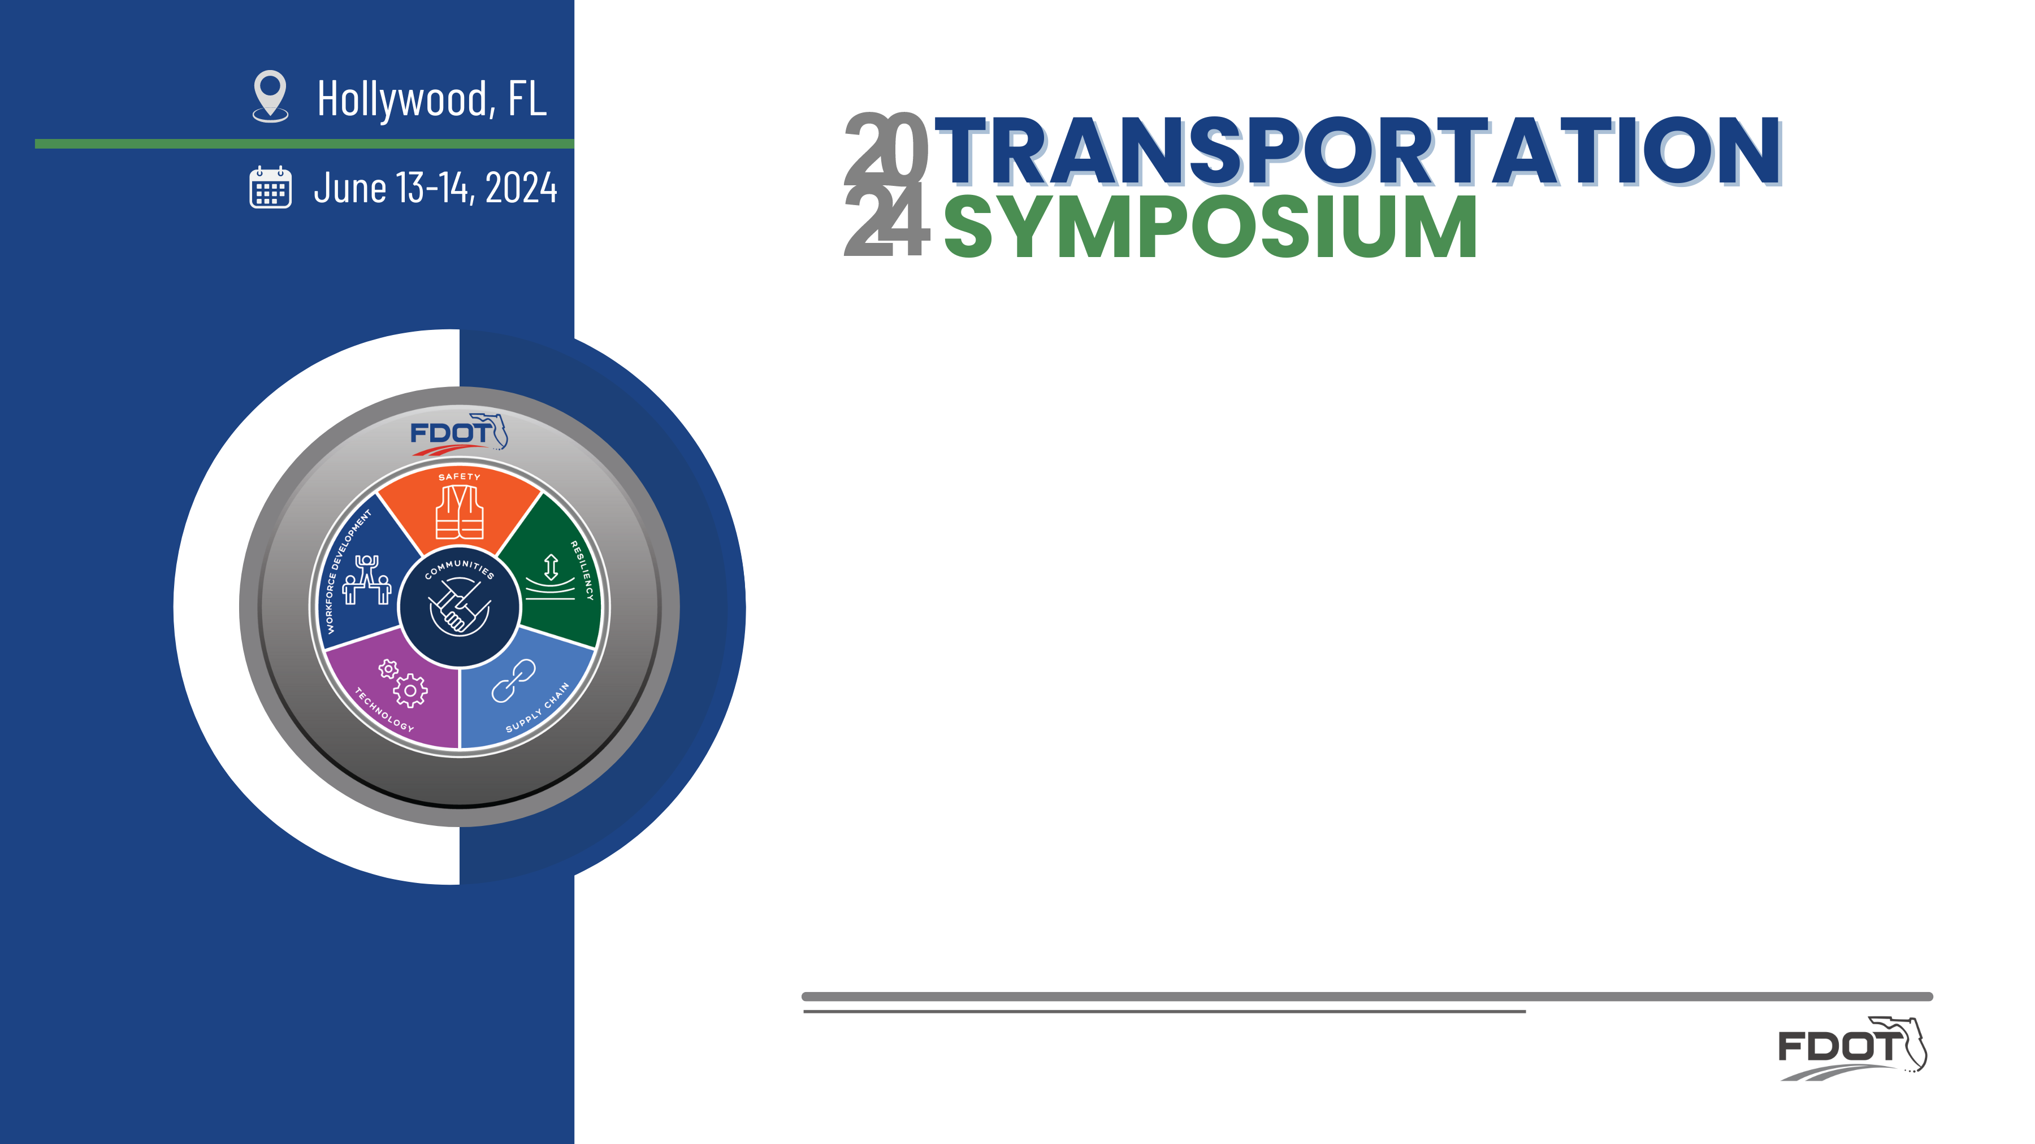

Intersection Control Evaluation (ICE) Implementation in Florida
Dibakar Saha, PhD, PE, PTOE, RSP2I
FDOT Traffic Engineering and Operations Office

Slide 2
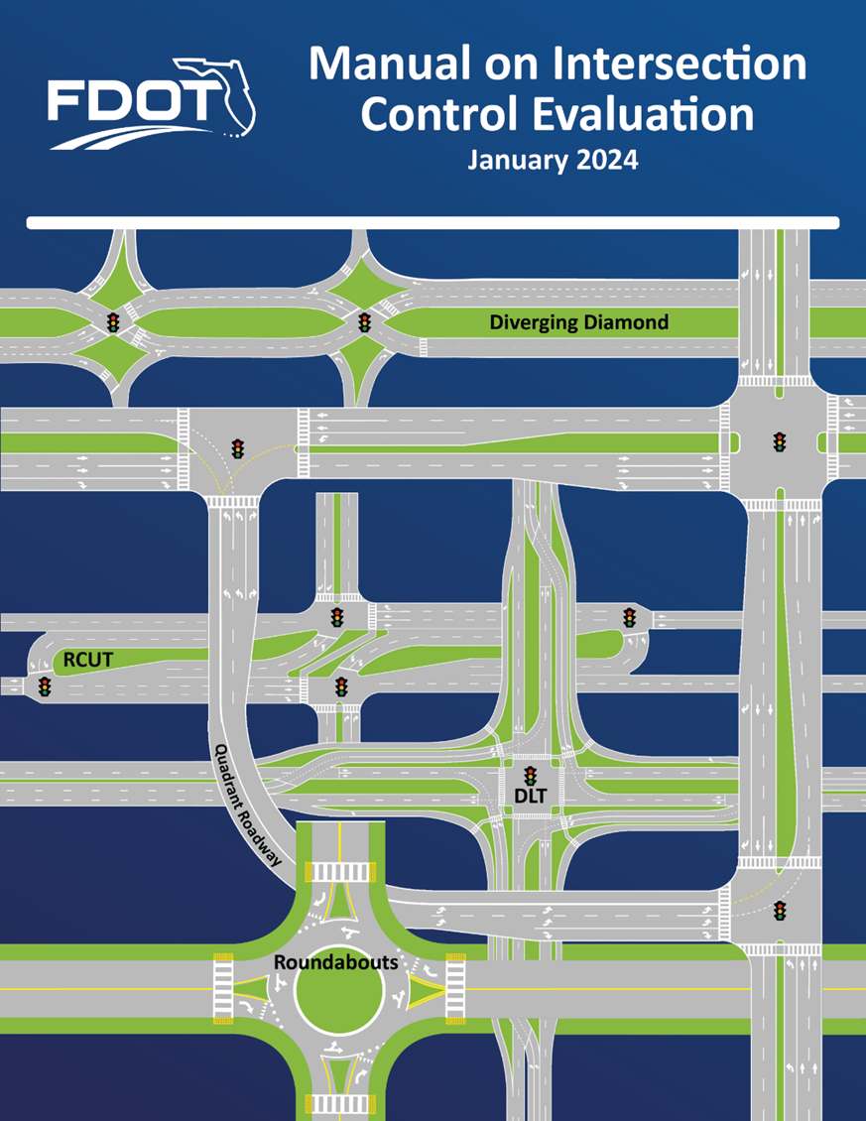
What is ICE?
Intersection Control Evaluation (ICE) entails a performance-based analytical approach to
  screen intersection alternatives among conventional and innovative intersection designs,
  identify an optimal context-sensitive solution for all road users
The first FDOT ICE policy in 2018
Several updates made to ICE procedure, with latest in January 2024

Slide 3
Applicability of ICE
When is ICE Required?
When is ICE NOT Required?
Signalization of a new or existing intersection
Midblock pedestrian signal
Major reconstruction of an existing
signalized intersection
No substantive changes to the intersection
Conversion of a directional/ bi-directional median opening to a full median opening
Minor intersection operational improvements (e.g., adding a
right-turn lane)
Driveway/Connection permit applications for category E, F, G
Non-state roads
DTOE and DDE consider an ICE a good fit

Slide 4
Intersection Types in ICE
At-Grade Intersection
Ramp Terminal Intersection
  Two-way Stop
  All-way Stop
  Signalized
  Roundabout
  Median U-Turn (MUT)
  Restricted Crossing U-Turn (RCUT)
  Jughandle
  Displaced Left Turn (DLT)
  Thru-Cut
  Bow-Tie
  Continuous Green T (CGT)
  Quadrant Roadway
  Diamond
  Partial Cloverleaf
  Diverging Diamond
  Single-Point Diamond
  Roundabout
  Tight Diamond

Slide 5
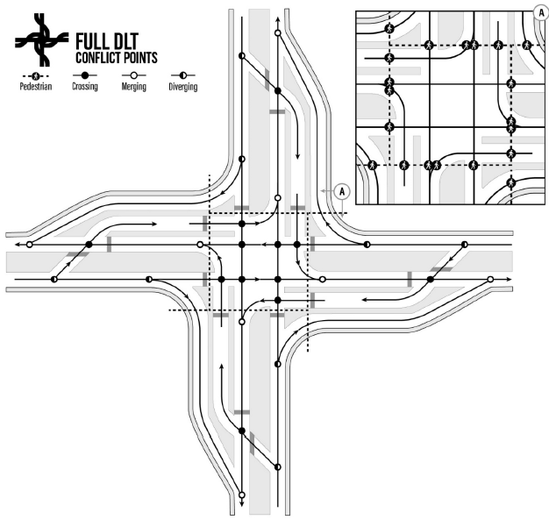
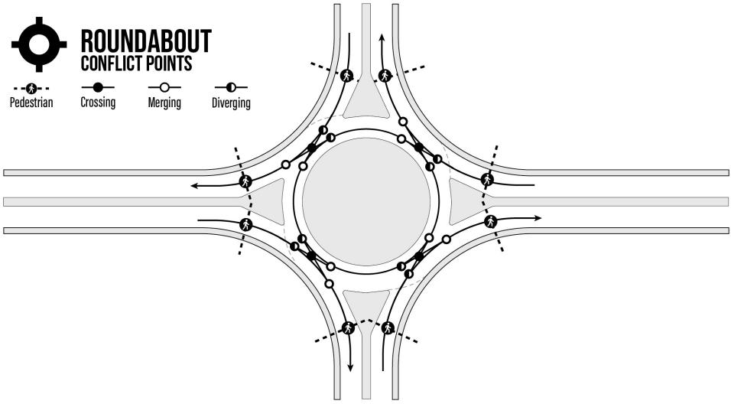
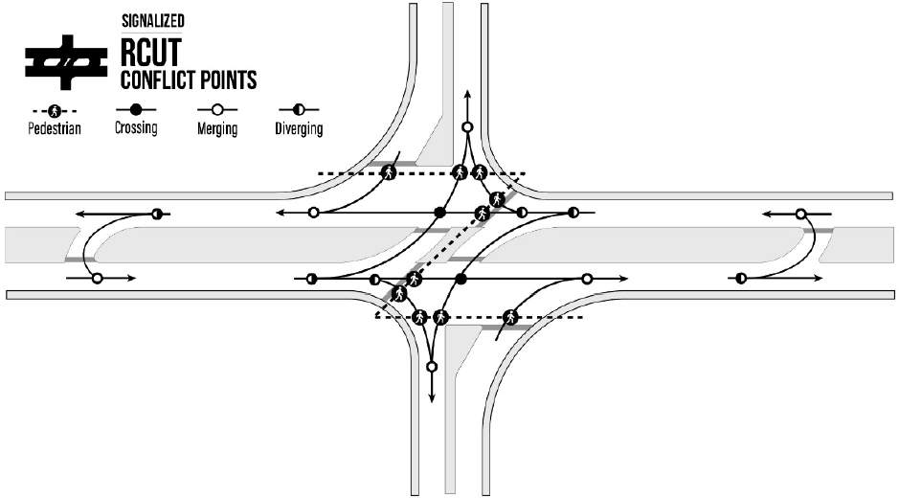
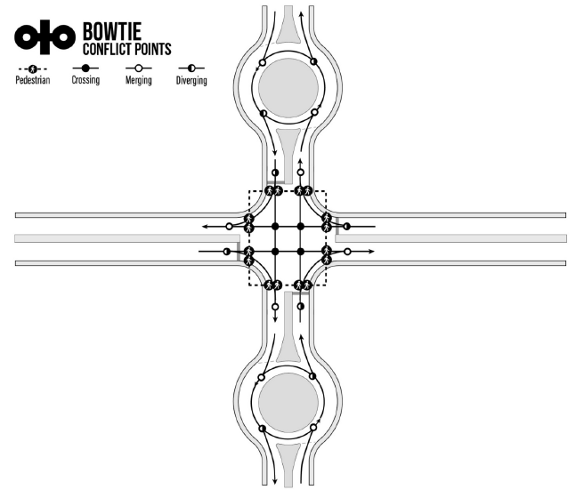
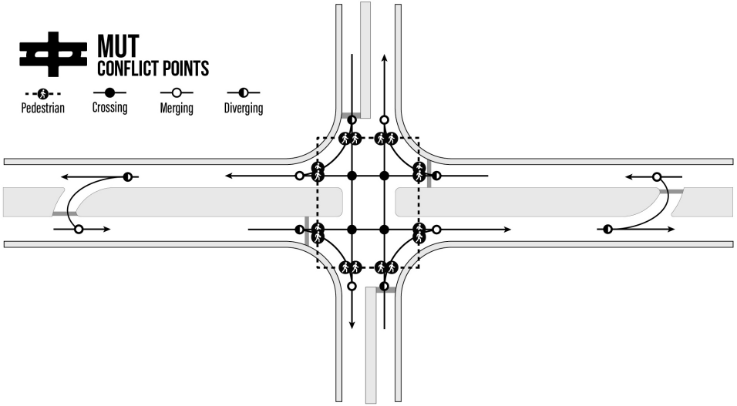
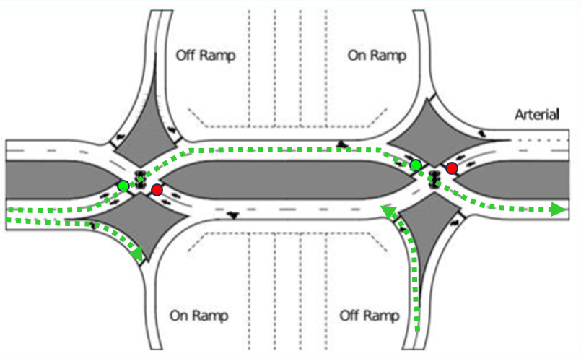
Innovative Intersection Designs
Reduce the number of conflict points
Reduce the collision angle
Image Sources: FHWA

Slide 6
Conducting an ICE
ICE procedure consists of 3 stages
  Stage 1: Screening/Preliminary Analysis
  Stage 2: Detailed Analysis
  Stage 3: Supplemental Analysis
Not all stages are required for every project
  A single control strategy cannot be identified at a given stage
  Funding source
Factors to be Considered
Project purpose and need
Basic roadway characteristics
Context classification
Multimodal use and needs
Safety performance
Operational performance
Environmental, Utility, and ROW impacts
Benefit-cost ratio
Public input

Slide 7
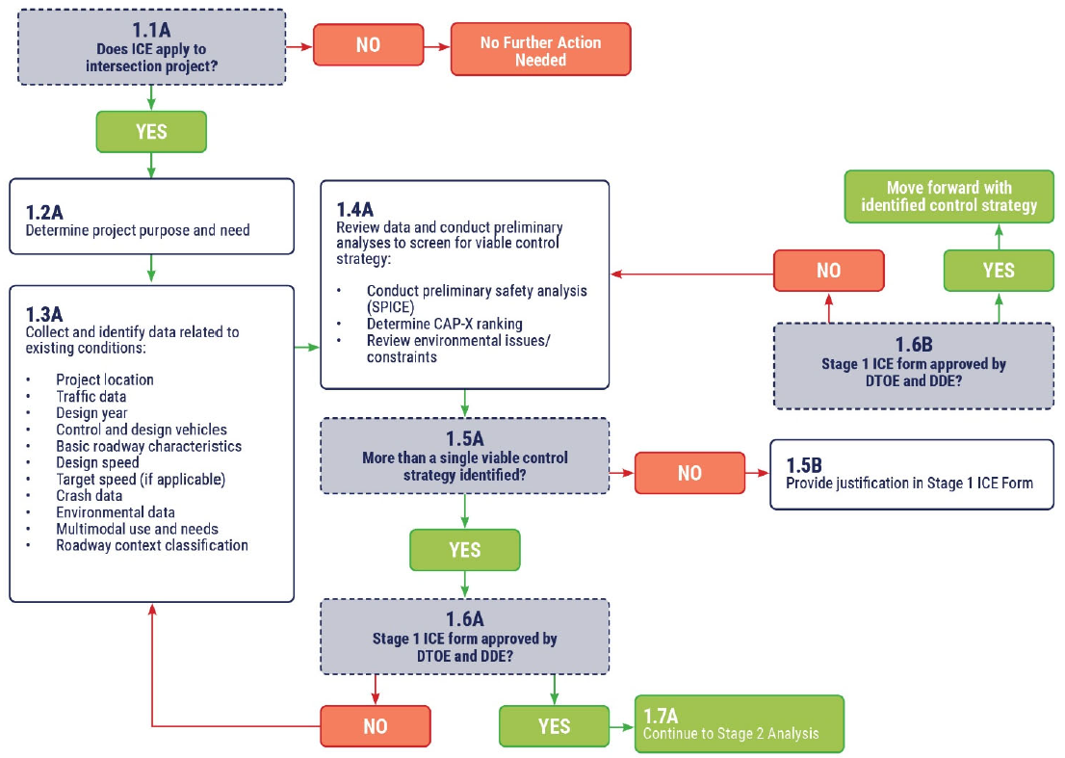
Stage 1: Screening/Preliminary Analysis
At planning level/initial stage of a project
Two Tools
  CAP-X: Capacity Analysis for Planning of Junctions
  SPICE: Safety Performance for Intersection Control Evaluation
Narrow down the list of viable control strategies
Complete and submit Stage 1 ICE Form with justification to selection to DDE and DTOE for approval

Slide 8
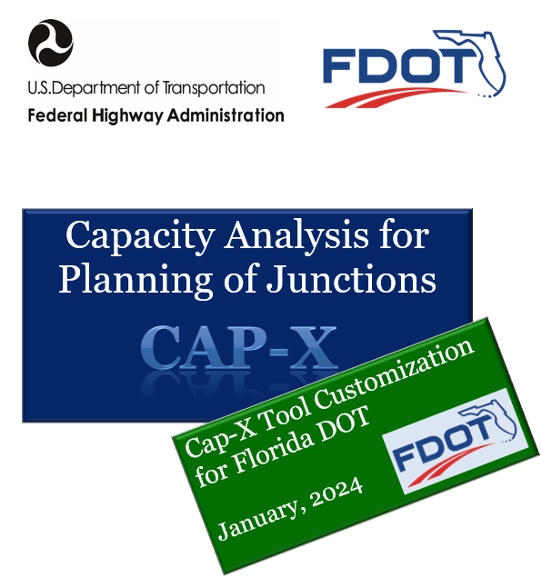
CAP-X: Capacity Analysis for Planning of Junctions
Microsoft Excel-based spreadsheet tool
Evaluate and compare operational performance
Simplified HCM methodology based on Critical Lane Volume
Multimodal (Pedestrian and Bicyclist) Accommodations
Inputs
  Turning movements counts during peak hour
  Truck percentage
  Lane configuration
  Pedestrian and Bicycle Facilities

Slide 9
Pedestrian and Bicycle Evaluations in Cap-X
Multimodal Ped Inputs
Multimodal Bike Inputs
Roadway Speeds (per crossing)
Auto-Populated Fields
Number of lanes (per crossing)
Conflicting vehicle type (per crossing)
Marking type (per crossing)
Vehicular volume (per crossing)
Multistage crossing (per intersection)
Out of direction travel (per intersection)
Default Input Fields
Required Input Fields
Major and minor street bicycle facility type
Conflicting control type (per leg)
Number of adjacent thru lanes (per leg)
Leg AADT
Roadway speeds
Out of direction travel (per leg)
Riding between travel lanes (per leg)
Riding across free flow ramp (per leg)
Default Input Fields
New Input Fields
Auto-Populated Fields

Slide 10
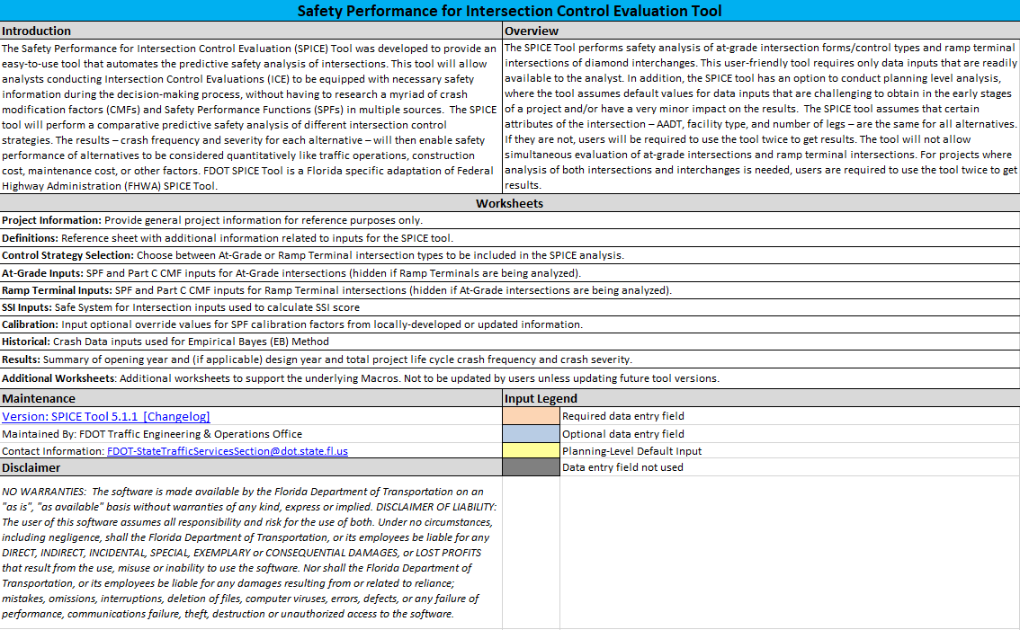
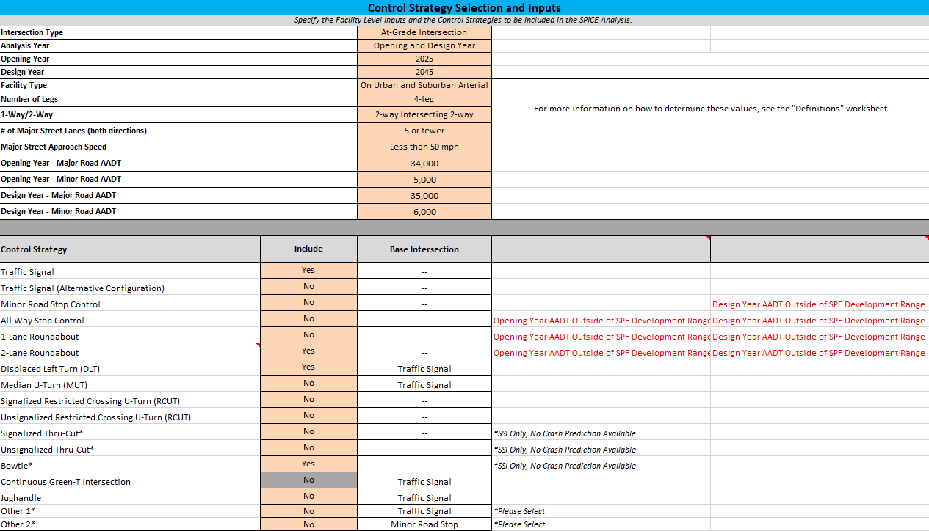
SPICE: Safety Performance for Intersection Control Evaluation
Microsoft Excel-based spreadsheet tool
Evaluate and compare safety performance based on
  Crash prediction method
    Highway Safety Manual
    NCHRP Project
    FDOT Research
    FHWA CMF Clearinghouse
  Safe System for Intersection (SSI) method

Slide 11

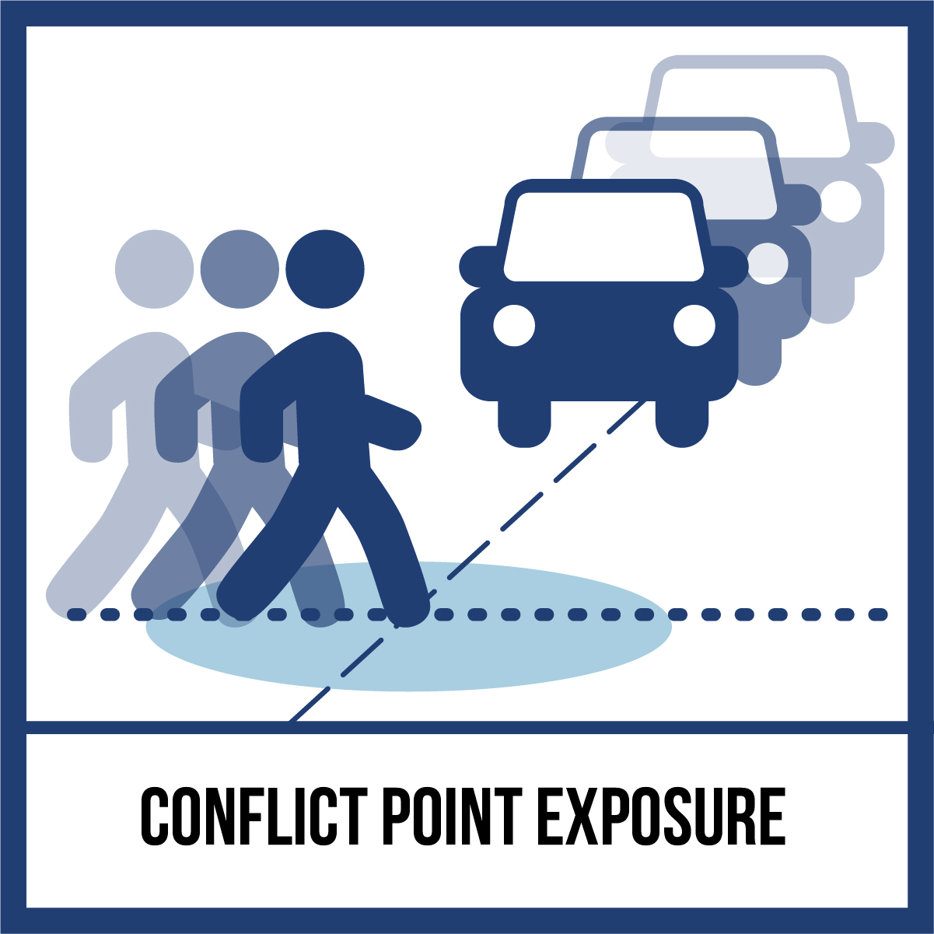

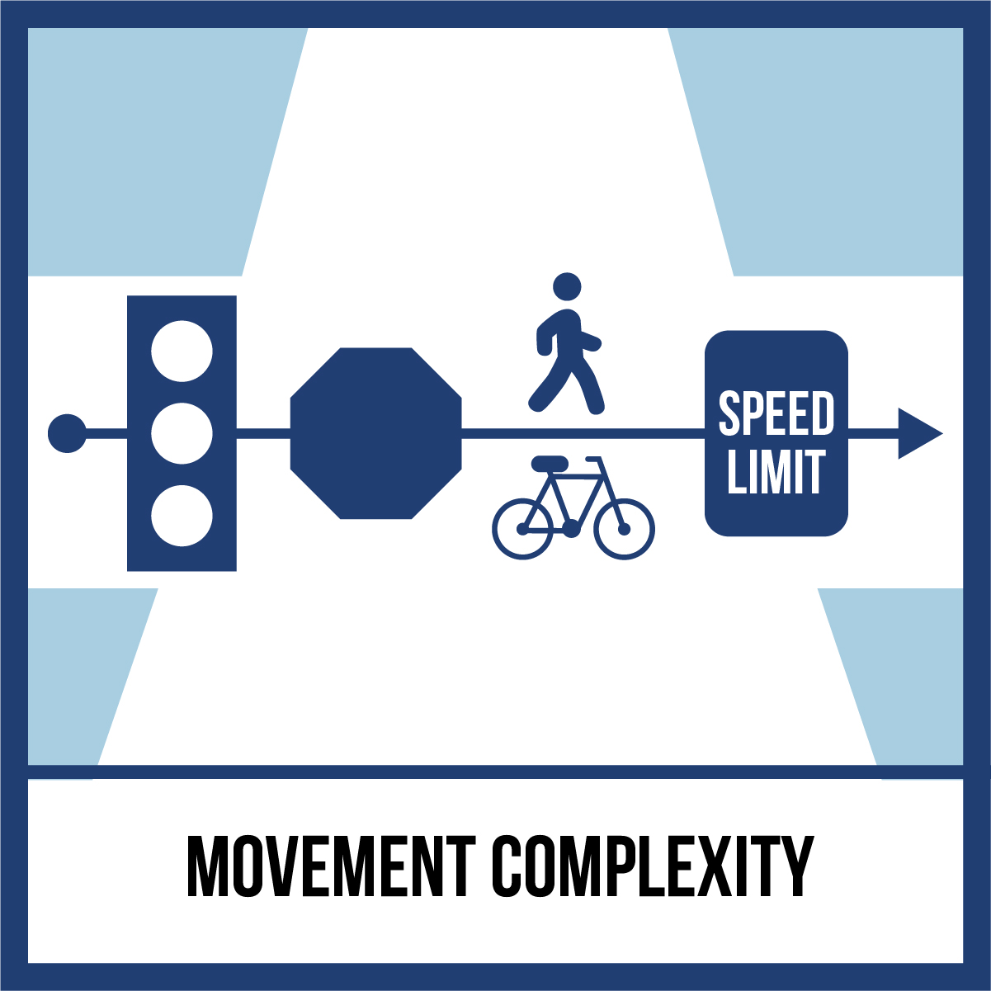
Safe System for Intersection Method
A technical framework to apply Safe System principles for informed intersection planning and design decisions
Kinetic energy management approach
Key characteristics
  Conflict point identification and classification - Crossing, merging, diverging, non-motorized
  Conflict point exposure – AADT or Turning movement counts
  Conflict point severity – P(FSI) based on MAIS scale, estimated speed, and conflict angle
  Movement Complexity – Conflicting traffic, traffic control devices, additional complexity for non-motorized users
Source: VHB

Slide 12
SSI Inputs and Score
Required Inputs
  Number of through lanes
  Median presence
  Posted speed limit
Ensure inputs for non-motorized activity match with inputs at other sheets
SSI score is not based on actual crash frequency or crash predictions
SSI score at an intersection is a combined score of four conflict types (crossing, merging, diverging, and non-motorized) based on exposure, severity, and complexity factor
SSI score ranges from 0 to 100: 100 indicating low probability of
F&SI crashes

Slide 13
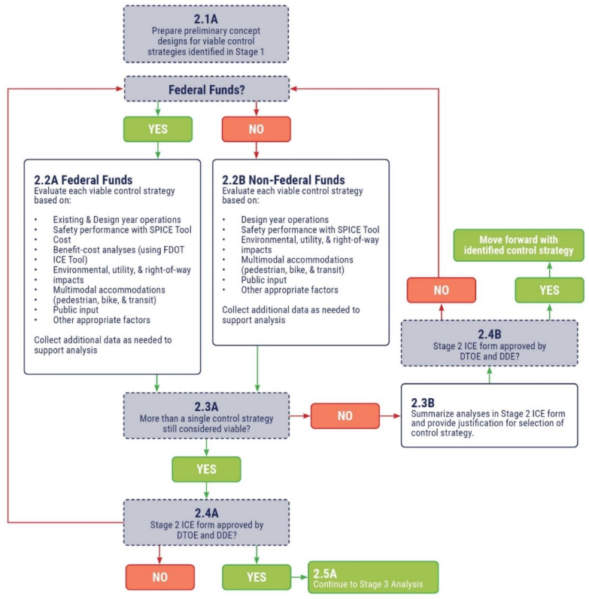
Stage 2: Detailed Analysis
Prepare preliminary conceptual design
Determine funding source
Three Tools
    FDOT SPICE Tool for comprehensive safety analysis
    FDOT ICE Tool for benefit/cost analysis
    Traffic simulation software (e.g., Synchro, SIDRA)
  Complete and submit Stage 2 ICE Form with justification to selection to DDE and DTOE for approval

Slide 14
SPICE Tool for Stage 2 Analysis
Use actual values for the CMF variables based on conceptual design
Enter historical crash data if not already done in Stage 1
SSI method intended only for Stage 1 analysis, NOT for Stage 2 analysis
  Assumptions on intersection designs may not match the conceptual design prepared in Stage 2
  Variation between conceptual design and SSI assumptions may not reflect in SSI score
No separate Stage 2 analysis for Thru-cut and bowtie intersections

Slide 15
FDOT ICE Tool
Compare life-cycle cost estimations between different intersection control strategies
The tool incorporates the following costs:
  safety
  vehicular delay
  operations and maintenance, design and construction, and ROW
Current version (FDOT ICE Tool 2.1) has estimation procedure for
  1-lane and 2-lane roundabout
  Unsignalized RCUT
  Thru-Cut (signalized and unsignalized)
  Jughandle (forward and reverse ramps)

Slide 16
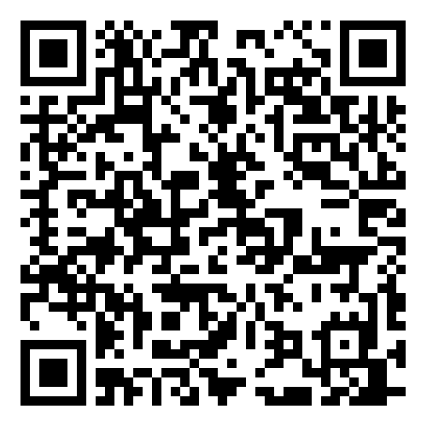
Synchro Templates
Synchro Templates are available for alternative intersection types in the FDOT webpage
  Bowtie
  Continuous Green T-Section
  Displaced Left-Turn
  Diverging Diamond
  Jughandle
  Median U-Turn
  Quadrant Roadway
  Restricted Crossing U-Turn
  Thru-Cut

Slide 17
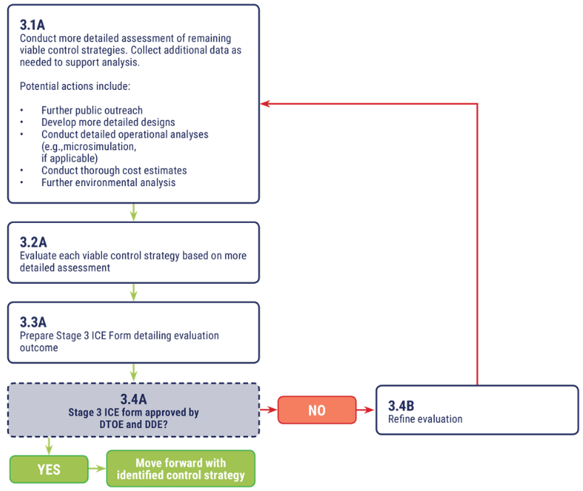
Stage 3: Supplemental Analysis
No additional tools
Conduct more in-depth analysis and/or public vetting
  Advancement of design plans
  More detailed traffic analysis
  More detailed cost estimation and ROW need determination
  Additional assessment of environmental impacts
  Additional engagement with the public or local officials
  Additional engagement with road users

Slide 18









Benefits of ICE
Integration of Safety into decision making
Data- driven process
Flexible and Scalable procedures
Consistent documentation
Increased awareness of innovative intersections
Cost-Effective Solutions

Slide 19
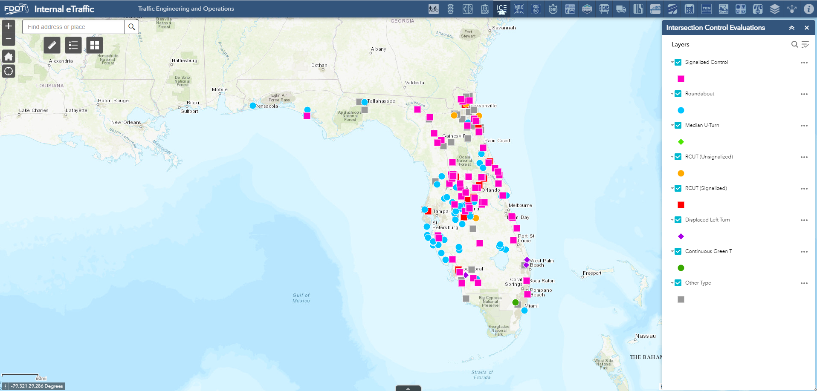
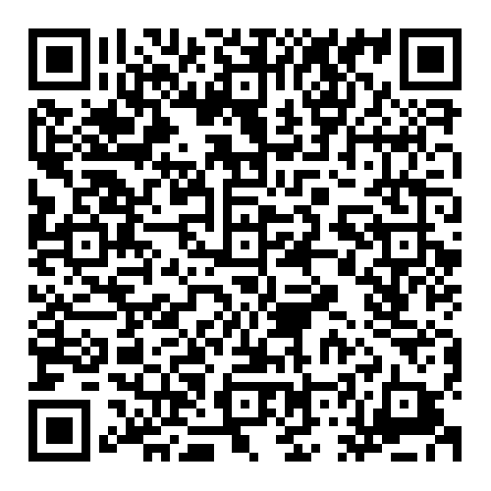
eTraffic
Signalized Control | 66
Roundabout | 74
Median U-Turn (MUT) | 5
Restricted Crossing U-Turn (RCUT) - Signalized | 13
RCUT - Unsignalzied | 4
Dispalced Left Turn (DLT) | 8
Continuous Green T | 1
Other | 55

Slide 20
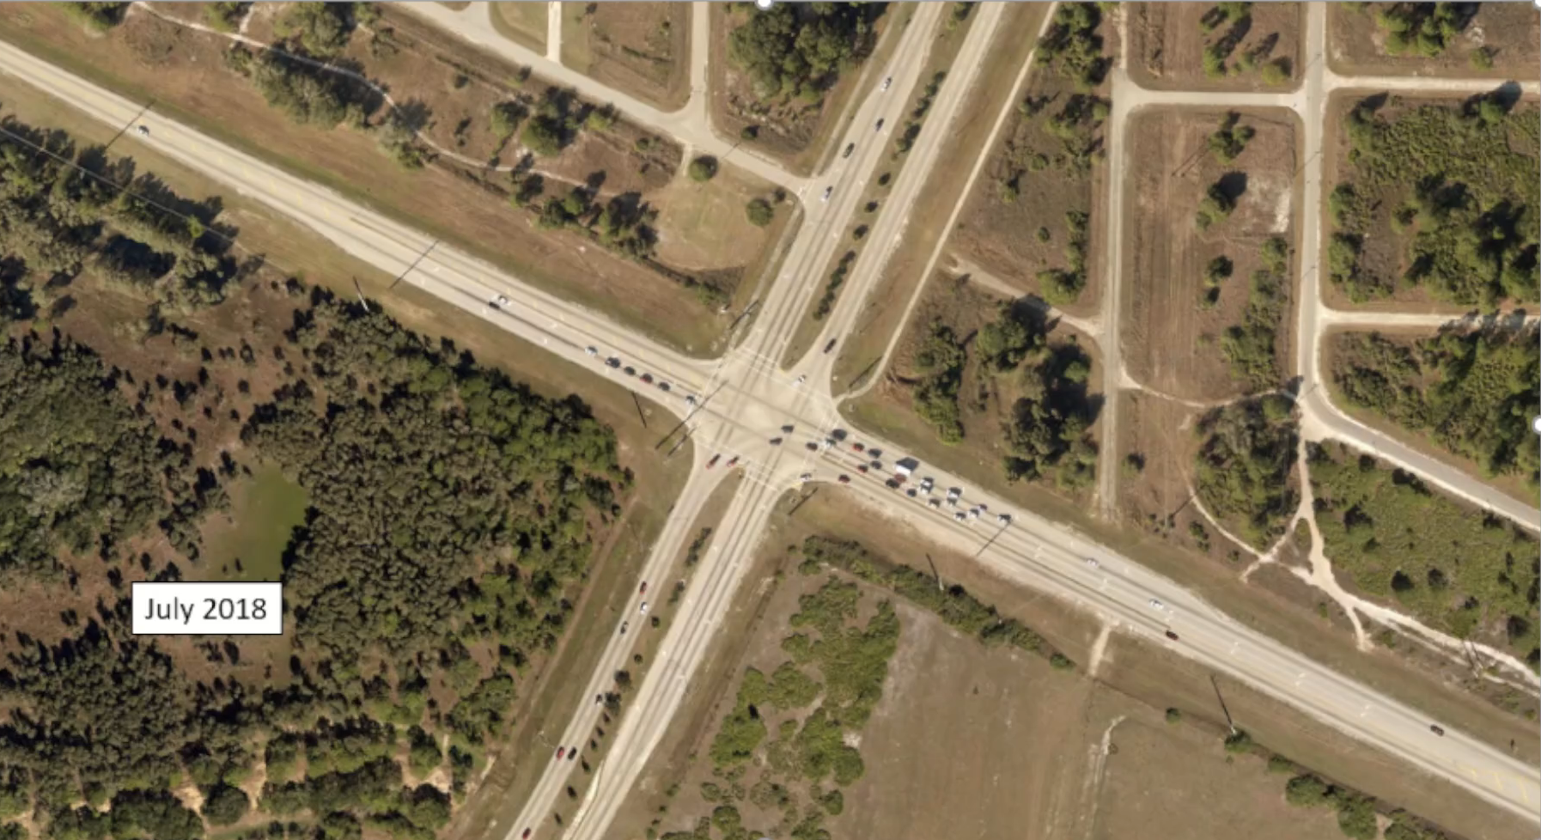
Implementation - Displaced Left Turn (DLT)
    District 1
    Lee County
    SR 82 and
    Daniels Parkway

Slide 21
What are We Currently Working On?
Multimodal ped and multimodal bike analyses for 3-leg intersections
Revision of default values in the multimodal ped and bike analysis
Add Traffic Signal (Alt) as an alternative in CAP-X (current present in SPICE and ICE spreadsheets)
Add analysis methods in SSI and CAP-X for remaining ramp terminal intersection
Investigate new CMFs to differentiate between PDLT and DLT and between PMUT and MUT in SPICE

Slide 22

Safety Message

Slide 23

Contact Info
Dibakar Saha, PhD, PE, PTOE, RSP2I
Traffic Services Safety Engineer
Traffic Engineering and Operations Office
Dibakar.Saha@dot.state.fl.us
850-410-5417

