Slide 1

FLORIDA LOAD RATING
andrew.devault@dot.state.fl.us
Notes:
1

Slide 2

FDOT safety message: adopt a road rage mantra.
“This too shall pass” or
“That vehicle too shall pass”
Notes:
2
AAA estimates road rage is a factor in up to 56% of fatal accidents.
That most of us, at one time or another, to one degree or another, have engaged in aggressive driving.
So adopt a quelling mantra like these, or make up your own

Slide 3
Load rating analysis approximates safe carrying capacity for bridges, establishes posting restrictions, and estimates strength for permit routing. Such analysis directly supports the Department’s Mission, to “… provide a safe transportation system that ensures the mobility of people and goods, enhances economic prosperity, and preserves the quality of our environment and communities.”
load rating - definition
Notes:
3

Slide 4
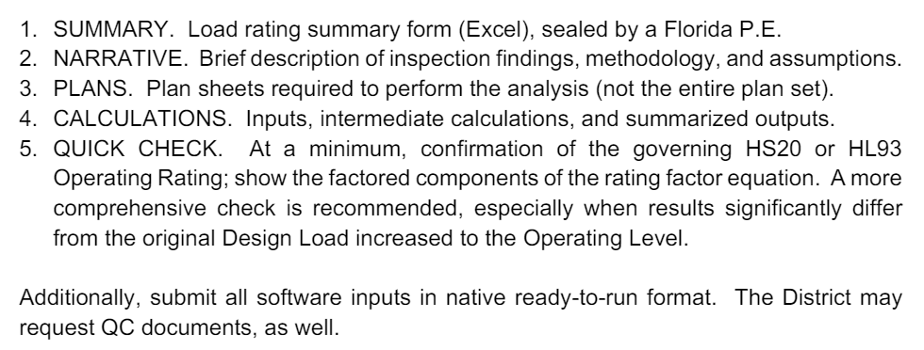
load rating - complete
Notes:
4

Slide 5
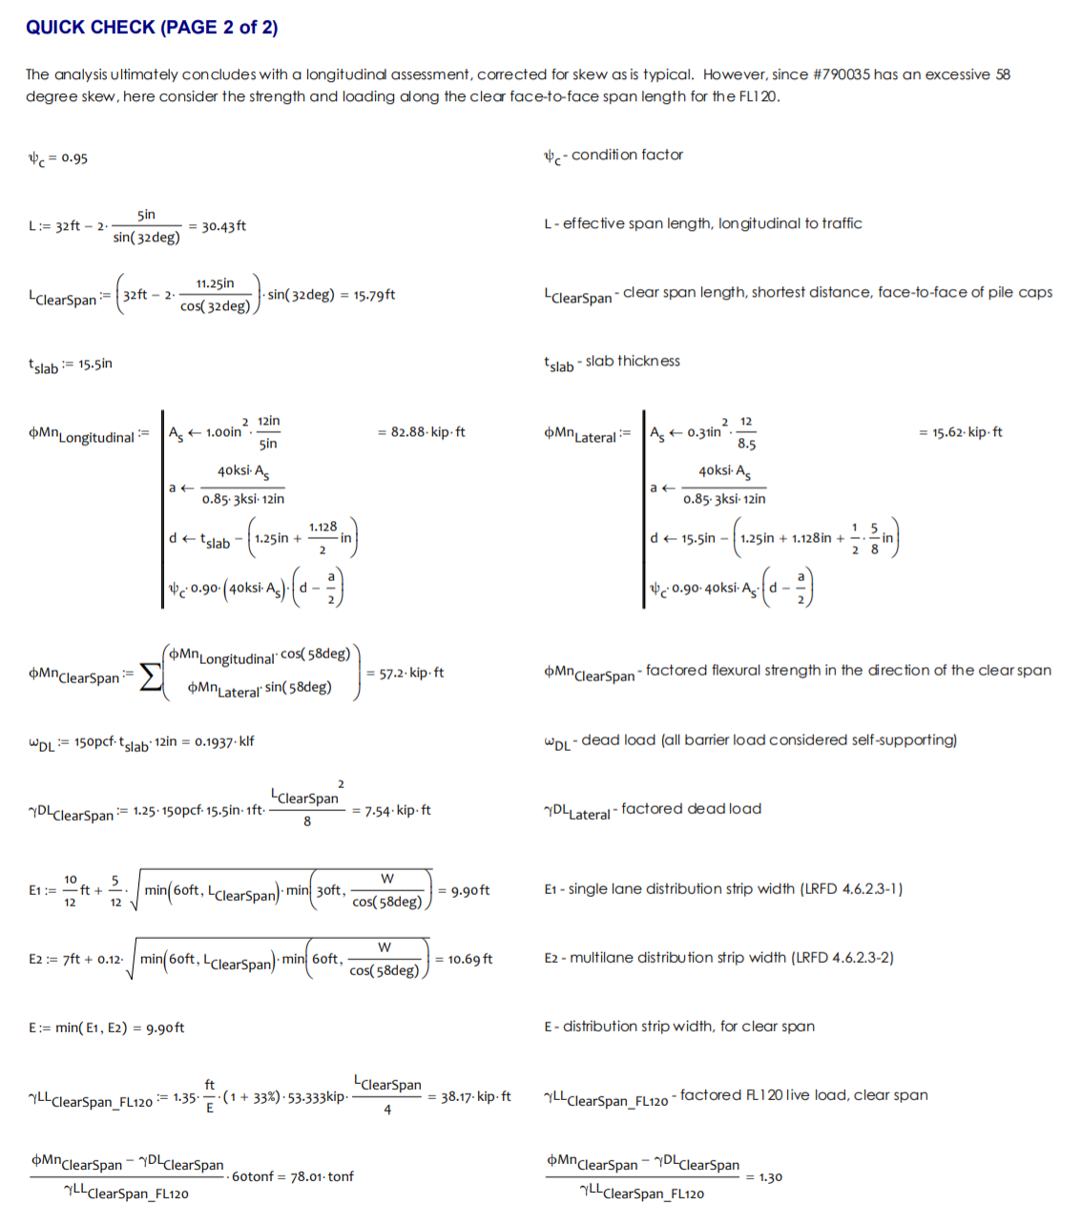
example
Notes:
5

Slide 6
  history
  inventory
  rationale
  BrR
  tips
Notes:
6

Slide 7
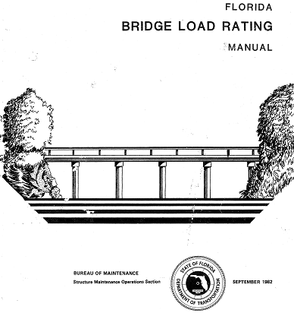

HISTORY
Notes:
7

Slide 8
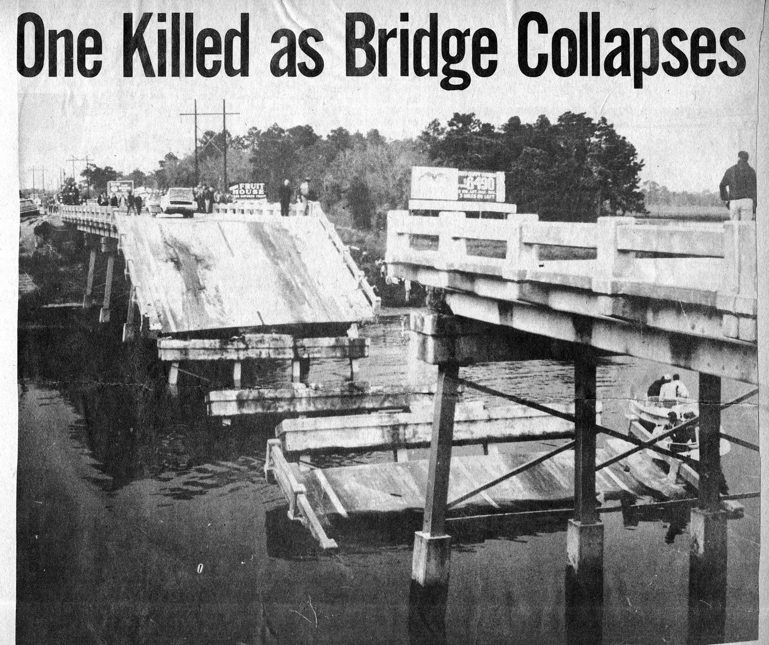
12-07-1968
US19 NB over Anclote River
Notes:
8
US19 NB - ANCLOTE RIVER
12-07-1968

Slide 9
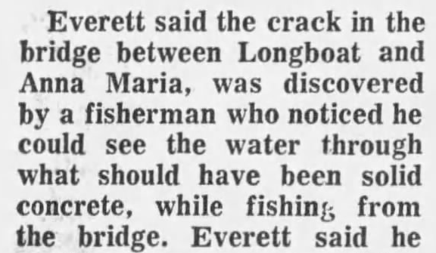
01-08-1969
Longboat Key
Notes:
9

Slide 10
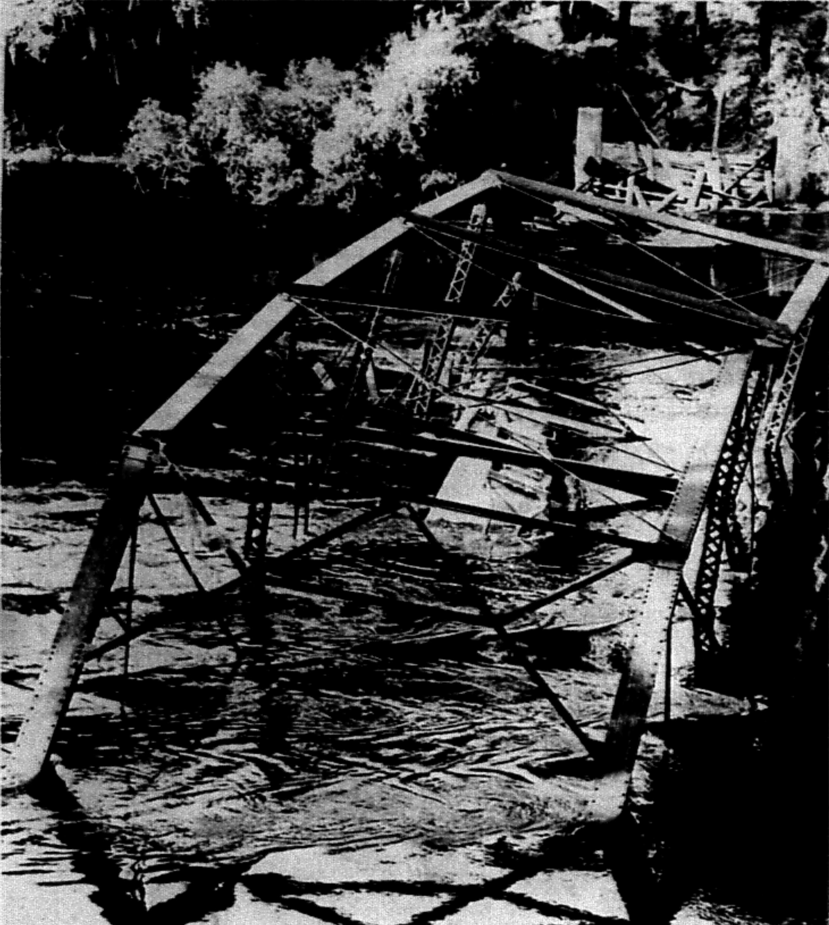
09-05-1969
Nobles Ferry - Suwannee River
Notes:
10

Slide 11
1967 Silver River
1968 Federal Highway Act compels bridge inspection
1968 US19 over Anclote River, corrosion
1969 Longboat Key, pile cap shift
1969 Noble’s Ferry over Suwannee, overload
1971 National Bridge Inspection, Federal Aid System
1978 NBI, all public bridges over 20 feet in length
Florida funded an inspection and repair program
Notes:
11
At the genesis of the bridge inspection program, Florida bridge failures coincided with national bridge failures.
Thereafter, maintenance and repair funding, at least for State bridges, was not an afterthought.

Slide 12
INVENTORY
Notes:
12

Slide 13
material
Notes:
13

Slide 14
built
Notes:
14

Slide 15
rating year
Notes:
15

Slide 16

SELECT SUM(CASE WHEN ROADWAY.ON_UNDER='1' THEN
ADTTOTAL*TRUCKPCT/100*365
ELSE 0 END) As 'Annual_Truck_Crossings'
FROM dbo.BRIDGE BRIDGE, dbo.ROADWAY ROADWAY
WHERE (BRIDGE.BRKEY = ROADWAY.BRKEY AND BRIDGE.BRKEY Not Like '%Q%' AND ROADWAY.ON_UNDER='1' AND BRIDGE.SERVTYPON IN ('1','4','5','6','7','8') AND BRIDGE.DISTRICT<>'09')
1/10 penny per
truck crossing
is 9.6 million per year
8.6 billion
truck crossings per year
Notes:
16
What’s it worth?
What’s it do?

Slide 17
RATIONALE
load rating – why do it?
Notes:
17
condition, posting, & permits

Slide 18
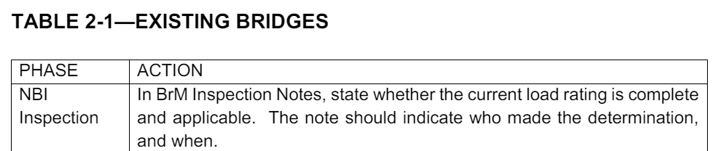
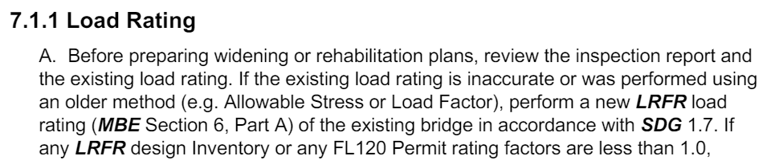
TRIGGERS
    condition – inspections/widenings/rehabs
    posting
    permits, inferred ratings
Notes:
18
This is what triggers a load rating –
INSPECTIONS – age of rating, conditions, or posting
WIDENING/REHAPS – whether the bridge is sufficiently strong to reinvest?
For widening/rehab, Design wants an Inventory Rating, while Maintenance wants an Operating Rating.
LFR/LRFR, 60 tons Operating/Permit HS20/FL120 is the requirement. It that’s true, the Inventory rating will be fine.
OVERLOADS – while these typically do not induce a new load rating, many thousands of rating factor inferences are made every day, based upon the existing load rating inventory

Slide 19
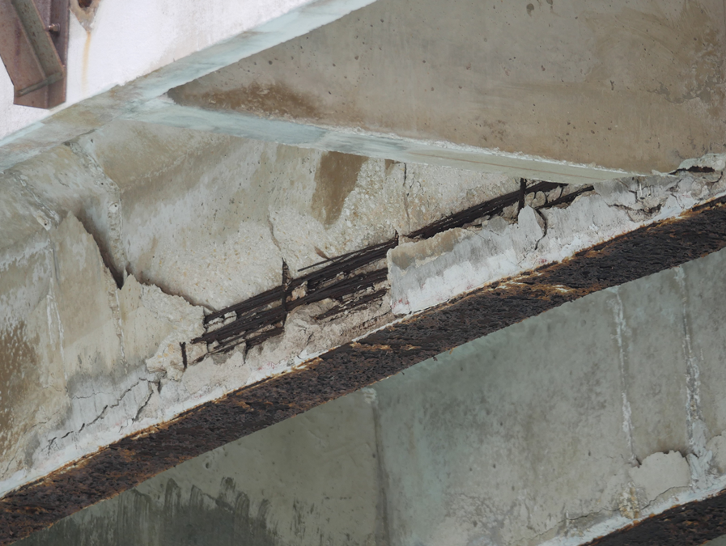
CONDITION
law, repairs, operations
Notes:
19
It’s the law. CFR requires NBI inspection for all public bridges, and NBI requires load ratings.
Capacity informs how a bridge can operate, indicates health, and people pay attention.

Slide 20
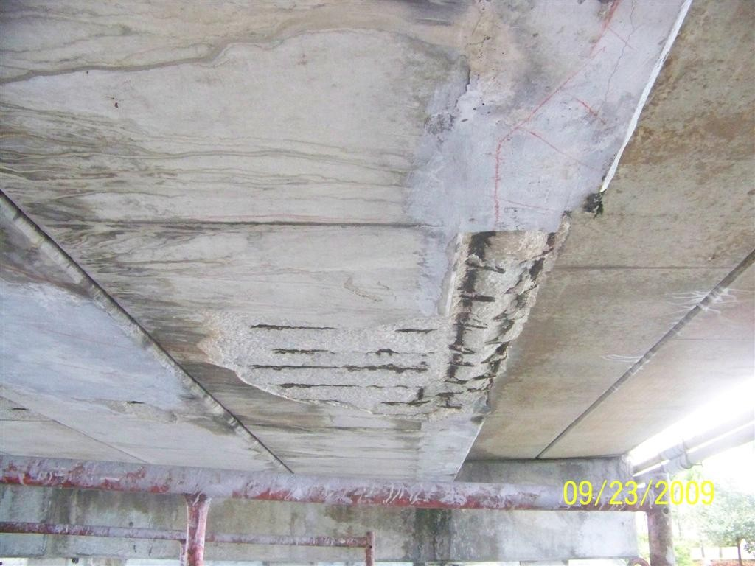
CONDITION
Notes:
20
This bridge cannot widened.
If it’s State it will be repaired. If it’s local the Owners will make a determination.
But regardless, a load rating will say whether it need be posted, and that posting will be public.

Slide 21
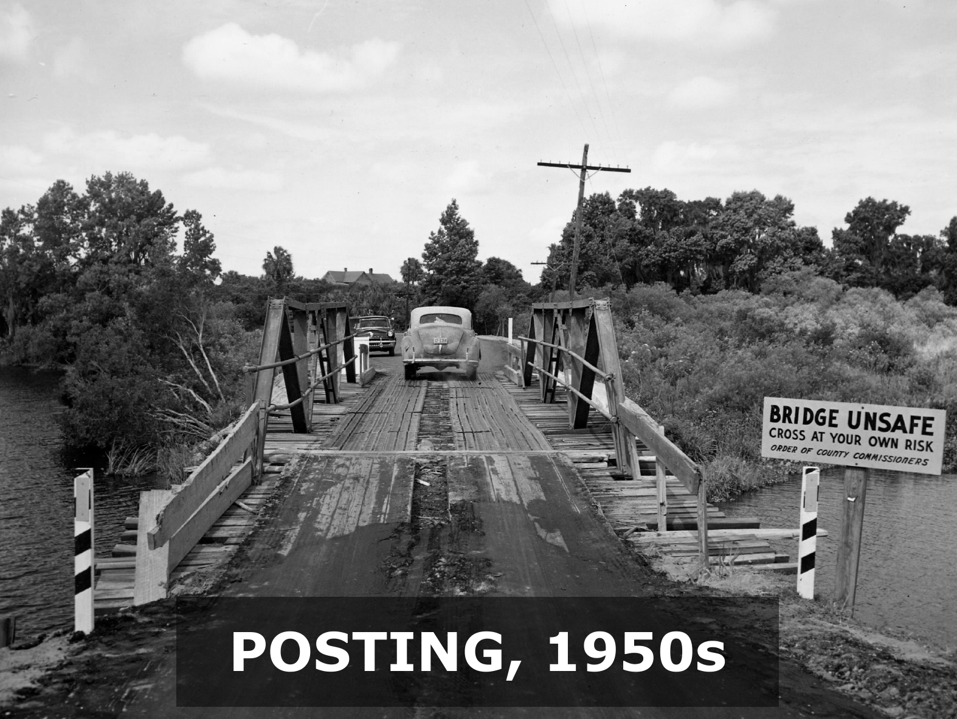
Notes:
21
21
Primitive posting

Slide 22
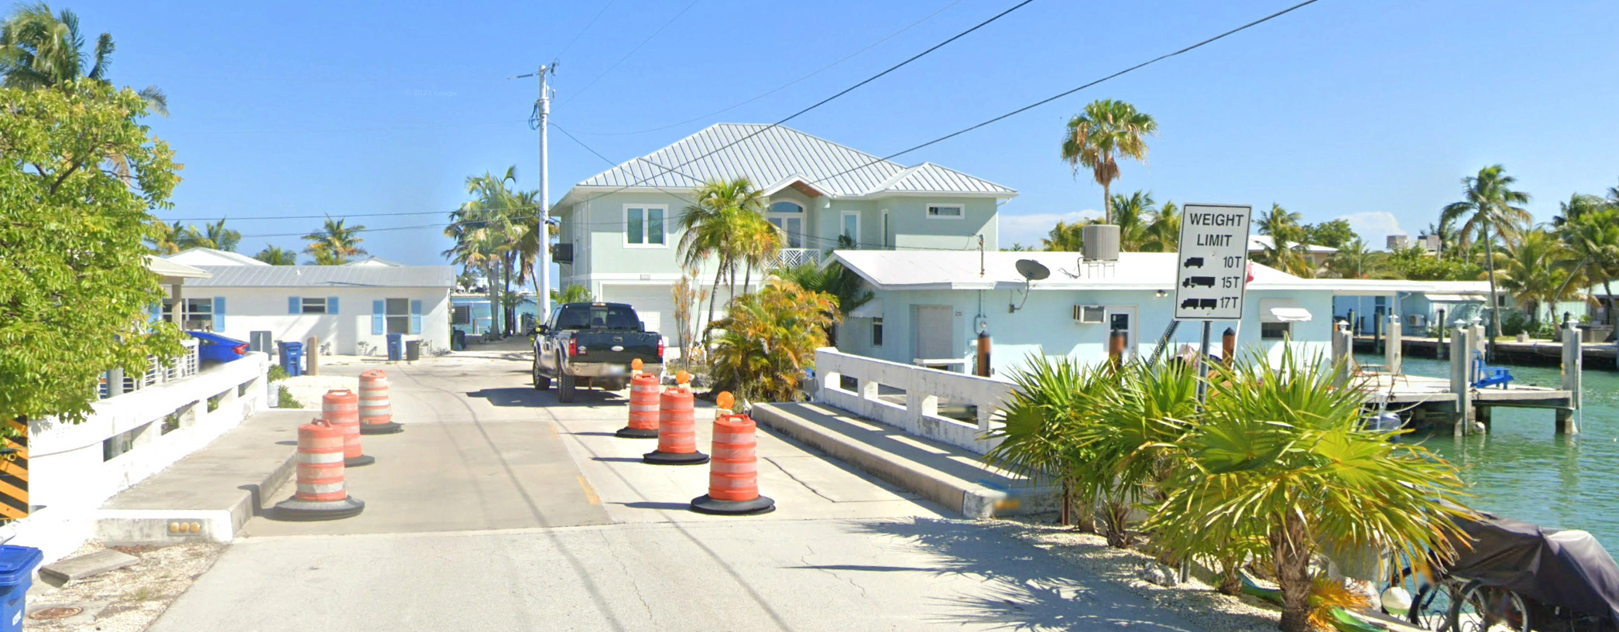
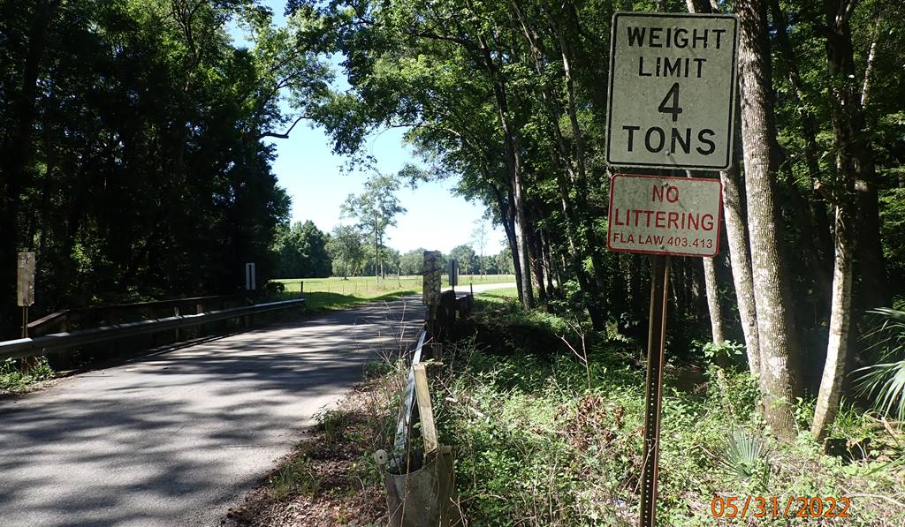
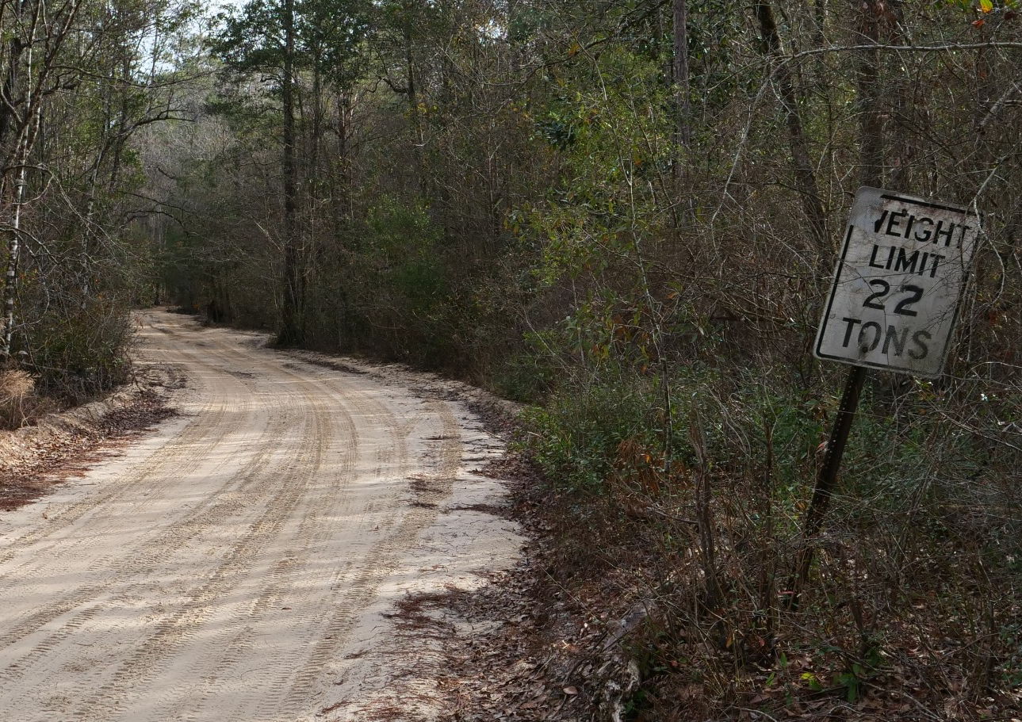
POSTING
Notes:
22
Modern postings.
NC and AL have axle weight postings – arguably a better posting arrangement.
But Florida now posts with a 3-silhouette sign, or a blanket posting, abiding the MUTCD.

Slide 23
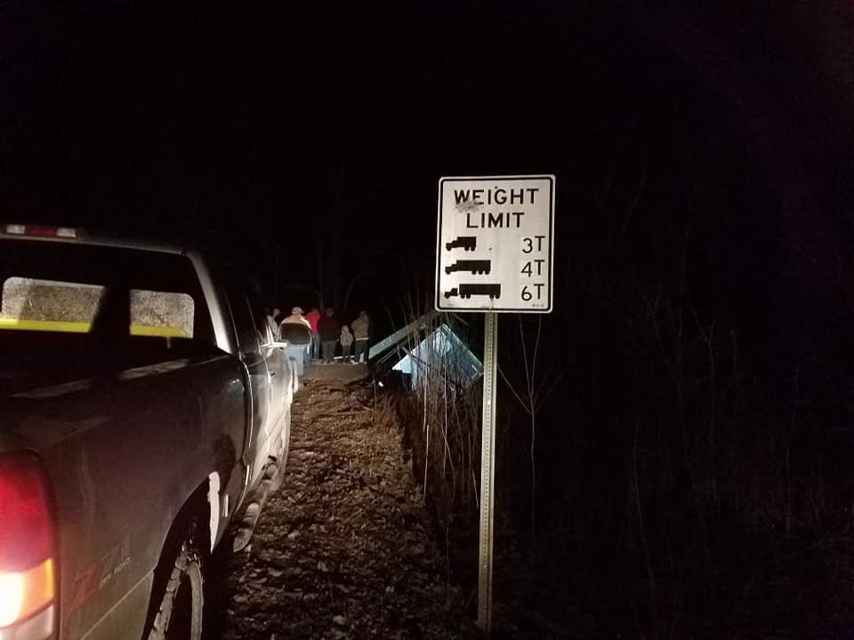
Notes:
23
Dale Bend Road over Pett Jean River, Yell County AR USA (01-30-2019)
IGNORED THE SIGN

Slide 24
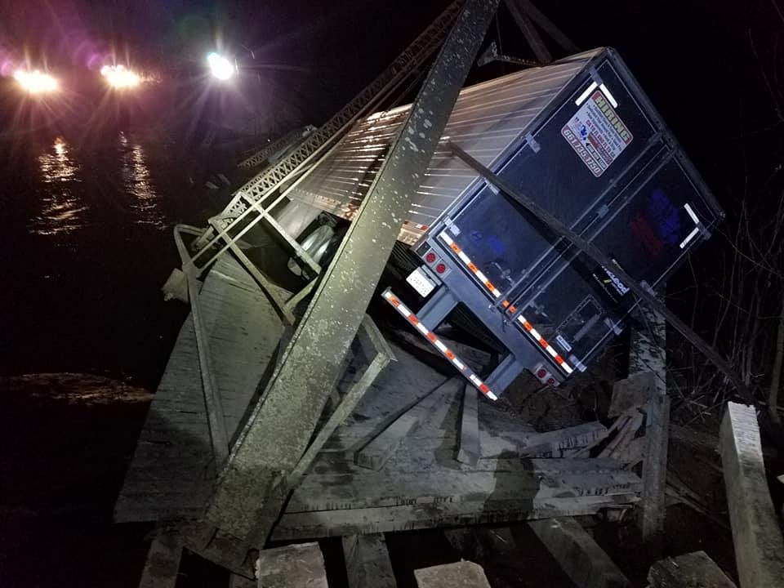
Notes:
24
Dale Bend Road over Pett Jean River, Yell County AR USA (01-30-2019) a

Slide 25
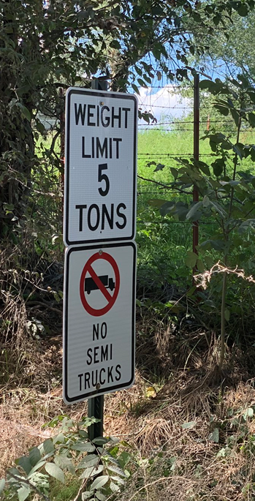
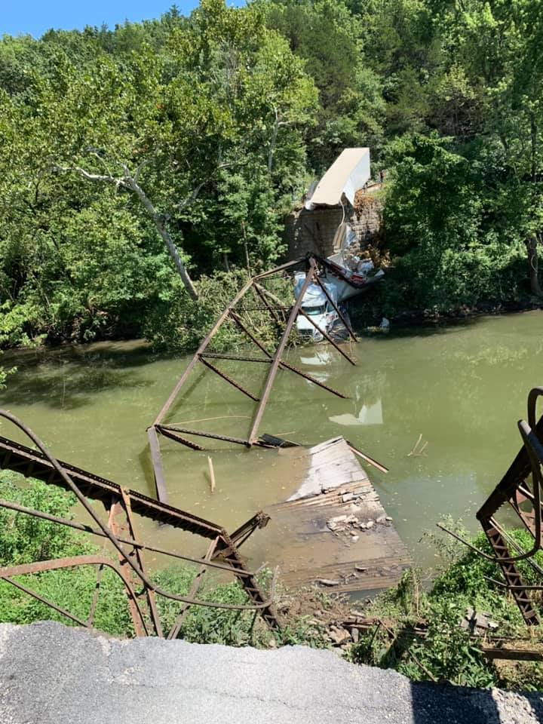
Notes:
25
(2020 08-17) Pentecostal_Bridge_Maries_River_Westphalia
IGNORED THE SIGN

Slide 26
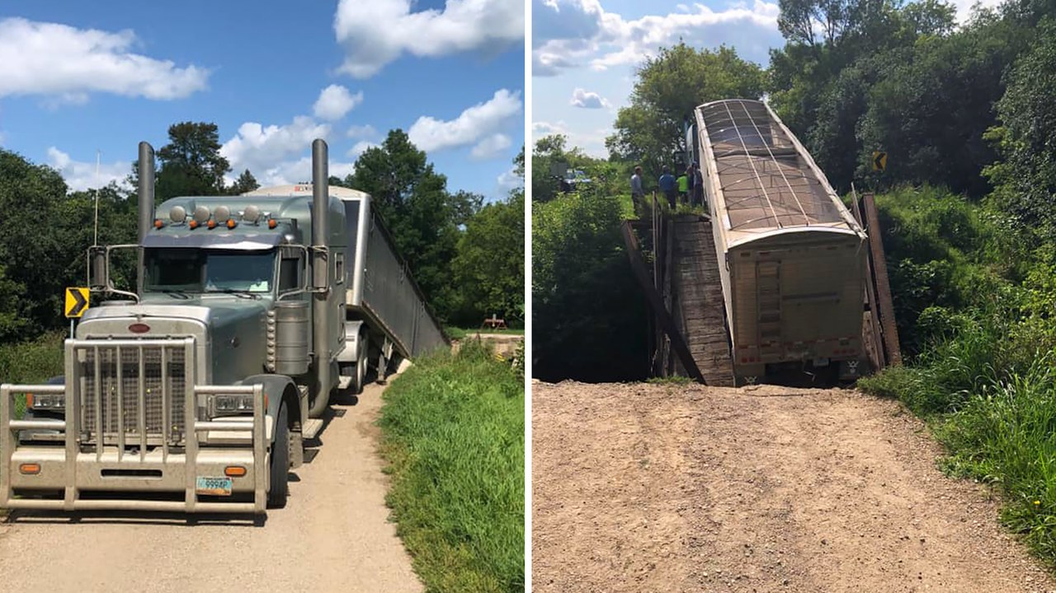
Notes:
26
https://www.google.com/maps/place/Northwood,+ND+58267/@47.7174266,-97.6085307,551
Goose River Bridge ND USA (2019 07-22)
IGNORED THE SIGN. GPS MADE ME DO IT.

Slide 27
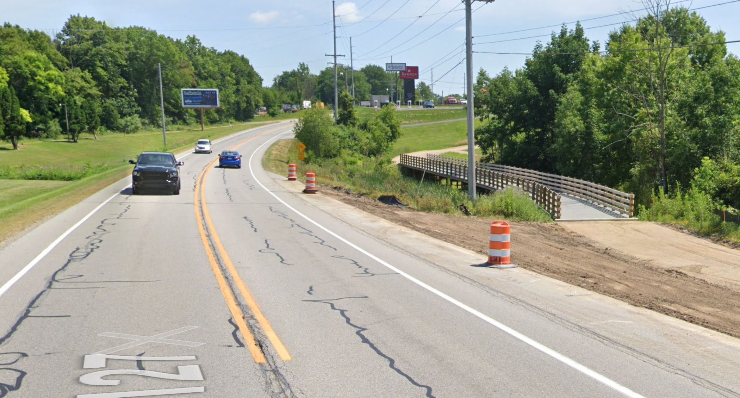
Notes:
27
Trail S.R. 127 near C.R. 400 North 5 mi North of Angola IN (November 2021)
GPS MADE ME DO IT

Slide 28
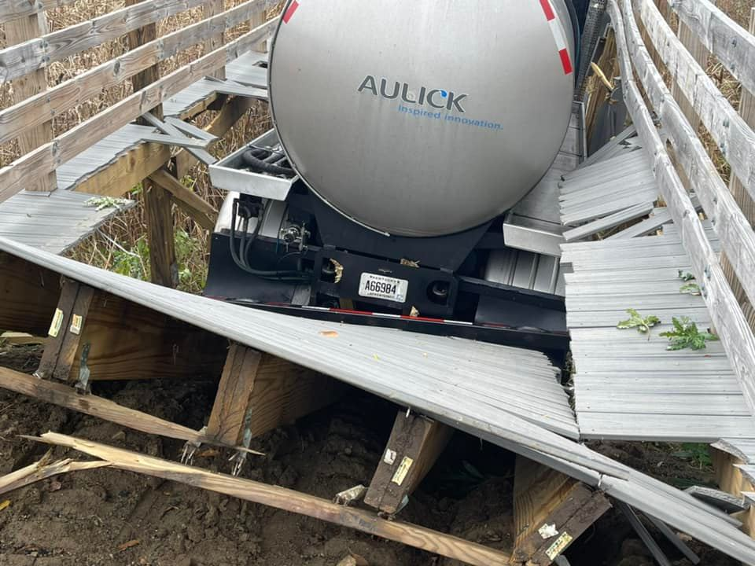
Notes:
28
Dale Bend Road over Pett Jean River, Yell County AR USA (01-30-2019) a

Slide 29
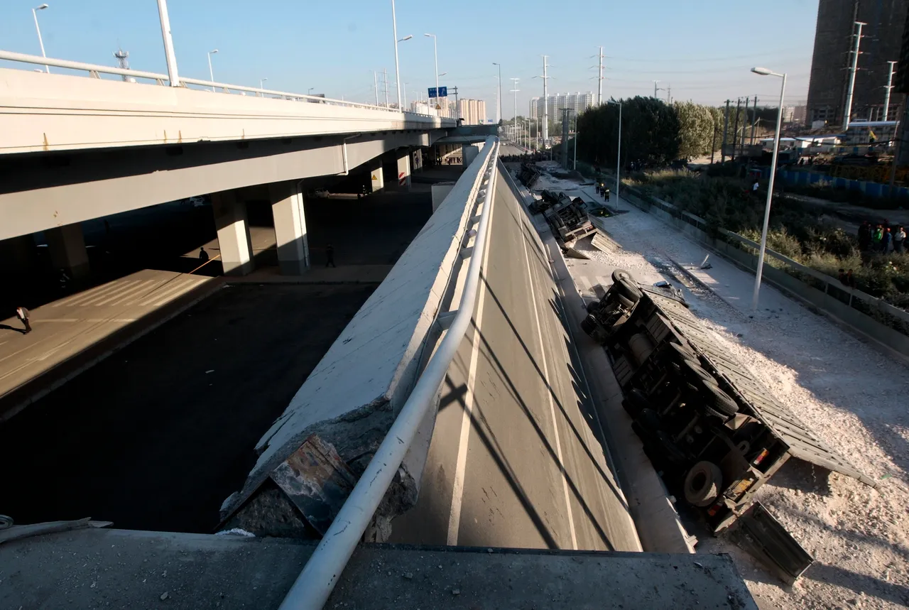
Notes:
29
Ezhou City Hubei Province Overload_(2021 12-19)
PLATOONS, ESP. IN CHINA

Slide 30
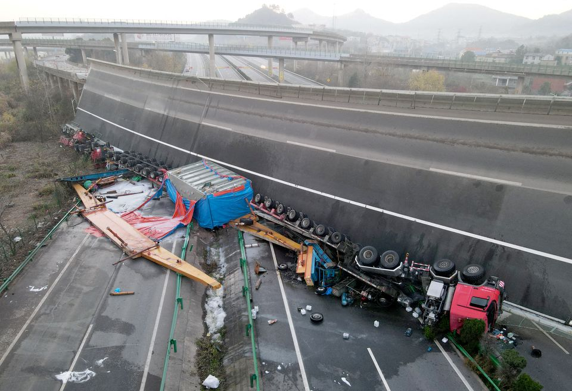
Notes:
30
Ezhou City Hubei Province Overload_(2021 12-19)
OVERLOAD

Slide 31
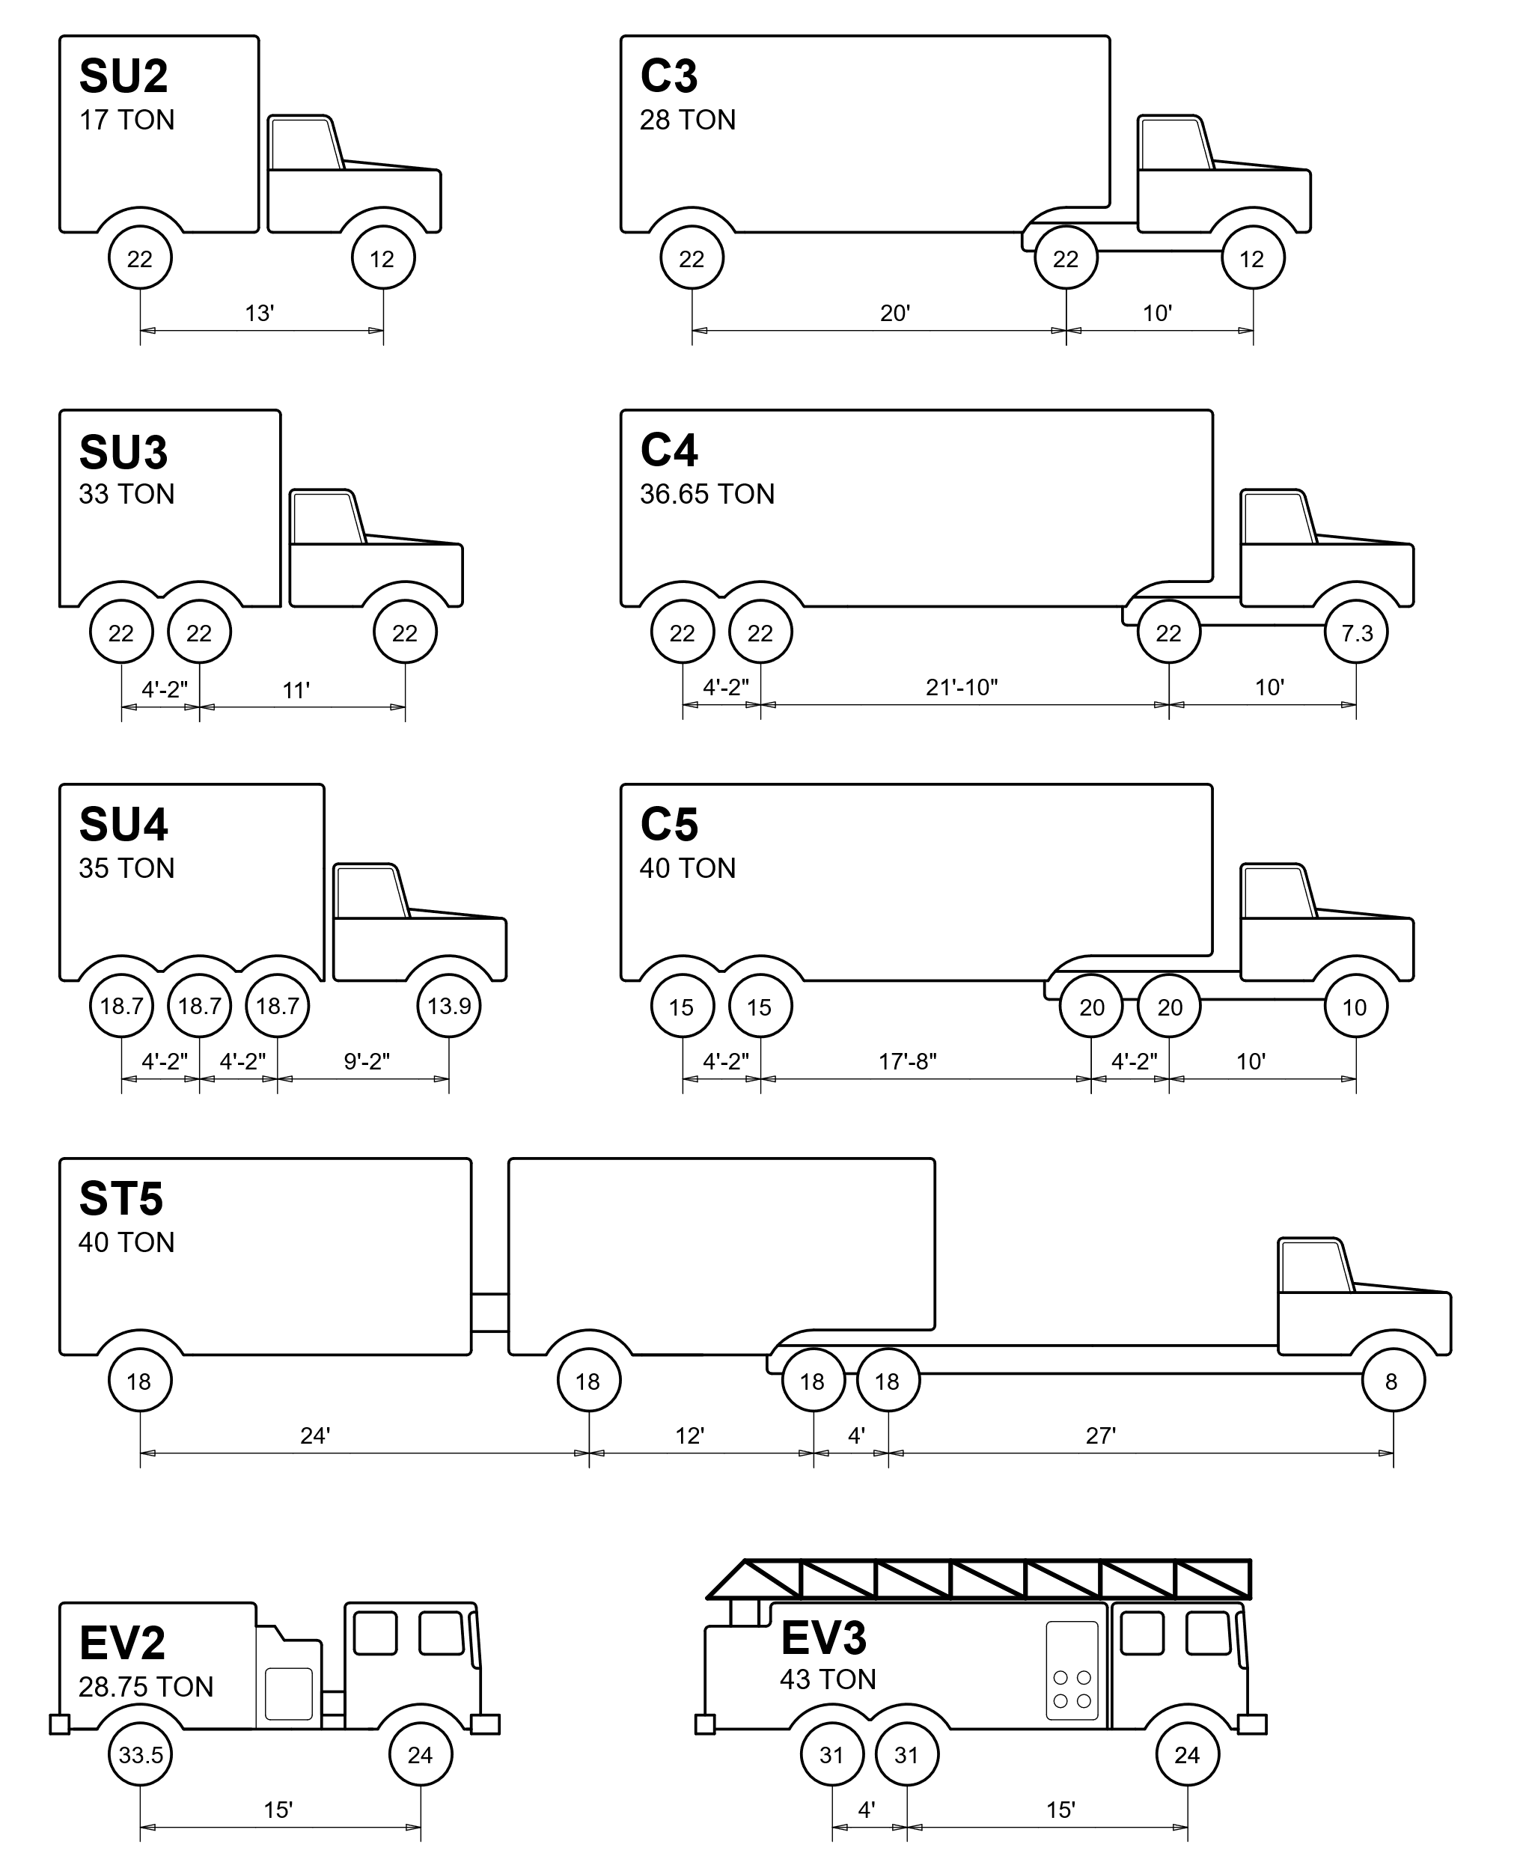
Florida legals
Notes:
31
Florida legals for simple spans.

Slide 32
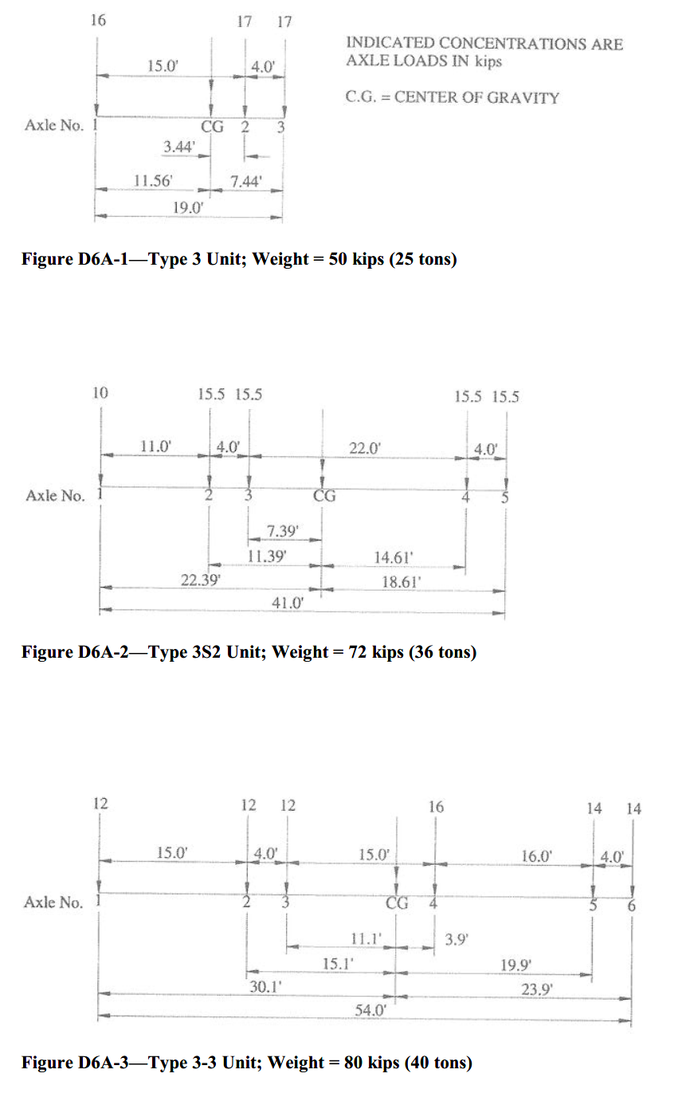
AASHTO
legals
Notes:
32
AASHTO legal trucks are comparatively too light.

Slide 33
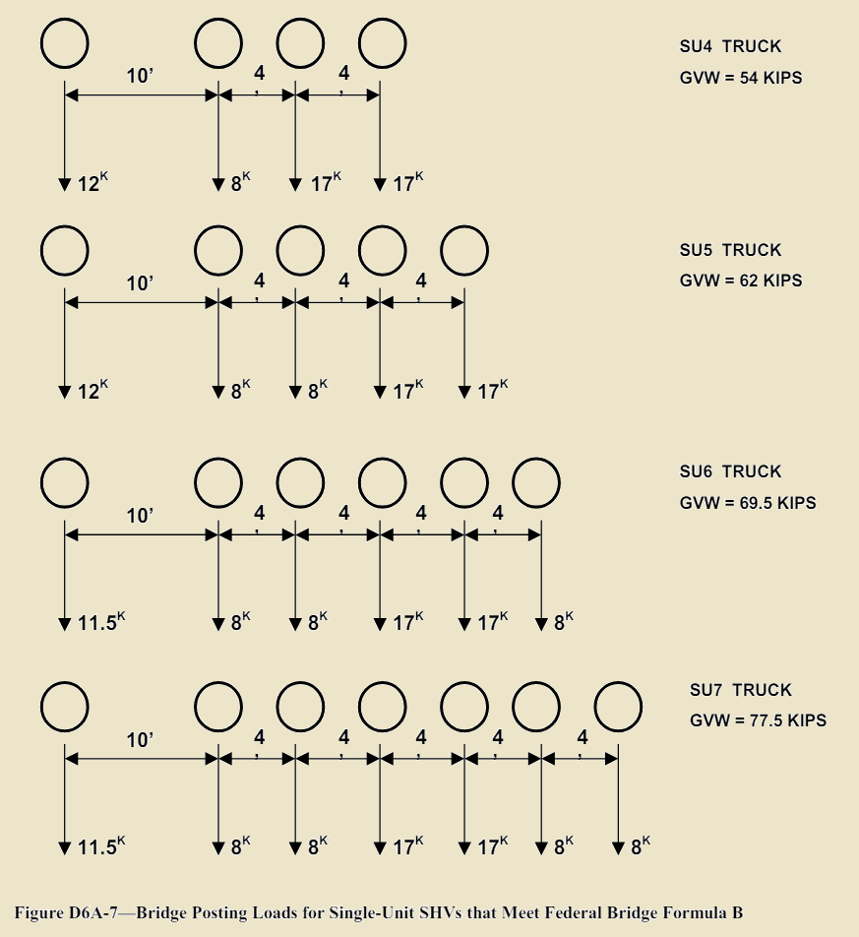
AASHTO
SHVs
Notes:
33
MBE code writers noticed the AASHTO trucks did not envelope longstanding Formula B SHVs, so they added these to catch the code up to the law.

Slide 34
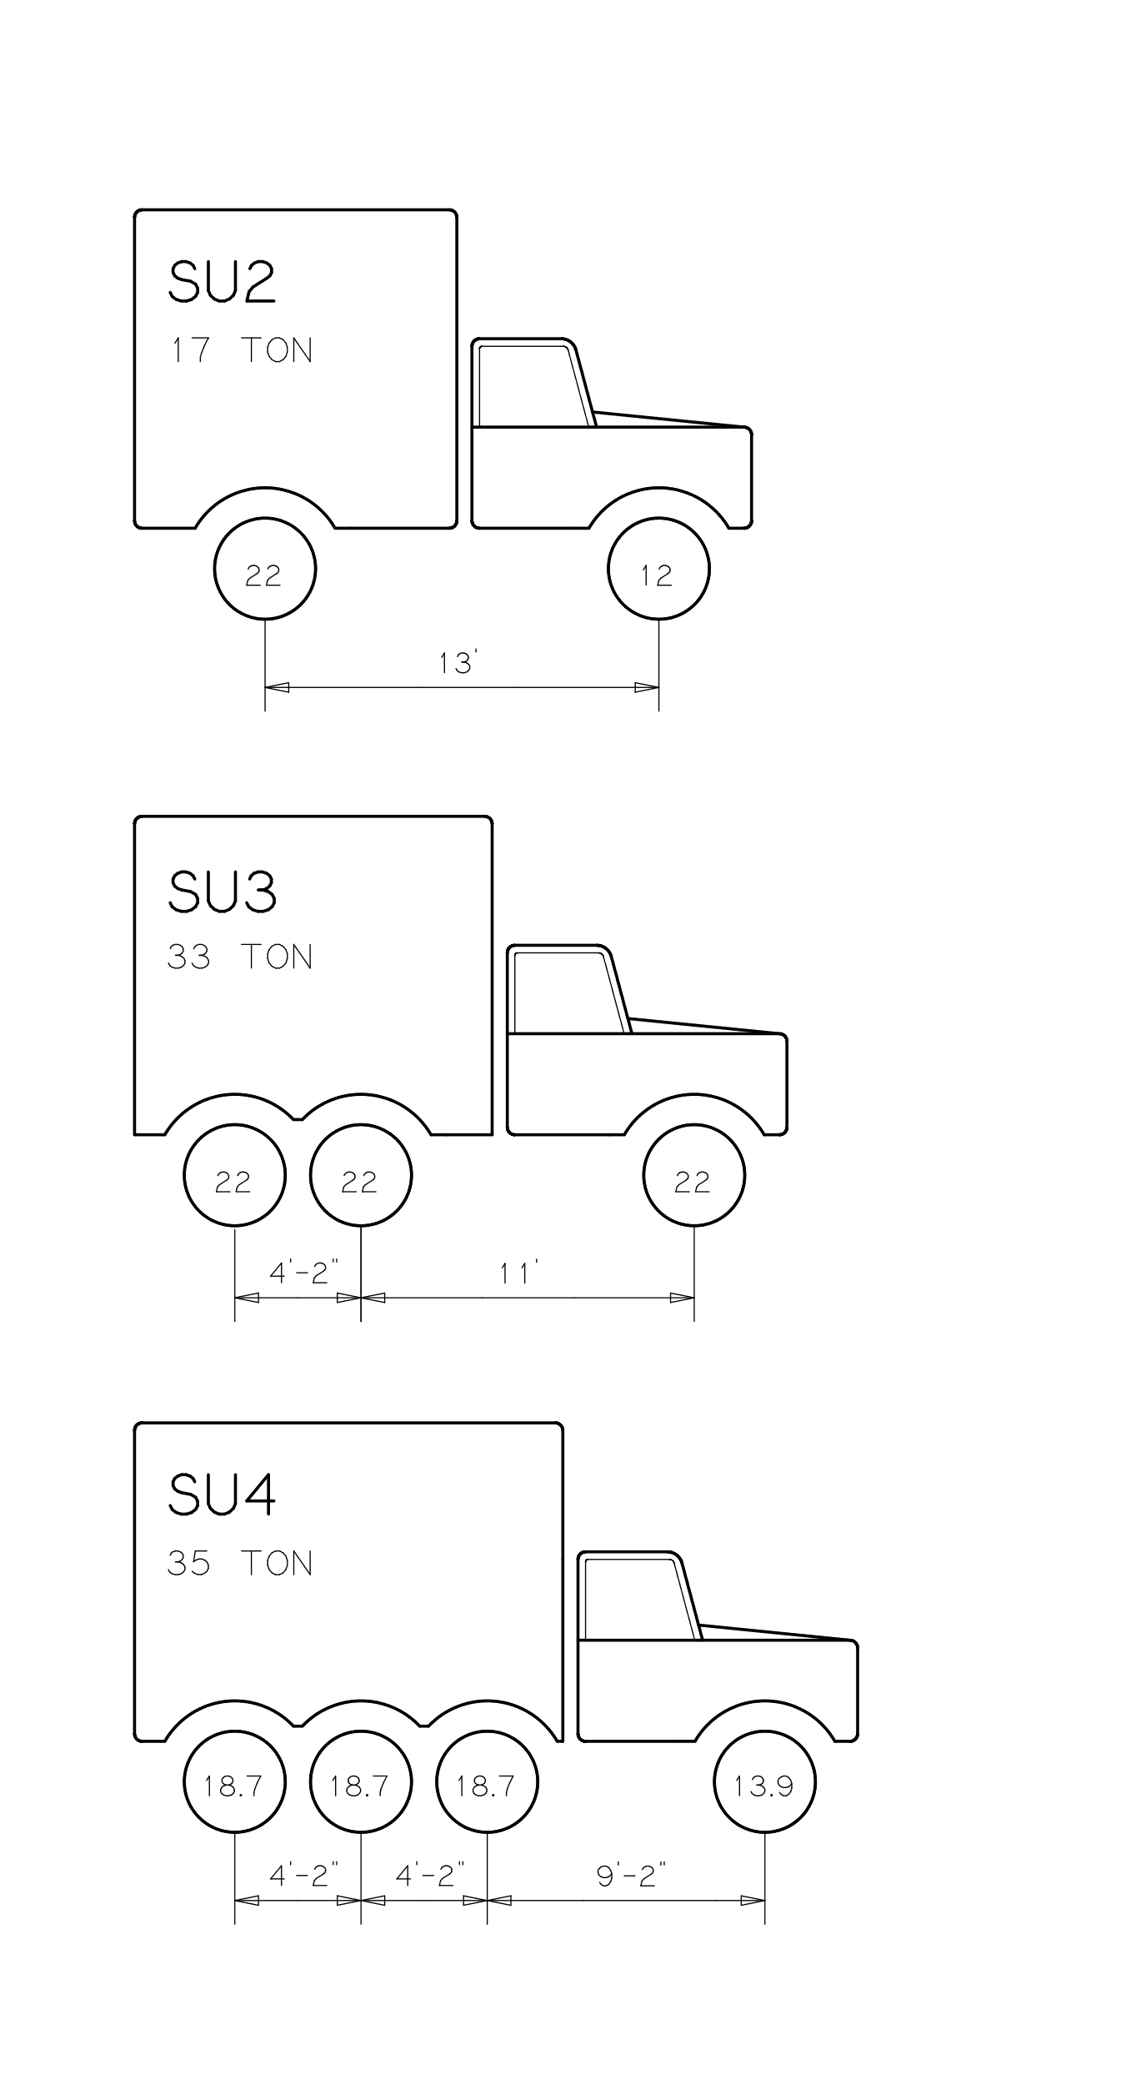
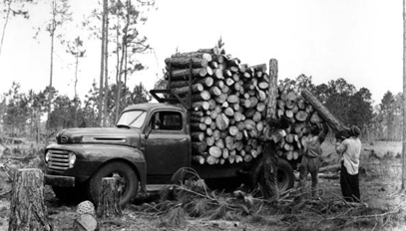
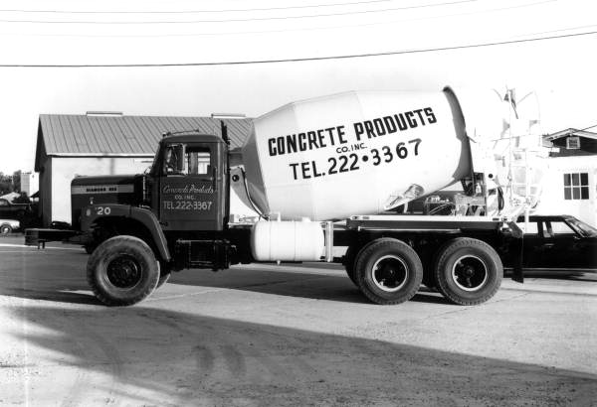
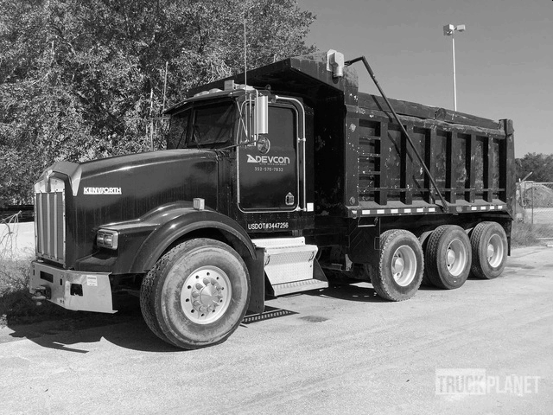
FDOT
SUs
legal trucks
Notes:
34
However Florida SU-SHVs were, like some other Southern States, quite heavy.

Slide 35
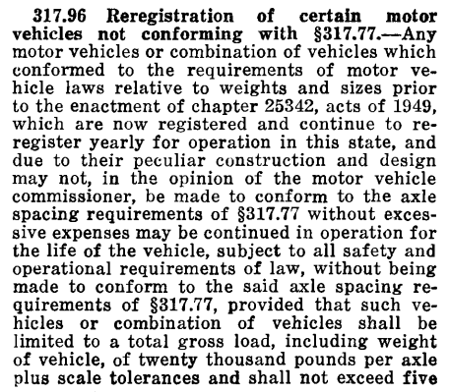
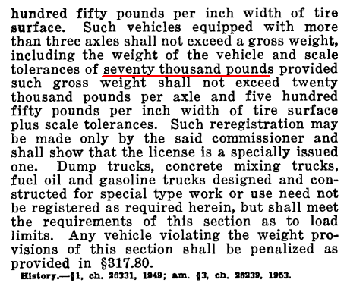
https://library.law.fsu.edu/Digital-Collections/FLStatutes/docs/1961/1961TXXIIC317.pdf
1961
Florida Statutes
Notes:
35
Which came from these statutes that established the Florida SU4

Slide 36
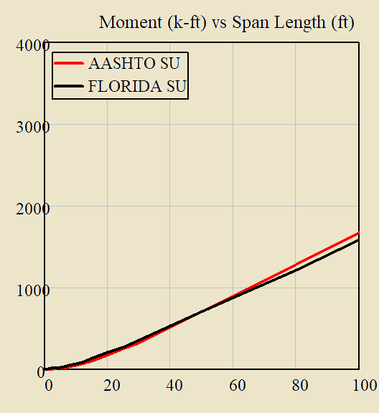
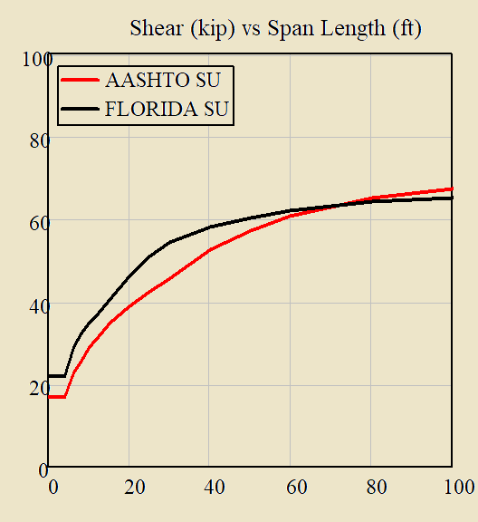
SHVs OK
FDOT vs AASHTO
Notes:
36
Thus, excepting longer spans which seldom approach posting and are limited by the C5,
Florida SHVs envelope AAHSTO SHVs.

Slide 37
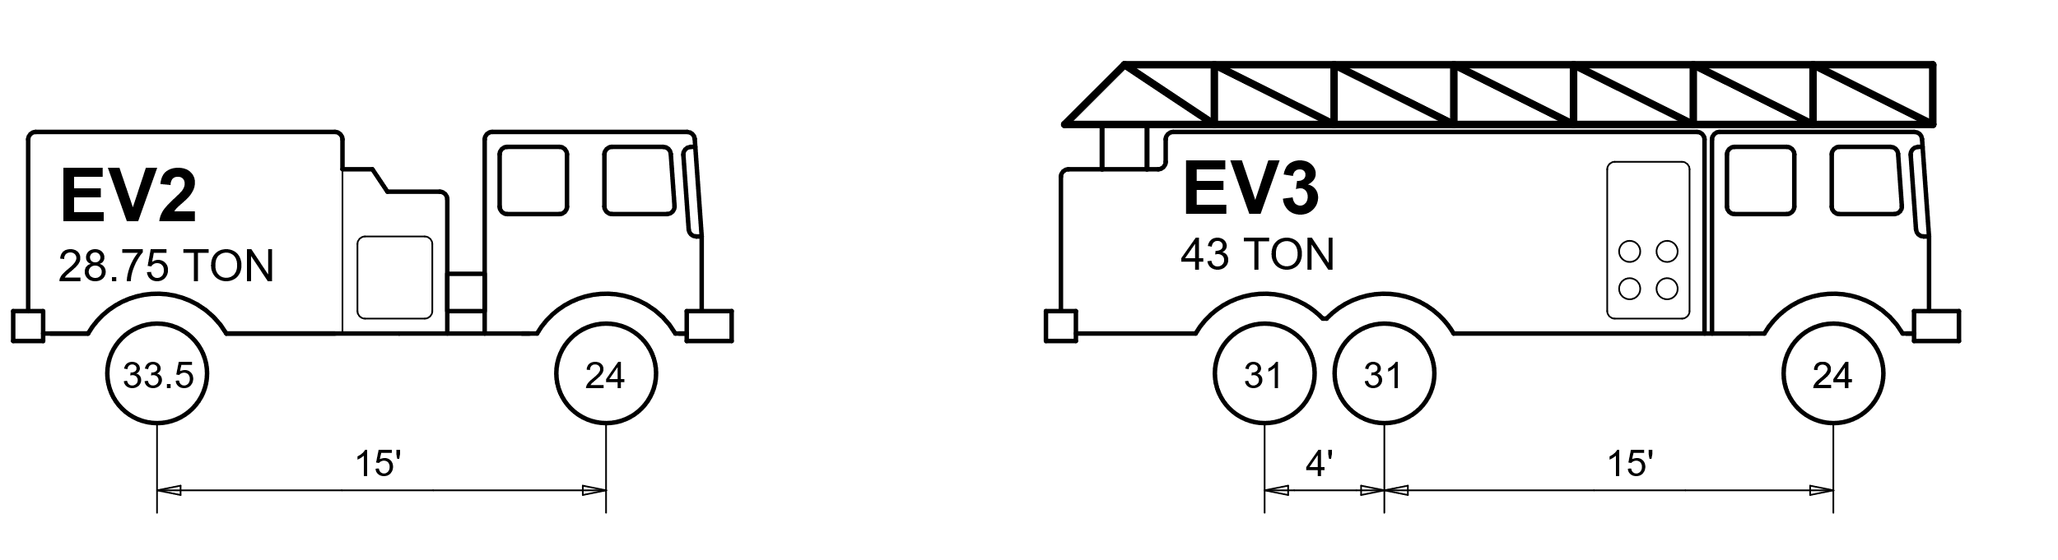
https://www.fdot.gov/maintenance/LoadRating.shtm
Florida Bridge Classification for Emergency Vehicles
EVs
EV > SU4, limited to interstate & 1 mile access
Notes:
37
However the 2018 EVs are much larger than the SUs, so assessments are required.
Still, the EVs are limited to the interstate and 1 mile reasonable access on State roads.

Slide 38
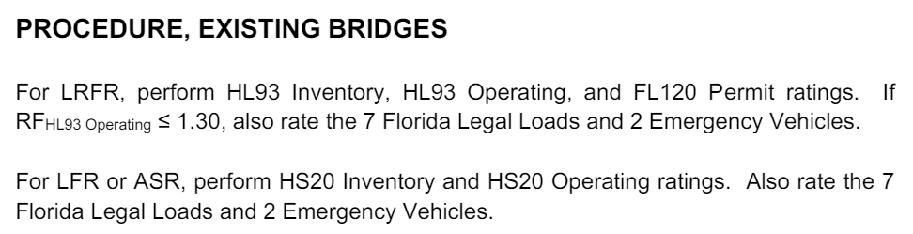
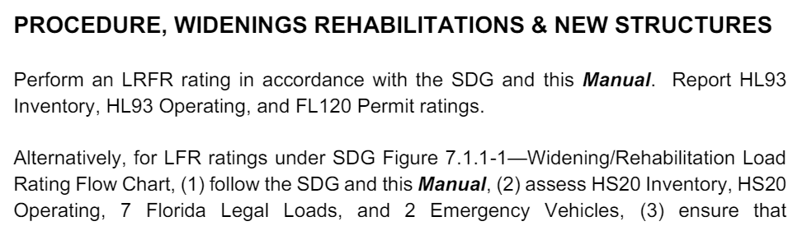
EVs
Notes:
38
Generally, if RF.HL93.Operating > 1.30, no EV assessment is necessary.
Otherwise, assess EVs. Also, avoid posting on the interstate and within 1 mile reasonable access.

Slide 39
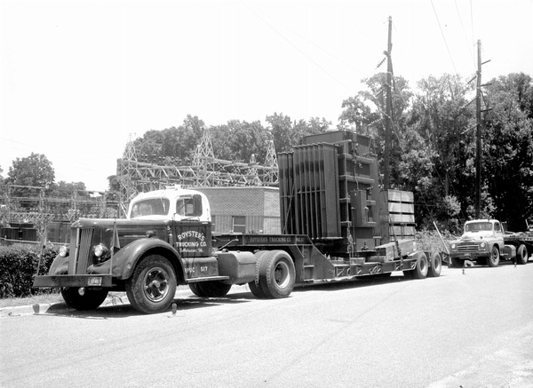
OSOW permits
Notes:
39
Another reason to perform load rating goes unseen – its use to route overload permit vehicles like this one, a transformer, for say air conditioning.

Slide 40
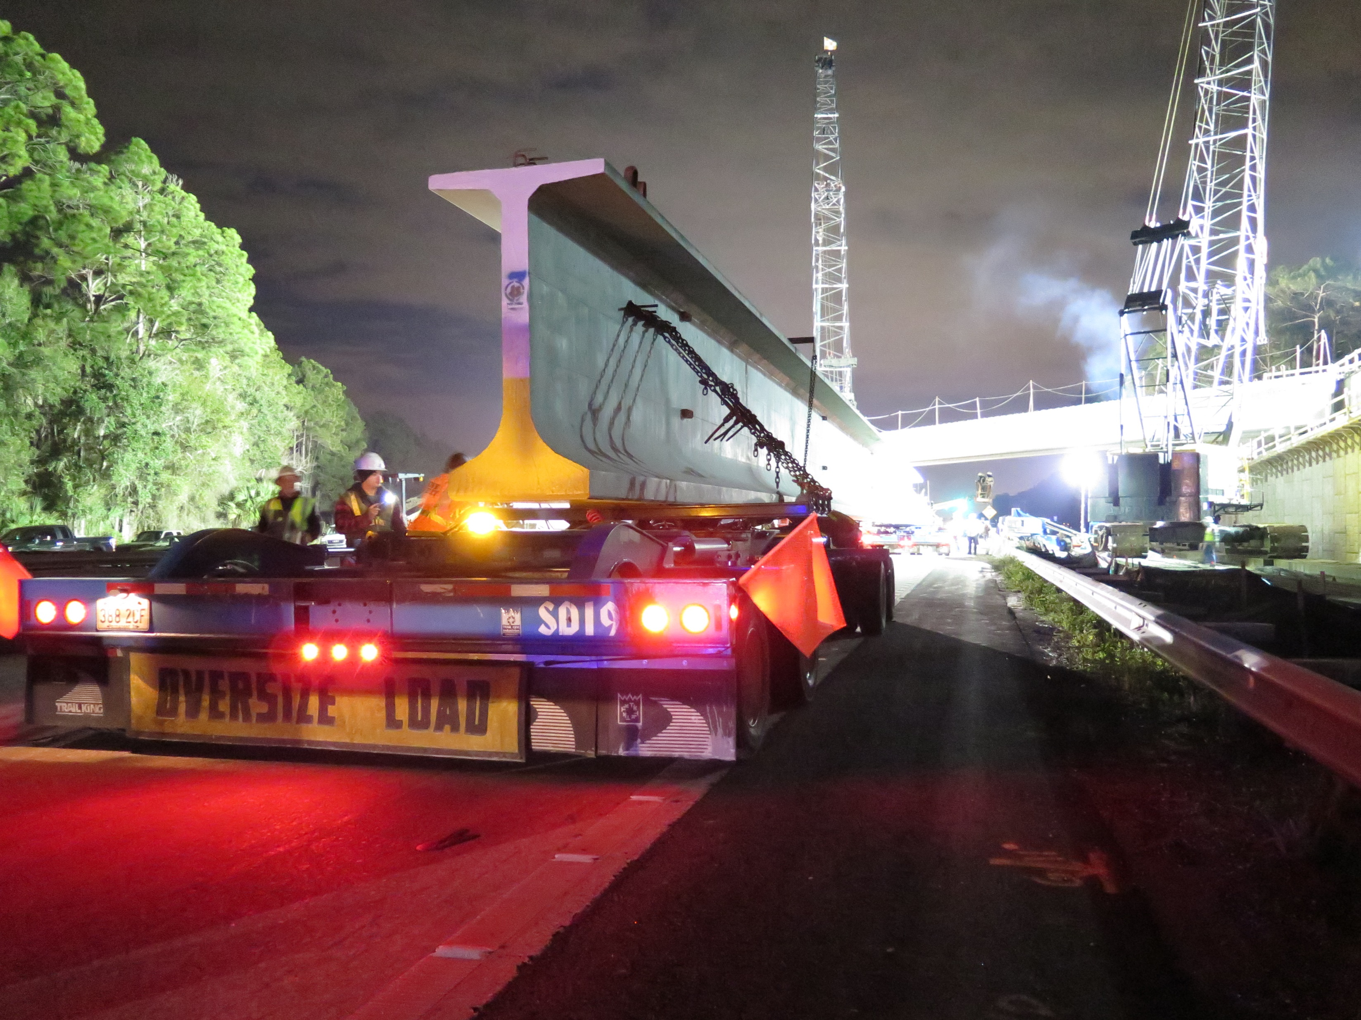
OSOW permits
Notes:
40
And, I never fail to add among designers, the Department load rates bridges for selfish reasons, too – to carry its own piles and beams to its own projects.
And it is necessary to achieve greater-than-legal capacity on main thoroughfares to accommodate overload freight – our own freight.

Slide 41
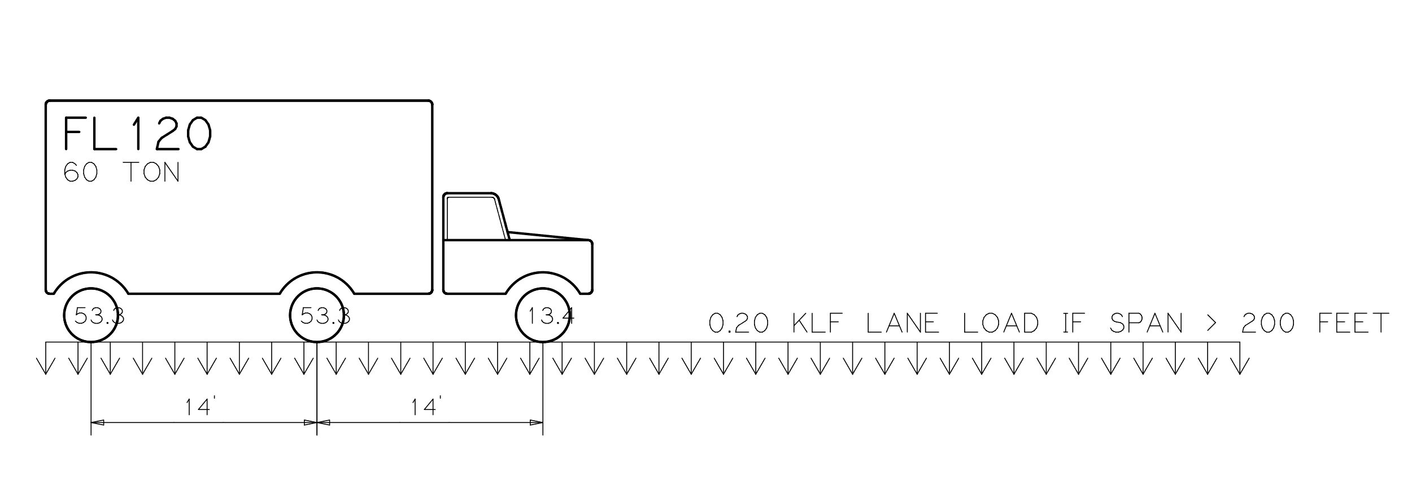
FL120 ~ 2.17/1.30∙HS20
routine permit reference truck
Notes:
41
FDOT uses the FL120 permit as a reference truck.
The FL120 harkens back to the past, It’s similar to the HS20.
If LFR and HS20 Inventory > 1, then HS20 Operating > 1.67, and 1.67*HS20 ~ FL120

Slide 42
1.67∙HS20 w LFR IM
vs
FL120 w LRFR IM
Notes:
42
The FL120 was a segway to the past, but…
Only works for spans 160’ or less
Stepwise at 200 feet.
Awful for LRFR prestress shear.

Slide 43
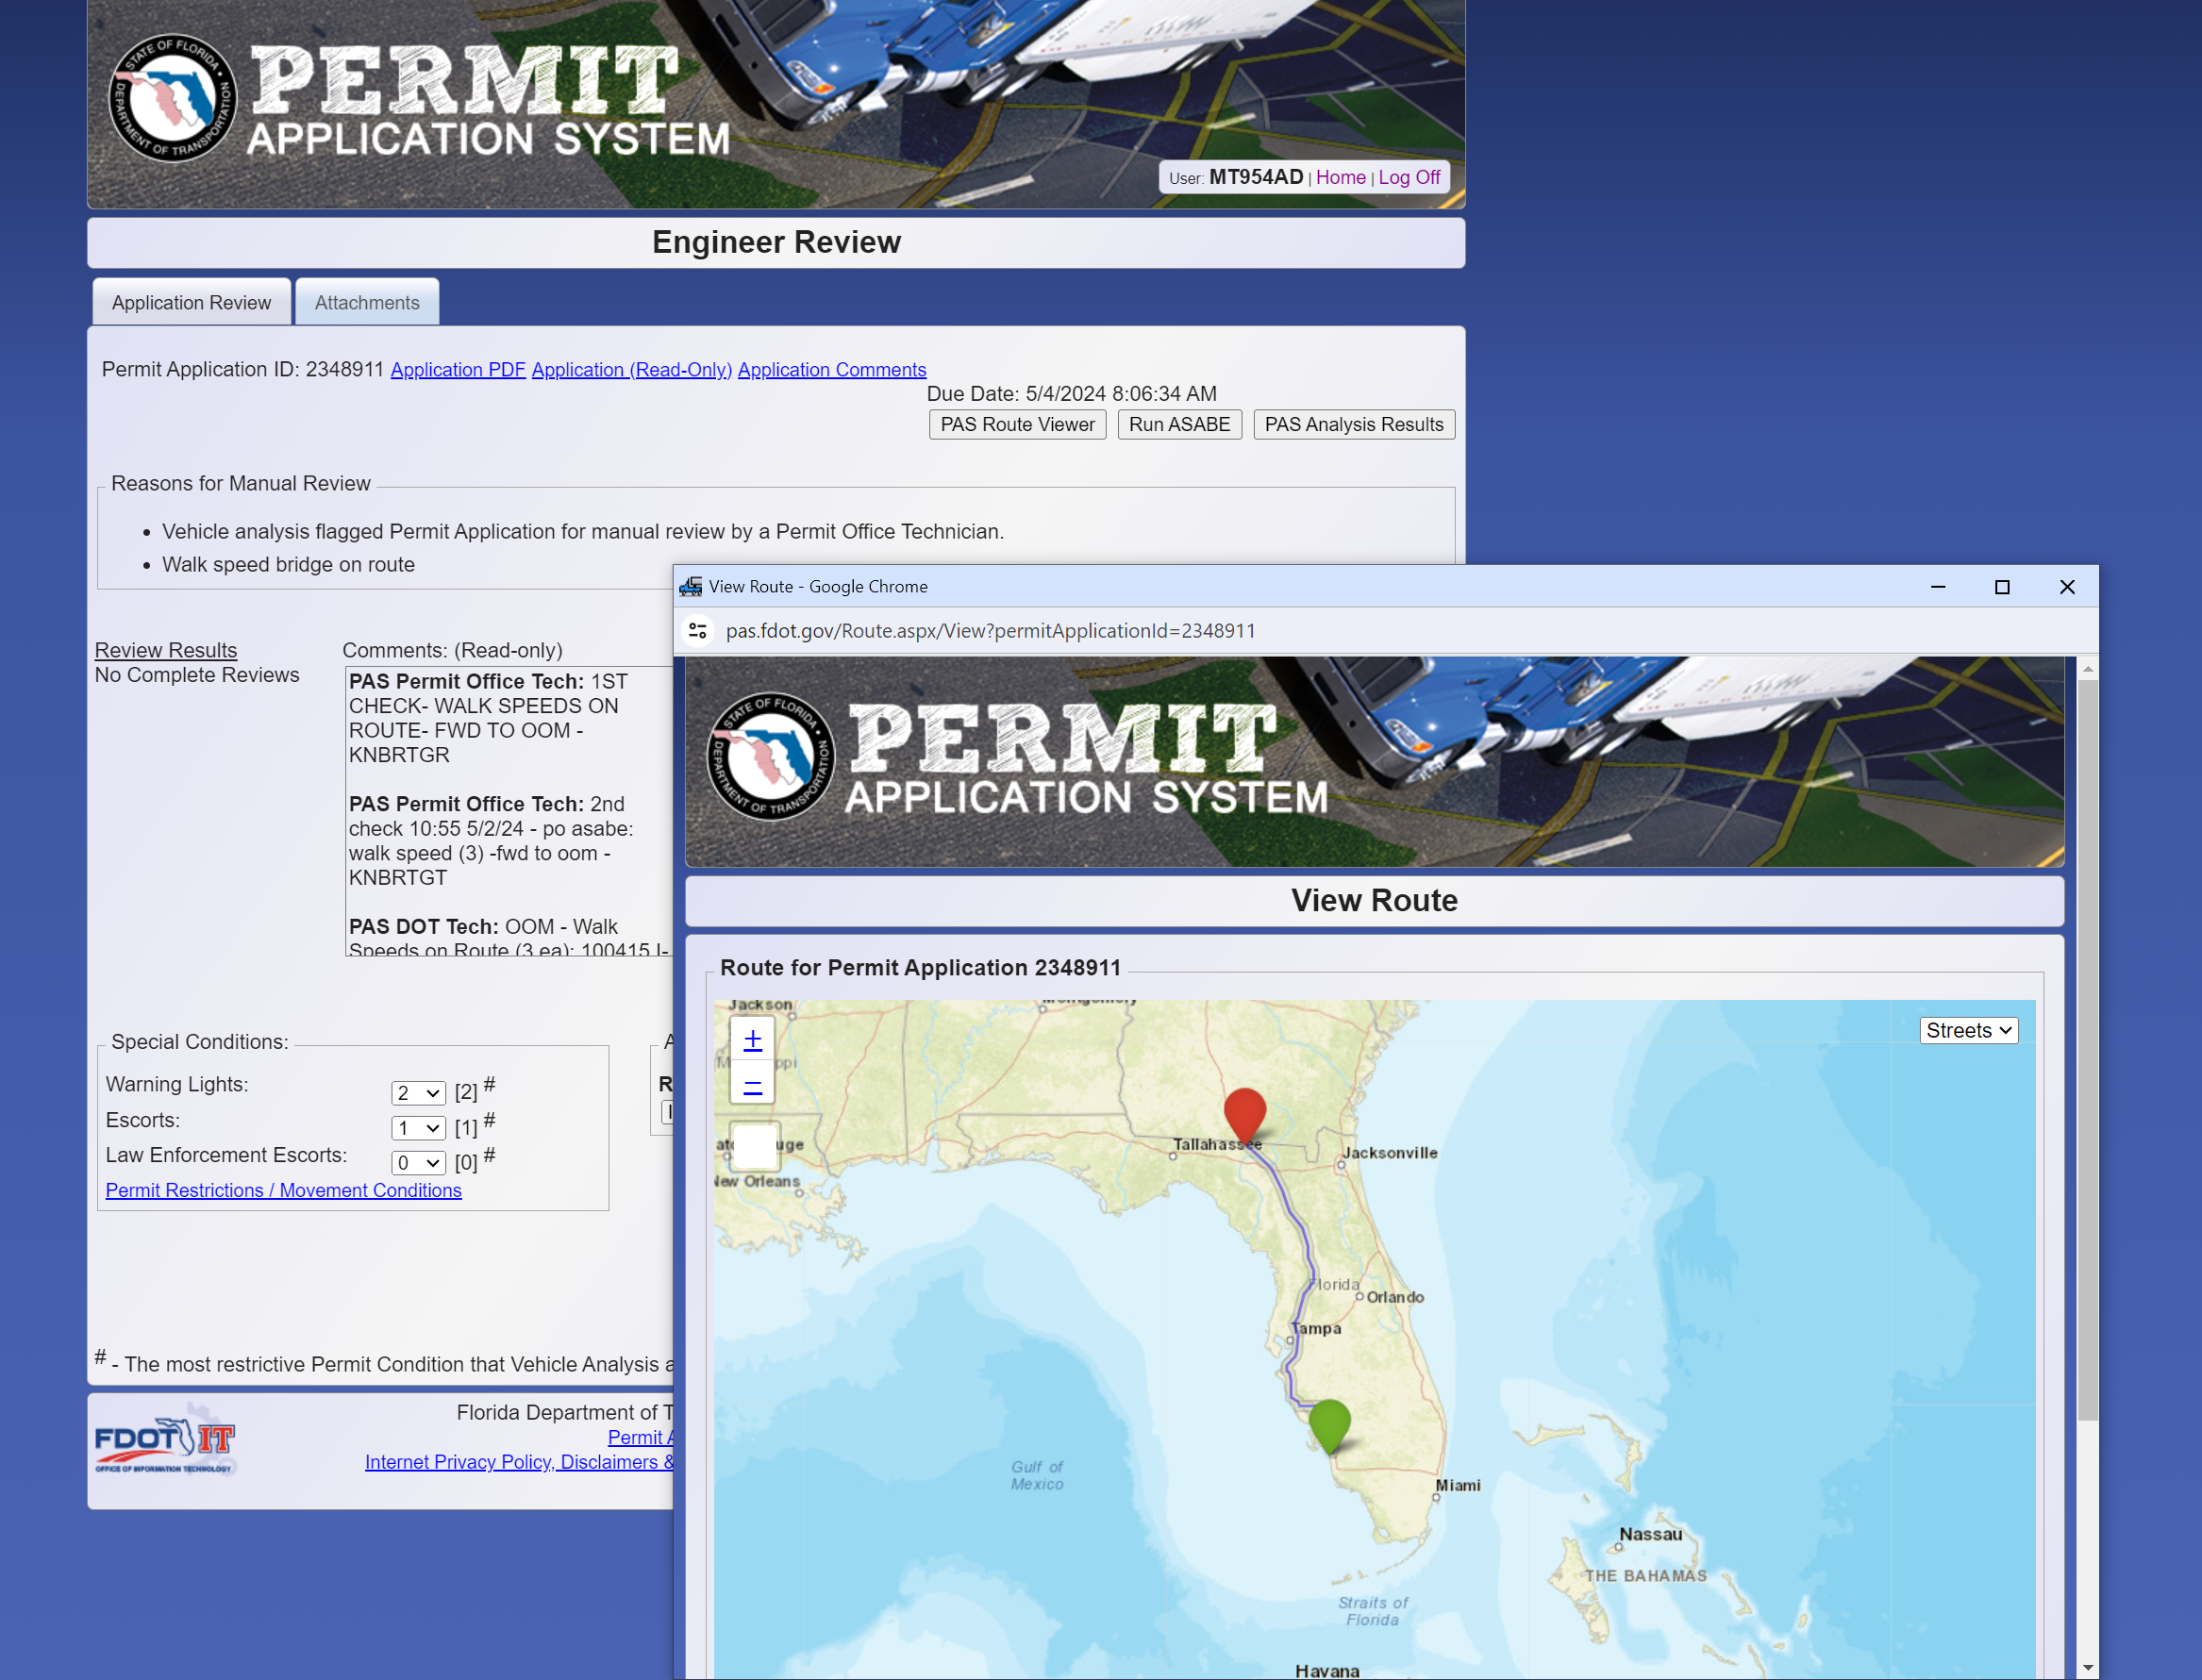
PAS
permit application system
Notes:
43
PAS: GIS routing, Payments, and Engineering.

Slide 44
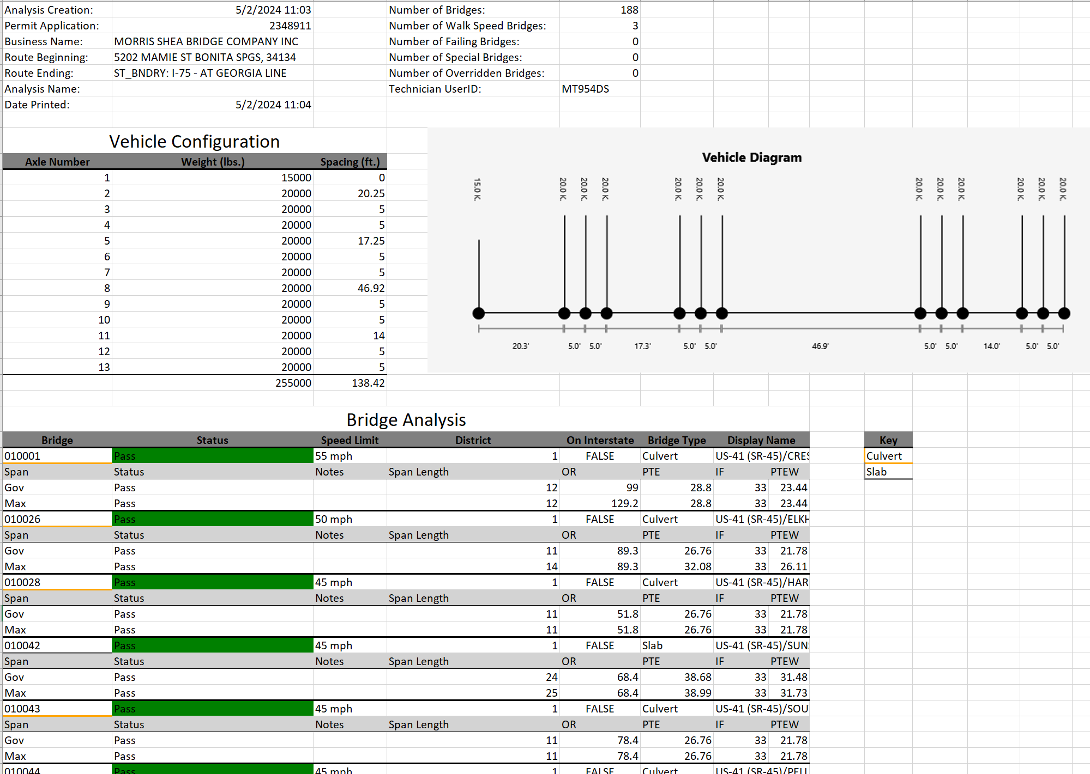
PAS
output
Notes:
44
Of the three components in PAS (GIS, $, engineering),
engineering is by far the simplest - at least for most bridges.
Continuous spans have some additional options.
Also, Florida has some adjustments for reduced speed and large gage width.
But generally,
(1) Compare the maximum flexural effects, reference vs permit.
(2) a multilane permit assumption prevails; the permit is present in all lanes.

Slide 45
SOFTWARE
Notes:
45
Example

Slide 46
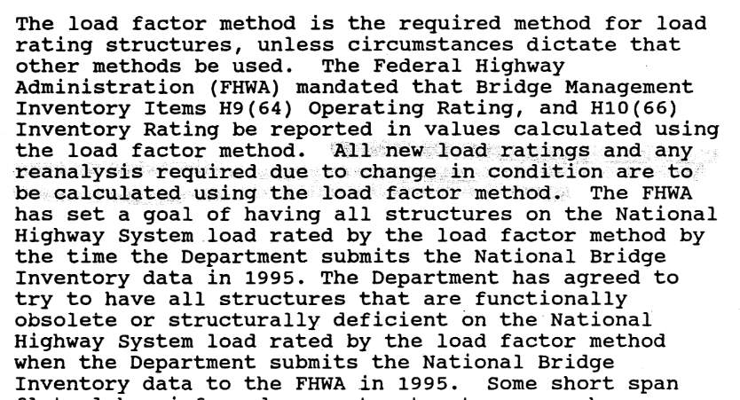
BLRM 1995
methodology – LFR
Notes:
46
1995 – LFR adopted per FHWA

Slide 47
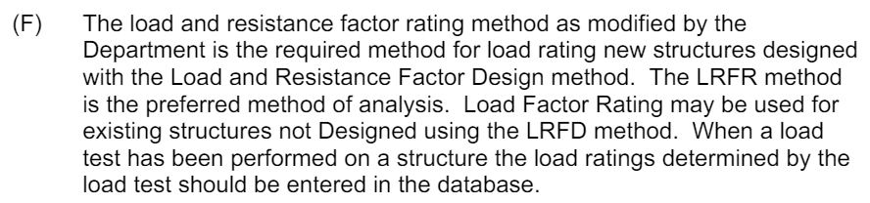
BLRM 2006
methodology – LRFR/LFR
Notes:
47
2005 – Florida adopts LRFD for new bridges.
2006 – BLRM adopts LRFR

Slide 48
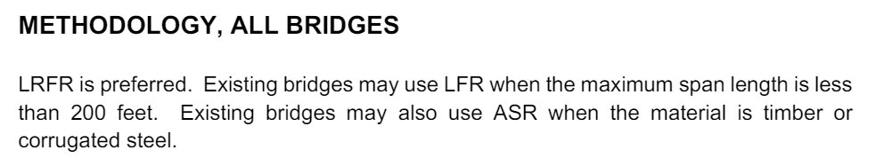
BLRM 2019
methodology – LRFR/LFR
Notes:
48
2019 – still LRFR/LFR, but limiting LFR

Slide 49
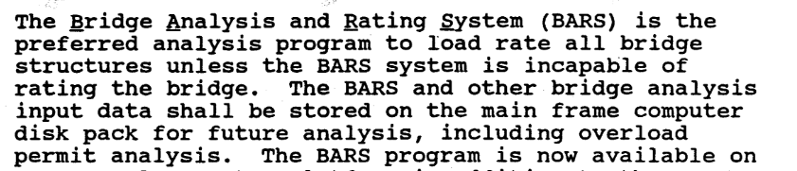

before 2005, BARS was ubiquitous
after 2006 – Virtis by rule, not practice
LFR software – BARS & Virtis
Notes:
49
Before LRFR, FDOT consistently used BARS.
After LRFR, FDOT tried Virtis but it didn’t take: unenforced. Also, 2006 Virtis was slow immature and buggy.

Slide 50
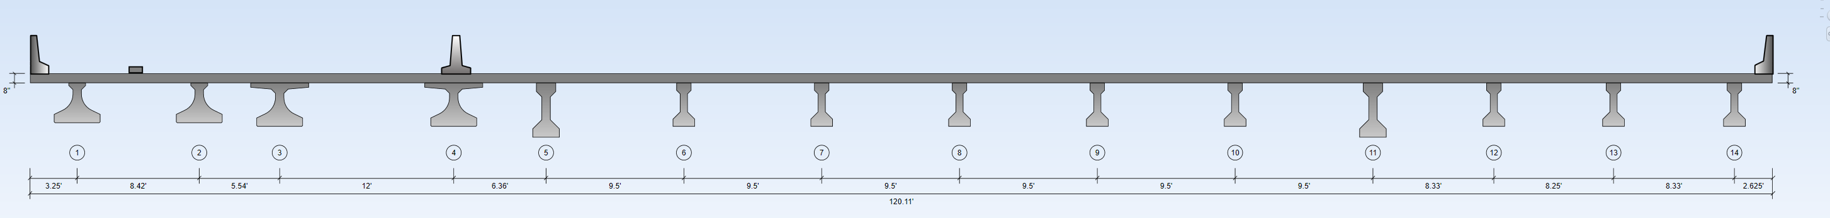
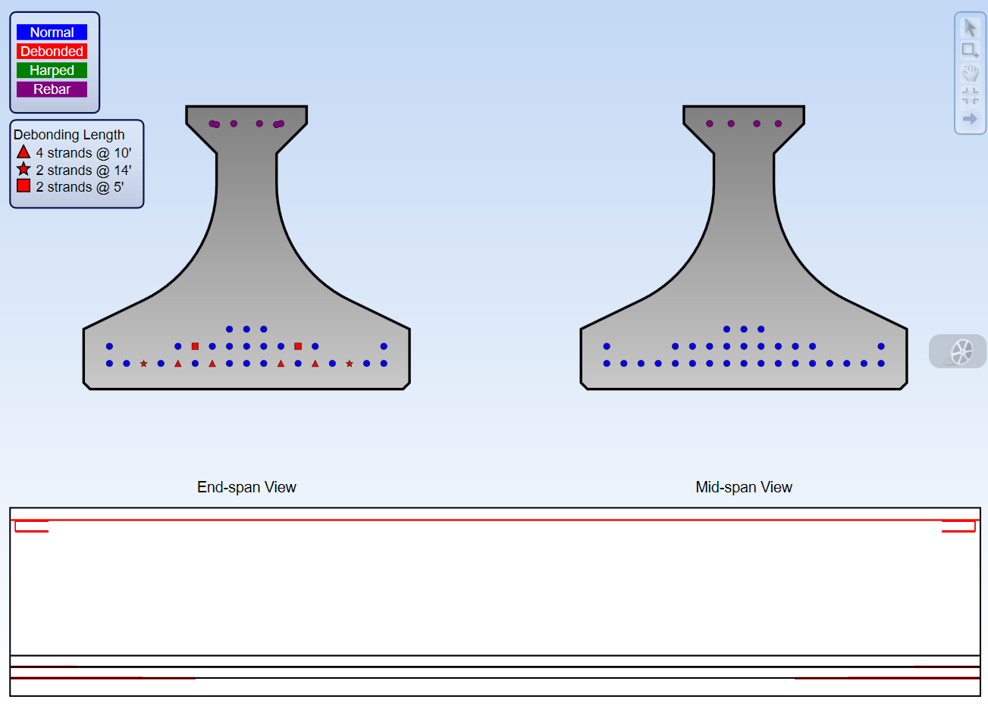
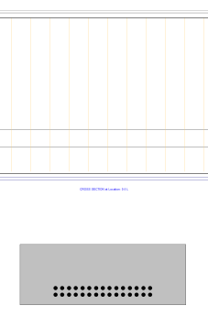
software – anything goes
Notes:
50
Presently, Florida allows any software.
Mostly Smart Bridge, Conspan, and MathCAD.
Some MDX, Strudl, Stadd, Midas, and Lusas

Slide 51
BENEFITS OF OPEN SOFTWARE POLICY
Exciting
Competitive
Forces cross-checking
Cheap for small firm one-offs
Can be cheaper the first time
Highly-tuned templates (especially culverts, FSBs)
BENEFITS OF SPECIFYING SOFTWARE
Consistent
Reusable
Checkable
Customizable
Emergency response (assign damage and share)
Competitive for Design and Construction, esp. DB
Opportunities for freight and permitting
Competitive if import-export door is open to others
Notes:
51
BrR

Slide 52
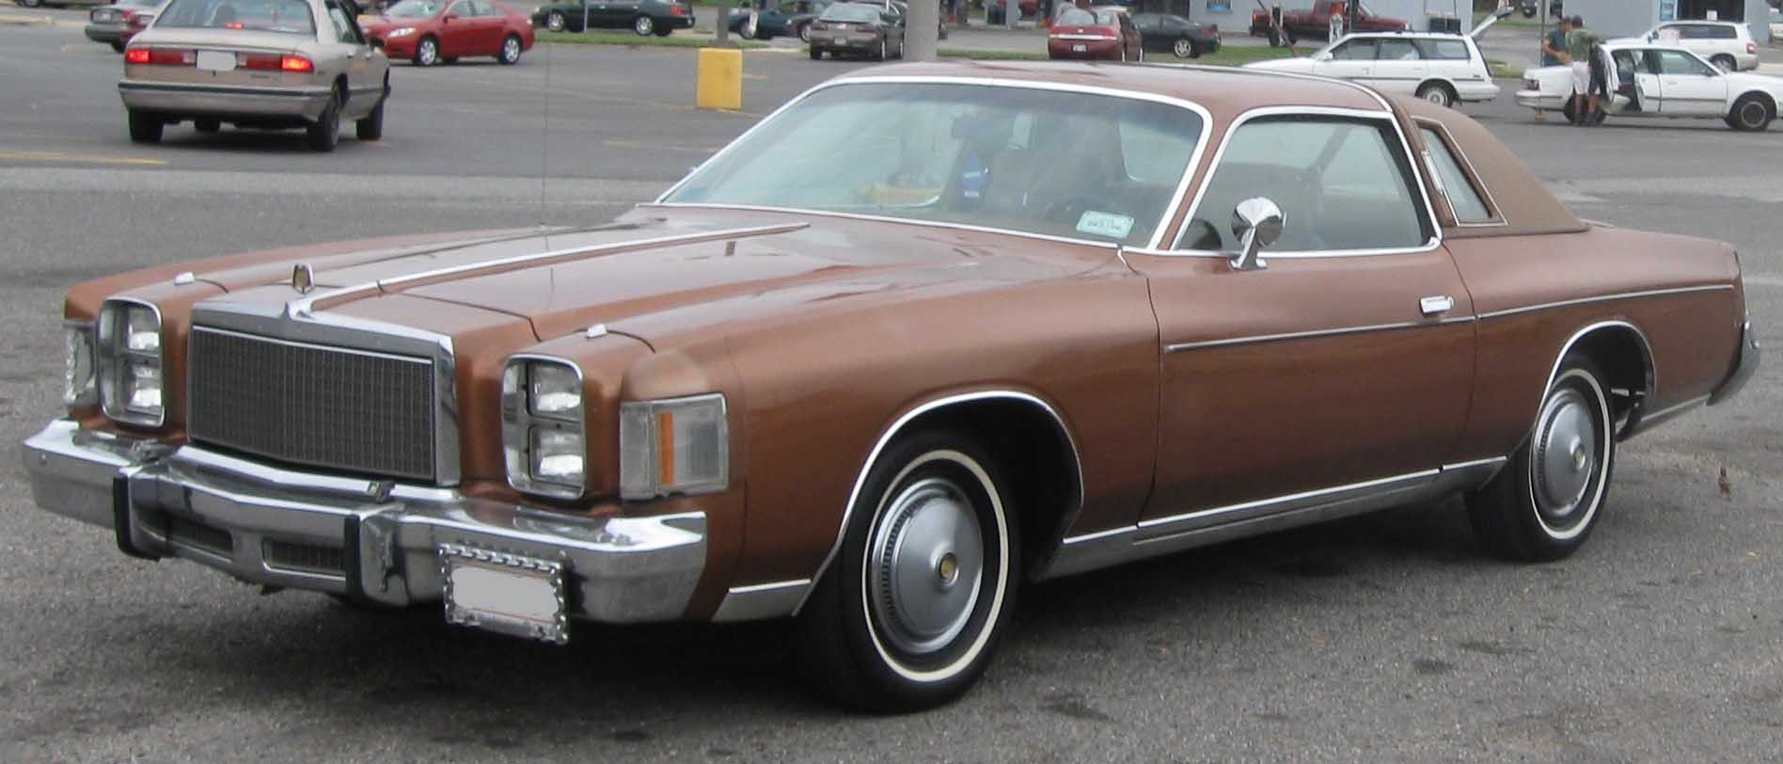

1985 BARS
2005 LRFD
Notes:
52
In 1985, FDOT adopted BARS - which was written during the time of the 1975 Chrysler Cordoba. Stodgy, instantly outdated, certainly ugly. But it got you down the road, BARS, was well-known, and in some respects elegant as a solution.
In 2005, FDOT’s “LRFD Rollout” implemented a new design code – before most other states. While the design community rapidly adapted, this introduced a somewhat anarchic period where the answer would vary by software and code interpretations.

Slide 53

2025
BrR inputs
Notes:
53
The software we need isn’t analogous to a SINGLE car at all.
It’s for the system at large, 13,000 bridges.
BrR is the best-available repository for that information.
And, eventually, the program can be anything you want it to be.

Slide 54

BLRM 2024
proposed
Notes:
54
Proposal to adopt AASHTOware BrR.
Or rather, that input files be legible to BrR.

Slide 55

BrR! Why?
This is from 2005, and it hasn’t gotten much better.
Notes:
55
Proposal to adopt AASHTOware BrR.
Or rather, that input files be legible to BrR.

Slide 56
  Steep learning curve
  Reports & graphics are poor
  Lacks elegance because it satisfies so many requirements (many states, many specifications, coupled with BrDr design, legacy interface), and chases too many structure types
  Users have too much faith in the software
BrR - Cons
Notes:
56
Proposal to adopt AASHTOware BrR.
Or rather, that input files be legible to BrR.

Slide 57
  Open candor, about bugs
  Community support and checking with “Jira”
  Ubiquitous, with a portable skill set
  Assesses most structure types
  Spec check outputs are candid and verbose
  Keeps up with code
  Plays well with others (PG Super, permits)
  We own it, literally
  Know what you are getting
  Enhancements by democracy or dollars
  Research inventory – effects of proposed code changes, new laws, new trucks etc.
  Capable & correct, for prestress shear
BrR - Pros
Notes:
57
Proposal to adopt AASHTOware BrR.
Or rather, that input files be legible to BrR.

Slide 58

BrR
Notes:
58
Proposal to adopt AASHTOware BrR.
Or rather, that input files be legible to BrR.

Slide 59

PG Super
www.pgsuper.com/content/content/screen-shots
Notes:
59
Right now, PG Super – BrR www.bridgesight.com is the only company that directly ports to BrR.
We should all be doing this. Not for BrR, but rather for a common BIM format.
https://www.pgsuper.com/content/content/screen-shots

Slide 60

PG Super
www.pgsuper.com/content/content/screen-shots
Notes:
60
Right now, PG Super – BrR www.bridgesight.com is the only company that directly ports to BrR.
We should all be doing this. Not for BrR, but rather for a common BIM format.
https://www.pgsuper.com/content/content/screen-shots

Slide 61
BrR FDOT customization
https://www.fdot.gov/maintenance/LoadRating.shtm
AASHTOware BrR training examples
https://www.aashtowarebridge.com/bridge-rating-and-design/training/
Michigan Tech BrR training
https://www.loadrating.michiganltap.org/
BrR catalog
https://www.aashtoware.org/wp-content/uploads/2024/05/FY-2025-AASHTOWare-Catalog_web.pdf#page=32
BrR resources
Notes:
61
Right now, this is the only company that directly ports to BrR.
We should all be doing this. Not for BrR, but rather for a common BIM format.

Slide 62
TIPS
Notes:
62

Slide 63

contacts
www.fdot.gov/maintenance/loadrating.shtm
Notes:
63
contacts

Slide 64

summary - BLRM factors and live load tables
www.fdot.gov/maintenance/loadrating.shtm
Notes:
64
BTW the summary includes
The BLRM factor tables
LL tables
Notes on changes – sometimes even who suggested the correction

Slide 65

examples
www.fdot.gov/maintenance/loadrating.shtm
Notes:
65
BrR customization
Old-school culvert in MathCAD
Vargas’ segmental example

Slide 66


get good plans
maintenance office
standard indexes
as-built plans
district microfilm
Notes:
66
maintenance office – always that one person who knows where things are
standard indexes – like this one in clear black-and-white
as-built plans – ProDo and microfilm
district microfilm – local tranches

Slide 67


for 40 ksi vs 60 ksi stirrups
Notes:
67
This quandary continues to plague load rating

Slide 68
From: Womble, Steve
Sent: Tuesday, July 20, 2010 1:49 PM
To: Pouliotte, Jeffrey
Cc: Ducher, Jean; Kerr, Richard; Deese, Gregory; Garcia, Jose
Subject: Prestressed beams; shear capacity
Many years ago we did hundreds of load ratings on BARS, and most of those early analyses did not include shear ratings. I think there were some problems with the program, or for other reasons (too far back now to recall), we routinely did not do the shear ratings. But as you know, we’re in process of updating all of the ratings by either coming up with the BARS backup for old ratings, obtaining backup for existing ratings from consultants, or in many cases doing a “start to finish” updated rating. We are routinely using Smart Bridge and Virtis, and are typically including a shear analysis, which brings me to the purpose of this note. In many cases shear governs, and in some cases the drop in tons is significant, and this has continued to concern us. Typically we do not have site conditions that indicate problems in shear, so we’ve continued to discuss the matter, such as the implications of a note found in most plans from the 1970s into the 1990s(?). That note says, with regards to shear steel in the beams, “use grade 40 or grade 60.” For a mid-80s bridge, and based on some discussion with your office, we today changed the shear steel strength to grade 60 (where that routine note is present), and the O.R. went from the high 40s to just over 60 tons, for a Cross Town Exwy bridge. The Inventory Rating came out almost perfectly at 36 tons, the weight of the design truck, which is what we would ideally expect. But I still had questions about older bridges such as the 70s decade, since we’ve seen very similar low shear rating results on many bridges from that period.
So, I called the FPCA earlier today, and was given a few Florida sources for precast concrete construction, and with that info I did some follow up. I called Coreslab Structures in Tampa, and was directed to a former staff member that had recently retired, David L. Bracewell. There is a nice article in the PCI Journal, Fall 2009, on David’s retirement, and here is the sum of that article: “David L. Bracewell retired from Coreslab Structures, Inc., this summer after 50 years of service to the precast-prestressed industry. Bracewell was chief engineer for Coreslab/Tampa since the plant was acquired in 1993. He was continuously affiliated with this plant under various business names and ownerships since 1959. Bracewell began his prestressed concrete career with Florida Prestressed Concrete and Douglas Cone, the first PCI chairperson, in 1959. In these early industry years Bracewell was involved in all phases of plant operations, primarily for piling, bridge girders, and railroad bridge slabs.”
I had a good chat with David Bracewell, and his is still quite sharp, with a good recall. On the question of the use of various grades of steel for prestressed beam construction, he said that in the late 1960s there was a shift from grade 40 to grade 60 for such beams, and he said that grade 60 was regularly used from then on, since if grade 40 was used, the precaster had to change the stirrup spacing. In other words, the spacing in such plans was based on grade 60, and if a lower grade was used, a correction had to be made on the rebar spacing. That said, I would like to suggest that we here (and others elsewhere?) begin routinely using grade 60 rebar in all of our prestressed load ratings from 1968 (the earlier date David used) onward, and this will improve our Operating Ratings on a large number of prestressed bridges. We typically check the BIR files for any indication of problems (i.e., shear cracks), and such problems are extremely rare (except for the Skyway trestle spans, as you are aware). Jean, what do you think about including this issue in the next Load Rating Steering Committee meeting?
best-available history
Notes:
68
The best-available evidence
Two experts – Bracewell and Womble
40ksi steel cost about the same as 60ksi steel. There was no incentive to stock 40ksi steel, and yards typically used 60ksi on everything, lest they be mixed
1954 was a reasonable date to declare 40 ksi, and 1972 was a reasonable date to declare 60 ksi

Slide 69

BLRM
Notes:
69
Confirming coupons sent to Materials for testing are welcome, especially where access is convenient during construction.
However, this table is acceptable.

Slide 70


Ultimate Demand Based Capacity (UDBC)
Notes:
70
We’ve been doing it wrong for 20 years
Or at least Maintenance has. For Design, it’s fine

Slide 71

UDBC
  Unnecessary for yes/no pass/fail design, or where RF=1.0.
  No effect where ε ~ 0 or RF~1.0; otherwise, closer to RF=1.0.
Notes:
71
When RF~1, traditional MCFT shear analysis is accurate
When RF<1, traditional MCFT shear can be inaccurate and conservative
When RF>1, traditional MCFT shear can be inaccurate and unconservative

Slide 72

  MCFT shear capacity is load dependent.
  Higher loads can reduce capacity.
  UDBC just matches the capacity to the load.
Notes:
72

Slide 73

44 tons
FL120, γ_{LL} = 1.35
ε_{eq.1.35∙60 tons} > ε_{result 1.35∙44 tons}
51 tons
FL102, γ_{LL} = 1.35
ε_{eq.1.35∙51 tons} = ε_{result 1.35∙51 tons}
51 tons
FL120, γ_{LL} = 1.147
ε_{eq.1.147∙60 tons} = ε_{result 1.35∙60 tons}
Notes:
73

Slide 74

UDBC
  Report RF_{FL120} = 0.85 at γLL = 1.35; 0.85∙60=51 tons.
  Know non-UDBC MCFT RF_{shear} > 1.00 is unconservative.
  BrR can perform UDBC natively
Notes:
74

Slide 75


MBE C6A.5.8-1
Notes:
75
Proposed for 2025 BLRM, available now.
Florida requires all widenings meet FL120/HS20 – which typically means FL120.
This MBE commentary, moving the failure plane toward the bearing, will help.

Slide 76
QUESTIONS?
REQUESTS?
andrew.devault@dot.state.fl.us, 850-410-5531
Notes:
76

