Slide 1
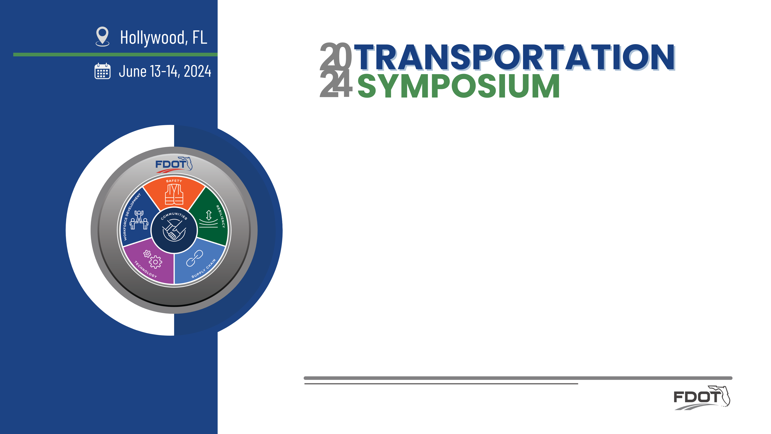
Model-Centric Design Initiatives
Vern Danforth, PE – State CADD Engineer
Production Support CADD Office -FDOT

Slide 2


Objectives:
SHOW ME THE MODEL !
Source: Jerry Maguire

Slide 3
Why invest?
Why Invest… | Yields
Survey Data Collection | More accurate design improvements
Geotech Sampling | Mitigate surprises in construction
Utility Verification | Identify potential clashes
Pavement Cores | Validate existing conditions
Drainage and Environmental Assessment | Mitigate construction impacts
Then…
Model centric design | All of the above!

Slide 4
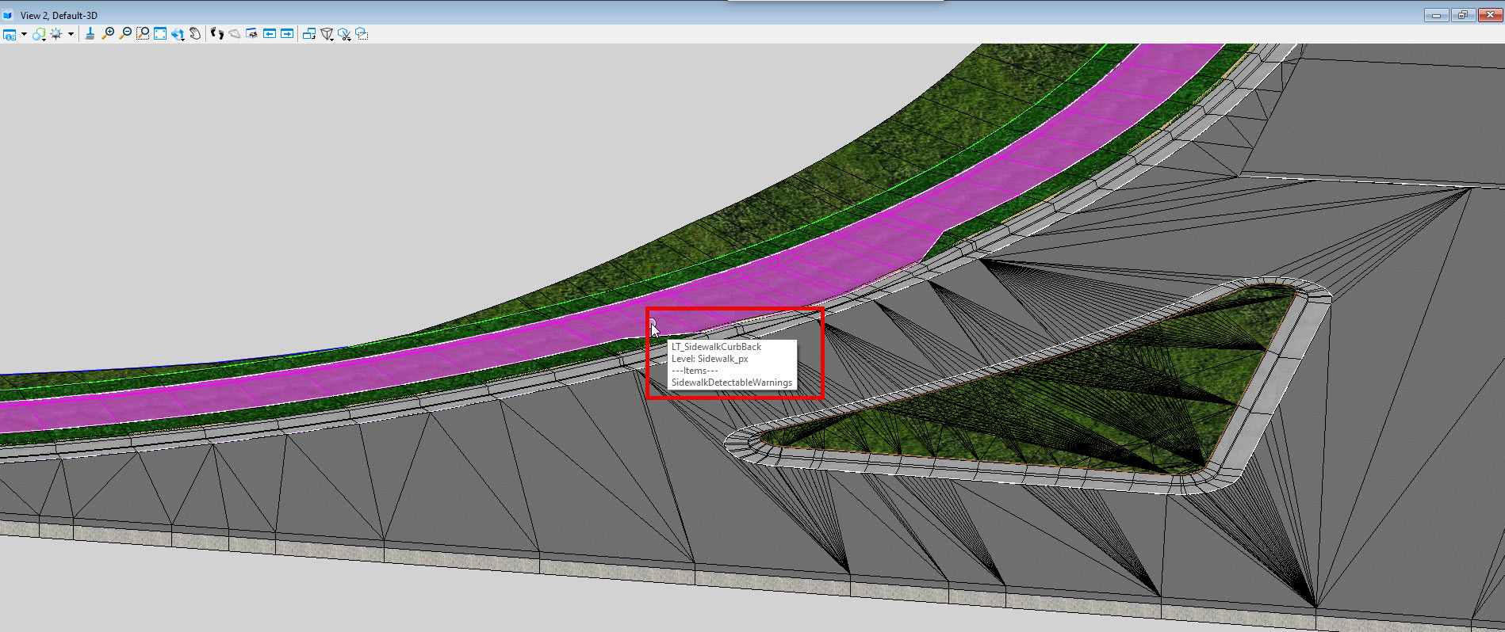
Curbs, Sidewalks,Curb Ramps:

Slide 5
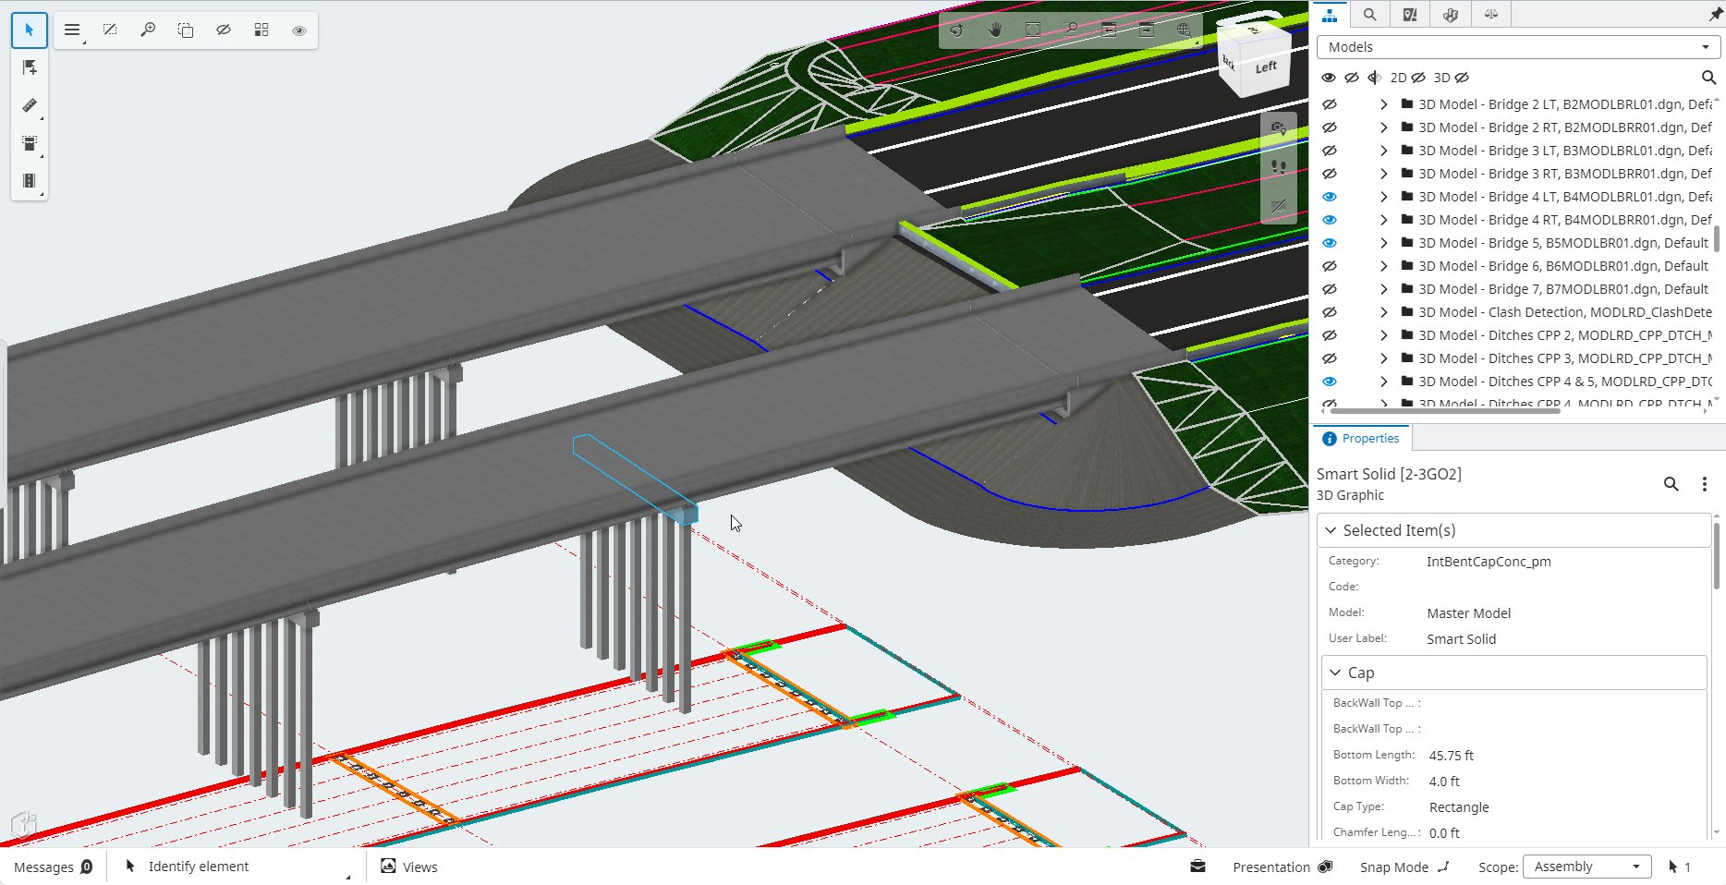
Bridge Deck, Beams, Piers, Slope Walls:
Image Source:
Design Review – CPP TPE/PGA Contract

Slide 6
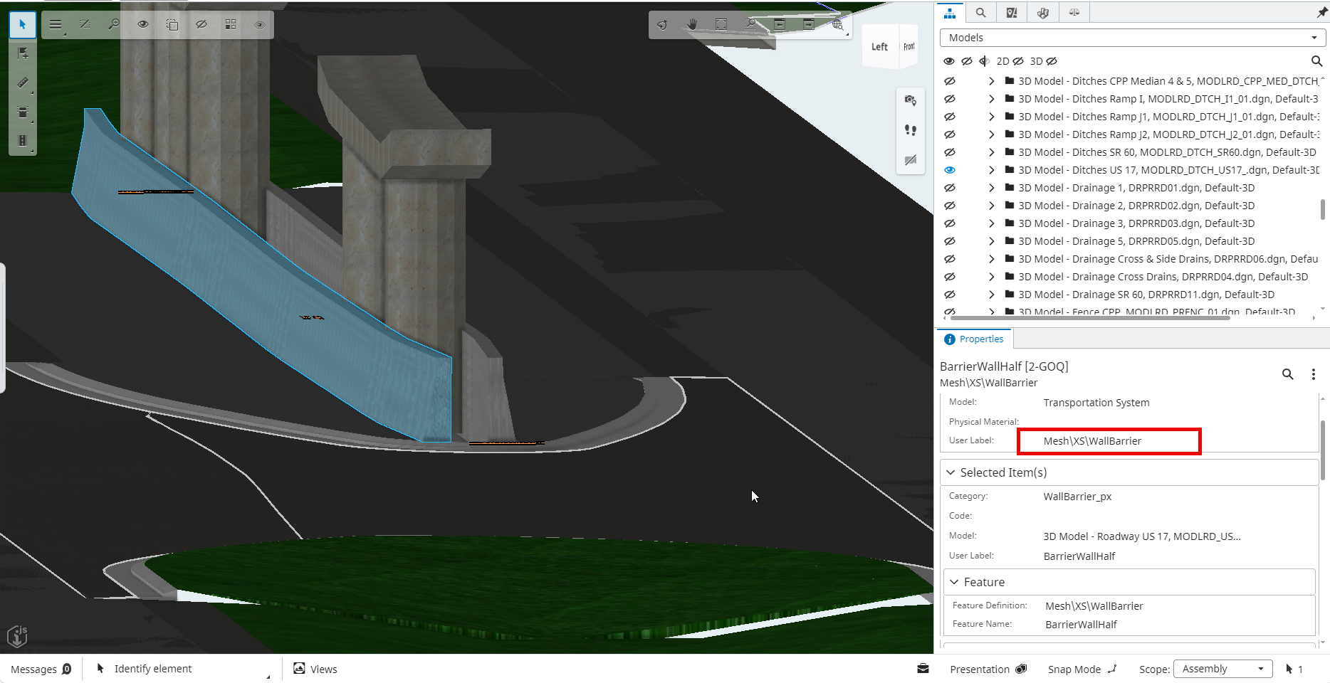
Barriers:
Image Source:
Design Review – CPP TPE/PGA Contract

Slide 7
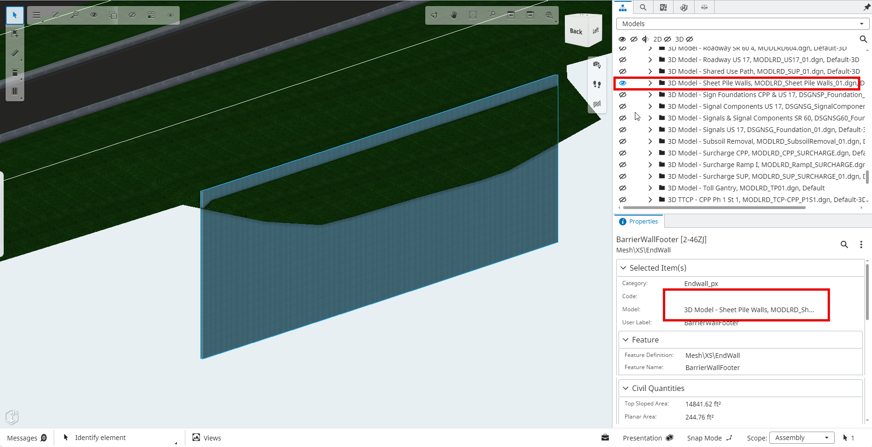
Sheet Pile Walls:
Image Source:
Design Review – CPP TPE/PGA Contract

Slide 8
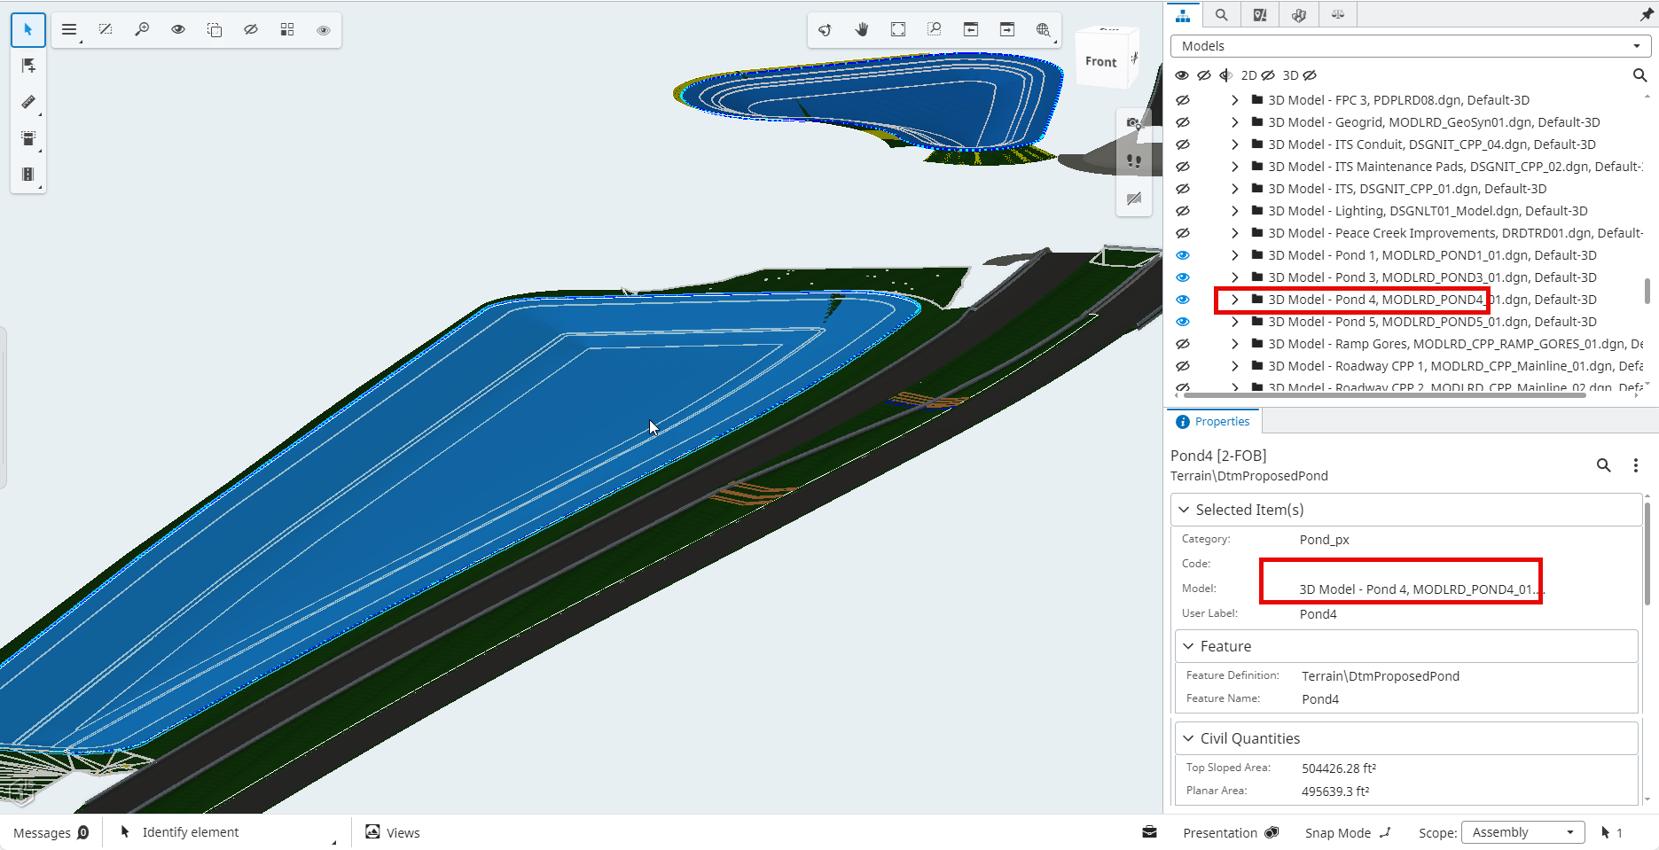
SWMF:
Image Source:
Design Review – CPP TPE/PGA Contract

Slide 9
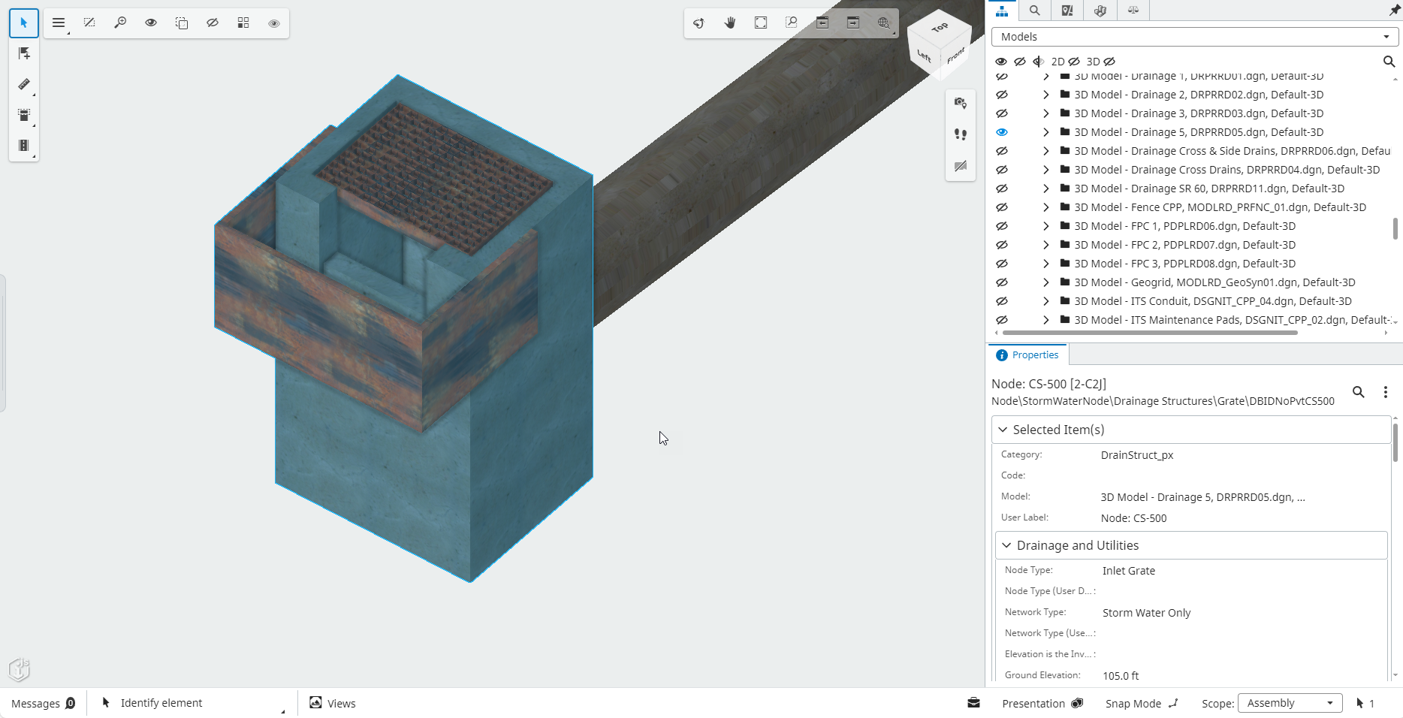
SWMF Control Structures:
Image Source:
Design Review – CPP TPE/PGA Contract

Slide 10
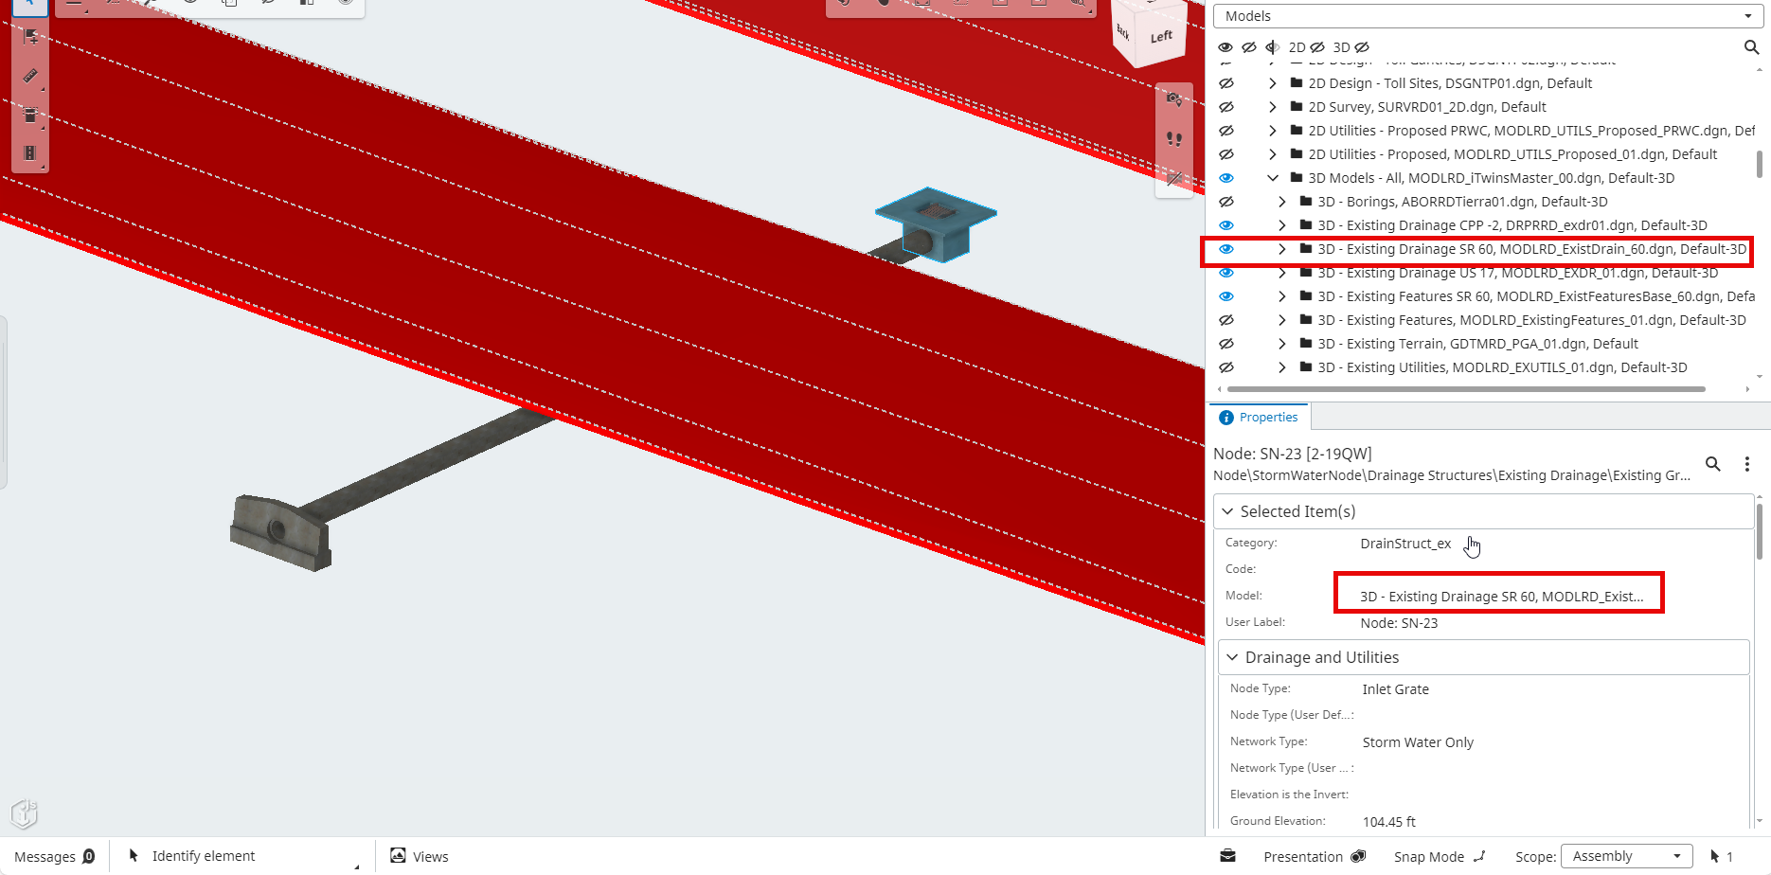
Existing Roads, Drainage, Utilities:
Image Source:
Design Review – CPP TPE/PGA Contract

Slide 11
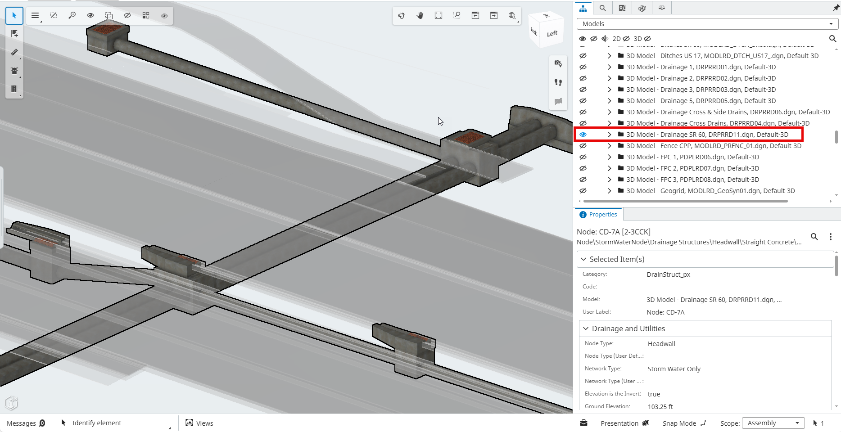
Proposed Roads, Drainage, Utilities:
Image Source:
Design Review – CPP TPE/PGA Contract

Slide 12
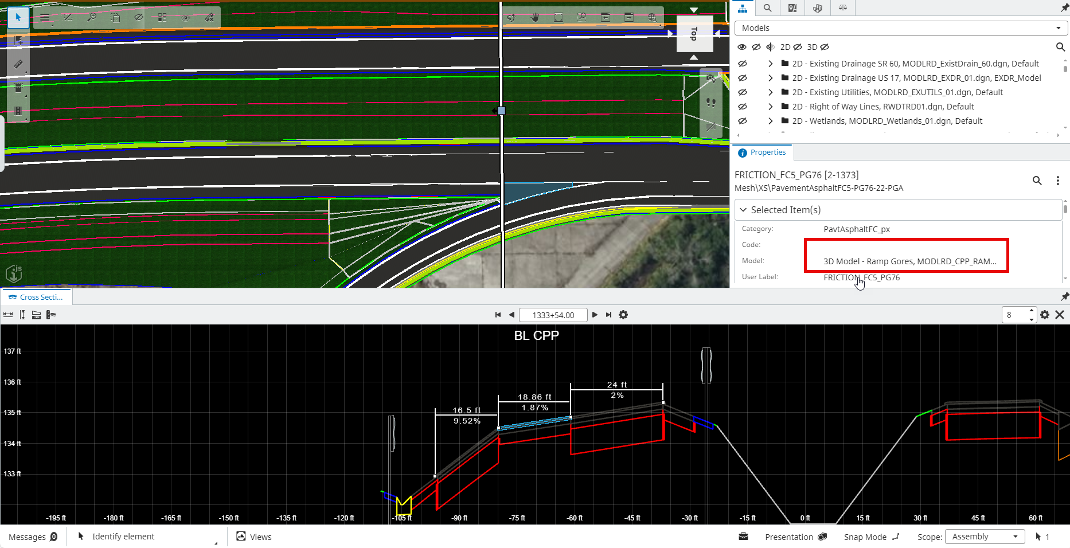
Proposed Ramps, Gores, Guardrail:
Image Source:
Design Review – CPP TPE/PGA Contract

Slide 13
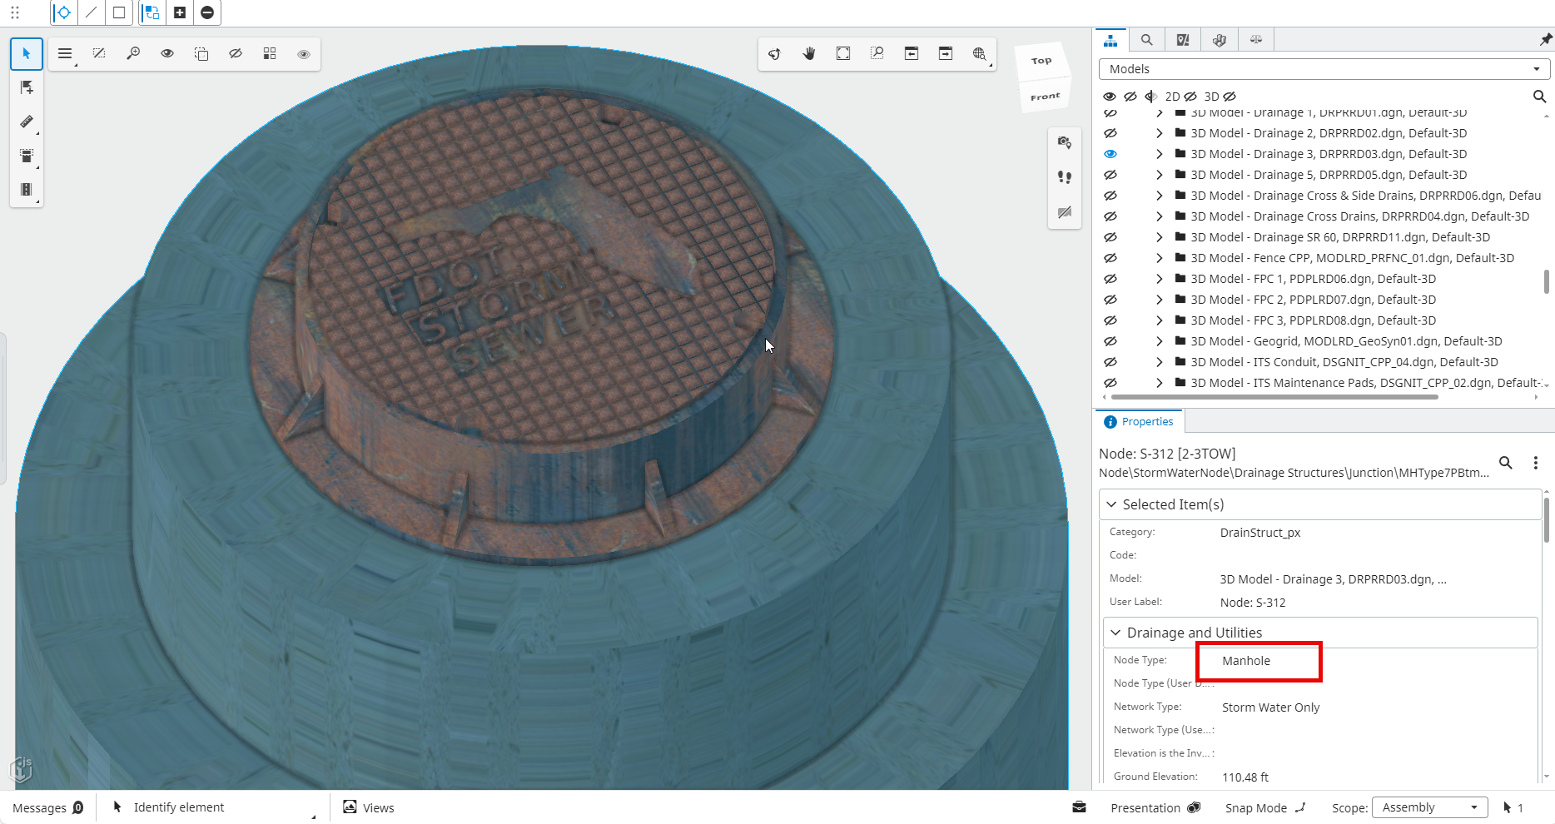
Drainage Level of Detail:
Image Source:
Design Review – CPP TPE/PGA Contract

Slide 14
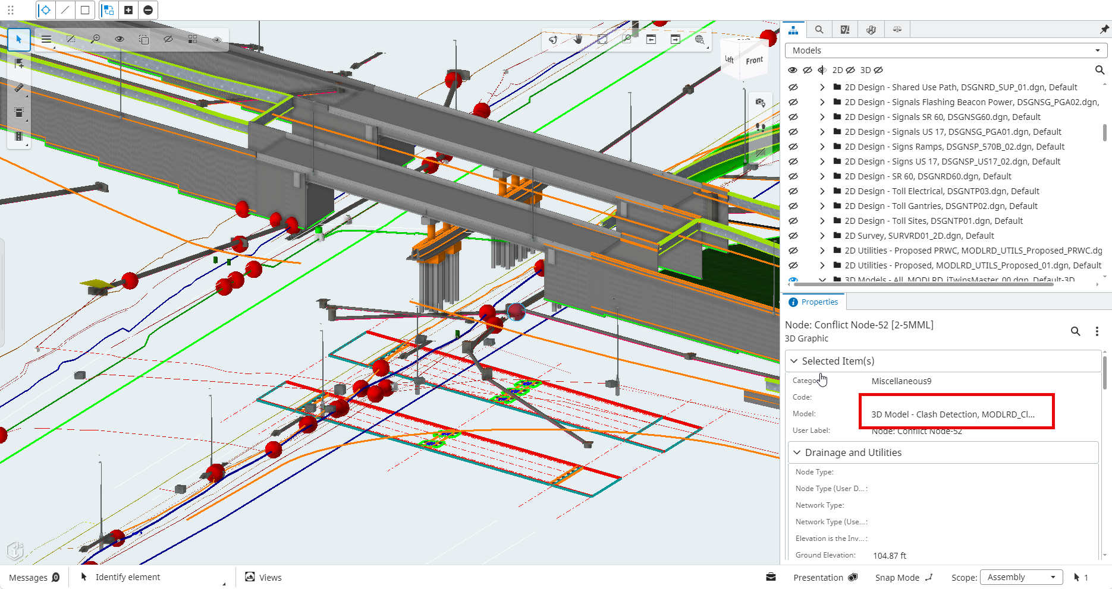
Drainage, Utilities Clashes:
Image Source:
Design Review – CPP TPE/PGA Contract

Slide 15
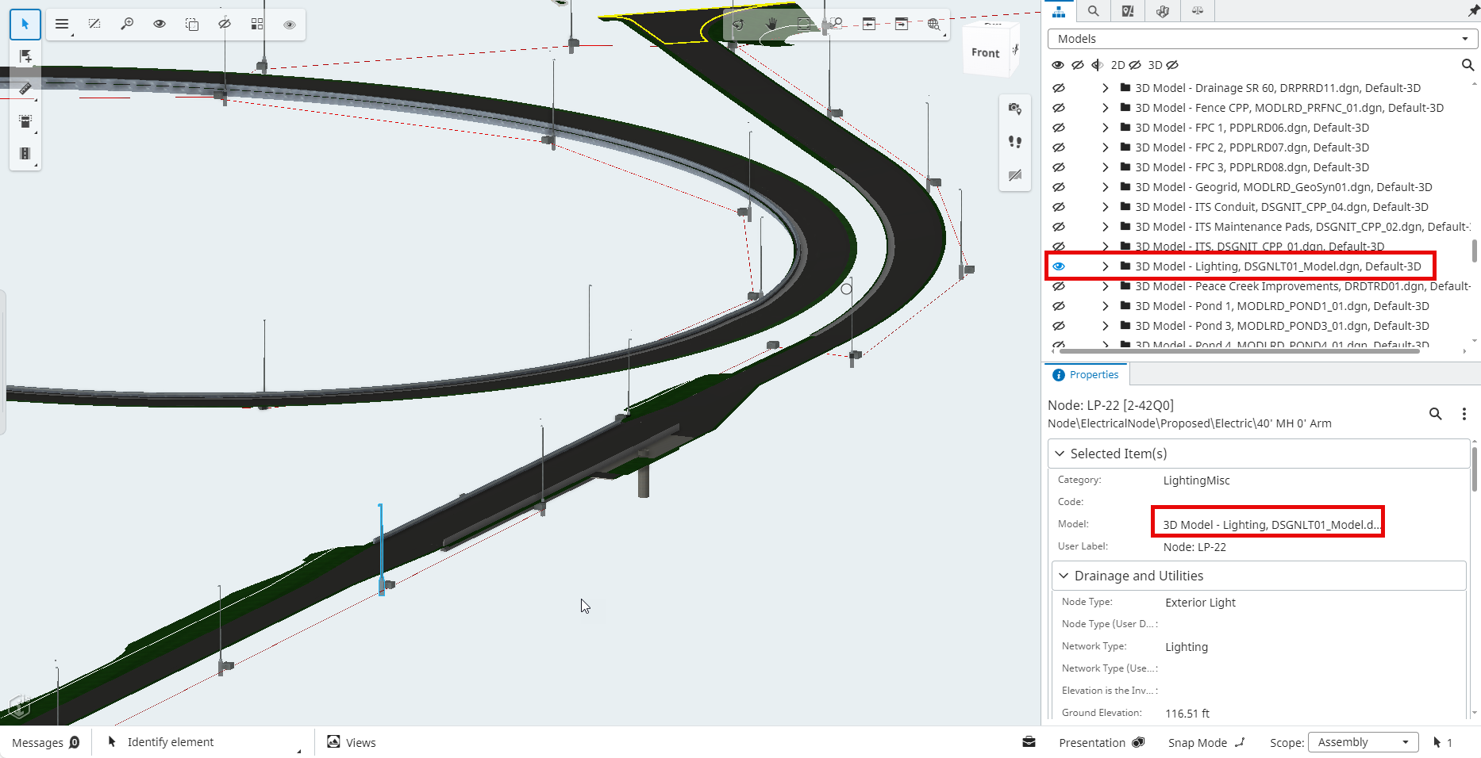
Lighting:
Image Source:
Design Review – CPP TPE/PGA Contract

Slide 16
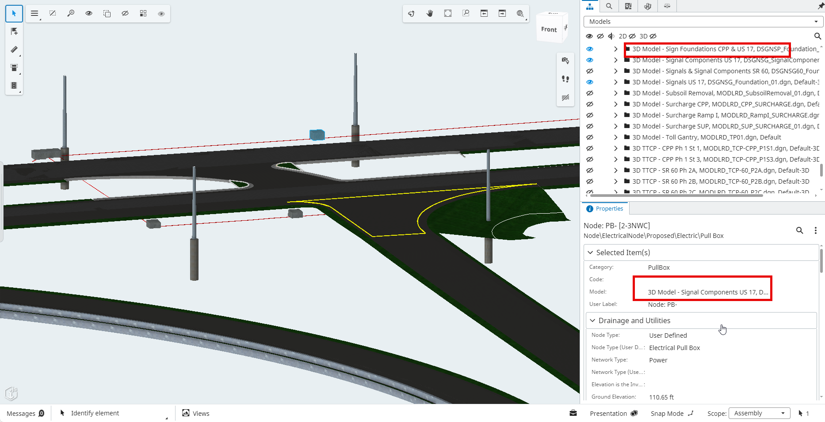
Signal and Sign Foundations:
Image Source:
Design Review – CPP TPE/PGA Contract

Slide 17
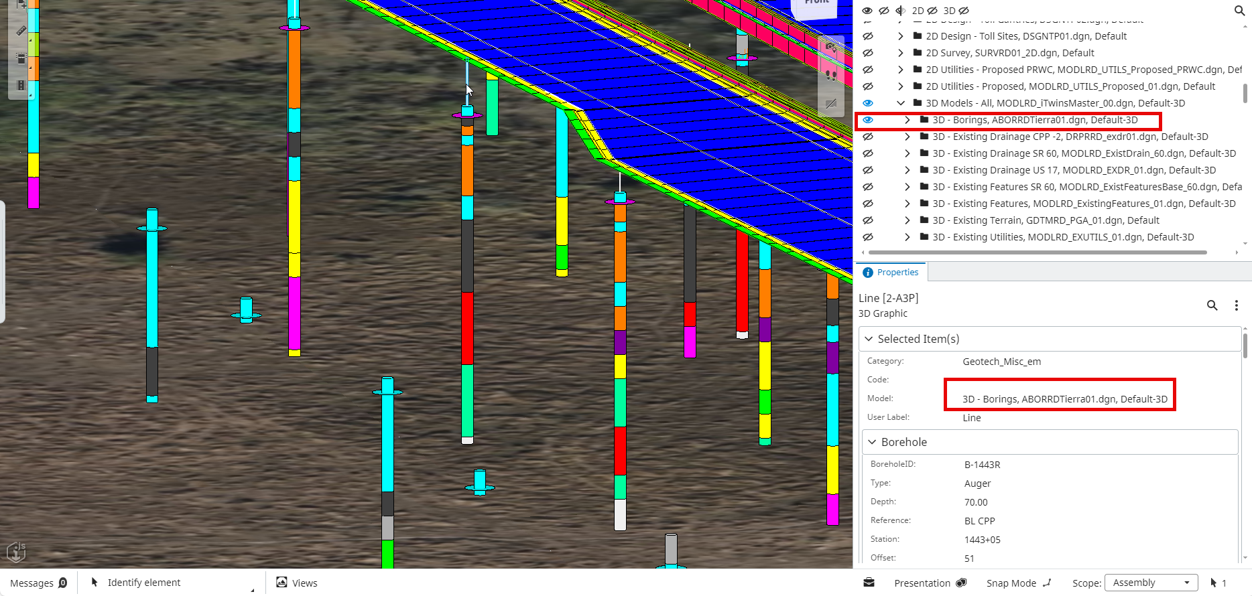
Geotechnical Cores:
Image Source:
Design Review – CPP TPE/PGA Contract

Slide 18
Objectives:
Timeline
FDOT Mission and objectives
BIM!
Standards, Criteria, Production, Contracts
National objectives

Slide 19
1393 days
3025 days
522 days
262 days
521 days
What’s Happening at the DOTs:
Jul 1
Models as Contract Documents
Model-Centric Design required on New Projects (ORD or C3D)
Jan 1
FDM Plans to support BIM
S&S BIM
Files
Selection
Digital Viewer
3D Modeling Supported by CADD
(BENTLEY AND AUTODESK)
3D Deliverable Standards to support AMG (CADD Manual)
Jul 1
Jul 1
Nov 1
2009
2009
2011
2013
2015
2017
2019
2021
2023
2024
3D CADD INITIATIVES
Standards for AMG
Digital Delivery for Construction AMG
Model Centric Plans and Quantities
Models as Contract Documents
Model-based Design Initiatives – 15 years
Digital Delivery Viewing Tools
Jul 1 – Nov. 2021
Notes:
FDOT 3D Initiatives Timeline
2009, CADD Office started research and developing 3D workflows for Design
2015, CADD Standards were published to support 3D Deliverables for AMG
2018, Concept of Next Generation (NexGen) Plans to support 3D Models started
2020, Two Pilot DBB Projects were contracted with Models as the Legal Document (BIM) and NexGen Plans
2021, All projects must use model-centric design software; Civil3D, OpenRoads Designer or OpenBridge Modeler
This year 2020-21, CADD Standards for BIM Delivery are being developed
beyond 2021 More Pilot Projects are planned for BIM and NexGen Plans Delivery

Slide 20
To move the department toward designing and delivering integrated 2D and 3D models
Design CADD Adopted Mission:

Slide 21
1. Designing in 3D is better!
2. To provide for Automated Machine Guidance (AMG)- contractor files
3. To deliver a Model as Contract Document – QA/QC by EOR
4. To Support Building Information Modeling (BIM) – pay it forward
Why?

Slide 22
Provides:
- Geospatial Orientation State Plane Coordinates XYZ
- Higher quality of design intent; better visually and quantitatively
- Better spatial relationships; utilities, drainage, bridges
- Improved constructability considerations; walls, slopes, ramps
- Better detailing; foundations, drainage boxes, slopes
Model-based design:

Slide 23
-Provides horizontal and vertical guidance in real time to construction equipment operators.
-Assists agencies and contractors in finishing projects in less time and with lower overall cost while providing higher quality and better safety.
Automated Machine Guidance (AMG):

Slide 24
Intelligent BIM Modeling throughout the project, including linking Operation, Maintenance, and Asset data to the model (created from the Design, Construction, 4D Coordination Models, and Subcontractor Fabrication Models) to deliver a record model to the owner or facility manager.
Model as a Contract Document:

Slide 25
Building Information Modeling (BIM) – What is BIM? https://youtu.be/bEI-TCPmmT0
-USDOTFHWA
What’s Happening at the DOTs:

Slide 26


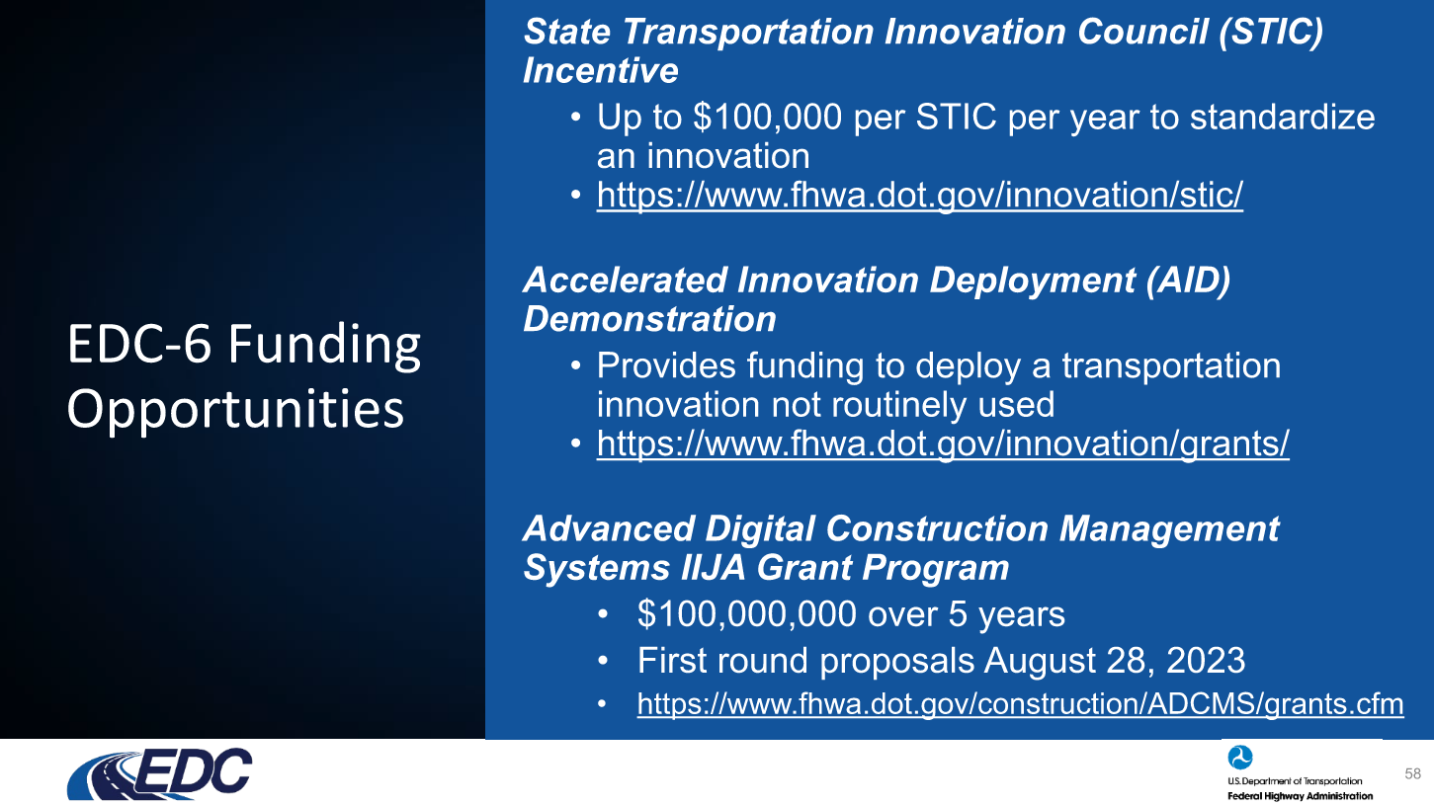
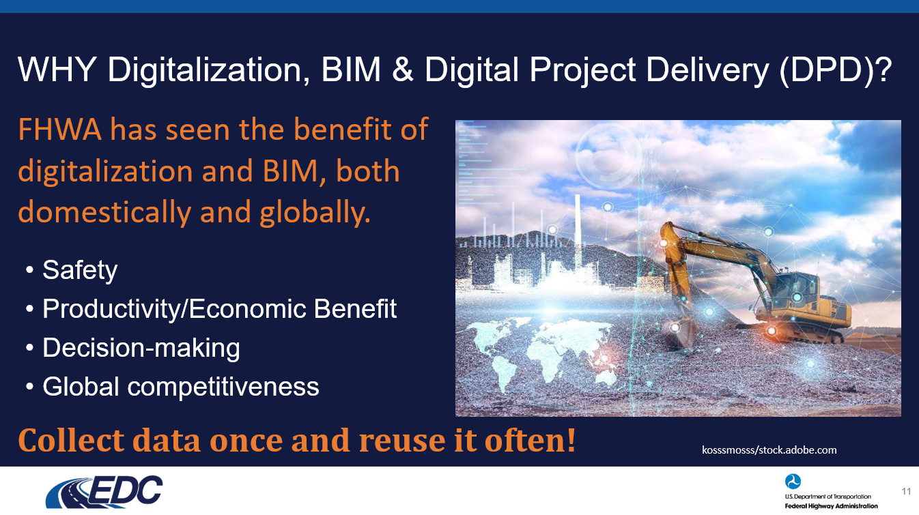
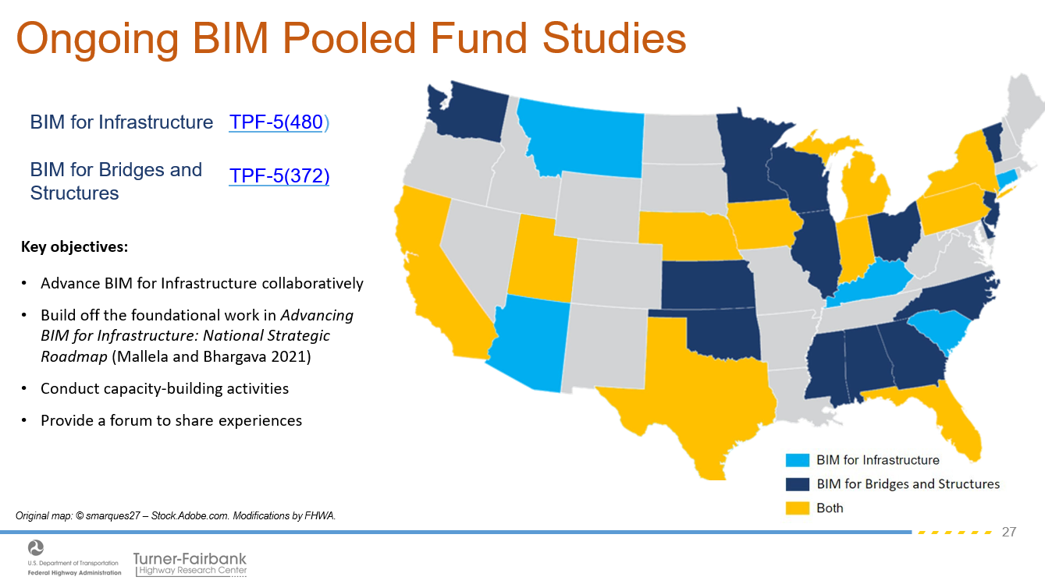
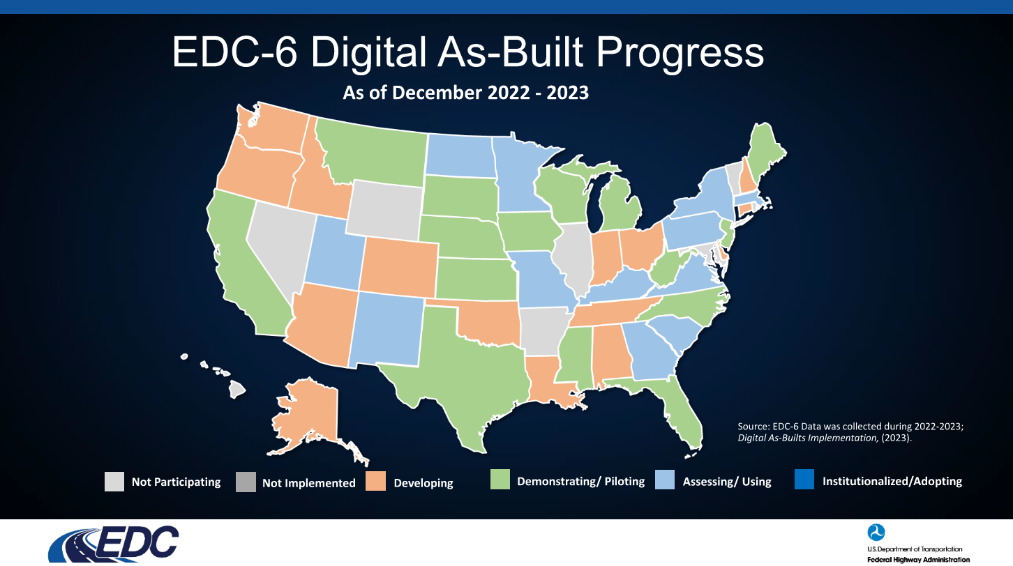

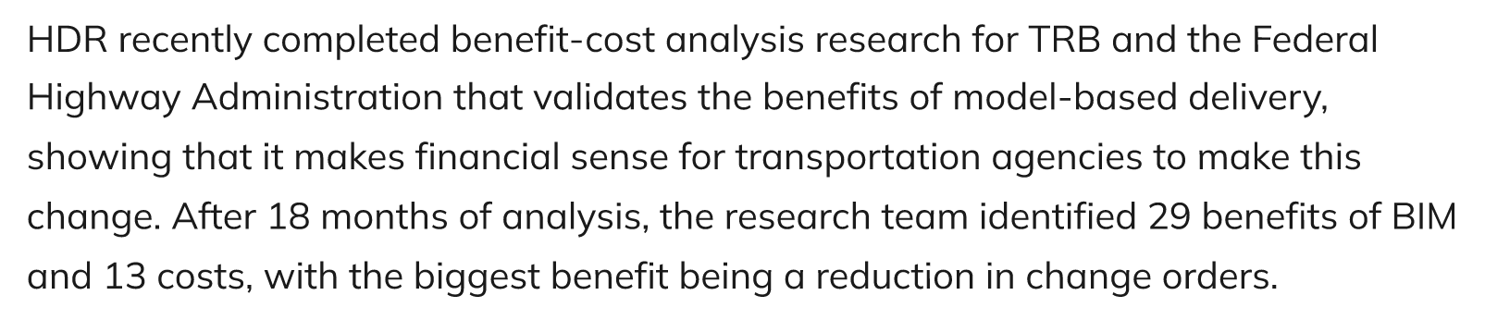

The Current
Situation
FHWA
Notes:
HDR estimates the biggest savings is in reduced Change Requests and projects can save up to 15% by DPD
FHWA has invested over $35M dollars in DPD through research and EDC programs.

Slide 27
FDM 900: NexGen Plans
Model Based - Estimated Quantities (EQ) Report
BIM Standards Delivery – Level of Development Specs.
3D Project BIM File Delivery
Design Services Staff Hour Guidelines
AMG Modified Special Provisions
3D CEI Contract Scope Changes
FDOT Standards and Policy Updates

Slide 28
    Changed the definition of Plans…
    To include digitally signed pdf 2D plans and digitally signed 3D BIM files.
    2D Plan show location, character, some dimensions, and details of the work
    3D Model is utilized for construction specific data; xyz of design intent
    To include implementation of large format sheets 24x36, 36x48, and 36x72
    To include 11x17 worksheets for printing purposes
FDM 900 Series Updates:

Slide 29
    Where applicable; Pay Item quantities are derived from the BIM file
    Other “Each, or Lump Sump” quantities are derived from the 2D plans
    Earthwork volumes are computed from surface to surface algorithms and can be checked using average end area
Model-centric Estimated Quantities reports:

Slide 30
3D Deliverables for AMG Standard Folder in CADD/BIM files
Modeling Standards FDOT CADD manual Section 5.16
Published BIM LOD Standards;100, 200, 300, 350, 400 levels
BIM Standards for Level of Development:

Slide 31
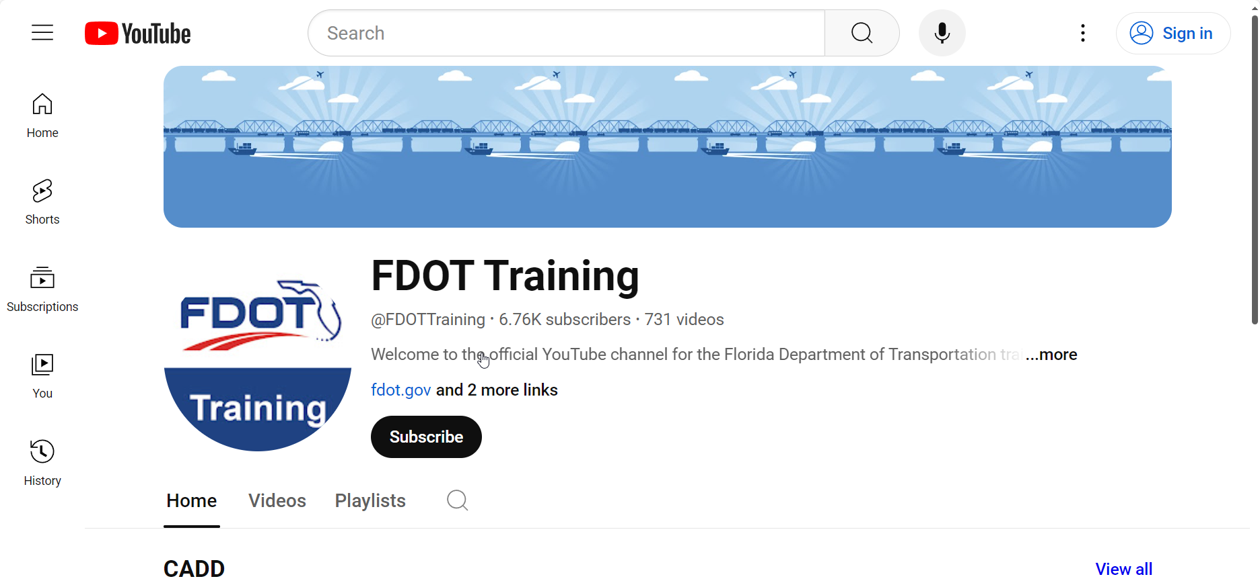
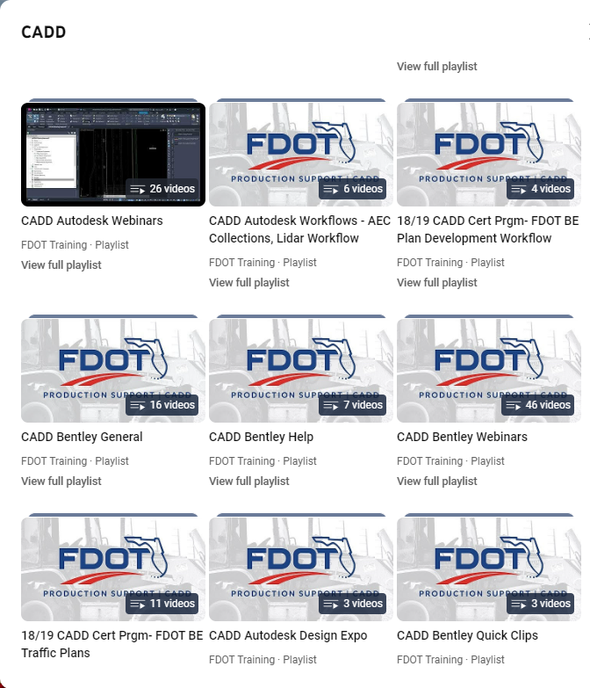
Model-Centric Production Training:

Slide 32
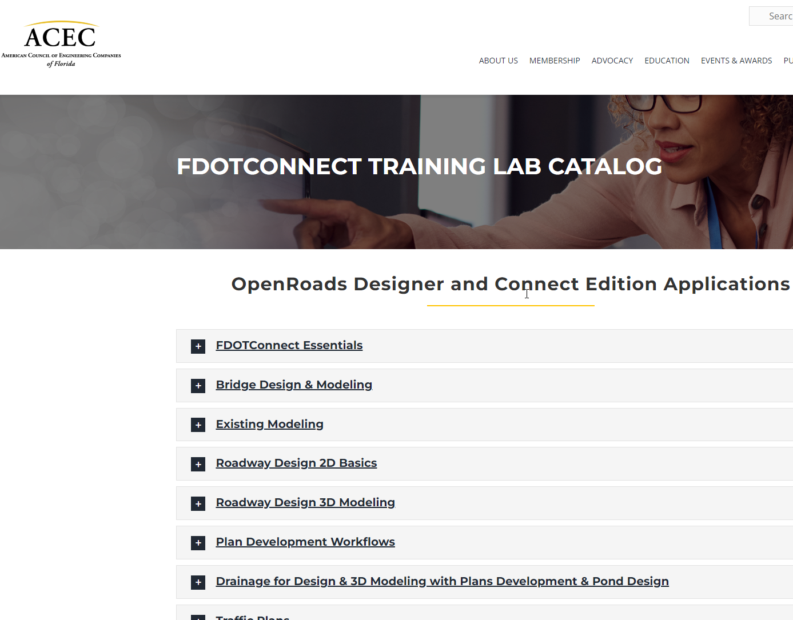
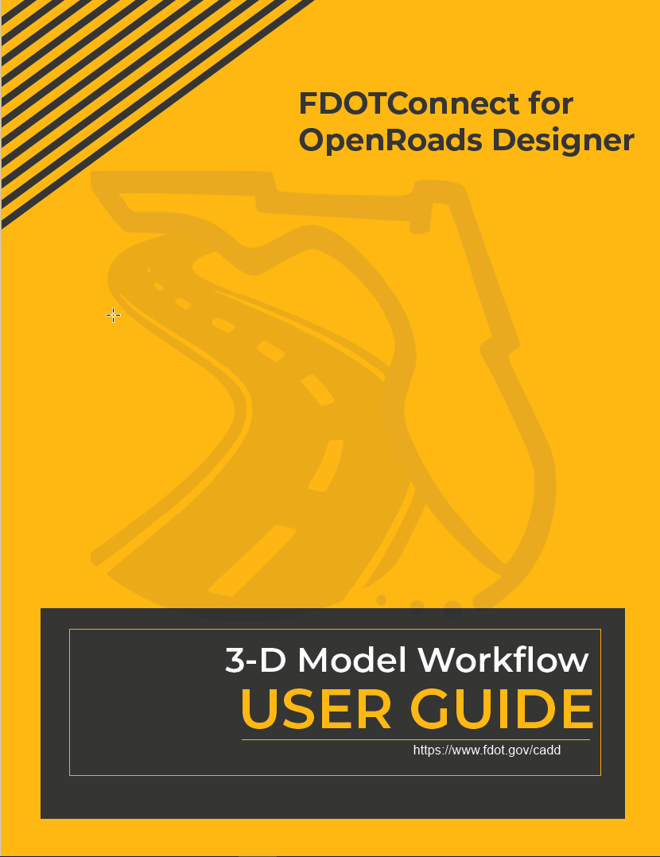
Model-Centric Production Training:

Slide 33
    Updating Staff Hour Estimate Guidelines available January 2024
    3D model standard by by project type for each design component
    FDOT 3D Model Project Reviews – Standard View tool RFP
    Pilot Projects – help develop norms, best practices and better guidelines
Project Management Updates:

Slide 34
    AMG Modified Special Provisions
    Developed for:
    Definition of “Plans and working drawings”
    Milling and Resurfacing Operations
    Engineering and Layout (Control of Work)
    Excavation and Embankment
    Stabilization
    Optional Base Course
    Hot Mix Asphalt
Modified Special Provisions:

Slide 35
    3D CEI Contract Scope Changes:
    Additional Needs for Personnel with Modeling Experience
    Additional Needs for Personnel with Advanced Survey Methods Experience
    Need for Advanced Equipment; Rovers, SiteVision, Etc.
    AS-BUILT Model development work ??
    Additional As-Built Asset Information
3D CEI Services:

Slide 36
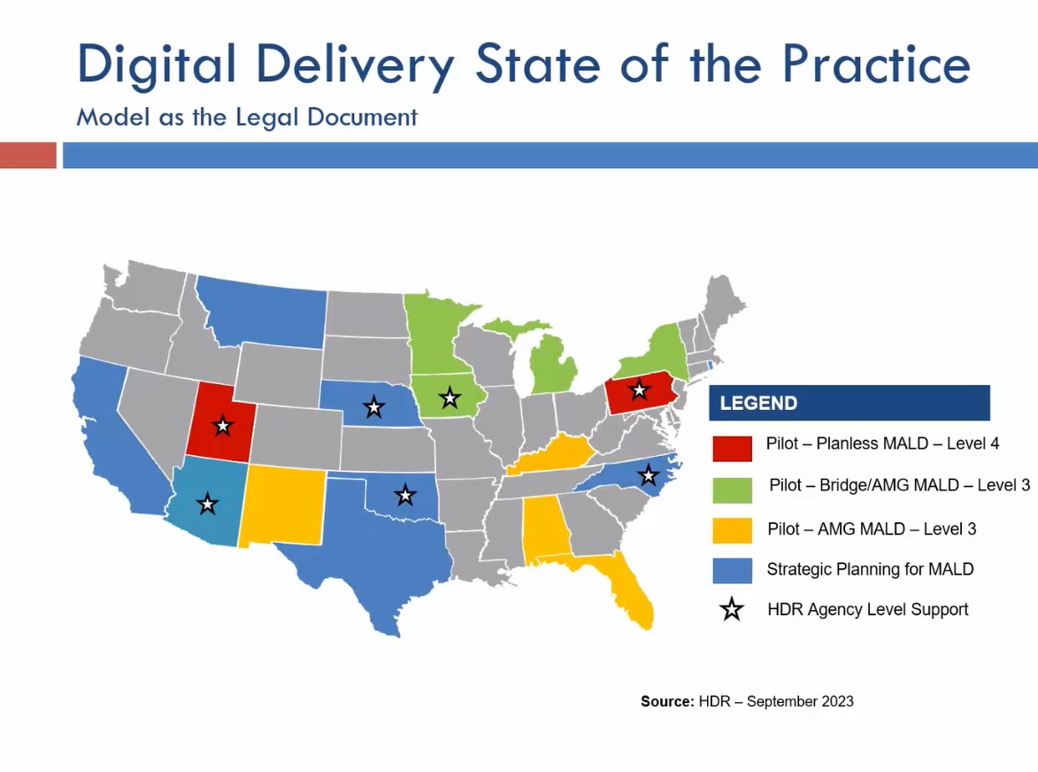
Nationally - DOTs:

Slide 37
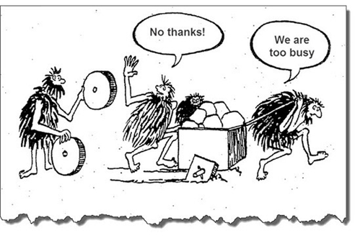
What’s Happening at the DOTs:
Applying for Grants (AID, STIC, RAISE, ADCMS)
Hiring Consultants
Creating Positions for Chief Data Officer, etc.
Conducting Peer Exchanges
Conducting Pilot Projects
Creating & Publishing Strategic Roadmaps
Encouraging Technology Partners to Collaborate
Working with FHWA and AASHTO
Working with ACEC and AGC Groups
Updating Agency Standards
Updating Training Programs
Sharing Results at Industry Events

Slide 38
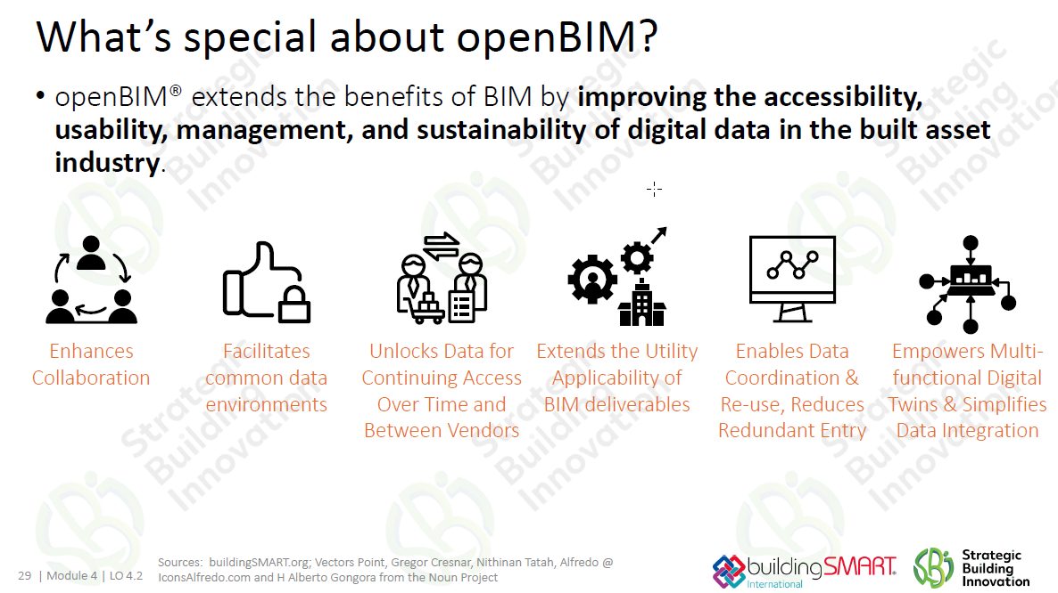
Challenges:

Slide 39
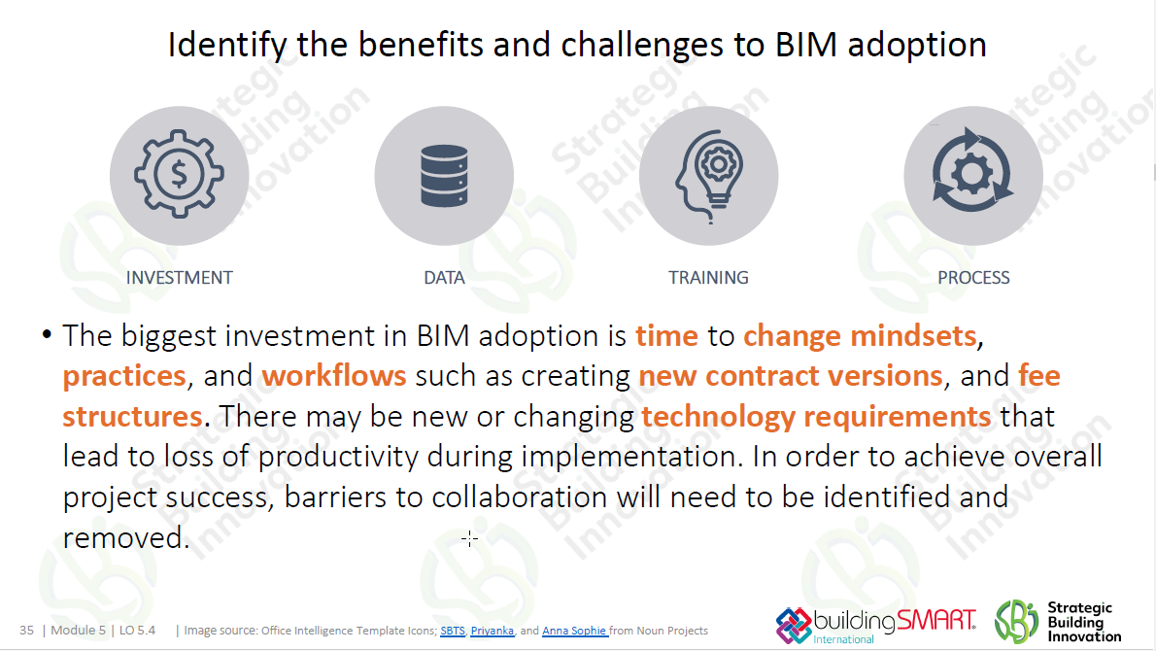
Challenges:

Slide 40
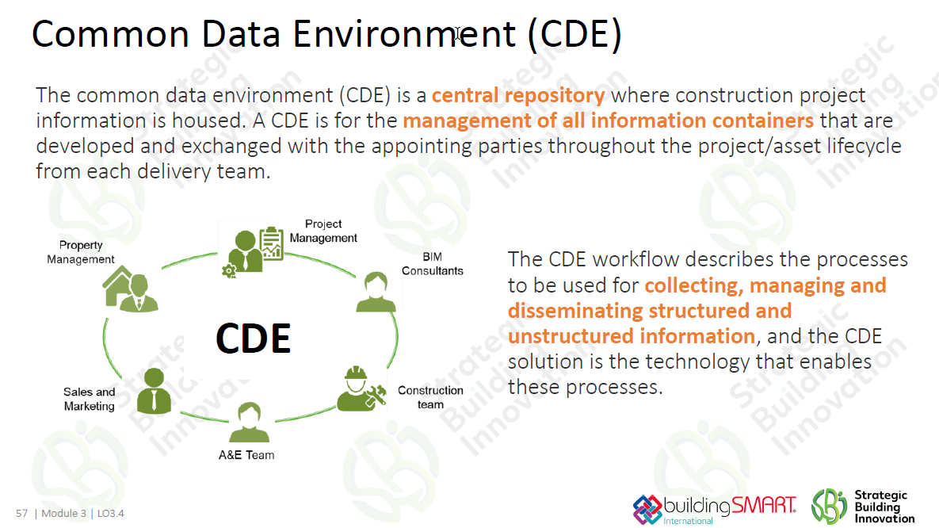
Data Environment:

Slide 41
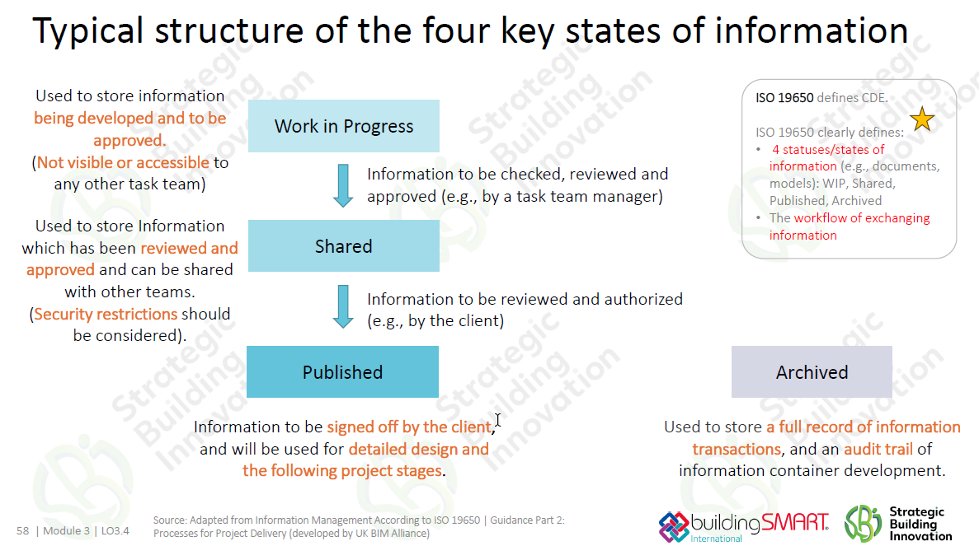
Versioning:

Slide 42
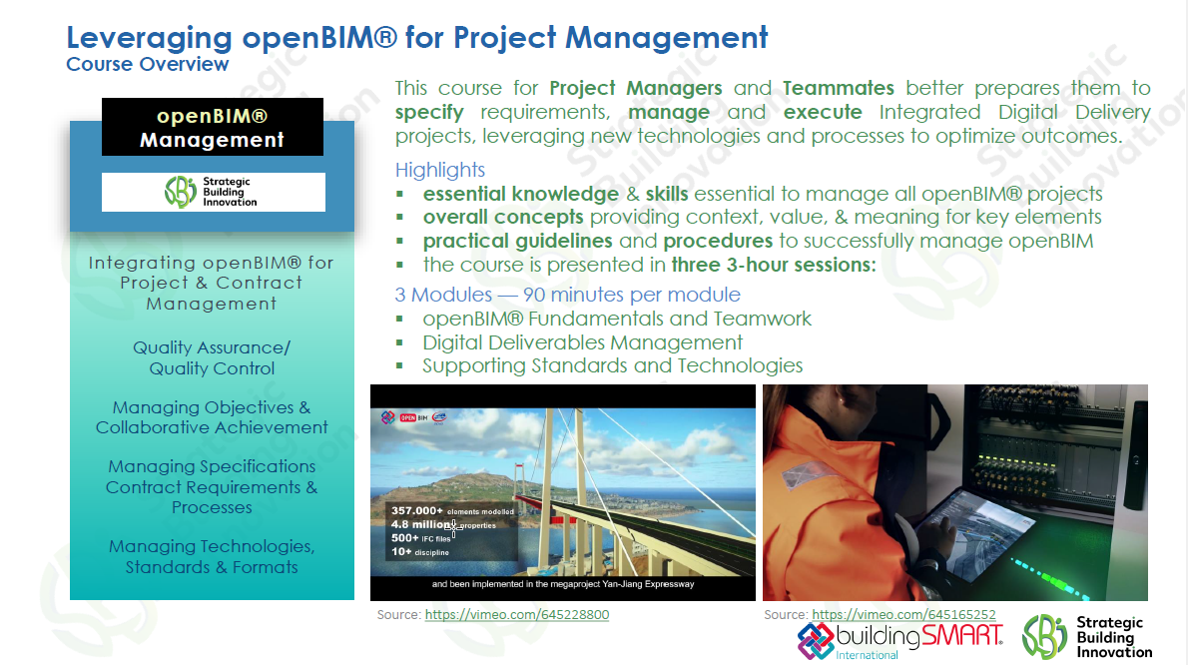
Professional Development:

Slide 43


Questions?
Contact Us
Thank you for joining our training session!
Need HELP? Contact us…
E-mail: vern.danforth@dot.state.fl.us
http://www.fdot.gov/cadd/

Slide 44

Contact Us
Thank you for joining our training session!
Need HELP? Contact us…
E-mail: vern.danforth@dot.state.fl.us
http://www.fdot.gov/cadd/

Slide 45
