Slide 1
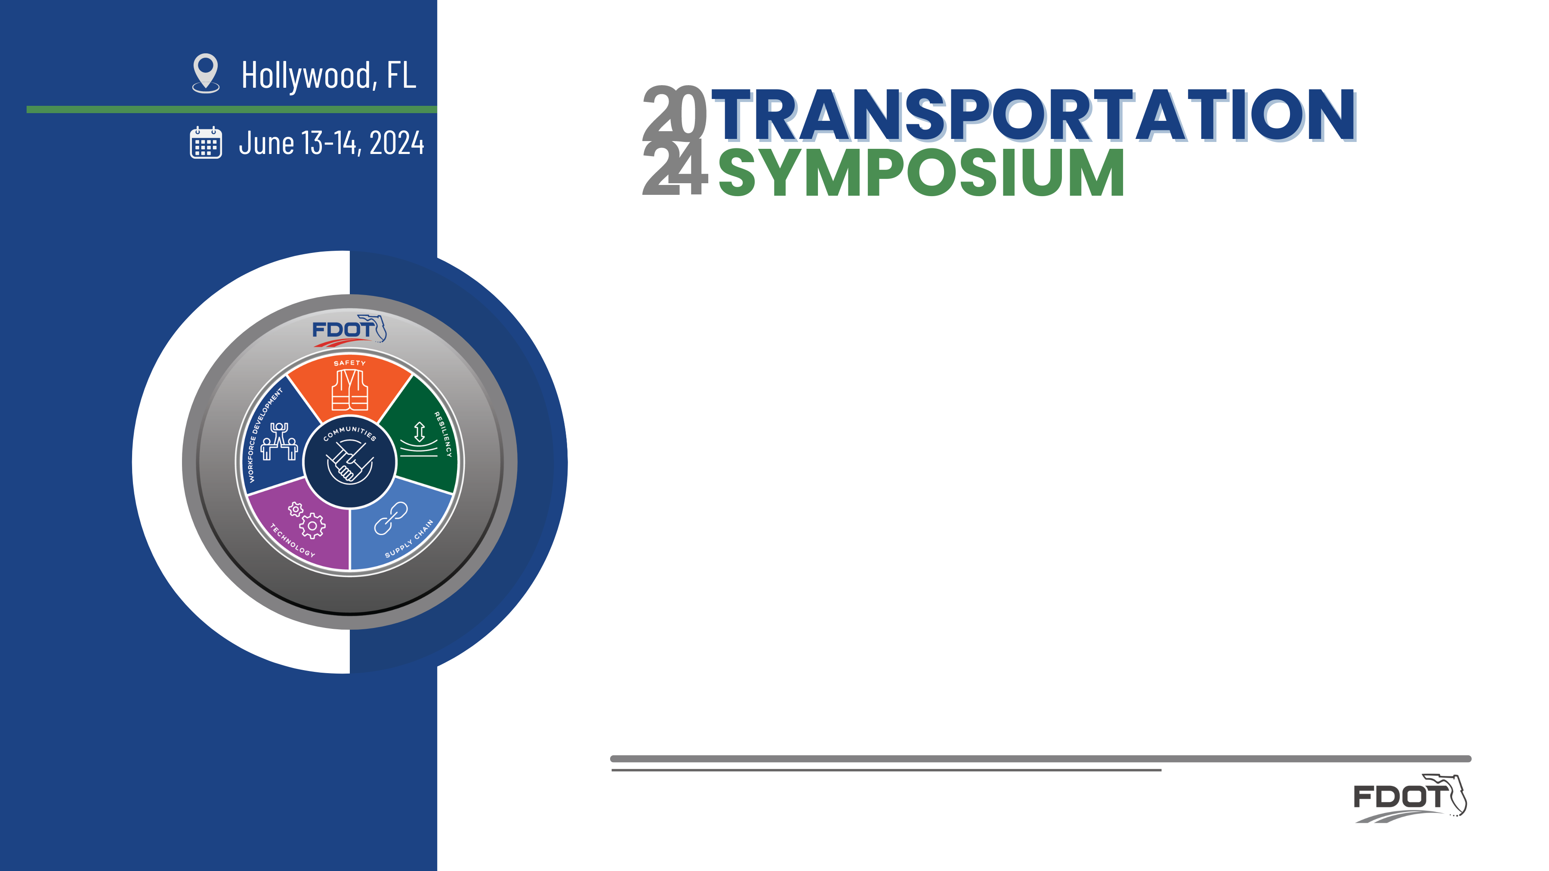

FHWA’s Project-Level Safe System Alignment Framework and Tool
Elliott Moore
FHWA Resource Center

Slide 2
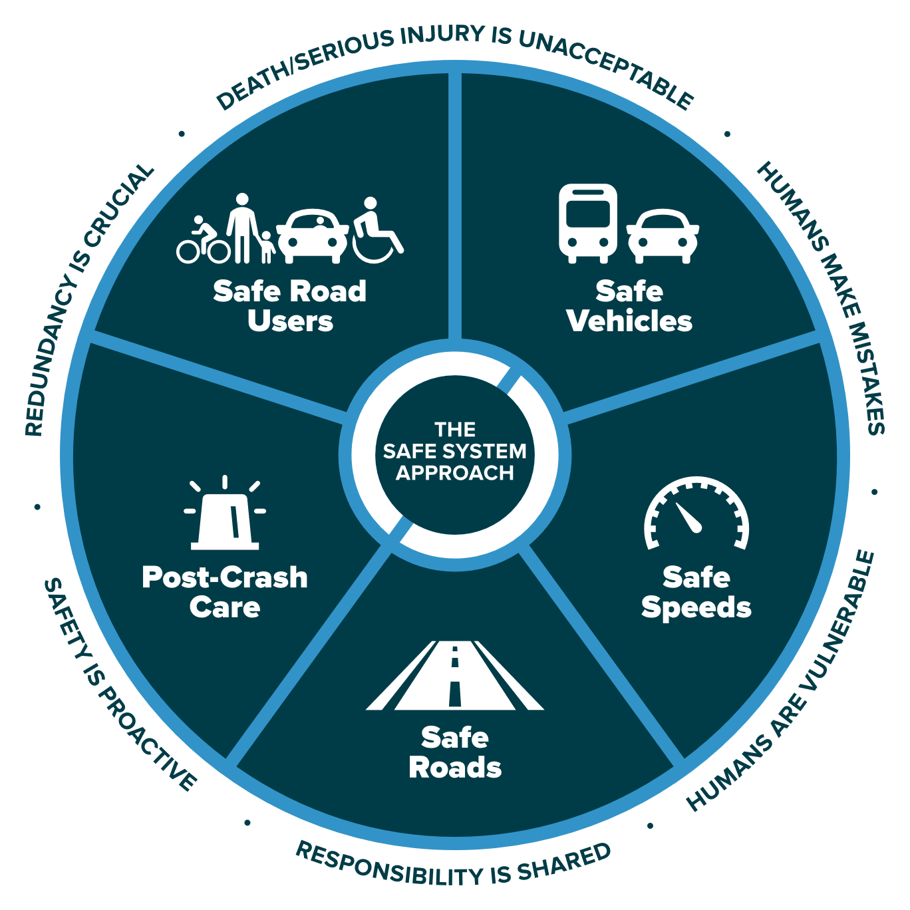






The Safe System Approach
Image Source: FHWA
Notes:
Key Message: This graphic presents an overview of the Safe System approach. There are three key components to understand, which will be explained on this and the following slides. These are the Safe System “approach,” “principles,” and “elements.” The Safe System “approach,” shown by the graphic on this slide, is the broadest term and describes all aspects of the Safe System.
In addition, the term “Safe System” is singular to depict an overall Safe Road System. The National Safety Council and our international partners also use this version.
Interactivity: No interactivity for this slide.
Background: This graphic was created for FHWA drawing inspiration from similar designs by the Institute of Transportation Engineers (ITE), the Road to Zero Coalition, and the Royal Society for the Prevention of Accidents (ROSPA) in the United Kingdom.
Notes: No notes for this slide.

Slide 3
Swiss Cheese Model
The “Swiss Cheese Model” of redundancy creates layers of protection
Death and serious injuries only happen when all layers fail
Safe road users
Safe road users
Safe vehicles
Safe vehicles
Safe speeds
Safe speeds
Safe roads
Safe roads
Post-crash care
Post-crash care
Adapted from James Reason’s model for analyzing accident causation
https://royalsocietypublishing.org/doi/10.1098/rstb.1990.0090
Image Source: FHWA
Notes:
A great way to visualize these “layers of protections” is to look at them through the Swiss Cheese Model.
Layered slices of swiss cheese (each with holes representing weaknesses) represent the individual elements of the “System”.
The basic principle is that lapses and weaknesses in one part of the system can occur (CLICK), but other parts compensate to not allow a failure (that is, a fatal crash).
A “failure” (CLICK) only results when a hole in each slice momentarily aligns (CLICK), permitting an incident to pass through holes in all the slices.
(Next Slide)
The “Swiss Cheese Model” is applicable to numerous risk management fields and was originally propounded by Dante Orlandella and James T. Reason of the University of Manchester

Slide 4
Top 3 Safe System “Takeaways”
The Safe System Approach is “Principles Based”
Achieving a Safe System requires all five elements to be strengthened
Safe Roads is a continuum, not an absolute
Notes:
Not an infrastructure initiative. If you get the principles, you’ll get it.
(CLICK)
There are 5 elements. Even though we’re only going to be talking about Safe Roads today, you need to strengthen all 5 Elements
(CLICK)
There are no “safe” or “unsafe” roads, but there are ways we can address the transportation system that can enhance the safety of its users. It’s not about eliminating risk, but REDUCING risk.
Key Message: The Safe System Approach is a complex topic and this presentation is an introduction. The top three things we want you to take away from this presentation are:
The Safe System Approach is “Principles Based” – you will learn the safe system principles that guide this approach and advance safety culture.
Achieving a Safe System requires all five elements to be strengthened – a system depends on each of its parts working together to achieve the best possible outcomes.
Safe Roads is a continuum, not an absolute – There are no “safe” or “unsafe” roads, but there are ways we can address the transportation system that can enhance the safety of its users.
Interactivity: No interactivity for this slide.
Background:

Slide 5
“… implementing the Safe System Approach”
What does that mean?
Applying a Safe System Approach
Different Thinking
Different Priorities
Different Decisions
Notes:
It’s not the same thing we’ve always done. I
We have to do things differently.
It’s about managing Kinetic Energy such that we can eliminate FATAL and SERIOUS INJURY crashes… not all crashes

Slide 6
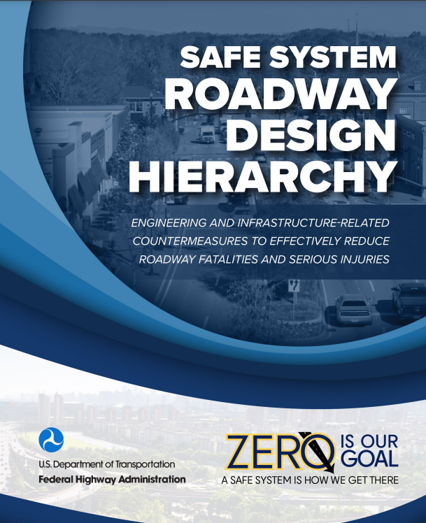
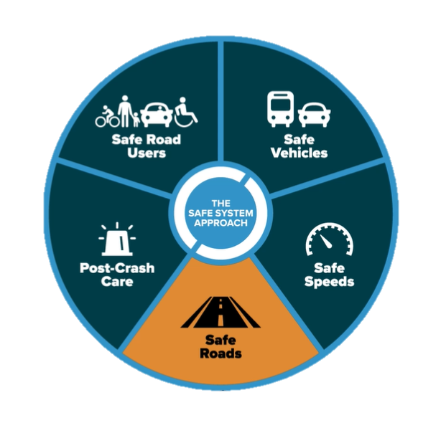
Advancing the Safe Roads Element in the SSA
https://highways.dot.gov/sites/fhwa.dot.gov/files/2024-01/Safe_System_Roadway_Design_Hierarchy.pdf
Source: FHWA
Notes:
The first part of this presentation is going to focus on the Safe System Roadway Design Hierarchy.
There are 5 elements, but we’re going to focus on the Safe Roads element.
Key Message: The five Safe System “elements,” highlighted in the middle ring of the graphic, are conduits through which the Safe System approach must be implemented. The key focus of the Safe System approach is to reduce death and serious injuries through design that accommodates human mistakes and injury tolerances. Making a commitment to zero deaths means addressing every aspect of crash risks through the five elements of a Safe System. These layers of protection and shared responsibility promote a holistic approach to safety across the entire roadway system. The five elements will be discussed in depth later in the presentation.
Interactivity: No interactivity for this slide.
Background: No background for this slide.
Notes: No notes for this slide.

Slide 7
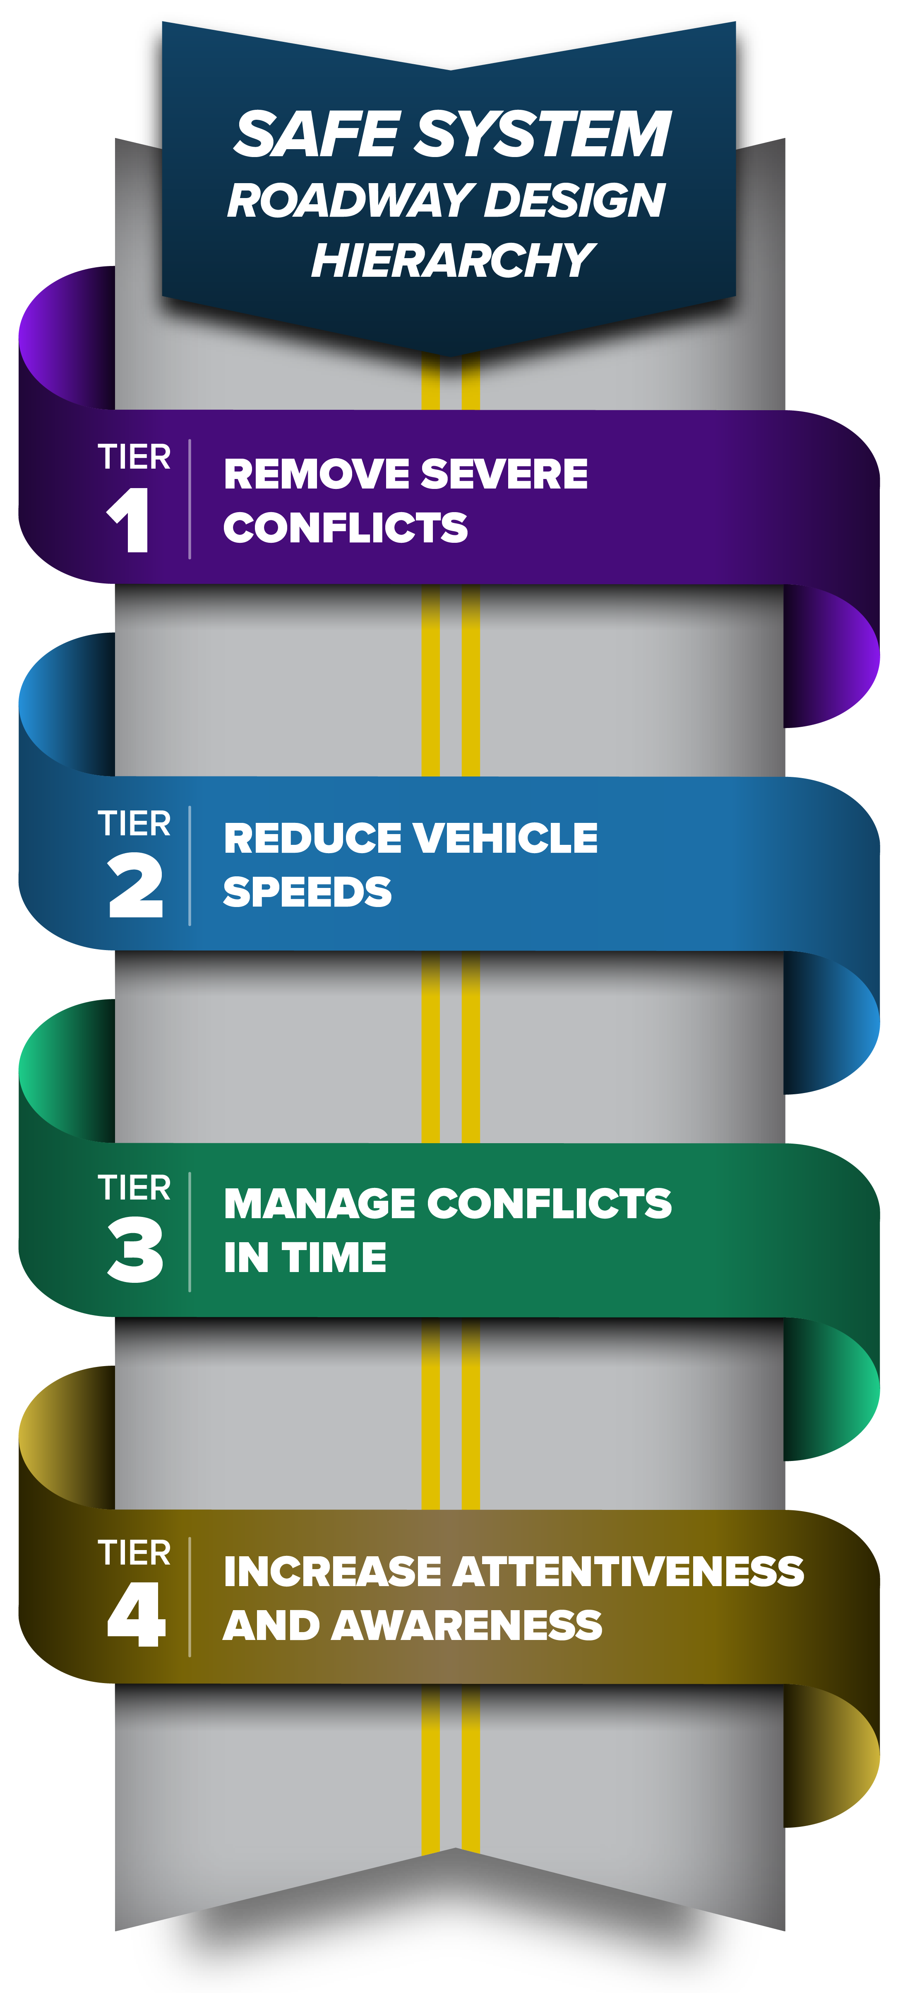

Safe System Roadway Design Hierarchy
The Safe System Roadway Design Hierarchy is a tool that characterizes engineering and infrastructure-based countermeasures and strategies relative to their alignment with the Safe System Approach (SSA).
Notes:
Here is a QR code so you can download this free publication.

Slide 8
Inspired by Occupational Safety
Hierarchy of Controls
The Safe System Roadway Design Hierarchy is emulated from the hierarchy of controls for workplace safety
Eliminate
Physically remove the hazard
More Effective
Substitute
Replace the hazard with option that lowers severity
Engineering Controls
Operate the system to reduce exposure
Administrative Controls
Education, legislation & policies to change behavior
Personal Protective Equipment
PPE, protective gear
Less Effective
Adapted from National Institute for Occupational Safety and Health – https://www.cdc.gov/niosh/topics/hierarchy/default.html
Notes:
At FHWA, we focus a lot of our efforts on R&D… Rip-off and Duplicate!
As you can see from our occupational safety counterparts, they two operate on a hierarchy of controls to PREVENT workplace events.
Prevention through Design
Initiative led by the National Institute for Occupational Safety and Health (NIOSH) to prevent or reduce occupational injuries, illnesses, and fatalities through efforts that anticipate and “design out” hazards to workers.
Hierarchy of controls is a
PtD strategy.
https://www.cdc.gov/niosh/topics/ptd/

Slide 9
Hierarchy of Street Safety Controls
MOST EFFECTIVE
ELIMINATION
Physically Remove Traffic Hazards.
Pedestrian Streets, Offstreet Paths, Scramble Crossings, Dedicated Transitways, Automated Speed Limiters
Replace with Lesser Hazards.
Home Zones, Shared Streets, Neighborhood Greenways, Roundabouts, Automated Speed Enforcement
SUBSTITUTION
ENGINEERING
CONTROLS
Isolate People from Traffic Conflicts.
Sidewalks, Protected Bikeways, Curbs, Bollards, Traffic Diverters, Pedestrian-Prioritized Signals, Speed Humps, Chicanes
ADMIN
CONTROLS
Change the Way People Travel.
Education Campaigns, Marked Crosswalks, Pedestrian Crossing Buttons, Sharrows, Permissive Signal Phases, Signage
PPE
Safeguard with Personal Protective Equipment.
Reflective Vests, Pedestrian Crossing Flags,
Bicycle Helmets, Seatbelts, Airbags
LEAST EFFECTIVE
vision-zero-strategic-plan-120120.pdf (bellevuewa.gov)
vision-zero-strategic-plan-120120.pdf (bellevuewa.gov)
Notes:
But at FHWA, we were not the first to rip off this concept The City of Bellevue in WA created this hierarchy that has some similar components to what we’ll be exploring today.
Adapted from versions created by Cathy Tuttle and Queen Anne Greenways. Based on Recommendations of Hazard prevention and Control created by US Department of Labor Occupational Safety & Health Administration and the Center for Disease Control and Prevention. Effective controls protect people from workplace hazards; help avoid injuries; illnesses and incidents; minimize or eliminate safety and health risks; and help employers provide workers with safe and healthful working conditions and help prevent and control hazards.

Slide 10
What’s Old is New
Hierarchy to address hazards within the roadside clear zone
Remove
Make Traversable
Make Crashworthy
Shield
Delineate
Derived from AASHTO Roadside Design Guide.
Source: FHWA
Notes:
The idea of a hierarchy isn’t new in transportation design either. Do any of you have prior experience with the AASHTO RDG?

Slide 11
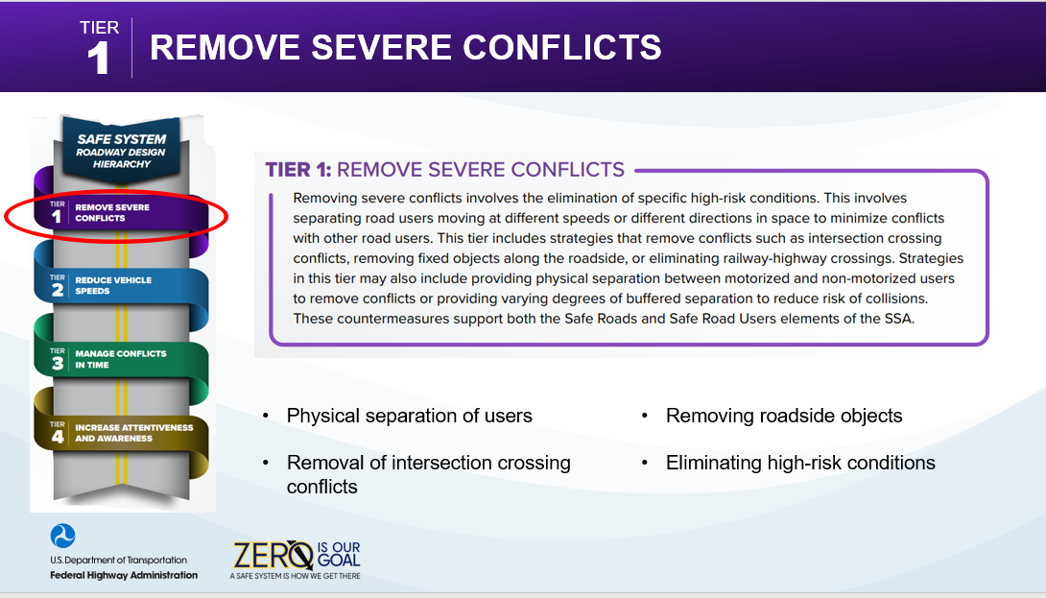
Slide Title

Slide 12
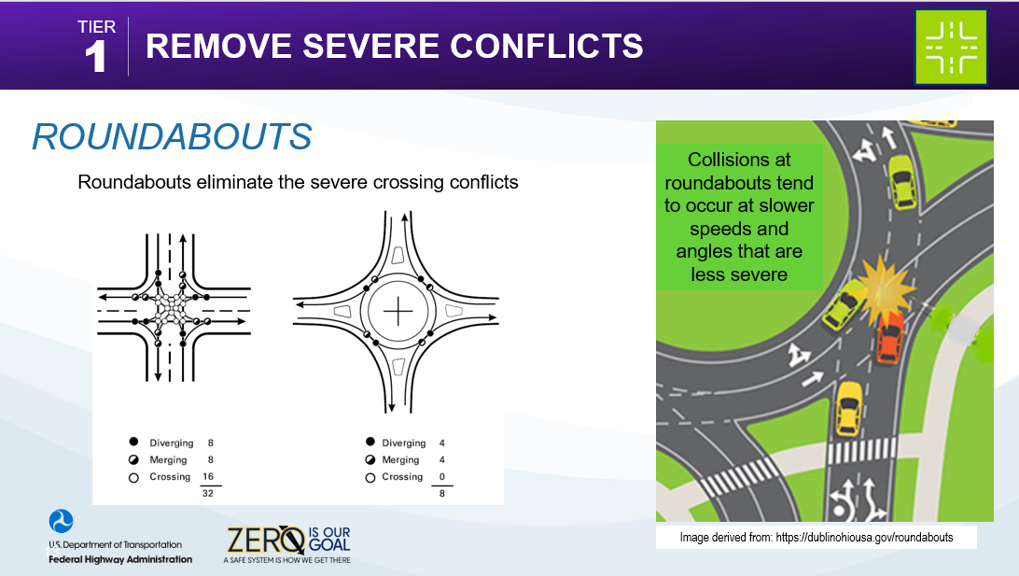

Slide 13
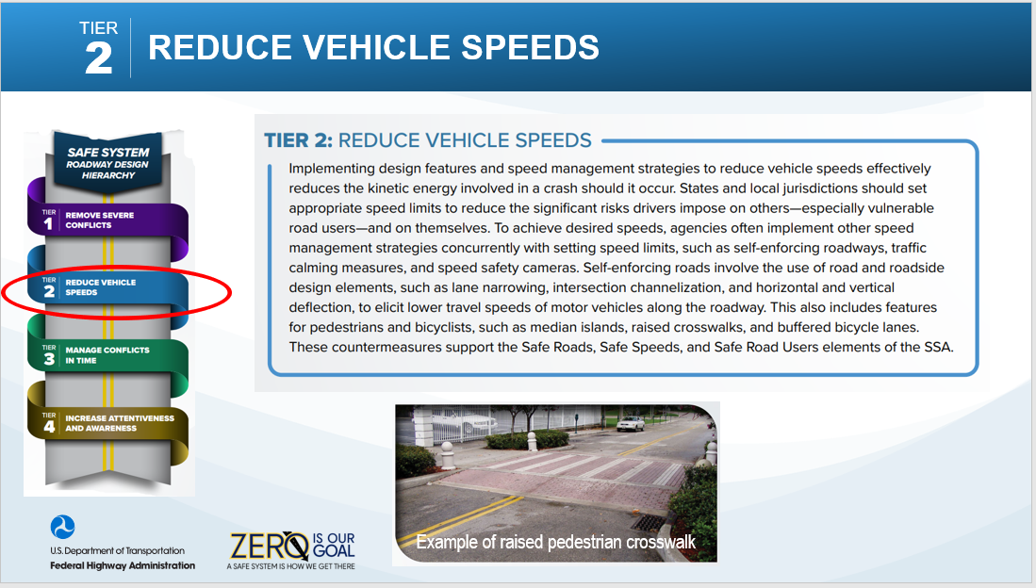

Slide 14
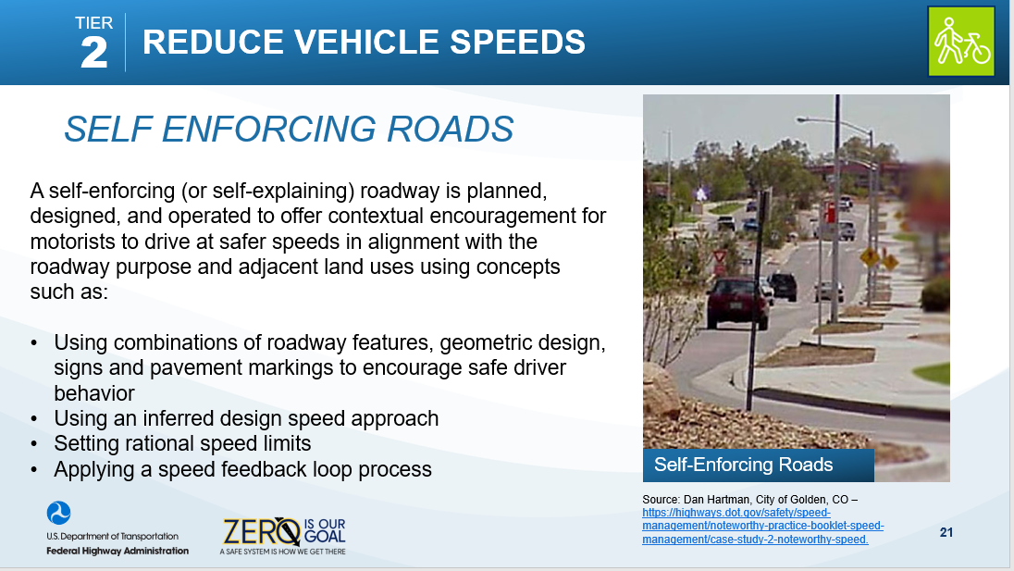

Slide 15
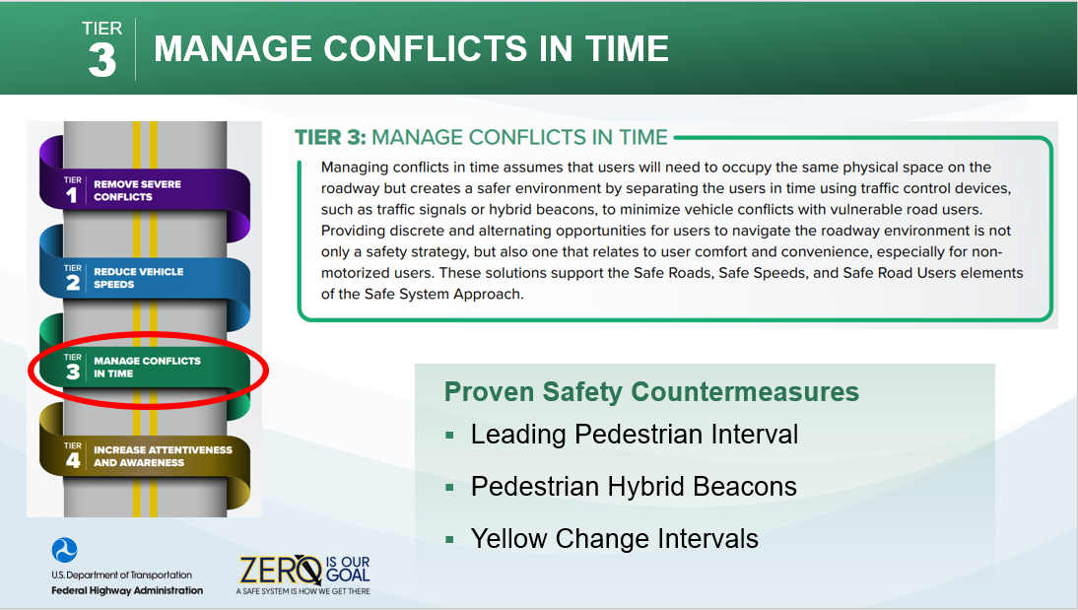

Slide 16

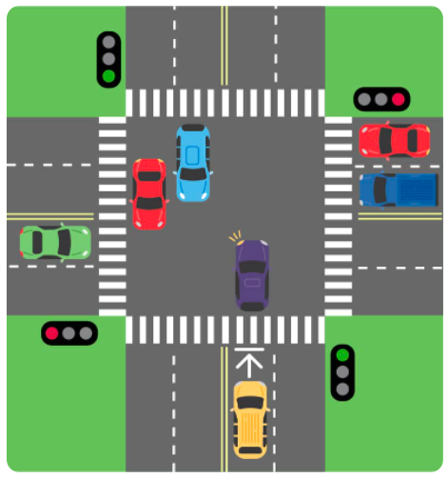


Protected Left Turn Signal Phasing
“Permissive” left-turning vehicular traffic is a concerning risk that pedestrians and cyclists face at many signalized intersections
Consider:
Protected only left turn signal phasing; or
Flashing Yellow Arrow to omit permissive movement when there is a pedestrian call
Notes:
FL has too many Protected-permissive operations.
Give Mike example.
“that’s going to mess up our LOS” – we have to do things different… different priorities…

Slide 17
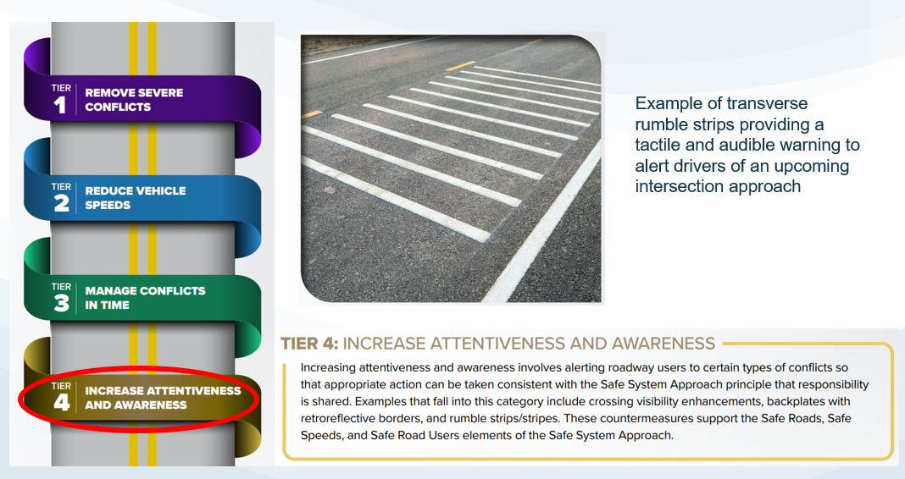
Notes:
It’s not that they’re not good, just not as affective

Slide 18
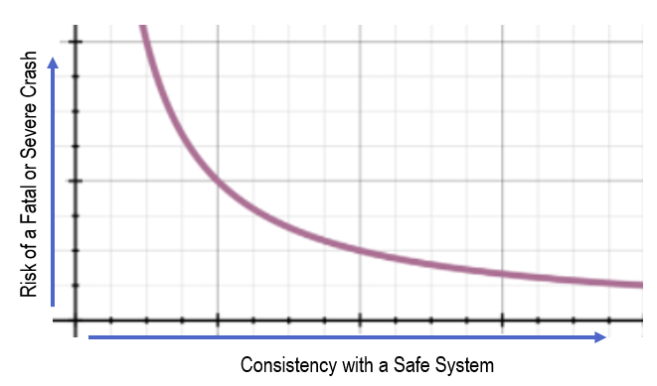




“Safe Roads” is a Continuum – Not an Absolute
Existing Condition
Note: This figure is a simplified graphical representation of a concept and is not intended to imply a precise numerical relationship. The lack of units on this graph is intentional.
Notes:
Shifting down a continuum.

Slide 19
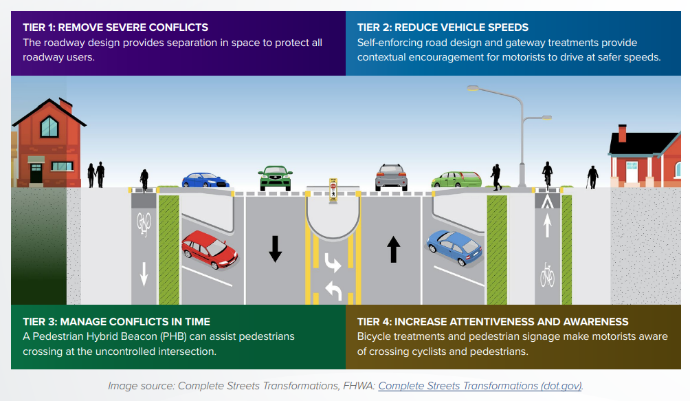
Applying the Hierarchy to Implement
Complete Streets
Complete Streets implementation may apply the Safe System Design Hierarchy to identify and prioritize safety enhancements.
Notes:
Plug for complete streets. Tiers can help prioritize complete street improvements

Slide 20
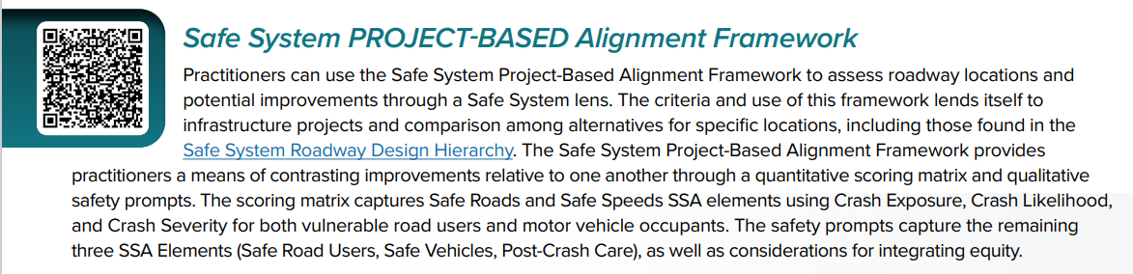
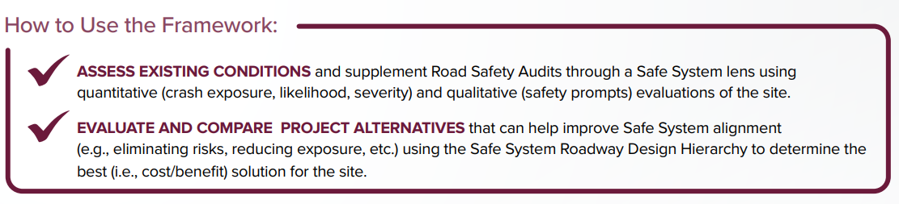
Safe System Alignment Frameworks (dot.gov)
Notes:
This project-based is intended to be simpler… I was told there is no MATH.
CAN BE USED ON ROAD SEGMENTS.

Slide 21
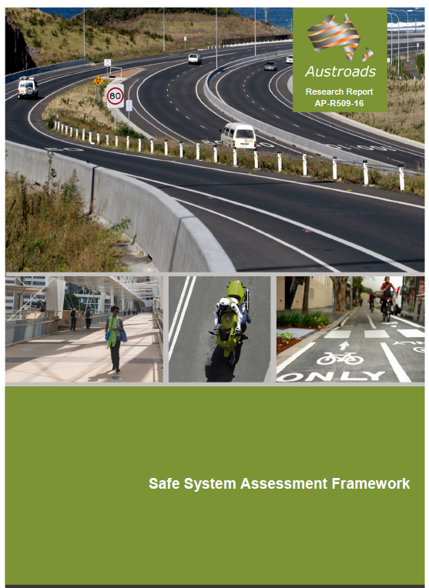
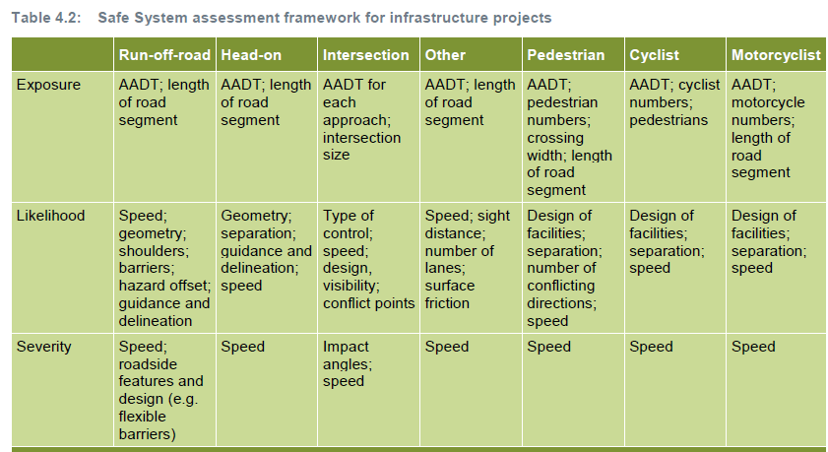
Background – International Perspectives
“… designed to help road agencies methodically consider Safe System objectives in road infrastructure projects.”
https://austroads.com.au/latest-news/safe-system-assessment-framework
Notes:
R&D – ripped off and duplicated. Inspired by Australia
All FHWA does is R&D…
Exposure/Likelihood/Severity
Ours is more quantitative vs qualitative

Slide 22
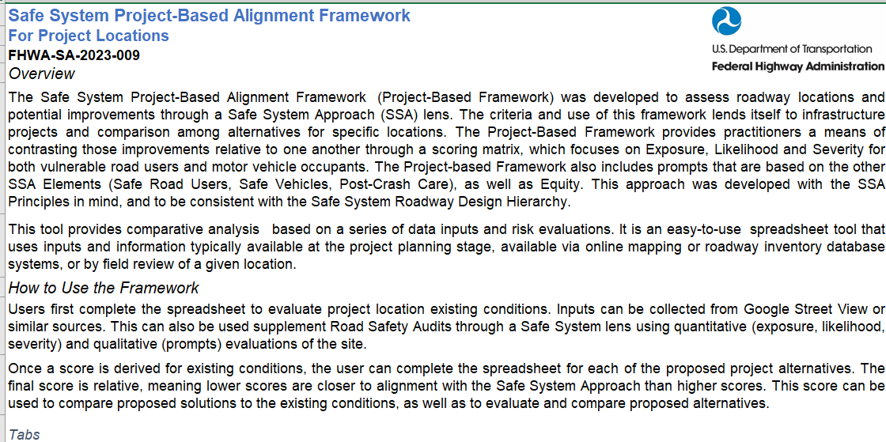
Notes:
Spreadsheet tool screenshots
Overview

Slide 23
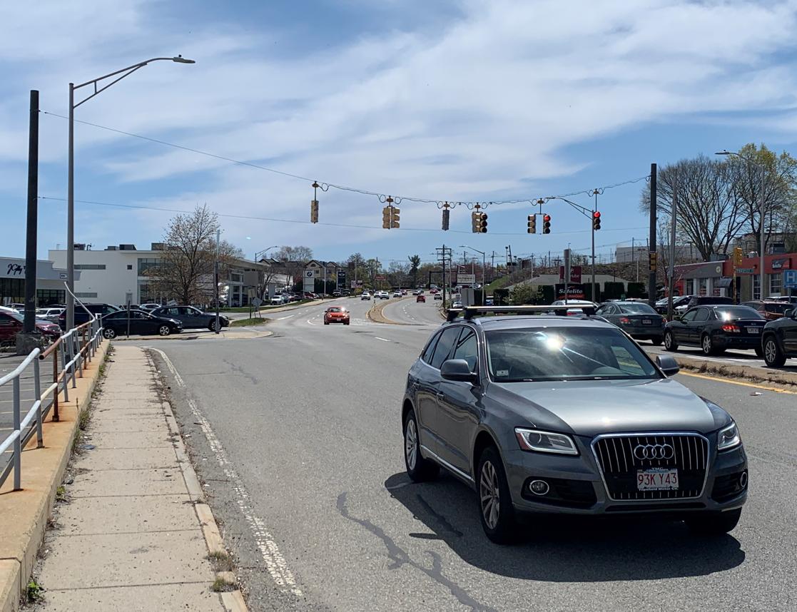
Project-Based Alignment Framework
Project-Based Alignment Framework Factors
Safe Speeds, Safe Roadways (Quantitative)
Crash Exposure
Crash Likelihood
Crash Severity
Safe Users, Safe Vehicles, Post-Crash Care (Qualitative)
Prompts and Questionnaires
Source: FHWA.
Notes:
Three legs of a stool
Exposure – traffic volumes, crossing distance, etc.
Likelihood – risk factors
Severity – primarily speed
High severity, but low exposure… maybe not as big of a concern…. Conversely, high exposure….

Slide 24


Managing Expectations
Flexible structure ≠ Rigid adherence to defaults
Source: https://www.merriam-webster.com/dictionary/framework
Notes:
Manage expectations… this is a framework… not end all be all
“Basic” structure
Framework is good… details can be flushed out later… framework is applicable to everyone
FL’s expectations for high volume vs Montana’s may be different… they can be changed based on your agency preference

Slide 25
Project-Based Alignment Framework
Score
Exposure
Likelihood
Severity
Notes:
These going into an SSA Score

Slide 26
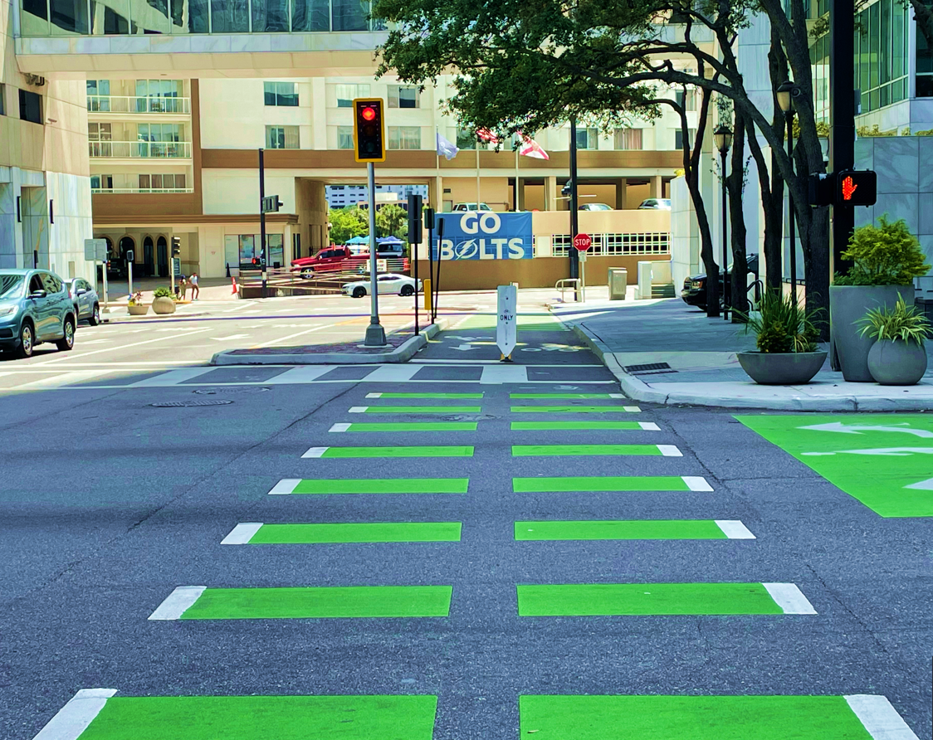
Exposure
The volume and/or length (distance) various users are using a facility and could be involved in a potential crash
Source: FHWA.

Slide 27
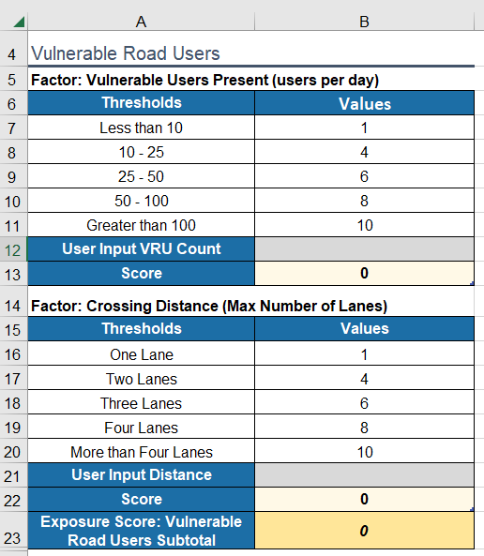
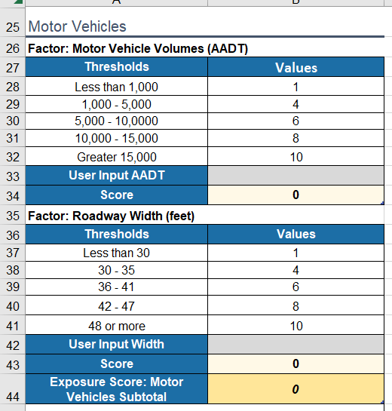
Project-Based Alignment Framework:
Exposure Scoring Matrix
Notes:
Inputs
Tool does differentiate between VRUs and Motor vehicles.
You can adjust to conditions that fit your state/district/locality… but the concept is to keep these categories

Slide 28
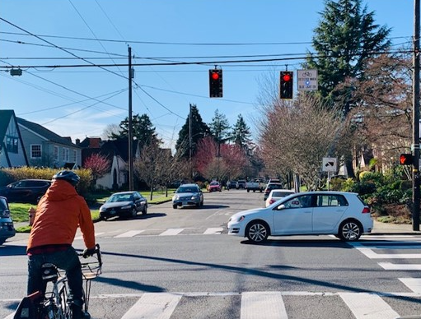
Likelihood
Elements and/or risks that impact the probability of a crash taking place by influencing the opportunity for conflict and/or user error rates
Source: FHWA.
Notes:
Definition of likelihood

Slide 29
Risk Factors – Motor Vehicles
Lighting Conditions
Fixed Objects
Right Turn on Red Conditions
Permissive Left Turns
Obstructed Sight Distance
Topography (grade)
Roadside Recovery Area
Roadside Drop Off
Rumble Strips
Right Turn Lane Channelization
Driveways
Separation of Opposing Traffic Movement
Crossing Conflicts
Intersection Skew
Road Curvature
The Framework Tool allows users to enter additional risk factors
Notes:
These are the motor vehicle risk factors that are currently included
Can add additional

Slide 30
Risk Factors – Pedestrians & Bicycles
Space Separation
Crosswalk Markings
Right Turn on Red Conditions
Permissive Left Turns
Bicycle Boxes
Separation in Time
Pedestrian Signal Phasing
Bicycle Signals
Lighting
Obstructed Sight Distance
Driveways
Topography (grade)
Free Flow Right Turns
Intersection Skew
Road Curvature
The Framework Tool allows users to enter additional risk factors

Slide 31
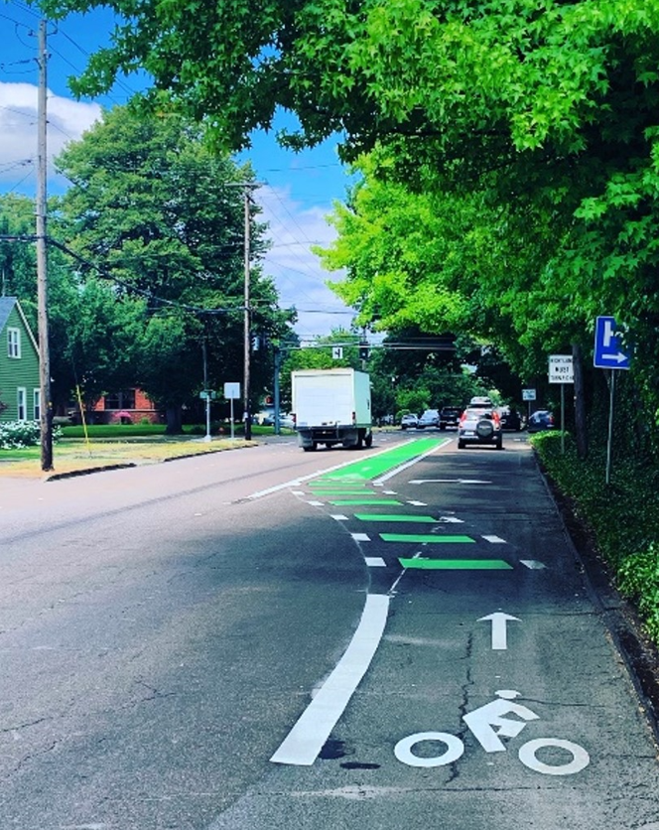
Severity
Factors that impact the probability of a serious or fatal injury in the event of a crash
Source: FHWA.
Notes:
Primarily speed

Slide 32
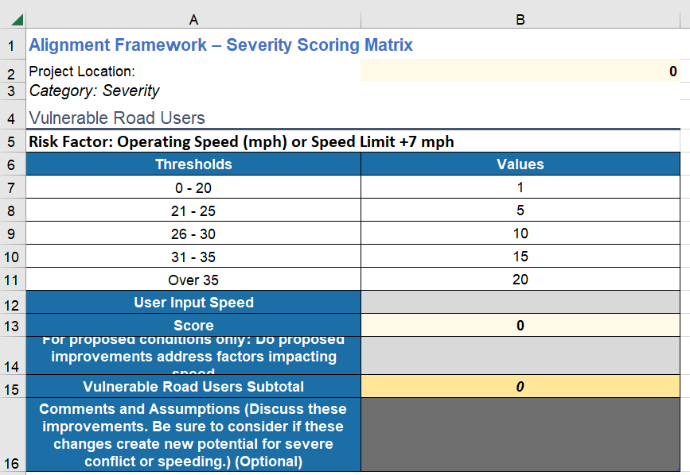
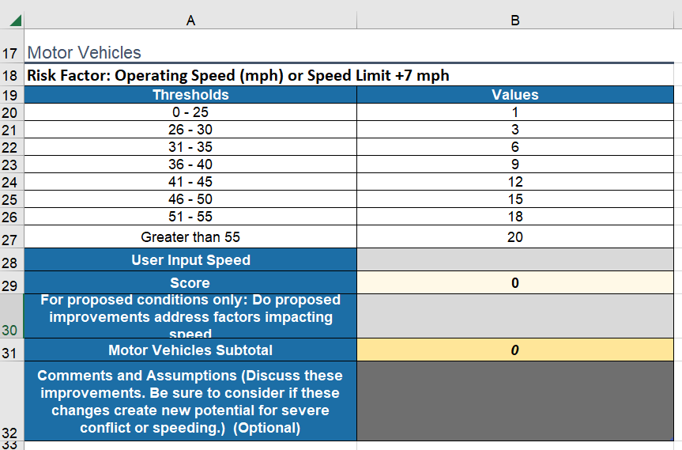
Severity Scoring

Slide 33
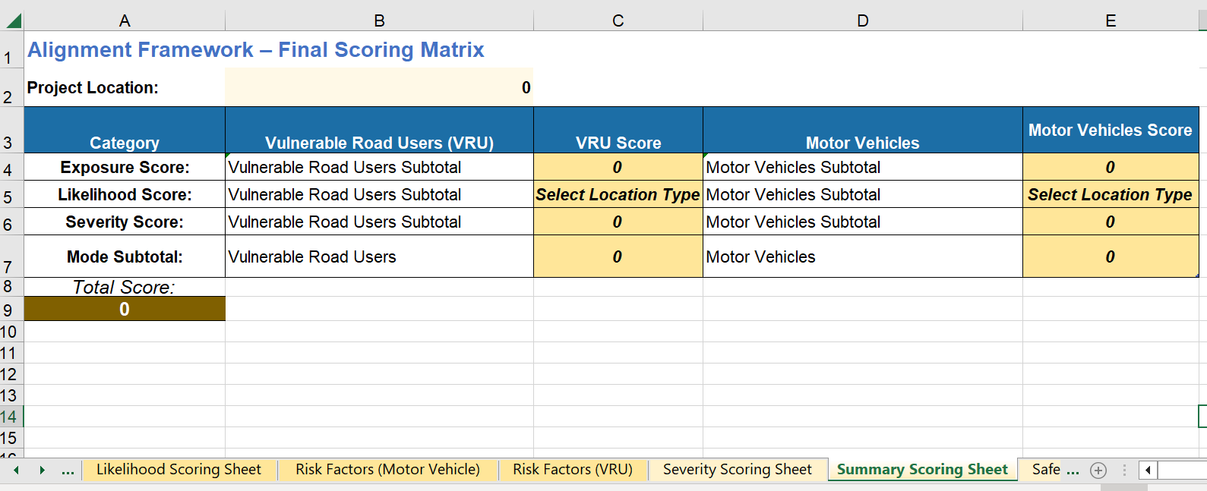
Alignment Scoring Matrix
Notes:
Enter all of the data and you get a score… you can use it to compare alternatives… it’s all relative to the other alternatives.

Slide 34
Reality Check
What do the scoring numbers mean?
  The scoring values are unitless and meant for comparison purposes only
For what purposes should I use this tool?
  Comparisons of current conditions to proposed improvements
  Comparisons of options and alternatives
Notes:
Think about RSAs

Slide 35
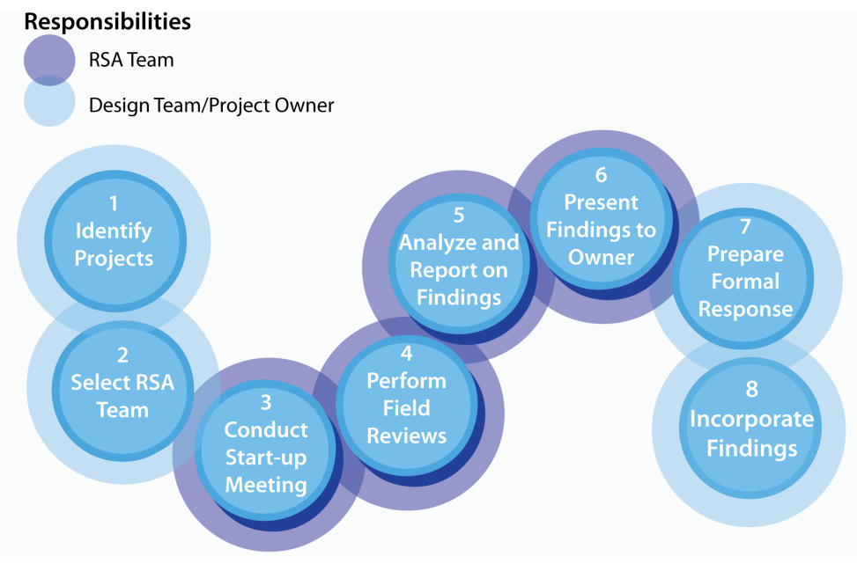

Application to Support Road Safety Audits
Application of Safe System Framework
Step 4 – Perform Field Reviews
Assess Framework Risk Factors
Step 5 – Analyze and Report on Findings
Quantitative Scores for Vulnerable Road Users and Motor Vehicles
Step 6 – Present Findings to Owner
Quantitative Comparison of Existing Conditions to RSA Suggestions
Road Safety Audits (RSA) | FHWA (dot.gov)

Slide 36
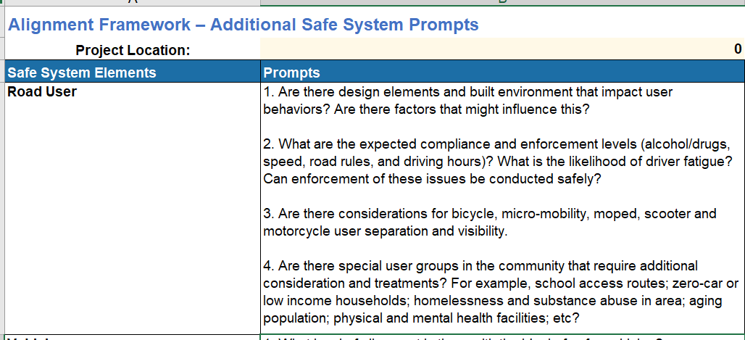
Other Safe System Elements
Notes:
Focuses on safer roads elements
Has Prompts in regards to the other SSA elements
You DON’T have to go through these… optional

Slide 37
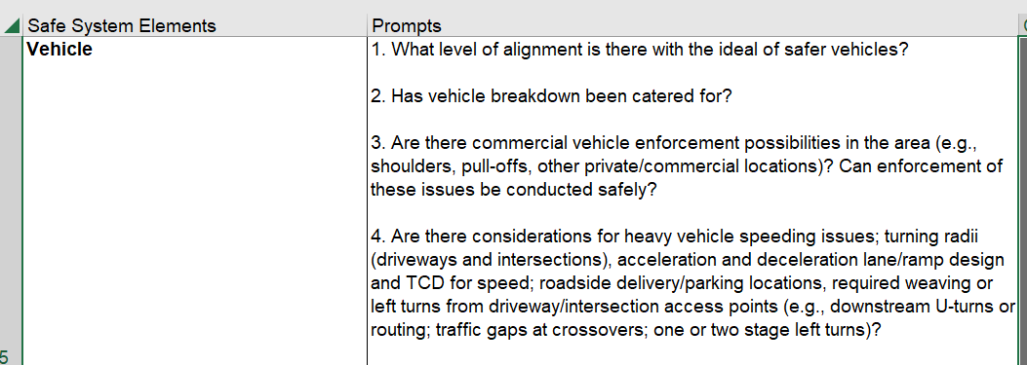
Other Safe System Elements

Slide 38
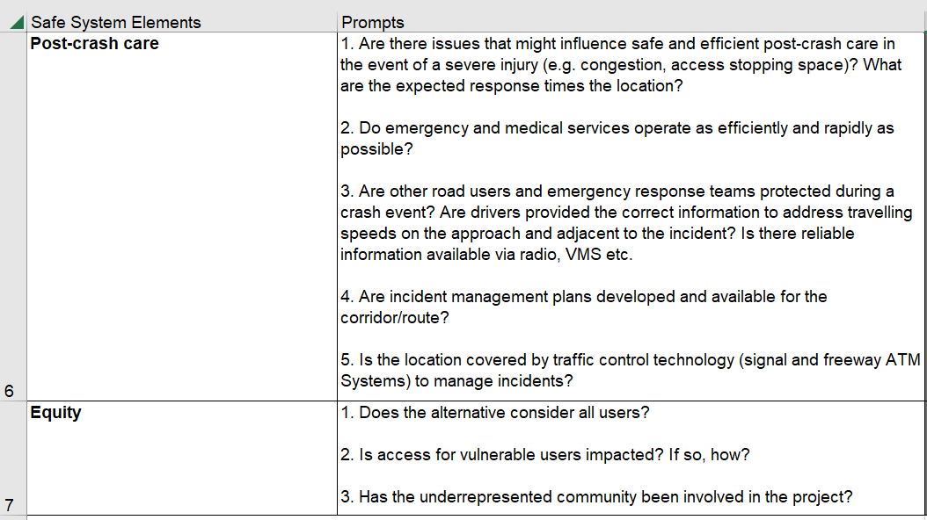
Notes:
Also has an equity prompt

Slide 39


Safety Analysis Toolbox
Crash-Based Tools (HSM)
SSA Alignment Tool
Regression-based models
Relies on past crash data
Context-based (rural/urban, functional class, segment/
intersection, etc.)
Local calibration is important
Safe System Intersection (SSI) Analytical Method
Does not rely on crash data
RSA-style, prompt-based series of questions
Framework allows for adjustments based on local conditions and priorities
Results characterized in numeric terms intended for relative comparison
Does not rely on crash data
Uses kinetic energy management model (KEMM)
Principles-based, not crash-based
Inputs, methodology are objective, numeric
Notes:
HSM is very data intensive – local calibration… statistics, math, applicability, etc.
SSA simple. Framework. Adjusted/flexible. Relative to project. However, still quantitative… EASY TO USE
SSI – math heavy… but does a better job quantifying FSI crashes (already in your SPICE V5 tool) – more robust

Slide 40
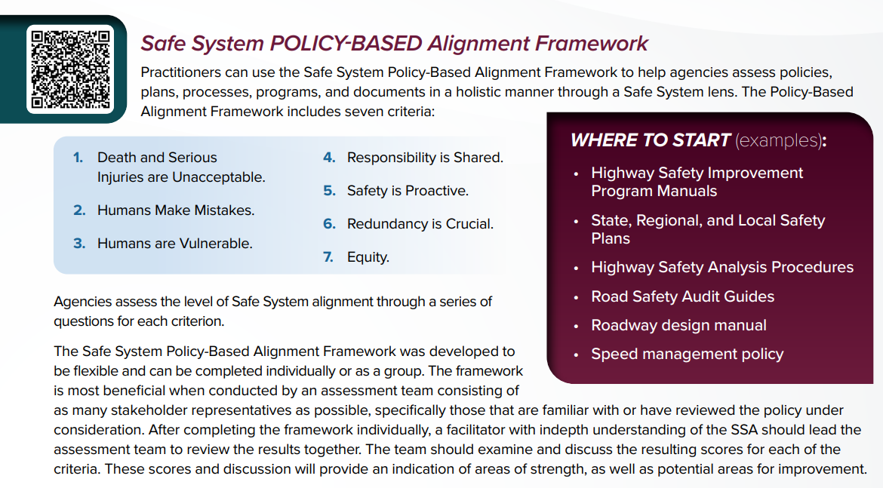
Notes:
Not going to get into this, but we do have a policy-based framework
Look at your existing policies to see how they align to SSA.
Mostly fluff
Broward County was one of pilot locations for applying this.

Slide 41


Contact Us
Elliott Moore, PE
Senior Safety Engineer
FHWA Resource Center
elliott.moore@dot.gov
Mark Doctor, PE
Senior Safety & Design Engineer
FHWA Resource Center
mark.doctor@dot.gov

