Slide 1
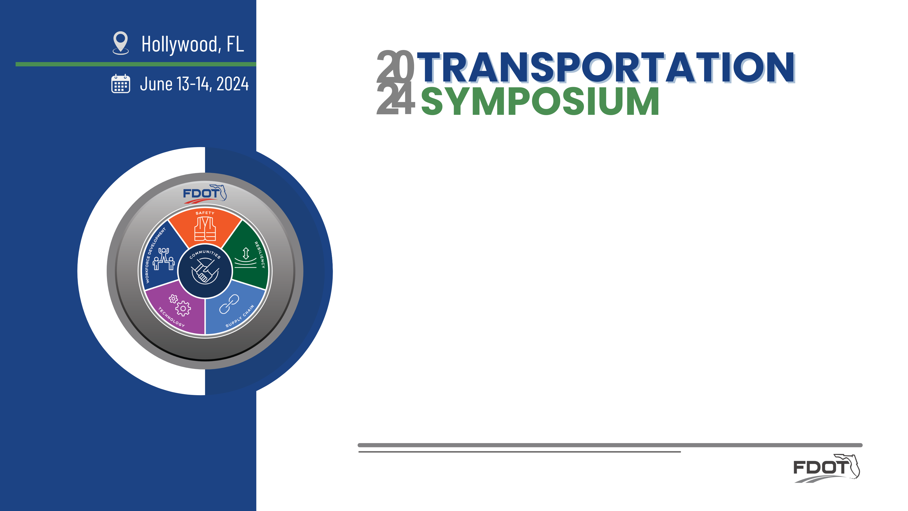
Innovations in Safety
Emmeth Duran, PE, RSP_{2I}
FDOT District 7 Safety Program Engineer

Slide 2
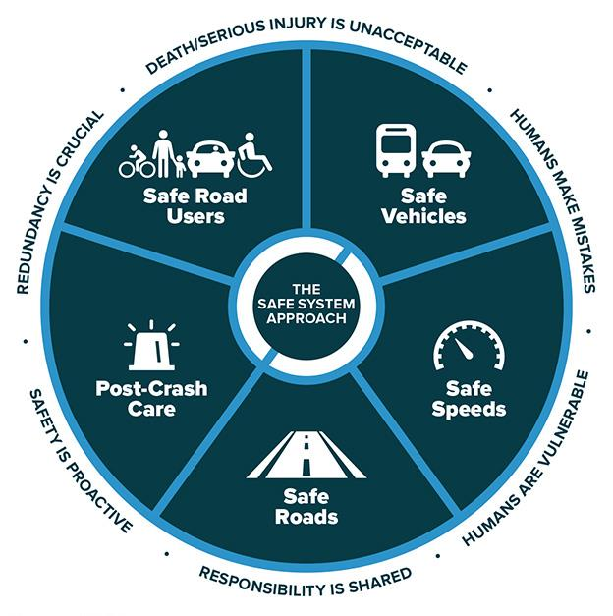

Presentation Outline:
Statewide & D7 Safety Performance
Work Zone Safety
Traffic Safety Initiatives & Innovation
Pavement Friction & Safety

Slide 3
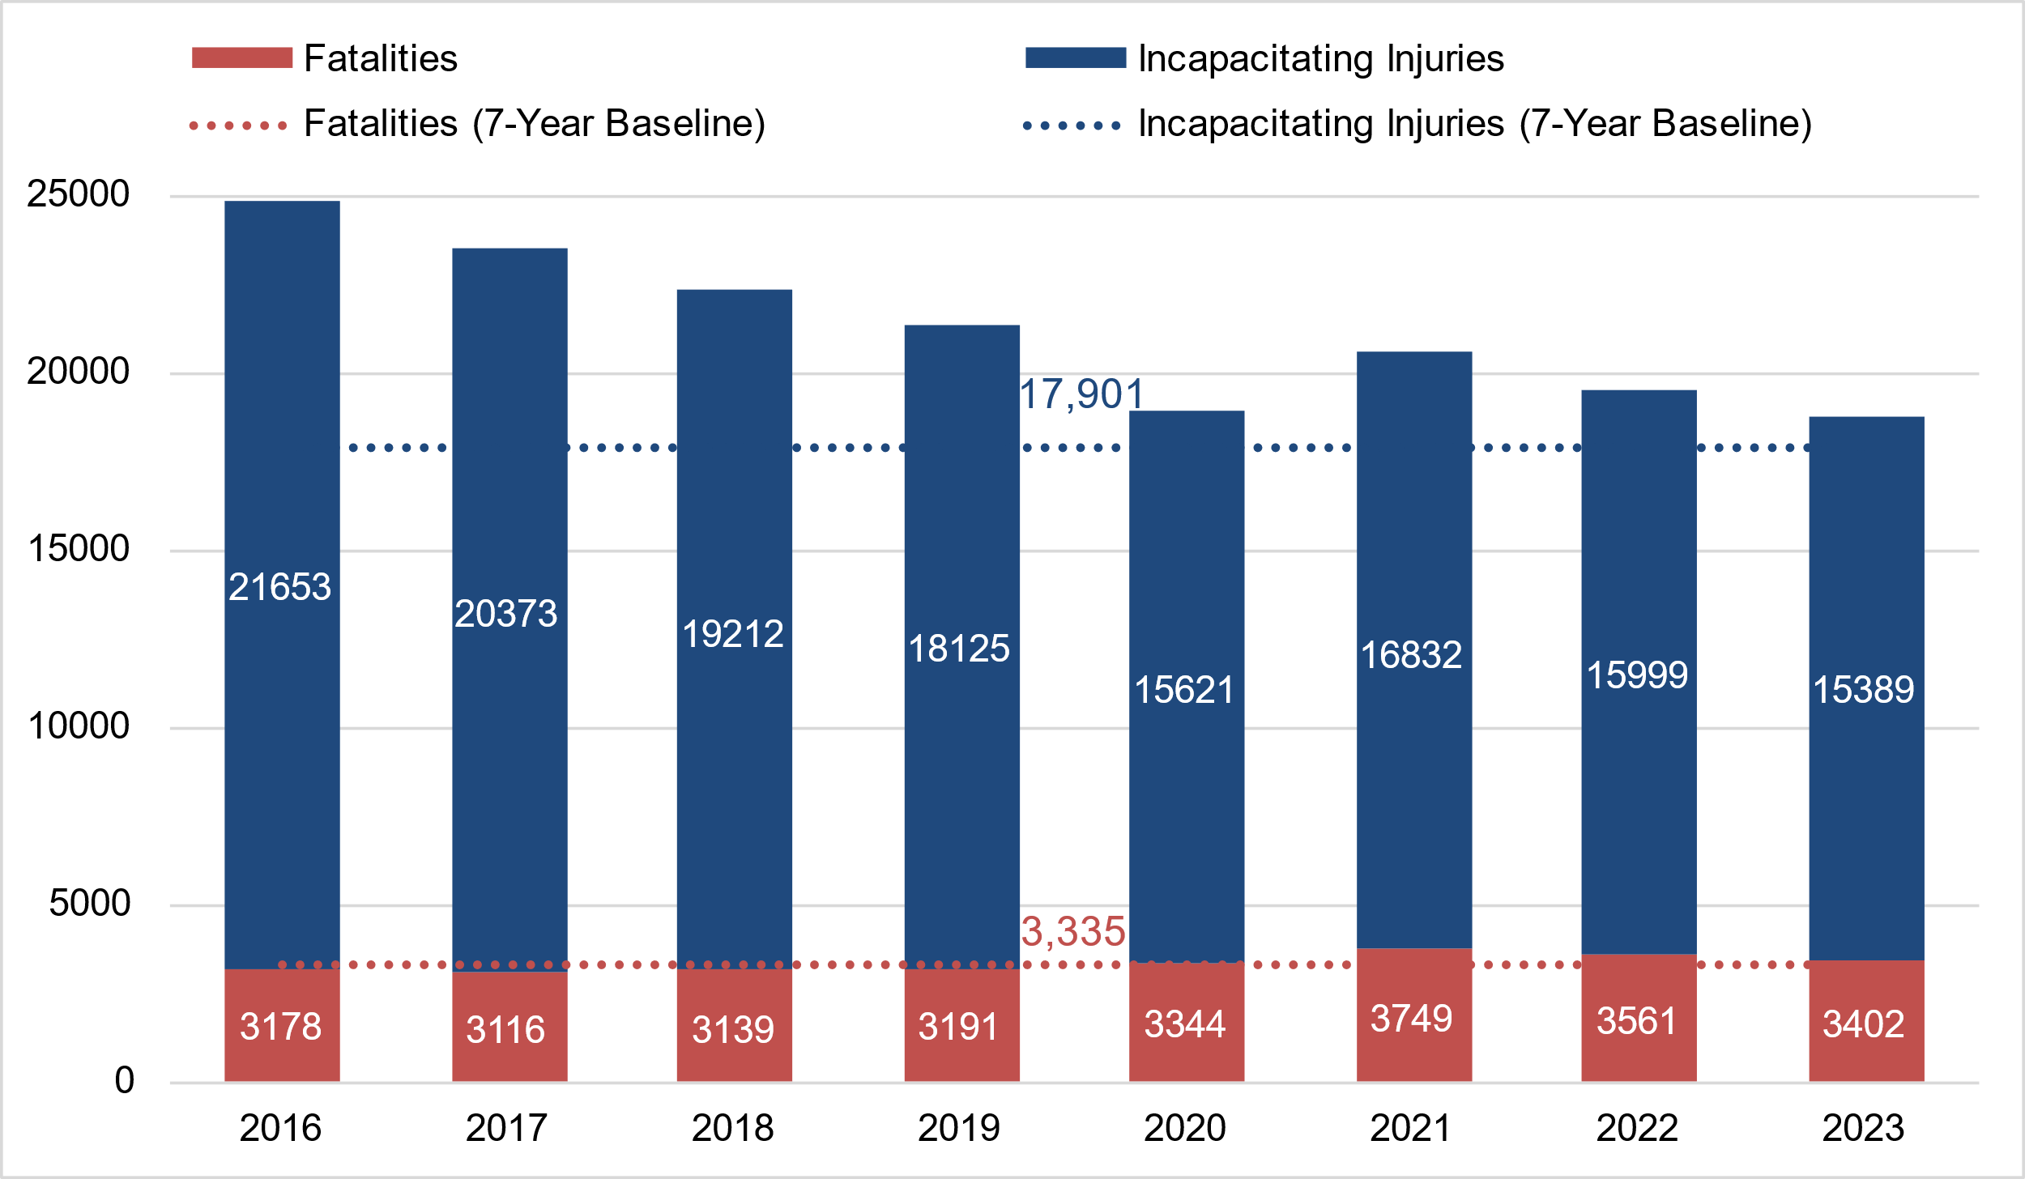
District 7 Safety Performance
Statewide Safety Performance
Severe Crashes in District 7 (2016 – 2023)
Fatalities are trending down overall compared to the 7-Year baseline after a slight uptick in 2021.
Fatalities decreased by 4.4% from 2022 to 2023.
Serious injuries decreased by 3.8% from 2022 to 2023.

Slide 4
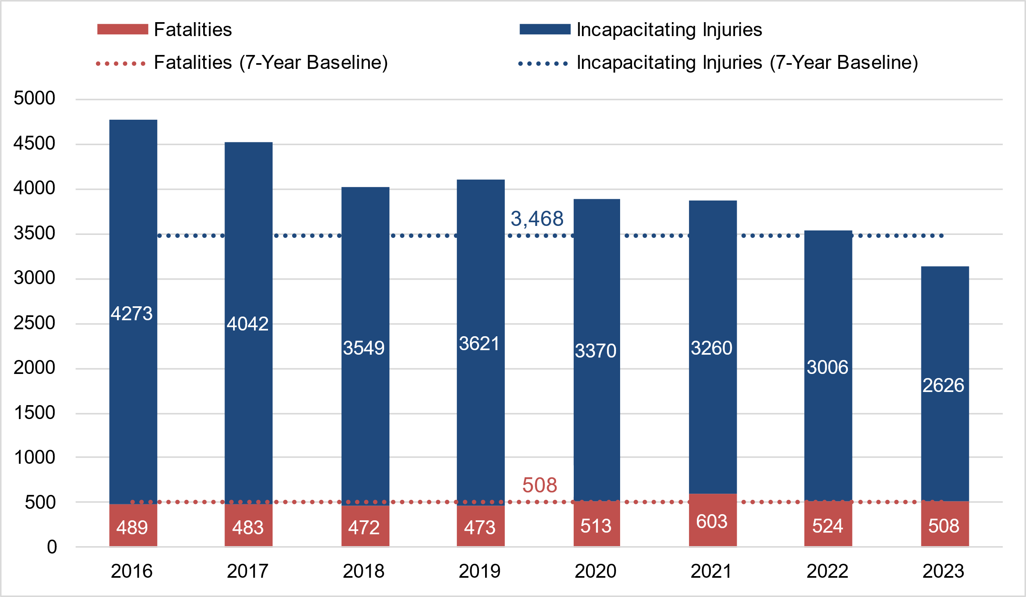
District 7 Safety Performance
District 7 Safety Performance
Severe Crashes in District 7 (2016 – 2023)
Incapacitating Injuries are trending down overall since 2016; Fatalities are trending down overall after an increase in 2021.
Fatalities decreased by 3.1% from 2022 to 2023.
Serious injuries decreased by 12.6 % from 2022 to 2023.
Despite the continuous growth in the Tampa Metro Area, overall trends are going the right direction.

Slide 5
Presentation Outline:
Statewide & D7 Safety Performance
Work Zone Safety
Traffic Safety Initiatives & Innovation
Pavement Friction & Safety

Slide 6
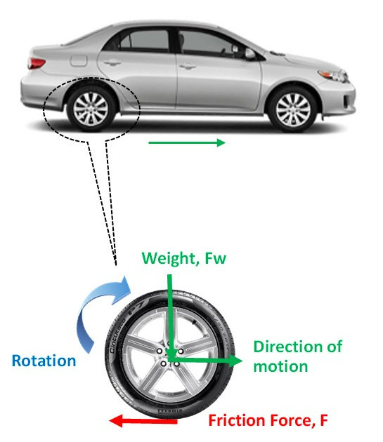
Pavement Friction & Safety?
Pavement friction is the force that resists the relative motion between a vehicle and a pavement surface.
Pavement friction is a significant factor contributing to traffic crashes
  Keep safely in the lanes when a vehicle changes direction
  Shorten braking distance to avoid potential collisions
  Reduce injury severity even if a collision happens
High friction demand facilities
  High-speed roads
  Curves
  Intersections
  Wet surface
Source: DOI: 10.3390/vehicles2010004

Slide 7
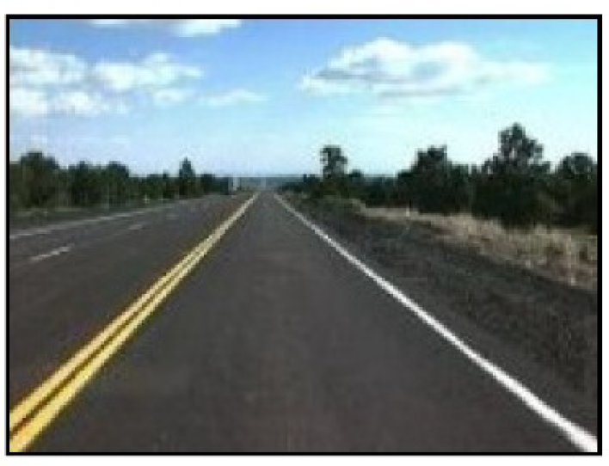
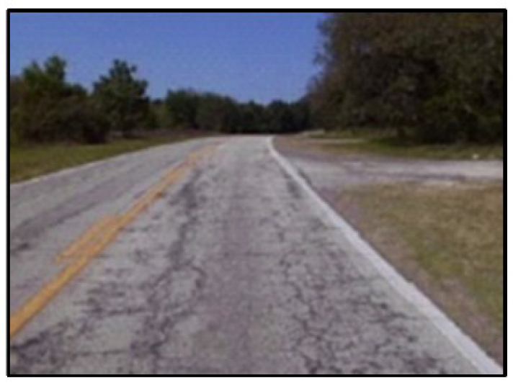
Pavement Friction & Safety?
Pavement friction deteriorates over time
Surface texture polishing by vehicle tires
Surface material property changes due to traffic and weather loadings
Measuring, monitoring, and maintaining pavement friction are vital in pavement and safety management
Especially at locations where vehicles are frequently turning, slowing, and stopping

Slide 8
Pavement Friction & Safety?
FHWA (SA-21-014):
“Including pavement friction as a parameter in road safety performance modeling, establishing friction performance thresholds based on context, and proactively and systemically managing friction can help your agency achieve its road safety goals to save lives and prevent serious injuries.”
Notes:
FHWA SA 21-014

Slide 9
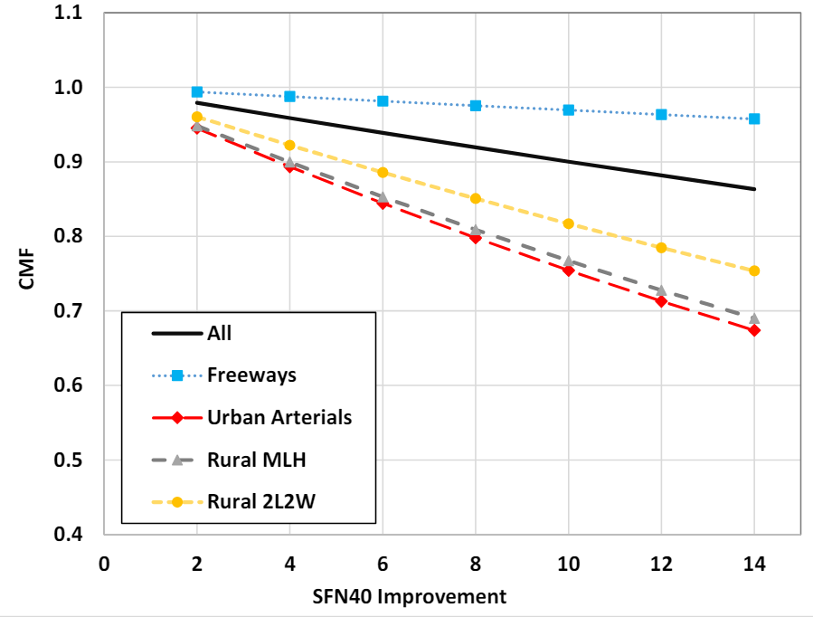
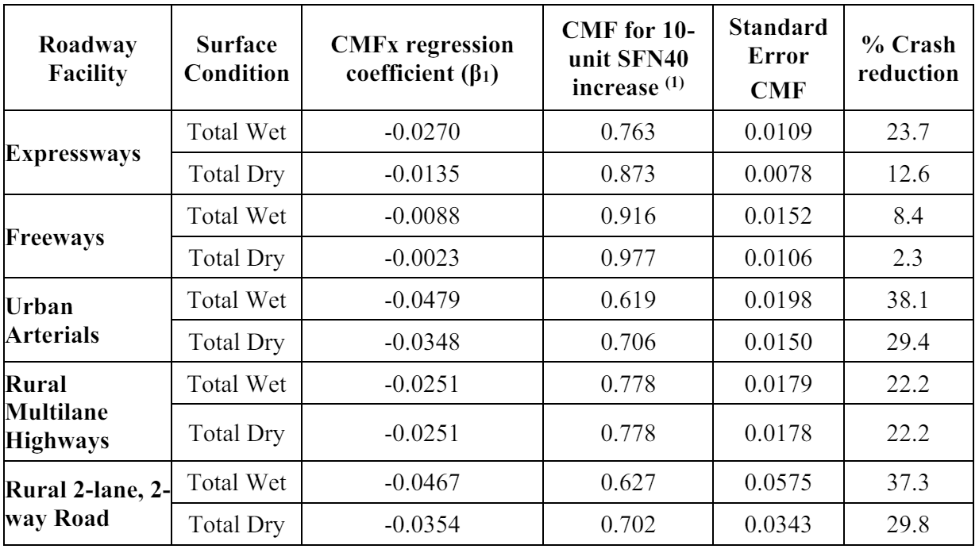
Pavement Friction & Safety?
CMF and percent crash reduction by surface condition for a 10-unit increase in SFN40
Data from Florida, North Dakota, Texas, Virginia, and Washington State
https://highways.dot.gov/sites/fhwa.dot.gov/files/202306/FHWA%20Characterizing%20Road%20Safety%20Performance%20Using%20Pavement%20Friction.pdf

Slide 10
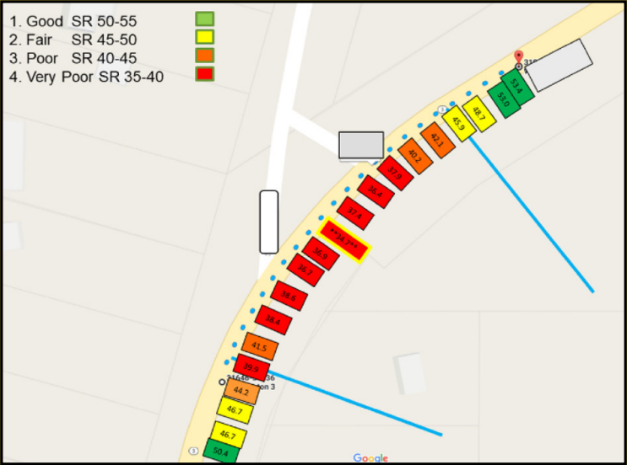
Pavement Friction & Safety?
Friction Management
  Recently added to list of proven safety countermeasures
  Pavement friction can prevent & reduce fatal and serious injury crashes at locations where friction is critical
  Typical method of measuring friction on roadway networks takes sample data generally not on curves or intersections and result in gaps in the data
  Best practice for targeting more efficient and effective installations of friction-enhancing treatments
Visualization of CFM data through a curve with an intersection in 30-foot averaged intervals
Source: US Department of Transportation Federal Highway Administration (FHWA)

Slide 11
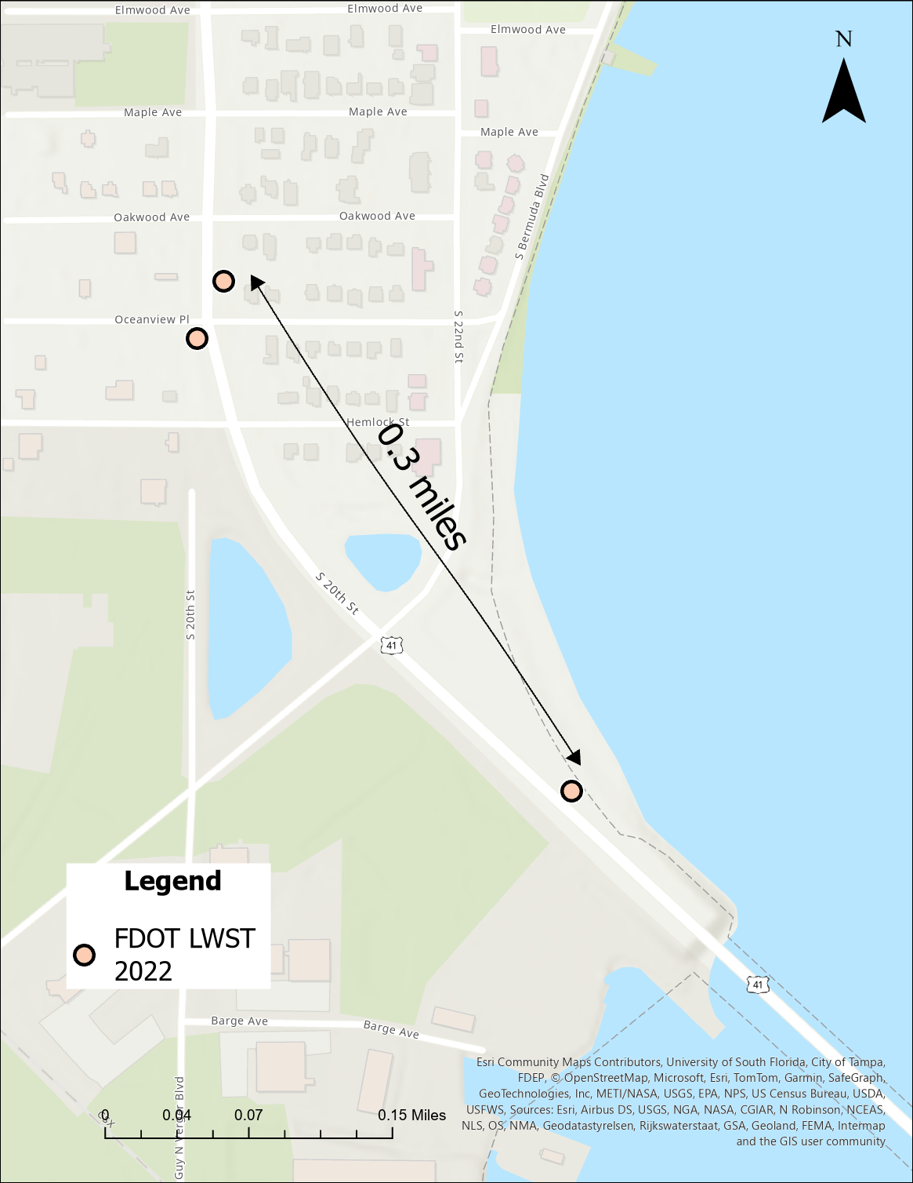
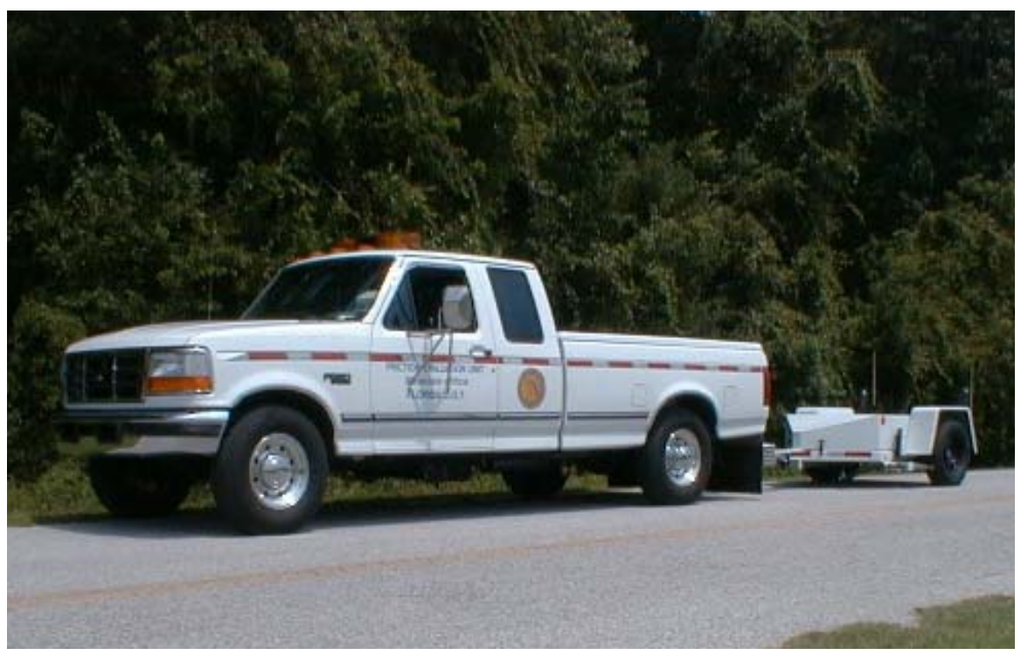
Traditional Pavement Data Collection
Traditionally, pavement friction data are measured from the Locked-Wheel Skid Test (LWST)
LWST friction measurements are intermittent with traffic control, typically only a few measurements (usually 1 to 5) per mile
The limited LWST samples make describing the pavement friction patterns at the crash location infeasible or inaccurate

Slide 12
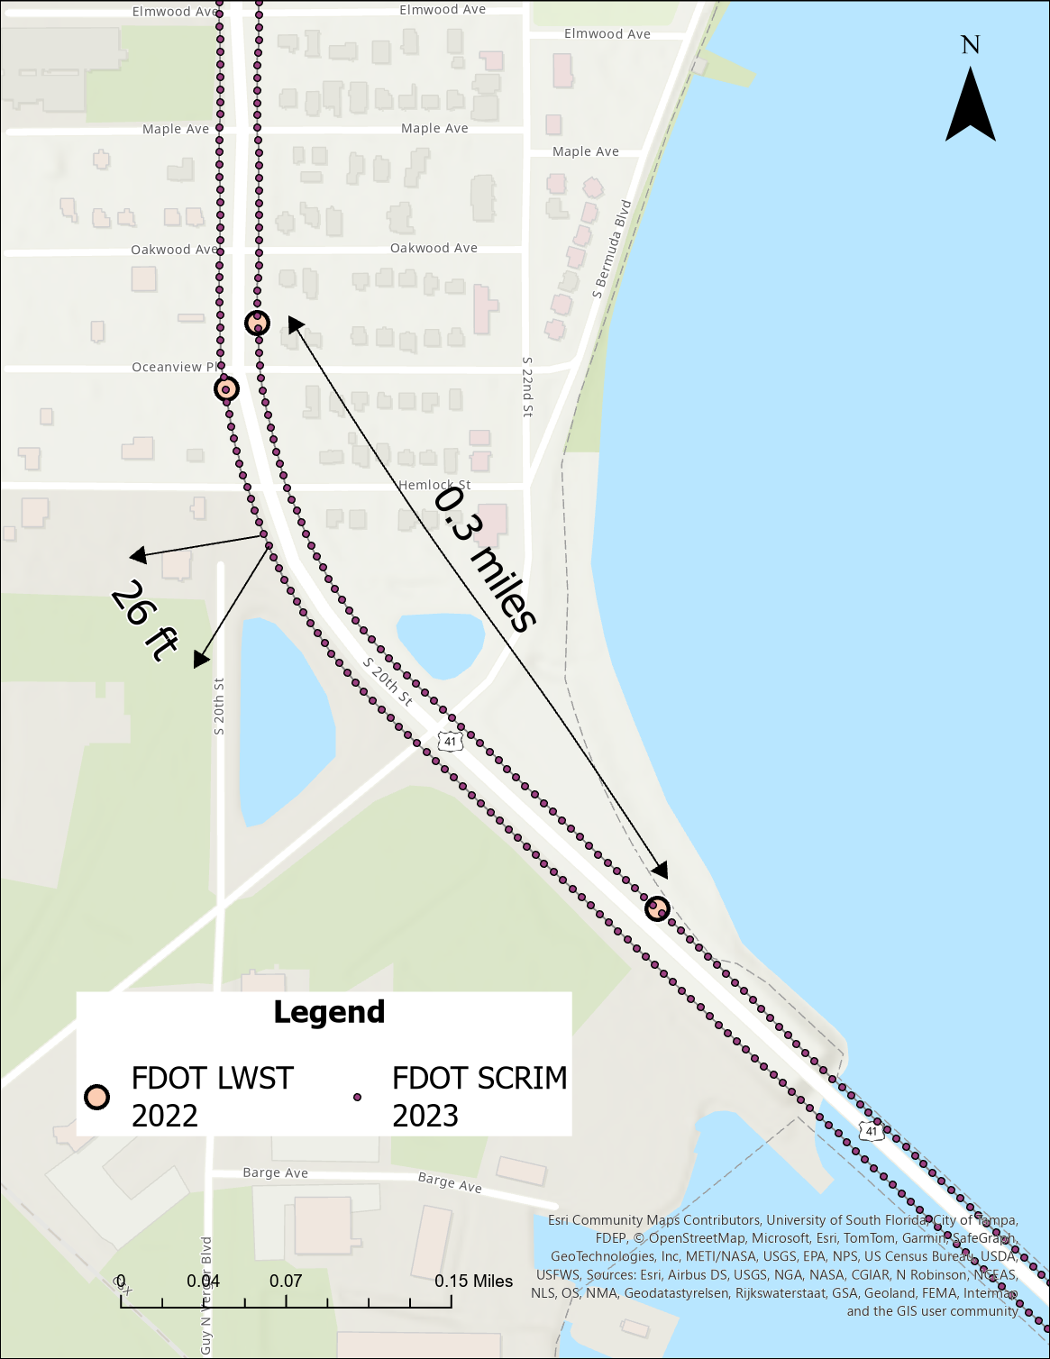
Continuous Pavement Friction Measurement
Continuous Pavement Friction Measurement (CPFM) continuously collects high-resolution pavement friction data
Very short distance intervals
Covering tangents, curves, and intersections
Revolutionize the understanding of the relationship between crash risks and friction patterns

Slide 13
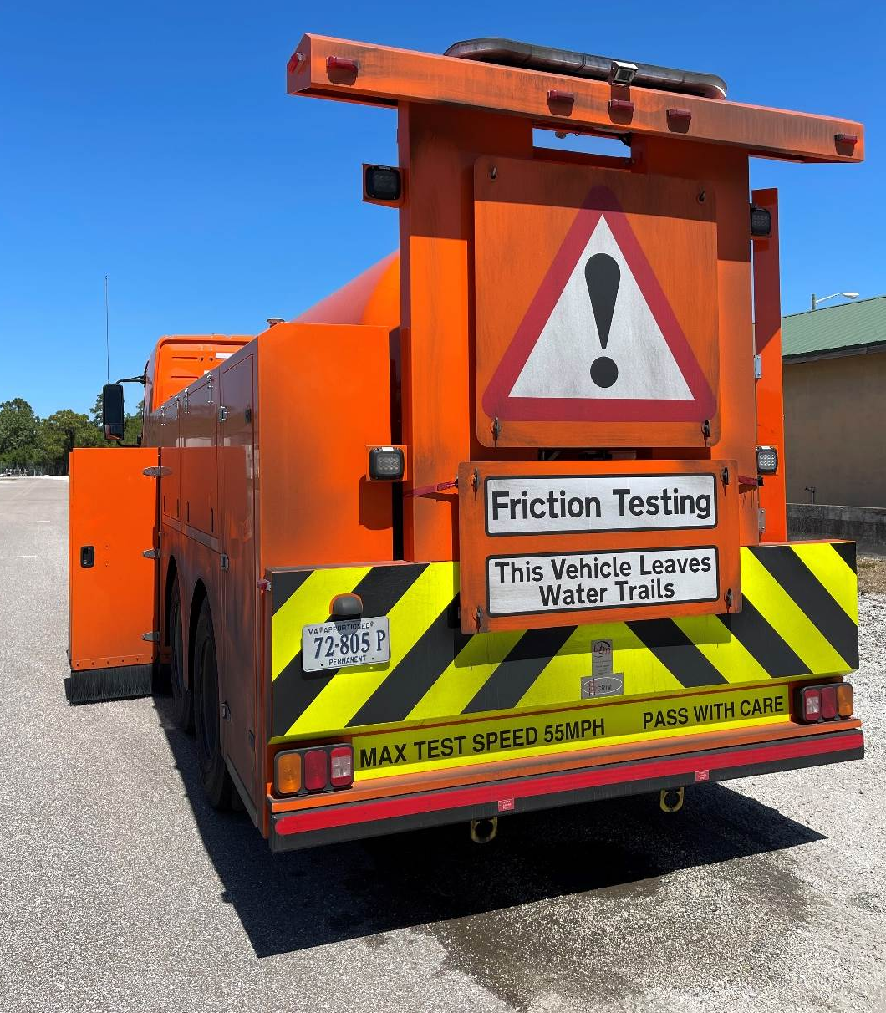
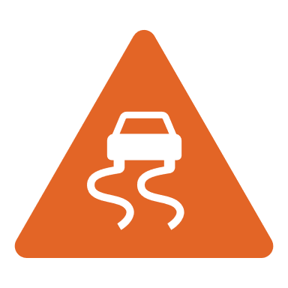

Continuous Measurement Method - SCRIM
SCRIM (Sideway-force Coefficient Routine Investigation Machine)
Continuously collected ~2,100 miles of GPS-linked friction and texture data, geometry (curve, grade, crossfall), and video in 14 days.
Can travel 15mph to 55mph for a range of 45-150 miles in one tank of water. No traffic control needed.
30%
40%
On wet roads
Fatalities
20%
On dry roads
BCR ~ 13:1 to 35:1

Slide 14
SCRIM Data Collected
Category | Date Item | Description
Pavement Friction | SCRIM Reading (SR) | Raw SCRIM pavement friction coefficients
 | SCRIM Coefficient (SC) | Speed and temperature-corrected SR
Macrotexture | Mean Profile Depth (MPD) | ISO 2019 standard calculation in millimeters and inches
Roughness | IRI | International Roughness Index, inches/mile
Geometry | Curve | Radius in feet (1/curvature * 3.281)
 | Grade | %, positive grade is uphill, negative grade is downhill
Measurement | Date/Time | Survey year-month-day hour/minute/second
 | Location | GPS longitude, latitude

Slide 15
SCRIM Data Applications
SCRIM Usage Nationwide
NCDOT – Has been sponsoring several research projects to investigate the trends of pavement friction and texture changes over time and appropriate threshold values
KYTC – Has developed robust Safety Performance Functions specific to Kentucky that will predict crashes and will use Empirical Bayes to determine expected crash rates
FHWA – Has published CMFs and investigatory thresholds to use for decision-making and projections for improving friction on roadways
VTTI – Has analyzed the Continuous Friction Measurement data to assess crash risk and develop investigatory or intervention levels of frictions for multiple states
WDM – Has worked with states to develop custom Safety Performance Functions and set thresholds that are solution-based

Slide 16
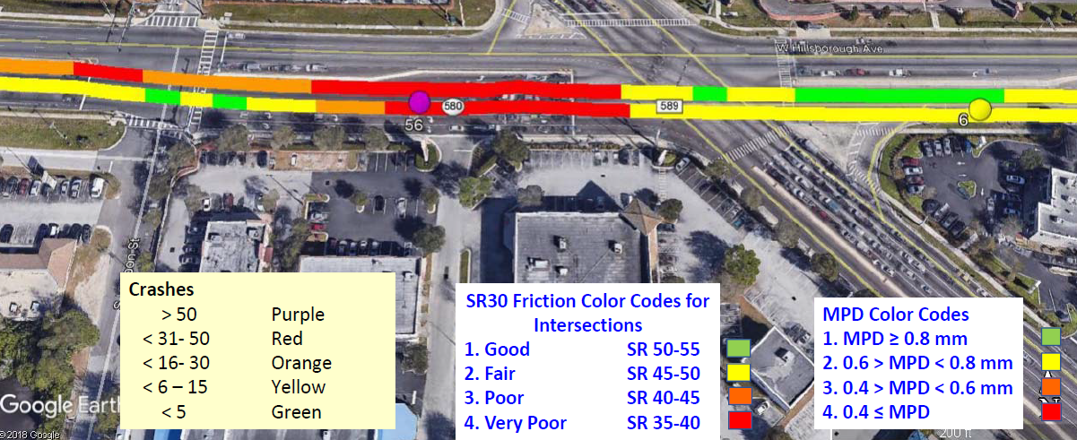
Pilot SCRIM Data Applications in D7
District 7 linked crash data with continuous friction measurements and road safety assessments to select intersections for High Friction Surface Treatment (HFST)

Slide 17
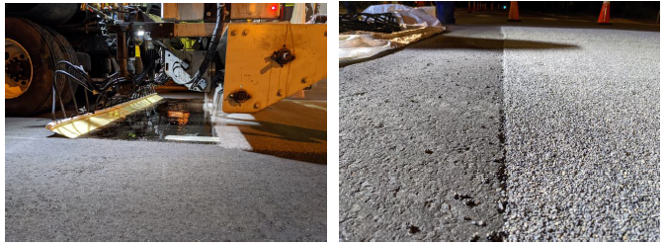
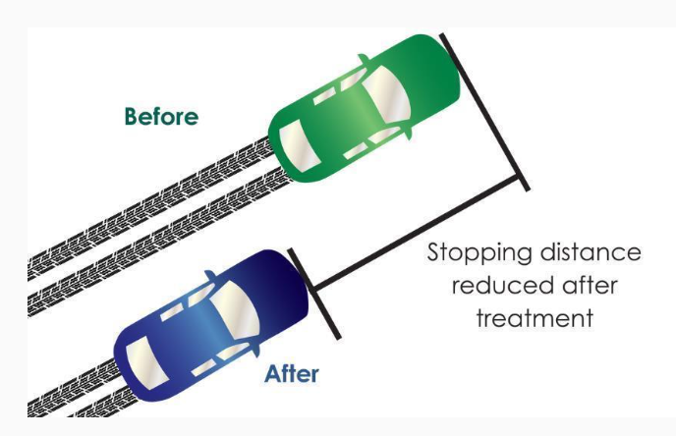
Utilizing SCRIM Data for Targeted HFST
High Friction Surface Treatment (HFST):
    The application of very high-quality aggregate to the pavement using a polymer binder to restore and/or maintain pavement friction
    Helps motorists maintain better control in both dry and wet driving conditions
    Reduces stopping distance
    Increase expected stopping behaviors (stop before stop bar)
    Reduce improper stopping behaviors (occupancy crosswalks)
    Reduce the risk of vehicle-pedestrian conflicts

Slide 18
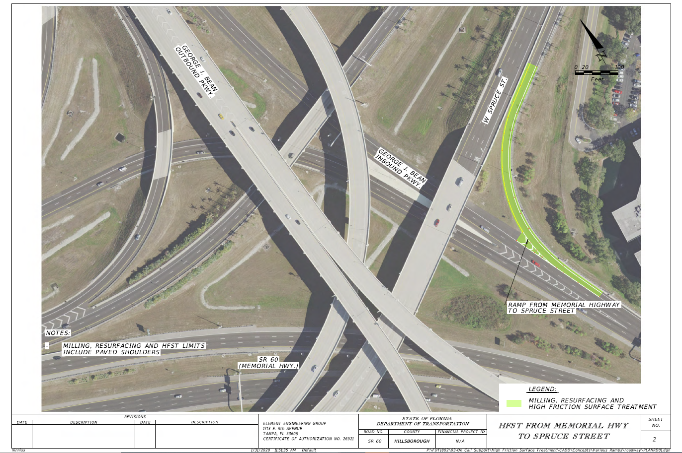
District 7 Targeted HFST Projects
HFST projects were then constructed at many intersections and curves through various contracting methods - Fast Response, Design-Build Pushbutton & Work Program
  Intersections
  Hillsborough Avenue at Central Avenue (2020)
  Hillsborough Avenue at Sheldon Street (2020)
  Hillsborough Avenue at Lagoon Street (2020)
  Hillsborough Avenue at George Road (2022)
  US 301 at Stacy Road (2022)
  Curves
  NB SR 589 Off Ramp at Independence Parkway (2021)
  SB SR 589 On Ramp at Independence Parkway (2021)
  US 41 (Tamiami Trail) South of SR 674 (College Avenue) (2022)
  Memorial Highway at Spruce Street (2022)
  USB 41 near Hemlock Street (2022)

Slide 19
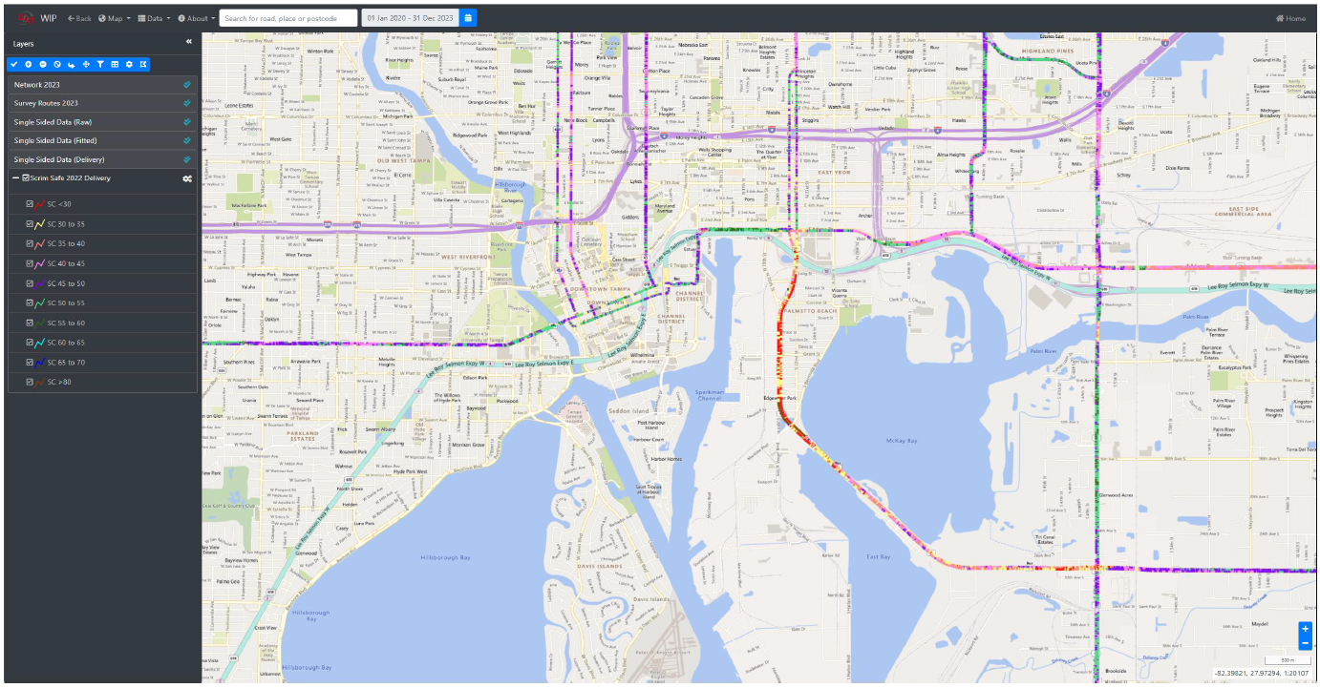
D7 Districtwide SCRIM Pilot Project Results

Slide 20
D7 Districtwide SCRIM Pilot Project Results
Low AADT locations have disproportionately high crash rates
The blue ‘line of best fit’ for all the data indicates an inverse relationship between friction and crash rate
The majority of this year’s SCRIM network coverage recorded friction (MSC) values between 40 and 50
Increases in friction (MSC) and mean profile depth (MPD) result in the largest predicted % decrease in crash rate, due to the large effect these measures have on roads with disproportionately high crash rates
Crash rates at or near intersections nearly 3x higher than non-intersections
Crash rates on inclines are slightly lower than flat roads

Slide 21
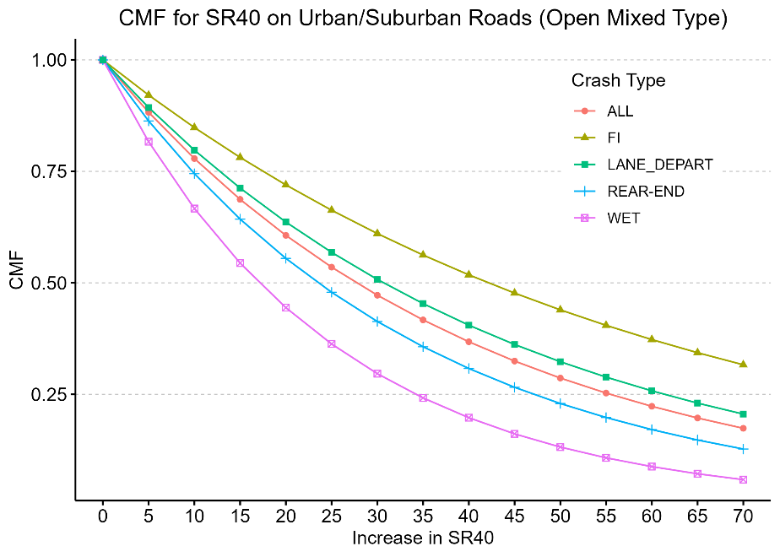
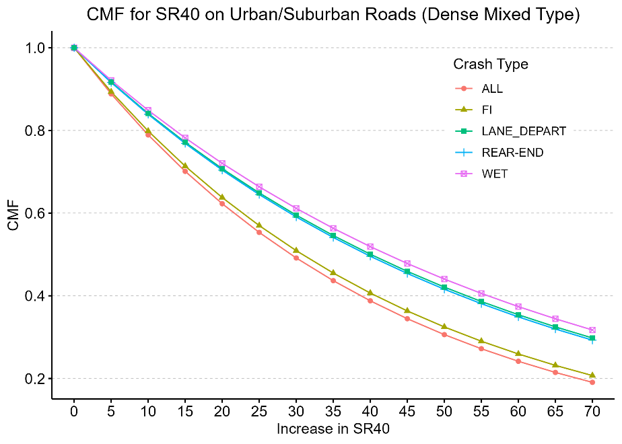
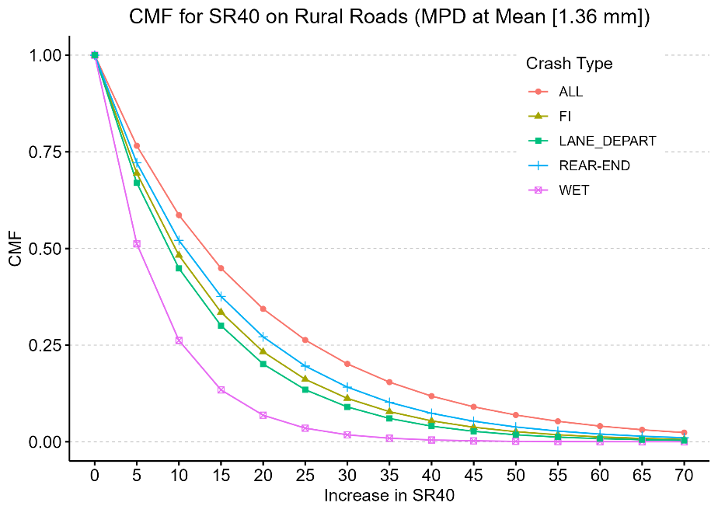
D7 DW SCRIM Pilot Results – Friction CMF
Notes:
Increasing the MSC by 10 you could see crash reductions between 16% to 20% depending on the type of surface. On open surfaces we would expect reduction between 15% to 34%
On dense pavements reductions of

Slide 22
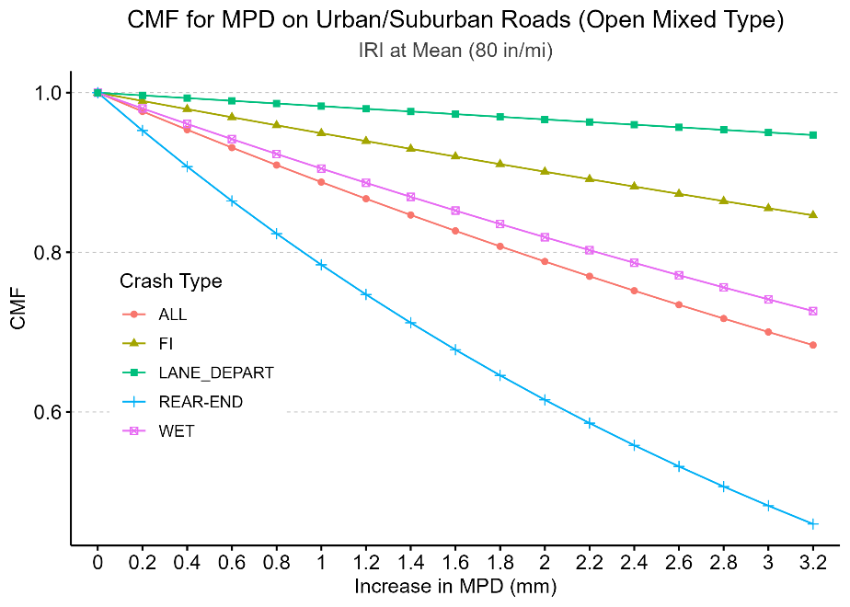
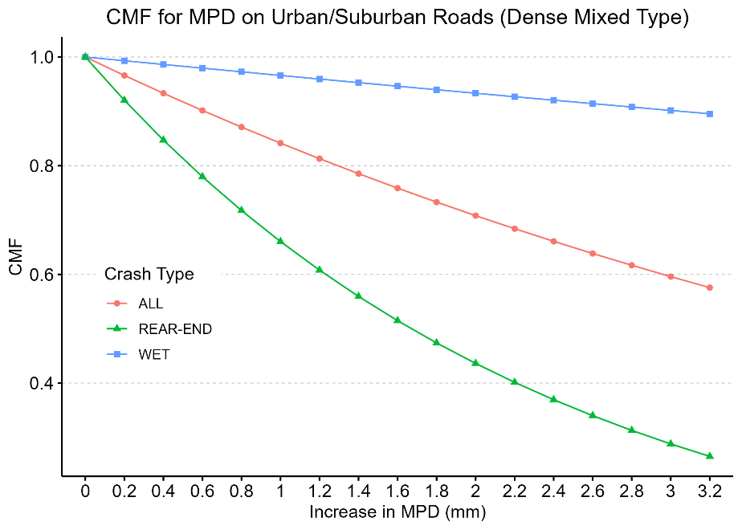
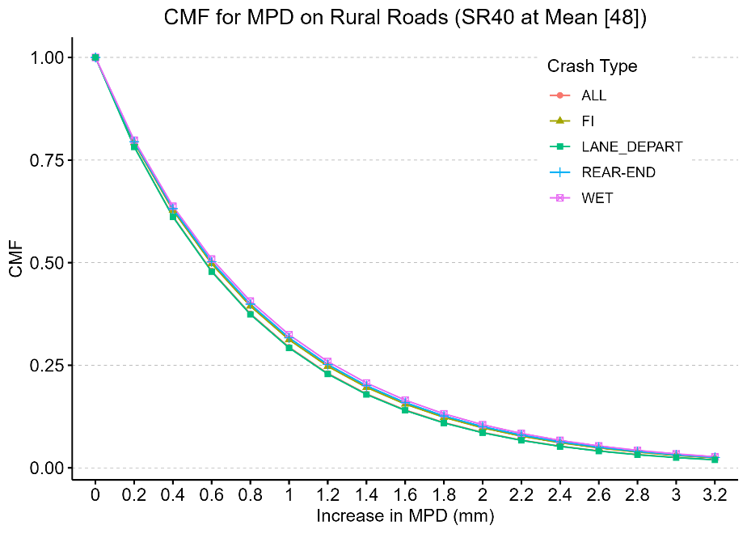
D7 DW SCRIM Pilot Results – Macrotexture CMF
Notes:
On average, a 0.5-mm increase in MPD is more likely to reduce crash frequencies by 0.8% - 11.4% for various crash types on open surfaces
On average, a 0.5-mm increase in MPD is more likely to reduce crash frequencies by 8.3% - 18.7% for various crash types on non-open surfaces.

Slide 23
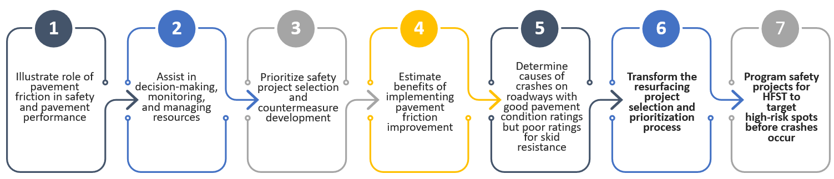
D7 Districtwide SCRIM Pilot Project Results
District 7 is utilizing SCRIM data to:
Investigate relationships among pavement condition, friction, crashes, and other FDOT big data
Identify key locations (programmed FY26+FY27 resurfacing projects, excessive crash history) with desktop and field road safety assessments (RSAs) for potential safety-focused treatment
Develop quantitative relationships for skid related crashes, friction, pavement condition, traffic type, facility type, and weather to predict likelihood of skid related crashes
Develop SPFs which can be incorporated into future prioritization processes
Estimate benefits/costs of pavement friction improvements to inform pavement friction management strategies
Enhance resurfacing project selection and prioritization which currently uses spot pavement measurements (crack, ride, and rut ratings)
Surveyed network where MSC<45
Green lines: MSC 40-45 (poor)
Blue lines: MSC <40 (very poor)

Slide 24
Presentation Outline:
Statewide & D7 Safety Performance
Work Zone Safety
Traffic Safety Initiatives & Innovation
Pavement Friction & Safety

Slide 25
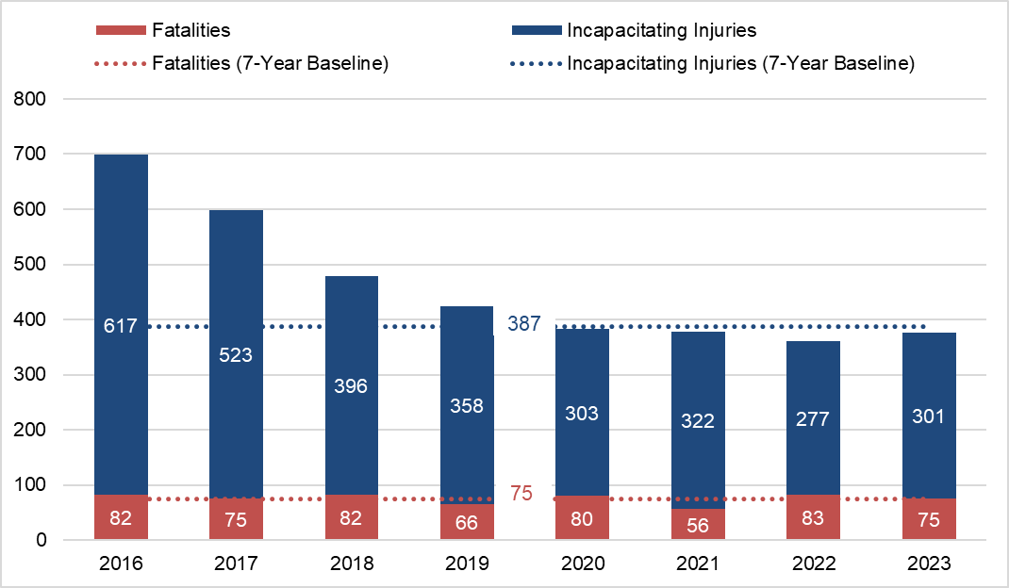
Work Zone Safety Stats
Severe Crash Performance 2016 – 2023 in Florida
Work Zone Safety Stats
Severe Crash Performance 2016 – 2023 in Florida
Key Takeaways
Incapacitating Injuries are trending down overall. Fatalities are going down after a jump in 2022.
Despite a higher overall number of work zone crashes in 2023 (12,143), the total number of fatal/ incapacitating injury crashes is lower
Despite motorcycles encompassing only 3% of registered vehicles, they are overrepresented with about 30% of WZ fatalities & serious injuries (44 out of 150 total WZ crashes in 2023)
Commercial vehicles were involved in 12% of work zone crashes and almost 4% of those resulted in a fatality or serious injury.

Slide 26
Work Zone Safety Action Plan
ENFORCEMENT
ENCOURAGEMENT
EVALUATION
ENGINEERING
EDUCATION
Designer, CEI, and Contractor Training Workshops
Webinars
Community Meetings
Lane Closure Notification System
Design Policy Changes
Design Safety Prompt List
Pilot Projects for New Technology
Smart Work Zones
Near-Miss Crash Analysis
ELEE Program
Contract Language Updates
Increased TCO presence in Work Zones
Streamline Communication
WZ RSAs
Design Phase Reviews
Geofencing Surveys
Before/After Analysis
Contractor Safety Technology Incentive Program
Recognition in D7 Safety Newsletter
FDOT Safety Challenge Coin

Slide 27

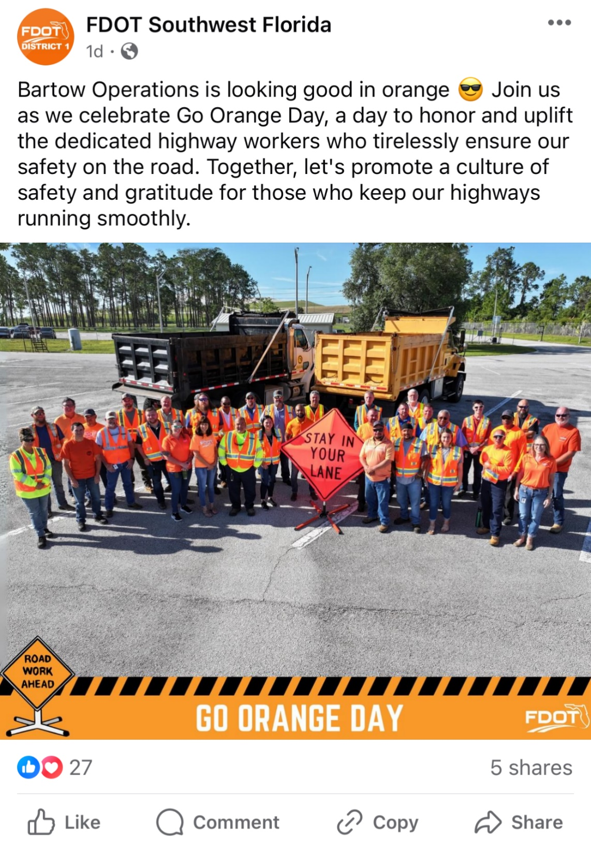
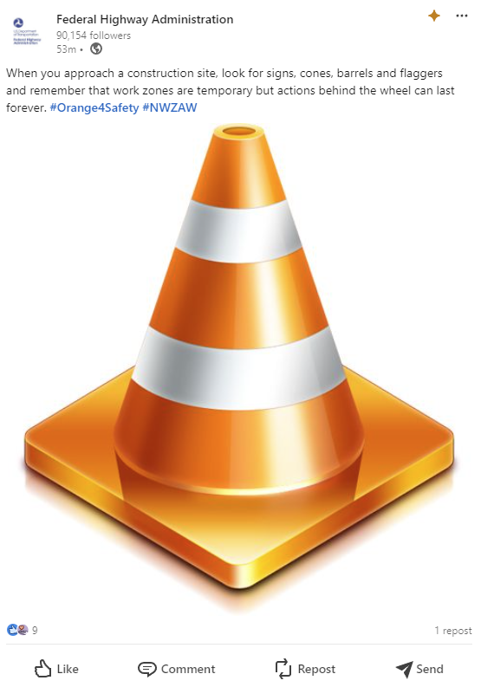
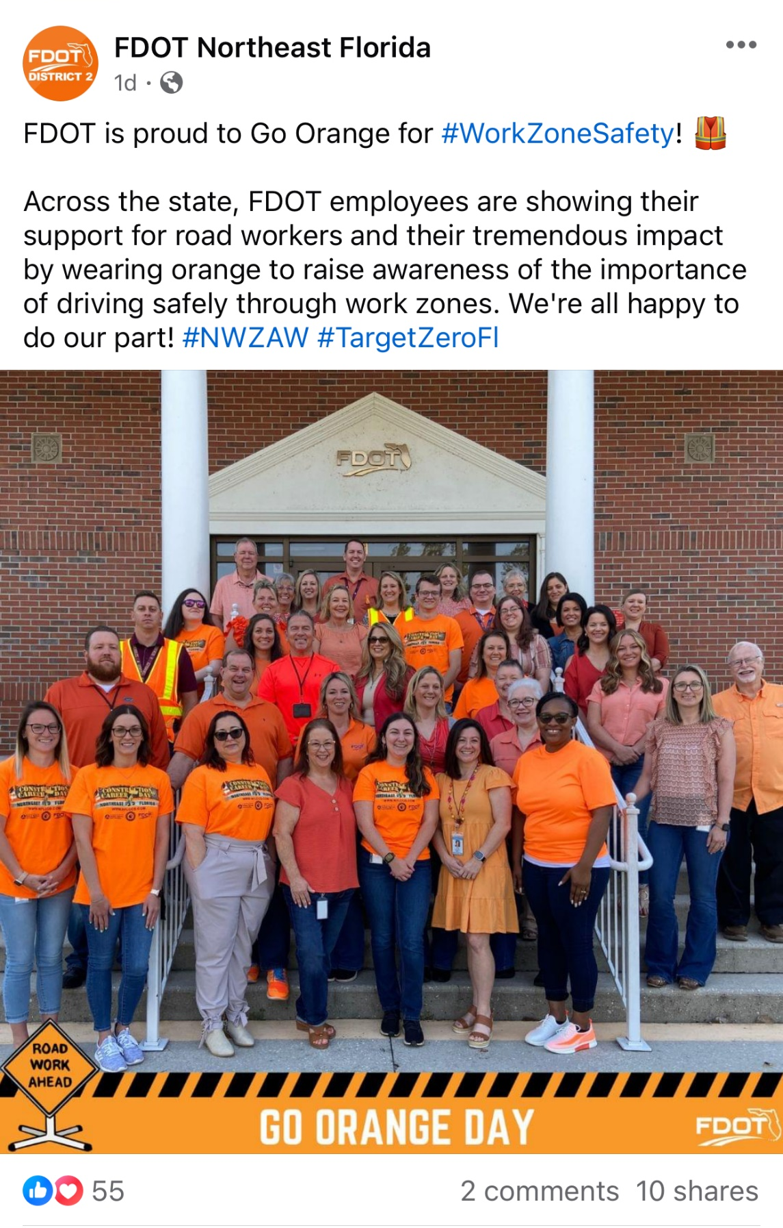
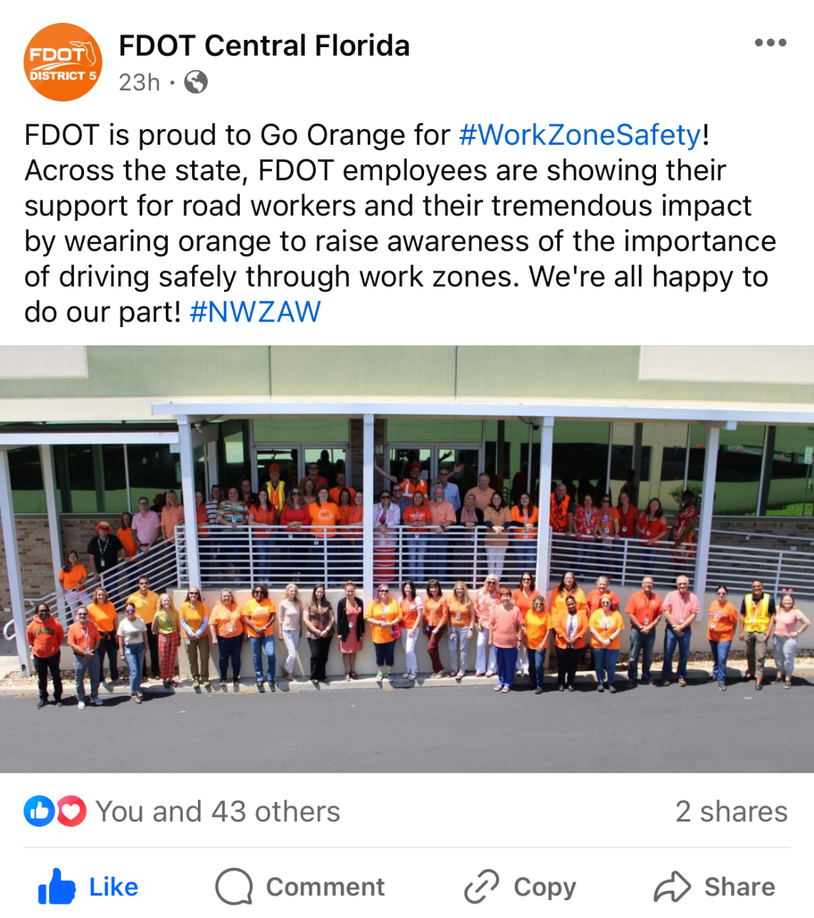
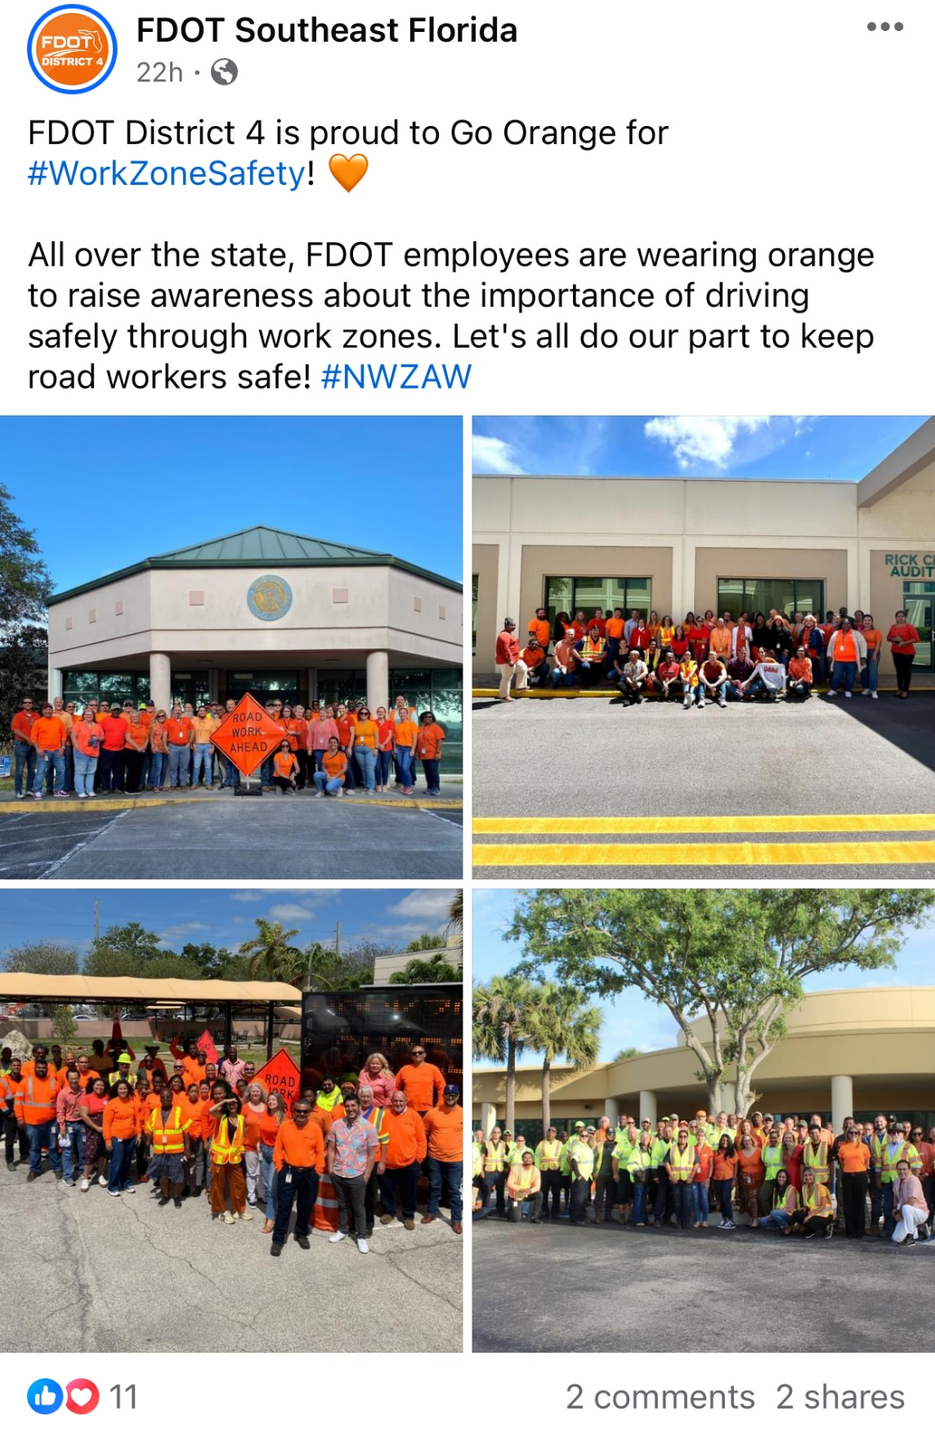

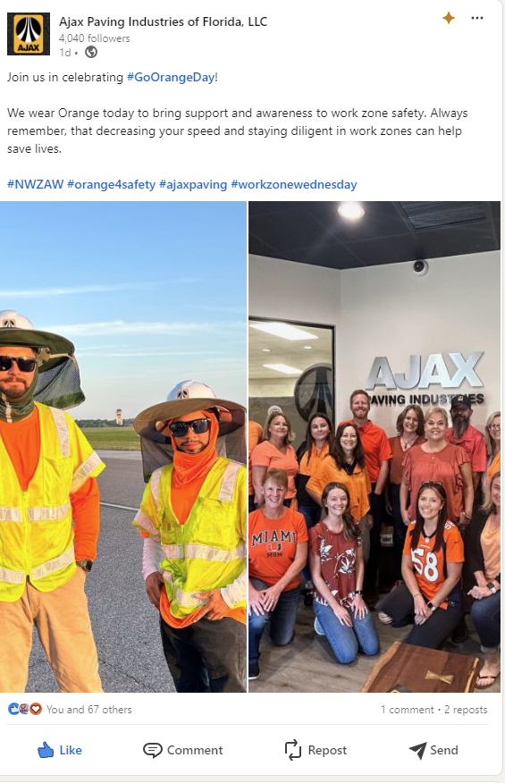
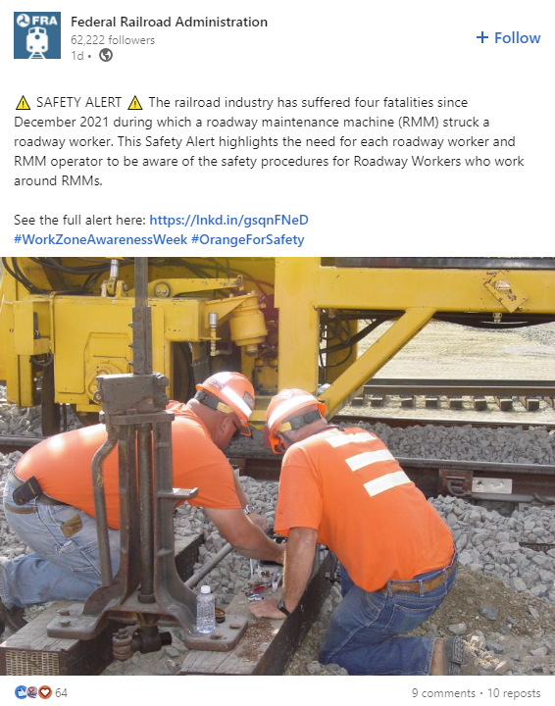
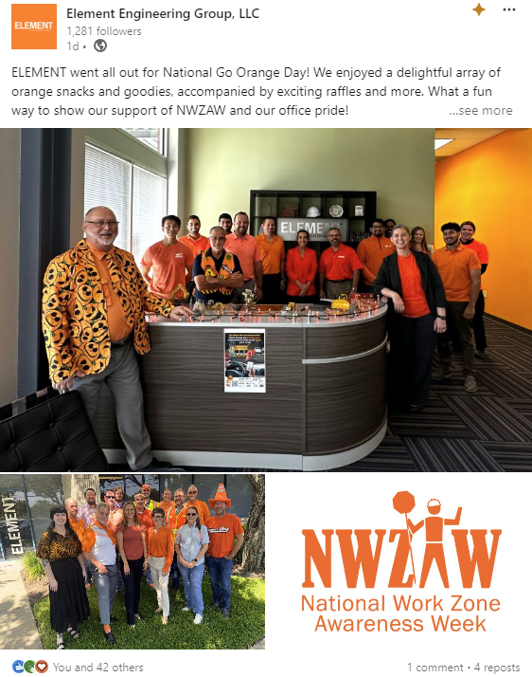
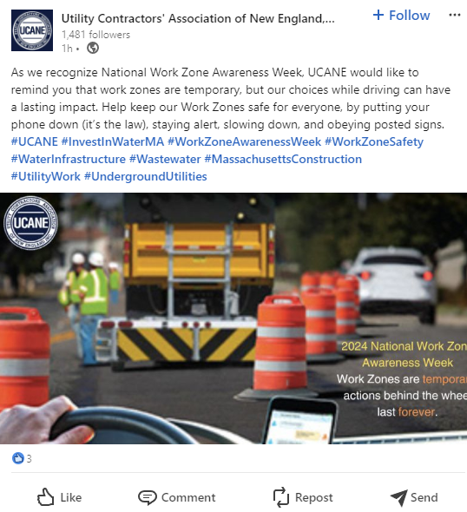
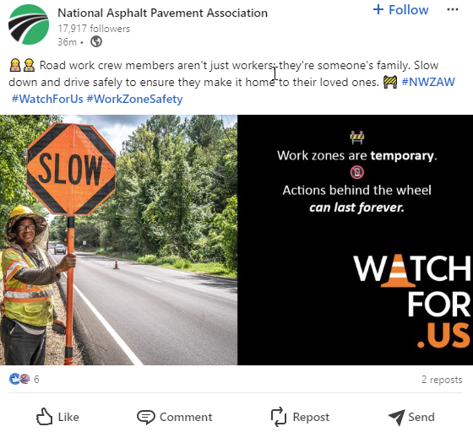
Work Zone Awareness Week 2024 Recap
Work Zone Awareness Week 2024 Recap
Multiple Contractors held stand-downs for safety
The Skyway goes Orange!
Go Orange Day/NWZAW sweeps the country

Slide 28
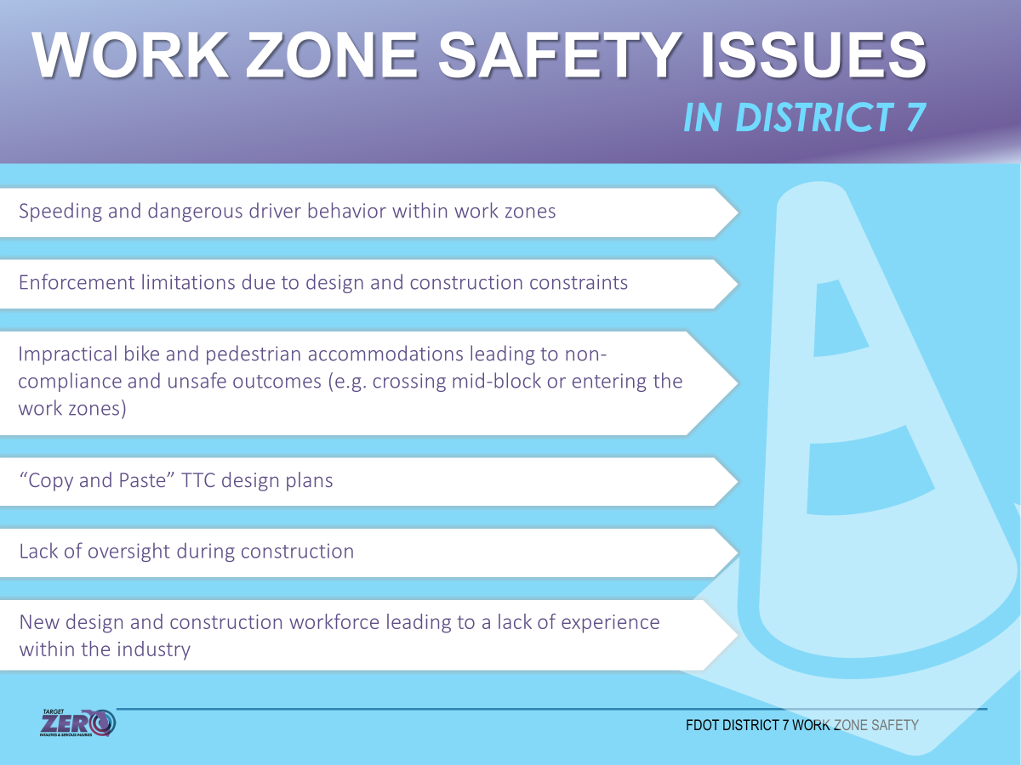
D7 Safety Issues

Slide 29
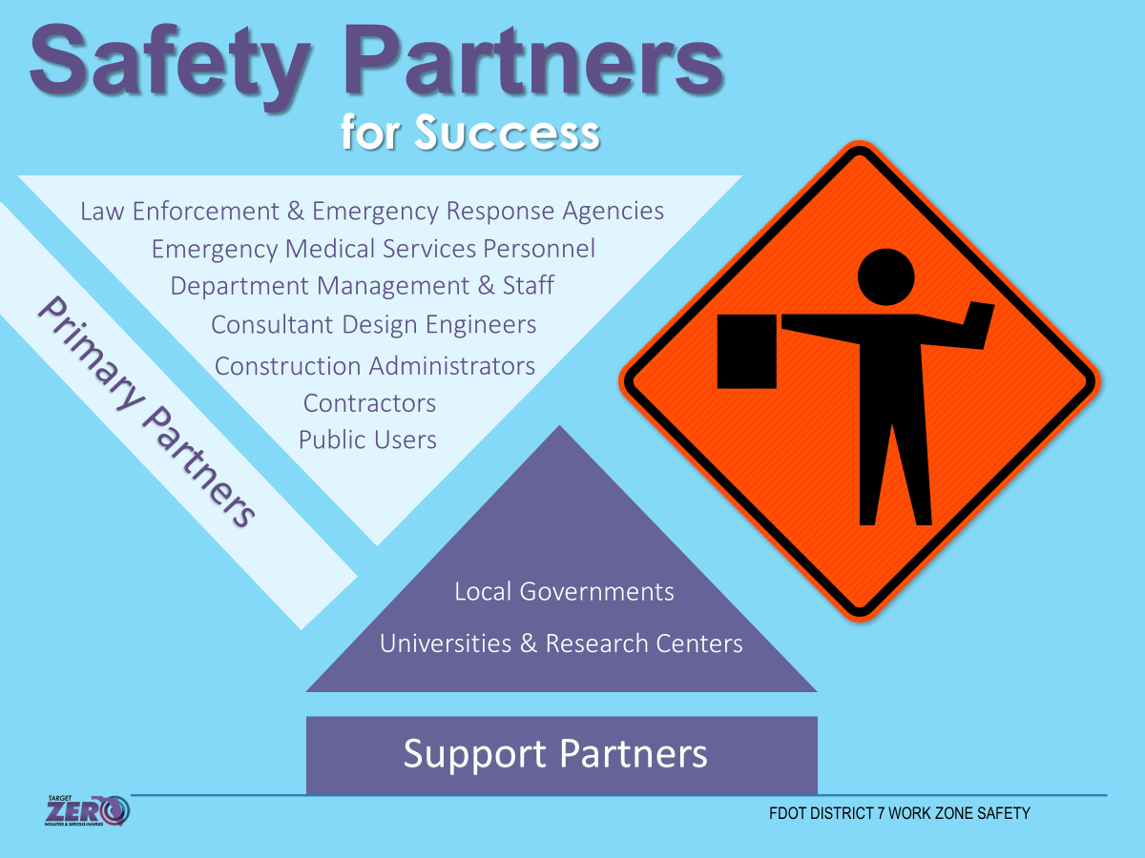
Work Zone Safety Partners

Slide 30
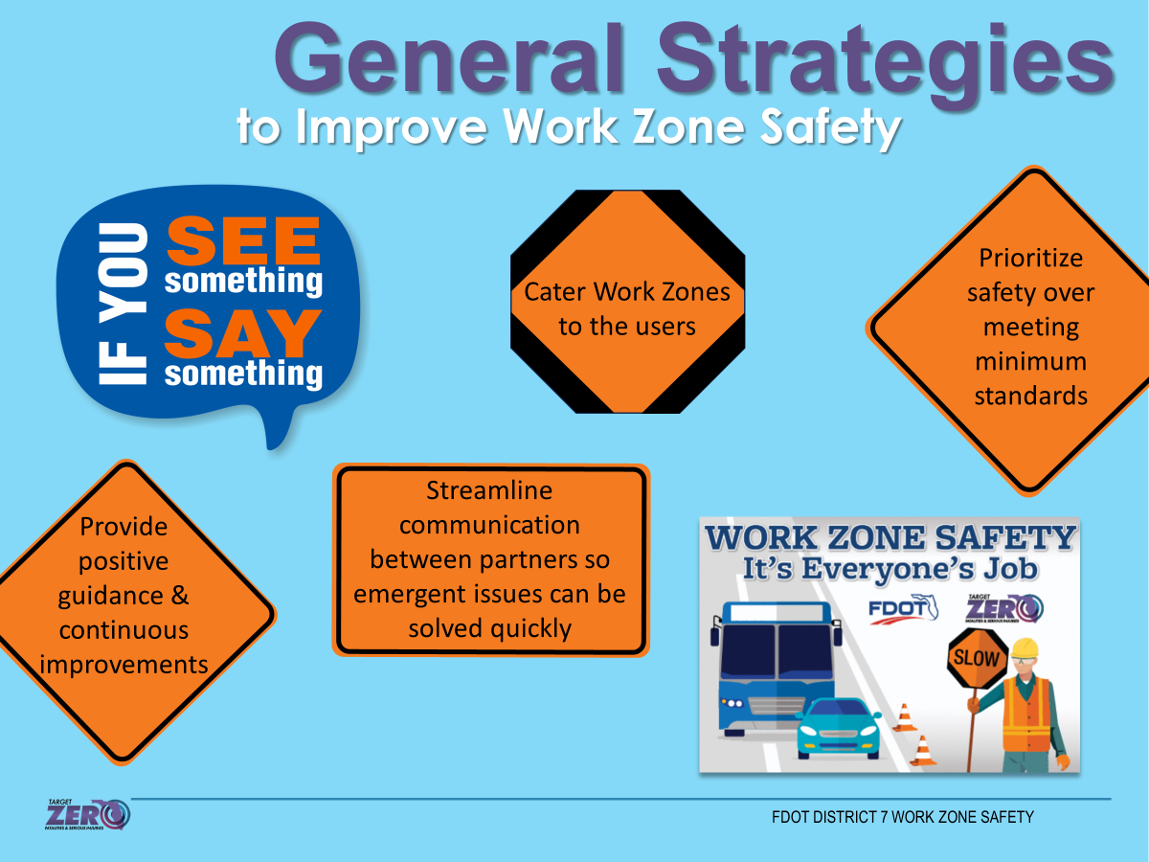
Strategies to Improve Work Zone Safety

Slide 31
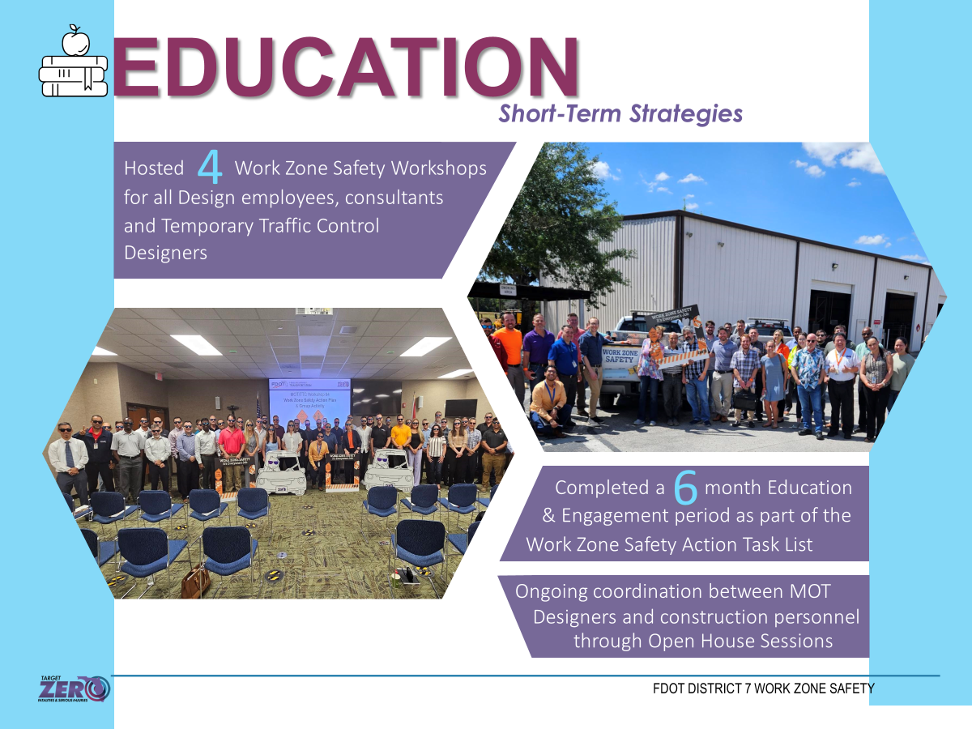
Work Zone Education

Slide 32
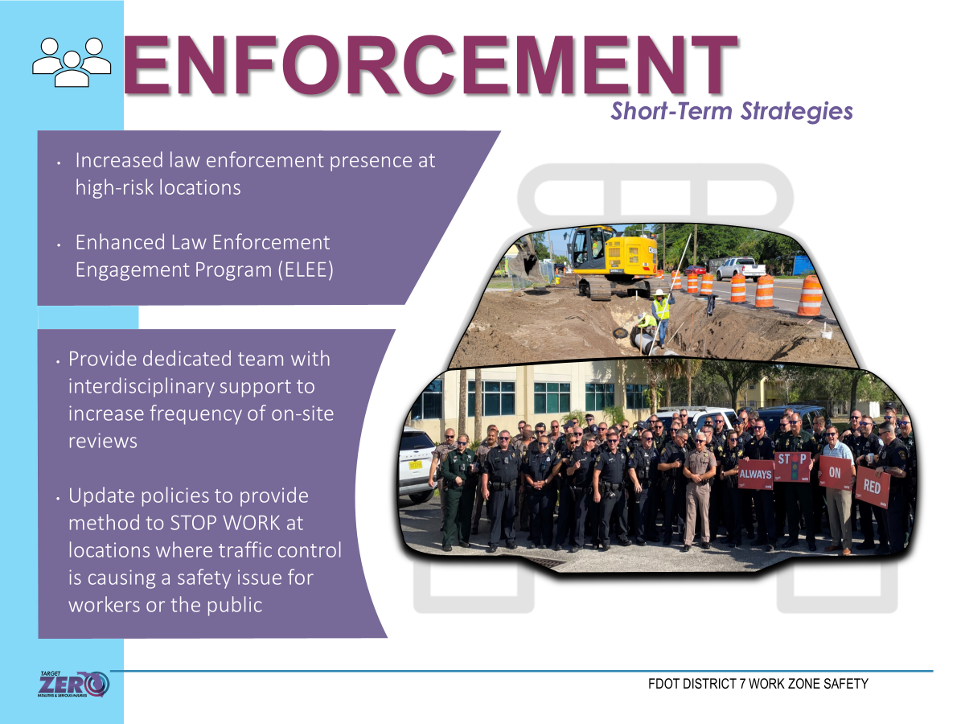
Work Zone Enforcement – Short Term

Slide 33
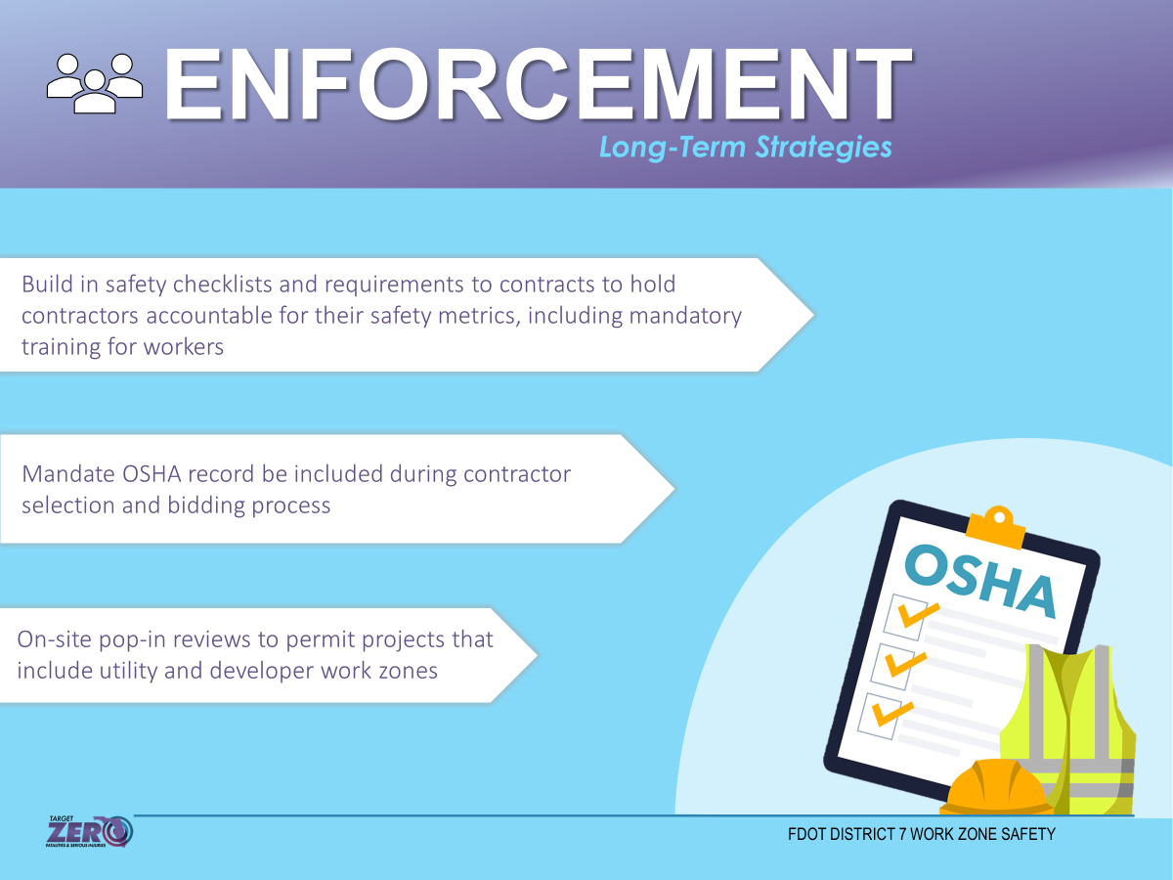
Work Zone Enforcement – Long Term

Slide 34
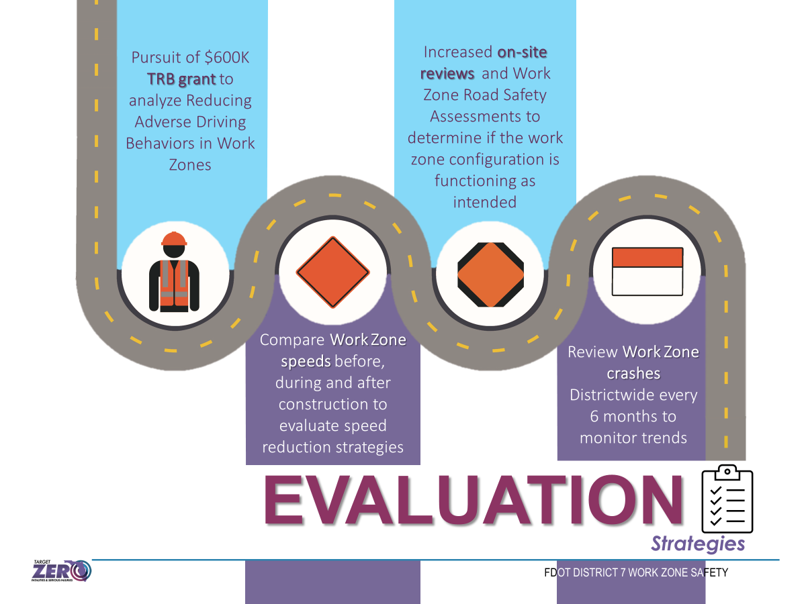
Work Zone Evaluation

Slide 35
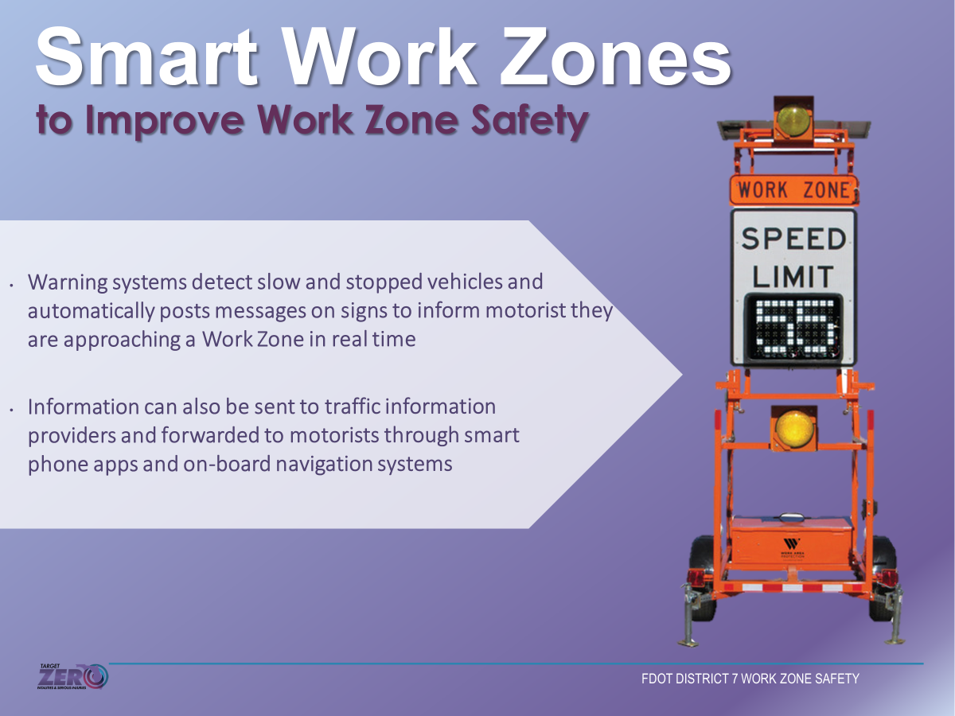
Smart Work Zones

Slide 36
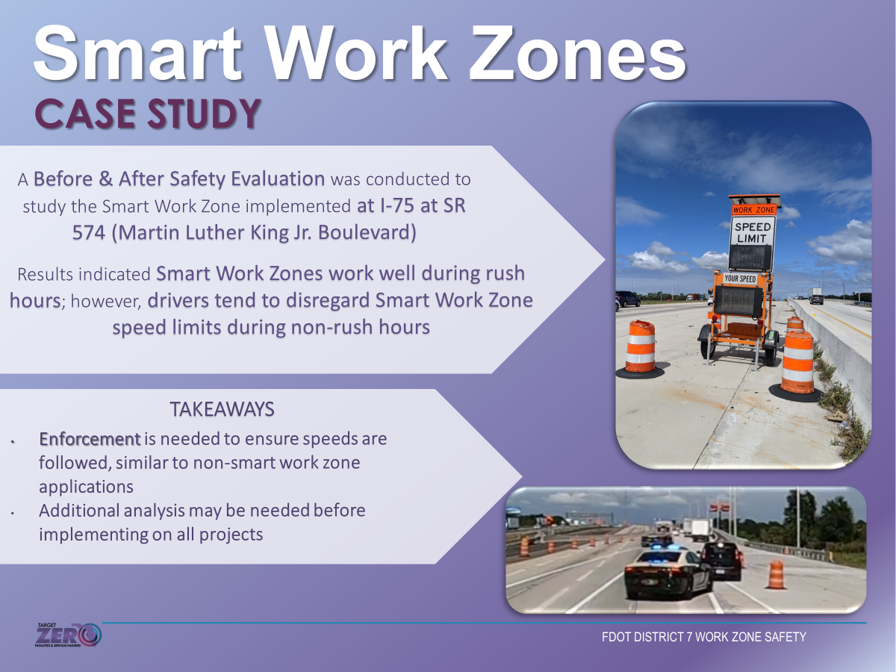
Smart Work Zones

Slide 37
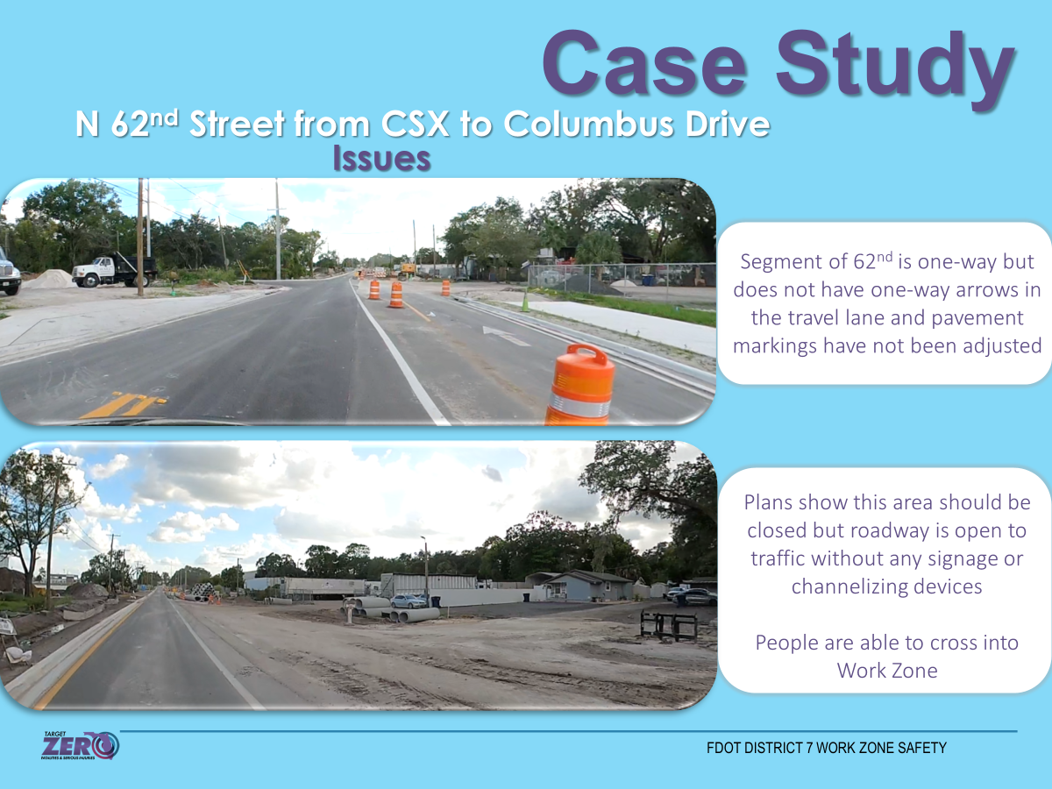
Addressing Work Zone Challenges

Slide 38
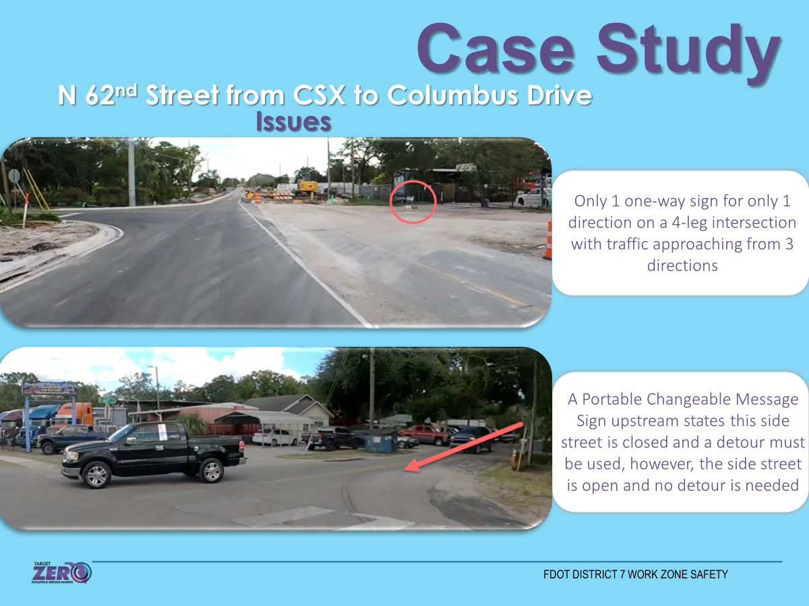
Addressing Work Zone Challenges

Slide 39
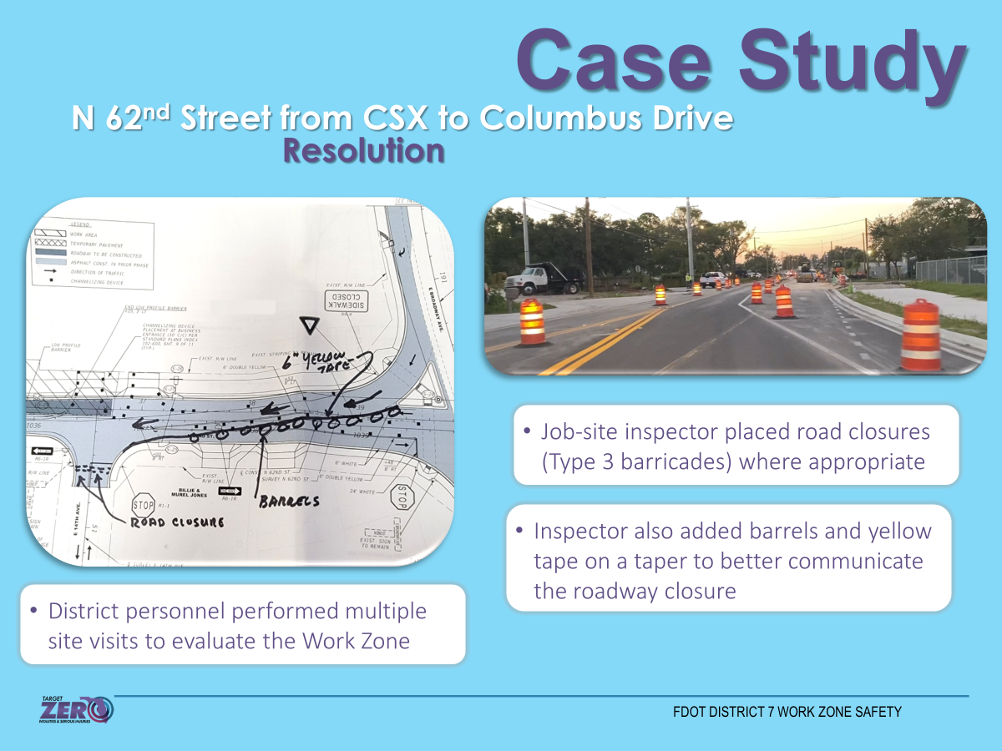
Addressing Work Zone Challenges

Slide 40

Addressing Work Zone Challenges

Slide 41
Presentation Outline:
Statewide & D7 Safety Performance
Work Zone Safety
Traffic Safety Initiatives & Innovation
Pavement Friction & Safety

Slide 42


Near Miss Technology
Near Miss Conflict Analysis
The safety office has worked with vendors to set up multiple near-miss technology pilots on state and local roads.
Near-miss technology allows us to identify areas with a high number of potential conflicts, allowing us to identify potential countermeasures before a crash ever occurs.

Slide 43


Near Miss Conflict Analysis
NEAR MISS CONFLICT ANALYSIS
Temporary Camera Installations:
  8 Hour, 24 Hour, 48 Hour, 1 Week, Etc.
  Excel Reports and Video Clips
  Captures:
-Vehicles to Pedestrians
-Vehicles to Bicycles
-Vehicles to Vehicles
Based on Post Encroachment Time (PET)
3 Thresholds: 1.5, 2.0 and 3.0 Seconds
Prioritizes High-Risk Movements
Notes:
Type your notes

Slide 44



Two-Stage Crossings
FDOT STUDY – 5 Locations
District 7 developed a PSA related to the usage of two-stage crosswalks.
  The PSA covers the benefits of two-stage crossings, as well as the process for safely using them.
Benefits of Two-Stage Crossings include:
  Ability to wait comfortably after crossing one leg.
  Gives pedestrians more time to cross the intersection.
Notes:
Type your notes

Slide 45

Leading Pedestrian Interval (LPI)
FDOT STUDY – 5 Locations
556 signalized intersections in D7 with LPI
More locations have been identified and
are currently in the works.
Some challenges:
  Old or incompatible signal equipment
  Shortage of expertise and manpower
  in smaller counties
Before & After Evaluation - Data collection phase ongoing
Notes:
Type your notes

Slide 46



Engineering Approaches
Signal Cabinet Wraps
Signal cabinet wraps at high pedestrian crossing locations feature artistic safety messages around a signal cabinet as part of a high school competition.
Sense of Community
Multiple locations in Tampa Bay.

Slide 47

Speed Management
D7 is analyzing the difference between the 85th percentile and posted speeds.
  Created a dashboard to compare weekday and weekend speeds during peak and off-peak hours.
Can be used to prioritize corridors for speed management countermeasures.

Slide 48

Reducing Right-Turn Turning Radii
FDOT District 7 conducted a pilot study (2021 – 2022)
  Three intersections along Fowler Ave in Tampa
  Compare safety measures before and after tight corner implementation
  Insufficient crash data available

Slide 49



Reducing Right-Turn Turning Radii
Record videos
  Before: 5/12/2021
  After: 5/18/2022
Review videos to observe:
  Yielding-to-pedestrian behaviors
  Right-turn speed
Statistically compare surrogate safety measures
Turning Vehicle Yield to Pedestrian/Bicyclist
Turning Speed
START
END
DISTANCE

Slide 50

Reducing Right-Turn Turning Radii
The tight right-turn corner design significantly improves pedestrian safety at signalized intersections
  Increase yielding-to-pedestrian rate by 7%
  Reduced right turn speed by 21.8%

Slide 51

Engineering Approaches
Lighting Level Analysis Tool
The results from this study indicate that LED not only introduces economic benefits (i.e., long service life, and energy savings) but also brings safety benefits.
The effective performance of LED lighting enables drivers to see better roadway conditions, resulting in safety benefits by reducing nighttime crashes. The higher blue content of the LED light spectrum can render brighter illuminance than conventional light sources at the same lumen output.

Slide 52

Engineering Approaches
Lighting Level Analysis Tool
This study concludes that if the lighting system on a roadway segment is upgraded from HPS to LED, nighttime crash frequency is more likely to be reduced by 17%, as shown in Figure 8, in FDOT District 7.

Slide 53

JUNE IS NATIONAL SAFETY MONTH
Over 3,000 lives are lost every year to PREVENTABLE CRASHES in Florida.
TOGETHER, we can bring this number down to ZERO.
Let’s Get Everyone Home
TargetZeroFL.com

Slide 54

Contact Us
Thank You!
Emmeth Duran, P.E., RSP2I
District 7 Traffic Safety Program Engineer
Emmeth.Duran@dot.state.fl.us
For more information, visit:
www.TargetZeroFL.com

