Slide 1
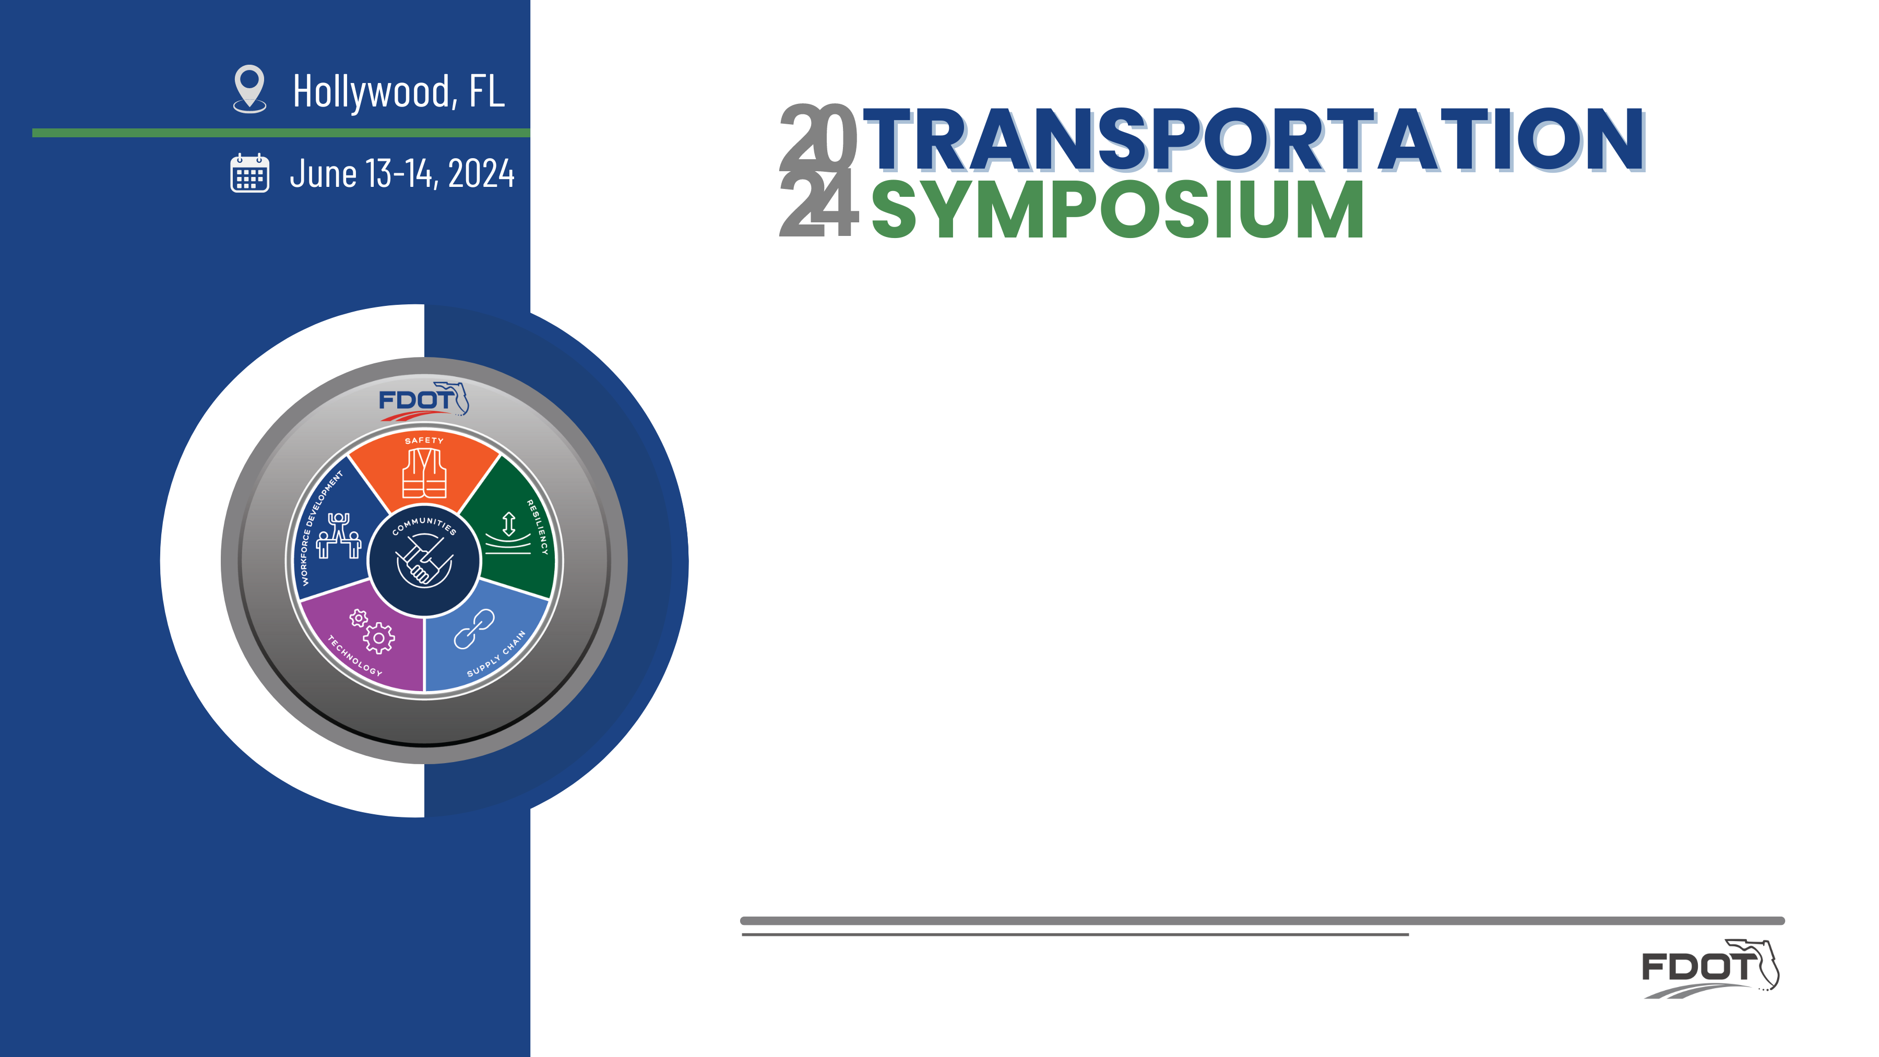

STRIDES 2 Zero Program Implementation and Challenges
Dibakar Saha
FDOT Traffic Engineering and Operations Office - CO
Maria Elena Anaya de Yeats
FDOT Traffic Engineering and Operations Office – D4
Cristina R. Morales - Quiles
FDOT Safety Office – D6

Slide 2

Outline
STRIDES 2 Zero (S2Z) program overview
  Objectives and strategies
  Processes we adopt: What, why, and how we do
  Implementation and coordination with Districts
District 4’s approach to S2Z implementation and challenges
District 6’s approach to S2Z implementation and challenges

Slide 3

What is STRIDES 2 Zero?
An initiative managed by FDOT Traffic Engineering and Operations Office in collaboration with Safety Office toward the goal of zero fatalities and serious injuries on our roadways
Enhance highway safety management practices in Florida through data-driven process
Provide engineering-based safety solutions for different transportation facilities and modes
STRIDES 2 Zero
State Traffic Roadway and Intersection Data Evaluation System Toward Zero Fatalities and Serious Injuries

Slide 4
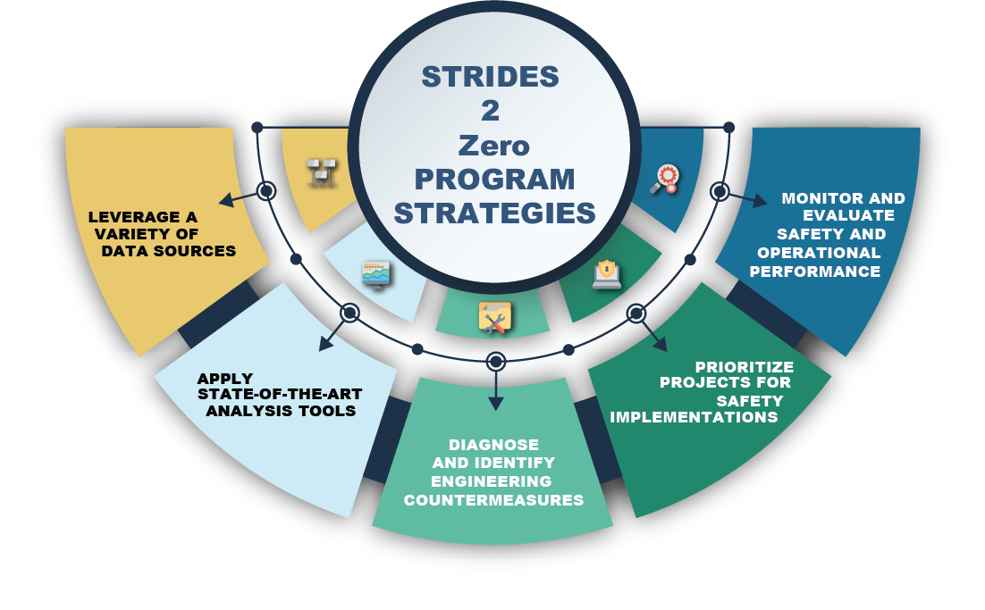
STRIDES 2 Zero Program Strategies
Leverage a variety of data sources
Apply state-of-the-art analysis tools
Diagnose and identify engineering countermeasures
Prioritize projects for safety implementation
Monitor and evaluate safety and operational performance of countermeasures

Slide 5
Focus Areas
Focus Areas
Signalized Intersection
Roadway Segment
Pedestrian and
Bicyclist
Unsignalized Intersection
All focus area efforts concentrated on State Highway System
Started with Signalized Intersection focus area

Slide 6
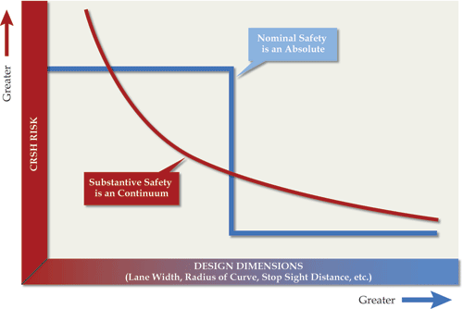
Evaluate Safety Performance
Nominal vs. Substantive Safety
Nominal Safety: a design feature or roadway either meets minimum criteria or it does not.
Substantive Safety: actual or expected long-term safety performance of a roadway.

Slide 7
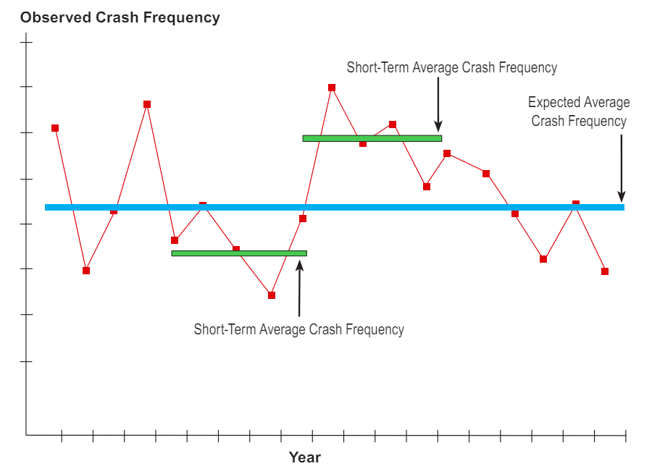
How to Determine Expected Safety Performance?
Concern #1: Natural Variability in Crash Frequency
  Crashes are random events
    What is the probability of a crash occurring at a site on a particular day and time?
  Observed average crash frequency over short periods
    Is it high, average, or low?

Slide 8
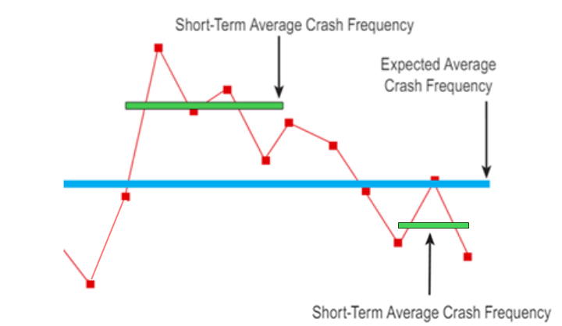
How to Determine Expected Safety Performance?
Concern #2: Regression-to-the-mean (RTM) Bias
  A period of high crash frequency is likely to be followed by a period of low crash frequency or vice versa.
  Had the treatment not been applied for, what would have been the safety performance of the site for which treatment is selected based on short-term observed average crash frequency?
Perceived Effectiveness of Treatment
RTM Reduction
Actual Reduction due to Treatment

Slide 9
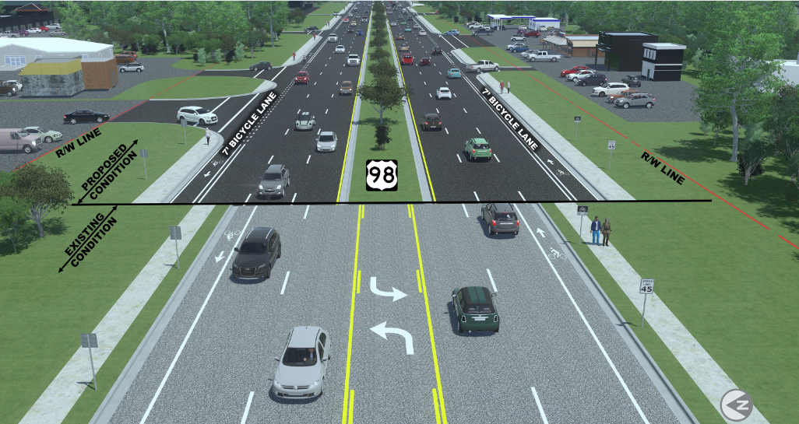
How to Determine Expected Safety Performance?
Concern #3: Variation in Roadway Characteristics
  Some roadway characteristics are subject to change over time.
  Some characteristics change on a continual basis.
  Use of a longer period of data may not capture the changes in site conditions that could be associated with occurrence or non-occurrence of crash incidents.

Slide 10
How to Determine Expected Safety Performance?
Concern #4: Conflict between Crash Frequency Variability and Changing Site Conditions
Acquire more years of crash data to address year-to-year variability
Use fewer years of crash data due to changes in roadway features

Slide 11
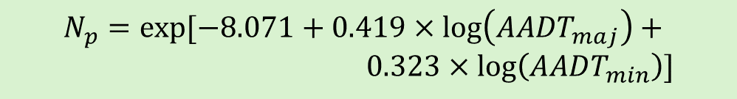

Predictive Method to Determine Expected Crash Freq.
Predictive method in the AASHTO Highway Safety Manual
Safety Performance Functions (SPFs) : A regression equation to estimate predicted average crash frequency as a function of exposure and roadway features.
Predicted Crash Frequency
  Expected crash frequency
Observed Crashes
Expected Crashes
Excess Expected Crashes
Crash Frequency
SPF
Predicted Crashes
$$N_{p}=exp⁡[−8.071+0.419×\log\left(AADT_{maj}\right)+ \\ 0.323×\log\left(AADT_{min}\right)]$$
AADT
$$N_{e}=w×N_{p}+\left(1−w\right)×N_{o}]$$

Slide 12
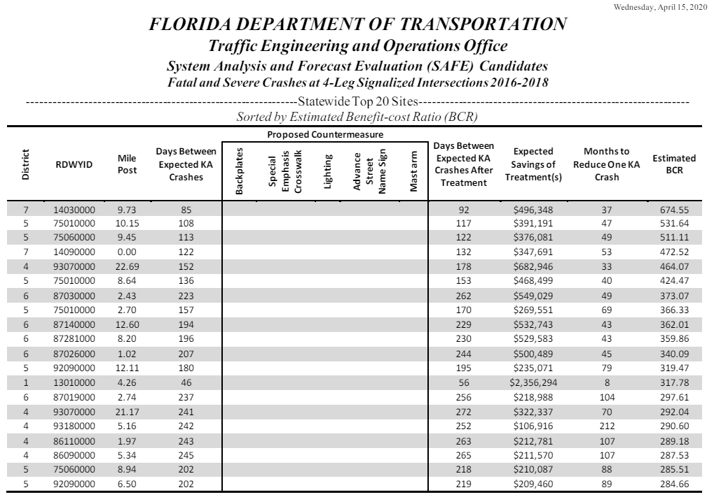
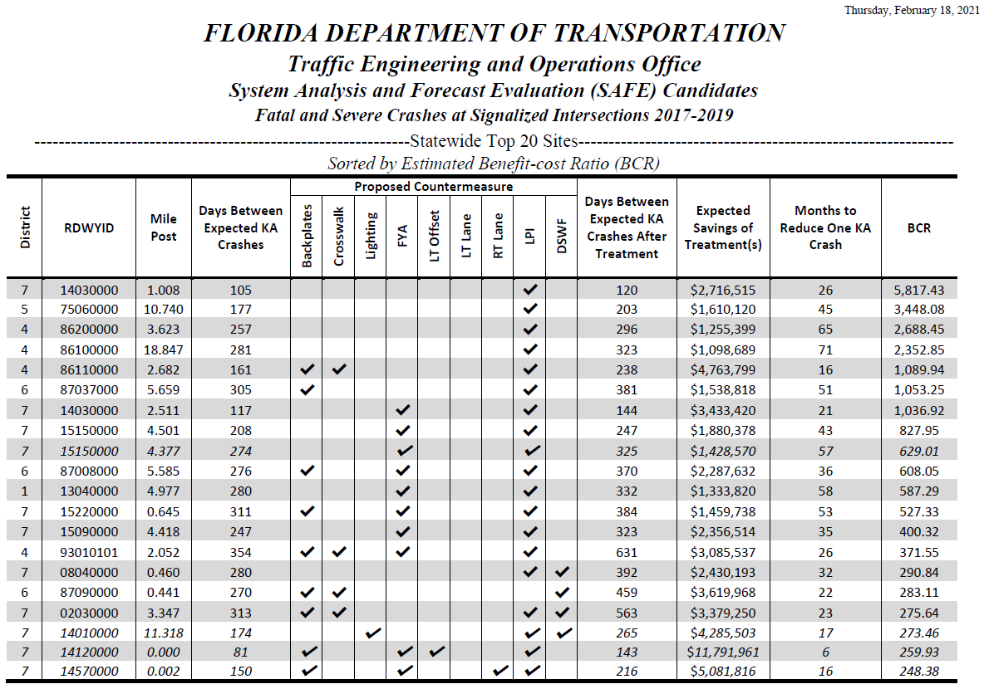
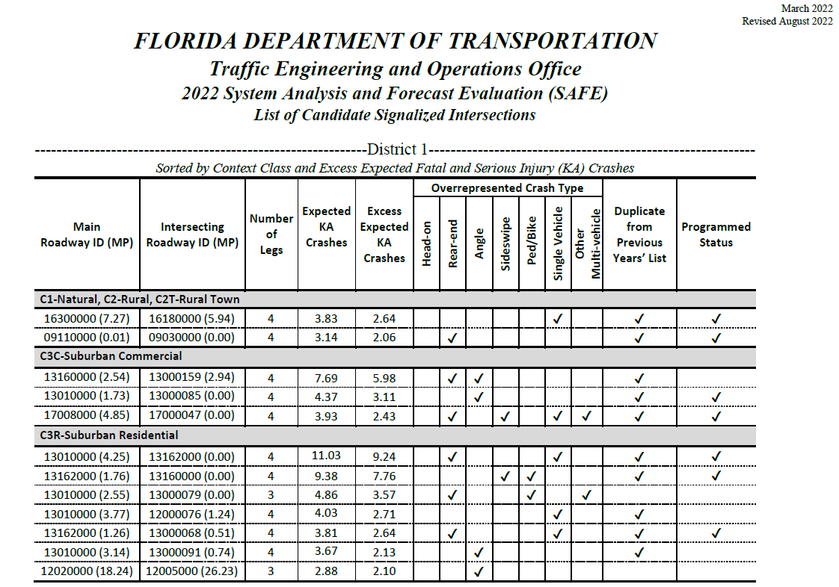
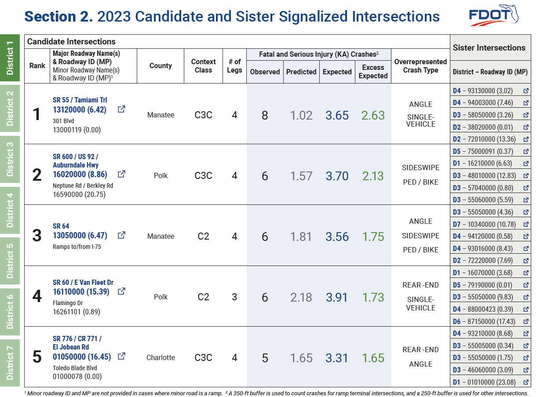
Signalized Intersections
Since 2020, annual network screening of signalized intersections
Annual SPFs using the latest three years of fatal-and-serious-injury (KA) crash and traffic data and incorporating roadway and intersection features
Candidate intersections based on the highest Excess Expected Crash Frequency (most reliable performance measure)
Overrepresented crash type
Sister intersection

Slide 13
Data Sources and Data Processes
Data Sources
eTraffic
RCI
FLARIS
Manual Data Collection
APLUS imagery
CARS
Signal 4 Analytics
Microsoft SQL Server
Spatial Analysis Tools (ArcGIS/QGIS)
Statistical Analysis Tool (R)
Power BI
Azure DevOps, SharePoint

Slide 14
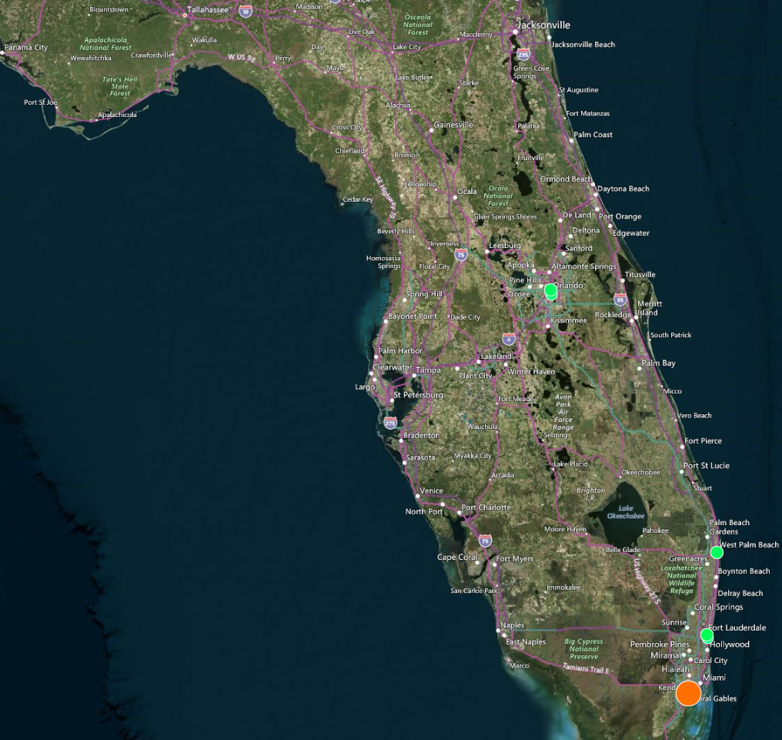
Sister Intersection – Unique Concept by FDOT
What is a sister intersection?
An intersection with similar characteristics and traffic volumes compared to a candidate intersection but experienced only a few KA crashes (0 or 1) during the study period
How is recognizing sister intersections useful?
  Identify existing safety features at better performing sister intersections, which may not be present at the candidate intersection
A set of five (5) sister intersections for each candidate intersection
Sister Intersections
Candidate Intersection

Slide 15
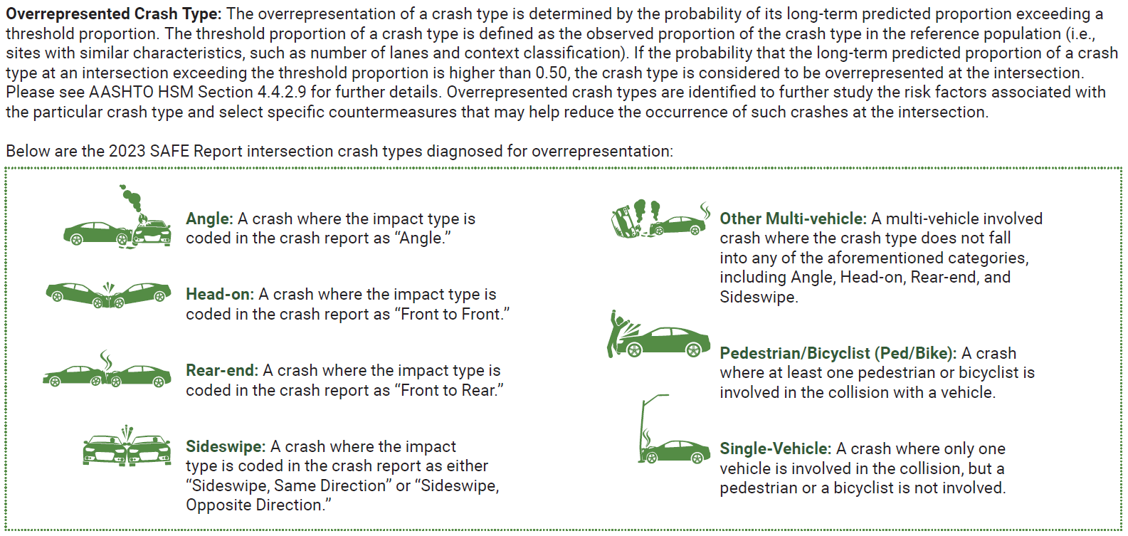
Diagnosis of Overrepresented Crash Type
Overrepresentation of a crash type is determined by the probability of long-term predicted proportion of the crash type exceeding a threshold proportion > 0.50
Assess the contributing factors associated with the particular crash type and select specific countermeasures that may help reduce the occurrence of such crashes

Slide 16
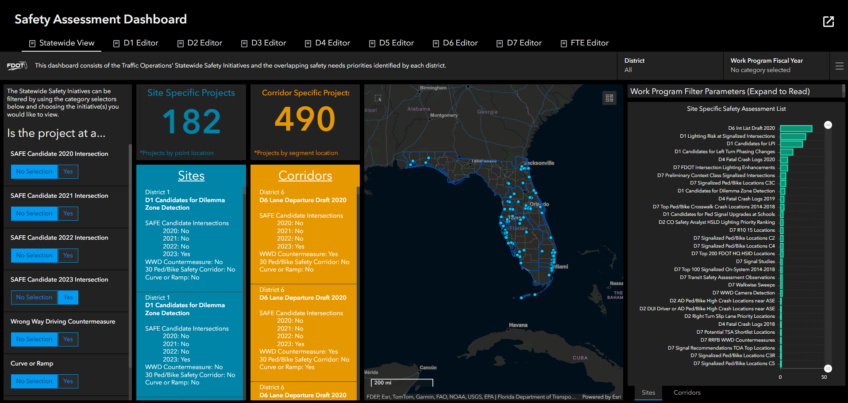
Mapping Locations with Existing Safety Priority Lists

Slide 17
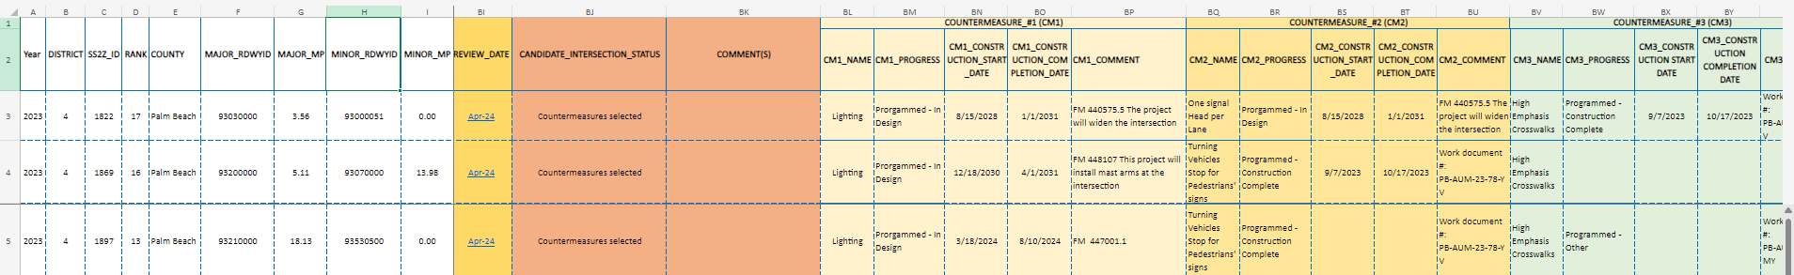
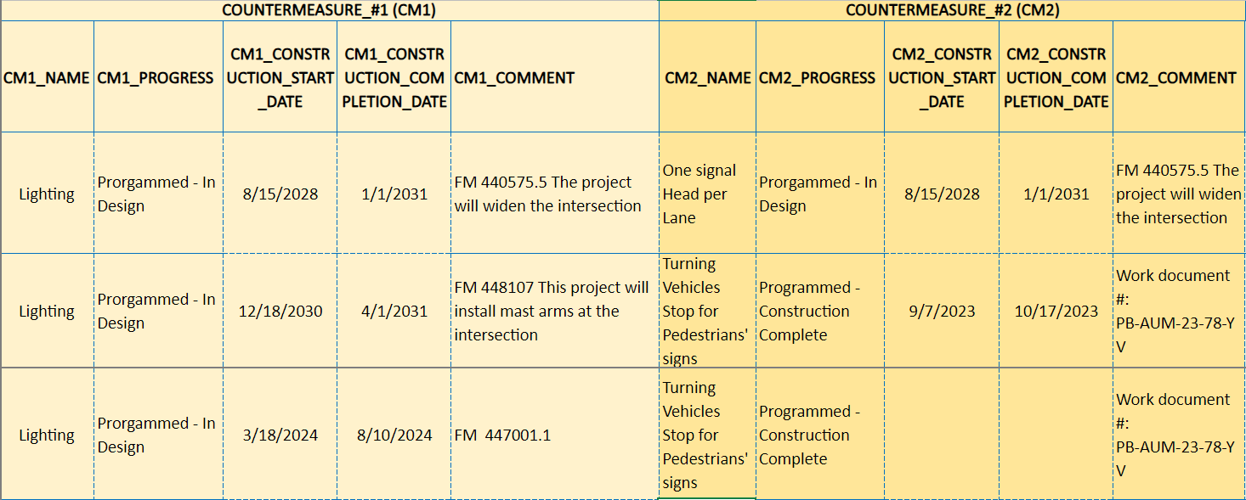
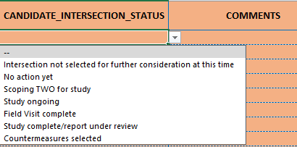
Monitor and Tracking of Implementations
Excel-based Form in Central SharePoint Site
Overall Status of Candidate Intersection
Countermeasure Implementation Status

Slide 18

District 4 STRIDES 2 Zero Program Implementation
District 4’s Approach to S2Z implementation
Traffic Operations Office and Safety Tag Team
Traffic Operations Office (comprised of Traffic Services/TSM&O)
Traffic Services assists with improving safety through implementation of short-term improvements
Notes:
Collaborative effort between two entities.
D4 promoting safety culture and the FDOT adopted safe system approach (SSA) – “Safety is a collective responsibility”
Zero is our goal – SSA objective

Slide 19
District 4 Team
Traffic Services Role:
Implement the short-term improvements Not requiring additional analysis/feasibility studies
Coordinate improvements through upcoming programmed projects
Coordinate improvements through local maintaining agencies
Traffic Services Resources:
Push Button Contracts
  Pavement Markings and Signing Contracts (PMS)
  Roadway & Signalization Contracts
  Maintenance
  Operation Centers Maintenance Units
  Asset Maintenance Contracts
  Supplementary Data/ Resources:
  FDOT Work Program (Recently completed projects/Upcoming projects)
  Traffic Operations/Safety Studies Database
Notes:
Safety is Separated from Traffic Operations
Implement Low-Hanging Fruit
Explain resources used for implementation

Slide 20
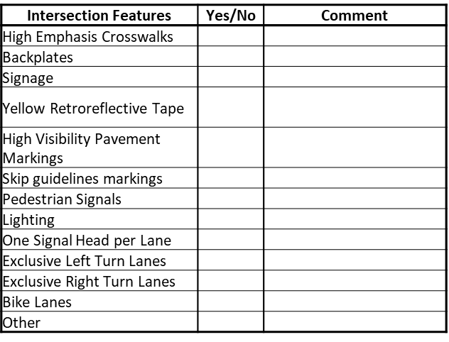
District 4 Approach
Obtain List of Candidate Intersections from CO
  34 Intersections for year 2023
Prepare checklist of Intersection Features at Sister Intersections
Compare Study Intersection features against Sister Intersections
Review Work Program and Studies Database
Identify short-term improvements that can be implemented using Traffic Services Resources
Determine potential improvements for coordination through upcoming projects and/or Local Maintenance Agencies
Notes:
Compare Study Intersection with Sister Intersections: list improvements observed in sister intersections not yet implemented in our study intersection.
Create a thorough list of improvements seen in the sister intersections but not yet applied to our study intersection, (addition of warning signs, street lighting, flexible backplates, turn lanes, high emphasis crosswalks, etc.).
Implement short-term improvements via push button or maintenance work order.
Identify which projects in the work program involve our study intersection and coordinate on adding extra improvements if possible and not already planned.

Slide 21
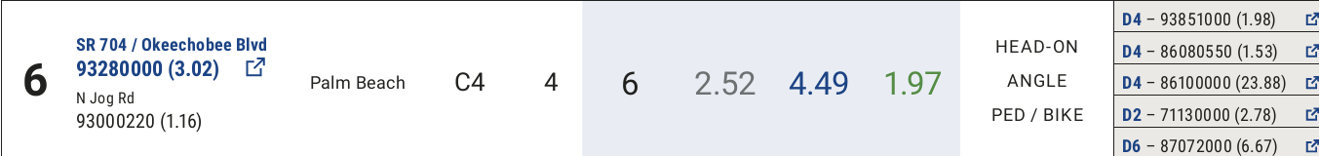
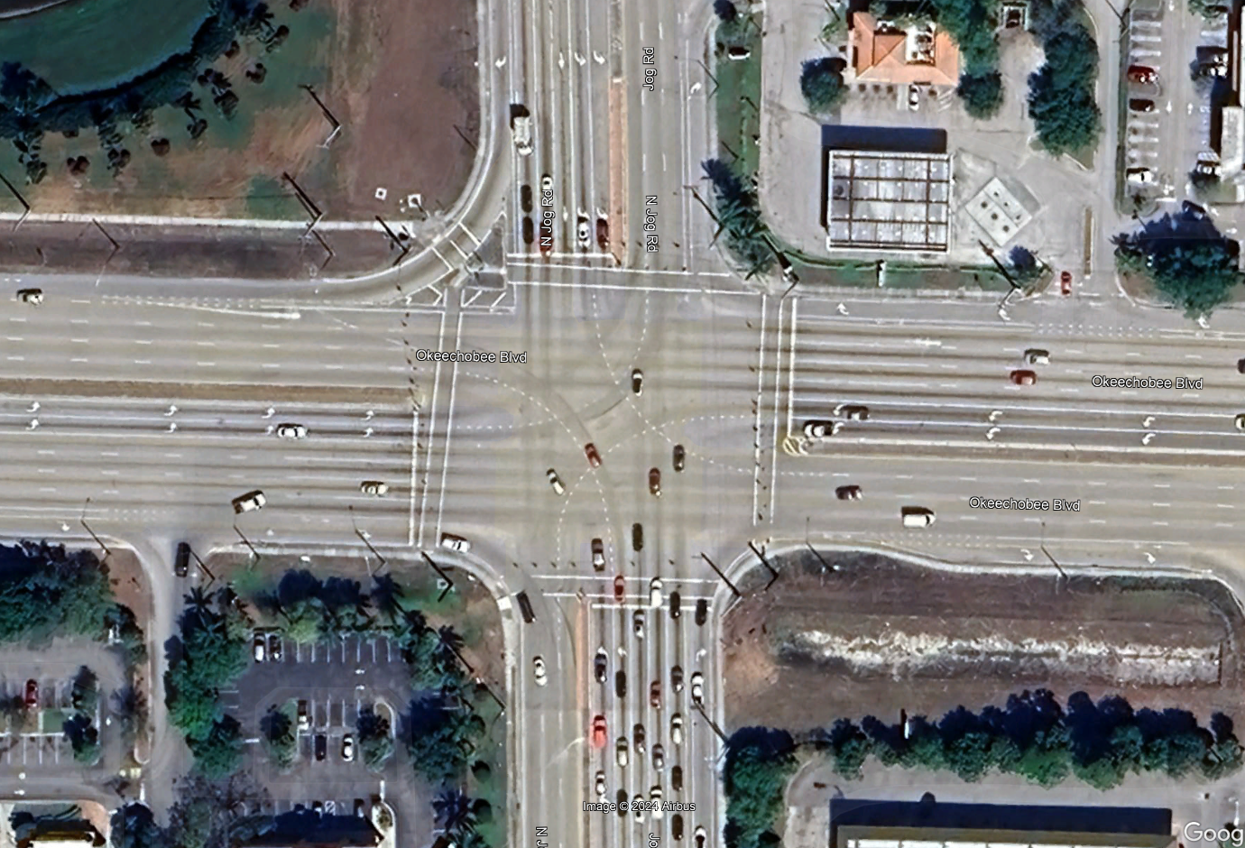
Example 1: N Jog Rd & SR 704/Okeechobee Blvd, West Palm Beach, FL
Jog Rd
Intersection Features | Yes/No | Comment
High Emphasis Crosswalks
Backplates
Signage
Yellow Retroreflective Tape
High Visibility Pavement Markings
Skip guidelines markings | ü
Pedestrian Signals | ü
Lighting | ü | Determine the need
One Signal Head per Lane | ü
Exclusive Left Turn Lanes | ü
Exclusive Right Turn Lanes | ü | Channelized SB RT Lane
Bike Lanes
Other
SR 704/Okeechobee Blvd
Notes:
Possible improvements for Head-On: Install/Improve pavement markings, channelize intersections, Create one-way streets, remove parked vehicles, install median divider, widen lanes
Possible improvements for Angle: Advance warning devices, signal lenses, overhead signals, visors backplates, improve location of signal heads, add additional signal heads, adjust amber phase, provide all red-clearance phases, signal actuation, retime signals progression
Possible improvements for ped crashes: Remove sight obstructions, install/improve ped crossings, reroute ped paths, add ped refuge islands, timing of ped phase

Slide 22
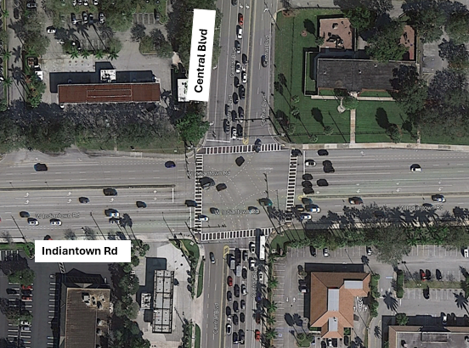
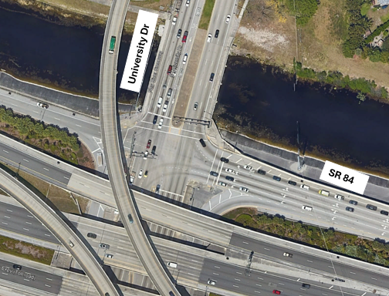
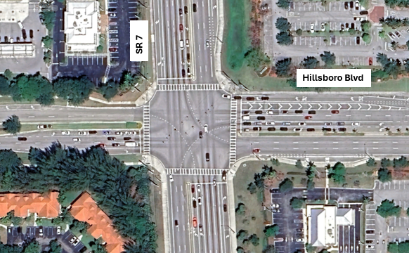
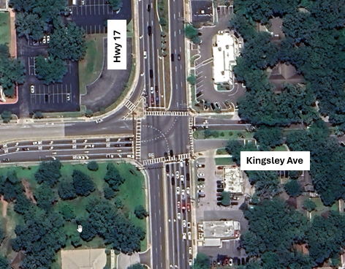
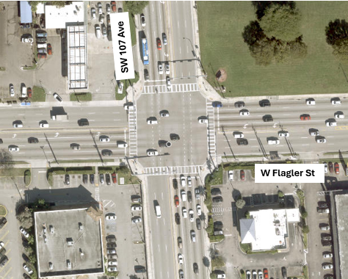
Sister Intersections

Slide 23
Sister Intersections Features
Intersection Features | Study Intersection Jog Road at Okeechobee Blvd | Sister Intersections |  |  |  |  | Comment
 |  | 1: SR 706/ Indiantown Rd & Central Blvd | 2: SR 84 & University Dr | 3: Hillsboro Blvd at SR 7 | 4: Hwy 17 & Kingsley Ave | 5: SR 968/Flagler St at SW 107th Ave
High Emphasis Crosswalks |  | ü |  | ü | ü | ü
Backplates |  | ü | ü | ü | ü | ü | 1, 2, 3, 4: EB/WB
Signage |  | ü | ü |  | ü |  | 1, 2: Turning Vehicles Stop for Pedestrian 1: U-Turn Yield to Right Turn on mast arms 4: No U-Turn, Do Not Block Intersection
Yellow Retroreflective Tape |  | ü |  | ü |  | ü | 1: EB/WB 3: WB
High Visibility Pavement Markings |  | ü | ü | ü | ü | ü
Skip guidelines markings | ü | ü | ü | ü | ü | ü
Pedestrian Signals | ü | ü | ü | ü | ü | ü
Lighting | ü¹ | ü |  | ü | ü | ü
One Signal Head per Lane | ü | ü | ü | ü | ü
Exclusive Left Turn Lanes | ü | ü | N/A | ü | ü | ü | 4: NB, SB, EB
Exclusive Right Turn Lanes | ü² | ü | N/A | ü | ü |  | 1, 4: EB 4: SB
Bike Lanes |  | ü | ü | ü
Other |  |  | One Way (WB) |  | Channelized Turn Lanes
¹ Determine the need
² Channelize SB RT Lane

Slide 24
N Jog Rd & Okeechobee Blvd - Planned Work Program Improvements & Potential Improvements Via Push Button
Planned Work Program Projects:
FM 449279.1 - SHSP Emphasis Area (S) – Intersection & Vulnerable Road Crashes - Add Lighting
Production Date: 3/3/2025
Quick Potential Improvements Implemented Via Push Button:
Addition of High Emphasis Crosswalks – Work Document prepared
Installation of Backplates with Yellow Retroreflective Tape: Programmed for June 2024 in the Push Button Program
Installation of “One Way” signs and “Do Not Enter” signs at median openings – Work Document Prepared
Incorporation of Pedestrian Signage – Work Document Prepared
Coordination with FDOT Maintenance Office and Palm Beach County:
  Refurbishment of Pavement Markings
  Verification of Pedestrian Clearance Times
Intersection Features | Yes/No | Comment
High Emphasis Crosswalks
Backplates
Signage
Yellow Retroreflective Tape
High Visibility Pavement Markings
Skip guidelines markings | ü
Pedestrian Signals | ü
Lighting | ü | Determine the need
One Signal Head per Lane | ü
Exclusive Left Turn Lanes | ü
Exclusive Right Turn Lanes | ü | Channelized SB RT Lane
Bike Lanes
Other
Notes:
Highlight key missing features at the intersection.
Discuss completed and upcoming projects briefly.
Emphasize the importance of reviewing the 3R Safety Report recommendations and coordinating additional improvements as necessary.
Consider adding one signal head per approach (structural analysis failed) Replacing the whole signal system? ROW is needed

Slide 25
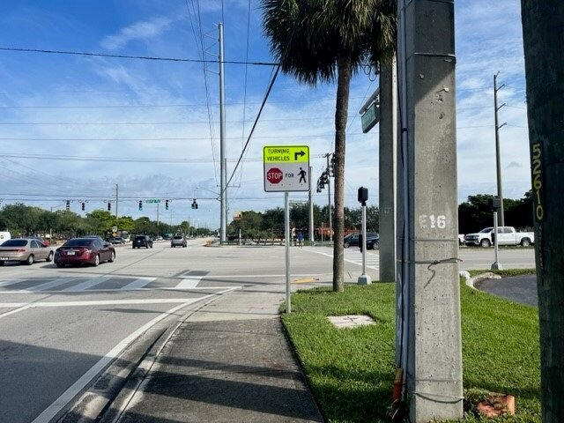
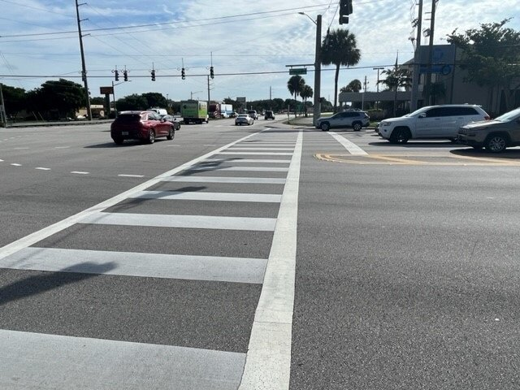
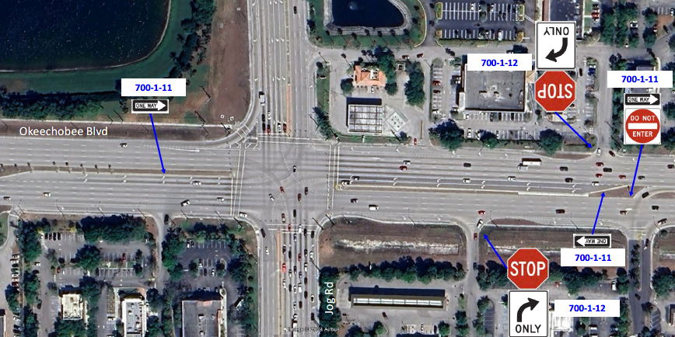
Improvements Implemented at N Jog Rd & Okeechobee Blvd
Head-On Crashes Prevention Treatment
Pedestrian Signage
High Emphasis Crosswalks

Slide 26
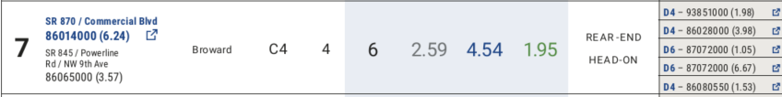
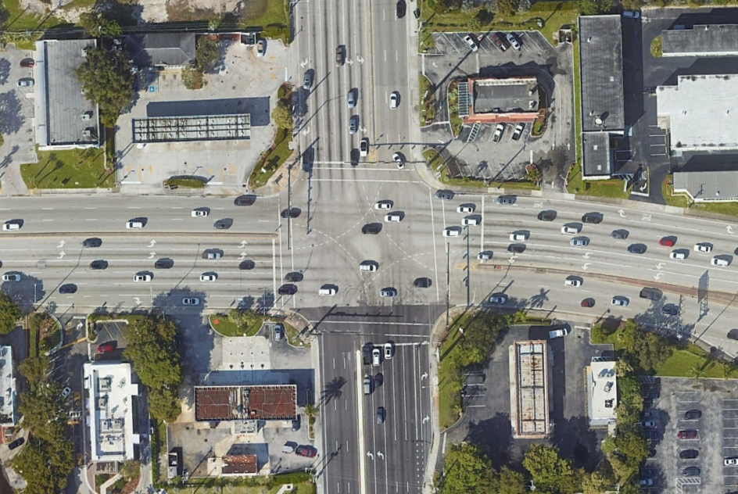
Example 2: SR 845/Powerline Rd & SR 870/Commercial Blvd
Intersection Features | Yes/No | Comment
High Emphasis Crosswalks |  | Only on south leg
Backplates | ü | EB/WB
Signage | ü | Next Signal Intersection signs
Yellow Retroreflective Tape
High Visibility Pavement Markings | ü
Skip guidelines markings | ü
Pedestrian Signals | ü
Lighting | ✓ | Determine the need
One Signal Head per Lane | ü
Exclusive Left Turn Lanes | ü
Exclusive Right Turn Lanes | ü
Bike Lanes
Other
Powerline Rd
Commercial Blvd
Notes:
Possible improvements for Head-On: Install/Improve pavement markings, channelize intersections, Create one-way streets, remove parked vehicles, install median divider, widen lanes
Possible improvements for Rear End: Poor visibility of signals: install advance warning signs, visors, backplates, relocate signals, add additional signal heads. Inadequate signal timing: Adjust amber phase, progression. Ped crossings: install HE Crosswalks, provide walk phases, illuminate crosswalks. Slippery Surface: Overlay Pavement, adequate drainage, groove pavement. Large turning volumes: Add left or right turn lanes, prohibit turns, increase curb ratio

Slide 27
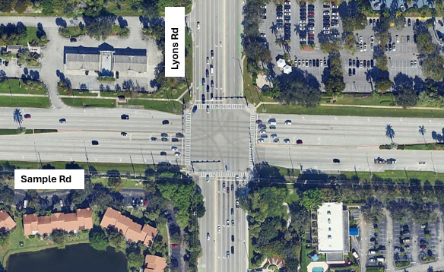
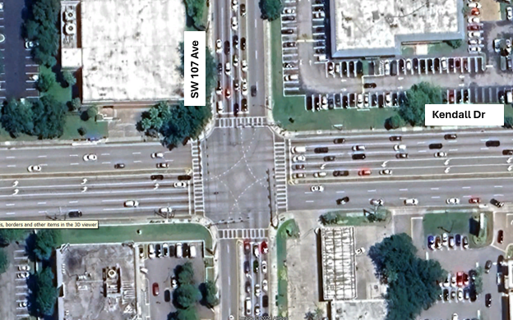
Sister Intersections

Slide 28
Sister Intersections Features
Intersection Features | Study Intersection Powerline Rd & Comercial Blvd | Sister Intersections |  |  |  |  | Comment
 |  | 1: SR 706/ Indiantown Rd & Central Blvd | 2: Lyons Rd & SR 834/ Sample Rd | 3: SW 107th Ave & SW 88th Street/Kendall Dr | 4: SR 968/Flagler St at SW 107th Ave | 5: SR 84 & University Dr
High Emphasis Crosswalks | ¹ | ü | ü | ü | ü
Backplates | ü² | ü | ü | ü | ü | ü | 1: EB/WB
Signage | ü³ | ü | ü | ü |  | ü | 1, 3: Turning Vehicles Stop for Pedestrian 1: U-Turn Yield to Right Turn on mast arms 2: Next Signal Intersection signs, 2: No U-Turn Sign (EB) 3: Next Signal Intersection signs 3: School Crossing Signs
Yellow Retroreflective Tape |  | ü | ü | ü | ü |  | 1, 3: EB/WB
High Visibility Pavement Markings | ü | ü | ü | ü | ü | ü
Skip guidelines markings | ü | ü | ü | ü | ü | ü
Pedestrian Signals | ü | ü | ü | ü | ü | ü
Lighting | ü⁴ | ü | ü | ü | ü
One Signal Head per Lane |  | ü | ü | ü |  | ü
Exclusive Left Turn Lanes | ü | ü | ü | ü | ü | N/A
Exclusive Right Turn Lanes | ü | ü | ü |  |  | N/A | 1: EB
Bike Lanes |  | ü | ü |  |  | ü
Other |  |  | Green Colored Bike lanes NB/SB |  |  | One Way (WB)
¹ Only on south leg
² EB/WB
³ Next Signal Signs
⁴ Determine the need

Slide 29
Powerline Rd & Commercial Blvd - Planned Work Program Improvements & Potential Improvements Via Push Button
FM 441944.1 & 441944.2: Install & Deploy Adaptive Traffic Controllers & Vehicle Detection
Estimated Work Begin Date: 12/04/24
FM 448408.1: The resurfacing project along Commercial Blvd excludes this intersection for now. However, its boundaries may expand pending safety funding to extend all left-turn and right-turn storage lanes as recommended in the safety report.
Estimated Work Begin Date: 10/14/25
Safety Study Proposed Improvements:
Extend all left-turn and right-turn storage lanes, Provide high emphasis crosswalks, Signal improvements (backplates, yellow reflective borders); Pedestrian Signage, Head-On crashes prevention signage (driveways).
Planned Work Program Projects:
FM 446196.1: Lighting Retrofit, Pedestrian Signalization Upgrades, Replacement of detection Loops. This project will incorporate some elements from the safety study: Pedestrian Signage, high emphasis crosswalks, Head-on crashes prevention signage (driveways)
Estimated Work Begin Date: 12/04/24
Notes:
Highlight key missing features at the intersection.
Discuss upcoming projects briefly.
Emphasize the importance of reviewing the 3R Safety Report recommendations and coordinating additional improvements as necessary.
Adaptive helps with Rear end crashes congestion

Slide 30
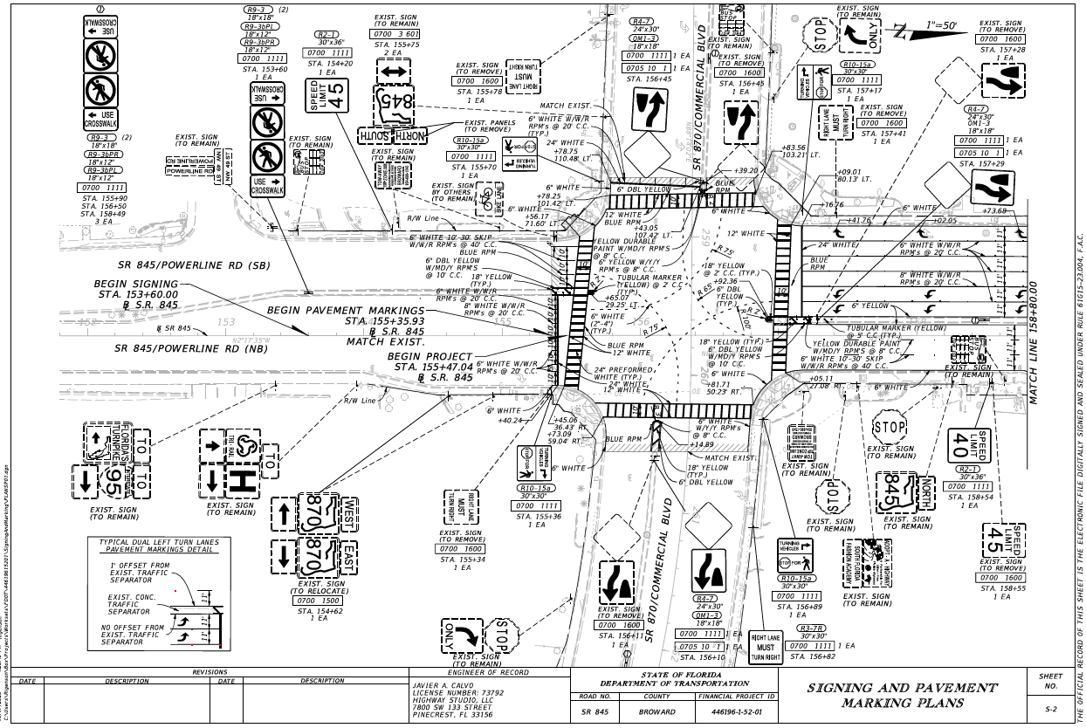
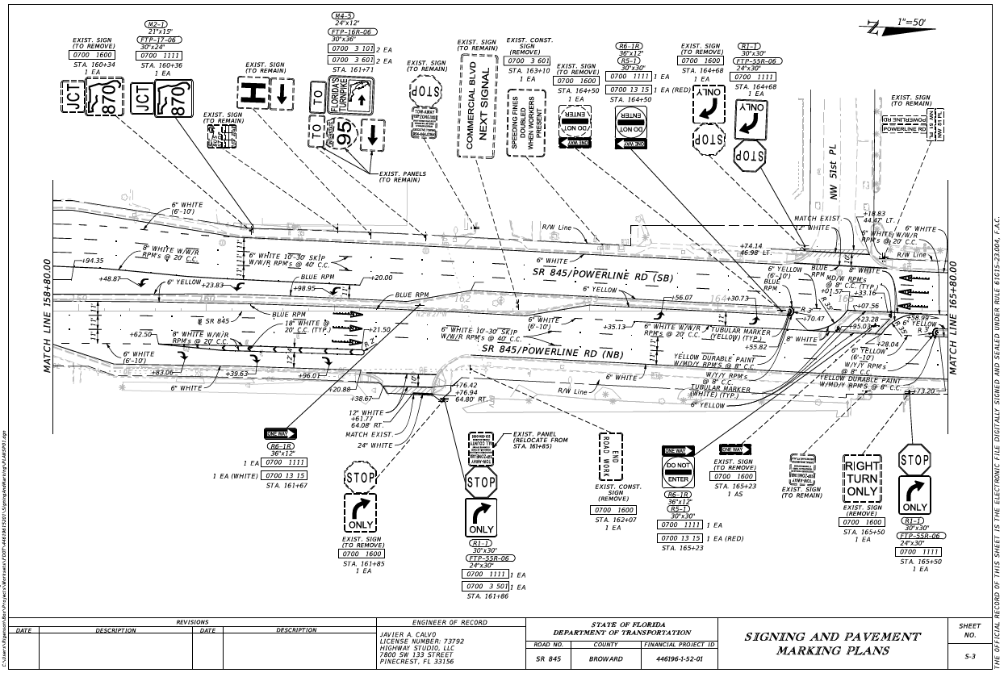
Powerline Rd & Commercial Blvd - Planned Work Program Improvements
FM 446196.1
Notes:
Highlight key missing features at the intersection.
Discuss upcoming projects briefly.
Emphasize the importance of reviewing the 3R Safety Report recommendations and coordinating additional improvements as necessary.
Adaptive helps with Rear end crashes congestion

Slide 31
Implementation Advantages/ Challenges
Advantages
Safety benefit achieved through quick implementation of short-term improvements
Consistent application of potential countermeasures (less deviation from driver expectancy)
Collaboration - shared responsibility for Safety
Challenges
ROW and Budget limitations
Improvements through programmed projects may take longer
Need for additional analysis/feasibility studies
Notes:
If improvements are implemented via a planned project, the implementation time will be longer

Slide 32
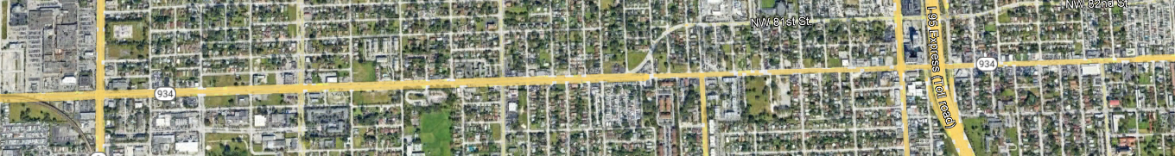
District 6 STRIDES 2 Zero Implementation
Presentation Outline
  Four intersections along SR 934/NW 79th St
  Background, Implementation, and Challenges
SR 934 & NW 27 Ave
SR 934 & NW 17 Ave
SR 934 & NW 9 Ave
SR 934 & NW 4 Ave

Slide 33
History
Originally, the Department programmed a RRR project along SR 934/NW 79 Street from NW 25 Avenue to NW 1 Place under FM 410646-4
Back in fiscal year 2019 a RRR Safety Review was performed and discovered a pattern of pedestrian and bicyclist crashes occurring at some of the intersection within the corridor.
After an additional safety study was conducted, all safety improvements were presented and approved to be under FM 410646-7.
When Safe Strides to Zero began, one of the intersections on the list provided by Central Office was along NW 79 Street at NW 27 Avenue, and at NW 17 Avenue.
An additional study for SS2Z was conducted in 2021, and those improvements were presented and approved to be added to the scope of the safety project FM 410646-7.

Slide 34
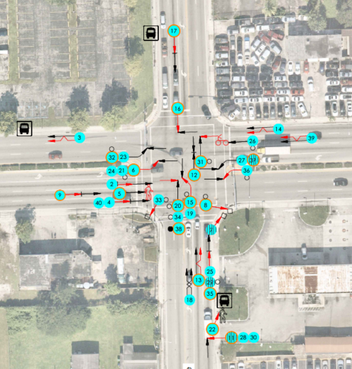
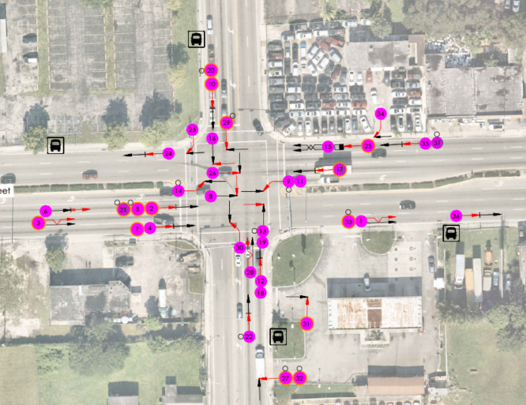
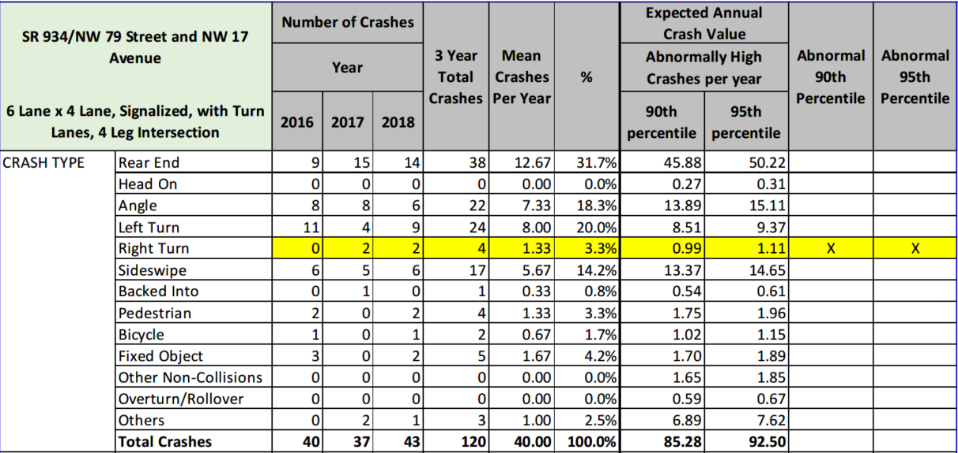
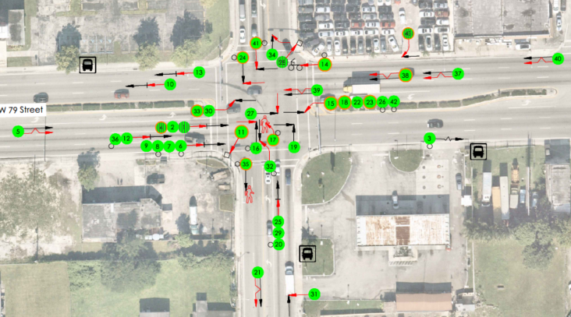
2016
2017
SR 934 and NW 17 Avenue
2018

Slide 35
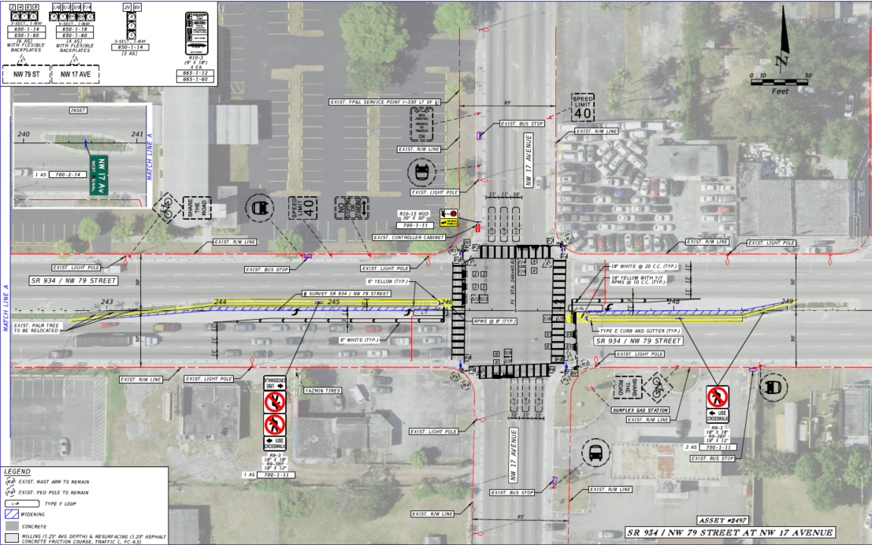
Recommendations
Notes:
Issue: area was failing before regarding drainage, currently in design we are working on addressing the drainage and adding the cost in safety

Slide 36
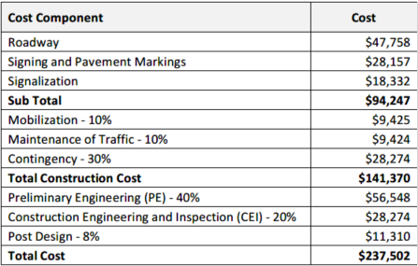
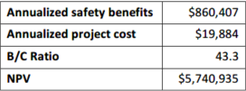
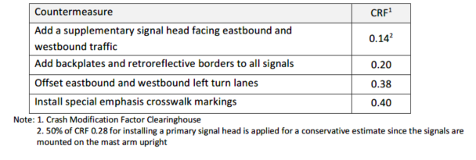
B/C Analysis at NW 17 Avenue

Slide 37
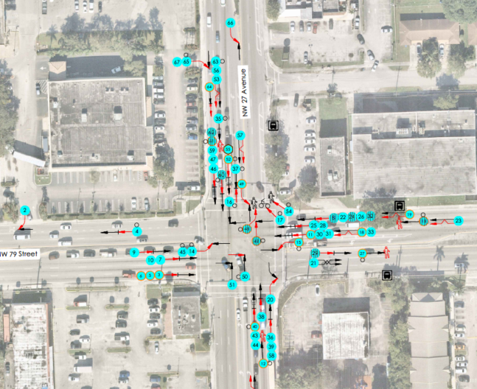
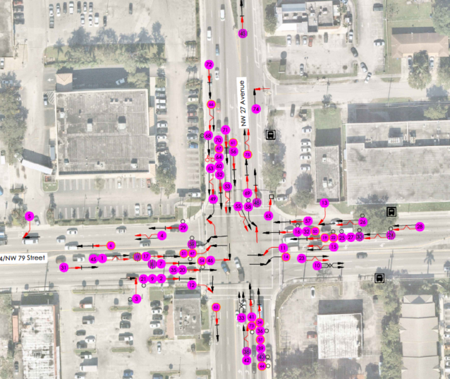
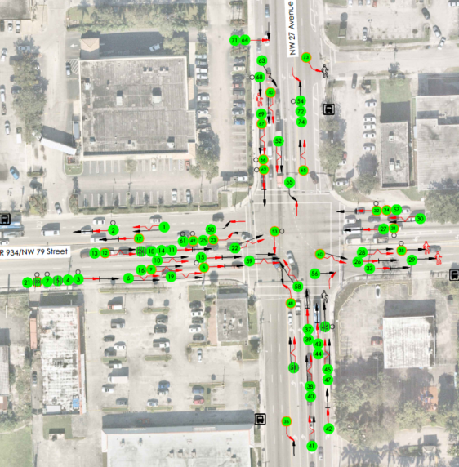
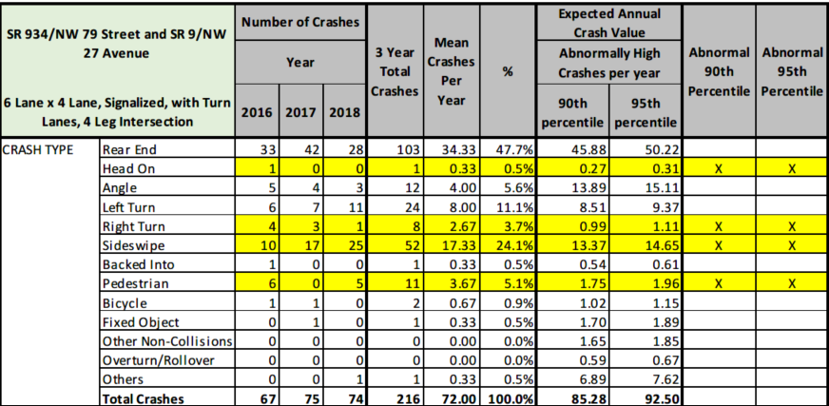
2017
SR 934 and NW 27 Avenue
2016
2018

Slide 38
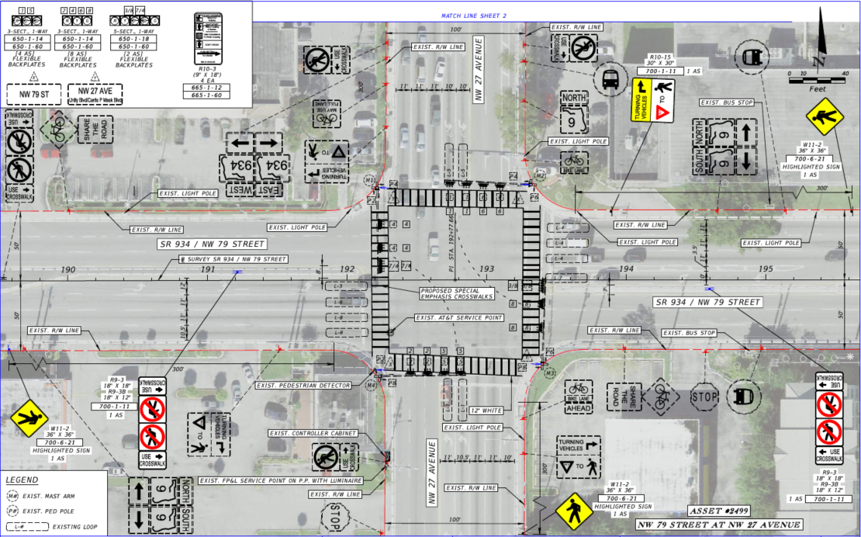
Recommendations
Notes:
Issue: new controllers are needed within the entire segment, including NW 27 Avenue.
Solution: trying to fit new controller at NW 27 Avenue within R/W to avoid additional costs

Slide 39
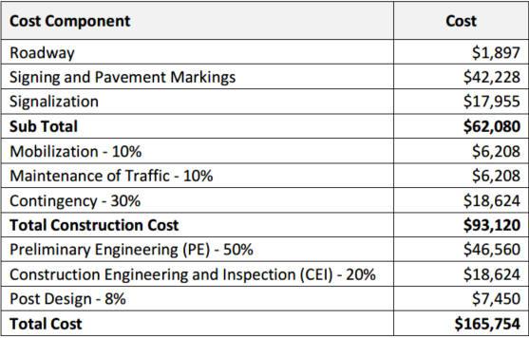
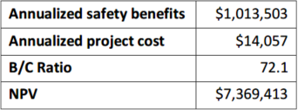

B/C Analysis at NW 27 Avenue

Slide 40

Challenges
SR 934/NW 79 Street is one of the top locations for pedestrian and bicycle crashes in District 6.
In addition to the Safe Strides to Zero Initiative, the safety study made recommendations to add midblock crossings and signalize existing stop-controlled intersections.
Crash analyses, pedestrian counts, adequate spacing, and existing grid conditions were taken into consideration for all recommendations.
For this presentation we will be highlighting NW 9 Avenue and NW 4 Avenue as the recommendations have changed due to challenges encountered during the design phase.
Notes:
Discuss that this is a 4 lane undivided roadway with a TWLTL in the middle. There are several median openings in between existing signals, therefore not many opportunities for pedestrians/bicyclists to cross.

Slide 41


NW 9 Avenue Initial Recommendations
Proposed signalized midblock crossing
Added landscaping and removed the left-turns from the two-way left-turn lane (TWLTL).
Extended left-turn storage to make an EBL into NW 8 Avenue or a WBL into NW 10 Avenue.
Add signage to enhance pedestrian safety.

Slide 42

NW 9 Avenue Challenges and Solutions
Notes:
Facing east at the proposed location of the midblock crossing.
Issue: proposed landing would be adjacent to existing driveways
Solution: move the crossing out to impact the eastern driveway
Most bus stops are being relocated already through MDT
Ask design to let us know when the plans are redesigned for our review

Slide 43

NW 9 Avenue Challenges and Solutions
Notes:
Facing east at the proposed location of the midblock crossing.
Issue: proposed landing would be adjacent to existing driveways
Solution: move the crossing out to impact the eastern driveway
Most bus stops are being relocated already through MDT
Ask design to let us know when the plans are redesigned for our review

Slide 44


NW 4 Avenue Initial Recommendations
Proposed to convert the two-way stop controlled (TWSC) intersection into a signalized intersection.
Proposed to add a midblock east of NW 4 Avenue.
Change the lane configuration east of NW 4 Avenue to two-way two lane undivided.
Add signage to enhance pedestrian safety.

Slide 45



NW 4 Avenue Challenges and Solutions
Notes:
Issue: the placement of the SB stop bar in the design plans was too far and we did not approve of the proposed distance. The reasons for the distance was due to the proposed NW curb radius would not allow proper left-turning, to avoid impacting the drainage inlet, driveways, and trigger adding additional clearance which impacts the operations of this intersection.
Solution: reduce the turning radius on the NW corner and bring the stop bar closer to the intersection
Ask design if there are any plans that are updated to show the before and after

Slide 46

NW 4 Avenue Challenges and Solutions
Notes:
Issue: the driveways at the Quick stop were too wide, along with an existing inlet at the existing corner, and existing driveway was not permitted along NW 79 Street
Solution: redesign the curb, relocate the inlet, and provide enough room to install the intersection
Ask design if there are any plans that are updated to show the before and after

Slide 47


Other Activities: Extension to Roadway Segments
Requires FDOT ArcGIS for Portal Account

Slide 48





Systemic Safety Analysis of Signalized Intersections
Power BI App Publicly Accessible

Slide 49
What Lies Ahad?
Unsignalized Intersections
Pedestrian and bicyclist corridor safety
Midblock pedestrian crossing screening
Evaluate pedestrian and bicyclist SPFs for Florida per NCHRP Report 1064
Continue improving process for safety analysis of signalized intersection and roadway segment
Develop Florida-specific CMFs based on countermeasure implemented

Slide 50

Safety Message

Slide 51

Contact Us
Dibakar Saha, PhD, PE, PTOE, RSP2I
Traffic Services Safety Engineer, CO
Dibakar.Saha@dot.state.fl.us
850-410-5417
Maria Elena Anaya de Yeats, E.I.
Traffic Specialist, D4
Maria.Anayadeyeats@dot.state.fl.us
954 -777 -4582
Cristina R. Morales – Quiles, FCCM, PE
Safety Studies Engineer, D6
Cristina.Morales@dot.state.fl.us
305-470-5311

