Slide 1
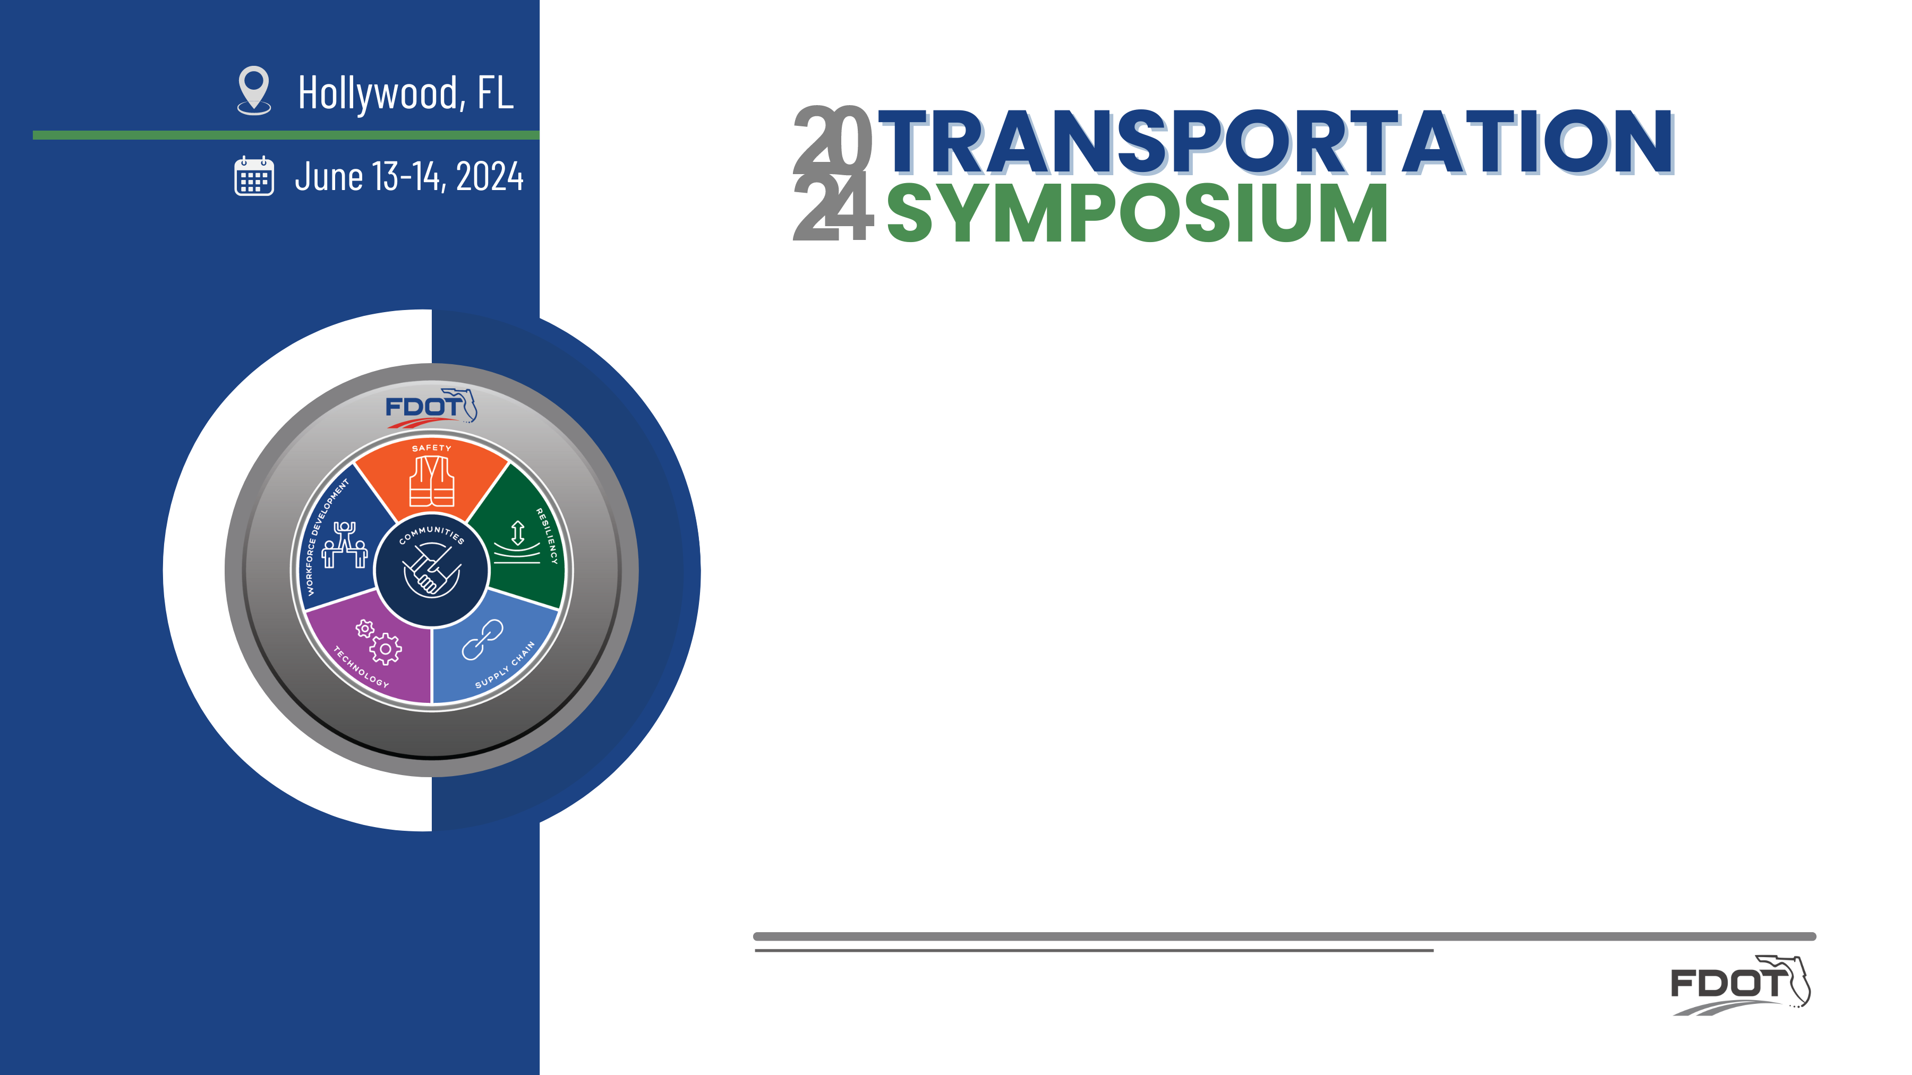

District Case Studies – Cultural Resources
Jennifer Marshall
Office of Environmental Management

Slide 2
Innovative Solutions to
Historic Preservation: The Relocation of the CSX Rail Bridge in Ft. Lauderdale
Lynn Kelley
FDOT District 4

Slide 3
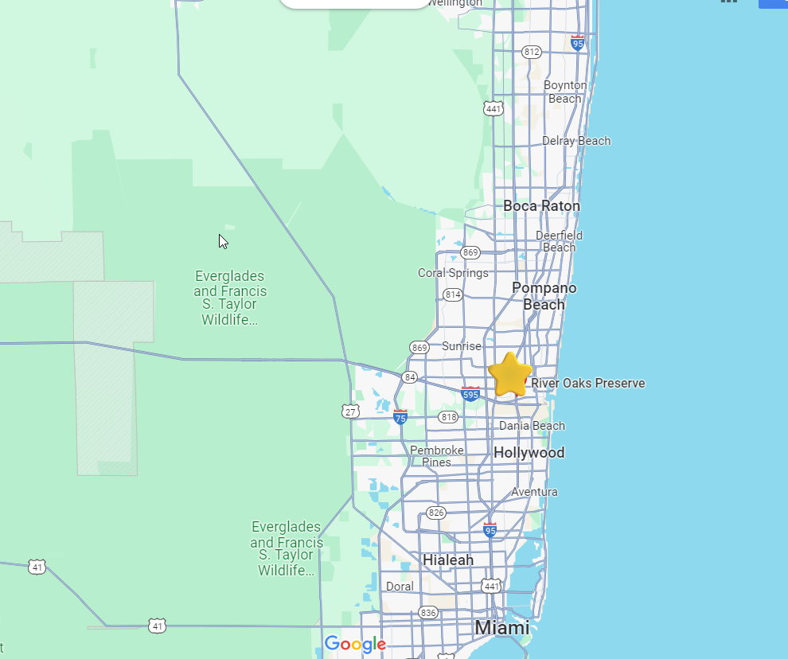
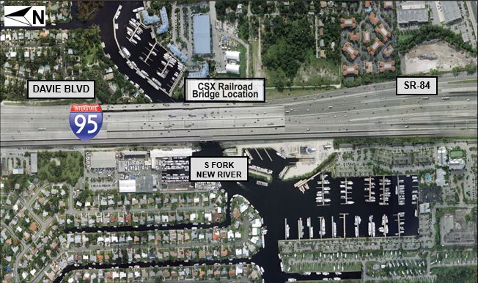
Project Location

Slide 4
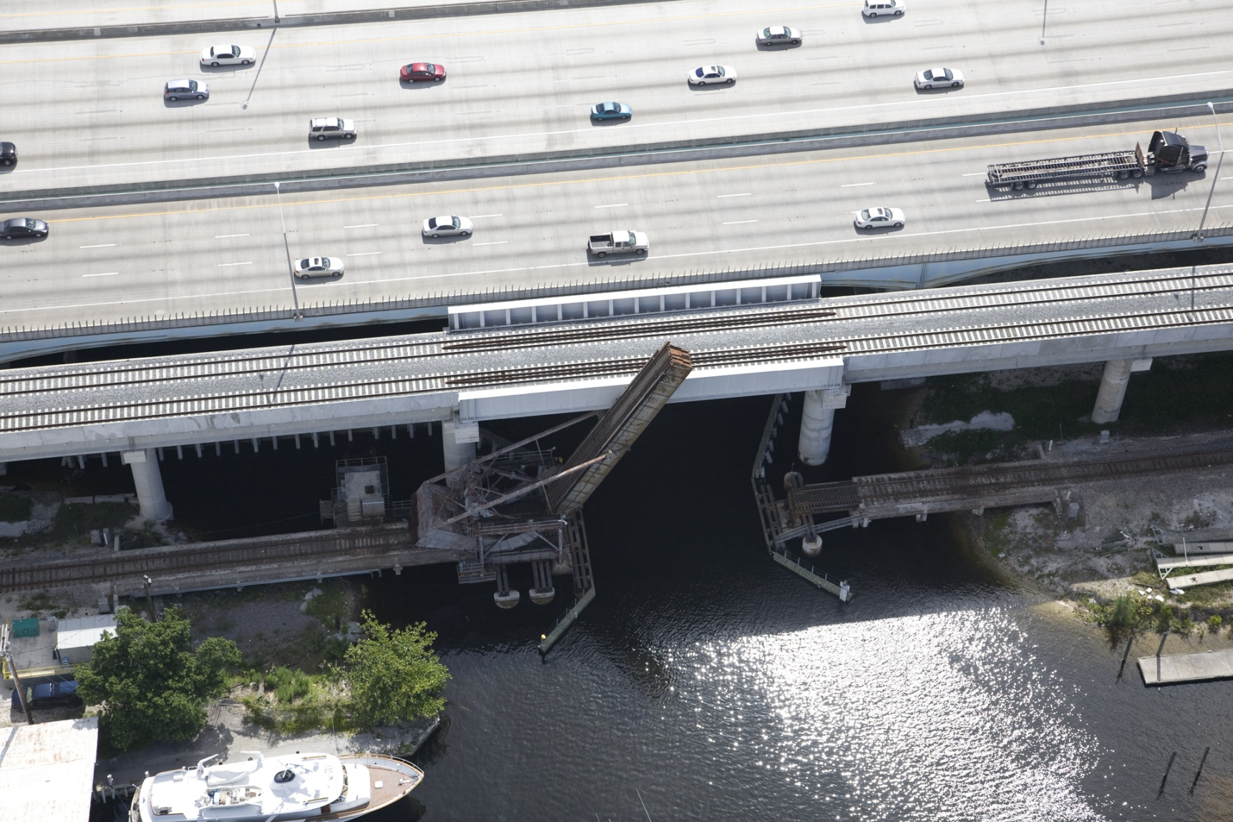
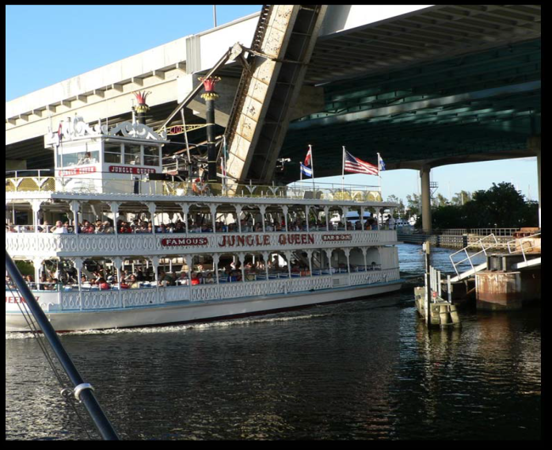
Project Objective: Replace Structurally Deficient Rail Bridge
Bridge did not meet substructure requirements
Functionally obsolete
  Did not meet design standards
  Did not meet train clearance standards
  Did not meet the USCG channel width requirement of 70 feet

Slide 5
Project Development & Environment Process
The PD&E Process ensures compliance with the National Environmental Policy Act (NEPA).
Requires an analysis on the project’s effects on the natural and social environment.
NEPA compliance is required to obtain Federal funds or Federal permits.
Section 106 of the NHPA: will the project have an adverse effect on a historic resource?

Slide 6
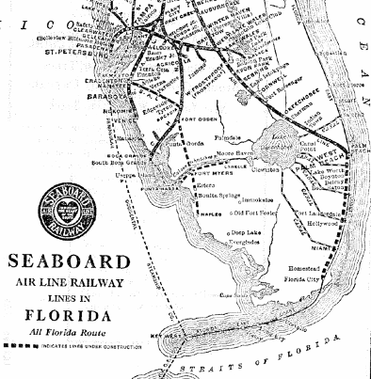
History of the CSX Rail Bridge
Constructed for the Miami Extension of the Seaboard Air Line Railway
Designed by the Scherzer Rolling Lift Bridge Company in Chicago, Illinois
Original plans prepared in March 1926
Constructed by the American Bridge Company
Open to train traffic in 1927
Approach spans replaced in 1978
S. Fla Rail Corridor purchased by FDOT in 1988 for Tri-Rail

Slide 7
Project Challenge
During the Project Development & Environment (PD&E) Study, SHPO determined that the rail bridge was eligible for listing in the National Register of Historic Places.
Removing the bridge would be an “adverse effect”
A commitment to preserve the bridge could mitigate for the adverse effect.

Slide 8
A Unique Mitigation Opportunity
The City of Fort Lauderdale was planning the “River Oaks Preserve”; a passive park which would alleviate flooding by providing stormwater storage.
The City agreed to incorporate the rail bridge into the park’s boardwalk.

Slide 9
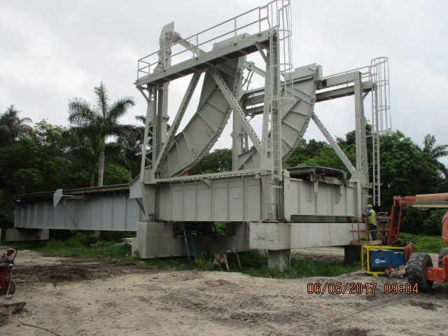
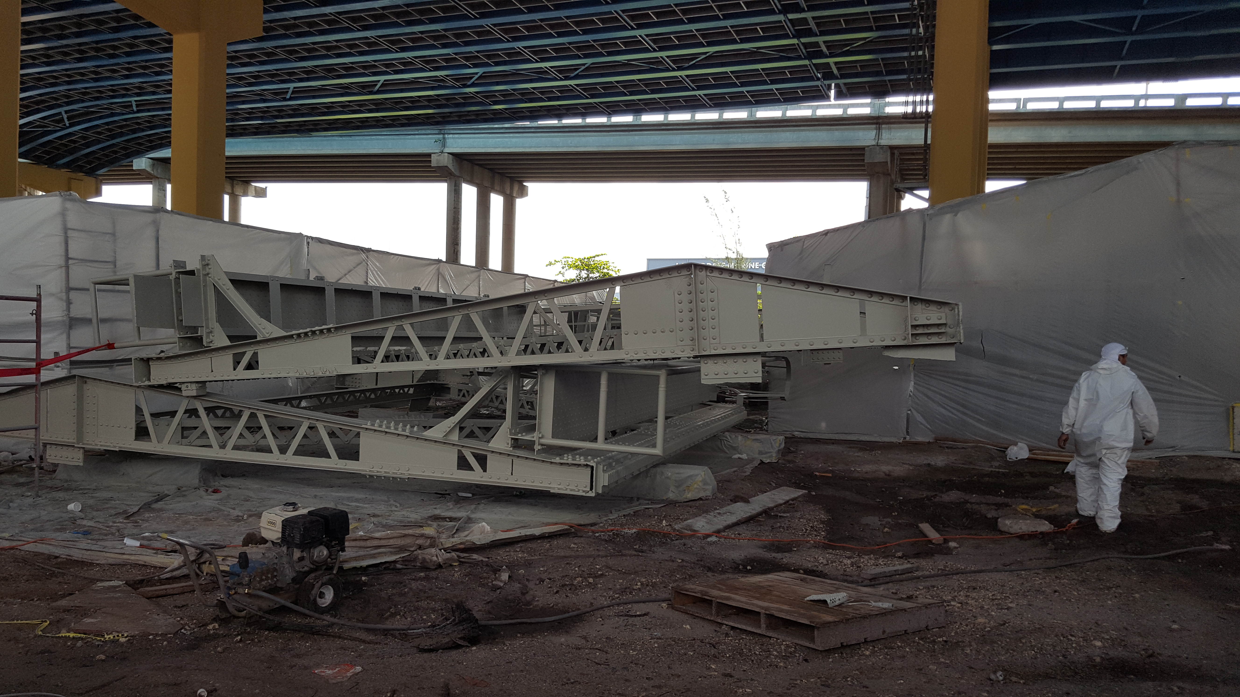
Moving the Bridge
Contamination remediation & repainting
Reassembly on the site

Slide 10

A Win-Win
Preservation of the historic bridge
Timely completion of the PD&E Process
Interpretive panels and kiosk
Wetland ponds and plants
Passive recreation and habitat creation

Slide 11
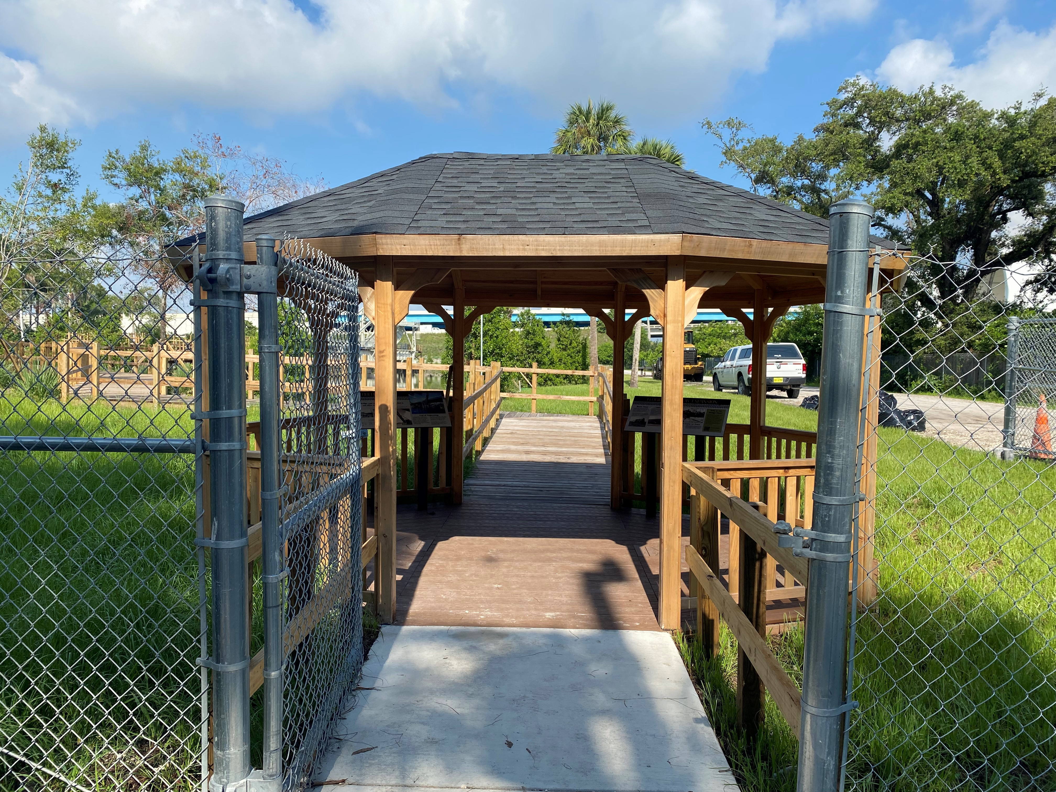
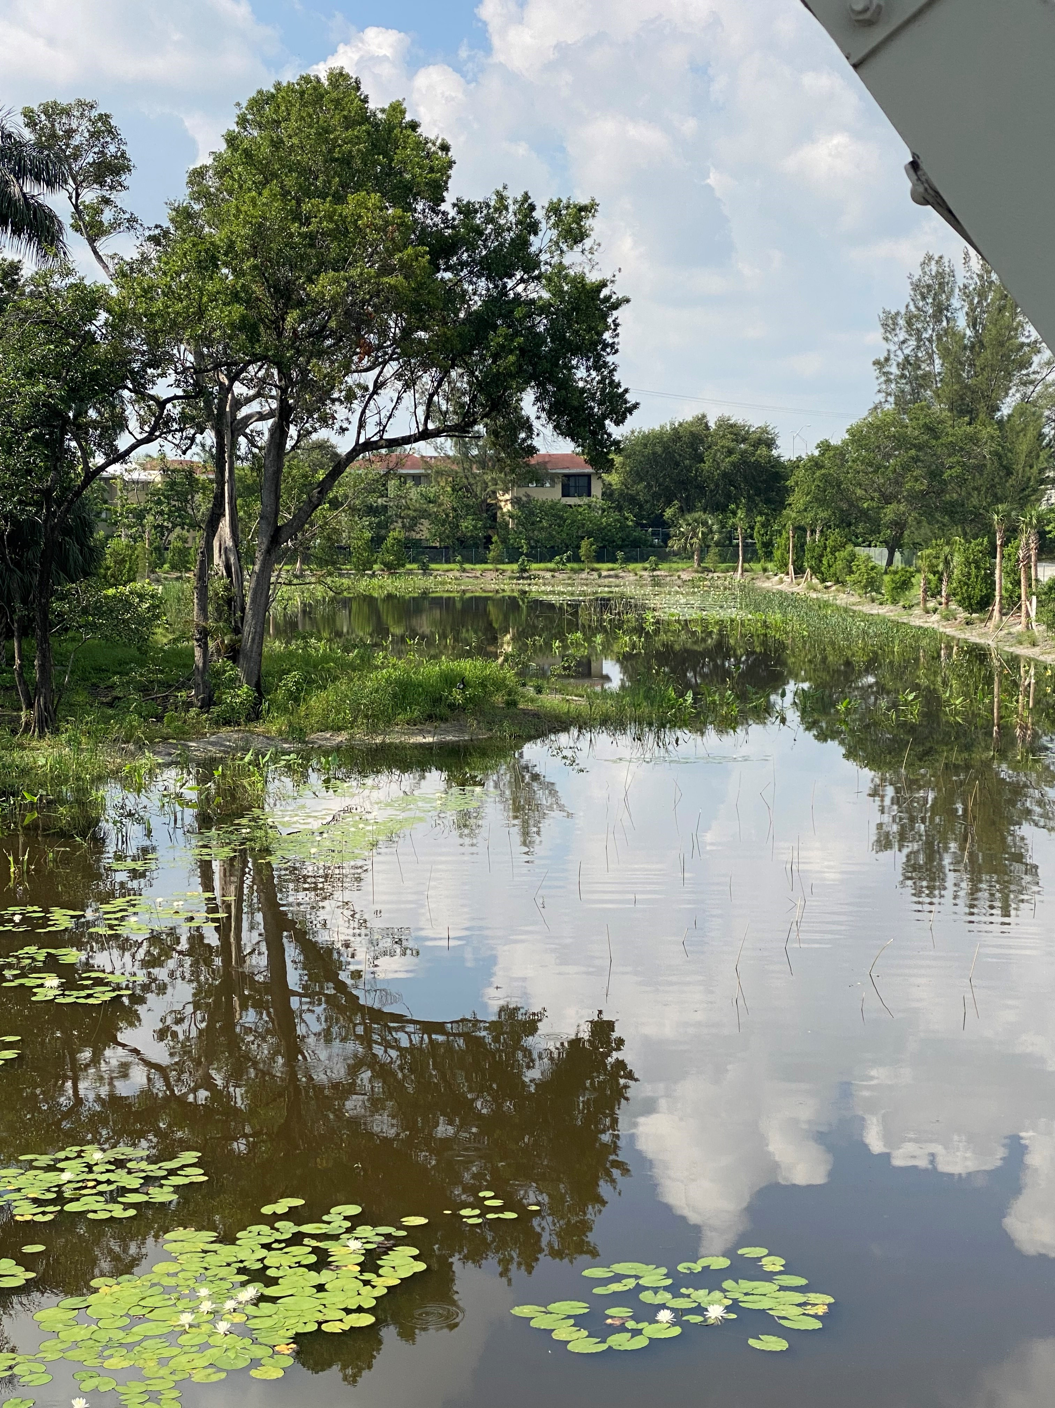
Photos

Slide 12
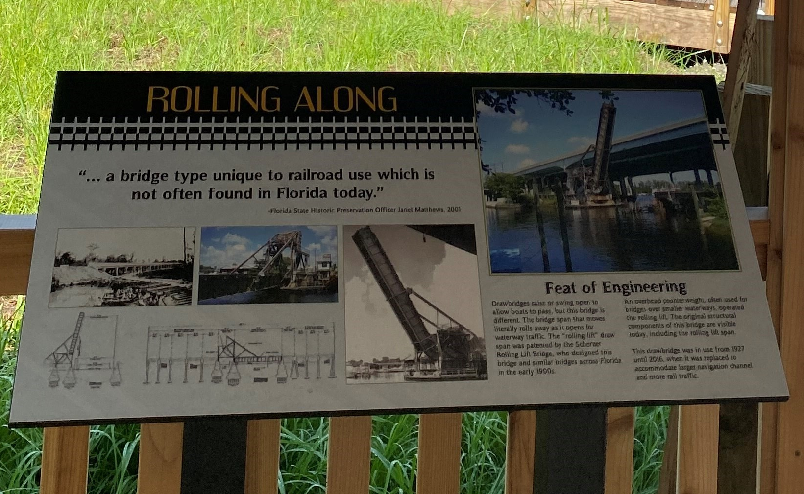
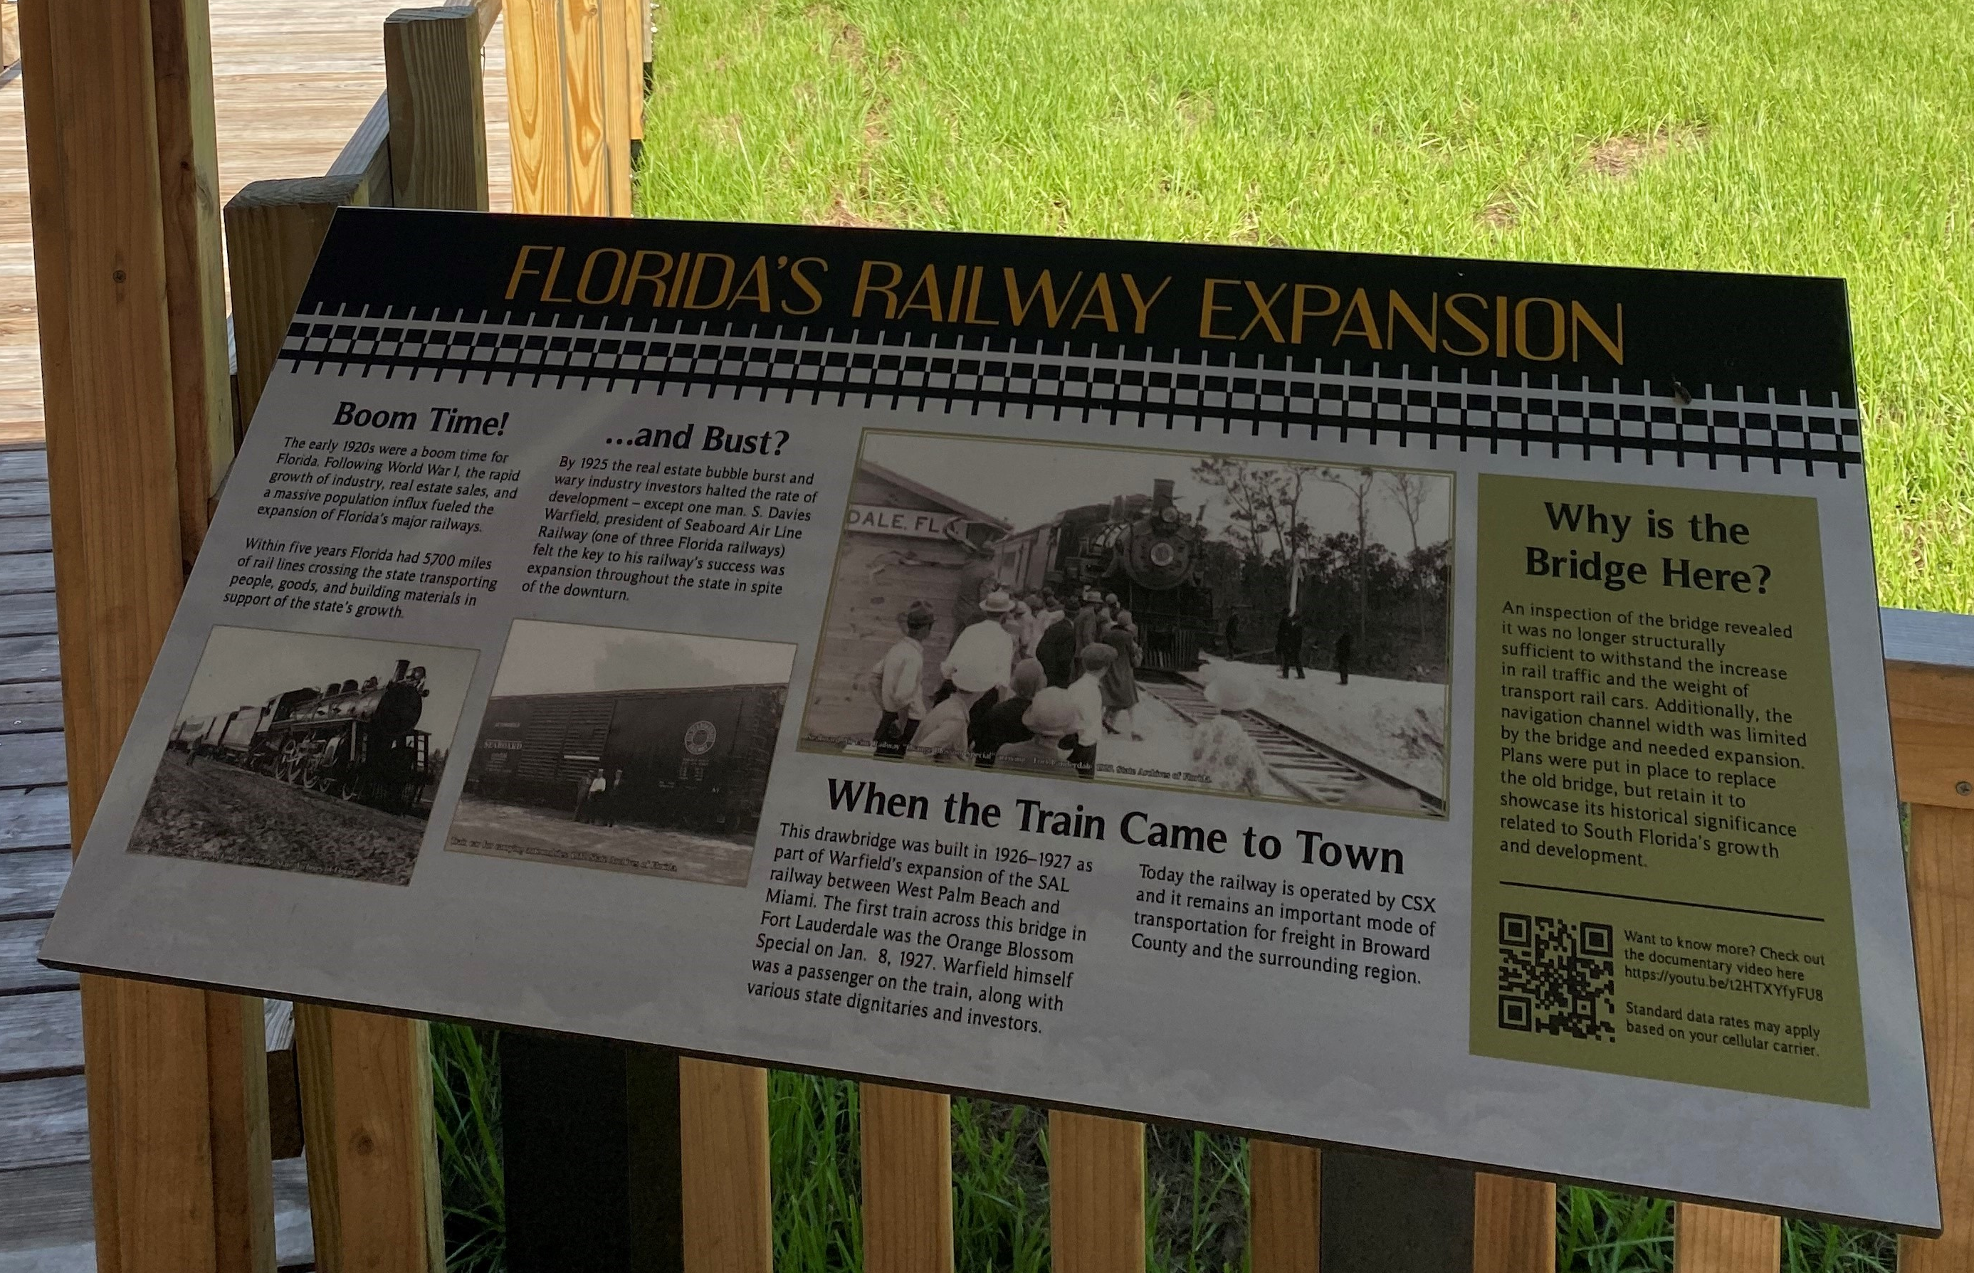
Photos

Slide 13
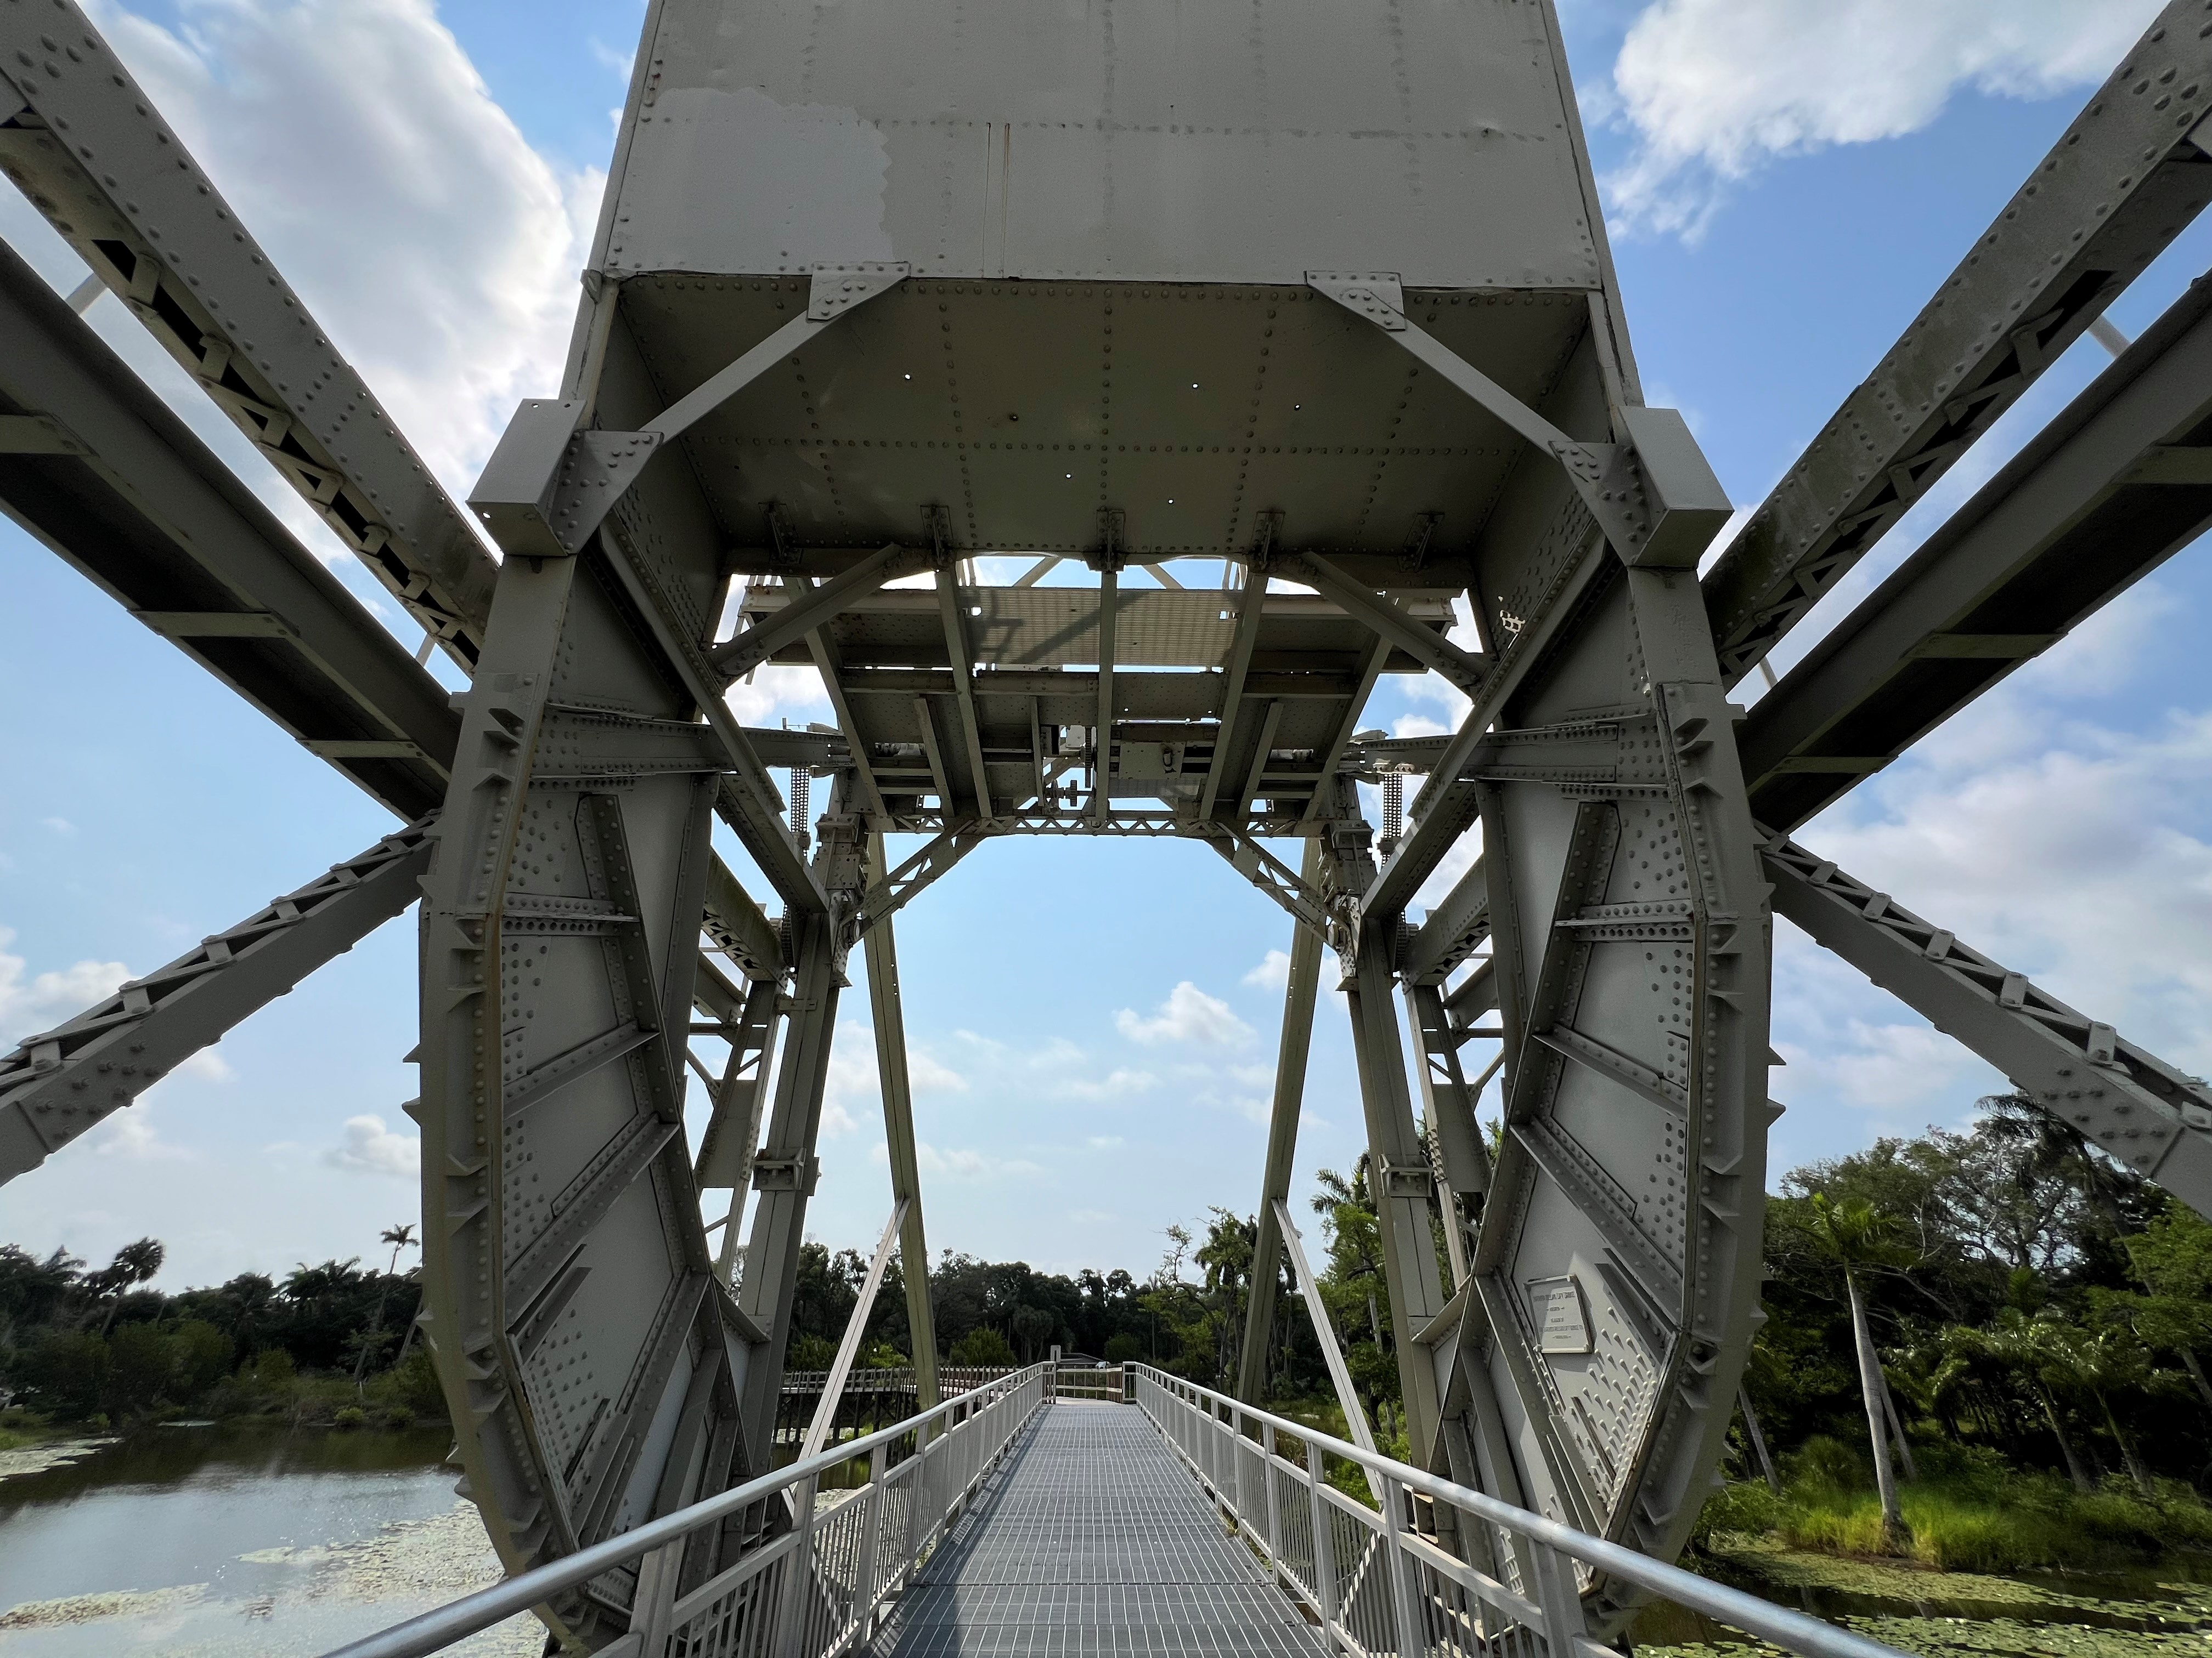
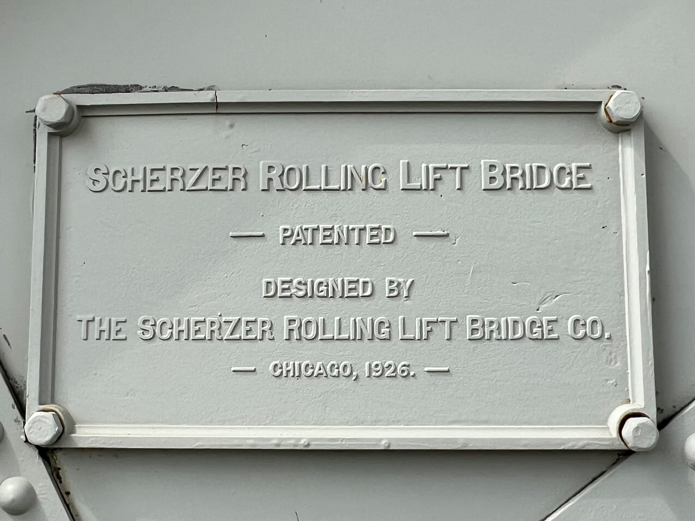
Photos

Slide 14
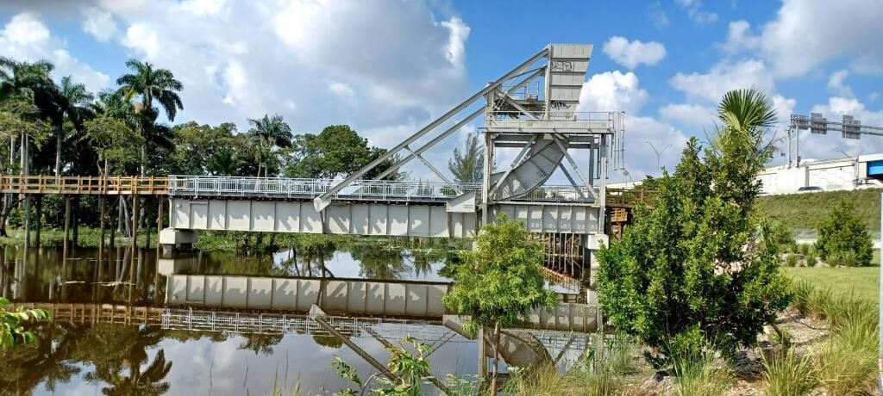
Photos

Slide 15
Lessons Learned
Early identification of potential NEPA issues is critical.
“Think outside the box” for mitigation solutions.
Seek partners.
Ensure that commitments are actually achievable.
Questions?
Thank you for your attention!

Slide 16
Good Faith Consultation and Resilient Processes: Navigating Cultural Resource Mitigation
Victoria Vogt and Max Adriel Imberman
FDOT District 6

Slide 17
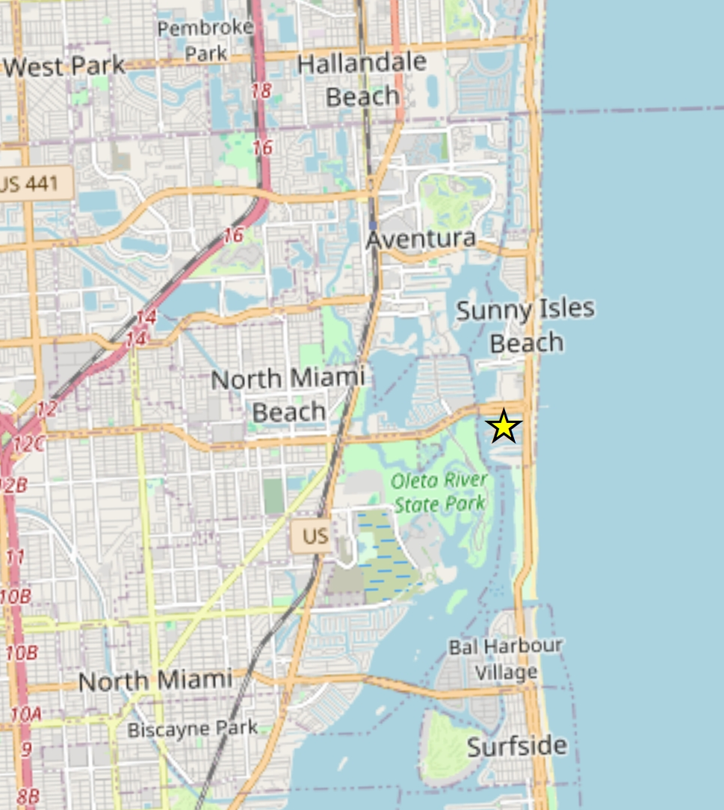
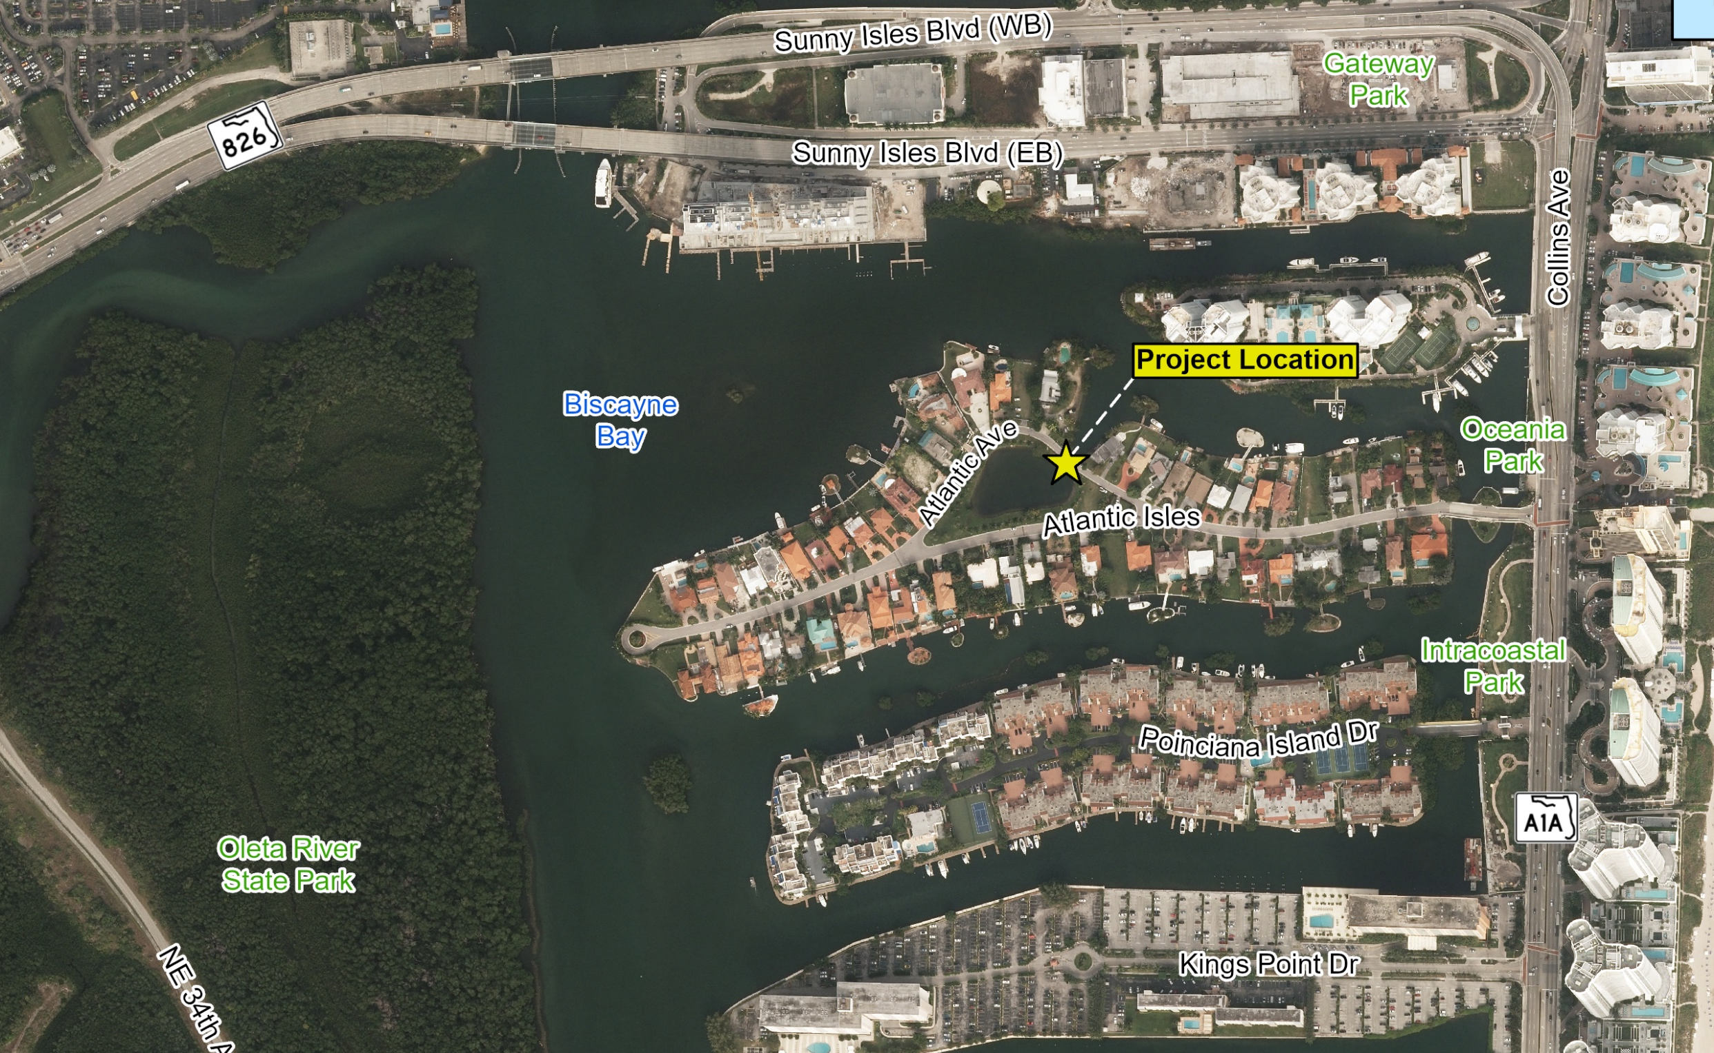
Atlantic Isle Bridge - Project Location
Notes:
Discuss how the bridges to the island were

Slide 18
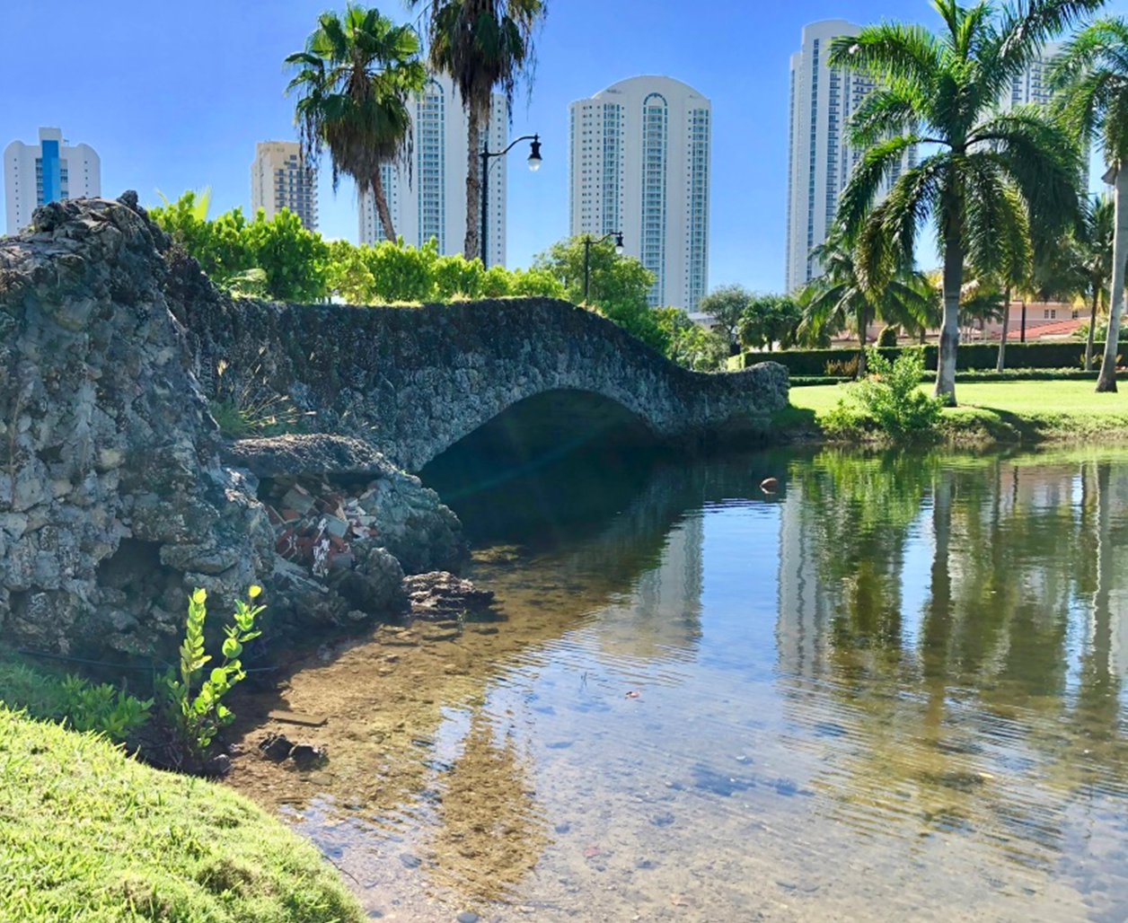
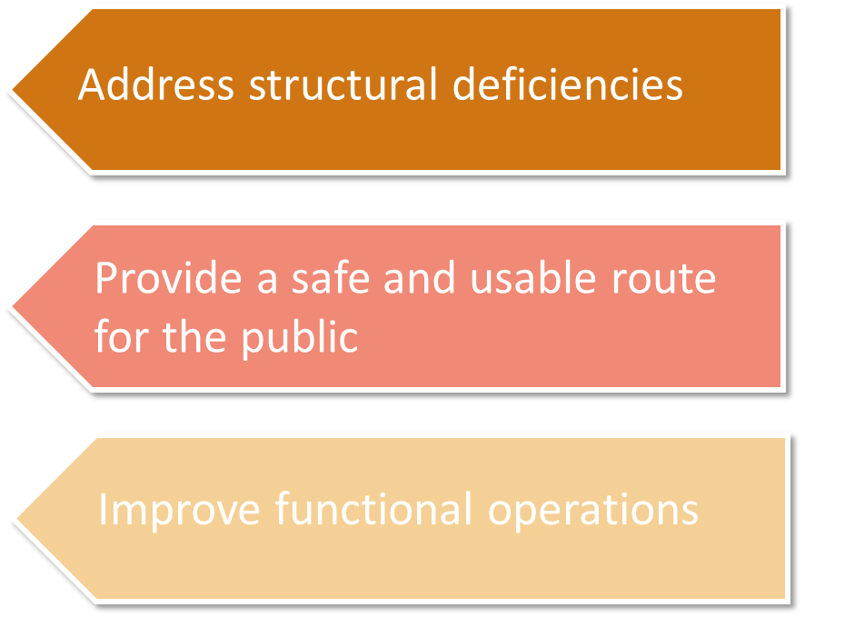

Purpose and Need

Slide 19
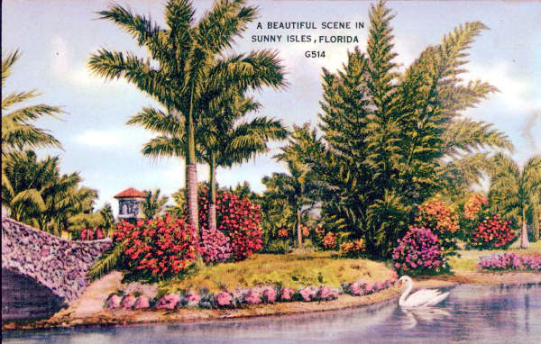
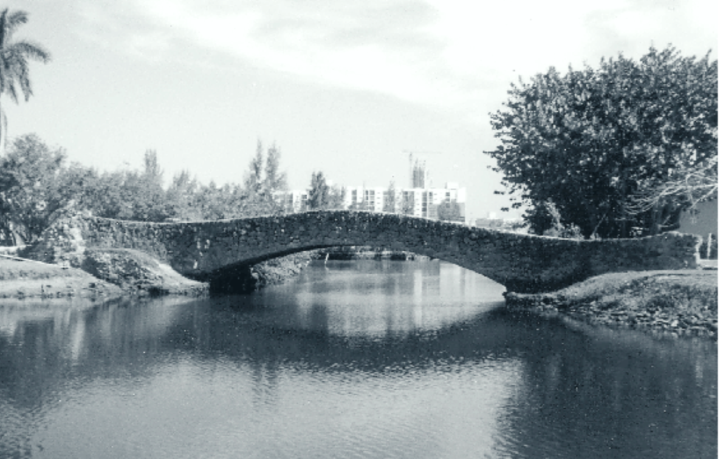
Atlantic Isle
Historic Significance
Atlantic Isle was constructed during the Florida Boom Period (1917–1929) and the original design included these resources:
  Atlantic Island Bridge
  Lake of the Isles (Lagoon)
  Atlantic Island Park
Atlantic Island Bridge Historic Elements
  Only remaining historic bridge on the island
  Oolitic limestone construction material
  Irregular whitewashed stucco on the bridge interior
  Early example of an arch deck bridge

Slide 20
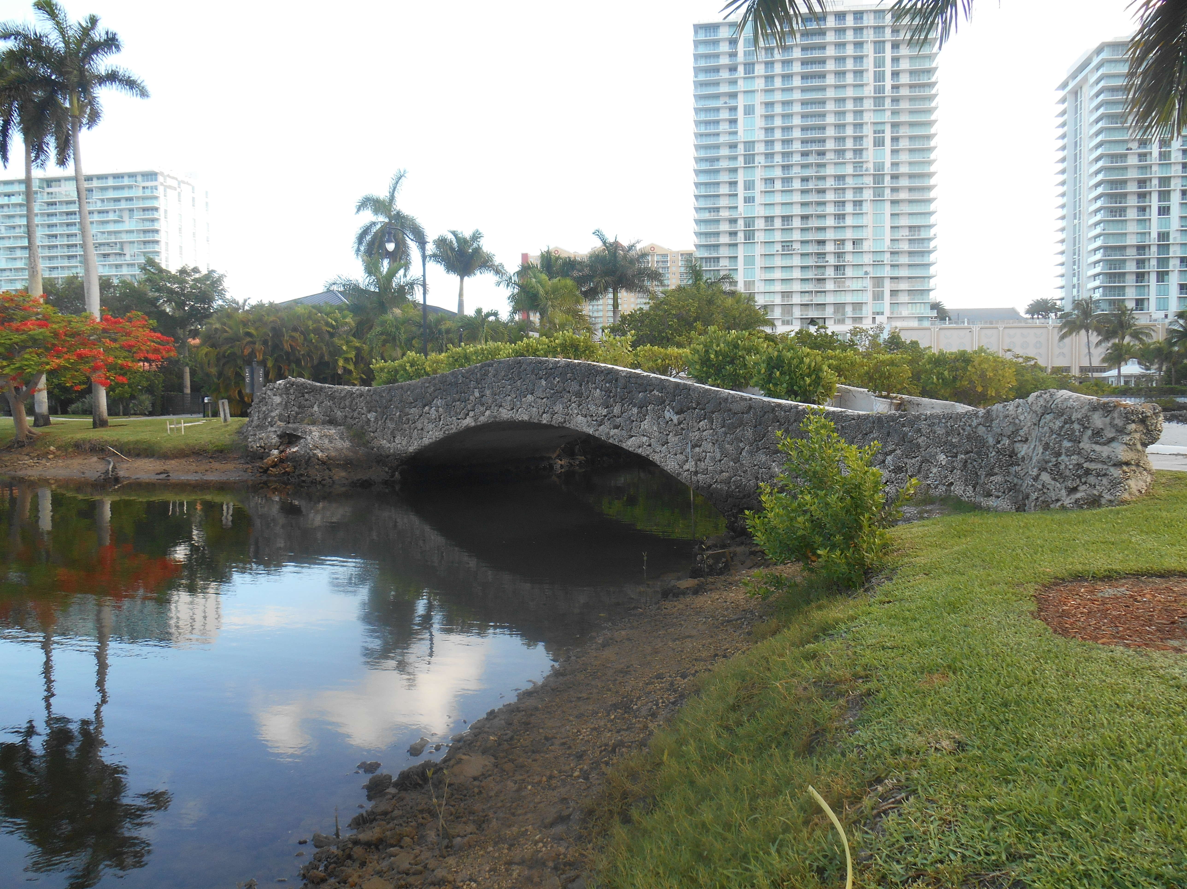
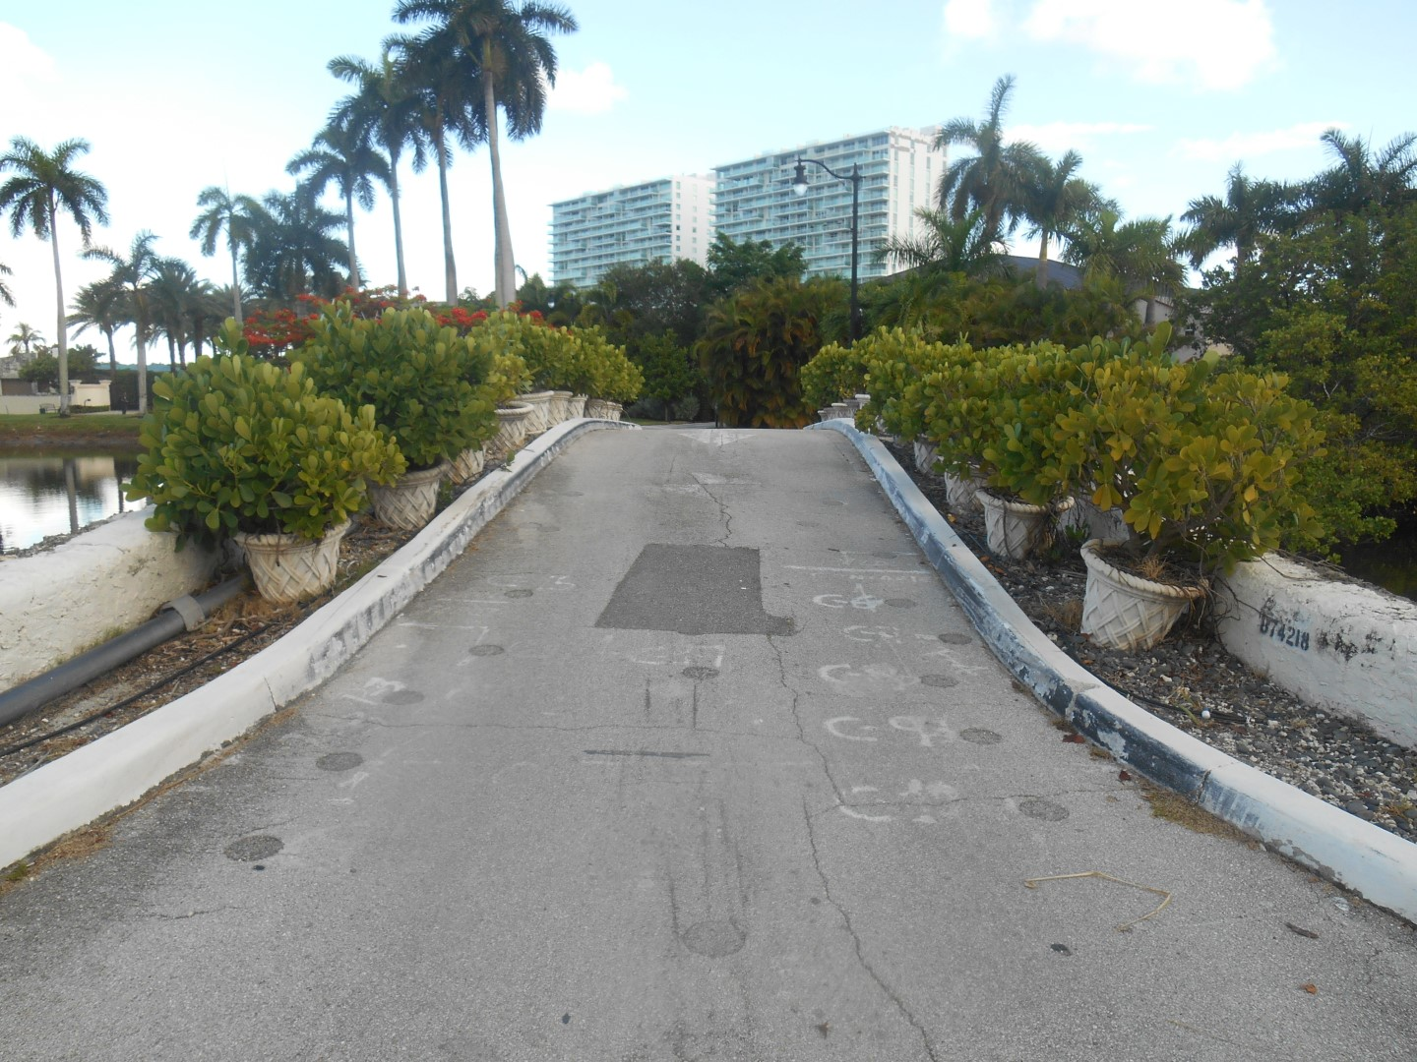
Photos of Atlantic Island Bridge

Slide 21
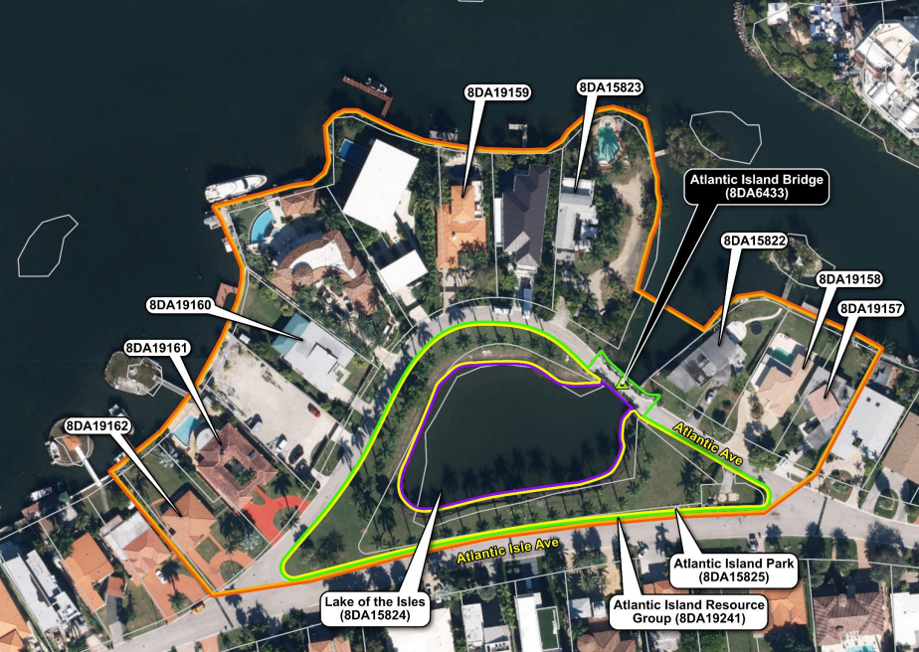


Identified Cultural Resources
August 23, 2016 – SHPO determined the Atlantic Island Bridge NRHP-eligible
February 24, 2022 – SHPO determined the Atlantic Island Resource Group eligible
Atlantic Island Resource Group includes:
  Atlantic Island Bridge
  Lakes of the Isles (Lagoon)
  Atlantic Island Park

Slide 22

Process Challenges
Off-System Project
  Additional coordination required
    Local Funding Agreement (LFA)
Navigating adverse effects and mitigation through Federal regulations
Adjustments to the project schedule during PD&E

Slide 23
Section 106 and
Good Faith Consultation
Cultural Resource Assessment Survey (CRAS) received SHPO concurrence on February 4, 2022.
Section 106 Case Study and Determination of Effects received SHPO concurrence on May 12, 2023.
Public Involvement occurred throughout PD&E Process
  3 public meetings
  2 Affected Parties Consultation Meetings
  2 City of Sunny Isles Beach Historic Preservation Board Meetings

Slide 24
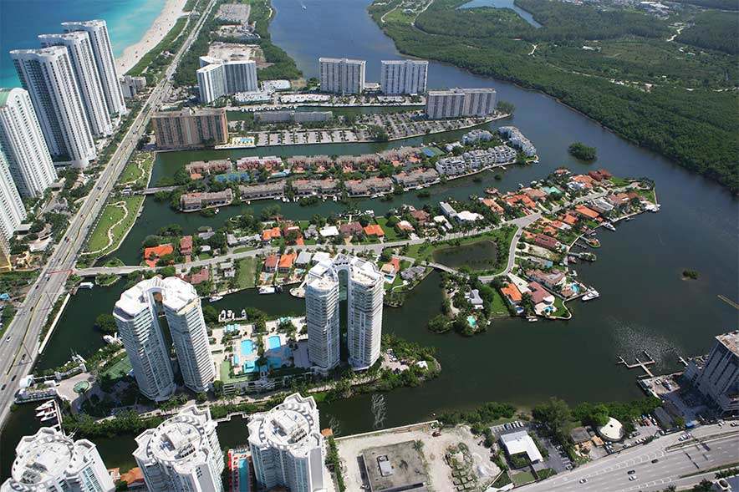
Section 4(f) of the U.S. Dept. Of Transportation Act
Section 4(f) refers to the original section within the U.S. Department of Transportation Act of 1966 which established the requirement for consideration of public park and recreational lands, wildlife and waterfowl refuges, and historic sites in transportation project development.

Slide 25
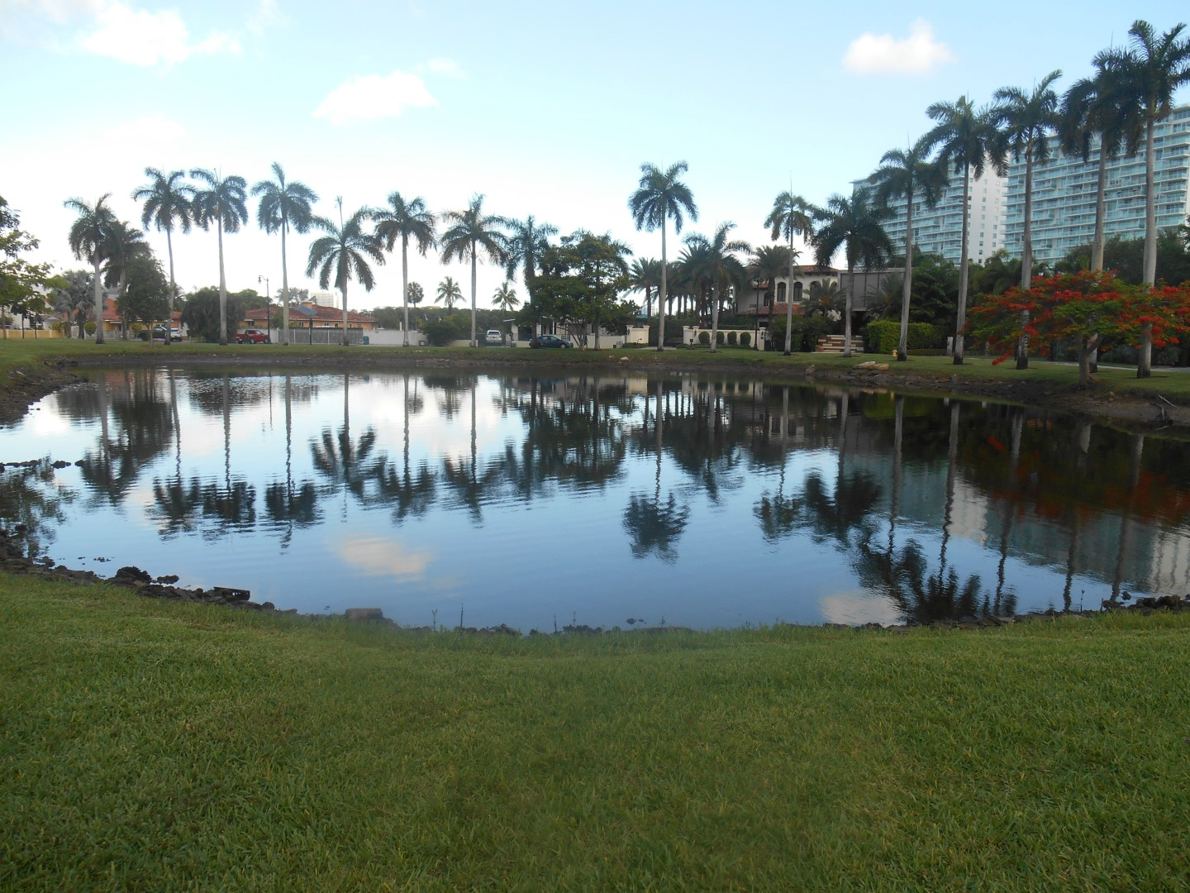
Individual Section 4(f) Analysis
Section 4(f) Resources Include:
  Atlantic Island Bridge
  Lake of the Isles
  Atlantic Island Park
  Atlantic Island Resource Group
Alternatives were Evaluated under Section 4(f)
Section 4(f) Analysis Completed in Connection with Section 106
Evaluated:
  Avoidance Alternative
  Least Harm Alternative
No Feasible And Prudent Avoidance Alternative
Notes:
What is an individual 4(f)?

Slide 26
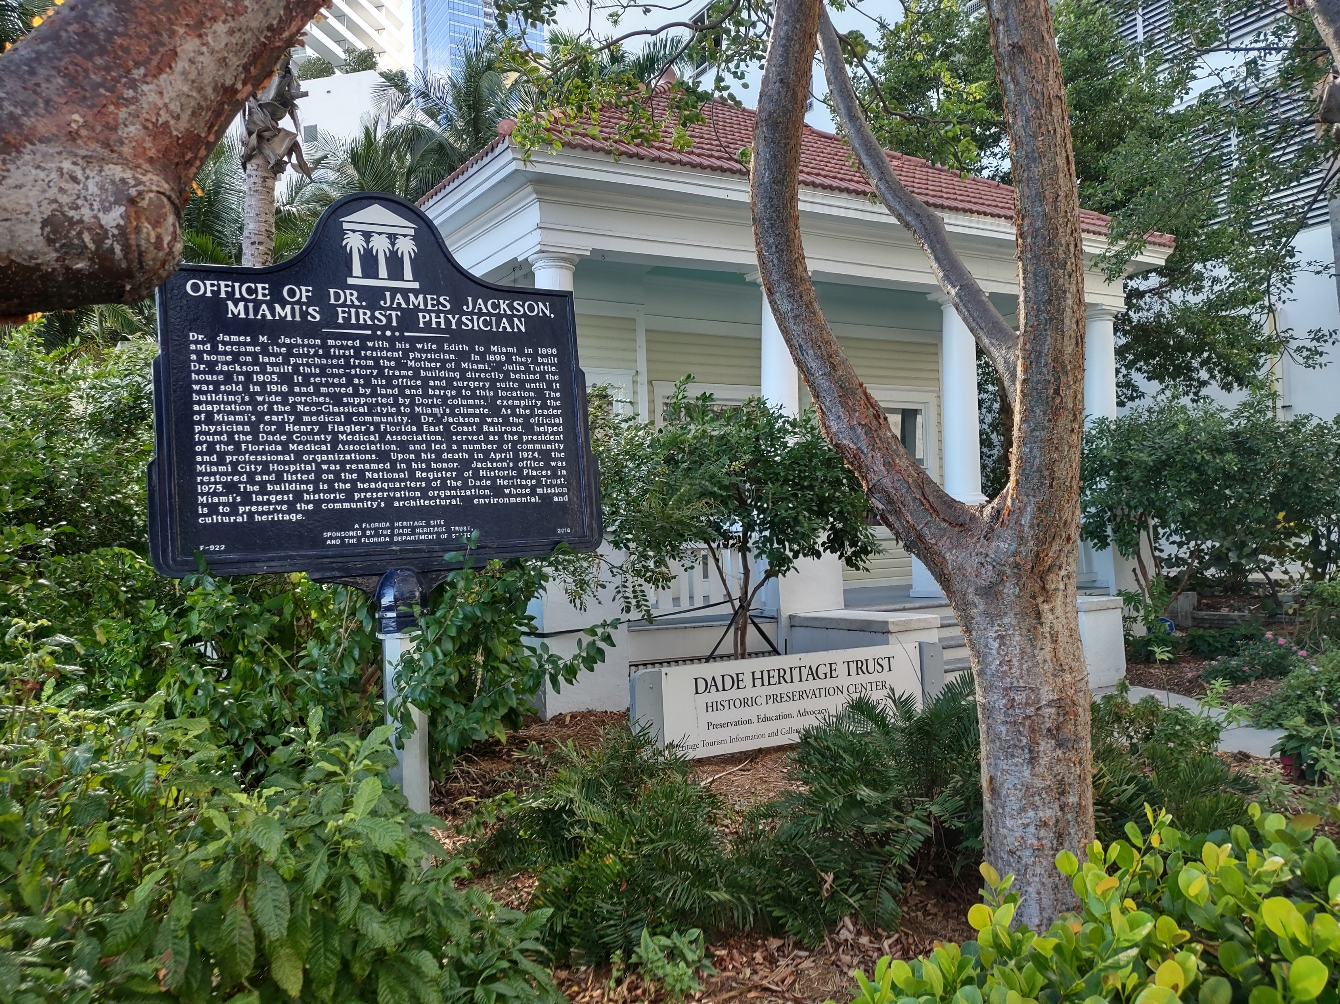
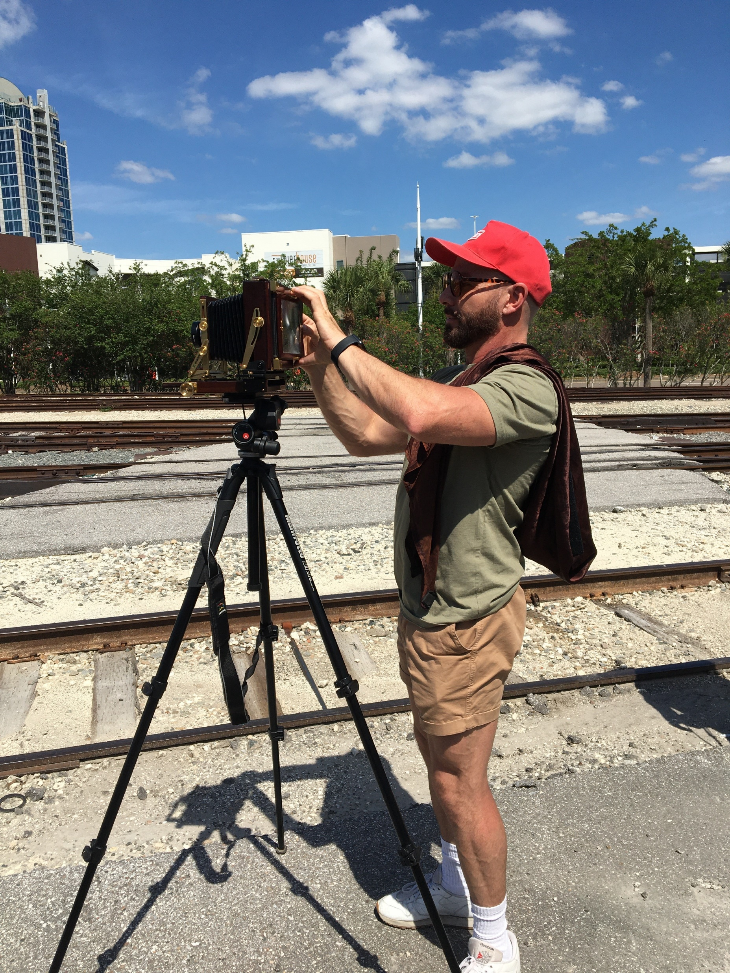
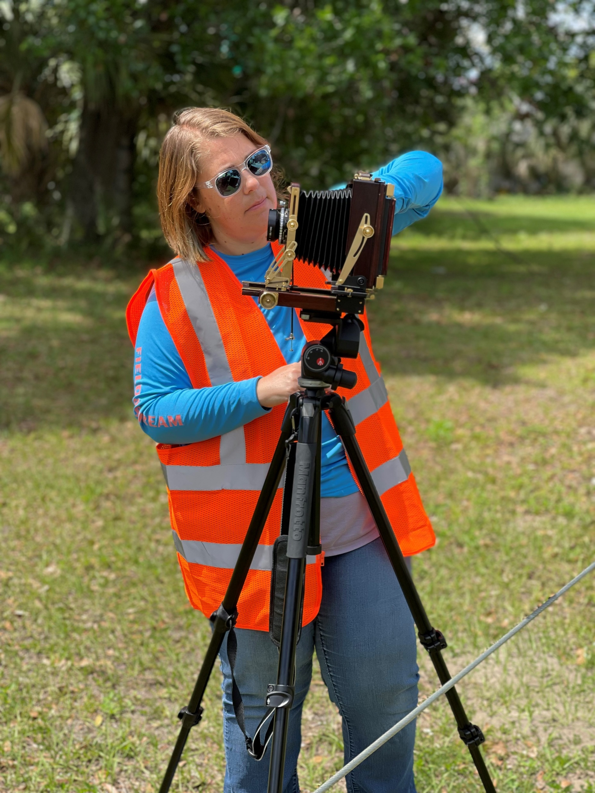
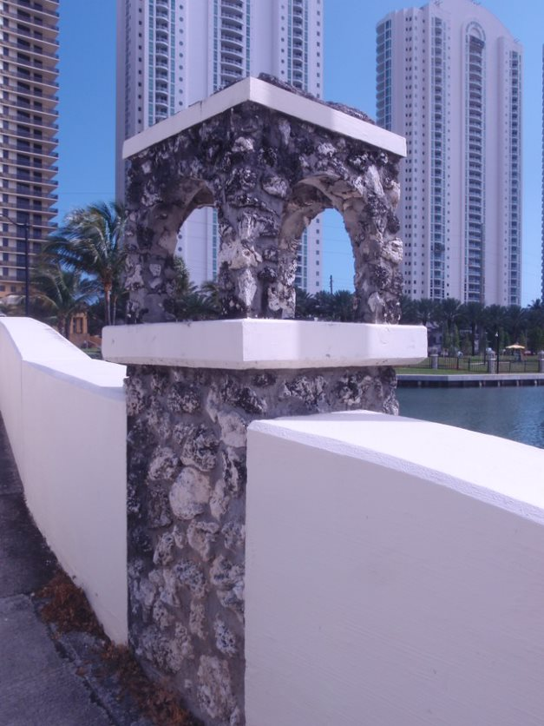
Minimization and Mitigation Measures
The Section 106 MOA between FDOT and SHPO was executed on April 10, 2024.
The MOA included the following mitigation measures:
  Incorporate Historical Design Elements into the New Bridge, as feasible
  City of Sunny Isles Beach and SHPO provided an opportunity to comment during the design phase
  Historic American Engineering Record (HAER) and Historic American Landscape Survey (HALS) Documentation - Bridge, Park, & Lagoon
  State Historic Marker - History of Atlantic Isles Design, Bridge, Park, & Lagoon

Slide 27

Process Successes
Affected Parties Consultation Meetings and coordination with the local Historic Preservation Board
Preservation of key aesthetic elements of the bridge as detailed in a Memorandum of Agreement (MOA)
Management of project schedule impacts to meet Location Design Concept Approval (LDCA)
Notes:
allowed the opportunity for FDOT to gather stakeholder concerns for the project throughout PD&E
Mitigation developed in coordination with stakeholders to address concerns regarding

Slide 28
Thanks for attending!
Do you have any questions?
Notes:
allowed the opportunity for FDOT to gather stakeholder concerns for the project throughout PD&E
Mitigation developed in coordination with stakeholders to address concerns regarding

Slide 29

Contact Information
Jennifer Marshall, P.E.
Director
Office of Environmental Management
Phone: (850) 414-4316
Jennifer.Marshall@dot.state.fl.us
Lynn Kelley
Senior Environmental Specialist
District 4
Phone: (954) 777-4334
Lynn.Kelley@dot.state.fl.us
Victoria Vogt, M.S., FCCM
Cultural Resources Coordinator
District 6
Phone: (305) 470-5420
Victoria.Vogt@dot.state.fl.us
Max Adriel Imberman, M.A.
Architectural Historian
Phone: (813) 330-9111
Max_Imberman@Janus-Research.com

Slide 30



DID YOU
KNOW?
Scan QR Code to find your perfect
(and safe) fit!
Wearing the right helmet makes a safety difference!
66% of Florida riders ages 50+ involved in fatal motorcycle crashes were not wearing USDOT- compliant helmets.*
RIDER AGE GROUPS USING NON-COMPLIANT HELMETS
Under Age 30
35%
Age 30-49
56%
Age Age 50+
66%

Slide 31
