Slide 1
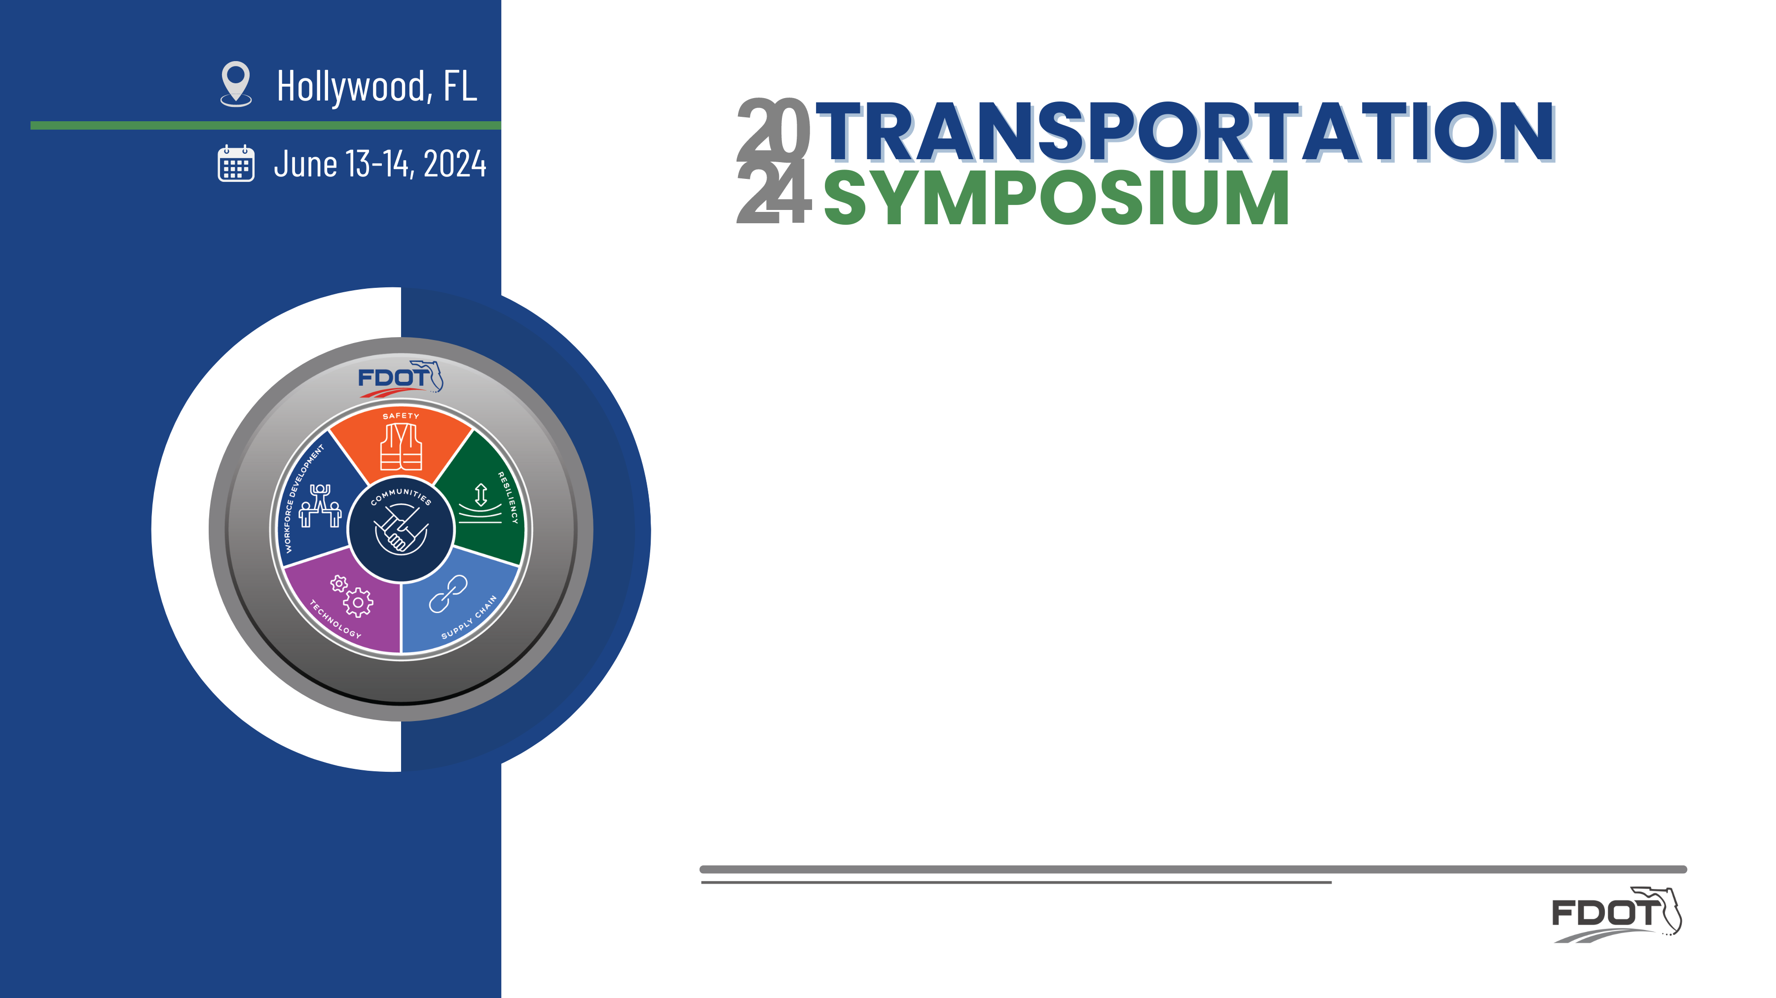

Non-Department Bridges over State ROW/Pedestrian Bridges
Pablo J. Orozco, P.E. & Darren K. Lucas, P.E.
District 6 Maintenance & SDO Plans Review Group

Slide 2
Disclaimer
This document shall not be construed as a governing regulation for design or construction purposes. It is the responsibility of the EOR to ensure an adequate design consistent with the project specific contract documents. The images included should not be interpreted as accepted precedents.

Slide 3
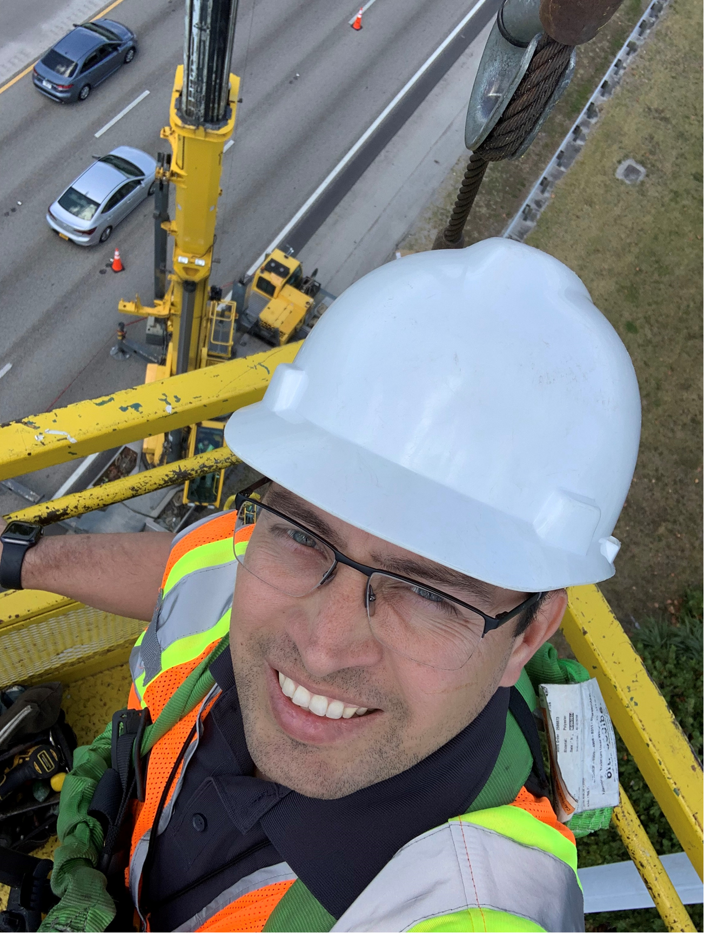
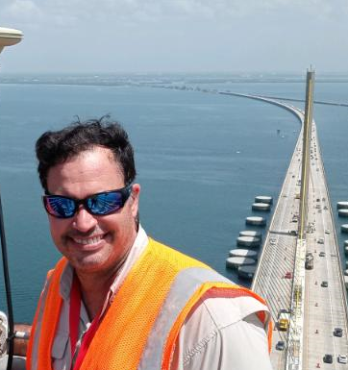
Presenters
Pablo Orozco is currently the District Six Structures Maintenance Engineer at FDOT. His responsibilities include overseeing the Structures Maintenance Program for Miami Dade and Monroe Counties. Pablo joined the Department in 2008 as a PE Trainee. He has managed several types of maintenance bridge contracts for bridge inspections, repairs, asset management, rehabilitation design, and special investigation tasks. Pablo is a Florida registered professional Engineer and graduated from Florida International University with a bachelor’s degree in Civil Engineering, and a master’s degree in Structural Engineering. He is a Certified Bridge Inspector, Certified Tunnel Inspector, and a Certified Public Manager.
Darren Lucas is an Assistant State Structures Engineer in the Structures Design Office acting as the Plans Review Group Section Leader. He has been with the Department since 2018 in various roles within the Plans Review Group. Prior to the Department, he worked around 19 years within the private sector both as a bridge designer and construction engineer on a variety of projects for municipal, state, federal, and private entities. Darren is a graduate of the University of Florida with a bachelor’s degree in Civil Engineering and is a Florida registered Professional Engineer.

Slide 4
Outline
Introduction of Bridges within FDOT ROW
Roadway vs. Pedestrian Bridges
Presentation of recent public & private bridges
Introduction of the current FDOT process/phasing
Roadway
Public vs. Private Bridges
Pedestrian
Railroad/Light Rail Transit
Design Review: Introduce items such as submittals, review process (duration), applicable standards, manuals, specifications, requirements. Highlight policy changes. Define Cat 1 & 2 structures per FDM.
Use & occupancy Agreements: Describe the type of agreement and what will be typically included. This is created by FDOT General Counsel Office and coordinated with the lessee representatives
Construction Permit: Describe how this process goes and the typical language and requirements included in this document
Construction Phase: Typical requirements during construction ( this will be included on the permit)
Post Construction Requirements (Typical requirements for inspection and maintenance)

Slide 5
Objective
Provide an educational overview to Engineers, Contractors, Owners as to:
  The current FDOT process/phasing when non-FDOT bridges are to be built within FDOT ROW.
  Types of non-Department Bridges.
  Example of recent projects with focus on Pedestrian Bridges.
  Approval processes, applicable criteria and project phases.

Slide 6
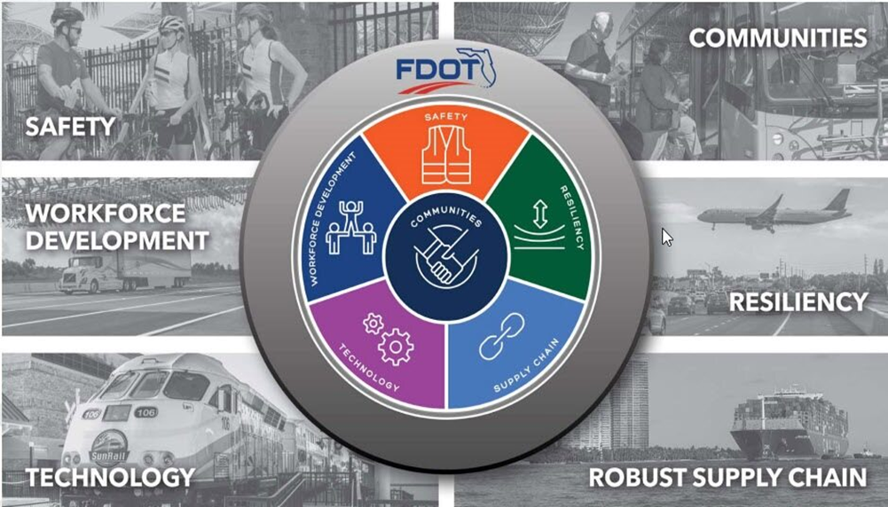
Safety Message
Safety Begins with You
When visiting any construction site, be sure to have all Personal Protection Equipment (PPE’s) required. Plan ahead!
Stay off the cell phone when walking around jobsite. Remove any earpieces that can impair hearing equipment backup alarms. Construction sites can be dangerous, congested places with heavy equipment moving all around.

Slide 7
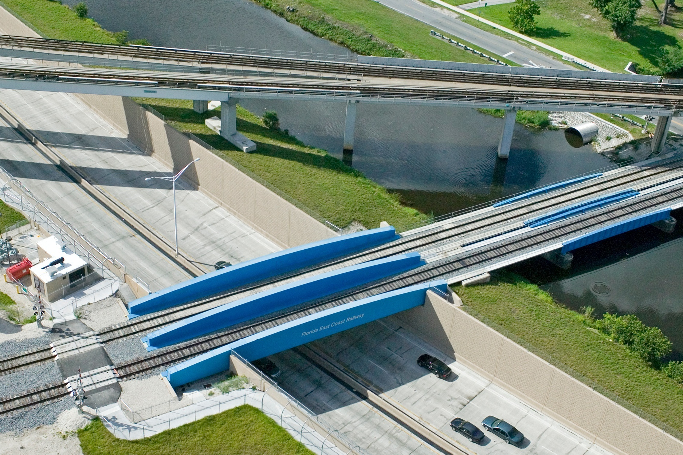
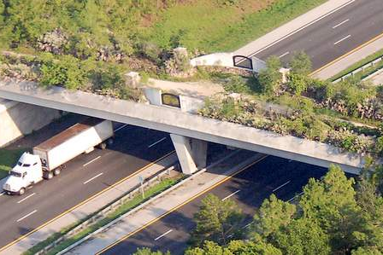
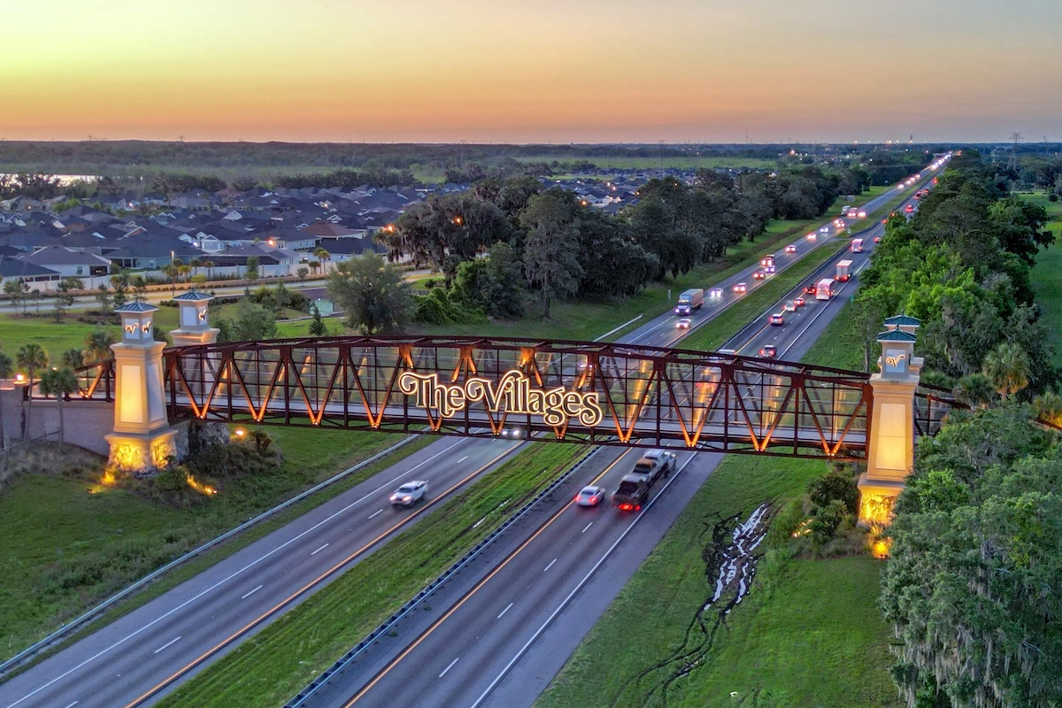
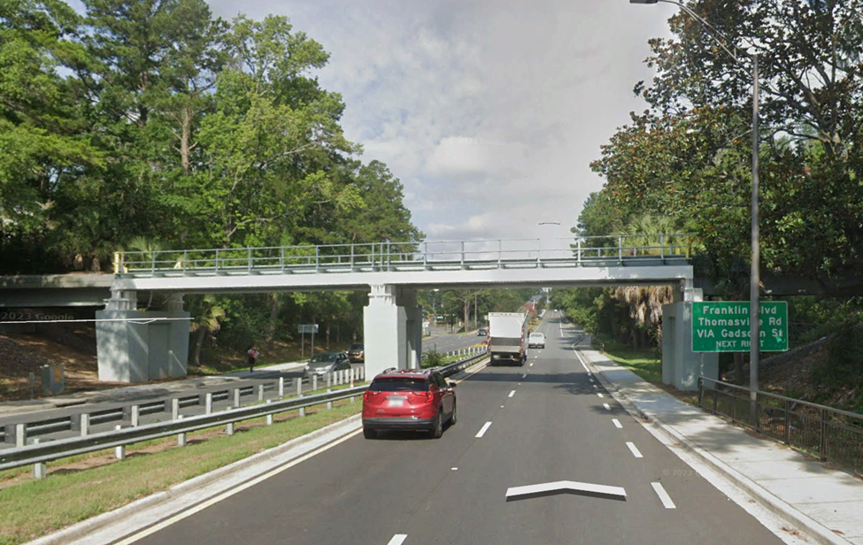
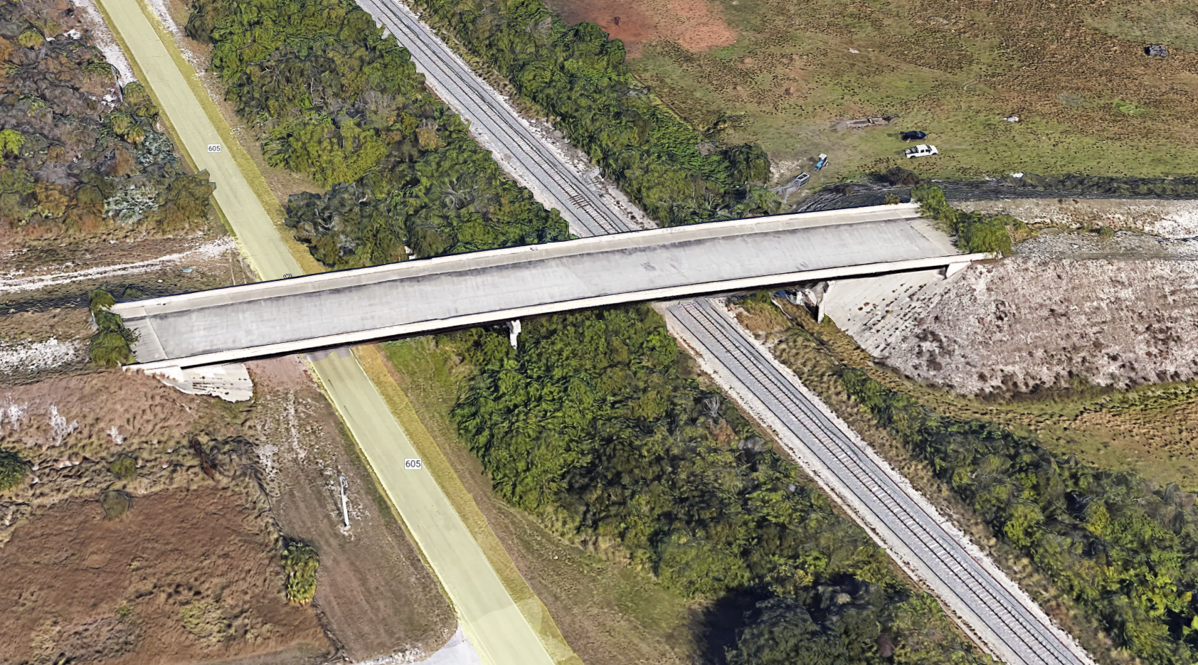
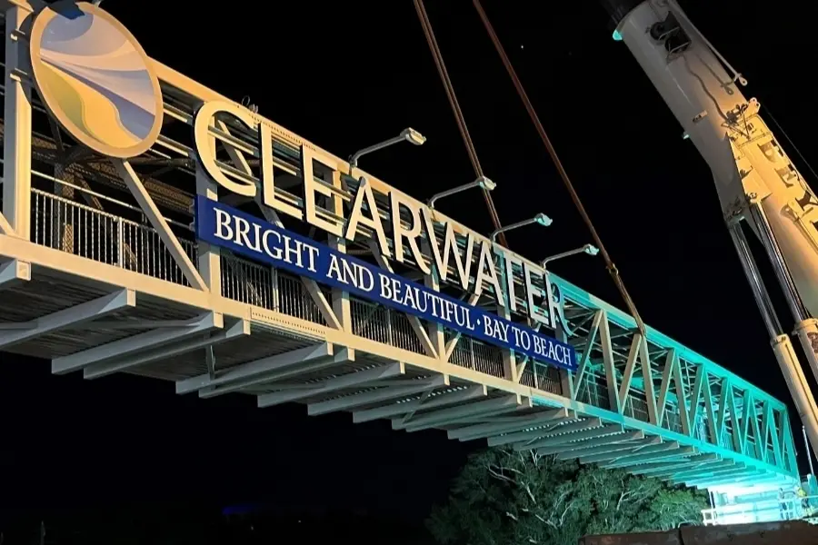

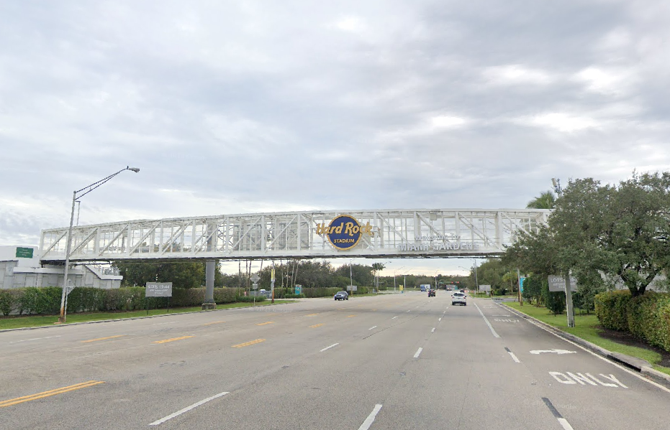

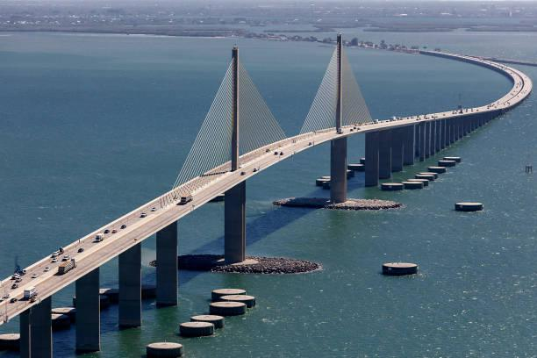
Introduction to Bridges within FDOT ROW
Location and Types of Bridges
On State ROW
Over State Roads
Over Channels and Rivers
Over Railroads
Notes:
Highlights a variety of different crossing types across the state.

Slide 8
Introduction to Bridges within FDOT ROW
Public vs. Private Bridges
Private Bridge: A bridge open to public travel and not owned by a public authority as defined in 23 U.S.C. 101. (23 CFR 650.305)
Public road: The term "public road" means any road or street under the jurisdiction of and maintained by a public authority and open to public travel as defined in 23 U.S.C. 101(a)(21). (23 CFR 650.305)
Public authority - The term "public authority" means a Federal, State, county, town, or township, Indian tribe, municipal or other local government or instrumentality with authority to finance, build, operate, or maintain toll or toll- free facilities as defined in 23 U.S.C. 101(a)(20). (23 CFR 650.305)

Slide 9
Introduction to Bridges within FDOT ROW
Public vs. Private Bridges
Private Bridges
  District Bridge Inventory
  Maintenance and Operations under bridge owner
  FDOT oversees that owner meet the requirements for M&O
  Owner is responsible for Inspection and Structural Analysis
Public Bridges
  National Bridge Inventory
  Maintenance and Operations under bridge owner
  FDOT is responsible for Inspection and Structural Analysis
  FDOT had authority to enforce bridge posting and closures
  FDOT is required to report bridge information to Federal Highway Administration

Slide 10
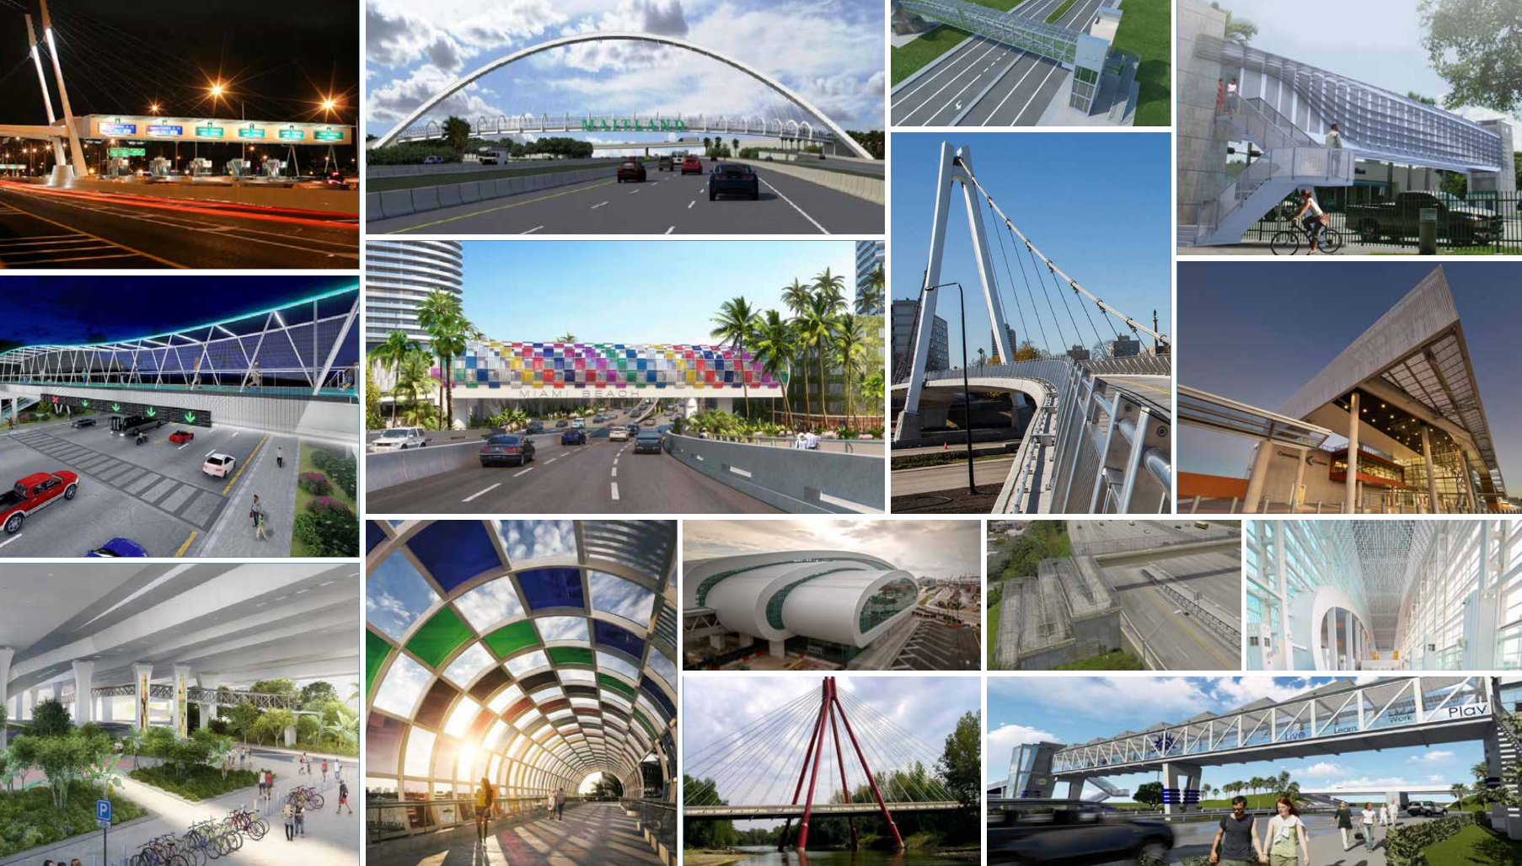
Recent Public and Private Bridges
Public and Private Bridges
Notes:
Growth requires connectivity through alternate means of mobility.

Slide 11
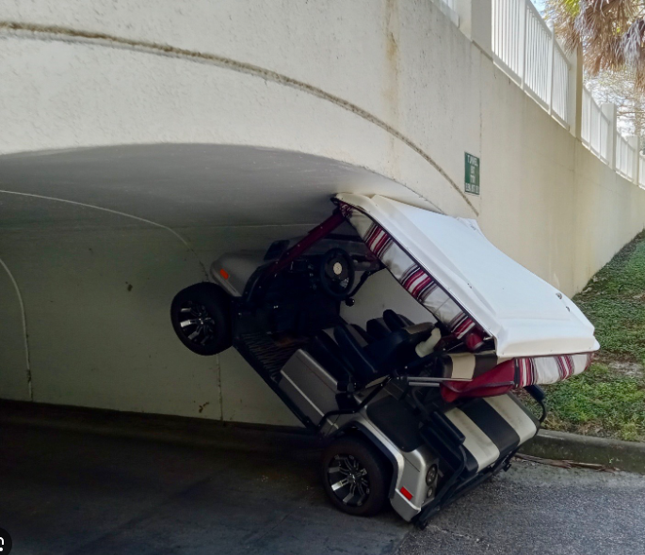
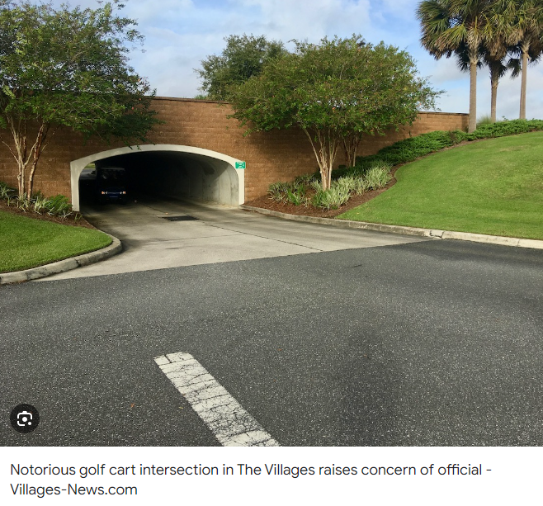
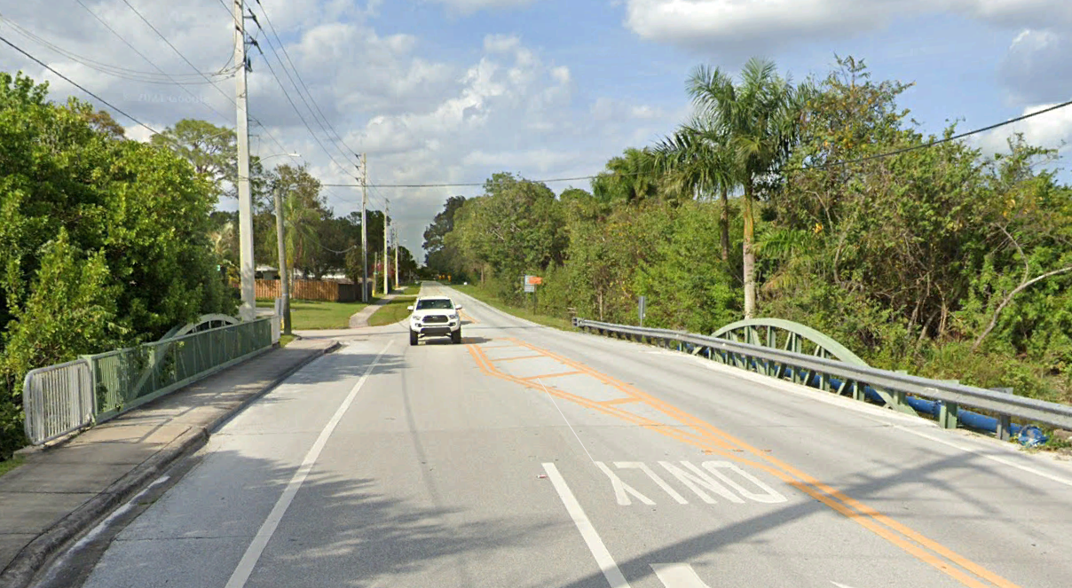
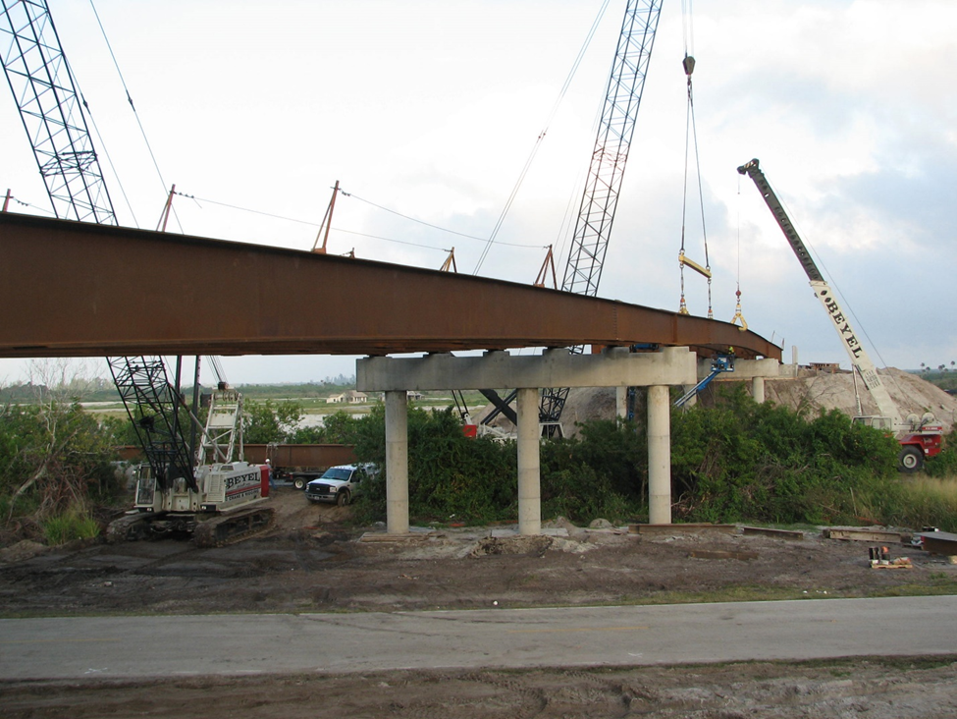
Recent Public and Private Bridges
Roadway Example
Notes:
Coconut Cove Bridge, St. Lucie County. Over A-1-A and FEC tracks. 3-sided culverts are a typical roadway underpass option as are these examples from the Villages.

Slide 12
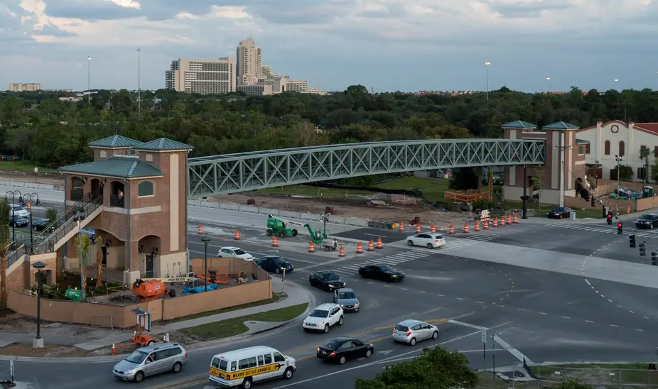
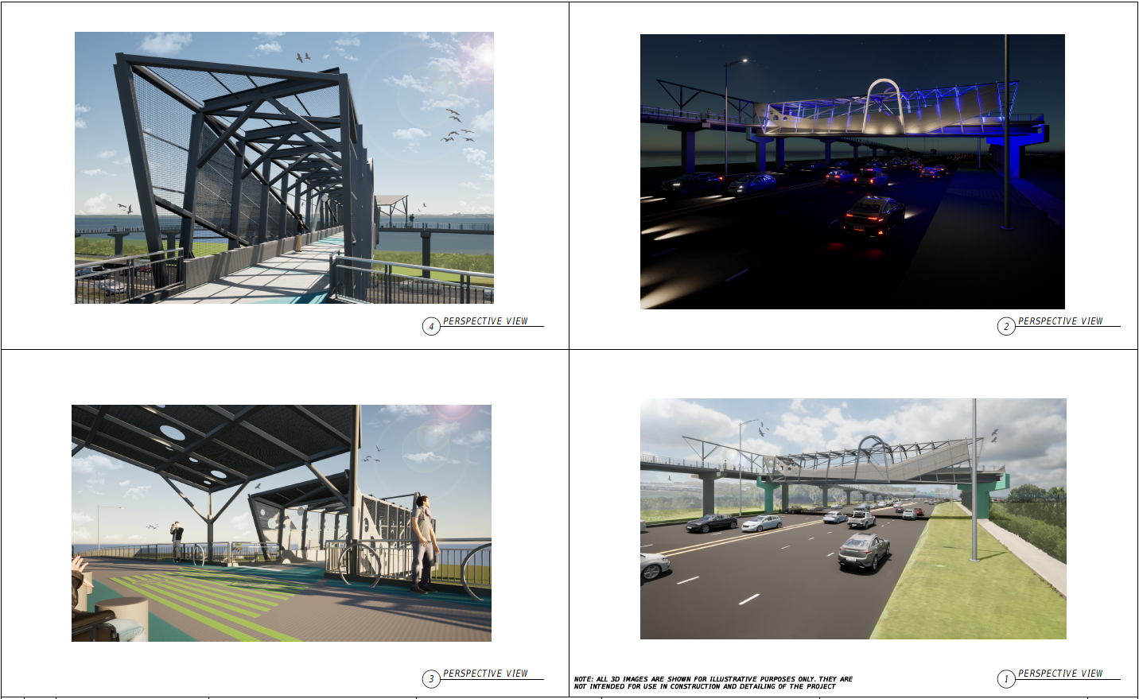
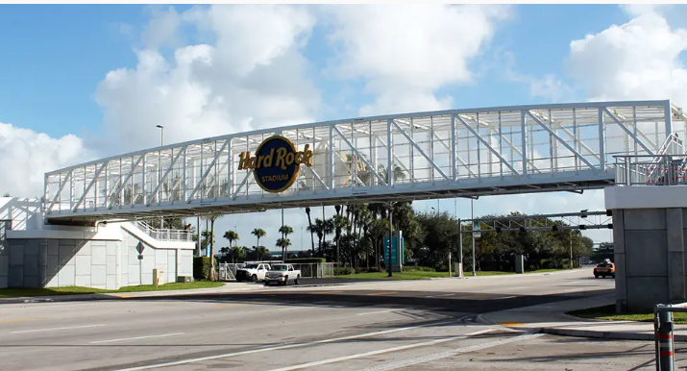
Recent Public and Private Bridges
Pedestrian
Notes:
Highlight aesthetics and complications. We are seeing increased emphasis on aesthetics to almost an “arms-race” level.

Slide 13
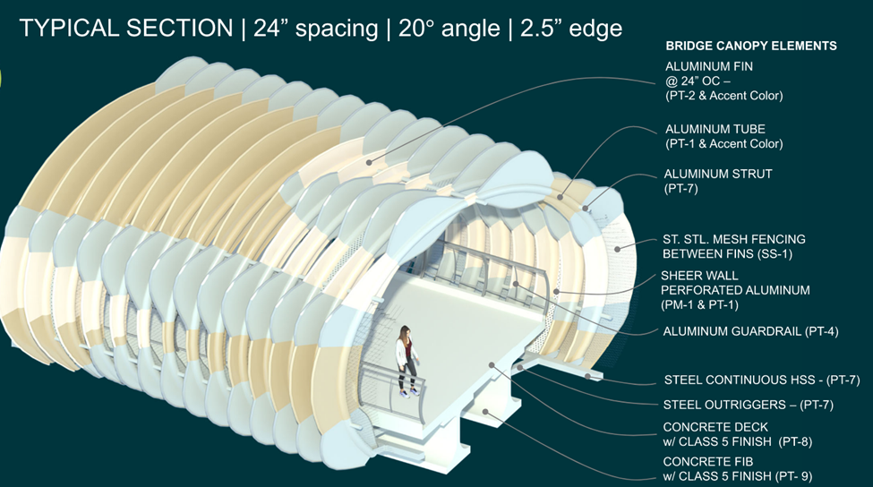
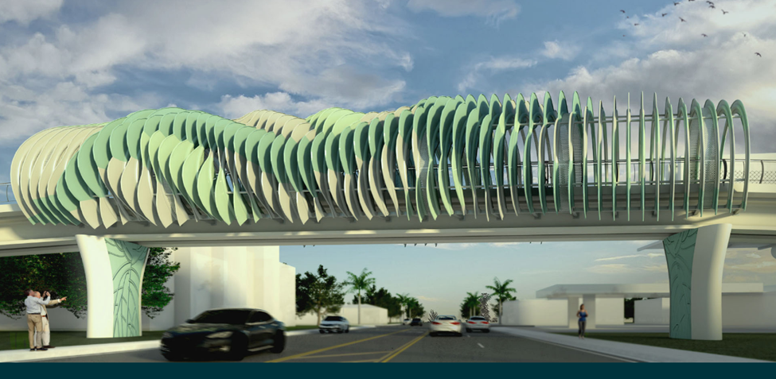
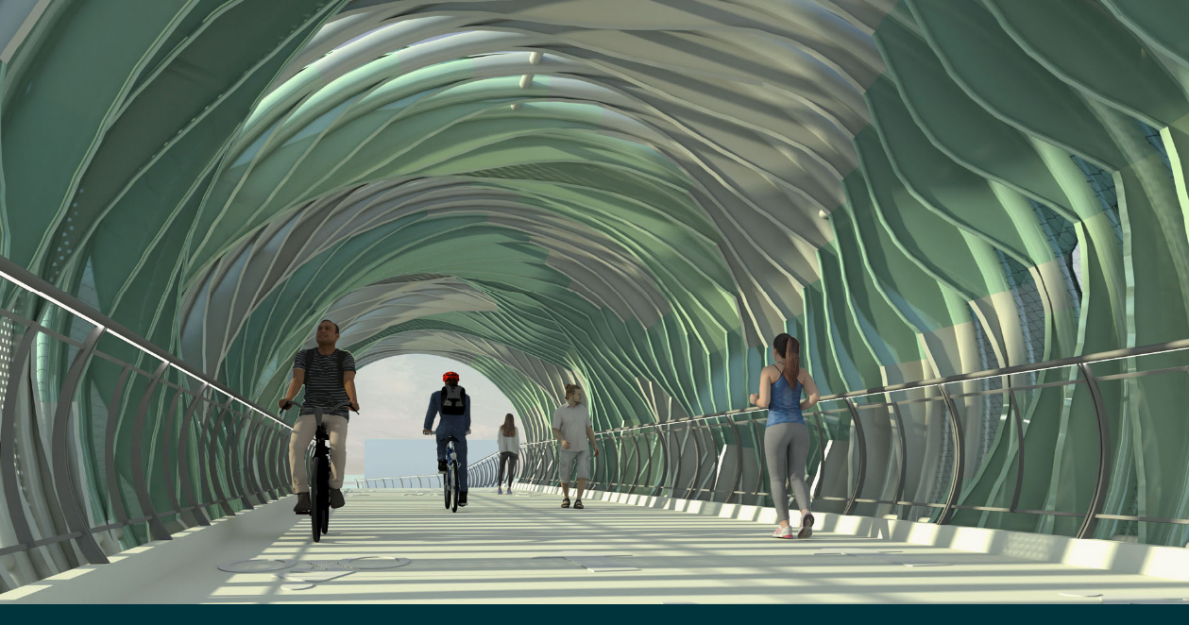
Recent Public and Private Bridges
Pedestrian
Notes:
Ludlam Trail

Slide 14
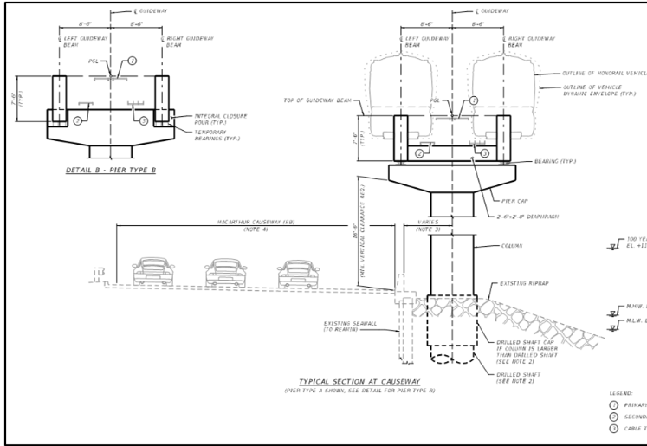
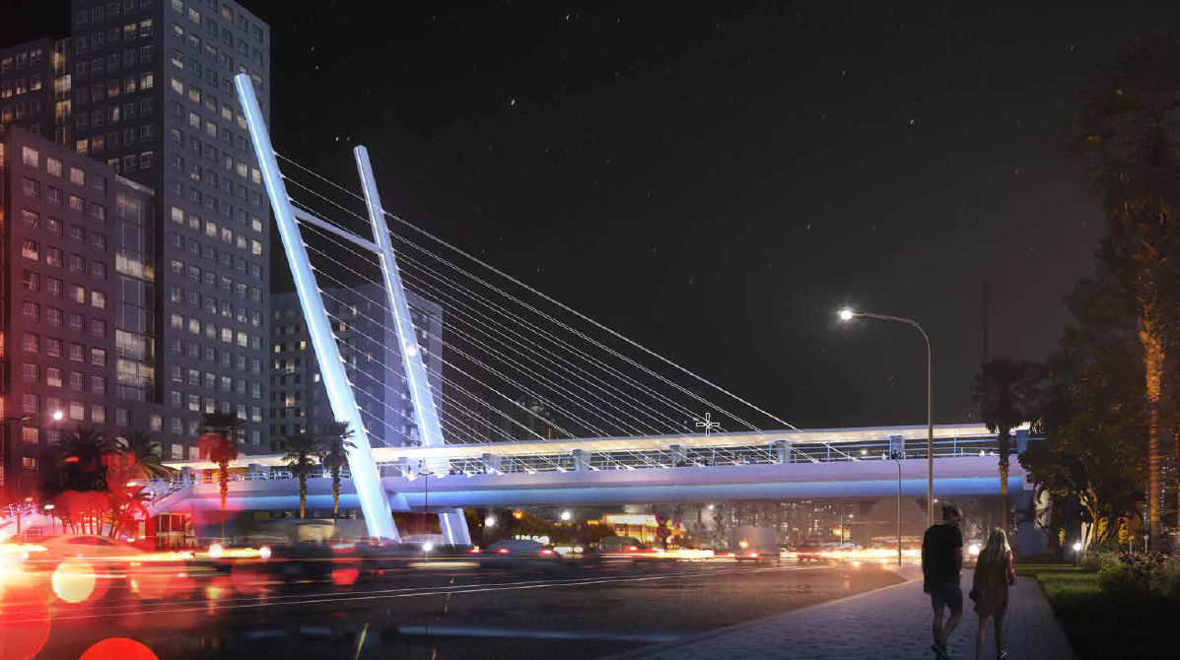
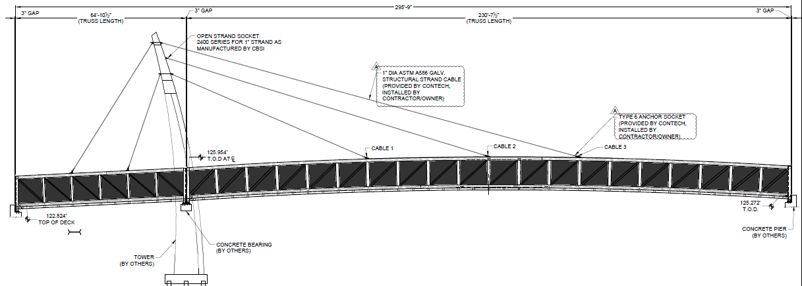
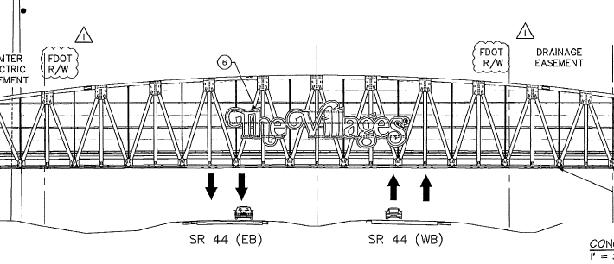
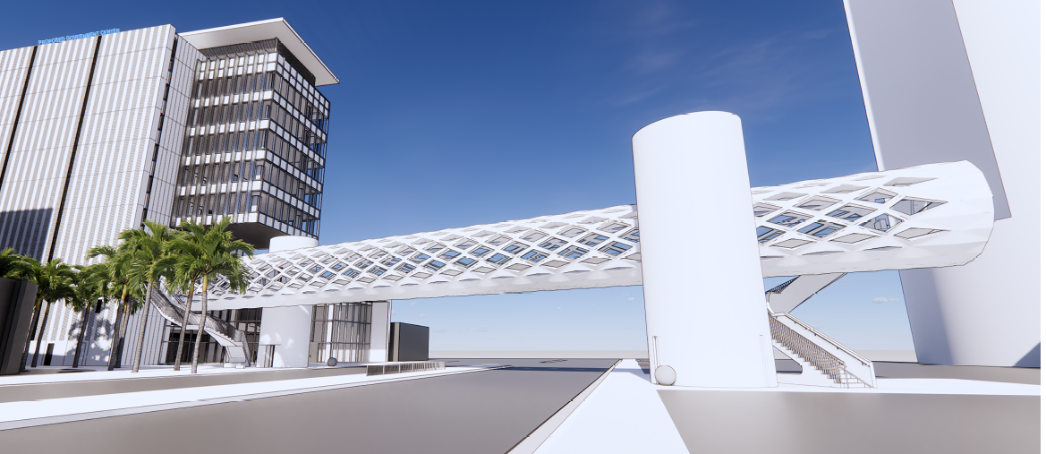
Recent Public and Private Bridges
Notes:
Provide locations

Slide 15
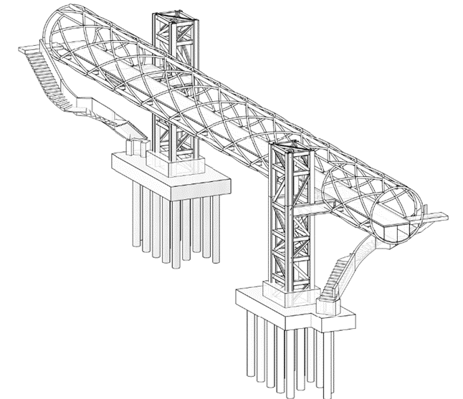
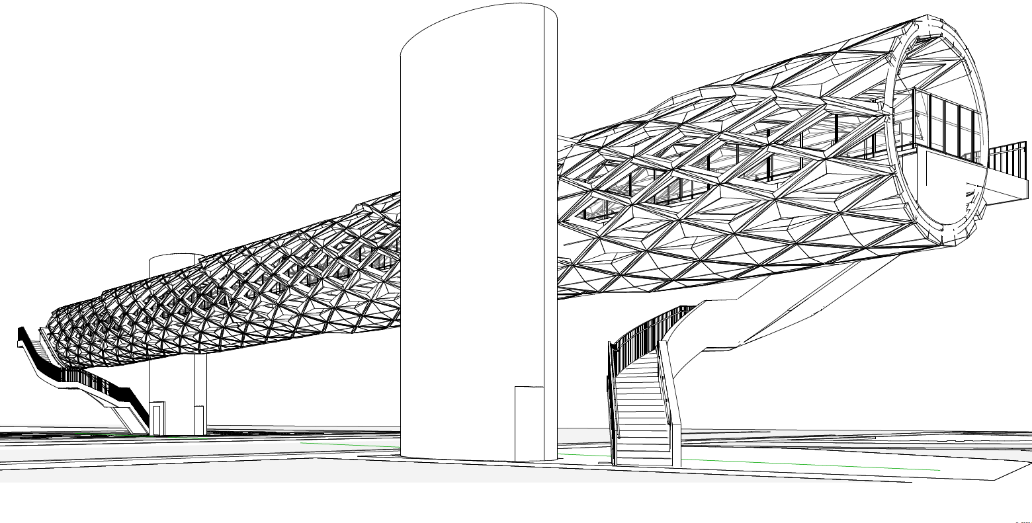
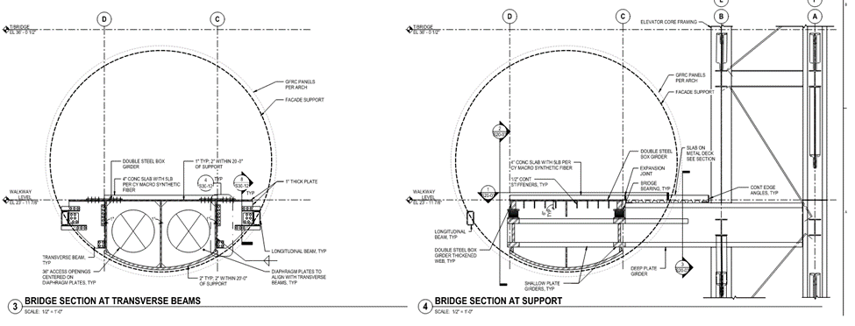
Recent Public and Private Bridges
Pedestrian
Notes:
Sunny Isles evolution. Initially enclosure framework was to be structural.

Slide 16
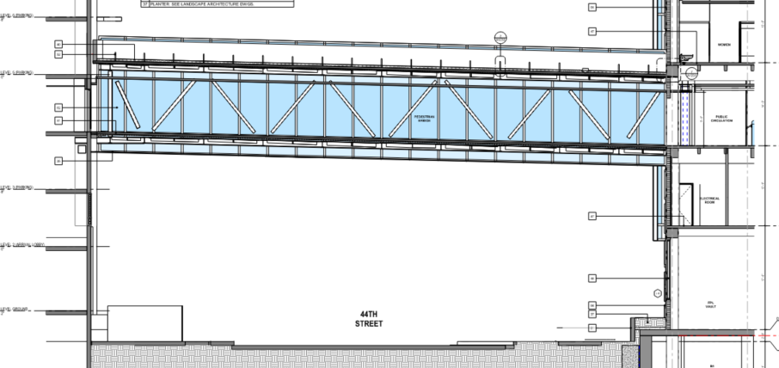
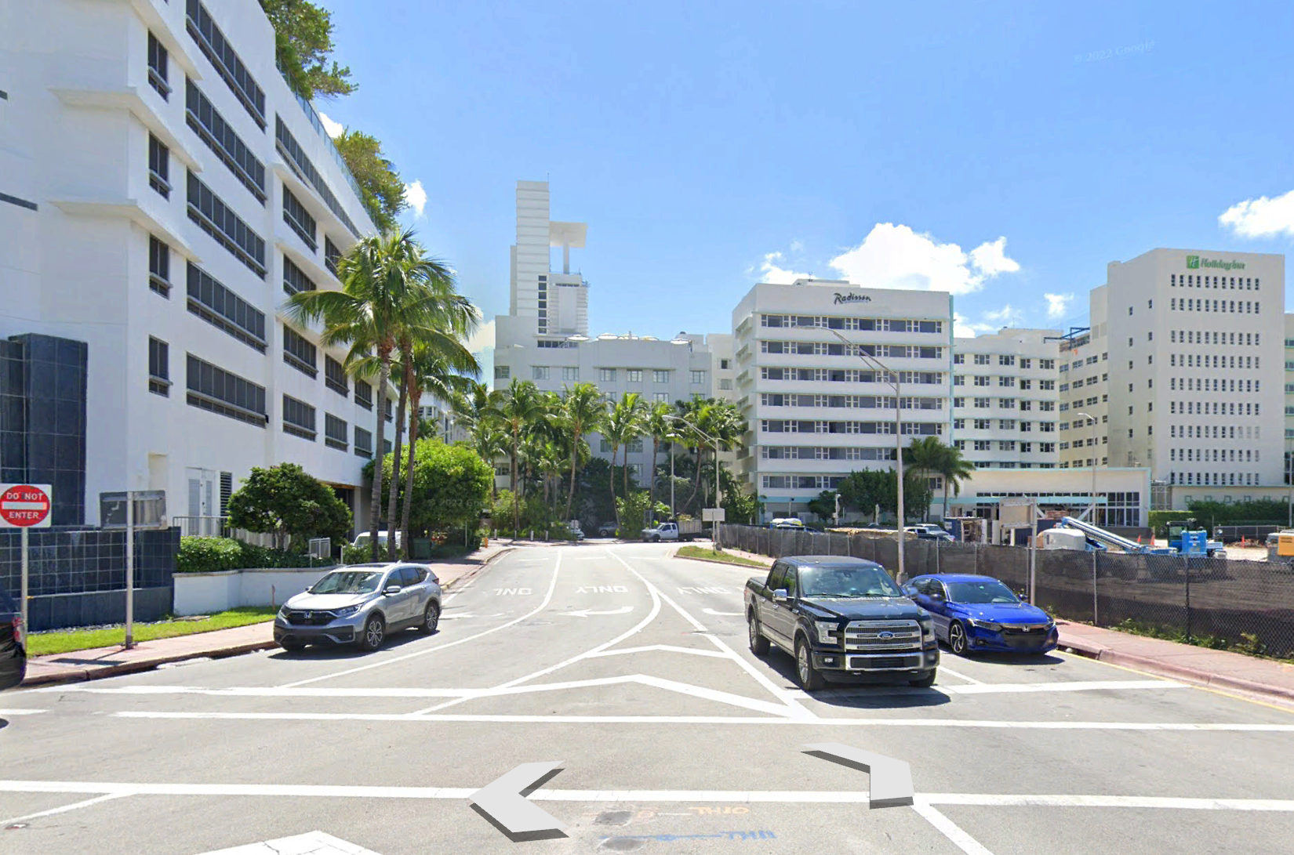
Recent Public and Private Bridges
Pedestrian
Notes:
Confirm adequate structural capacity of existing structures being connect.

Slide 17
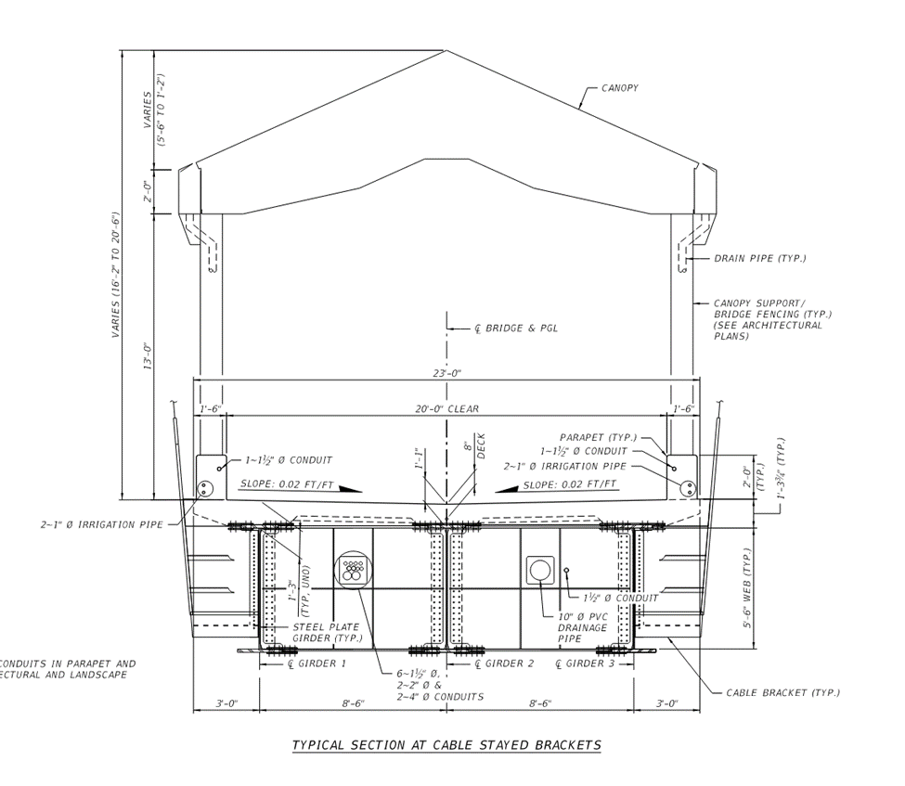
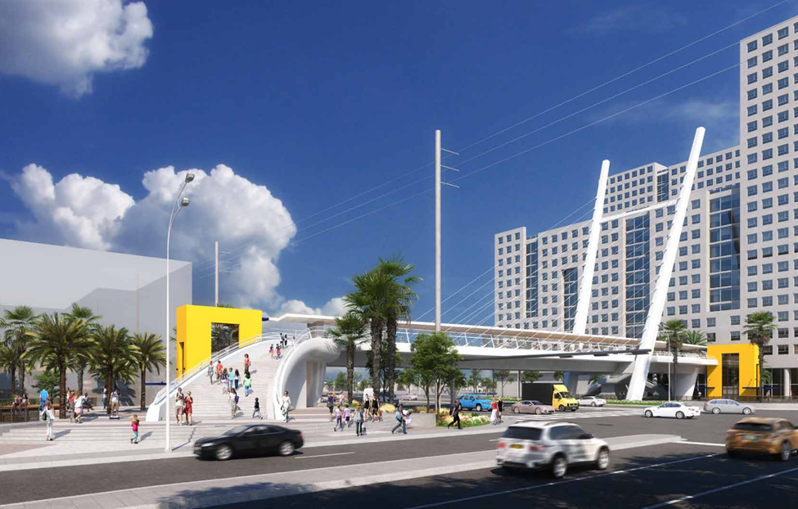
Recent Public and Private Bridges
Pedestrian

Slide 18
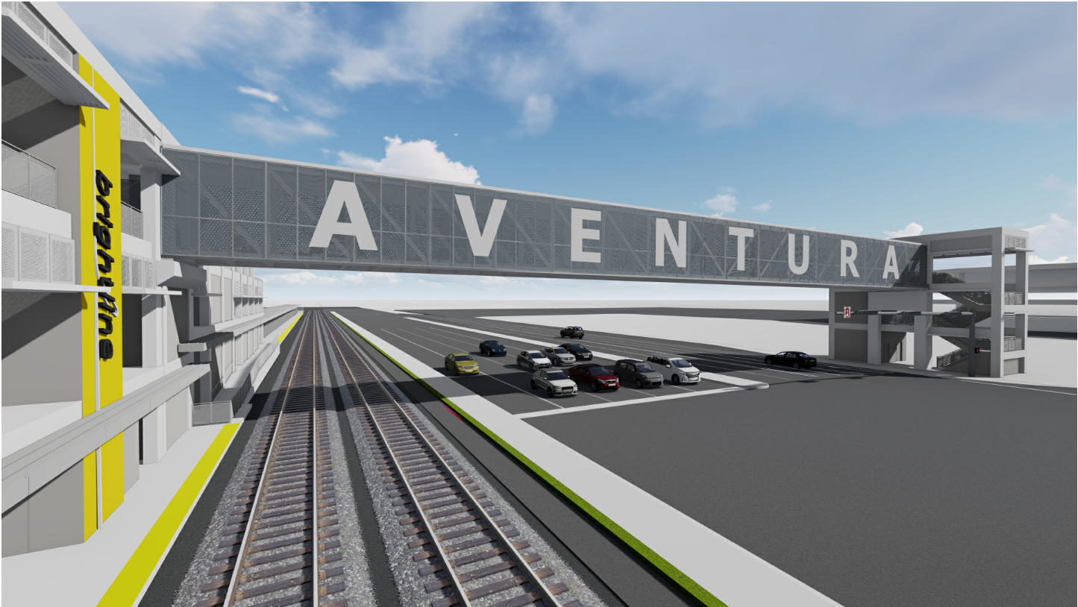
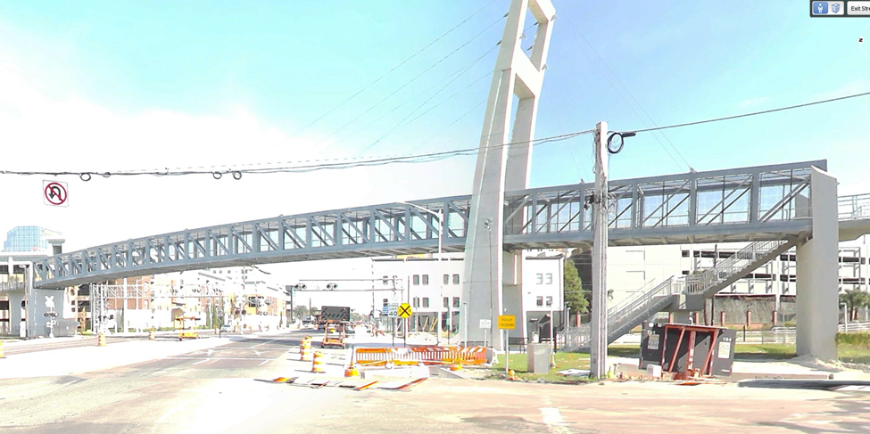
Recent Public and Private Bridges
Pedestrian
Notes:
Colonial Ave Orlando & Brightline/Aventura Mall.

Slide 19
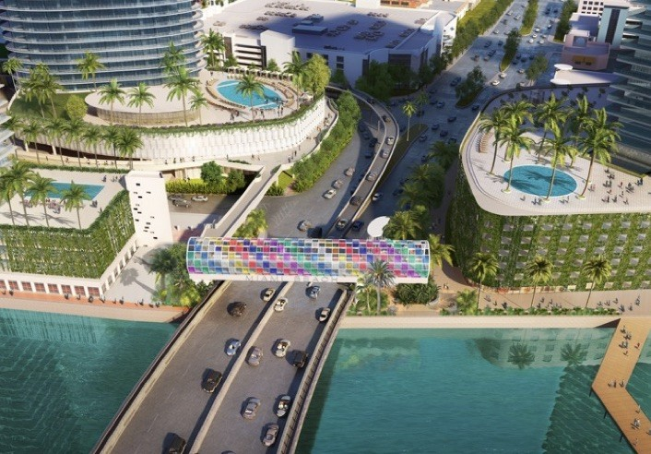


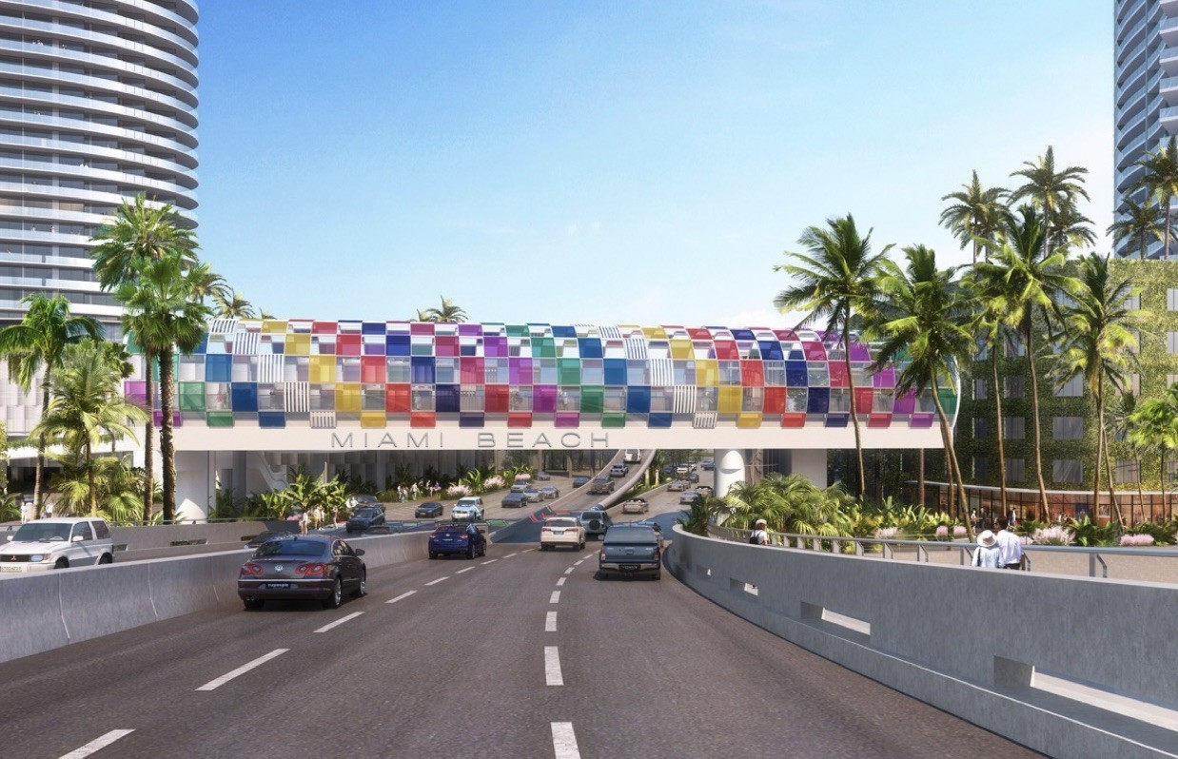
Recent Public and Private Bridges
Pedestrian
Notes:
City of Miami Beach at MacArthur Causeway.

Slide 20
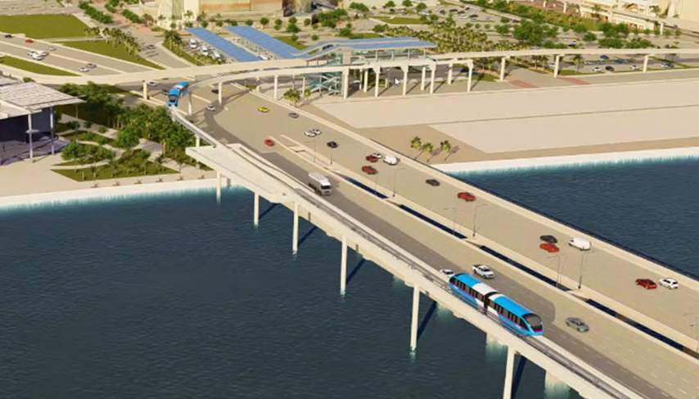
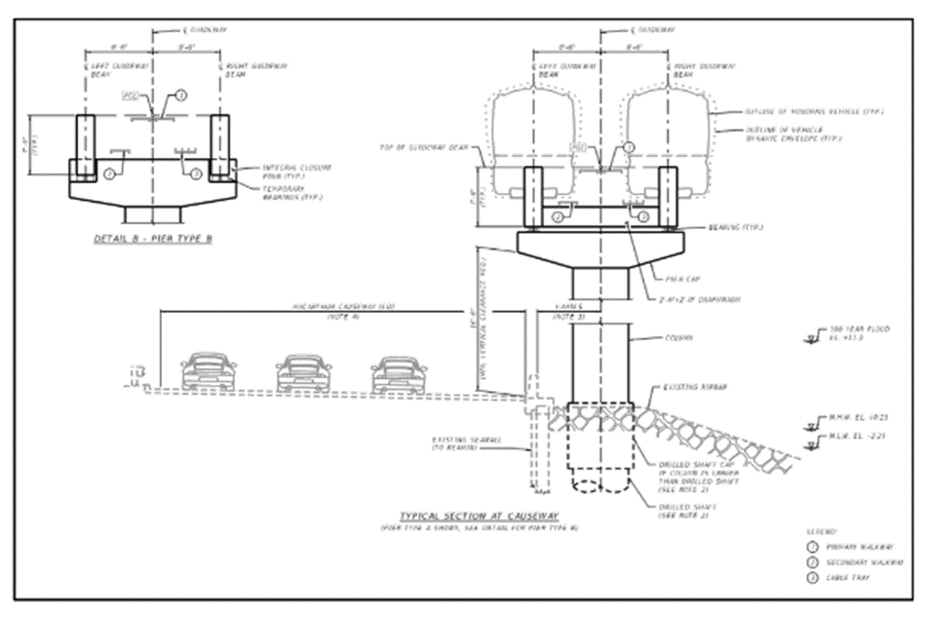
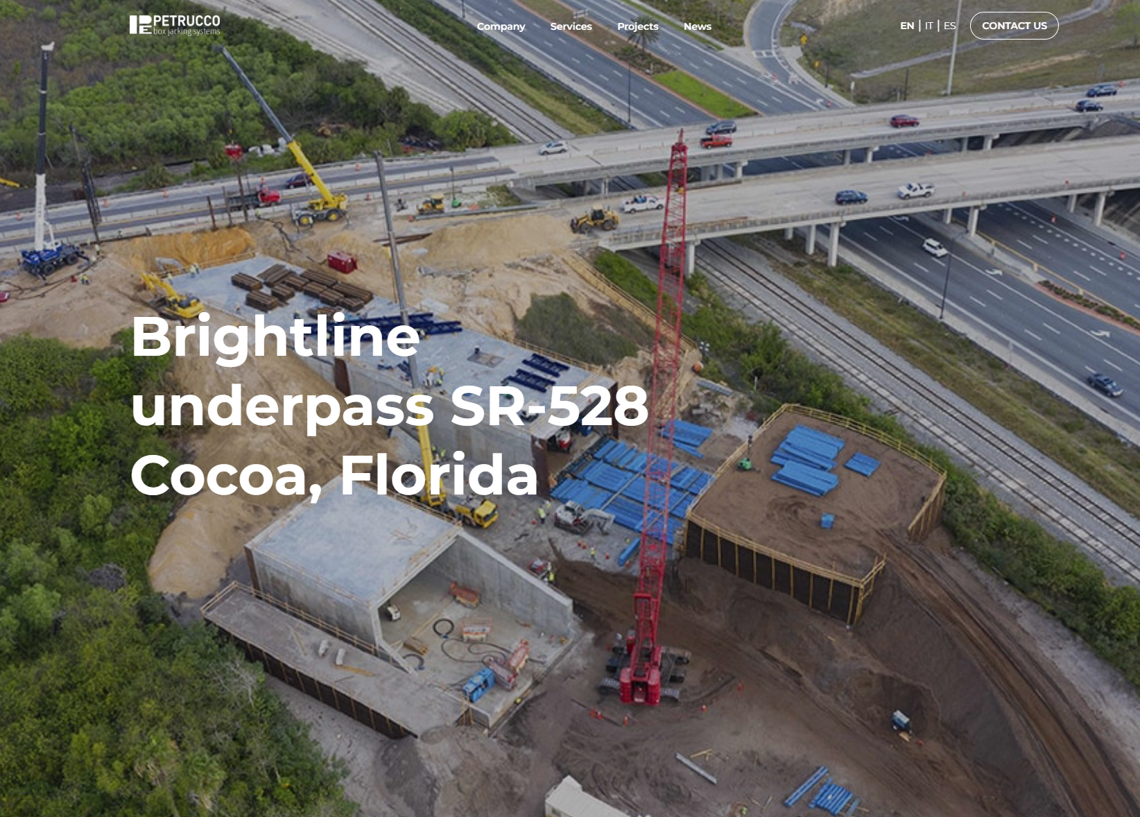
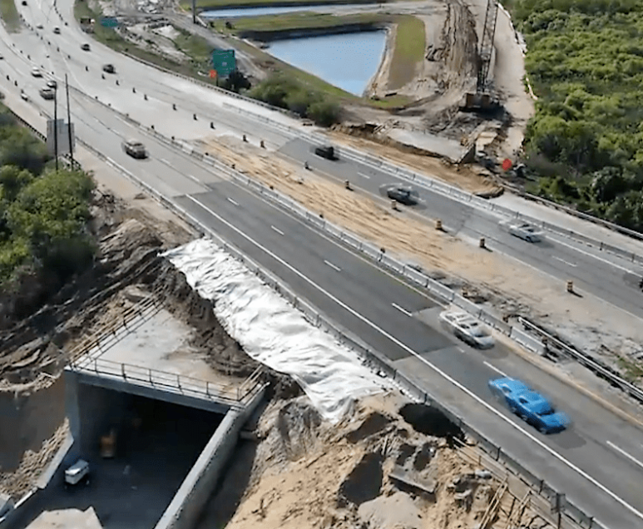
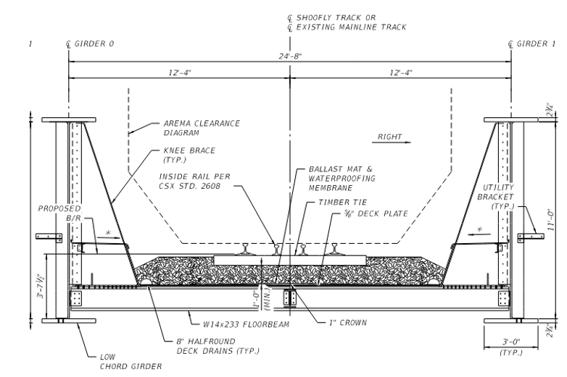
Recent Public and Private Bridges
Railroad/Light Rail Train
Notes:
Brightling jack-and-bore tunnel & Miami Beach

Slide 21

Introduction of the Current FDOT Process/Phasing
Major steps:
Pre-Application Meeting
Design Phase Reviews
Use and Occupancy Agreement
Construction Permit
Post Construction Requirements

Slide 22

Introduction of the Current FDOT Process/Phasing
Pre-Application Meeting
  A pre-application meeting to discuss the proposed pedestrian bridge with Department personnel is required to initiate the process.
    FDOT PM
    FDOT District Permit Engineer
    Contact information can be found at FDOT’s
    One Stop Permitting website
Notes:
At this meeting it will be discussed the process and timeline for the project. It is important to have this meeting very early in the project to avoid delays.
The meeting should be attended by the key staff that will communicate with FDOT.
Each District will designate a FDOT PM to lead the Plans Review Phase
Also, the District Permit Engineer will attend this meeting and provide guidance for the permit process
Other offices such as Design, Traffic Operations, Maintenance and Construction should participate.

Slide 23
Introduction of the Current FDOT Process/Phasing
Design Review
AASHTO LRFD Bridge Design Specifications (9th ed current)
AASHTO Pedestrian Bridge Guide Specifications
Florida Design Manual (FDM)
Structures Manual (4 Volumes)
Local Programs Manual (LAP)
The Department has a policy to require that structures built of the FDOT ROW to be designed, built, and construction in accordance with all FDOT requirements. All requirements are contained with these governing documents:
Notes:
Documents are interrelated. Documents that pertain to non-department bridge include.

Slide 24
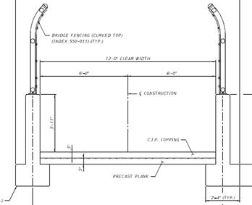
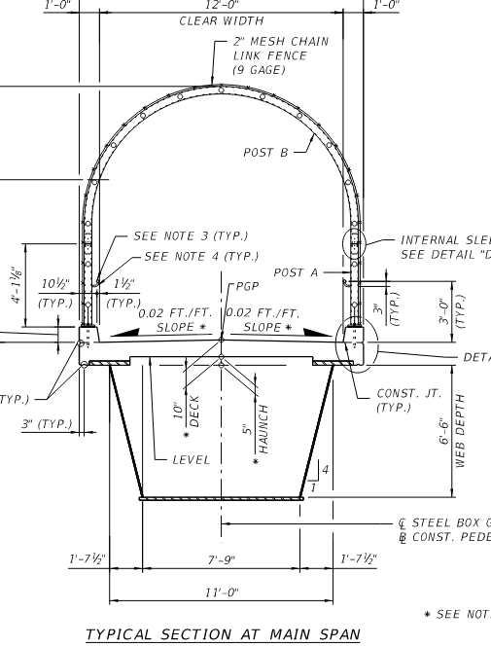
Introduction of the Current FDOT Process/Phasing
First a couple of quotes:
Form follows function – Louis Sullivan (1856–1924)
Department should not be required to waive design criteria to accommodate unique form/aesthetics. The purpose of a crossing is to convey vehicles or pedestrians safely across an FDOT facility
Past Performance is not a guarantee of future results – standard investment industry disclaimer
In this context “performance” should be changed to “precedent”. A request to waive Department design criteria should not be based on there being a previous example in service.
Recent precedent
examples
Notes:
Bottom line is a crossing, whether a pedestrian or roadway bridge’s first and foremost function is safe conveyance.

Slide 25
Introduction of the Current FDOT Process/Phasing
Design Review
Phase reviews (30%/Phase I, 60%/Phase II, 90%/Phase III, 100%/Phase IV). See FDM 121.14 for content requirements.
Design submittals (plans and calculations) must be from an FDOT pre-approved engineering firm. This now includes pedestrian bridges per FDM 266.2.
The 90% and 100% submissions must include Independent Peer Review certifications. See FDM 121 for specifics.
Comments must be closed out prior to progressing to next phase.
Most important thing to remember – it’s in the EOR’s and Owner’s best interest to not try skipping phase submittals. Getting FDOT involved late in design process can result in costly rework and schedule impacts.
Notes:
Regarding the relatively new FDM requirement for prequalified firms for ped bridges, previously firms only had to meet the experience requirements of FAC 14-75. What was happening is that developers would assume their “go to” architecture/engineering firm could get prequalified and would not submit the resumes until well into design which put the Department in an awkward position. Plus, requiring prequalified firms helped with getting firms with some level of familiarity with Department processes and procedures.
Getting plans at 90+% completion for first time can result in re-work that could be avoided through early coordination with CO and District Maintenance

Slide 26
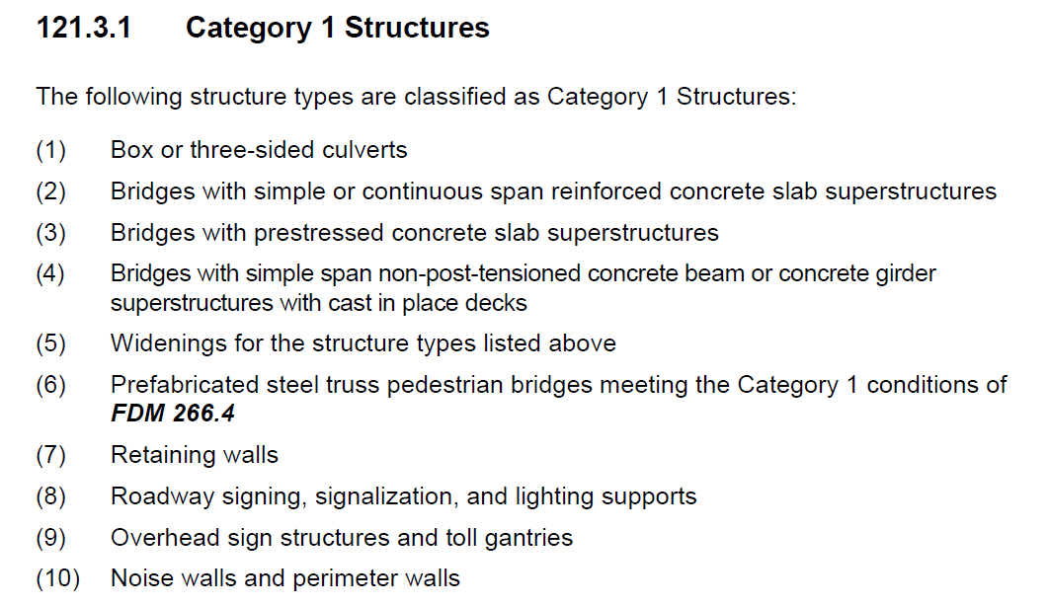
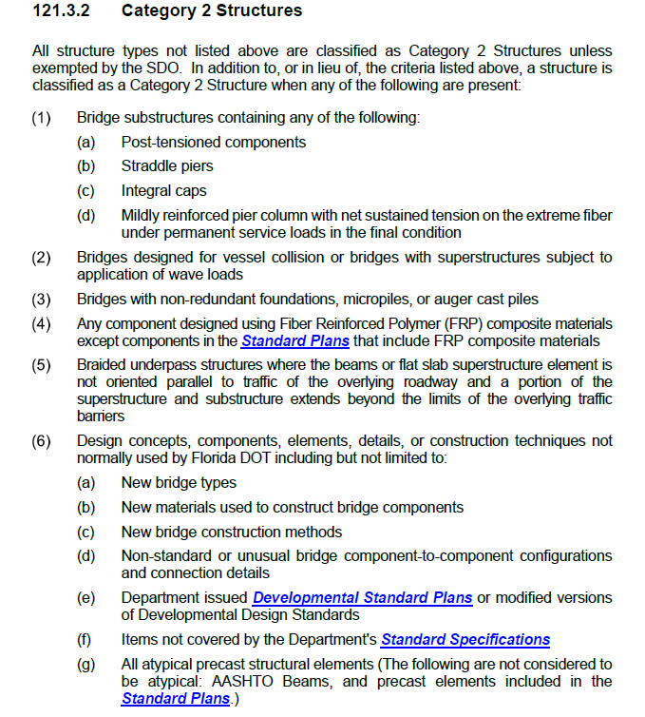
Introduction of the Current FDOT Process/Phasing
Relevant Policy – FDM 121
Just a reminder that structures are divided into two Categories…
Note that Category 2 structures must be reviewed by SDO and that design schedules will need to accommodate.
Notes:
Prior to jumping into the various policy document…..

Slide 27
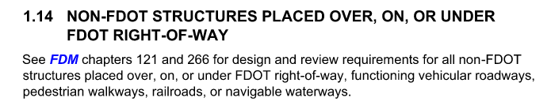
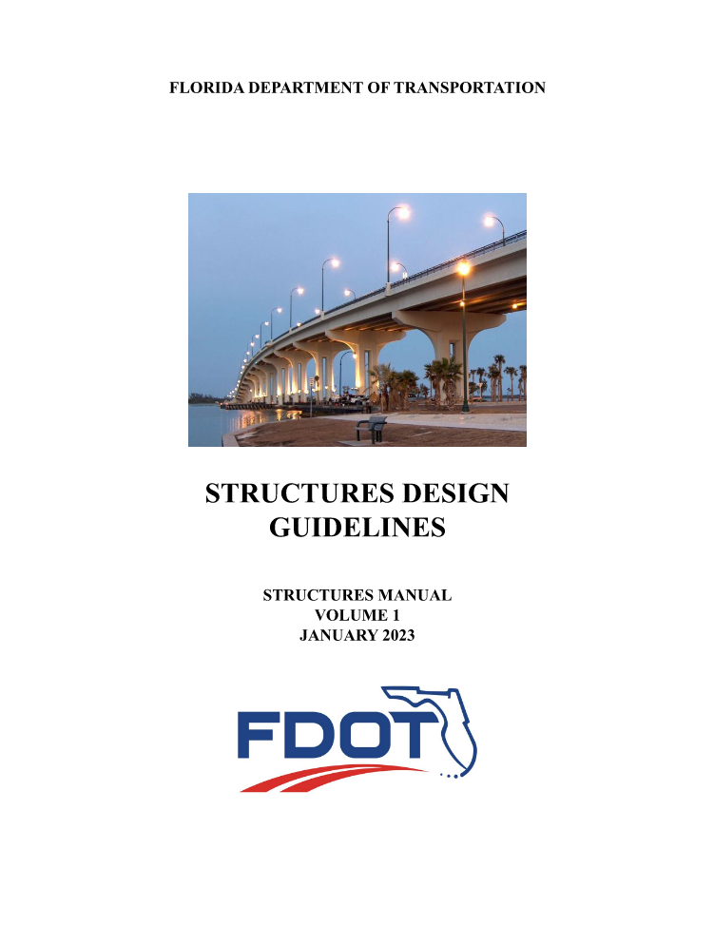



Introduction of the Current FDOT Process/Phasing
Relevant Policy
Notes:
Most important thing to remember is all sections of FDM and the SM are to be assumed to pertain to non-Department bridges unless specifically modified.

Slide 28

Introduction of the Current FDOT Process/Phasing
For design submittals, Non-Department structures built over FDOT ROW are reviewed to the same extent regardless of funding source or owner.
An Independent Peer Review (IPR) is required for Non-Department structures or components (including retrofits and modifications) built over FDOT ROW. Excludes miscellaneous structures.
Important Sections include but are not limited to:
121 Bridge Project Development: Defines Category 1 and 2 structure types. Provides Independent Peer Review (IPR) requirements. Sets forth design phase submissions.
222.4 Pedestrian facilities: Addresses railing requirements.
260 Bridge Structures: Provides geometric requirements

Slide 29

Introduction of the Current FDOT Process/Phasing
260 Table 260.6.1:
266 Bicycle and Pedestrian Bridges: Important Section !!!
1. Newly added requirement for Designer (EOR firm) pre-qualifications.
2. Provide limitations on using prefabricated steel truss pedestrian bridges
Notes:
Prior to 20___ requirement was that designer had to meet same experience requirement as prequalified firm in relevant FS 14-75 Work Type. Note that prefabricated trusses meeting these requirements are classified as Cat 1 structures and do not require CO review.

Slide 30

Introduction of the Current FDOT Process/Phasing
266 Bicycle and Pedestrian Bridges:
Important to note that if a steel truss does not meet the prefabricated steel truss requirements, the superstructure design cannot be deferred to a pre-approved producer but instead must be fully detailed in the design drawings by a prequalified firm.
Notes:
Prior to the 2023 FDM, requirement was that designer had to meet same experience requirement as prequalified firm in relevant FS 14-75 Work Type. Note that prefabricated trusses meeting these equirements are classified as Cat 1 structures and do not require CO review.

Slide 31


Introduction of the Current FDOT Process/Phasing
210’ Span
231’ Span
Daytona Beach Speedway
The Villages Water Lily Bridge over the Turnpike
Notes:
This bridges do not meet prefabricated truss criteria.

Slide 32


Introduction of the Current FDOT Process/Phasing
Independent Peer Review for Category 2 structures
Certifications are required at 90% and 100% design phases for submissions to be deemed complete and able to be reviewed by FDOT.
IPR requirements for each phase submission are set forth in FDM 121.
Notes:
This bridges do not meet prefabricated truss criteria.

Slide 33

Introduction of the Current FDOT Process/Phasing
The SM is intended to modify the AASHTO LRFD BDS. Complete Manual is composed of 4 volumes but the main ones pertaining to non-Department bridges are
Structures Design Guidelines (SDG)
Structures Detailing Manual (SDM)
Most important thing to remember – all sections of these volumes apply to non-Department bridges except for Non-Conventional project Blue Boxes. These only apply to Department Non-Conventional projects.

Slide 34




Introduction of the Current FDOT Process/Phasing
Notes:
Applying redundancy factors does not default in a non-redundant structures becoming redundant. Note that 4.1A.3’s reference to 10.2 does not over-ride need to get SDO approval for 2-girder structures. This is a relatively new change with further guidance forthcoming in next release.

Slide 35




Relevant Policy – redundancy & over-height vehicle impacts
Introduction of the Current FDOT Process/Phasing
Notes:
Applying redundancy factors does not default in a non-redundant structures becoming redundant.

Slide 36

Temporary Traffic Control Plan
Introduction of the Current FDOT Process/Phasing
Note that if a bridge includes extensive cladding or enclosures, the TTCP will need to accommodate erection of these elements. Inclusion of a workable erection sequence is a design submission requirement per SDG 6.10C for certain structure types and the Department may require erection plans for structures with extensive cladding/enclosures to demonstrate compatibility with TTCP. Remember that these elements must be designed considering transportation and erection limitations.

Slide 37
Non-Department Bridges-Pedestrian Design Comments
Introduction of the Current FDOT Process/Phasing
Frequently made comments on Design Reviews:
Substructure outside of R/W supporting a span within FDOT R/W must be submitted for review.
Structure lacks redundancy and a clear alternate load path.
Main supporting elements must be readily inspectable. Claddings must accommodate.
Stormwater runoff must be conveyed off of structure and not discharged onto underlying road. Architectural features and canopies must consider this requirement.
If cladding or signage is to be included, wind drag effects must be considered in design of super and substructures.
Signage and cladding connections must be included in design and not delegated to shop drawings.
IPR must be performed by an FDOT pre-qualified firm.
Confirm the AASHTO Guide Spec for Pedestrian Bridges’ vehicle loads have been accommodated if access is not prevented.
Canopies subject to FBC need to met the more stringent of FBC or AASHTO/FDOT criteria.
Minimum concrete deck thickness per SDG has to be met. SIP metal forms are not to be included in capacity calculations.
Plans are incomplete and do not follow FDOT’s plans preparation requirements.

Slide 38

Introduction of the Current FDOT Process/Phasing
Final thought on design:
Not valid reason to request waiving or approval of Design Variations include:
It’s not a Department-owned bridge.
It was assumed that the Structure Manual was just suggestions and not required criteria.
Cost.
Not compatible with aesthetics.
Schedule does not permit complying with Department criteria.
Add graphic
Note that the higher level of aesthetics or higher complexity of design may warrant further analysis. Prime example is wind analysis to confirm if suspectable to wind induced affects such as vibration or galloping.
Notes:
We commonly get plans not meeting all Department criteria. When omission are pointed out in review, we routinely get request to waive our criteria.

Slide 39

Introduction of the Current FDOT Process/Phasing
Use & Occupancy Agreements
Legal Agreement
  Prepared and executed by both parties
ROW needs
  Right-of-Way Office Coordination
  Parcel Sketch
  Approved Design Plans
Final Document
Notes:
The General Counsel Office with the help from other FDOT offices will prepare a Use & Occupancy Agreement
Coordination with the Department’s Right-of-Way Office is required to effectuate the necessary agreement(s) to allow for the operation and maintenance of the proposed bridge structure.
A legal description and parcel sketch along with the final approved plans must be submitted by the applicant to initiate development of the required agreement(s).

Slide 40

Introduction of the Current FDOT Process/Phasing
Use & Occupancy Agreements
Common Sections
  Recitals
  Term
  Use and Occupancy Fee
  Use, Occupancy, and Maintenance
  Indemnification
  Insurance, Performance Bond
  Default and Termination
  Eminent Domain
  Miscellaneous
Notes:
The General Counsel Office with the help from other FDOT offices will prepare a Use & Occupancy Agreement
Coordination with the Department’s Right-of-Way Office is required to effectuate the necessary agreement(s) to allow for the operation and maintenance of the proposed bridge structure.
A legal description and parcel sketch along with the final approved plans must be submitted by the applicant to initiate development of the required agreement(s).

Slide 41
Introduction of the Current FDOT Process/Phasing
Construction Phase
Construction Agreement
Standard Specifications for Road and Bridge Construction (Std Spec)
FDOT Materials Manual
Construction Project Administration Manual (CPAM)
Governing documents include:

Slide 42
Introduction of the Current FDOT Process/Phasing
Construction Permit
One Stop Permitting (https://osp.fdot.gov/#/home)
  Contact the District Permit Office
  Apply Online
  Include Approved Design Plans
  Approval takes 90 days per Florida Status (30 days goal)
  Once Permit is Approved the Construction Starts
Notes:
After completion of all plan phase reviews and resolution of all outstanding comments, a construction Agreement will be required prior to commencing any work. Information on the process for obtaining a construction agreement can be found on the Department’s One Stop Permitting Website
Florida Statutes allows us 90 days to approve or deny a permit. Our goal for all permit types is to complete our review in no more than 30 days.

Slide 43
Introduction of the Current FDOT Process/Phasing
Construction Agreement (Form 850-040-89)
Important Sections regarding design & construction:
Requires design per Department policies/standards and construction per Department specifications (Article 2).
Allows for Department to reject designs not meeting FDOT standards (Article 3).
Requires Construction Coordinator to take emergency steps to close a public road whenever there is a risk to life, health, and safety of the traveling public. Also requires notification of the District Maintenance Engineer of all observed defects (Article 9).
Places responsibility on Construction Coordinator for provision of CEI services and for monitoring construction operations (Article 13).
Construction Agreement

Slide 44
Introduction of the Current FDOT Process/Phasing
Construction Agreement – Special Provisions
Typically, the standard Construction Agreement form is supplemented with a project-specific Special Provisions Exhibit setting forth additional responsibilities of the Construction Coordinator. Some important ones include:
As-builts
Material certifications
Contractor Quality Control (QC) and CEI Verification (VT) certifications
Specialty Engineer requirements
Qualified Special Inspector requirements
Specific MOT requirements
Performance bond requirements
Additional MOT and working time restrictions.
Construction Agreement

Slide 45

Introduction of the Current FDOT Process/Phasing
Construction Phase
All section of FDOT’s Construction Project Administration Manual (CPAM) are applicable to Non-Department bridges (unless noted otherwise) and are to be adhered to by CEI. This is noted in the Construction Agreement.
All sections of FDOT’s Standard Specifications for Road and Bridge Construction are applicable to Non-Department bridges (unless noted otherwise) and are to be adhered to by CEI.

Slide 46

Introduction of the Current FDOT Process/Phasing
Construction Process- Steel Bridges
All steel bridge have to undergo Commercial Inspection.
There are three specific sections related to Commercial Inspection. They are designed to speak to each respective party (Contractor, Fabricator, Project Administration). It outlines who is needed to be approved, most of their qualification requirements, and may be a good resource if someone wants to know how to get on the MAC page for approved producers.
Here is the “request for inspection” form which can be filled out by any project personnel and submitted to begin the inspection process.
Notes:
Background is we recently had a private pedestrian bridge where the owner thought they could fabricate (not just assemble) literally on the side of the road! As such we thought it important to review the fabrications and materials requirements managed by the State Materials Office.

Slide 47

Introduction of the Current FDOT Process/Phasing
Construction Process- Steel Bridges
2. Materials Manual 11.1 Vol II (Speaking to the Fabricator)
11.1.13 COMMERCIAL INSPECTION: This section of the Materials Manual discusses the scope, application, and scheduling of Commercial Inspection. The Contractor is responsible for sending the Production Facility’s schedule to the Engineer at least 30 days prior to the beginning of fabrication. The components identified in Table 4 require commercial inspection.

Slide 48

Introduction of the Current FDOT Process/Phasing
Construction Process- Steel Bridges
Standard Specification for Road and Bridge Construction:
  Section 105-1.2.3 (Speaking to the Contractor)105-1.2.3 Notification of Placing Order: Order materials sufficiently in advance of their incorporation in the work to allow time for sampling, testing and inspection. Notify the Engineer prior to placing orders for materials. Submit to the Engineer a fabrication schedule for all items requiring commercial inspection at least 30 days before beginning fabrication. These items include steel bridge components, moveable bridge components, pedestrian bridges, castings, forgings, structures erected either partially or completely over the travelled roadway or mounted on bridges as overhead traffic signs (some of these may be further classified as cantilevered, overhead trusses, or monotubes) or any other item identified as an item requiring commercial inspection in the Contract Documents.
  460-1.2 Fabrication Categories: As a prerequisite for being on the Department’s Production Facility Listing, fabricators must currently be accredited in accordance with one of the programs in Table 460-1, by fabrication category/categories of the products that they are producing. Fabricators are required to submit their proposed fabrication Quality Control (QC) Plan for review by the Department.

Slide 49
Introduction of the Current FDOT Process/Phasing
Construction Process- Steel Bridges
3. CPAM 3.3 (Speaks to Project Administrators)
3.3.5 Contractor’s QCP Review and Approval
(A3) Commercial Inspection – On contracts with Steel and Miscellaneous Metals materials that require commercial inspection, the PA must indicate in MAC if an optional inspection is being requested on any items or processes on the contract that do not typically require commercial inspection. The PA must also indicate if there are steel and miscellaneous metal items on the contract that will not be commercially inspected. The PA must ensure that the Contractor attaches the fabrication schedule for items that require commercial inspection and list the production facility or facilities that will be fabricating the items under the appropriate material type(s) 30 days before fabrication has begun per Specifications Section 105-1.2.3.
What is MAC? Materials Acceptance and Certification System

Slide 50

Introduction of the Current FDOT Process/Phasing
Construction Process- Steel Bridges
Make sure steel components are being sourced from a MAC-listed source.
If your fabricator is not pre-approved, start application process early.

Slide 51
List of Approved Metal Fabricators, Coaters and Timber producers https://mac.fdot.gov/smoreports
Important FDOT Links (Specifications, Materials Manual, Standard Plans/Designs, Commercial Inspection, Welding Forms, Audit Program, Approved Facilities & QC Managers, Guardrail Reports) https://www.fdot.gov/materials/structural/fieldoperations/commericalinspection/structural-steel-metals-coatings-timber-audit-program
Introduction of the Current FDOT Process/Phasing
Construction Process- Steel Bridges

Slide 52

Introduction of the Current FDOT Process/Phasing
Construction Process
Note on Concrete Structures
If your project includes either precast materials and/or prestress materials, as consistent with steel components, these must be sourced from a pre-approved facility. For questions on applicability, please consult the designated FDOT PM or District Materials Offices.
Note that consistent with steel components, the sections of Standard Spec’s pertaining to construction of concrete structures are all still relevant.

Slide 53
Introduction of the Current FDOT Process/Phasing
Post Construction Requirements
FDOT Inspection
Initial Bridge Inspection Occurs concurrently
  Procedures 850-030-010
  Work Types 5.1, or 5.3
Routine and Special Bridge Inspection
  Procedures 850-030-010
  Work Types 5.1, or 5.3
Routine Maintenance
Rehabilitation Projects

Slide 54

Future Changes
Presented process is current practice. In the future, the Department may issue a state-wide policy document generally following this process and phasing.
Notes:
This document would be along the line of guideline document developed by District 6

Slide 55

Lessons Learned
Meeting with FDOT first is a Must! This action will avoid unnecessary waste of applicant’s resources.
Must follow Department processes prior to design and construction.
Non-Department bridges are held to same standards as Department-owned structures.
Reach out to the Department early in the design phase- especially on more complex structures.
Must allow adequate time in schedule to work through the process.
Complexity, including cladding and enclosures, generally require additional review duration. The design is most probably going to change.
Maintainability is a very important factor as all elements of the bridge must be accessible for inspection and maintenance.
Trying to skip steps will lead to additional cost and schedule delays.
Notes:
Process may seem complicated and burdensome but hopefully this presentation has provided some insight as to reasoning behind it.

Slide 56
Conclusions
  It is hoped that this presentation provided better insight and understanding into the current FDOT approval process/phasing when non-FDOT bridges are to be built within FDOT ROW. As can be seen from the examples bridges that there are a variety of non-Department bridges that can pose unique issues that must be resolve during the review and approval process. This has been especially seen of late with non-FDOT pedestrian bridges. With better understanding of the process and expectations by EOR and Owners, it is hoped that the approval process can be streamline and positive one for all parties involved.
Notes:
Process may seem complicated and burdensome but hopefully this presentation has provided some insight as to reasoning behind it.

Slide 57

Who to contact with technical/policy questions:
For Category 2 structures
For Category 1 structures
Note that Category 2 reviews require a minimum 20- working day review durations

Slide 58

STRUCTURES DESIGN OFFICE
PLANS REVIEW GROUP
The Plans Review Group consists of Area Structures Design Engineers, each one assigned to specific districts that work with the District Structures Design Engineers to review and approve major, complex, and movable bridge plans (referred to as Category 2 Structures). The group ensures that Category 2 bridge plans are in general compliance with Department policies and procedures.
Darren Lucas, P.E. (Section Leader)
Alex Randell, P.E. (Districts 1, 3, & 4)
Jim Johnstone, P.E. (Districts 2, 5 & 7)
Ton Tu, P.E. (Districts 6 & Turnpike)

Slide 59
Maintenance Office

Slide 60

Contact Us
Pablo J. Orozco, P.E., MSCE, CPM
District Six Structures Maintenance Engineer
pablo.orozco@dot.state.fl.us
Direct: (305) 470-5370
Darren K. Lucas, P.E.
Plans Review Group Section Leader
FDOT Central Office - Structures Design Office
darren.lucas@dot.state.fl.us
Direct: (850) 414-4260

