Slide 1
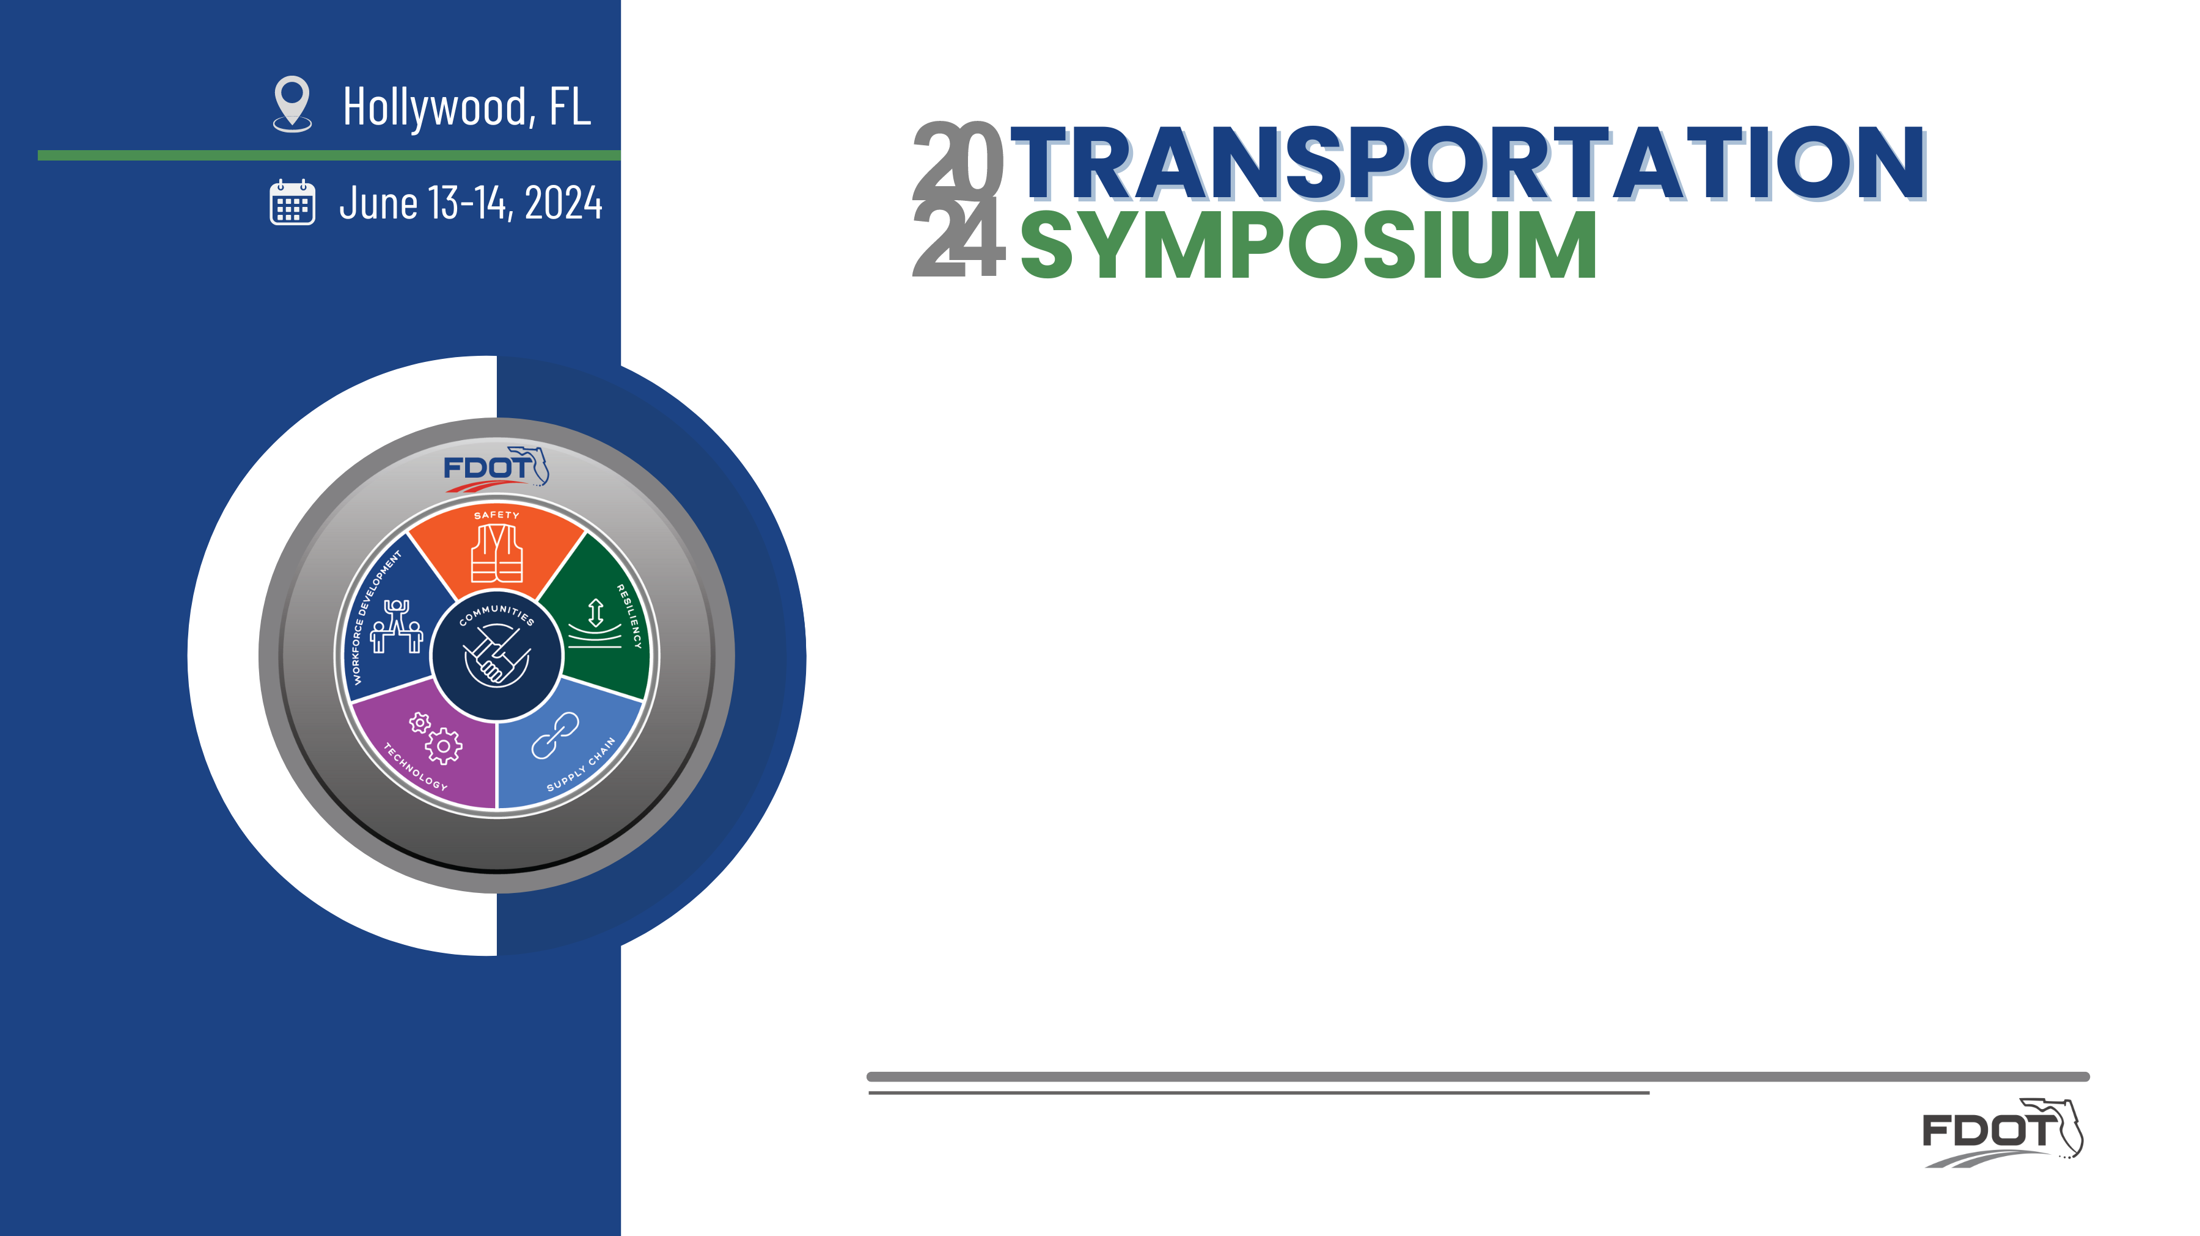
FDOT Freight Mobility Initiatives in
Miami-Dade County
Daniel Lameck &
Armando Moscoso

Slide 2
FDOT Freight Mobility Initiatives in Miami Dade County
Daniel Lameck & Armando Moscoso

Slide 3
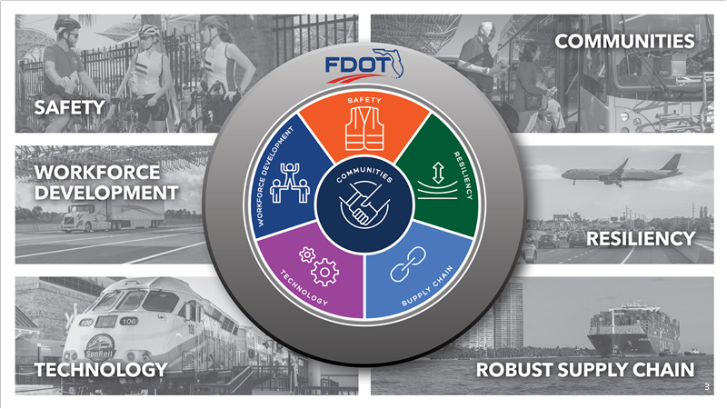

Slide 4
Agenda
Freight Improvement Initiatives
Truck Parking
Federal Funding Opportunities
National Highway Freight Program (NHFP) Overview
NHFP Funding
Project Selection
Q&A/Discussion

Slide 5
Freight Improvement Initiatives

Slide 6

Freight Industrial Sub-Areas
District 6 identified the following freight-intensive sub-areas:
  Town of Medley
  City of Opa-Locka
  Port of Miami River Corridor
  City of Doral
  City of Miami Gardens
  City of Hialeah
  City of Homestead
  Monroe County

Slide 7

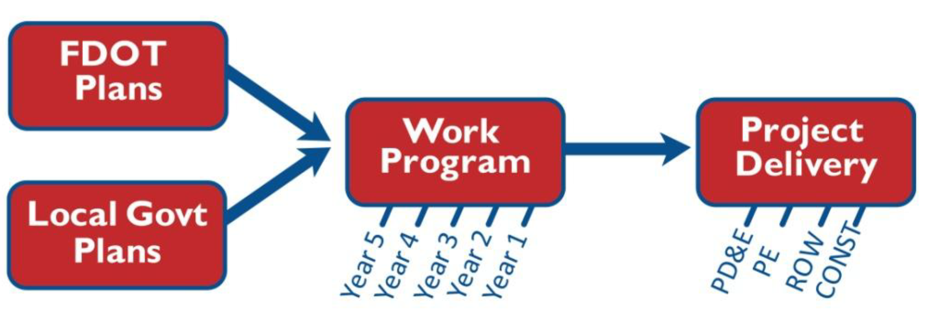
Freight Sub-Area Studies
  FDOT performed planning level studies that assessed freight accessibility to and from each sub-area and develop strategies to enhance access and improve freight mobility. FDOT has completed all Sub-area Freight Improvement Studies.
  FDOT is currently performing one more additional Freight Study that will be countywide and look at various type of updated improvements we can make to our sub-areas. This will be known as the Miami-Dade Freight Village Countywide Analysis.
  This study will serve the purpose of providing a comprehensive updated Project Bank of freight-specific and freight-oriented projects.

Slide 8

Freight Village Countywide Analysis
Provide
Provide an updated profile of the state of freight and logistics in District Six in terms of transportation assets, demand and usage, and programmed improvements.
Describe
Describe the policy, regulatory, and funding framework for freight planning.
Characterize
Characterize history, emerging, and anticipated trends driving freight and logistics activity.
Examine
Examine various freight modal system components as to their resources, current funding, performance, needs outlook, shortfalls, and options and strategies for addressing future requirements.
Devise
Devise potential solutions to identified needs, not just for infrastructure projects, but more broadly in terms of strategies and innovations to meet expected demand and mitigate current shortfalls.
Develop
Develop a project bank of freight infrastructure projects, prioritized based on how effectively each project meets existing and future freight transportation.

Slide 9
Truck Parking

Slide 10
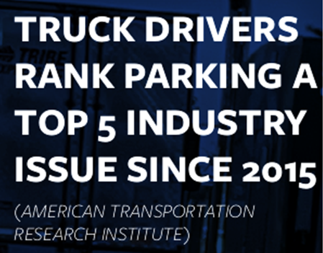
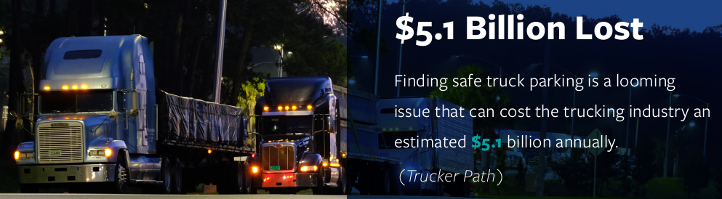
THE TRUCK PARKING CHALLENGE
98% of truck drivers report problems finding safe parking, costing drivers more than 56 minutes of drive time. That wasted time is estimated to cost drivers $5,500 per year – roughly a 12% pay cut. (American Transportation Association and Owner Operator Independent Drivers Association)
58% of drivers say they have parked in unauthorized places at least three times a week. (American Transportation Research Institute

Slide 11
Truck Parking
FDOT completed a Miami-Dade County Truck Parking supply and demand Master Plan in 2022. The objectives were:
Evaluated truck parking supply and needs for Miami-Dade County
Focused on the regional, short-haul truck flows that drive parking demand in South Florida.
Performed an inventory of existing legal and illegal truck parking supply within the County
Forecasted truck parking demand for 2045
Coordinated with stakeholders to get support for parcel development

Slide 12
Truck Parking
Challenges
  Increased use of industrial lands for development of distribution centers –less remaining for truck parking
  Increasing Land values limit truck parking development
  Overflow of truck parking from busy industrial facilities results in unauthorized parking
Opportunities
  County designated lands outside UDB
  Shared use truck parking
  Real-time Truck Parking Availability Systems

Slide 13
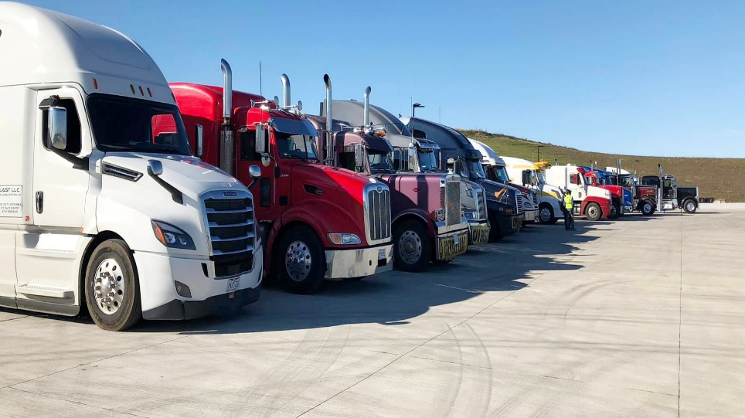
Truck Parking
District Six will continue addressing the goals of the Master Plan
  Site Feasiblity Analysis is a core goal
  Analysis will identify feasible brownfields, industrial, and vacant parcels that could be developed as truck parking facilities
The Study was completed in Spring 2024
  Implementation of Truck Parking site scheduled to in FY 28

Slide 14
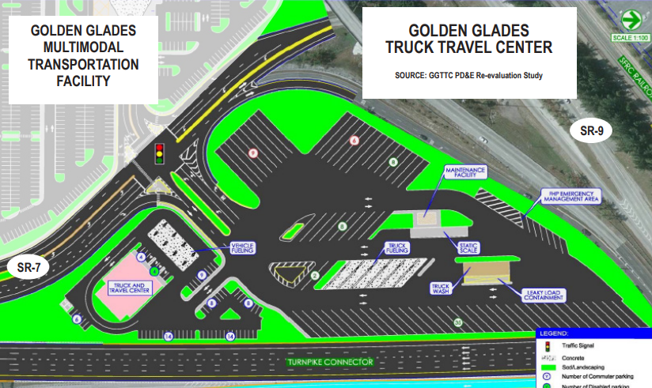
Golden Glades Truck Travel Center
  135 truck parking spaces, fueling stations, travel center, truck repair facility, truck wash, and scale, Truck Parking Availability System (TPAS), security features, and Intelligent Transportation Systems (ITS)
  Scheduled to start construction after completion of Golden Glades Interchange Project
The Wedge Parcel:
  Potential 316 total truck parking spots
  30 EV truck parking.
  Scheduled to start PD&E study 2028

Slide 15
Federal Funding Opportunities

Slide 16
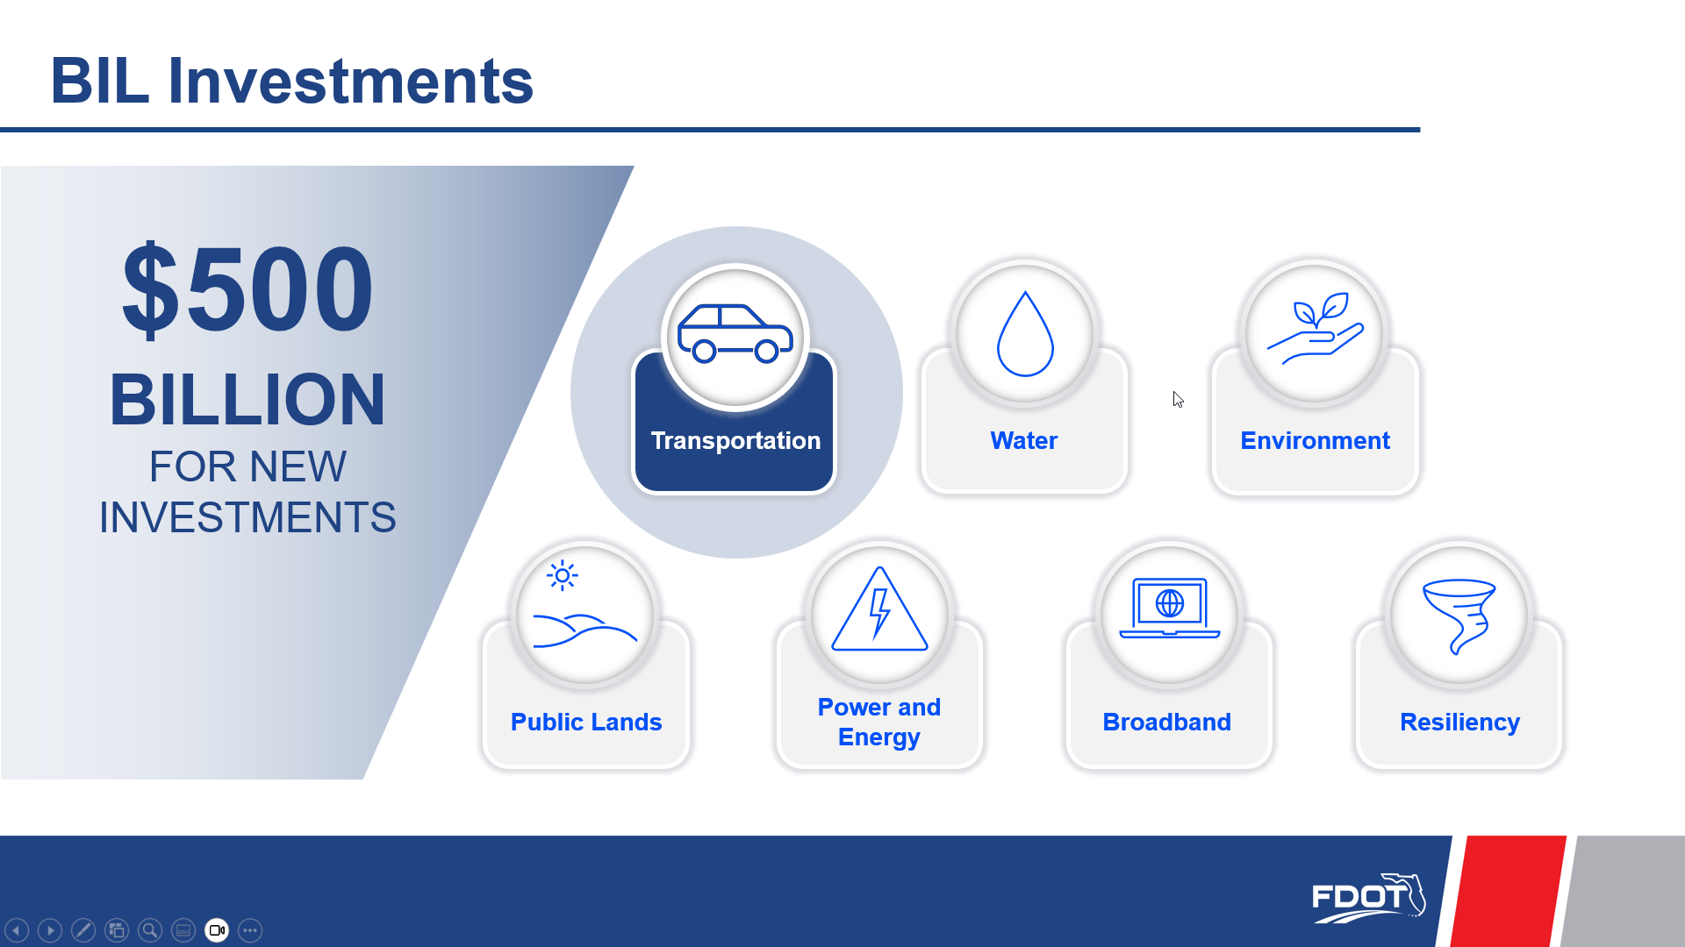
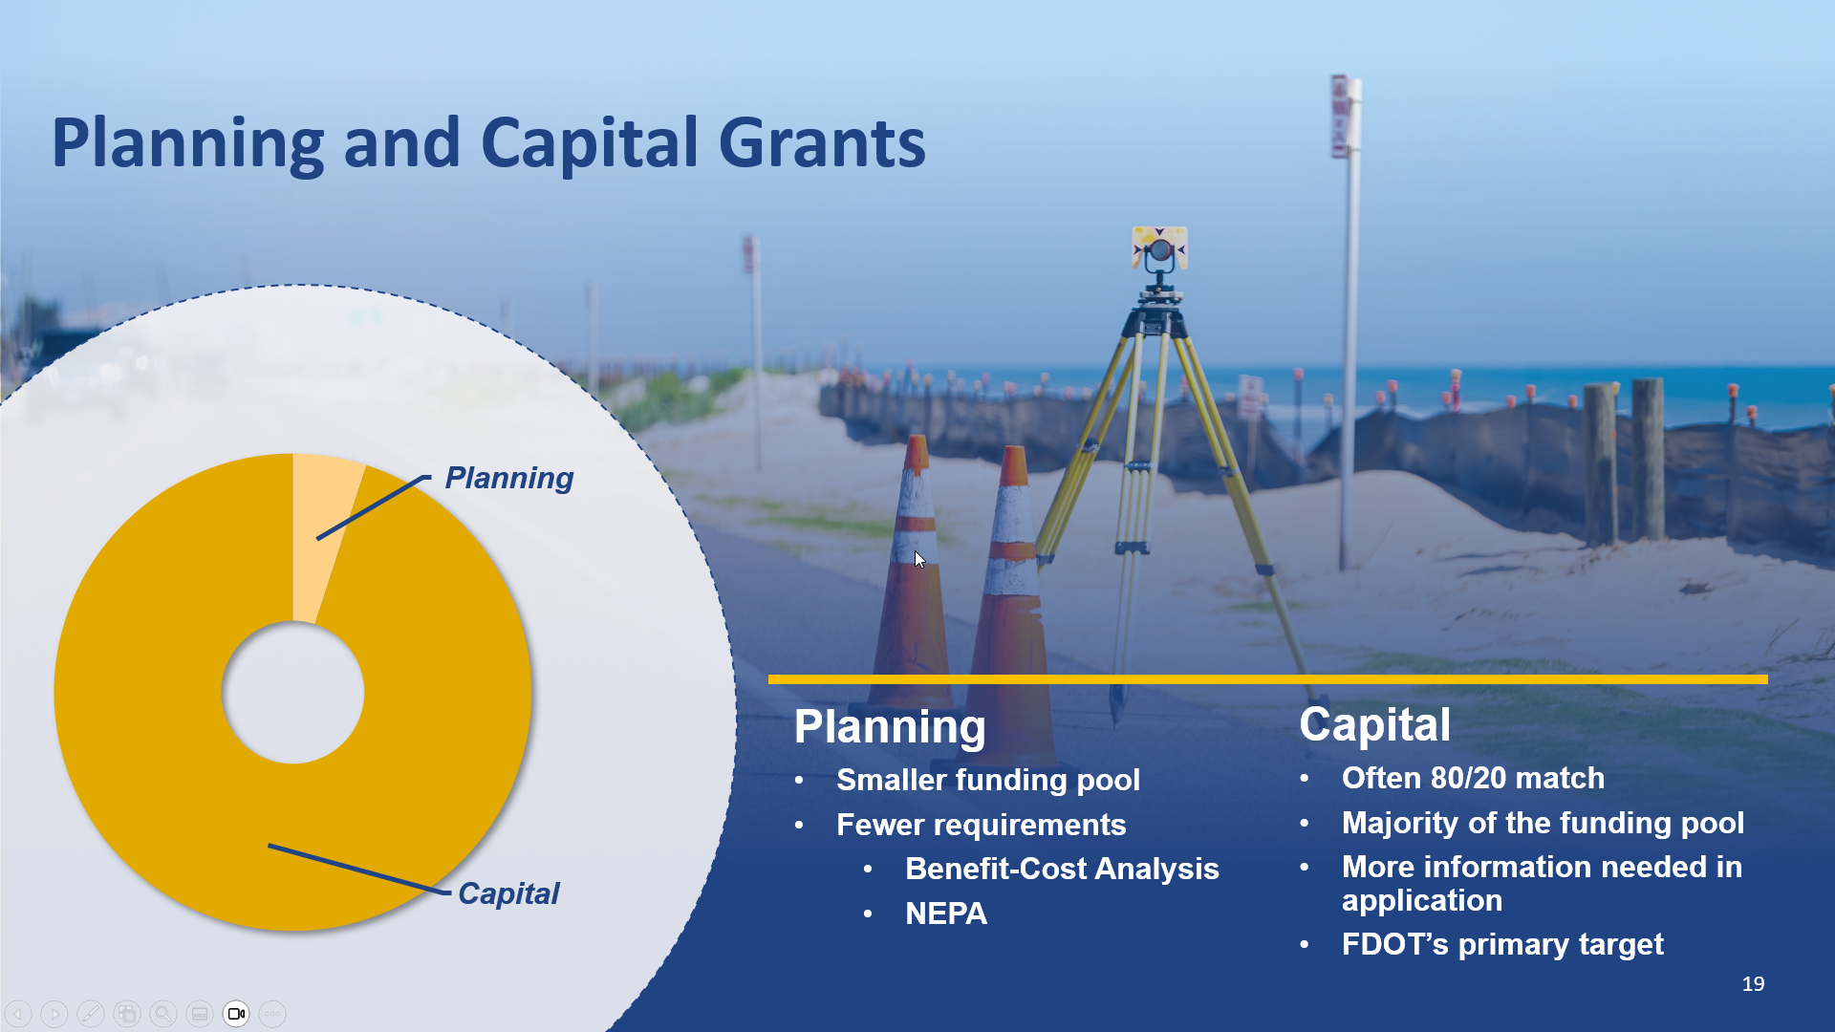
Federal Funding Opportunities
The Bipartisan Infrastructure Law (BIL) includes
  $973 billion in funding over five years from FFY 2022 through FFY 2026,
  $550 billion for new investments for all modes of transportation
Most federal transportation grants are broken into planning and capital grants
  Planning grants may not have a minimum funding amount and may not require a match
  FDOT encourages partners to apply for planning grants and capital grants.
  FDOT generally will only apply for capital grants
Notes:
The planning grant applications are usually a little easier and do not need a Benefit Cost Analysis (BCA).

Slide 17
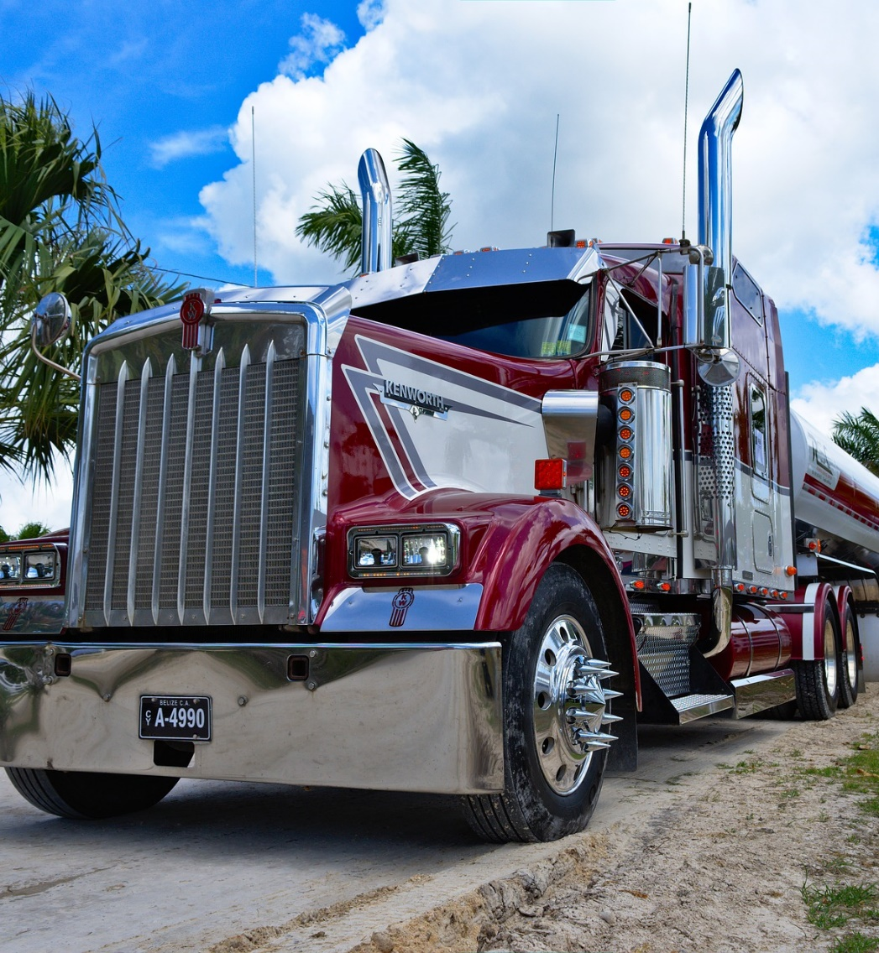
Freight Federal Funding Opportunities
$1.8 billion for the National Infrastructure Project Assistance (Mega) program
$3.1 billion for the Infrastructure for Rebuilding America (INFRA) program
$675 million for the Rural Surface Transportation Grant (Rural) program
Notes:
$1.8 billion for the National Infrastructure Project Assistance (Mega) program: The Mega program supports large, complex projects that are difficult to fund by other means and are likely to generate national or regional economic, mobility, or safety benefits. Eligible projects could include highway, bridge, freight, port, passenger rail, and public transportation projects of national or regional significance. Per the law, 50 percent of funds are available for projects above $500 million in total cost, and 50 percent are available for projects between $100 million and $500 million in total cost.
$3.1 billion for the Infrastructure for Rebuilding America (INFRA) program: The INFRA program awards competitive grants to multimodal freight and highway projects of national or regional significance to improve the safety, accessibility, efficiency, and reliability of the movement of freight and people in and across rural and urban areas. Eligible projects will improve safety, generate economic benefits, reduce congestion, enhance resiliency, and hold the greatest promise to eliminate supply chain bottlenecks and improve critical freight movements.
$675 million for the Rural Surface Transportation Grant (Rural) program: The Rural program supports projects that improve and expand our nation’s surface transportation infrastructure in rural areas in order to increase connectivity, improve the safety and reliability of the movement of people and freight, and generate regional economic growth and improve quality of life. Eligible projects for Rural grants include highway, bridge, and tunnel projects that help improve freight, safety, and provide or increase access to agricultural, commercial, energy, or transportation facilities that support the economy of a rural area. 90% of rural funding must be awarded in $25 million or greater amounts.

Slide 18
National Highway Freight Program Overview

Slide 19

History
In December 2015, the Fixing America’s Surface Transportation Act (FAST Act) was signed into law
  The FAST Act established the new National Highway Freight Program (NHFP)
Notes:
Enacted so States and local governments could move forward with critical transportation projects with confidence that they will have a Federal partner over this term
The FAST Act established the new National Highway Freight Program (NHFP) to improve the efficient movement of freight on the National Highway Freight Network and to improve safety, flexibility, efficiency, and reduce environmental impacts of freight movement in the country

Slide 20

Federal Policy
  Federal Requirements for NHFP
    Establishment of the National Highway Freight Network (NHFN)
      The Primary Highway Freight System (PHFS)
      Critical Rural Freight Corridors (CRFC)
      Critical Urban Freight Corridors (CUFC)
Notes:
The Division Office finds that the Plan contains all elements required by 49 U.S.C. § 70202. The prerequisite in 23 U.S.C. § 167(i)(4) that the state develops a State Freight Plan in accordance with 49 U.S.C. § 70202 before it may obligate funds apportioned to the State under 23 U.S.C. § 104(b)(5) has been satisfied. The State may continue to obligate such funds for projects that meet all National Highway Freight Program (NHFP) eligibility requirements described in 23 U.S.C. § 167, and all other applicable Federal requirements, as identified in the plan.
Please be advised that the Division Office’s finding that the Plan satisfies the requirements of 49 U.S.C. § 70202 and 23 U.S.C. § 167(i)(4) is not a determination that the projects listed in the freight investment plan component of the Plan required by 49 U.S.C. § 70202(b) meet all other NHFP eligibility requirements set forth in 23 U.S.C. § 167, or any other applicable Federal requirement.
Resources:
114th Congress – FAST Act text
FAST Act Freight Provisions – USDOT Factsheet

Slide 21
Statewide Network

Slide 22
FDOT District 6 Network

Slide 23


Requirements for Projects
The project must be on the NHFN
Link to ArcGIS network map
The project must be in the state’s Freight Mobility and Trade Plan (FMTP)
The project must be an eligible project type

Slide 24
Eligible Project Types
1. Development phase and preconstruction activities.
2. Construction, reconstruction, rehabilitation, and operational improvements directly relating to improving system performance.
3. Intelligent transportation systems and other technology to improve the flow of freight.
4. Efforts to reduce the environmental impacts of freight movement.
5. Environmental and community mitigation for freight movement.
6. Railway-highway grade separation.
7. Geometric improvements to interchanges and ramps.
8. Truck-only lanes.
9. Climbing and runaway truck lanes.
10. Adding or widening of shoulders.
11. Truck parking facilities eligible for funding under section 1401 (Jason’s Law) of MAP-21.
12. Real-time traffic, truck parking, roadway condition, and multimodal transportation information systems.
13. Electronic screening and credentialing systems for vehicles.
14. Track signal optimization, including synchronized and adaptive signals.
15. Work zone management and information systems.
16. Highway ramp metering.
17. Electronic cargo and border security technologies that improve truck freight movement.
18. Intelligent transportation systems that would increase truck freight efficiencies inside the boundaries of intermodal facilities.
19. Additional road capacity to address highway freight bottlenecks.
20. Physical separation of passenger vehicles from commercial motor freight.
21. Enhancement of the resiliency of critical highway infrastructure to improve the flow of freight.
22. A highway or bridge project to improve the flow of freight on the NHFN.
23. Any other surface transportation project to improve the flow of freight into and out of an eligible intermodal freight facility.
24. Diesel retrofit or alternative fuel projects.
25. Conducting analyses and data collection related to the NHFP

Slide 25
NHFP Funding

Slide 26
FDOT Statewide
Totals by
Year
Fiscal Year | Estimated NHFP Funding* ** | Estimated NHFP Project Cost *** | Estimated Cumulative Spending
2016 | $53,926,568 | $-
2017 | $51,581,934 | $38,711,324 | $38,711,324
2018 | $56,271,202 | $78,429,007 | $117,140,331
2019 | $63,305,102 | $39,417,950 | $156,558,281
2020 | $70,339,002 | $62,388,661 | $218,946,942
2021 | $69,530,857 | $18,791,915 | $237,738,857
2022 | $65,707,643 | $66,540,501 | $304,279,358
2023 | $67,021,795 | $92,425,049 | $396,704,407
2024 | $68,362,231 | $67,000,335 | $463,704,742
2025 | $69,729,476 | $53,361,508 | $517,066,250
2026 | $70,000,000 | $62,611,063 | $579,677,313
2027 | $70,000,000 | $61,162,124 | $640,839,437
2028 | $70,000,000 | $60,229,759 | $701,069,196
2029 | $70,000,000 | $53,726,602 | $754,795,798
Total | $949,424,734 | $754,795,798
  Expected Statewide funding amount per FY is $70M
    Totals finalized in yearly approval process

Slide 27
FDOT District 6
Totals By
Year
Fiscal Year | Estimated NHFP Funding
2019 | $ 849,478
2020 | $ 500,000
2021 | $ 1,924,665
2022 | $ 464,598
2023 | $ 23,014,024
2024 | $ 8,283,193
2025 | $ 12,590,388
2026 | $ 704,970
2027 | $ 5,720,000
2028 | $ 12,983,000
Total | $ 67,034,316
  Expected Statewide funding amount per FY is $70M
    Totals finalized in yearly approval process

Slide 28
District 6 Totals by type
Work Mix | Total Cost
ADD LANES & RECONSTRUCT | $ 1,968,000.00
ADD LANES & REHABILITATE PVMNT | $ 595,000.00
BRIDGE - PAINTING | $ 704,970.00
BRIDGE-REPAIR/REHABILITATION | $ 1,040,388.00
MODAL SYSTEMS PLANNING | $ 2,645,908.00
OTHER ITS | $ 4,930,000.00
PD&E/EMO STUDY | $ 53,800,572.00
PTO STUDIES | $ 1,349,478.00
Grand Total | $ 67,034,316.00
  Total funding for projects through 2028 is $67M
  13 Projects funded through 2028
    Variety of project types

Slide 29
Project Selection Process

Slide 30
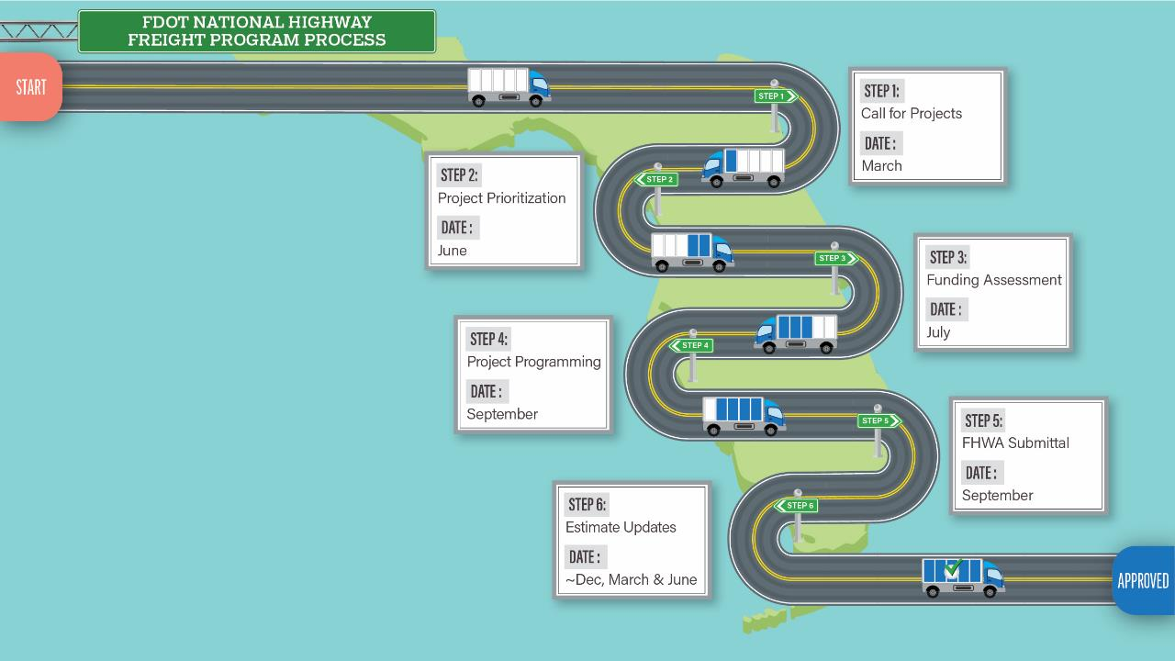
Call for Projects Process
Step 1: Initiate Call
Step 2: Project Prioritization
Step 3: Funding Assessment
Step 4: Project Programming
Step 5: Submittal to FHWA
Call for Projects Process

Slide 31
Scoring and Ranking
  The 2024 FMTP has two parts to the prioritization scoring process
    The quantitative portion is based on geographical/locational factors,
    The qualitative portion weighs a project's ability to affect FRO priorities
  The quantitative score is a GIS-based analysis run in Central Office
  The qualitative score is done as the Districts fill out the excel template for project information
    The template scores the projects’ qualitative criteria in real time. Each "Yes" response requires additional details in the "Project Details" box to receive points

Slide 32
Quantitative
The quantitative score is tied to freight performance measures:
  Truck Injuries/Truck VMT) *1000
  (Truck Fatalities/Truck VMT) *1000
  Crime Index
  Roadways within 100 Year Flood Zones
  Presence of Structurally Deficient Bridges
  Presence of Poor Pavement Condition Segments
  Roadways with Top Bottlenecks
  Truck AADT
  Vicinity to Hubs
  Roadways within Freight Intensive Areas
Labor Force Size (Ratio of labor force by county population relative to average statewide ratio)
County GRP Level (Relative to the average county GRP level in FL)
Transportation and Warehousing Industry Share of Total Employment
County Population Density (Relative to the average county-level population density in FL)
On Designated Alternative Fuels Corridors
Number of Alternative Fueling Stations within 1 Mile of Roadway

Slide 33
Qualitative
The qualitative score weighs a project's ability to effect FRO priorities:
  Does this project implement safety or security enhancements?
  Does this project improve the state’s data gathering efforts?
  Does this project address the environmental or economic resiliency of the freight system?
  Does this project optimize the functionality and efficiency of the freight system?
  Does this project preserve the existing State Highway System?
  Does this project address Truck Parking?
  Does this project create a Grade separation?
  Is this a tech driven and/or TSM&O project?
  Does this project improve multimodal freight connectivity?
  Does this project use public/private partnerships?
  Does this project capitalize on emerging freight trends?
  Is this project on the MPOAC freight project list?
  Does this project promote the use of LNG/CNG/electric vehicles?

Slide 34
What to do if your project is not on the NHFN ?
Baseline Requirement
  Only real requirement is: “Is the segment determined by the State to be vital to improving the efficient movement of freight of importance to the economy of the State”
  Does your Off-Network project meet this requirement?
    If so, we can redesignate the CUFC-CRFC
Redesignating CUFC-CRFC
  By redesignating the CUFC-CRFC sections, off network projects can be brought into the network
How to know if Project will score well
  We have created a dashboard that shows scores of roadways near NHFN
    Potential NHFN Critical Freight Corridors (arcgis.com)

Slide 35
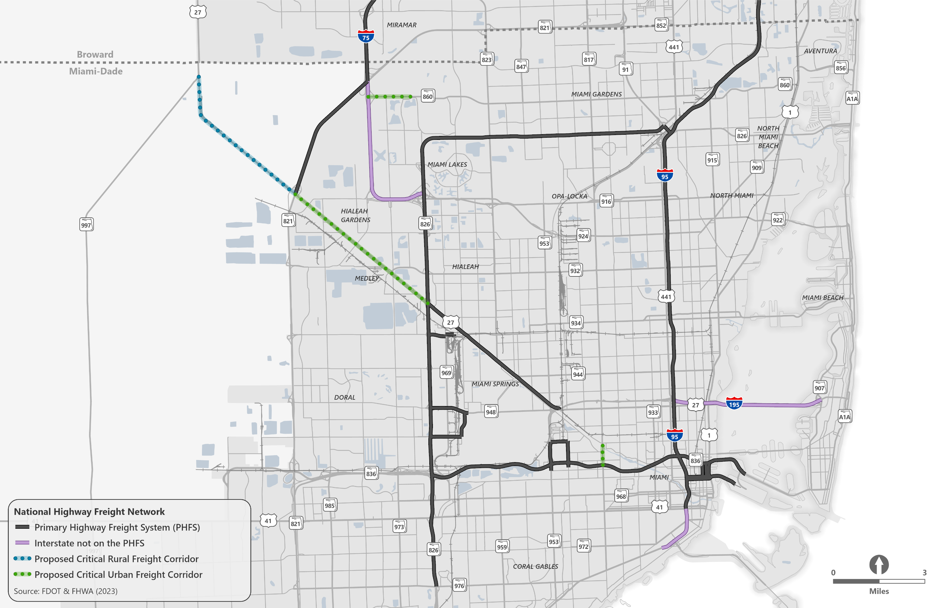
Network Designation
FDOT District 6 is one of the first Districts to submit projects off the active network to have it updated.

Slide 36

Questions?
SAFETY MESSAGE
Hurricane season began on June 1st
Be sure to have a plan for you and your family's safety
Create a disaster supply kit and keep it ready
  Ensure that all supplies are effective and not expired
Know the safe areas within your home and understand which flood zones you are in
  Understand the evacuation routes and plan for their use
And of course, stay safe

Slide 37
Questions?

