Slide 1
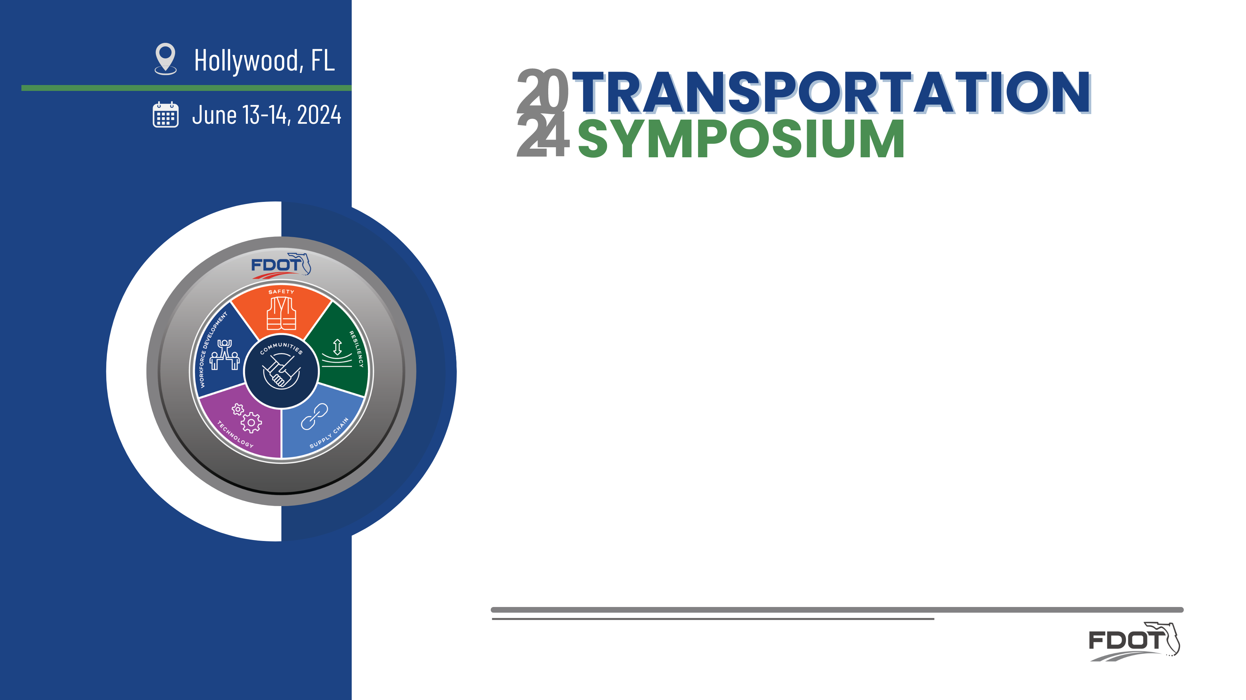
Signal4 Analytics for Safety Analysis
Benjamin Jacobs, Crash Records and Research Administrator
FDOT State Safety Office, Crash Records and Research Section

Slide 2
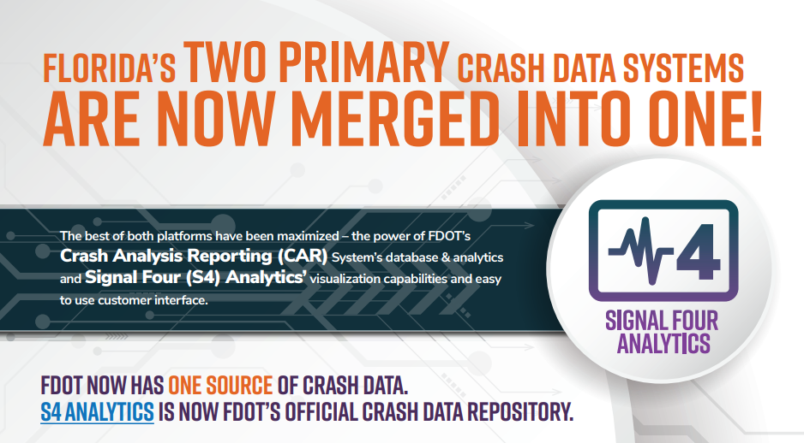

Signal4 Analytics for Safety Analysis

Slide 3
Objectives:
Overview
  CAR System Legacy
  Signal4 Analytics
  Merging of databases
  Who can use Signal4?
  Public dashboard
  Tools inside the log-in
    Crash data query and filtering
    Network analyses
Examples:
  Overview
    Planning
    PD&E
    Design
    Construction
  Data Guidance and Steps

Slide 4
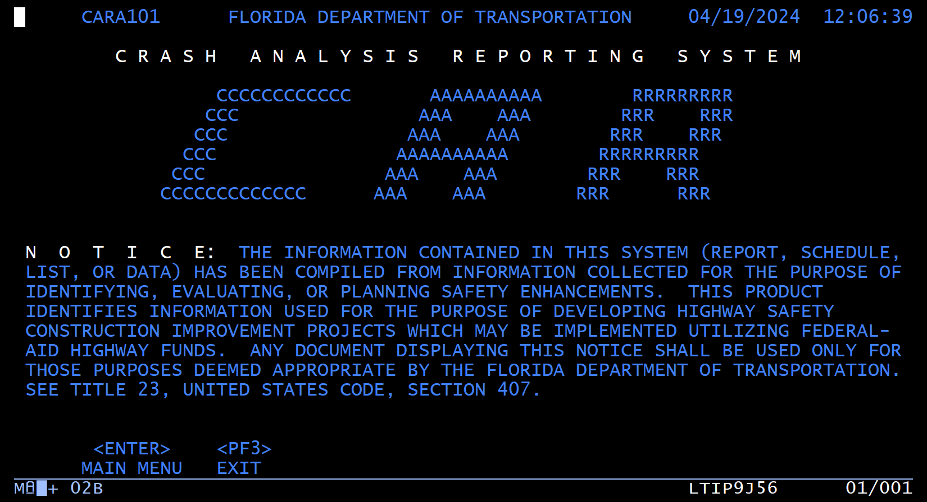
CAR System Legacy
R.I.P.
Crash Analysis Reporting System
1995-2024

Slide 5
CAR System Legacy
DB2
COBOL
CICS
GIS
Patrick Brady, P.E. 1950-2008
FDOT roadway inventory data
Crash data entry and processing
Network Analysis
Crash search and results output
Notes:
CAR System development
IBM DB2 database
COBOL, with CICS interface
GIS was not supported
Architect was Patrick Brady, P.E. 1950-2008 https://www.legacy.com/us/obituaries/tallahassee/name/patrick-brady-obituary?id=7925185
Started as roadway data entry and capture
Incorporated crash data capture and processing
Added tools for crash reporting and network analysis

Slide 6
Signal4 Analytics: What is it?
Integrates crash data through an interactive web-based platform developed by and hosted at University of Florida, Geoplan Center.
Creates both spatial and non-spatial data downloads for users.
Supports the crash mapping and analysis needs of law enforcement, traffic engineering, transportation planning agencies, and research institutions in the state of Florida.

Slide 7
Signal4 Analytics: Developed through TRCC
Signal4 Analytics was created to improve accessibility and utilization of crash data in Florida by creating a web-based GIS analytical system for analysis and reporting of traffic crashes statewide.
2006
2008
2010
2011
2020
2022
Crash Data Management System for Palm Beach County
Expanded to Regional system, for Metroplan Orlando
Expanded to statewide, all crash data from FLHSMV
Selected to replace FDOT Crash Analysis Reporting (CAR) system, modified for FDOT use
Added Miami-Dade, Martin & Alachua Counties, hosted at U.F.
Received grant from the state Traffic Records Coordinating Committee to expand to statewide system with FL Highway Patrol data
FDOT official transition to Signal4
Notes:
2006: originally developed as web-based CDMS for Palm Beach County
Expanded to include more counties, hosted at UF.
Expanded to regional system for Metroplan Orlando.
2010: The first full version of Signal4 Analytics was developed with grant funds from TRCC. Expanded to statewide, using FHP crash data.
2011: Began incorporating all crash data, statewide.
Original goal was to improve accessibility and utilization of crash data in Florida by creating a web-based GIS analytical system for analysis and reporting of traffic crashes statewide.
Eventually this was expanded to include citations.

Slide 8
S4 and CAR: Merging of databases
FDOT data fields and historical data from the Crash Analysis Reporting database have been transferred to the Signal4 database
Signal4 is now the database of record for FDOT crash data

Slide 9
Signal4 Analytics : FLHSMV data loaded to S4
New and updated crash data are transferred daily from FLHSMV
Preliminary locations are completed and reportable within 24 hours
FDOT changes become visible within 24 hours of update
Law Enforcement Information on Crash Report and Citation
FDOT Map and Roadway and Traffic Information
FLARIS database
Annual from Department of Transportation
Crash Data
FL HSMV 900105
Daily from Department of Highway Safety and Motor Vehicles
Citation Data
Uniform Traffic Citation
Daily from Florida Court Clerks & Comptrollers
Signal Four Analytics
Mirror Data Element
As received from DHSMV and FCCC
Derived Data Element
From elements received from DHSMV and FCCC
S4 Developed Elements
Mapped Crashes, Bicycle Typing, Pedestrian Typing
FDOT Additional Elements
Roadway Inventory, Crash Event Evaluation, Network Screening
Signal Four Analytics Users

Slide 10
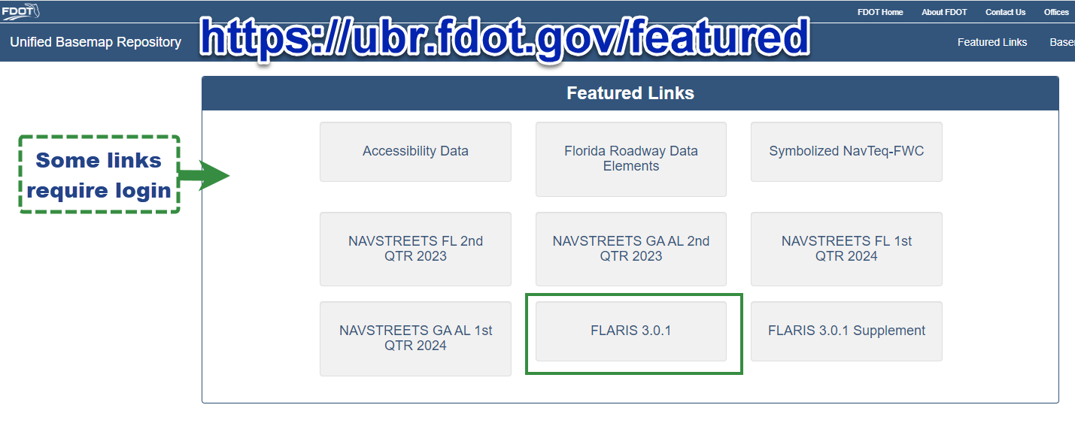
S4: FDOT reference map – FLARIS & ARBM
FDOT Map and Roadway and Traffic Information
FLARIS database
Annual from Department of Transportation
FL A R I S: Florida All Roads, Intersections, and Streets database
A R B M: All Roads BaseMap dataset
Notes:
FDOT State Safety Office generates a Florida all public roads dataset (FLARIS) and Signal4 incorporates this map as its basemap for geolocation and as its roadway data source. FLARIS includes roadway characteristic inventory (RCI) data for all FDOT roads and covers all public roads. It uses the commercial HERE dataset to incorporate the local roads that are not in the RCI.

Slide 11
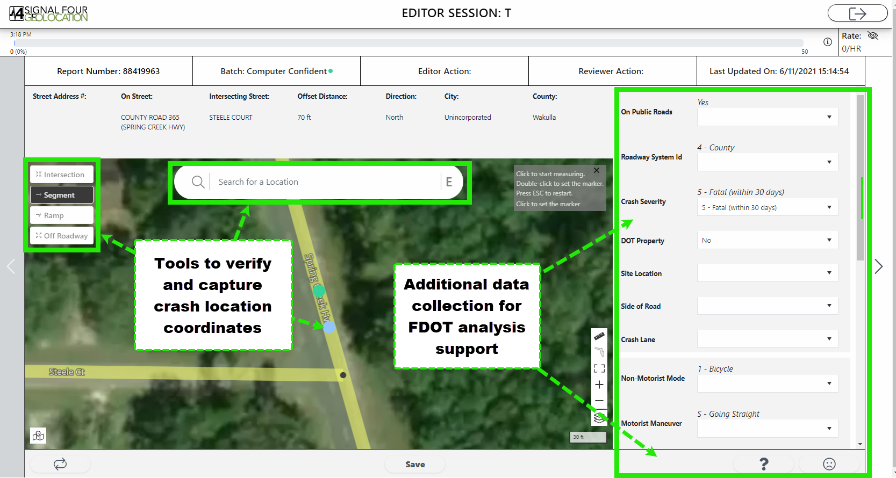
S4: Adapted for FDOT needs
FDOT Additional Elements
Roadway Inventory, Crash Event Evaluation, Network Screening
S4 Geolocation tools adapted for FDOT data collection
Notes:
DOT Geolocation Tool (DGT) application allows staff to review and update officer-plotted and system-plotted locations; allows for collection of additional information not included in the original crash report form.

Slide 12
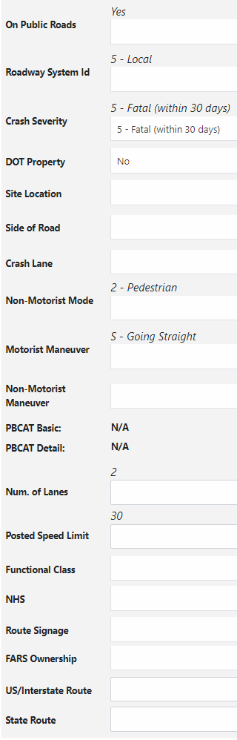
S4 post-processing: FDOT value-added data
FDOT Additional Elements
Roadway Inventory, Crash Event Evaluation, Network Screening
FDOT
analyzes each crash report
collects additional data – added to the Signal4 database for each crash
Updated or added for all crashes
Updated or added for ped & bike crashes
Updated or added for fatal crashes
Notes:
FDOT editors add information about the roadway (including information needed for reporting to the NHTSA Fatality Analysis Reporting System (FARS)), whether FDOT property was damaged in the crash, the precise location of the crash event on the roadway, and pedestrian/bicycle crash analysis typing information.

Slide 13
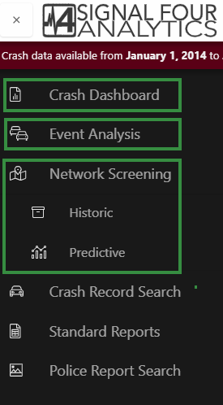
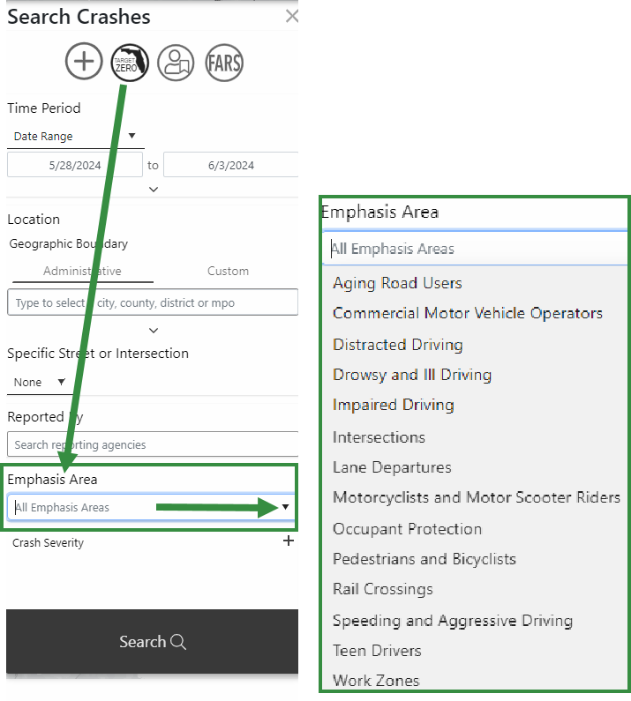
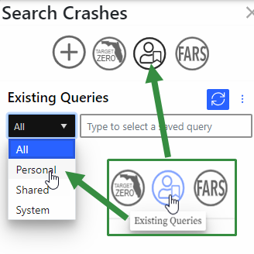
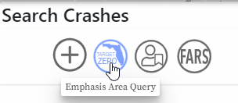
S4 post-processing: FDOT value-added data
FDOT Additional Elements
Roadway Inventory, Crash Event Evaluation, Network Screening
Notes:
Once crash locations are reviewed, corrected, and verified, and after the additional data are collected for each crash, the Signal4 system provides FDOT-driven analyses and analysis tools. It performs sets of annual network screening output for segment-based and intersection-based crash rates and frequency, using both historic and predictive crash rate analysis methods. It provides predetermined crash type filtering for standard crash types and categories. And it allows users to create sets of location criteria and filter criteria and save them for re-use and sharing.

Slide 14
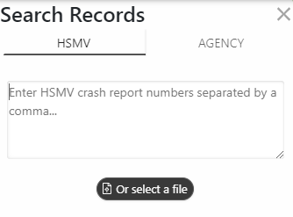
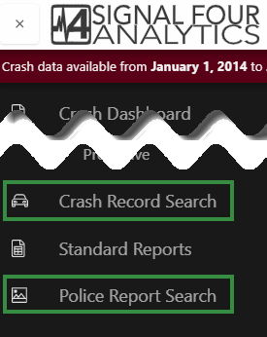
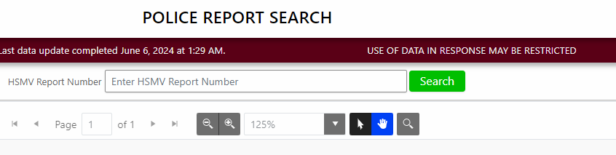
S4: Crash report lookup
Crash reports are linked from the data grid in the query results, or they can be searched by document number
Notes:
For authorized users, Signal4 provides ta crash report document lookup that views the reports directly from the FLHSMV database. The crash report searches require that you know the HSMV report number or the reporting agency document/report number.

Slide 15
Crash Reports: Personally-Identifying Information
Personal information (PII) | Driver Privacy Protection Act (DPPA) 18 U.S.C. s. 2721(3) “information that identifies an individual, including an individual’s photograph, social security number, driver identification number, name, address (but not the 5-digit zip code), telephone number, and medical or disability information, but does not include information on vehicular accidents, driving violations, and driver’s status”
Home or employment telephone number | Title XXIII F.S. s. 119.071(4)(d)1.c. “includes home telephone numbers, personal cellular telephone numbers, personal pager telephone numbers, and telephone numbers associated with personal communications devices”
Home or employment address | Title XXIII F.S. s. 119.071(4)(d)1.a. “the dwelling location at which an individual resides and includes the physical address, mailing address, street address, parcel identification number, plot identification number, legal property description, neighborhood name and lot number, GPS coordinates, and any other descriptive property information that may reveal the home address”
Driver license or identification card number
Date of birth
Other personal information | Title XXIII F.S. s. 119.071(5) – includes social security number; ss. 119.071(5)(b) – includes bank account numbers and debit, charge, and credit card numbers
Notes:
The statute language specifically limits reports or data containing personally identifying information. The information under this category is explicitly listed in the statute.

Slide 16
Crash Reports: Confidentiality of PII
Reports with PII
    Can be shared immediately with certain parties (listed in statute)
    Can be shared after 60 days with parties applying for access for “permissible uses” as defined in 18 U.S. Code s. 2721(b)
    Are not available except to those defined above
Reports with PII removed (redacted) are not directly addressed in the statute
“Crash reports that reveal the identity, home or employment telephone number or home or employment address of, or other personal information concerning the parties involved in the crash and that are held by an agency, as defined in s. 119.011, are confidential and exempt from s. 119.07(1) and s. 24(a), Art. I of the State Constitution for a period of 60 days after the date the report is filed.” (s. 316.066(2)(a), F.S.)

Slide 17
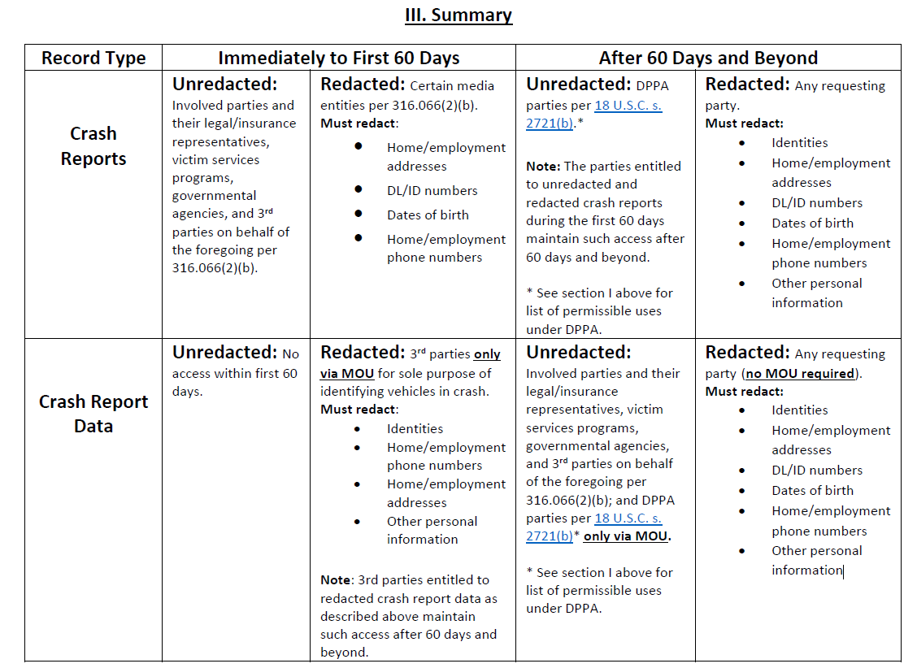
FLHSMV Data: Statutory access restrictions
Protect personal information
2 groups restricted: (1) crash reports (all) and (2) crash data less than 60 days before the current date (s. 316.066(2)(g), F.S.)
1
See Title XXIII section 316.066 Florida Statutes
2

Slide 18
Crash Data Responsibility
Any person or agency who has copies of or access to the data and/or documents has the same responsibility to maintain its confidentiality as the FLHSMV.
Includes legal and civil liability for misuse of the data that are shared
Must sign a Memorandum of Understanding (MOU) that stipulates:
may not share the data with anyone who is not eligible to receive it under law
may not sell the information to a third party

Slide 19
Who can use Signal4 Analytics?
Signal4 Analytics login
General Public
Public Agency Employee
Only available to public agencies (government and law enforcement)
Press/ Media
Academic/ Researcher not working with Public Agency
Consultant under contract w/ Public Agency
Academic/ Researcher working with Public Agency on publicly-funded project
Vendor/ Consultant not under contract

Slide 20
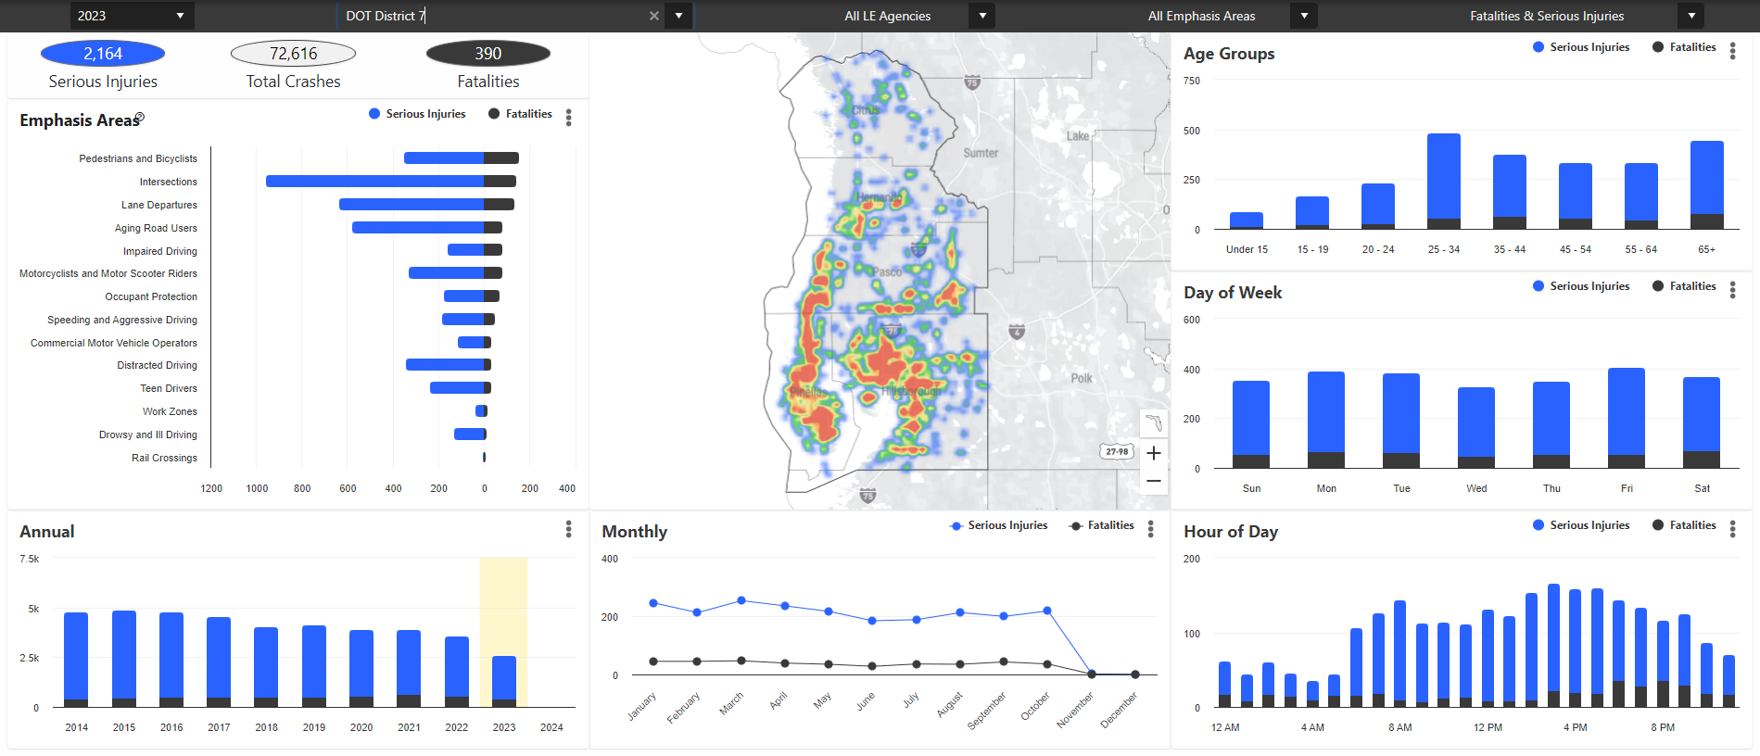
Signal4 Analytics Public Dashboard
https://signal4analytics.com/
General Public
General Public
Press/ Media
Press/ Media
Academic/ Researcher not working with Public Agency
Academic/ Researcher not working with Public Agency
Vendor/ Consultant not under contract
Vendor/ Consultant not under contract
Notes:
- Dashboard is publicly available.
- Controls under the banner at the top of the window allow for limited filtering of the aggregated crash data.
- By law, crash data are confidential for 60 days after a crash report is filed, so the data available in the dashboard will always lag by about 70 days from the current date. 70 days is up to 10 days that law enforcement is allowed to complete and file an initial crash report plus 60 days confidentiality after the report is filed.

Slide 21
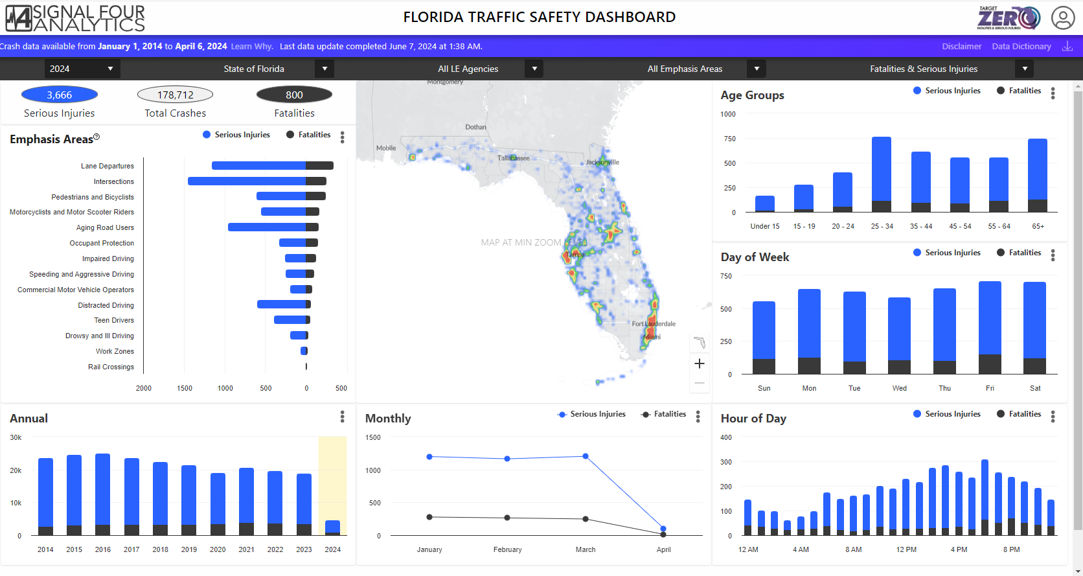
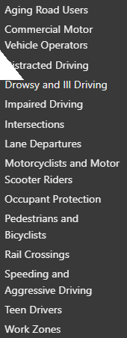

S4 Dashboard: SHSP Emphasis Area filters
Strategic Highway Safety Plan (SHSP)
Data definitions on pages 48-49
Notes:
The statistics displayed are for traffic crashes and associated fatalities and serious injuries.
The public dashboard allows the user to filter the data displayed by
- year
- geographic area (state, county, city, MPO)
- reporting agency
- Strategic Highway Safety Plan emphasis area (crash type or category)
- toggle between fatal, serious injury, or both
SHSP document can be found at: https://fdotwww.blob.core.windows.net/sitefinity/docs/default-source/safety/shsp-2021/shsp_mar21.pdf?sfvrsn=5452dad_0

Slide 22
S4 Tools Inside the Log-in
Authorized users can access
additional search filters
individual crash data
crash rate analyses
Click the user icon to log in

Slide 23
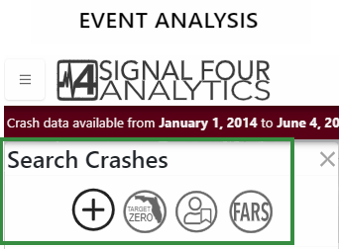
S4 Tools: Crash data query and filtering
General Queries
Target Zero Reporting
Fatal Crash Reporting
Saved Queries

Slide 24
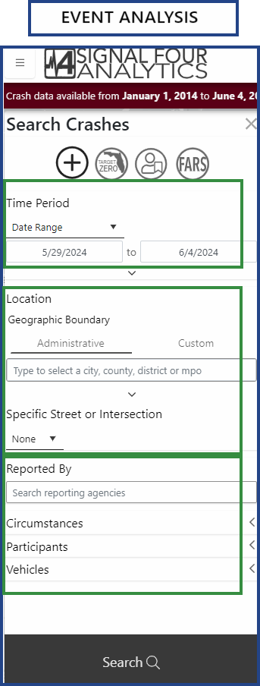
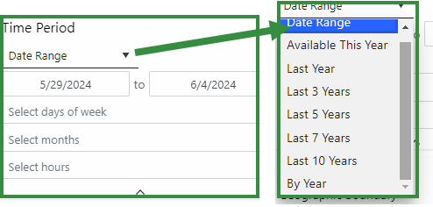
S4 Tools: Crash data query and filtering
Screen by
Date Range

Slide 25
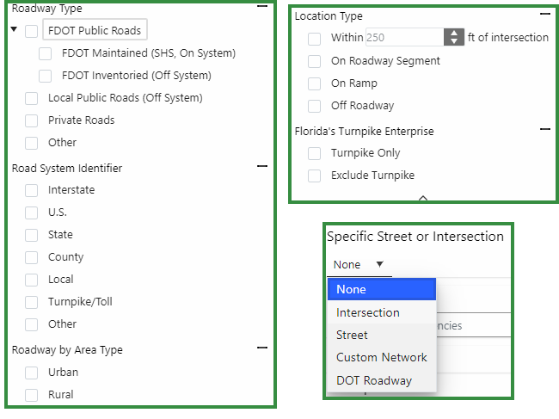
S4 Tools: Crash data query and filtering
Screen by
Date Range
Location

Slide 26

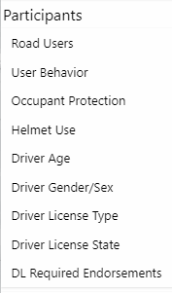
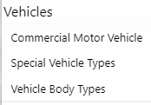
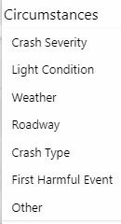
S4 Tools: Crash data query and filtering
Screen by
Date Range
Location
Filter Options

Slide 27
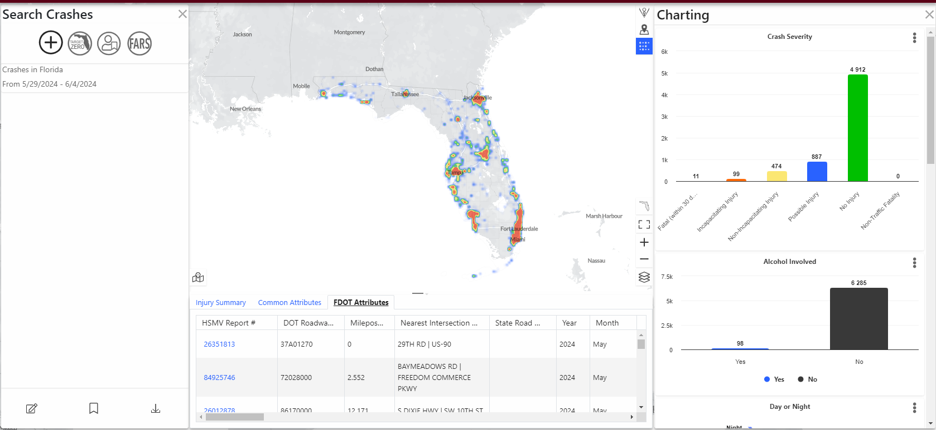
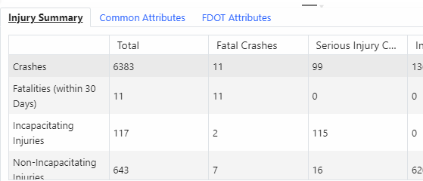
S4 Tools: Data Grid – Crash Listings

Slide 28
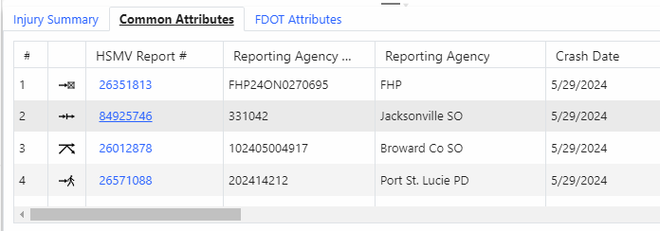
S4 Tools: Data Grid – Crash Listings

Slide 29
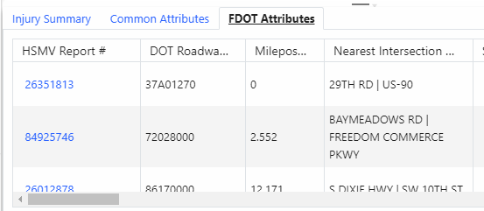
S4 Tools: Data Grid – Crash Listings

Slide 30
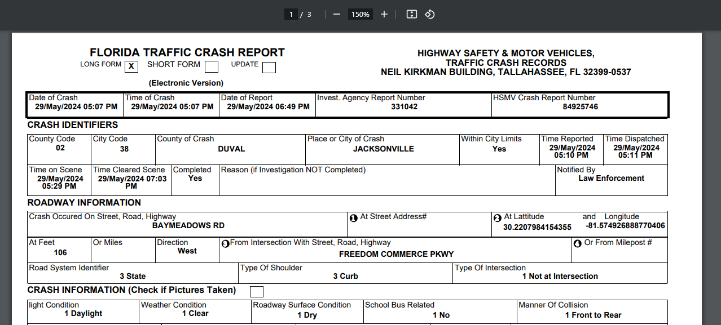
S4 Tools: Link to Crash Reports
Click crash report number to link to document

Slide 31
S4 Tools: Data Visualization
Several charts generated, scroll for more

Slide 32
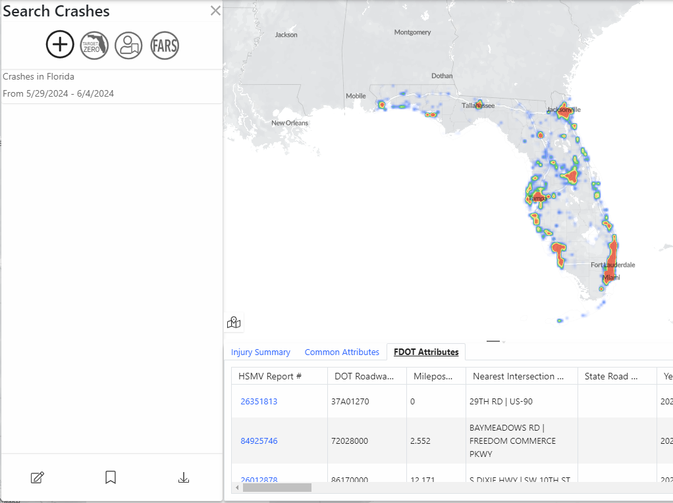



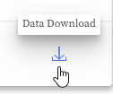
S4 Tools: Save and Edit Queries, Download Data

Slide 33
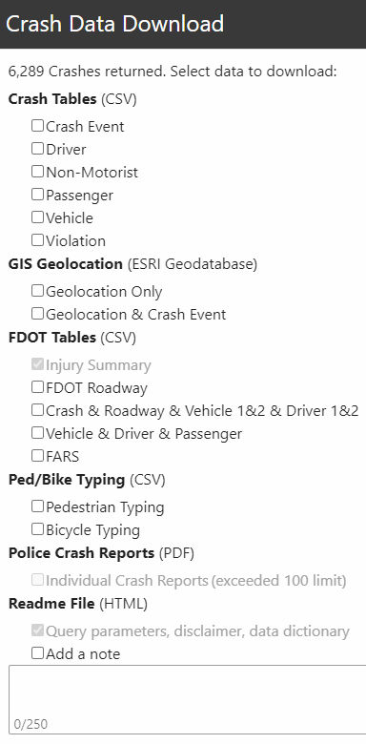
S4 Tools: Data Download Formats
Available Downloads include:
Crash Tables (CSV)
GIS Geolocation (ESRI Geodatabase)
FDOT Tables (CSV)
Ped/Bike Typing (CSV)
Police Crash Reports (PDF)
Readme File (HTML)

Slide 34
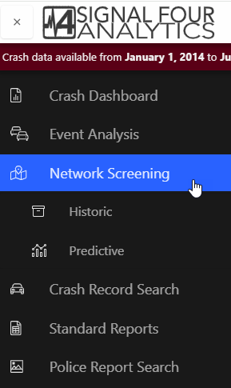
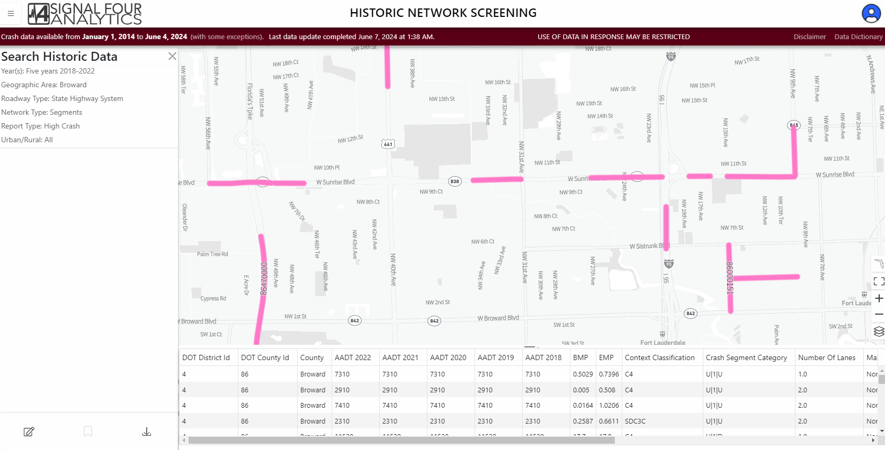
S4 Tools: Network Analyses
Historical Crash Rate Analysis
Predictive Crash Rate Analysis

Slide 35
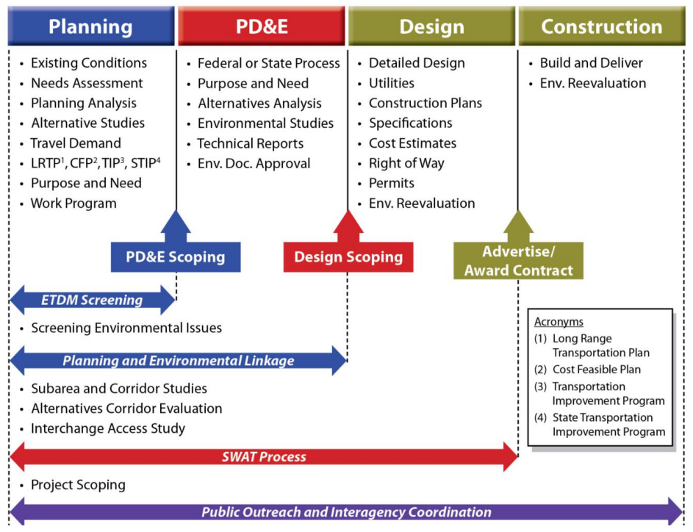
Safety Analysis
Notes:
Safety Analysis can (and should) occur at different parts of the project development process.
Highlighted are some examples of key areas within Planning, PD&E, and Design where safety analysis is considered and evaluated.

Slide 36
Safety Analysis
Notes:
Different types of safety studies may be required for different types of projects, and the study requirements can vary across study types.

Slide 37
Safety Analysis
Operations & Maintenance
Intersection Safety Studies
Corridor Safety Study
Intersection Control Evaluation (ICE)
Pedestrian & Bicycle Study
Transit Stop Evaluation
High Crash List
Fatal Crash Reviews
RRR Evaluation
…and More!
Notes:
Even after a project is constructed, facilities can still be subject to various types of safety studies as part of Operations and Maintenance.
As a key part of FDOT’s mission and a core element in the Compass, safety will always be a critical element in the work we do. Depending on the type of project you have or where you are in the project’s lifecycle, there may be nuances to the specific requirements of a given project’s safety analysis.

Slide 38
Examples of Various Requirements
PD&E Study
Design Exception / Variation (FDM 122)
Intersection Control Evaluation (ICE)
Data driven safety analysis (e.g., analyzing historic crash data and applying HSM methods) should be used to the extent practicable to quantitatively assess safety performance of project alternatives.
5 years of historical crash data.
Description of anticipated impact on safety, long and short-term effects, and any anticipated cumulative effects.
Comparison of predicted or expected crash frequency.
Safety Performance for Intersection Control Evaluation (SPICE) Tool, which includes two complimentary approaches to safety analysis:
  Crash prediction method
  Safe System for Intersections (SSI) method
Notes:
Here are 3 examples of the written requirements for safety evaluations – for PD&E Studies, Design Exceptions or Variations, and an Intersection Control Evaluation, or ICE.
Note a PD&E study should include data driven analysis, including application of the Highway Safety Manual (HSM) predictive methods, to the extent practicable. The analysis focused on the ability to quantitatively assess safety performance of project alternatives and to be able to compare the safety performance across alternatives (among other performance measures).
The safety analysis associated with a design exception or variation is going to be location specific and oftentimes focused on a particular crash type or safety effect that may be associated with the design feature of interest.
For ICE, FDOT has developed a specific tool to aid in the required safety analysis called SPICE – or Safety Performance for Intersection Control Evaluation. The SPICE tool considers historical crash data, traffic volumes, and traffic volume forecasts to compare the safety performance of the various intersection alternatives. In addition to crash prediction, SPICE also incorporates the Safe System for Intersections (SSI) method which focuses on conflict types and vulnerable road user conflicts to assess an intersection alternative’s propensity for crashes involving severe injuries and fatalities.
While the specific nuances of these 3 requirements may differ, you will see that all require historic crash data and all desire to produce data driven safety analysis that results in quantitative insights for project decision making.

Slide 39
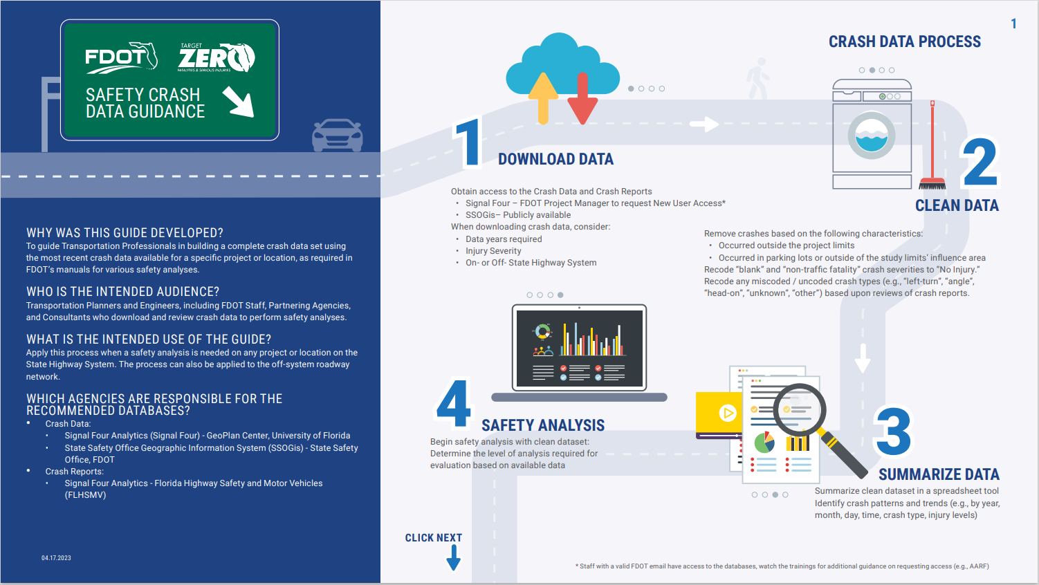
Manuals Providing Guidance On the Use of Crash Data
FDOT Highway Safety Manual User Guide
Project Development and Environment (PD&E) Manual
Interchange Access Request Safety Guidance
Access Management Guidebook
FDOT Design Manual (FDM)
Speed Zoning Manual
Manual on Uniform Traffic Studies (MUTS)
Traffic Engineering Manual (TEM)
Intersection Control Evaluation (ICE) Manual
FDOT Crash Data Guidance
Notes:
There are a variety of manuals and guidebooks that address how to conduct the required or recommended safety analysis, again depending upon type of project you have or where you are in the project’s lifecycle.
No matter where you are in that process, the State Safety Office produced the FDOT Crash Data Guidance to assist you with detailed instructions on gathering the appropriate crash data to begin your analysis.

Slide 40
FDOT Crash Data Guidance
Notes:
The crash data guidance was developed to guide transportation professional in building a complete crash data set using the most recent data available for a specific project or location as required in FDOT’s manuals for various safety analyses. The guide is readily available on the safety engineering website.

Slide 41
FDOT Crash Data Guidance
Notes:
The first step is to *click* download data

Slide 42
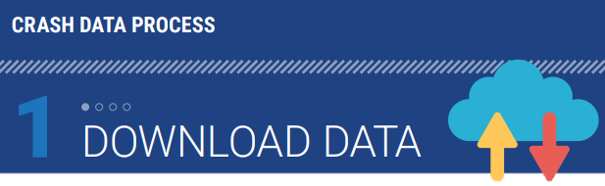
FDOT Crash Data Guidance
How do you access crash data?
How do you pull crash reports?
Signal 4 Analytics - Pre-approval needed for non-FDOT staff
SSOgis – Open to the public
Available on Signal 4 Analytics
Use the unique crash numbers
How do you define project limits?
How many years of crash data should be downloaded?
Intersection: turn lane extent or minimum 0.1mile from center of intersection
Segment: recommended minimum length is 0.2 miles
Pull last five (5) full calendar years and the partial year up to the day before the crash data is available
Notes:
When downloading the data you are going to want to ask four major questions
How do you access crash data, How do you pull crash reports? How do you define project limits? and How many years of crash data should be downloaded?
*click*
There are two resources for downloading data – Signal4 which requires FDOT access, and SSOgis which is open to the public
*click*
Crash reports are available on Signal 4 analytics using the unique crash numbers
*click*
Your project limits for an intersection includes the turn lanes extents, or a minimum of 0.1mile from the center of the intersection. The recommended minimum length for a segment is 0.2miles.
*click*
You should pull the last five (5) full calendar year and the partial year up to the day before the crash data is avialable

Slide 43
FDOT Crash Data Guidance
Notes:
After downloading the data, the next step is to *click* clean the data

Slide 44

FDOT Crash Data Guidance
How is crash data cleaned?
Based on location
Based on crash attributes for safety analysis
Non-public roadways
Crash Severity
Crash type interpretation
Outside of project limits
Notes:
The process of cleaning crash data can be divided into two categories, based on location and based on crash attributes:
Remove crashes that occurred in parking lots, forest roads, or private roadways, or outside of the influence area.
Use GIS and/or the crash-specific roadway ID and milepost to determine if a crash occurred outside the influence area.
Recode crash severity from blank or “non-traffic fatality” to “No Injury”. A crash severity level is coded as a zero when person-level injury data was not reported. A crash severity level is coded as a non-traffic fatality when the only injury reported in the crash is a fatal not related to traffic (e.g., heart attack).
To verify crash types are coded correctly, review crash reports for all or specific crash types.

Slide 45
FDOT Crash Data Guidance
Notes:
After cleaning the data, the next step is to *click* summarize the data

Slide 46
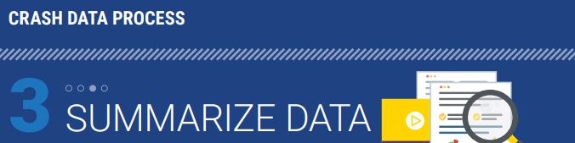

FDOT Crash Data Guidance
How should crash data be summarized?
Crashes by Year and Severity
Crashes by Type and Severity
Crashes by Lighting Condition and Severity
Crashes by Pavement Condition and Severity
Collision Diagram
Crashes by SHSP Emphasis Area
Notes:
How should crash data be summarized? There are a couple of ways…

Slide 47
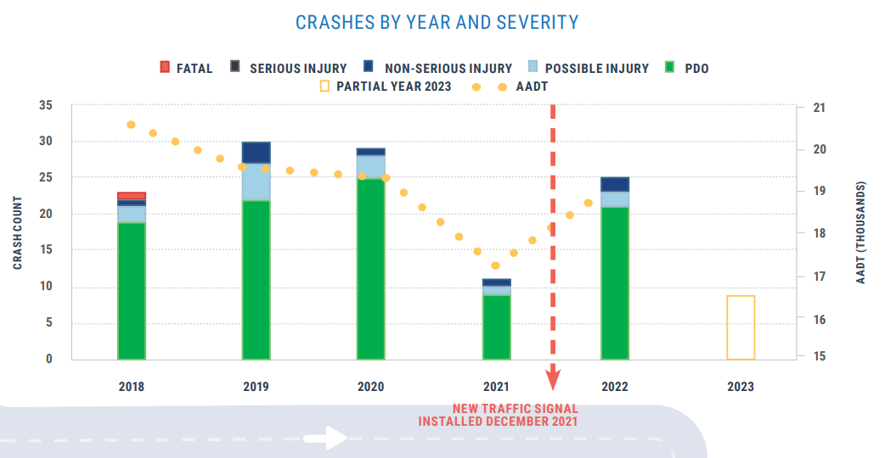
FDOT Crash Data Guidance
How should crash data be summarized?
Crashes by Year and Severity
Crashes by Type and Severity
Crashes by Lighting Condition and Severity
Crashes by Pavement Condition and Severity
Collision Diagram
Crashes by SHSP Emphasis Area
Notes:
Crashes can be summarized by year and severity

Slide 48
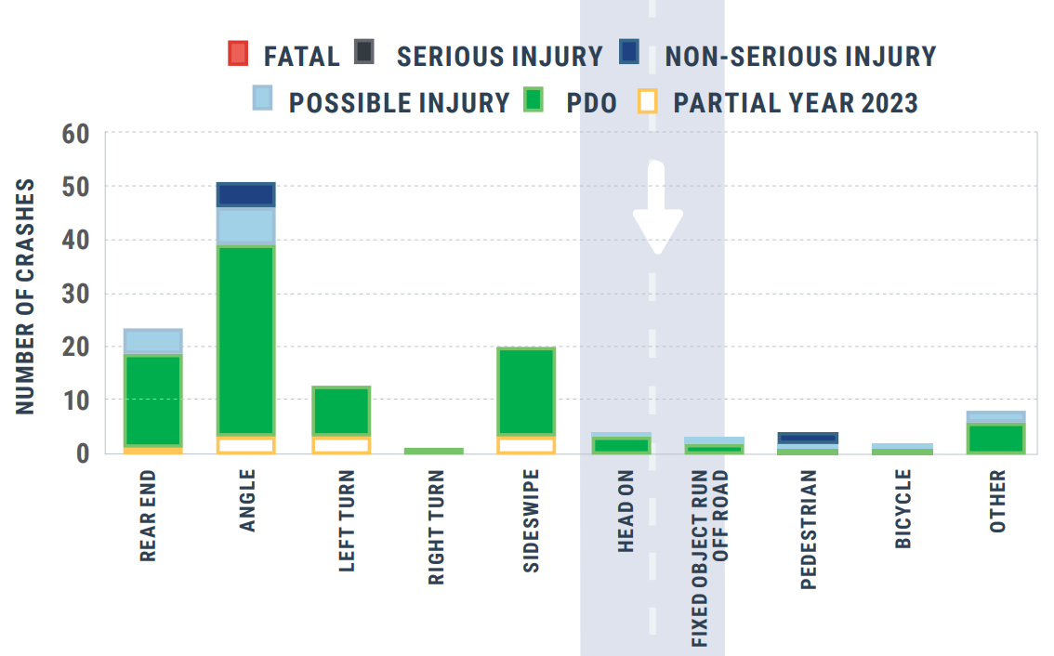
FDOT Crash Data Guidance
How should crash data be summarized?
Crashes by Year and Severity
Crashes by Type and Severity
Crashes by Lighting Condition and Severity
Crashes by Pavement Condition and Severity
Collision Diagram
Crashes by SHSP Emphasis Area
Notes:
By type and severity

Slide 49
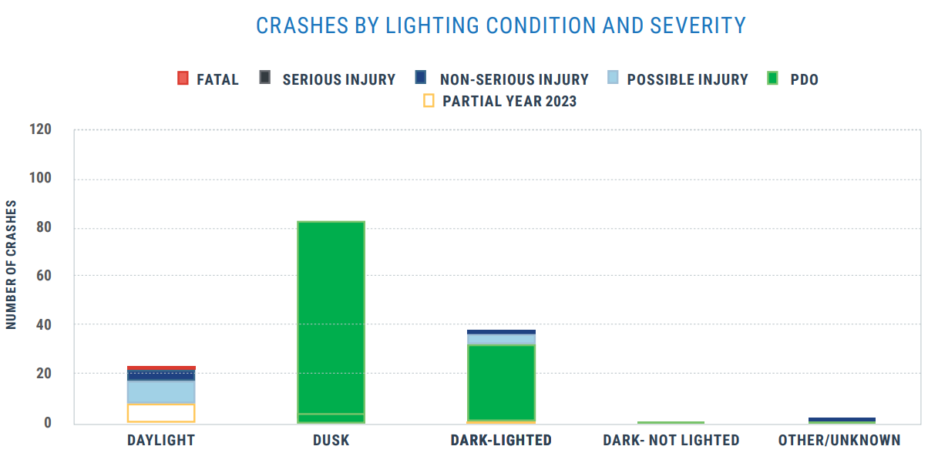
FDOT Crash Data Guidance
How should crash data be summarized?
Crashes by Year and Severity
Crashes by Type and Severity
Crashes by Lighting Condition and Severity
Crashes by Pavement Condition and Severity
Collision Diagram
Crashes by SHSP Emphasis Area
Notes:
By lighting condition and severity

Slide 50

FDOT Crash Data Guidance
How should crash data be summarized?
Crashes by Year and Severity
Crashes by Type and Severity
Crashes by Lighting Condition and Severity
Crashes by Pavement Condition and Severity
Collision Diagram
Crashes by SHSP Emphasis Area
Notes:
By pavement condition and severity

Slide 51
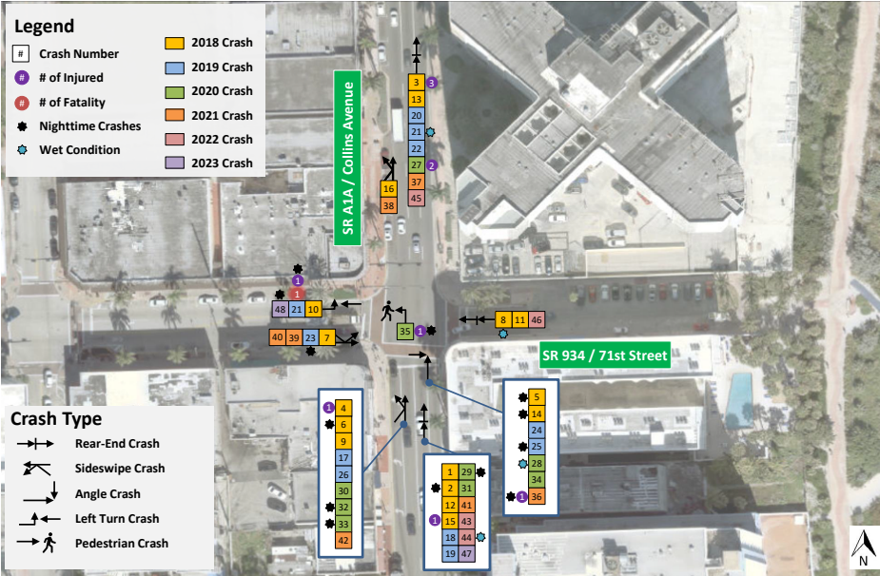
FDOT Crash Data Guidance
How should crash data be summarized?
Crashes by Year and Severity
Crashes by Type and Severity
Crashes by Lighting Condition and Severity
Crashes by Pavement Condition and Severity
Collision Diagram
Crashes by SHSP Emphasis Area
Notes:
As a collision diagram showing the crash type, locations and some of the other factors mentioned above

Slide 52
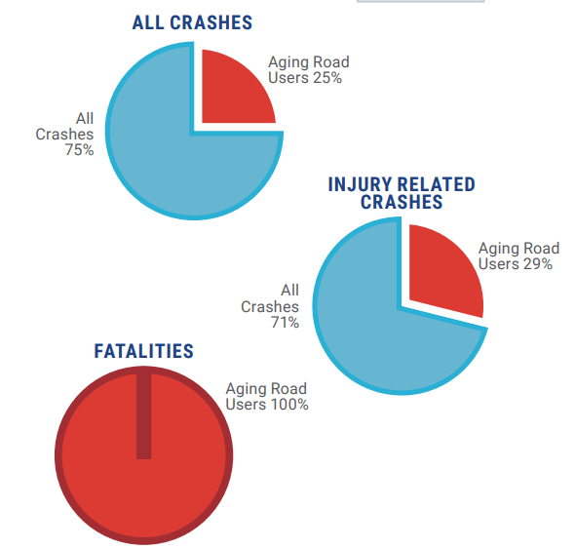
FDOT Crash Data Guidance
How should crash data be summarized?
Crashes by Year and Severity
Crashes by Type and Severity
Crashes by Lighting Condition and Severity
Crashes by Pavement Condition and Severity
Collision Diagram
Crashes by SHSP Emphasis Area
Notes:
As well as looking at the SHSP emphasis areas, as an example here for aging road users

Slide 53
FDOT Crash Data Guidance
Notes:
After summarizing the data, the final step is the safety analysis

Slide 54
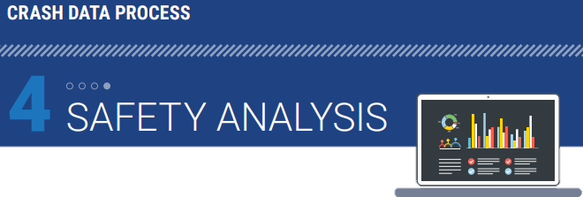
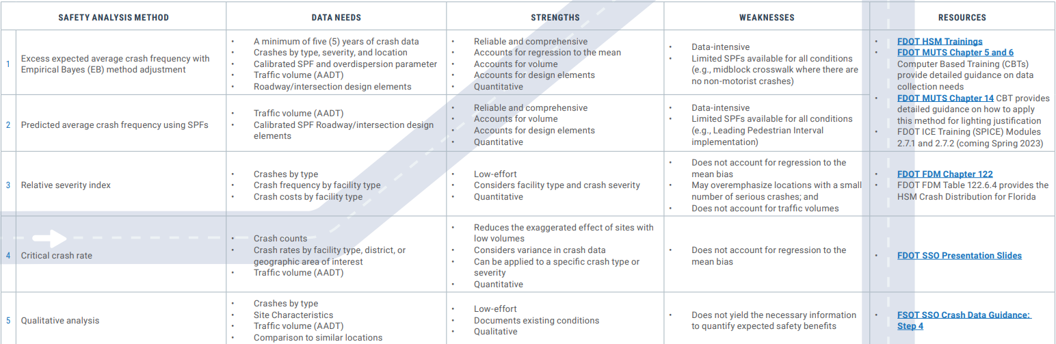
FDOT Crash Data Guidance
What safety analysis method should be used?
Notes:
Are five methods approved to analyze a location’s safety performance. The methods, in order of FDOT preference, are:
Excess expected average crash frequency with Empirical Bayes (EB) method adjustments;
Predicted average crash frequency using SPFs;
Relative severity;
Critical crash rate; and
Qualitative analysis.
When should each safety analysis method be used? Each method has different strengths, weaknesses, and data needs. Only conduct a qualitative safety analysis if performing a quantitative safety analysis cannot be done using available data and methods.
Methods one and two use Safety Performance Functions (SPFs). SPFs are available for various facility types and provide predicted crash frequency. *click* and some of the methods are more low-efforts.

Slide 55
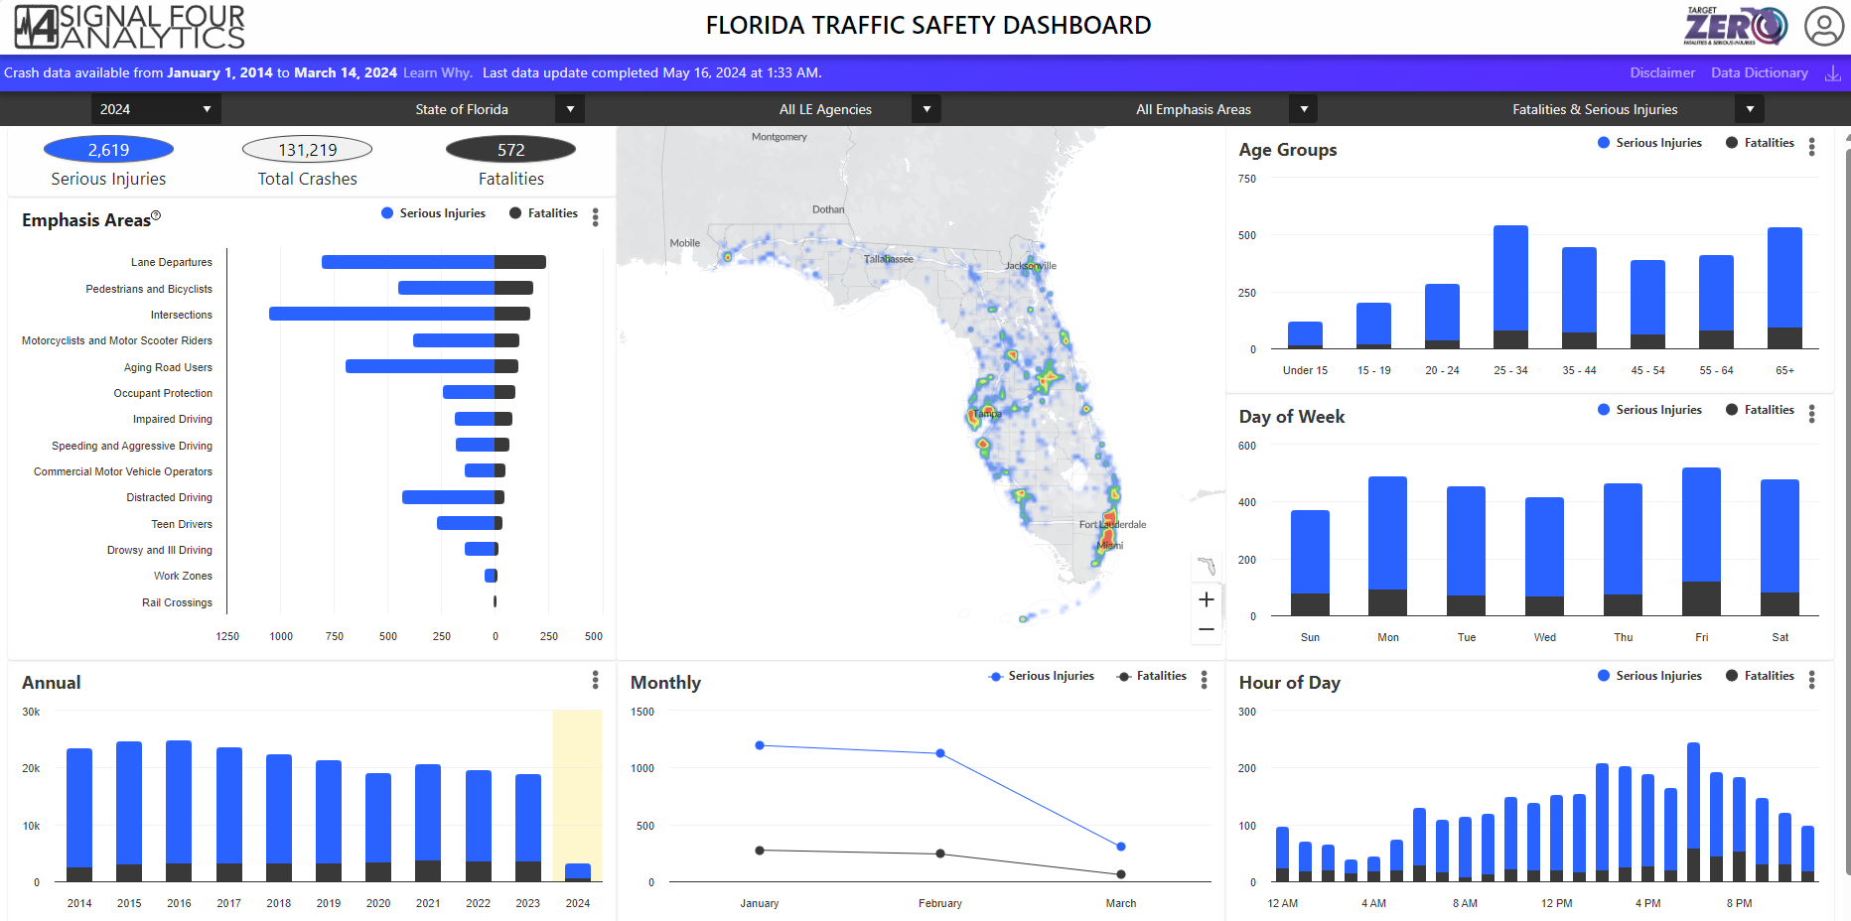
Signal 4 Crash Data Demo
Notes:
So with that great guide, let’s walk through these 4 steps together using Signal 4 analytics. What you see here is the main page before you login using your FDOT credentials

Slide 56
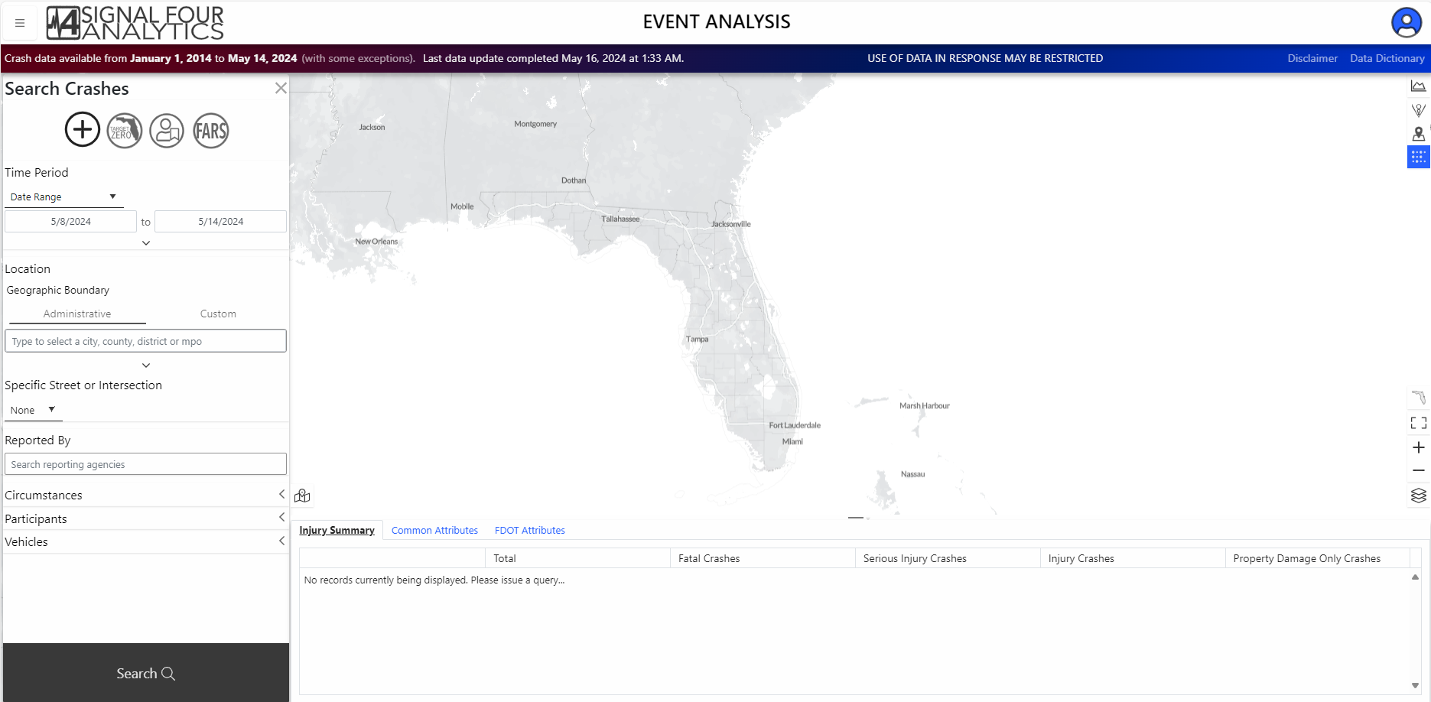
Signal 4 Crash Data Query Options
Notes:
When logged in, you can now download the data. *click* the list to the left includes multiple query options

Slide 57
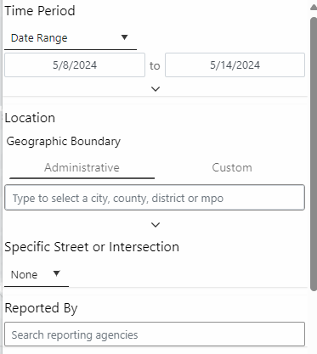
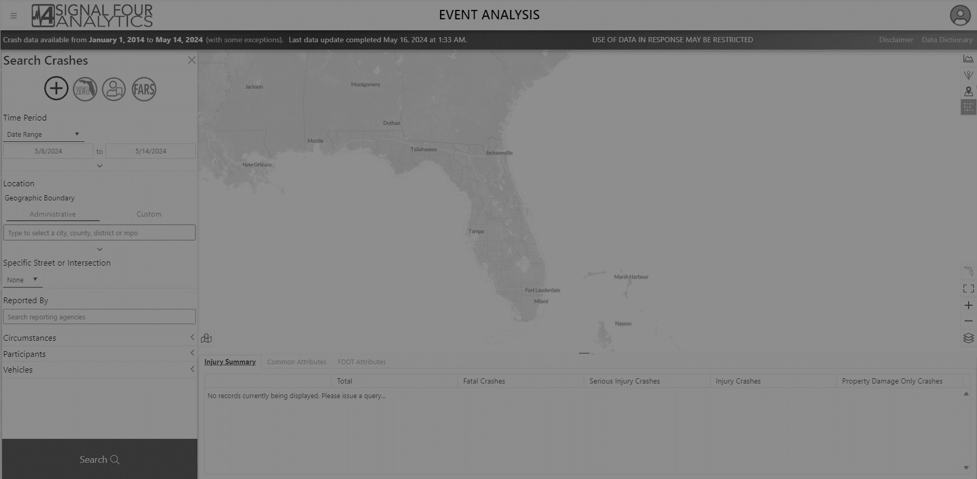
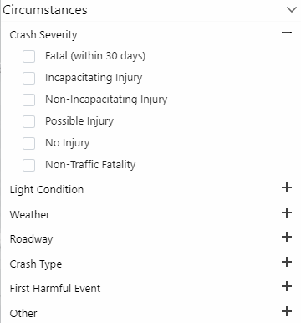


Signal 4 Crash Data Query Options
5/31/2024
Notes:
You can query by time period and location. Either by a city, a roadway name, or by geolocation.
*click*
You can query by different circumstances such as crash severity, light condition, weather, roadway, crash type, etc.
*click*
Looking at different participants such as road users, driver age, driver gender, etc.
*click*
And finally, you can query by vehicle type

Slide 58

Signal 4 Crash Data Query Options
5/31/2024
Notes:
For example,
*click*
Let’s download full 5 calendar years of data (2019-2023), plus partial 2024 data through may
*click*
For our location we will look at Gainsville
*click*
And we are interested in fatal and serious injury crashes

Slide 59

Signal 4 Crash Data Query Options
Notes:
*click*
Finally, we want to narrow it down to pedestrian and bicyclists
*click*
And then you click search

Slide 60

Signal 4 Crash Data Query Options
5/31/2024
Notes:
The search result will give you a heatmap, some graphs summarizing the data to the right, and you can also open the attribute table for a quick look
*click*
Here is how you download the data

Slide 61


Signal 4 Crash Data Output Options
Notes:
You will get a crash data download options, and you will select in what format you want your crash data before clicking OK

Slide 62


Signal 4 Crash Data Output Options
Raw Data Output
GIS Shapefile
More detail on roadway, vehicle and driver
Pedestrian and Bicycle Crash typing
Crash Report
Notes:
The Crash Tables will give you the raw output by crash event, driver, or vehicle level. You can also get the GIS Geolocation, FDOT Tables will give you information by the crash, roadway, vehicle and driver in a different format, you can also get pedestrian and bicycle crash typing data, and finally individual crash reports

Slide 63

Signal 4 Crash Data Download
Notes:
When you have downloaded the data, you will receive an email with he download link, which will give you a ZIP folder with the requested data

Slide 64

Signal 4 Crash Data Download
Notes:
In the Zip folder we can see these items

Slide 65


Signal 4 Crash Data Download
Notes:
You have the Pedestriana nd bicycle crash typing data in a CSV file which give you the crash number of crash group description for the crash typing

Slide 66

Signal 4 Crash Data Download
Notes:
The GIS Geolocation folder provides a geodatabase with the crashes

Slide 67

Signal 4 Crash Data Download
Notes:
The crash tables will give you the raw csv output of the crashes. *click* we will take a look at the “crash_event” which will have a row for each crash

Slide 68

Signal 4 Crash Data Download
Notes:
Opening the spreadsheet we get many columns of data, including the crash number, crash date and time, crash type, crash severity, pavement conditions, lighting conditions, and many more.

Slide 69


Signal 4 Crash Data Cleaning
Remove Forest Road, Parking Lot, & Private Roadway
Recode “Blank” or “Non-Traffic Fatality” to “No Injury”
Good to go!
Notes:
Our next step is to clean the data. We will look at cleaning the road system identifier column and removing any parking lot, private roadway, or forest road crashes. In our case we had some aprkinglot and private roadway crashes to remove. Then we will look at the S4 crash severity detail column and recode any Blanks or Non Traffic fatalities to “No Injury”. In our case, we didn’t have any of those, so we are good to go!

Slide 70
Signal 4 Crash Data Summary
Notes:
Final step is to summarize the data and then you are ready for the safety analysis depending on the type of project you are doing

Slide 71
Resources and Links
Crash Data Guidance: a short guide on how to pull, process, and analyze crash data
Crash Data Systems and Mapping (fdot.gov)
Signal4 Analytics: FDOT’s crash data repository
Florida Traffic Safety Dashboard - S4Analytics (signal4analytics.com)
Root Cause Analysis: a data-driven methodology to identify key risk factors prevalent in Florida’s top 3 SHSP emphasis areas to inform strategic safety investments toward Florida’s target of ZERO roadway fatalities and serious injuries.
Safety Engineering (fdot.gov)
Lane Departure Emphasis Area Fact Sheet
Ped/Bike Emphasis Area Fact Sheet
Intersection Emphasis Area Fact Sheet
FDOT Safety Analysis Methods & Resources: a brief overview of safety analysis methods and a repository of FDOT’s HSM Tools
Safety Analysis Methods (fdot.gov)
Training Resources:
Guidance for MPO Partners: The NEW Signal 4 Analytics for Our MPO Partners - Florida LTAP Center
Crash Data Guidance: Safety Crash Data Guidance - Step 1: Signal Four Analytics (S4) Crash Data Download – YouTube
FDOT Safety Engineering: Training (fdot.gov)
Signal4 Analytics: Signal4 Analytics Training Page
FDOT Safety Data Integration Space: these public apps provide simple access to information and tools for you to collect data and help your users understand your data.
SDIS Public (fdot.gov)

Slide 72
Resources and Links
Unified Basemap Repository: a site that offers mapped datasets for download
https://ubr.fdot.gov/basemaps
Florida’s Strategic Highway Safety Plan 2021-2024:
https://www.fdot.gov/Safety/shsp/shsp.shtm

Slide 73



Safety Message
BEHIND THE WHEEL, THE FOCUS MUST BE ON ONE AND
ONLY ONE TASK:
SAFE DRIVING
LET’S GET EVERYONE HOME.

Slide 74

Contact Us
Crash Records
Benjamin Jacobs benjamin.jacobs@dot.state.fl.us
Safety Data
Rupert Giroux rupert.giroux@dot.state.fl.us
State Safety Engineer
Brenda Young brenda.young@dot.state.fl.us

Slide 75


