Slide 1
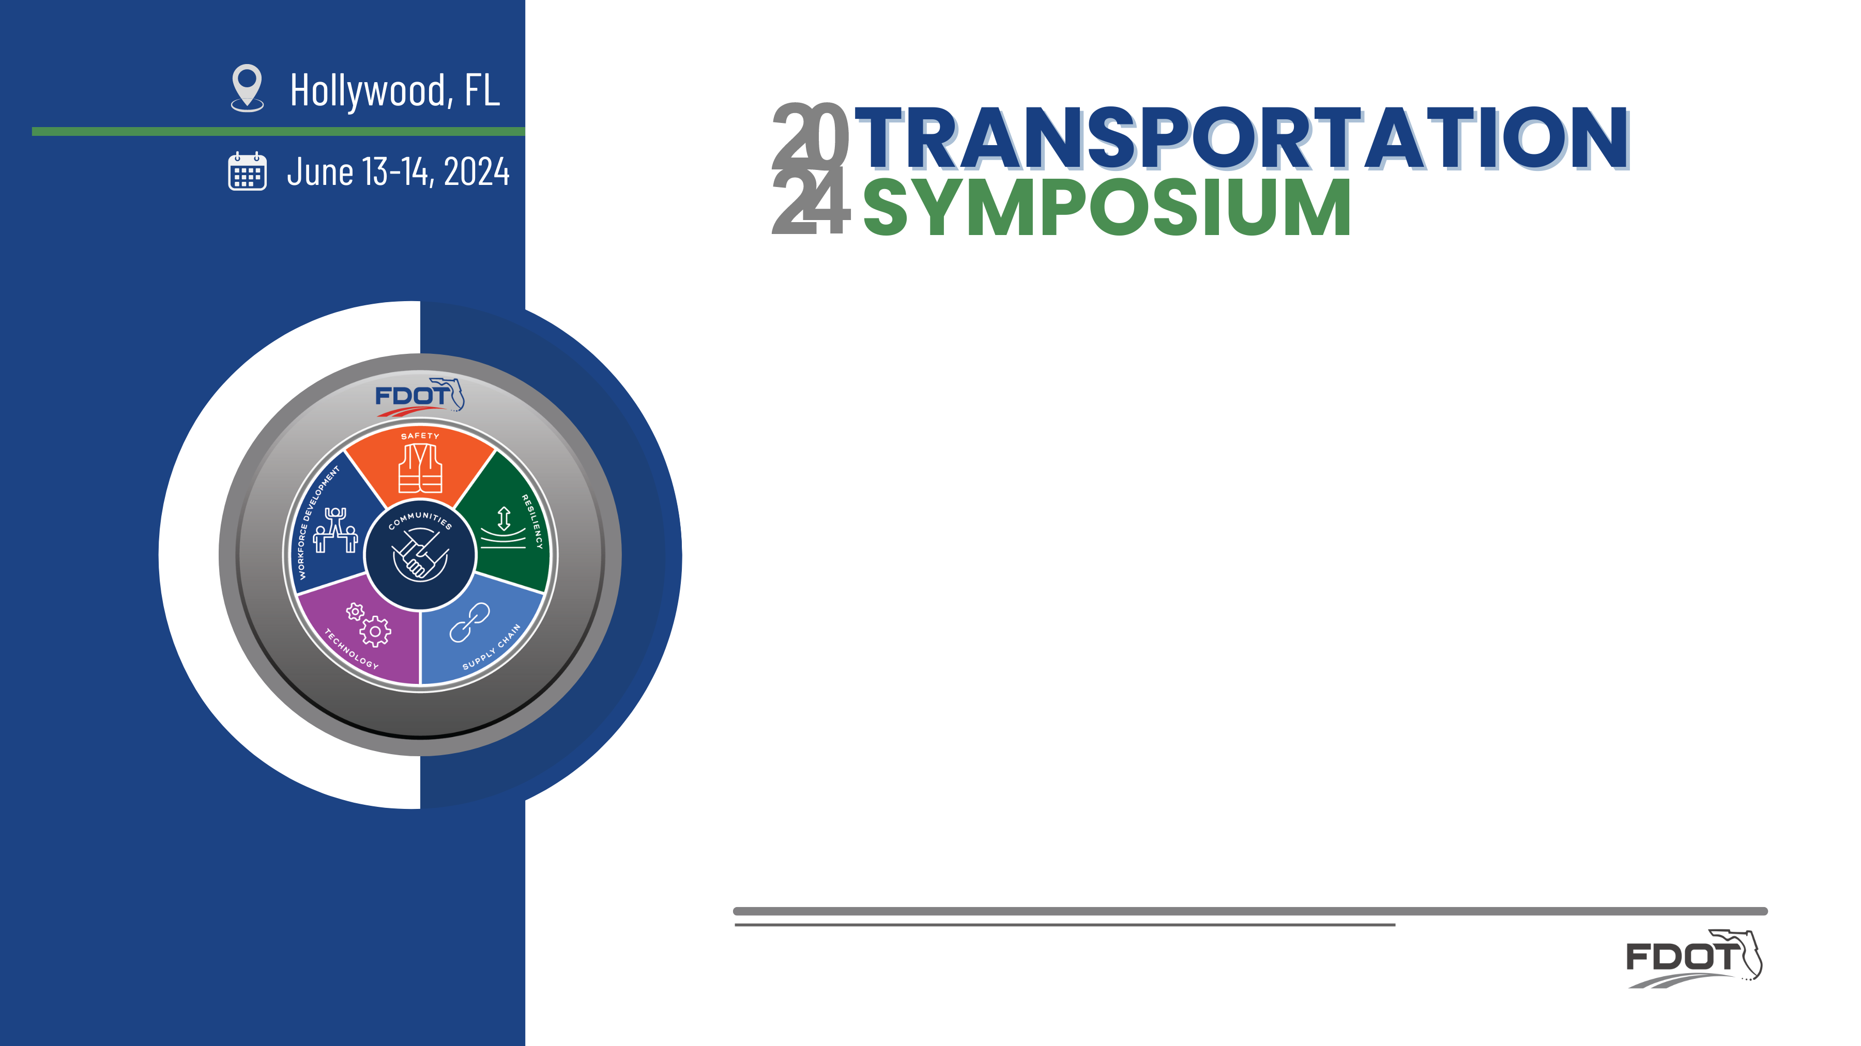
Deciphering the Process: Coordination and Permitting of the Sebastian Inlet Bridge Replacement Project
Ann Broadwell
Binod Basnet, P.E.
FDOT District 4
Planning & Environmental Office
FDOT District 4
Design Office
Notes:
Thank you for joining us for the Friday morning session of the June 2024 Transportation Symposium
Introduce Beth Beam and Ian Biava
This project has been recognized by ACEC for PD&E Project of the Year.

Slide 2
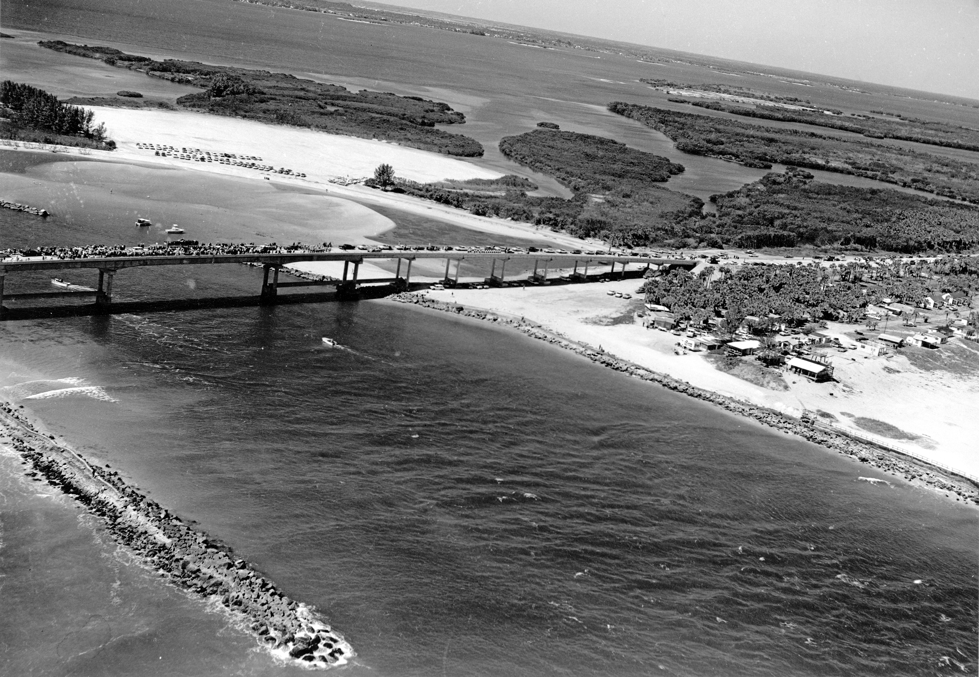

Presentation Objectives
History of the Bridge
Project Preparation
  Feasibility Study and ETAT coordination
  Purpose and Need of Project
  PD&E Commitments
Stakeholders and working our way through the permitting process
Notes:
Today we will be discussing the history of this beautiful area.
How we came to the realization that this bridge replacement was a perfect candidate for the FDOT bridge replacement program, and what steps District 4 took to make that a reality
Our list of Stakeholders includes our friends in District 5, they have been involved from the start.

Slide 3
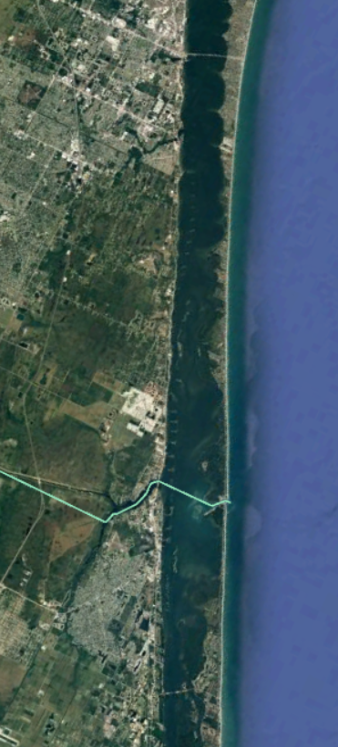
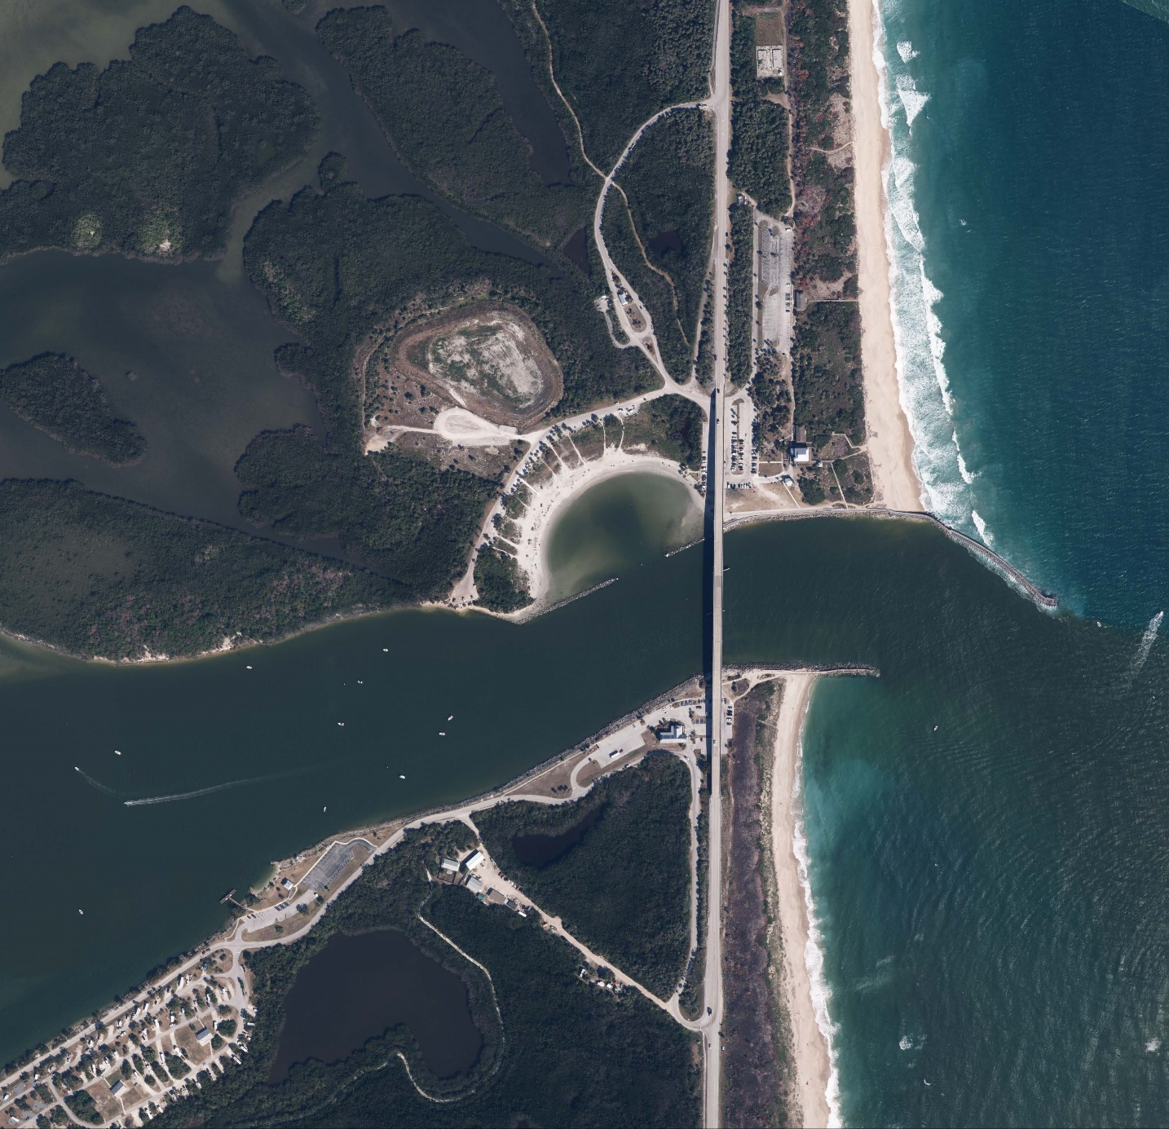






Project Location
NTS
SEBASTIAN INLET STATE PARK
NTS
INDIAN
RIVER
INLET GRILL & GIFTS
SEBASTIAN INLET SWIMMING COVE
INLET BAIT & TACKLE
SEBASTIAN INLET
BREVARD COUNTY
BREVARD COUNTY
SEBASTIAN FISHING MUSEUM
INDIAN RIVER COUNTY
INDIAN RIVER COUNTY
SEBASTIAN INLET STATE PARK CAMPGROUND
SEBASTIAN INLET STATE PARK
Legend
Project Limits
Notes:
The Sebastian Inlet Bridge (also known as the James H. Pruitt Memorial Bridge) is located along State Road A1A at the Indian River and Brevard County boundary. The bridge spans both District 4 and 5.
The bridge crosses the Sebastian Inlet and is surrounded by the Sebastian Inlet State Park. The Atlantic Ocean is to the east or right and the Indian River Lagoon is to the west or left.
The views are spectacular, and the park has a beach cam for surfers. The fishing is great, any given day the jetty is lined with anglers.

Slide 4
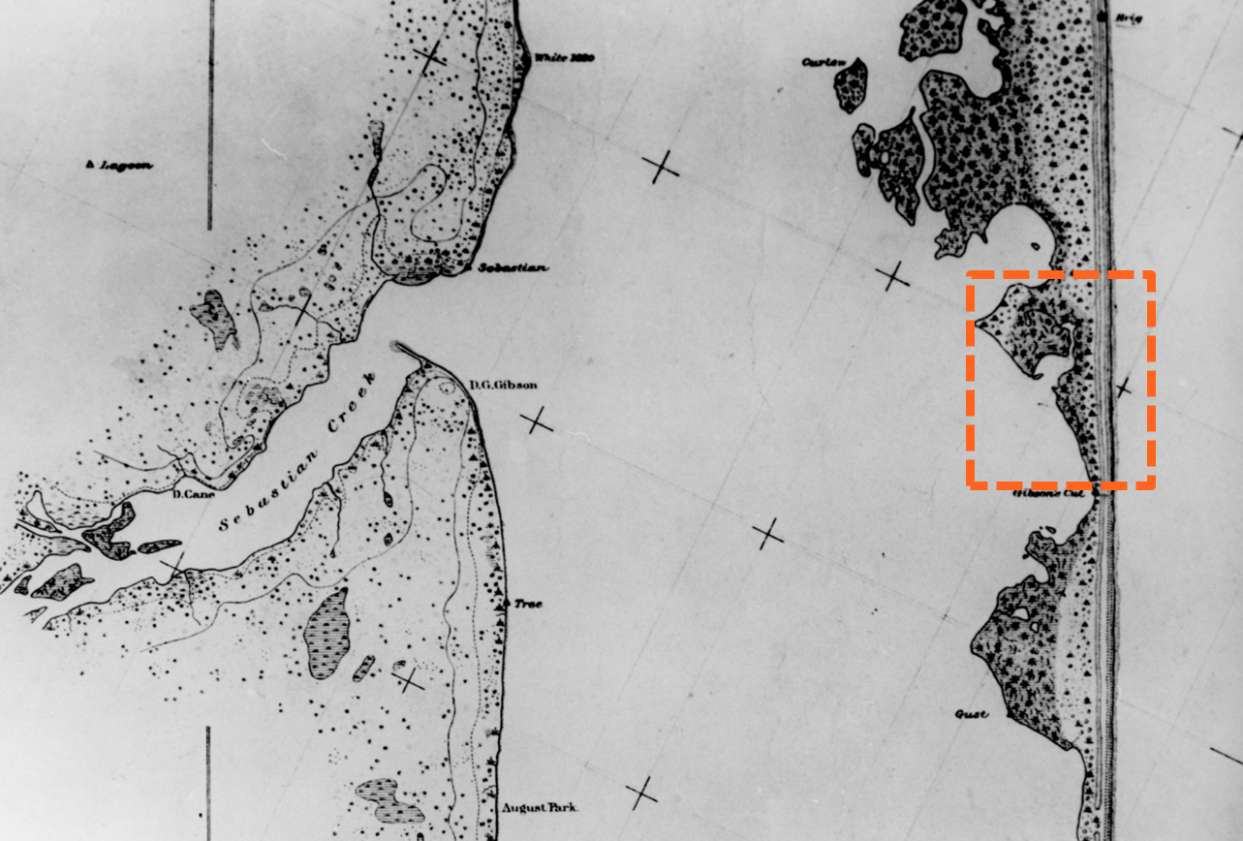
History
Sebastian Inlet
    All Historic Sebastian Inlet Maps and Photographs Courtesy of the Sebastian Inlet District
Notes:
The history of this area is what makes this bridge replacement project unique so we would like to take a few minutes to set the stage.
The uniqueness of the area is what is driving the engineering bus on this project.
It is not traffic data, congestion, capacity improvements or the typical needs that are addressed in a PD&E study.
The uniqueness of the area is what brings the various resource and permitting agencies into the project.
Shown on this slide, is an 1880s Geodetic Survey Map which identifies “Gibson’s Cut”. This area is the location where an early settler named D.P. Gibson first attempted to create an inlet.
The orange box shows the State Park and the blue line is the present day inlet.

Slide 5
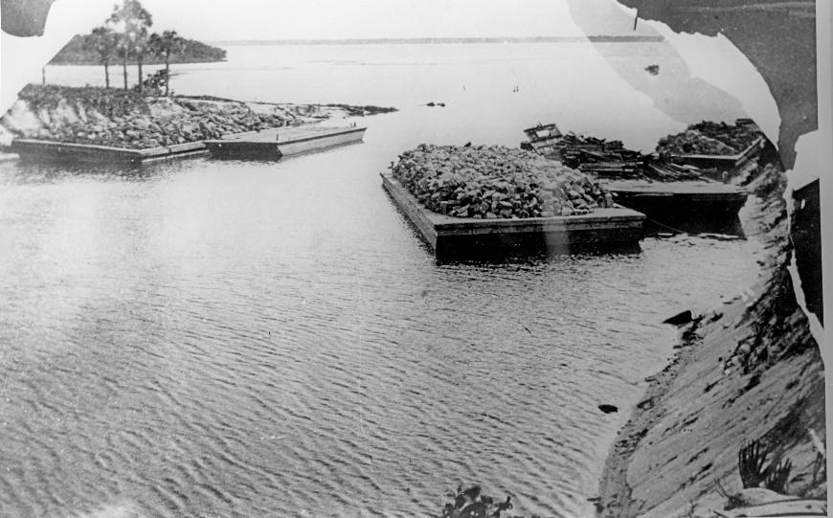
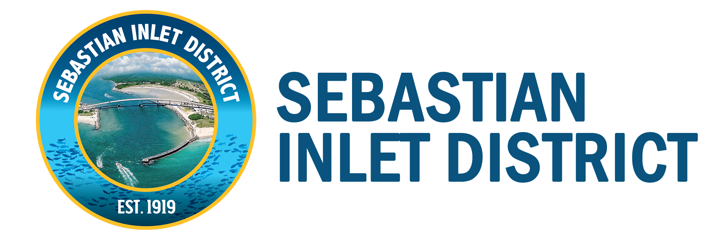
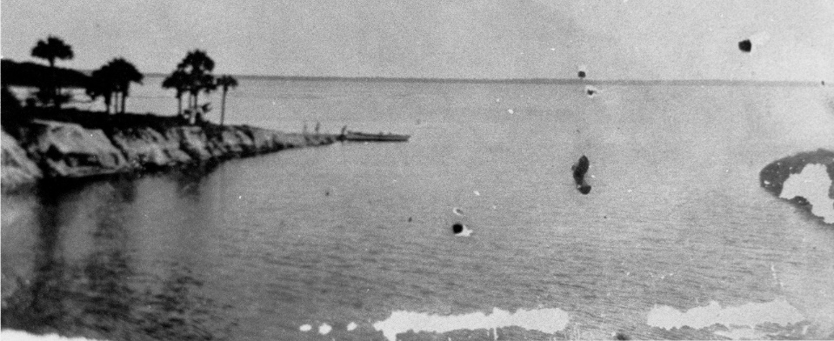
History
Sebastian Inlet
    1905 - 1918
Notes:
At least six substantiated attempts were made by 1905, all were closed by sand, storm and other natural causes almost as soon as they were opened
The Sebastian Inlet District was created in 1919 and is a special taxing district to maintain the Inlet and its submerged lands
The Inlet was reopened in 1923.

Slide 6
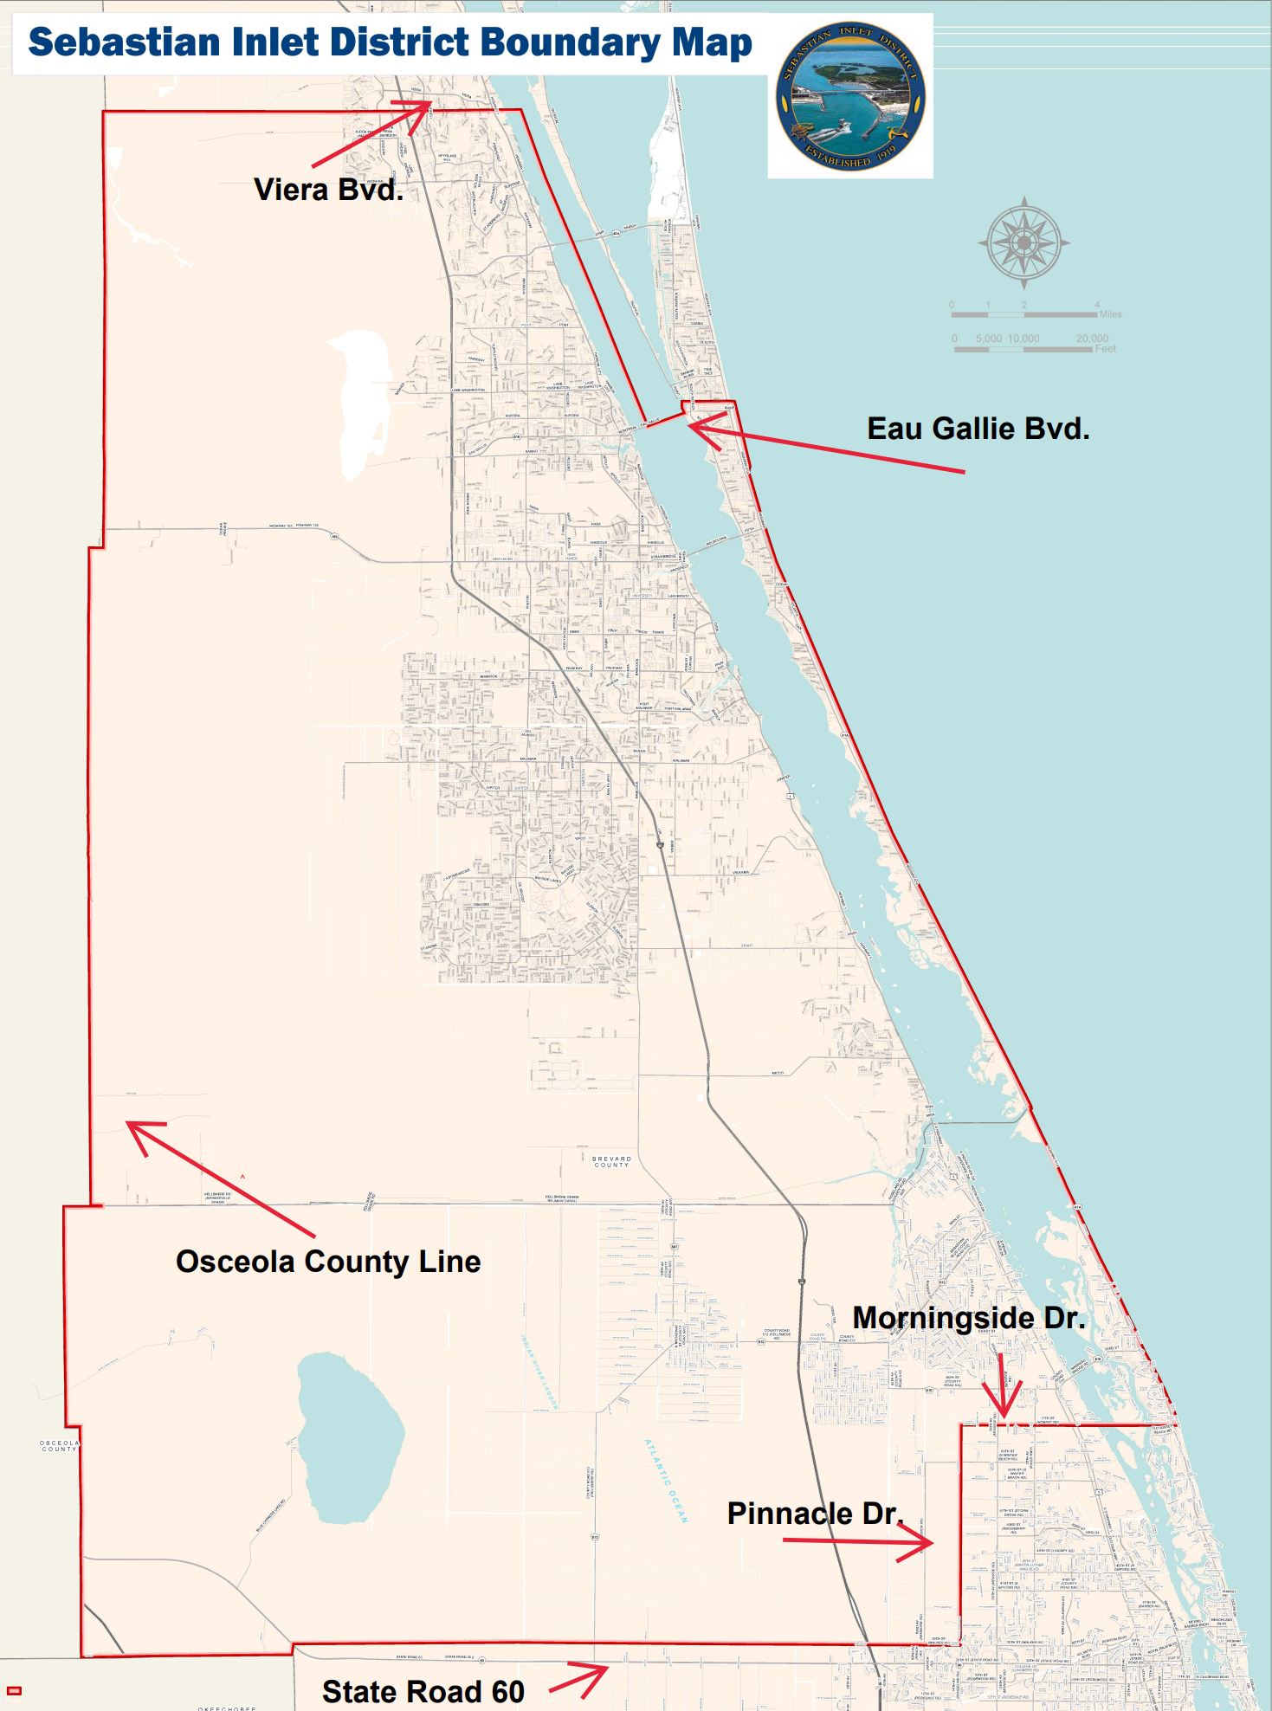
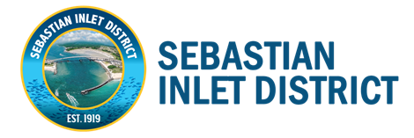
History
Sebastian Inlet
The Tax District goes west to Osceola County, east to the Ocean,
north to Viera Blvd in
Brevard County and
south to SR 60 in
Indian River County
Notes:
The Sebastian Inlet District was created in 1919 as a special taxing district to maintain the Inlet.
Flagler’s Railroad was heading south with a station in Sebastian, Florida.
There was also the east/west Trans Florida rail line that ran from Fellsmere to Sebastian. This rail brought fruits and vegetables to Sebastian. It was known to locals as the Dinky Line.
The pedestrian bridge over I 95 north of the SR 512 exit is in the location of the old rail line.
Access to the ocean allowed produce and fish to move to Jacksonville and Miami.

Slide 7
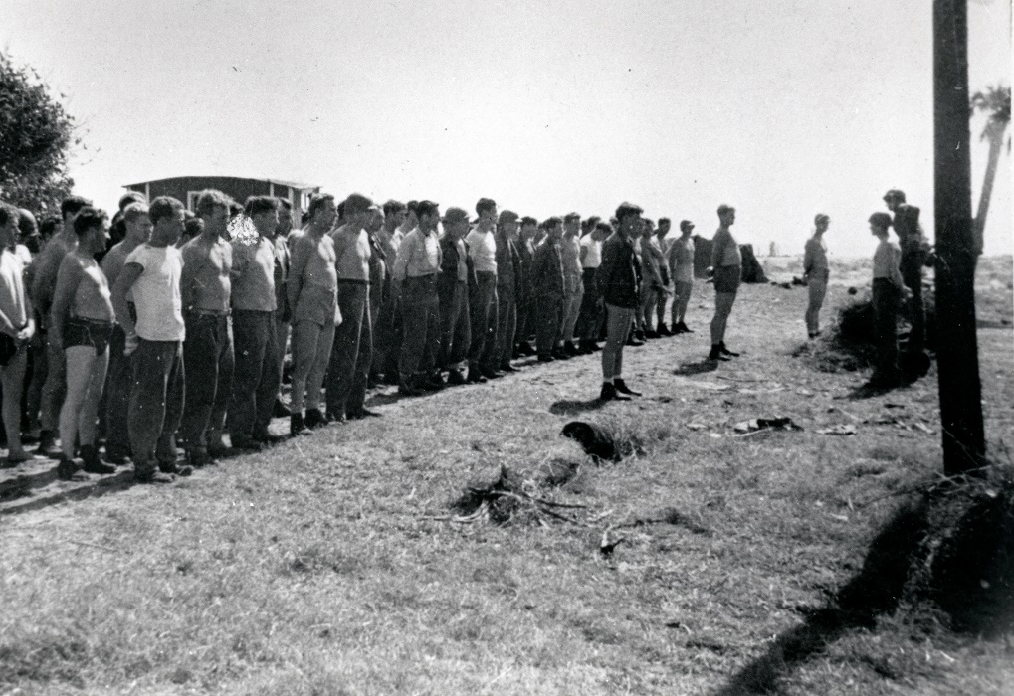
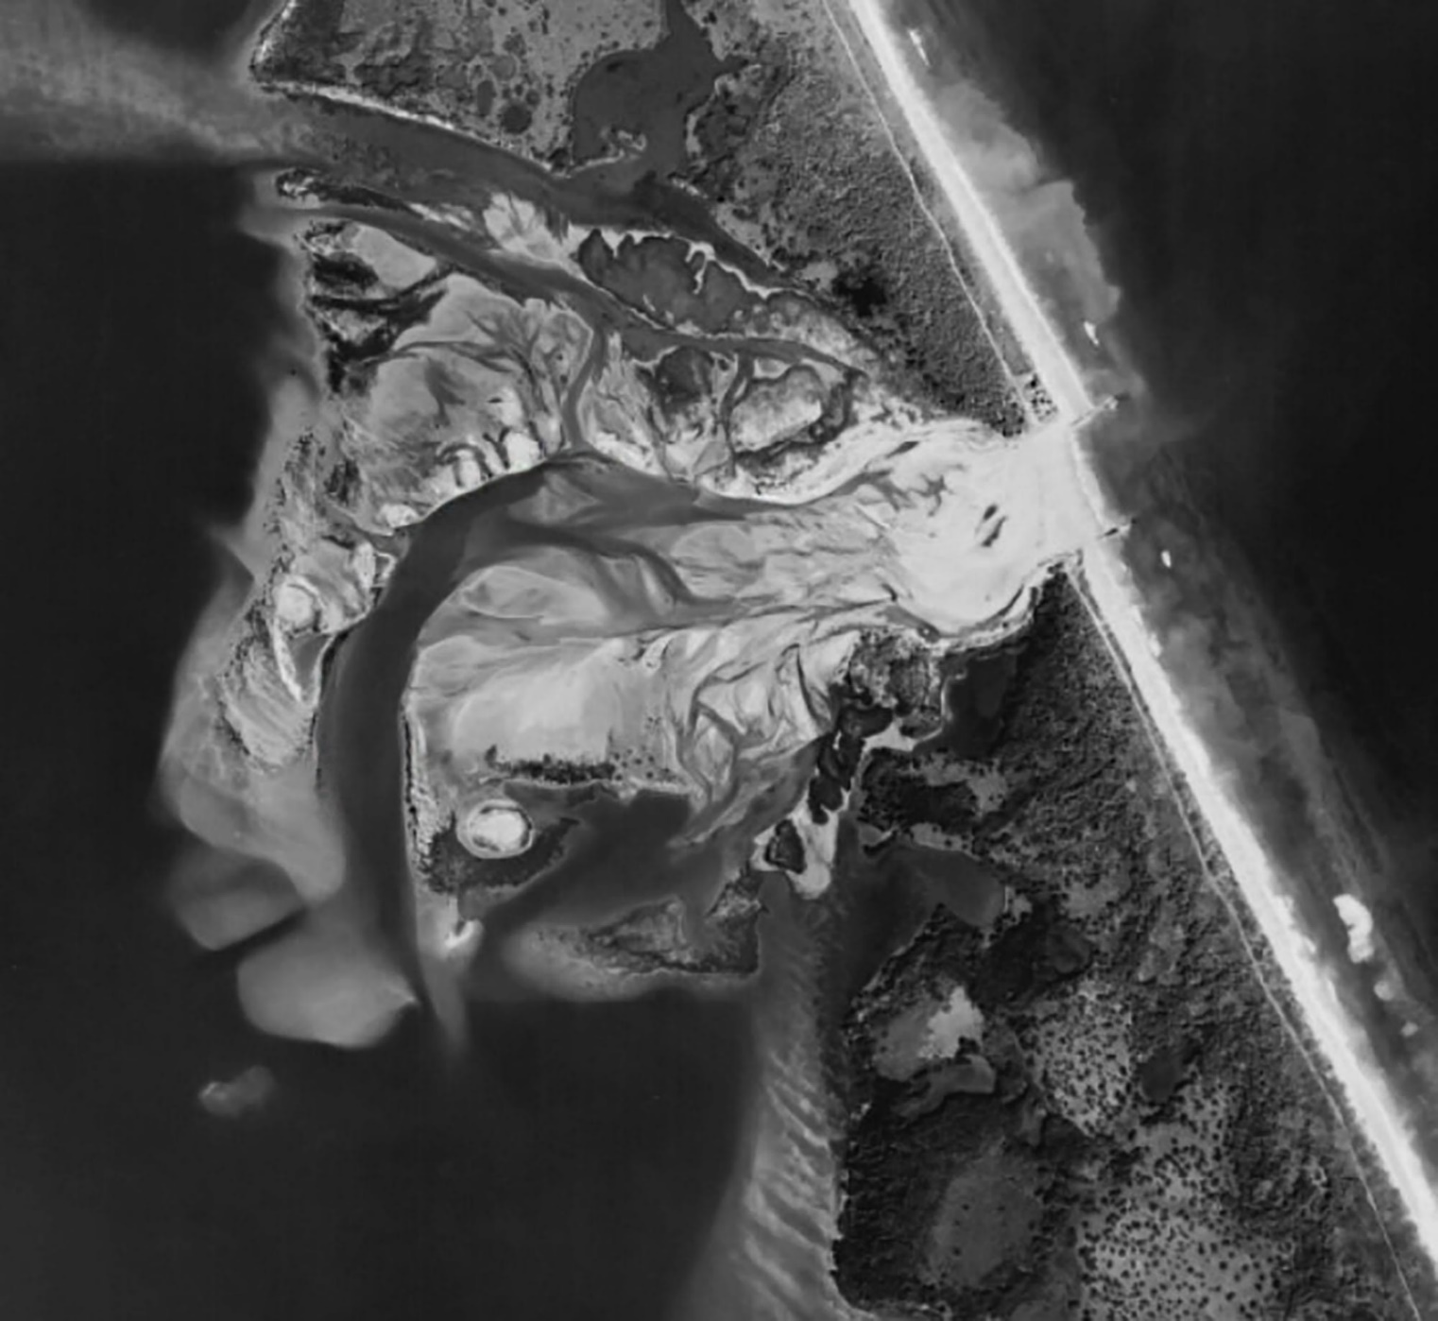
History - during WW II
Sebastian Inlet
Notes:
Pearl Harbor was attacked by Japanese Navy Air Service on December 7 1941. Coincidently, a strong Atlantic Ocean Noreaster filled the inlet with sand on the same day. It remained closed until after World War II ended.

Slide 8
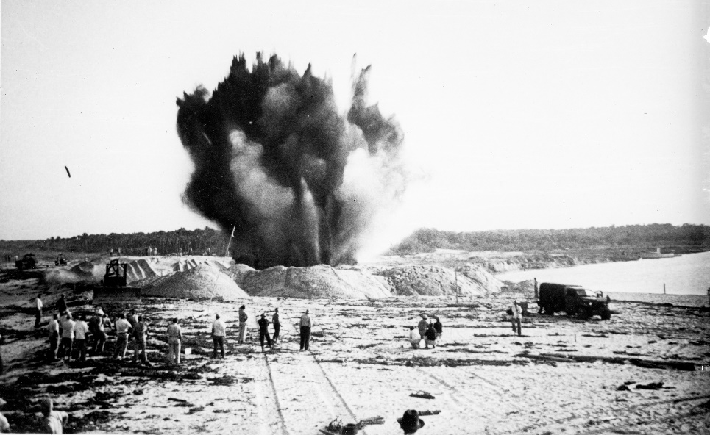
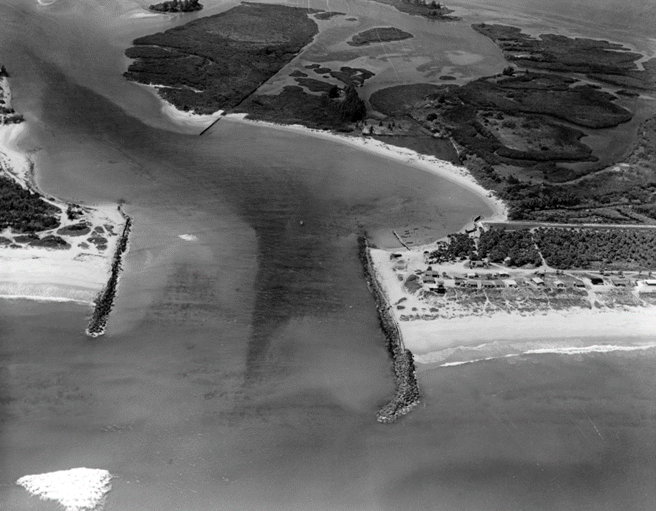
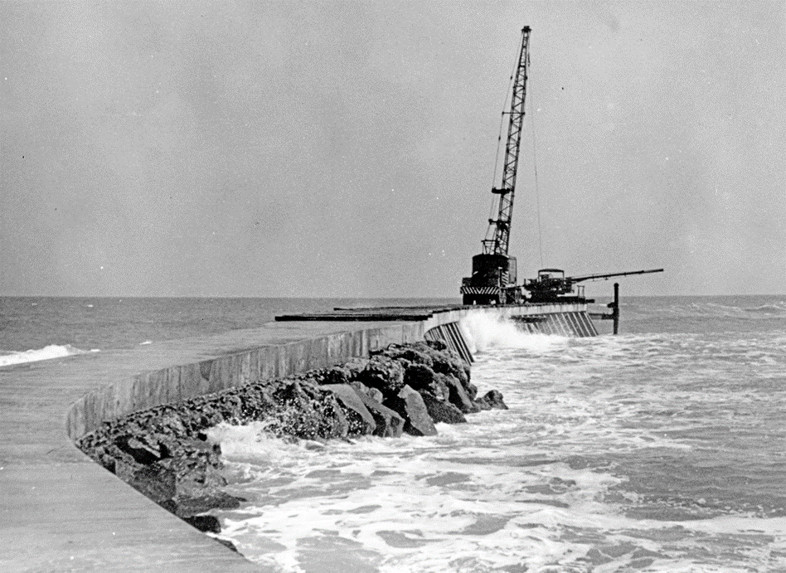
History – after WW II
8
Sebastian Inlet
Notes:
The US Navy established the Navy SEAL training center in Fort Pierce Florida in 1943.
The Center included Underwater Demolition Training (UDT).
In 1948, the Navy training center used surplus explosives to re-open the inlet.
During the 1950’s, the Taxing District oversaw the construction of the jetties that would prevent sand from filling in the inlet.

Slide 9
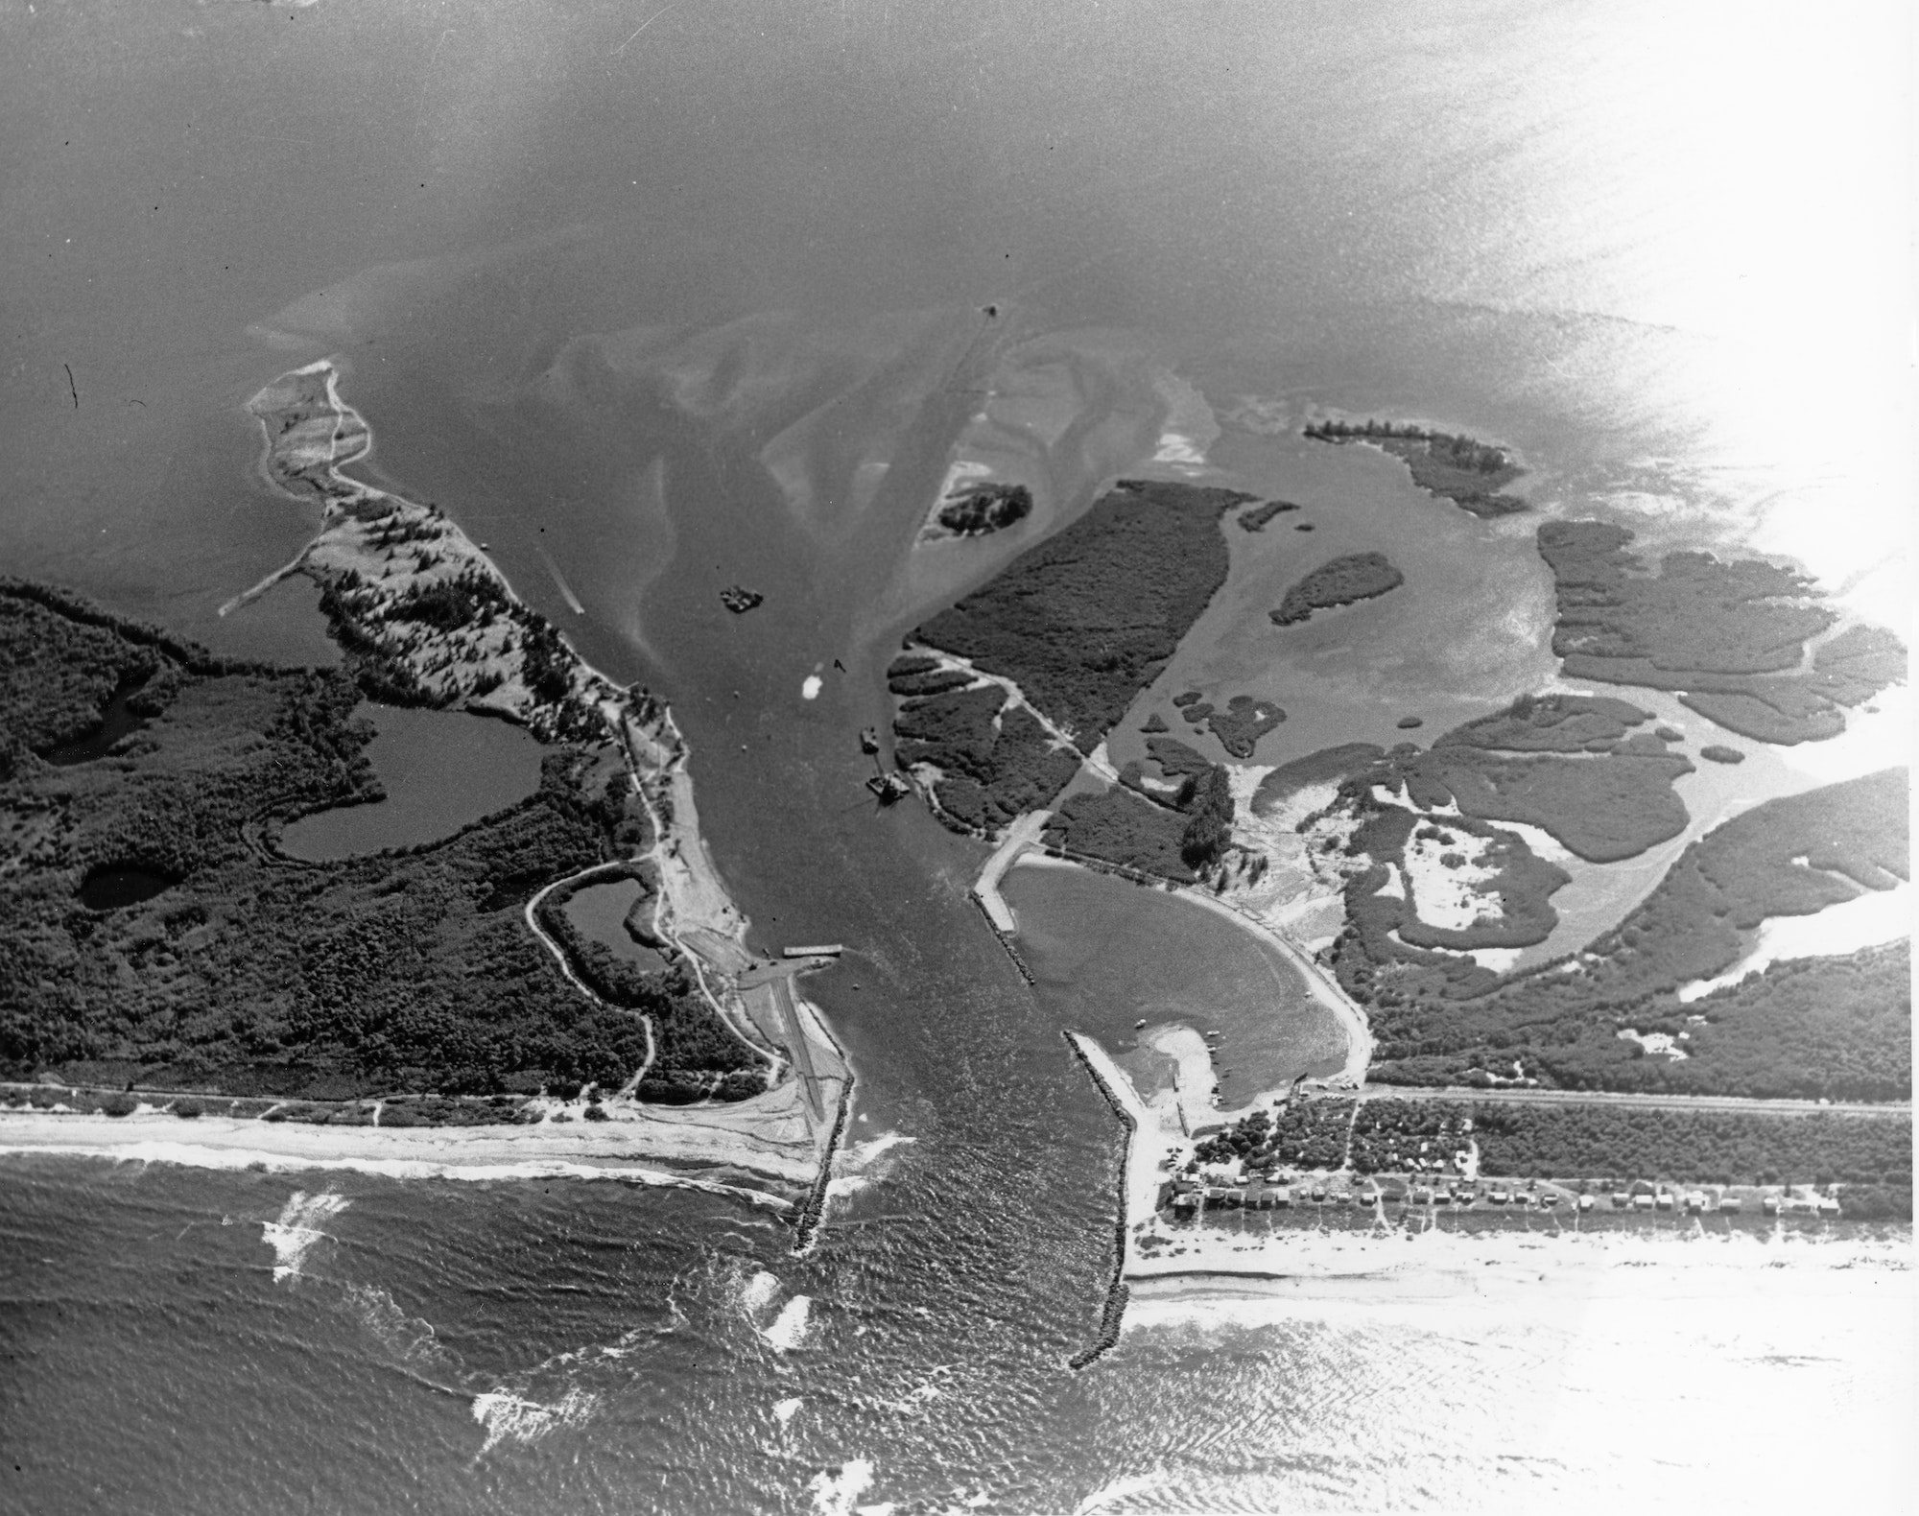
History
State Road A1A
SR A1A in Brevard County was constructed by the Florida State Road Department between 1951 and 1956.
SR A1A in Indian River County was acquired by the Florida State Road Department around 1961 and constructed prior to completion of the bridge
SR A1A INDIAN RIVER COUNTY
NOT CONSTRUCTED UNTIL 1961
SR A1A
BREVARD COUNTY
Notes:
SRD constructed SR A1A up to the inlet.

Slide 10
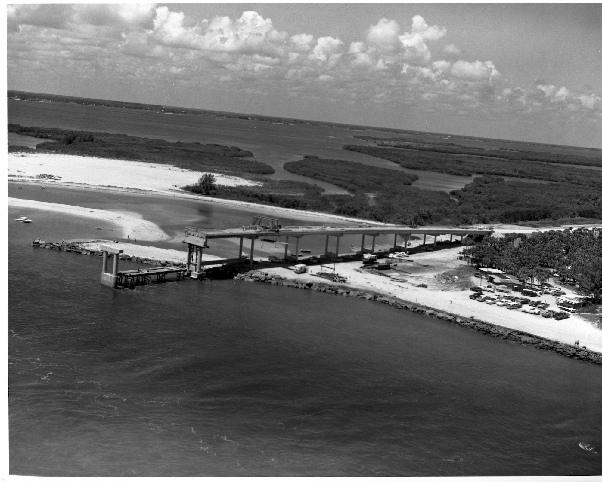
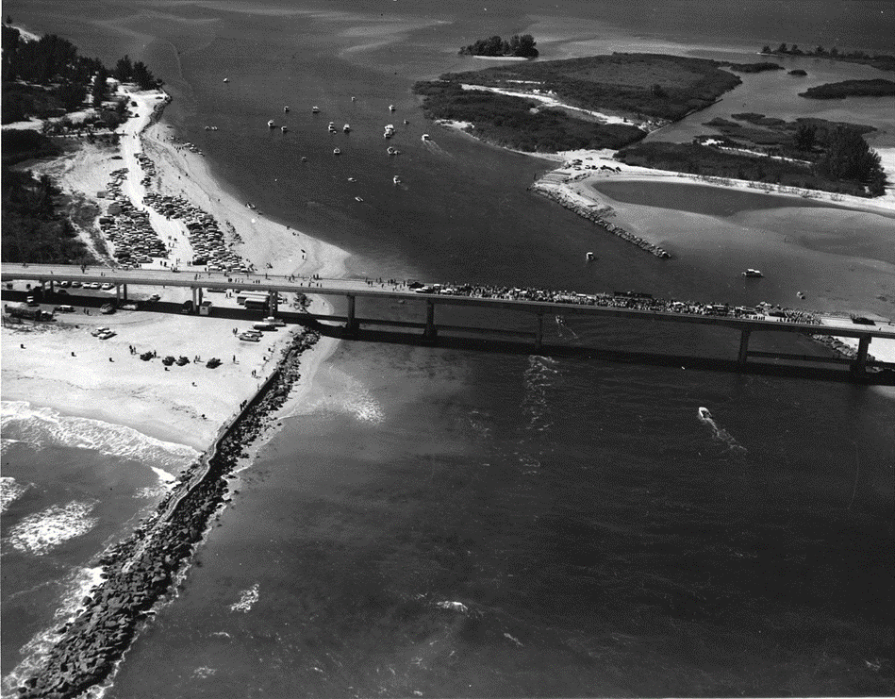
History
Sebastian Inlet Bridge
    1960s
Notes:
State Road Dept started bridge construction in 1960 in order to close the gap.
This is a picture of the construction and the Bridge Grand opening.
Folks attended the ribbon cutting by land and sea!

Slide 11
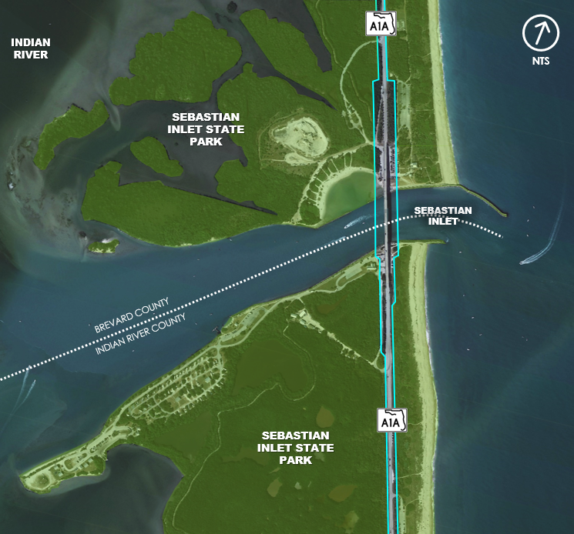
History
State Park
State of Florida, FDEP Division of State Lands, acquired land surrounding the inlet and in 1971 Sebastian Inlet State Park was established
The Sebastian Inlet State Park has grown to 971 acres
NTS
ATLANTIC OCEAN

Slide 12
History
FDOT Right-of-Way
The Sebastian Inlet District (SID) owns the land (fee simple title) under the bridge
SID granted an easement to the Florida State Roads Department through a July 22, 1963 agreement
ROW Widths:
  Bridge 240-feet wide
  SR A1A 100-feet wide
    1963 Survey
Notes:
This small area has 13 easements in various stages of use.
One of the activities we did at the very start of the PD&E study was to find out who was using what and who owns what.
The 1963 survey was very straight forward, but that has changed and we needed that information sooner rather than later.

Slide 13
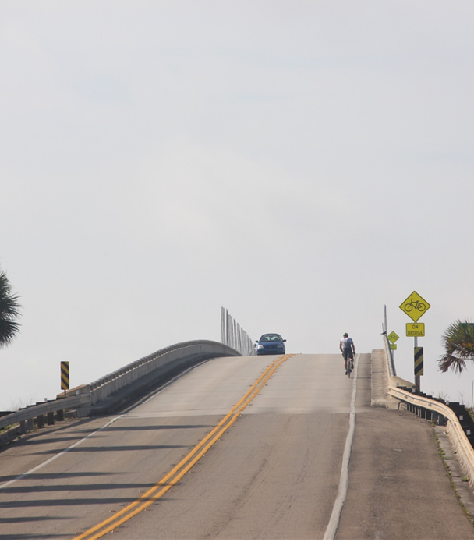
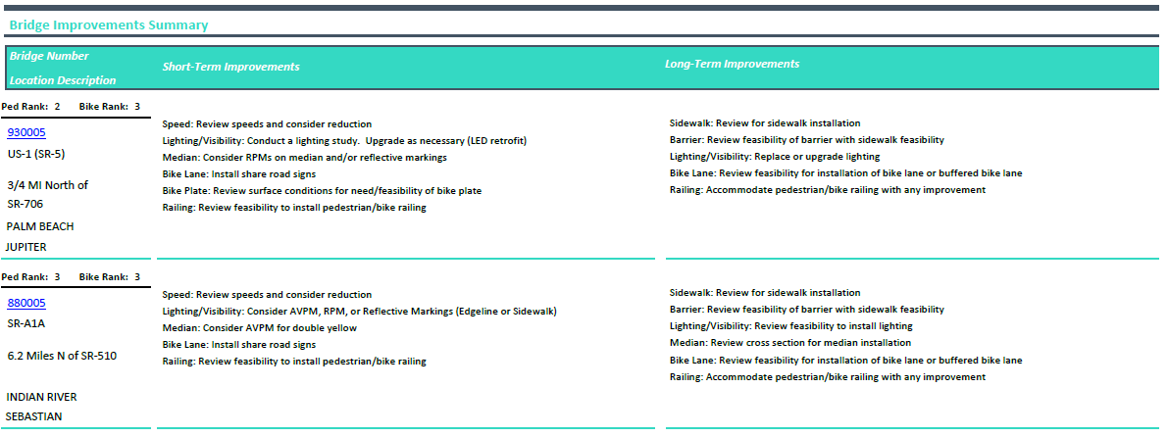
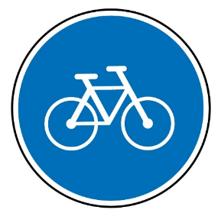
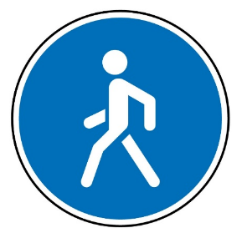
It all Started with a Safety Study………
NTS
2019 Bicycle/Pedestrian Data Counts
Dec 12 – Dec 15 6:00 AM to 6:00 PM
ATLANTIC OCEAN
231 Bicyclists
5 Pedestrians
Currently crossing the bridge despite not having appropriate bicycle and pedestrian facilities
Notes:
District 4 Traffic Operations conducted a bike/ped safety study of all the movable bridges over the ICWW in District 4. They listed the deficiencies related to bike/ped features.
The report identified Jupiter Inlet Bridge and SR A1A over the Sebastian inlet as priorities.
The Jupiter Inlet bridge rehab project morphed into a PD&E study, later design and now under construction.
This is Sebastian inlet bridge and you can see the short term safety improvement (cautionary signs) recommended from the bike ped study.
People walk and bike over this bridge everyday.
A cost benefit analysis was conducted for the bridge to determine next steps. A feasibility study was done and concluded that the bridge should be replaced. But when? The structure was inspected and it was determined that the ratings all fell below sufficiency criteria.

Slide 14
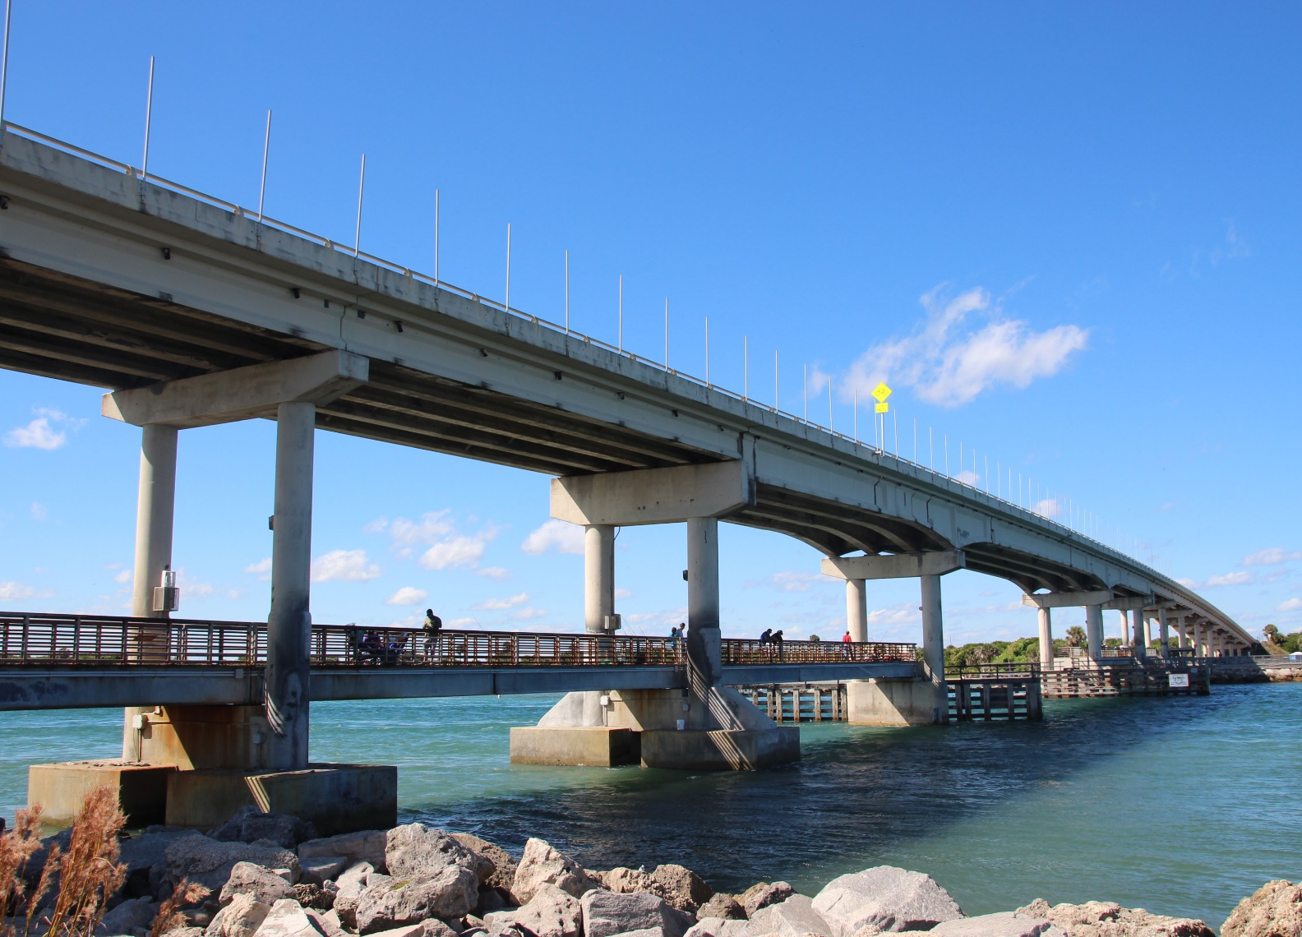
Purpose and Need
Existing Bridge Condition
Structurally Deficient
substructure rated “Poor”
superstructure rated “Poor”
NTS
Functionally Obsolete
no sidewalks
no bike lanes
no shoulders
ATLANTIC OCEAN
Notes:
The purpose of this project is to address the bridge structural and functional deficiencies, address the gap in system linkage for bicyclists and pedestrians.
The Need for the project is based on the November 2018 FDOT bridge inspection report that indicated a structural deficiency rating for the bridge and a bridge health index of 79.8.
The bridge is also functionally deficient or outdated in that it has minimal shoulders, and no bicycle and pedestrian facilities.
This project also supports the Indian River County Bicycle and Pedestrian Plan for SR A1A at this location.
Bicycle and pedestrian counts collected over a 4-day period in December 2019 show 231 bicyclists and 5 pedestrians crossed the bridge despite not having appropriate bicycle and pedestrian facilities.

Slide 15
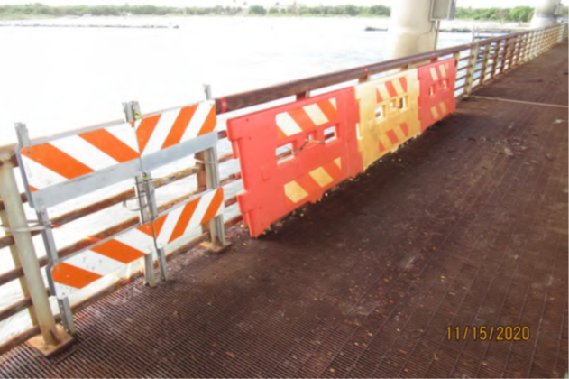
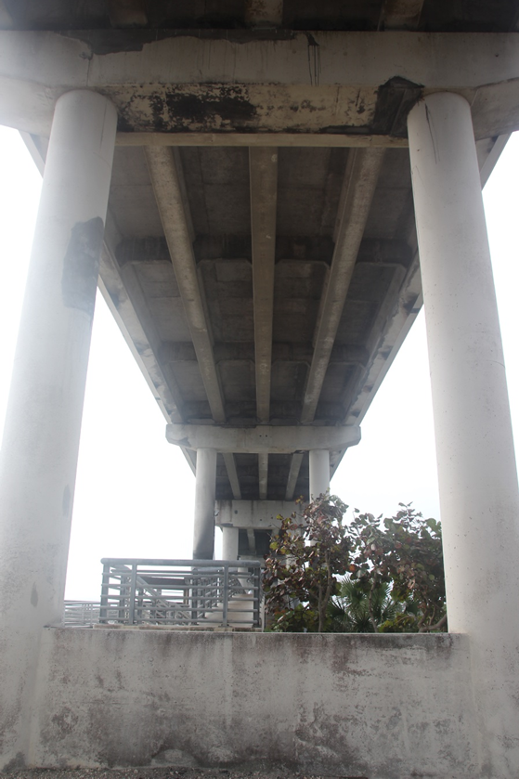
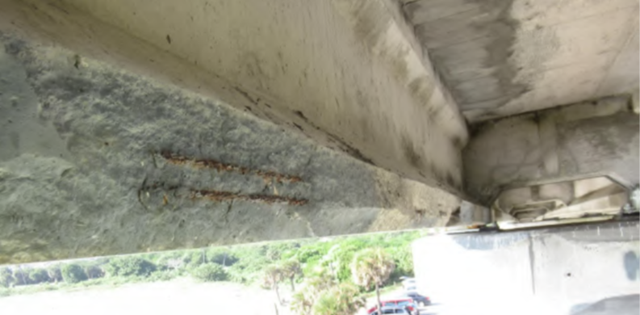
Purpose and Need
Existing Bridge Condition
NTS
ATLANTIC OCEAN
Notes:
Here are some examples of the spalling and the corroded fishing pier, which is now closed to the public.
The bridge has been retrofitted or repaired in 1978 and 2003.

Slide 16
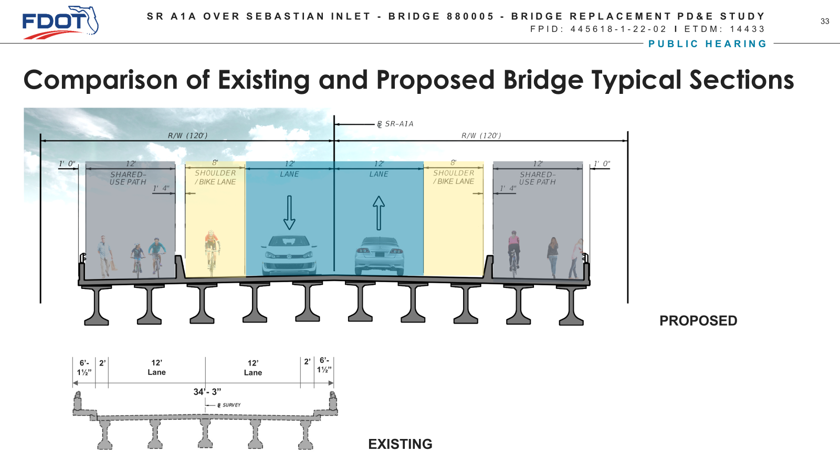
Purpose and Need: Preferred Alternative
16
NTS
ATLANTIC OCEAN
Notes:
The existing typical section is approx. 35 feet wide and there is a 31’ vertical clearance over the water.
The proposed typical section is approx. 70 feet with a 51’ vertical clearance.
No capacity improvements are being considered but to bring SR A1A up to todays design standards, the typical section doubled.

Slide 17
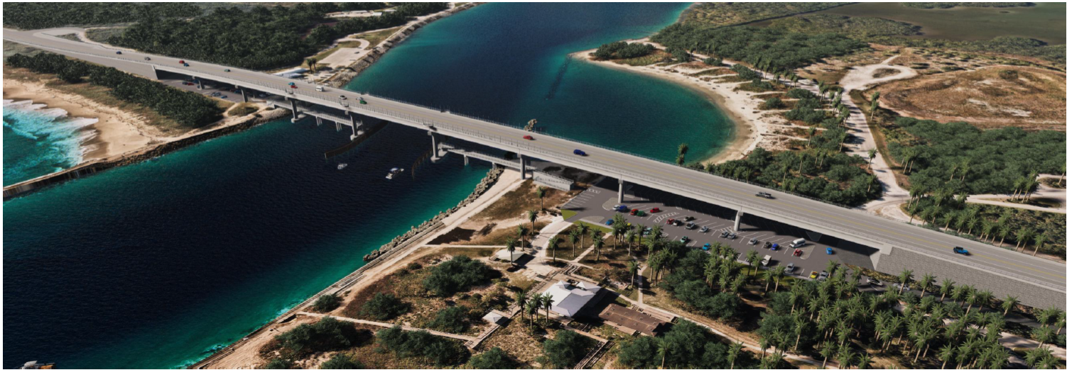
Purpose and Need: Preferred Alternative
17
NTS
ATLANTIC OCEAN
Notes:
This depicts the MSE walls used to reduce the impact to the dunes that start in FDOT ROW and transition into the Park.
The PD&E and Design teams recognized the importance of this coastal habitat and avoided impacts.

Slide 18
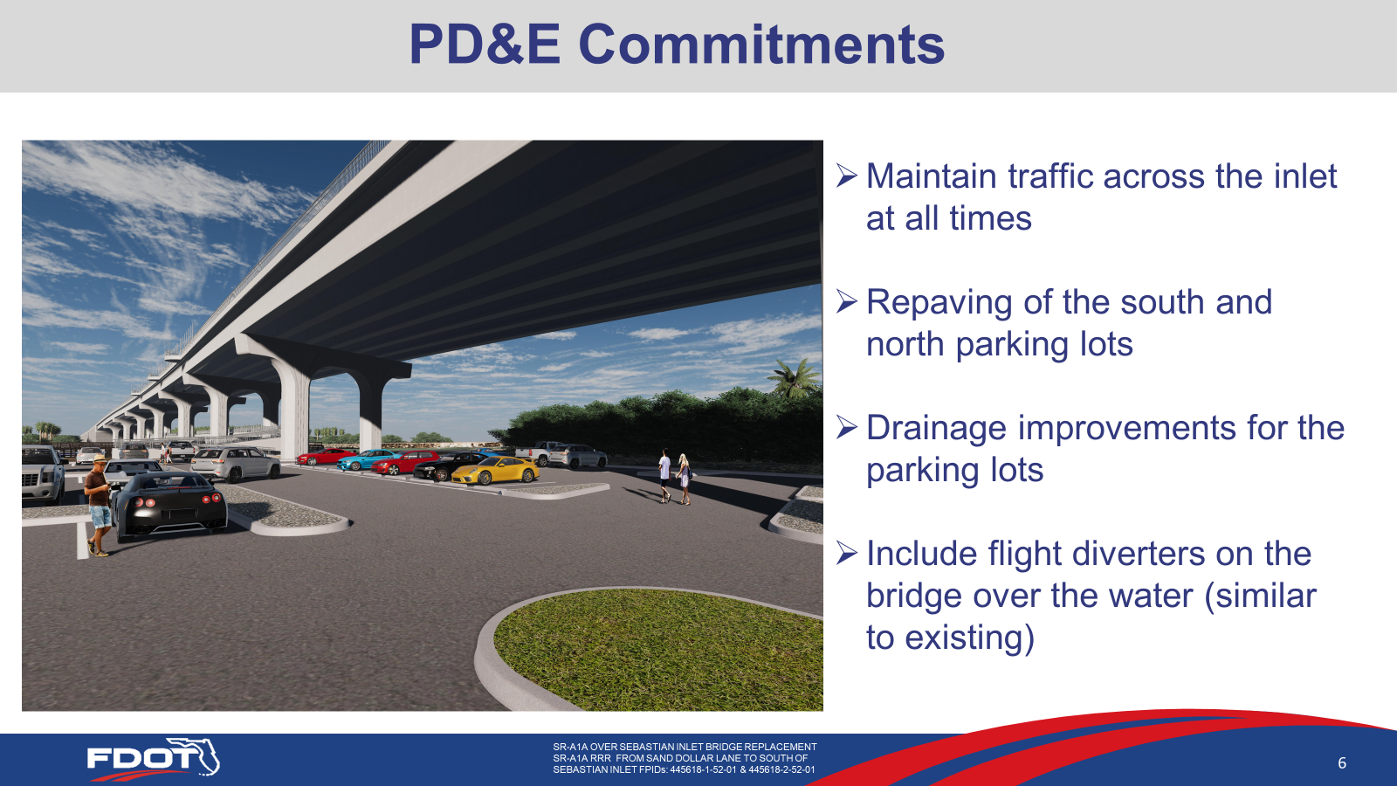
Purpose and Need: Preferred Alternative
18
NTS
ATLANTIC OCEAN
Notes:
These are the commitments that are being implemented during the design phase of this project. These are noted in SWEPT on the Project Commitment Record.
There is also a commitment to have an archeological monitor on site during excavation. This is also included in the Standard Specifications.

Slide 19
PD&E Schedule
19
Start PD&E/NTP – 11/20/2020
LDCA – 5/23/2023
NTS
Production – 10/02/2025 !!!!
ATLANTIC OCEAN
Notes:
The PD&E process took 29 months with several environmental resource processes that had to be accomplished –
Section 4(f)
Section 106
ARC - Acquisition and Restoration Council coordination. This activity does not have to be completed by LDCA.
There was a VE conducted during the PD&E study that helped lay the groundwork for the preferred alternative and the understanding that the bridge had to remain open during construction. The 45 mile detour was not an option.
The Design consultant was brought on board after the PD&E Alternatives Workshop so there was a 6 month overlap with the consultant teams.

Slide 20
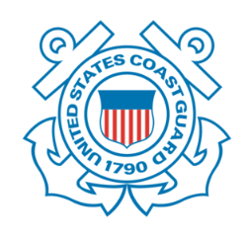


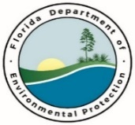


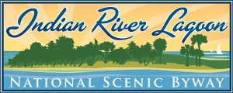


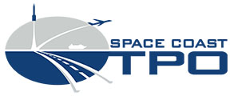



Permits and Coordination:
Federal and State
NTS
US Coast Guard
US Army Corps of Engineers
US Fish & Wildlife Service
NOAA National Marine Fisheries Service
Florida Department of State Parks – Sebastian Inlet State Park
Florida Department of Environmental Protection
Florida Fish and Wildlife Conservation Commission
State Historic Preservation Office
Local Agencies
ATLANTIC OCEAN
Sebastian Inlet District
Florida Inland Navigation District
Indian River County and Metropolitan Planning Organization
Brevard County
Space Coast Transportation Planning Organization
Indian River Lagoon Council
Indian River Scenic Byway Coalition
Notes:
I am going to go through the activities that District 4 engaged in with the Resource/permitting agencies and show you when in the life of the project we started coordination. You do not have to wait for a permit application to coordinate with most of the ETAT (explain ETAT). ETDM is not just a paperwork exercise, we reached out to ETAT during the Feasibility study, based on lessons learned on other bridge replacement projects. Engage with these folks early and often.
FHWA funds the positions, use that to your advantage.
The Resource/Permitting Agencies should be treated as a Community, not the enemy
Don’t assume that once you have submitted your application, everything is golden. Tell the story about the ACOE RAI and the 30 days that were lost because we never bothered to follow up. Technology is great – WHEN IT WORKS.
DO THE PROCESS, don’t argue how to get around the process - SHPO and Section 106.

Slide 21
Agency Coordination – FDEP Park Management
Feasibility/Planning – Coordination Meeting with Park Management, discuss fishing piers and maintenance responsibility
NTS
PD&E – research existing agreements and ROW documents,
research how Park uses FDOT ROW under existing bridge, address Section 4(f) impacts, fishing pier to be included in design and construction
Design and Permitting – discuss temporary trestles and impacts to park, design park entrances with safety in mind,
develop updated ROW documents (both D4 & D5)
ATLANTIC OCEAN
Notes:
Over the years, Treasure Coast Operations has worked with the Park on various maintenance projects.
We started our conversations with them to find out if they would be receptive to a 45 mile detour,
did they want the fishing pier under the new bridge and would they be willing to maintain it, and Par Feedback from the public at both the kick off and alternatives workshop indicated no one was in favor of the detour.
Park staff needs to be on both sides of inlet daily. They were not opposed to the temporary work trestle.

Slide 22
Agency Coordination – FDEP Recreation and Parks
Feasibility/Planning –
NTS
PD&E – research existing agreements and ROW documents,
research how Park uses FDOT ROW under existing bridge, address Section 4(f) impacts
Design and Permitting – discuss temporary trestles and impacts to park, design park entrances with safety in mind,
develop an updated ROW easement agreements (both D4 & D5),
discuss construction phasing
ATLANTIC OCEAN
Notes:
We thought coordinating with the local Park Manager was all that was necessary. We were wrong, there is a FDEP Park Planning component in Tallahassee that gets involved when Park impacts are anticipated.

Slide 23
Agency Coordination – FDEP Division of State Lands
Feasibility/Planning –
NTS
PD&E – New chapter in the PD&E Manual, Volume II, Chapter 23 Acquisition and Restoration Council (ARC) Coordination
Design and Permitting – prepare Upland Easement Application Package, demonstrate that the project meets the Linear Facilities Policy, prepare to present at the ARC meeting. The end goal is a MOA.
ATLANTIC OCEAN
Notes:
The use of State Owned Lands involves the Florida Board of Trustees of the Internal Improvement Trust Funds (TIIF)
ARC involves 9 very specific steps that include getting a letter from the State Park (local) that states the project will provide a net positive benefit to the park. To demonstrate a net positive benefit from this project, District 4 is proposing to repave and reconfigure the parking lots (more parking spaces means more revenue) provide a new drainage system for the parking lots, use MSE wall to minimize footprint of new bridge, these items were developed during PD&E and are documented on the Project Commitment Record (PCR).
When we went through the exercise of programming funds, I asked for C8 funds to cover any of the Project Commitment Records and mitigation for the project. I always program C2/C8 funds at the beginning of the project to address NEPA related items.

Slide 24
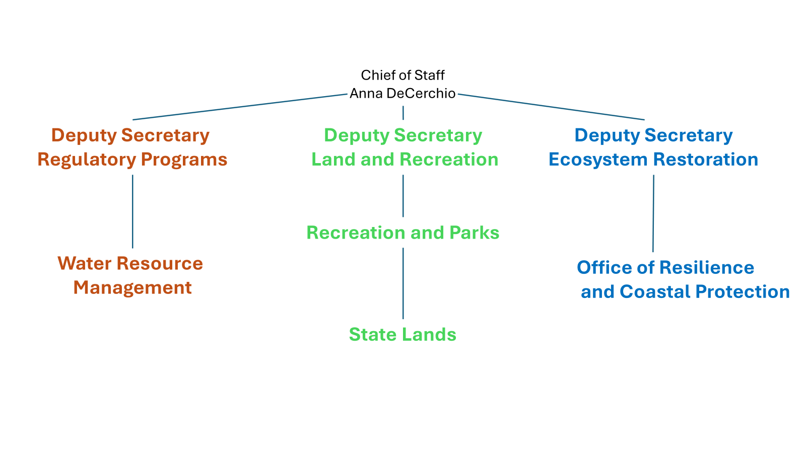
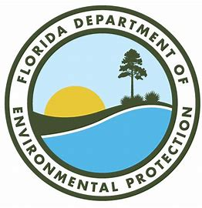
Permits and Coordination - but wait, there’s more
NTS
ATLANTIC OCEAN

Slide 25
Agency Coordination – FDEP Office of Resilience and Coastal Protection
Feasibility/Planning –
NTS
PD&E –
Design and Permitting – they came to us asking about impacts to the sand trap at the western end of the inlet.
Good News - No additional permit required!
ATLANTIC OCEAN

Slide 26
Agency Coordination – FDEP Water Resource Management (Not 404)
Planning/Feasibility –
NTS
PD&E – Started coordination with SJRWMD. Established that a Coastal Construction Control Line permit is necessary. FDEP will take the lead on State ERP
Design and Permitting – pre-application meeting to occur this month. Goal is one submittal, no RAI
ATLANTIC OCEAN

Slide 27
Agency Coordination – Sebastian Inlet District
Planning/Feasibility – Coordination Meeting with SID and Park Management, project support established
NTS
PD&E – research existing agreements and ROW documents,
research how SID uses the SR A1A driveway, research how SID maintains the jetties and inlet. SID continue to support the project
Design and Permitting – design a safe driveway,
develop an updated ROW easement agreement,
discuss construction phasing
ATLANTIC OCEAN

Slide 28
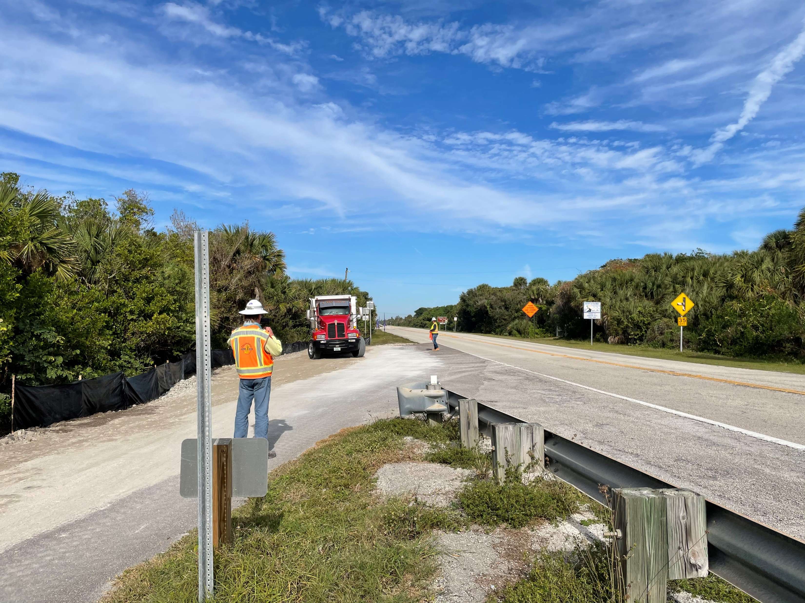
Agency Coordination – Sebastian Inlet District
FDOT has an easement to be in SID ROW and SID has an easement for the driveway connection
NTS
ATLANTIC OCEAN
Notes:
SID gets the sand from the sand trap at the west end of the inlet, stockpiles it and delivers it to beaches by land for renourishment. The current sand hauling operation requires the dump trucks to turn around on the north side of the bridge and use the driveway to get unto SR A1A to head south. This is not a safe turning movement. Remember these ROW documents date back to the 1960/70s and we are working to update them.

Slide 29
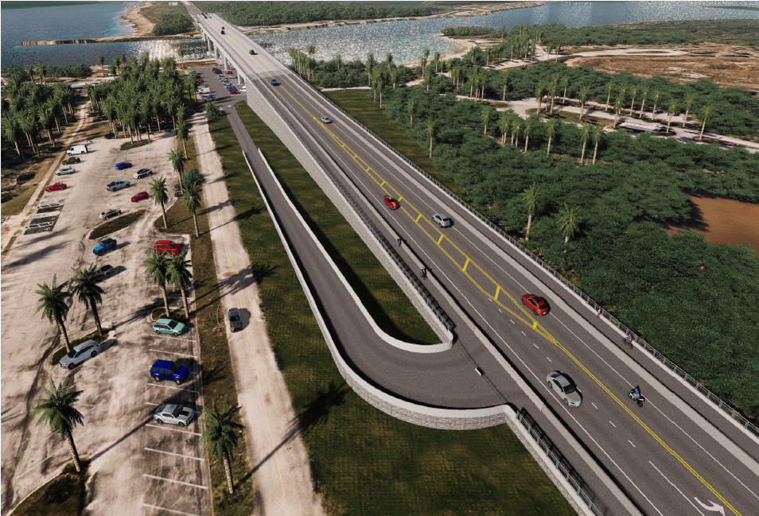
Agency Coordination – Sebastian Inlet District
NTS
Relocating the SID driveway provides a safer condition for the sand hauling and the SR A1A travelers
ATLANTIC OCEAN

Slide 30
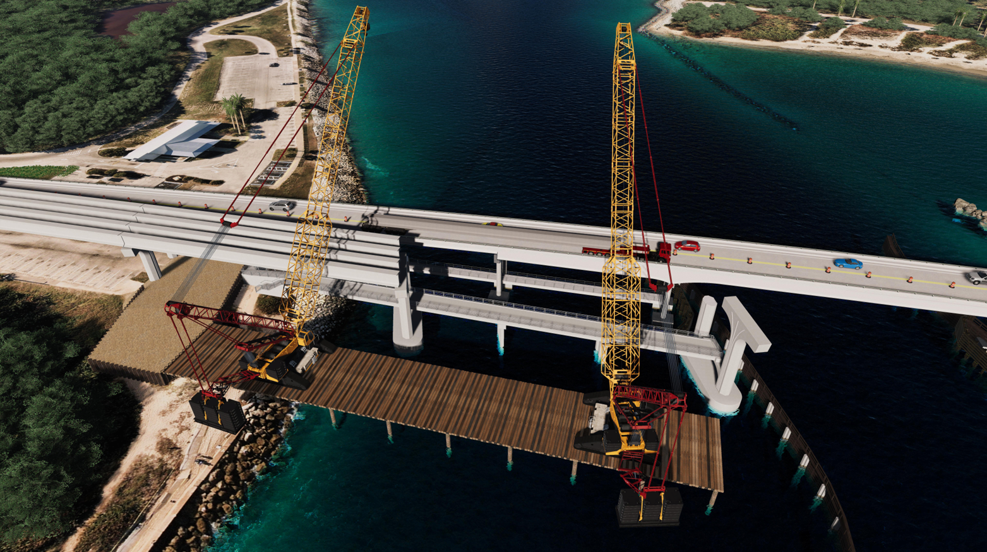
Agency Coordination – Construction Phasing
NTS
ATLANTIC OCEAN
Notes:
Since detouring traffic during construction was not an option, coordination continued with the agencies regarding temporary work trestles. Since Sebastian Inlet District owns and maintains the jetty and the trestles have to go over the jetty on all four corners during different phases, SID coordination continues.
The Park Manager and the Park Planning office in Tallahassee are involved as well. Parking on either side of the bridge will be impacted during construction but FDOT is offsetting those impacts with new drainage, resurfacing and restriping the parking areas.
Now I know that this makes you all twitchy, YOU CAN’T DICTATE means and methods to the Contractor, the risk of leaving this type of agency coordination up to the contractor is too great and we would never meet our Production schedule.

Slide 31
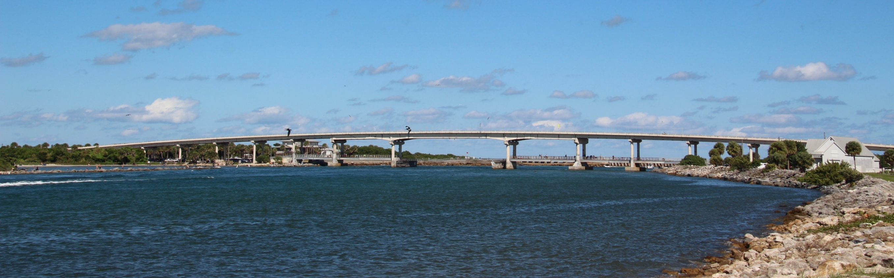
Agency Coordination – State Historic Preservation Office
Eligible for the National Register of Historic Places (NRHP)
Determined Eligible for Listing under Criterion C in the area of Engineering for its high-integrity embodiment of a prestressed concrete bridge in Florida
Notes:
SHPO coordination started before the PD&E study started as well. Based on past rehab projects, we knew the bridge was eligible for listing on the National Register of Historic Places in the area of Engineering. A Cultural Resource Assessment Survey was submitted to SHPO, with an understanding that bridge replacement would have an adverse effect. Check with LYNN – I think 2 commitments plaque and monitoring
It is important to have the SHPO letter to include in the permit application package. If you do not include this letter, the permitting agency stops processing the application, initiates consultation with SHPO (which we already did in PD&E) and requests a concurrence letter. This is duplication of work effort. The SHPO letter is in SWEPT and here is District 4, PLEMO uploads agency concurrence letters into PSEE. Including the SHPO letter with the initial permit application prevents RAIs.

Slide 32
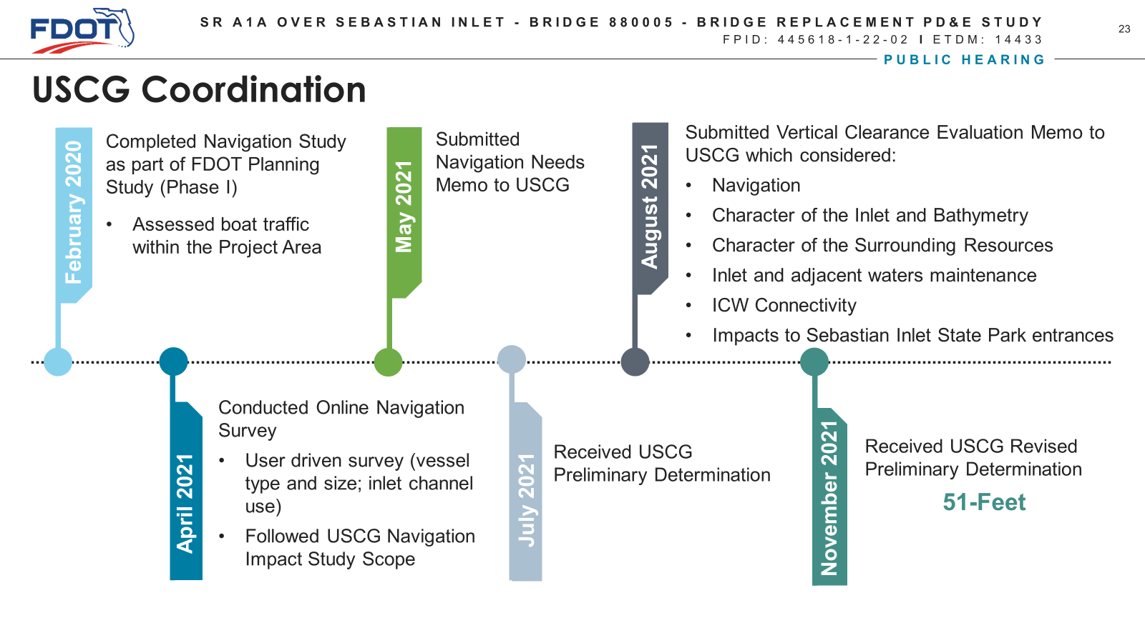
Agency Coordination - USCG
NTS
ATLANTIC OCEAN
Notes:
The USCG permit application has been submitted with the proposed 51’ vertical clearance, the Public Notice is going out soon.
USCG is part of ETDM/ETAT. We started talking to them even before the PD&E study was advertised. Navigation studies were conducted during the Feasibility study and again during the PD&E study. Research demonstrated that although the SID connects to the ICWW, it is not part of the ICWW. The typical vertical and horizontal clearance criteria do not apply. Although USCG did state that if mariners/boaters comment on clearances during the Public Notice, we will have to regroup and continue the discussion.

Slide 33
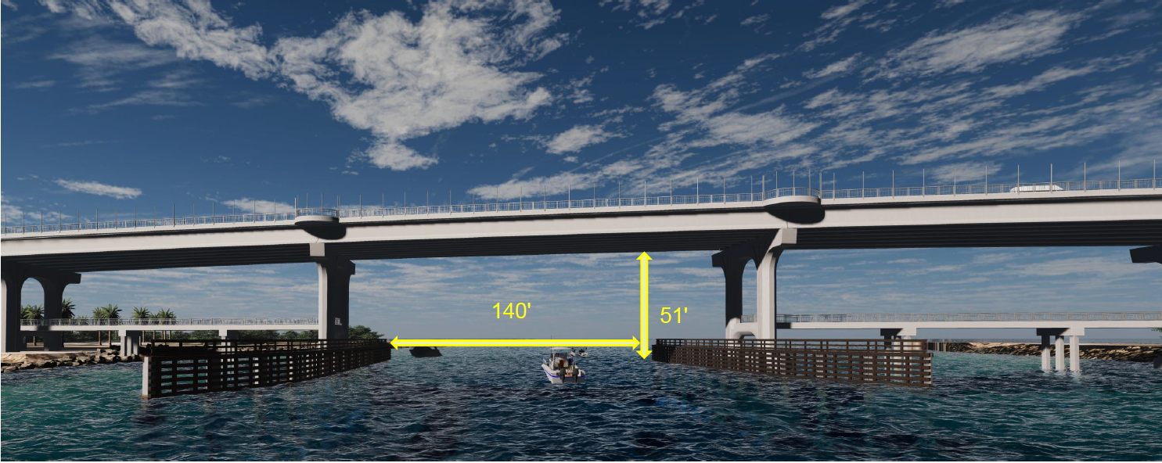
Agency Coordination - USCG
NTS
ATLANTIC OCEAN
Notes:
There are park entrances on the north and south side of the bridge. To reduce impacts to park property (avoid Section 4(f) and reduce the footprint to State owned lands) the entrances were used to determine the structures vertical clearance.

Slide 34
Permits and Coordination: Best Practices
Coordinate with stakeholders early and often
NTS
Research your project and the community around it
Overlap PD&E and Design, avoid re-design
of the Preferred Alternative
Always, always, always look for
opportunities to improve safety
ATLANTIC OCEAN
Give the people what they want

Slide 35

Project website: https://www.fdot.gov/projects/SebastianInletBridge
Contact Us
FDOT
CONSULTANTS
Ann Broadwell
District Environmental Manager
FDOT District 4
Planning and Environmental Office
Phone: 954-777-4325
Email: Ann.Broadwell@dot.state.fl.us
Ian Biava, P.E.
Consultant Project Manager - Design
TranSystems
Phone: 954-200-8264
Email: Ibiava@TranSystems.com
Binod Basnet, P.E.
Project Management Supervisor
FDOT District 4
Consultant Management Section, Design Office
Phone: 954-777-4146
Email: Binod.Basnet @dot.state.fl.us
Beth Beam MS, AICP
Consultant Project Manager – PD&E Study
Stantec
Phone: 407-627-9772
Email: Beth.Beam@Stantec.com

Slide 36
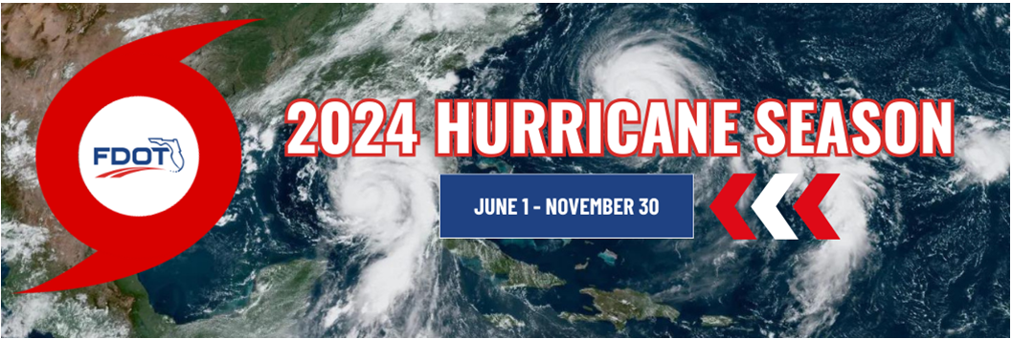
District 4 Safety Message
.
Be Prepared

Slide 37
