Slide 1
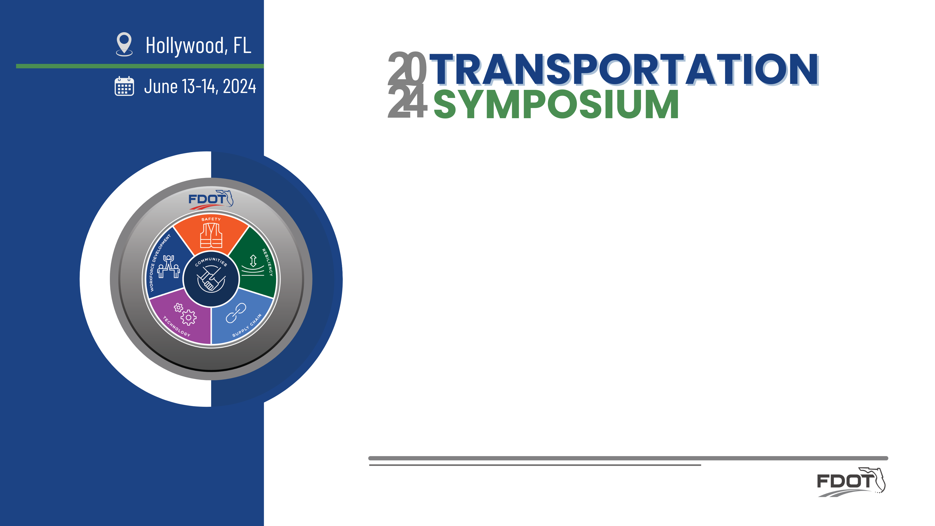
Smart Work Zone Design
James McGinnis, P.E.
State Roadway Design Office
W.D. Baldwin, P.E.
State Traffic Engineering & Operations Office
Notes:
James
Please save q’s to end.

Slide 2

Objectives
What is a Smart Work Zone (SWZ)?
What Are Benefits of SWZ?
FDOT SWZ Strategies
SWZ Design Resources
Use of Resources for Selecting and Designing SWZ Strategies
Notes:
(James)
Through this presentation we will cover the following:
•characteristics of a SWZ
•some of the benefits of SWZ
•the 4 current SWZ Strategies,
•how SWZ’s can be mainstreamed into FDOT work zone and the available resources,
•SWZ resources, and
•how to select and design SWZ Strategies on a project.

Slide 3




What Makes SWZ Smart?
SWZ have the following general characteristics:
Real-time: The system obtains and analyzes traffic flow data in real-time, providing frequently updated information to motorists.
Portable: The system is portable, allowing its installation at different locations (with configuration modifications, as necessary).
Automated: The system operates in an automated manner with minimal human supervision.
Reliable: The system provides accurate and reliable information, keeping in mind the serious consequences of misinforming motorists in work zone situations.
Notes:
(James)
What makes a smart work zone…. Smart?
In general, S.W.Z.s have the following general characteristics:
They obtain, process, and analyze traffic data and provide near real-time information to motorists.,
They are portable,
Automated, and
Reliable.
Traditional M.O.T. Temporary Traffic Control (TTC) plans use static signs and portable changeable message signs (P.C.M.S.). The P.C.M.S. are more visible than static signs, but the messages are not updated as real-time traffic conditions change.
As with traditional MOTTTC, SWZ technologies are portable, allowing the roadside equipment to be moved or repositioned as the traffic patterns change within the work zone.
Unlike traditional MOTTTC, SWZ technologies and strategies are automated, often using a cloud-based SWZ processor, and require little, if any, human intervention to perform analysis or output information. Some strategies require initial configuration for each specific TTCP phase or lane closure to ensure optimal performance. This configuration is done remotely through an Internet-based user interface
SWZ technologies are reliable and function in a manner that allow transportation officials and road users to trust the outputs and results of these systems.

Slide 4
SWZ Strategies
SWZs use combinations of technologies to create strategies in response to work zone traffic impact scenarios. FDOT SWZ strategies covered in the SWZ Guidebook and Developmental Design Concept (DDC) include:
  Work Zone Data Exchange (WZDx)
  Dynamic End of Queue/Slow Speed Warning (DQW)
  Dynamic Lane Merge (DLM)
  Dynamic Speed Harmonization (DSH)
Notes:
(James)
To date, FDOT is developing guidance materials, developmental standards, and specifications for four S.W.Z. strategies. The S.W.Z. strategies are:
Work Zone Data Exchange (also known nationally as W.Z.Dx),
Dynamic Queue Detection / Slow Speed Warning (D.Q.W.),
Dynamic Lane Merge (D.L.M.),
Dynamic Speed Harmonization (D.S.H.), and
Except for W.Z.Dx, the S.W.Z. strategy acronyms are primarily only used within FDOT. The strategies, technologies, and guidance materials are described in greater detail in the next few sides.

Slide 5
Benefits of SWZ
Benefits | WZDx | DQW | DLM | DSH
Reduce WZ crashes (sideswipe) |  |  | P
Reduce WZ crashes (rear-end) |  | P | P | P
Reduce WZ speed variation, stop and go traffic |  | P | P | P
Improve WZ vehicle throughput |  | P | P | P
Reduce WZ congestion |  | P | P | P
Improve WZ traveler information | P | P | P | P
Notes:
(James)
Before getting into details of the four S.W.Z. strategies, this slide provides a high-level overview of the typical benefits seen when using S.W.Z. strategies. All the S.W.Z. strategies are intended to improve safety and efficiency for traffic approaching and moving through work zones. These strategies also support increased safety for construction workers. The next few slides summarize the applications, benefits, and technologies for each S.W.Z. strategy shown in this table.

Slide 6
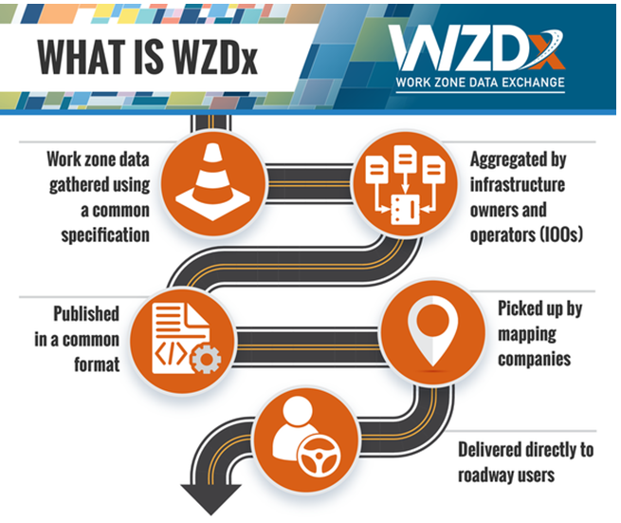
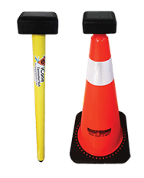
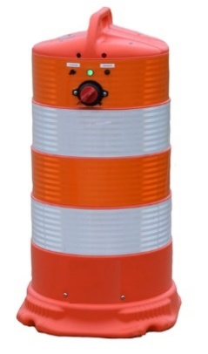
Work Zone Data Exchange (WZDx)
Program Sponsor: Federal Highway Administration (FHWA)
Goal: Safe work zone navigation for vehicles equipped with automated driving systems (ADS)
Work Zone Data: Near real-time work zone data for third party use
Recommended: Use for projects impacting traffic or when workers are adjacent to open traffic lanes
Long Term: Eventually use WZDx on all projects that potentially impact traffic
Notes:
(James)
The first strategy is the W.Z.Dx. The W.Z.Dx. is a national program sponsored and promoted by the Federal Highway Administration (F.H.W.A.). F.H.W.A. has developed the Work Zone Data Exchange (WZDx) Specification to provide uniform guidance and instructions. The W.Z.Dx. enables infrastructure owners and operators, like FDOT, to make work zone data available for third party use.
The goal of W.Z.Dx. is to enhance the ability of vehicles equipped with automated driving systems (A.D.S.) to safely and efficiently navigate work zones. FDOT is planning to transition toward use of W.Z.Dx. for projects on limited access or high-speed roadways with Level of Service E or F (existing or anticipated during construction), with work zone traffic impacts lasting 5 days or more, and with a construction duration 6 months or greater.
The W.Z.Dx. uses a roadside device that transmits its location and certain messages to the “cloud” using cellular Internet. W.Z.Dx. devices are placed at ROAD WORK AHEAD sign locations and are located on P.C.M.S. and Arrow Boards.
The messages the W.Z.Dx. device transmits is based on its location. For example, a W.Z.Dx. device located with an Arrow Board will transmit a “right or left lane closed” message to the W.Z.Dx. data exchange hosted by FHWA.

Slide 7
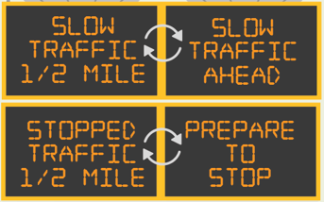
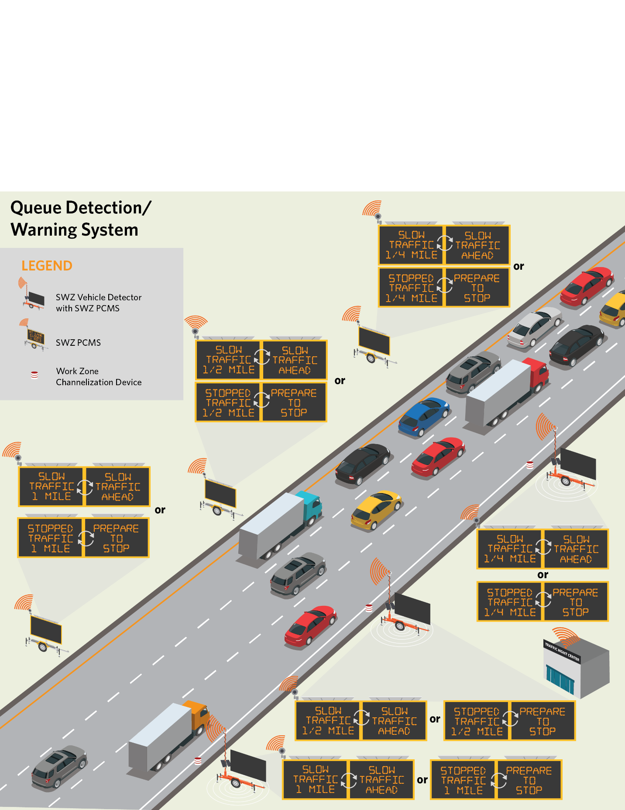
Dynamic Queue Detection / Slow Speed Warning (DQW)
Goals
  Fewer work zone crashes
  Increased throughput
SWZ Vehicle Detectors
  Traffic speeds
  Traffic volumes
SWZ Central Processor
  Locate slower traffic
  Locate stopped traffic
  Locate end of queue
  Selects messages from pre-approved library
  Posts messages to PCMS
Portable Changeable Message Signs (PCMS)
Notes:
(James)
The S.W.Z. strategy nationally used is the Dynamic Queue Detection/Slow Speed Warning. FDOT has abbreviated this strategy as D.Q.W. The D.Q.W. is deployed where lane closures, restrictions, or other construction activities may cause traffic to slow or stop. This causes queues to build upstream from the traffic restriction. The queues often result in stop-and-go or slow-and-go conditions and could potentially cause rear-end collisions. This strategy is used to alert motorists of the conditions ahead giving them heightened awareness and time to slow before coming upon this downstream congestion.
The D.W.Q. uses S.W.Z. vehicle detectors located in, and ahead of, the work zone to monitor traffic speeds and volumes. Then algorithms developed for the speed or traffic and placement of the equipment are set to activate upstream S.W.Z. P.C.M.S. messages to warn traffic of the condition ahead when certain vehicle speed and volume thresholds are met. The messages provide information on the traffic conditions, whether slow or stopped, and the distance the motorist is likely to encounter these conditions.

Slide 8
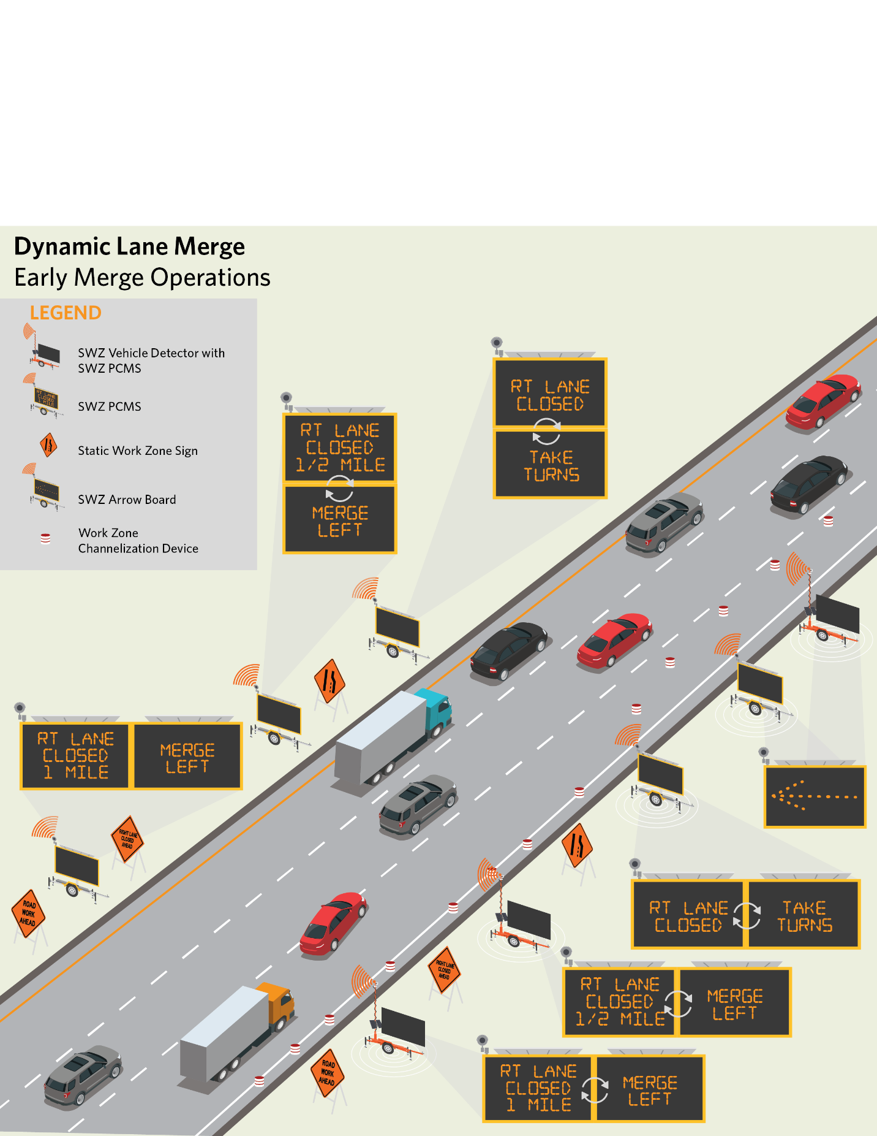
Dynamic Lane Merge (DLM)
DLM Scenarios
  Early Merge: move traffic (≤1,500 vehicles/lane/hour) to open lanes as early as possible
  Late Merge / Zipper Merge: keep traffic (>1,500 vehicles/lane/hour) in all lanes until the lane closure
Goals
  Increase safety (hard braking, road rage)
  Reduce queue length
  Increase throughput
SWZ Detectors
  Speed and volume approaching merge and through the work area
SWZ Central Processor
  Determine applicability of early merge or late merge based on pre-determined algorithms
  Select PCMS messages from pre-approved library
  Post messages to PCMS
SWZ PCMS
  Post early merge or late merge messages from Central Processor
Notes:
(James)
Another frequently used S.W.Z. strategy is Dynamic Lane Merge, or D.L.M. The D.L.M. strategy is used for highway lane closures to increase safety and reduce traffic delays.
Typically, during a highway lane closure, there are some drivers who move over immediately once they see the first advisory sign while other motorists will wait until the last possible moment before merging over to the open lane. This variability in the decisions and attitudes of motorist's results in traffic speed differentials, hard braking, road rage, and crashes
The D.L.M. strategy is used to create more orderly merging conditions at lane closures based on traffic volumes and communicates guidance to drivers through P.C.M.S. or through connected vehicle on-board units. This strategy has 2 operational scenarios: dynamic early merge and dynamic late merge (also called “Zipper Merge”).
D.L.M.-Early Merge operation works best for low traffic volume conditions when there are ample gaps in traffic to get all vehicles to merge into the open lanes early so that they are traveling at uniform speeds when they approach the lane closure.
The D.L.M.-Late Merge strategy works best when approaching traffic volumes are nearing or exceed the capacity of the remaining open lanes. Unlike early merge where drivers are encouraged to move lanes as soon as possible, late merge directs motorists to stay in their existing lanes and merge at a single point just prior to the lane closure. Then, motorists are directed to merge (or zipper) with other drivers by taking turns in an orderly fashion. Late merge has been shown to reduce crashes and delay for lane closures in high-volume conditions.
The S.W.Z. Central Processor uses data from the S.W.Z. Portable Vehicle Detectors to implement either early or late merge based on real-time traffic conditions and transitions between the two modes as traffic conditions change. The S.W.Z. Central Processor posts the relevant messages to the S.W.Z. P.C.M.S. from a library of pre-approved messages.
The next two slides show possible S.W.Z. P.C.M.S. messages for early and late merge scenarios.

Slide 9



Dynamic Lane Merge (DLM)
PCMS for DLM
Early Merge Scenario
Notes:
(James)
This slide shows possible P.C.M.S. messages for the D.L.M.-Early Merge scenario. The S.W.Z. P.C.M.S. directs drivers to move to the open lanes early so that by the time they get to the lane closure, all traffic is merged and flowing at a uniform speed.

Slide 10
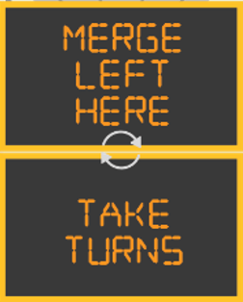
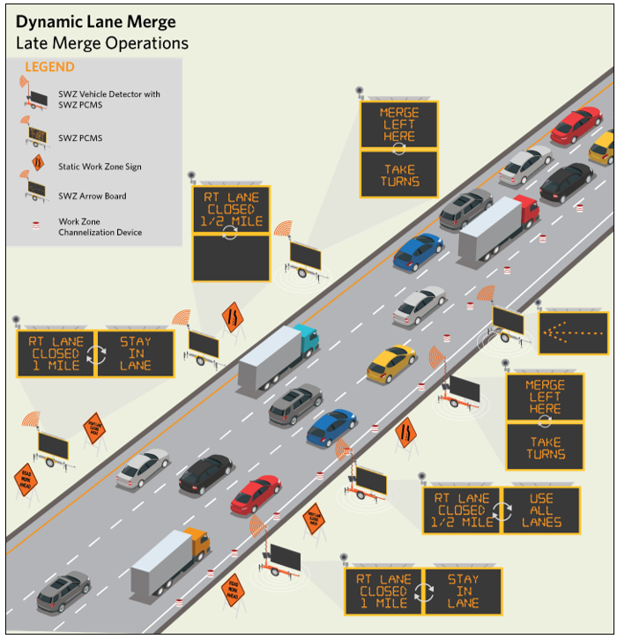


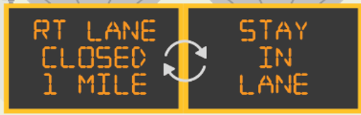
Dynamic Lane Merge (DLM)
PCMS for DLM
Late Merge Scenario
Notes:
(James)
This slide shows possible P.C.M.S. messages for the D.L.M. - Late Merge scenario. The S.W.Z. P.C.M.S. directs drivers to use all lanes until they get to the merge point. At the merge point, drivers are encouraged to take turns or “zipper” into the open lane or lanes.
A zipper-type merge has been attempted using only static signs but directing drivers to merge late during low volume conditions may result in hazardous maneuvers at the merge point.
As noted earlier, this operational scenario has been shown to reduce delay and to reduce the overall length of queues resulting from the lane closure when high traffic volumes exist.

Slide 11
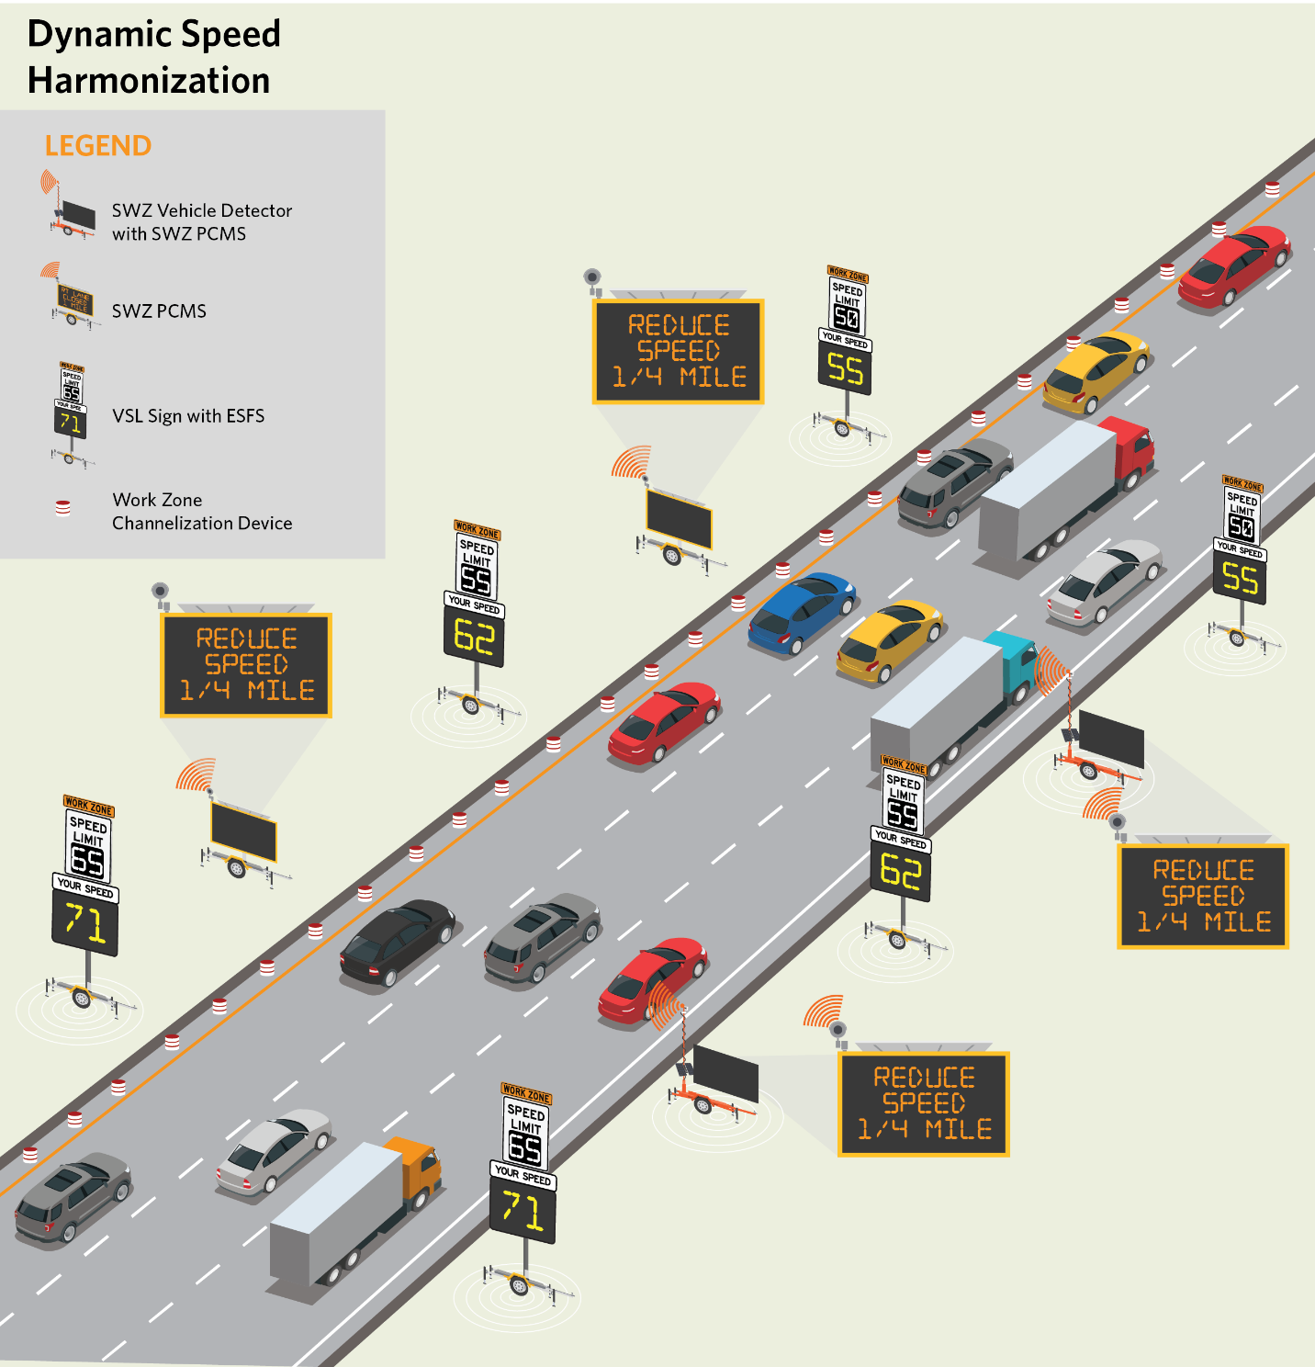
Dynamic Speed Harmonization (DSH)
Goals
  Uniform speeds approaching and the through work zones
SWZ Vehicle Detectors
  Vehicle speeds approaching and through work area
SWZ Central Processor
  Locates slow traffic speed areas
  Determines speed limits for traffic approaching slowed speed areas and posts speeds to SWZ VSL signs
  Determines PCMS messages from pre-approved library and posts messages to SWZ PCMS
SWZ PCMS
  Reduced speed ahead messages
SWZ Variable Speed Limit (VSL) Signs with Electronic Speed Feedback Signs (ESFS)
  VSL: Current speed limit based on downstream traffic
  ESFS: Displays speed of traffic passing the sign
Notes:
(James)
A less commonly used but highly promising S.W.Z. strategy is Dynamic Speed Harmonization, or D.S.H. D.S.H. is intended to uniformly reduce speeds as traffic approaches areas of traffic congestion, bottlenecks, incidents, special events, and other conditions that affect traffic flow. The D.S.H. strategy assists in maintaining traffic flow by reducing unnecessary stops and starts and maintaining consistent speeds. The speed limits generated by the S.W.Z. Central Processor are displayed on S.W.Z. portable variable speed limit signs (V.S.L.) and are sent to the W.Z.Dx to be available as on-board messages for connected vehicles.
There are two common instances for using DSH in work zones:
The first instance is when traffic speeds vary through the work zone and/or where the traffic speed approaching the work zone is considerably higher than speed through the work zone.
The second instance is when lower speed limits are needed to protect workers who are close in proximity to passing traffic as compared to when they are protected by barriers.
The S.W.Z. Central Processor gathers approaching and through vehicle data for the work zone. Using pre-defined algorithms, the S.W.Z. Central Processor calculates and sends regulatory speed limits to the portable V.S.L. signs with the intent of gradually slowing traffic as it approaches the (slowed traffic condition? bottleneck). Also, Electronic Speed Feedback Signs (E.S.F.S.) are used to reinforce to drivers the need to obey the speed limit. Further, off-duty law enforcement officers are also used to reinforce the speed limit even when they can’t safety enforce the work zone speed limits. Lastly, S.W.Z. P.C.M.S. warn drivers of the speed reduction ahead.
The next slide shows a conceptual layout for the D.S.H. strategy.

Slide 12
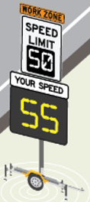
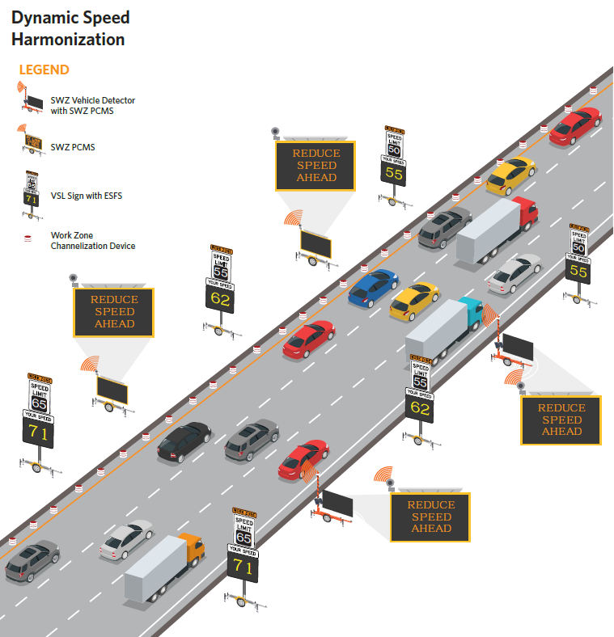
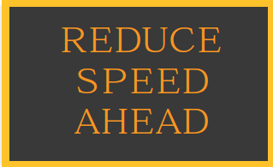
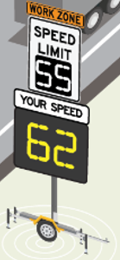
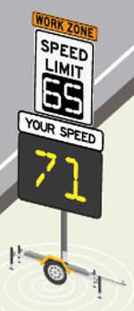
Dynamic Speed Harmonization (DSH)
SWZ PCMS and VSL with ESFS for DSH
Notes:
(James)
For the D.S.H. strategy, speed limits are determined by the S.W.Z. Central Processor using pre-approved scenarios for setting the maximum and minimum speed limits, and the incremental speed limit changes from V.S.L. sign to V.S.L. sign.
The speed limits are based on current downstream traffic speeds.
S.W.Z. P.C.M.S. warn motorists the distance until the next reduction in speed that will be shown on a S.W.Z .V.S.L. sign.
FDOT’s speed zoning manual requires speed limits to be approved by the District Traffic Operations Engineer or a delegate. Typically, this role will be delegated to an Operator at the Regional Transportation Management Center who will review and accept the speed limits generated by the SWZ Central Processor through an Internet-based interface with the system.
An advantage of the D.S.H. strategy is that lower speed limits can be posted where workers are present or allowing a higher speed limit where workers are not present and where lane restrictions allow a higher speed limit.

Slide 13
Goal is to Mainstream Smart Work Zones
Mainstream SWZ into projects based on objective criteria
Promote statewide driver expectations and recognition
Notes:
(James)
The FDOT Transportation Systems Management and Operations (T.S.M.&O.) Strategic Plan identifies “mainstreaming” as a priority focus area for T.S.M.&O., including S.W.Z., implementation.
FDOT uses guides, standards, manuals, and specifications to mainstream transportation practices and technologies. All together, these documents will lead to consistent S.W.Z. implementation. With consistent implementation drivers will have greater awareness and recognition of S.W.Z strategies as they traverse work zones.
Over the next few years, FDOT will gain additional familiarity with S.W.Z.s and continue to improve the Standards, FDOT Design Manual, and Specifications.
The next group of slides summarize how the S.W.Z. strategies and technologies are addressed in the guide document, Developmental Standard Plans, Developmental Design Criteria, and Developmental Specifications.
(Hand-off to WD)

Slide 14
Resources to Support Design & Construction
Smart Work Zone Design and Operations Guidebook
Developmental Standard Plans for 102-600 series
Developmental Design Criteria (DDC) for FDOT Design Manual (FDM) Section 240 Transportation Management Plan
Developmental Specs (DevSpecs) for:
  Section 102 Maintenance of Traffic
  Section 990 Temporary Traffic Control Device Materials
Notes:
(WD)
As James mentioned on the last slide, FDOT has developed S.W.Z. guidance documentation, Developmental Design Standard Plans, Developmental Design Criteria, and Developmental Specifications. The goals of these developmental efforts are consistent deployment of S.W.Z. technologies and consistent use of S.W.Z. strategies and technologies by design and construction personnel. Consistency will also promote increased driver familiarity leading to improved safety and traffic operations through S.W.Z. work zones.
FDOT has developed the following documents for the design and use of S.W.Z.s:
The Smart Work Zone Design and Operations Guidebook,
Developmental Standard Plans related to Index 102-600 series,
Developmental Design Criteria (D.D.C.) for the FDOT Design Manual (F.D.M.) Section 240, and
Developmental Specifications (DevSpecs) for Section 102 (Maintenance of Traffic) and Section 990 (Temporary Traffic Control Devices Materials)

Slide 15
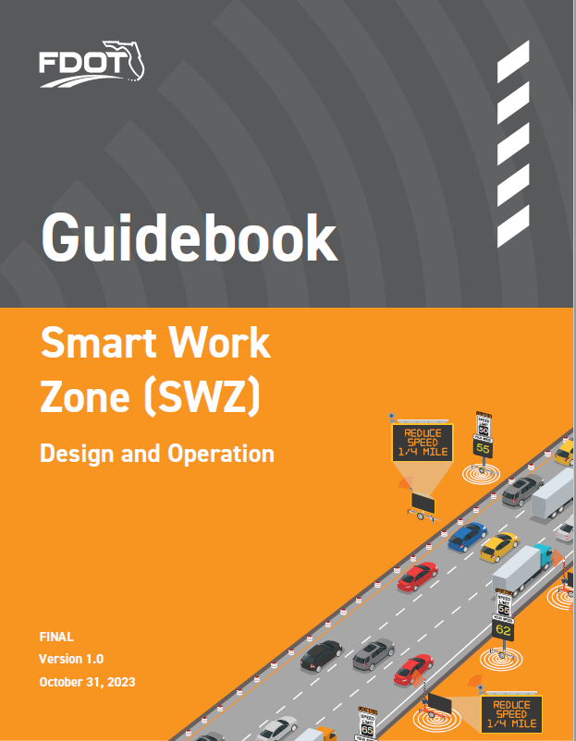
SWZ Design and Operations Guidebook
Chapters:
  Introduction
  Programming and Scoping
  Identification and Selection of SWZ Strategies
  SWZ Systems Engineering Analysis
  SWZ Public Information Plan
Notes:
(WD)
Released this past fall, The Smart Work Zone Design and Operation Guidebook was intended to be an overview of the technologies and processes for SWZ systems. Encourage you to read this first to get an overall understanding of FDOT SWZ.
It provides readers with:
A high-level description of S.W.Z. strategies,
Overview of the processes for programming S.W.Z. into projects,
Discusses the processes for identification and selection of S.W.Z. strategies, and
The Guidebook suggests ideas for including S.W.Z.s in the Public Information Plan required by F.D.M. Chapter 240.
Since S.W.Z.s are considered intelligent transportation systems and eligible for federal funding, the Guidebook also provides an overview of the Systems Engineering Analysis when S.W.Z..s are being included in a Temporary Traffic Control Plan.

Slide 16
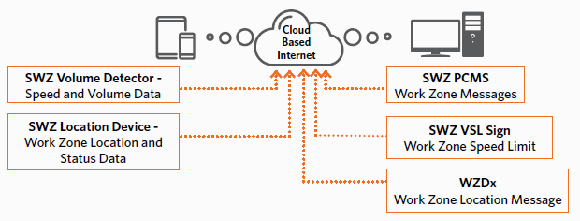
Guidebook Chapter 1 - Introduction
Chapter 1 Contents:
Purpose of the SWZ Guidebook
Characteristics of SWZ
SWZ Technologies
SWZ Strategies and Systems
SWZ Operations
SWZ Central (Cloud-based) Processor
Notes:
(WD)
The Introduction Chapter of the S.W.Z. Guidebook has five subsections.
These subsections contain the following:
The purpose of the manual and the characteristics of S.W.Z.s ,
Identification and description of S.W.Z. technologies and S.W.Z. strategies, and lastly
An overview of how SWZ strategies are operated primarily using a S.W.Z. Central (Cloud-based) Processor.

Slide 17
Guidebook Chapter 2 - Programming and Scoping
Highway Functional Classification
Existing Posted Speed
Existing LOS, Work Zone Congestion
Work Zone Traffic Impacts
Construction Duration
Implement SWZ Strategy
  Chapter 2 Contents:
  Assess Projects for SWZ Priority
  Include SWZ in the Design Scope of Services
Notes:
(WD)
Chapter 2 of the Guidebook, Programming and Scoping, prioritizes the use of S.W.Z. applications when work zones negatively impact traffic safety and throughput.
Some factors designers should consider to assess the priority for S.W.Z. implementation are the type of route, the existing posted speed limit, pre-construction congestion, and duration of traffic impacts.
Designers should also look at the Developmental Design Criteria F.D.M. 240.6.2. There, it lists additional S.W.Z. considerations such as truck volumes, crash history, and geometric constraints. These subjective criteria can be applied during project planning and programming.
Lastly, Chapter 2 reminds project managers to include S.W.Z.s in the Design Scope of Services for both design-bid-build and design-build projects.

Slide 18
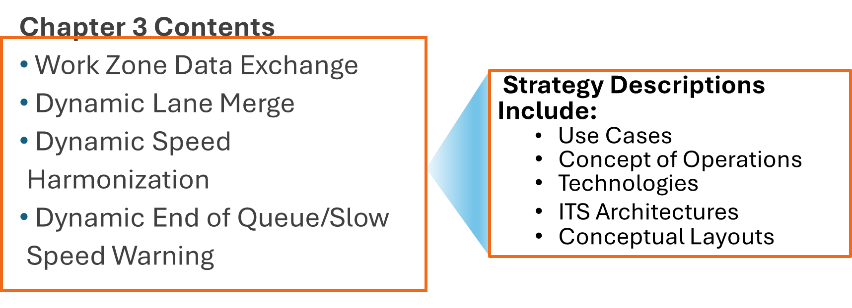
Guidebook Chapter 3 - SWZ Strategies
Notes:
(WD)
Chapter 3, the longest chapter in the Guidebook, describes the various S.W.Z. strategies in detail.
Also, Chapter 3 provides conceptual layouts to help designers better understand how these strategies function.
Lastly, Chapter 3 discusses Use Cases, Concepts of Operations, Technologies, and basic ITS Architectures applicable to each of the SWZ strategies.

Slide 19
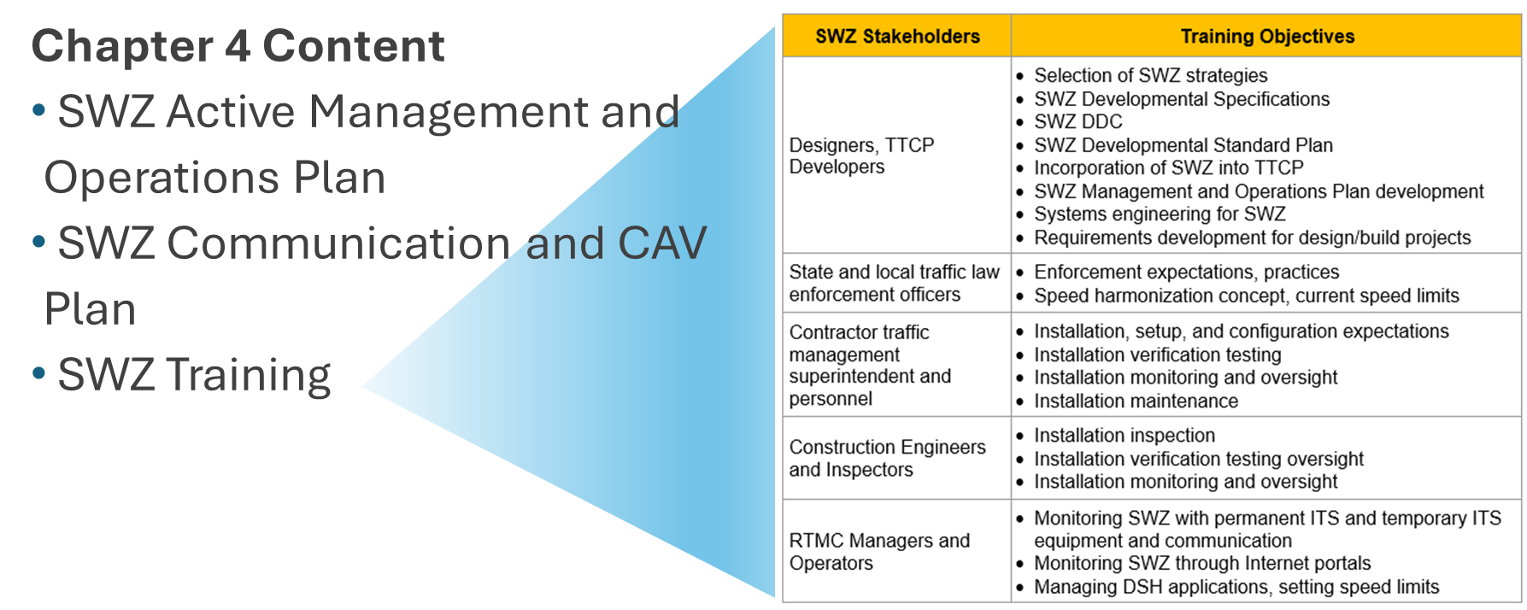
Guidebook Ch 4 - SWZ Systems Engineering Analysis
Notes:
(WD)
Chapter 4, Systems Engineering Analysis, provides information needed to comply with FDOT Procedure No. 750-040-003 FDOT Systems Engineering and ITS Architecture Procedure when S.W.Z. implementation is planned in a project.
Chapter 4 also discusses how to address S.W.Z.s in the Transportation Operations Plan using the Developmental Design Criteria in F.D.M. Chapter 240.
Further, Chapter 4 provides additional details about S.W.Z. roles and responsibilities for various agencies and personnel, and on the S.W.Z. Central Processor.
S.W.Z.s need a communication plan. Chapter 4 covers how to develop one. The communication plan covers how S.W.Z. roadside devices communicate with the S.W.Z. Central Processor and the communication plan covers how S.W.Z. roadside devices communicate with connected vehicles, if that technology is part of the project.
Finally, Chapter 4 provides a high-level S.W.Z. training plan, as shown in the table on this slide. The training plan identifies S.W.Z. Stakeholders and potential training targets for each Stakeholder.

Slide 20
Guidebook Chapter 5 - SWZ Public Information Plan
Chapter 5 Content
  When using SWZ strategies and technologies in the TTCP, the Public Information Plan (PIP) described in FDM 240.4 should address SWZ elements included in the project. The PIP should communicate to the traveling public the intent, features, and duration of smart work zone strategies planned for the project. The PIP should take into consideration needs relative to multiple trip types such as daily commuters and tourists.
Notes:
(WD)
The last Chapter of the Guidebook, Chapter 5 : SWZ Public Information Plan, recommends addressing S.W.Z.s in the Public Information Plan, P.I.P., as described in FDM 240.4. The Developmental Design Criteria in FDM 240.4 also encourages S.W.Z.s to be addressed in the P.I.P.
The P.I.P. should focus on communicating to the pubic the intent, features, and duration of the S.W.Z. strategies planned for the project. Some agencies have even developed public safety messages with short videos describing a specific S.W.Z. strategy with what a driver should expect to observe and how a driver should respond.
The next few slides will summarize the Developmental Design Standard Plans (or Indexes), the F.D.M. Developmental Design Criteria, and the Developmental Specifications available for S.W.Z. design and implementation.

Slide 21
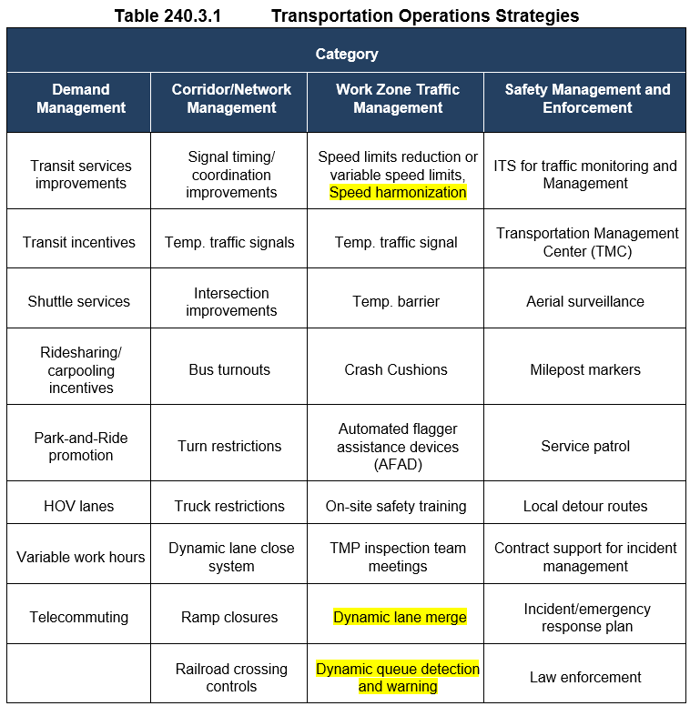
Developmental Design Criteria - Section 240 Transportation Management Plan
DDC Content Includes:
  Sec 240.2.1.2 – Work Zone Speed
  Table 240.3 Transportation Operations Plans – adds SWZ strategies to Table 240.3.1
  Sec 240.4 – addresses SWZ in Public Information Plans
  Sec 240.6 – SWZ Strategies and Technologies
    240.6.1 SWZ Strategies and Technologies
    240.6.2 Smart Work Zone Criteria
Notes:
(WD)
The F.D.M. is the primary source for design criteria and guidance. Chapter 240 contains the criteria for the development of Transportation Management Plans, and Temporary Traffic Control Plans.
The Developmental Design Criteria, D.D.C., for 240 adds Smart Work Zone elements to FDM 240. For example, D.D.C. Chapter 240.2.1.2: Work Zone Speed, allows speed limit reductions when using Smart Work Zones. Also, D.D.C. Section 240.3 adds S.W.Z.s to Table 240.3.1 Transportation Operations Strategies.

Slide 22
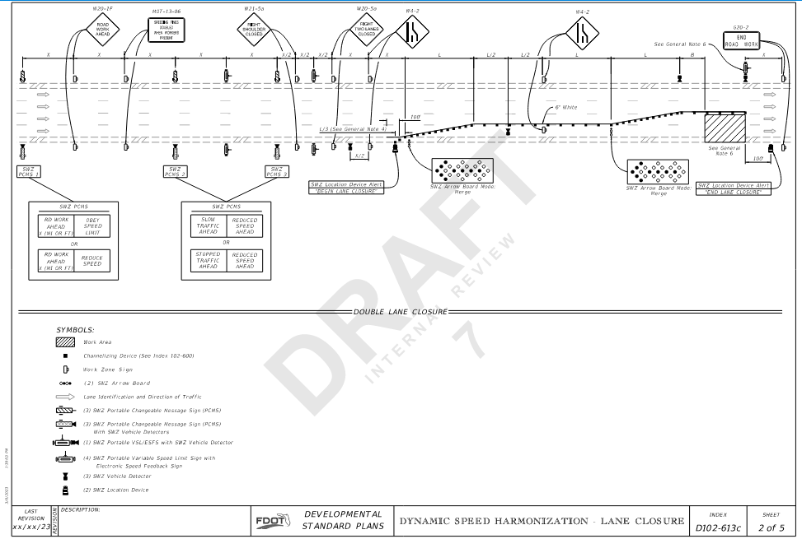
Developmental Standard Plans
Index 102-600 Series
Developmental Indexes
  D102-608 Two-Lane, Two-Way Diversion Connection
  D102-613 Multi-Lane Roadway, Lane Closures
  D102-620 Multi-Lane Roadway, Temporary Diversion
  These Indexes cover DQW, DSH, and DLM SWZ strategies
Notes:
(WD)
THESE ARE JUST A FOUNDATIONAL TOOL FOR DEVELOPING SITE SPECIFIC PLANS! You will want to start with this and add as needed for your specific project conditions.
A series of Developmental Standard Plans for based off the Standard Plans 102-600 Series, show the layout and contents of the S.W.Z strategies discussed earlier in various applications. These Developmental Standard Plans provide designers and construction personnel with a general layout and spacing of the various S.W.Z. roadside devices approaching and driving through a work zone.
The Developmental Indexes are D102-608: Two-Lane, Two-Way Diversion Connection, D102-613: Multilane Roadway Lane Closures, and D102-620: Multi-Lane Roadway Temporary Diversion. It is recommended that designers refer to both the S.W.Z. Guidebook and the F.D.M. D.D.C. 240 when selecting, designing, and implementing S.W.Z. strategies.
Just like other standard plans, the Developmental Standard Plans are the basis for developing site-specific plan sheets and layouts for these systems. Ultimately Temporary Traffic Control Plan sheets must be developed to match the project conditions.

Slide 23
Developmental Specifications - Dev 102 & 990
Developmental Specs (DevSpecs)
  Dev102SWZ: Maintenance of Traffic – Smart Work Zone (SWZ) Management
  Dev990SWZ: Temporary Traffic Control Device Materials – Smart Work Zone (SWZ) Management System
990-3 Portable Devices (Arrow Boards, SWZ Arrow Boards, Changeable Message Signs, SWZ Changeable Message Signs, Regulatory Signs, Radar Speed Display Units and Truck Mounted Changeable Message Signs, Automated Flagger Assistance Devices SWZ Variable Speed Limit (VSL) Signs, SWZ VSL with an Electronic Speed Feedback Sign (ESFS), SWZ Vehicle Detectors, SWZ Cameras).
990-3.1 General: With the exception of the SWZ Camera and SWZ Vehicle Detector, all portable devices shall meet the physical display and operational requirements of the Manual on Uniform Traffic Control Devices (MUTCD). With the exception of SWZ devices, all portable devices shall be listed on the Department’s Approved Product List (APL). Except for SWZ location devices, all SWZ devices are mounted on trailers. Manufacturers seeking evaluation of their product must submit the following:
Notes:
(WD)
Finally, Developmental Specifications (DevSpecs) addressing the various SWZ strategies and devices are now available for use in accordance with FDOT procedures for using DevSpecs. The DevSpecs are titled:
Dev102SWZ Maintenance of Traffic – Smart Work Zone (SWZ) Management, and
Dev990SWZ Temporary Control Devices Materials – Smart Work Zone (SWZ) Management System
Dev102SWZ addresses use, installation, and payment for SWZ systems and devices and references Dev990SWZ for materials requirements.
Examples of materials specifications added to Dev990SWZ include the following:
990-3 Portable Devices (SWZ Arrow Boards, SWZ Changeable Message Signs, SWZ Variable Speed Limit Sign, SWZ Variable Speed Limit Sign with Electronic Speed Feedback Sign, SWZ Vehicle Detector, SWZ Advanced Work Zone Information System, Arrow Boards, Changeable Message Signs, Regulatory Signs, Radar Speed Display Units and Truck Mounted Changeable Message Signs, Automated Flagger Assistance Devices).
990-3.1.6 Smart Work Zone Central Processor,
990-3.2 Portable Arrow Board and SWZ Portable Arrow Board,
990-3.3 Portable Changeable Message Sign and SWZ Portable Changeable Message Sign,
990-3.8 SWZ Variable Speed Limit Sign and VSL with Electronic Speed Feedback Sign (ESFS),
990-3.9 Smart Work Zone Vehicle Detector, and
990-3.10 Portable SWZ Advanced Work Zone Information System
Designers and Contractors using the SWZ Guidance Document, the SWZ DDC, the SWZ Developmental Standard Plans, and the SWZ Dev Specs should be able to successfully design, implement, operate, and maintain SWZ strategies on roadway projects.

Slide 24
SWZ Strategy Selection, Design, and Implementation Process
Notes:
(WD)
Let’s utilize these resources to now go through how we would select, design, and implement a strategy.

Slide 25
Steps of Process
SWZ Priority, Assessment, Strategy Selection
Systems Engineering and Design
Implement SWZ
Public Information Plan
Project Outcome Analysis
Notes:
(WD)
Like an Intelligent Transportation Systems project, S.W.Z. applications are developed through a process. The process includes the following steps:
Determine priority for S.W.Z. Strategies for the roadway Project and Program S.W.Z. into the Project,
Assess the potential S.W.Z. Strategy(ies) for the Project,
Select one or more S.W.Z. strategies for implementation,
Perform Systems Engineering Analysis for the selected S.W.Z. strategies,
Design the selected S.W.Z. strategies using the Standard Plans and Specifications,
Implement, Operate, and Maintain the S.W.Z. strategies during construction,
Create public awareness through the S.W.Z. Public Information Plan, and
Analyze S.W.Z. outcomes through an After-Construction impact analysis.
The next several slides summarize the process for determining if a S.W.Z. is a priority for a specific project and how to analyze the outcomes and benefits of the S.W.Z. systems that could be implemented.

Slide 26
Steps of Process
Priority, Assessment, Selection
Syst Engr & Design
Implement
Public Info Plan
Outcome
Notes:
(WD)
Simplified key to help you follow along on where we are in process.

Slide 27
Step One - A : Determine Priority
Primary Prioritization Factors
Additional Considerations
Highway Functional Classification
Existing posted speed
Existing Level of Service or anticipated work zone traffic congestion
Work zone traffic impacts (Lane closures, diversions, lane shifts)
Construction duration
Truck volume
Speed compliance history
Crash history
Frequent changes in traffic conditions
Sight distance, lateral offset, clear zone, or other geometric restrictions
Emergencies, special event, or traffic incident management need
Priority, Assessment, Selection
Syst Engr & Design
Implement
Public Info Plan
Outcome
Notes:
(WD)
The first step is to determine the priority for using S.W.Z. Strategies on a project by using the S.W.Z. Guidebook Chapter 2, and the F.D.M. D.D.C. Section 240.6.2.
The D.D.C. Section 240.6.2, provides 5 “primary” and 6 “additional” considerations when prioritizing the need for S.W.Z. applications.
The five primary considerations are:
Highway Functional Classification,
Existing Posted Speed,
Level of Service or anticipated work zone traffic congestion
Work Zone Traffic Impacts like lane closures, diversions, and lane shifts, and
Construction duration.
The six additional considerations are:
Truck Volume,
Speed compliance or variability,
Crash History,
Frequent changes in traffic conditions,
Projects with sight distance, lateral offset, clear zone, or other geometric constraint; and,
Emergency, special event, or traffic incident management.
Designers should assess each of these considerations and evaluate the existence and magnitude or severity of the factor. The higher the severity or magnitude, the higher the priority the project is for S.W.Z. implementation.

Slide 28
Step One - A : Determine Priority
FDM DDC 6.2 SWZ Criteria - Mandatory SWZ use
Route Characteristics → Limited access or high-speed route with Level of Service E/F (Existing or anticipated during construction)
Traffic Impact Duration → 5 days or longer
Construction Duration → 6 months or greater with anticipated queuing or travel time delays
All Projects with Traffic Impacts → WZDx SWZ Location Devices
Priority, Assessment, Selection
Syst Engr & Design
Implement
Public Info Plan
Outcome
Notes:
(WD)
F.D.M. D.D.C. Section 240.6.2 discusses a condition where SW.Z. strategies must be included on a project.
The project must contain all the following:
Limited access or high-speed routes with Level of Service E or F either currently existing or anticipated during construction,
Traffic impacts such as lane closures or geometric restrictions with a duration of 5 days or longer, and
Construction duration of 6 months or longer with anticipated queuing or travel time delays.
Section 240.6.2 also requires, at a minimum, that a W.Z.Dx. strategy and S.W.Z. Location Devices be included in the Temporary Traffic Control Plan.

Slide 29
Step One - B : Assess Candidate Strategies
DLM USE CASES
DSH USE CASES
Predicable traffic speed and volume changes
Speed differentials between lanes
Speed variation through work zone
High speeds approaching work zone
Workers exposed to traffic
DQW Use case
Tools from SWZ Guidebook
3.2.1 DLM Use Cases
3.3.1 DSH Use Case
3.4.1 DQW Use Case
Slow or stopped traffic in work zone due to work activities or a traffic incident causing variable length queues
Priority, Assessment, Selection
Syst Engr & Design
Implement
Public Info Plan
Outcome
Notes:
(WD)
After it is determined that the project needs to include a SWZ strategy, we assess which S.W.Z. strategy or strategies are potentially the most beneficial for the project.
Guidance for assessing the selected S.W.Z. strategies is contained in the S.W.Z. Guidebook Chapter 3. Chapter 3 provides details of each S.W.Z. strategy including “Use Cases”. The Use Cases identify conditions where using the strategy is beneficial to safety and/or traffic operations during construction.
As you can see from the slide, there are overlaps in the use cases. This means there is no one right answer for each situation.

Slide 30
Step One - C : Select Strategy or Strategies
Minimum: WZDx
Other SWZ Strategy or Strategies Inputs
  Collaboration: Design, Traffic Operations, Construction
  Construction staging and phases
  Lane closures (long and short-term)
  Geometric restrictions (curves, sight distance, shoulders, lane width, etc.)
Resources:
  SWZ Guidebook, Chapter 3 Identification and Selection of SWZ Strategies
  FHWA Work Zone Intelligent Transportation Systems Implementation Guide, Jan 2014
Priority, Assessment, Selection
Syst Engr & Design
Implement
Public Info Plan
Outcome
Notes:
(WD)
Finally in this step, select the S.W.Z. strategy or strategies for the project. If multiple strategies are selected, additional design considerations are needed to ensure constructability and on incorporating the strategies together. As noted on the previous slide, at a minimum, a W.Z.Dx. strategy and S.W.Z. Location Devices should be provided.
Since S.W.Z. strategies are active, it is recommended that the Designer involve a cross-section of FDOT personnel including Traffic Operation and Construction personnel who will have a role in the construction operation of the work zone.
The Designer should look at all construction staging scenarios for the project and identify likely traffic impacts that the project will have. The team should also Identify S.W.Z. performance goals, like traffic throughput, safety, reduced delay, etc., that establish what the S.W.Z. strategies are intended to accomplish. From these inputs, the Designer can best select the best S.W.Z. option(s) to use on the project.
Lastly, another good resource to help designers understand the various technologies used in the S.W.Z. strategies is the FHWA Work Zone Intelligent Transportation Systems Implementation Guide.

Slide 31
Step Two – A : Systems Engineering for SWZ
Include SWZ Systems Engineering in Design Scope of Services
Identify SWZ Stakeholder, Roles, and Responsibilities
Develop Concept of Operations
Develop Operational Plan
Develop Agreements between Stakeholder, if Needed
Assess SWZ Risk and Complexity: Do Developmental Standard Plans Apply?
TOOLS:
  Guidebook Chapter 3 Identification and Selection of SWZ Strategies
  Guidebook Chapter 4: SWZ Systems Engineering Analysis
  FDOT Procedure 750-040-002 Systems Engineering and Intelligent Transportation Systems (ITS) Architecture Procedure
  FDM Sec. 240.3 Transportation Operations Plan
Priority, Assessment, Selection
Syst Engr & Design
Implement
Public Info Plan
Outcome
Notes:
(WD)
FDOT requires a Systems Engineering Analysis to be conducted when Intelligent Transportation Systems elements are involved in a project. Chapter 4 of the S.W.Z. Guidebook provides an overview of this process for these S.W.Z. strategies.
The Design Scope should include the scope of work and hours for the S.W.Z. Systems Engineering Analysis in addition to the scope and hours for any permanent Intelligent Transportation Systems included in the project.
Steps of the Systems Engineering Analysis include:
Stakeholder identification and definition of roles and responsibilities for each stakeholder including answering these questions:
Will the District Regional Transportation Management Center have a role in operations of the S.W.Z. strategy, and
Will the District Traffic Engineer have a role in setting or verifying variable speed limits for the D.S.H. strategy?
Documentation for the S.W.Z. strategy including the Concept of Operations and Management and Operations Plans. These documents should be scaled according to the risk and complexity of the S.W.Z. strategy implementation. For example, the implementation of the WZDx strategy and S.W.Z. Location Devices is not very complex and have minimal risk while a D.S.H. strategy implementation would be more complex and may include the possible need for formal or informal operational agreements.
For more guidance on the Systems Engineering Analysis, designers can use the following:
S.W.Z. Guidebook Chapters 3 and 4,
FDOT Procedure 750-040-003 Systems Engineering and Intelligent Transportation Systems (I.T.S.) Architecture Procedure, and
FDM D.D.C. Section 240.3: Transportation Operations Plan.

Slide 32
Step Two - B : SWZ Plans, Specs, & Estimates
Include SWZ Design in the Design Scope of Services
Develop SWZ plans from Developmental Standard Plans for each phase construction phase requiring lane closures (daily or long term)
Adjust device layouts based on actual roadway conditions. Extend devices upstream beyond backups
For Design/Build: Include SWZ in Scope of Services. Reference applicable developmental standards and specifications
Tools:
  SWZ Guidebook
    Chapter 3 Identification and Selection of SWZ Strategies
  Dev Standard Plans:
    D102-608 Two-Lane, Two-Way Diversion Connection
    D102-613 Multi-Lane Roadway, Lane Closures
    D102-620 Multi-Lane Roadway, Temporary Diversion
Priority, Assessment, Selection
Syst Engr & Design
Implement
Public Info Plan
Outcome
Notes:
(WD)
The next step is developing the plans, specifications, and estimates for the S.W.Z. strategies selected in Step One.
For Design-Bid-Build projects, designers need to develop plans for each Temporary Traffic Control Plan that includes S.W.Z. strategy elements. Designers need to use the applicable Developmental Standard Indexes as a foundation and adjust the S.W.Z. device layouts for the actual road conditions, number of lanes, intervening interchange ramps. Also, designers should ensure the beginning point of the S.W.Z. layout is far enough from the construction constraints so that the traffic impacts do not extend upstream beyond the first P.C.M.S. sign.
For Design-Build projects, developers of the technical requirements must assess and include the appropriate S.W.Z. requirements into the Scope of Services. Also, the designers within the Design-Build Team must perform the same design steps as the Design-Bid-Build Designer, and the Design-Build Requests For Proposals must also attach or reference applicable D.D.C., Design Indexes, and Developmental Specifications that cover the S.W.Z. strategies.
For more guidance on developing the plans, specifications, and estimates for the S.W.Z. strategies see the following:
S.W.Z. Guidebook Chapter 3 and 4,
Developmental Standard Plans: Indexes D102-608, 613, and 620. Each of these Indexes have a version for D.Q.W. and D.S.H. Indexes D102-613 and 620 also have versions for D.L.M.

Slide 33
Step Two - C : SWZ Plans, Specs, & Estimates
Include SWZ Design in the Design Scope of Services
Develop specifications Package
Develop engineering estimates
FDOT Resources for Development of TSP and MSP:
FDOT Specifications Handbook
FDOT Specifications Guidance
FDOT Procedure 630-010-001 “Specification Development”
Developmental Specifications
  Dev102SWZ Maintenance of Traffic – Smart Work Zone (SWZ) Management System
  Dev990SWZ Temporary Traffic Control Device Materials – Smart Work Zone (SWZ) Management System
Priority, Assessment, Selection
Syst Engr & Design
Implement
Public Info Plan
Outcome
Notes:
(WD)
As the plans are finalized, the Designer will prepare the Specifications. If a designer needs to deviate from the Developmental Specifications due to a project specific need, then a Technical Special Provision, T.S.P., or a Modified Special Provision, M.S.P is needed.
For more information on developing T.S.P.s and M.S.P.s, see the following documents:
FDOT Specifications Handbook,
FDOT Specifications Guidance,
FDOT Procedure 630-010-001 “Specification Development”, and
Developmental Specifications Dev102SWZ and Dev990SWZ.
Since FDOT historical bid costs do not yet include bidding history for S.W.Z. devices, it is recommended that the estimator use the unit bid prices for basic portable changeable message signs, arrow boards, etc., plus a factor to account for unknowns to cover the additional cost of the S.W.Z. devices including the communication, S.W.Z. Central Processor, and operations during construction.

Slide 34
Step Three - Implement SWZ
Install devices per Dev Std Plans and Temporary Transportation Control Plans
Integrate SWZ Devices with SWZ Cloud Processor. Verify SWZ is functioning
Train personnel on SWZ Cloud Processor, Responsibilities for Operations and Maintenance
Activate, use, and monitor SWZ strategy per Operations Plan
TOOLS:
  SWZ Guidebook
    Chapter 3 Identification and Selection of SWZ Strategies
  Guidebook Chapter 4:
    SWZ Systems Engineering Analysis
    Concept of Operations
    Management and Operations Plan
  TTCP
  Specifications
    MSP, TSP
    DevSpecs Dev102SWZ, Dev990SWZ
Priority, Assessment, Selection
Syst Engr & Design
Implement
Public Info Plan
Outcome
Notes:
(WD)
S.W.Z. implementation in the field will involve the installation of the S.W.Z. devices per the Developmental Standard Plans and the site-specific Temporary Traffic Control Plan.
As part of the system activation and testing, the S.W.Z. devices must first be integrated with any S.W.Z. Central Processor systems to ensure they are in working order prior to use. The Designer may have a role in the integration verification process to ensure the devices are correctly communicating to the Central Processor and the Central Processor is posting the correct messages to the P.C.M.S. and Variable Speed Limit signs.
The designer may need to provide support to the contractor on the operational concept for the S.W.Z. devices and strategies.
The S.W.Z. vendor will also provide training to field personnel on interfacing with and operating the systems in the S.W.Z. Central Processor. Once the S.W.Z. systems are integrated and tested, the S.W.Z. strategy is ready to be activated for operation and use per the strategy’s concept of operations.
For more information on implementing S.W.Z. strategies see the following::
S.W.Z. Guidebook Chapter 3 and 4,
The Management and Operations Plan for the strategy,
Applicable Developmental Standard Plans,
The T.S.P.s , M.S.P.s, and,
Developmental Specifications Dev102SWZ and D990SWZ

Slide 35
Step Four - SWZ Public Information Plan
Develop Public Information Plan (PIP), prior to activating the SWZ strategy
Activate the PIP public information elements
Monitor and Assess public feedback on the SWZ
Consider modifications to SWZ depending on public comments
TOOLS:
  DDC Section 240.4 Public Information Plan
  Guidebook Chapter 5: Public Information Plan
Priority, Assessment, Selection
Syst Engr & Design
Implement
Public Info Plan
Outcome
Notes:
(WD)
The D.D.C. Section 240.4 requires designers to provide information to travelers about the S.W.Z. strategies that are used on a project. These strategies are going to be most effective if motorists are aware of them and follow the messages posted on the S.W.Z. P.C.M.S. and if they obey the speed limits posted on the S.W.Z. variable speed limit signs.
This is accomplished through a Public Information Plan. The Public Information Plan must provide the following:
General S.W.Z. information tailored to motorists explaining the purpose and benefits of FDOT’s use of S.W.Z. strategies, and
Specific information about the various S.W.Z. strategies the motorists will encounter in the work zone, what to expect, how they should drive through the work zone, and the benefits of these systems.
As FDOT implements S.W.Z strategies, it is beneficial to assess the public responses to the S.W.Z. strategies. This feedback can be used to adjust the messages for specific projects and considered for implementation on future projects.
For more information on the development of a Public Information Plan refer to the following:
D.D.C. Section 240.4, and
S.W.Z. Guidebook Chapter 5

Slide 36
Step Five - SWZ After Analysis
Assessments
  Did the SWZ system work as intended?
  How well did the SWZ strategy worked relative to the goals?
Data Sources
  SWZ Central Processor data
  FDOT traffic, speed, and/or crash data
Possible Assessment Milestones
  Monthly
  At end of SWZ construction Phase
  At end of the project
  At the end of each construction phase using SWZ
Develop feedback for updates to DDC, Dev Std. Plans, DevSpecs, and Guidebook
TOOLS:
  Data collected by SWZ Central Processor
  Field observations
  Evaluation plan (if developed as a part of the ConOps)
Priority, Assessment, Selection
Syst Engr & Design
Implement
Public Info Plan
Outcome
Notes:
Finally, following the implementation and use of the S.W.Z. Strategies and systems, assess the strategies and systems to ensure they worked as intended and whether they met their safety and operational goals.
The assessments can occur at various intervals such as monthly, end of each construction phase, or at end of the project. FDOT Process Reviews, input from system users, contractor personnel, construction inspection personnel, traveler surveys, or other tools may be used to assess performance of SWZ system. The goal of these assessments is to develop feedback for the continuous improvement of the S.W.Z. Guidebook, D.D.C., Developmental Specifications, and Developmental Standard Plans.
The S.W.Z. Central Processor is a useful tool that can be used as it collects and stores traffic volumes, speeds, S.W.Z. output messages, and the variable speed limits. The information from the Processor can also be used to provide monthly assessment reports to help with the performance analysis.
(WD Pass back to James)

Slide 37
What We Covered
  Basics of SWZ
  SWZ Benefits
  Four SWZ Strategies
  SWZ Mainstreaming and Design Resources
  Use of Resources for Selecting, Designing, and Implementing SWZ Strategies
Notes:
(James)
We have covered a lot today for SWZ:
What Smart Work Zones are,
The benefits of using SWZ on roadway projects,
The SWZ Strategies and related technologies currently covered in FDOT Guides and Developmental Standards and Specifications,
How FDOT is mainstreaming SWZ into roadway projects,
General awareness of the SWZ Guide, the SWZ DDC, the SWZ Developmental Standard Plans, and the SWZ DevSpecs, and
How to use those recourses and the steps needed to design and implement a smart work zone system.

Slide 38

Contact Us
James McGinnis, P.E.
State Roadway Design Office
850-414-4952
James.McGinnis@dot.state.fl.us
W.D. Baldwin, P.E.
Traffic Engineering & Operations Office
850-410-5579
WD.Baldwin@dot.state.fl.us

Slide 39
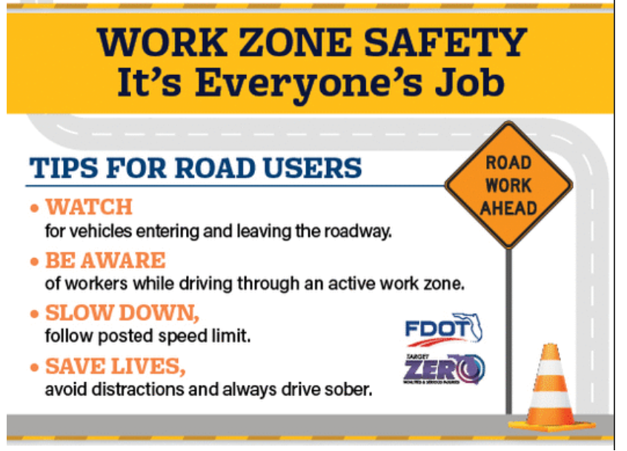
Thank you!

Slide 40
