Slide 1

Truck Parking:
The Challenge and Meeting the Challenge
Marie Tucker& Ronald Meyer
FDOT Traffic Engineering and Operations Office
FDOT Freight and Rail Office

Slide 2

OBJECTIVES
Provide overview of FDOT Truck Parking needs and initiatives
Share challenges, successes, and lessons learned from system design and deployment experiences
Notes:
Trucking touches nearly every aspect of the economy. Still, it can often be overlooked even though trucks are responsible for delivering raw materials to manufacturing plants, transporting products between distribution facilities, and delivering ﬁnished products to businesses and consumers.
Each link in the supply chain is supported by the trucking industry, making safe and reliable truck parking a major consideration for state and local governments.

Slide 3
Truck Parking:
Toolbox and Implementation Strategies
Marie Tucker
FDOT State Traffic Engineering and Operations Office

Slide 4
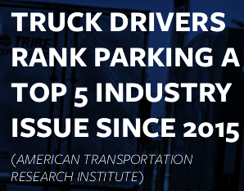
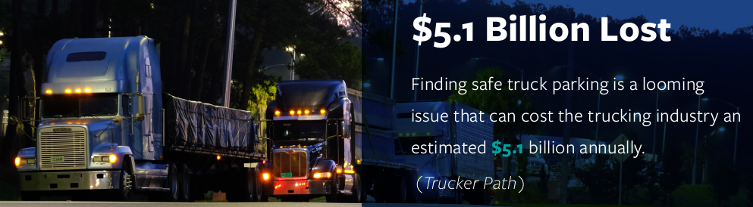
THE TRUCK PARKING CHALLENGE
98% of truck drivers report problems finding safe parking, costing drivers more than 56 minutes of drive time. That wasted time is estimated to cost drivers $5,500 per year – roughly a 12% pay cut. (American Transportation Association and Owner Operator Independent Drivers Association)
58% of drivers say they have parked in unauthorized places at least three times a week. (American Transportation Research Institute)
Notes:
Truck drivers are responsible for delivering nearly 80% of Florida’s freight, bringing the essential goods to stores and doorsteps across the state.
The shortage of available truck parking can create delays in the delivery of those essential goods, and ultimately lead to higher prices for consumers.
In Florida, the truck parking shortages are in and around major urban areas along the interstate corridors: I-4, I-95, I-75, and I-10.

Slide 5
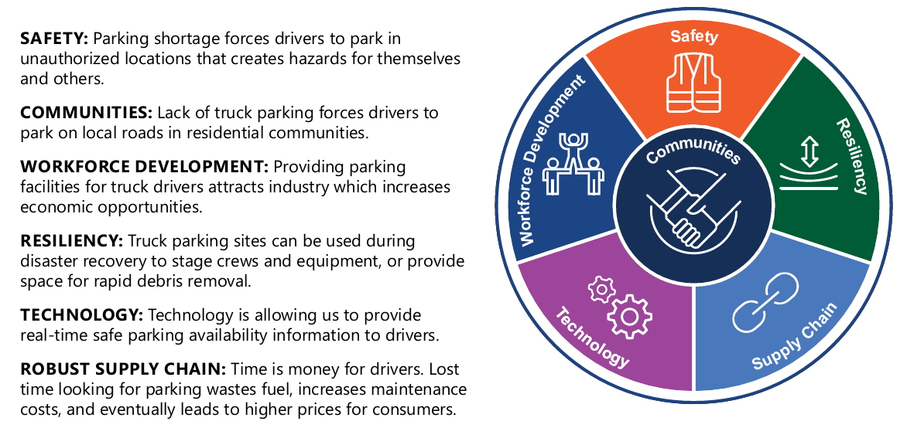
SOLVING ALIGNS WITH FDOT’S PRIORITIES
Notes:
This effort focuses on Supply Chain, but ties into implementation of all the Secretary’s Compass Elements.

Slide 6
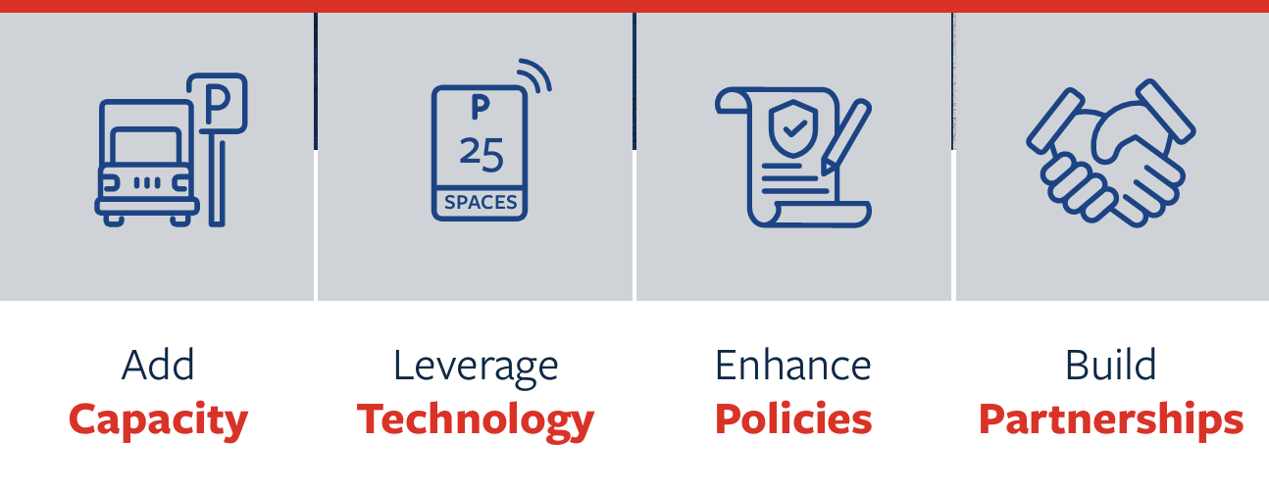
HOW FDOT IS MEETING THE CHALLENGE
FDOT TRUCK PARKING TOOLBOX includes the following implementation approach to strategically meet the critical demand for additional truck parking spaces
Notes:
We’re expanding capacity, using state of the art technology, leveraging our industry partnerships, and enhancing policies to meet the critical demand for additional truck parking spaces.
As noted on the first slide, this has been a known need for a decade and FDOT had been hesitant to build any NEW capacity outside our Rest Area Program as there were no funding resources for ongoing O&M.
We prioritized technology options and studies to optimize the spaces we already had available and worked with private entities to essentially share where we identified areas of greatest need to save them some research efforts.

Slide 7
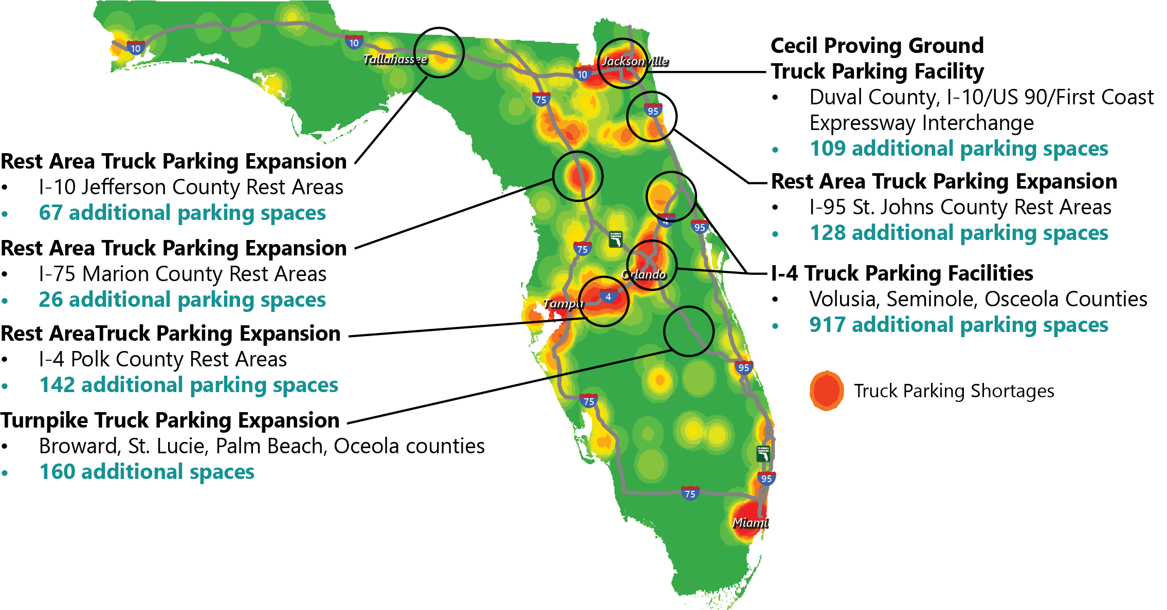
SPOTLIGHT TRUCK PARKING CAPACITY
Key Factor: # of spaces may change as many projects are still in design
Notes:
Capacity projects are being implemented around the state along interstate corridors where the needs are greatest.
Some projects will expand existing Rest Areas/Turnpike facilities while others will develop all new facilities.

Slide 8
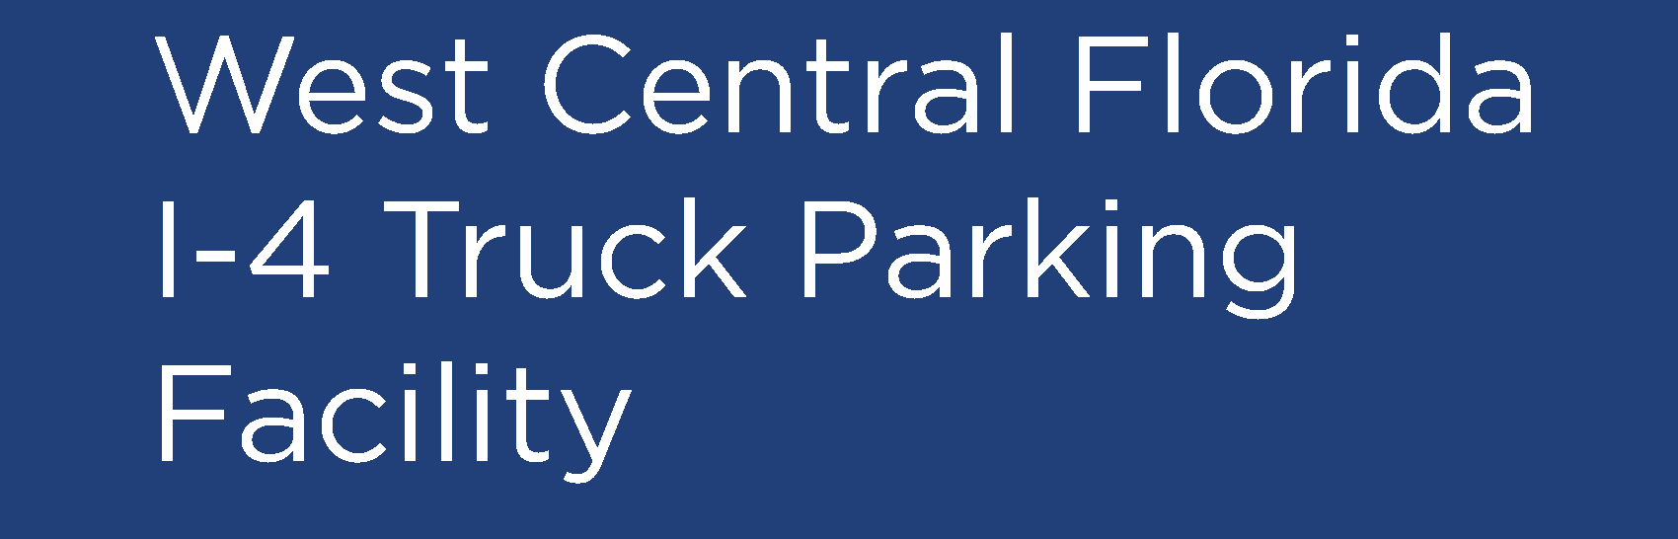
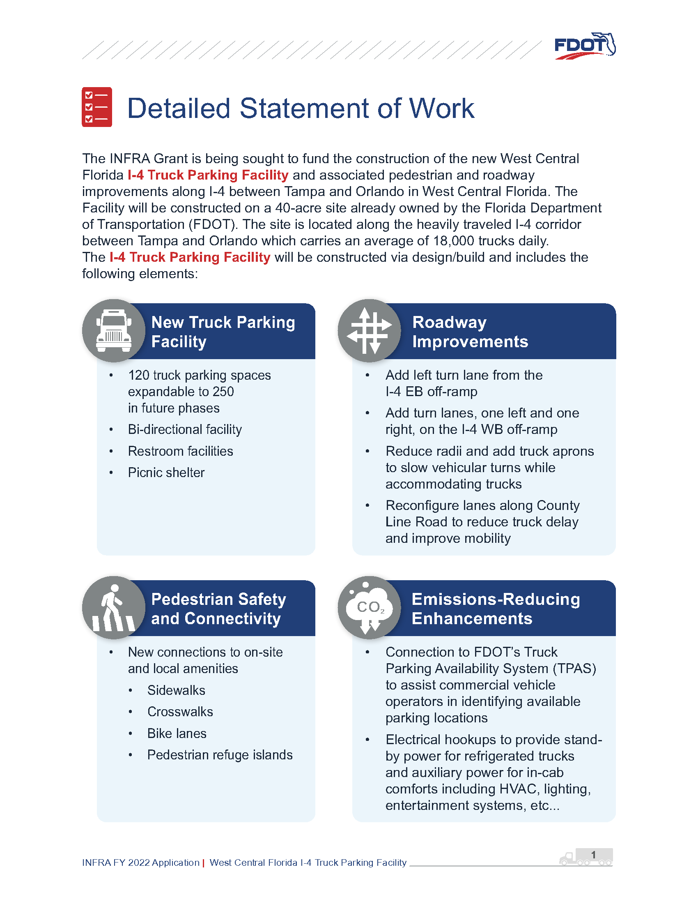
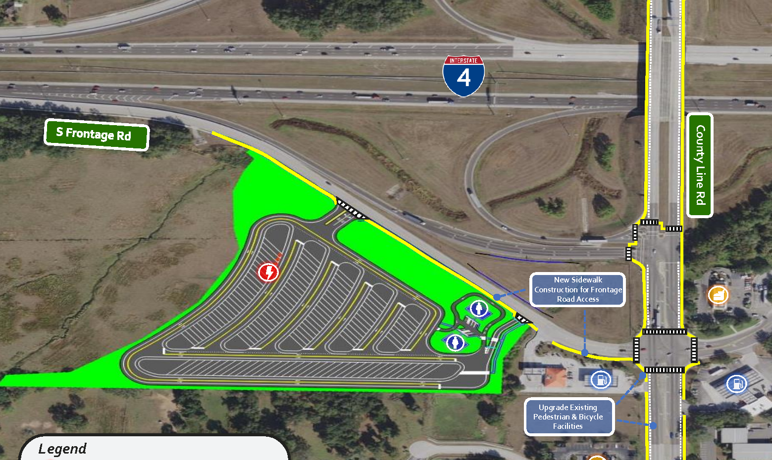
SPOTLIGHT PROJECT
Currently in Design Phase
Notes:
This slide and the next are spotlight capacity projects that have received federal INFRA grant funds in the last few years.
This project addresses a shortage in parking for commercial vehicles on a corridor between Tampa and Orlando which carries an average of 18,000 trucks daily and reduces parking in unauthorized areas such as vacant lots or highway shoulders. By providing reliable parking capacity, the project reduces time drivers spend searching for commercial vehicle parking, making supply chain movement more efficient.
This design-build project will construct a new truck parking facility with approximately 120 spaces, electric hookups, and pedestrian infrastructure to access nearby commercial amenities.
The truck parking facility will be connected to the Florida Department of Transportation’s Truck Parking Availability System to assist commercial vehicle operators in identifying available parking locations.
Currently in the design phase. Construction anticipated to start in 2025.

Slide 9
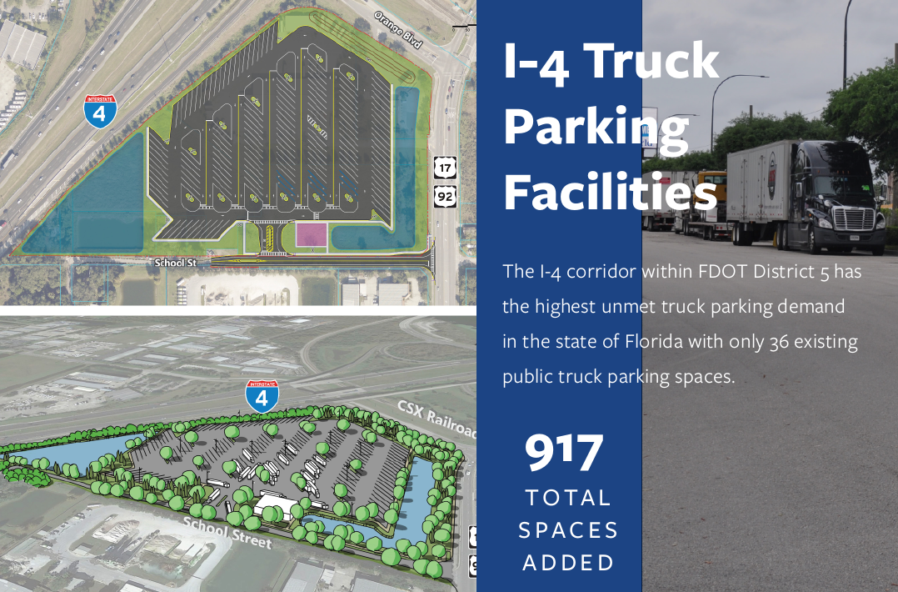
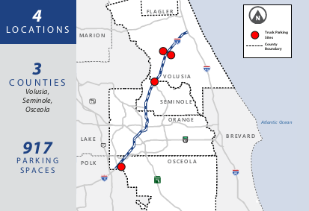

SPOTLIGHT PROJECT
Notes:
The I-4 corridor within FDOT District Five has the highest unmet truck parking demand in the State of Florida with only 36 existing public truck parking spaces, while the existing demand is 481 spaces. With continued population, employment, and tourism growth in the region, truck parking demand is expected to grow.
This project will provide an additional 917 truck parking spaces within four different sites in Volusia, Seminole, and Osceola Counties.
During emergencies, these truck parking sites will be utilized for securing fleet and staging crews aiding in emergency response, debris removal and reconstruction, etc.
The Project PD&E Study is being completed now, and Construction is expected to be completed by 2028 now that the INFRA grant has allowed for the project to advance.

Slide 10
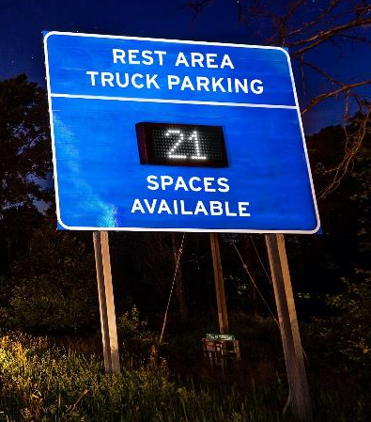
SPOTLIGHT TRUCK PARKING TECHNOLOGY
OPERATIONS INNOVATION
FDOT implemented the Truck Parking Availability System (TPAS) in 2017. This statewide program gives information about the number of available spaces at Florida weigh stations, rest areas, and Welcome Centers via FL511.
2,719 state-owned truck parking spaces monitored by TPAS
NEXT STEPS
Technology to automate detection of over-parking and provide continuous/real-time utilization data for all state-owned facilities
Notes:
FDOT implemented TPAS way back in 2017, and this was part of FDOT’s effort to make sure we optimized use of existing facilities prior to adding any new capacity.
We’ll talk more about TPAS lessons learned shortly.

Slide 11






SPOTLIGHT POLICIES & PARTNERSHIPS
Formalize a statewide truck parking program (TPIP) and working group for a consistent approach to implementation
Initiate a statewide communications and outreach campaign
Incorporate alternative parking solutions in FDM
Identify funding opportunities for capacity concepts
Notes:
In addition to building new spaces and using technology, FDOT has been meeting the truck parking challenge via working together to define best practices and how best to communicate that guidance to all.
Truck parking touches quite a few FDOT offices, partner agencies, industry, and communities, and that collaboration is needed for a consistent approach from design through construction.

Slide 12
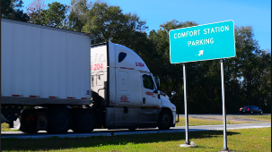
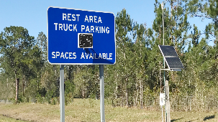
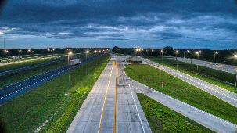
LATEST OBJECTIVES
  Improve truck parking utilization at Motor Carrier Size and Weight (MCSAW) weigh station facilities
  Increase truck parking capacity at state-owned rest areas, welcome centers, and weigh stations
  Identify innovative uses of FDOT right-of-way for truck parking
Notes:
In the last few months, FDOT completed a Truck Parking Implementation Study to continue meeting the truck parking challenge.
Project objectives included a mix of toolbox solutions, including optimizing use of existing facilities with technology and partnerships, increasing capacity on state-owned facilities, and continuing to develop innovative policy solutions to gain additional capacity within existing ROW through alternative design.

Slide 13
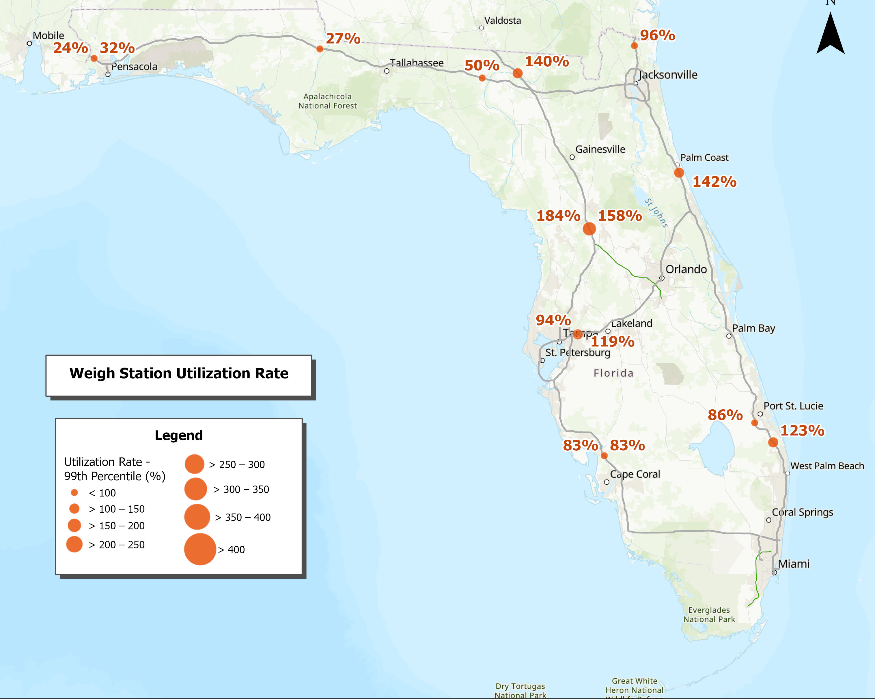
INCREASING WEIGH STATION UTILIZATION
I-10 Facilities Underutilized = Pilot Opportunities

Slide 14
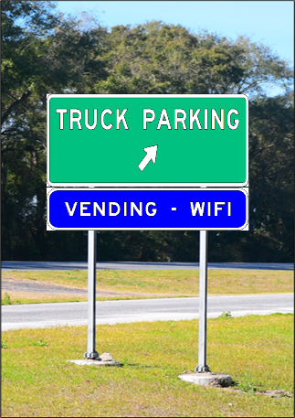
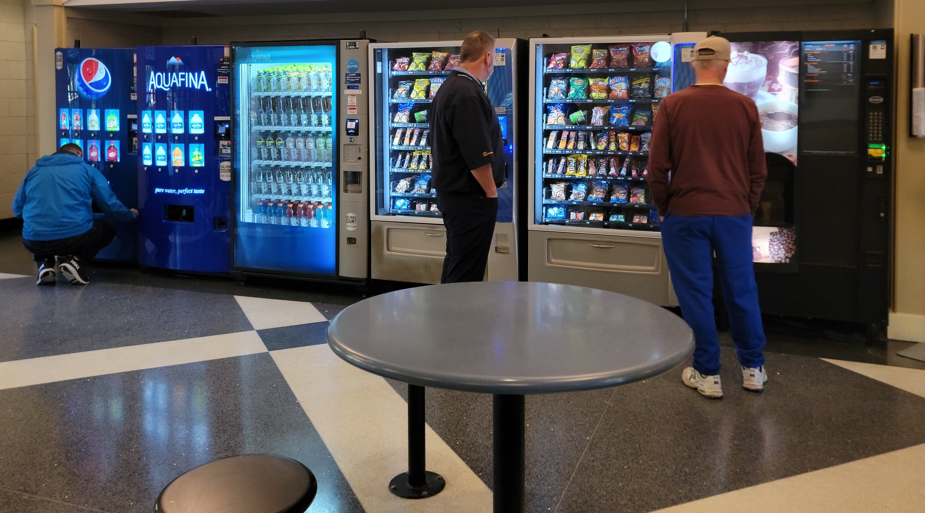
ENHANCED AMENITIES & IMPROVED SIGNAGE
  Provide WiFi and vending machines at underutilized facilities
  I-10 corridor pilot projects
  Include supplemental signage that communicates available amenities at all facilities
  Provide clearer messaging that truck parking is available
  Change “Comfort Station” to “Truck Parking”

Slide 15
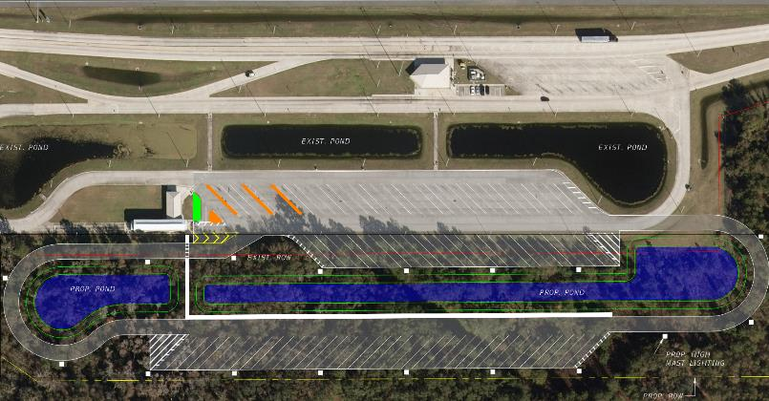
WEIGH STATION CAPACITY PROJECT CONCEPTS
  Concepts were developed to increase capacity at facilities experiencing significant overutilization including Flagler, White Springs, Seffner, and Wildwood
  Low, medium, and high right of way (ROW) impact concepts were developed for each identified site that included:
    Conceptual design
    Environmental screening
    Cost estimates
High Impact: Considerable ROW acquisition required for additional pavement and drainage.
Additional concept plans have been developed for Low and Medium impact applications.

Slide 16

REST AREAS – ADDITIONAL CAPACITY
  Design considerations and FDM standards developed for back-in, parallel, and ramp parking strategies
  Back-in parking can provide up to 30% more capacity and requires less ROW compared to pull-through design
  Parallel and ramp parking utilize existing roadways, ramps, and shoulders to increase parking and should consider:
      Distance from gore area
      Sight line
      Clear zone
      Safety
      Innovative pavement solutions

Slide 17
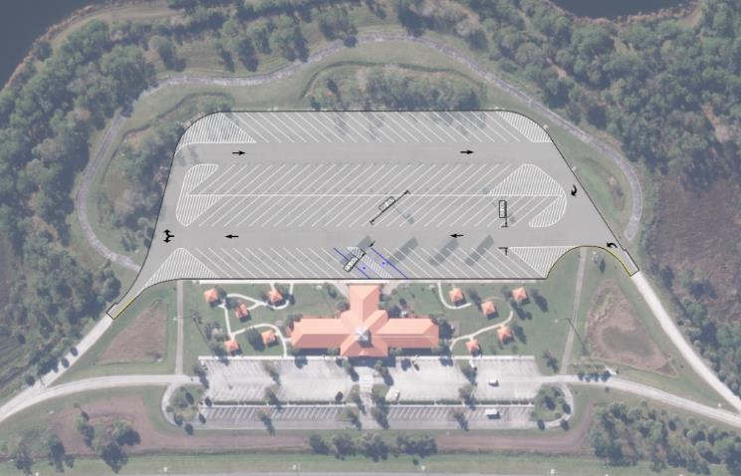
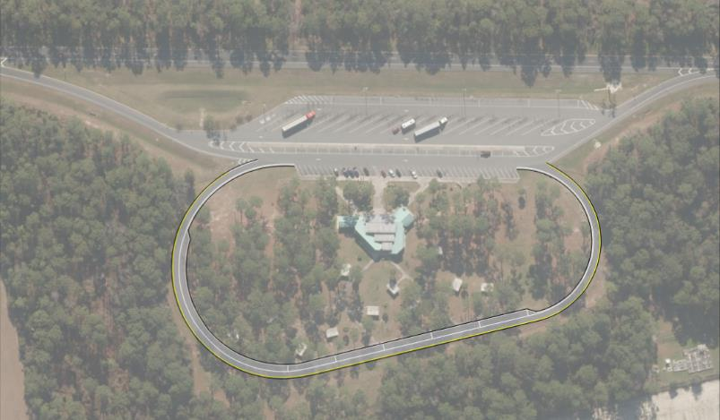
REST AREAS – ADDITIONAL CAPACITY
Restriping:
In this example, an FDOT rest area was re-configured to include 30% more truck parking spaces by switching to a back-in parking layout.
Repurposing:
In this concept an existing picnic loop is repurposed to accommodate parallel parking

Slide 18
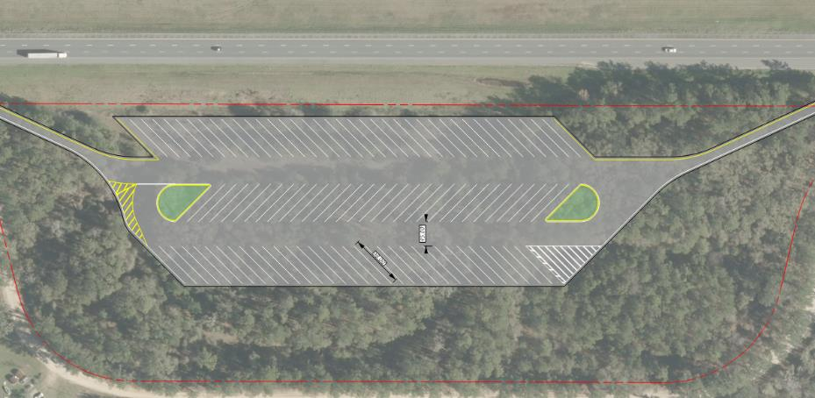
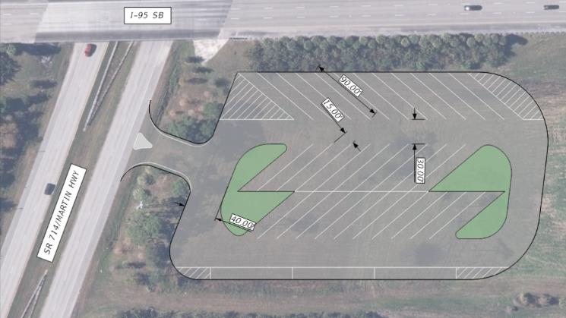
ALTERNATIVE ROW CONCEPTS
Rehabilitating:
This concept was developed using the footprint of a closed rest area and utilizes a back-in parking strategy.
Median Parking:
This concept was developed to increase truck parking capacity utilizing available space in medians.

Slide 19
Truck Parking:
TPAS Technology and Deployment Experiences
Ronald Meyer
FDOT Traffic Engineering and Operation Office
Traffic Engineering Research Laboratory (TERL)

Slide 20
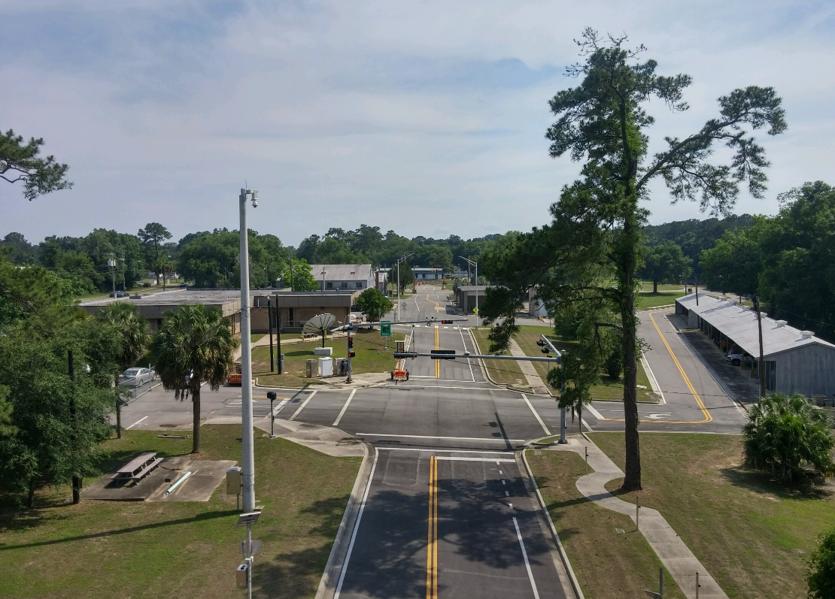
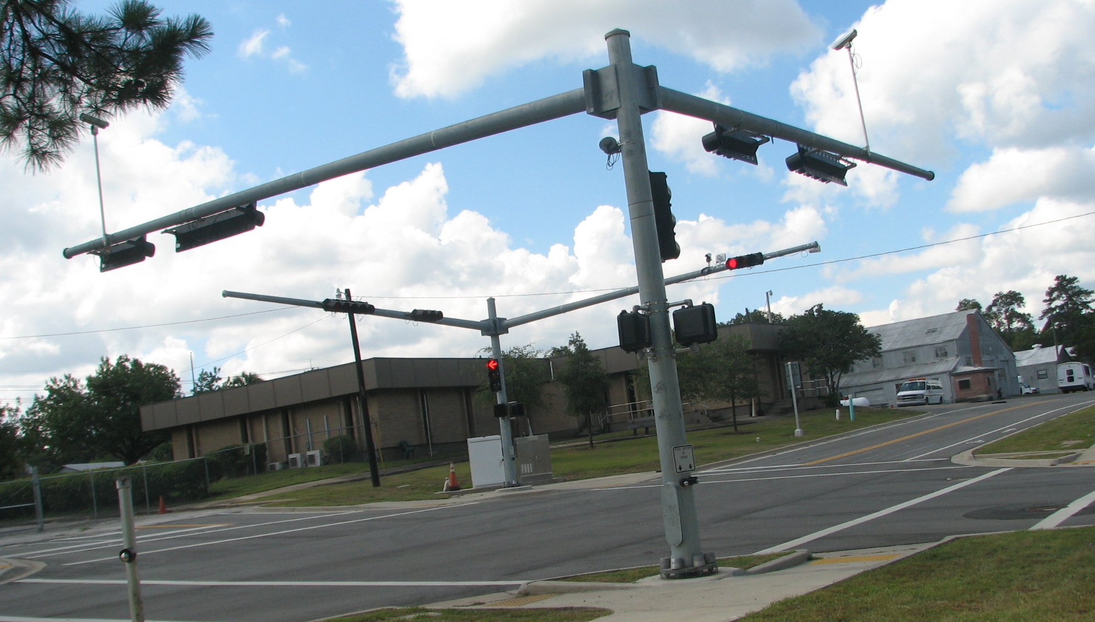
ROLE OF THE TERL
Approved Products List (APL)
Florida Statutes 316.0745, Uniform signals and devices
Evaluation of new products and technologies

Slide 21

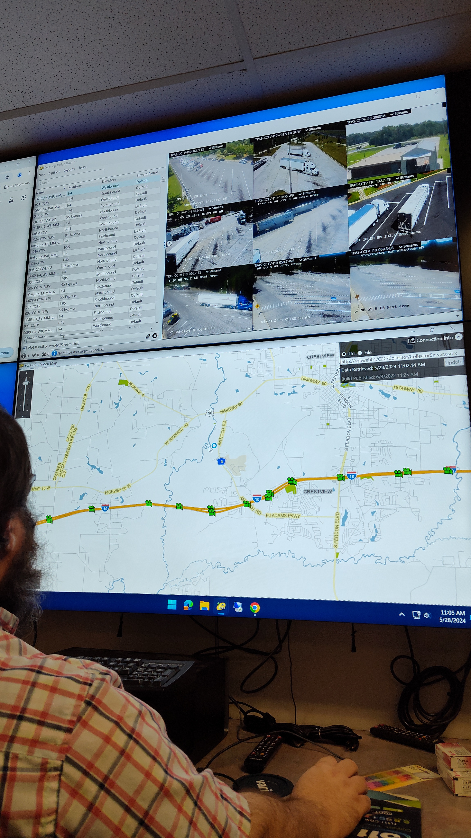
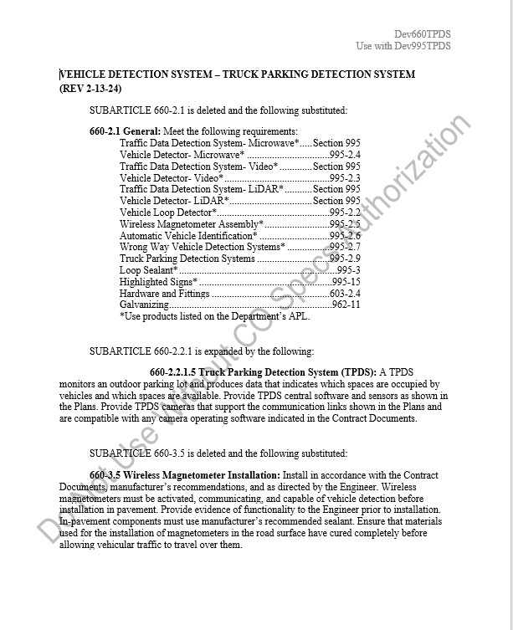

TERL TPAS ACTIVITIES
Support evaluation and use of new technologies by FDOT Districts
Preliminary system evaluations
Developmental Specifications
Support for ongoing SunGuide development and enhancements, including Truck Parking Subsystem

Slide 22
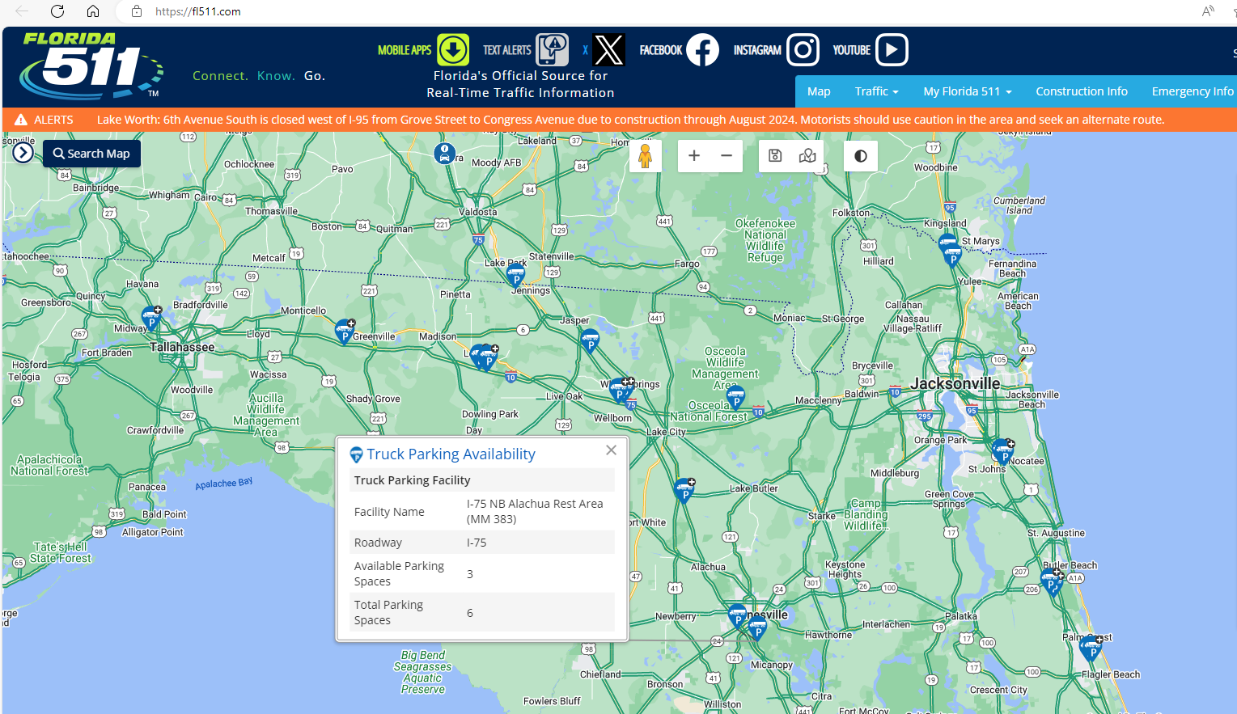
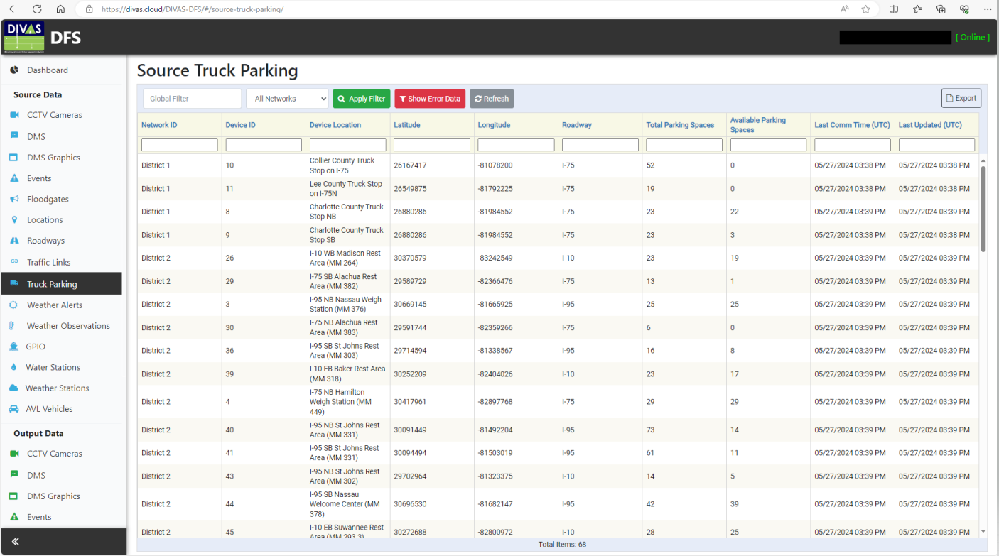
TPAS GOALS AND USE OF OTHER FDOT SYSTEMS

Slide 23
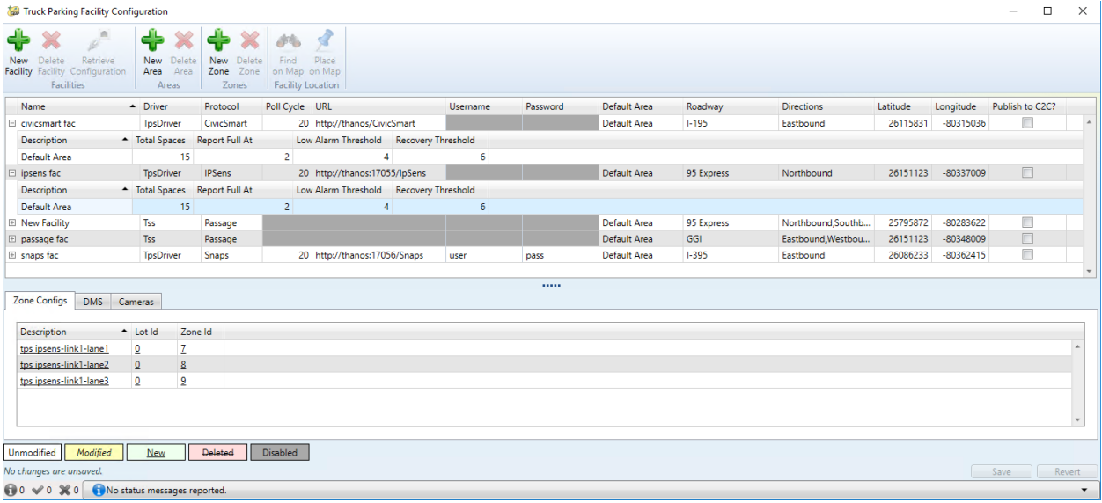
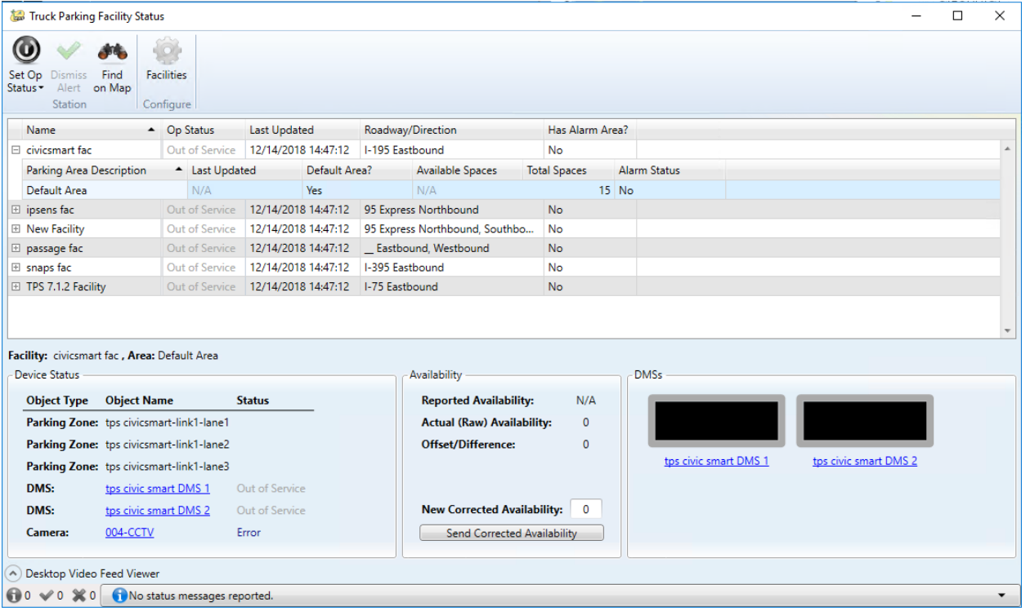
TPAS GOALS AND USE OF OTHER FDOT SYSTEMS

Slide 24
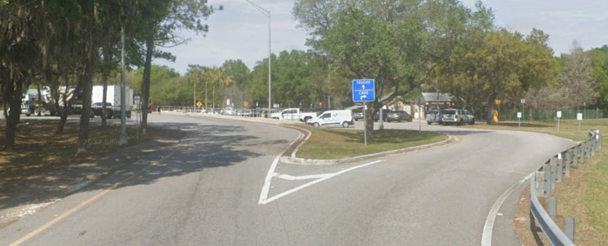
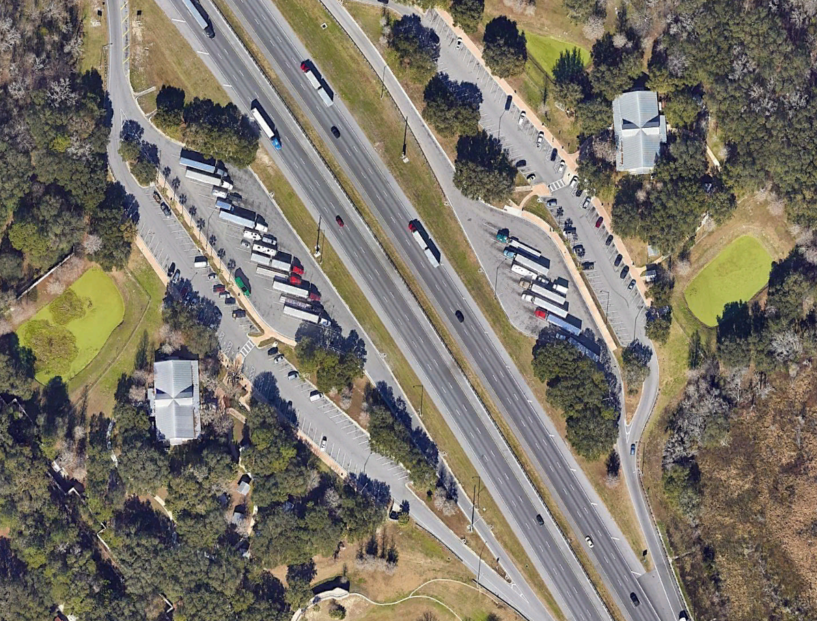
TPAS DETECTION SYSTEM ARCHITECTURES
Count In / Count Out
  Works best with tightly controlled truck entry and exit points
  Unable to provide additional data (e.g., individual space utilization, etc.)
Per Space
  Can provide additional operational information besides overall counts (e.g., space utilization metrics, overstay, etc.)

Slide 25
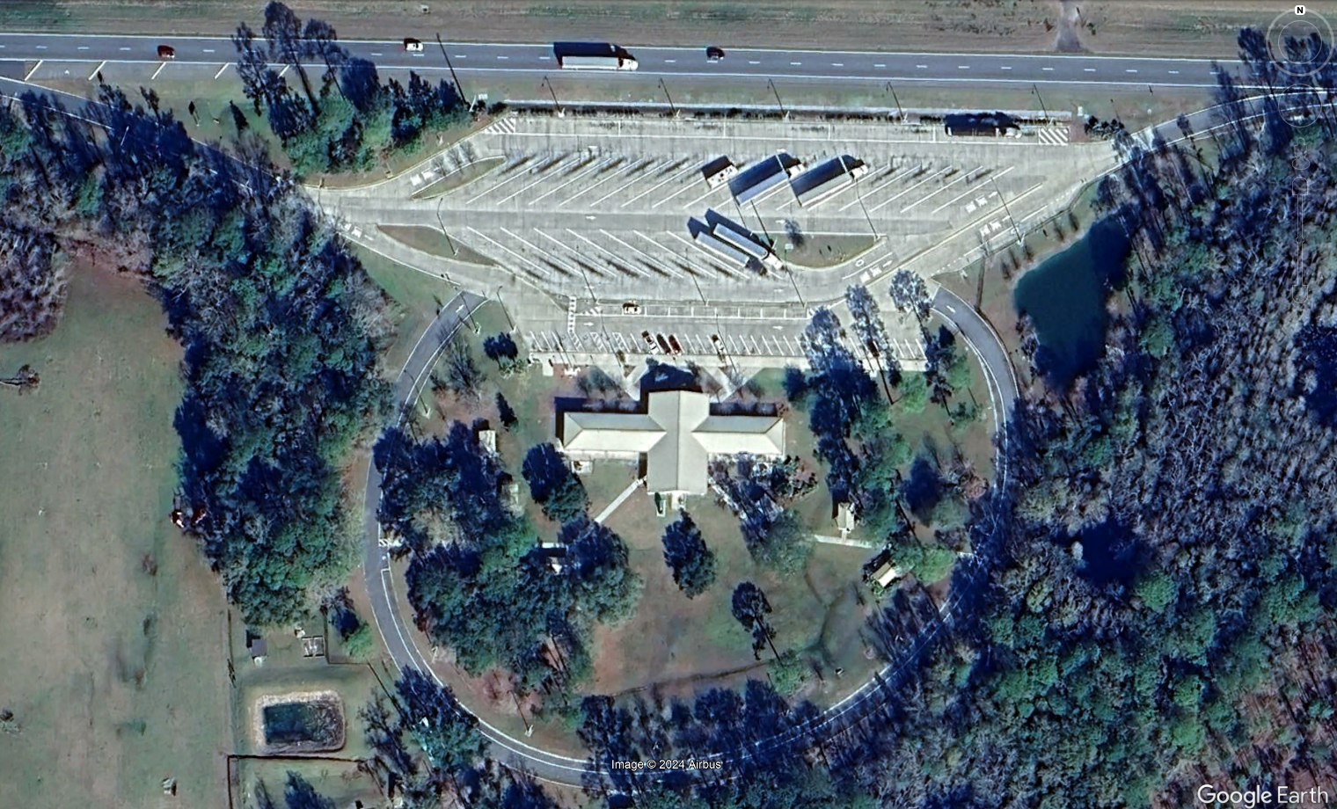
“COUNT-IN / COUNT-OUT” SYSTEMS
Not as easy as you may think
Needs dedicated ingress/egress for best accuracy
Expect the unexpected
Count detectors are imperfect
Human intervention often required

Slide 26

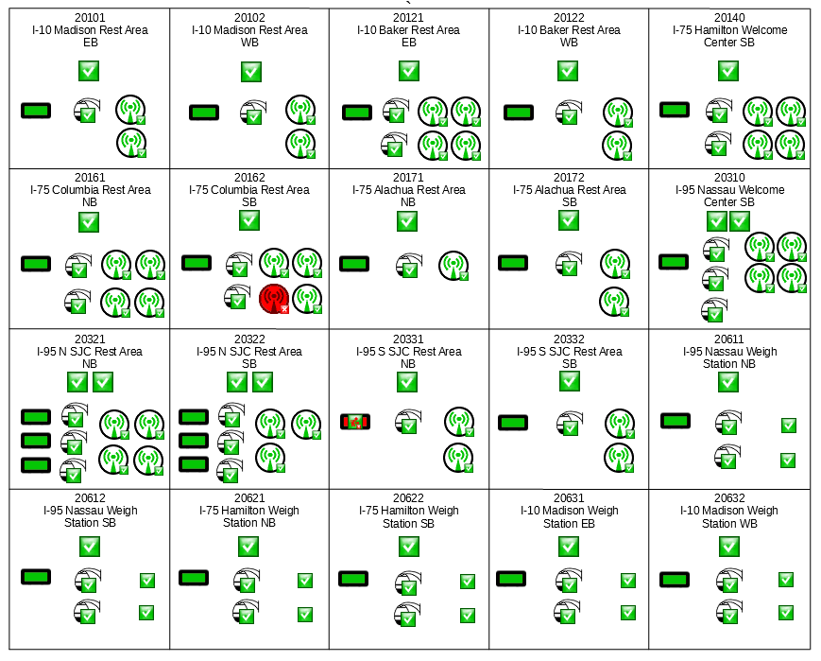
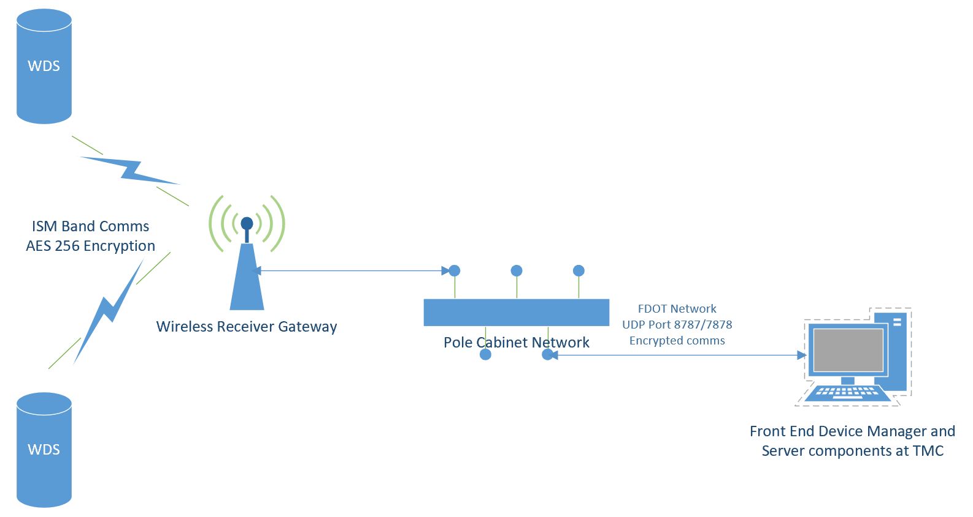
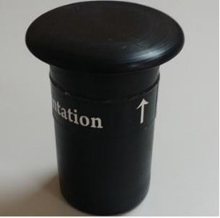
“PER SPACE” SYSTEMS (WIRELESS DETECTORS)

Slide 27
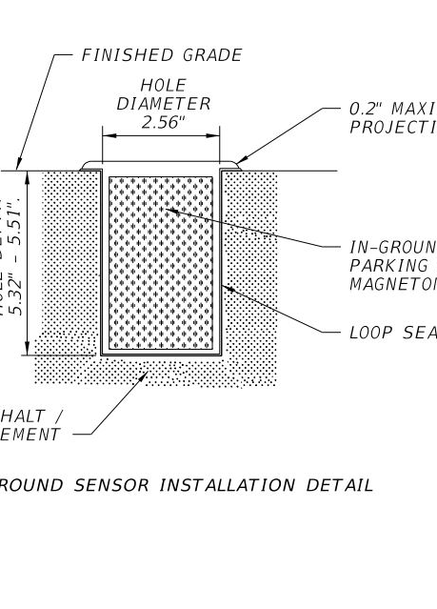
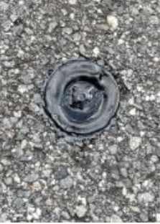
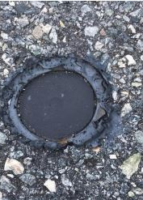
“PER SPACE” SYSTEMS (WIRELESS DETECTORS)
Significant detector failures
Frequent site visits and repairs needed to keep operational
Supply chain issues with replacement pucks
Cost of hardware removal/replacement
Software licensing costs

Slide 28
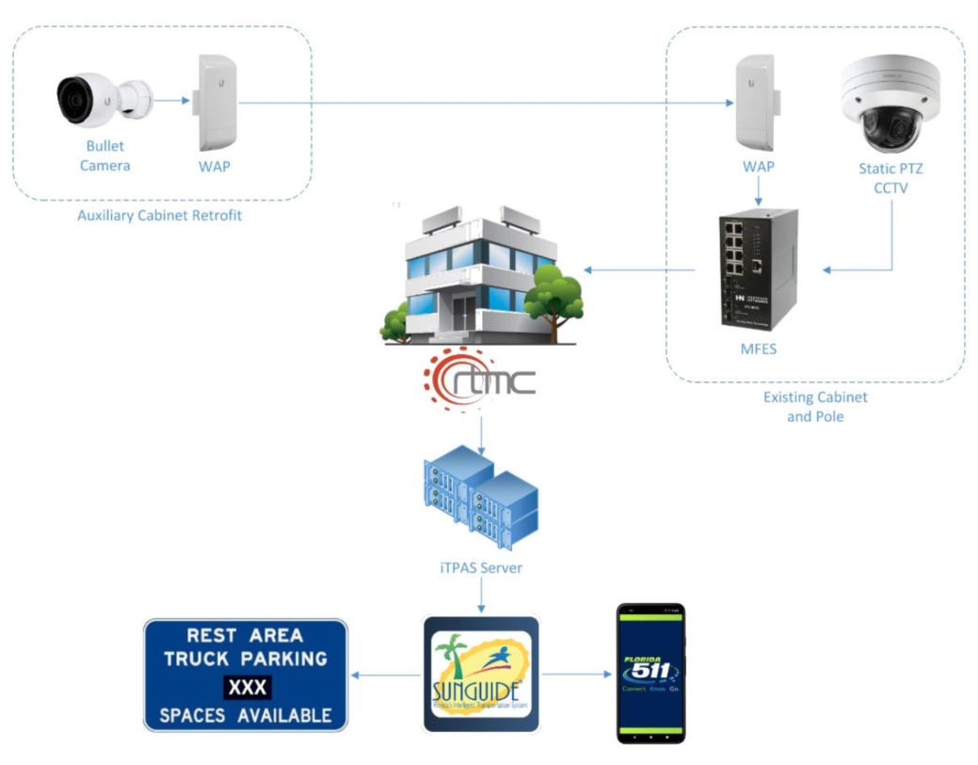
“PER SPACE” SYSTEMS (VIDEO ANALYTICS)
Cameras capture images of parking areas at regular intervals
Images are sent to a server for real-time analytics
Computer vision algorithms process the latest image to determine occupied and available spaces
Counts from multiple images are aggregated, displayed with images for confirmation, and timestamped count data is made available to SunGuide.

Slide 29
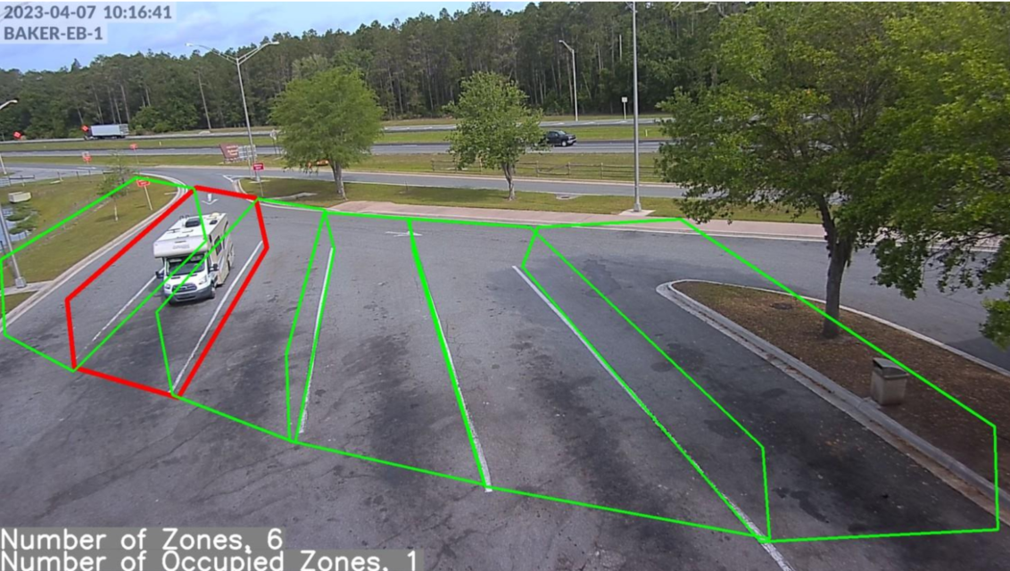
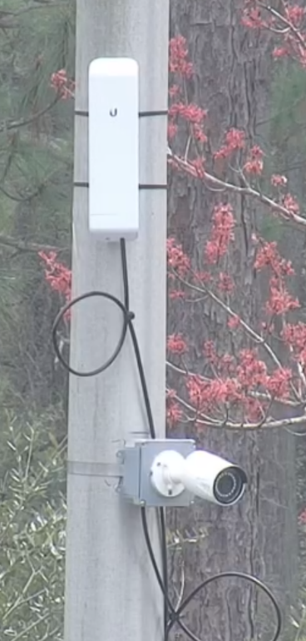
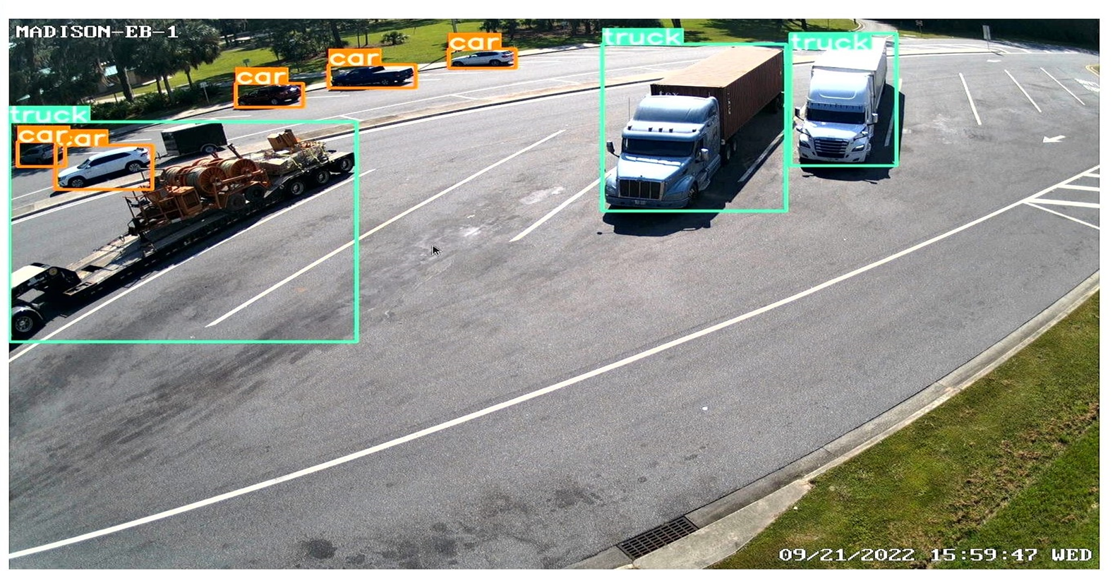
“PER SPACE” SYSTEMS (VIDEO ANALYTICS)
Fixed camera retrofit on existing light pole
Poles are often positioned adjacent to travel lanes for angle parking, etc.
Low cost camera and wireless system can be used (only requires power connection at pole).
Sample image shows typical field of view with camera at 20’ height.
Images processed by YOLOv5 detection module

Slide 30
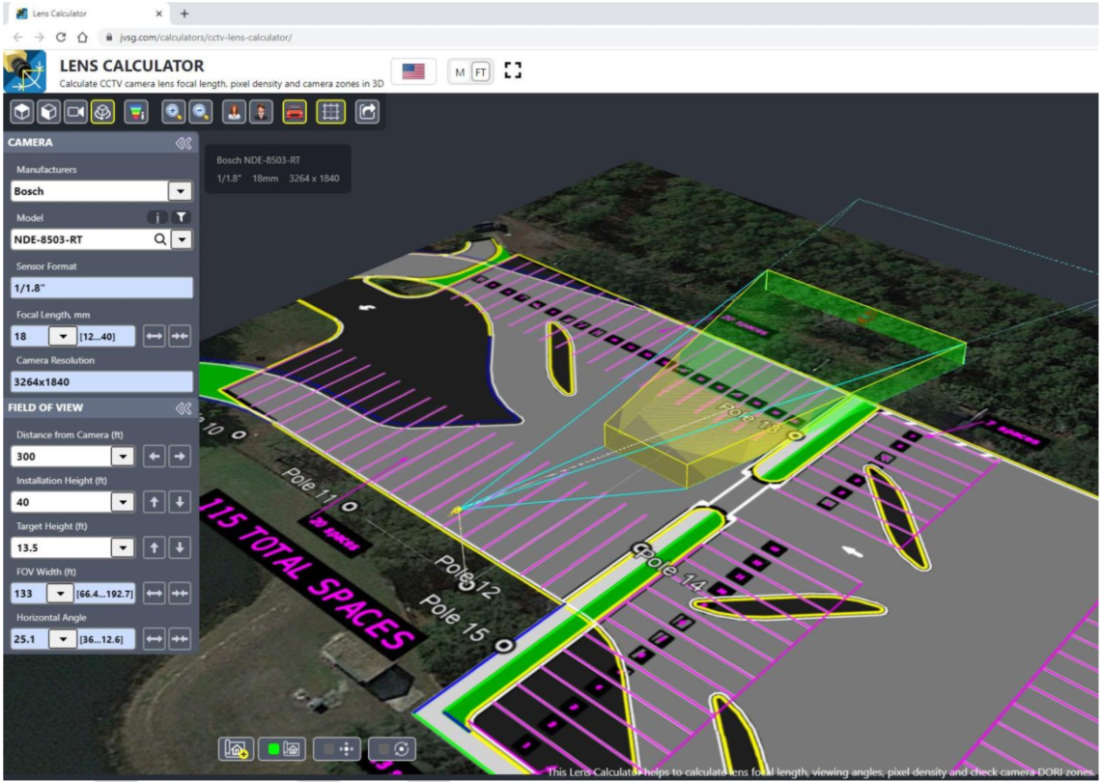
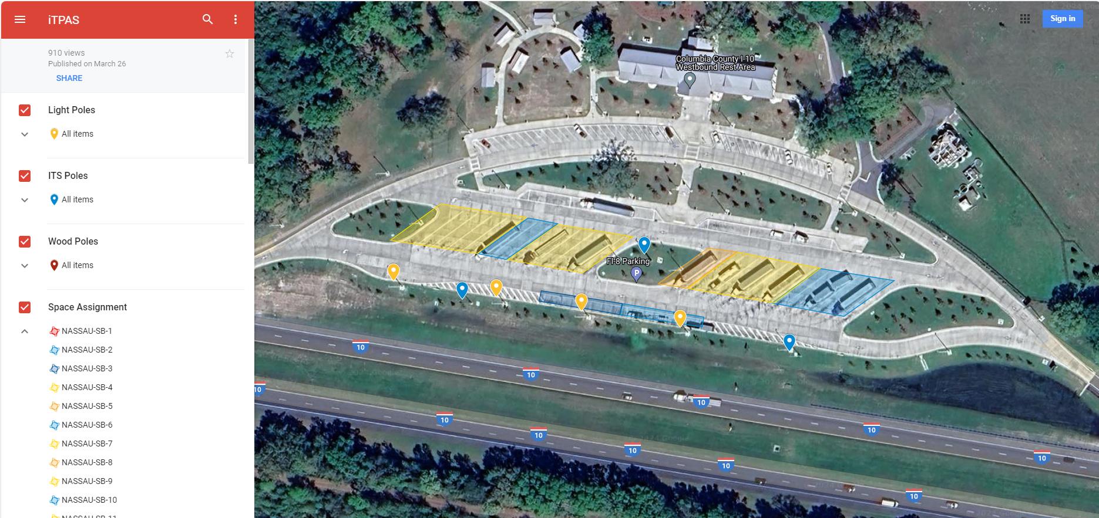
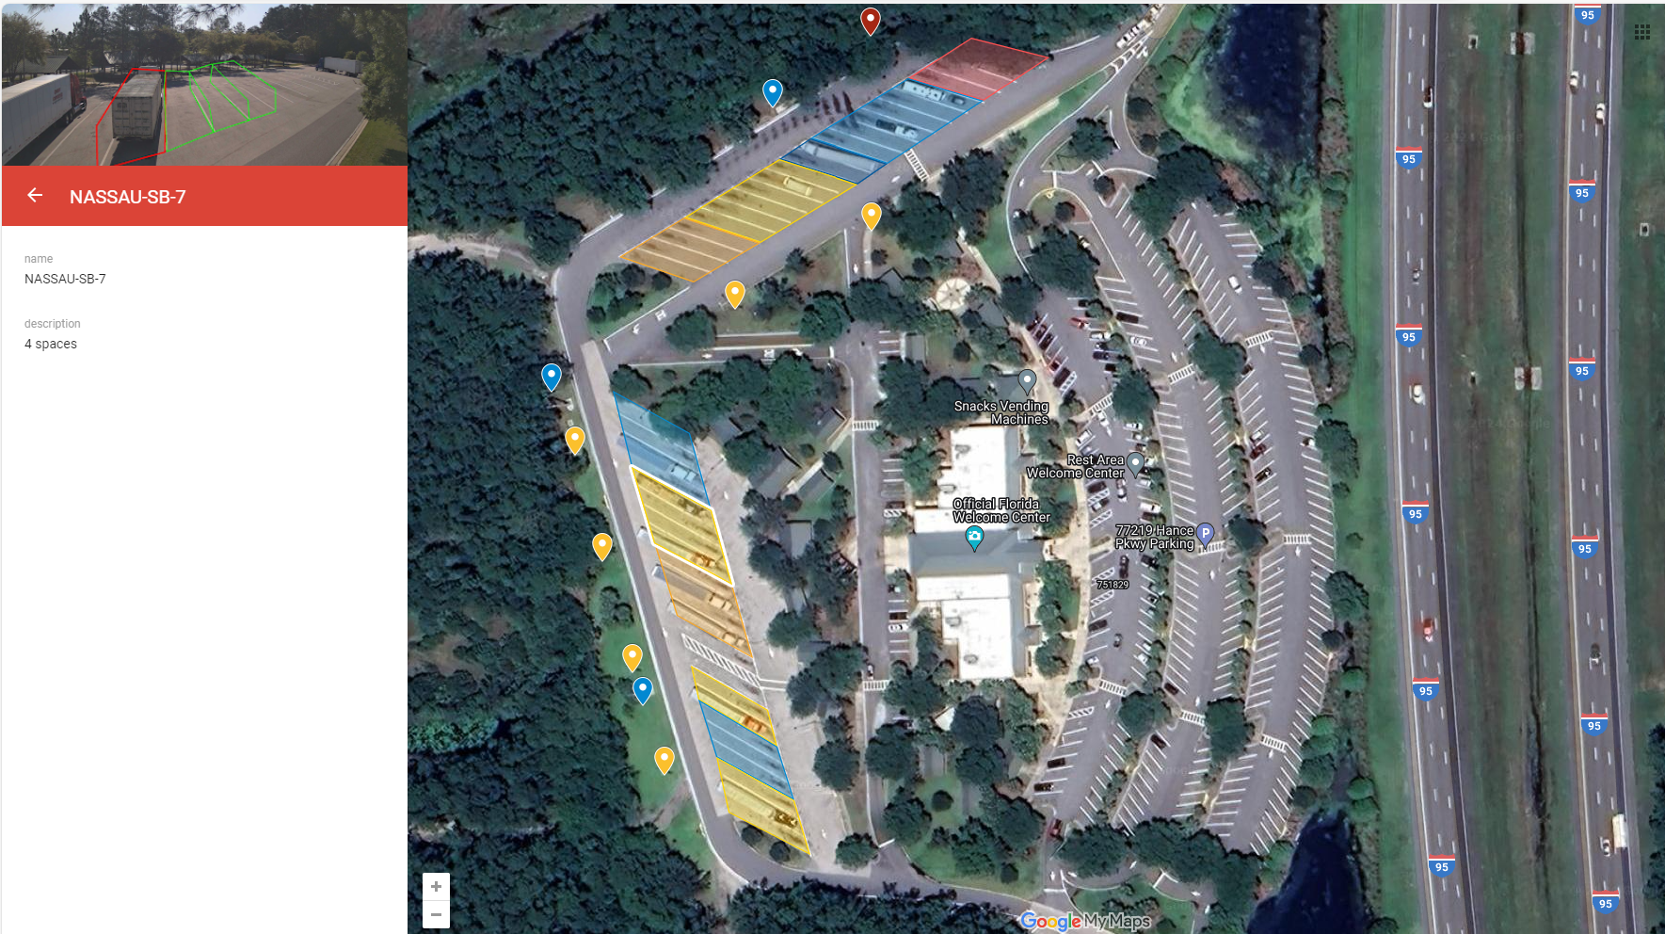
“PER SPACE” SYSTEMS (VIDEO ANALYTICS)
https://www.jvsg.com/calculators/cctv-lens-calculator/

Slide 31
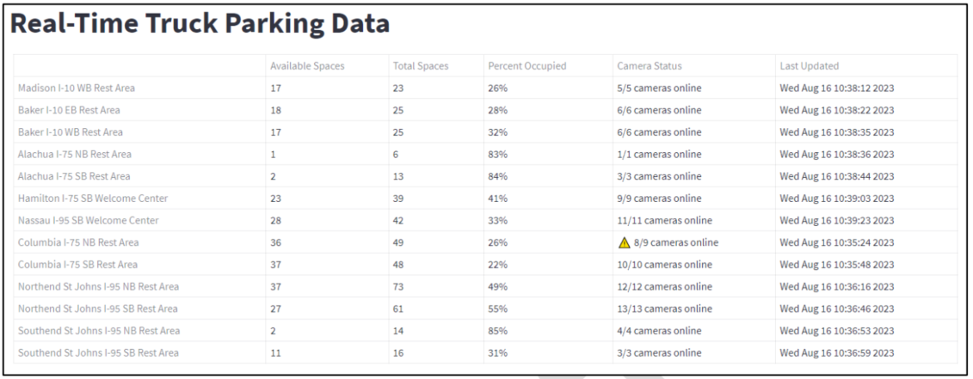
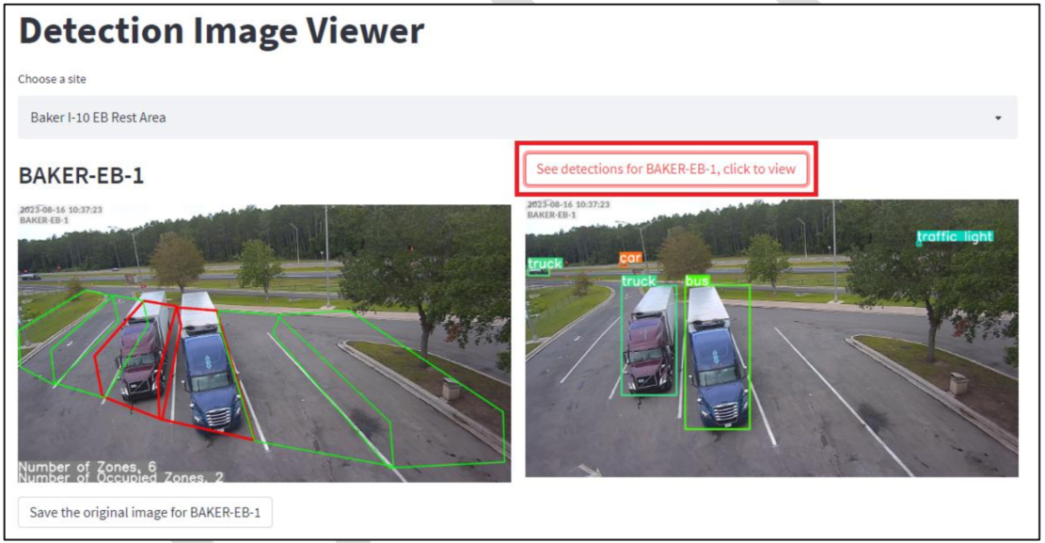
“PER SPACE” SYSTEMS (VIDEO ANALYTICS)

Slide 32
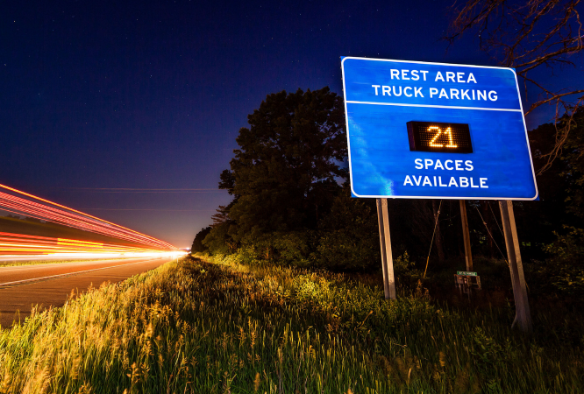
TPAS ARCHITECTURES AND FUTURE DIRECTION
TPAS Architecture Capability Matrix
Function | Support
 | Count in/out | Per Space
Total count of vehicles in lot | Yes | Yes
Duration of stay (e.g., overstay alerts that warrant occupant health/safety checks) | Yes* | Yes
Duration of stay per space | No | Yes
Handicapped space utilization | No | Yes
Parking behavior (e.g., identifying preferred spaces, space selection/use trends) | No | Yes
Space utilization by vehicle class (e.g., tractor-trailer, bus, RV) | No | Yes**
Detection of vehicles parking outside of designated spaces | No | Yes**
*Only supported if counting system is also capable of unique vehicle ID (e.g., license plate recognition at ingress/egress)
**Generally requires use of systems that rely upon video analytics

Slide 33
TPAS ARCHITECTURES AND FUTURE DIRECTION
TPAS Architecture Capability Matrix
Function | Support
 | Count in/out | Per Space
Total count of vehicles in lot | Yes | Yes
Duration of stay (e.g., overstay alerts that warrant occupant health/safety checks) | Yes* | Yes
Duration of stay per space | No | Yes
Handicapped space utilization | No | Yes
Parking behavior (e.g., identifying preferred spaces, space selection/use trends) | No | Yes
Space utilization by vehicle class (e.g., tractor-trailer, bus, RV) | No | Yes**
Detection of vehicles parking outside of designated spaces | No | Yes**
*Only supported if counting system is also capable of unique vehicle ID (e.g., license plate recognition at ingress/egress)
**Generally requires use of systems that rely upon video analytics

Slide 34
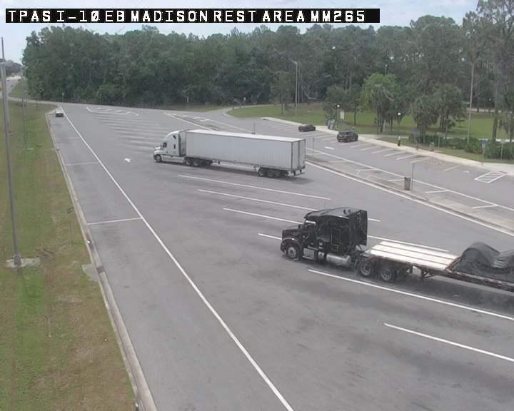


Thank You!

Slide 35

Questions?
CONTACT US
Marie.Tucker@dot.state.fl.us
Ronald.Meyer@dot.state.fl.us
Holly.Cohen@dot.state.fl.us

Slide 36


