Slide 1
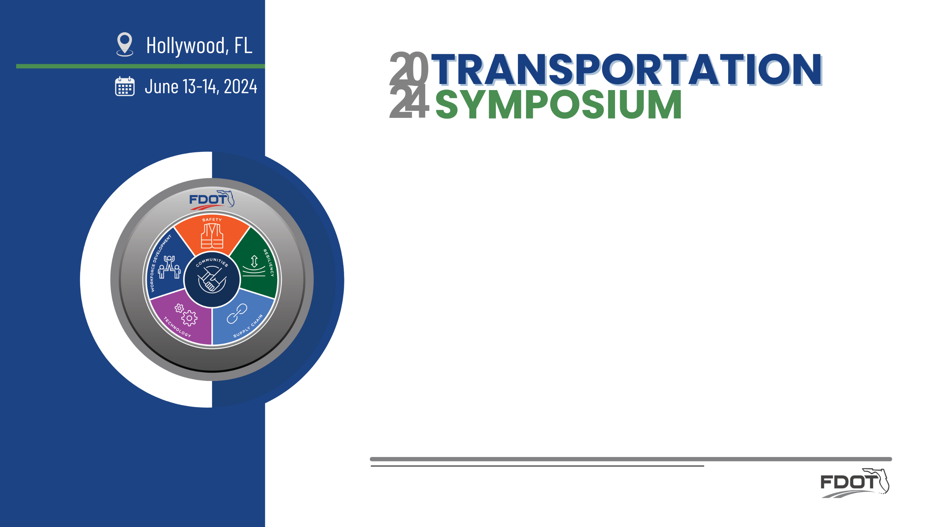
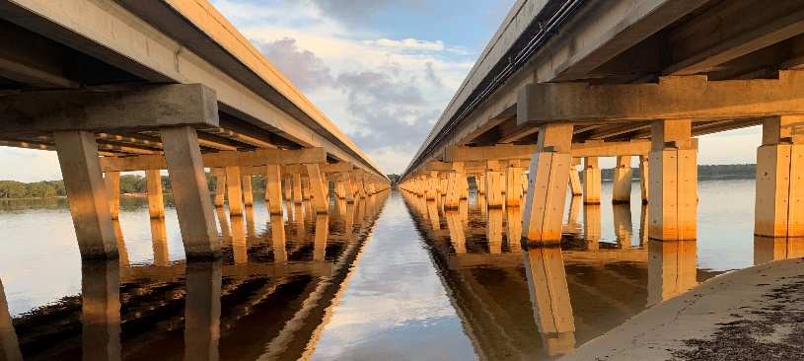
FRP Reinforced Concrete Structures:
10-year update, Lessons Learned, and Emerging Best Practices
Steven Nolan, P.E.
State Structures Design Office, FDOT (Tallahassee)

Slide 2


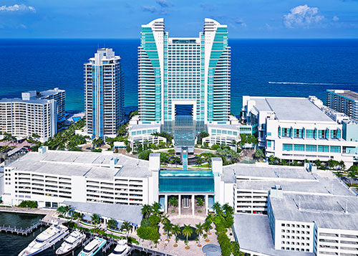
Objectives
What is a symposium?
Symposiums are organized, often large-scale meetings, that bring together experts, researchers, practitioners, and professionals. The purpose of a symposium is to discuss and exchange knowledge, research findings, and insights on a particular topic or theme.
Highlight the improvements in FRP Reinforced and Prestressed Concrete since 2014, including:
  Structural design practices and standards
  Materials specifications, testing, and qualification
  Construction including representative projects
Provide Lessons Learned during both design and construction.
Highlight latest research and planned improvements future implementation.

Slide 3

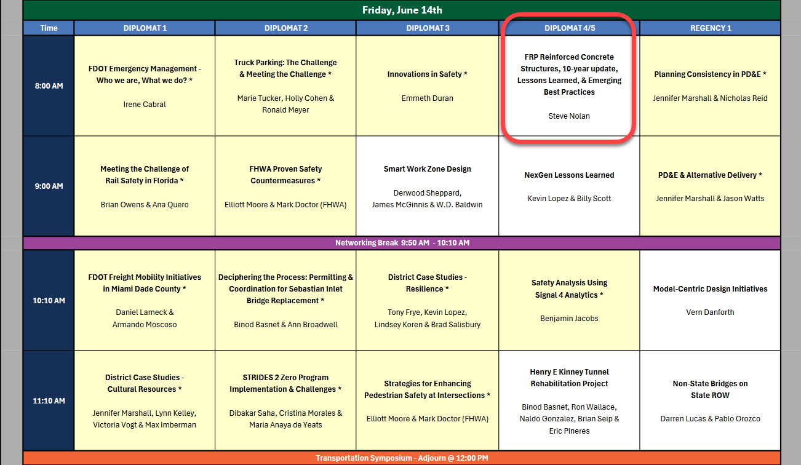
Schedule
  Design: Practices and Standards for FRP-RC/PC.
  Materials: Specifications, Testing, and Qualification.
  Construction: Example Projects & Lessons Learned.

Slide 4

Speaker Bio:
Steven Nolan, P.E.
Professional Engineer in Florida since 2003, current technical lead coordinator for Florida DOT for implementation of Fiber-Reinforced Polymer reinforcing and prestressing, stainless-steel prestressing, and UHPC for structural applications. 10-years’ experience with development of design guidance for FRP, 30-years’ experience with concrete design and construction including 25-years with bridge design specification and standards development. Current member of TRB committee AKB10-Innovative Highway Structures, ACI 440C & CSAO, ASCE-Structural Engineering Institute, Bridge Engineering Institute, and fib (International Federation for Structural Concrete).

Slide 5
Background:
FDOT introduced guidance for the implementation of Fiber-Reinforced Polymer-Reinforced and Prestressed Concrete (FRP-RC & FRP-PC) at the 2014 Design Training Expo. We highlighted the planned release of Standard Specifications, Structures Manual, and Materials Manual updates, and the early design work for the seminal demonstration project - Halls River Bridge.
Reflecting on 10 years of implementation and the evolution of design guidance, standard specifications and plans, many projects have now been successful completed and continue to be monitored with the goal of improving the state-of-the-practice and cost efficiency.

Slide 6
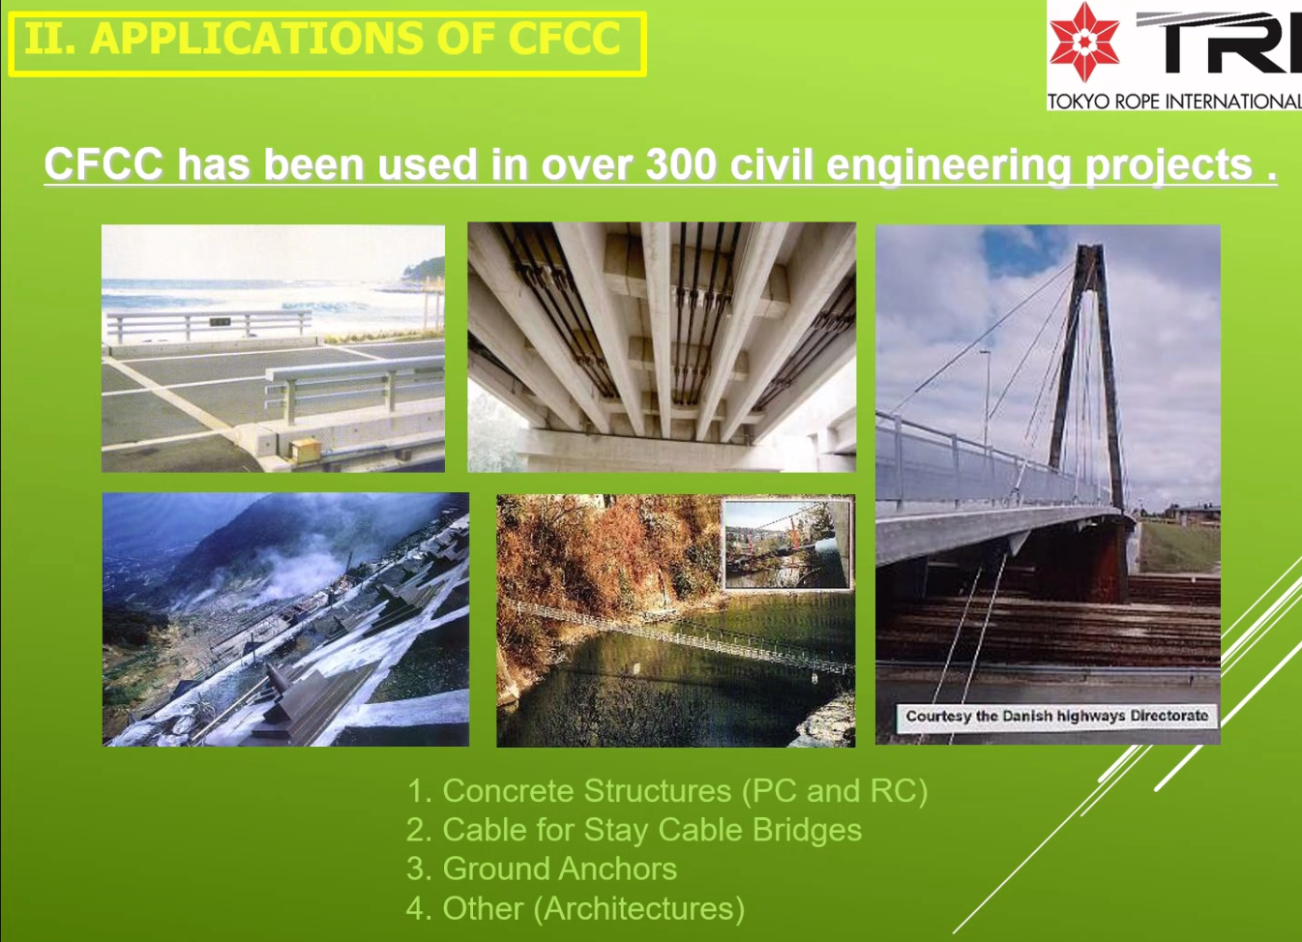
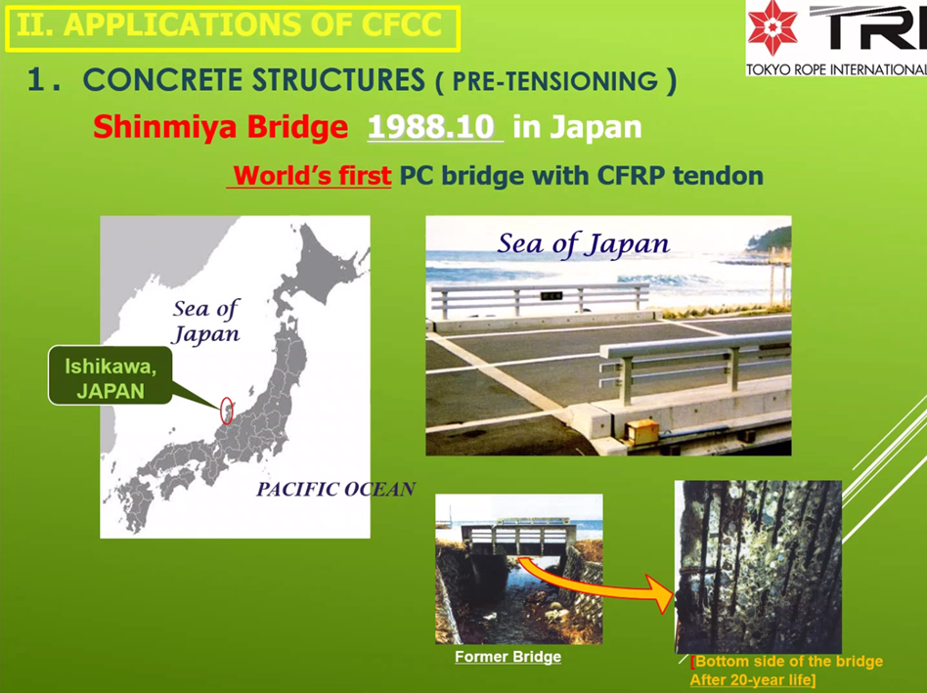
Way Way Back: CFRP Prestressing Strand
CFCC: Developed in Japan with first prestressed bridge application in 1988

Slide 7
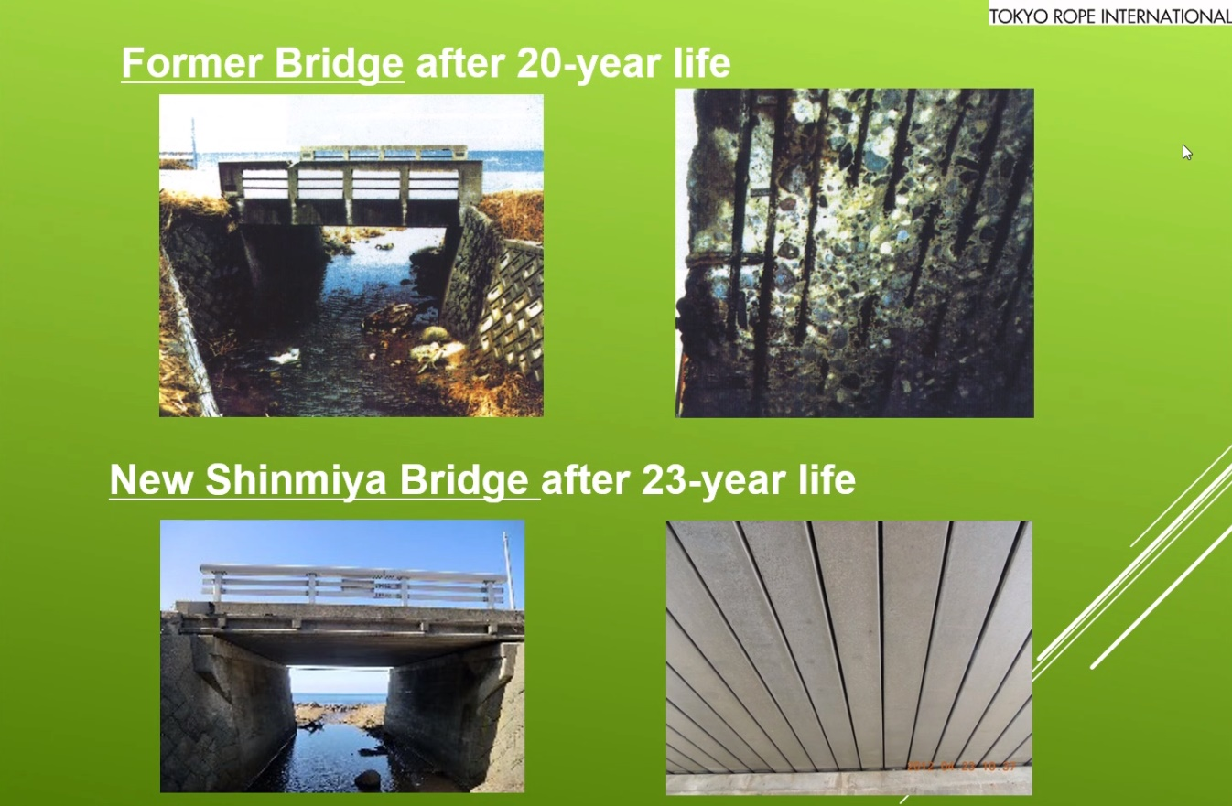
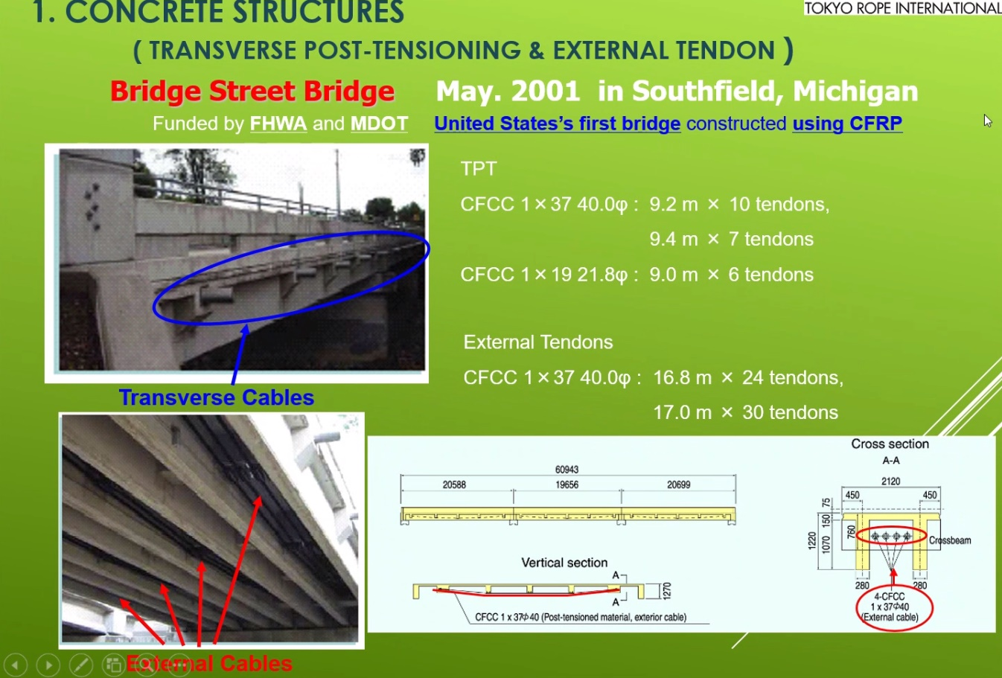
Way Back: CFRP Prestressing Strand
CFCC: First USA bridge application in Michigan in 2001 – Post-Tensioning
(Steel Reinforcing)
(2011)

Slide 8
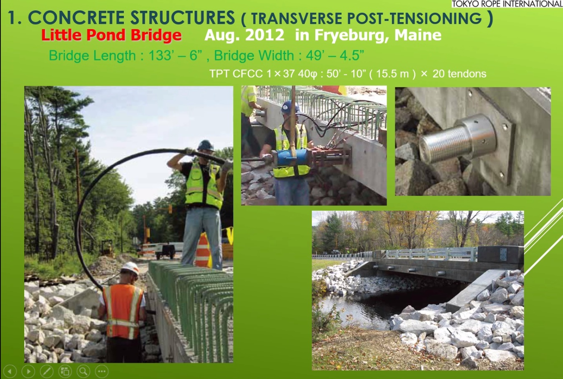
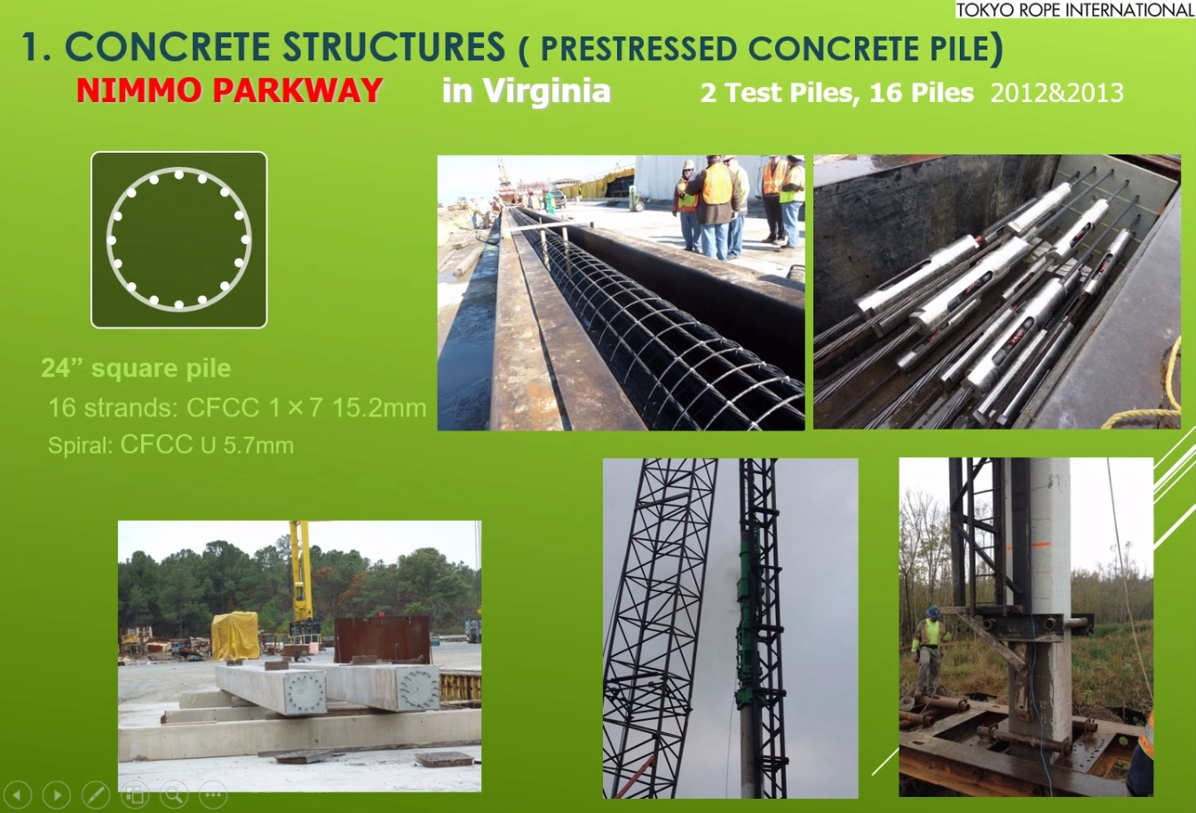
Back a Decade: CFRP Prestressing Strand
2012 (Maine) & 2012-13 (Virginia)

Slide 9
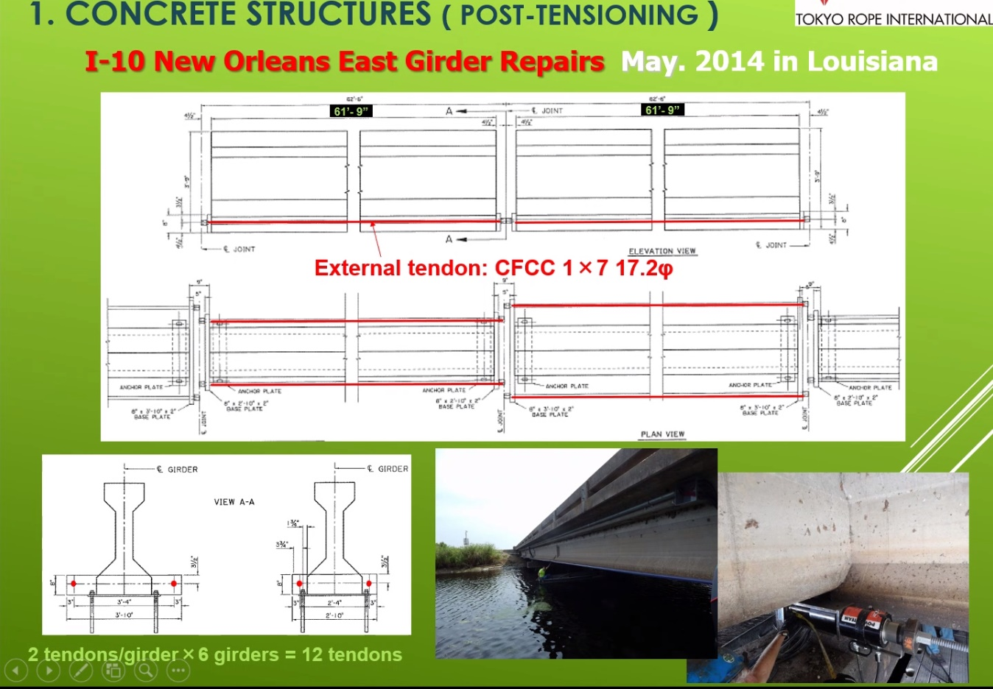
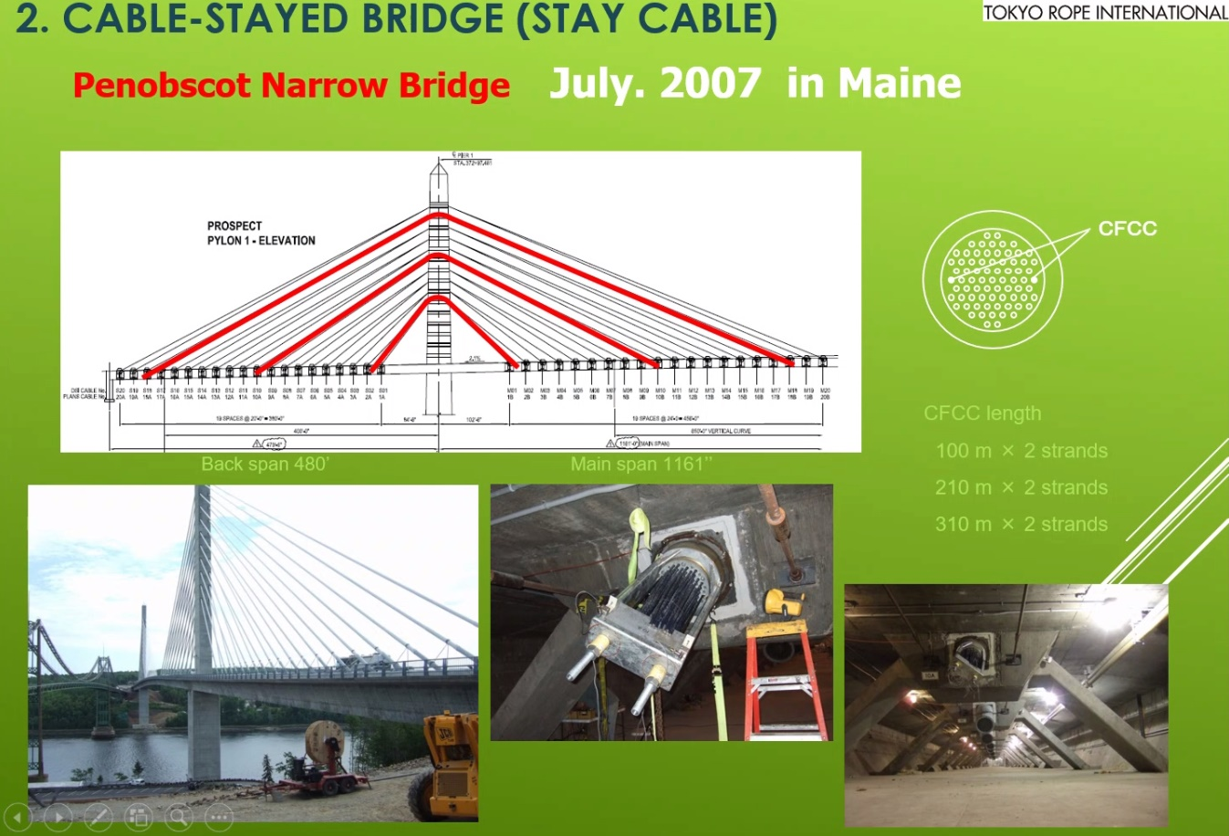
Back a Decade : CFRP Prestressing Strand
2014 (Louisiana) & 2016 (Maine)

Slide 10
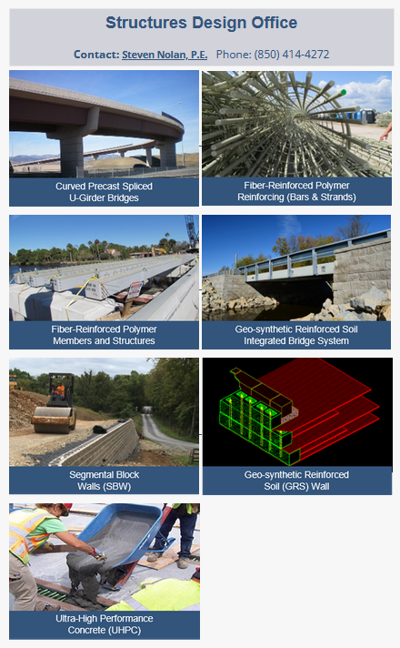

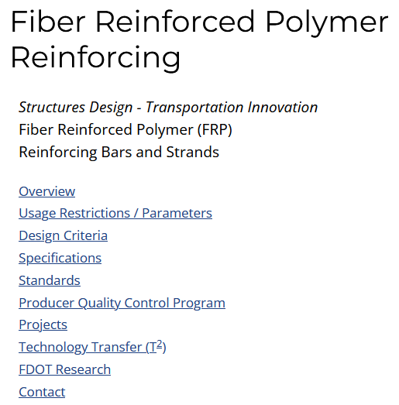
Back a Decade : Launched FRP Innovation Webpage
2014 FDOT (Invitation to Innovation)
https://www.fdot.gov/structures/innovation/frp.shtm

Slide 11
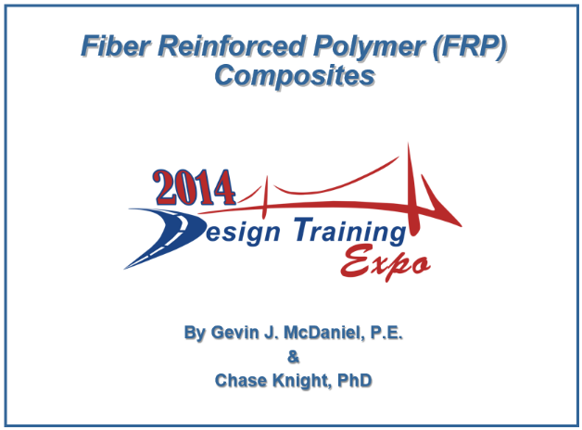

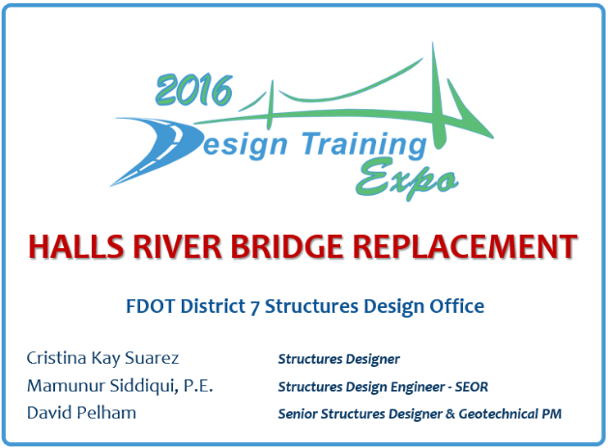
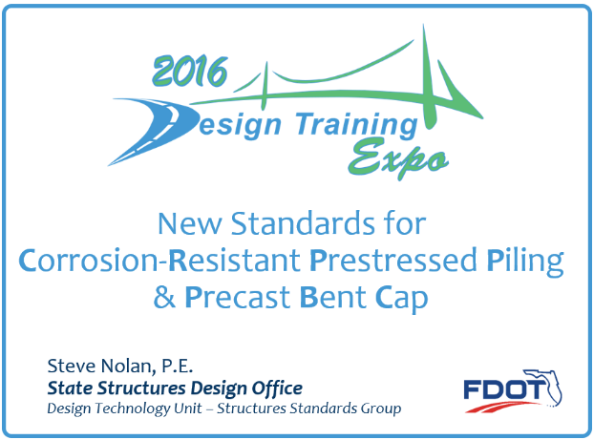
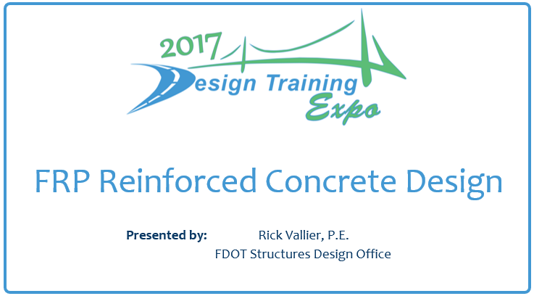
CFRP Prestressing Strand & more… at FDOT
8/1/1992 | Feasibility of Fiberglass Pretensioned Piles in a Marine Environment | Sen, Rajan (USF)
8/1/1995 | Durability of CFRP Pretensioned Piles in Marine Environment Volume II | Sen, Rajan (USF)
11/30/1998 | Studies on Carbon FRP (CFRP) Prestressed Concrete Bridge Columns and Piles in Marine Environment | Arockiasamy, M. (FAU)

Slide 12
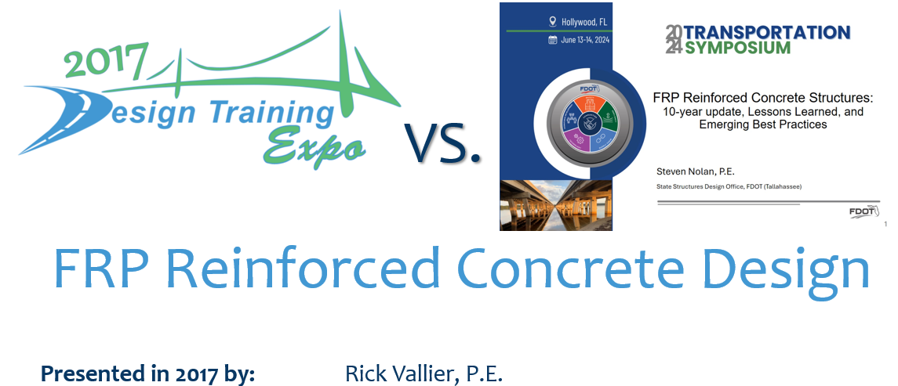
Design: Practices and Standards for FRP-RC/PC
Updates in 2024 by: Steven Nolan, P.E.

Slide 13
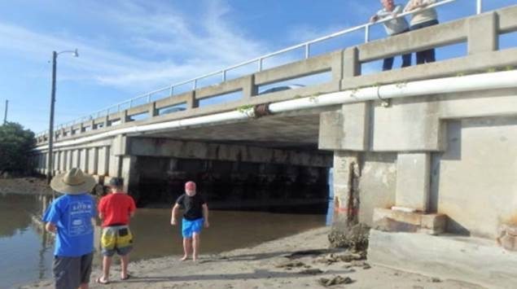
2017 vs. 2024 FRP Reinforced Concrete Outline
FRP Reinforcing Bars
Research
Structures Manual
Design Standards
Developmental Design
Standards
Standard Specifications
Challenges

Slide 14
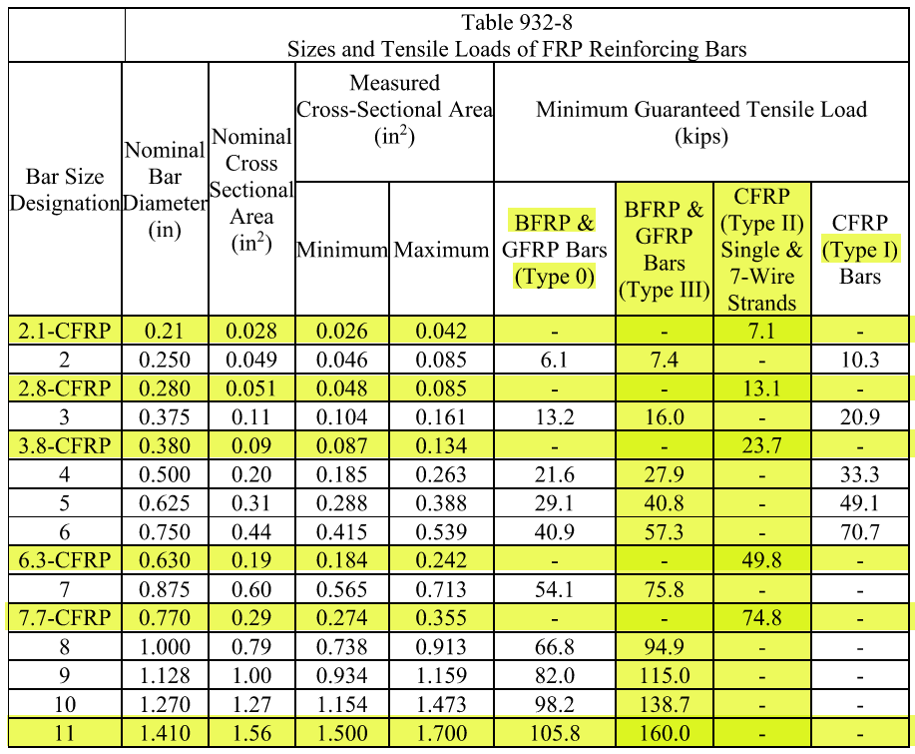
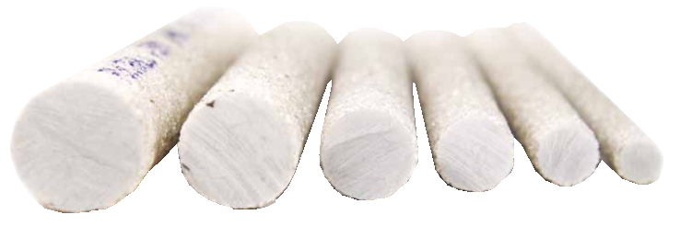
A. Reinforcing Bars
Spec. 932-4.2 Bar Sizes and Loads

Slide 15
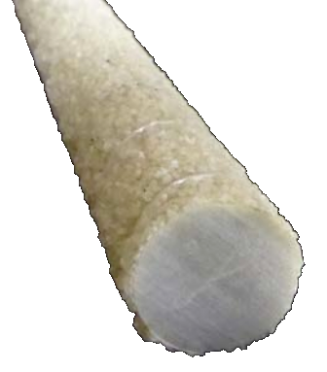
A. Reinforcing Bars
Characteristics of FRP Reinforcement:
Polymer resin matrix relatively weak:
  Bond force is transferred through resin to fibers.
  Shear resistance is considered relatively weak (~60%).
Low compressive strength of FRP:
  Design contribution of FRP reinforcement to resist compression is not recommended ignored.
Modulus of elasticity is low:
  Due to lower stiffness (6.5 msi & 8.7 msi), serviceability often controls the design.
Creep-rupture threshold is low (25% 30% f_{u}):
  Sustained high tension can cause fibers to fail after a period of time
  GFRP is considered more susceptible than CFRP (70% f_{u}).

Slide 16
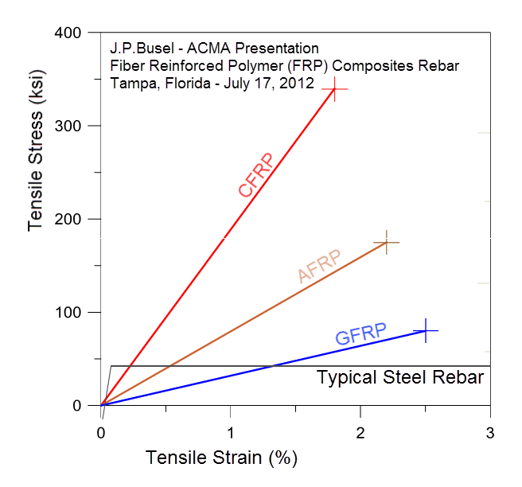
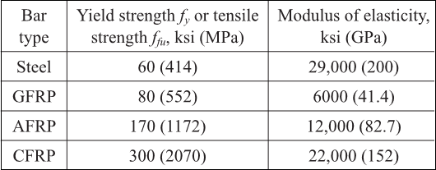
A. Reinforcing Bars
Characteristics of FRP Reinforcement:
Linear Elastic to Failure
No Yielding (but higher strain at 60 ksi)
Higher Ultimate Strength
Lower Strain at Failure
(Type II)
GFRP (Type III)
(Type 0)
(Type 0)
to 120
6,500
67
(Type III)
105 to 150
8,700
(Type II)
22,480
From ACI 440.1R-15 FDOT Spec 932-4, ASTM D7957 & D8505

Slide 17
A. Reinforcing Bars
FRP Bar Mechanical Characteristics Influenced By:
Pre-Construction
  Manufacturing Process (FDOT MM Chapter 12.1)
  Rate of Curing
  Quality and Quantity of Constituents
Construction and Post-Construction
  Moisture (current limitation on BFRP in submerged marine environments. See FRPG 2.1)
  Ultraviolet Exposure (Spec. 416 limits on exposure)
  Elevated Temperature (Fire < T_{g})
  Alkaline, Acidic, Saline Solutions (C_{E} = 0.70)

Slide 18
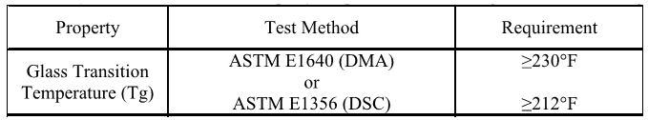
A. Reinforcing Bars
Characteristics of FRP Reinforcement:
Endurance time in fire or elevated temperature less than for steel for anchorage zones (ACI 440-H is working on criteria):
  Reinforcement type, aggregate type, and concrete cover will influence fire performance
  Tensile, compressive, and shear properties of the resin material diminish as temperature approaches the glass transition temp. (Tg)
Specification 932-4 https://www.fdot.gov/programmanagement/specs.shtm

Slide 19
A. Reinforcing Bars
Characteristics of FRP Reinforcement:
Life cycle costs likely lower where steel corrosion is a concern (see HRB).
SCMs (HRPs) for corrosion protection are may not be needed:
Silica Fume
Metakaolin
  Ultrafine Fly Ash
  Calcium Nitrite
Transportation costs are lower and handling easier for FRP due to light weight (~25%).
Concrete cover reduction is allowed (see FRPG Table 2.2).

Slide 20
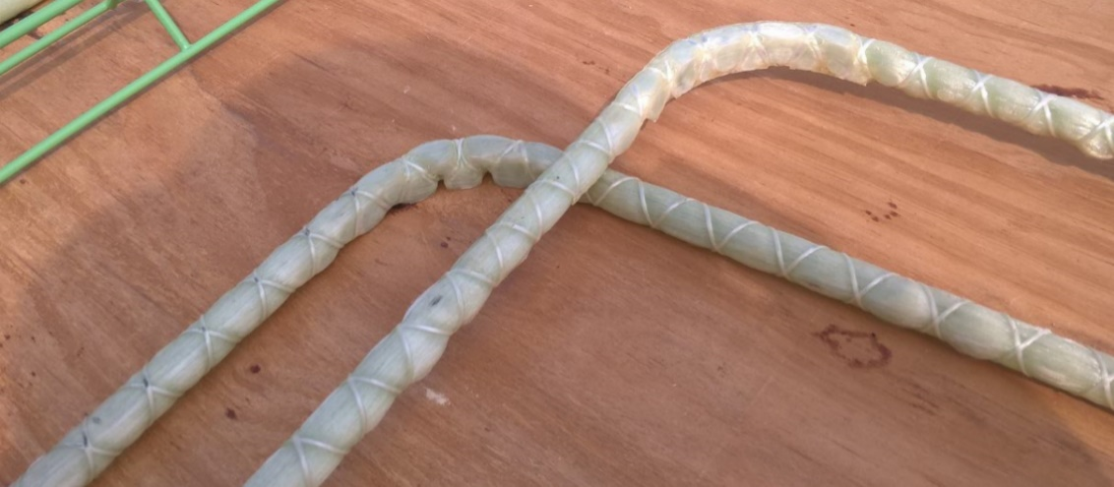
A. Reinforcing Bars
Bent Bars Characteristics:
FRP is pultruded from thermoset resin (viable thermoplastic resins are emerging)
FRP is fabricated with bends (thermoplastic and olefin resin will allow controlled thermal bending – NCHRP IDEA-207 validated this):
  Sharp bends can be manufactured, but avoided due to potential low stress failure.
  Bend Radius / Bar Diameter ≥ 3.
  Tail Length = 12 x Bar Diameter.
  Field bending not permitted.
Developmental Design Standard
Plan Index 415-010 D21310 Bar Bending Details

Slide 21
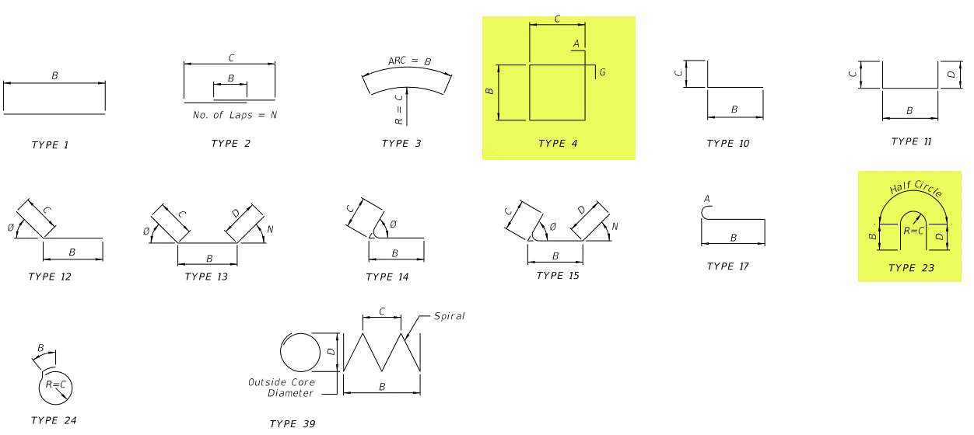
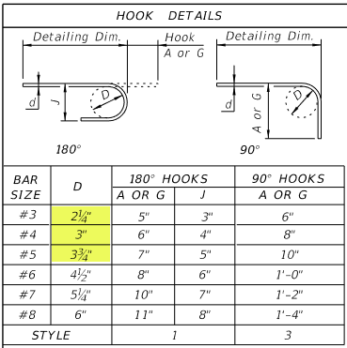
A. Reinforcing Bars
From Developmental Design Standard Plans Index D21310 415-010: (renumbering to match steel bar bending Index)

Slide 22
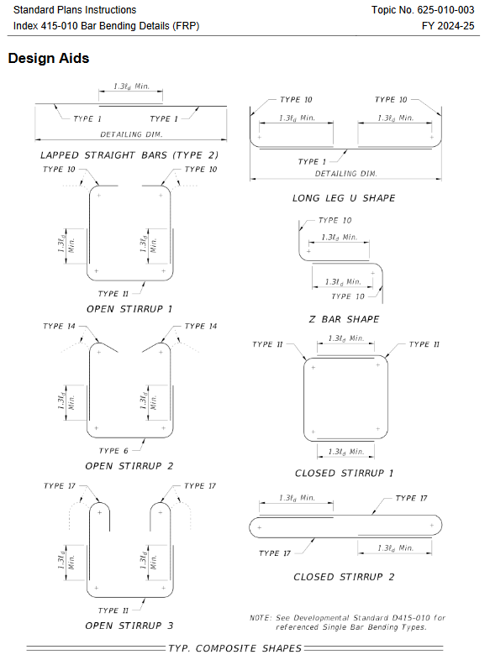
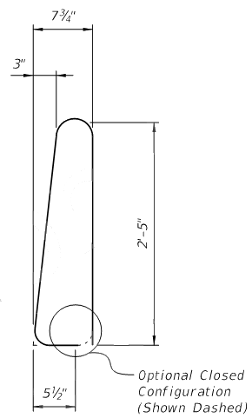
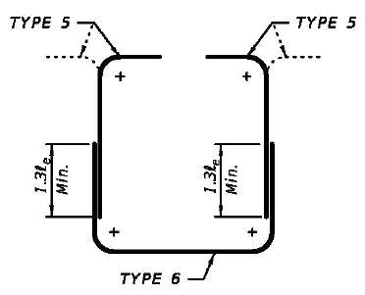
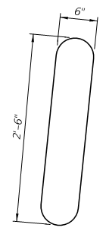
A. Reinforcing Bars
Complex Shapes:

Slide 23
A. Reinforcing Bars
Cost Comparison (Installed Price)
Bar Size | Nominal Diameter | Average Unit Costs HRB (3-bids) / ** |  | FDOT Structures Manual for BDR Cost Estimating / **
 |  | GFRP Bars 2016 | GFRP Bars 2023 | Grade 60 Steel | Stainless-Steel
#4 | 0.500” | $1.18 / LF | $1.90 / LF | $0.60 1.11 / LF | $2.72 5.25 / LF
#5 | 0.625” | $1.37 / LF | $2.29/ LF | $0.94 1.74 / LF | $4.19 8.09 / LF
#6 | 0.750” | $1.55 / LF | $2.71/ LF | $1.35 2.51 / LF | $5.98 11.54 / LF
#8 | 1.000” | $2.54 / LF | $4.04/ LF | $2.40 4.45 / LF | $10.74 20.73 / LF
Note: There is not 1:1 substitution of FRP for steel bars.
Black steel bar based on $1.67**$0.90 / lb for all bar sizes.
Stainless steel bar based on $7.72**$4.00 / lb for all bar sizes.
** 2023 FDOT Bid Avg.

Slide 24
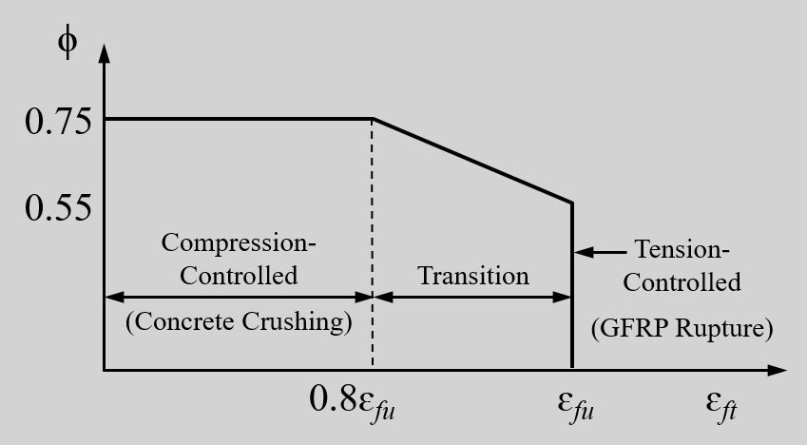
A. Reinforcing Bars
Flexural Strength Design Philosophy
Steel Reinforced Concrete Design
  Tension-Controlled Behavior
  Yielding of Steel Prior to Concrete Crushing Provides Ductility and Warning of Distress through extensive cracking and deformation
FRP Reinforced Concrete Design
  Tension-Controlled Behavior
    FRP Rupture (phi = 0.55)
  Compression-Controlled Behavior
    Concrete Crushing prior to FRP Rupture (phi = 0.65 0.75)
  Margin of Safety is Higher than for Steel Reinforced Design

Slide 25
A. Reinforcing Bars
Design Assumptions
Plane sections remain plane
Flexural strength using equivalent rectangular concrete stress distribution
Compressive strain in concrete assumed to be 0.003
Tensile strength of concrete is ignored
Perfect bond exists between concrete and FRP reinforcement
Tensile behavior of FRP reinforcement is linear elastic until failure
Compressive strength of FRP reinforcement is ignored

Slide 26
B. FDOT Research
Research and field implementation of FRP materials is ongoing and design recommendations continue to evolve and improved.
Completed | Title | Researcher | Institution | Research No.
Nov. 2018 | Performance Evaluation of GFRP Reinforcing Bars Embedded in Concrete Under Aggressive Environments | R. Kampmann | FAMU-FSU | BDV30 977-18
April 2019 | Degradation Mechanisms and Service Life Estimation of FRP Concrete Reinforcements | A. El Safty | UNF | BDV34 977-05
6/30/2019 | Performance Evaluation of Basalt Fiber Reinforced Polymer (BFRP) Reinforcing Bars Embedded in Concrete | R. Kampmann | FAMU-FSU | BVD30 986-01
April 2022 | Epoxy Dowel Pile Splice Evaluation with FRP Bars | A. Mehrabi | FIU | BDV29 977-52
Dec. 2020 | “Stainless Steel Strands and Lightweight Concrete for Pretensioned Concrete Girders” (w/ GFRP shear stirrups) | M. Roddenberry | FAMU-FSU | BDV30 977-27 (Report A)
07/30/2022 | Improving Testing Protocol and Material Specifications for Basalt Fiber Reinforced Polymer Bars | R. Kampmann | FAMU-FSU | BE694
http://www.fdot.gov/structures/innovation/FRP.shtm

Slide 27
B. FDOT Research - Completed and In-progress
Research and field implementation of FRP materials is ongoing and expanding…
Completion Date | Title | Researcher | Institution | Research No.
08/29/2022 | Development of GFRP Reinforced Single Slope Bridge Rail | G. Consolazio | UF | BDV31 977-110
12/31/2023 | Evaluation of Glass Fiber Reinforced Polymers (GFRP) Spirals in Corrosion Resistant Concrete Piles | S. Jung | FAMU-FSU | BDV30 977-27
Feb. 2025 | FSBs With Stainless Steel Strands and GFRP Shear Reinforcement﻿ | M. Roddenberry | FAMU-FSU | BED30 977-09
April 2025 | Waterline Pile Cap Footings for Bridges using Large Diameter FRP Reinforcing – Material Characterization and Design | A. Nanni | UM | BEE76 977-01
May 2025 | HRB Extraction and Physio-Mechanical Testing of FRP Reinforcing Bars from 5-year-old Seawater Concrete Test Blocks on Halls River Bridge Bulkhead | F. De Caso | UM | BEE76 977-02

Slide 28
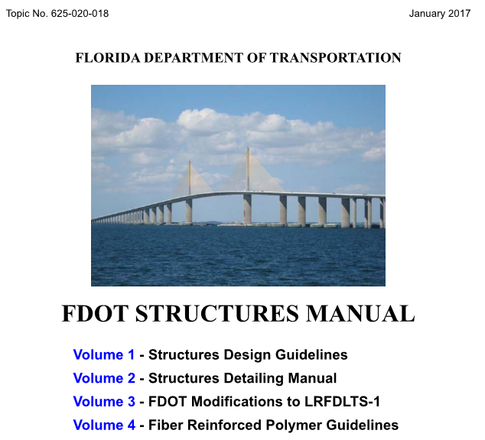

C. FDOT Structures Manual
FDOT Design Criteria for FRP:
Vol. 1 – SDG
Bearing Piles – 3.5
Fender Systems – 3.14
Structural FRC– 3.17
BDR Cost Estimating – 9.2
  Bearing Piles
  Sheet Pile
Vol. 2 – SDM
Fender Systems – 24
Vol. 4 – FRPG
Reinforcing Bars – 2
Strands – 3
Strengthening – 4
Pultruded Shapes – 5
VIP Shapes – 6
Thermoplastic Shapes – 7
http://www.fdot.gov/structures

Slide 29
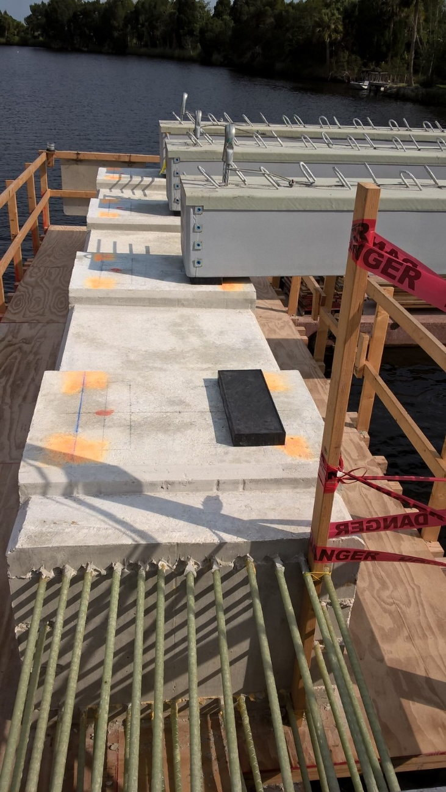
C. FDOT Structures Manual
FDOT Design Criteria for using FRP Composites:
The Structures Manual implements basic design
guidelines for FRP composites in specific
applications.
As is the case with all structural materials, the
engineer must practice the appropriate standard
of care when designing components using FRP
composites.

Slide 30
C. FDOT Structures Manual
Volume 4 - Fiber Reinforced Polymer Guidelines (FRPG)
Unless otherwise stated within the FRPG, the use of FRP composites requires approval of the State Structures Design Office.
Obtain concept approval before proceeding with any design effort.
After concept is approved, submit the design to the State Structures Design Office for review.
FDM 121.3.2: “Any component designed using Fiber Reinforced Polymer (FRP) composite materials except components in the Standard Plans” is designated as Category 2 Structure.

Slide 31
C. FDOT Structures Manual
Volume 4 - Fiber Reinforced Polymer Guidelines (FRPG) – Section 2: Permitted use when approved by the SSDE:
Approach Slabs
Bridge Decks & Bridge Overlays
Cast-in-Place Flat Slab Superstructure
Pile Bent Caps not in direct contact with water
Pile Jackets
Pier Columns and Caps not in direct contact with water
Retaining Walls, Noise Walls, Perimeter Walls
Traffic Railings
Pedestrian/Bicycle Railings
Bulkheads and Bulkhead Copings
MSE Wall Panels and Copings
Drainage Structures
Dowel Bars for Exp. Joints
Note: Other locations will be considered on a case-by-case basis.

Slide 32
C. FDOT Structures Manual
FDOT Structures Manual – Vol. 4 FRPG 2.3
Concrete Cover Requirements in Extremely Aggressive Environments
Component | FRP Cover Requirements | Steel Cover Requirements
External Surface Cast Against Earth | 3 in. | 4.5 in.
Box Culverts | 2.5 2 in. | 3 in.
C.I.P. Cantilever Retaining Walls | 2.5 2 in. | 3 in.
MSE Walls | 2 1.5 in. | 3 in.
Bulkheads and Sheet Pile Caps | 3 2 in. | 4 in.
See FDOT Structures Manual for cover requirements for other components. http://www.fdot.gov/structures

Slide 33
C. FDOT Structures Manual
GFRP/CFRP Reinforcing Bars – Section 2 – Design Criteria
Design concrete members with FRP reinforcement according to:
AASHTO LRFD Bridge Design Guide Specifications for GFRP-Reinforced Concrete ACI 440.1 Guide for the Design and Construction of Structural Concrete Reinforced with FRP Bars.
AASHTO Guide Specification for the Design of Concrete Bridge Beams Prestressed with CFRP Systems. ACI 440.4 Prestressing Concrete Structures with FRP Tendons
Design Bridge Decks according to:
AASHTO LRFD Bridge Design Guide Specifications for GFRP-Reinforced Concrete Bridge Decks and Traffic Railings (2nd Edition)
Use FRP Mechanical Properties per FDOT Section 932-4.

Slide 34
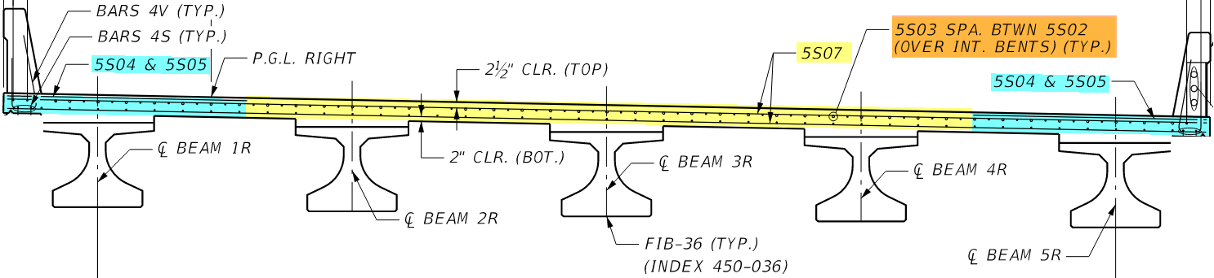
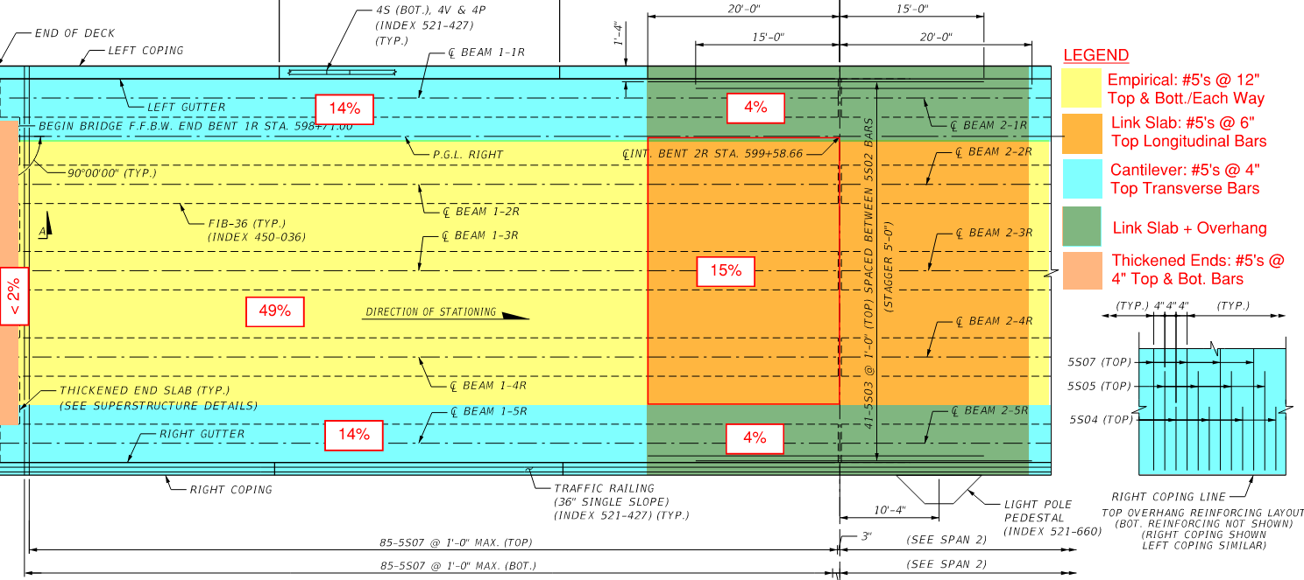
Comparison of Rebar Qty. – Bridge Deck Example A
End Span (Relative Areas):
1.
← 49%
2.
← 15%
3.
← 28%
4.
← 8%
← Ignore <2%
End Span Bridge Deck - Example A

Slide 35
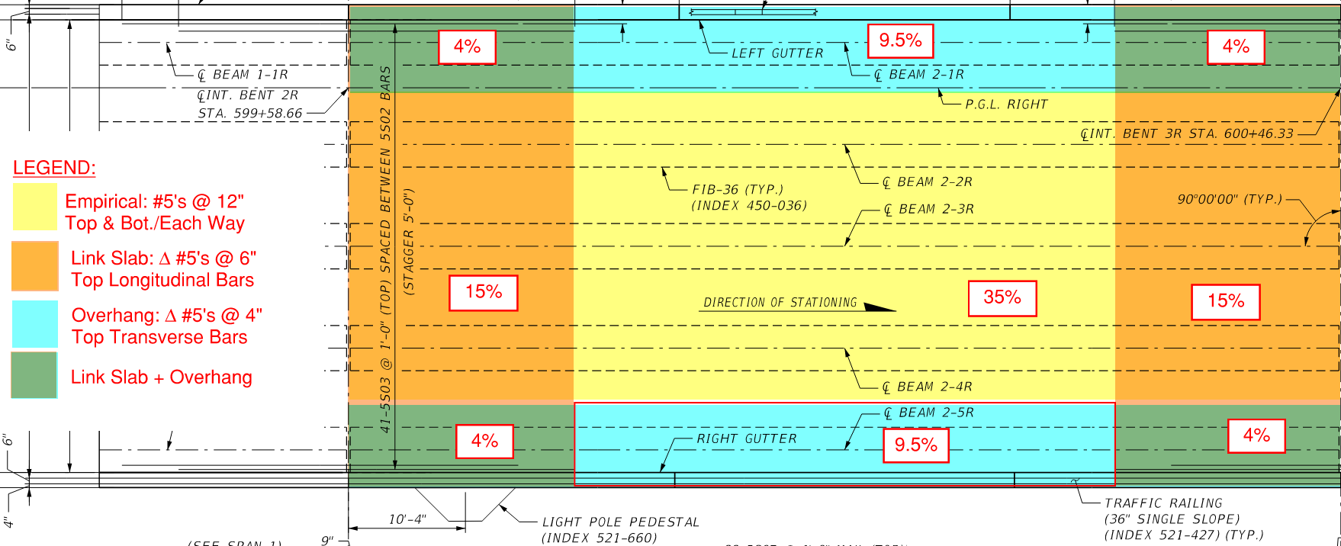
Comparison of Rebar Qty. – Bridge Deck Example B
Example Not Provided
Interior Span
(Relative Areas):
35% →
1.
30% →
2.
19% →
16% →
3.
4.
Interior Span Example

Slide 36
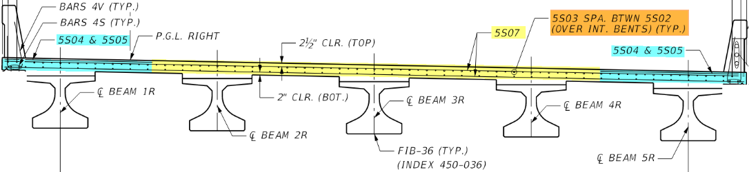
Comparison of Material Qty. – Deck Area 1 (Example A)
Convention CS-RC (ASTM A615):
Thickness = 8”
Concrete Cover = 2”
Flexural Depth (#5’s) d = 5.7”
Empirical (AASHTO-BDS): Bottom layers = #5’s @ 13.8” (0.27 in²/ft); Top layers = #4’s @ 13.3” (0.18 in²/ft)
Empirical (FDOT): #5’s @ 12” **
Total Rebar (AASHTO): A_{s}= 0.90 in²/ft²; (FDOT): A_{s}= 1.24 in²/ ft²
GFRP-RC (ASTM D8505-23):
Thickness = 7” → Δ_{vol.}= -12%; Δ_{weight} = -15%
Concrete Cover = 1”
Flexural Depth (#5’s) d = 5.7”
Empirical (AASHTO-GSG): ** Bottom transverse layer = #5’s @ 6.5” (0.83%) Other 3-layers = #5’s @ 12” (0.35%)
Total Rebar: A_{f} = 1.50 in²/ft² deck)
→ Δ_{volume} (AASHTO) = +67%; Δ_{weight} = -58%
→ Δ_{volume} (FDOT) = +21%; Δ_{weight} = -70%
Interior Section
End Span Bridge Deck - Example A
** Minimum bar size and spacing governs

Slide 37
Comparison of Material Qty. – Deck Area 2 (Example A)
Convention CS-RC (ASTM A615):
Thickness = 8”
Concrete Cover = 2”
Flexural Depth (#5’s) d = 5.7”
Empirical: (AASHTO): Bottom layers = #5’s @ 13.8” (0.27 in²/ft); Top transverse = #4’s @ 13.3” (0.18 in²/ft); + Top long. = #5’s @ 6” (0.62 in²/ft)
Empirical: (FDOT): 3-layers @ #5’s @ 12” ** (0.31 in²/ft);
Total Rebar (AASHTO): A_{s}= 1.34 in²/ ft²
(FDOT): A_{s}= 1.55 in²/ ft²
GFRP-RC (ASTM D8505-23):
Thickness = 7” → D_{vol.}= -12%; D_{weight} = -15%
Concrete Cover = 1”
Flexural Depth (#5’s) d = 5.7”
Empirical (FDOT/AASHTO-GSG): **Bottom transverse = #5’s @ 6.5” (0.83% = 0.57 in²); Other 2-layers = #5’s @ 12” (0.35% = 0.31 in²); + Top long. = #5’s @ 6” (0.62 in²/ft)
Total Rebar: A_{f} = 1.81 in²/ft²
→ Δ_{vol.} (AASHTO) = +35%; Δ_{weight} = -66 %
→ Δ_{vol.} (FDOT) = +17%; Δ_{weight} = -71 %
Link-Slab Section
End Span Bridge Deck - Example A
** Minimum bar size and spacing governs

Slide 38
Comparison of Material Qty. – Deck Area 3 (Example A)
Convention CS-RC (ASTM A615):
Thickness = 8”
Concrete Cover = 2”
Flexural Depth (#5’s) d = 5.7”
Empirical (AASHTO-BDS): 2~Bot. layers = #5’s @ 13.8” (0.27 in²/ft); Top long. = #4’s @ 13.3” (0.18 in²/ft); Top transv. = #4’s + #5’s @ 4” (0.82 in²/ft).
Empirical (FDOT): 3-layers #5’s @ 12” ** (0.31 in²/ft); Top Tranv. = #5’s @ 4”(0.93 in²/ft).
Total Rebar (AASHTO): A_{s}= 1.54 in²/ft²; (FDOT): A_{s}= 1.86 in²/ ft².
GFRP-RC (ASTM D8505-23):
Thickness = 7” → Δ_{vol.}= 88%; Δ_{weight} = 85%
Concrete Cover = 1”
Flexural Depth (#5’s) d = 5.7”
Empirical (AASHTO-GSG): Bot. ** transv. = #5’s @ 6.5” (>0.83% = 0.57 in²); 2~long. layers = #5’s @ 12” (> 0.35% = 0.31 in²); Top transv. = #5’s @ 4” (0.93 in²/ft).
Total Rebar: A_{f} = 2.12 in²/ft² deck)
→ Δ_{volume} (AASHTO) = +38%; Δ_{weight} = -66 %
→ Δ_{volume} (FDOT) = +14%; Δ_{weight} = -72 %
Overhangs (midspan)
End Span Bridge Deck - Example A
** Minimum bar size and spacing governs

Slide 39
Comparison of Material Qty. – Deck Area 4 (Example A)
Convention CS-RC (ASTM A615):
Thickness = 8”
Concrete Cover = 2”
Flexural Depth (#5’s) d = 5.7”
Empirical Overhang + Link-Slab (AASHTO-BDS): 2~Bot. layers = #5’s @ 13.8” (0.27 in²/ft); Top long. = #4’s & #5’s @ 6.7” (0.46 in²/ft); Top transv. = #4’s + #5’s @ 4” (0.82 in²/ft).
Empirical-Link (FDOT): 2~Bot. layers #5’s @ 12” ** (0.31 in²/ft); Top Tranv. = #5’s @ 4”(0.93 in²/ft). Top. long. = #5’s @ 6”(0.62 in²/ft).
Total Rebar (AASHTO): A_{s}= 1.82 in²/ft²;
(FDOT): A_{s}= 2.17 in²/ ft².
GFRP-RC (ASTM D8505-23):
Thickness = 7” → Δ_{vol.}= -12%; Δ_{weight} = -15%
Concrete Cover = 1”
Flexural Depth (#5’s) d = 5.7”
Empirical Overhang + Link-Slab (AASHTO-GSG): Bot. ** transv. = #5’s @ 6.5” (>0.83% = 0.57 in²); Bot. long. = #5’s @ 12” (> 0.35% = 0.31 in²); Top transv. = #5’s @ 4” (0.93 in²/ft). Top long. = #5’s @ 6” (0.62 in²)
Total Rebar: A_{f} = 2.69 in²/ft² deck)
→ Δ_{volume} (AASHTO) = +48%; Δ_{weight} = -67 %
→ Δ_{volume} (FDOT) = +24%; Δ_{weight} = -69 %
Overhangs @ Link-Slab
End Span Bridge Deck - Example A
** Minimum bar size and spacing governs

Slide 40
Comparison of Material Quantities – Example A Summary
Convention CS-RC (ASTM A615):
Example A (End Span Rebar)
  Empirical (AASHTO): As= 0.49*0.90 + 0.15*1.34 + 0.28*1.54 + 0.08*1.82 = 1.22 in²/ ft²
  Empirical (FDOT): A_{s} = 0.49*1.24 + 0.15*1.55 + 0.28*1.86 + 0.08*2.17 = 1.53 in²/ ft²
GFRP-RC (ASTM D8505-23):
Example A (End Span Rebar)
  Empirical (both): As= 0.49*1.50 + 0.15*1.81 + 0.28*2.12 + 0.08*2.69 = 1.82 in²/ ft²
Concrete → Δ_{vol.} (AASHTO) = -12%; Δ_{weight} = -15% for GFRP-RC
Rebar → Δ_{volume} (AASHTO) = +49%; Δ_{weight} = -63 %.
Rebar → Δ_{volume} (FDOT) = +19%; Δ_{weight} = -70 %.
End Span Bridge Deck - Example A
** Minimum bar size and spacing governs

Slide 41
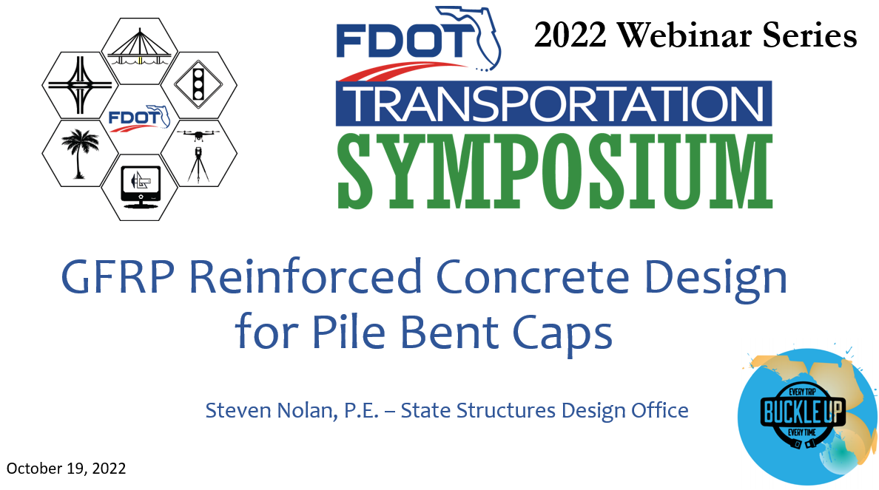
Comparison of Rebar Qty. – Pile Bent Cap Example C
10/20/2022 | GFRP Reinforced Concrete Design for Pile Bent Caps | Presentation
https://transportationsymposium.fdot.gov/Attendee/PastWebinars2022

Slide 42
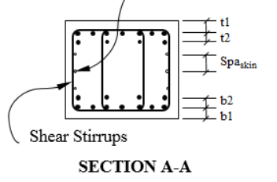
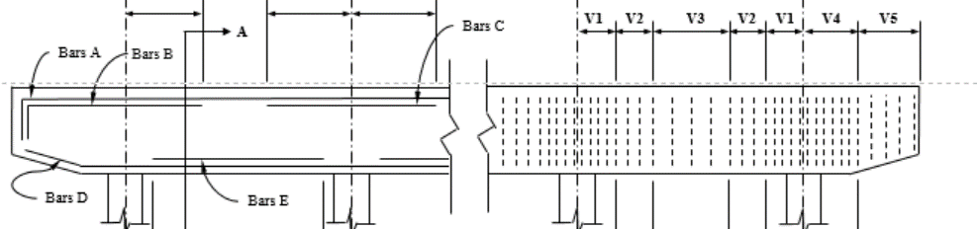
Design Example for Pile Bent Cap Summary
Comparison of different design alternates for 5-piles @ 9-ft spacing (Example 1) – Higher Modulus GFRP Rebar (Ef = 6,500 psi to 8,700 psi for future enhancements to ASTM D7957)
Rebar Location | GFRP-RC (Type 0) 3-ft Deep Cap (E_{f} = 6,500 ksi) | GFRP-RC 3-ft Deep Cap (E_{f} = 7,250 ksi) | GFRP-RC (Type III) 3-ft Deep Cap (E_{f} = 8,700 ksi)
Bars A - Flexural Top | 6 ~ #8’s (A_{f} = 4.7 in²) | 7 ~ #7’s (A_{f} = 4.2 in²) | 6 ~ #7’s (A_{f} = 3.6 in²)
Bars D & E - Flexural Bottom | 8 ~ #8’s (A_{f} = 6.3 in²) | 7 ~ #8’s (A_{f} = 5.5 in²) | 6 ~ #8’s (A_{f} = 4.7 in²)
Bars V3 - Shear Stirrups | 4-legs #5 at 11" sp. (A_{f} = 1.4 in²/ft) | 4-legs #5 at 13" sp. (A_{f} = 1.1 in²/ft) | 4-legs #4 at 10" sp. (A_{f} = 1.0 in²/ft)

Slide 43
Design Example for Pile Bent Cap Summary
Comparison of different design alternates for 5-piles @ 9-ft spacing (Example 1)
Rebar Location | GFRP-RC (Type 0) 3-ft Deep Cap | Δ_{volume} _{Type 0 or (Type III)} | Steel-RC 3-ft Deep Cap
Bars A - Flexural Top | 6 ~ #8’s (A_{f} = 4.7 in²) | +80% or (+38%) | 6 ~ #6’s (A_{s} = 2.6 in²)
Bars D & E - Flexural Bottom | 8 ~ #8’s (A_{f} = 6.3 in²) | +50% or (+12%) | 7 ~ #7’s (A_{s} = 4.2 in²)
Bars V3 - Shear Stirrups | 4-legs #5 at 11" sp. (A_{f} = 1.4 in²/ft) | +75% or (+25%) | 4-legs #4 at 12" sp. (A_{s} = 0.8 in²)
Part 3 – Design & AASHTO Checks

Slide 44
Construction: Example Projects & Lessons Learned
Projects with Fast-Facts Sheet
Upcoming Bridge and Seawall Projects
4th St North over Big Island Gap (D7) – In-house Design.
40th Ave NE over Placido Bayou (D7)
Arthur Drive over Lynn Haven Bayou (D3)
Bakers Haulover Cut Bulkhead Replacement (D6)
Bimini Dr Bridge on Duck Key (D6)
Cedar Key Bulkhead Rehab (D2)
Halls River Bridge (D7) – In-house Design.
Key West Bight Ferry Terminal Extension (D7)
NE 23rd Ave over Ibis Waterway (D6)
PortMiami Tunnel Retaining Walls (D6)
South Maydell Dr over Palm River (D7)
SR-A1A Flagler Beach Seawall (Segment 3) (D5)
SR-A1A over Myrtle Creek and Simpson Creek (D2)
SR-5 (US-17) over Trout River (D2)
SR-5 (US 41) over Morning Star and Sunset Waterways (D1)
SR-30 over St Joe Inlet (D3)
SR-45 (US 41) over North Creek (D1)
SR 112/I-195 Over Westshore Waterway (D5)
SR-312 over Matanzas River (D2)
SR-520 over Indian River Bulkhead Rehab (D5)
Sunshine Skyway Seawall Rehabilitation (D7)
UM Innovation Bridge
UM Fate Bridge
UM I-Dock
US-1 over Cow Key Channel (D6)
D2: US1/King St over San Sebastian River (437428-1)
D2: St. Augustine A1A/Avenida Menendez Seawall replacement (428271-2)
D2: CR 357 over Shired Creek (437402-1)
D3: CR30A over Western Lake (443331-1)
D3: CR30B/Indian Lagoon (441185-2)
D3: CR 372/Surf Road over Otter Creek Rise (442951-1)
D4: US 1/Jupiter Federal Observation Platform (428400-2)
D4: SR-A1A North Causeway Bridge Observation Platform (429936-2)
D4: 17th St/Indian River, East End-Vero (446106-2)
D4: SR 5/US 1 Over Earman River (442891-1) – In-house Design.
D5: SR-A1A Seawalls - Flagler Beach & Nth Volusia Co. (452443-1 & 452444-1)
D5: Barracuda Blvd New Smyrna (437935-1) – In-house Design.
D5: 5th Street over Yacht Club Cut (437936-1)
D5: US1 over Pellicer Ck (447118-1)
D6: FKOSH Bridge Replacement… (448206-1 & (448207-1)
https://www.fdot.gov/structures/innovation/FRP.shtm

Slide 45
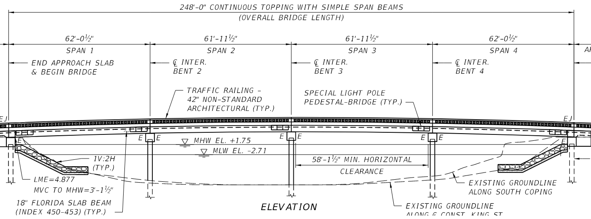
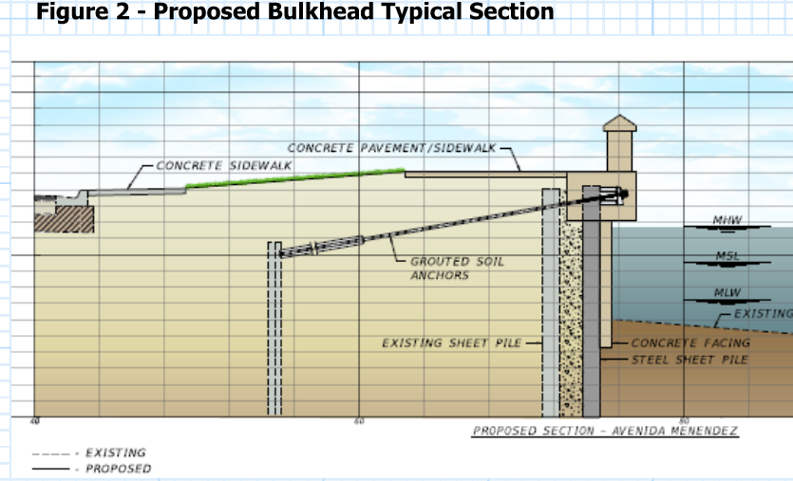
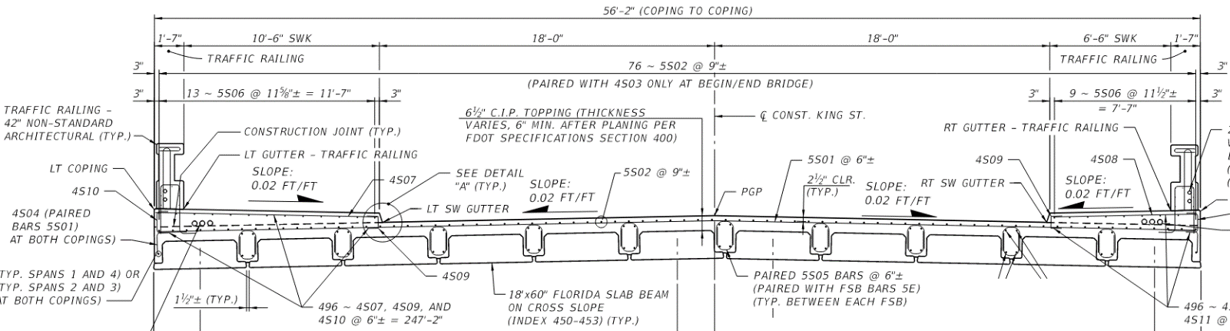
Future Construction: D2 Example Projects
US1/King St over San Sebastian River (437428-1)
St. Augustine A1A/Avenida Menendez Seawall Replacement (428271-2)

Slide 46
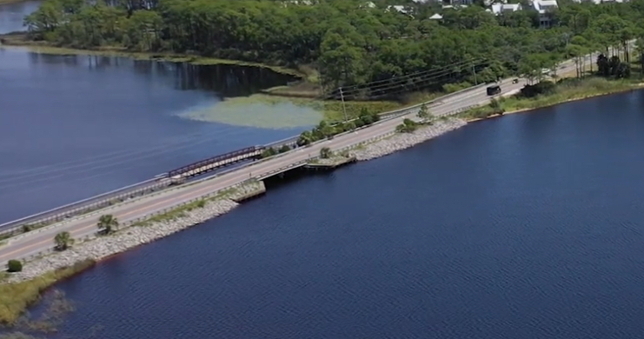
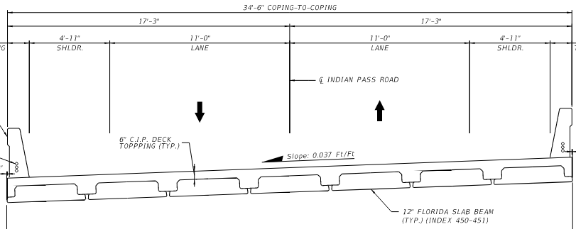
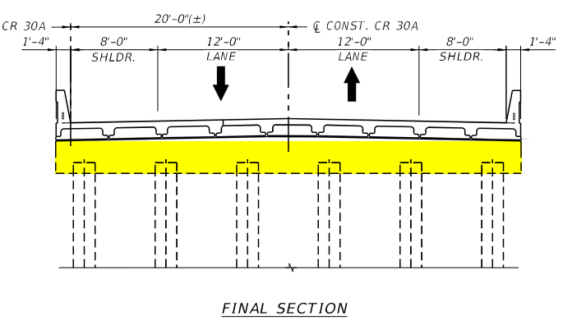
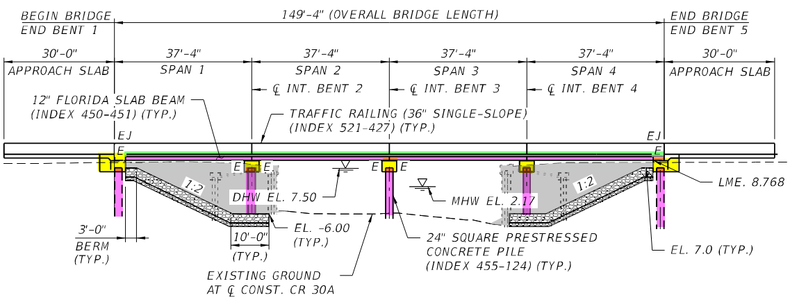

Construction: D3 Example Projects
CR30A over Western Lake (443331-1)
CR30B/Indian Lagoon (441185-2)

Slide 47




Construction: D4 Example Projects
17th St/Indian River, East End-Vero (446106-2)
SR 5/US 1 Over Earman River (442891-1) In-house Design

Slide 48







Construction: D5 Example Projects
SR-A1A Seawalls - Flagler Beach & Nth Volusia Co. (452443-1 & 452444-1)
Barracuda Blvd over Canal Bradano (437935-1) In-house Design

Slide 49


Future Construction: D6 Example Projects
Long Key Bridge Replacement (448206-1 & (448207-1)
Seven Mile Bridge Replacement (448207-1)

Slide 50
FRP RC/PC Design Innovation webpage
https://www.fdot.gov/structures/innovation/frp.shtm

Slide 51



Contact Us
Steven Nolan, P.E.
State Structures Design Office
Florida Department of Transportation
Email: steven.nolan@dot.state.fl.us
Office #: 850-414-4272
Website: https://www.fdot.gov/design/Innovation/

Slide 52


