Slide 1
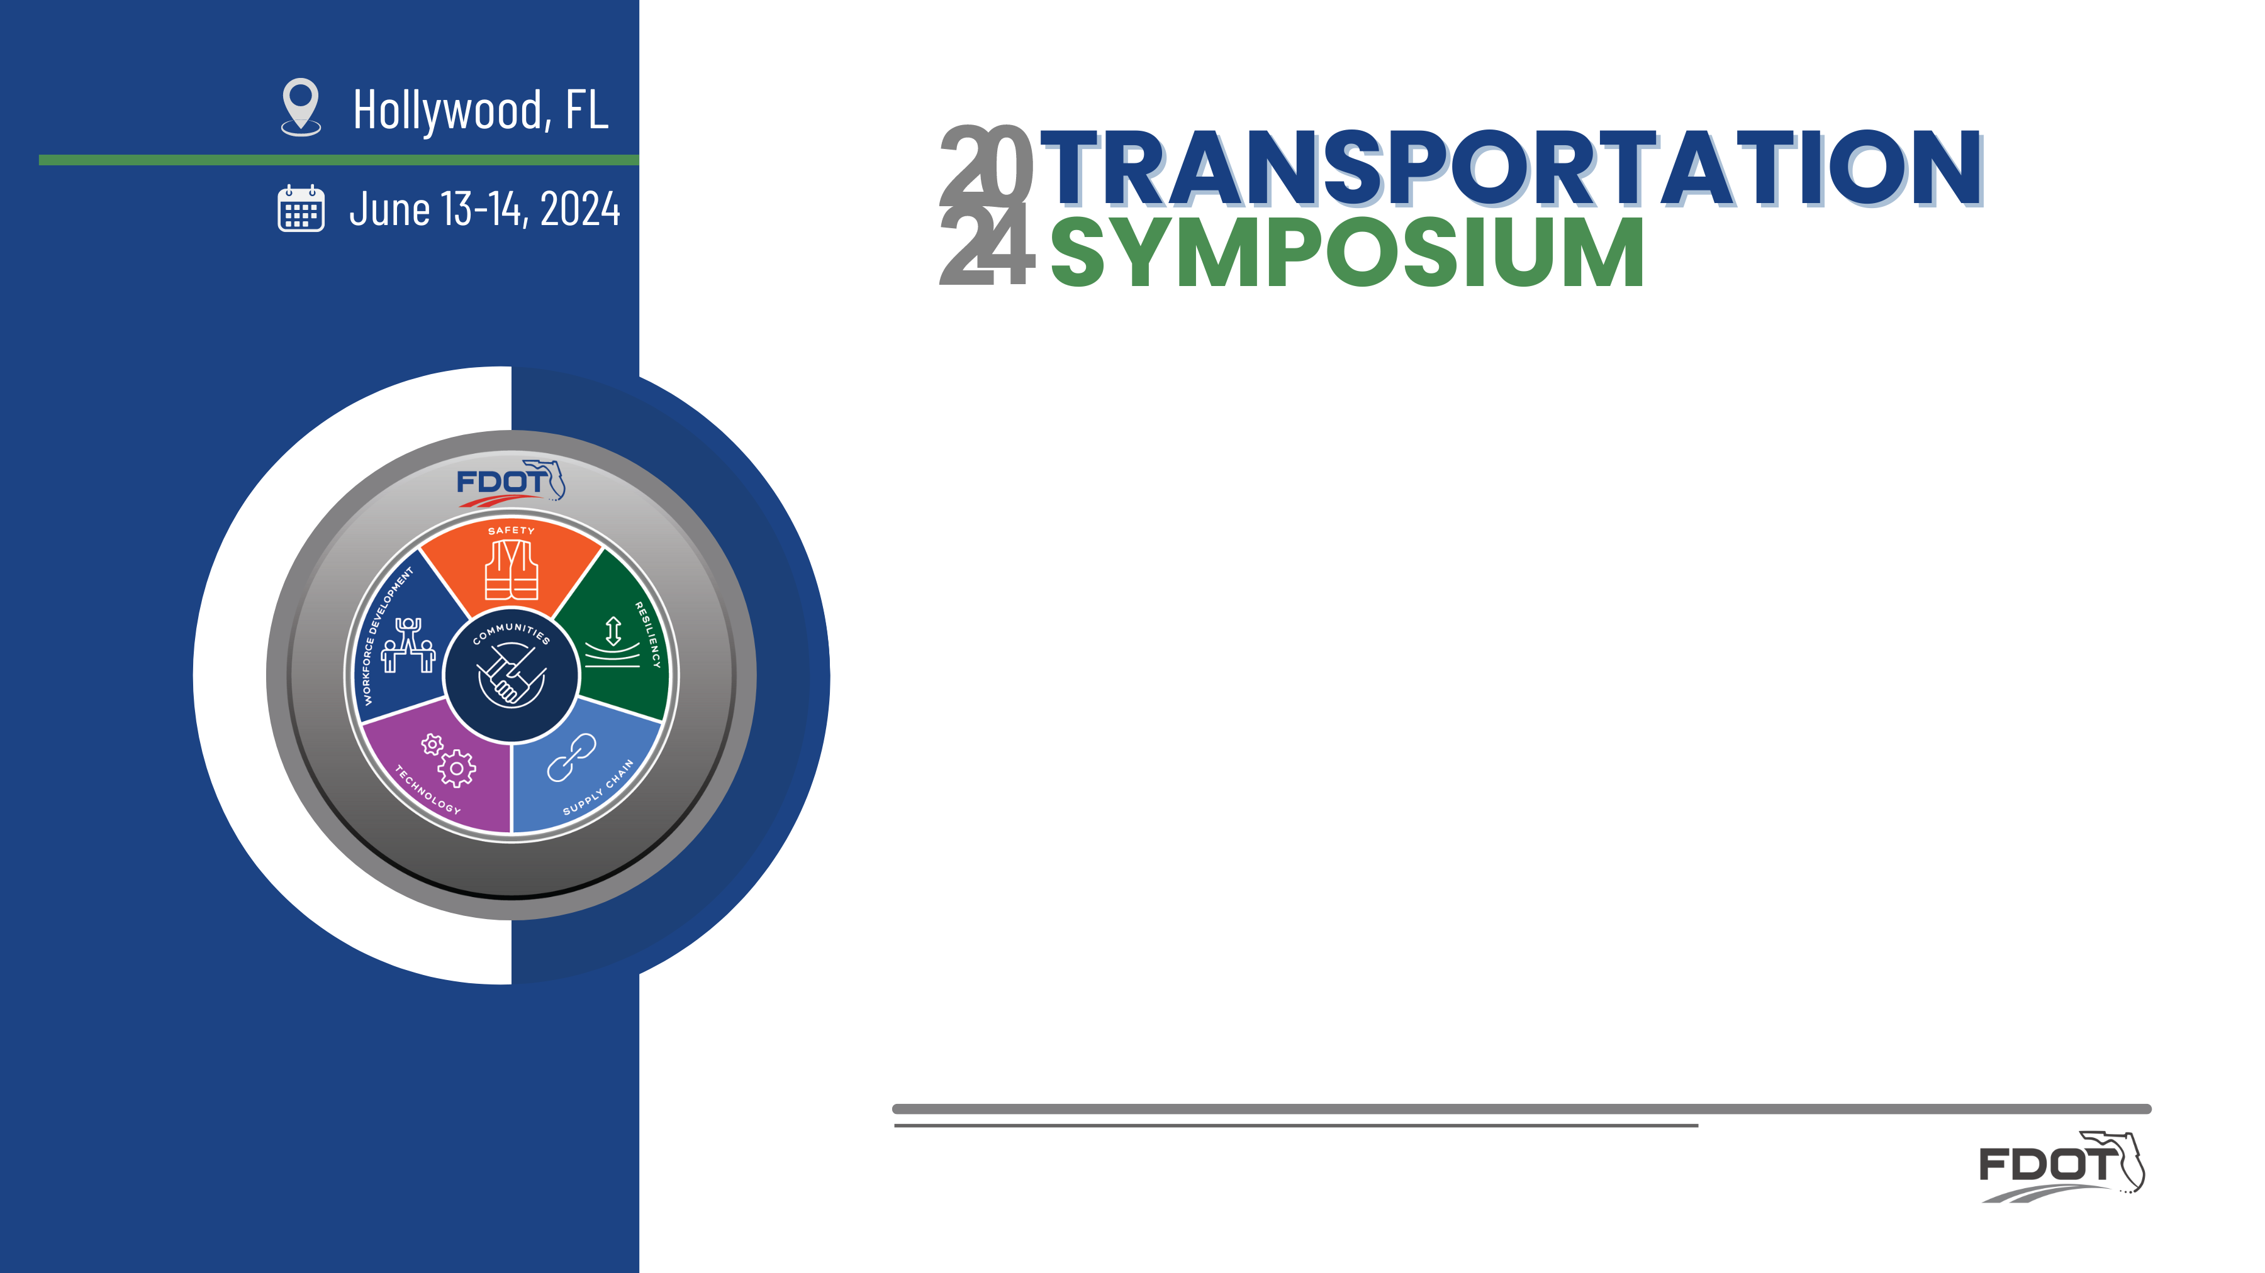
Resurfacing, Restoration, and Rehabilitation (RRR) Process in District 4 and 6
Geysa Sosa, PE
Raymond Valido, PE
FDOT D4 Project Development Manager
FDOT D6 Roadway Design Engineer
Notes:
GS

Slide 2

Agenda:
Introduction
Background
D4 RRR Process
D6 RRR Process
Questions and Answer
Notes:
GS

Slide 3
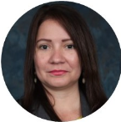
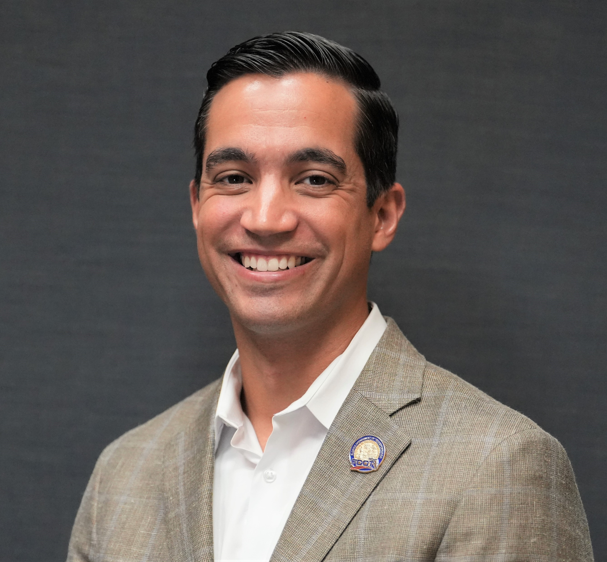
Introduction:
Raymond Valido, PE
Geysa Sosa, PE
FDOT D4 Project Development Manager
20 Years of Experience
  9 with FDOT
  8 as a Transportation/Traffic Consultant
  3 with IDOT
FDOT D6 District Roadway Design Engineer
13 Years of Experience
  8 with FDOT
  5 as a Design Consultant
Notes:
GS/RV

Slide 4
Introduction:
Florida Statutes – Section 334.046
(1) The prevailing principles to be considered in planning and developing an integrated, balanced statewide transportation system are: preserving the existing transportation infrastructure; enhancing Florida’s economic competitiveness; and improving travel choices to ensure mobility.
(4) At a minimum, the department’s goals shall address the following prevailing principles.
(a) Preservation.—Protecting the state’s transportation infrastructure investment. Preservation includes:
1. Ensuring that 80 percent of the pavement on the State Highway System meets department standards;
80%
Notes:
GS

Slide 5
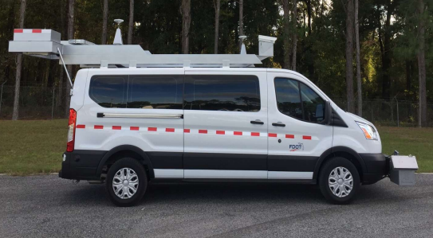
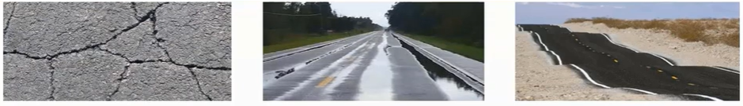
Introduction:
Work Program Instructions Part III – Chapter 27: Resurfacing
  Projects are established in accordance with:
    Criteria of safety (Friction, rutting, and/or raveling)
    Preservation of the system (cracking or structural deficiency)
    Ride (roughness, measured by the laser profile),
    Or other, as needed, to maintain the integrity of the system
Notes:
RV
Many of our procedures are closely tied together from a criteria requirements and funding standpoint.
Our WP Instructions also highlights how we program our resurfacing program
Specifically Chapter 27 states
On the screen you see our pavement condition survey equipment.
The rut, ride, crack ratings are based on a value of 1 -10, with 10 being the best.

Slide 6
Introduction:
Resurfacing, Restoration, and Rehabilitation (RRR) Projects:
  “Defined as work undertaken to extend the service life of an existing highway and enhance highway safety for all modes of travel. This includes the placement of additional surface materials and other work necessary to return an existing roadway to a condition of structural and functional adequacy.” – FDM 114.1
Notes:
RV
Within FDOT we define RRR’s as follows

Slide 7
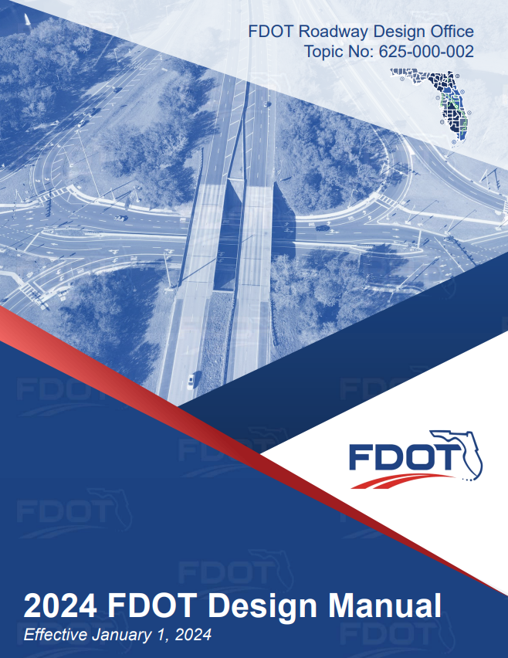
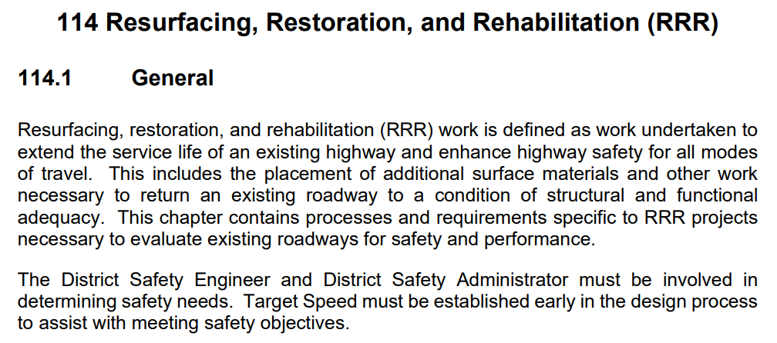
Background:
FDM – 114
Notes:
RV
Before we got into the details of each district and our processes, I wanted to speak about the FDM requirements.
FDM 114 provides criteria on RRR projects.

Slide 8
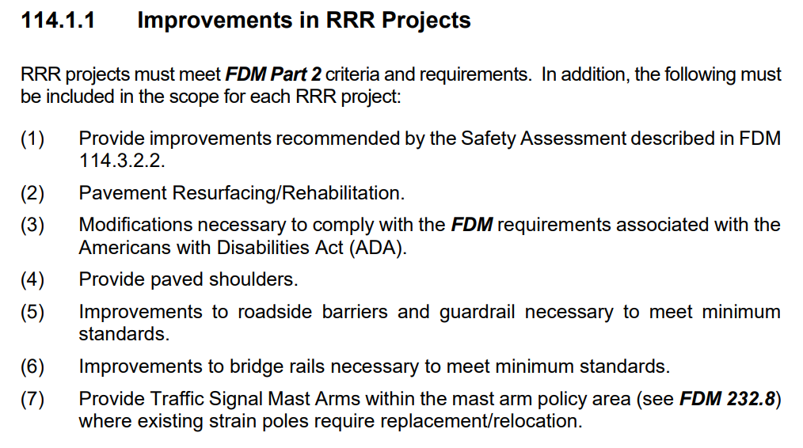
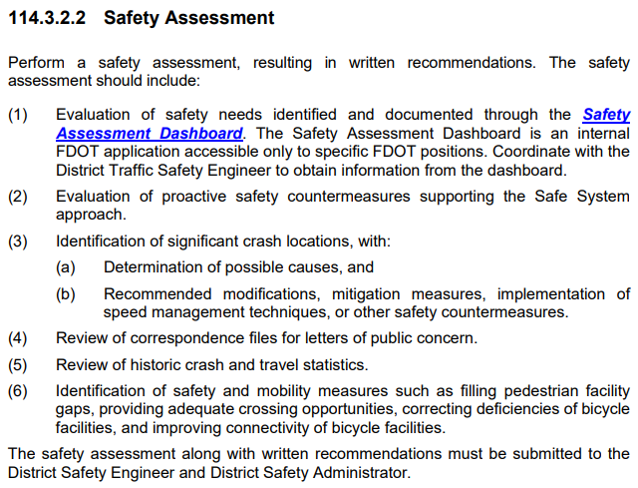
Background:
FDM – 114
Notes:
RV
As we scroll through FDM we see detailed information on how districts should consistently program and scope their projects.
On the screen you see 7 important items that need to be considered.
Bullet 1 safety assessment to the right.
FDM Part 2

Slide 9
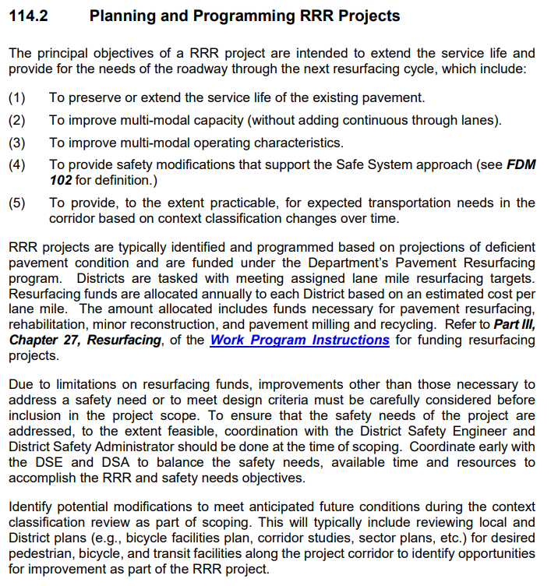
Background:
FDM – 114
Notes:
RV
FDM 114.2 – Planning and Programing discusses language on the objectives of RRR.
I like to highlight two important sections.
First that resurfacing funds are limited.
Related to safety needs, it requires coordination.
Makes mention of the balance of safety needs, available time and resources to accomplish the RRR and safety needs.
Is the RRR the right project to do those improvements being contemplated.

Slide 10
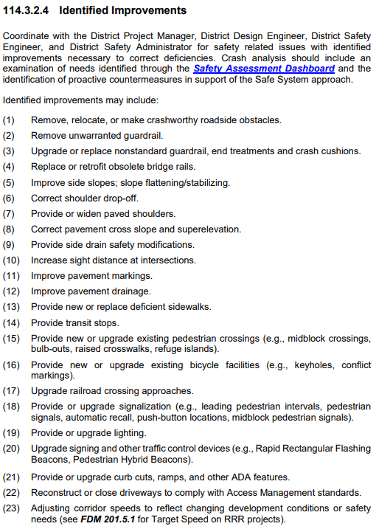
Background:
FDM – 114
Notes:
FDM 114.3.2.4 is a list of items that can be included on a RRR as needed.
This is through coordination with multiple offices.

Slide 11
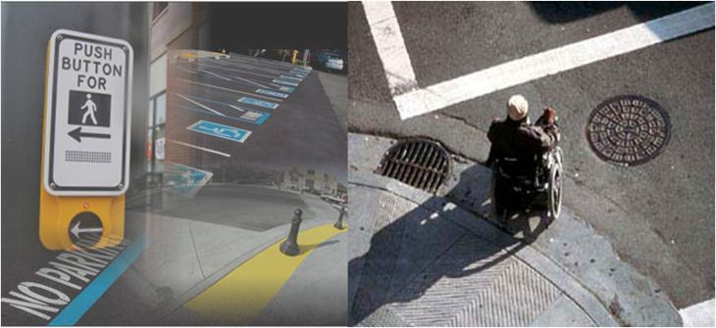


Background:
FDM – 114
  Extend service life of pavement
  Address ADA
  Improve Safety
Notes:
RV
A lot of information pertaining to RRR projects.
I like to summarize it as shown on the screen. 3 things
Our pavement life
Meet ADA requirements
Improve safety – In a manner that is beneficial and conducive to the use of dedicated RRR funds.

Slide 12
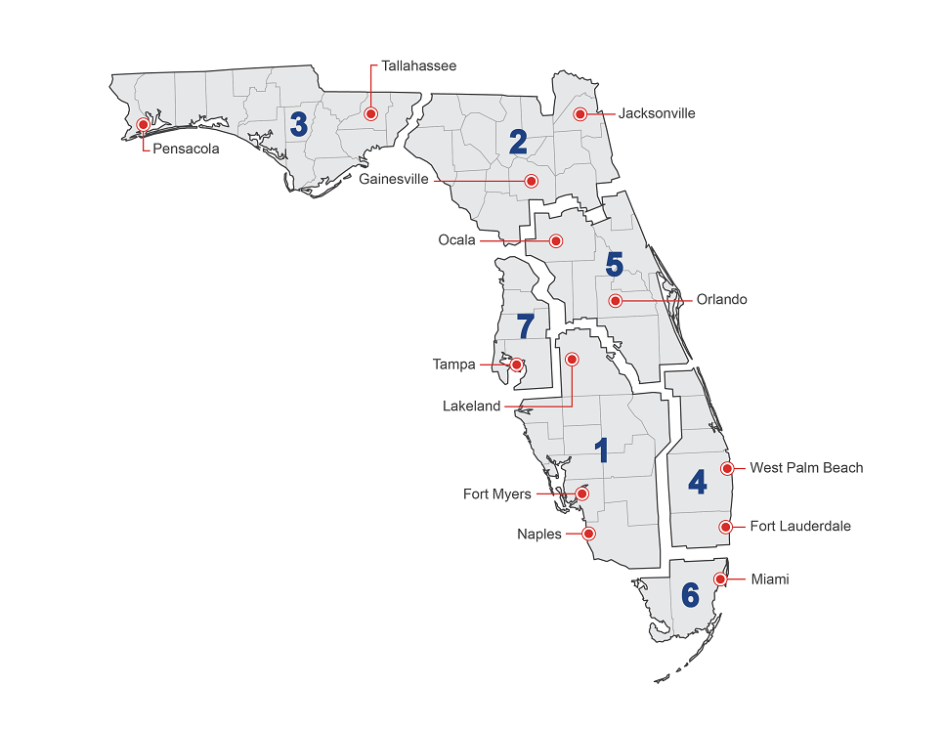
Background:
D4 and D6 share many of the same consultants
Overview of RRR Process for D4 and D6
  Each district implements different internal processes to meet requirements
Notes:
RV
Now that we’ve talked about RRR projects and an intro,
Why did we have the idea to create this presentation.
We know that there has been a lot of conversation and discussion on RRR projects and scoping in recent years throughout the state.
As d4 and d6 regionally share consultants, we felt it would be the perfect forum to have those discussions collectively and share our processes

Slide 13
Background:
Florida continues to invest in Transportation Infrastructure
  19/20 Budget → $10.8 Billion
  23/24 Proposed Budget → $14.8 Billion
    37% increase
Cost escalation is impacting how we program our RRR Projects
  Example Statewide Historical Unit Cost
    Superpave TLC PG76-22
      4/1/20 – 9/30/20: $98.21
      10-1/23 – 3/31/24: $171.49
        75% increase
    Curb & Gutter Type F
      4/1/20 – 9/30/20: $22.48
      10-1/23 – 3/31/24: $49.31
        119% increase
Notes:
RV

Slide 14

District Processes
Notes:
RV

Slide 15
D4 Process
Notes:
GS

Slide 16
D4 Process
1
2
3
4
5
Lane Mile and Candidate Selection
Candidate List Distribution
Project Scoping Process and coordination
Project Scoping completion and Management Review
Project Handoff to Design Office
Field reviews
Coordination with technical disciplines
Coordination with external local agencies
SRT ongoing coordination with Complete Streets Team and Safety Office
Lane mile (LM) target is established by Central Office
D4 Operations Offices and Materials Lab conduct pavement condition survey to select RRR candidates
RRR candidates list is distributed to:
Scoping Refinement Team (SRT)
Safety Office
Multimodal Scoping Checklist (MMSC) coordination starts
After obtaining concurrence from D4 Management
SRT completes the RRR Project Scoping to include 7 Deliverables
When a Project Manager is assigned to the RRR, they schedule a hand off meeting with SRT
Notes:
3. Also SRT Starts the planning level scoping process
Safety Office starts the Safety Assessments

Slide 17
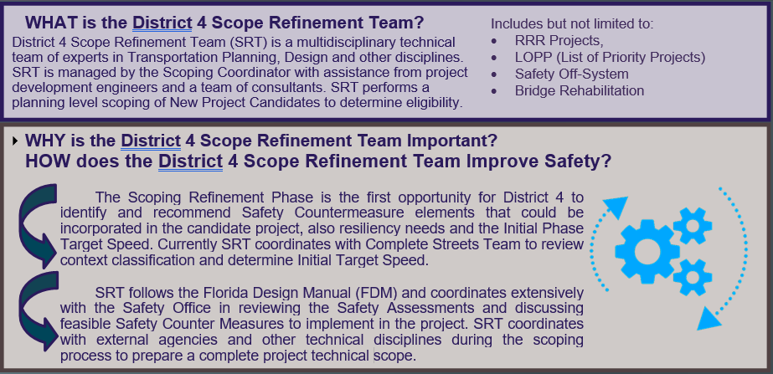
D4 Process

Slide 18
D4 Process
PLEMO Office
  Project Scoping
  Field visits
SAFETY Office
  Safety Review
  Coordination with SRT
OMD Office
  Context Classification and MMSC
  Target Speed

Slide 19
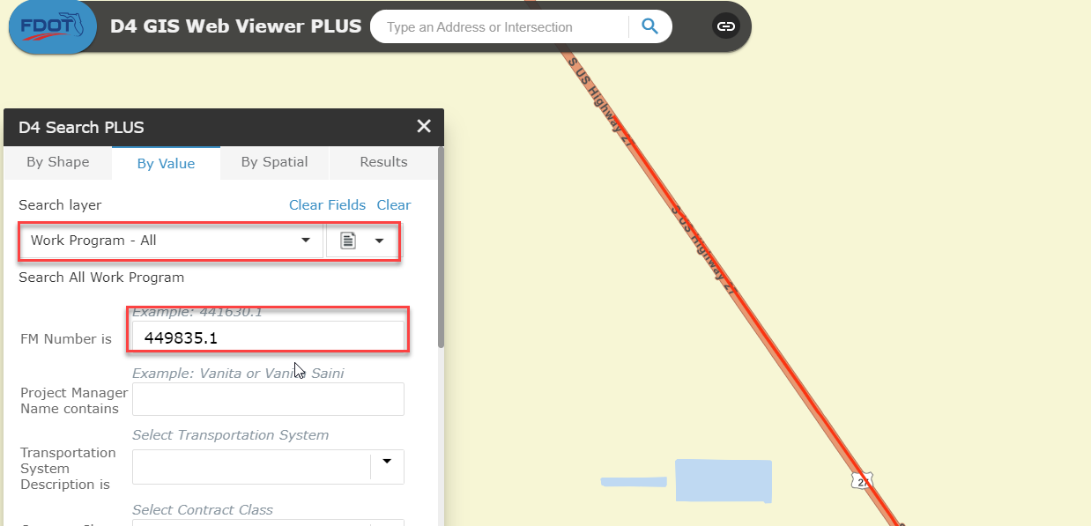
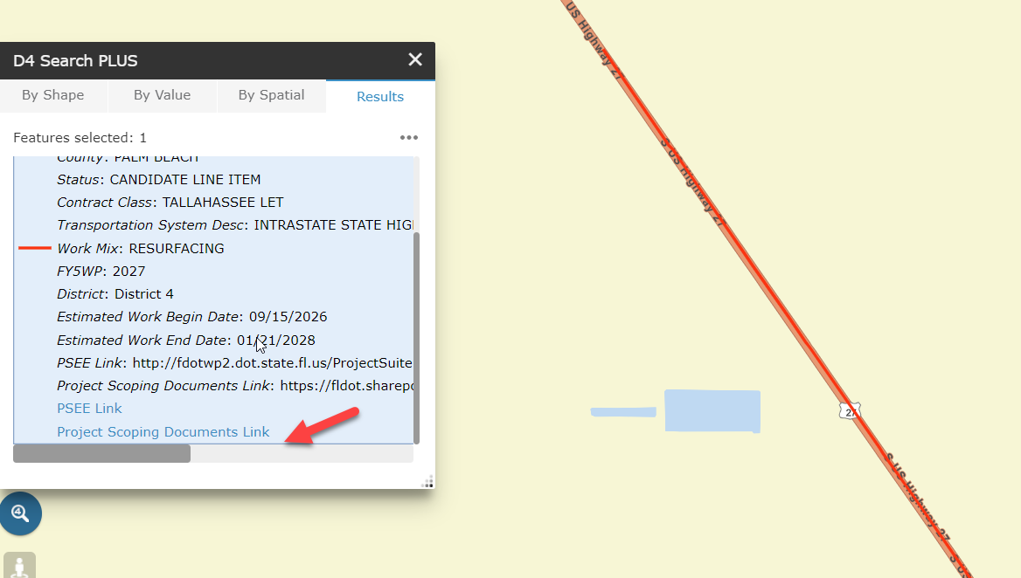
D4 Process

Slide 20
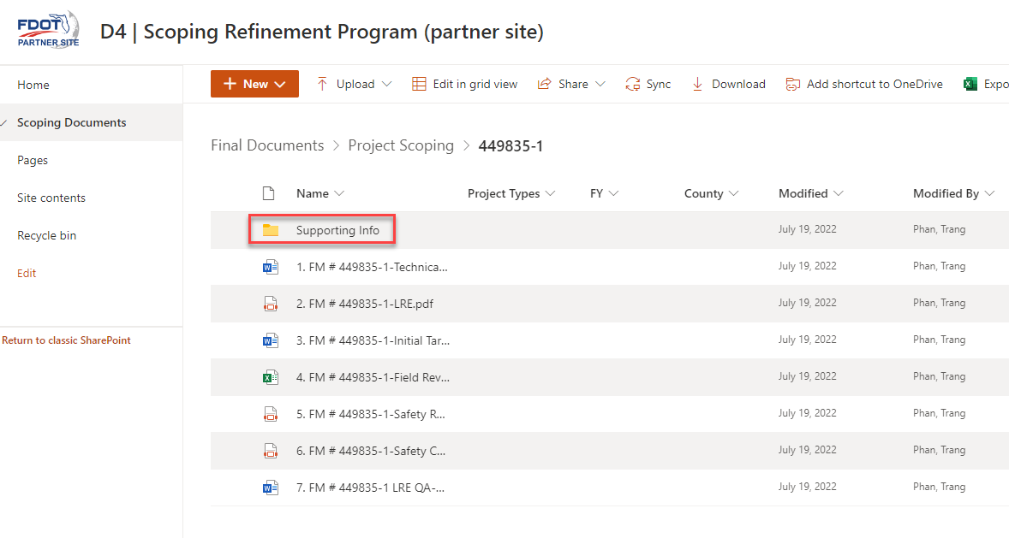
D4 Process
Technical Scope
Multimodal Scoping Checklist
Initial Target Speed Memo
Safety Review Assessment
LRE
LRE Checklist
Field
Review Checklist

Slide 21
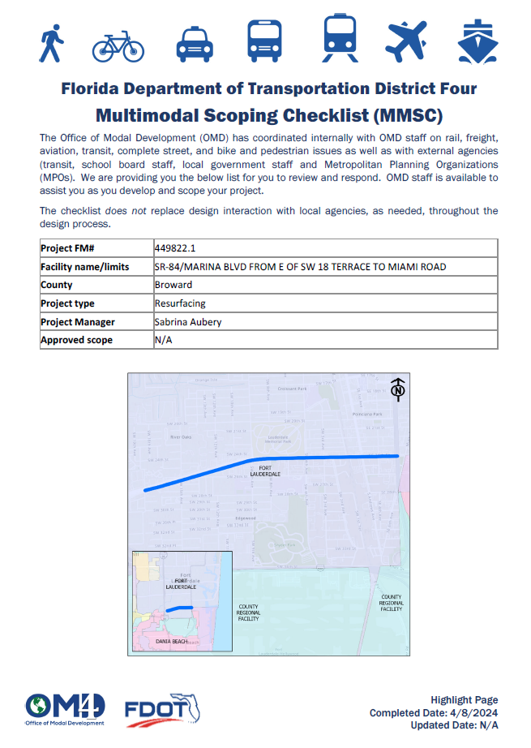
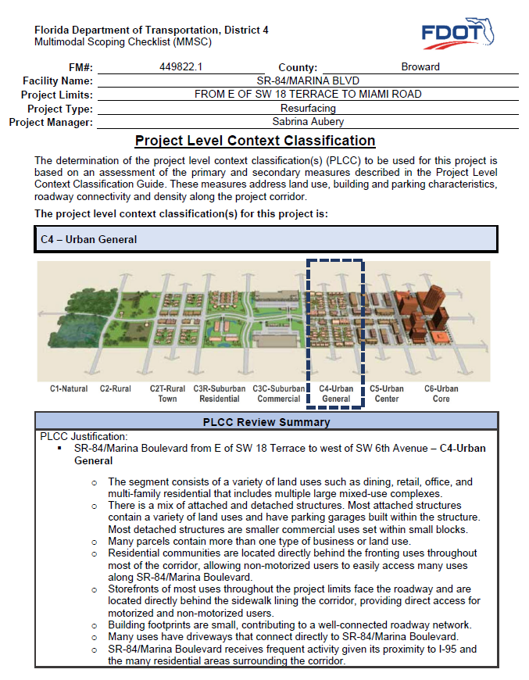
D4 Process
Project Documents

Slide 22
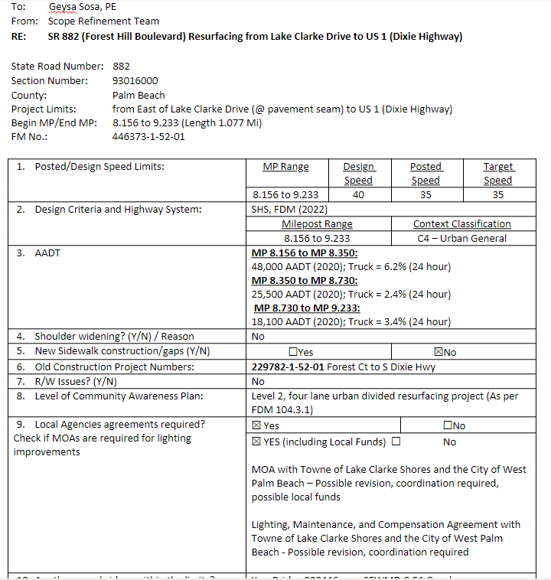
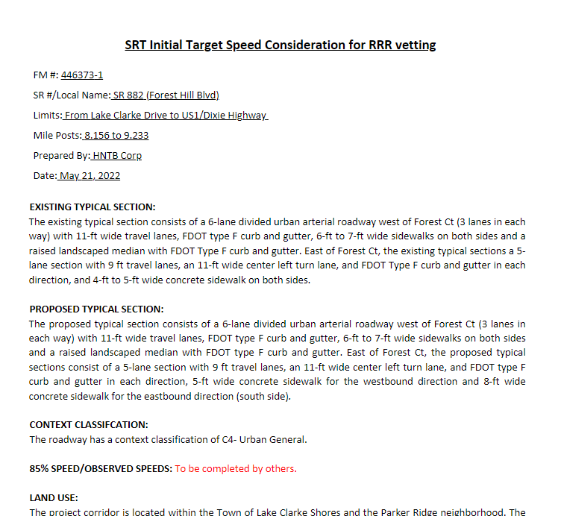
D4 Process
Project Documents

Slide 23
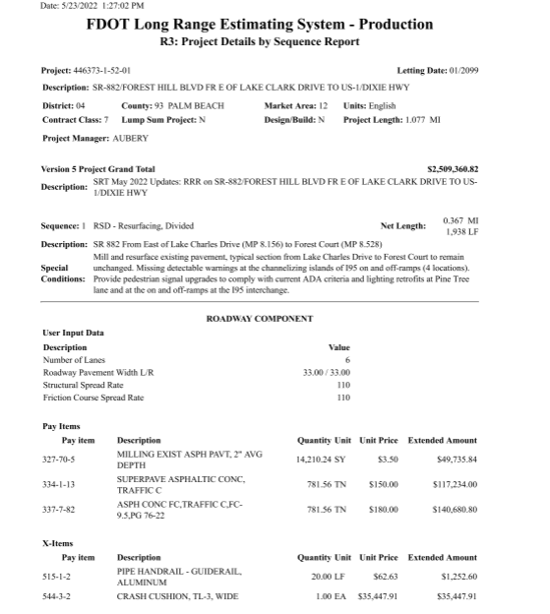
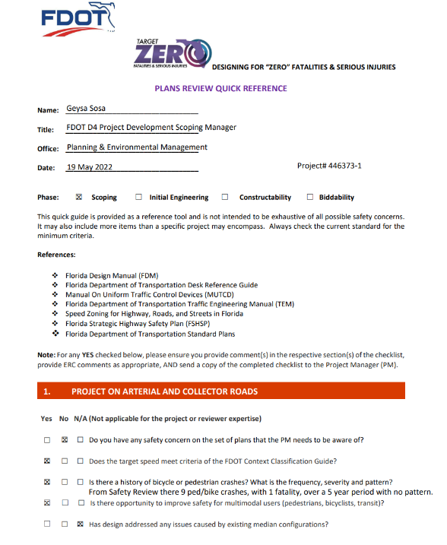
D4 Process
Project Documents

Slide 24
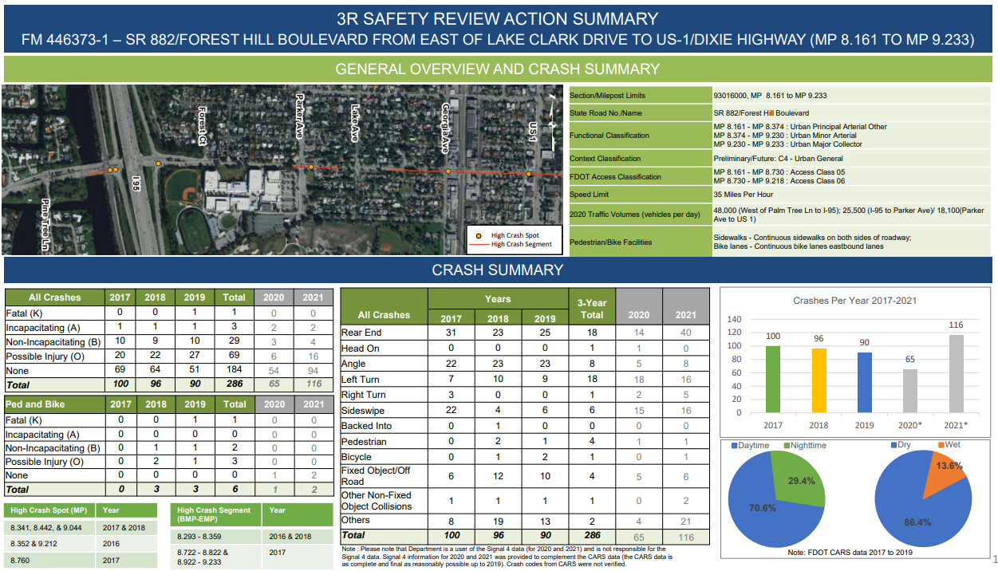
D4 Process
Project Documents

Slide 25

D4 Process
Multi Modal Scoping Checklist
Resiliency Module on PSEE
Safety Counter Measures Module on PSEE

Slide 26
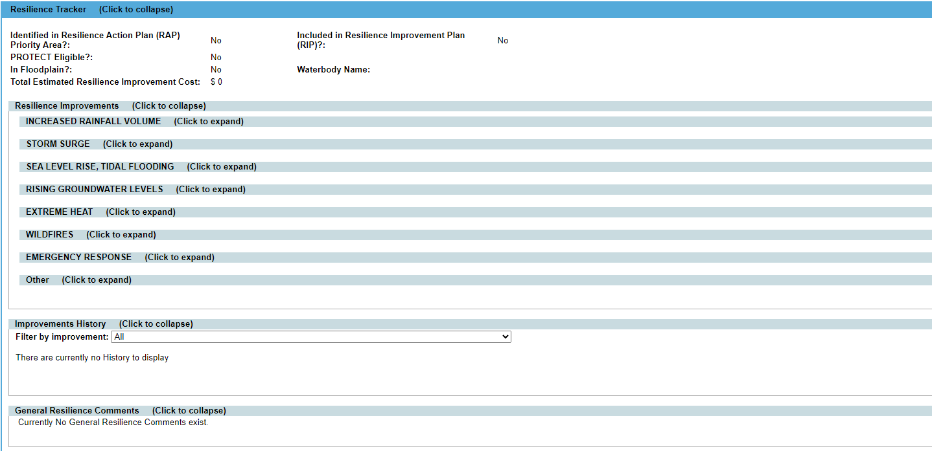
D4 Process
Resiliency Module Tracker

Slide 27
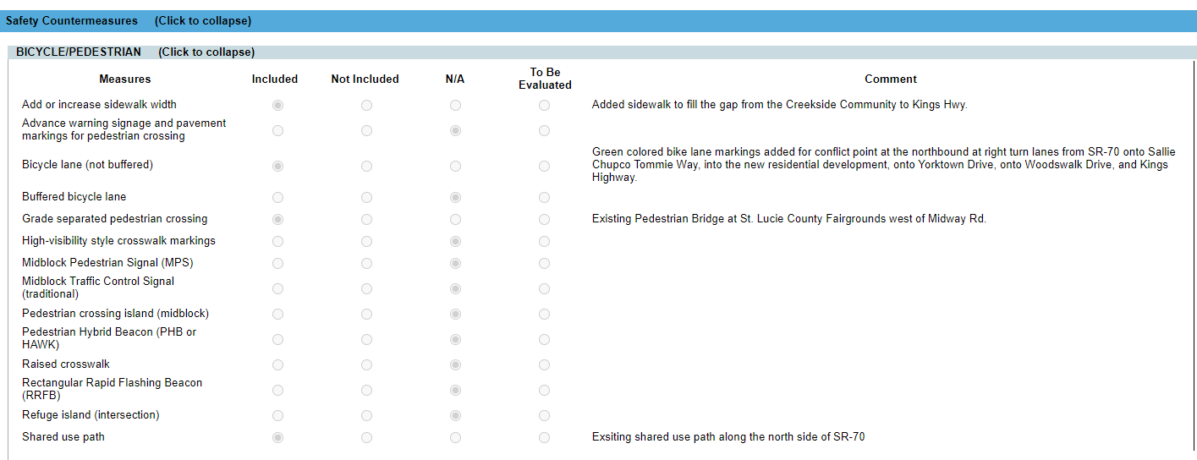
D4 Process
Safety Countermeasures Module

Slide 28
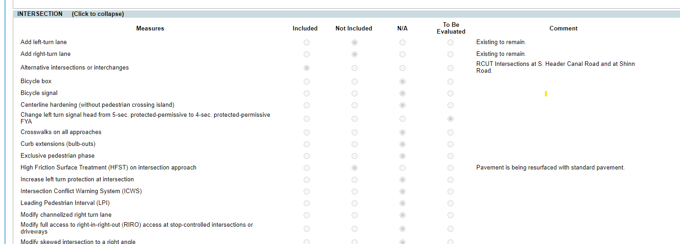
D4 Process
Safety Countermeasures Module

Slide 29
D6 Processes

Slide 30
D6 Process
Plan
Pavement condition survey
Lane mile (LM) target
Program
Prioritize projects to meet LM target
Scoping
Conduct field review
Complete scoping report
Identify Improve ments
Design
Scope phasing
Align scope to fund allocation
RRR committee review
Procure design consultant
ERC Phase review

Slide 31
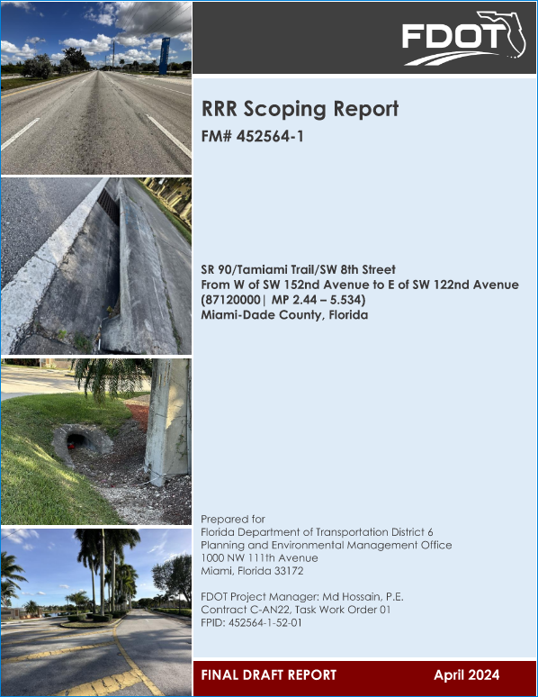
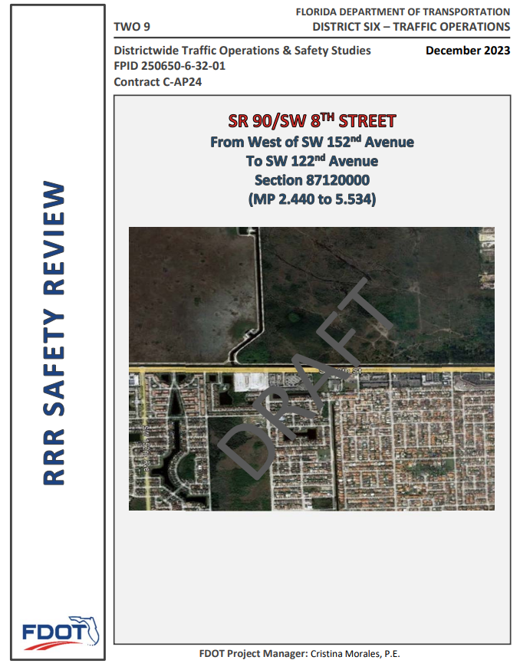
D6 Process
Scoping
  Scoping consultant develops draft report
  Safety office develops RRR Safety Review
  Reports are reviewed through ERC

Slide 32

D6 Process
Scoping Reports
  To differentiate RRR Scope vs other scope, our recommendations are divided as follows:
    Category A : Pavement Restoration Elements; including pavement restoration, ADA curb ramps, signals, signing, and pavement marking.
    Category B1 : RRR Safety Enhancements as identified in the RRR Safety Review Report or a RRR Safety Report. Recommendations have dedicated safety funds.
    Category B2 : RRR Safety Enhancements as identified in the RRR Safety Review Report or RRR Safety Report. Recommendations do not qualify or have dedicated safety funds.
    Category C : Other Improvements

Slide 33
D6 Process
Scoping Reports
  Written to the designers to clearly delineate the future designers scope
  Identifies items that are maintenance responsibility
  Identifies items that were considered but not included in the scope

Slide 34
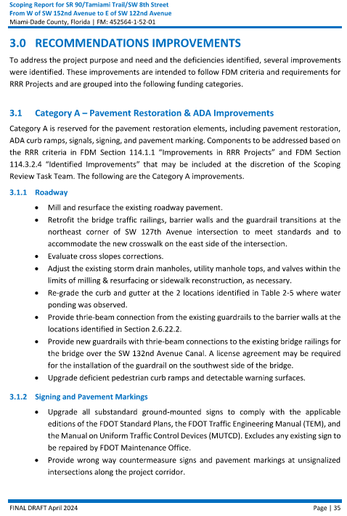
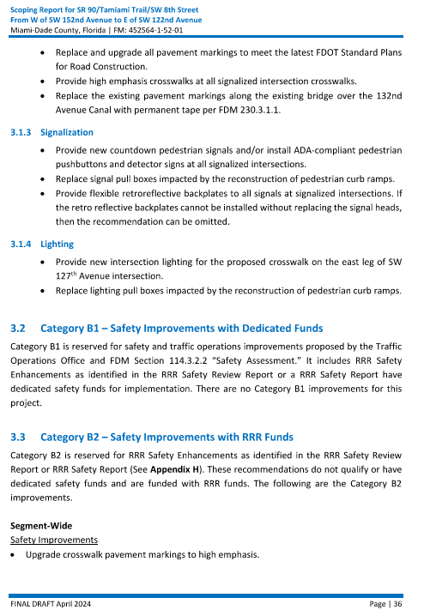
D6 Process
Scoping Report Example

Slide 35
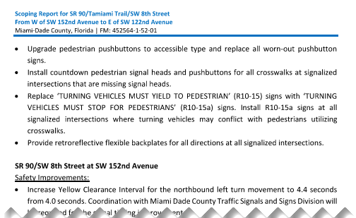
D6 Process
Scoping Report Example

Slide 36
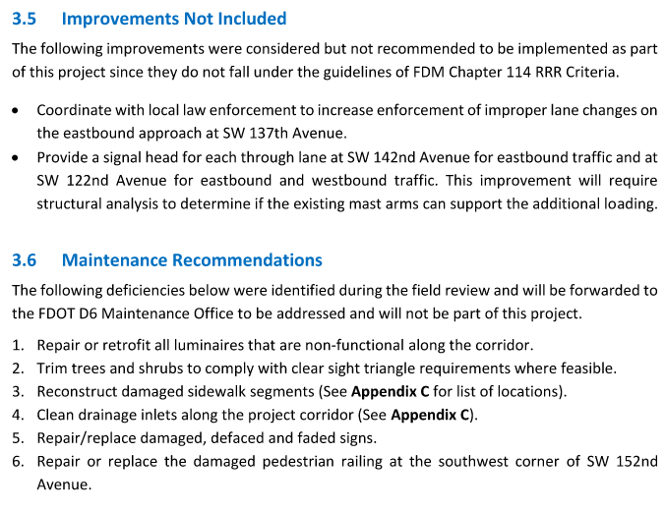
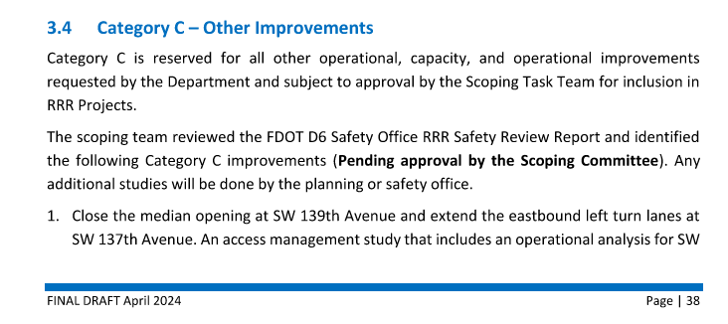
D6 Process
Scoping Report Example

Slide 37
D6 Process
District Planning and Environmental Administrator
District Design Engineer
District Consultant Project Management Engineer
District Right of Way Administrator
District Modal Development Administrator
District Program Management Administrator
District Construction Engineer
District Traffic Operations Engineer
District Maintenance Engineer
D6 Scoping Committee
Traffic Operations Safety Engineer
Scoping Project Manager
Work Program Administrator
RRR Subcommittee
Roadway Design Engineer
Deputy Maintenance Engineer
Draft report is reviewed by RRR Subcommittee
Subcommittee reports to District Scoping committee

Slide 38
D6 Process
Draft reports distributed to subcommittee
Subcommittee reviews reports and meets to discuss findings
Subcommittee presents findings to Scoping Committee
Scoping reports updated based on feedback from Scoping Committee
Final repots reviewed by subcommittee
Final recommendations presented to Scoping Committee for Concurrence
Scoping Committee presents recommendations to Director for approval of scope
RRR Subcommittee Process

Slide 39
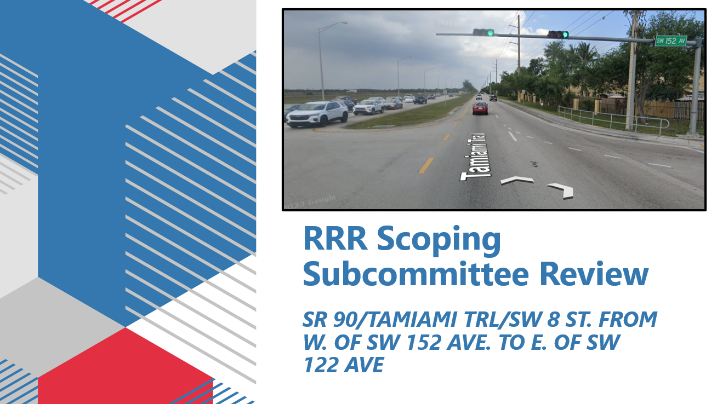
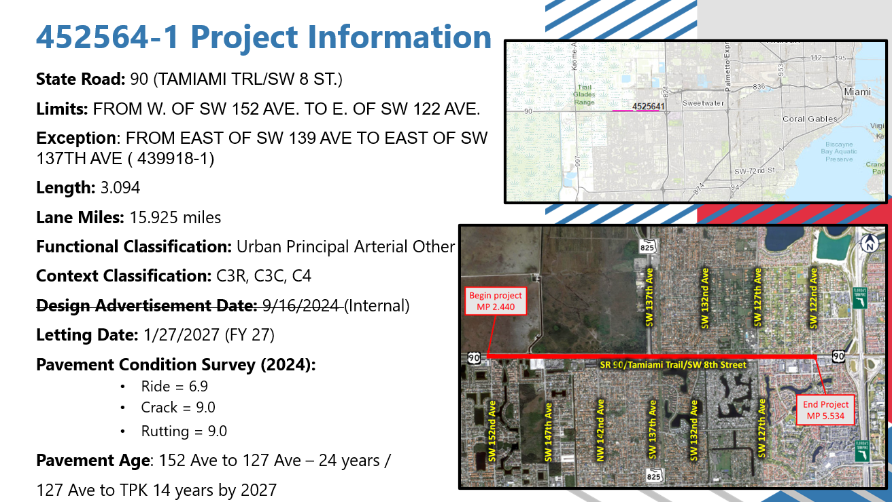
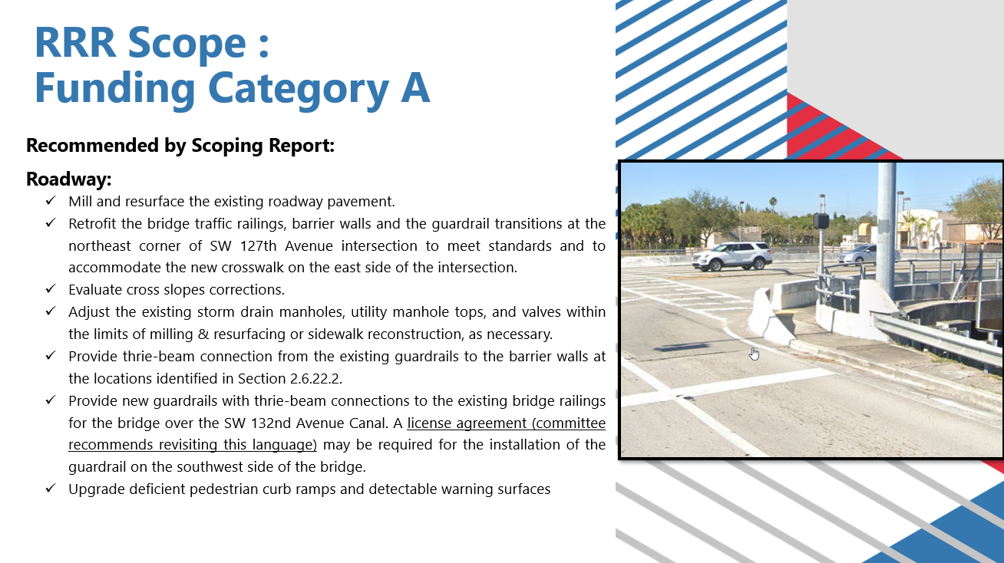
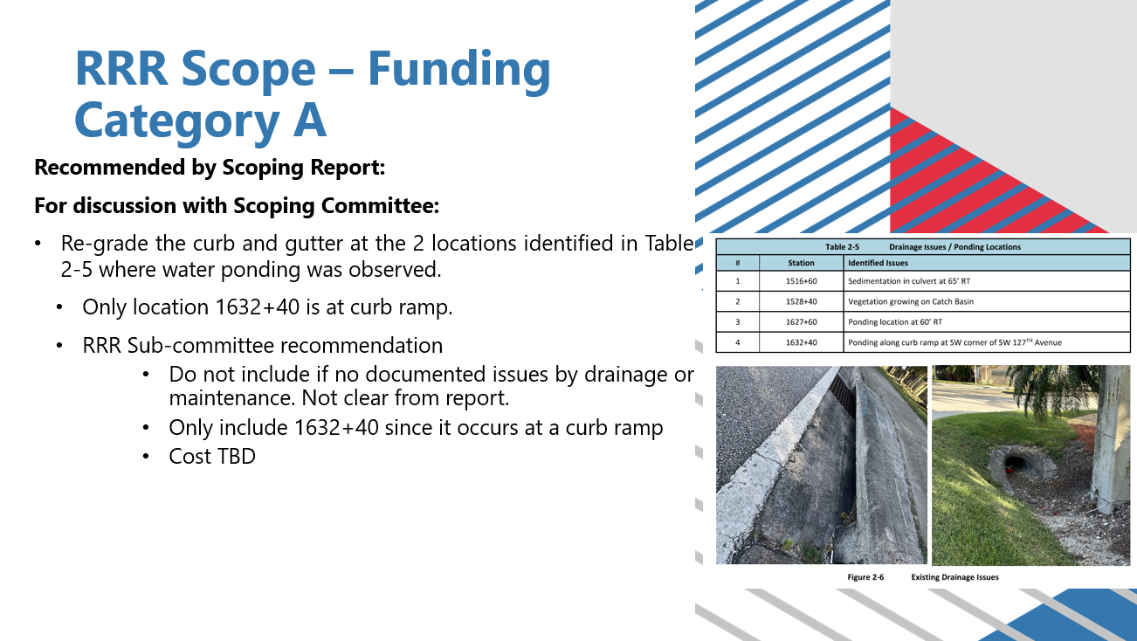
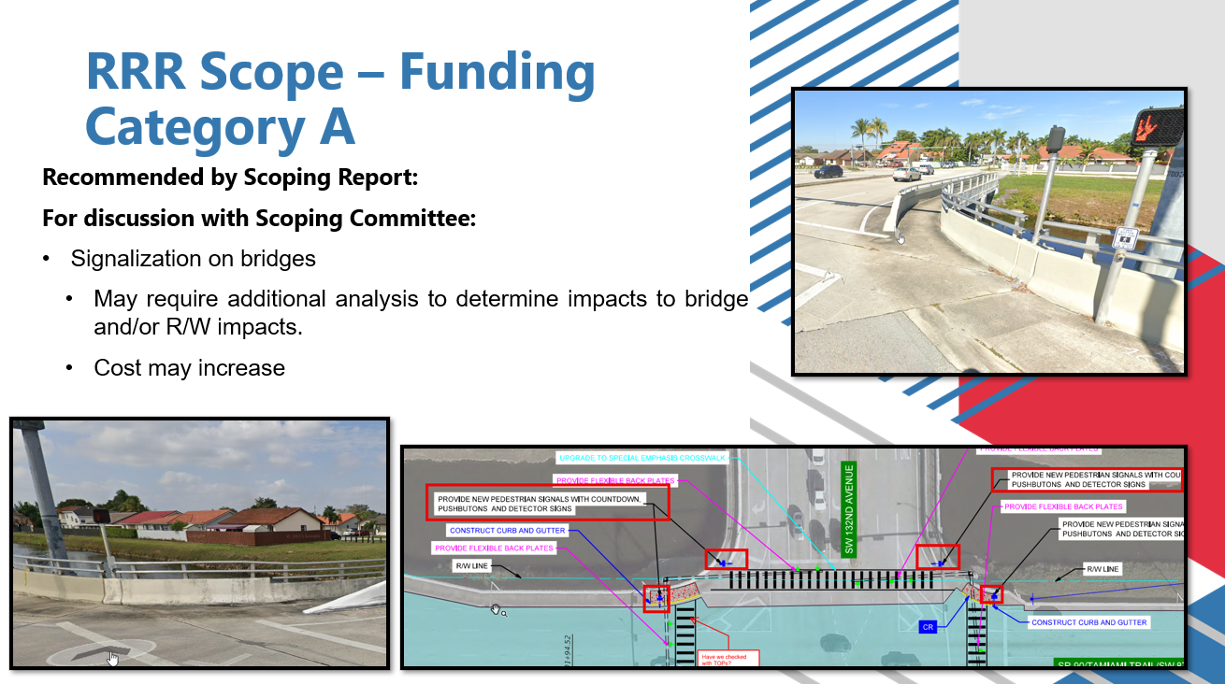
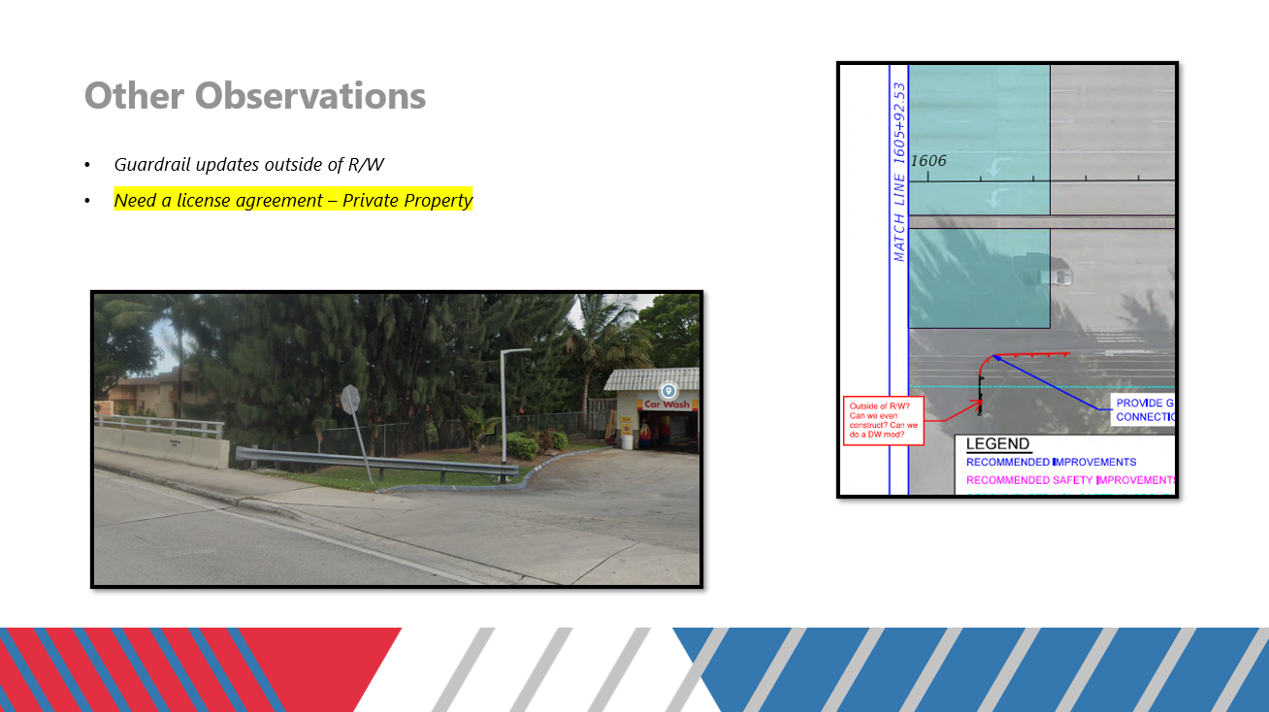
D6 Process
RRR Subcommittee Presentation

Slide 40
D6 Process
RRR Subcommittee Presentation

Slide 41
D6 Process
RRR Subcommittee Presentation

Slide 42
D6 Process
RRR Subcommittee Presentation

Slide 43
D6 Process
RRR Subcommittee Presentation

Slide 44
D6 Process
RRR Subcommittee Presentation

Slide 45

D6 Process
RRR Subcommittee
  Subcommittee makes recommendations to District Scoping Committee, not decisions
  Provide consistency in scope delineation
  Avoid scope creep
  Avoid creating confusion for designers

Slide 46
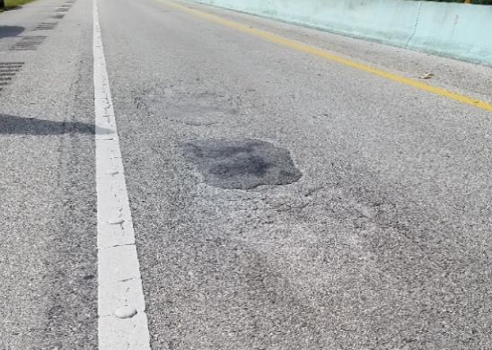
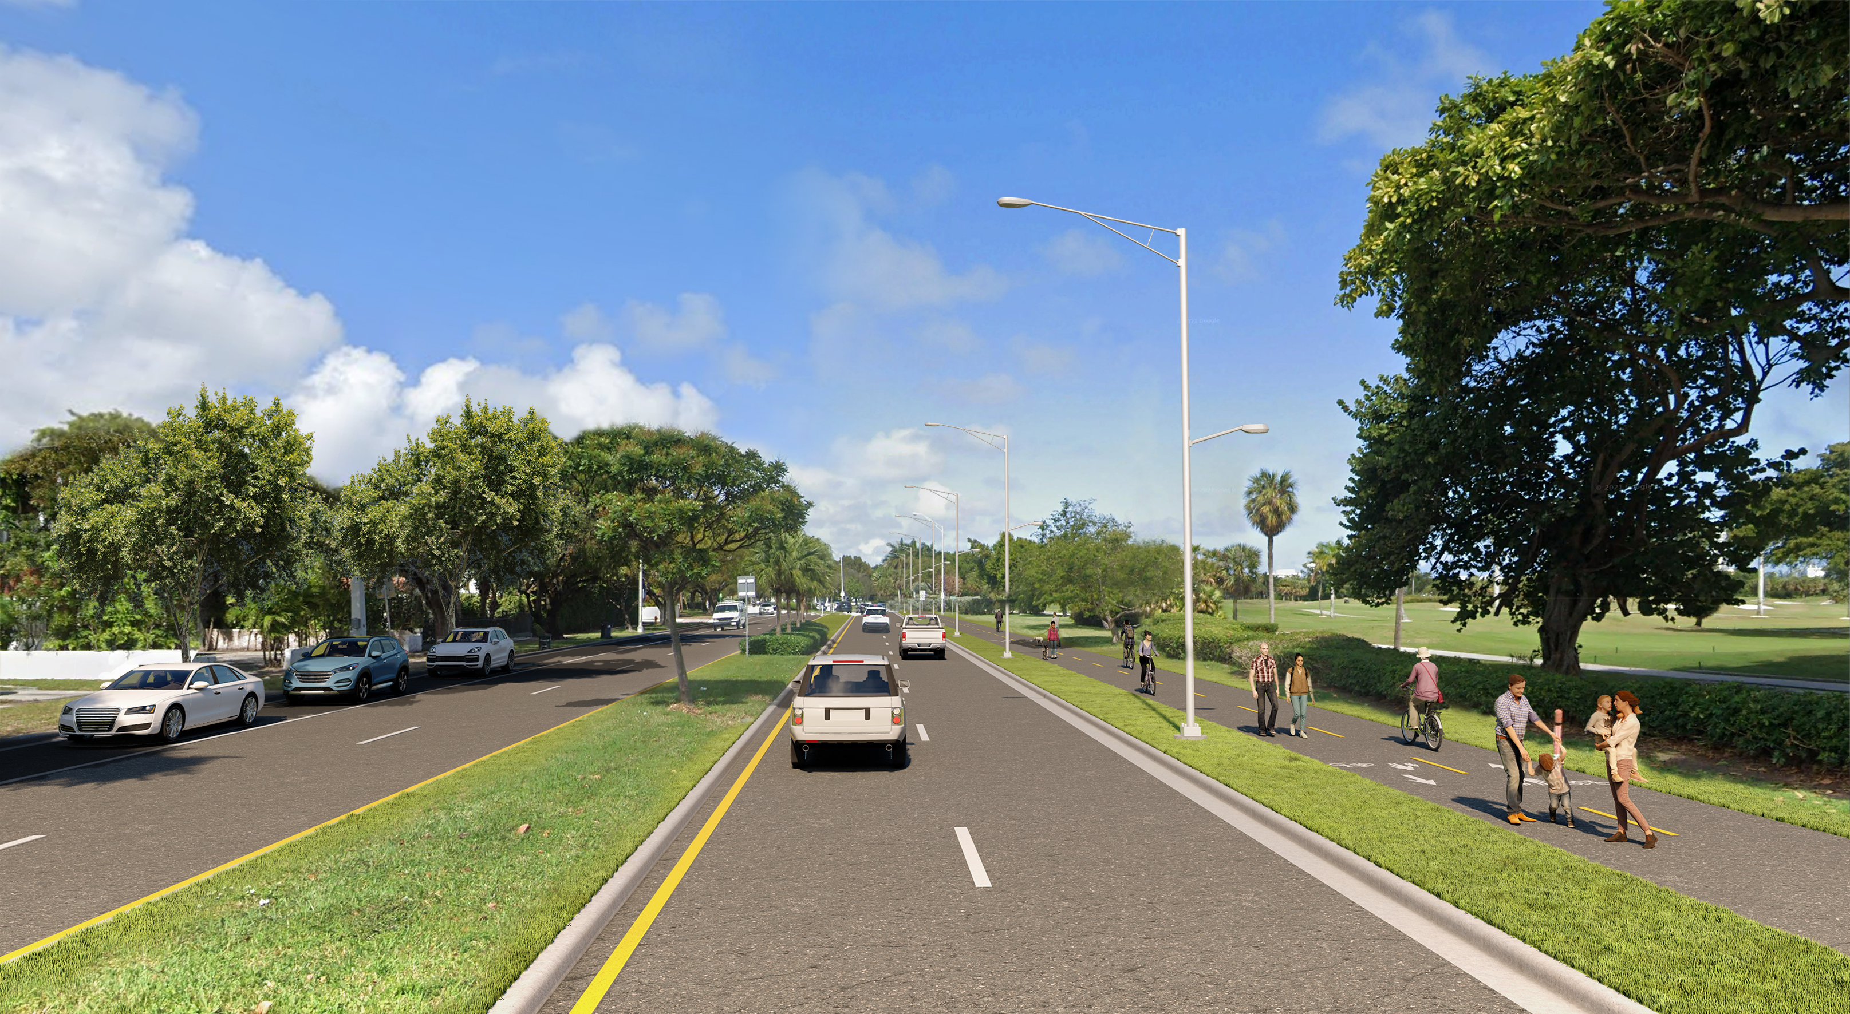
D6 Process
RRR Program
  RRR vs Pavement Only Project (POP) vs Ride-only
  Non-RRR related request by other agencies

Slide 47
D6 Process
Design Phase
  Designers uses recommendations in scoping report to begin design
    Designer still required to review all FDM criteria
  Major changes to scope need to be presented to District Scoping Committee
  Work program team flags projects which large cost changes

Slide 48

Contact Us
Geysa Y. Sosa
Project Development Manager
954-777-4323
geysa.sosa@dot.state.fl.us
Raymond Valido
District Roadway Design Engineer
305-470-5266
raymond.valido@dot.state.fl.us

Slide 49

Safety Message

Slide 50
