Slide 1
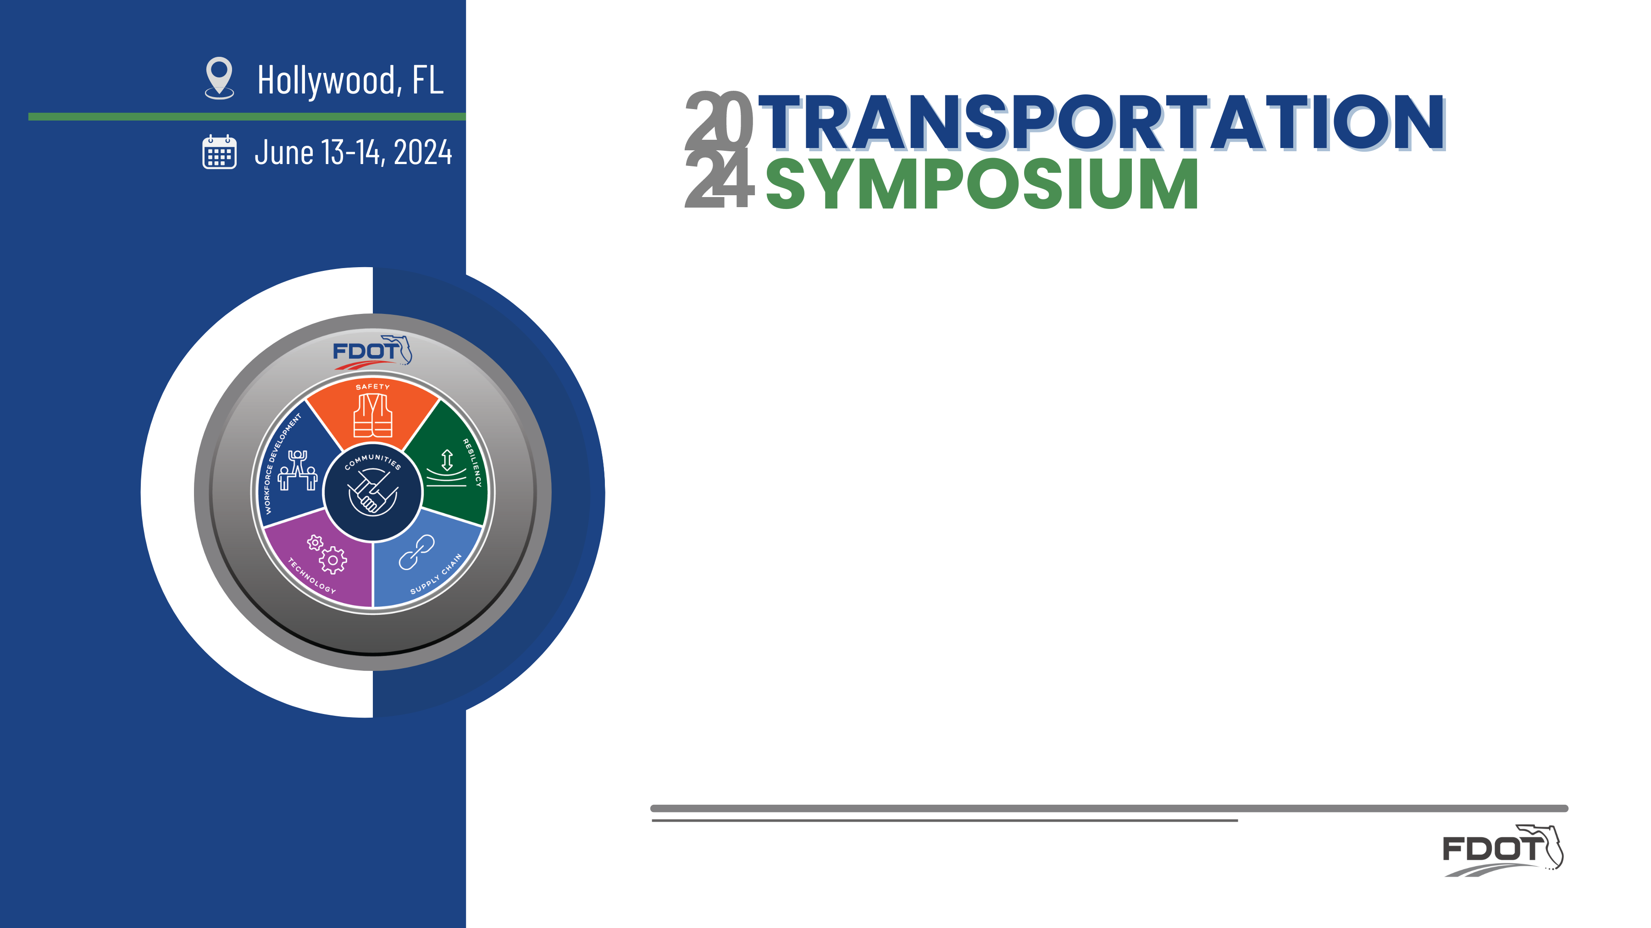
I-95 at Glades Road Diverging Diamond Interchange (DDI)
Vanita Saini, PE - Daniel Smith, PMP -
Yamila Hernandez, PE
FDOT District IV and WSP USA Inc.

Slide 2
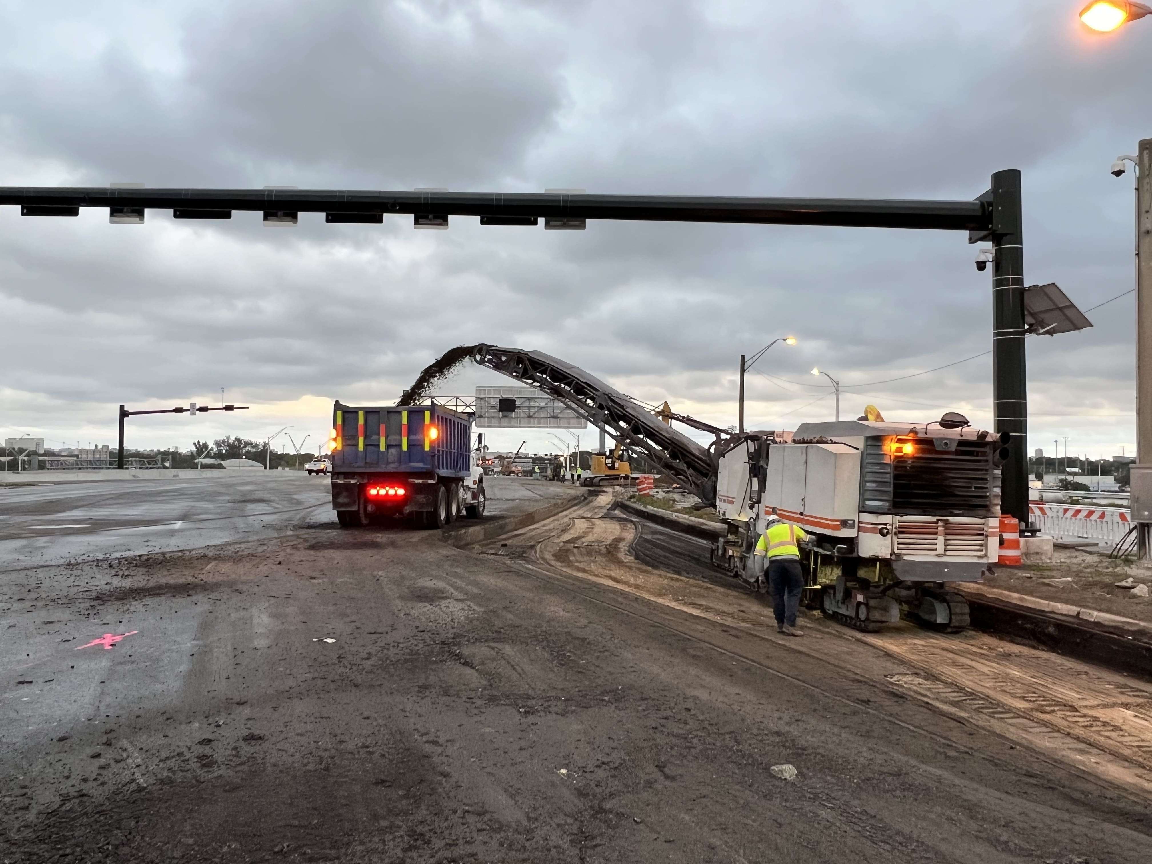
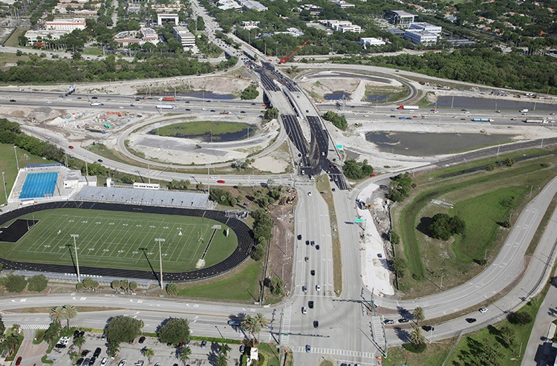
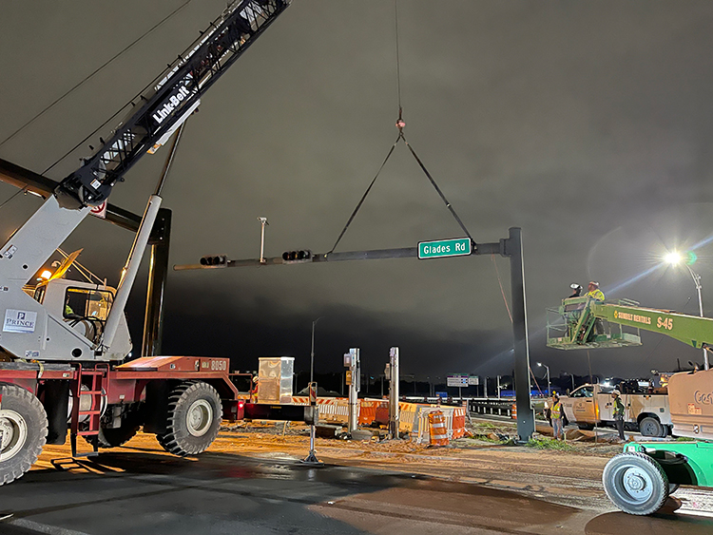
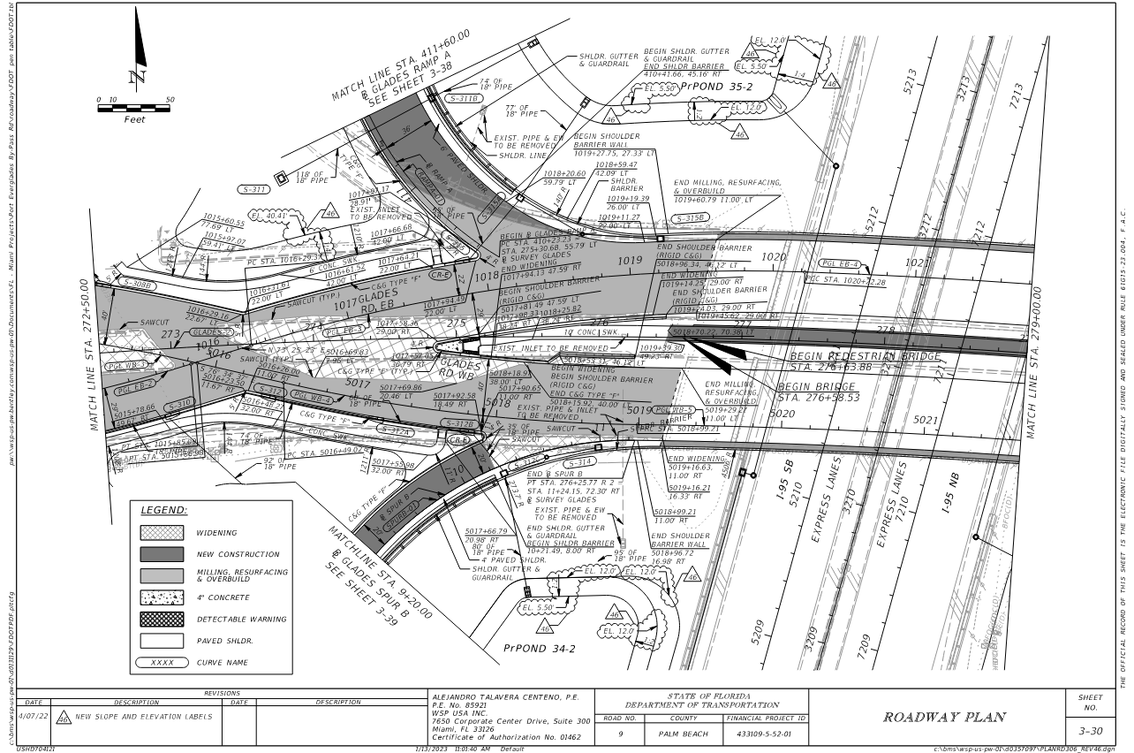
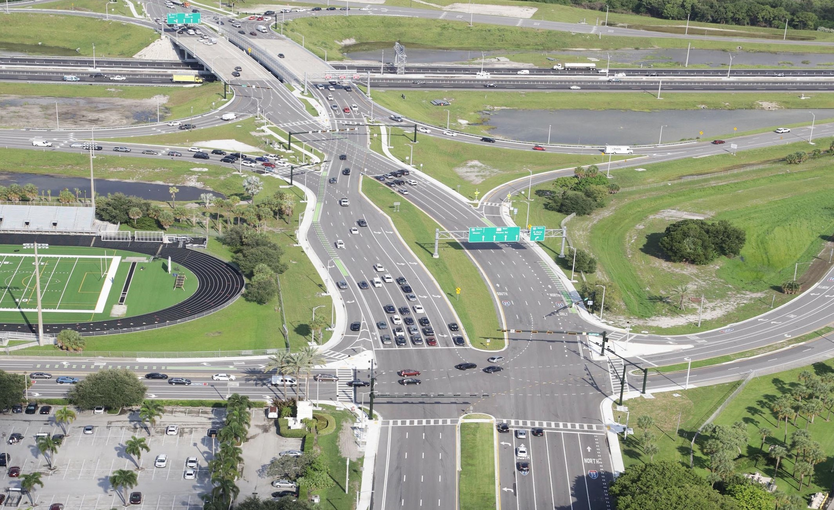
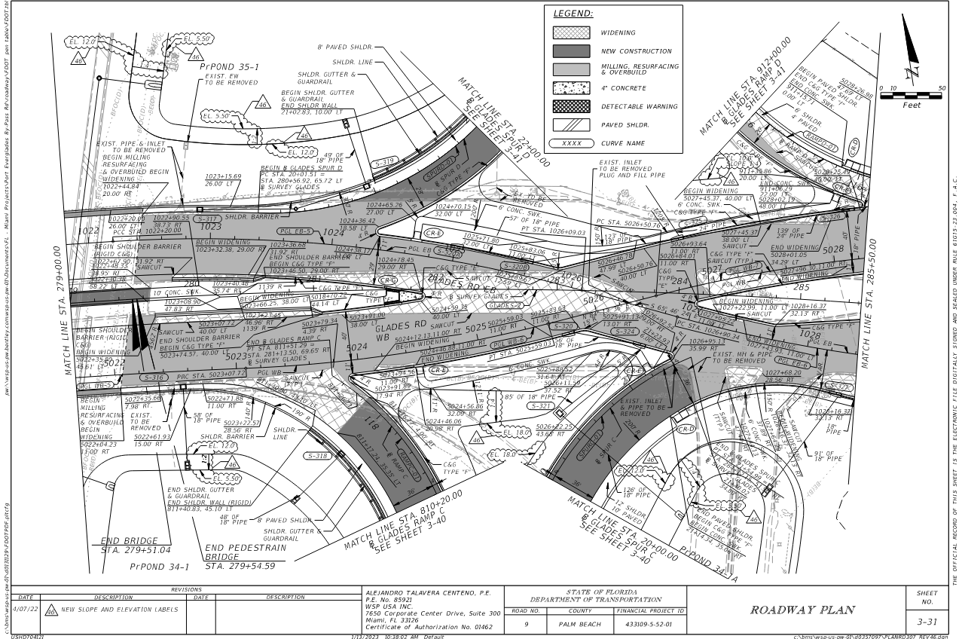
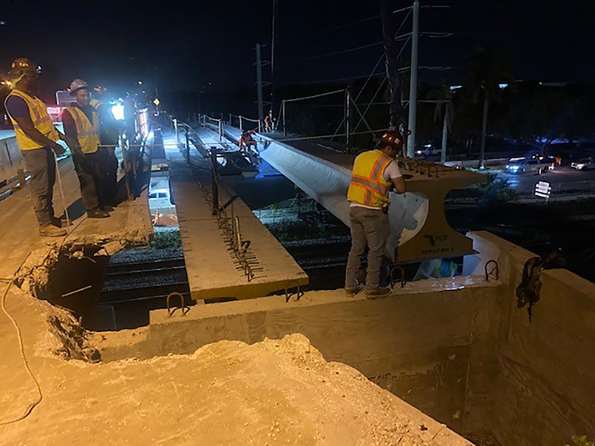

Objectives
Best Practices and Lessons Learned
  Design
  Construction
  Implementation

Slide 3
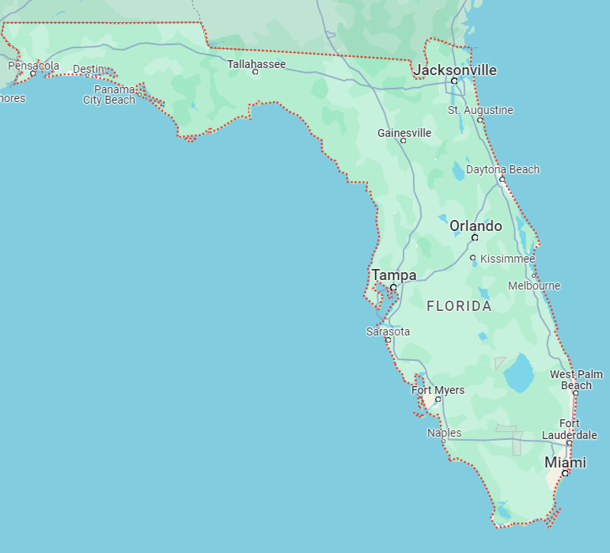
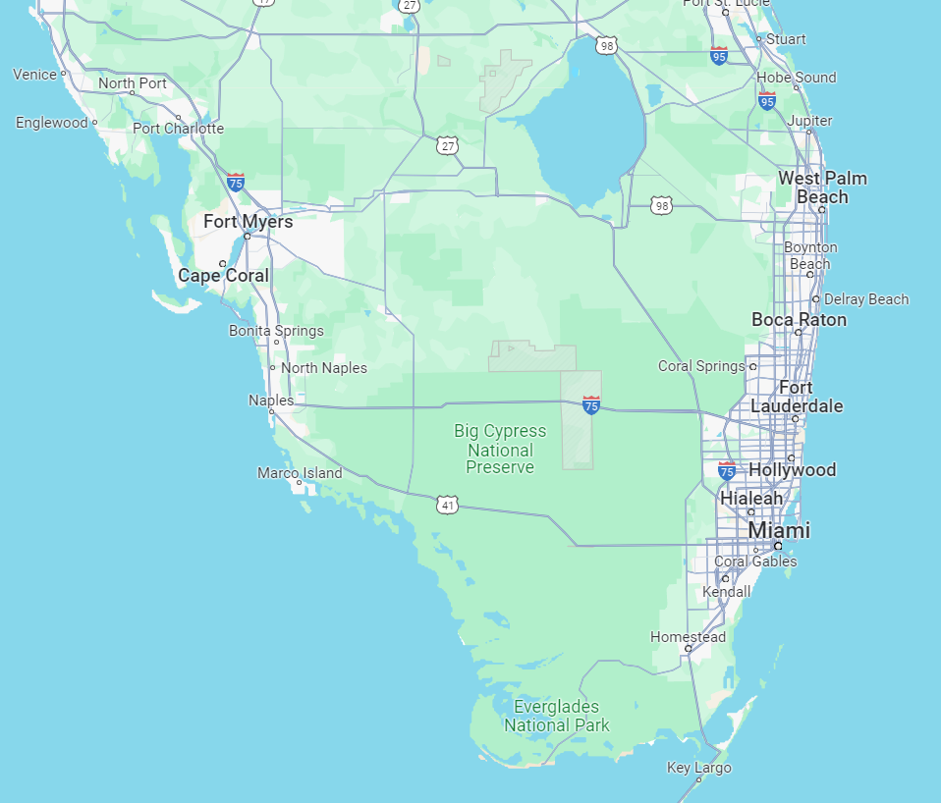
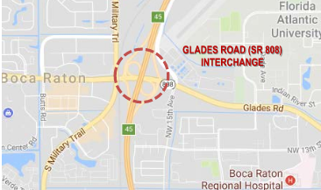
About the Project
PROJECT LOCATION:
SR 9/I-95 at Glades Road interchange, Palm Beach County, Florida (City of Boca Raton)
SCOPE:
Interchange reconfiguration and roadway improvements along Glades Road from Butts Road to West University Drive

Slide 4
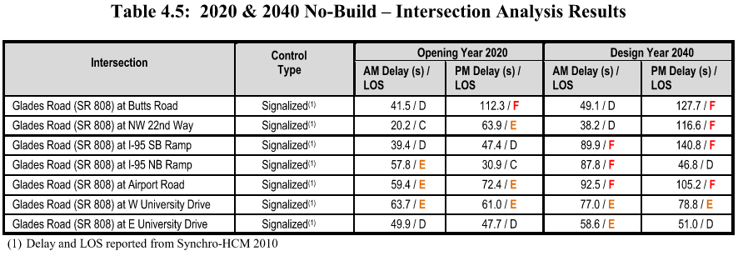
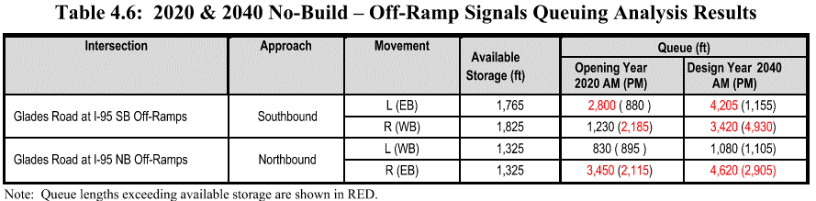

Project Purpose and Need
Reconfigure Glades Road Interchange to improve traffic operations, reduce congestion, and increase safety
Implement interchange design to address traffic spillback onto I-95
Alleviate existing and future traffic congestion thereby improving safety at the interchange
Source: 2018 I-95 at Glades Road approved IMR

Slide 5
Project Background
I-95 PD&E Study from south of Glades Road to north of Yamato Road. Location Design and Concept Acceptance (LDCA) in 2006
I-95 PD&E Study from south of Glades Road to south of Linton Blvd. Location Design and Concept Acceptance (LDCA) in 2010
I-95 at Glades Road (SR 808) Interchange Modification Report (IMR) Approval in 2018
I-95 at Glades Road (SR 808) Interchange Reevaluation Concurrence in 2021

Slide 6
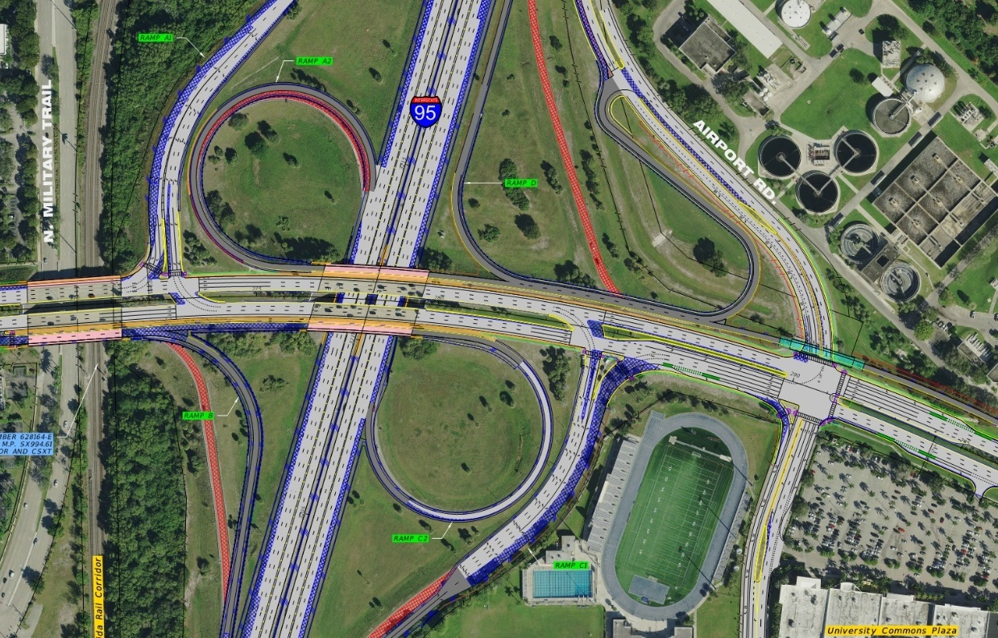
Glades Interchange Concept
Single-point entrances added to address weaving and to pull Interstate commuters from the arterial onto C-D roads.
Additional lane(s) proposed at I-95 exit ramps.
Grade-separated flyover bridge allowing I-95 commuters to bypass the Glades Road / NW 15th Avenue / Airport Road Intersection. I-95 commuters traveling NB along NW 15th Avenue would be required to cross Glades Road and enter the Interstate via a left-turn entrance at a new signalized intersection located along Airport Road.

Slide 7





Glades Interchange Concept
Projected 2040 Peak Hour Volumes
for Interchange Concept
70 (165)
350 (410)
1020 (1095)
1260 (560)
1405 (2575)
SB I-95 off-ramp
55 (145)
185 (135)
95 (105)
65 (60)
550 (1505)
140 (50)
NB I-95 on-ramp
(260) 215
(455) 390
(1140) 1590
(2015) 1320
445
(795)
520
(1020)
Airport Rd
(280) 195
(2005) 3125
(325) 690
675
(1390)
(235) 180
(400) 365
(110) 270
SB I-95 on-ramp
NW 15th Ave
965 (1815)
800 (1905)
NB I-95 off-ramp
(1700) 2850
(670) 605
(910) 1160

Slide 8
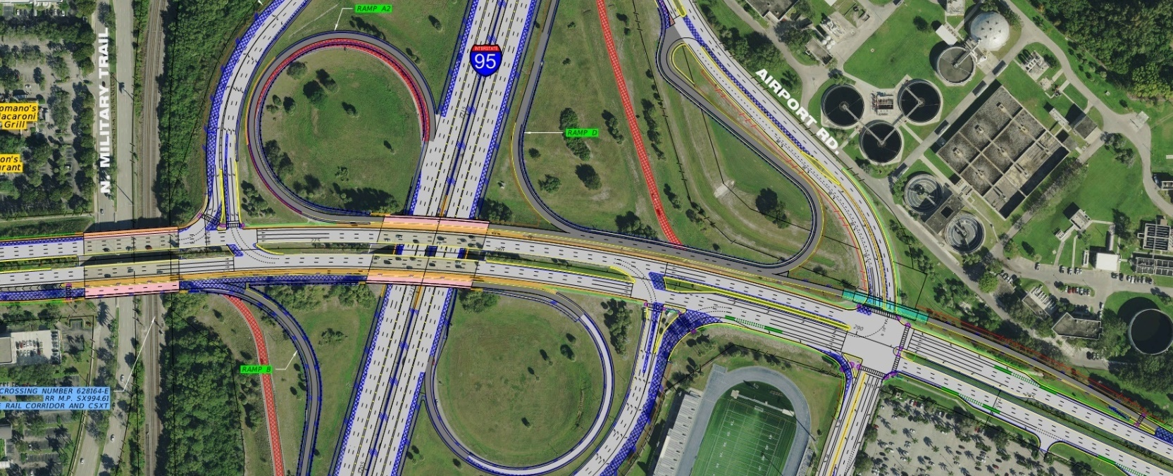



Glades Interchange Concept
Interchange Concept (2040)
(Lane configuration, Delay and LOS)
22.1/C
50.6/D
32.9/C
SB I-95
off-ramp
10.0/A
17.6/B
49.8/D
41.1/D
43.5/D
Airport Rd
23.8/C
38.2/D
31.1/C
12.0/B
1
Glades Rd
2
Glades Rd
3
Glades Rd
to NB I-95
on-ramp
4
Level Of Service
AM Delay / LOS
19.5/B
29.7/C
58.1/E
A
B
C
D
E
F
PM Delay / LOS
13.4/B
25.4/C
59.8/E
68.5/E
Airport Rd
0.5/A
NB I-95
off-ramp
56.8/E
23.9/C
67.5/E
6.2/A
SB I-95
off-ramp
4
12.1/B
Military Trai
17.4/B
18.1/B
Airport Rd
30.4/C
37.7/D
1
30.0/C
Glades Rd
2
58.1/E
31.3/C
3
SFRC
NB I-95
Off-ramp
NW 15th Ave

Slide 9
Alternative Technical Concept Design Change
  Description:
  Proposed Alternative Technical Concept (ATC) changed the I-95 (SR 9)/Glades Road interchange from a modified existing partial cloverleaf (ParClo) interchange, as identified in the SR 9 (I-95) Interchange Modification Report (IMR) for Glades Road (SR 808) Interchange for the 2040 recommended build alternative, to a DDI.
  Benefits:
  Reduced impacts to existing infrastructure
    Eliminated ramp flyover bridge over Airport Road
    Eliminated bridge widening for Glades Road EB & WB bridges over I-95 and EB bridge over Military Trail / SFRC
    Reduced bride widening for Glades Road WB bridge over Military Trail / SFRC
    Eliminated 0.38 Acres of R/W acquisition from the Boca Raton Water Treatment Plant Property
    Enhanced safety and fewer crashes due to reduction of conflict points. Proposed DDI 14 Conflict Points vs. FDOT Concept Modified ParClo Design 18 Conflict Points.
    Optimized 2-phase signal operations at intersections within the interchange

Slide 10
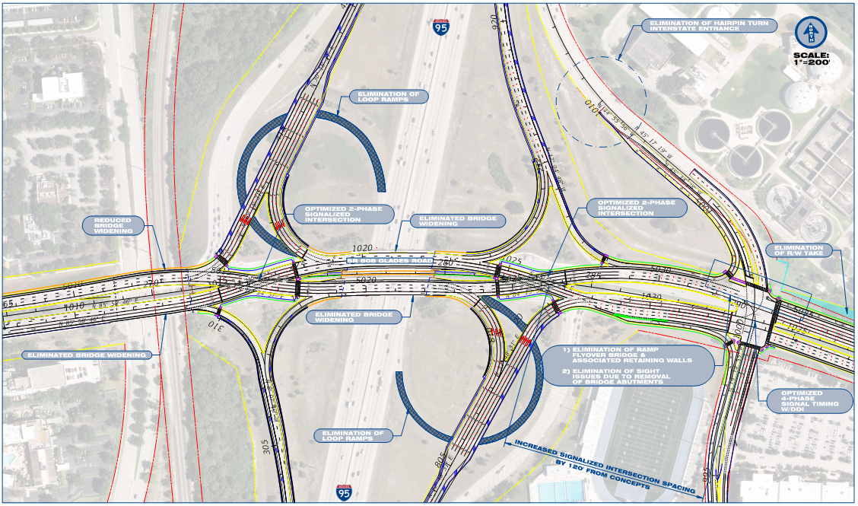
Glades Interchange ATC
Enhanced motorist/pedestrian/bicyclist safety and reduction of overall conflict points.
Elimination of auxiliary lane widening along I-95 Mainline beneath Glades Road due to the elimination of proposed loop ramps from RFP Concept.
Reduction of signal phases at ramp terminal intersections. Crossover intersections allow motorists to enter Interstate via free-flow movements.
Comprehensive pavement marking and signage plan to ensure all users understand proper lane guidance in advance of the required movement(s).

Slide 11
Glades Interchange ATC
Projected 2040 Peak Hour Volumes
for DDI Concept
125 (310)
185 (135)
95 (105)
65 (60)
1245 (2895)
140 (50)
11
(32)
SB I-95 off-ramp
NB I-95 on-ramp
2435 (2410)
475 (905)
1405 (2575)
445 (795)
845
(1110)
Airport Rd
(280) 195
(2165) 3125
(325) 690
1020
(1095)
1260
(560)
520
(1020)
(495) 395
(140) 150
(110) 270
475
(905)
445
(795)
605
(670)
1160
(910)
I-95 NB Off-Ramp
NW 15th Ave
520 (1020)
1245 (2700)
SB I-95 on-ramp
845 (1110)
2850 (1860)

Slide 12
Glades Interchange ATC
DDI Concept (2040)
(Lane configuration, Delay and LOS)
11.6/B
37.8/D
89.8/F
SB I-95
off-ramp
20.3/C
26.7/C
18.1/B
37.1/D
21.5/C
91.9/F
Airport Rd
19.8/B
26.5/C
29.4/C
Level Of Service
AM Delay / LOS
1
Glades Rd
2
Glades Rd
3
Glades Rd
A
B
C
D
E
F
PM Delay / LOS
8.6/A
12.1/B
37.7/D
NB I-95
off-ramp
1.0/A
61.1/E
77.1/E
21.6/C
21.6/C
28.9/C
23.3/C
23.4/C
81.0/F
SB I-95
off-ramp
Airport Rd
Military Trail
9.9/A
22.3 C
21.6/C
28.2 C
1
Glades Rd
2
41.4 D
33.3 C
3
SFRC
NB I-95
Off-ramp
NW 15th Ave

Slide 13
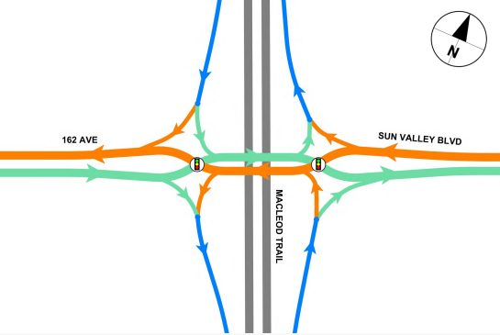

Diverging Diamond Interchange Defined
A Diverging Diamond Interchange is a form of diamond interchange that allows the two directions of traffic on the crossroad to temporarily divide and cross to the opposite side of the road to provide easier left-turns to and from the freeway.
Glades Rd.

Slide 14
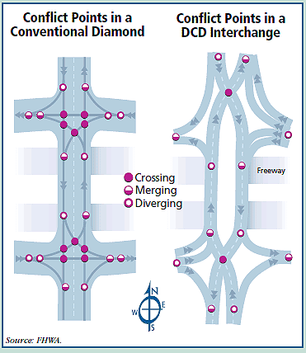
Diverging Diamond Interchange Advantages
Fewer conflict points (14 for DDI, 26 for conventional diamond)
Improved intersection sight distance
Pedestrian crossings are shorter
  “Free flow” or simple left and right turns from freeway
  Increases left turn lane capacity without needing additional lanes
  Only two phases needed for traffic signals, shorter cycle length
Bridge widening is reduced
Construction time is reduced
Conflict Points in a
Conventional Diamond
Conflict Points in a
DDI

Slide 15
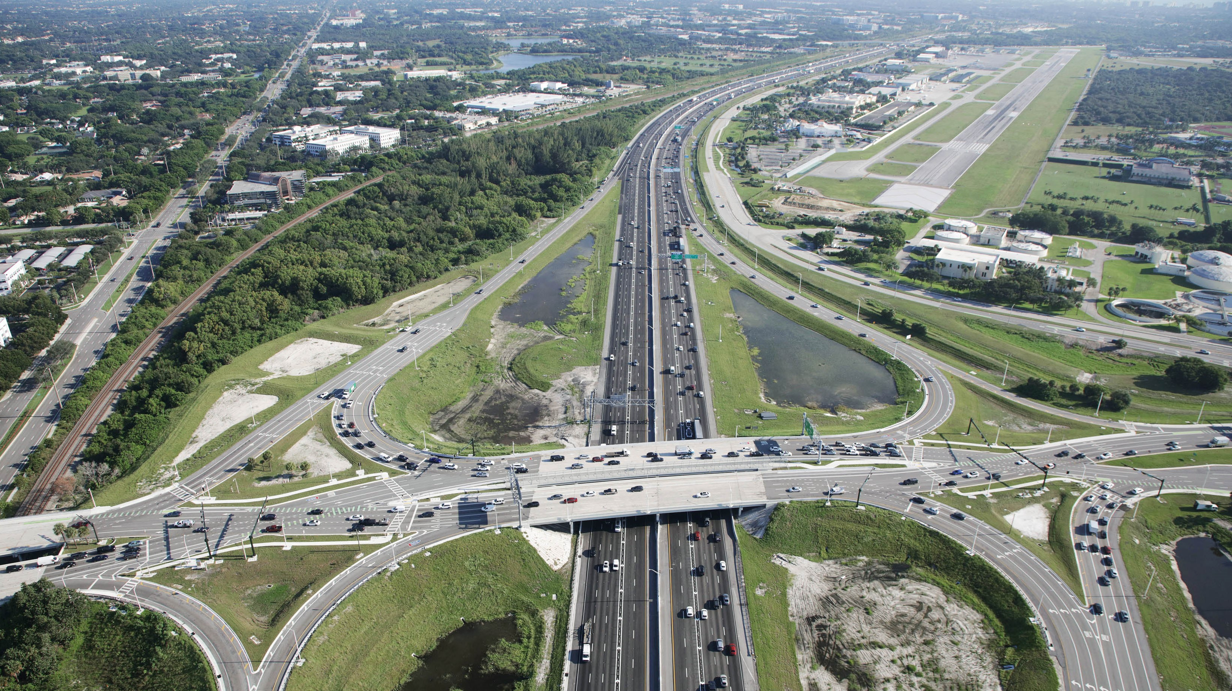
Glades Diverging Diamond Interchange
Alternative | AM Peak |  |  | PM Peak
 | Southbound Interchange | Northbound Interchange | Airport Road | Southbound Interchange | Northbound Interchange | Airport Road
Concept
DDI
LEGEND | Level of Service (LOS)
 |  | LOS E; Severe Congestion
 |  | LOS D; Moderate Congestion
 |  | LOS C; Some Congestion
 |  | LOS B or Better; Best Traffic Conditions

Slide 16
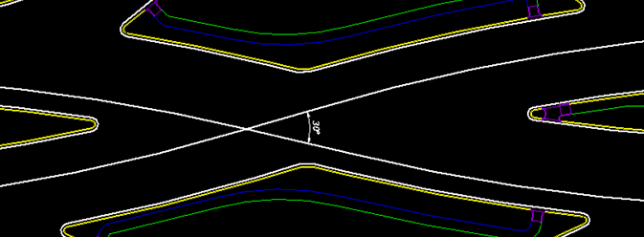
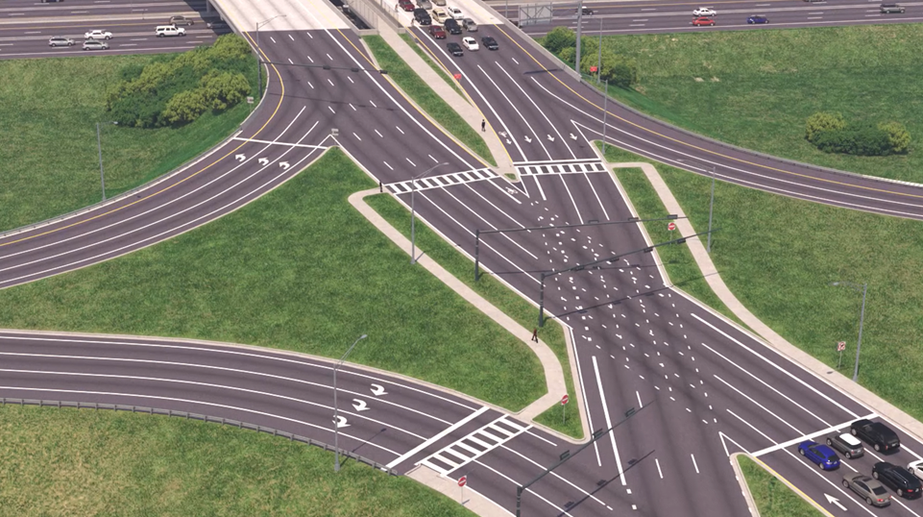
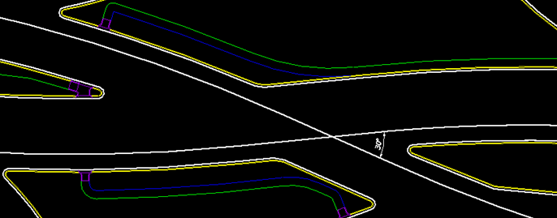
Glades DDI Design
Geometric Design that complies with 2018 AASHTO A Policy on Geometric Design of Highways and Streets
Crossover angle of 30 degrees (angle between tangent segment of EB & WB alignments) that accommodates geometric parameters such as normal crown cross slope
30°
West Crossover Intersection
Eyebrow
30°
East Crossover Intersection
Eyebrow geometry that minimizes likelihood of wrong-way movements

Slide 17
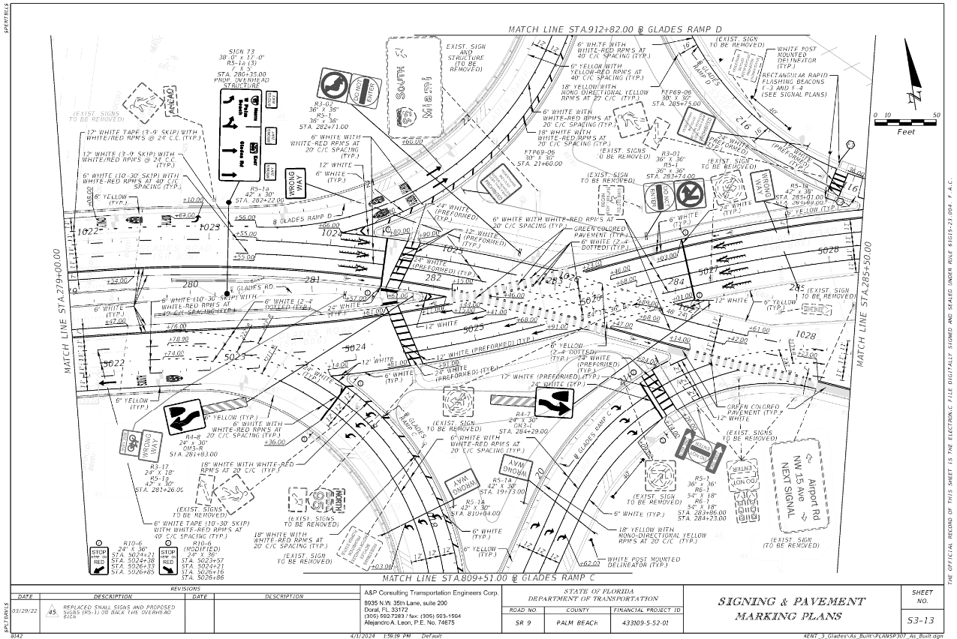
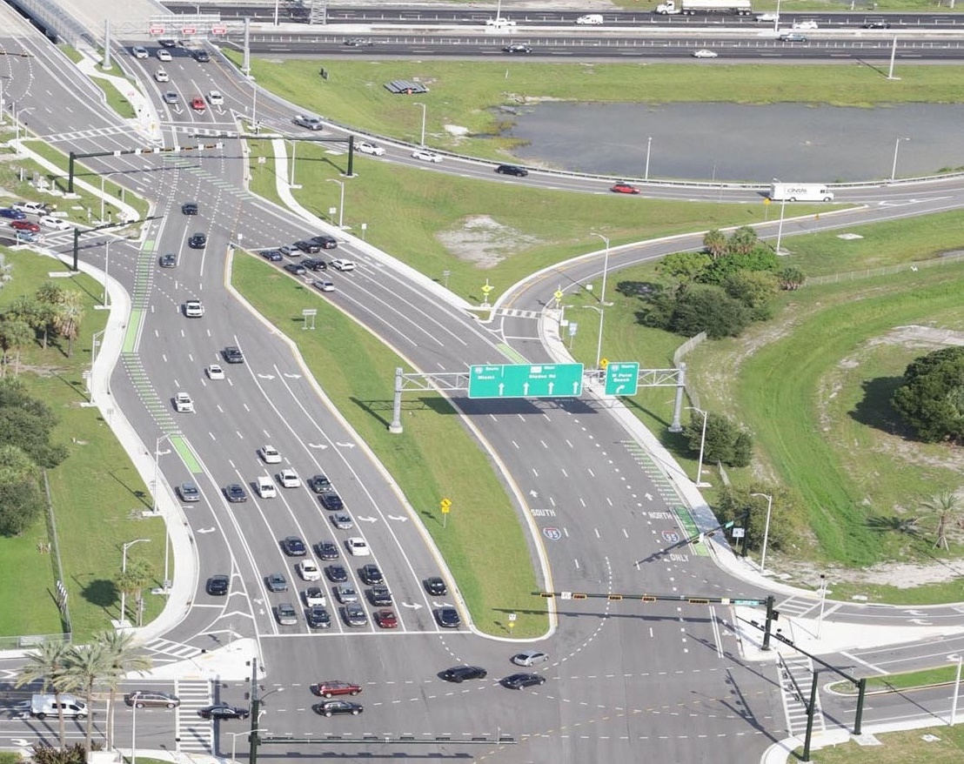
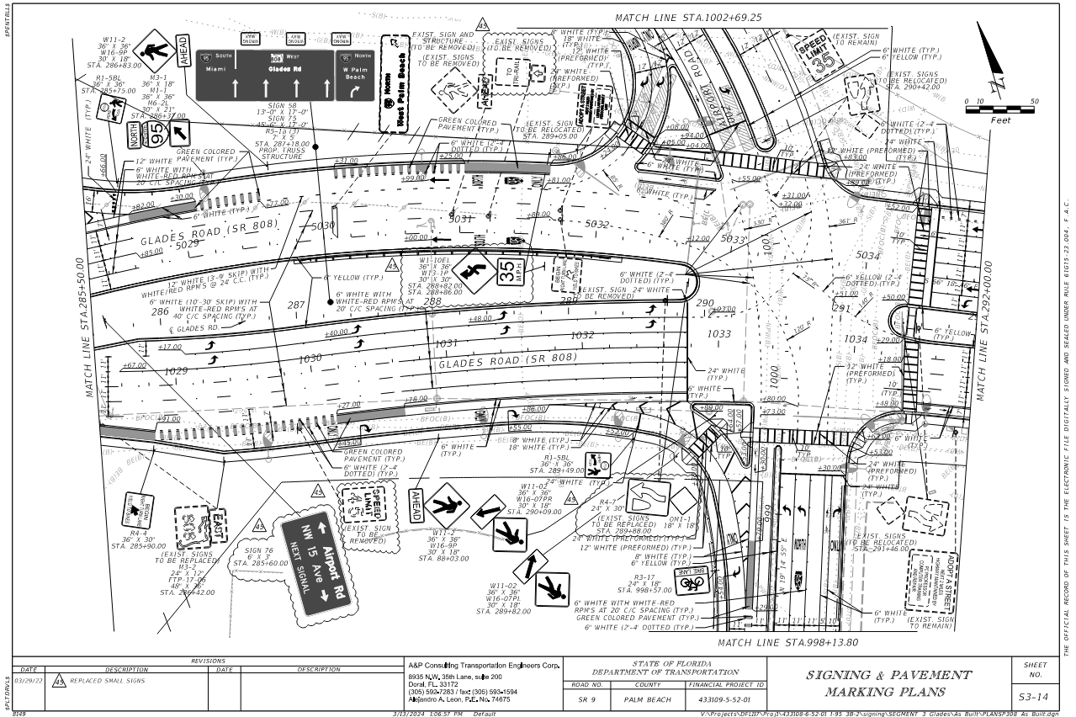


Glades DDI Design
Supplemental signs and pavement markings providing lane guidance in advanced of decision points.

Slide 18
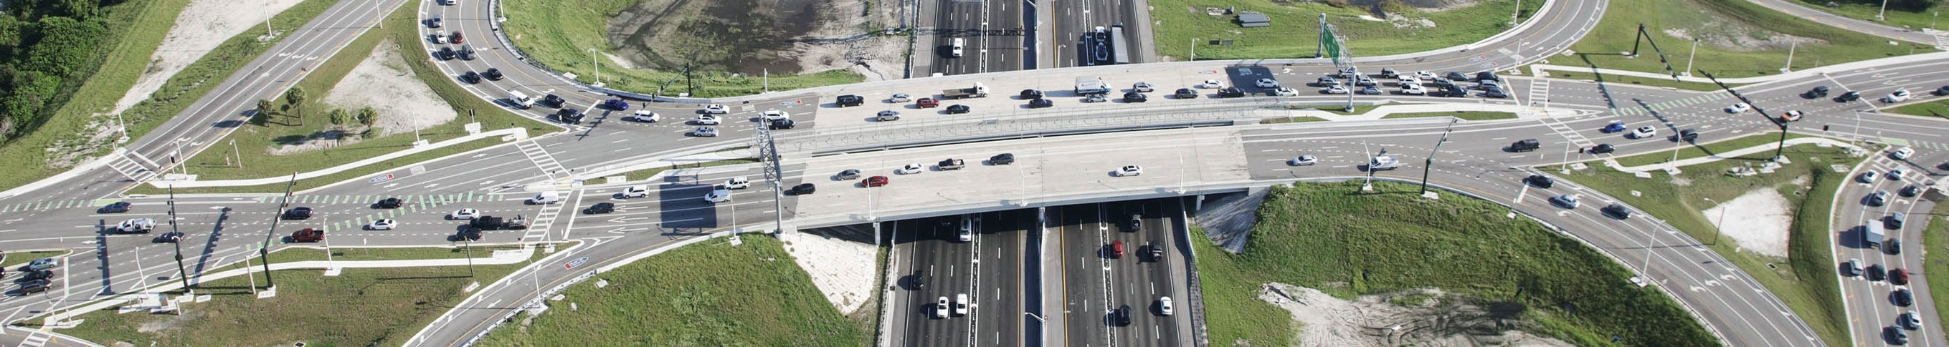
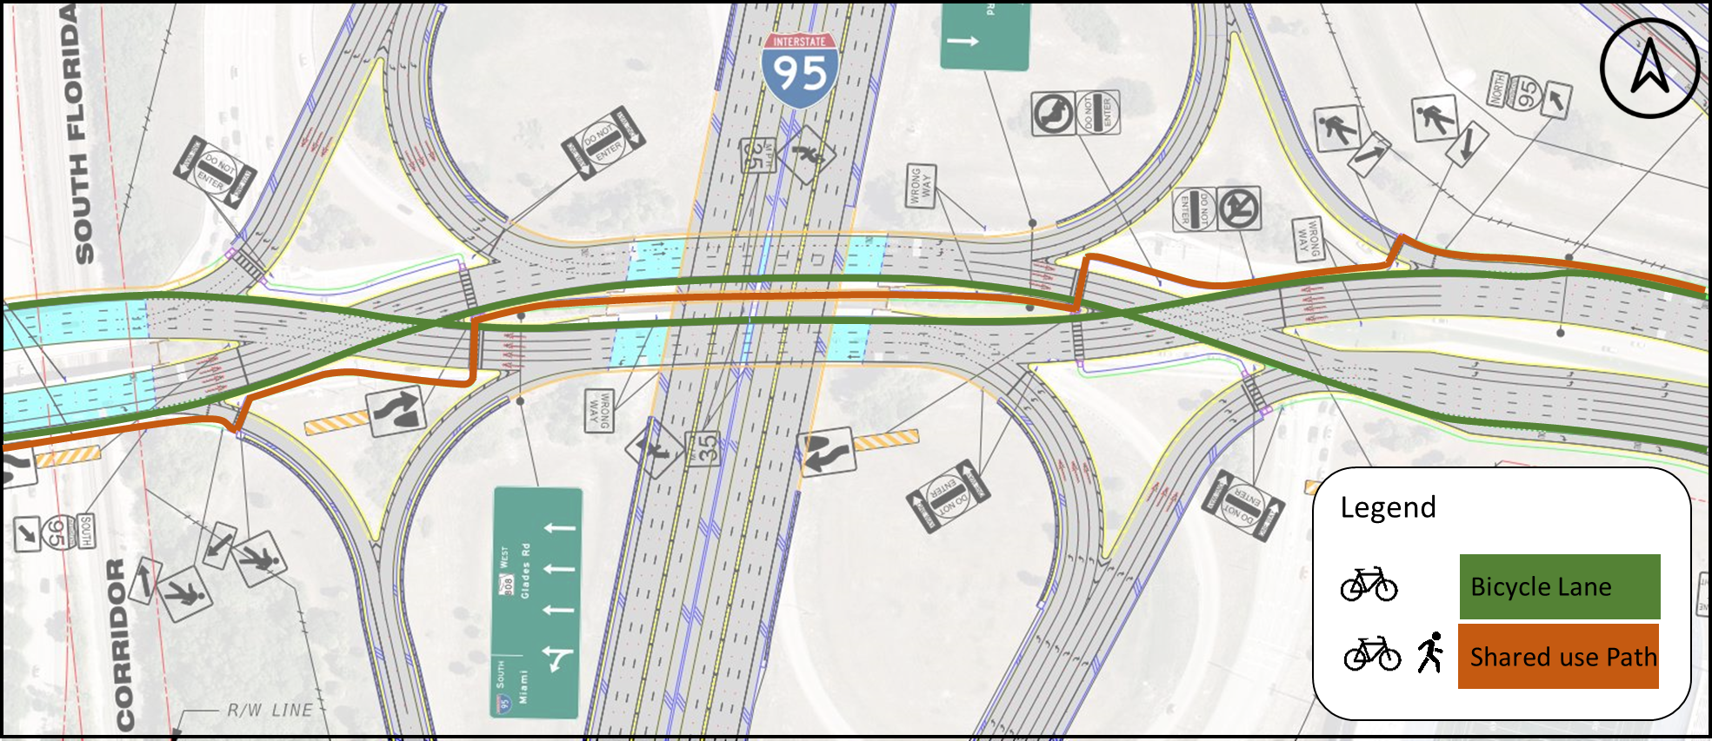
Glades DDI Design
Enhanced safety for bicycles and pedestrians with a seven-foot buffered bicycle lane and a new 10-foot shared use path for pedestrians and recreational cyclists through the interchange

Slide 19
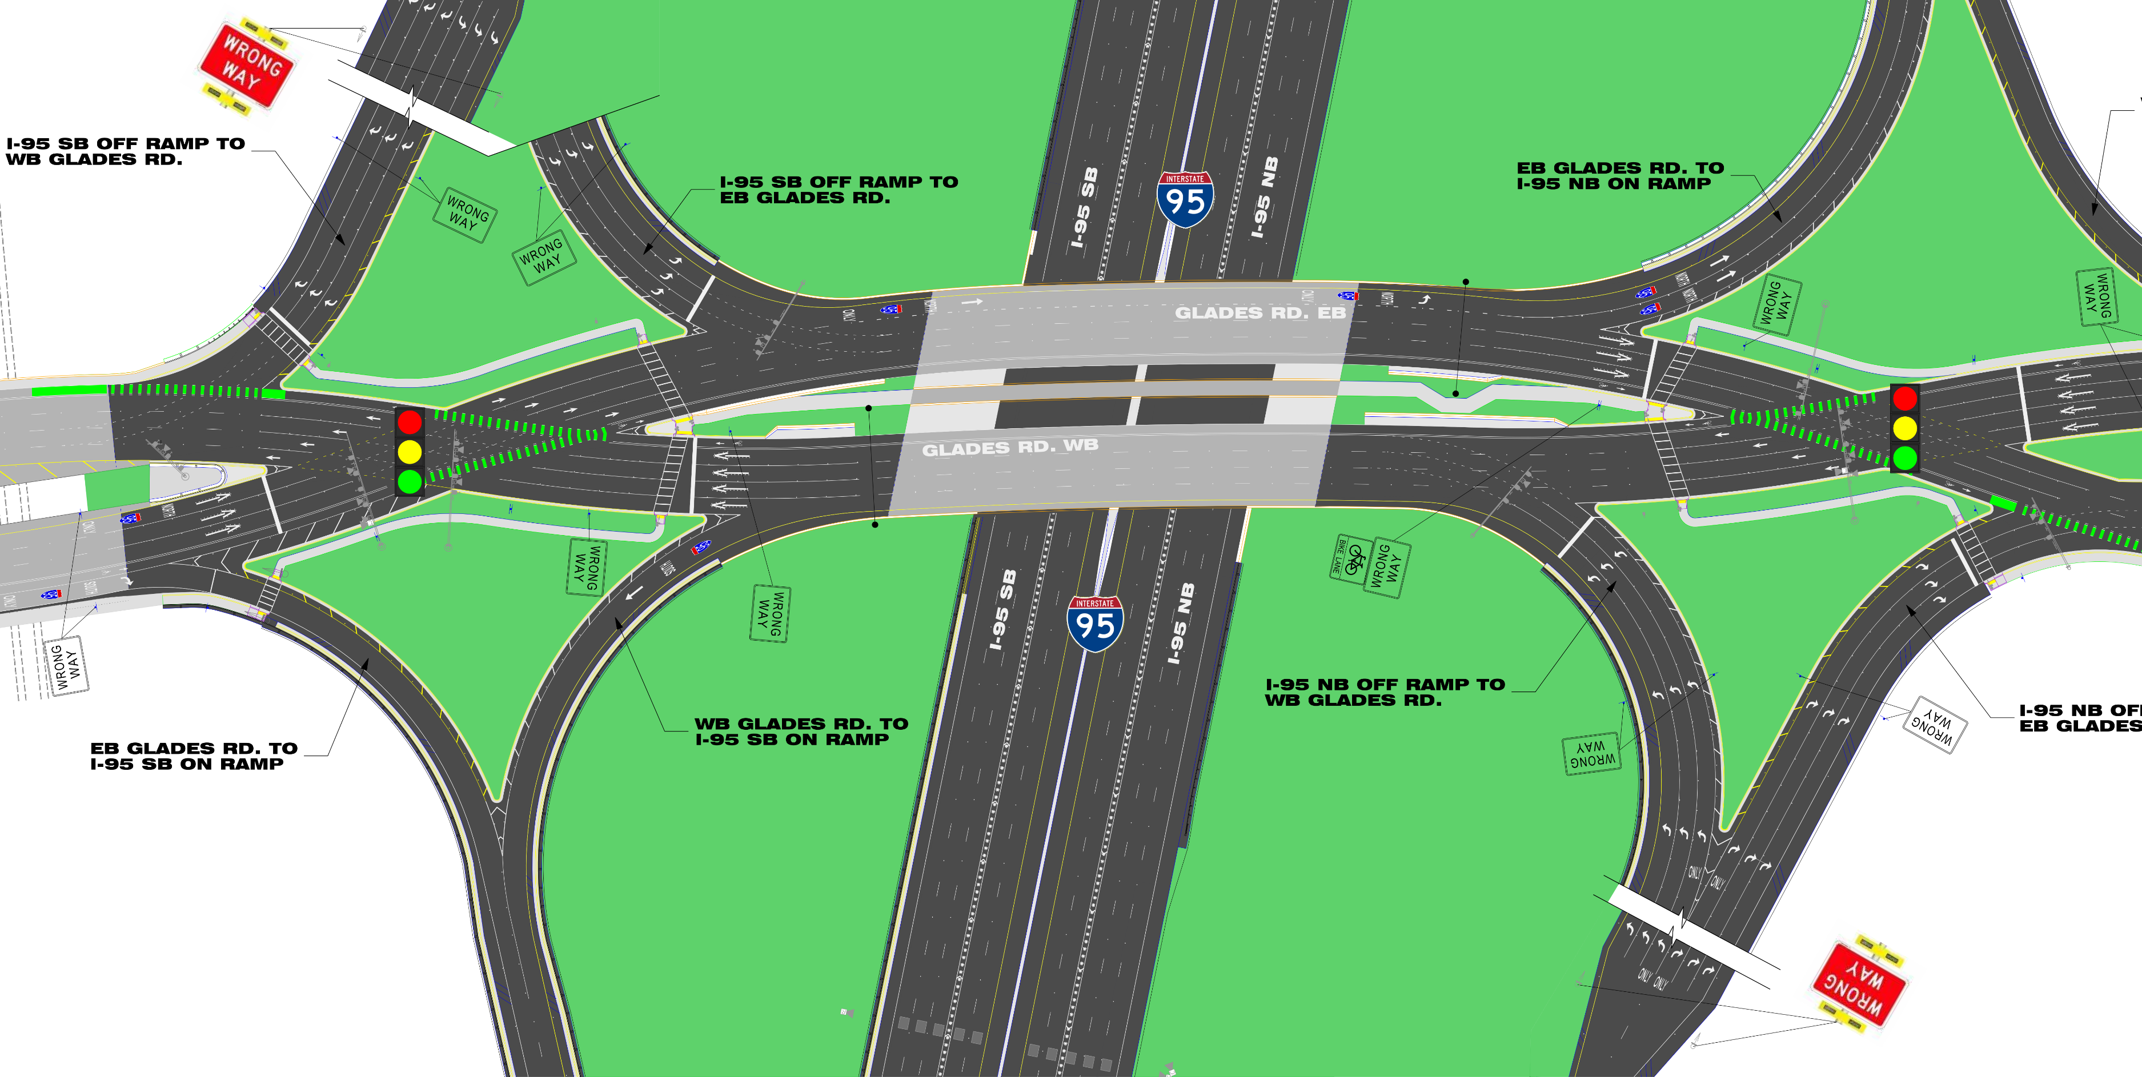
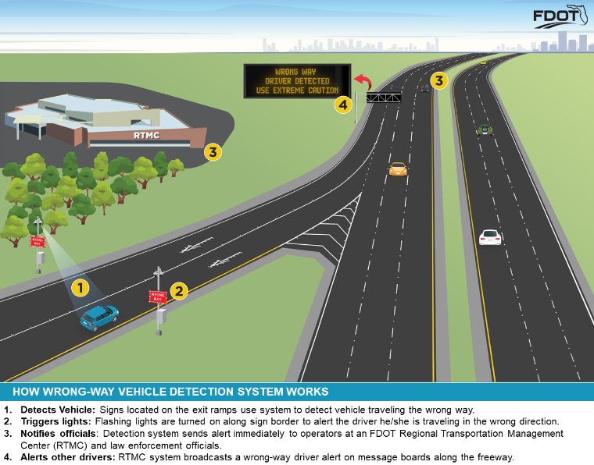
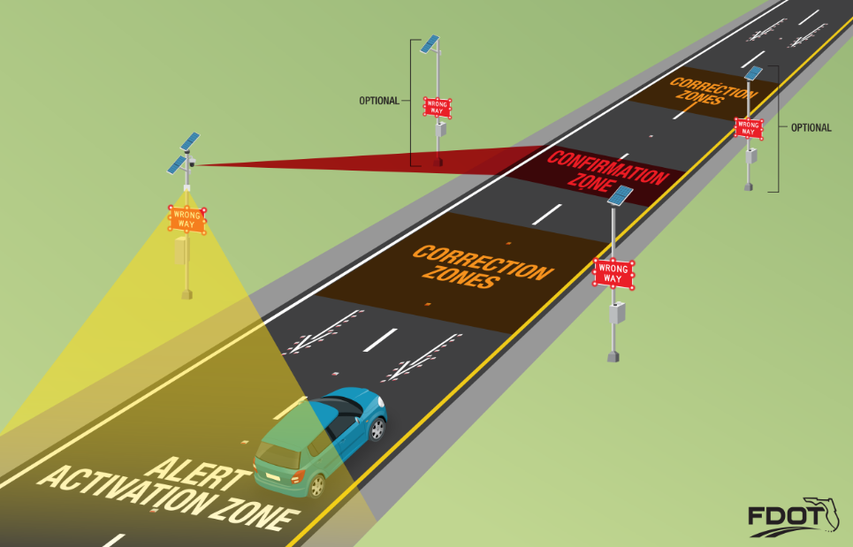

Glades DDI Design

Slide 20
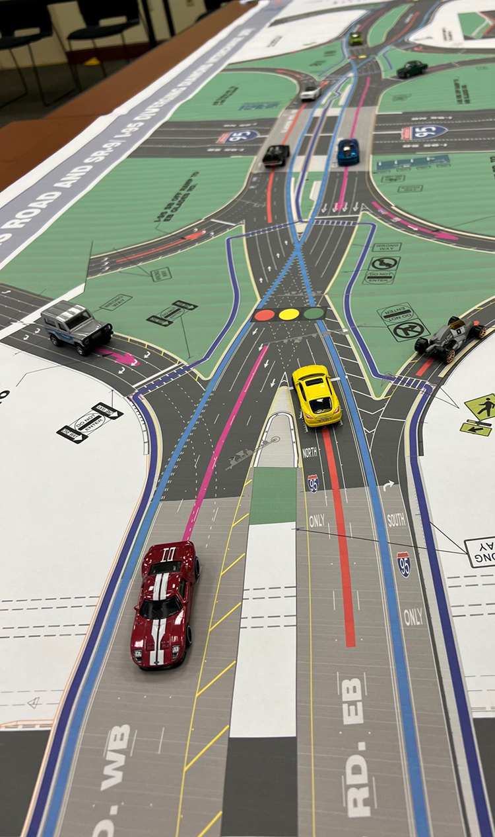
Glades DDI Stakeholder Outreach
Boca Raton High School
Palm Beach County School Board
FAU Research Park
FAU
Public Meeting/Open House
City of Boca
Palm Beach State college
FAU Stadium
Boca Raton Airport
Boca Raton Utilities
University Commons Shopping Plaza
Boca Raton Homeowner’s Association
Palm Beach Traffic Incident Management
Palm Beach County TPA, TAC
Palm Beach County TPA CAC
PALM BEACH COUNTY TPA Bicycle, Trailways, Pedestrian Advisory Committee
Whole Foods University Commons

Slide 21
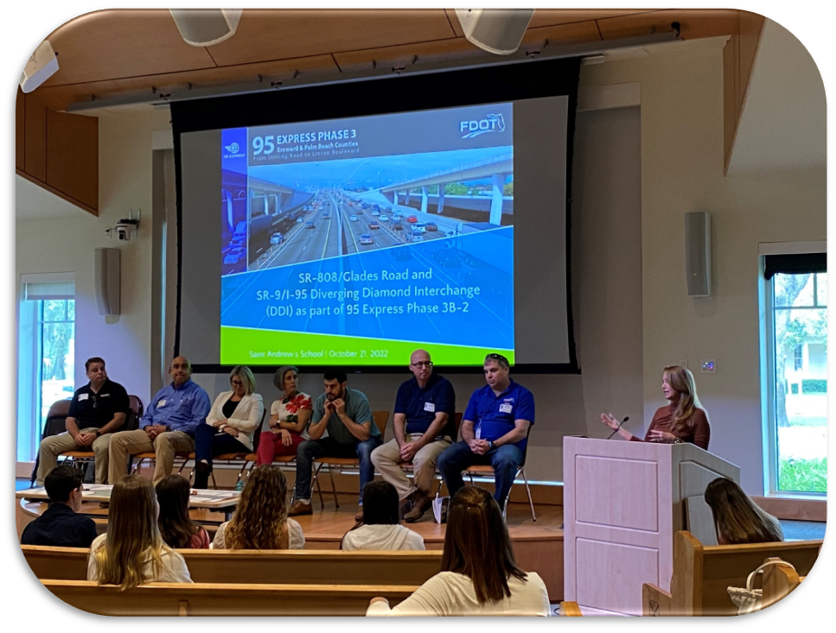
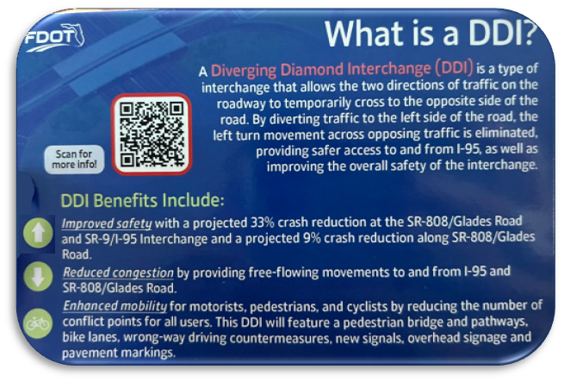
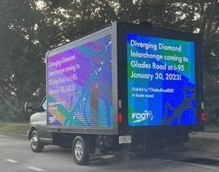
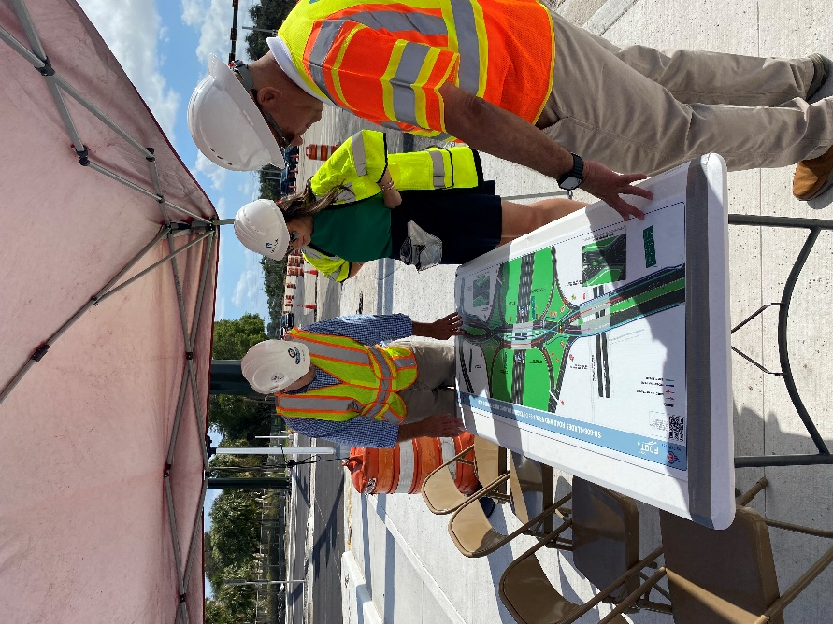
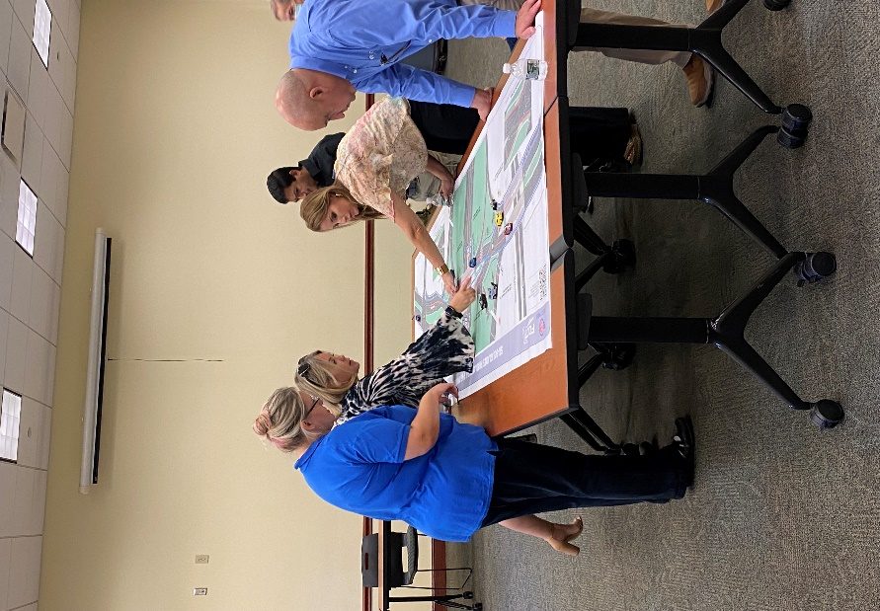
Glades DDI Stakeholder Outreach-Strategies
Mobile Billboards
PSA at FAU Stadium, Field, and Gym Sporting Events
In-person presentations for FAU, St. Andrews School and Boca Raton High School
Attend the Mayor’s Town Forum
Bi-monthly Coffee with the Contractor
Regularly meetings with business owners
Social Media Campaign and Updates
Staffed Boca Traffic Management Center (TMC) [300+ signal timing tweaks over 8 weeks]

Slide 22
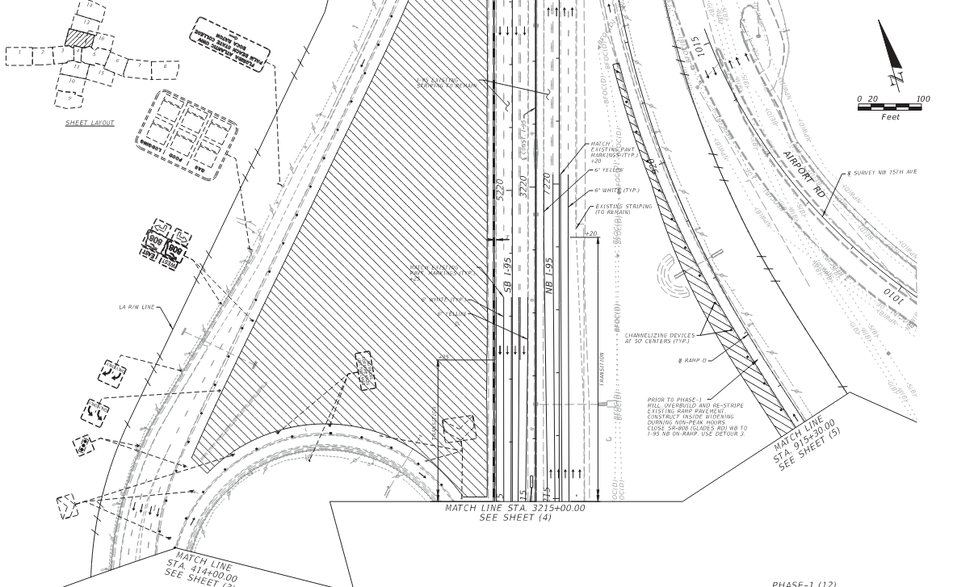
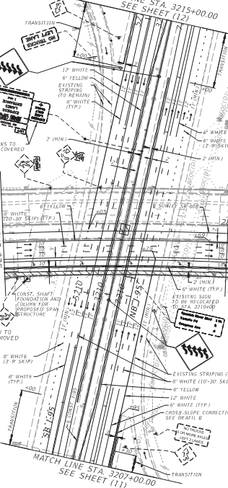
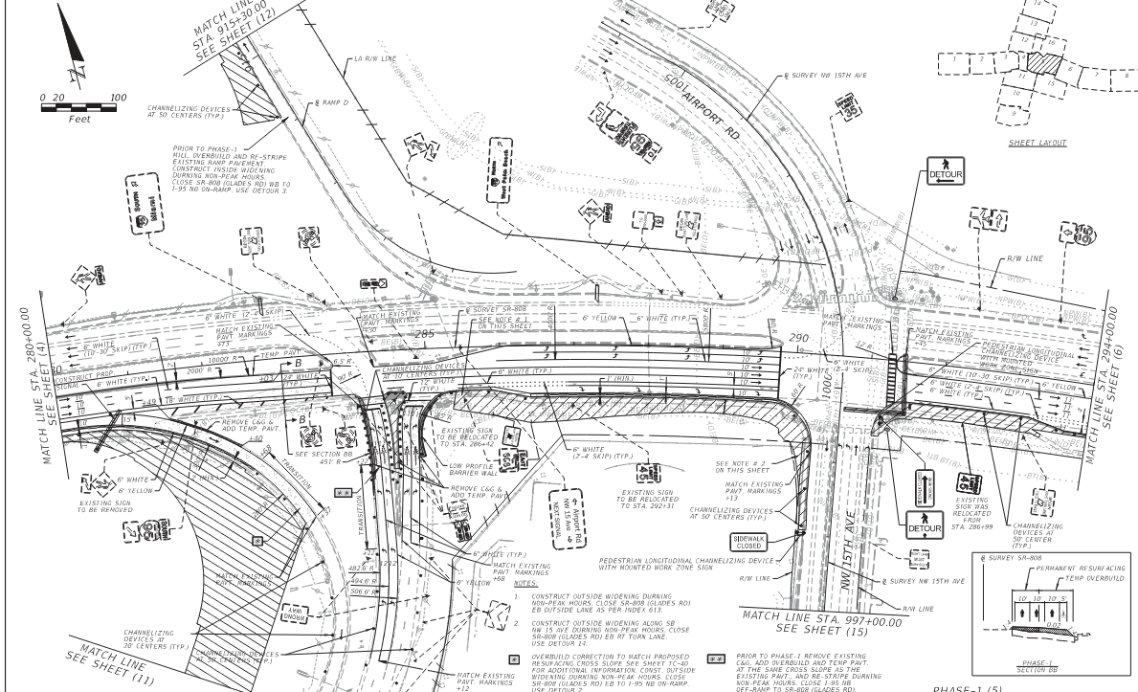
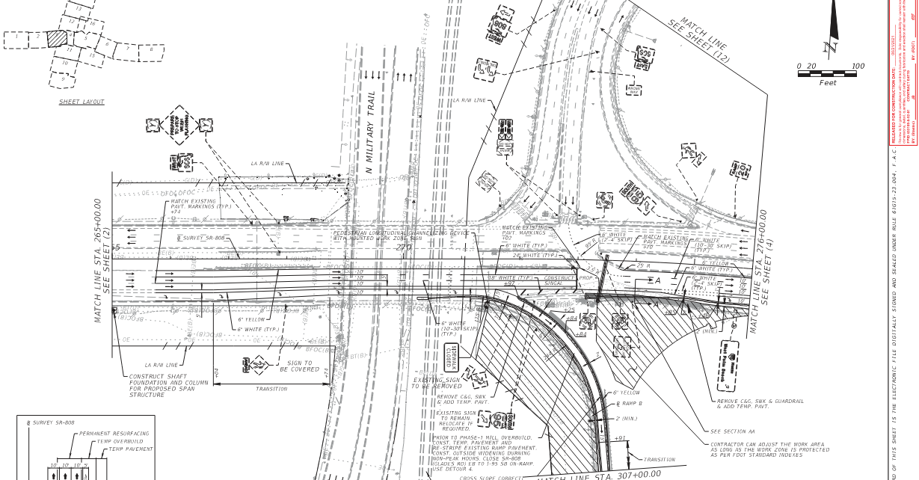
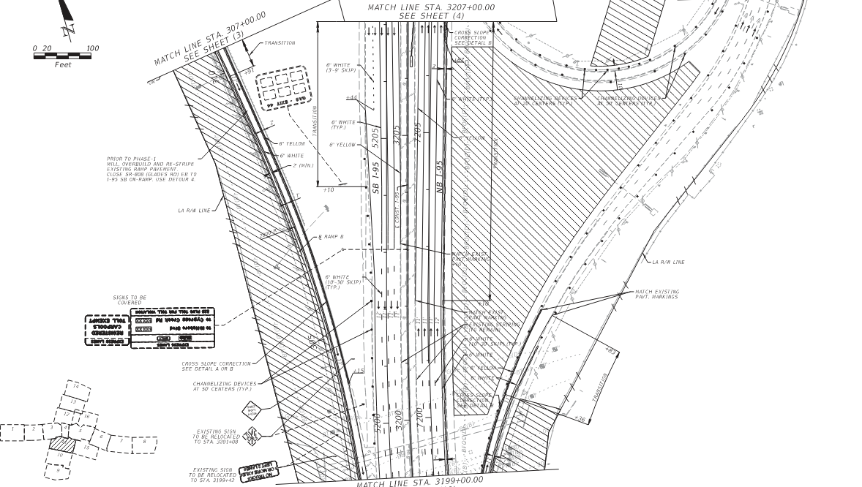
Glades DDI Temporary Traffic Control

Slide 23
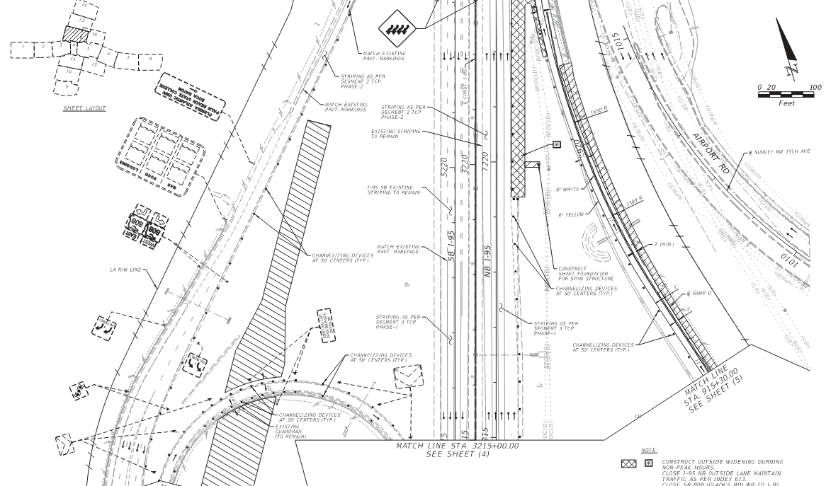
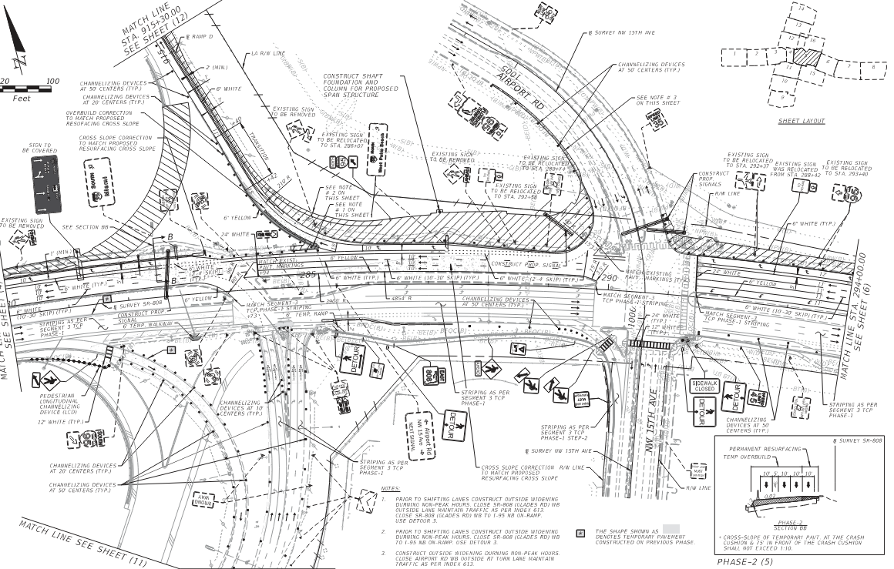
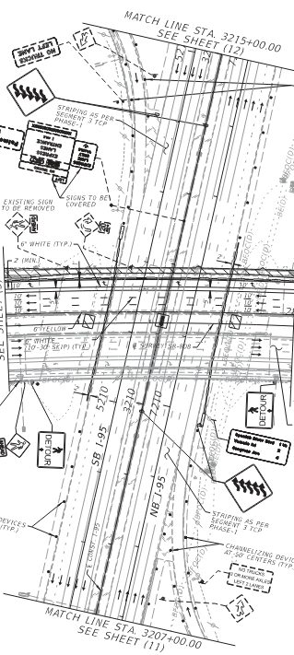
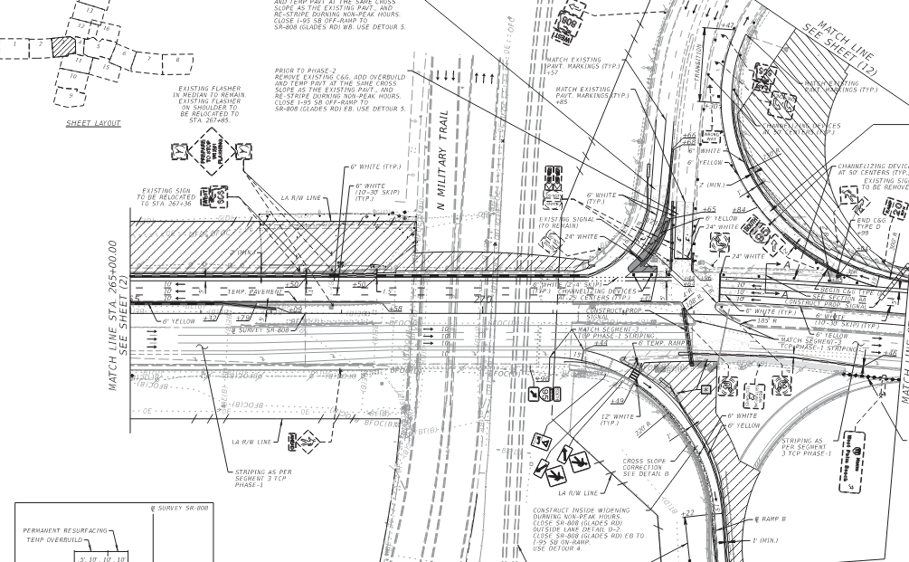
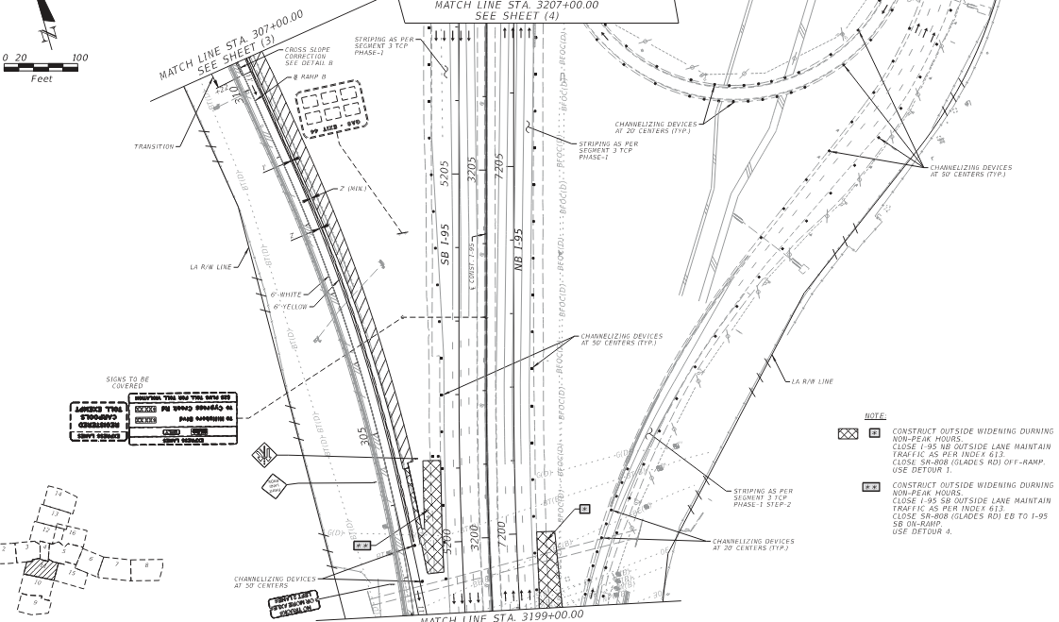
Glades DDI Temporary Traffic Control

Slide 24
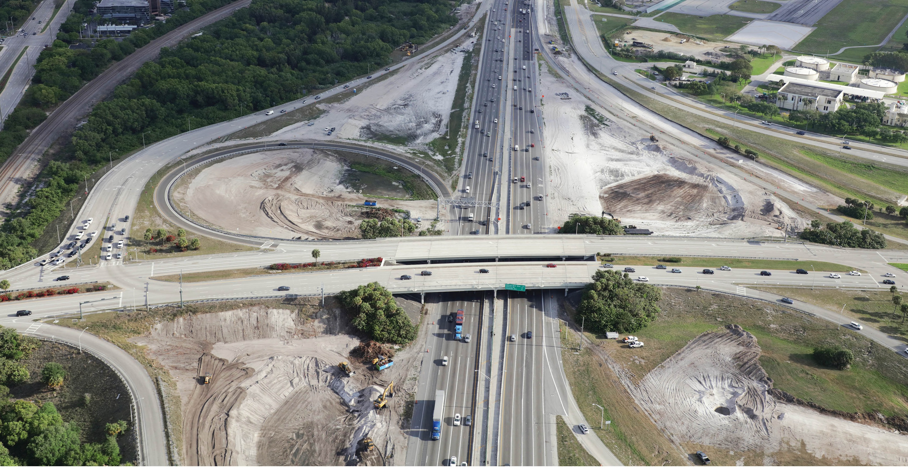
Glades DDI Construction

Slide 25
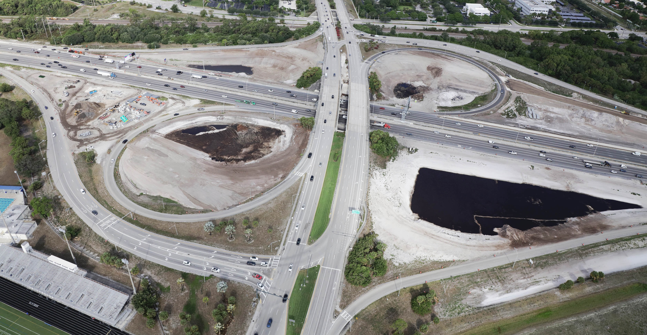
Glades DDI Construction

Slide 26
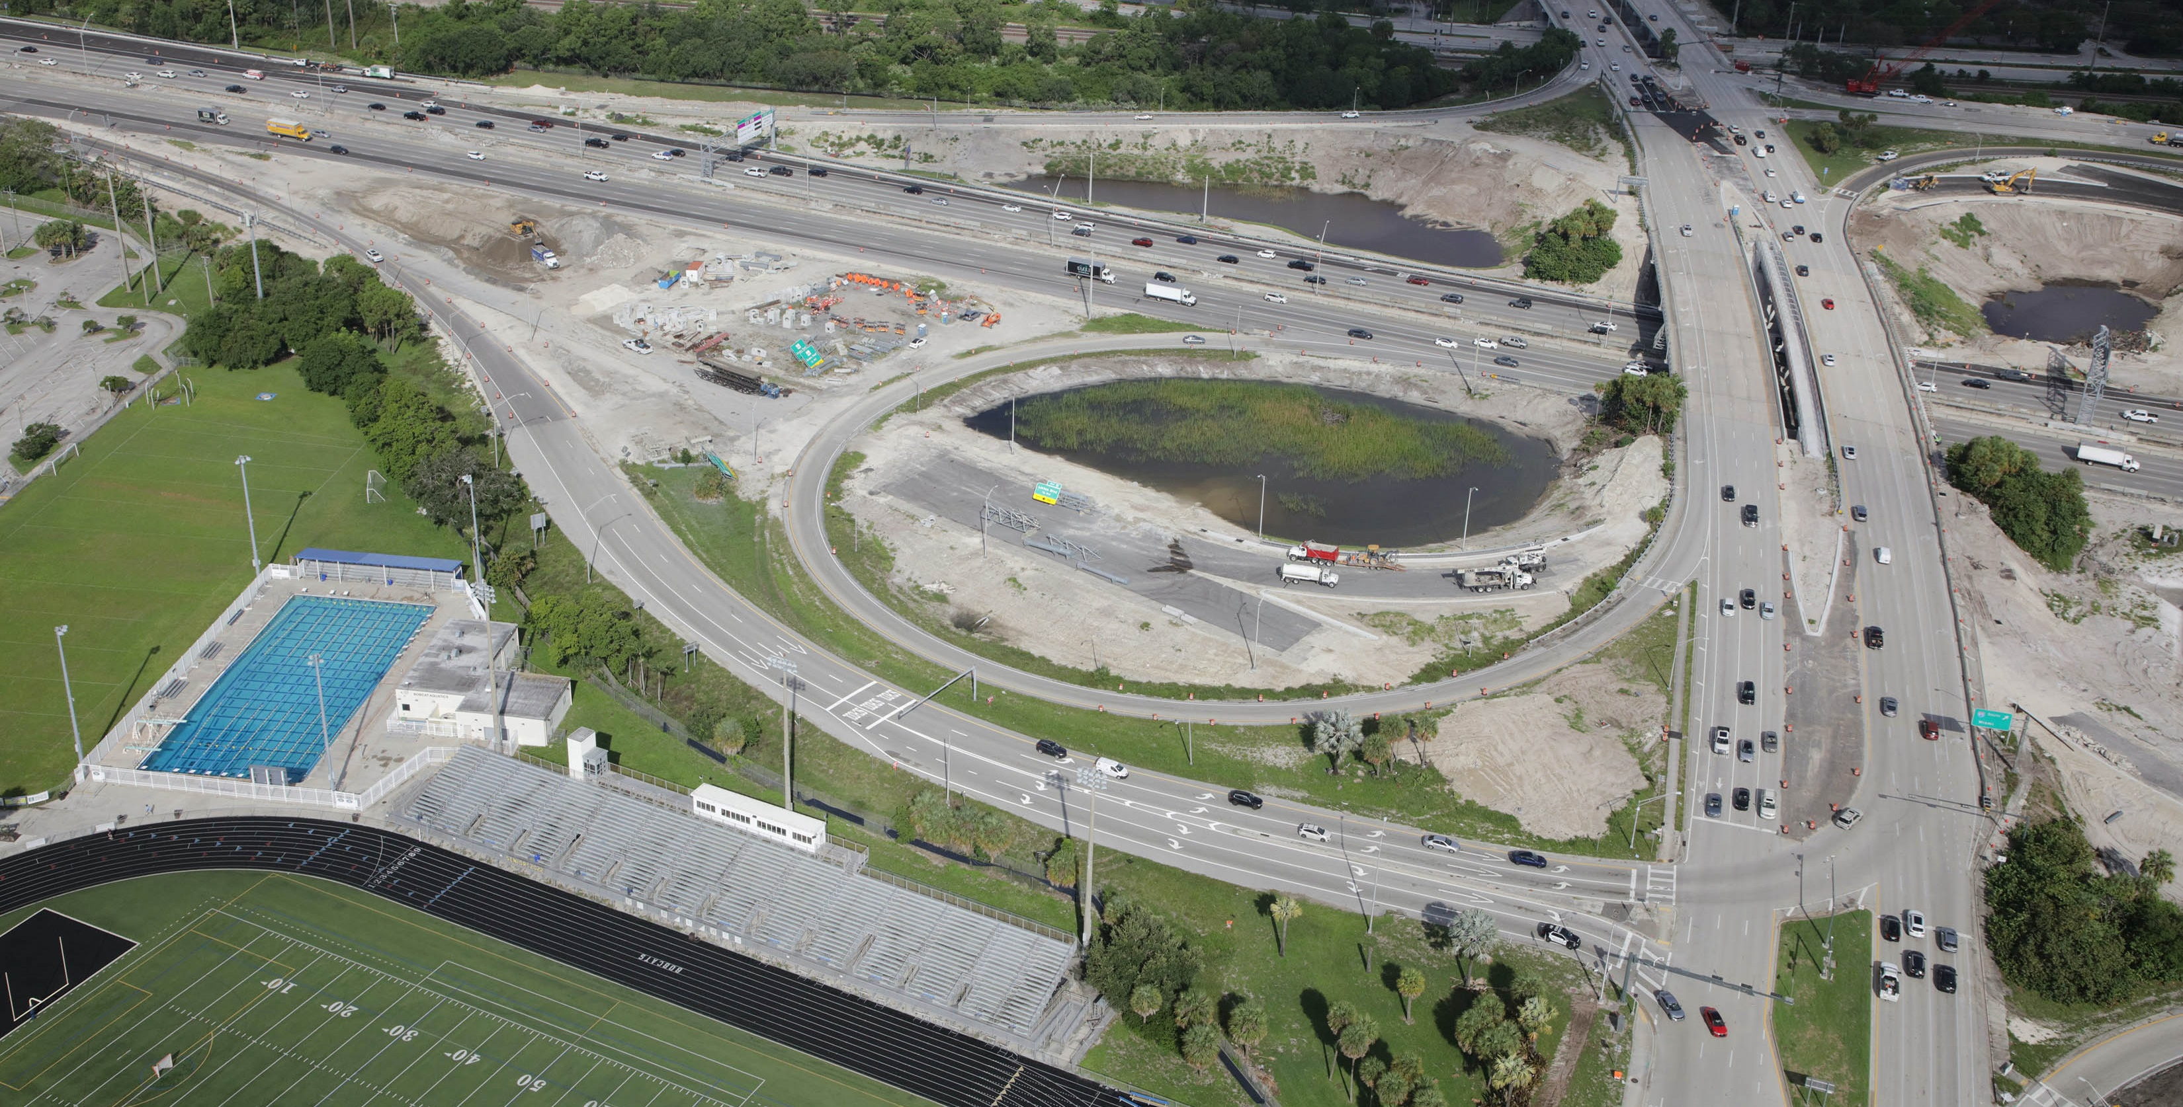
Glades DDI Construction

Slide 27
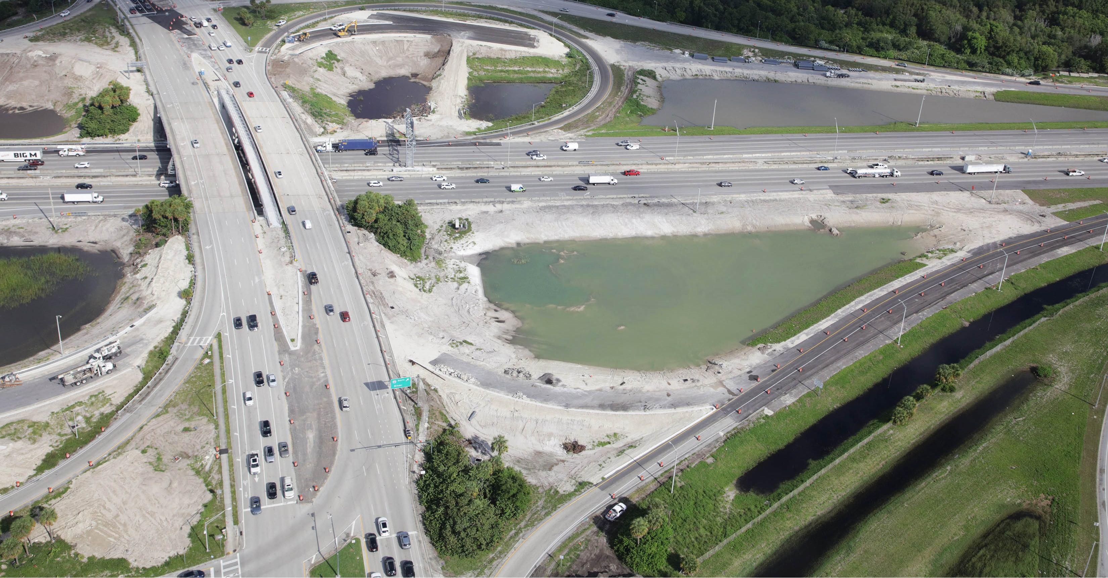
Glades DDI Construction

Slide 28



Glades DDI Construction

Slide 29




Glades DDI Temporary Traffic Control-Change

Slide 30





Glades DDI Temporary Traffic Control-Change
One Weekend Closure Detour VS Four Weekend Closures

Slide 31




Glades DDI Construction-Weekend Closure

Slide 32




Glades DDI Construction-Weekend Closure

Slide 33



Glades DDI Construction-Weekend Closure

Slide 34


Glades DDI Construction

Slide 35

Glades DDI Final

Slide 36

Glades DDI Final (east crossover)

Slide 37

Glades DDI Final (west crossover)

Slide 38












Glades DDI Smart Work Zone (SWZ) Overview
What is the District Four SWZ Process?
What is a Smart Work Zone?
Technology + People + Relationships + A Plan
Improved Safety and Mobility
Work Zones
Detour Routes
Area of Influence
Smart Devices
People
Relationships
A Plan
Deploy
Monitoring
Plan Implementation

Slide 39




Stakeholder Communication Ecosystem
Project Overview
  Roles each stakeholder needs to fulfill
  Considerations to improve DDI operation
Education
  Assist the public with understanding the new layout, allowing them to meet the team and asks questions
Smart Work Zone Elements
  Feedback from the public, monitoring, data collection, and weekly briefings.
SWZ Consultant:
Monitoring DDI Implementation
Observed Queuing In NBL on Airport Road: Out of Place Drum
Coordination with Contractor
Results
Contractor Fixed Drum Issue
Contact CEI
Contractor:
SWZ Consultant:
CEI:

Slide 40

Glades DDI Operations Lessons Learned
Stop Bar Compliance
Observed sneakers and creepers.
Recommendations of:
  “Stop Here On Red” signs.
Pedestrian crossing signs.
Robust striping.
Team verifying stop bar locations.
Old MOT faded striping – drivers need clean message.
Thermo-plastic vs. paint for temporary MOT

Slide 41


Glades DDI Operations Lessons Learned
Conflict Points SBL Movement, Weaving
EBT sneakers are creating conflict with SBL movement as they don’t have time to get in the line of sight of SBL turning vehicles.
Since all lanes are not yet available, all departure lanes don’t have a receiving lane causing weaving.

Slide 42

Glades DDI Operations Lessons Learned
Signalization: Traffic Signal System
Highly Recommend a “single traffic controller”
  Glades Road running two controllers. (1 might be better)
  Run the system in “Overlap” and other technology solutions
Be cautious of standard “phasing and timing” in design
  This is not a standard signal
  Must be field adjusted due to dynamic nature of Freeway demand. (Hint, driver behavior)

Slide 43

Safety Reminder

Slide 44


Contact Us
Vanita Saini, P.E.
Project Manager
Florida Department of
Transportation, District Four
3400 West Commercial Boulevard
Fort Lauderdale, FL 33309
Phone: 954-777-4468
Toll Free: 866-336-8435, ext. 4468
Email:
vanita.saini@dot.state.fl.us

Slide 45
Thank You / Questions

Slide 46


