Slide 1
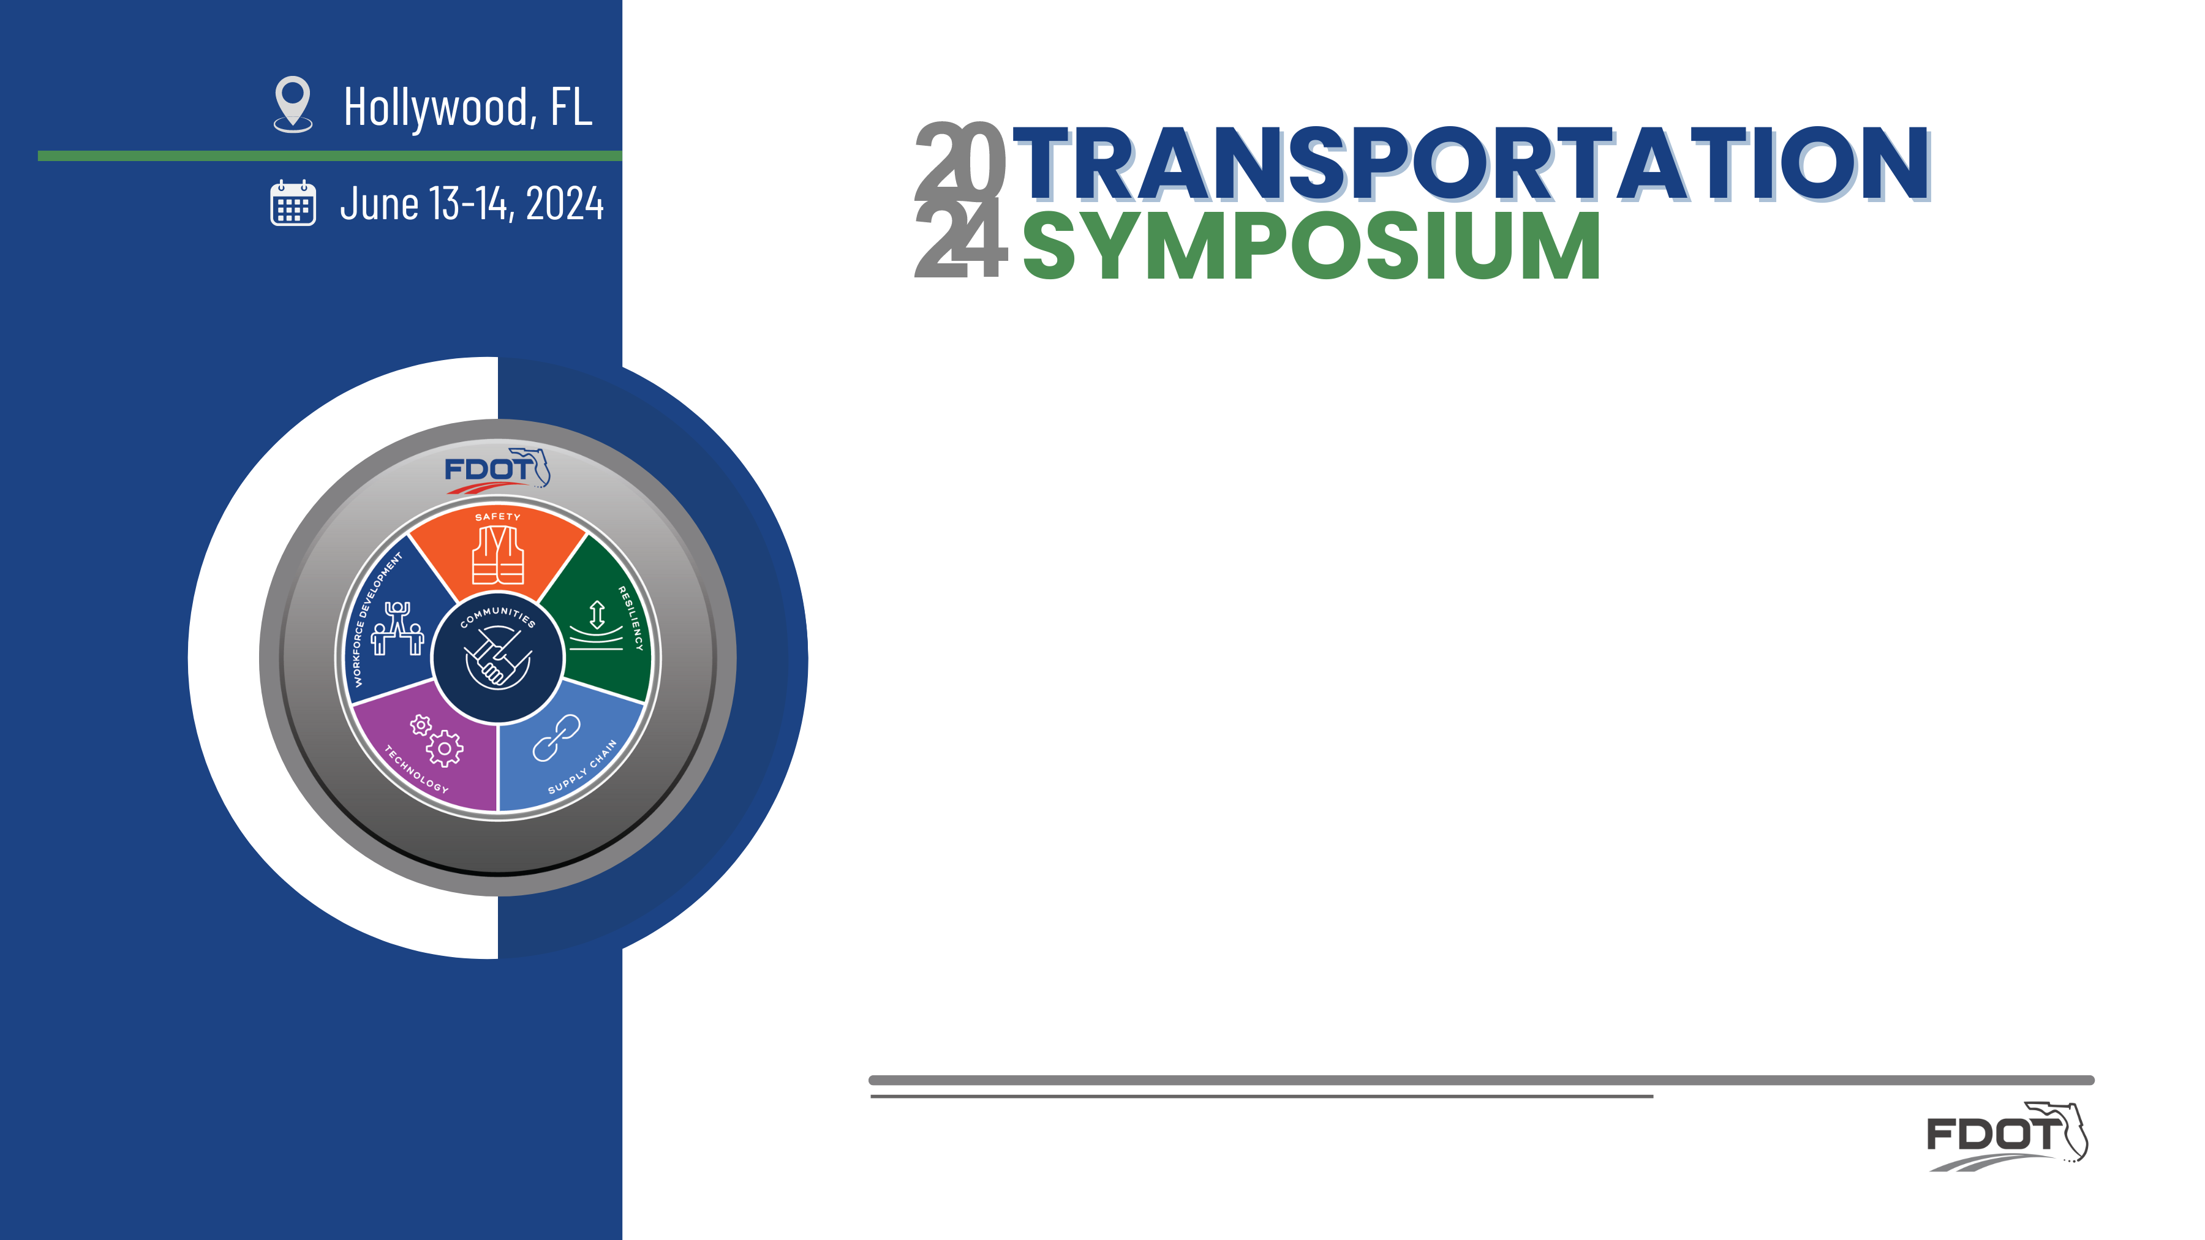
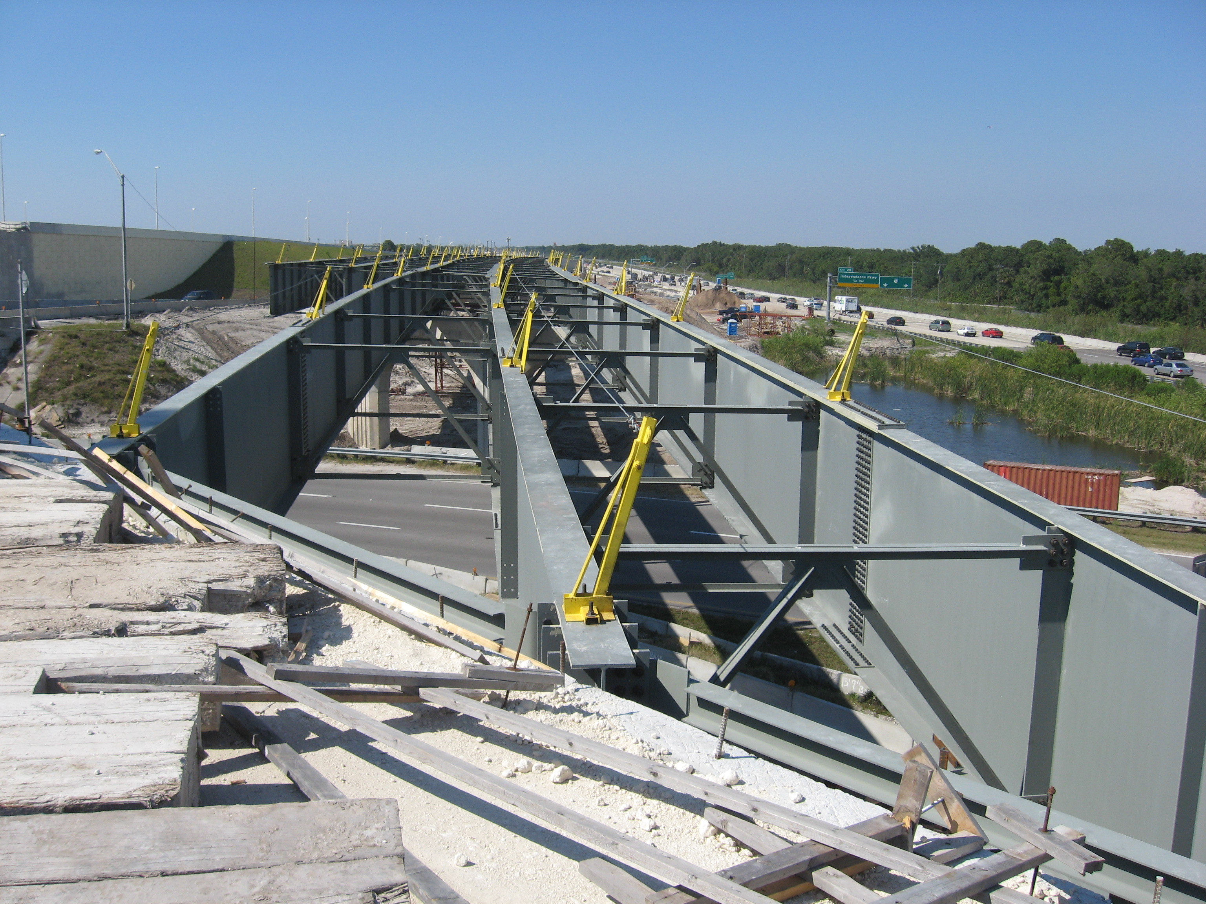
New Criteria for Straight Steel I-Girder (SSI-G) Bridges (aka SDB 24-01)
Dennis Golabek, PE
State Structures Design Office / WSP GEC

Slide 2
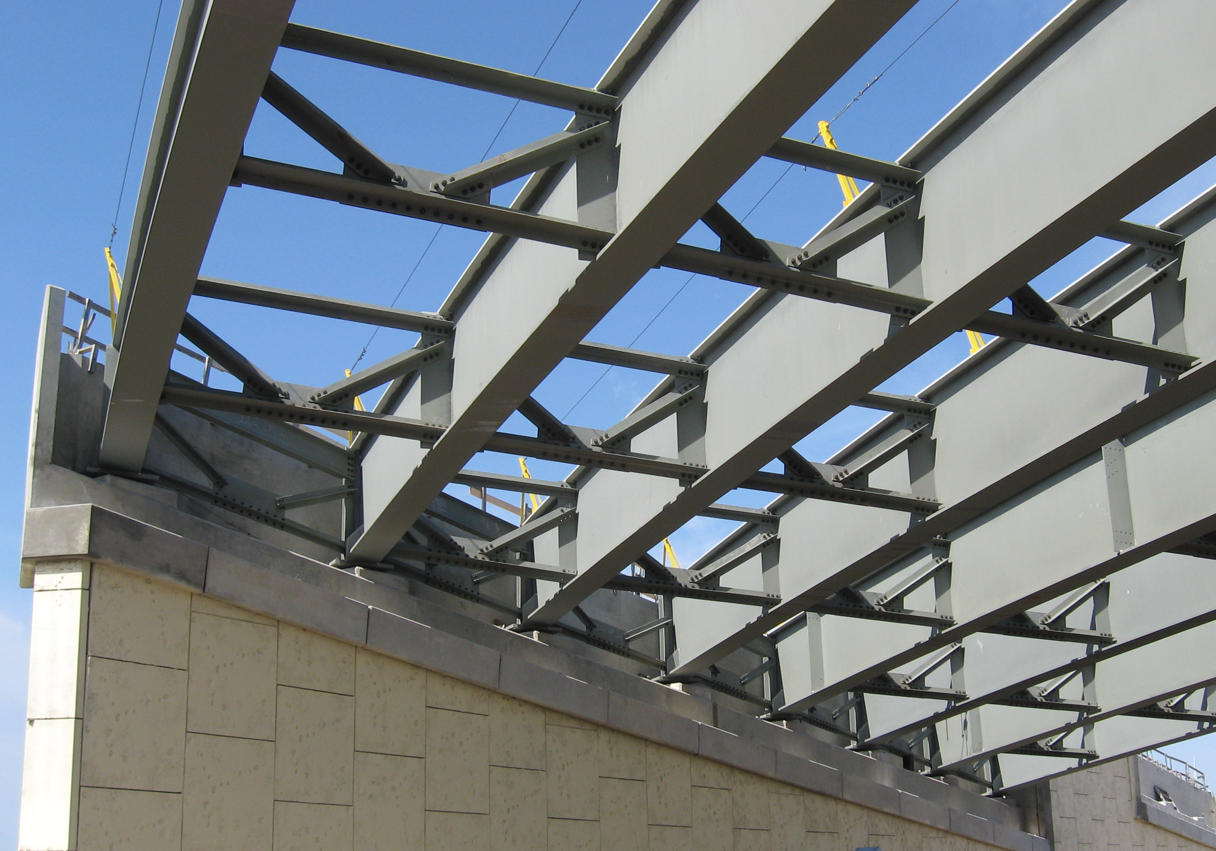

Objective: NEW Criteria - Analysis and Design
Review Past and Current SDGs Criteria
Background
Five Cases
Phase Construction and Widening Rules
Criteria Revisions - Curved Steel I-G and Steel Boxes
Procedure to Calculate the ADTT_{SL}
Straight Steel I-Girder (SSI-G)
SDB 24-01
Released ?
2

Slide 3
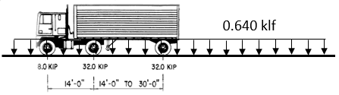
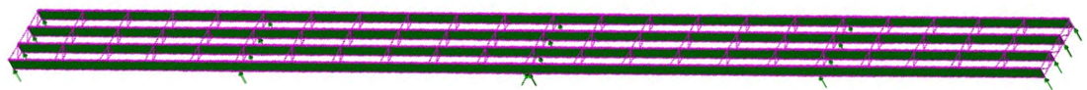
Review Past and Current SDGs Criteria
SDG allows both Approximate and Refined Methods of Analyses (as required).
Historically, the Approximate Method (Line Girder Analysis) has produced efficient and robust designs.
LRFD 4.6.2 Approximate Method of Analysis – allows for high skew angles.
Live load transversely distributed to the single girder by empirical equations
LRFD 4.6.3 Refined Method of Analysis (RMA) - more expensive software and greater Design/LR effort.
Some “design gaps” when using LGA
3

Slide 4
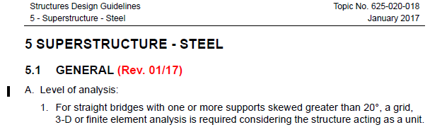
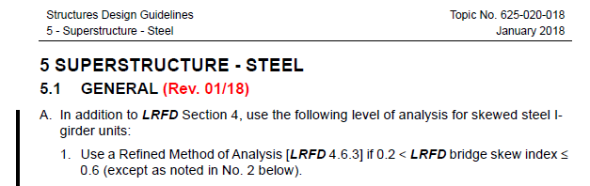
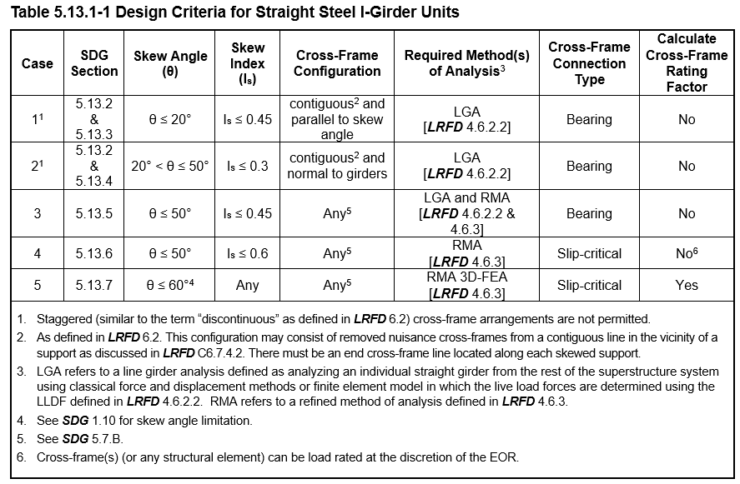
Review Past and Current SDGs Criteria
Method of Analysis determined by:
Skew Angle (θ) Up till 2017
Skew Index (I_{S}) 2018 to Current
θ, I_{S}, & CF-Configuration SDB 24-01
4

Slide 5
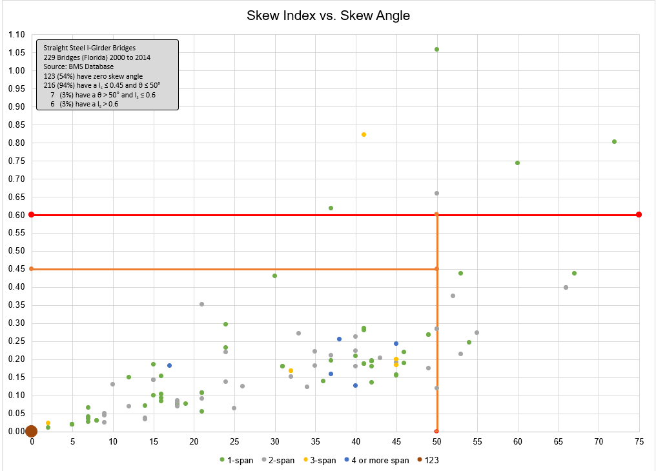
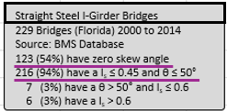
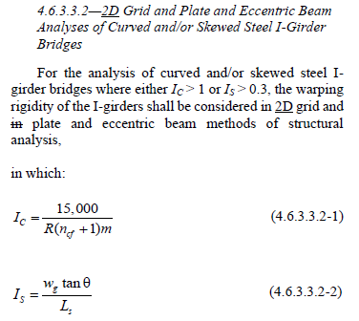
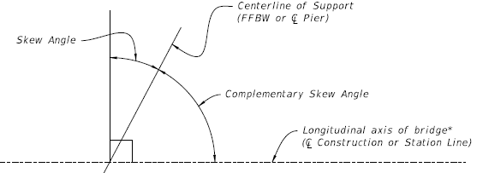
Background: Survey 2000-2014
Skew Index
Skew Angle
5

Slide 6
Background: FDOT Research Reports
FDOT Research Report BE535 (~25 bridges) Established Cases based on skew angles, skew indexes and CF conf.
  Case 1 and 2 can use a LGA and could estimate FLB stresses and cross-frame forces.
FDOT Research Report BEB13 (~25 bridges) Focused on Cases 1 and 2.
FDOT TWO (40 bridges) Focused on Case 2.
Girder Behavior (LGA vs. 3D-FEA) | Cases 1 & 2 Adjustment to LGA
STR I and SER II Bending Moments (Positive and Negative) | No
STR I and SER II Vertical Shear Forces | No
STR I Bearing Reactions for the Exterior Girder (obtuse corner & pier) | Yes, multiplicative factor for Case 2
Fatigue Vertical Shear Force Ranges | Yes, multiplicative factor for Case 2
Fatigue Flexural Stresses for Exterior Girder | Yes, new LLDF equation (FDOT)
Total Dead Load Vertical Displacements | No
Live Load Deflections | Yes, use LLDF for moments
Girder Layovers under the total dead load | Simplified EQN
6

Slide 7
Background: Agenda Item 37
2021 AASHTO BRIDGE COMMITTEE AGENDA ITEM: 37
TECHNICAL COMMITTEE: T-14 / T-5
Commentary EXCERPTS 6.7.4 Diaphragms and Cross-Frames
Refined analysis model for simple bridge geometries is not typically warranted.
NCHRP (2021) bridges with a skew index > 0.3 produced significant live load forces in cross-frames.
ADTT_{SL} > 1,500, engineering judgment should be used.
In Summary -LRFD COMMENTARY states
Do not need to do an RMA if:
Is ≤ 0.3, and ADTT_{SL} < 1500 otherwise ….use Engineering Judgment
SDG 5.13 provides specific requirements for using LGA or RFM
7

Slide 8
Five Cases for SSI-G Units Overview
8

Slide 9
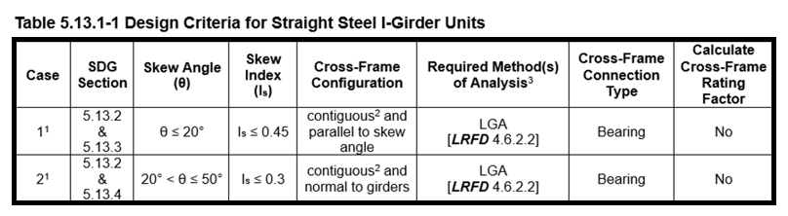
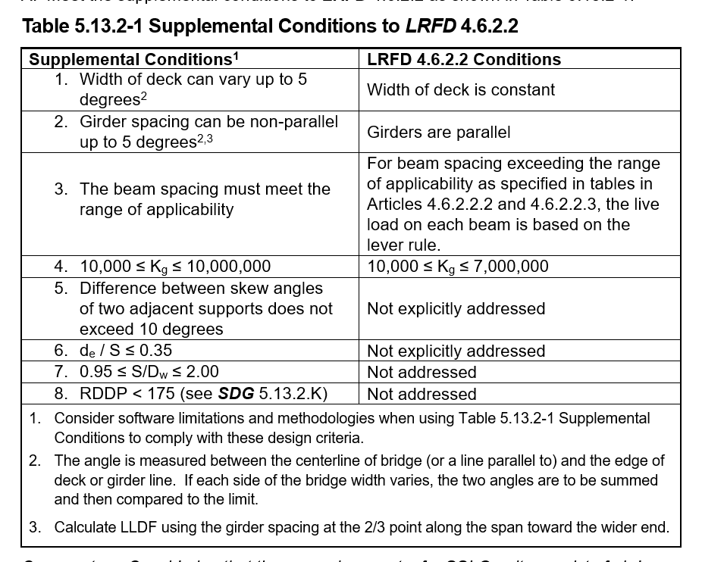


Cases 1 & 2: General Criteria
Case 1
Rigid Differential Deflection Parameter
Case 2
L_{s}=174 ft; θ=20°; I_{s}=0.07
Cross-frames are parallel to skew angle
L_{s}=190 ft; θ=50°; I_{s}=0.30
Cross-frames are normal to girders
If the steel unit does not meet all these criteria
go to Case 3
9

Slide 10
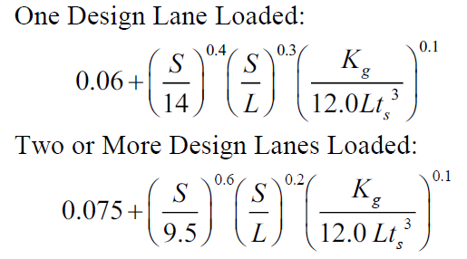
Cases 1 & 2: LGA
Rules (clarifications) for Performing an LGA
Distribute all non-composite dead loads equally to all girders.
Rules for calculating the single weighted average value for K_{g}.
K_{g} = n(I+Ae_{g}²)
Skew Correction Factor: apply to the lever rule and the rigid cross-section method.
e_{g}
Do not use the reduction factor for moment LLDF.
Optional live load deflection criteria, calculate using the moment LLDF.
All girders in the unit must be the same.
10

Slide 11
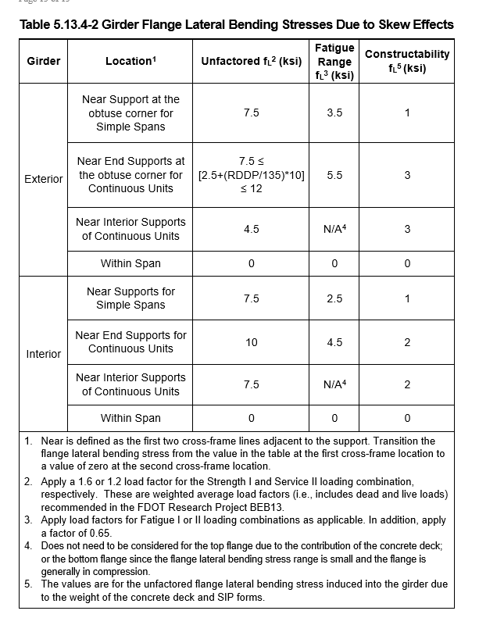
Cases 1 & 2: Flange Lateral Bending
Girder Design Checks (Case 2) for:
Case 1 FLB = 0
Strength I (1.6x) and Service II (1.2x)
Fatigue I (or II) (need to factor and apply 0.65x)
Constructability
Exterior
Interior
Full FLB
“0” FLB
11

Slide 12
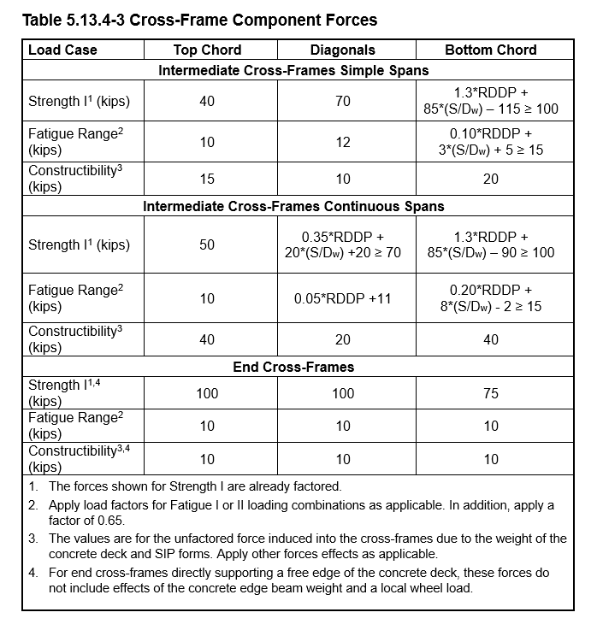
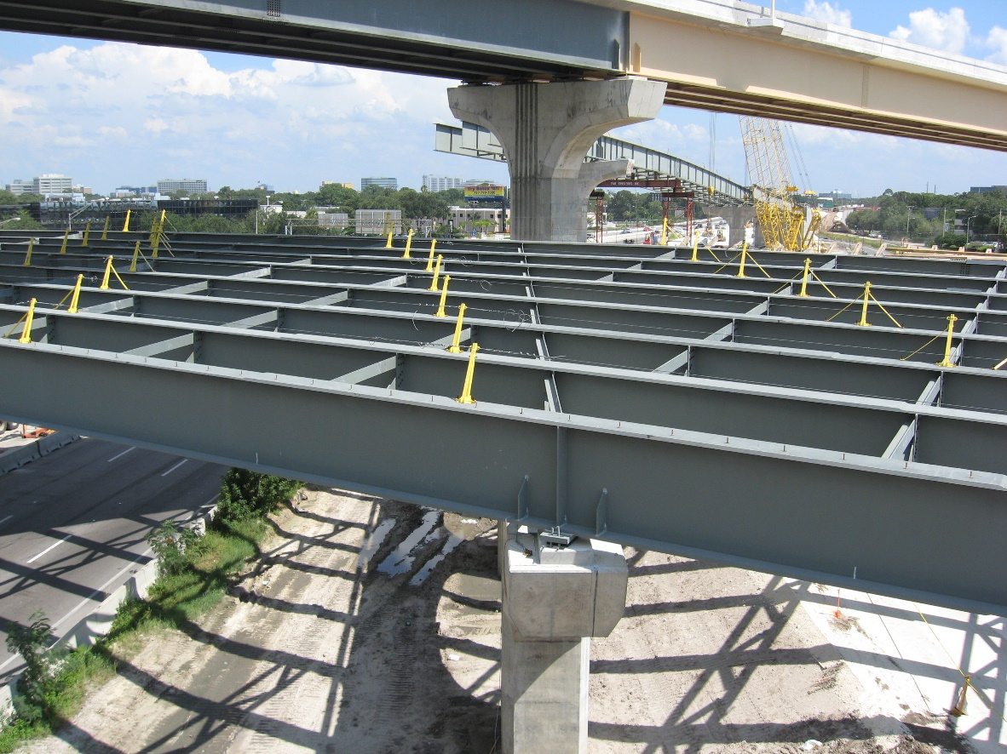
Cases 1 & 2: Cross-frame Forces
For intermediate cross-frames, use only load combinations for:
Table 5.13.3-1 Case 1
Strength I
Fatigue I or II (NEW SDG 2.12.3 for ADTT_{SL})
Constructability
Use “K” frames for intermediate cross-frames as shown in SDM Figure 16.7-1.
Evenly space cross-frames, with a spacing not to exceed 30‑feet.
12

Slide 13
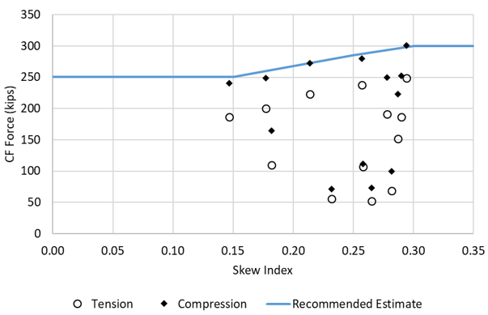
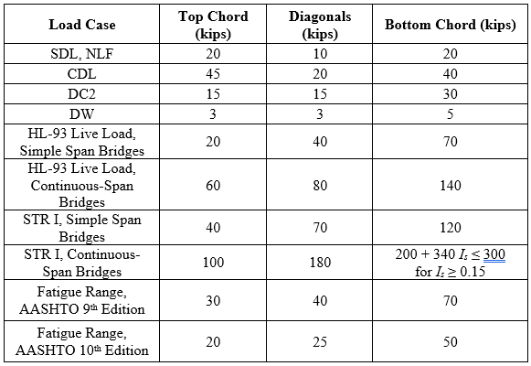
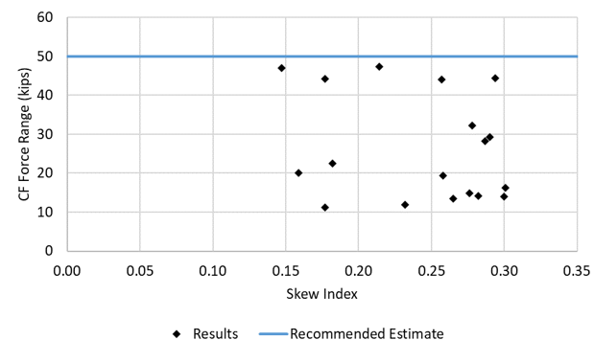
Cases 1 & 2: RDDP
Rigid Differential Deflection Parameter
BEB13 Figure 121. Maximum STR I forces in bottom chords of intermediate cross frames in continuous‑span Category 2C bridges
BEB13 Table 47. Recommended force estimates for intermediate cross frames in Category 2C bridges
BEB13 Figure 133. Maximum fatigue force ranges, AASHTO 10th edition, in bottom chords of intermediate cross frames in Category 2C bridges
13

Slide 14
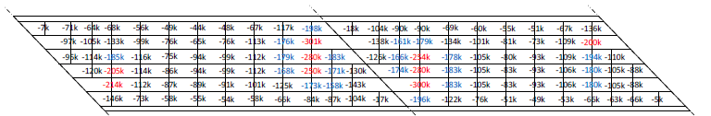
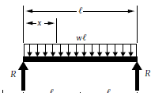

Cases 1 & 2: RDDP
θ
x
STR I Compression Forces in Bottom Chords (Bridge 2C2-46) Figure 125 BEB13
“Δ_{x}”
“0”
“Δ_{x}”
“0”
w_{g}
“0”
“Δ_{x}”
“0”
“Δ_{x}”
Δ_{x} = w * [x(L³-2Lx²+x³) / 24EI]
x = w_{g} * tan θ
L = maximum span length in the unit
K_{g} = 24EI (LRFD longitudinal stiffness parameter)
Simple Beam Formula
Define: Differential Deflection Parameter
DDP = x(L³-2Lx²+x³)/K_{g}
14

Slide 15
Cases 1 & 2: RDDP
STR I Bottom Chord Forces (k)
15

Slide 16
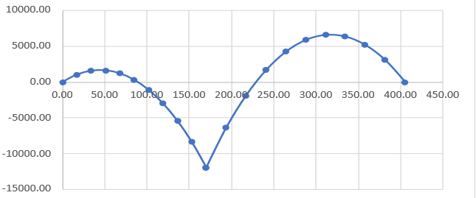
Cases 1 & 2: RDDP
By trial and error, added two other variables
(L_{eff}/100) * cos θ * DDP = RDDP
Rigid Differential Deflection Parameter
L_{eff} = Effective Span Length
For Simple spans, L_{eff} = span length
L_{eff1}
L_{eff2}
For continuous spans
(non-composite dead load contraflexure - NCDLC):
distance between a simple support and a NCDLC, or
between points of NCDLC.
For Two-span continuous, use maximum.
For three or more continuous spans, use the largest of:
effective span length of the maximum interior span,
50% of the maximum interior span length, or
65% of the effective length of the maximum end span.
16

Slide 17
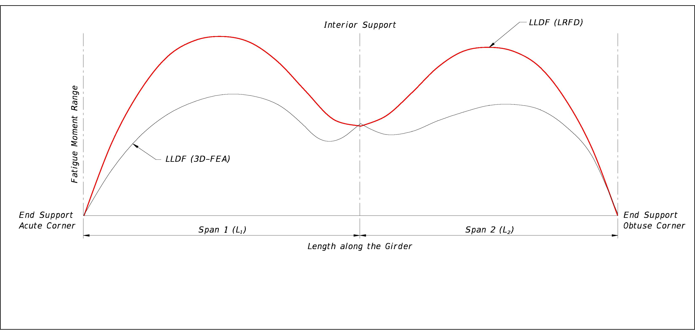
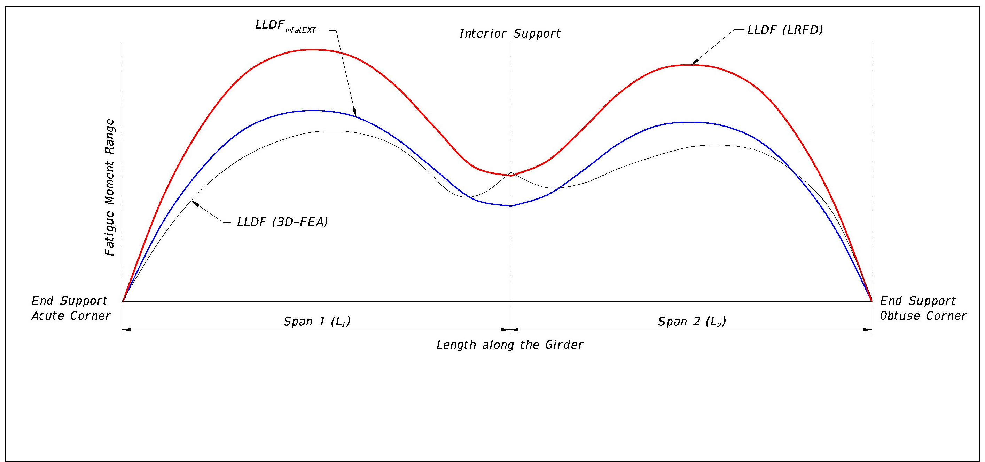
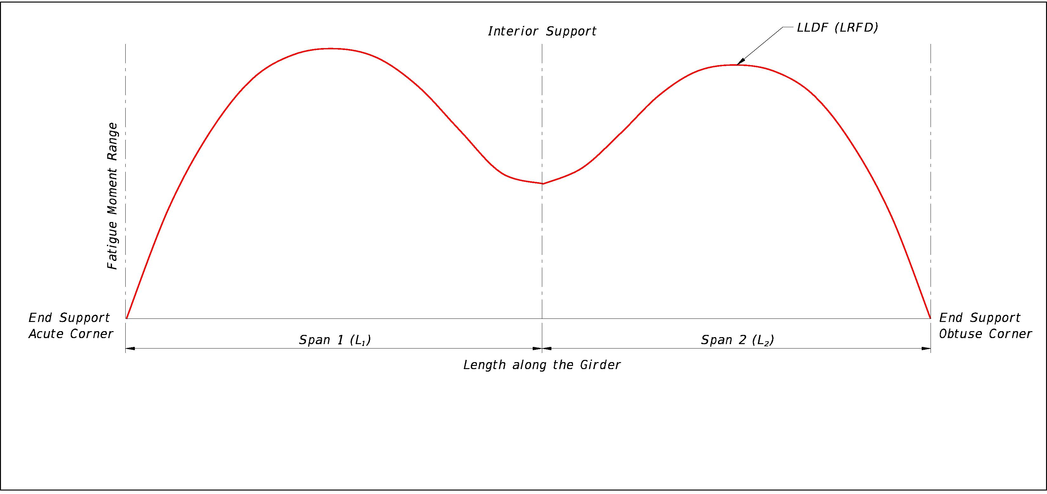
Cases 1 & 2: Fatigue Moment Range LLDF
One standard deviation above the average positive fatigue moment LLDFs determined using a 3D-FEA.
17

Slide 18
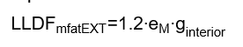
Cases 1 & 2: Fatigue Moment Range LLDF
g_{interior} is the “One Design Lane Loaded” equation from LRFD Table 4.6.2.2.2b-1.
  Do not divide by 1.2 per LRFD 3.6.1.1.2.
e_{M} is the same as “e” per LRFD Table 4.6.2.2.2d-1 with the value not to exceed 1.0.
Applies to:
Case 1 continuous spans and Case 2.
4 or more girders.
All spans in Unit have lengths ≥ 150’.
Girder spacing ≥ 9’.
d_{e}/S ≤ 0.26
18

Slide 19
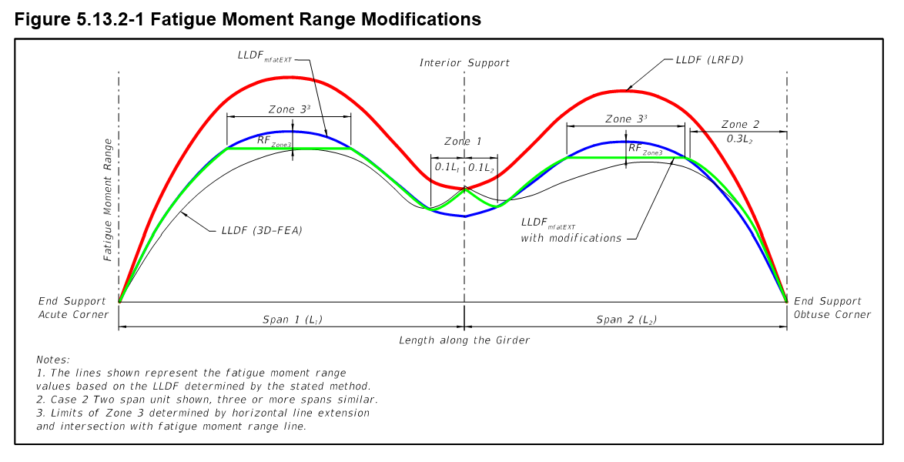
Cases 1 & 2: Fatigue Moment Range Modifications
Zone 1: In the vicinity of the Support
Use the LRFD LLDF at the support
Use LLDF_{mfatExt} at the adjacent 10th point on each side of the support
Transition linear interpolate between points
19

Slide 20
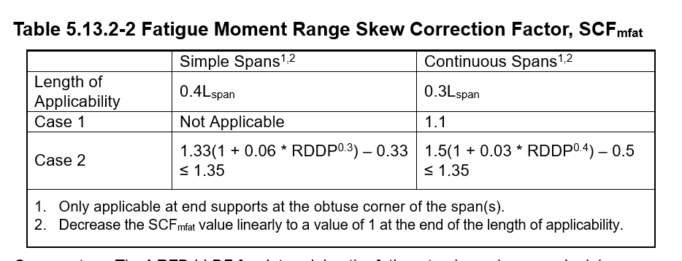
Cases 1 & 2: Fatigue Moment Range Modifications
Zone 2: In the vicinity of the End Support at the obtuse corner
Applies to the last 30% of the span length
Calculate SCR at the tenth points
20

Slide 21
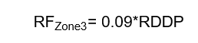
Cases 1 & 2: Fatigue Moment Range Modifications
Zone 3: In the vicinity of positive moment areas
Calculate the reduction factor, RF_{Zone3}
Apply it to the maximum stress range
Extend this Reduced maximum value as a horizontal line
21

Slide 22
Cases 1 & 2: Summary
Girder Behavior Modifications - Case 2
Flange Lateral Bending stresses
NEW Fatigue Moment LLDF for the Exterior Girder
Cross-frame loads
LGA - Required
22

Slide 23
Case 3: LGA & RMA
Criteria
Supplemental Conditions 5, 6, 7 and 8 are not applicable.
Use RMA for other force effects.
Cross-frames are secondary members with bearing connections.
Use LGA - ensures girder capacity is sufficient without relying on the cross-frames to transfer gravity loads.
23

Slide 24
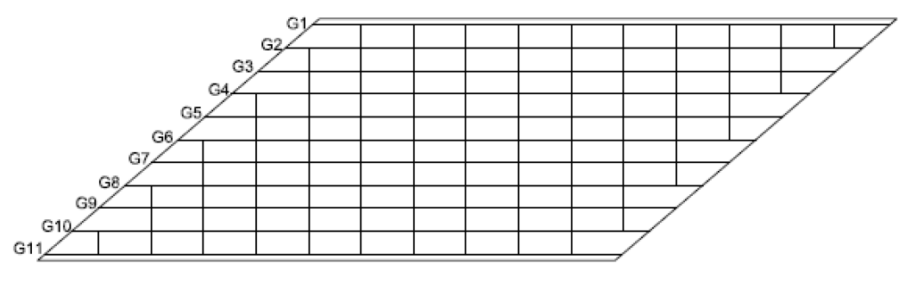
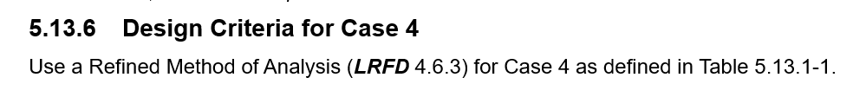
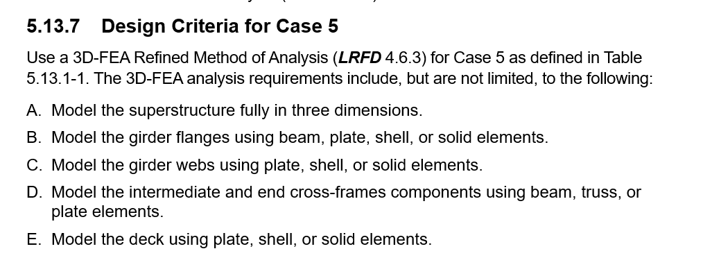
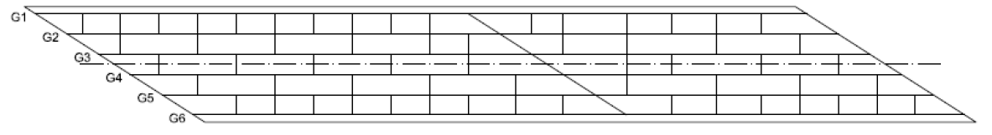
Cases 4 & 5: RMA (Case 5 3D-FEA)
Bridge 1 (Ls = 208 ft; wg = 82.5 ft; θ = 49.4°, 49.4°; Is = 0.46) BE535
Bridge 10 (Ls = 202 ft, 158 ft; wg = 57.5 ft; θ = 57.2°, 57.2°, 57.2°; Is = 0.47) BE535
24

Slide 25
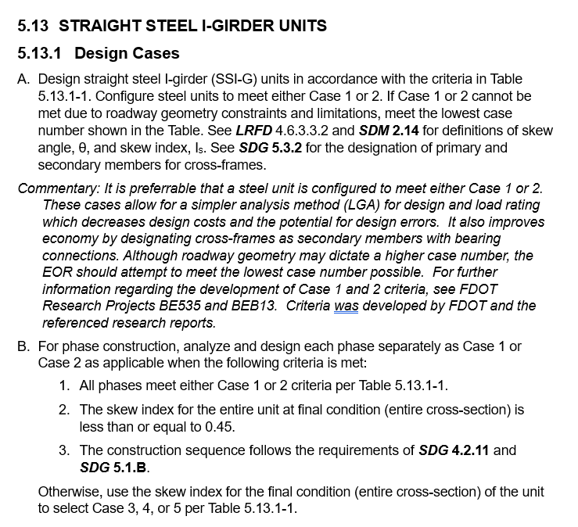
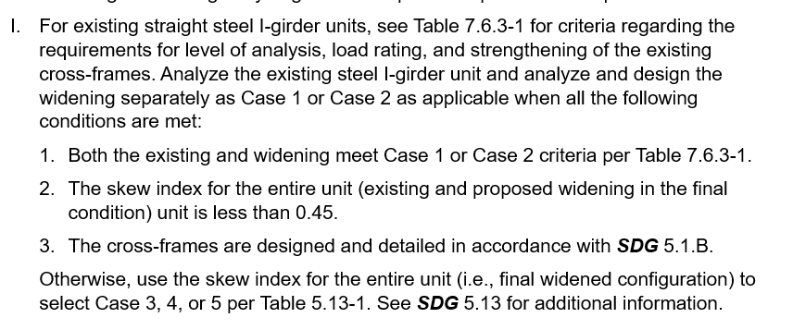
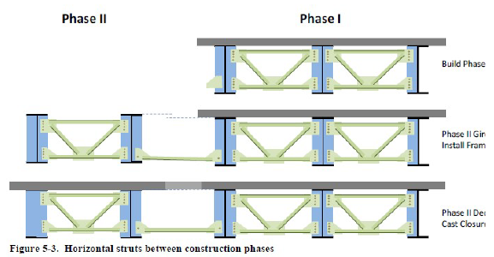
Phase Construction and Widening Rules:
Closure pour required
Widening Existing
Widening Existing
Final Condition
25

Slide 26
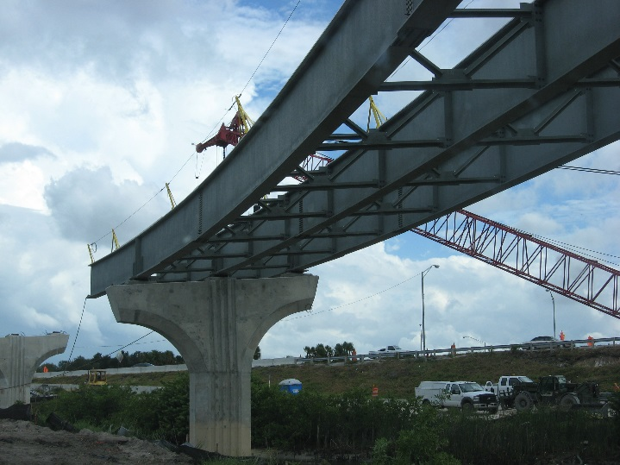
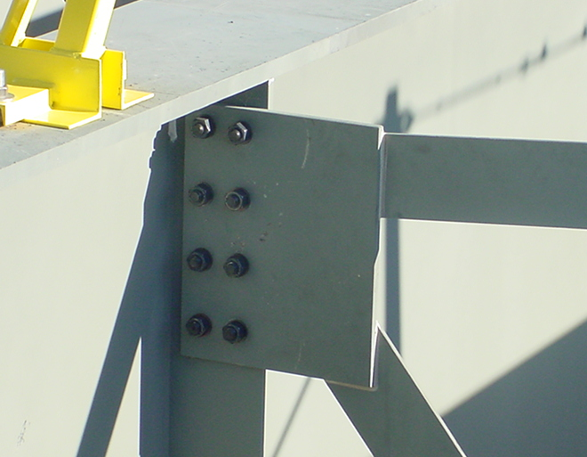
Criteria Revisions – Also for Curved I-G and Box
AASHTO Approved Ballots Upcoming 10th Ed.
Primary and Secondary Members
Bolted Connections
  Bearing Type Connections (SM Only)
  HS Bolts – Threads Excluded for CF
Load Rating requirements for Cross-frames
26

Slide 27
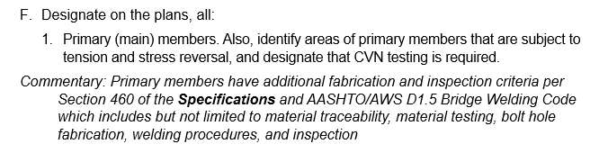
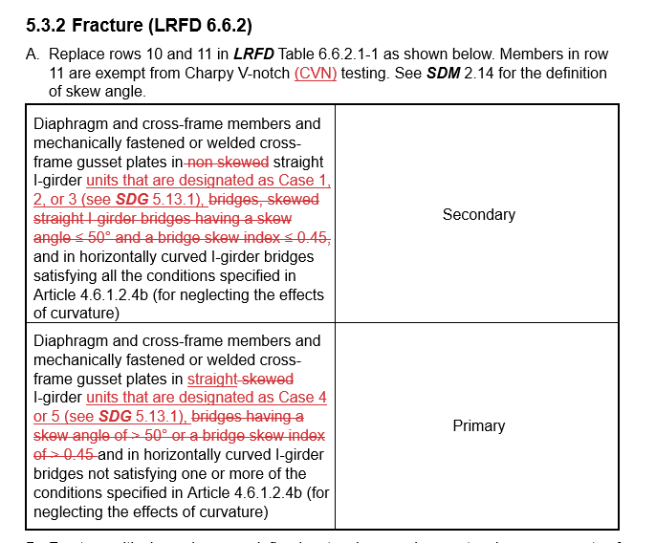
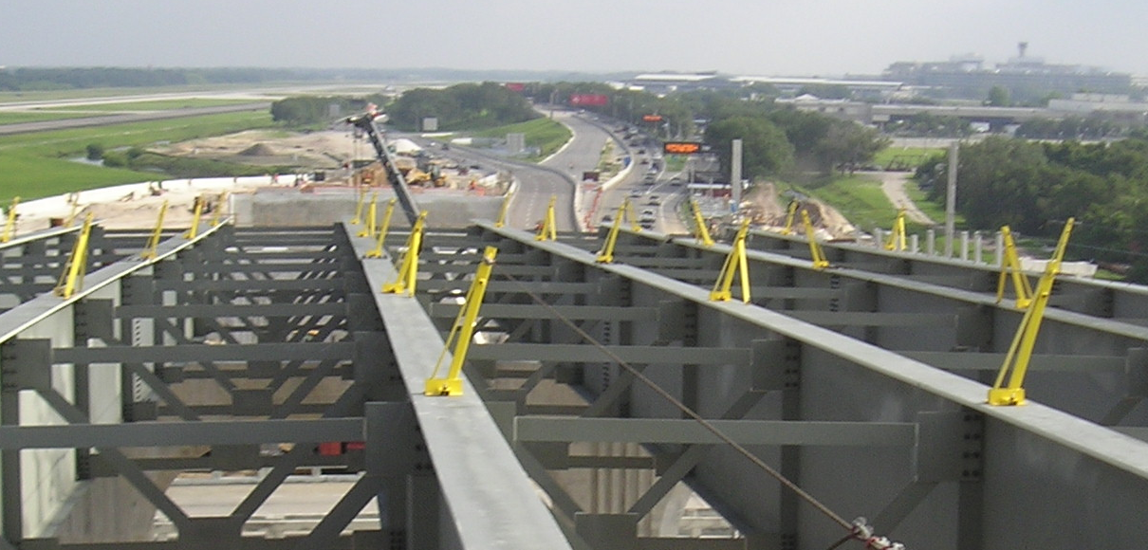
Criteria Revisions – Also for Curved I-G and Box
Primary and Secondary Members
Row 10
Row 11
27

Slide 28
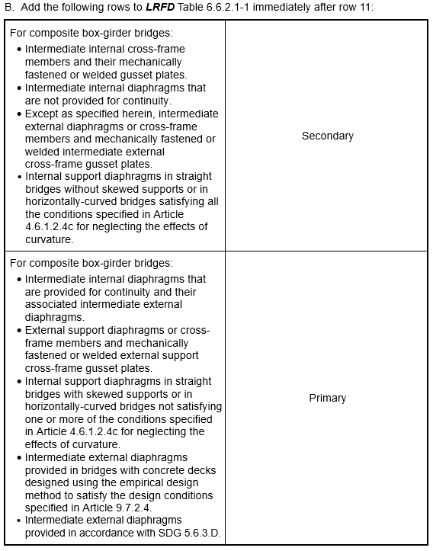
Criteria Revisions – Also for Curved I-G and Box
Primary and Secondary Members
Steel Box - added information from the 10th Ed.
FDOT specific: added reference to SDG 5.6.3.D
28

Slide 29
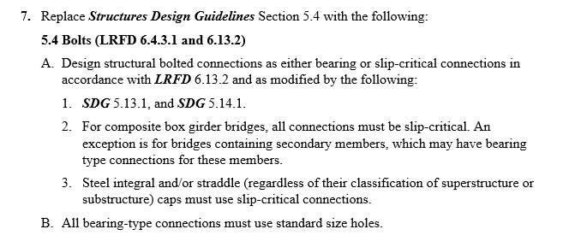
Criteria Revisions – Also for Curved I-G and Box
Bearing Type Connections (Secondary Members)
SDM 16 Revised Several Figures
SDM 5.3.E (Typical Steel GN)
Re-formatted several notes regarding bolted connections
Added plan notes regarding bearing connections
  Bolts need to be tightened per Section 460-5
  Faying surface to be prepared to SSPC SP-10
Note K:
Specify the connection type (i.e., slip-critical or bearing).
Specify if threads are excluded from the shear plane (see SDG 5.11.C).
Note L:
Specify as primary or secondary member.
29

Slide 30
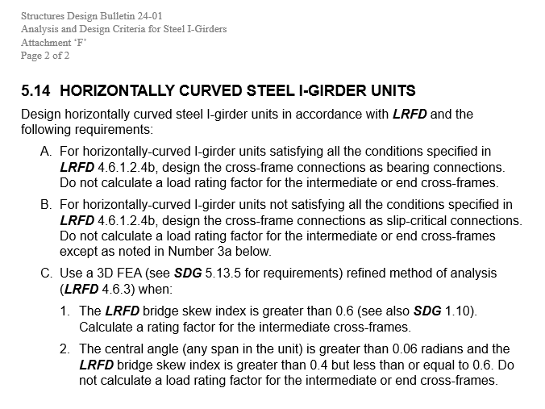
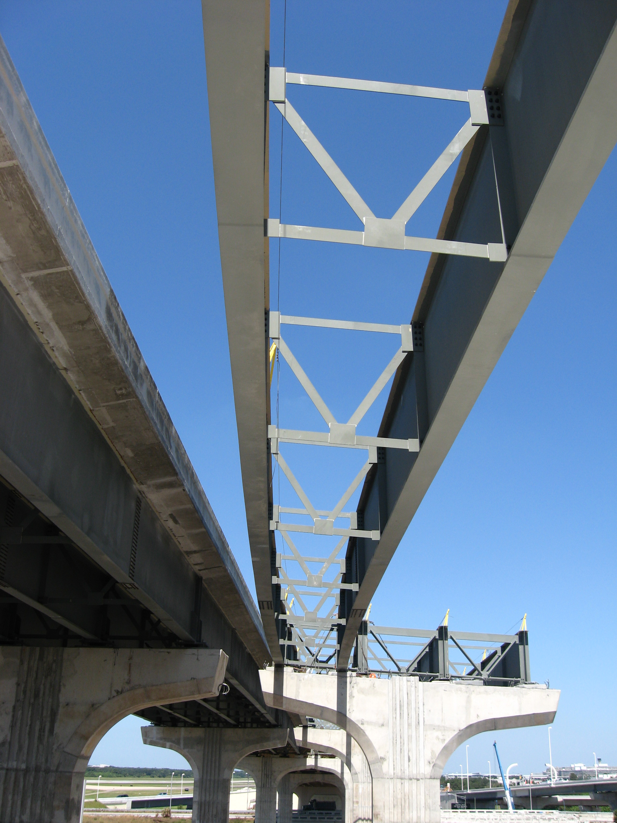
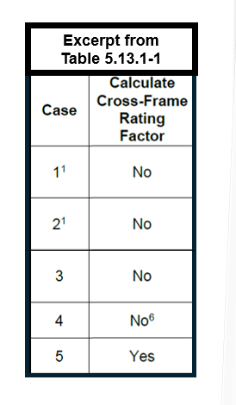
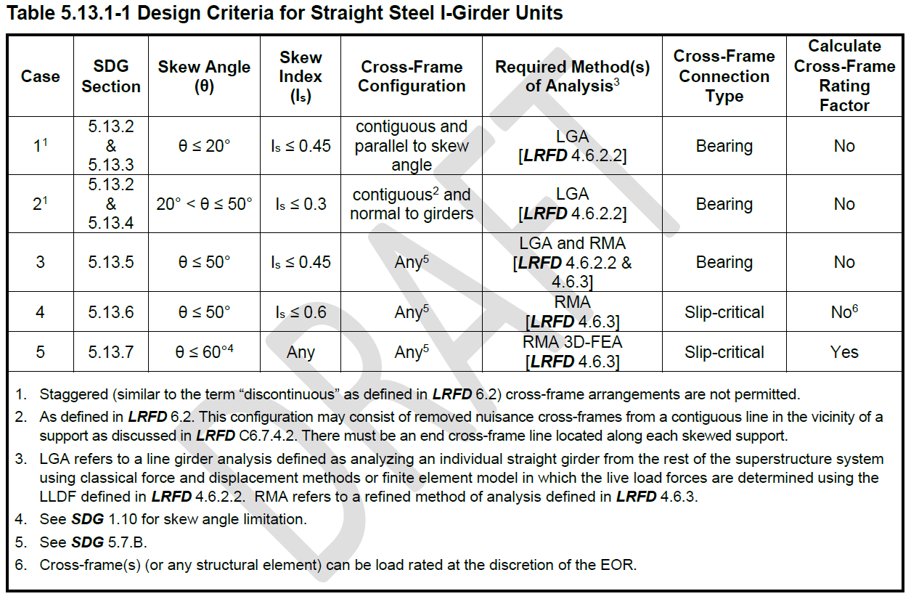
Criteria Revisions – Also for Curved I-G and Box
Load Rating of Cross-frames
Excerpt from
Table 5.13.1-1
30

Slide 31
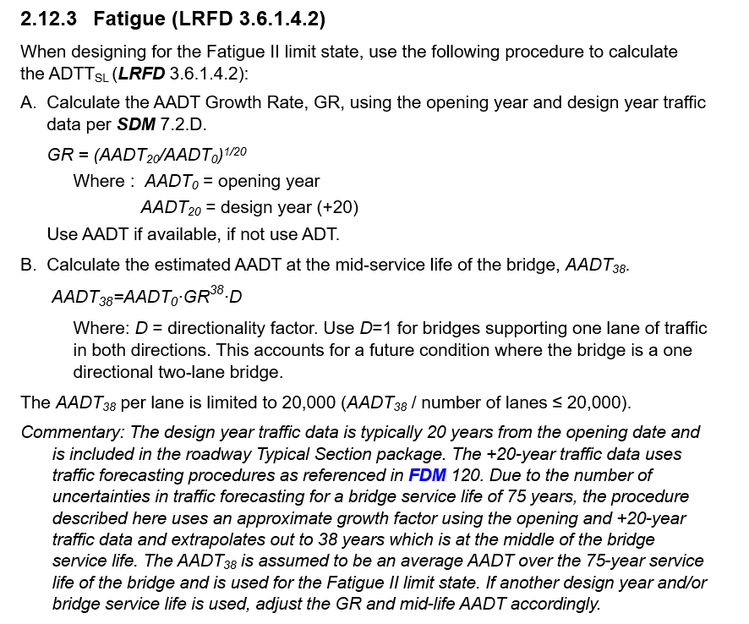



ADTT_{SL}
ADTT_{SL} is used to determine if a fatigue detail category is Fatigue I or II
What we have: AADT-opening year, and the design year AADT data which is typically 20 years from the opening date (roadway Typical Section package) (uses traffic forecasting procedures as referenced in FDM 120)
GR
AADT₃₈
ADTT_{SL}
Number of Cycles
IF bridge life is 75 years, what AADT-year should the ADTT_{SL} be based on?
AADT₃₈
Check for Fatigue I or II
Fatigue I –
Fatigue II –
AADT₃₈ is assumed to be an average AADT over the 75-year life of the bridge
If another design year and/or bridge life is used, adjust the GR and mid-life AADT accordingly.
31

Slide 32
Wrap-Up
θ , I_{s} & CF arrangement defines Cases for SSI-G bridges
5 Cases: Required Method of Analysis, CF connection type, and CF LR
  Cases 1 & 2 LGA with tabulated FLB stresses and CF loads
  Case 3 LGA supplemented with RMA
  Case 4 & 5 RMA
Phase Construction and Widening Rules
Criteria Revisions – Also for Curved Steel I-G and Steel Boxes
  Primary and Secondary Members
  Bearing Connections for Secondary Members
  Load Rating of Cross-frames
Design Example
ADTT_{SL} (Growth factor, AADT₃₈)
32

Slide 33

Quiz:
1. True or False. You can always use a 3D-FEM for the method of analysis of an SSI-G unit.
For calculating the ADTT(SL) use which of the following:
  +20-year AADT
  +38-year AADT
  +75-year AADT
2. True or False. HS Bolted connection in a primary member may be designed for only bearing if you meet the criteria in SDB 24-01.
3. True or False. For a SSSI-G unit with a skew index > 0.6, you must use a full 3D-FEA.
RDDP stands for:
  Remote Direct Data Placement
  Rigid Differential Deflection Parameter
  Required Driven Development Process
4. True or False. Cross-frames are not required to be load rated for SSSI-G units meeting any Case 1 to 4.
33

Slide 34



Contact Us
Vickie Young, P.E.
Assistant State Structures Design Engineer
(850) 414-4301
Vickie.Young@dot.state.fl.us
34

Slide 35

FDOT Safety Message
34

Slide 36


Slide 37

Questions:

