Slide 1
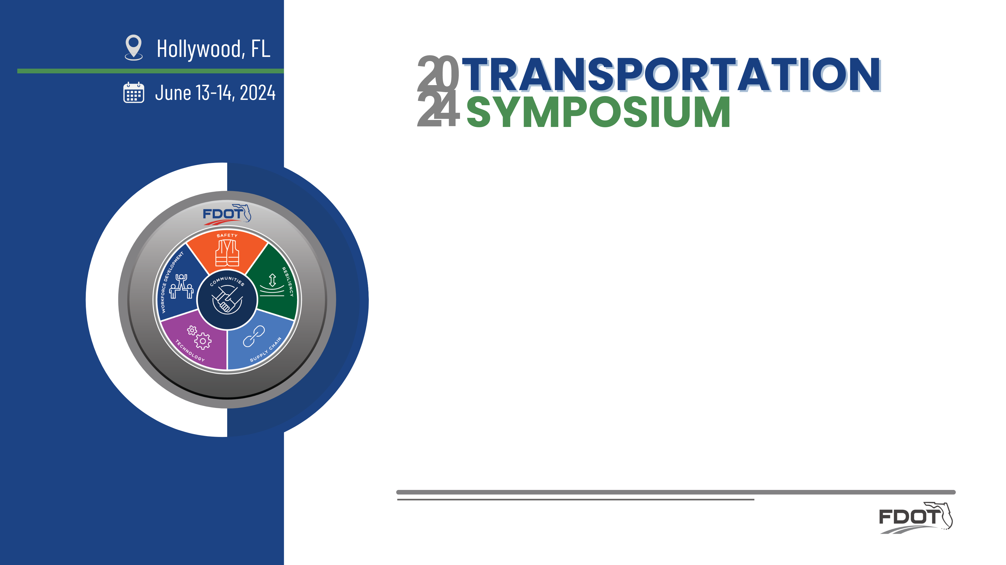

Design Lessons Learned
Leslie Wetherell, PE
FDOT, District 4

Slide 2
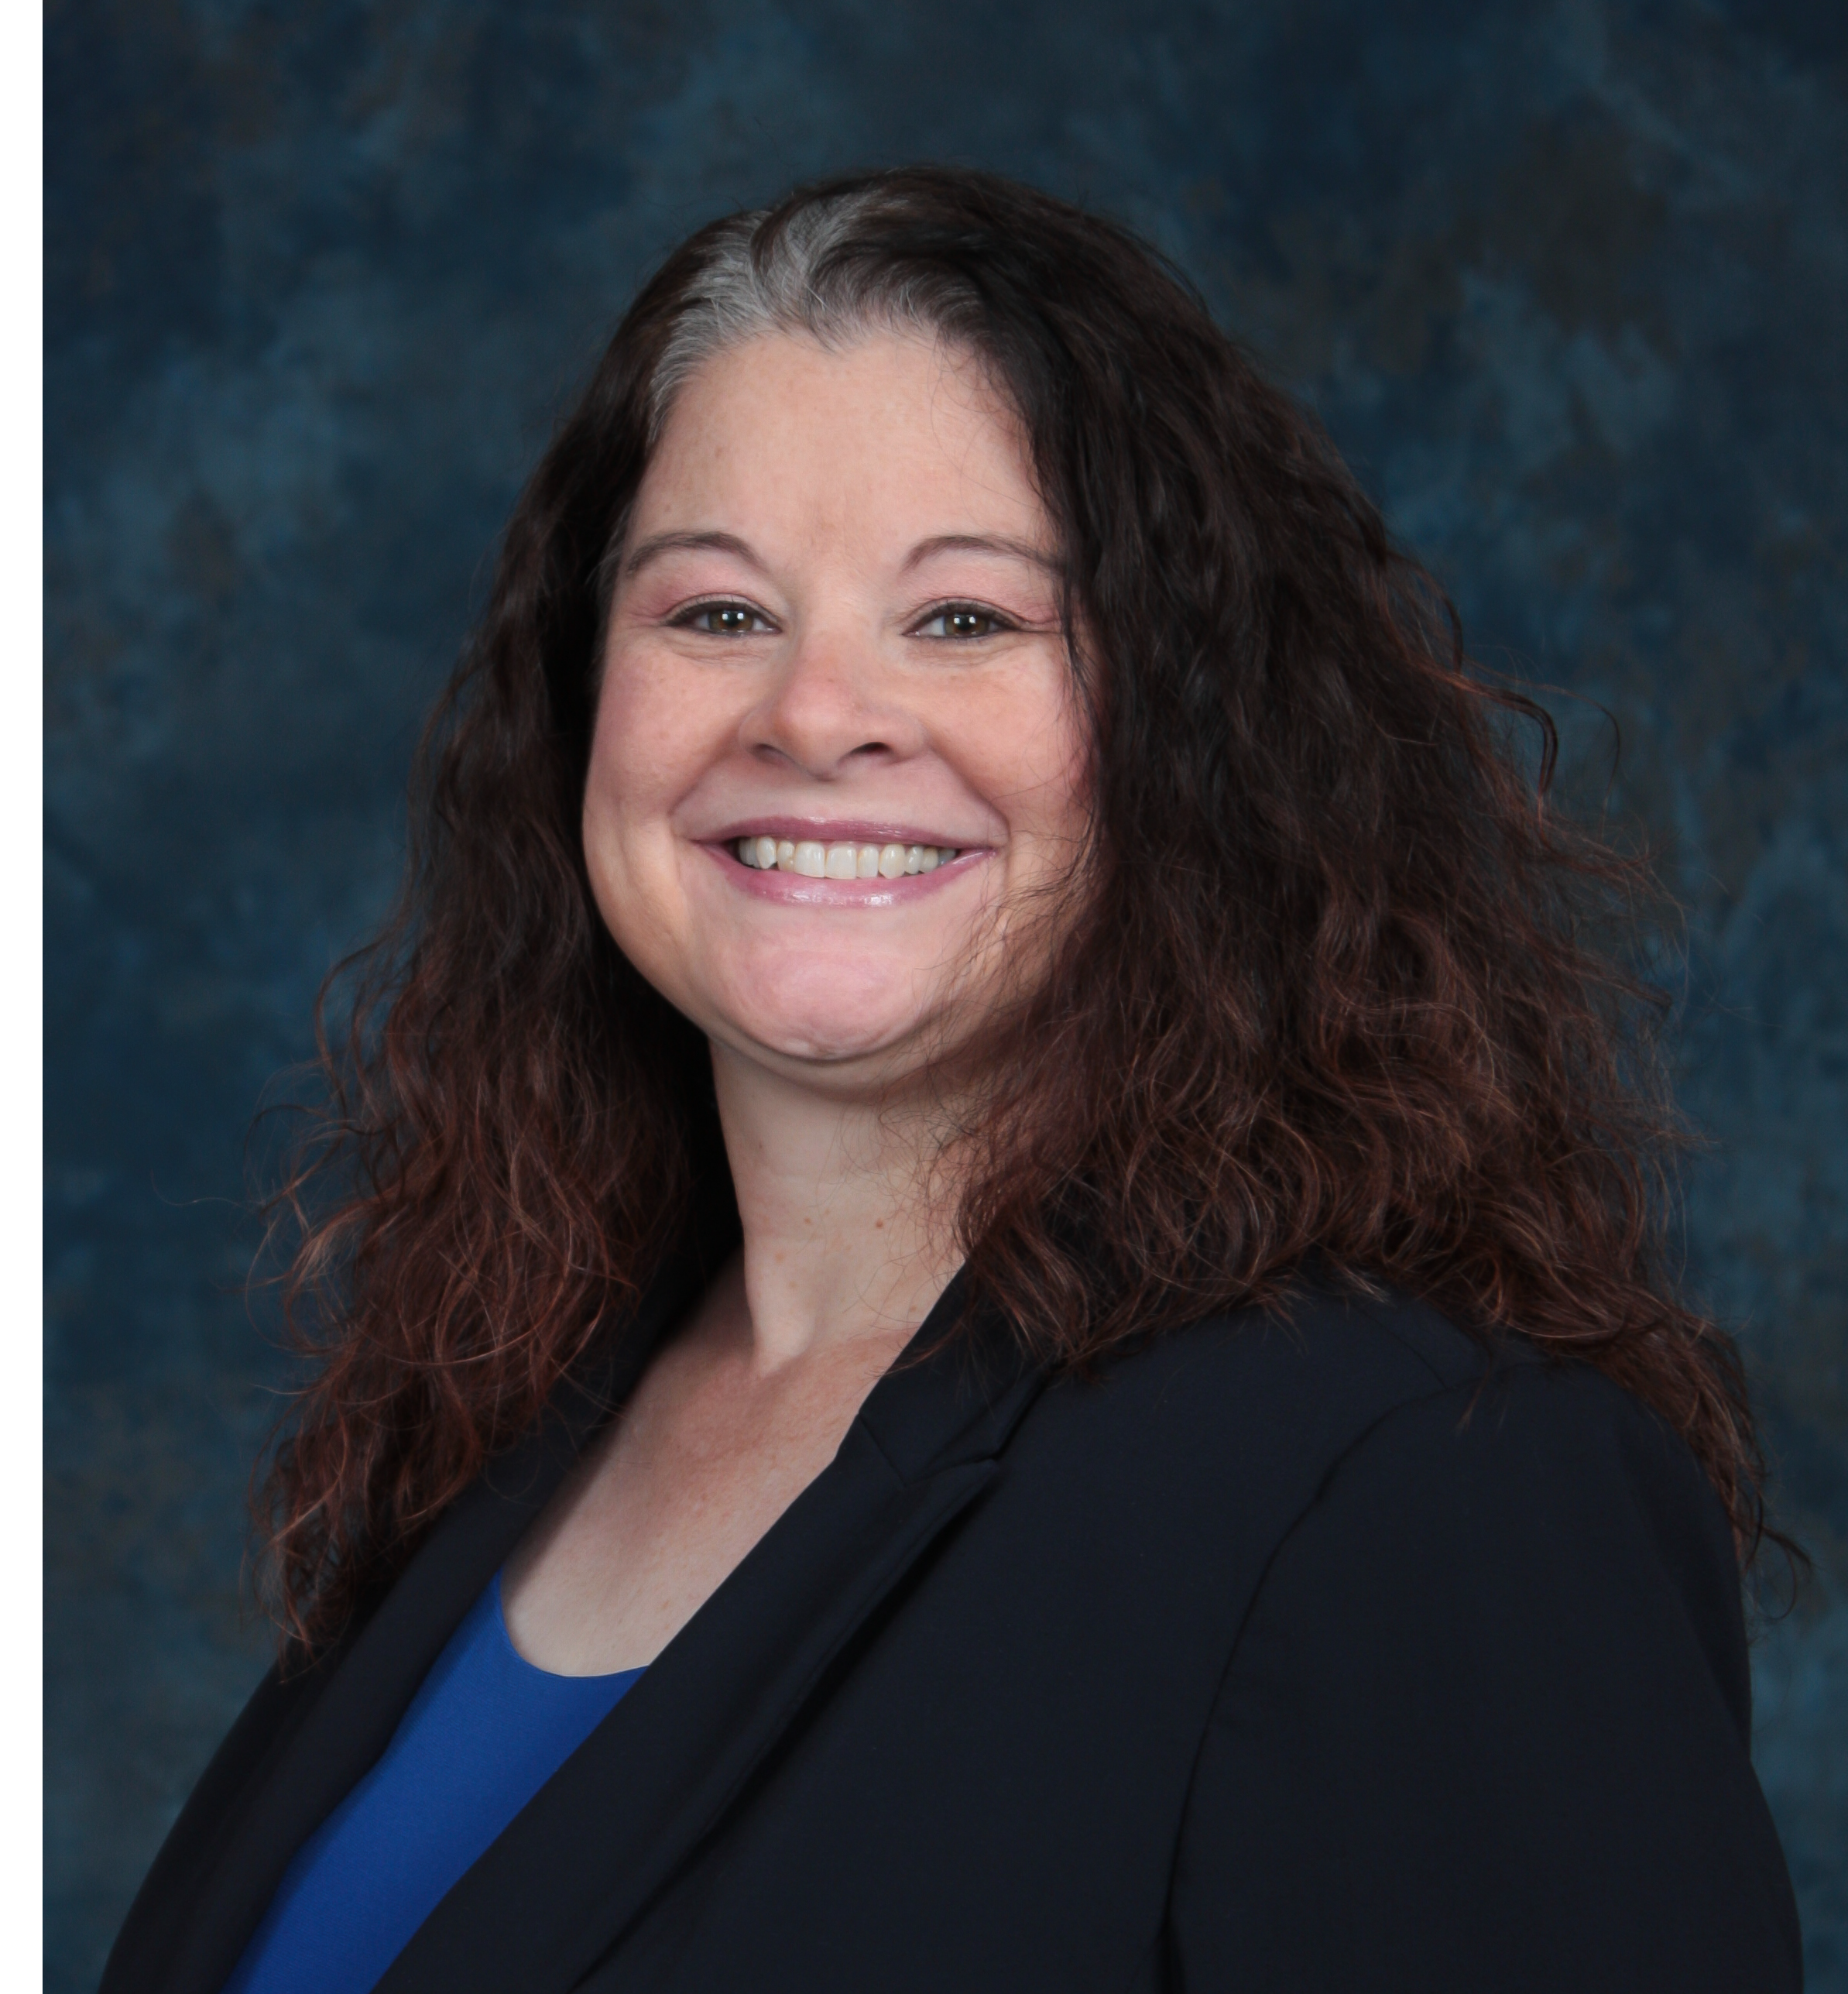
Presenter Info
Leslie Wetherell, P.E.
  Project Manager
  FDOT Design
  District 4
  3400 W Commercial Blvd
  Ft Lauderdale, FL 33309
  (954) 777-4438
  leslie.Wetherell@dot.state.fl.us

Slide 3
Objectives
Lessons Learned
Tips and Tricks
How can we continue to improve based on past experiences?

Slide 4
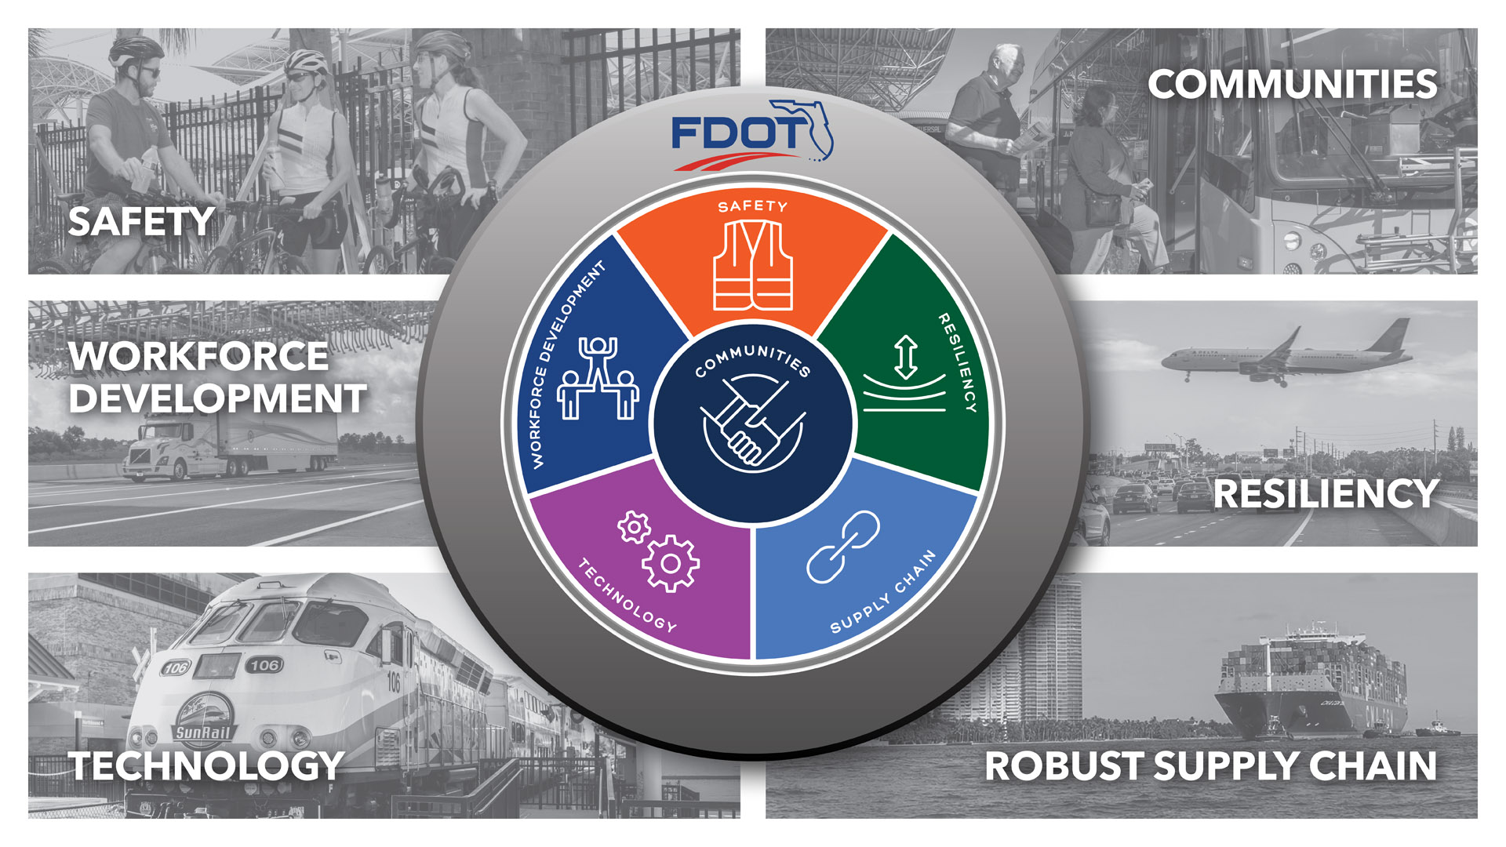
FDOT COMPASS

Slide 5
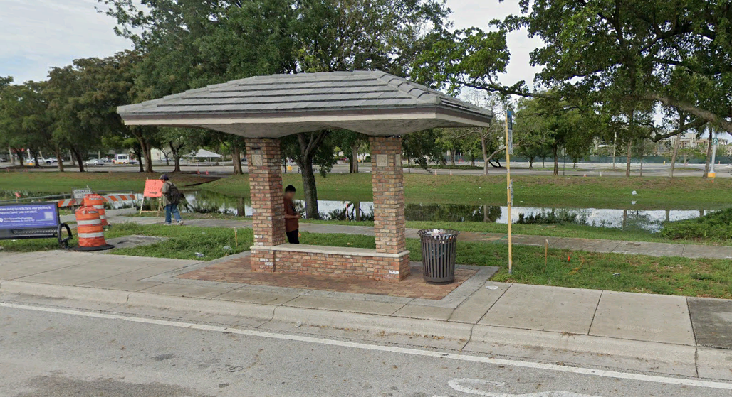
Lessons Learned – Bus Shelters
Bus Shelters
Check with Transit Agency
FTA

Slide 6
Lessons Learned – Proprietary Products
Proprietary Products
Lighting
Signal
ITS
Irrigation
Other
BABA

Slide 7
Lessons Learned – Proprietary Products
Proprietary Products (PPC)
Need
Form 110 (located in FDM)
Letter from Agency
Specifications
Must be BABA (Build America, Buy America Act) compliant
Plans notes

Slide 8
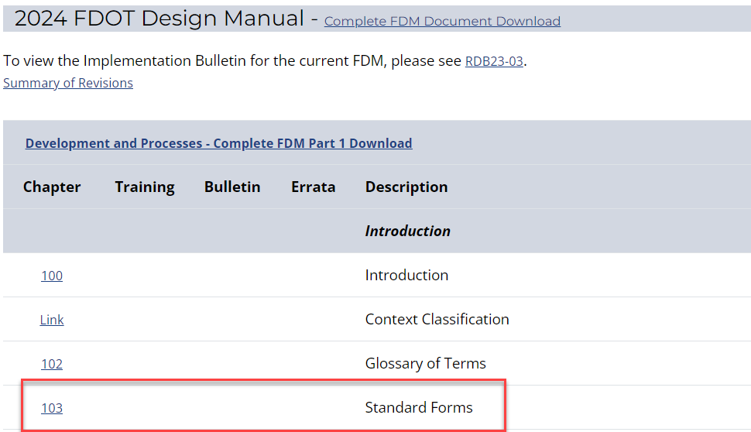
Lessons Learned – Proprietary Products
Form 110 (located in FDM)

Slide 9
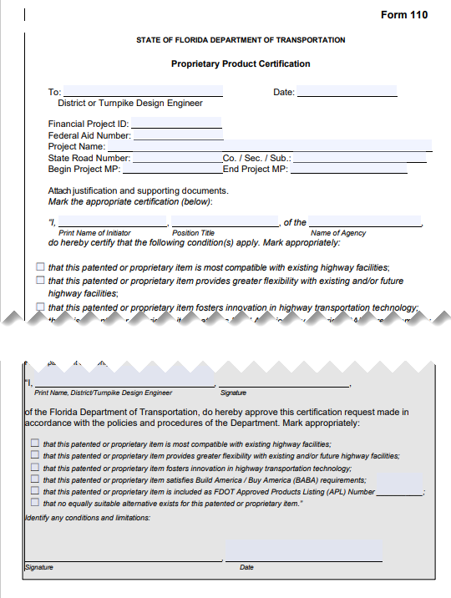
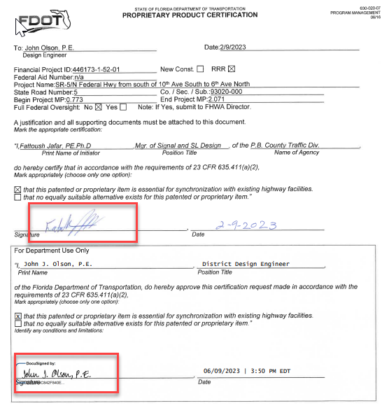
Lessons Learned – Proprietary Products
Form 110 (located in FDM)

Slide 10
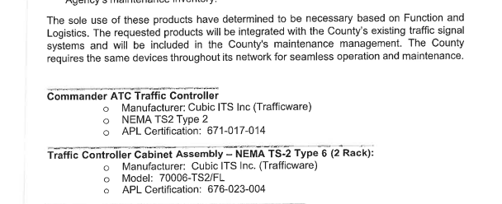
Lessons Learned – Proprietary Products
Excerpt of letter from agency (or FDOT)
Good example

Slide 11
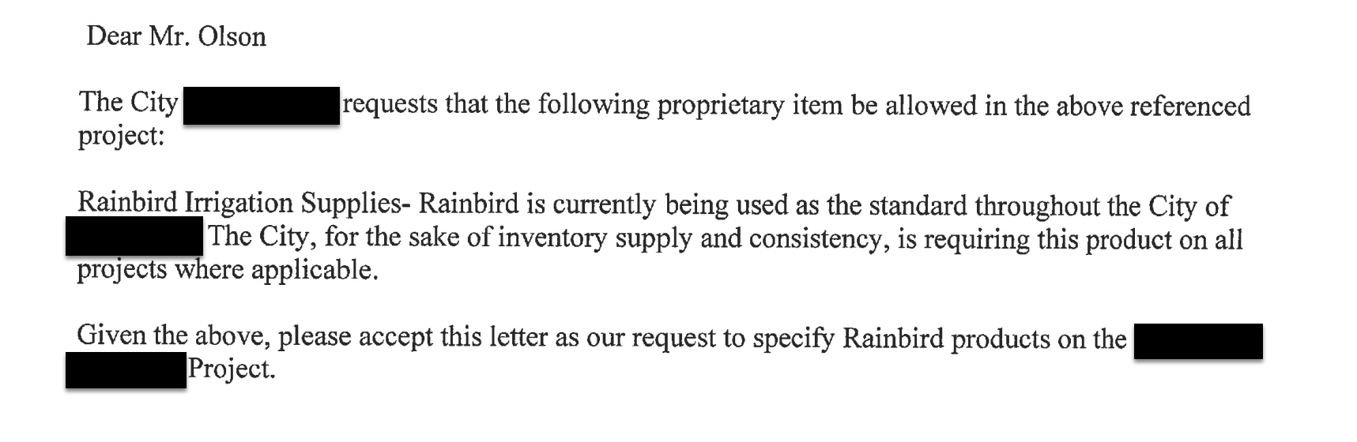
Lessons Learned – Proprietary Products
Excerpt of letter from agency (or FDOT)
Bad example

Slide 12
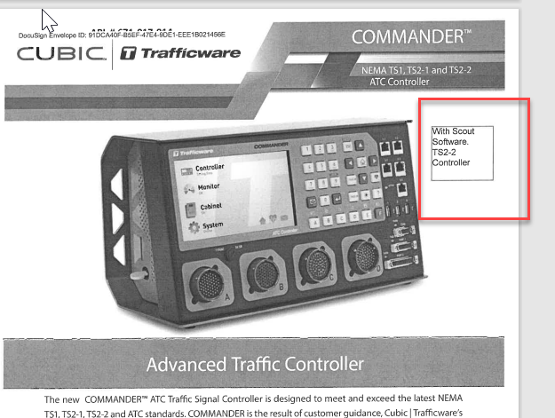
Lessons Learned – Proprietary Products
Specs

Slide 13

Lessons Learned – Proprietary Products
Plan notes

Slide 14
Lessons Learned – Proprietary Products
FDOT
  Some FDOT Offices request proprietary products
    ITS
    Drainage
    MUST process the same paperwork as an agency
  Not a solution
    Plan note/design plans reflecting “…or approved equal to XXXX…”

Slide 15
Lessons Learned – Proprietary Products
Traffic Signal Devices must be on the APL
Florida Statute 316.0745 (3) requires “All official traffic control signals or official traffic control devices purchased and installed in this state by any public body or official shall conform with the manual and specifications published by the Department of Transportation pursuant to subsection (2).”
Please refer to the Department’s Traffic Engineering Research Laboratory (TERL) Product Certification Handbook (PCH) Section 4 for a list of all Traffic Control Devices with required APL listing
Don’t wait until the last minute. Agencies that are requesting PPC items that are not on the APL must work with the vendors to get the items on the APL, and it might not even possible, and then the agency has to determine an alternate approach.

Slide 16



Lessons Learned – Utilities
Utilities – Power Supply
Remember, there are different power companies
FPL
FPUA
Lake Worth Beach
You MUST confirm with each power company their preferences for service drops/meters/etc, do NOT assume based on past projects

Slide 17
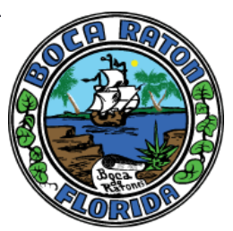








Lessons Learned – Signals - Lighting
Signals - Lighting
Remember, there are different maintaining agencies for signals
All counties
Some cities
And lighting
Counties
Cities/Villages/towns
FDOT
You MUST confirm with maintaining agencies their preferences for signals and/or lighting, do NOT assume based on past projects

Slide 18
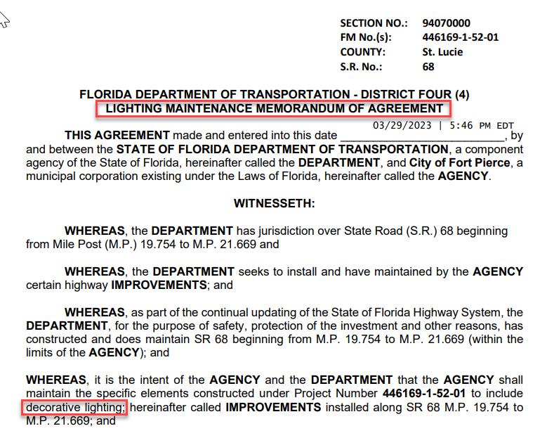
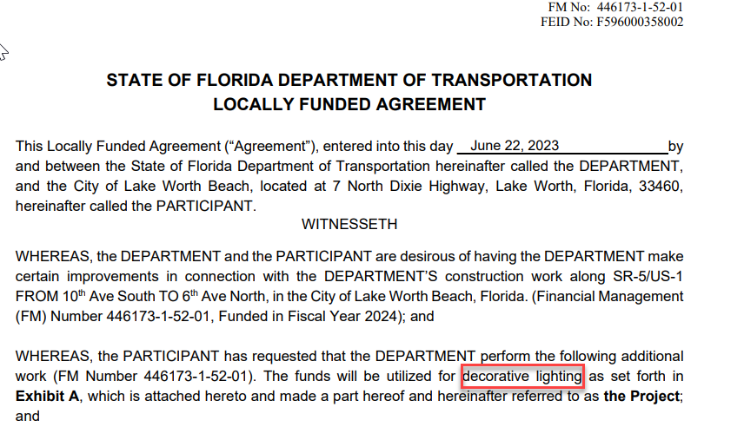
Lessons Learned – MMOAs
Don’t forget the MMOA (Maintenance Memorandum of Agreement)
Decorative lighting and painted mast arms require a MMOA (and also typically an LFA—locally funded agreement)

Slide 19
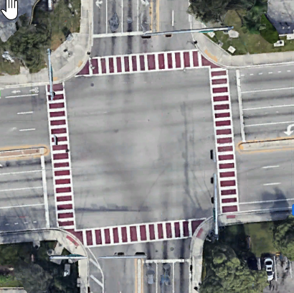
Lessons Learned – MMOAs
MMOAs
  Not just for decorative lighting and painting of mast arms
  Also needed landscape, hardscape, and irrigation
Let’s talk Patterned Pavement
  Needs local contribution
  Needs MMOA
    Requires biennial skid testing
    Early coordination is critical

Slide 20
Lessons Learned – TIP/STIP
TIP / STIP Amendments
  Costs increase more than $2M AND 20% AMENDMENT NEEDED
  Costs decreases No Amendment Needed
  *Length increases by 1/2 mile AND 20% AMENDMENT NEEDED
  *Length decreases by 1/2 mile AND 20% AMENDMENT NEEDED
  TIP amendments can take up to four months depending on MPOs schedules/calendars
  *Bonus: EOG may also be needed

Slide 21

Lessons Learned – Maintenance Maps
Maintenance Maps
Tool to assist the Department in obtaining a Project’s R/W Certification
Used when roadway encroachments outside the right of way have been maintained by the Department for the statutory length of time
Only needed if you will be doing construction on above referenced encroachments
  Only needed if the encroachments are over 0.35’ threshold

Slide 22
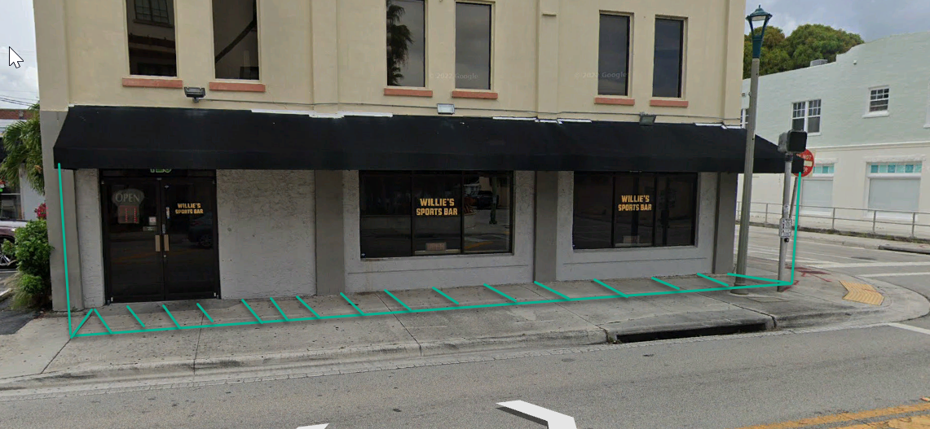
Lessons Learned – Maintenance Maps
Don’t forget to look up!
  We couldn’t do a maintenance map for the sidewalk to the building we are maintaining below because it would’ve impacted the awning of the private property. Fortunately, we didn’t end up needing the maintenance map

Slide 23
Lessons Learned – Funds vs Budget
Funds vs Budget
Funds and budget are NOT the same thing
Budget is permission to spend funds (any flavor of funds—including local funds)
FDOT must have budget to let every job (and hire every consultant, etc…)
Budget is set approximately 2 years in advance of when it’s used
Local funds (LF)
Budget can’t be magically created because of late scope additions
Such as patterned pavement, installing a new utility line, etc.
You need to account for your LF needs at least 2 fiscal years in advance with your LREs/PERs in order to capture budget

Slide 24
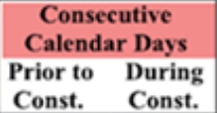
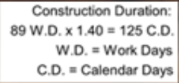
Lessons Learned – UWS
UWS (Utility Work Schedule)
UAO fills in the “Consecutive Calendar Days”
But do they really mean calendar days or work days?
The CTE divides the value given in the UWS by 1.4
  Did the UAO just lose days?
  Ensure UAOs are aware time needs to be given in calendar days, not work days.

Slide 25
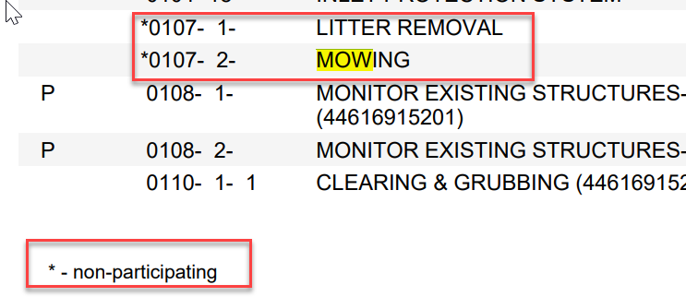
Lessons Learned – Mowing & Litter Removal
For off-system projects let by FDOT
Mowing and Litter removal is NOT FHWA eligible, nor can the state pay for it

Slide 26
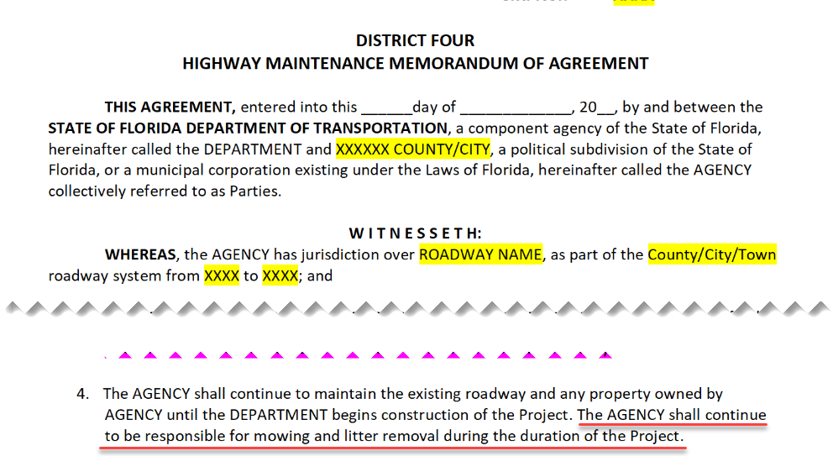
Lessons Learned – Mowing & Litter Removal
Solutions
  Locals can enter into a LFA (Locally funded agreement) to give $ to the Department to include mowing and litter removal in the construction plans
  Locals can commit to doing the mowing and litter removal during construction
    Commitment must be legally binding, such as within an HMMOA
    A MSP must also be processed to do this
    Not a solution
    To not do the mowing and litter removal

Slide 27
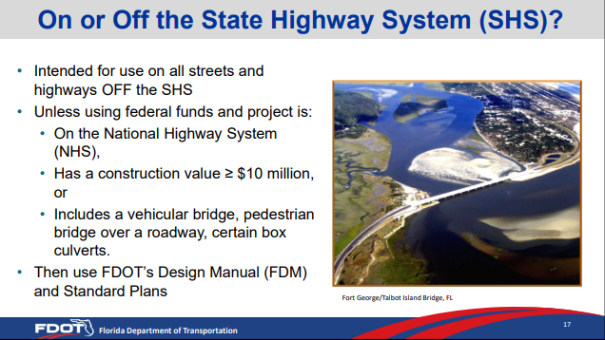
Lessons Learned – Off-system Design criteria
For off-system projects let by FDOT
If you have an off-system project and you meet at least one of the three criteria noted, you need to use FDM
Talk to your DDE about options to use Florida Green Book if desired
  May/may not be possible
Check Local Programs Manual for additional info

Slide 28
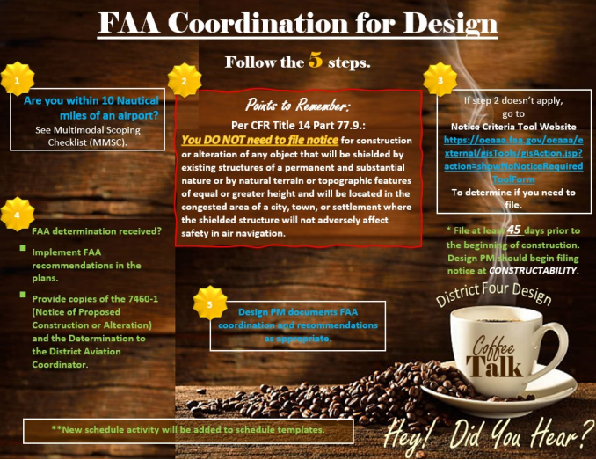
Lessons Learned – FAA Coordination

Slide 29
Lessons Learned – License Agts vs TCEs
License Agreements
  These are used solely for the benefit of the property owner
  Any work within the license agreement cannot be required for the construction/operation/maintenance of the project/facility
  If the license agreement is revoked, the project can still be built
Temporary Easement/Permanent Easement/Fee/Donation
  All four of these are acquisition, yes--even donations
  If you cannot build your project/operate/maintain it in the finished condition, you may need one of these types of acquisition
  Acquisition takes time - generally speaking, an acquisition phase will add three (3) years to your schedule

Slide 30
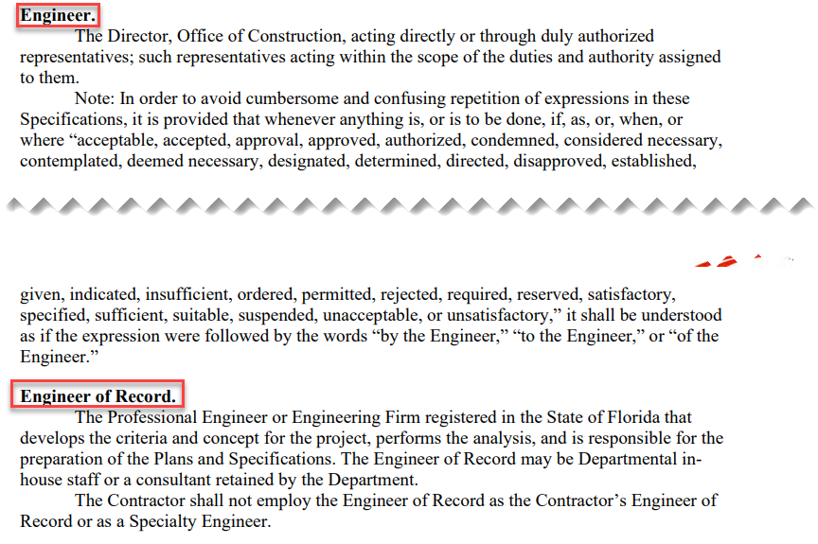
Lessons Learned – Shop Drawings
Engineer vs Engineer of Record

Slide 31
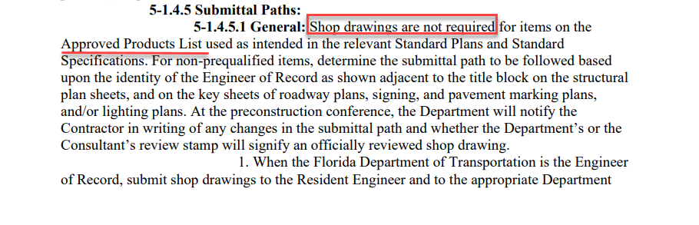
Lessons Learned – Shop Drawings
APL

Slide 32
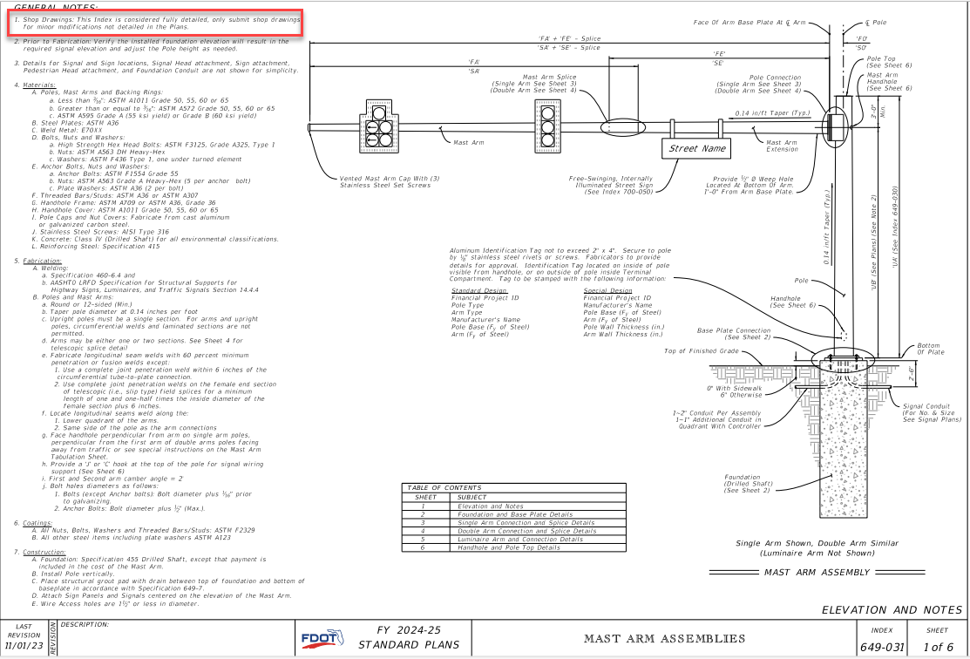

Lessons Learned – Shop Drawings
Standard Plans

Slide 33
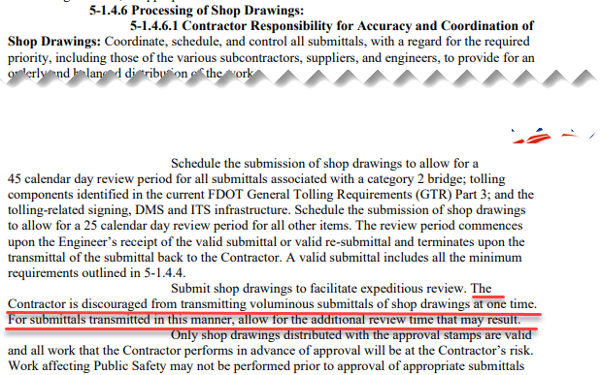
Lessons Learned – Shop Drawings
Processing of Shop Drawings

Slide 34
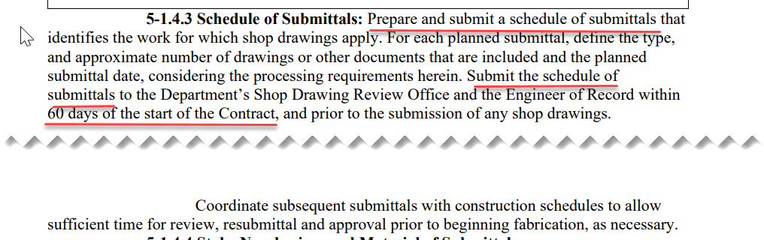
Lessons Learned – Shop Drawings
Processing of Shop Drawings

Slide 35
Lessons Learned – Shop Drawings
Solutions
  Design and Construction/CEI teams understanding roles/responsibilities of each team
  Hand-off meeting between Design and CEI teams at/around letting and prior to Construction NTP being issued

Slide 36
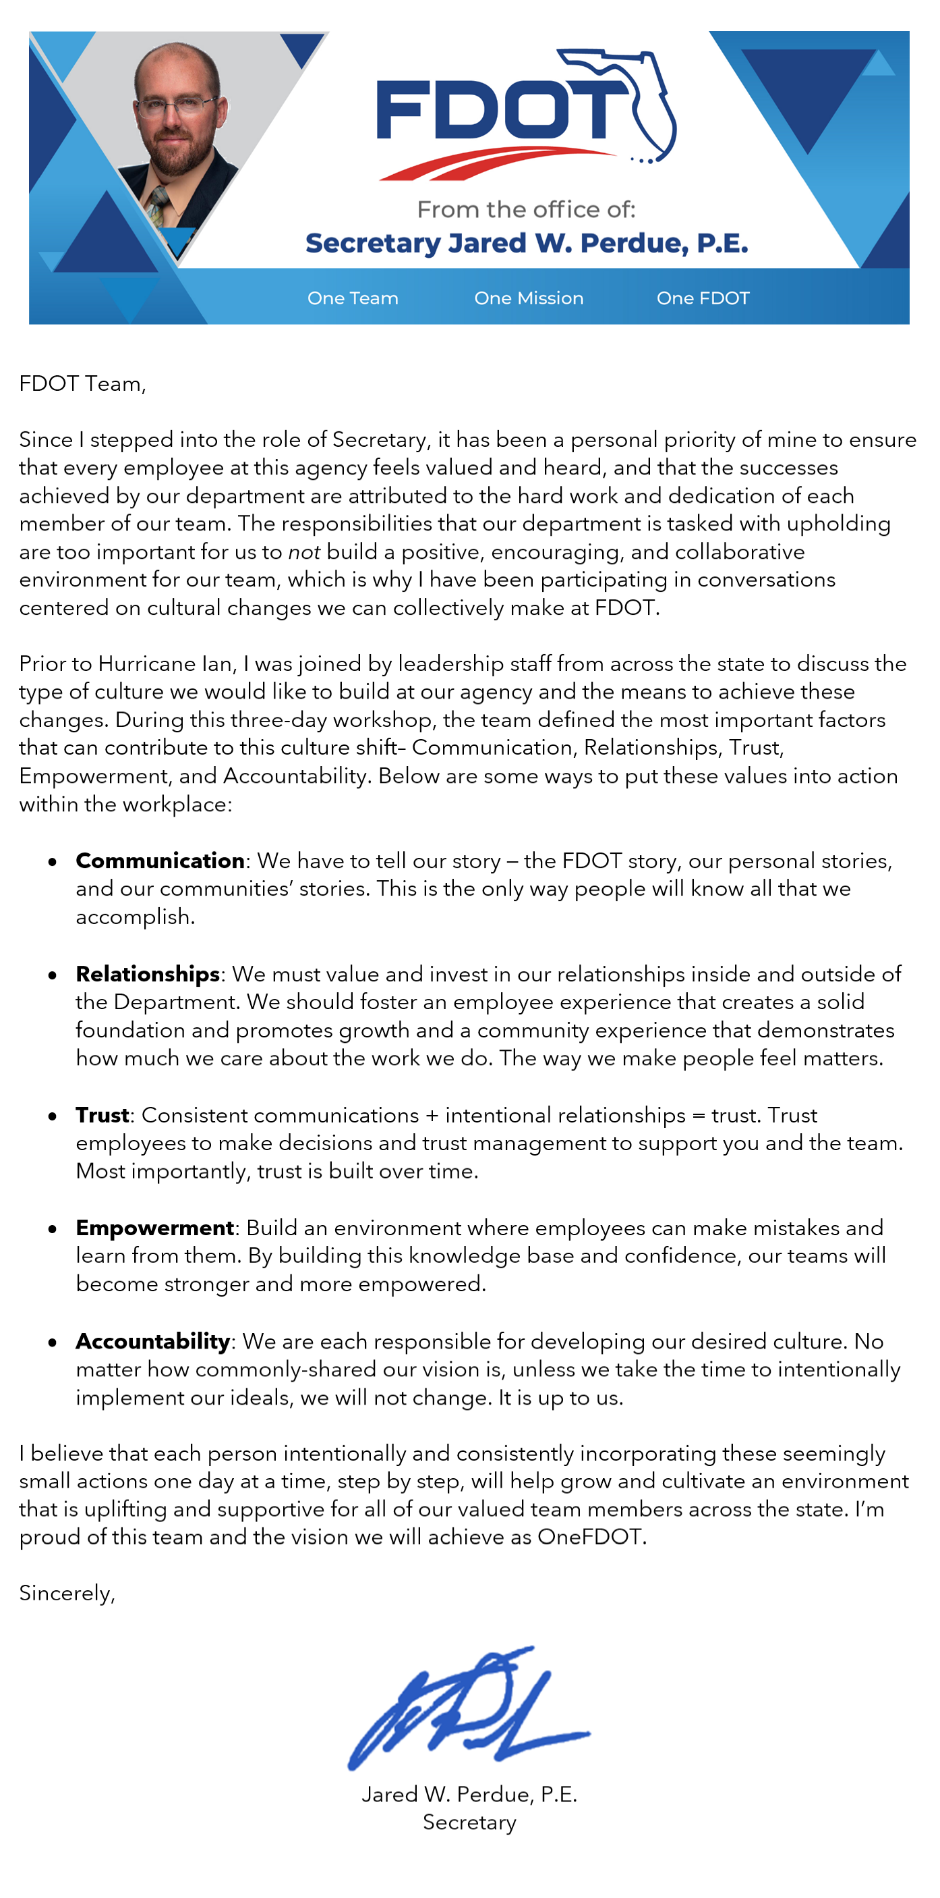
Lessons Learned – Why?
Why are Lessons Learned important?
Remember CREATE
C COMMUNICATION
R RELATIONSHIPS
E EMPOWERMENT
A ACCOUNTABILITY
T TRUST
  wE are OneFDOT!

Slide 37
Lessons Learned – Mowing & Litter Removal
What Questions do you have?

Slide 38
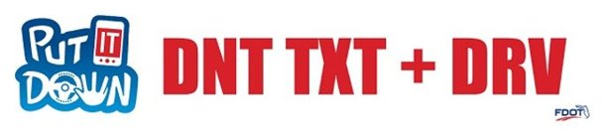
Safety Message

Slide 39

Contact Us
Leslie Wetherell, P.E.
Project Manager
FDOT
Design
District 4
3400 W Commercial Blvd
Ft Lauderdale, FL 33309
(954) 777-4438 / leslie.Wetherell@dot.state.fl.us

