Slide 1
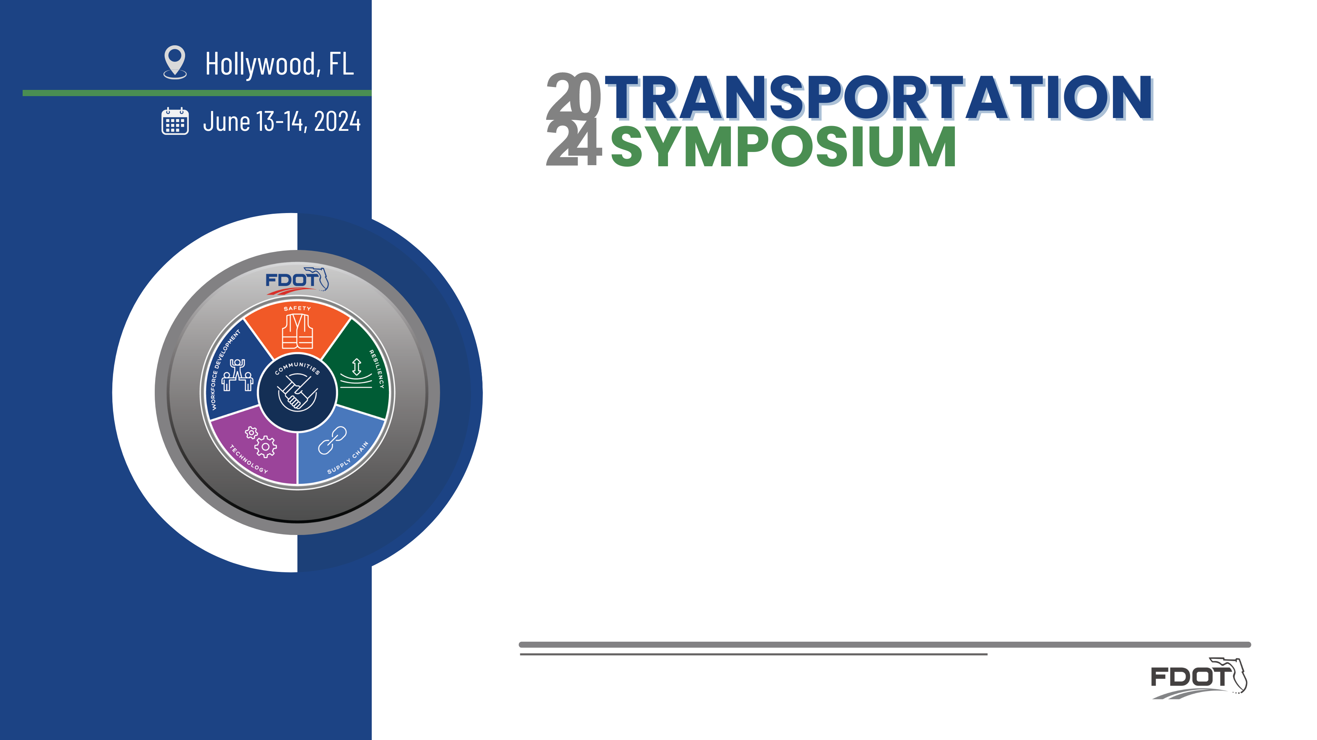

Use of ACROW Bridges on FDOT Projects
Bruno Vasconcelos | Will Smith
FDOT | ACROW

Slide 2
Objectives
What is ACROW?
What does the Department own?
How to request it?
How to Deploy 300 Series
How to Deploy 700XS Series
  ACROW Bridge Design & Construction Considerations
  ACROW 700XS® / FDOT Standards
  Installation methods
  Examples

Slide 3
What is ACROW Bridging?
Proprietary steel design derived from the original Bailey Bridge of WWII
World leader in design, engineering and manufacture of prefabricated modular steel bridges
Headquartered in Parsippany, NJ
Offices across USA, Canada, Italy, UK, Poland
Manufacturing facilities in Milton, PA; and Lydney, Gloucestershire, UK
Staging yards in Lafayette, NJ; Eden, NC; and Centralia, WA
Source: https://en.wikipedia.org/wiki/Bailey_bridge
Notes:
Established in 1951
300+ employees

Slide 4





What is ACROW Bridging?
Advance Major Bridge w/ fracture critical endorsement

Slide 5
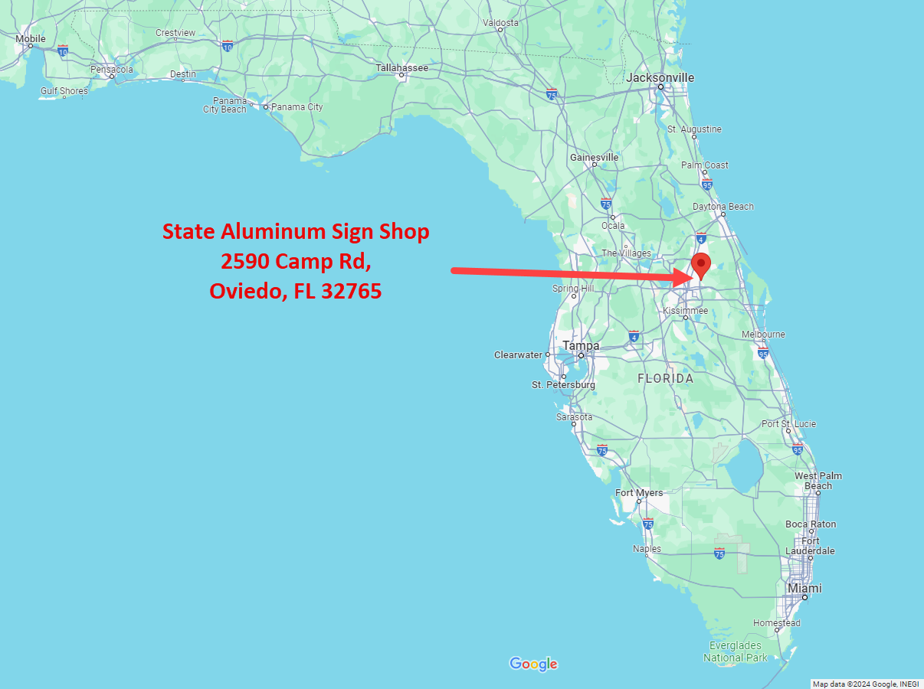
What is ACROW Bridging?
Initial bridging created in 1989
  Combination of Bailey Bridging and ACROW
Virtually all single laned bridging initially
Previous Inventory Locations
  Defuniak Springs – NW Florida
  S. Dade – South Florida
Current Location
  Oviedo – Central Florida

Slide 6
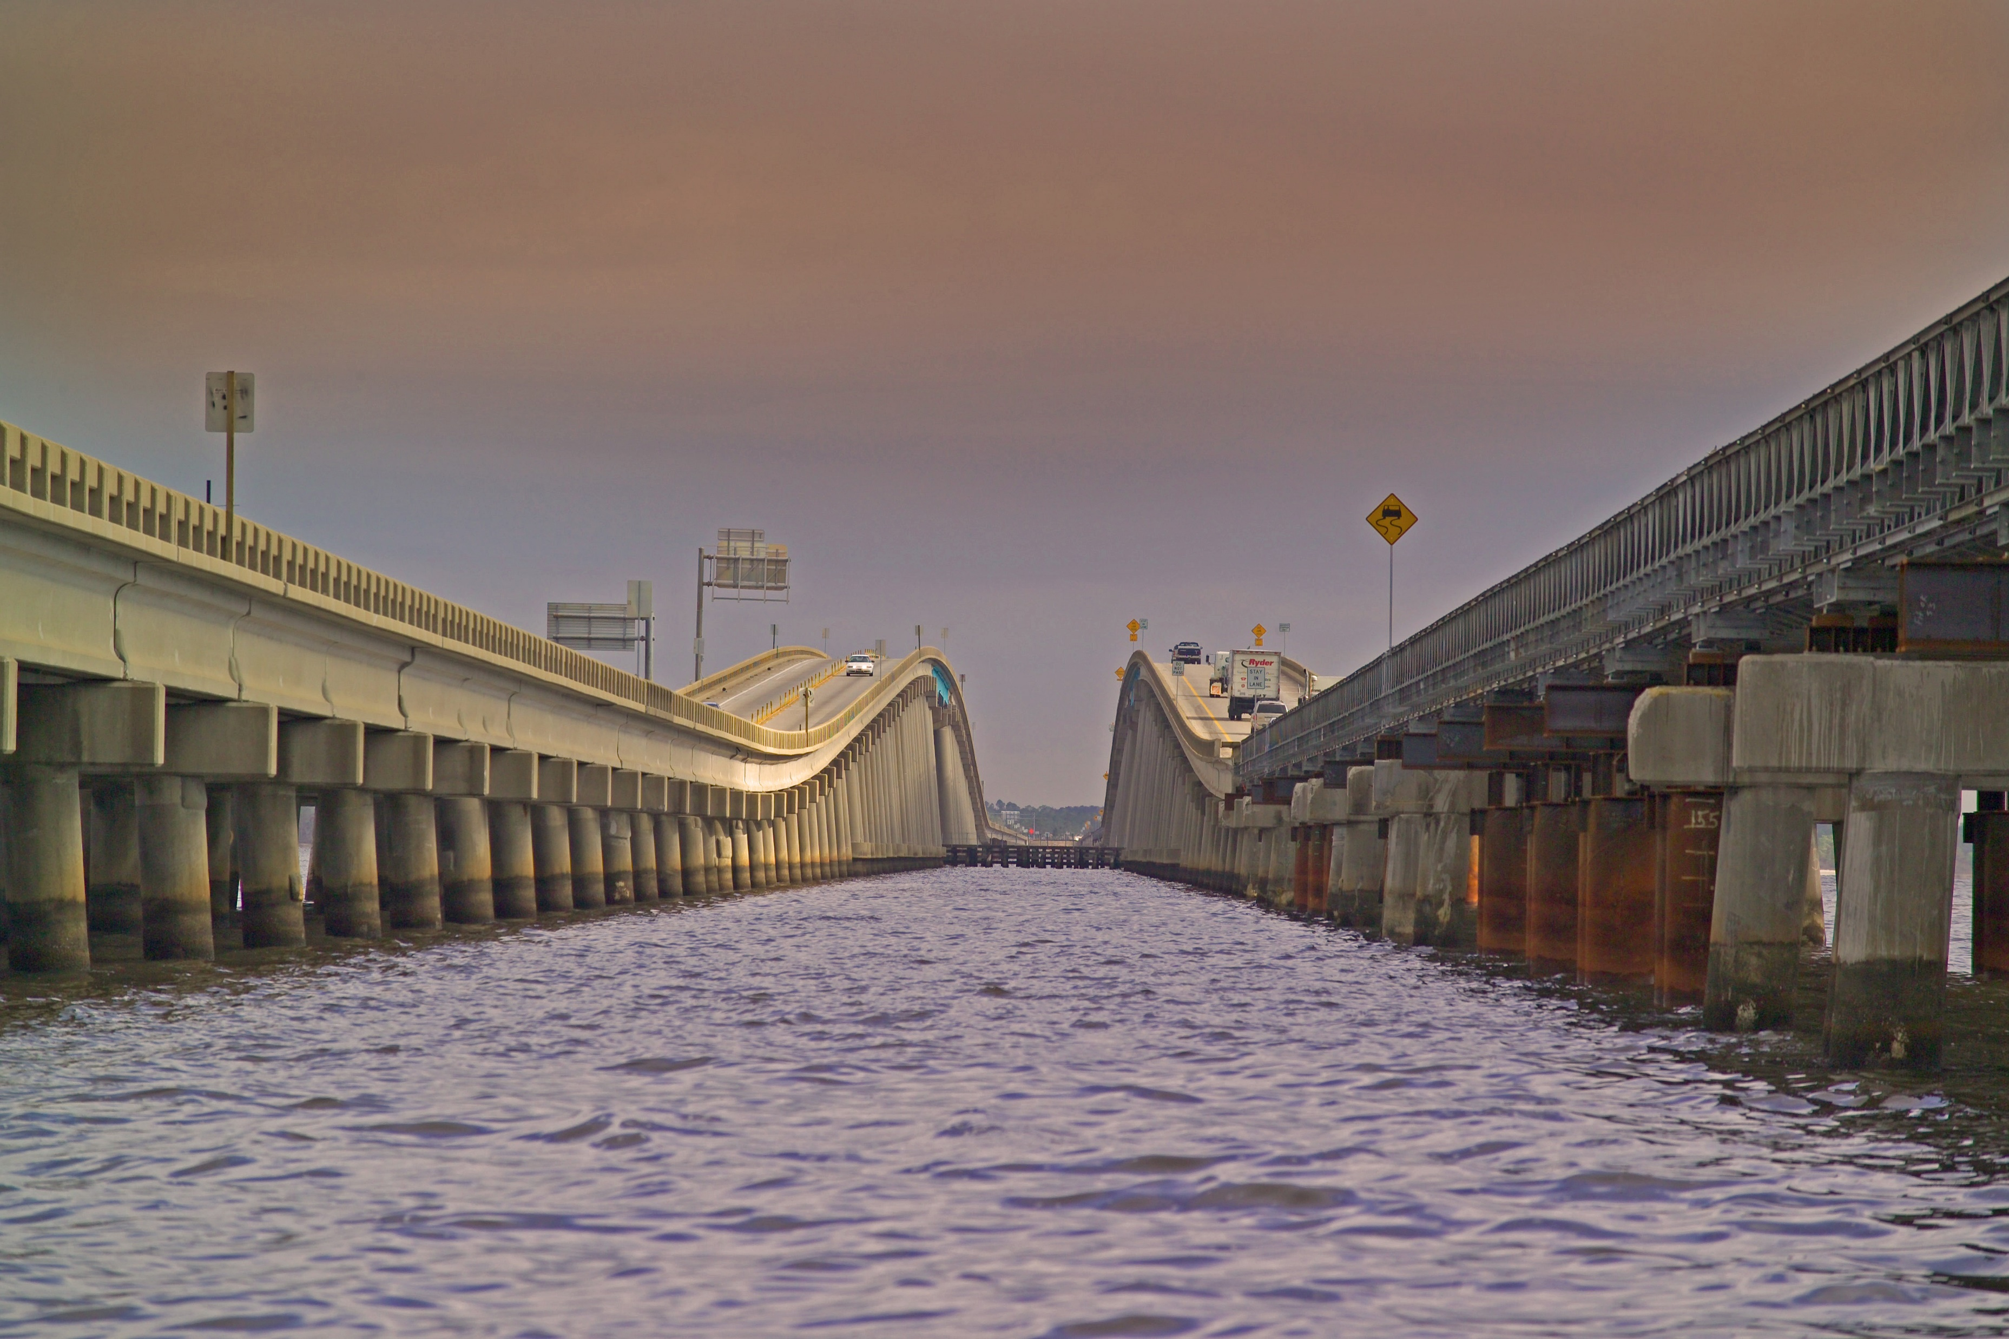
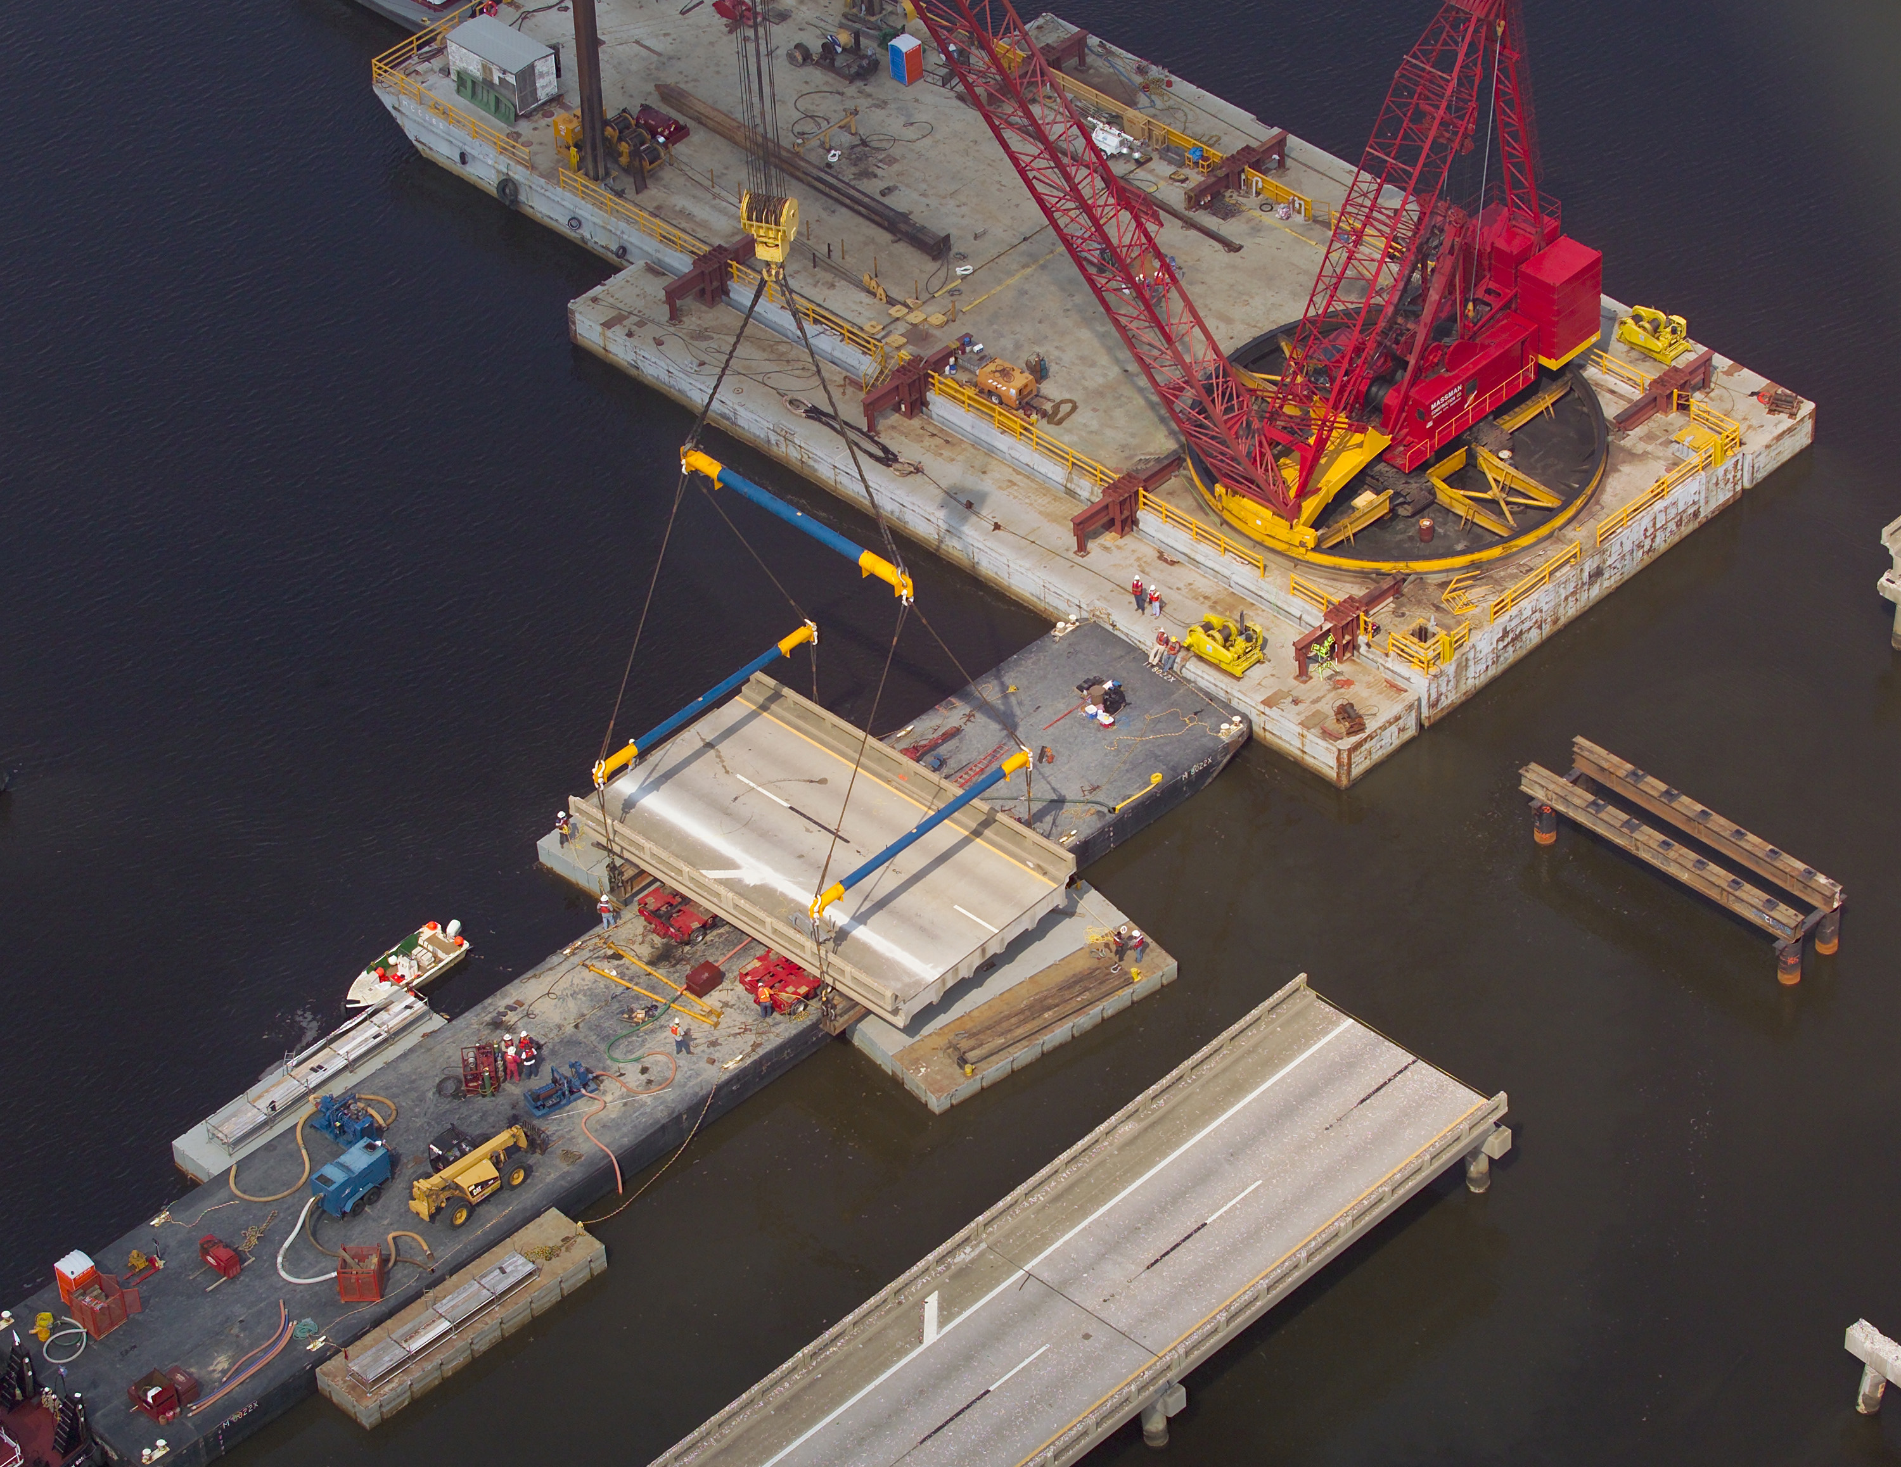
What does the Department own?
I-10 Escambia Bay Bridges suffered damage.
45 roadway sections removed
25 concrete piers reconstructed
3,720 LF of ACROW Bridge
  300 Series
https://www.massman.net/project/display/338
Notes:
Something like a third of the decking was damaged
Similar technique used on I-10 over Lake Pontchartrain
Damaged by Katrina in 2005
FDOT personnel visited to see 700 series in action

Slide 7
What does the Department own?
In June 2007 Bailey bridging was released to District 3
  Much of it ended up with Forestry Department
Defuniak yard was eliminated
South Dade yard inventory moved to Oviedo
Old extra wide single lane ACROW was ultimately surplused.
  Roughly 2000 ft of bridging
All ACROW bridging and components were centralized to Oviedo.
Notes:
Some Bailey and old ACROW bridging has been left out to be used as permanent in low ADT areas.
All bridging is now in Oviedo. No other official source of bridging exists in the State.
All bridging is released with new banding on it.

Slide 8
What does the Department own?
 | Linear Feet
 | Total | Deployed | In Repair | Available
ACROW Series 300 Two Lane (24') | 6,000 | 1,010 | 430 | 4,560
ACROW Series 700XS Two Lane (24') | 3,000 | 0 | 0 | 3,000
ACROW Series 700XS Three Lane (36') | 1,300 | 160 | 0 | 1,140
ACROW Series 700XS Three Lane (42') | 320 | 70 | 0 | 250
All ACROW Bridging kept at:
State Aluminum Structures Shop
2590 Camp Road
Oviedo, FL 32765
Notes:
10,620ft of total bridging, a little over 2 miles
Typically, only about 10-15% of inventory out
Department policy requires we keep 3000ft on hand for emergency use

Slide 9
What does the Department own?
300 Series
<45mph
Only available in 24ft roadway width.
Used with a Standard Plan.
  60ft max span
700XS Series
>45mph
Can accommodate widths of 24ft, 36ft, and 42ft.
ACROW must be involved with design.
Can be launched from a single side.
Notes:
No vertical curves
No horizontal curves
No cross-slope
No crane activity on the bridge unless building the bridge.

Slide 10
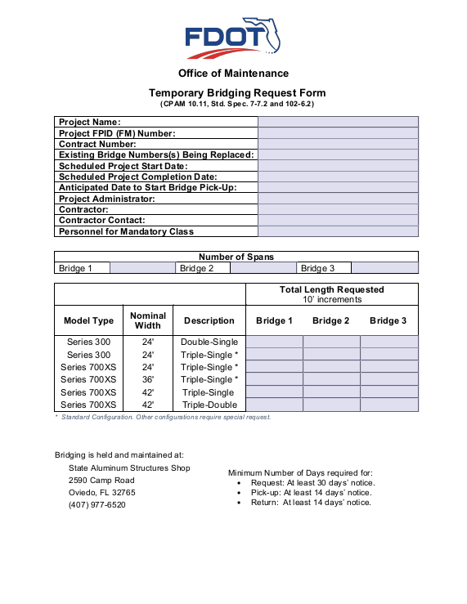
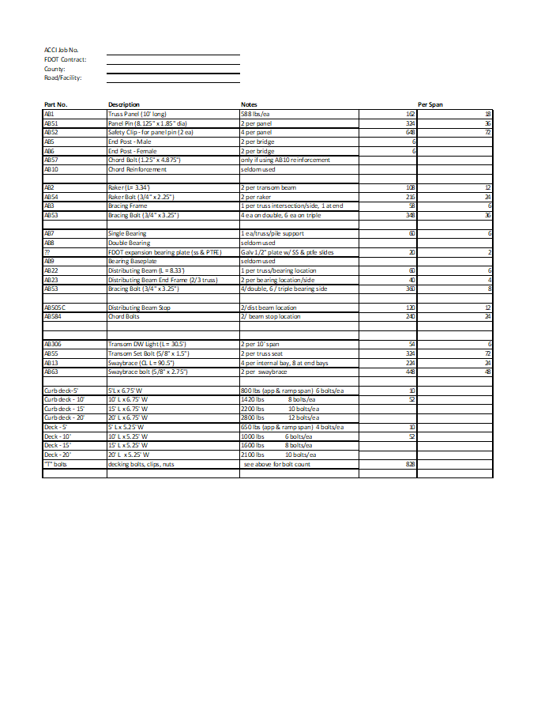
How to Request ACROW?
Contact Central Office (me)
Fill out the request form and provide parts list
Coordinate pick-up
Lead times to follow:
  30 day for request form
  10 days for pick-up
  10 days for drop-off
Initial Inspection for 300 series performed by Department. (me again)
Notes:
We do not provide launching parts
Oviedo yard only places parts on trucks
Freight is contractor’s responsibility, must provide own dunnage.

Slide 11
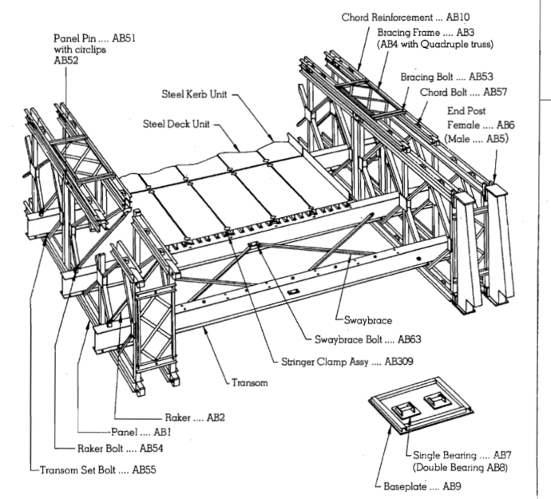
How to Deploy 300 Series
Relatively simple to assemble.
ACROW Bridge manager (me) performs initial inspection.
Contractor must provide personnel for training at Oviedo.
A sample bridge is kept erected on site to instruct staff.
All repairs are made on site to bridging.
Always placed with a crane.

Slide 12
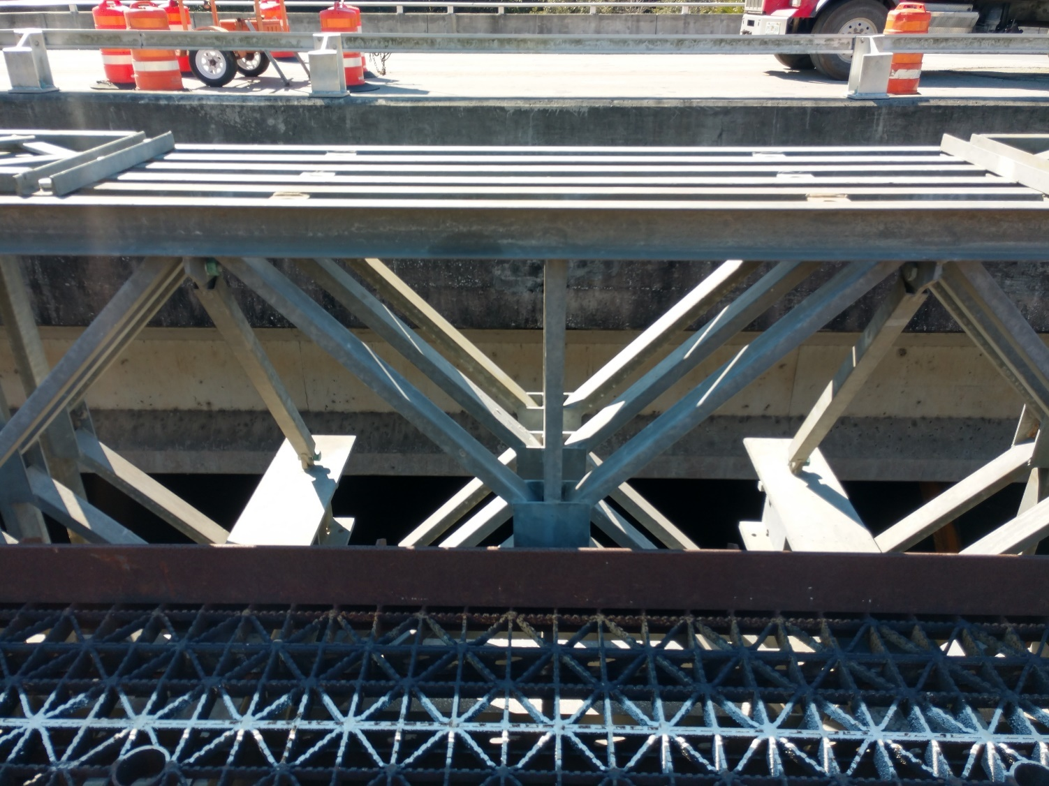
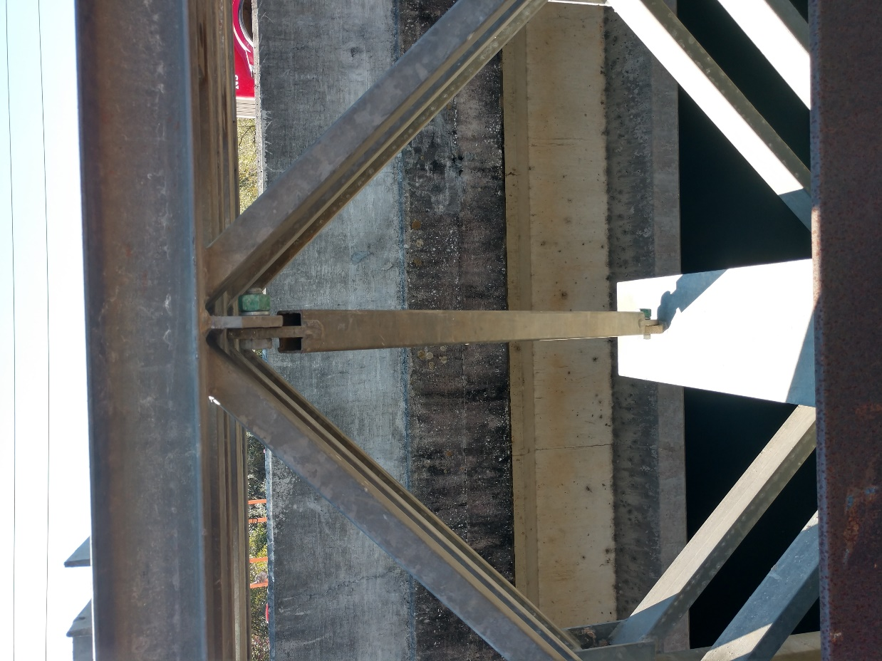
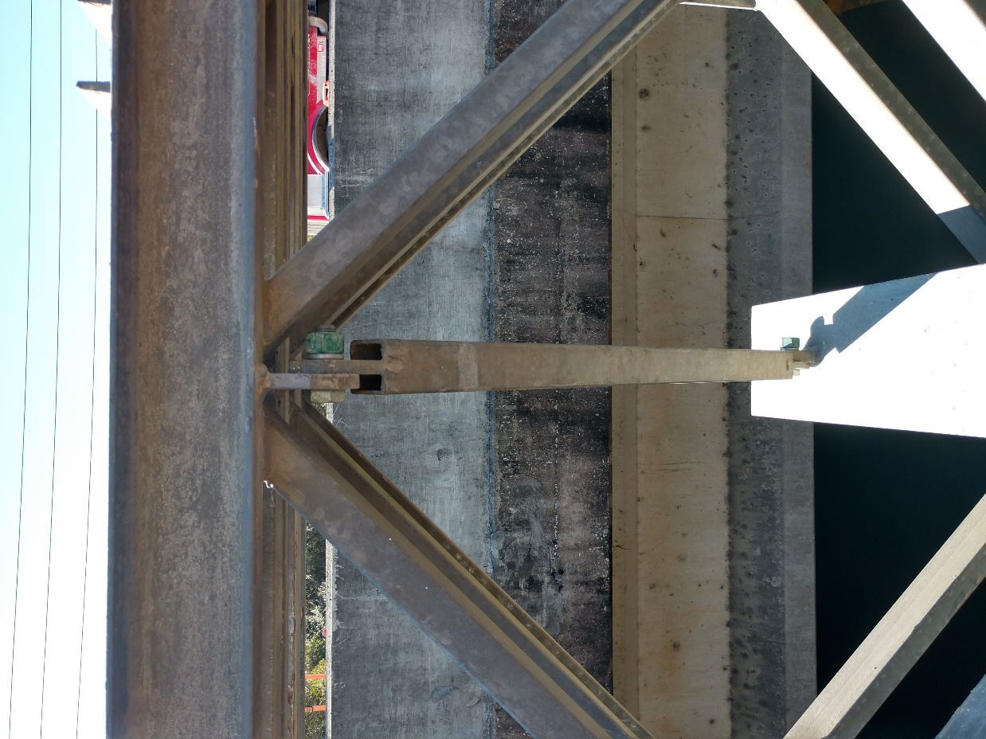
How to Deploy 300 Series

Slide 13
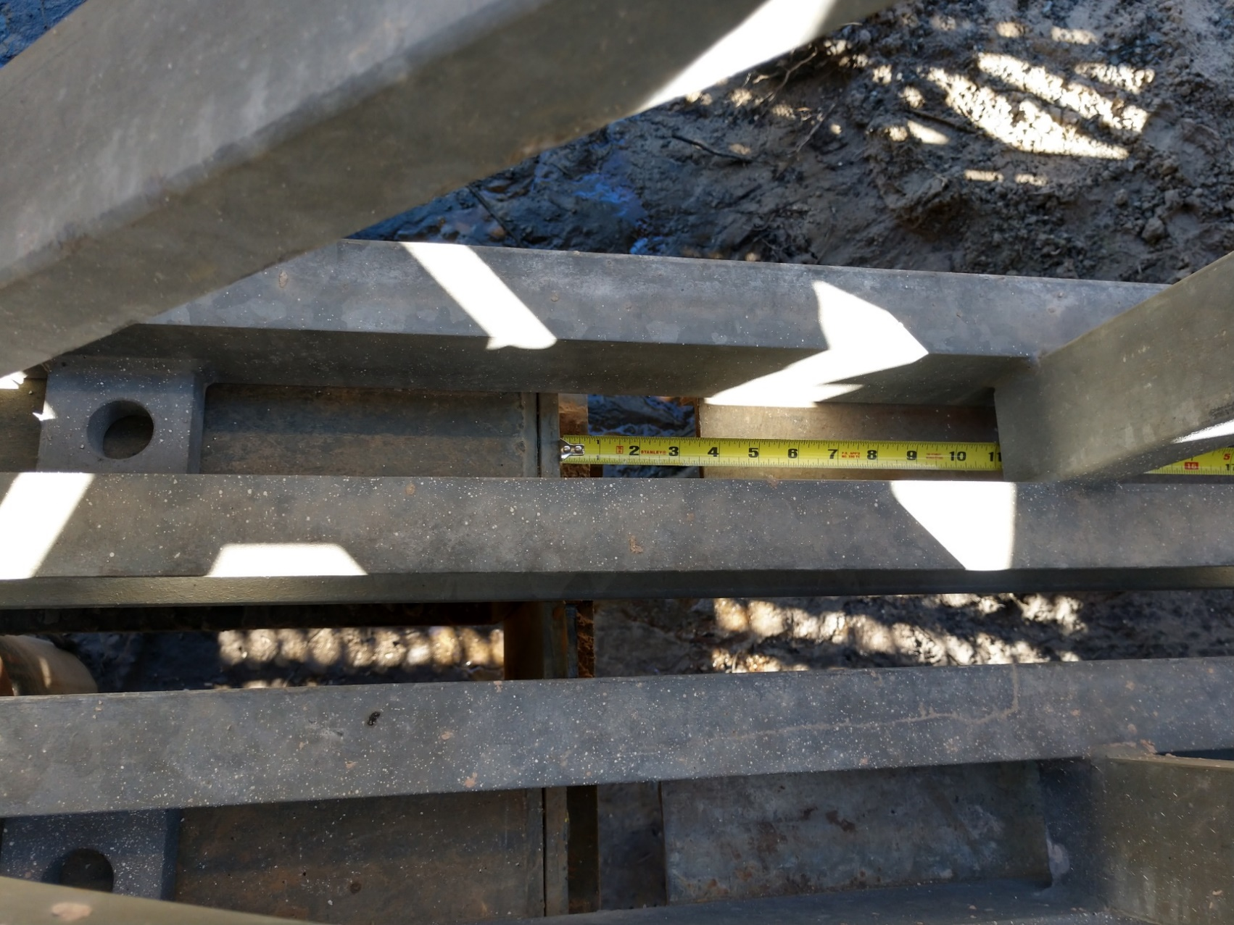
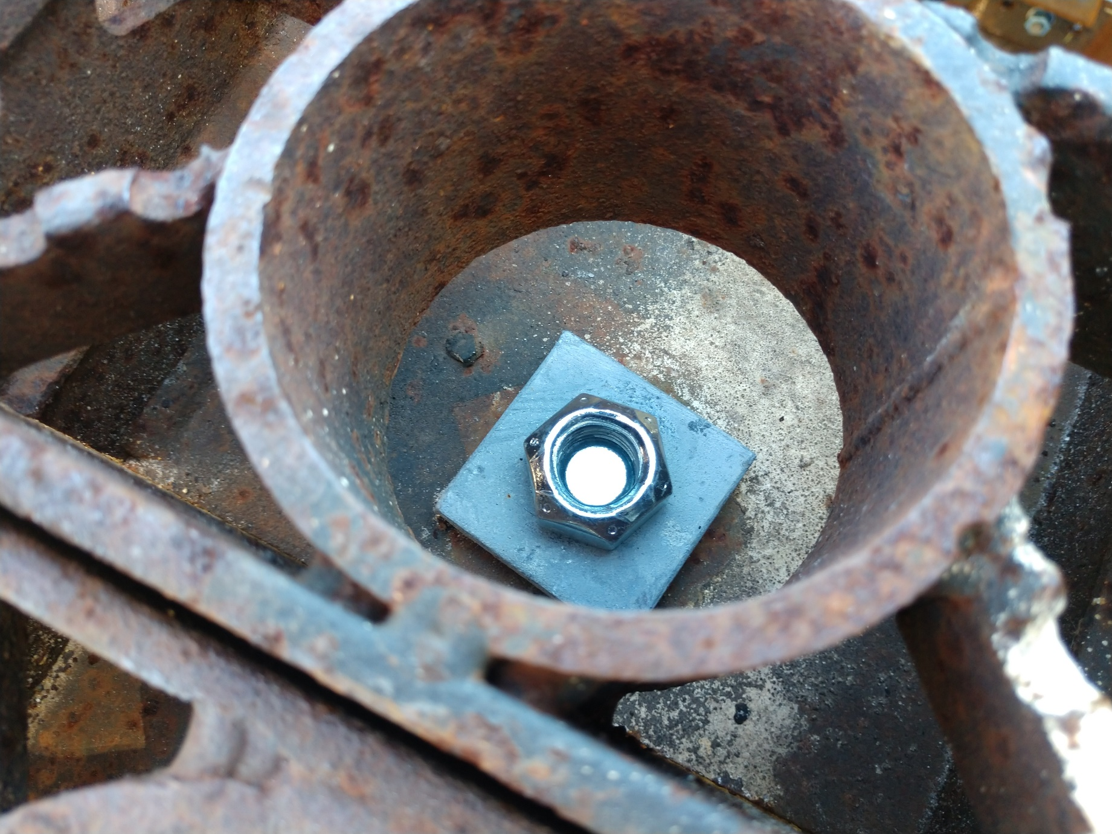
How to Deploy 300 Series
Insufficient bolt threads through nut. After initial set and traffic vibration bolts can easily come loose if not sufficiently engaged with nuts.
Also ensure deck bolts are installed bottom up with the bolt head resting on the transom and the nut being tighten from above.
Correct
Correct
Notes:
Excessive distance between Distributing Beam Stop (AB505C) and Distributing Beam with Distributing End Frames (AB22/23). Although Std. Plans 102-200 shows this as flush, or near flush, this distance should not exceed 1” to prevent excessive movement or thermal effects on the bridging
Note from ACROW 300 Design Manual, pg. 163. Follow this suggestion of re-tightening of bolts 30 days after opening to traffic to limit probability of fastening hardware coming loose prematurely.

Slide 14
How to Deploy 700XS Series
Three Main Components
1. Truss Panel – AB701, Shear Truss Panel – AB702,
Heavy Shear Truss Panel – AB708. Dimensions = 10’ long x 7.5’ wide, pinhole to pinhole.
2. Orthotropic AB601 Deck & AB602 Curb Unit – 10’ x 6’. Curb unit is the same but has 6” high welded curb. FDOT owns plain steel decks. Bridges using plain steel decks require an asphalt overlay typically to provide a crown or cross slope.
3. Transom Beams – SC0017 - 24’ roadway width, AB957 - 36’ roadway width, and AB978 – 42’ roadway width.

Slide 15
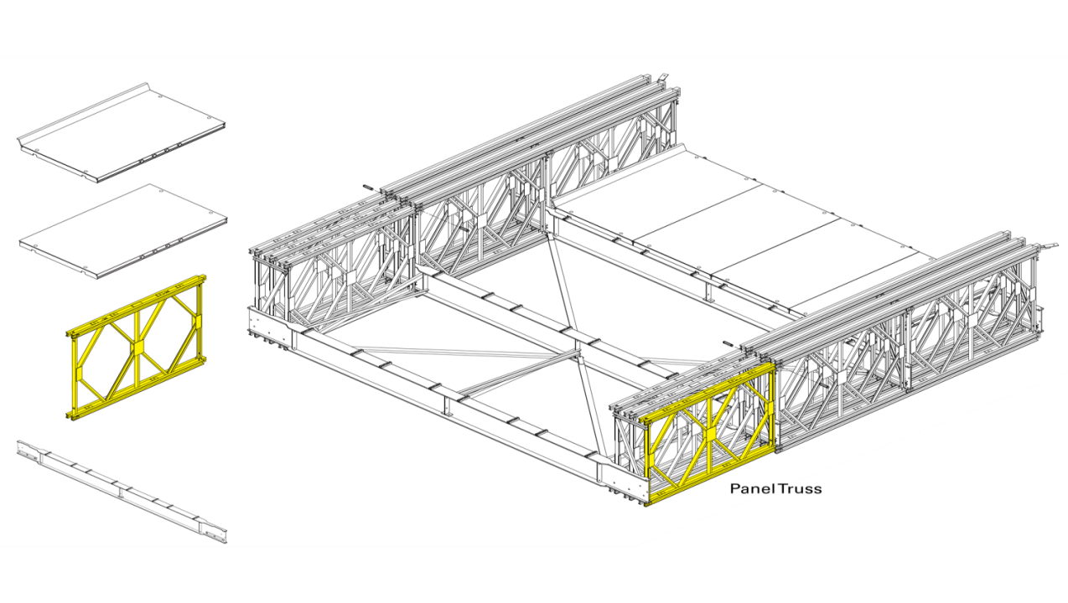
700XS Series / Truss Panel (AB701/AB702/AB708)
*AB701 - Truss Panel (693#)
*AB702 - Shear Truss Panel(896#)
*AB708 - Heavy Shear Truss Panel (1300#)
Dimensions = 10’ long x 7.5’ wide, pinhole to pinhole.

Slide 16
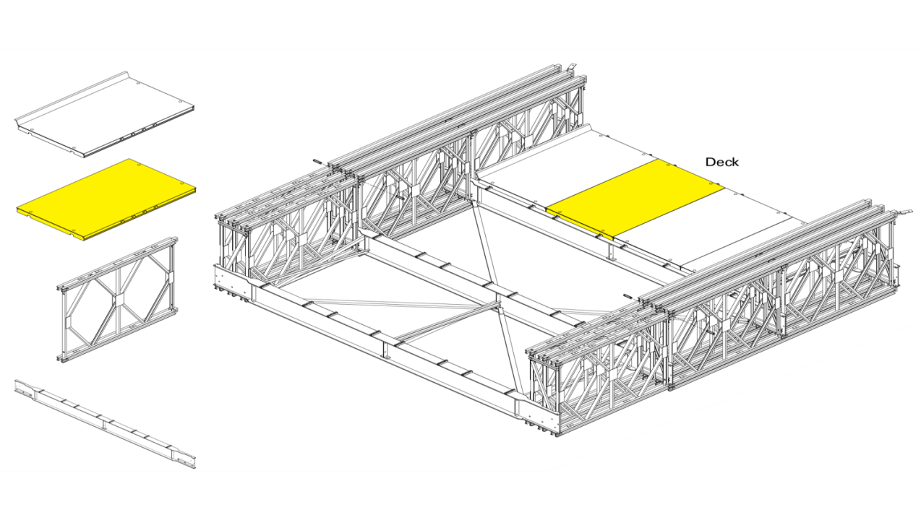
700XS Series / Deck Panel (AB601)
Orthotropic AB601 Deck Unit *Dimensions– 10’ x 6’ x 5 3/8”.
(1525#)
FDOT owns plain steel curbs. Bridges using plain steel decks require an asphalt overlay typically to provide a crown or cross slope.

Slide 17
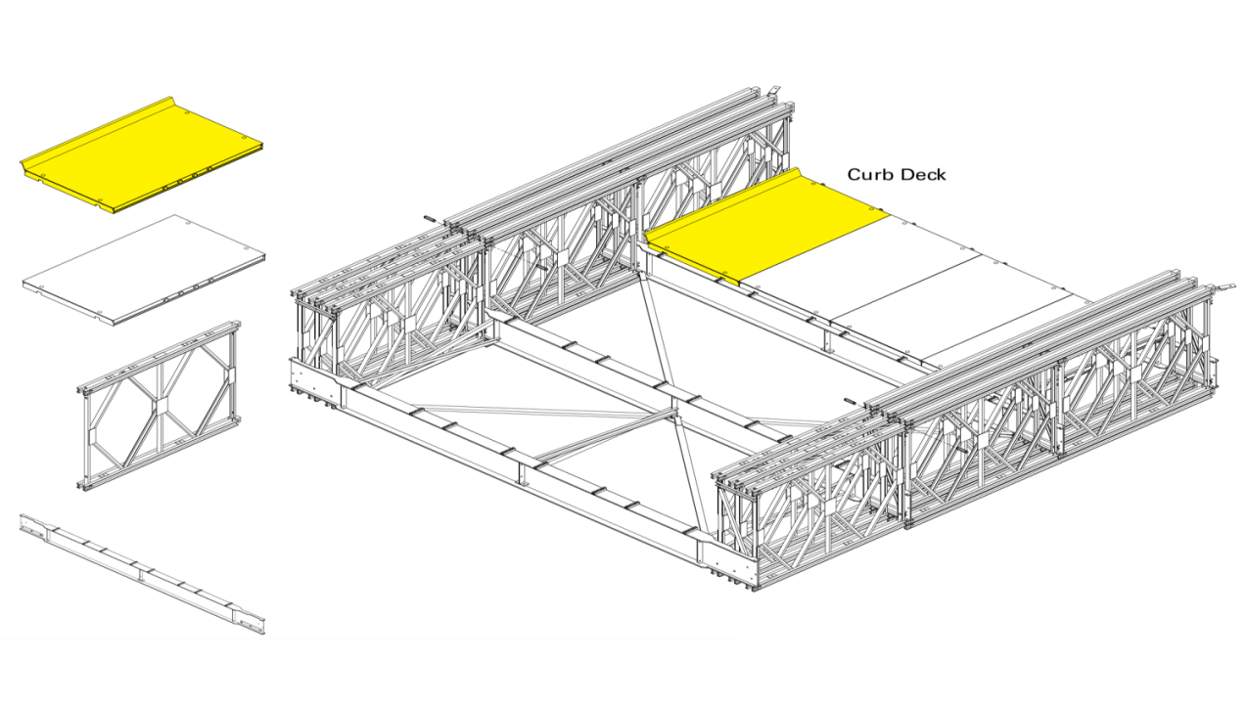
700XS Series / Curb Panel (AB602)
Orthotropic AB602 Curb Unit *Dimensions– 10’ x 6’ x 5 3/8”.
*Curb unit is the same but has 6” high welded curb. (1632#)
FDOT owns plain steel curbs. Bridges using plain steel decks require an asphalt overlay typically to provide a crown or cross slope.

Slide 18
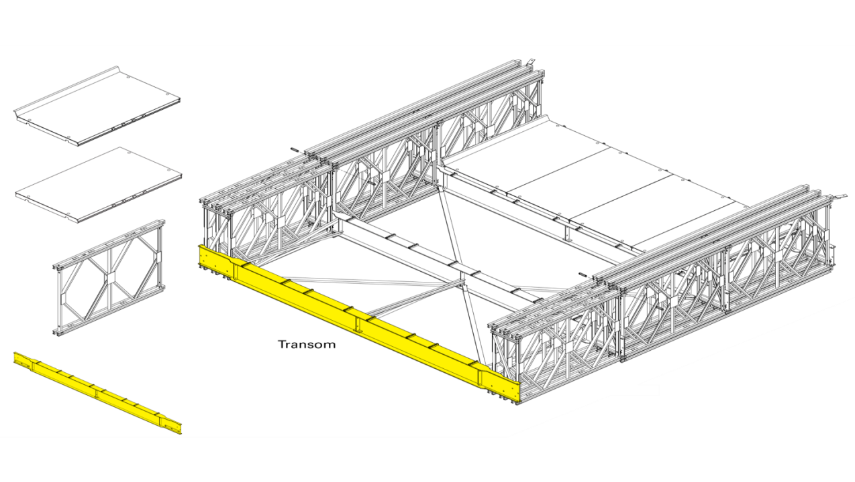
700XS Series / Transom Beams
(SC0017-24’ / AB957-36’ / AB978-42’)
Transom Beams
*SC0017 - 24’ roadway width (3,000#)
Approximately 3,000’ available in FDOT inventory
*AB957 - 36’ roadway width (7600#)
Approximately 1,320’ available in FDOT inventory
*AB978 – 42’ roadway width (9600#)
Approximately 280’ available in FDOT inventory

Slide 19
700XS Series / Truss Configurations

Slide 20
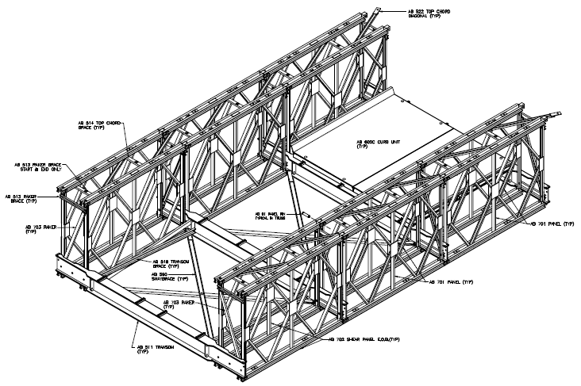
700XS Series / Truss Configurations
DOUBLE SINGLE
(DS)
DS

Slide 21
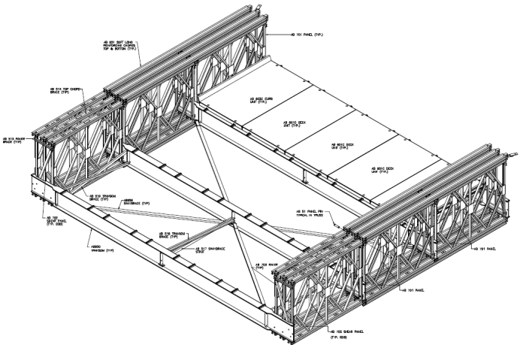
700XS Series / Truss Configurations
TRIPLE SINGLE
(TS)
TSR3

Slide 22
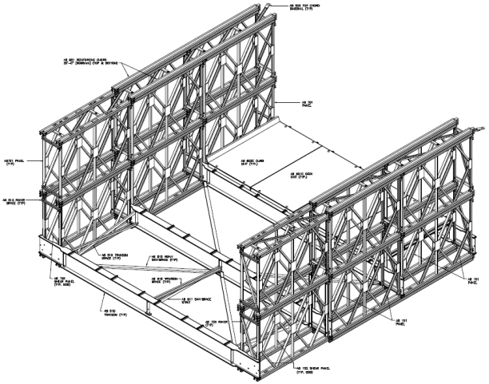
700XS Series / Truss Configurations
DOUBLE DOUBLE
(DD)
DDR2

Slide 23
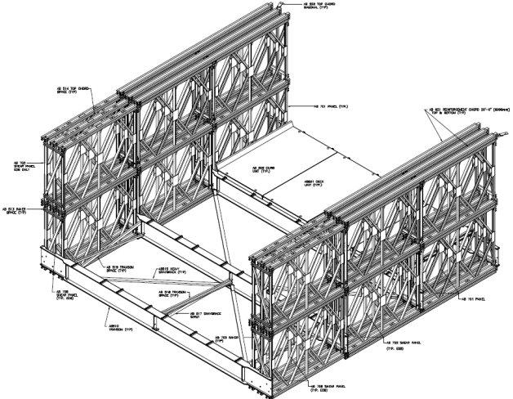
700XS Series / Truss Configurations
TRIPLE DOUBLE
(TD)
TDR3

Slide 24
700XS Series
Engineering/Consultant Support
Contact Acrow (ME) about pre-planning & engineering support.
If an FDOT owned Acrow 700XS is required, truss construction, preliminary general arrangement drawings and preliminary reactions can be provided to assist with the project design including the substructure design.
Acrow only provides superstructure submittals which includes the design from the bottom of the bearings up. Design of substructure is by others.

Slide 25
700XS Series
Engineering/Consultant Design Criteria
When designing……Specify:
Bridge length, single or multiple spans, span lengths & roadway width.
Loading Design – Typically LRFD HL93 and load rating if required for highway bridges based on FDOT 120 Permit loads
Bridge deck type:
    FDOT owns plain steel deck requiring an asphalt overlay
    If a highway application, a paving membrane is also required
Bridge profile: Prefer crown, can accommodate some superelevation/cross slope. Both crown and superelevation using asphalt with limits or special beams for superelevation
Bridge Rail Test Level Design TL-2 up to TL-4

Slide 26
700XS Series
Consultant/Construction Support
For projects utilizing FDOT owned Acrow 700XS bridging Acrow provides PE stamped superstructure submittals and load rating if required
Develop site-specific bridge assembly and installation procedure with contractor using one of three methods; either cantilevered launch, crane-assisted launch, or crane lift-in
Onsite field support / advisor for contractor’s installation
Rental of required launch equipment. This usually involves rollers, and bridge components for the launch “nose” and/or launch “tail”
Bridge inspections and certification as needed

Slide 27
700XS Series
Performed by “Others”
Assembly & erection by contractor/installer
Abutment engineering & abutments including bolsters for end-of-span floorbeams
Asphalt overlay & paving membrane (if required). See info on paving thickness in FDOT 700XS standards
Approach guard rail to bridge guide rail transitions (FDOT has standard design)
Anchor bolts and retention angles
Lighting or signage (if required)
Bridge inspections and certification, if not provided by Acrow
Bridge assembly tools, including jacks (tool list provided to installer/contractor)

Slide 28
FDOT ACROW 700XS DESIGN STANDARDS
Developed by FDOT in coordination with Acrow Bridge
Based specifically on the Acrow 700XS components owned by FDOT and stored in the Oviedo, FL yard
Other options available but would have to be rented and/or purchased from Acrow.

Slide 29
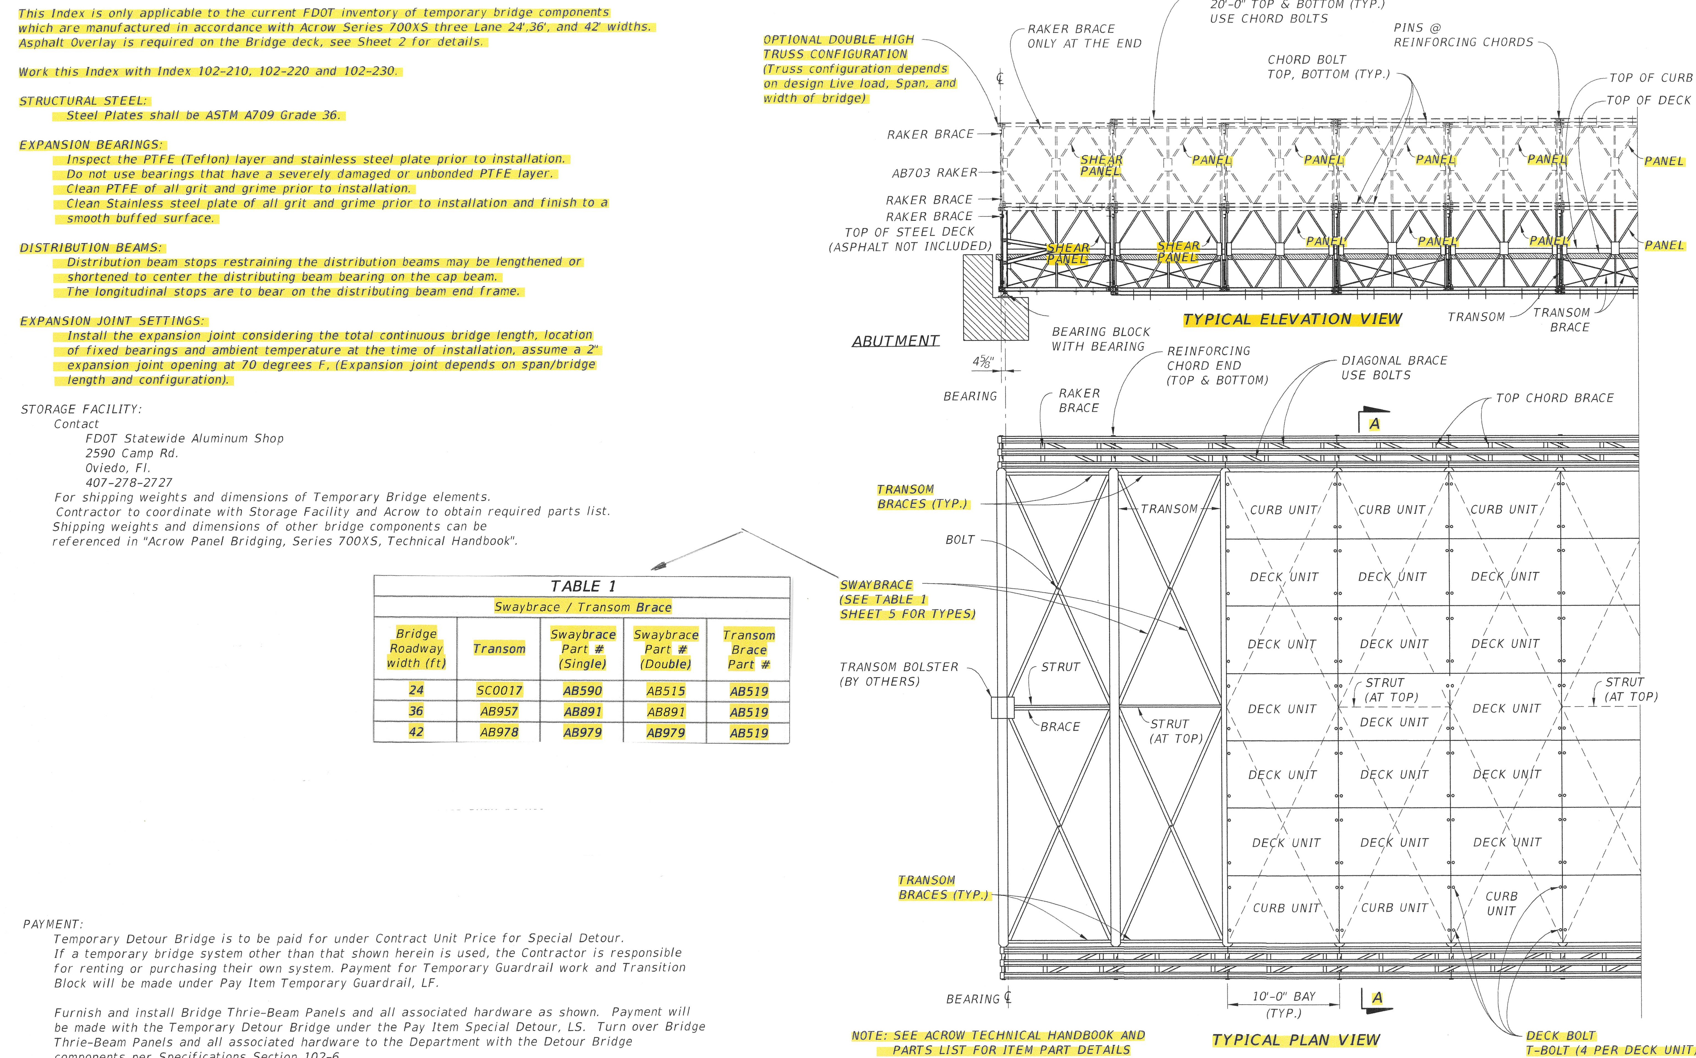
FDOT ACROW 700XS DESIGN STANDARDS / General Notes & Details
Notes:
1. Applicable to only FDOT owned material. 2. Shows shear panels at bridge/span ends. 3. Distribution beam can be placed anywhere along bottom of truss panel. 4. Table 1 (pg 5 of FDOT standards shows sway brace and part #s for each width bridge.

Slide 30
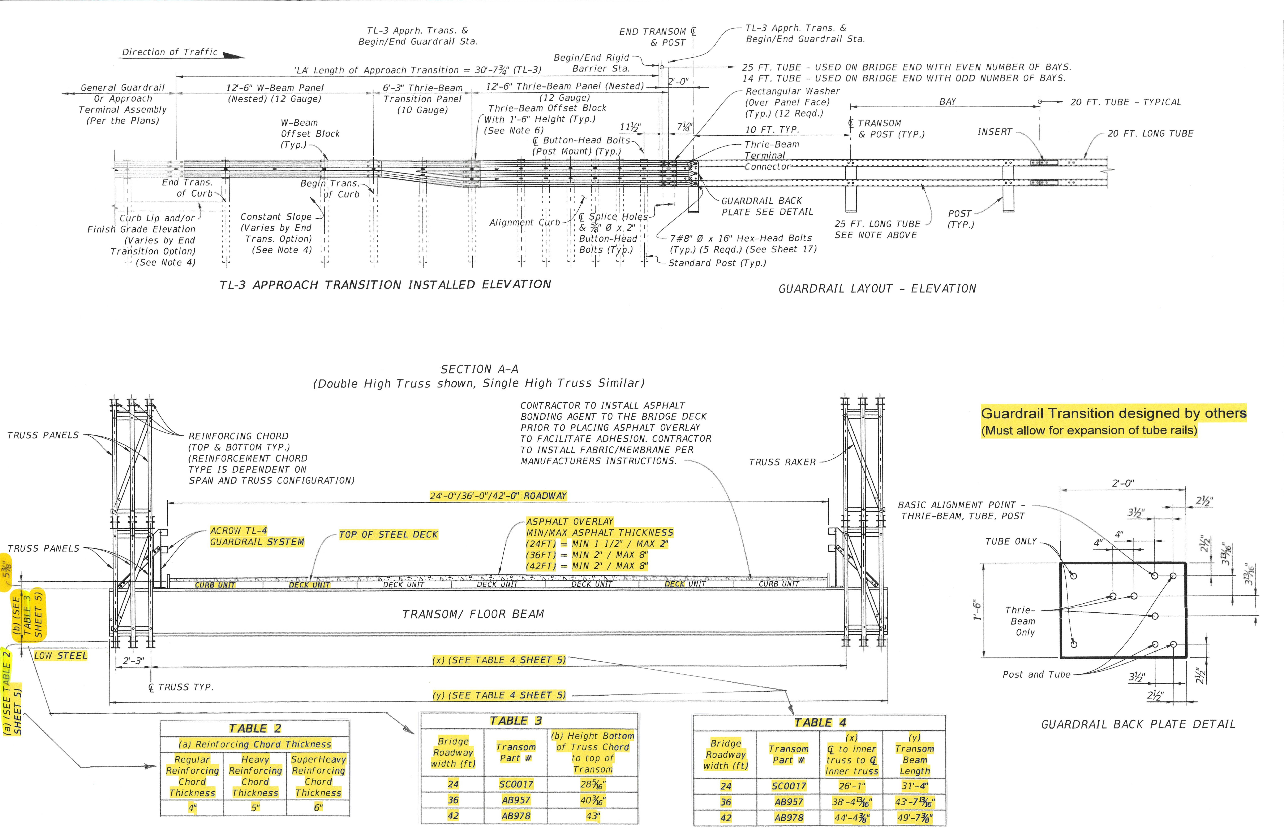
FDOT ACROW 700XS DESIGN STANDARDS / Beam & Guardrail Details
Notes:
1. Shows FDOT design for approach to bridge guard rail (not by Acrow). However, the guardrail transition must allow for expansion & contraction. 2. Since an asphalt overlay is required, guidelines for minimum & maximum asphalt overlay are provided to achieve crown profile. Table 2 shows the reinforcing chords thicknesses. FDOT owns plenty of regular chords, some Heavy chords, but no super heavy chords. Table 3 shows the measurements from bottom of truss chord to top of transom beam. The combination of the measurements from Table 2 and Table 3 and deck height of 5 – 3/8” will provide measurement of low steel to top of deck (without asphalt). Table 4 provides measurement between the C/Ls of the two inner trusses and the overall transom beam lengths. The transom beam lengths provides the out-to-out measurement for the bridge.

Slide 31
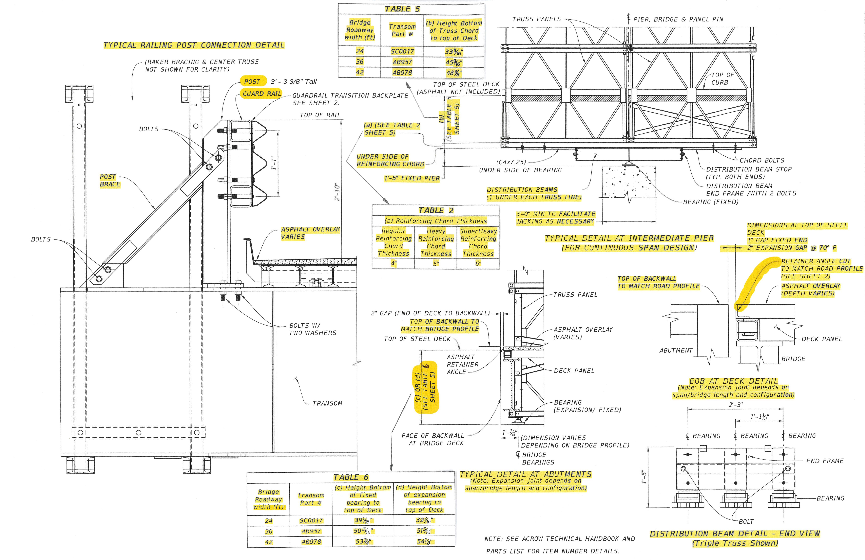
FDOT ACROW 700XS DESIGN STANDARDS / Other Typical Details
Notes:
1. Typical Railing Post Connection Detail - This shows a closeup of the guard rail system including the Post, Post Brace and 5” square tube rails. It also shows the FDOT thrie-beam and backplate. 2. Typical Detail at Intermediate Pier (continuous) The measurement of Table 5 which is the measurement of bottom truss chord to the top of deck plus the chord thickness gives you the low steel measurement. It also shows the measurement from the bottom of the fixed bearing to the underside of the reinforcing chord as 1’ – 5”. If this was an expansion bearing, it would add 3/8”. As I mentioned previously, the distribution beam can be located anywhere along the bottom of the truss panel. It does not have to be centered at the truss panel/transom connection. Also note that we recommend at least a 3ft wide pier and abutment seat to accommodate jacking if required. “Explain continuous vs broken”. Typical Detail at Abutments – Table 6 provides the measurement from the bottom of both the expansion bearing & fixed bearing to the top of deck (asphalt not included). EOB Deck Detail – Typical ~1” gap at the fixed bearing end 7 ~2” gap at the expansion bearing end. Notice that there is a retainer angle at the bridge end. This is typically tack welded onto the end-of-bridge deck unit to “retain” the asphalt. The top of the retainer angle is cut along the top to match the roadway profile. Distribution Beam Detail/End View – shows that there is a bearing and distribution beam for each truss line.

Slide 32
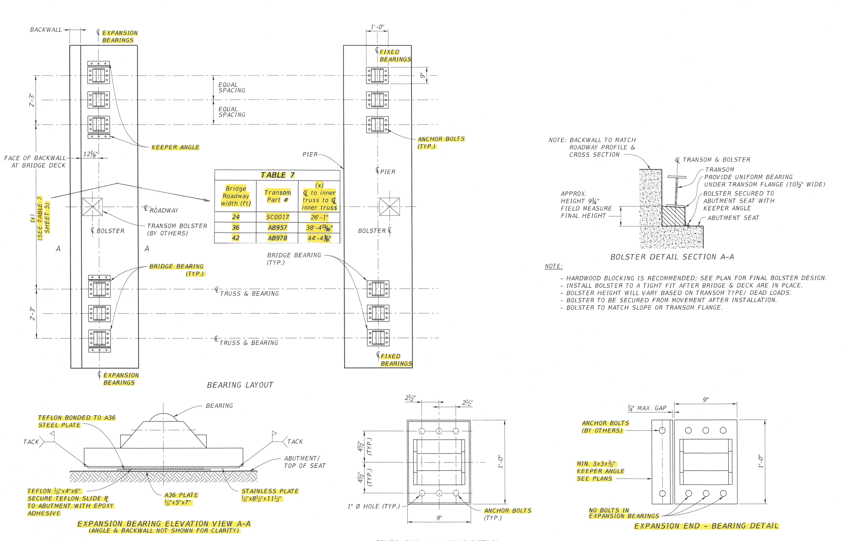
FDOT ACROW 700XS DESIGN STANDARDS / Bearing Layout Details
Notes:
1. Bearing Layout Details – Left end shows expansion bearings (notice Keeper Angles). Table 7 provides measurements between the C/L of the inside trusses for each bridge width. Notice that the fixed bearings utilize anchor bolts to secure to the abutment/pier seat. Only the keeper angles utilize anchor bolts for the expansion bearings.

Slide 33
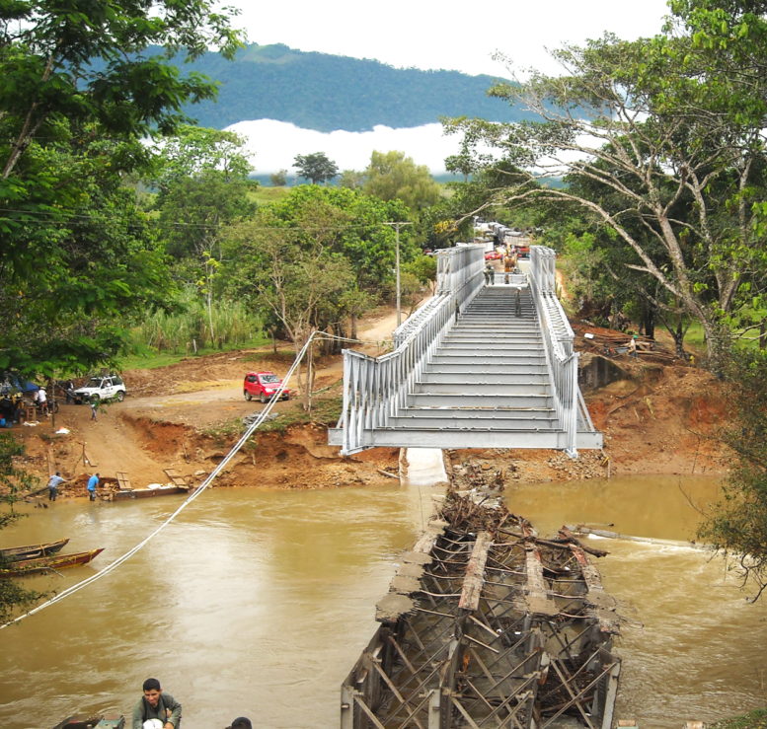
700XS Series
Cantilevered
The exact method & procedures are determined by site specific conditions such as bridge design, build area, equipment availability, grade and contractor experience. The goal is to keep the COG behind the home abutment.
2. Crane-Assisted
The exact method & procedures are determined by site specific conditions such as bridge design, build area, equipment availability, grade and contractor experience. Like with the cantilevered launch, the goal is to keep the COG behind the home abutment.
3. Crane Lift-in

Slide 34
Cantilevered

Slide 35
Crane-assisted

Slide 36
Crane Lift-in

Slide 37
FDOT ACROW 700XS DETOUR EXAMPLES
Considered Accelerated Bridge Construction (ABC)
Ensures safe detours around construction sites
Compliant with AASHTO and state design codes
Increases safety for motorists & workers
Rapidly installed in days
Expert site support services as required

Slide 38
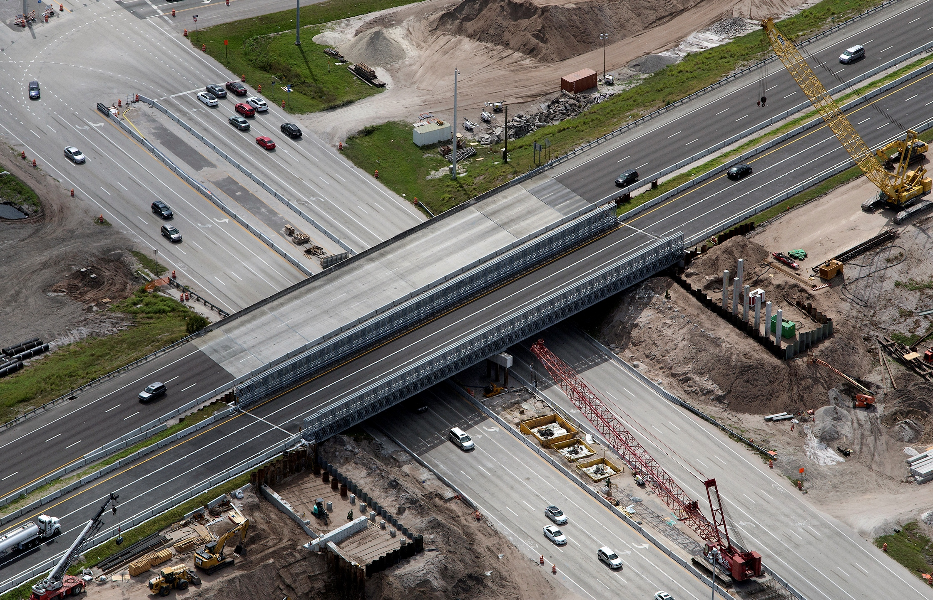
I-75 Sarasota, FL / Diverging Diamond
I-75 NB/SB
Heavily-travelled interstate traffic
In place for 2 years
2% crown using asphalt with paving fabric (fabric helps asphalt adhere to deck)
Length: 280’ two-span
Width: 42’ (widest yet in US)
Design Load: HL-93 + Florida 120 permit loads

Slide 39
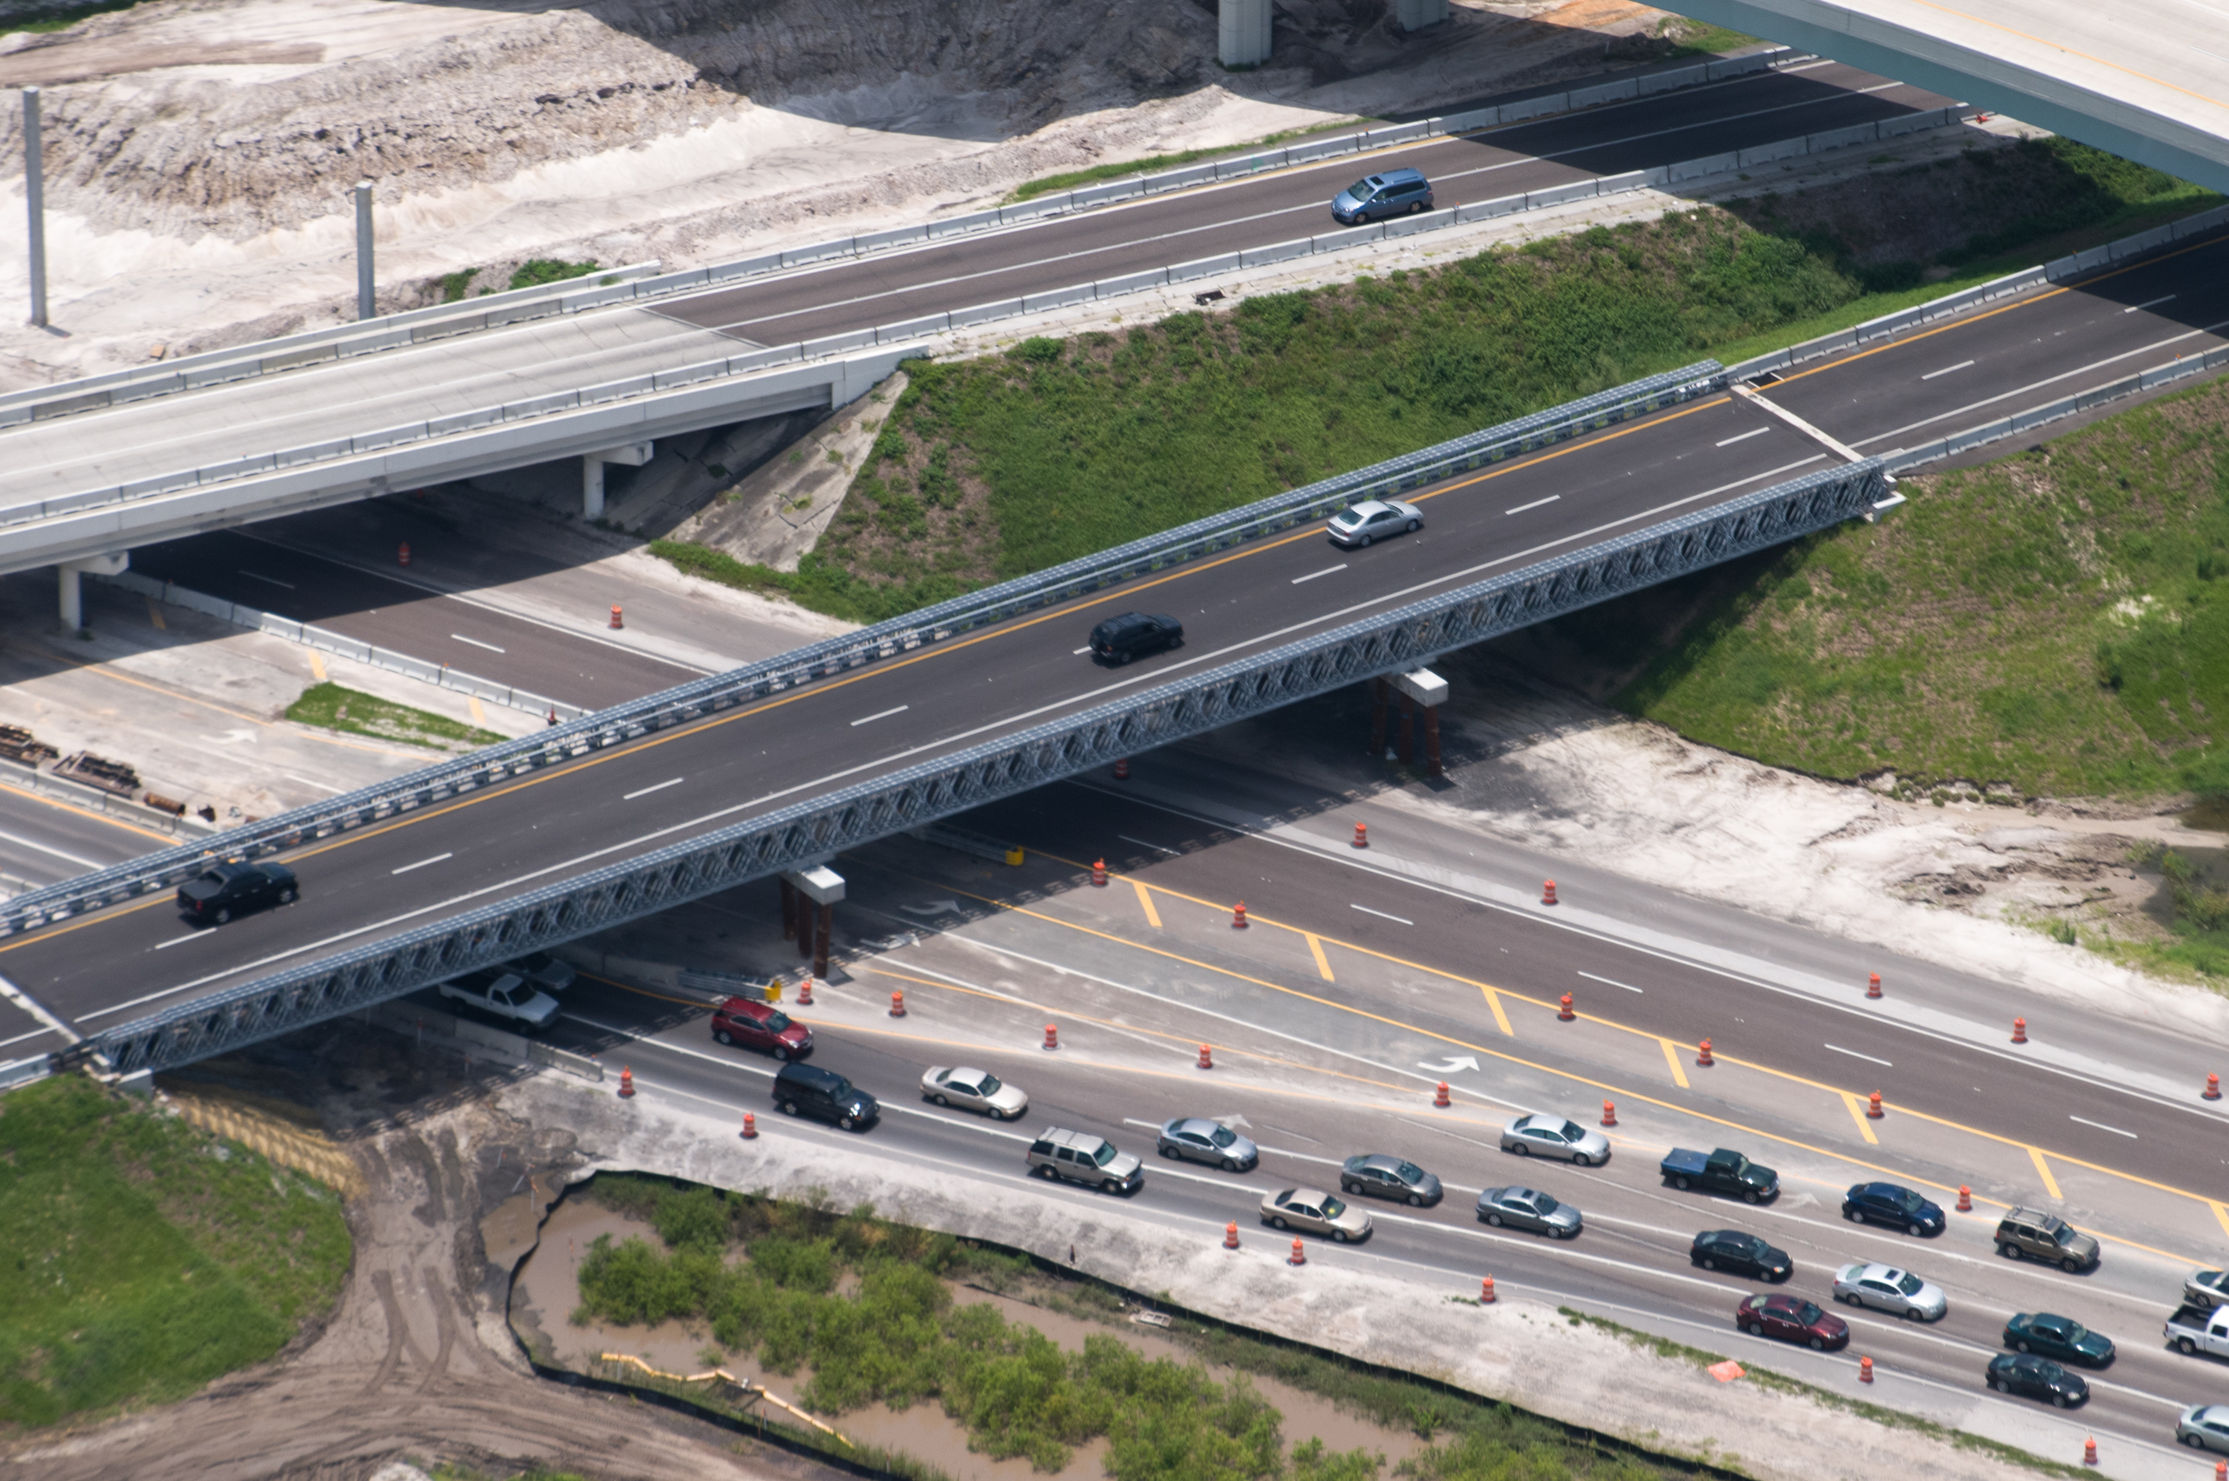
I-75 Tampa, FL / over Bruce B. Downs Blvd.
I-75 NB/SB
Heavily-travelled interstate traffic
In place for 2 years
Offset 2% crown using asphalt with paving fabric (fabric helps asphalt adhere to deck)
Length: 320’ three-span
Width: 36’ for 2-lanes
Design Load: HL-93 + Florida 120 permit loads

Slide 40
700XS Series
Superelevated/Cross Sloped Roadways
Starting to see more requirement for an increasing amount of cross slope
A cross slope can be achieved in different ways on a truss panel bridge
  Asphalt overlay higher on one side with a 2” thick base layer
    Membrane required for highway bridges to assist with asphalt adhesion.
    SC0017 24’ roadway transom -> 2” base + 4” asphalt on high side = 1.4% cross slope. (The SC0017 transom can only accept a 2” average max overlay using HL93 design load)
    AB957 36’ roadway transom -> 2” base + 4” asphalt on high side = 0.92% cross slope
    AB978 42’ roadway transom -> 2” base + 4” asphalt on high side = 0.8% cross slope
  Tilt Bridge (NOT PERMITTED). Per AASHTO bridge girders “must” be in vertical plane.
  PREFERRED - Prefer a crown be designed into the bridge profile, or an even layer of asphalt applied. Special transoms with cross slope built in can be utilized but they are not part of the FDOT inventory.

Slide 41
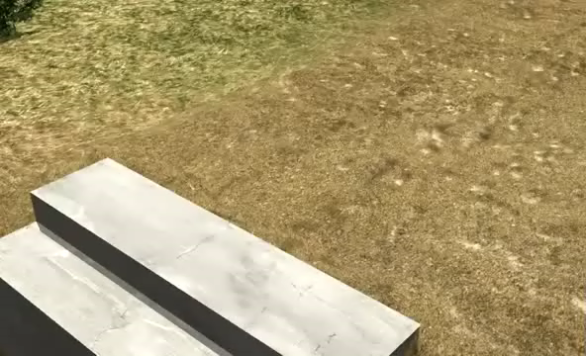
CANTILEVER INSTALLATION

Slide 42

Safety Message

Slide 43


Contact Us
Thank you!
Bruno Vasconcelos, PE
o: 850-410-5808 | c: 850-688-7061
https://www.fdot.gov/maintenance/acrow-bridge
Will Smith, SE:
o: 251-928-8450 | c: 251-408-1340
wsmith@acrow.com

