Slide 1


Florida Department of Transportation – District Six
Put it Down – Distracted Driving Awareness Campaign

Slide 2

OFFICIAL CAMPAIGN PSA
PSA available in 15, 30 and 60-second versions
English and Spanish
Links to YouTube video and downloadable versions available
https://youtu.be/NHKVf2MkN4w

Slide 3
CAMPAIGN OBJECTIVES
Educate the public about the dangers of distracted driving and the reality of its consequences, including the new Florida State law
Provide drivers with steps to eliminate distracted driving within their families, schools, businesses or organizations
Help eliminate crashes attributable to distracted driving
Build partnerships within the community that maximize existing communications resources and spread the safety message to as many people as possible

Slide 4
CAMPAIGN MESSAGING
Next time you’re behind the wheel, just PUT IT DOWN!
  Put it Down – It Can Wait
  Put it Down – It’s the Law
  Put it Down – Don’t Text and Drive
Target Audience:
  Primary: Ages 16 to 24
  Residents of Miami-Dade and Monroe Counties

Slide 5
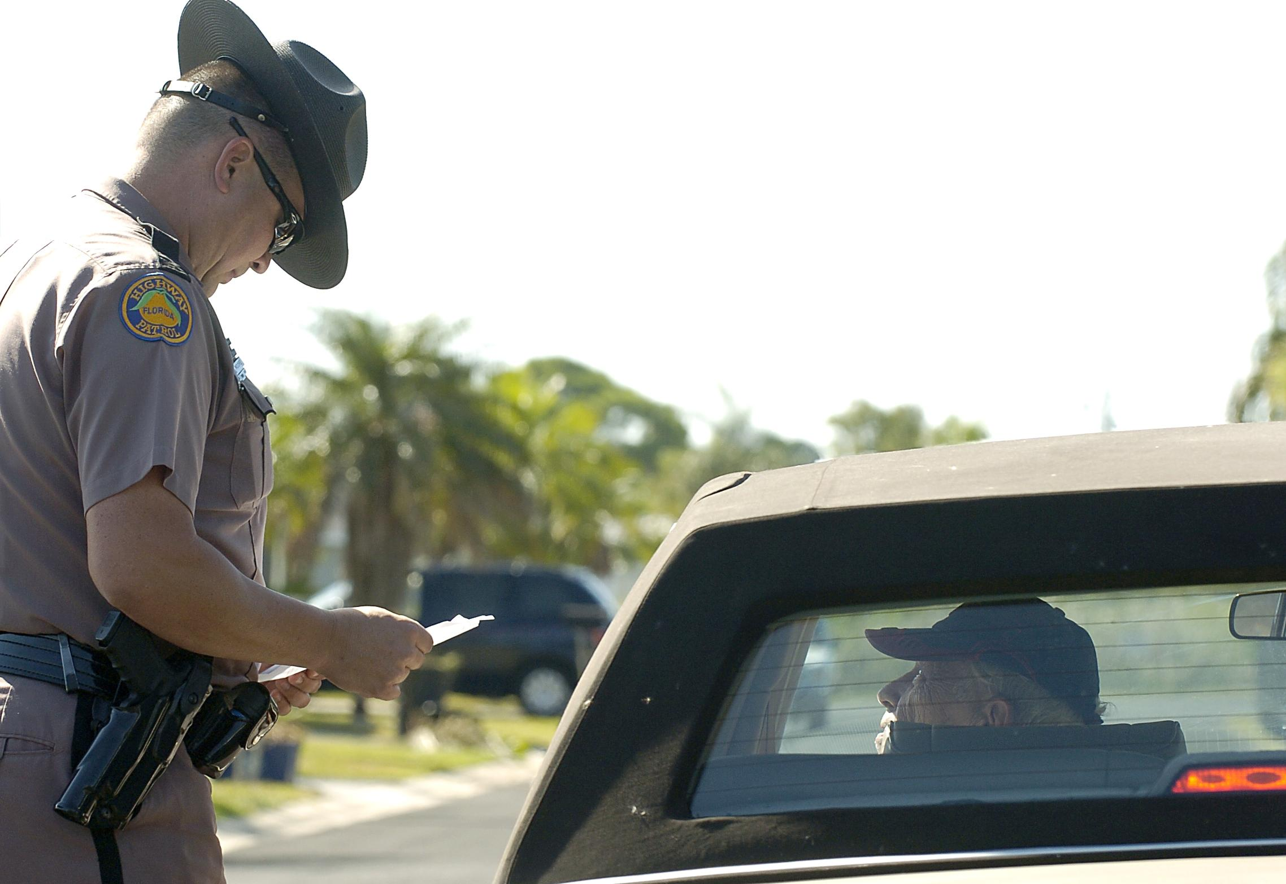
NEW FLORIDA STATE LAW
Starting July 1, 2019, Florida motorists can be stopped and cited for texting and driving.
  First violation: non-moving offense with no points
  Second violation: moving violation with three points
  FHP Troopers will issue warnings through December 31, 2019, to provide drivers with additional education of the new law. Exceptions would apply in extremely dangerous driving situations.
Starting October 1, 2019, wireless communications devices can only be used in a handsfree manner when driving in a designated school crossing, school zone, or active work zone area.
Starting January 1, 2020, drivers will be cited for using any wireless communication devices in a handheld manner in a work zone or school zone.

Slide 6

STATISTICS/FACTS
Distraction is present during 52% of normal driving
Texting takes your eyes off the road for an average of 4.6 seconds; that is like driving the length of a football field at 55mph, blind
Cell phone use is highest among 16 to 24-year-old drivers
Teens whose parents drive distracted are 2
to 4 times more likely to also drive distracted

Slide 7

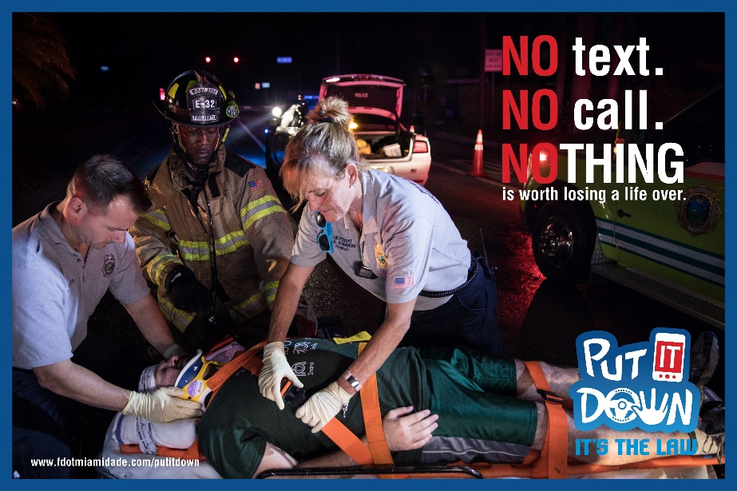
CAMPAIGN MATERIALS
Three Languages (English, Spanish and Creole)
Posters
TV Monitor Images
Web Banners
Email Blasts
Social Media Images
Trilingual brochure
Pledge Card

Slide 8
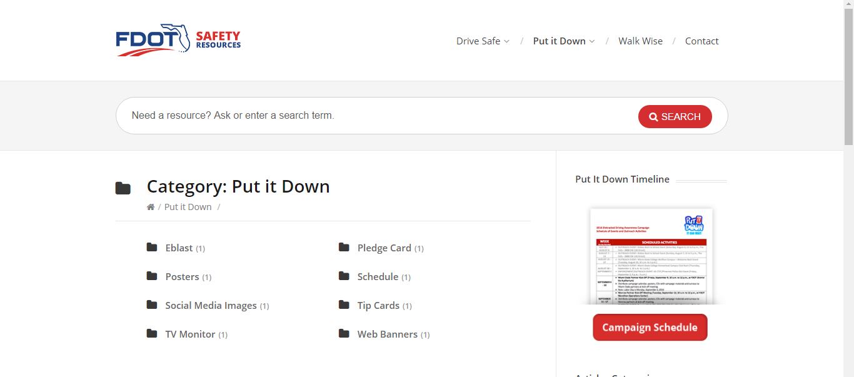

HOW YOU CAN HELP
Promote the campaign messages by using our free resources tool link: www.fdotsafetyresources.com
Track your social media outreach and share with FDOT.

Slide 9


FOR MORE INFORMATION
Carlos Sarmiento
Community Traffic Safety Program Coordinator
Florida Department of Transportation - District 6
Phone: (305) 470-5437 Email: carlos.sarmiento@dot.state.fl.us
Jeanette Gorgas
Senior Public Information Officer
Media Relations Group, LLC
Phone: (786) 607-3004 Email: JGorgas@mrgmiami.com

