Slide 1
Florida Department of Transportation – District Six
Community Traffic Safety Team (CTST) Program

Slide 2
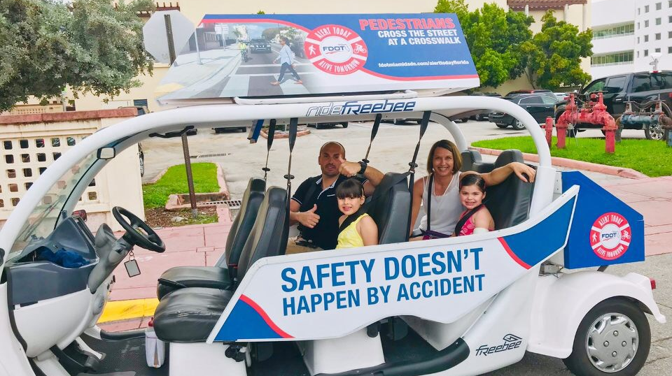
THE CHALLENGE
How can we bring traffic safety to our communities?

Slide 3
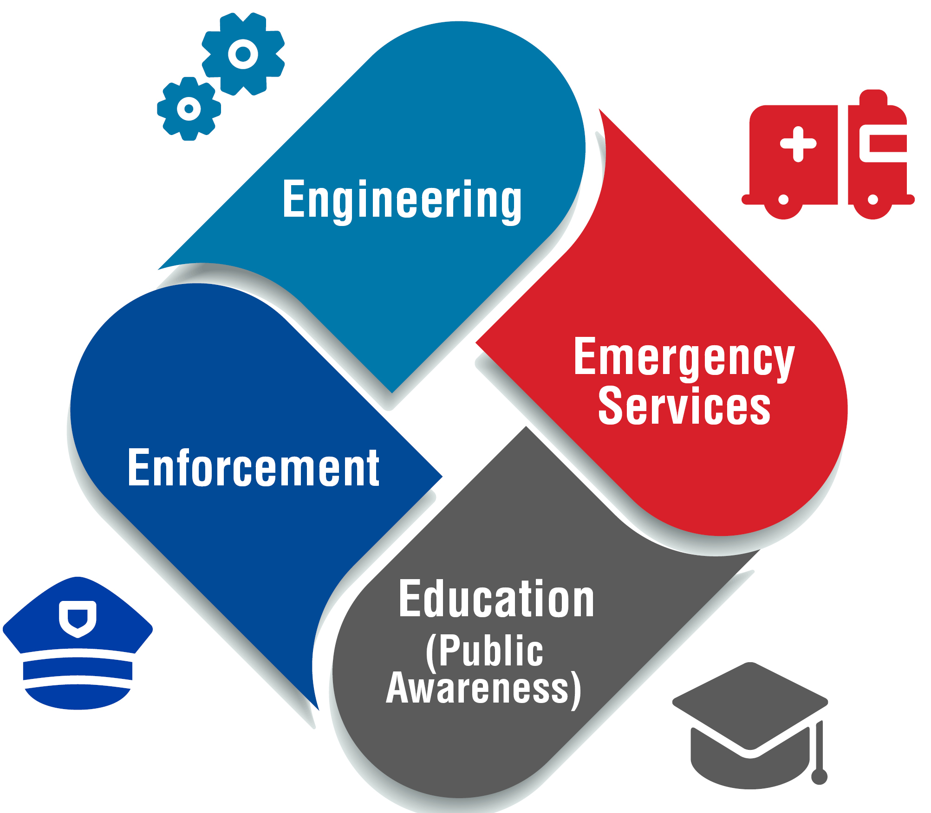
THE CTST PROGRAM MISSION
The Four “E” Approach

Slide 4
DEVELOPING A CTST
Law Enforcement (State, County, Municipal agencies)
FDOT/Local Public Works
Traffic Safety Organizations
School Representation
Community Leadership
Medical Trauma Representation
Emergency Services
Media
Motivated Citizens

Slide 5
DISTRICT SIX CTST TEAMS
Miami-Dade County
  NE CTST
  NW CTST
  SE CTST
  SW CTST
  Miami-Dade County Public Schools CTST
  University of Miami CTST
  Florida International University CTST
  Miami CTST
  Miami Beach CTST
  Miami Lakes CTST
Monroe County
  Upper Keys CTST
  Marathon CTST
  Key West CST

Slide 6
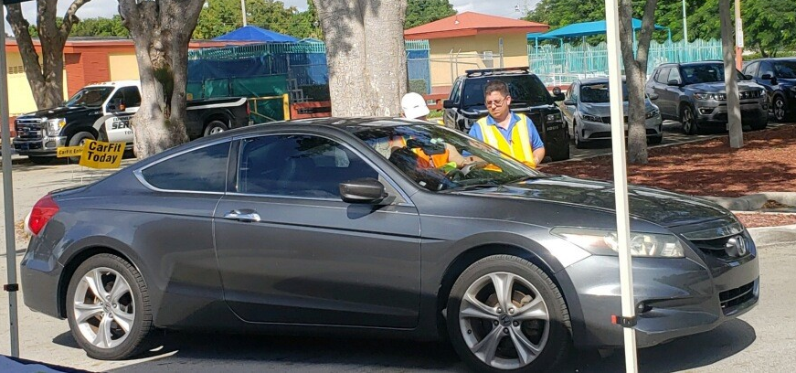
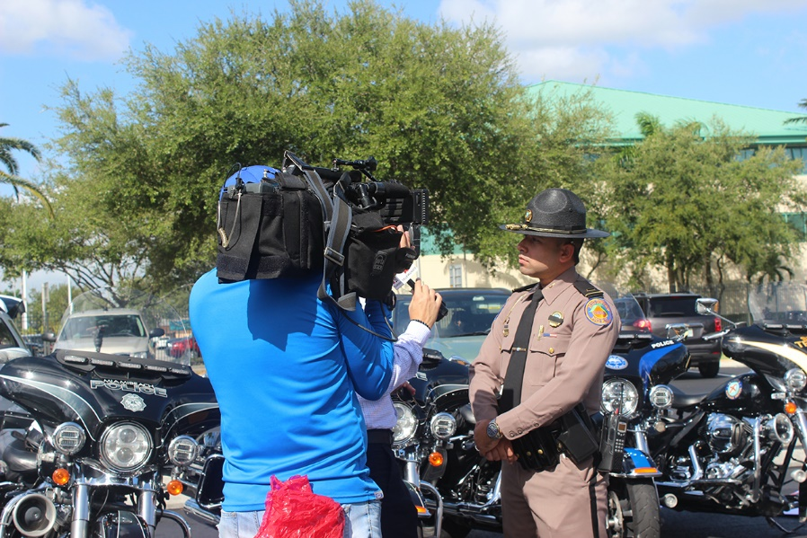
STATE AND LOCAL INITIATIVES
Multi-agency Enforcement/Educational Operations
Multi-agency DUI Checkpoints
Car Seat Checkpoints
CarFit
Bike Rodeos/Bike Safety Events
Pedestrian Safety Events
Traffic Safety Fairs/Educational Outreach
Safe Routes to School

Slide 7



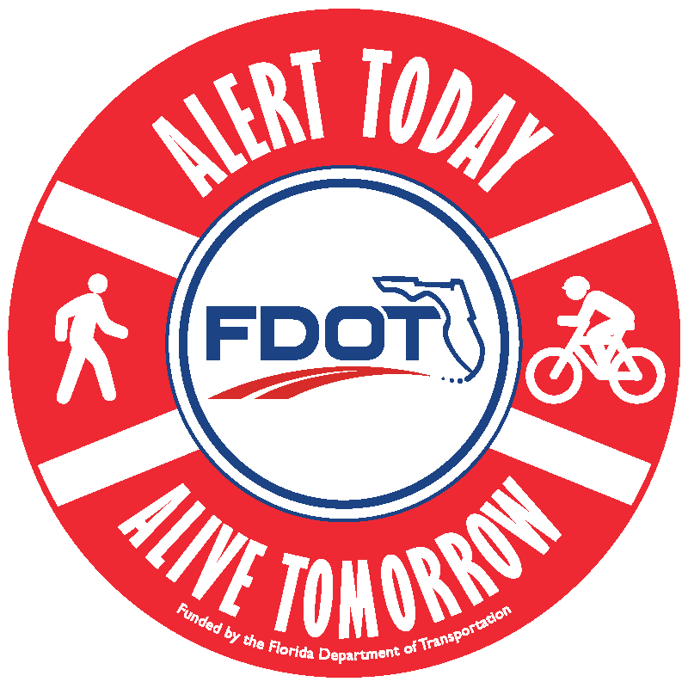


TRAFFIC SAFETY CAMPAIGNS & PROGRAMS

Slide 8

AGGRESSIVE DRIVING AWARENESS CAMPAIGN – DRIVE SAFE
Educate the public about the dangers of aggressive driving and the reality of its consequences​
Provide tips to eliminate aggressive driving​
In online surveys of Floridians, aggressive driving is always identified in the public's top three issues of traffic safety​
Speeding is one of the most prevalent aggressive behaviors
Support local law enforcement agencies with multi-agency education/enforcement operations​

Slide 9

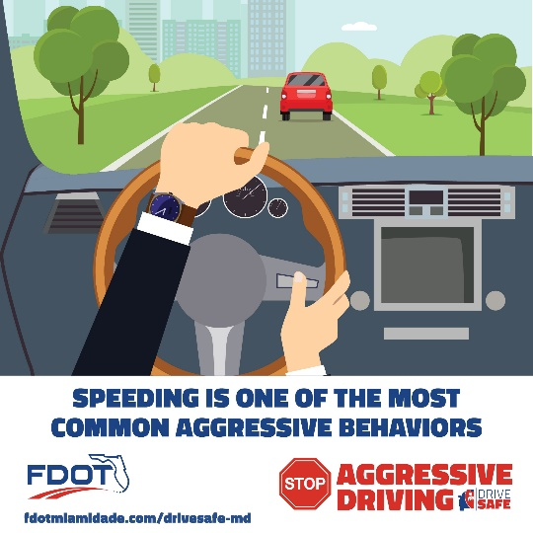
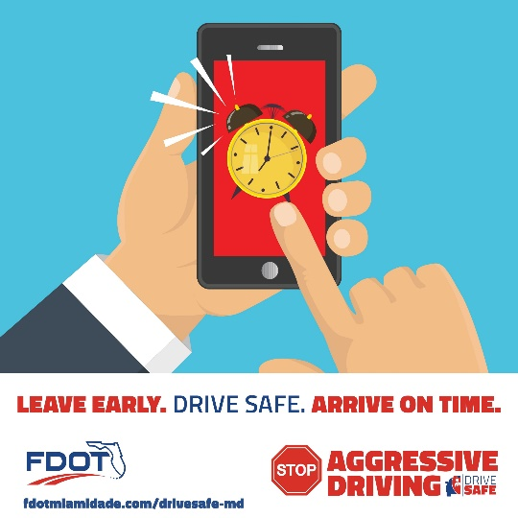
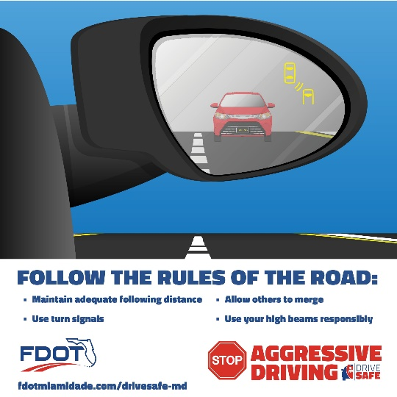
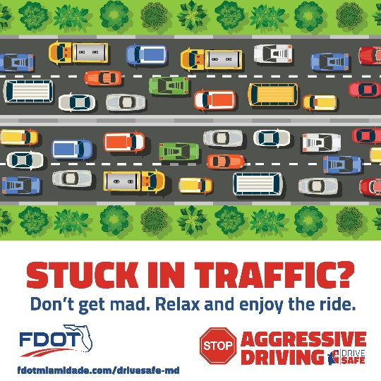
CAMPAIGN MATERIALS

Slide 10

DRIVE SAFE BY THE NUMBERS
 | 2016 | 2017 | 2018 | 2019
Campaign Partners | 85 | 90 | 104 | 119
Outreach Events | 47 | 68 | 76 | 26
Multi-Agency Enforcement Operations | 11 | 7 | 11 | 8
Overall Campaign Impressions | 23.1 million | 96.4 million | 56.5 million | 56.7 million

Slide 11




MOTORCYCLE SAFETY AWARENESS CAMPAIGN – RIDE SMART
May is Motorcycle Safety Awareness Month
Encouraging all road users to share the road and watch for motorcycles

Slide 12
ALERT TODAY, ALIVE TOMORROW CAMPAIGN
Educate the community about the dangers of:​
  Jaywalking​
  Drivers not yielding to pedestrians when making left or right-hand turns​
  Bicyclists riding against traffic​
Provide tips to eliminate unsafe behaviors
Build partnerships within the community that maximize existing communications resources and spread the safety message to as many people as possible​
Support local law enforcement agencies with multi-agency education/enforcement operations​

Slide 13
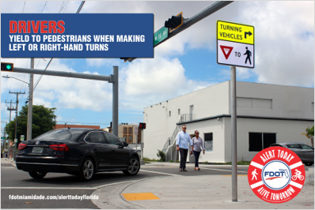
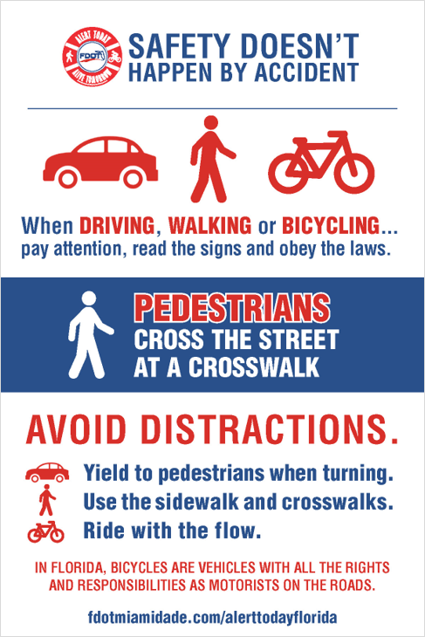
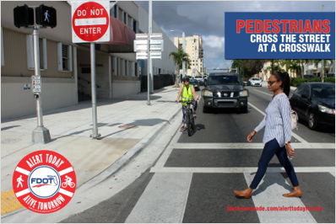
CAMPAIGN MATERIALS

Slide 14
ATAT BY THE NUMBERS
 | 2019
Campaign Partners | 62
Outreach Events | 10
Multi-Agency Enforcement Operations | 2
Overall Campaign Impressions | 10 million

Slide 15

DISTRACTED DRIVING AWARENESS CAMPAIGN – PUT IT DOWN
Educate the public about the dangers of distracted driving and the reality of its consequences, including the new Florida State law
Provide drivers with steps to eliminate distracted driving within their families, schools, businesses or organizations
Texting takes your eyes off the road for an average of 4.6 seconds; that is like driving the length of a football field at 55mph, blind
Teens whose parents drive distracted are 2 to 4 times more likely to also drive distracted

Slide 16
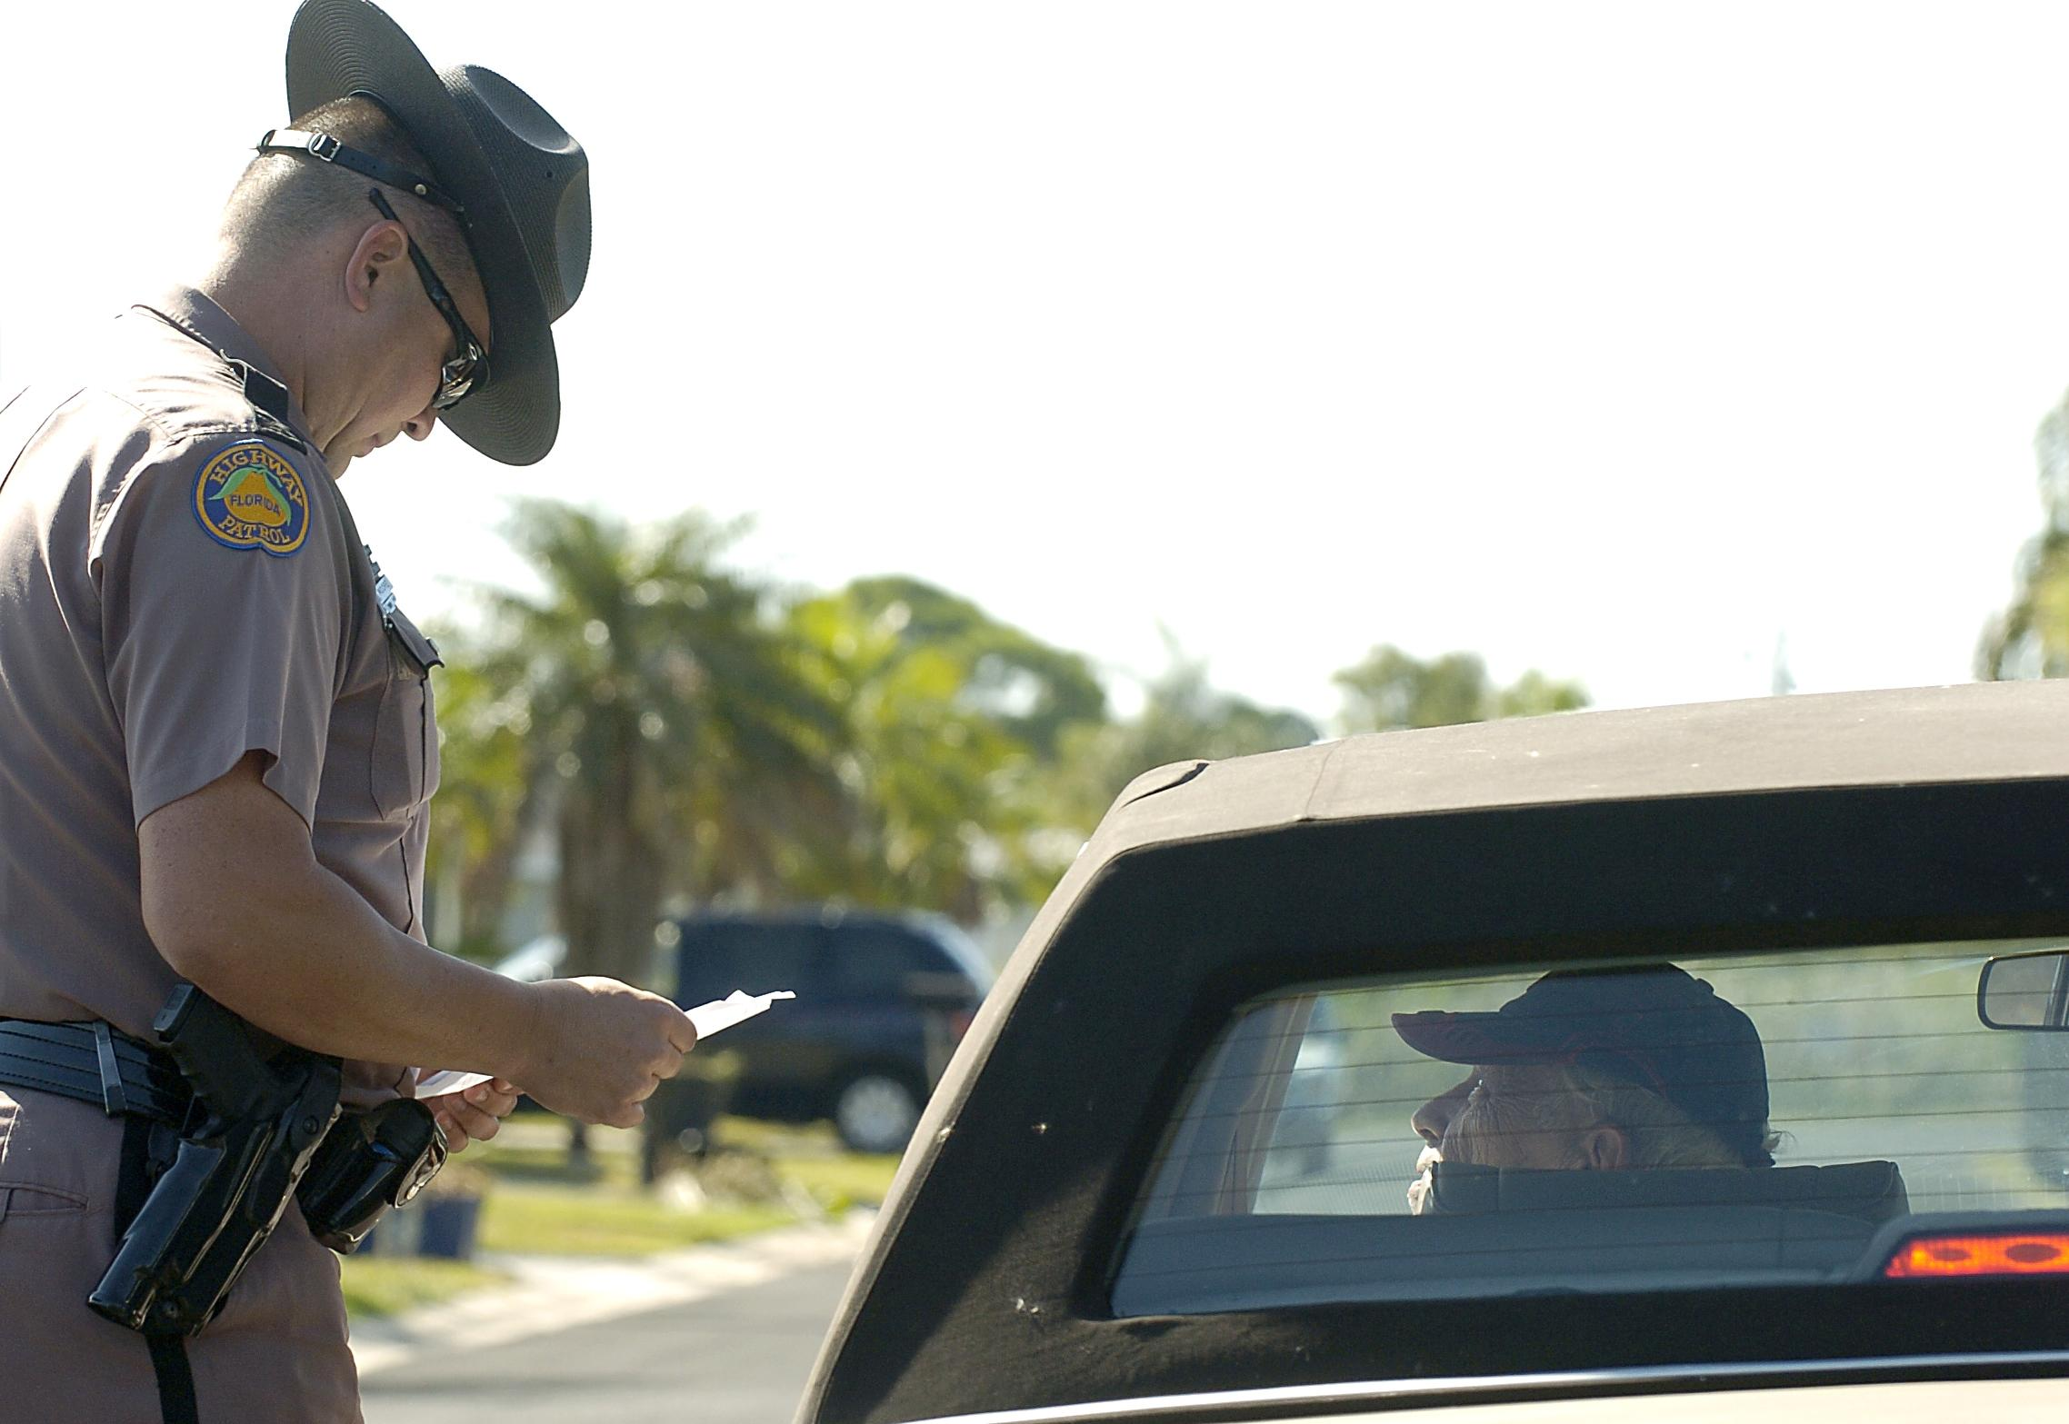
NEW FLORIDA STATE LAW
Starting July 1, 2019, Florida motorists can be stopped and cited for texting and driving.
  First violation: non-moving offense with no points
  Second violation: moving violation with three points
  FHP Troopers will issue warnings through December 31, 2019, to provide drivers with additional education of the new law. Exceptions would apply in extremely dangerous driving situations.
Starting October 1, 2019, wireless communications devices can only be used in a handsfree manner when driving in a designated school crossing, school zone, or active work zone area.
Starting January 1, 2020, drivers will be cited for using any wireless communication devices in a handheld manner in a work zone or school zone.

Slide 17
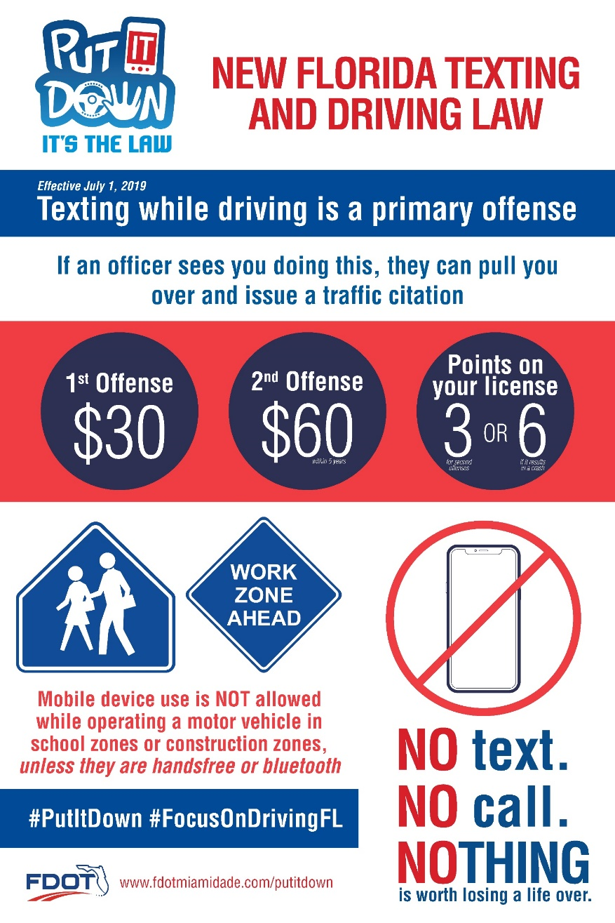

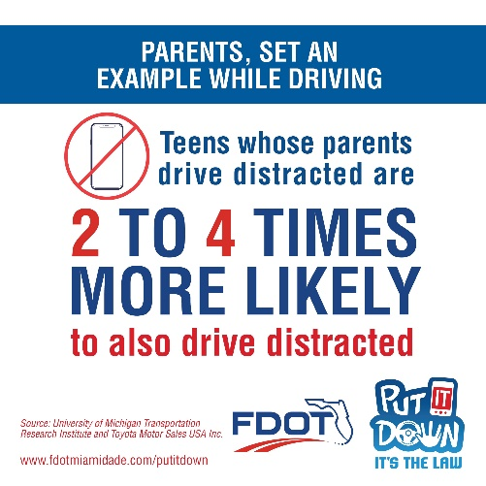
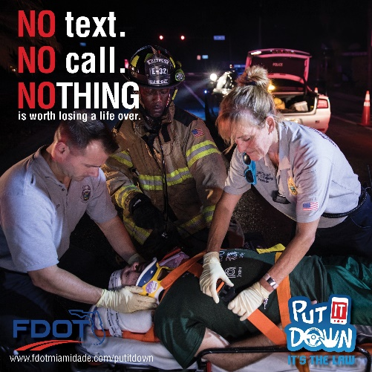
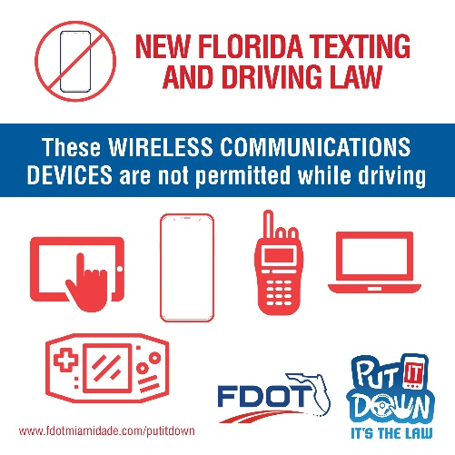

CAMPAIGN MATERIALS

Slide 18
PUT IT DOWN BY THE NUMBERS
 | 2011 | 2012 | 2013 | 2014 | 2015 | 2016 | 2017 | 2018 | 2019
PARTNERS | 7 | 13 | 40 | 98 | 108 | 112 | 120 | 135 | 160
OUTREACH EVENTS | 14 | 22 | 40 | 73 | 72 | 64 | 53 | 78 | 157
CAMPAIGN IMPRESSIONS | 3.1 million | 6.0 million | 40.3 million | 38.6 million | 61.5 million | 114.5 million | 76.2 million | 153.8 million | 353.3 million

Slide 19

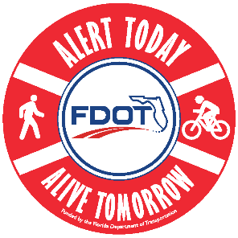



FOR MORE INFORMATION
Carlos Sarmiento
Community Traffic Safety Program Coordinator
Florida Department of Transportation - District Six
Phone: (305) 470-5437
Email: Carlos.Sarmiento@dot.state.fl.us

