Slide 1
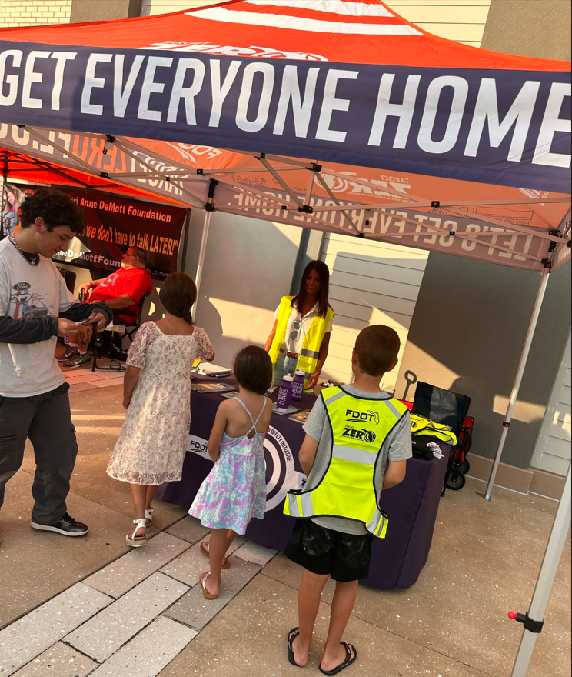
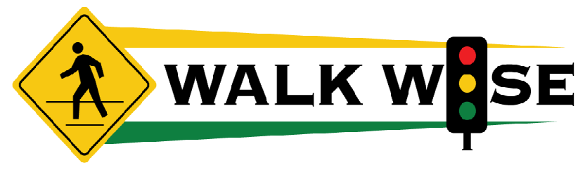
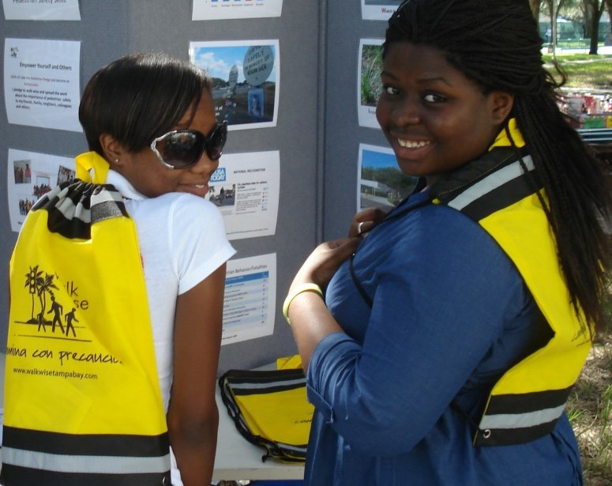



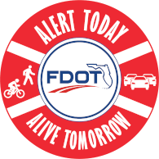
Safety Tips for People who Walk, Bike, and Drive
Notes:
Hi, I’m XXX, here on behalf of the FDOT to talk to you about Safety.
Safety is the top priority for FDOT and we’re going to talk about Safety for when you are out Walking, Biking and Driving
We offer these safety tips as part of WALKWISE, and we’ll learn what those letters stand for.

Slide 2

Today’s Agenda
Tips for safer walking, biking, and driving
Ask questions! Get answers!
Take the WalkWise pledge and receive a WalkWise bag
How you can help
Notes:
Today’s Agenda includes these Tips for Safer Walking, Biking and Driving
Please ask questions. Some of these safety rules may be different from other places where you’ve lived or may be different from your own experiences.
We’ll take a pledge to be WALKWISE and then I’ll give out our WalkWise bags which contain safety gear and more safety information.
Then we hope you’ll help by further sharing this information.

Slide 3
On average, how many people die each day in Florida due to traffic crashes?
0 to 3 people
4 to 7 people
8 to 10 people
11 to 15 people
Notes:
First, let’s see if anyone knows:
On average, how many people die every day in Florida due to traffic crashes?
By a show of hands, how many people think it’s A – 0 to 3 people?
How many think it’s B – 4 to 7 people
How many think it’s C – 8 to 10 people
And how many think it’s D – 11 to 15 people?
The correct answer is C – 8 to 10 people.

Slide 4

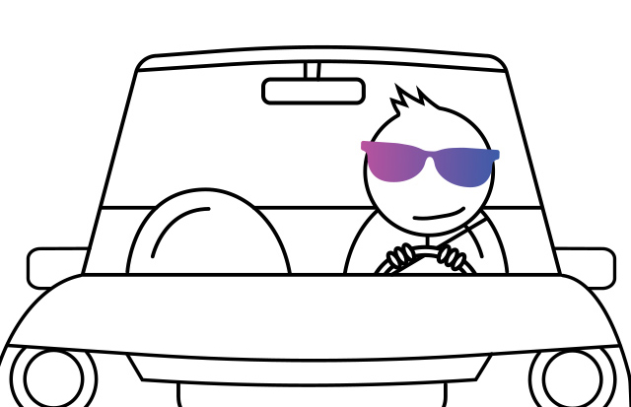
An average of 9 people die and 49 people are seriously injured on Florida’s roadways EACH DAY.
Safety Begins with Me!
Safety Begins with You!
Notes:
Every day in Florida, an average of 9 people die and 49 people are seriously injured on Florida’s roadways.
For those who thought that it was D – 11 to 15 people, you may have been thinking of those who were in severe crashes. Thanks to medical advancements, more people are able to survive those crashes.
But still, 9 people dying each day is too many.
The only acceptable number is Zero. That’s why Florida has a Target Zero. We are aiming to reduce road fatalities and serious injuries to Zero.
Safety Begins with Me
Safety Begins with You

Slide 5
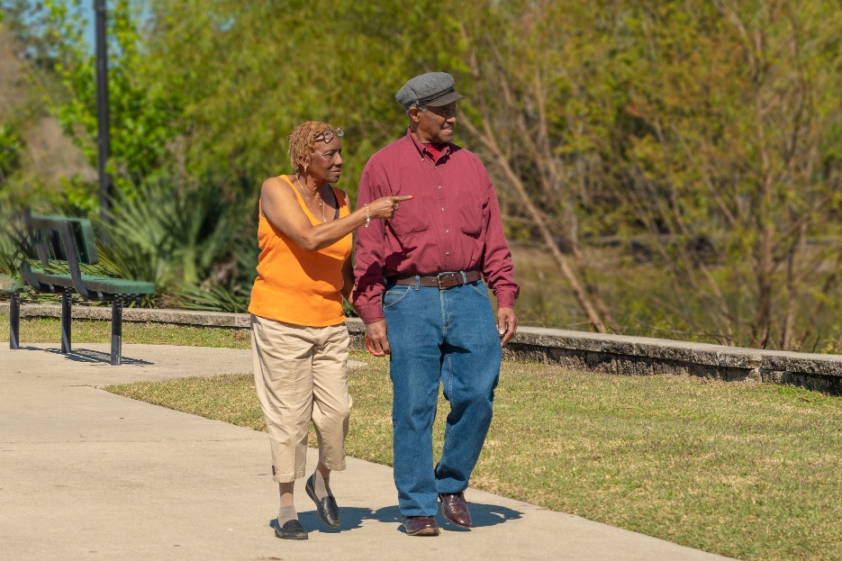
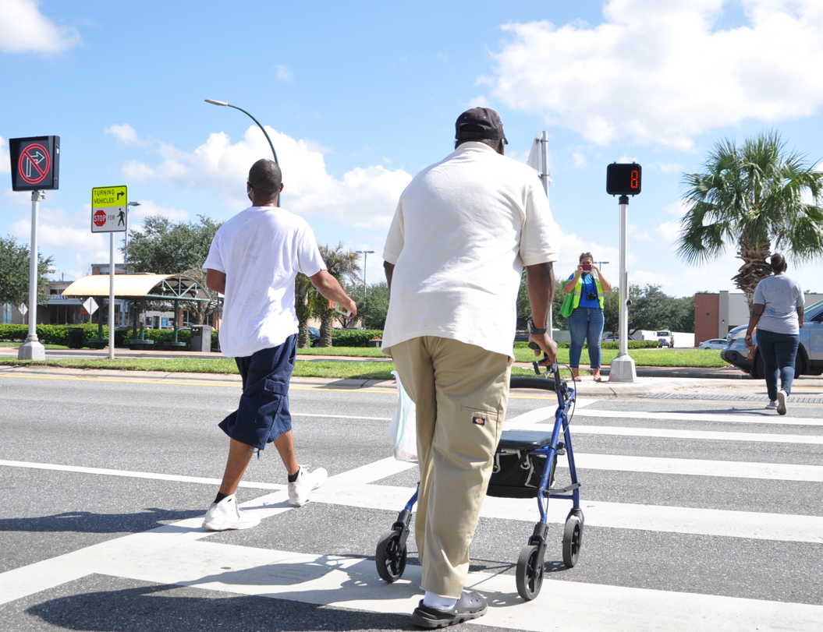
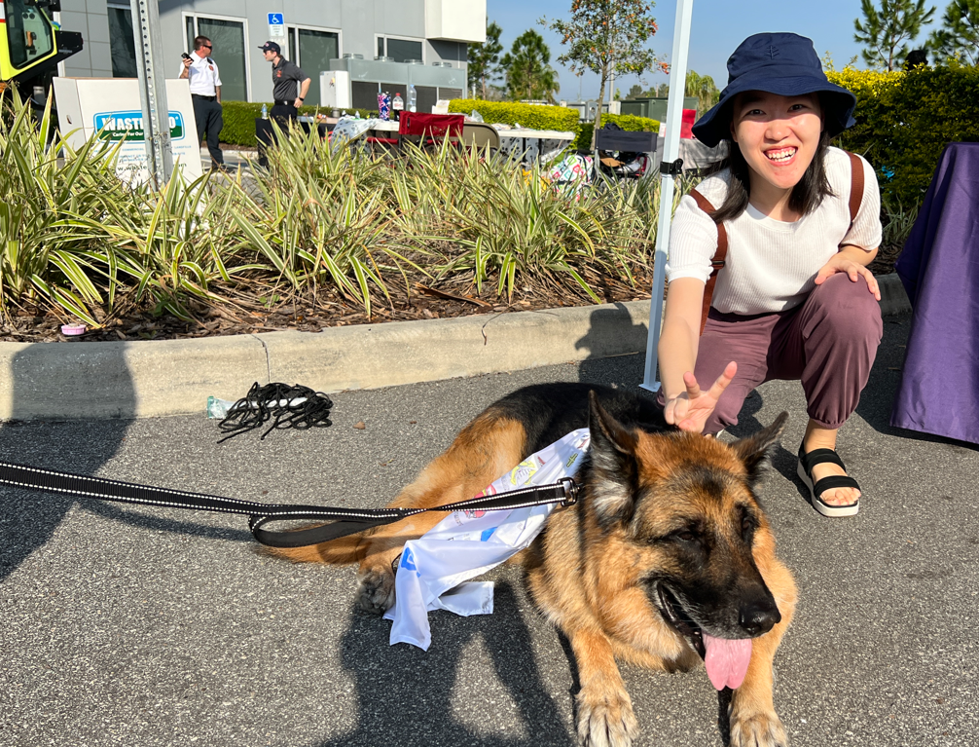
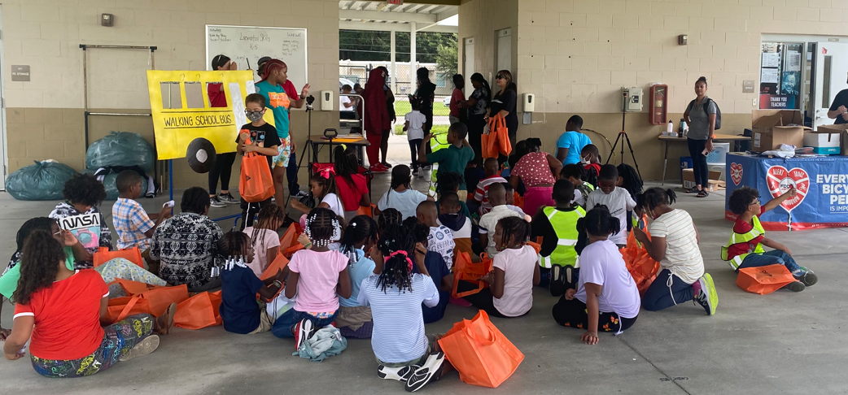
Who is a pedestrian?
Notes:
So who is a pedestrian?
These photos show various people – a couple on the sidewalk, a man with a walker in a crosswalk, a woman and a dog, and several school children.
Are all of these people pedestrians?
Are all of us pedestrians?
Yes, at some point in the day, we are pedestrians, walking outside.

Slide 6
In your opinion, how safe are the roads in Florida
for people who walk and bike?
Very safe
Somewhat safe
Neither safe nor unsafe
Somewhat unsafe
Very unsafe
Notes:
Let’s talk about how you feel about walking and biking outside.
In your opinion, how safe are the roads in Florida for people who walk and bike?
By a show of hands, how many people think the roads are very safe?
Somewhat safe?
Neither safe nor unsafe?
Somewhat unsafe?
Or do you think the roads are very unsafe for people who walk and bike?

Slide 7
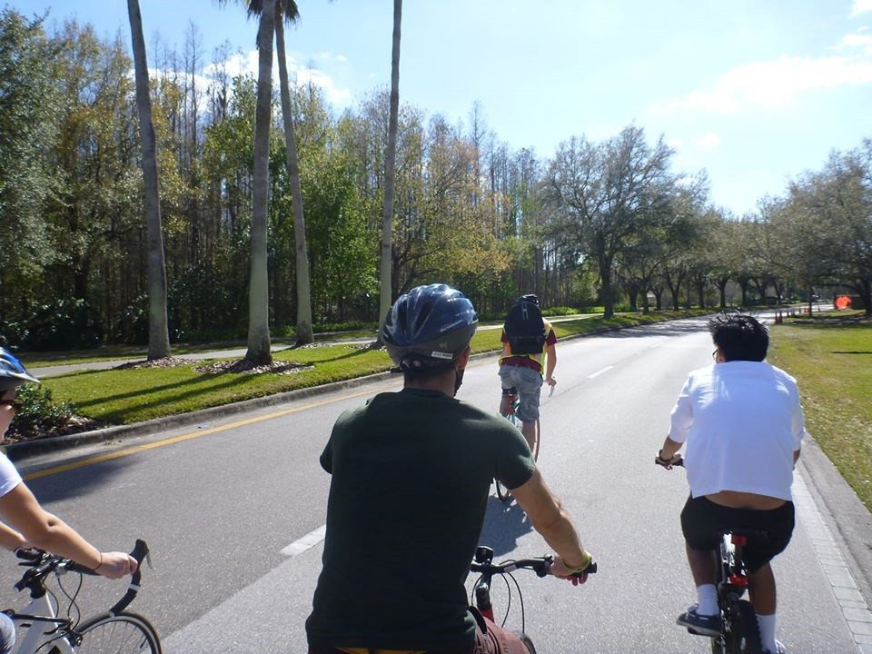
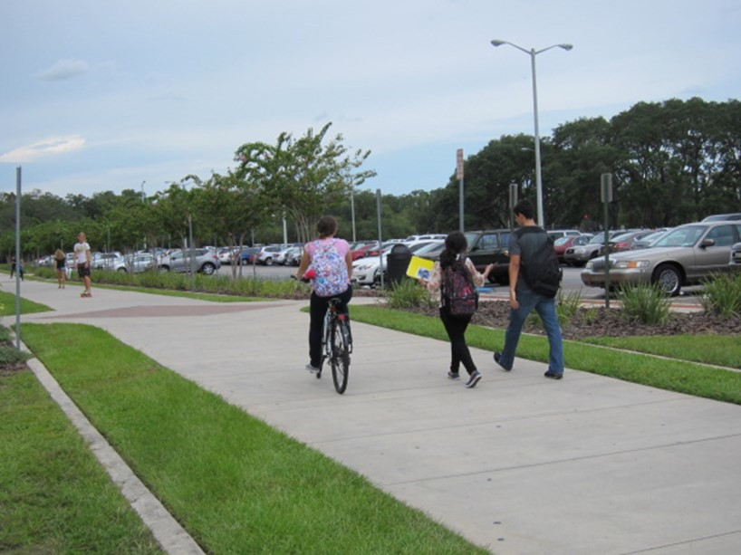
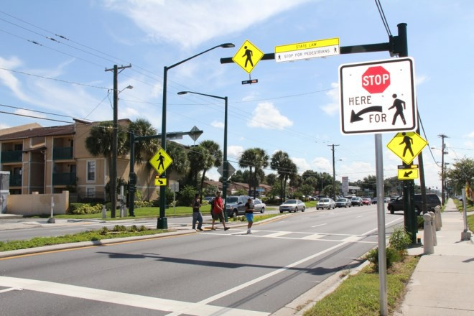
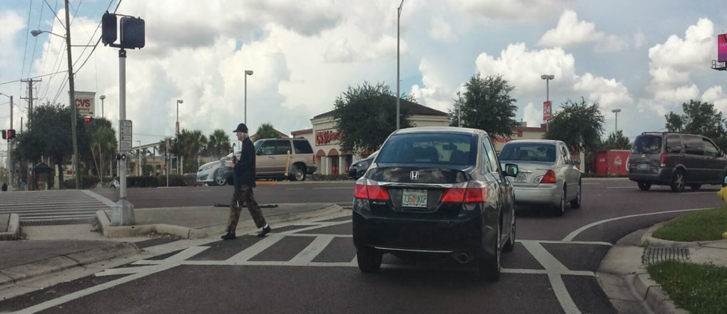
What makes you feel safe or unsafe?
Notes:
Let’s talk more about that. What makes you feel safe or unsafe when you walk or bike?
(Allow some discussion)

Slide 8
When sidewalks are not provided on a roadway,
where should you walk?
Walk facing traffic
Walk in the same direction as traffic
I don’t know
Notes:
So let’s talk about your safety as a pedestrian.
When there are no sidewalks, in which direction should you walk?
With a show of hands, do you think you should walk facing traffic?
Or should you walk in the same direction as traffic?
Or maybe you don’t know.
The answer is A, You should walk facing traffic.

Slide 9
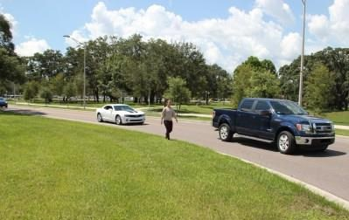
WITH
WALK FACING TRAFFIC
FACING
Notes:
When you walk facing traffic, you are able to see what is happening and are able to react to it.
When you walk with traffic, vehicles are coming up behind you and you can’t see them coming, potentially making you more vulnerable.

Slide 10
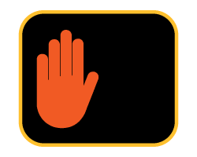
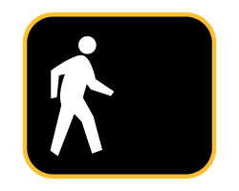
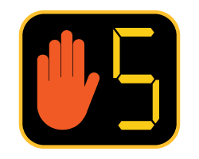

At a crosswalk with a pedestrian signal, you should START crossing with which of the following signals:
A. Flashing Hand
B. Steady Walking
Flashing Hand with countdown
Steady Hand
Notes:
At a crosswalk with a pedestrian signal, when should you START crossing the road?
Again, with a show of hands, should you A. start crossing when you see a flashing hand
B. Start walking with the steady walking symbol
C. Start walking with the flashing hand and a countdown
Or D. Start walking with the steady hand.
The Answer is B. Start crossing with the Steady Walking Symbol

Slide 11
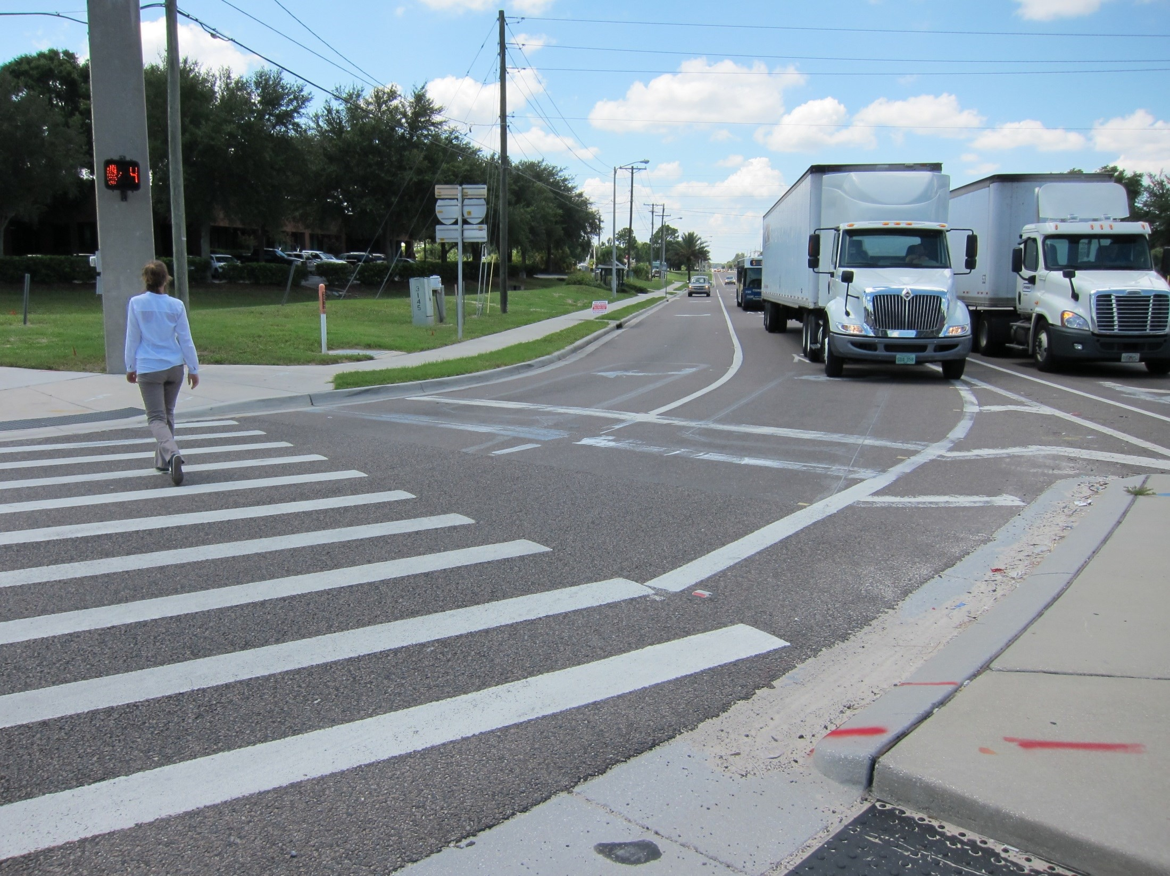
Notes:
At a lighted pedestrian crosswalk, the steady walking symbol will appear when it’s time to cross the street. Pedestrians will have a few seconds head start to begin crossing before the parallel traffic gets a green light. This is called a leading pedestrian interval.
The crosswalk will then display the flashing hand, usually with a countdown. The means the time to cross the street is limited. You should be cautious about crossing then because there may be traffic making a right turn and they may not be able to yield to you.

Slide 12
Is jaywalking a crime?
True
False
I don’t know
Notes:
Is jaywalking a crime?
By a show a hands, who thinks this is true?
Who thinks this is false?
Who doesn’t know?
The answer is B. It is false.

Slide 13
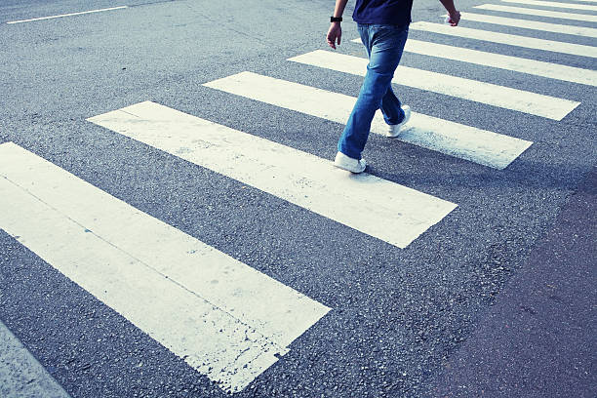
“Jaywalking” is not a term used in Florida law.
Jaywalking refers to a person crossing a road where there are no marked crosswalks. Though not specifically illegal, it can be unsafe.
A person driving a vehicle may not be ready to stop for a person who is crossing the road outside of a marked or unmarked crosswalk.
Notes:
Jaywalking means walking across a road where there are no marked crosswalks.
This term is not in Florida law. It is not in the statutes.
There are some states where it is a crime.
Now, though it may not be a crime in Florida, it is certainly unsafe.
A person who is crossing the road other than at a marked or unmarked crosswalk is vulnerable to traffic because someone driving on that road may not be ready to stop and yield. That is the risk.

Slide 14
In Florida, people are legally allowed
to ride bicycles on sidewalks.
True
False
I don’t know
Notes:
In Florida, people are allowed to ride bicycles on sidewalks.
Is that true?
Is that false?
Or who isn’t sure?
The answer is A. True

Slide 15
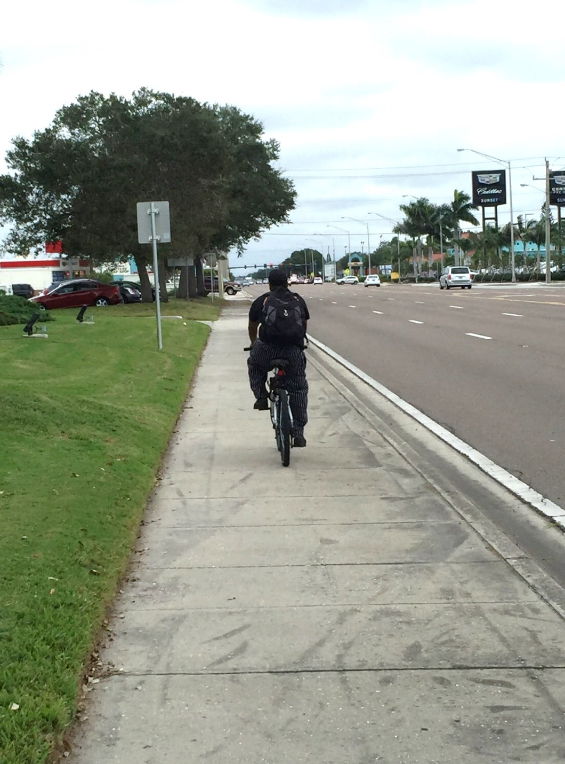

In Florida, people on bikes can legally ride on sidewalks unless posted.
“On your left!”
or
Ring a bicycle bell!
People on bikes must yield to people walking and make an audible warning when passing.
Notes:
In general, people in Florida can legally ride bicycles on sidewalks.
There are exceptions where a local city may prohibit bicycles on sidewalks and there should be a posted sign declaring that. This occurs for example, in business districts where they may have sidewalk cafes and more people walking.
However, there are more 10-foot-wide shared paths being built and these can accommodate people walking, biking or riding scooters.
If you ride your bicycle on the sidewalk, you must yield to anyone walking. If you are going to pass someone who is walking, you must warn them that you are passing, by announcing “on your left” or ring your bicycle bell.

Slide 16
Which direction is safest to ride, if I am riding a bicycle in the road?
A. Ride in the same direction as traffic
B. Ride facing oncoming traffic
Notes:
If you are riding your bicycle in the road, in which direction is it safest to ride?
Raise your hand if you think it’s A. ride in the same direction as traffic?
Or B. Ride facing ongoing traffic?
The correct answer is A. Ride in the same direction as traffic.

Slide 17
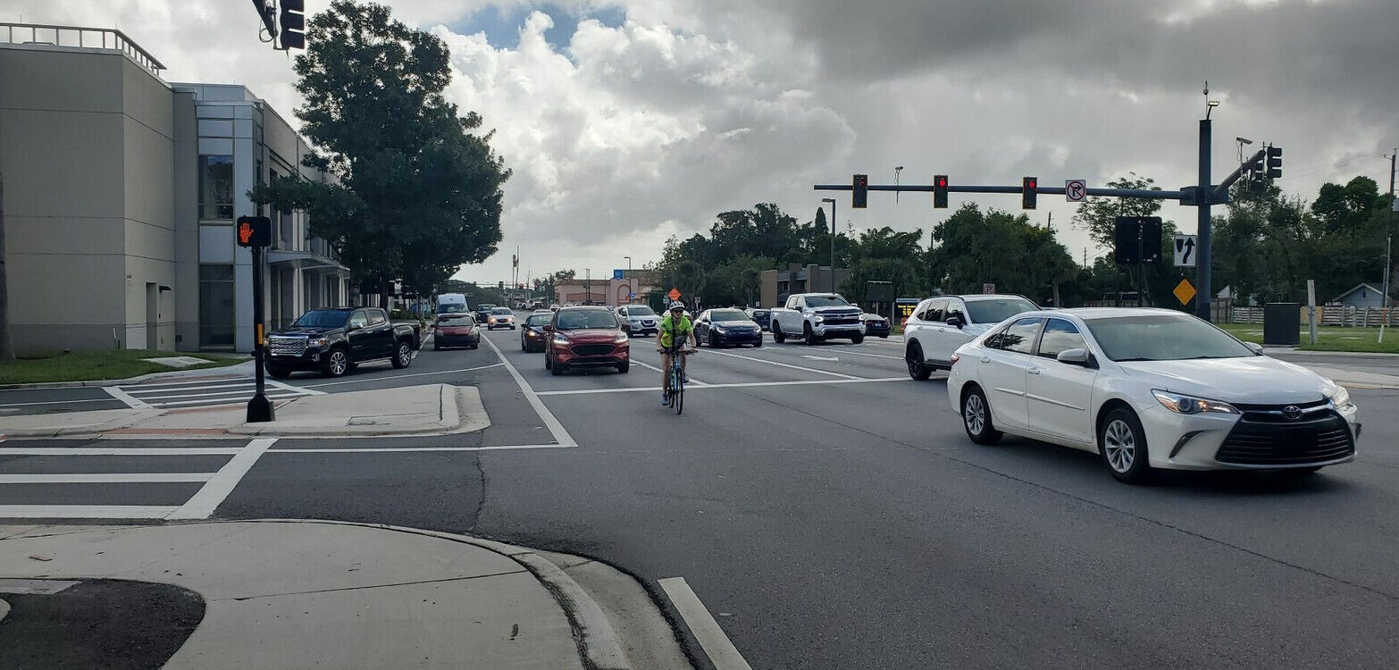
A bicycle is a legal vehicle.
People riding bicycles on roadways fare best when they act and are treated as vehicles.
Notes:
A bicycle is a legal vehicle and when you ride a bicycle on roadways, you should ride with traffic and follow the same traffic rules as any vehicle.

Slide 18
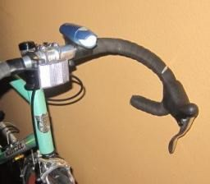
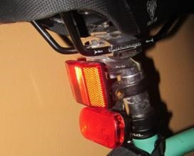
A bicycle operating between sunset and sunrise
must be equipped with:
Red reflector and redlight on the rear
Front white light
Bicycle lights are vital for safety. In 2021, 52% of people killed while riding a bicycle were involved in crashes that occurred in the dark.
Notes:
If you ride a bicycle between sunset and sunrise – namely when it is dark – you should ride with bicycle lights on – a white light on the front and a red light and a red reflector in the rear.
Bicycle lights are vital for safety.
According to national statistics (NHTSA 2021), of all the people who killed while riding a bicycle, more than half of those people were riding their bicycles in the dark.
We do have bicycle lights available in our safety kits.

Slide 19
Important Tips for Safer Walking
Notes:
Now let’s talk about being WalkWise – these are important tips for Safer Walking

Slide 20
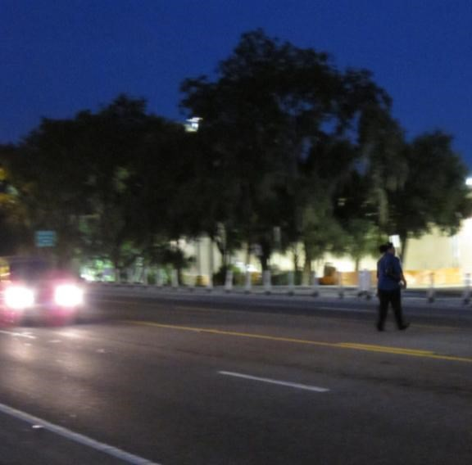
WALKWISE
In 2021, 77% of people who were killed while walking were involved in crashes that occurred in the dark.
Wear bright colors or reflective clothing night and day to increase your visibility.
Notes:
The first W in WalkWise: Wear bright colors or reflective clothing to increase your visibility, especially at night.
Do you see someone in this photo?
What is the safety risk here?
Yes, she is wearing a dark shirt and dark pants, which makes it difficult for someone who is driving a car to see her.
In the safety kits we are giving out, there are bright yellow safety vests and lighted armbands to help improve your visibility at night.
Here is another fact from national statistics (NHTSA), of all the people who were walking and killed in crashes, 77 percent of those people were killed in crashes that occurred in the dark.

Slide 21
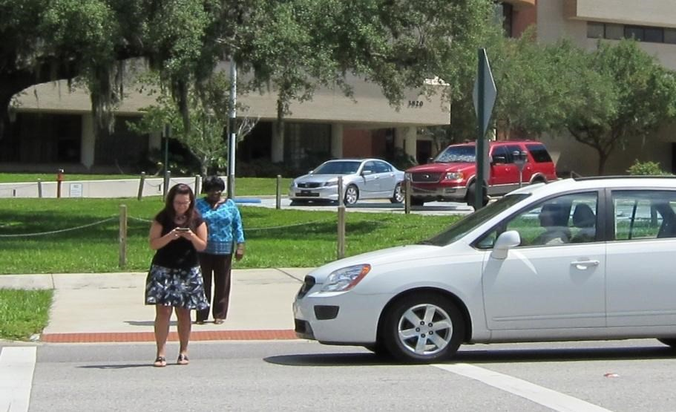
WALKWISE
Always be Alert.
Never text or talk on your phone while crossing a road.
Notes:
A – Always be Alert.
When you are crossing a road, your focus should be on your safety and on what the traffic is doing.
Just like in a car, a phone can be distracting while you’re walking. So stop texting or talking on your phone and put it away as you cross the street.

Slide 22
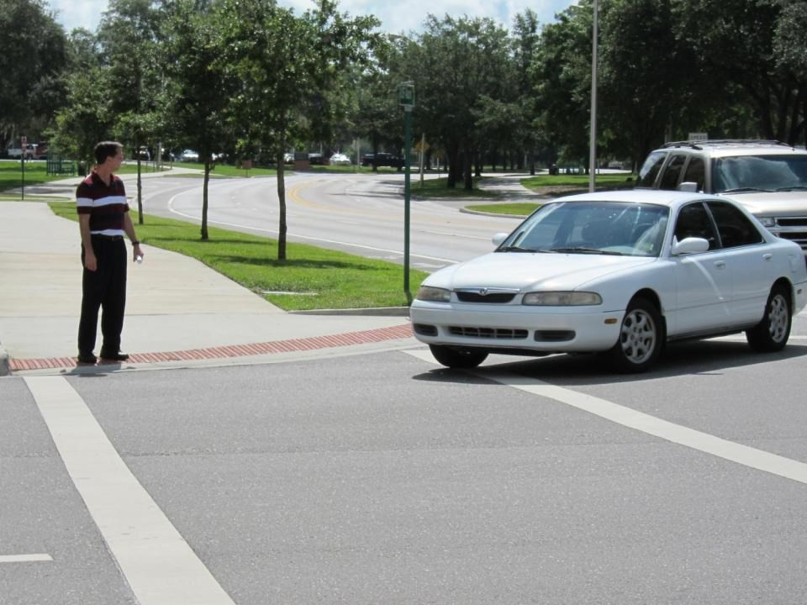
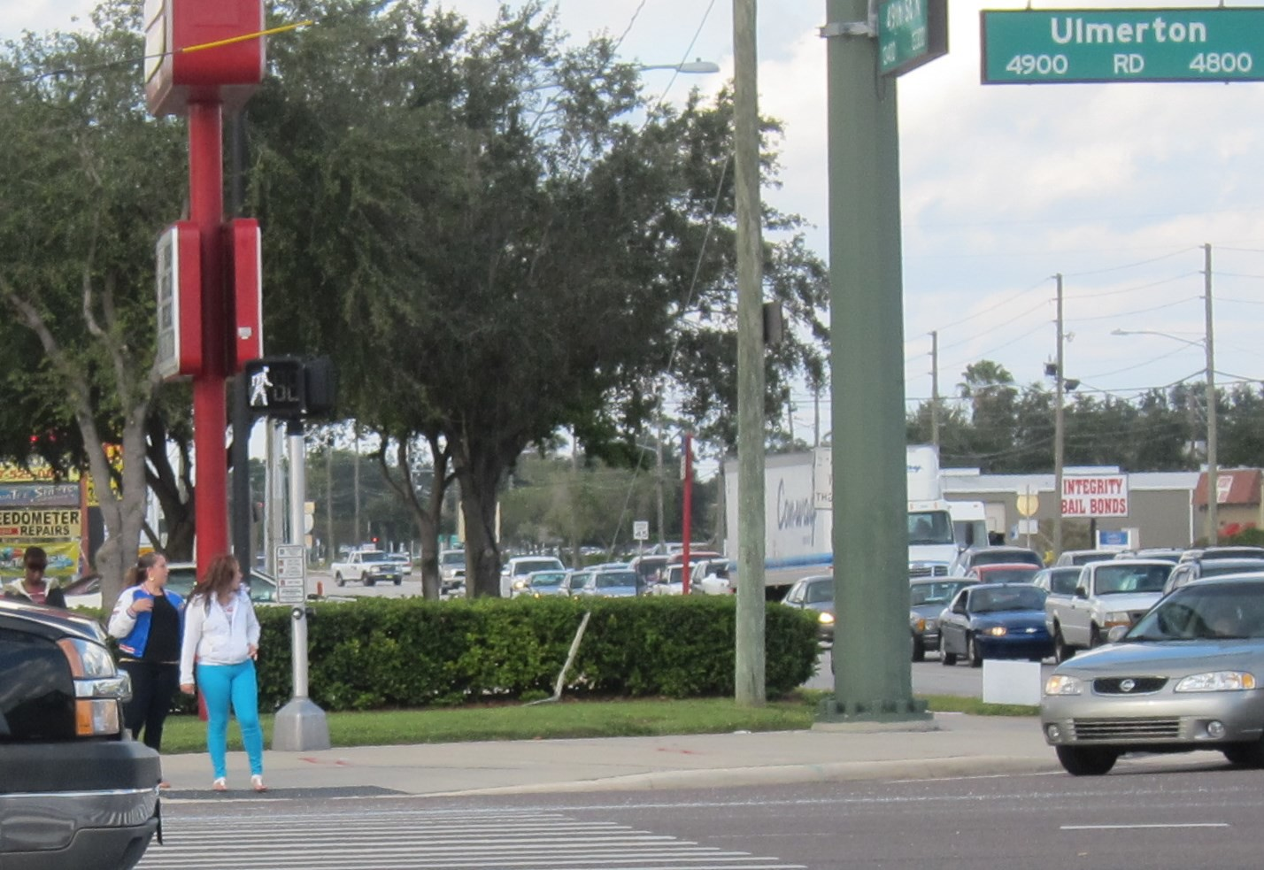
WALKWISE
Look left, right, and left again. Make eye contact with drivers. Look for cars making right hand turns.
Notes:
L – Look left, look right, and then look left again when you cross the road.
Make eye contact with drivers.
And look especially for drivers in cars making right hand turns.

Slide 23
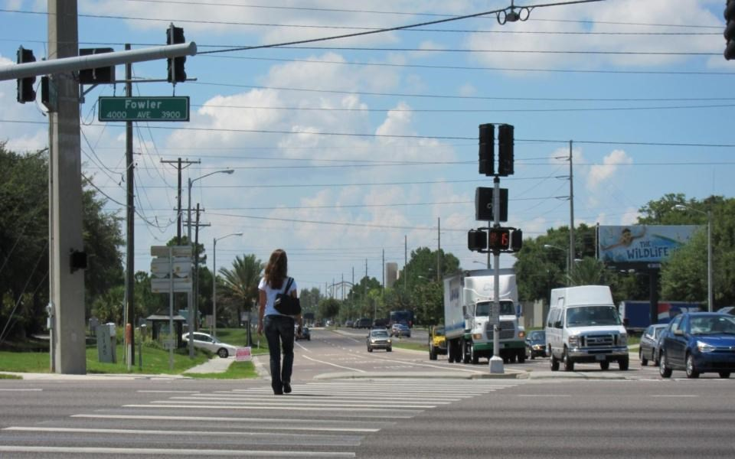
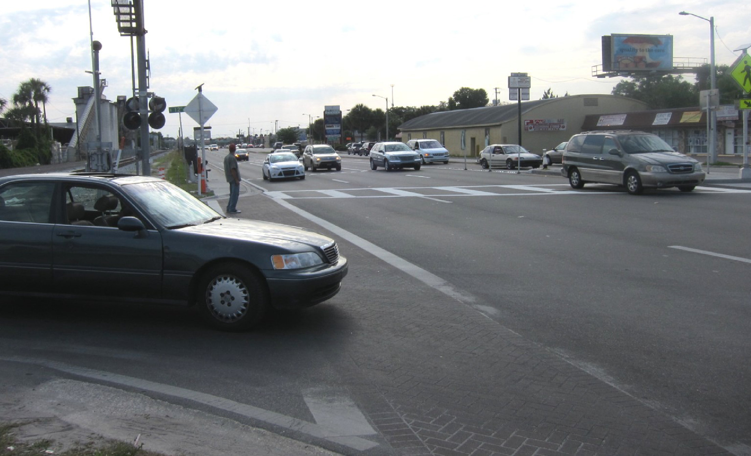
WALKWISE
Know your surroundings. Use extra caution when crossing multiple-lane, higher-speed streets.
Notes:
K – Know your surroundings. When you must cross multiple lane, higher speed streets, use extra caution.
There are 3 cars highlighted in yellow here. There is a man in the crosswalk and if he attempts to cross, those 3 cars are very close and pose the greatest risk to his safety.

Slide 24
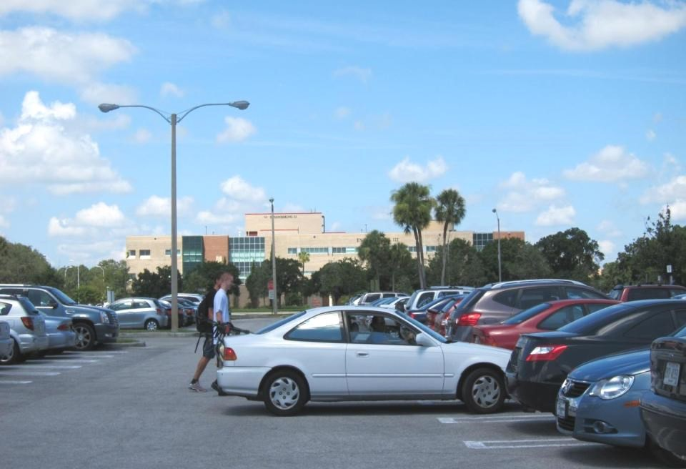
WALKWISE
Watch for cars in parking lots.
Notes:
W – Watch for cars in parking lots.
What is the risk in parking lots?
Yes, people who are backing out of spaces may not see you in their blind spots. While you’re walking through a parking lot, notice the cars ready to reverse.

Slide 25
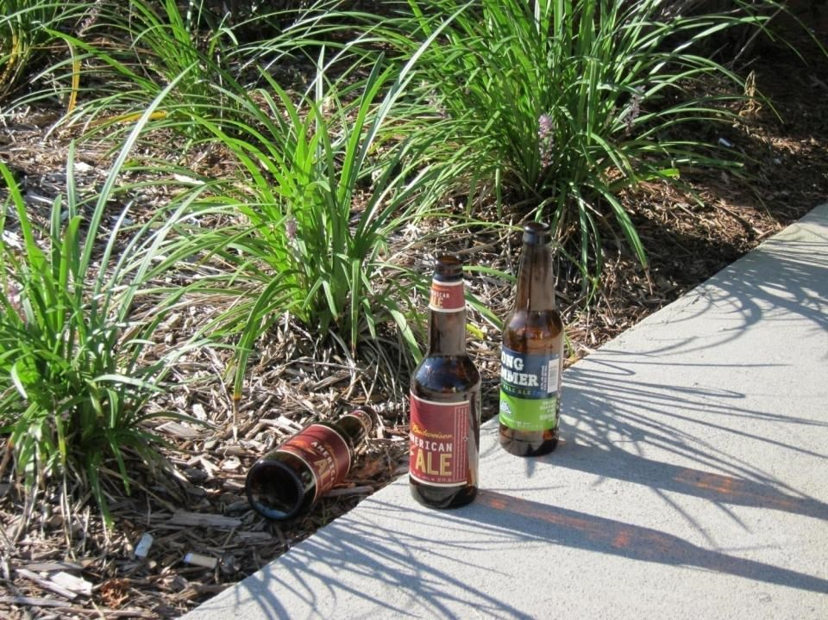
WALKWISE
Impaired walking, cycling, or
driving puts everyone at risk.
Notes:
I – Impaired walking, cycling or driving puts everyone at risk.
What happens when you consume alcohol or take drugs?
It affects your coordination, your reflexes. It alters your judgment and perception. You become less alert. It slows down your thinking. And you may be more apt to take risks.
So just as you should not drink and drive, you should not drink and ride a bicycle and you should be cautious even when you drink and walk.

Slide 26
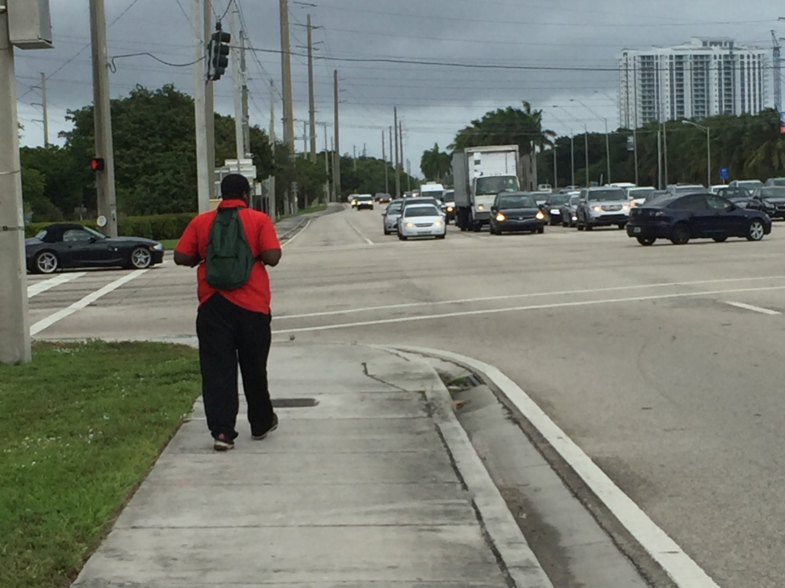
WALKWISE
WALKWISE
Stay on sidewalks when available.
Notes:
S – Stay on sidewalks when available. That’s what they’re there for – for people to walk or ride bicycles, away from vehicular traffic.

Slide 27
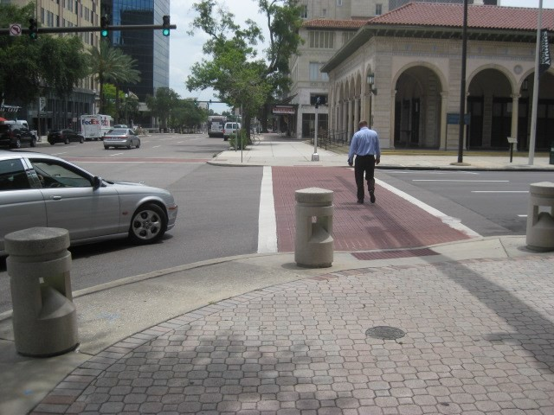
WALKWISE
Expect the unExpected. Walk defensively.
You never know when a car will fail to yield.
Notes:
And E – Expect the unexpected.
You should walk defensively for your own safety.
You never know when a car will fail to yield.

Slide 28
W A L K W
Wear bright colors or reflective clothing.
Always be Alert.
Look Left, Right, and Left again.
Know your surroundings.
Watch for cars in parking lots.
I
Impaired walking, cycling, and driving
can be hazardous.
S E
Stay on Sidewalks.
Expect the unExpected.
Notes:
To recap the WalkWise tips:
W – Wear bright colors or reflective clothing.
A – Always be Alert
L – Look left, right and left again.
K – Know Your Surroundings.
W – Watch for cars in parking lots
I – Impaired walking, cycling, and driving can be hazardous.
S – Stay on sidewalks.
E – Expect the unexpected.

Slide 29
Test Your Knowledge!
Notes:
Now, let’s test your knowledge.

Slide 30
When sidewalks are not provided,
as a person walking, I would choose to:
Walk facing traffic
Walk in the same direction as traffic
Notes:
When you are walking and there are no sidewalks, you should
Walk facing traffic or
Walk in the same direction as traffic
The answer is A – walk facing traffic.

Slide 31
A person riding a bicycle on the road must legally ride in which direction?
A. Ride in the same direction as traffic
B. Ride facing oncoming traffic
Notes:
When riding a bicycle on the road, in which direction should a person ride?
Ride in the same direction as traffic
Ride facing oncoming traffic
The answer is A. ride in the same direction as traffic.

Slide 32
In Florida, people are legally allowed
to ride bicycles on sidewalks.
True
False
I don’t know
Notes:
In Florida, people are legally allowed to ride bicycles on sidewalks.
Is that True or False?
The answer is A. That is true.

Slide 33
What do you believe is the
MOST important behavior you can practice
when walking?
Don’t drink and walk.
Wear bright colors.
Be alert. Expect the unexpected.
Follow the law.
Notes:
And this last question – What do you believe is the most important behavior you can practice when walking?
Don’t drink and walk.
Wear bright colors.
Be alert. Expect the unexpected
Follow the law.
All of these behaviors are included in our safety tips. But C encapsulates them – Be alert and expect the unexpected

Slide 34
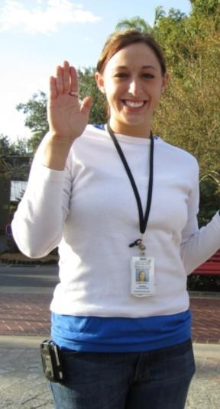
Safety Starts with Me!
Safety Starts with You!
I pledge to Walk, Bike, and Drive safely, and spread the word about the importance of safe behaviors to my friends, family, neighbors, co-workers, and others!
Notes:
Now would you raise your hands and recite this pledge to be WalkWise
Safety starts with me.
Safety starts with you.
I pledge
To walk, bike, and drive safely
And spread the word
About the importance of safe behaviors
To my friends, family, neighbors, co-workers and others.

Slide 35
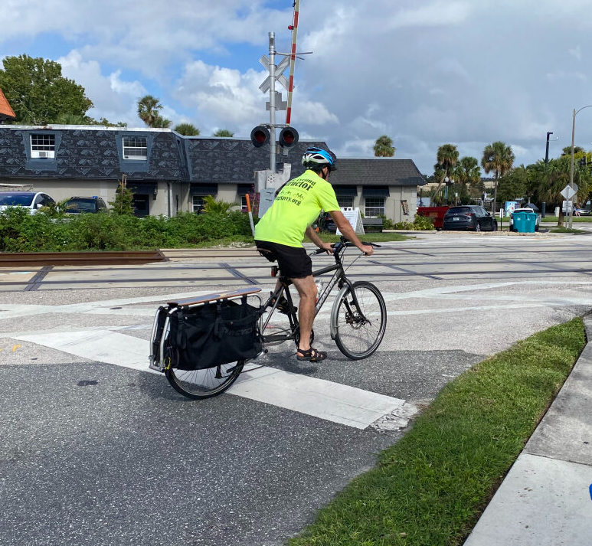
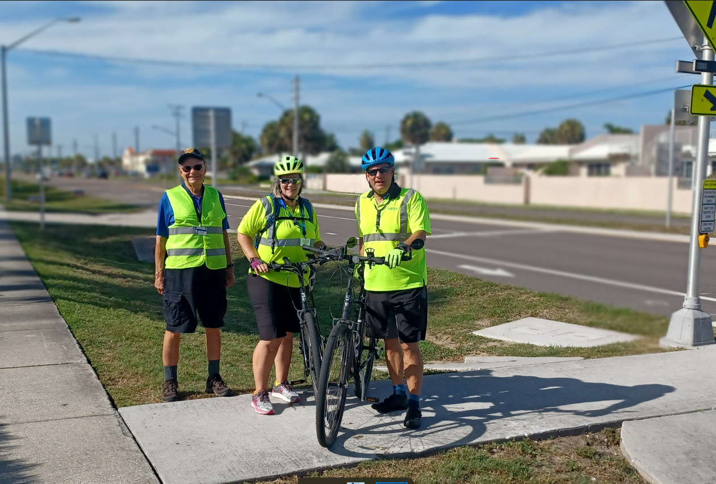
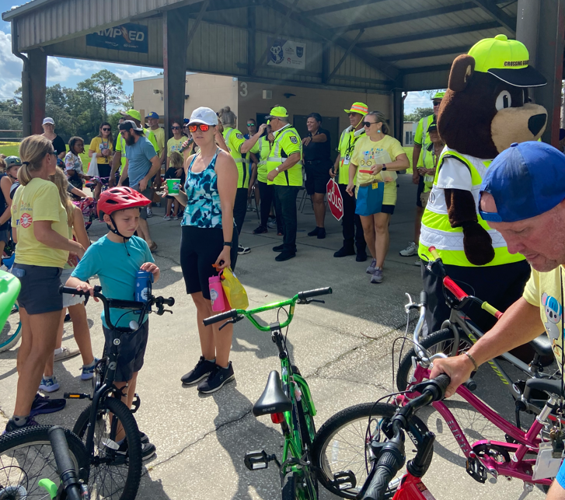
Go Walk and Bike!!
Transportation
Health
Community
Notes:
And with that, yes we do want you to go out and walk and bike!
This may be your means of transportation. It’s good for your health. And it’s part of being in our community.

Slide 36
How You Can Help
Refer a Friend / Group
Share on Social Media
Visit WalkWiseFlorida.com
Visit the FDOT District 5 Office of Safety website
fdot.gov/d5safety
Notes:
You can help others to be WalkWise.
Share this information.
Let friends and others know about these presentations
On your social media, share these tips
You can also visit the WalkWiseFlorida.com website and the website for the FDOT District 5 Office of Safety
Any questions?
Thank you again for your attention and please be WalkWise.
We have safety kits available for everyone.

