Slide 1

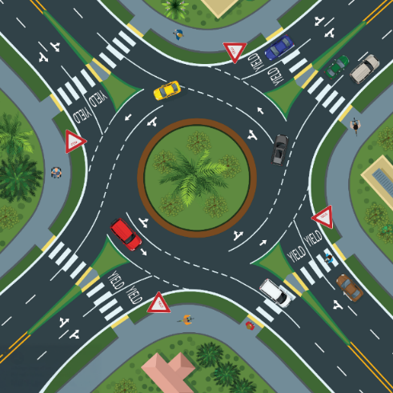
WHAT IS A ROUNDABOUT?
A roundabout is a circular intersection without traffic signal equipment in which traffic flows around a center island.

Slide 2


HOW TO USE A ROUNDABOUT
Slow to 10-15 mph on approach.
Follow signs and markings to determine the lane(s) that will serve your destination.
Yield to bicyclists merging into the lane.
Yield to pedestrians in crosswalks.
Yield to vehicles already in the roundabout.
Enter the roundabout when it's safe.
When you approach your destination street, use your right-turn signal and exit the roundabout.
Yield to pedestrians as you exit.
FDOT Roundabouts 101: RIGHT OF WAY IN A ROUNDABOUT
https://www.youtube.com/watch?v=i22yyM8dOfw

Slide 3
WHY ROUNDABOUTS?
Roundabouts have been proven to reduce fatal and severe injury crashes by:
82% over a stop-controlled intersection.
78% over a signalized intersection.

