Slide 1
Microtransit: Evolving Trends in Demand Response Transit
Joel Volinski
September 16, 2019 l FPTA Annual Conference, Orlando

Slide 2
Funding for the Project
Project was selected and funded through the Transit Cooperative Research Program
TCRP Synthesis Project #141 was published April 2019
Purpose was to provide an overview of microtransit services provided by transit agencies for the general public made possible by new technologies

Slide 3
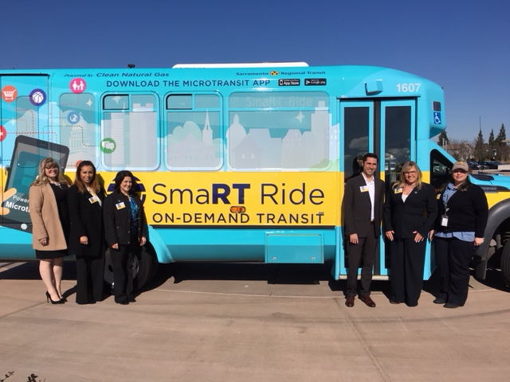
Definitions
Microtransit - shared public sector transit services that offer fixed or dynamically allocated routes and schedules in response to individual or aggregate consumer demand, using smaller vehicles and capitalizing on mobile GPS and internet connectivity.

Slide 4
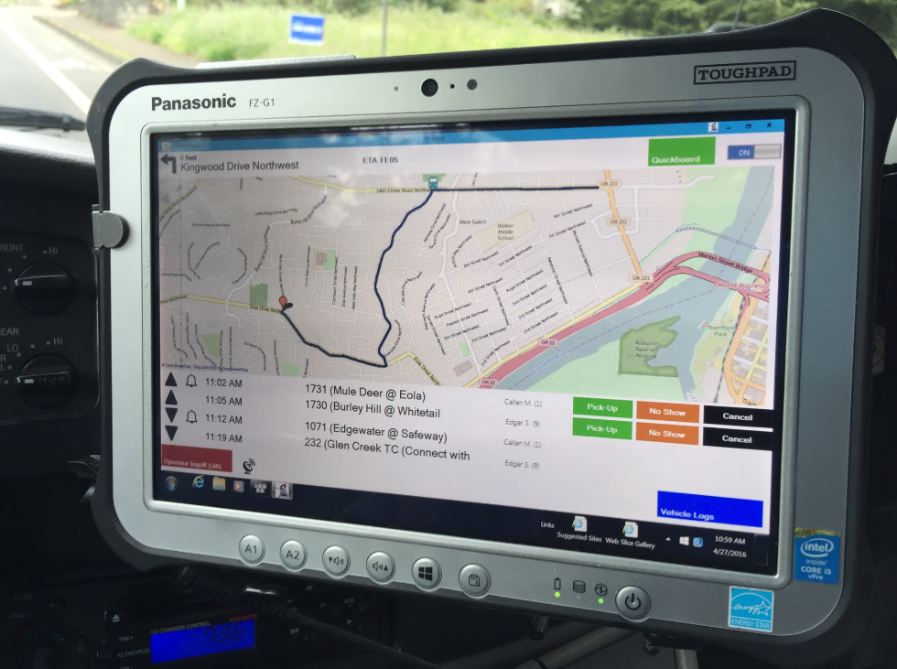
Other Definitions and Labels
On-Demand Transit - transit service that responds quickly to rider demands. This type of service often requires riders to book their trip, either in real-time or in advance.
This type of service is also sometimes called Flex Service, Call-n-Ride, Dial-a-Ride, or On Call.

Slide 5
On-Demand service is the “Tweener” of Public Transit
Less expensive than paratransit per trip, but more expensive than fixed route per trip
More efficient than fixed route in areas (or times) of low demand, but less efficient than fixed route in areas (or times) of high demand
It is more demand-driven than fixed route, but not quite as convenient (or expensive) as TNC services

Slide 6
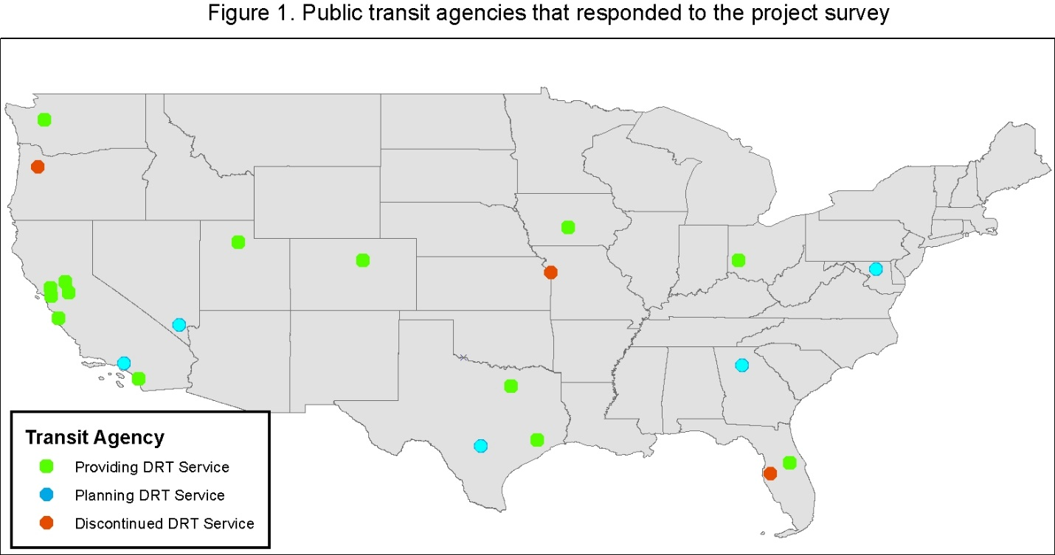
Where is On-Demand service provided?

Slide 7
Where is On-Demand service provided?
Agency Name | Year Started | Status
Hillsborough Area Regional Transit Authority (HART) | 2016 | Ended 2018
Kansas City Area Transportation Authority (KCATA) | 2014 | Ended 2015
Salem –Keizer Transit (Cherriots) | 2015 | Ended 2017
Alameda-Contra Costa Transit District (AC Transit) | 2016 | Ongoing
Central Florida Regional Transportation Authority (LYNX) | 2008 | Ongoing
Dallas Area Rapid Transit (DART) | 2006 | Ongoing
Denver Regional Transportation District (RTD) | 2004 | Ongoing
Des Moines Area Regional Transit Authority (DART) | 2002 | Ongoing
Greater Dayton Regional Transit Authority (GDRTA) | 2017 | Ongoing
Kitsap Transit | 2015 | Ongoing
Houston Metro | 2015 | Ongoing
Monterey-Salinas Transit (MTS) | 2010 | Ongoing
Napa Valley Transportation Authority (NVTA) | 2015 | Ongoing
North County Transit District (NCTD) | 2011 | Ongoing
Sacramento Regional Transit District (SacRT) | 2018 | Ongoing
San Joaquin Regional Transit District (SJRTD) | 2009 | Ongoing
Transit District of Utah (TDU) | 2008 | Ongoing
Gwinnett County Transit (GCT) | Planning
Los Angeles County Metropolitan Transportation Authority (LA Metro) | Planning
Maryland Department of Transportation | Planning
Regional Transportation Commission of Southern Nevada (RTC) | Planning
VIA Metropolitan Transit (VIA) | Planning

Slide 8
Where is On-Demand service provided?
In areas (and times) of lower demand
In lower density suburbs, rural areas, & small communities
In communities with disjointed street patterns or narrow streets
In areas where walking is difficult due to terrain or lack of sidewalks
In newly developing areas that don’t yet have sufficient demand for fixed routes
In neighborhoods that have declined and now have more lower income people who might need transit

Slide 9
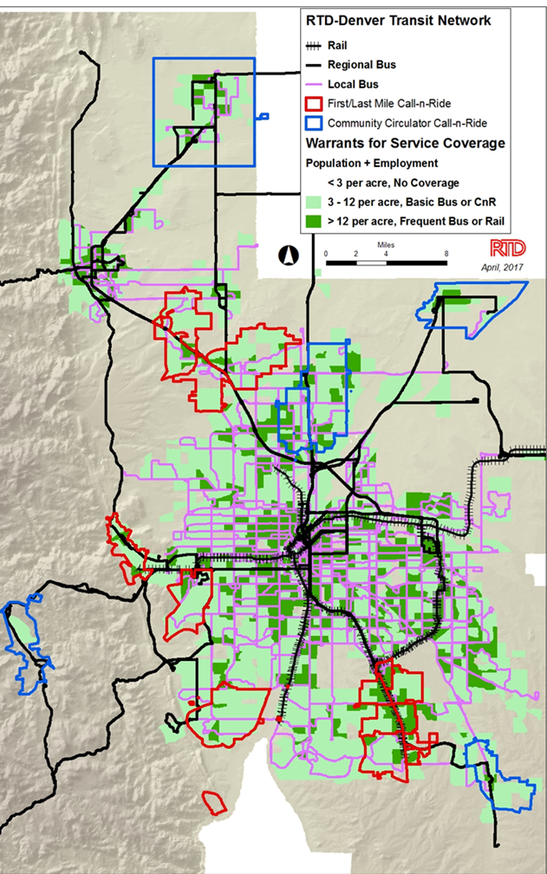
Where is On-Demand service provided?

Slide 10
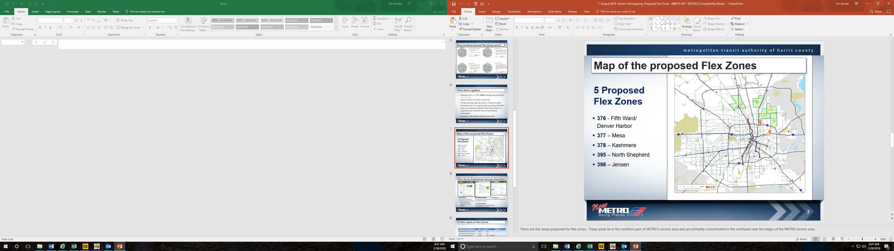
Where is On-Demand service provided?

Slide 11
Why is On-Demand service being provided?
Transit ridership is decreasing
Most of the new population growth is in the suburbs and beyond. On-demand service can be a solution to the first/last mile challenge
Customer expectations for service of all kinds is changing (think Netflix, Uber, Lyft, Grub Hub (etc.)
It is not hard to understand how attractive it is to customers to know the bus can find them versus the other way around.

Slide 12
Other reasons to provide On-Demand service
Jurisdictional and socioeconomic equity
Transition paratransit customers by transporting them in a less expensive manner to a fixed route transfer point.
Could help in redesigning system service by providing coverage to low demand areas and reallocating resources to high demand areas
Don’t want to be a Sears in a time of Amazon
New ridesharing technology makes provision more feasible and affordable

Slide 13
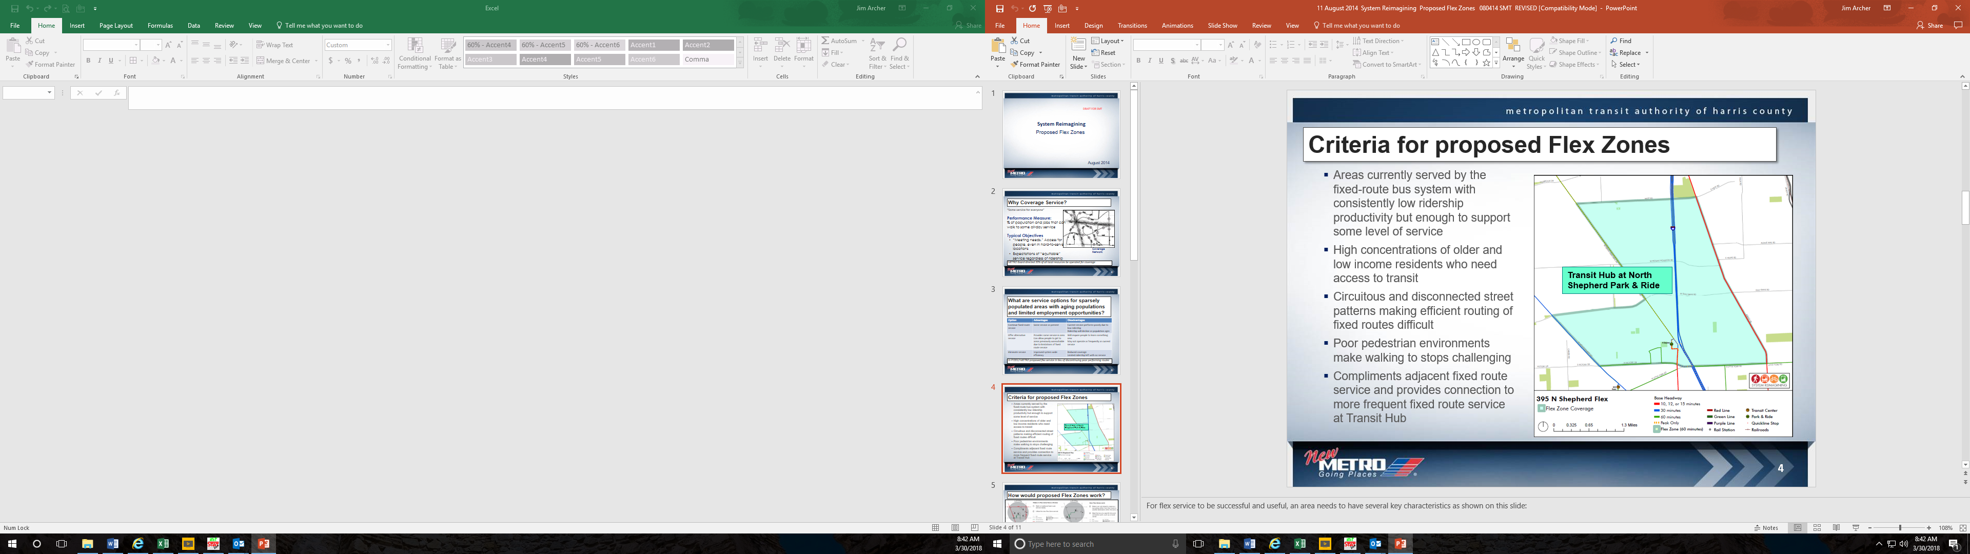
One area’s reasons for On-Demand:

Slide 14
How is On-Demand service being provided?
Most often through contracted service by companies with demand response experience particularly in areas with no existing service (more flexibility)
Sometimes turnkey, other times transit agency might provide vehicles, facilities, or fuel
Fines levied for failure to meet standards for on-time performance, time to answer phone calls, miles between breakdowns, missed trips, meeting connections, etc.
Most often provided by transit agency personnel in areas being converted from fixed route to On-Demand

Slide 15
Vehicles used to provide service
Almost always fully accessible minibuses with capacity between 12 and 28 passengers
Small enough for savings (fuel efficiency), but large enough to handle occasional larger demands (schools, employment centers, transfer stations)
Easier to maneuver on smaller streets and more acceptable in neighborhoods
Provides flexibility with paratransit services in case of breakdowns or service requirements
CDLs not required for smaller vehicles

Slide 16
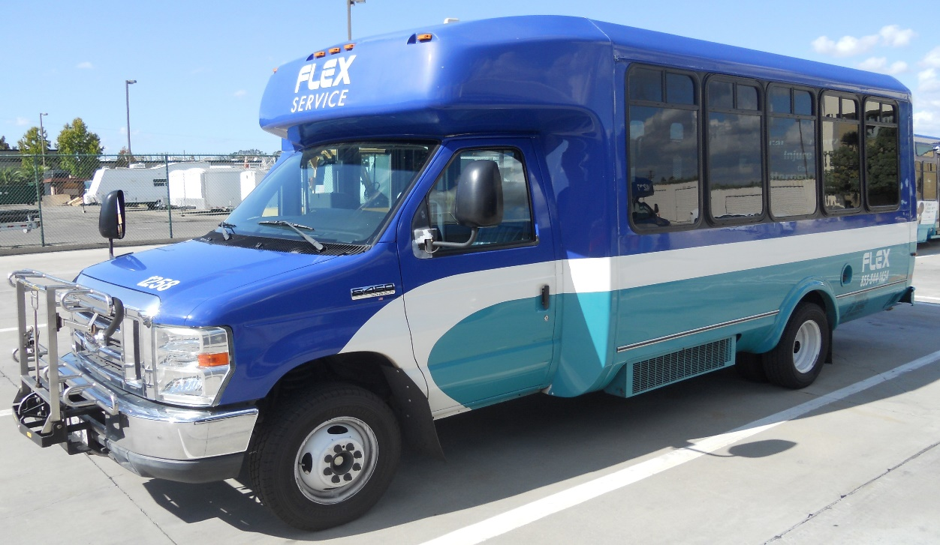
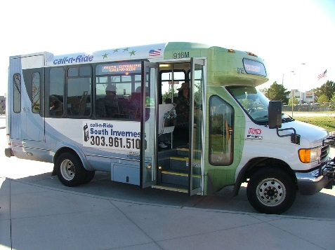
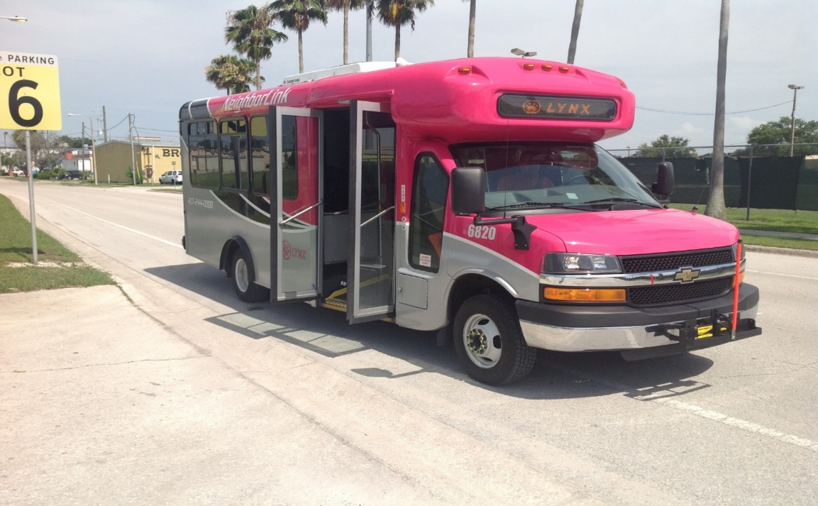
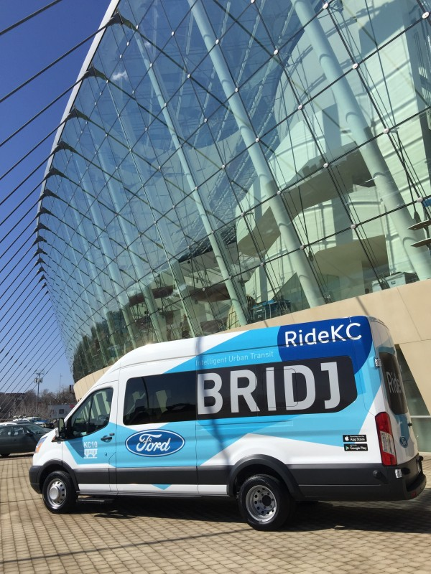
Vehicles used to provide service

Slide 18
Planning and design of On-Demand Service
Many-to-many/few, on-demand, community-based
Feeder to transit network through scheduled connections
Point deviation (flex-route) – DRT with regularly scheduled checkpoints and other requested pickups or drop-offs
Route deviation (flex-route) – fixed route with regularly or dynamically scheduled, off-route pickups or drop-offs

Slide 19
Planning and design of On-Demand Service
Flex zones vary from 1 to 30 square miles (average 7) depending on density and demand
The cycle time determines the boundary limits or size of the DRT service area since the minibus can only cover so much distance before needing to be back to the cycle point where it typically connects with regional bus or rail service.
Typically only one vehicle per zone, but could be more

Slide 20
Examples of Feasible Cycle Schedules Based on Service Conditions

Slide 21
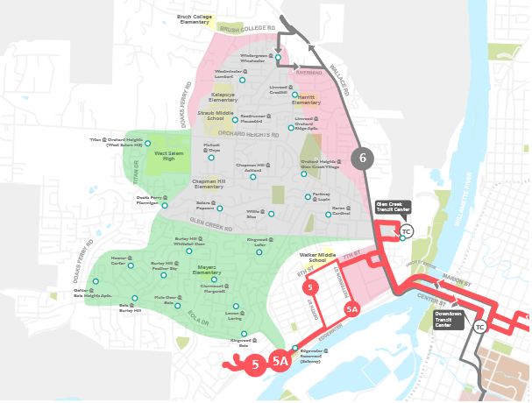
Example of Flex zone with strategic stops
Areas in West Salem served by the Connector On-Demand service

Slide 22
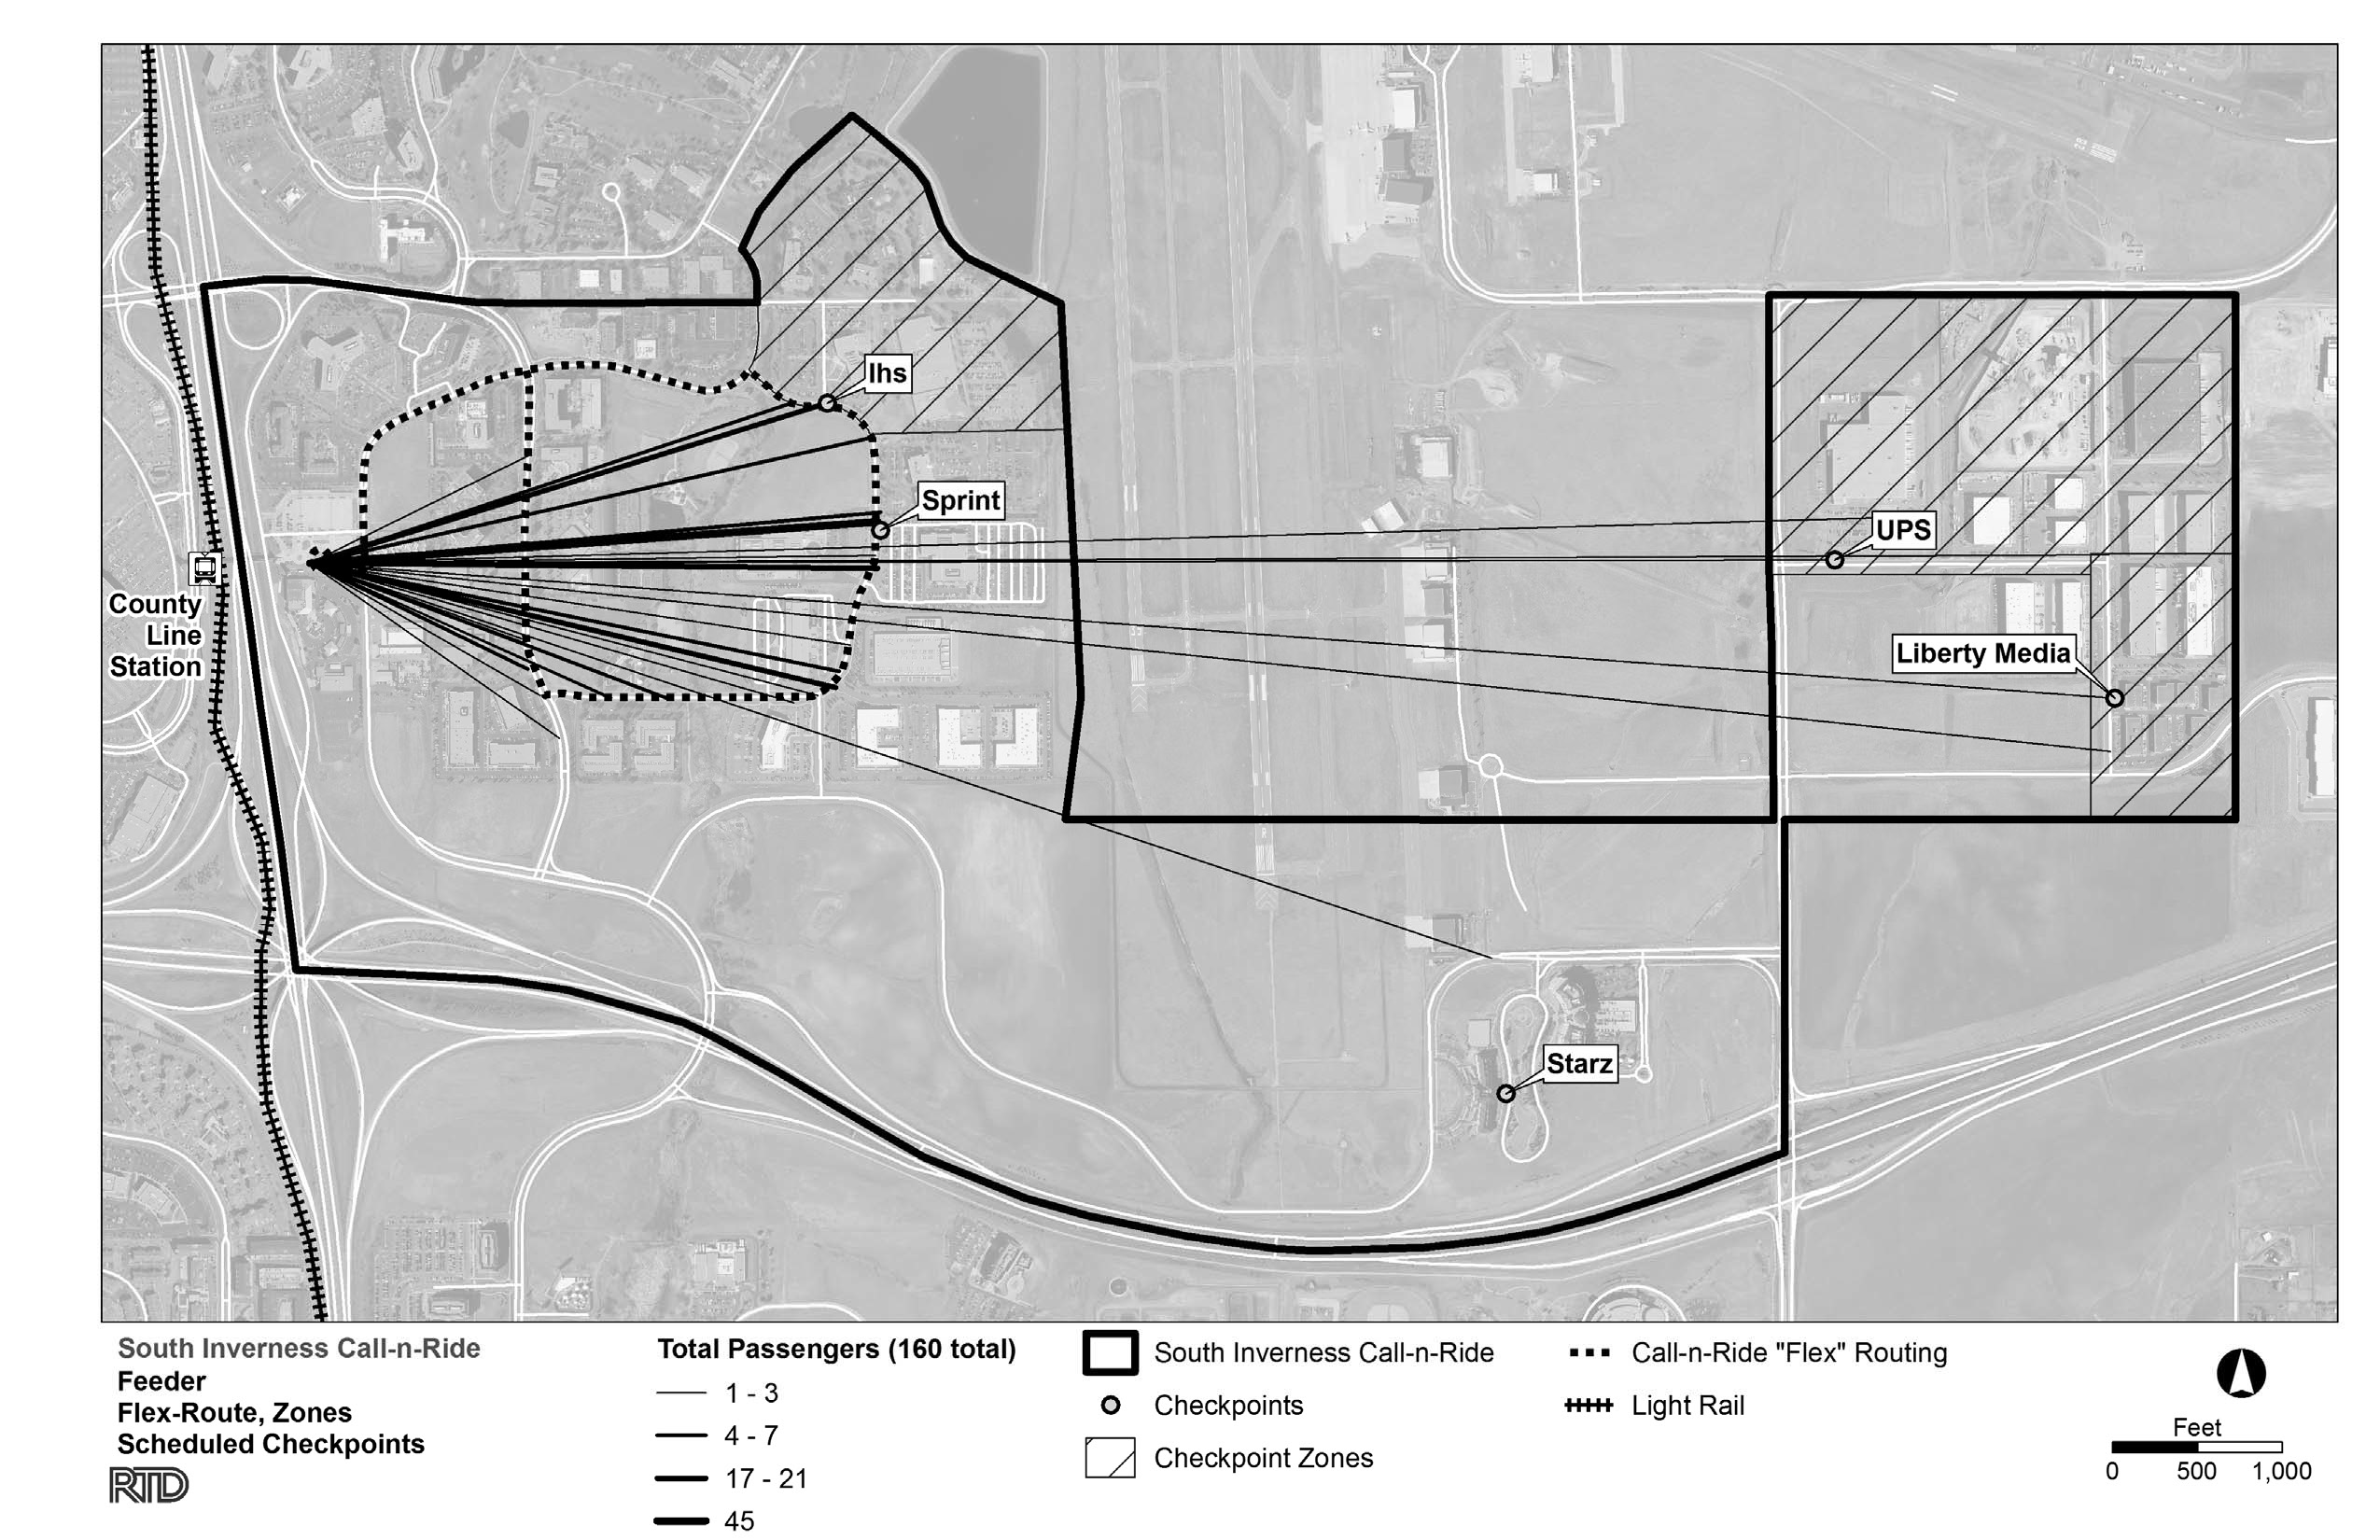
Flex zone with point deviation (some major generators, other demand scattered)

Slide 23
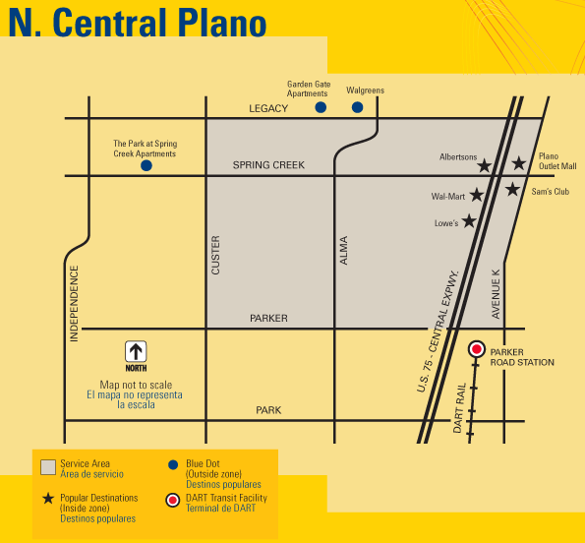
Many-to-Many Flex Zone

Slide 24
Planning and design of On-Demand Service
Need to research demand, travel patterns, trip generators, and travel speeds to appropriately size the service area and select checkpoints
Since the service is different from what people are familiar with, and there are many options, there is a need to work closely with the community to inform them of the differences and to receive their input on what would be most useful.

Slide 25
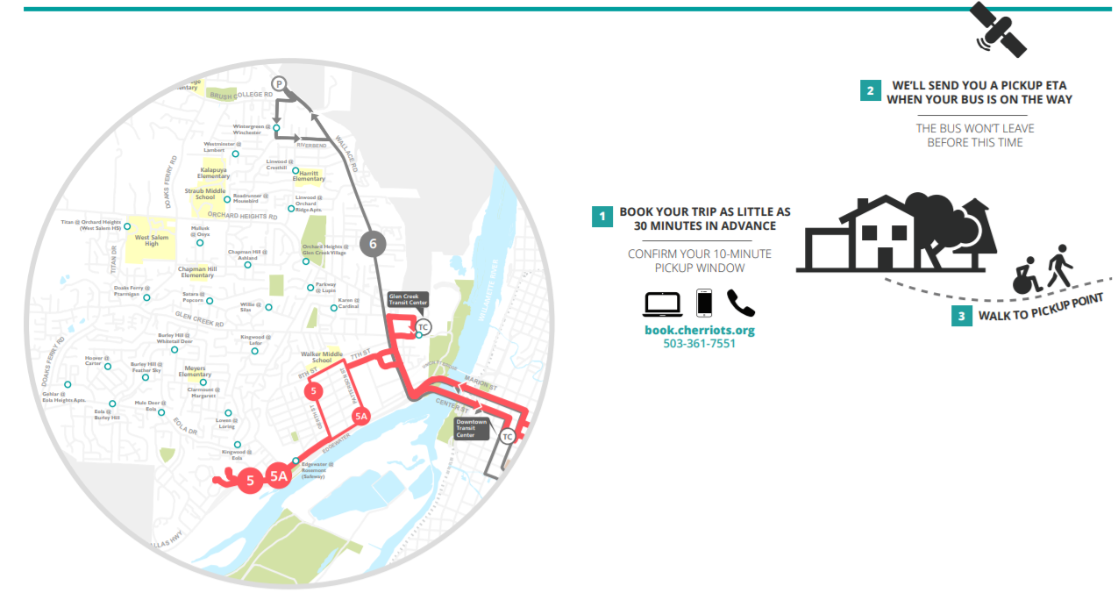
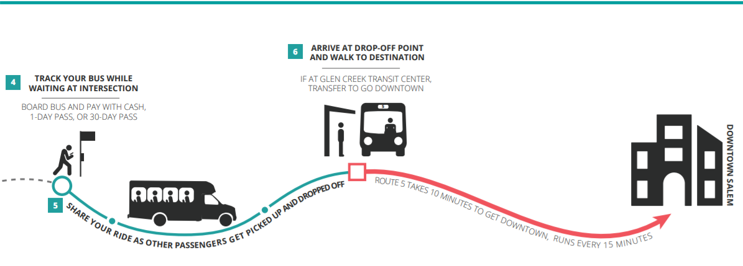
Marketing new and unfamiliar service presents challenges and takes time

Slide 26
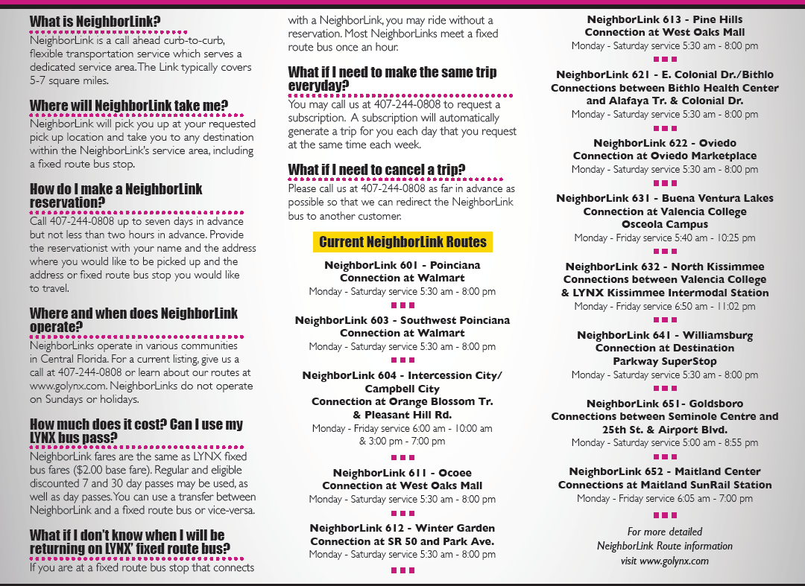
Service explanation brochure from Lynx (Greater Orlando area)

Slide 27
Some reported marketing methods
Direct mail along with free ride coupons
Brochures, flyers, seat drops, and car cards
Information on website and social media
Conducting direct outreach to political jurisdictions, planning commissions, government agencies, human services agencies, employers, and neighborhoods
Press conferences, press releases, arranging television and radio news coverage
Training/educating agency staff
Notes:
This amount represents the value of time lost during weekdays between 9 AM and 4:30 PM under current conditions. It does not include potential effects of developments that are currently under construction or future developments. In addition, the study reflects the conditions experienced during the two-day fieldwork, which may differ in a different week or month.

Slide 28
Branding
All services carry the logo of the local transit agency though they give this service its own brand or moniker:
The Connector
NeighborLink
RTA Connect – On Demand
Call-n-Ride
On Call
SmaRT Ride
Flex Service

Slide 29
Fares and hours of service
Fares are usually the same for on-demand service as for regular service
Transfers are usually treated the same as any other route
Some regard on-demand as premium service and charge accordingly
Service span is often the same hours as regular transit service, but sometimes starts and ends sooner or later reflecting markets being served

Slide 30
Technology
By 2005 a multitude of technology advances led to:
Smart phones
A mobile internet
Global Positioning Systems
Google maps
Interactive Voice Response
Voice over Internet Protocol and SaaS (Software as a Service)
Suddenly there was an ability to assemble platforms and applications and to use cloud computing resources.

Slide 31
Technology advances enabled:
Web-based customer self-service reservations application for automated booking and estimated times of arrival
Automated scheduling with algorithmic capability for dynamic service delivery
Web-connected, GPS-enabled, mobile device to host mobile app for map-based trip routing and automated data communication
Automated manifest for mobile service delivery, data capture, streamlined back office processes, real-time supervision, and facilitated service planning and performance analysis
An automated customer notiﬁcation system that supports all relevant communication channels, namely text messaging, e-mail, and automated voice, to inform customers of upcoming trips and to provide advance notice of when a vehicle is due to arrive—or to notify the customer that it is running behind schedule.

Slide 32
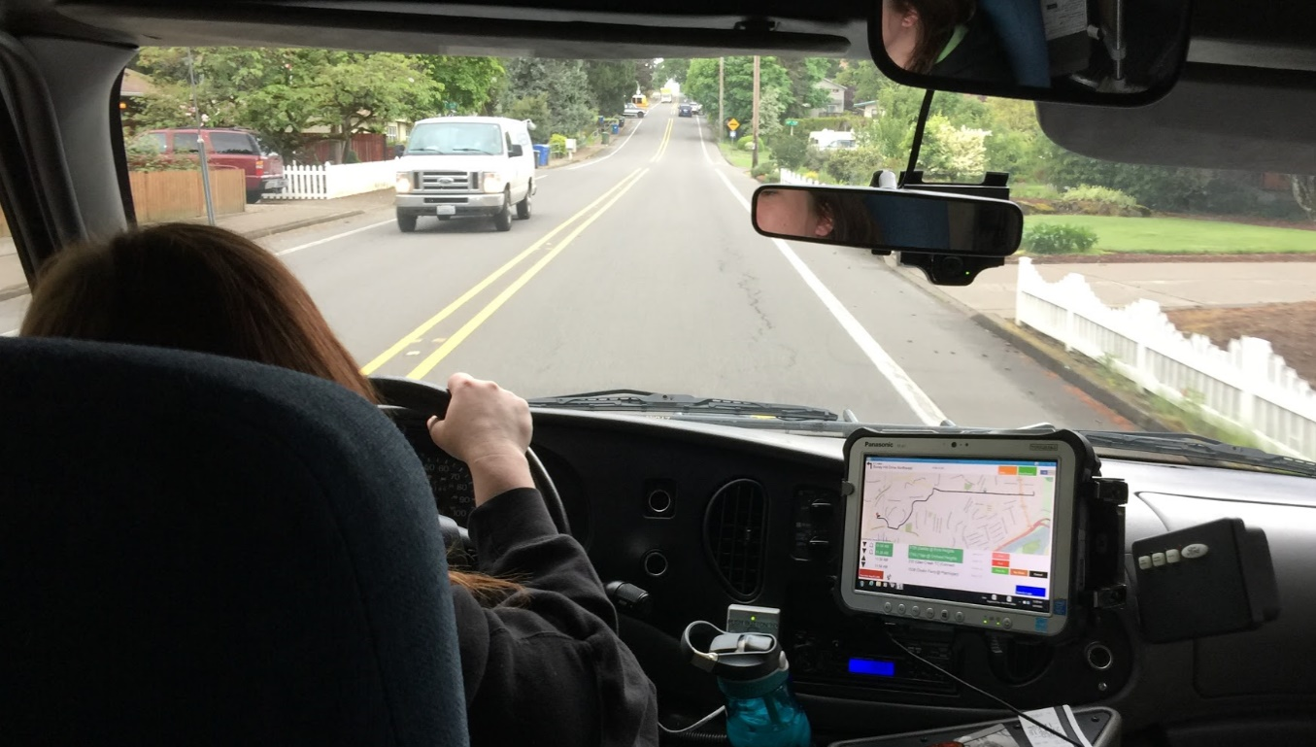
No human interaction required
Mechanisms to track the vehicles in real-time (displayed on a map) and to enable the service provider(s) to continuously view the status of operations in each service area

Slide 34
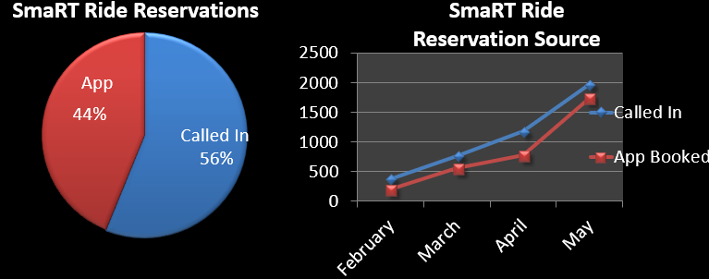
SacRT experience with use of app

Slide 35
Costs associated with technology
The price of technology is decreasing rapidly. Lynx reported that their procurement of the technology necessary to provide dynamic demand response service initially took three years and over $800,000 when they started the process in 2014.
In 2018 SacRT reported they paid only $25,000 to TransLoc to utilize the already-developed software they needed to effectuate their microtransit service.

Slide 36
Performance metrics for On-Demand Service
Transit Agency | Contract or In-house | Cost per Vehicle Service Hour | Passengers per Vehicle Service Hour | Cost per Passenger Trip
AC Transit | In-house | $214 (fully allocated) | 3 | $71.00
Cherriots | In-house | $65.00 | 3.5 | $18.57
DART | Contracted (DART provides vehicles and facilities, but not fuel) | $46 | 2.5 for original DRT service and 3.5 for new GoLink service | $18.40 $13.14
Greater Dayton RTA | In-house and contracted | RTA pays Lyft and taxis and uses in-house paratransit | NA | $13.00
Denver RTD | Contracted | $83 | 3.8 | $21.84
HART | Contracted | HART pays contractor by trip and not by hour | 3.5 | $10.00
Houston METRO | In-house | $75 | 2.4 | $31.25
Kitsap Transit | In-house | $130.72 | 3.66 | $35.68
Lynx | Contracted | $41.17 | 3.3 | $12.60
MTS | Contracted | $54.18 | 4.03 | $13.44
NVTA | Contracted | $44.48 | 2.6 | $17.00
NCTD | Contracted | $97 | 2.7 | $36.00
DTU | Contracted and In-house | $34.69 | 4.7 | $7.34

Slide 37
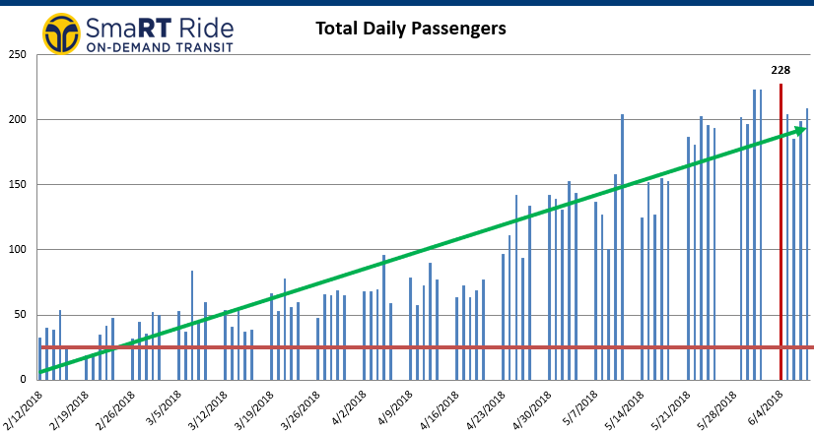
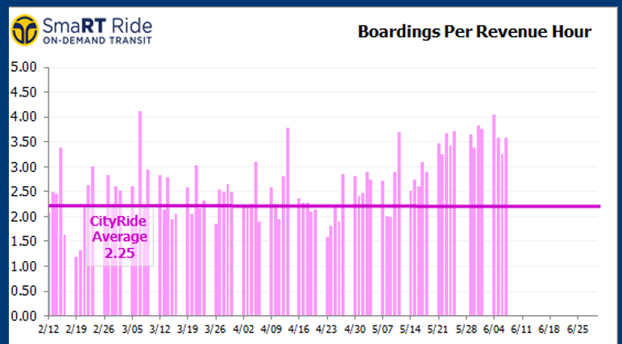
Ridership trends at Sacramento

Slide 38
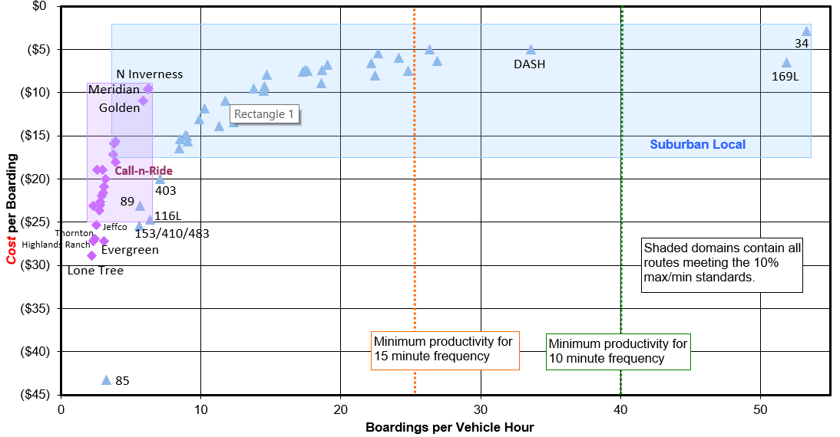
Performance metrics at RTD

Slide 39
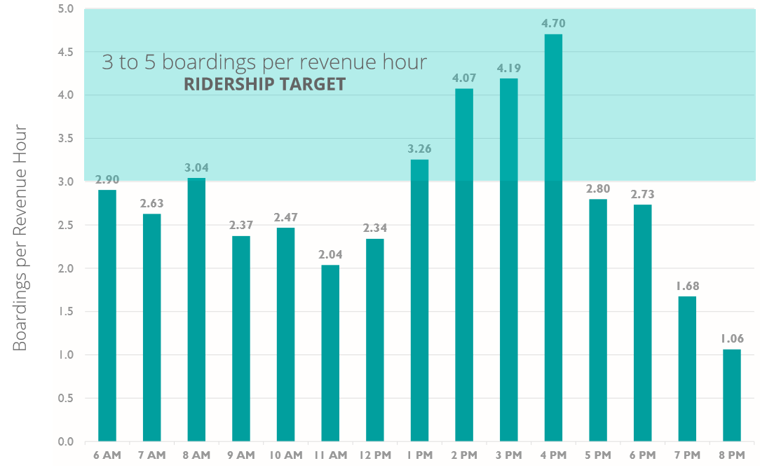
On-Demand ridership at Cherriots

Slide 40
Example of Flex zone with strategic stops
Areas in West Salem served by the Connector On-Demand service

Slide 41
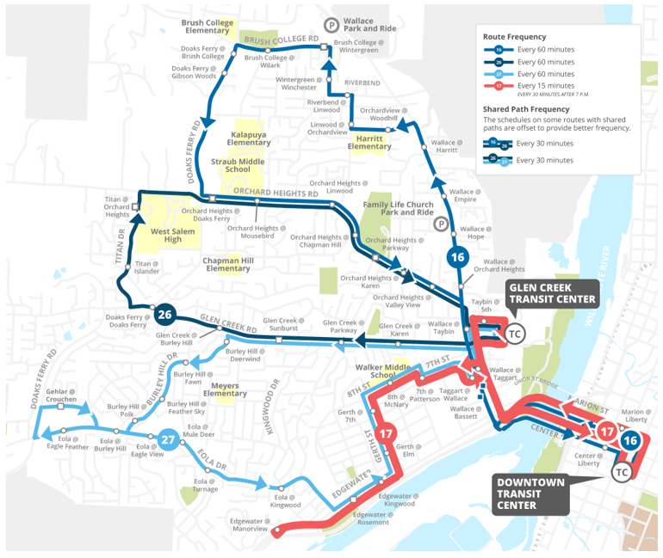
Fixed route service that replaced on-demand service at Cheeriots

Slide 42
Customer Feedback
Denver RTD passengers give the Call-n-Ride Program the highest ratings of any of its services (4.5 on a scale of 5)
94% of AC Transit riders surveyed preferred Flex over restoring the fixed route, and 70% said they would take transit more if the service were expanded
Customer satisfaction ratings for Houston Metro’s On-Demand service are significantly higher than for the fixed-route bus service

Slide 43
Lessons Learned
Set realistic goals – this is a low ridership service (3 – 5 pph) and be sure your Board understands that (coverage vs. ridership)
7 passengers per service hour typically approaches the limit of service productivity. Trip denials start to happen above this or an additional vehicle or service ($) is required.
Establish small service zones (5 – 7 sq. miles)
Plan and configure the service to meet needs
Its hard to strike the right balance between subscription and real-time dynamic requests

Slide 44
Lessons Learned
Ensure that time connections are met
App-based dynamic technology is needed to efficiently operate well used flex services.
Pilot projects are useful to gain experience
It is easier to establish pilot projects where there is no transit service
Marketing microtransit can be time consuming
Offer free travel training to the disabled
Use drivers with prior paratransit experience

Slide 45
Lessons Learned
Use the same fare structure and fare media as fixed route services
More booking options for customers (standard phones, smart phones, walk-on boardings, and subscriptions) results in more productivity
Consider using TNCs for peak hour service or when subscription reservations are high
The transit agency should have control over the mobile application data. When the contractor owns the data, it does not allow for proper monitoring of service. New contracts should require a dashboard for monitoring of data

Slide 46
Conclusions
Microtransit is another tool in the toolbox transit agencies can use as they try to provide the appropriate levels of supply to match the various levels of demand in their diverse service areas.
Microtransit aims to fill-in gaps between traditional fixed-route services, ride-hailing, and other point-to-point options to more efficiently serve areas or times of lower demand for service
Microtransit provides a lower cost way to address questions of jurisdictional equity and socioeconomic equity

Slide 47
Conclusions
The technology is readily available and the prices are coming down
It is popular with riders and generates interest from the media. Multiple pilot projects all over the U.S.
It could help when there is insufficient remote parking for rail/BRT services
The total number of Microtransit passengers usually comprise far less than one percent of a transit system’s total ridership.
It might catch on in a growing shared economy and as owning cars becomes less popular
Developments such as automated electric vehicles produced with 3-D printing could rev up interest

Slide 48
Contact
Joel Volinski
volinski@cutr.usf.edu
(954) 554-7011

