Slide 1



Florida Transit Safety and Operations Network (FTSON)
September 16, 2019 @ 10:15-11:30am
2019 FPTA/CTD Conference

Slide 2
Introductions
Ashley Porter, FDOT Transit Safety Manager
Paul Goyette, FTSON Project Manager, CUTR
CUTR staff introductions
Sign-in sheet
Notes:
Moderator to provide introductions and make certain everyone signs in

Slide 3
Session Objectives
Determine new direction for FTSON
Identify areas of concern for further research
Develop a shortlist of action items
Identify task force members to address action items
Use listserv and visit FTSON website
Discussion on upcoming deadline for PTASP
Notes:
Moderator to describe the session objectives

Slide 4
Direction of the FTSON
Process to identify action items (listserv/agency challenges)
Rotating task force members assigned to action items (CUTR to assist)
Review current action item list
Discussion

Slide 5
Action Item Examples
Protective barriers for bus operators
Standardized code of conduct for passengers
Trespassing passengers, standardized SOP, and best practices
Operator safety
Oversized mobility devices
Certified operator trainers

Slide 6
Action Items Examples (cont’d)
Oxygen tank transport on transit vehicles
Operator ride checks
Emergency management standards
Safety performance metrics (SMS/PTASP)
Safety risk assessment and hazard identification processes (SMS/PTASP)
Contractor – Agency SMS/PTASP compliance template

Slide 7

General Discussion
Open discussion
Comments
New ideas

Slide 8
Contact Information
Ashley Porter
FDOT Transit Safety Manager
ashley.l.porter@dot.state.fl.us
Paul Goyette
FTSON Project Manager
pmgoyette@cutr.usf.edu
Website: www.ftson.org
Listserv: ftson@listserv.usf.edu

Slide 9
Manatee County Raptor
Jim Egbert – Manatee County Transit

Slide 10
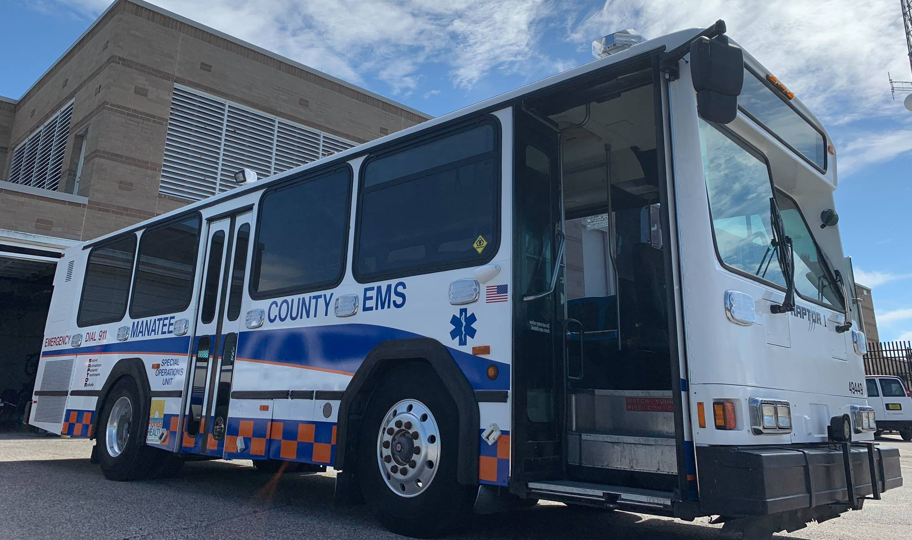
Manatee County Raptor

Slide 11
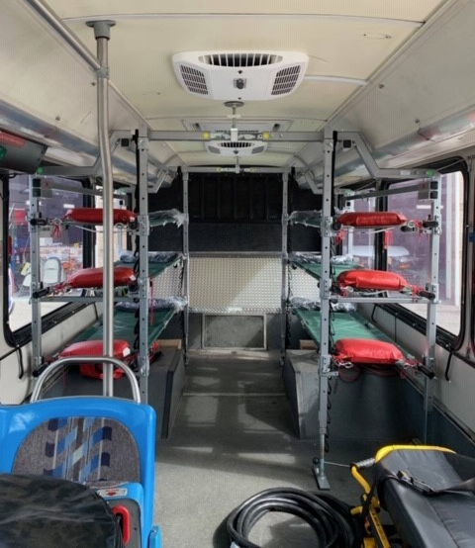
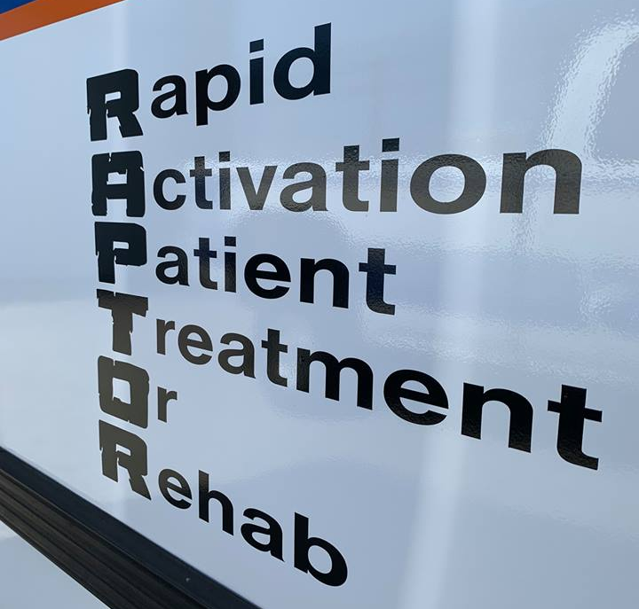
Manatee County Raptor

Slide 12
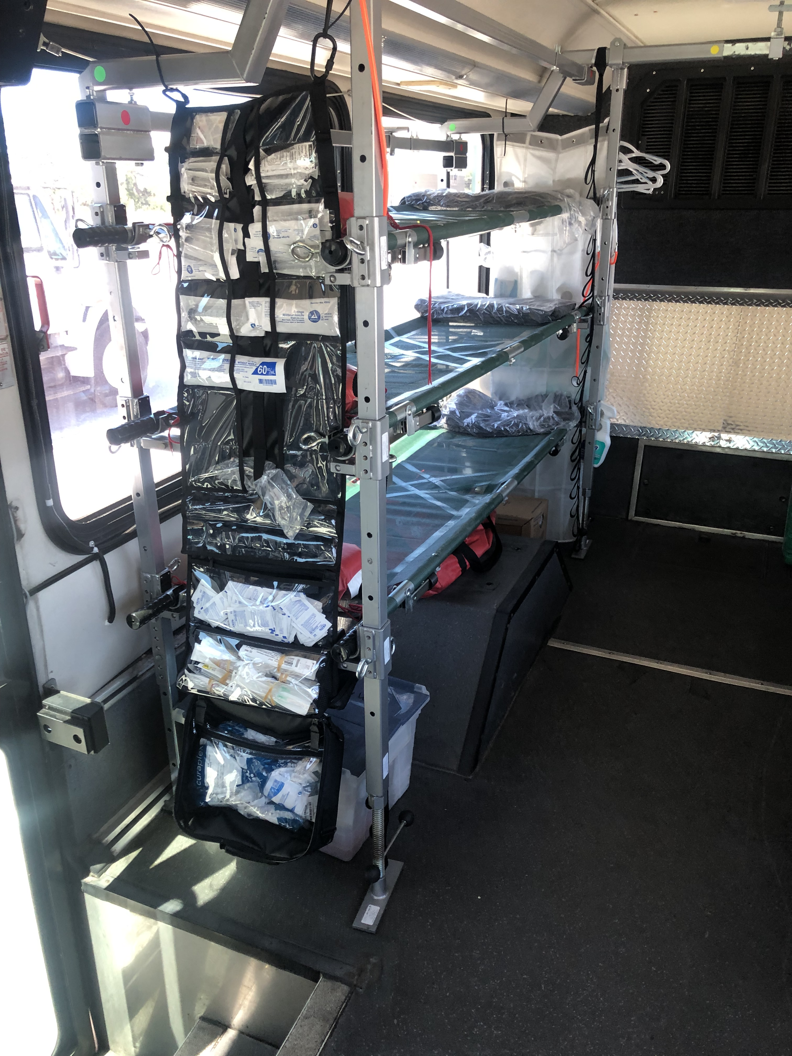
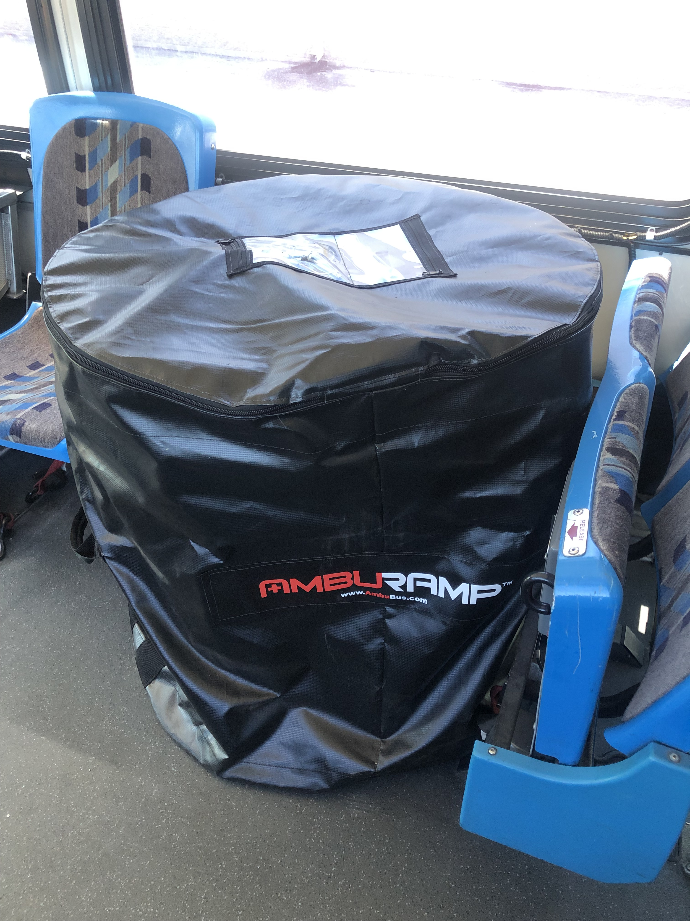
Manatee County Raptor

Slide 13
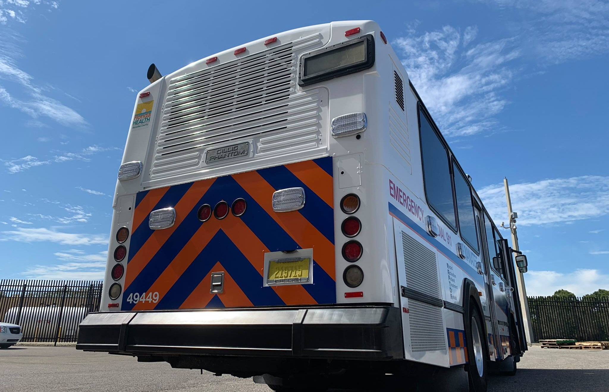
Manatee County Raptor

Slide 14
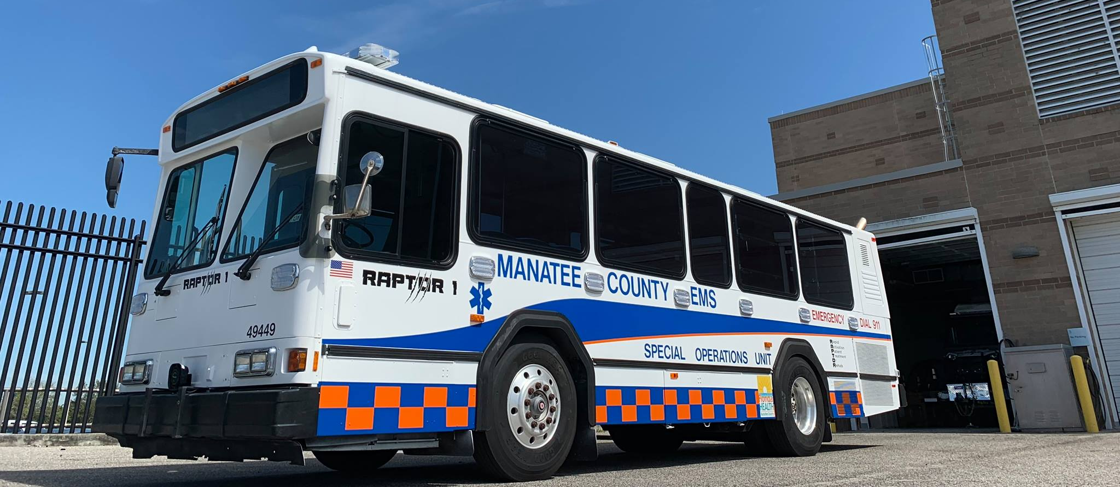
Manatee County Raptor

Slide 15
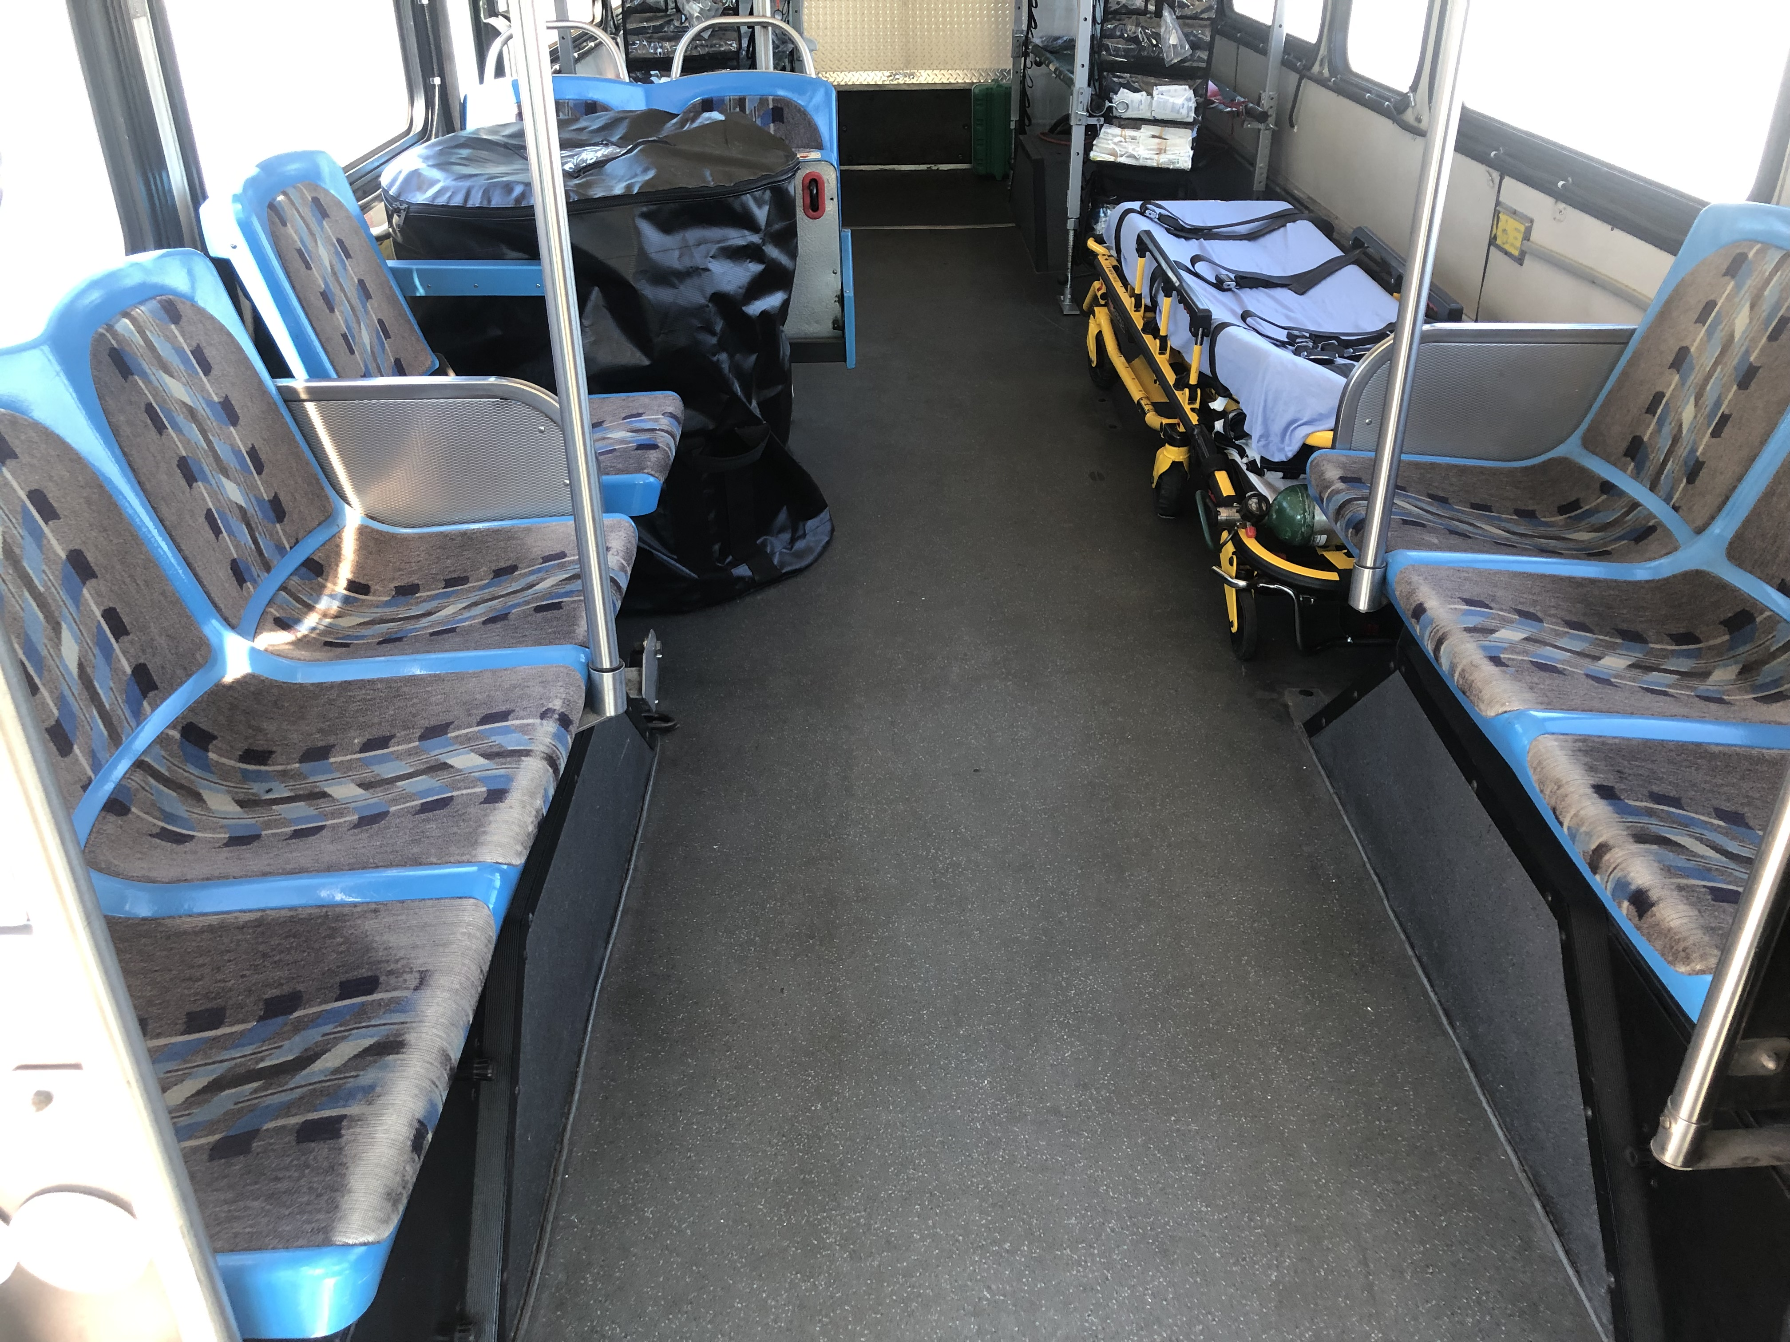
Manatee County Raptor

