Slide 1


Worldwide Marketing
Best Practices
Florida Public Transportation Association
September 16, 2019

Slide 2


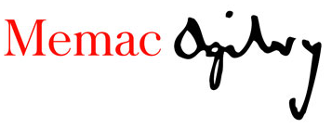
Mobilize for Qatar: an International Project
Project Team
Qatar Ministry of Transport and Communications (MoTC)
Mowasalat (Karwa)
Memac Ogilvy Mather
Global-5

Slide 3
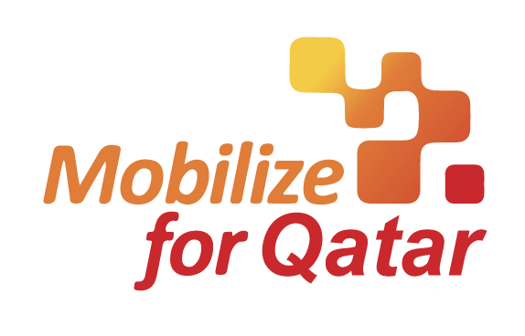
Mobilize for Qatar: an International Project
Prepare Qatar Integrated Public Transport Marketing Strategy & Wayfinding Standards
Promote public transportation system
Increase resident and tourist ridership
Prepare Qatar to host 2022 FIFA World Cup

Slide 4
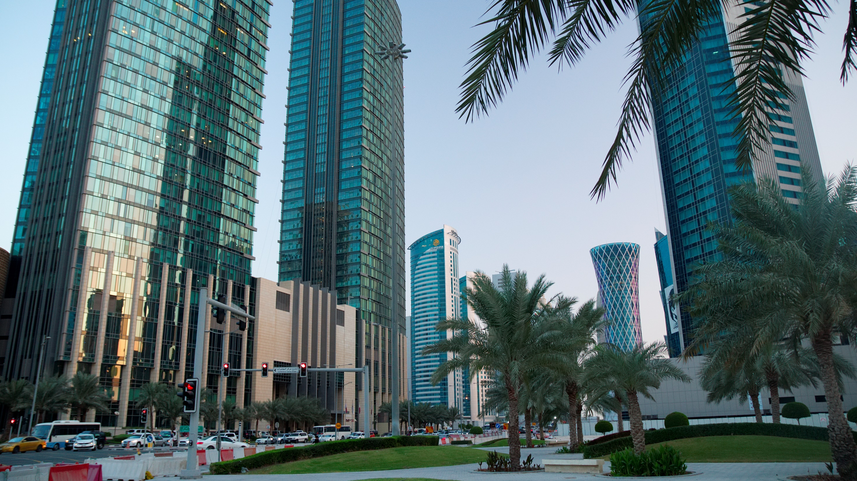

Qatar Integrated Public
Transport Communication
Best Practice

Slide 5
Objectives
Identify how public transport systems affect change
Identify how marketing generates ridership and reaches target audiences
Identify effective content strategies and media Identify methods unique to public transport
    Real-time information
    First-mile and last-mile connectivity

Slide 6
Methodology
Research current practices by 5 public transport systems
Analyze third-party metrics and data
  SimilarWeb.com (web and social traffic analytics)
  Moz.com (backlinks and traffic sources)
Identify best practices

Slide 7
Selection Criteria
World-class public transport system
Hosted a major international sporting event
Tourism destination
Bi-lingual or multi-lingual ridership base
Digital and mobile tools
Real-time data

Slide 8





Five Public Transit Systems
London, England
United Kingdom
Transport for London (TfL)
TfL is part of the Greater London Authority which owns and operates 12 public transportation services for the City of London and 32 boroughs
London Underground
London Overground
London Buses
TfL Rail
Docklands Light Railway
London Trams
London River Services
London Dial-a-Ride
Victoria Coach Station
Santander Cycles
Emirates Air Line
Paris, Île-de-France
France
Régie Autonome des Transports Parisiens (RATP)
RATP (Autonomous Operator of Parisian Transports in English) is a state-owned company which operates 6 public transportation services for the city of Paris and surrounding Île-de-France region on behalf of Île-de-France Mobilités, the transit authority for the Paris region
Metro
Réseau Express Régional (RER)
Tramway
Transilien
Bus
Noctilien
Amsterdam, Holland
Netherlands
Gemeentelijk Vervoerbedrijf (GVB)
GVB (Municipal Transport Company in English) is a private corporation wholly owned by the city of Amsterdam that operates 5 public transportation services for the city
Subway
Tram
Train
Bus
Ferry
Dubai, Emirate of Dubai
United Arab Emirates
Roads and Transport Authority (RTA)
RTA is the government transportation authority for the city of Dubai which operates 5 public transportation services
Metro
Tram
Marine
Bus
Taxi
Orlando, Florida
United States of America
LYNX
LYNX is a public bus system owned and operated by the Central Florida Regional Transportation Authority which provides service throughout Orange, Seminole and Osceola counties, and limited service in Polk county
Bus

Slide 9
Ridership
London, England
United Kingdom
TfL annually carries more than 4 billion passengers in the greater London metropolitan area, which has an estimated population of 8.8 million inside 1,569 square kilometres (606 square miles).
Paris, Île-de-France
France
RATP annually carries more than 3 billion passengers in the greater Paris metropolitan area, which has an estimated population of 12 million inside 12,012 square kilometres (4,638 square miles).
Amsterdam, Holland
Netherlands
GVB annually carries more than 260 million passengers in the greater Amsterdam metropolitan area, which has an estimated population of 1.3 million inside 219.4 square kilometers (84.7 square miles)
Dubai, Emirate of Dubai
United Arab Emirates
RTA annually carries more than 543 million passengers in the greater Dubai metropolitan area, which has an estimated population of 2.5 million inside 4,114 square kilometers (1,588 square miles)
Orlando, Florida
United States of America
LYNX annually carries more than 30 million passengers primarily in the greater Orlando metropolitan area, which has an estimated population of 2.3 million inside 294.61 square kilometres (113.75 square miles)
4
3
260
543
30
BILLION
BILLION
MILLION
MILLION
MILLION

Slide 10
Best Practices
Branding
Information & Tools
  Owned Media
    Website
    Push Communication
    Social Media Content
  Earned Media
  Shared Media
    Social Media
    Partnerships
  Paid Media
Mobile Applications & Real-Time Data
  Public Policy

Slide 11
System Branding

Slide 12
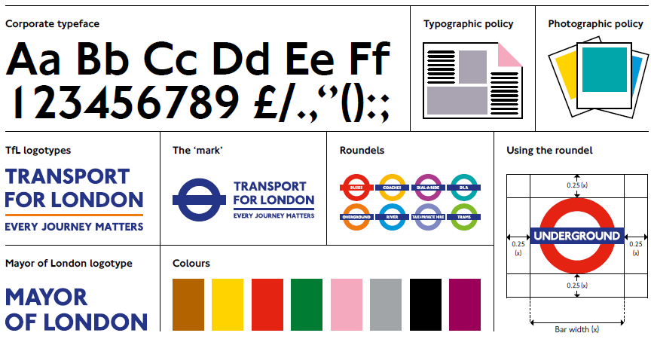
Transport for London System Branding

Slide 13


Transport for London System Branding

Slide 14
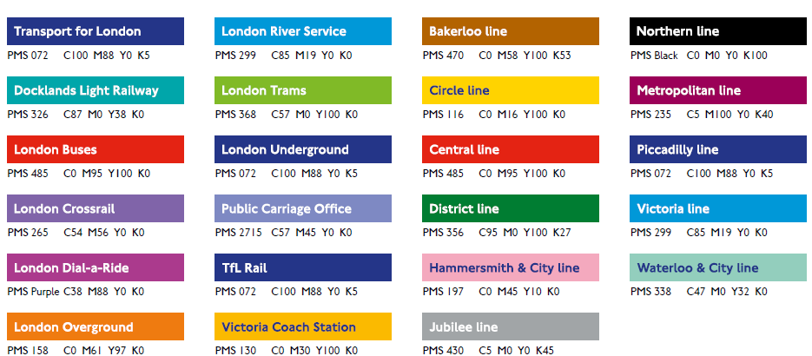
Transport for London System Branding

Slide 15
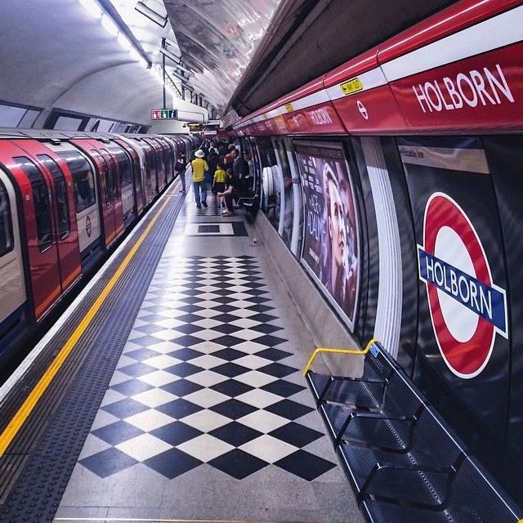
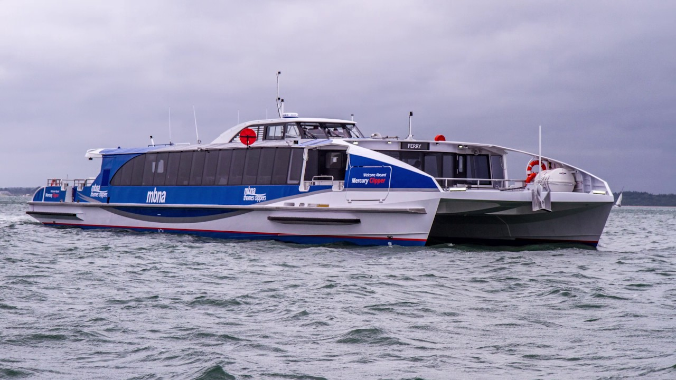
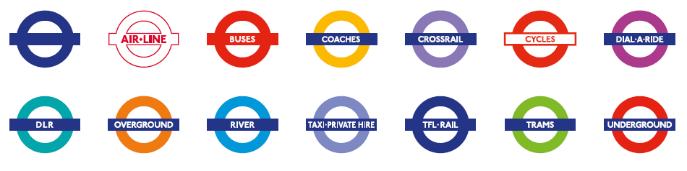
Transport for London System Branding

Slide 16
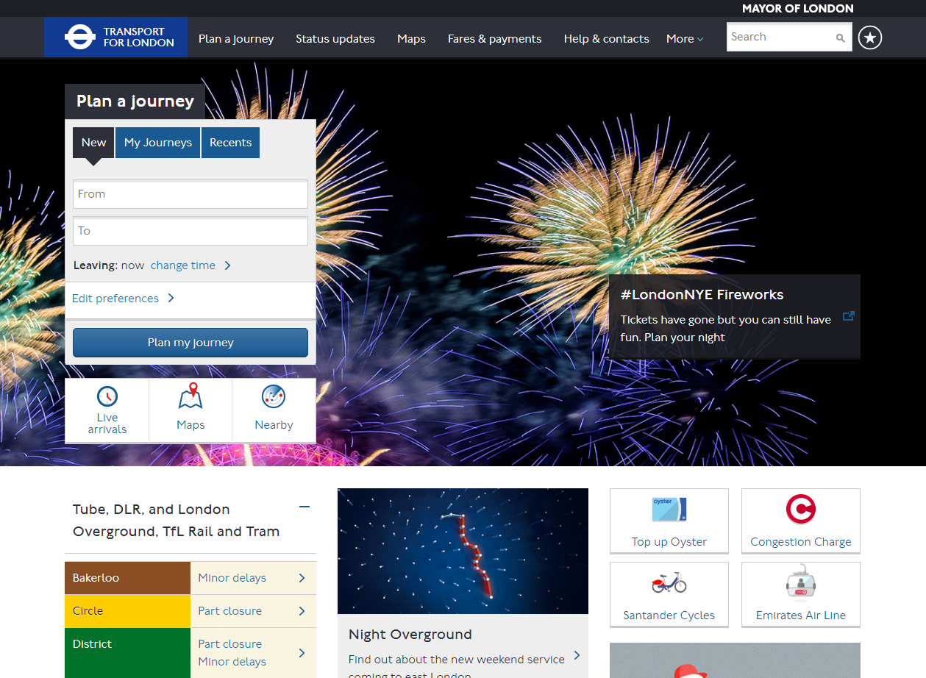
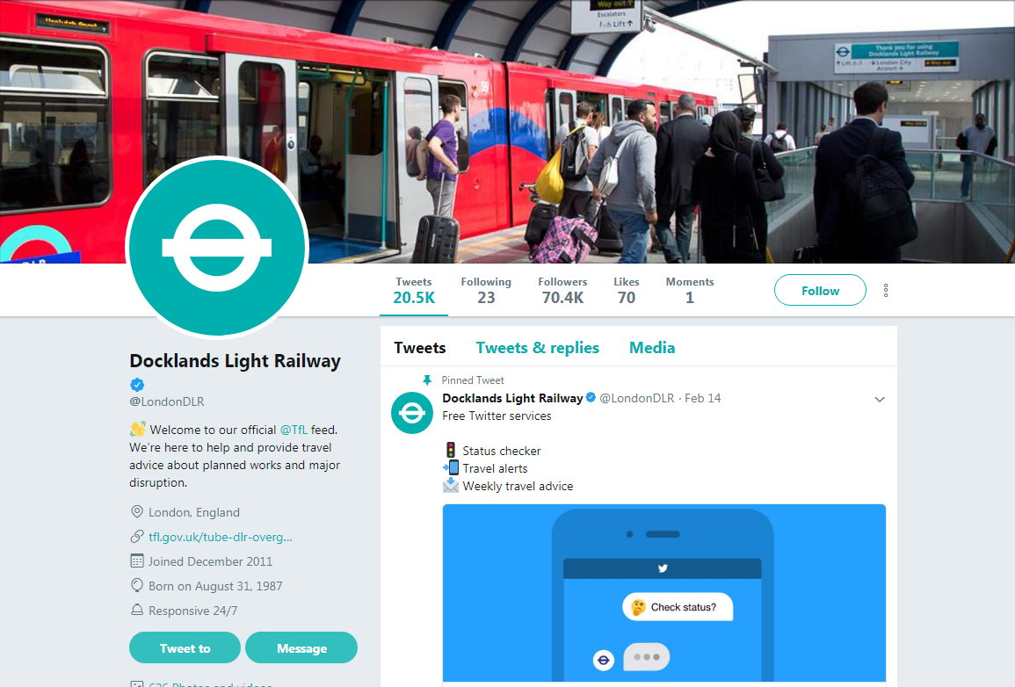
Transport for London System Branding

Slide 17
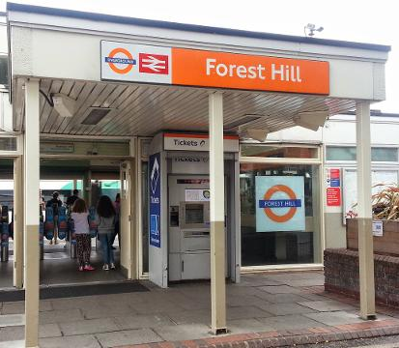
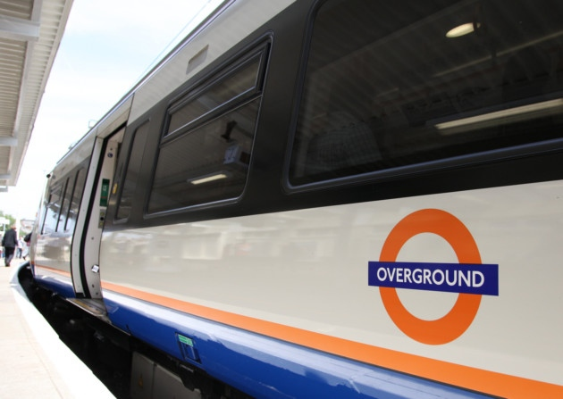
Transport for London System Branding

Slide 18
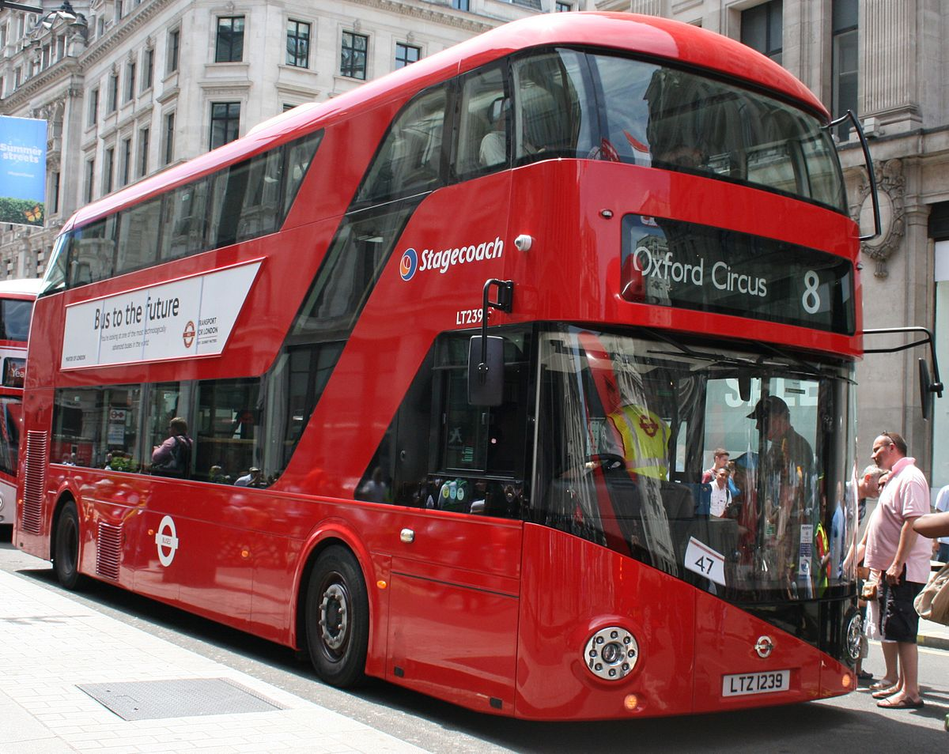
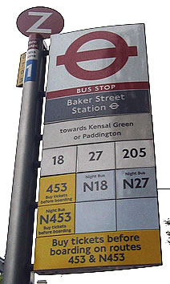
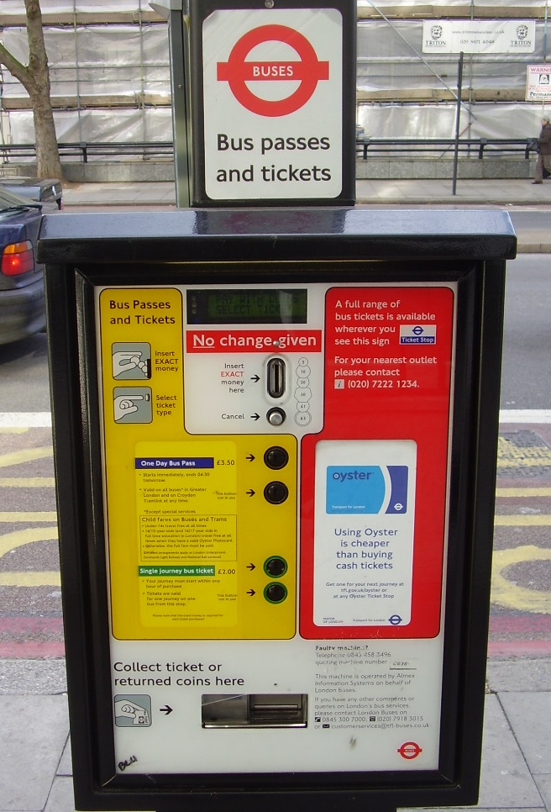
Transport for London System Branding

Slide 19
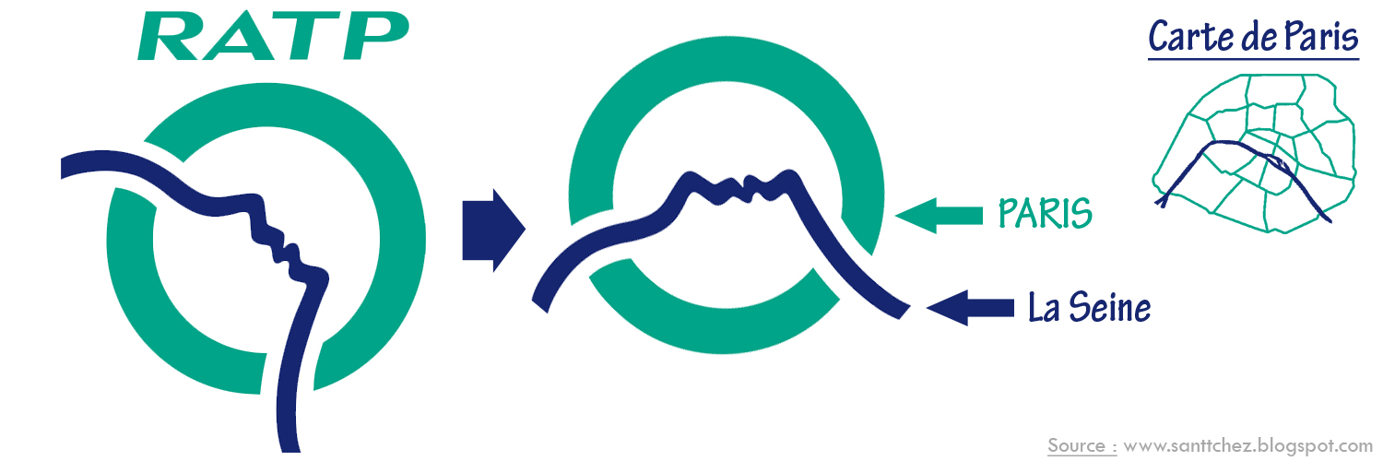
RATP System Branding

Slide 20
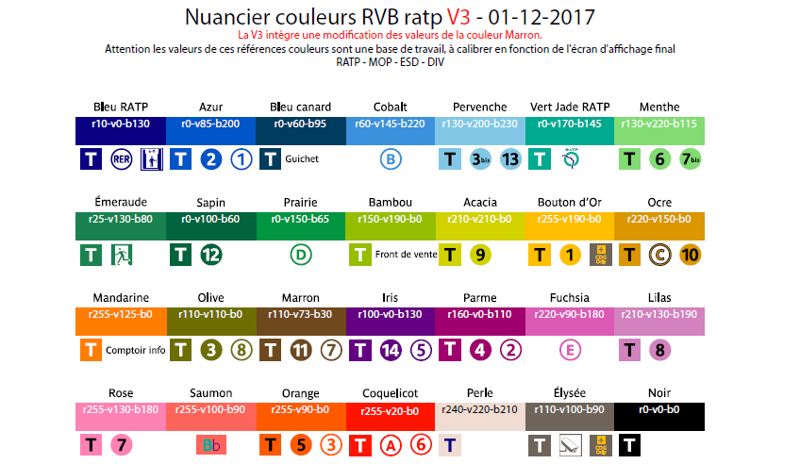
RATP System Branding

Slide 21
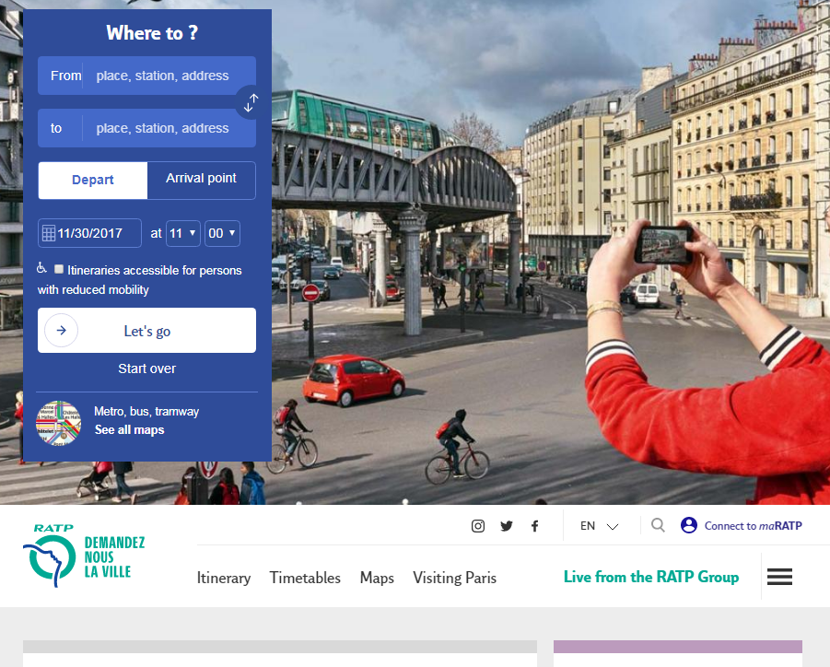
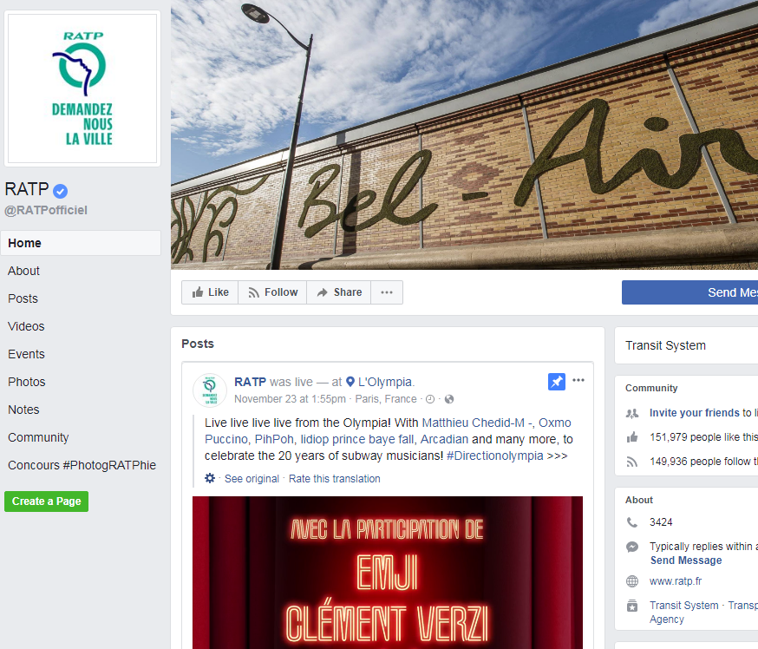
RATP System Branding

Slide 22
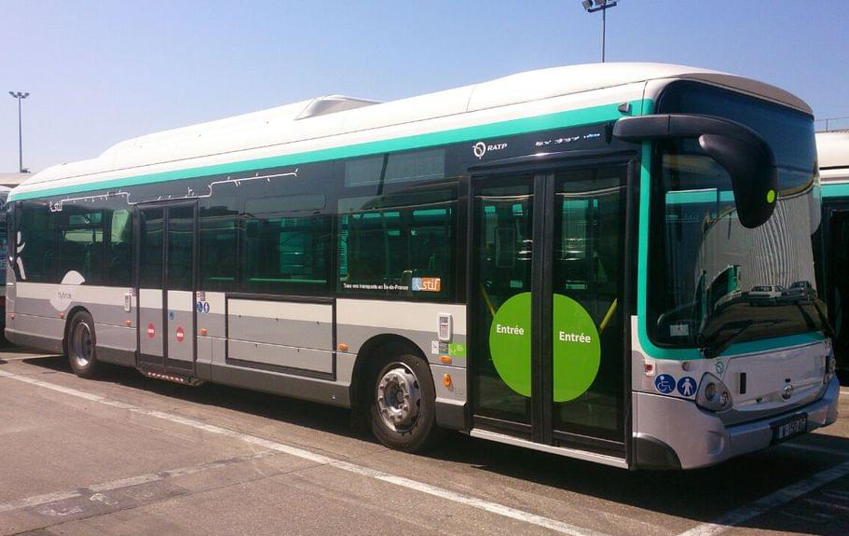
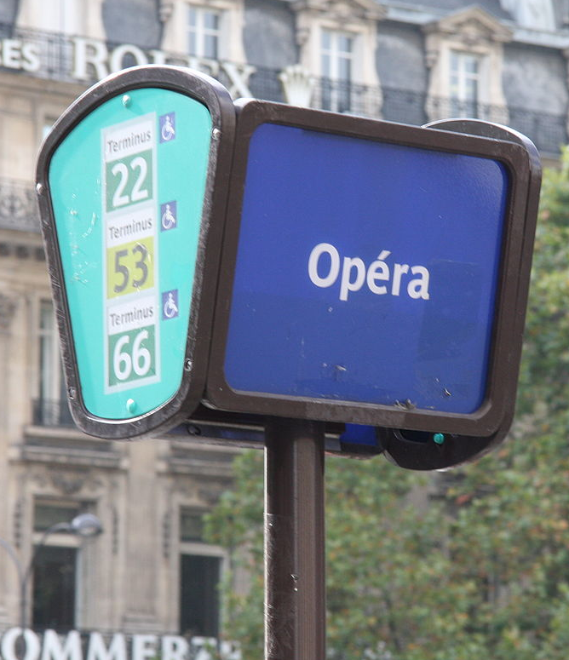
RATP System Branding

Slide 23
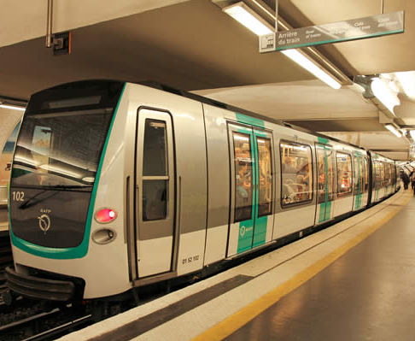
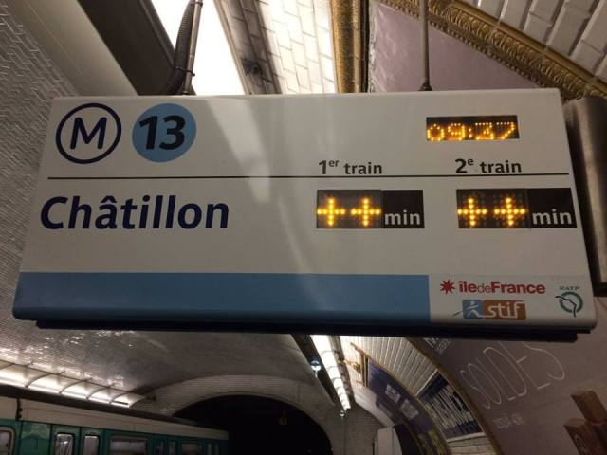
RATP System Branding

Slide 24
Information & Tools

Slide 25

Trip Planning

Slide 26
Transport for London Trip Planning

Slide 27
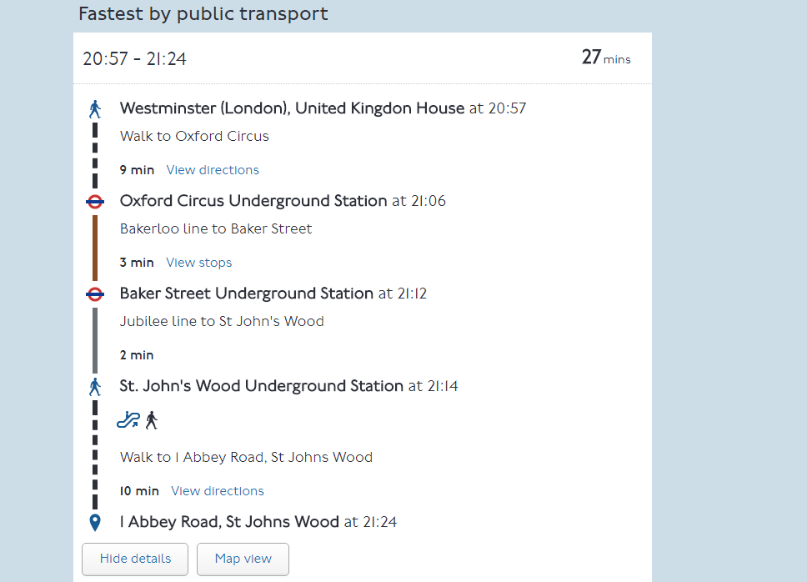
Transport for London Trip Planning

Slide 28
RATP Trip Planning

Slide 29
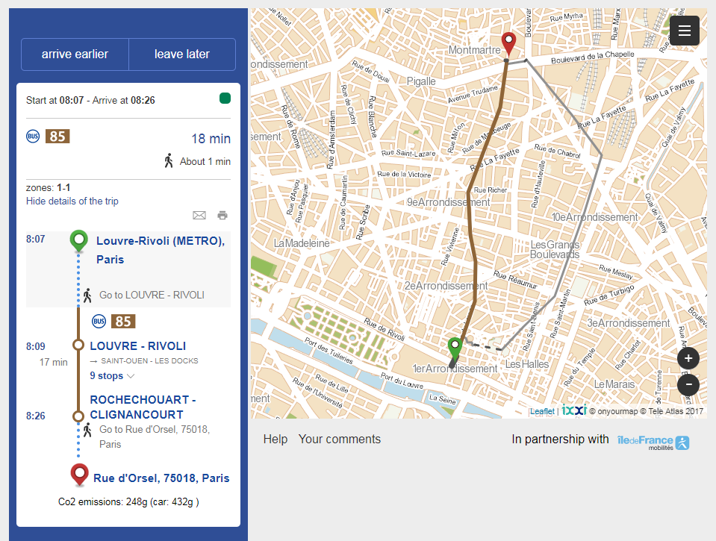
RATP Trip Planning

Slide 30
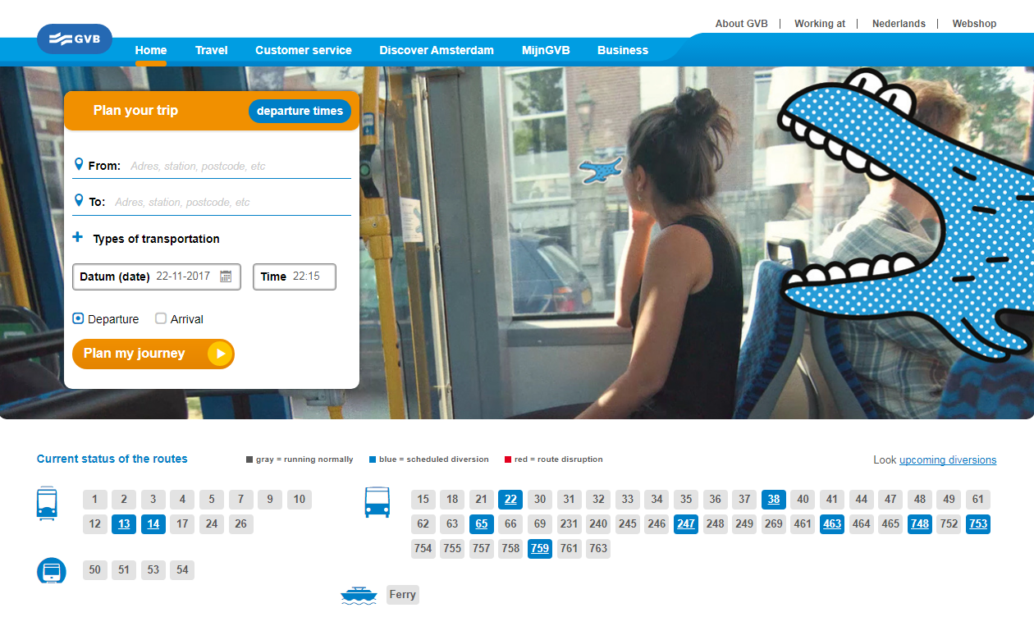
GVB Trip Planning

Slide 31
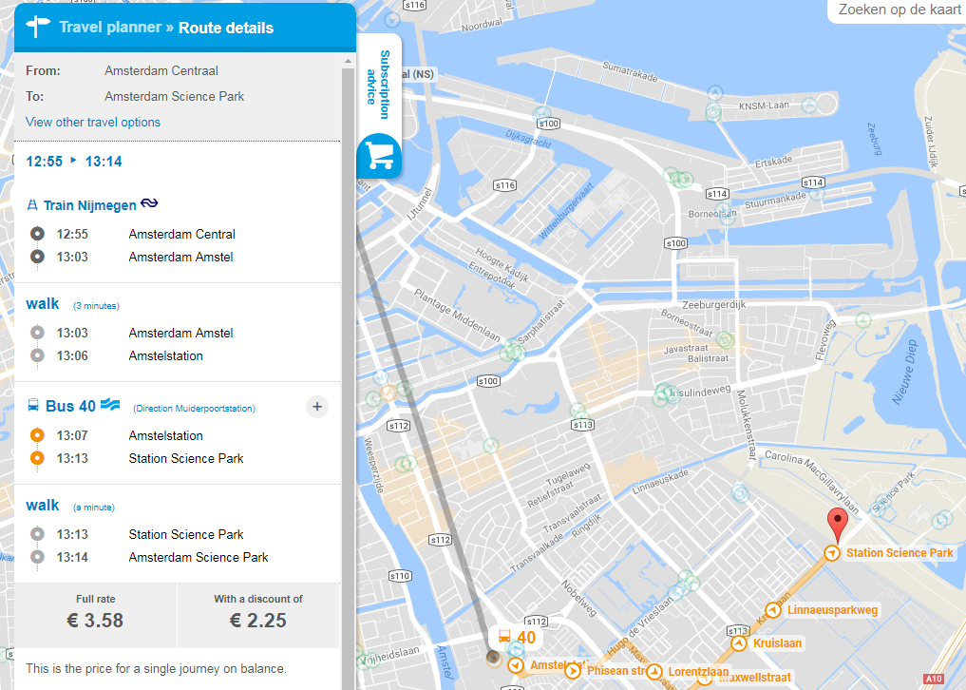
GVB Trip Planning

Slide 32

Real-Time Status Updates

Slide 33
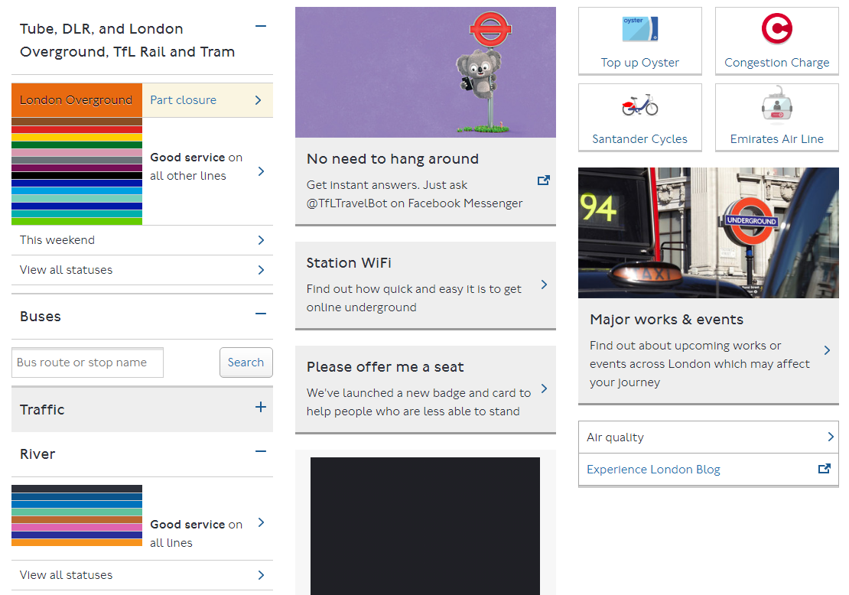
London Real-Time Status Updates

Slide 34
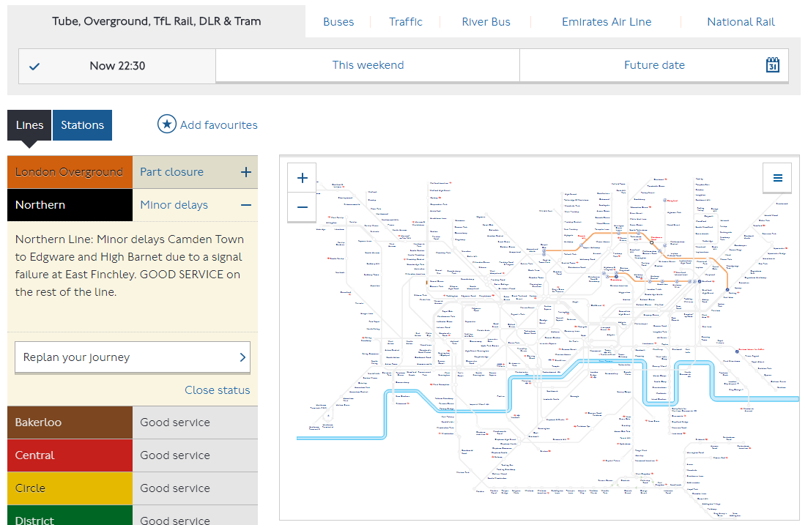
London Real-Time Status Updates

Slide 35
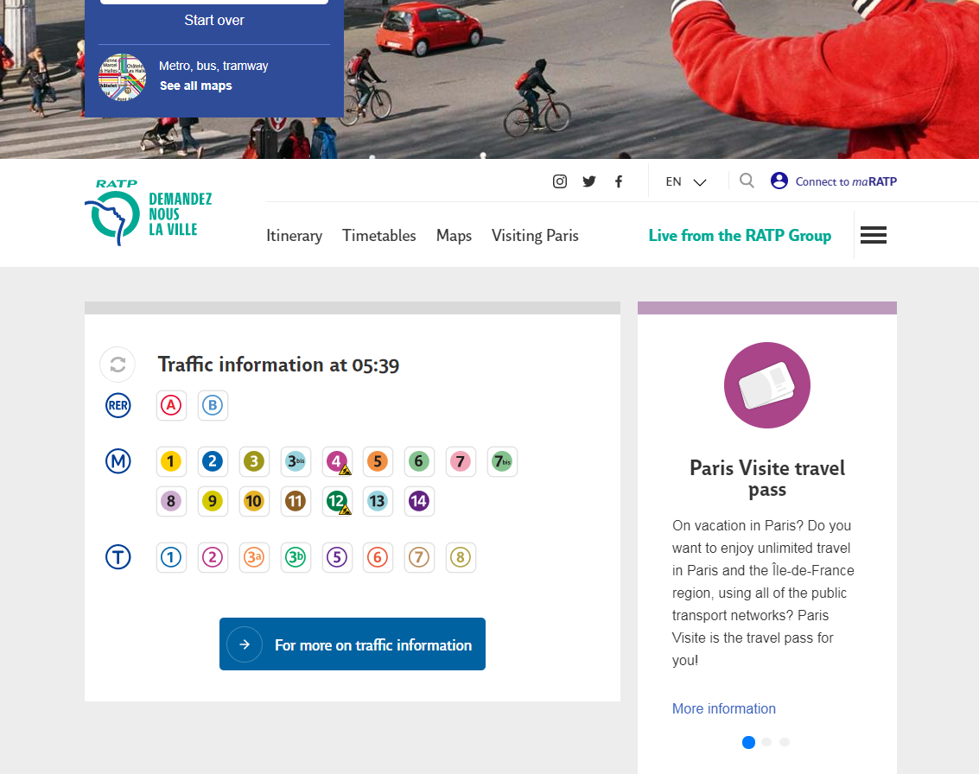
RATP Real-Time Status Updates

Slide 36
GVB Real-Time Status Updates

Slide 37
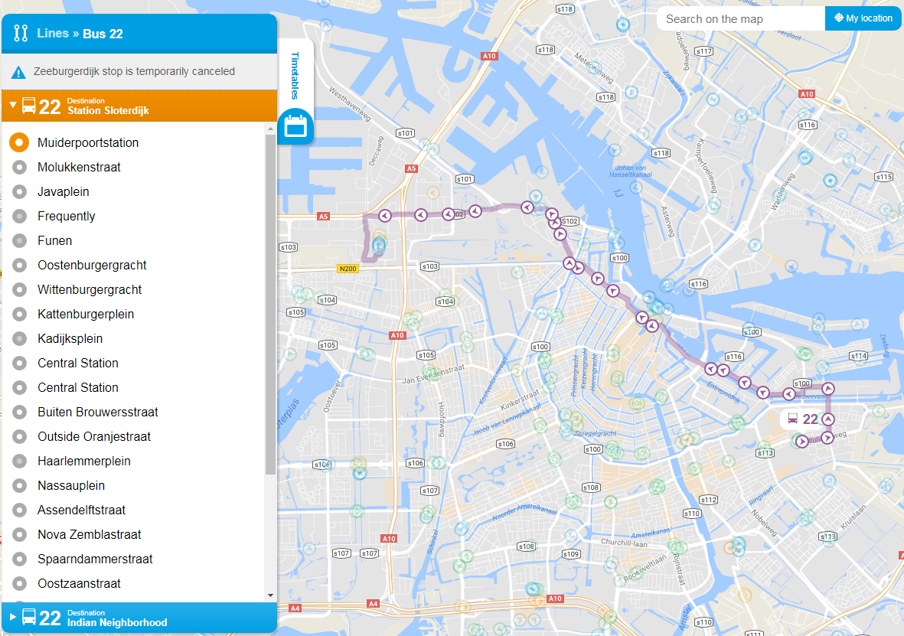
GVB Real-Time Status Updates
Route Change

Slide 38
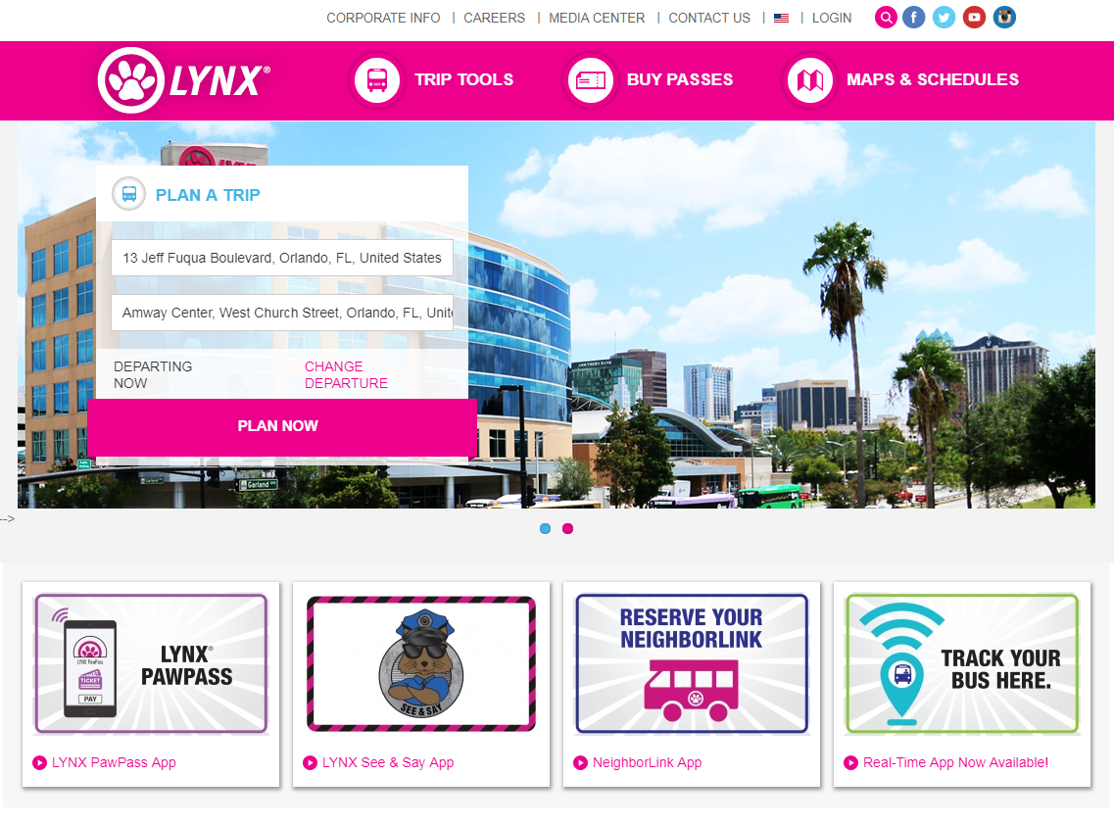
LYNX Real-Time Status Updates

Slide 39
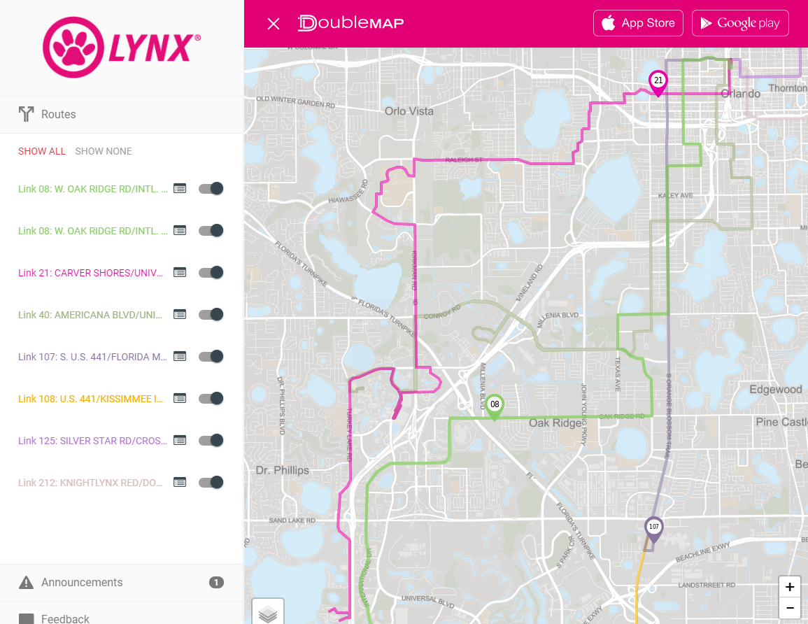
LYNX Real-Time Status Updates

Slide 40
Fare Purchases

Slide 41
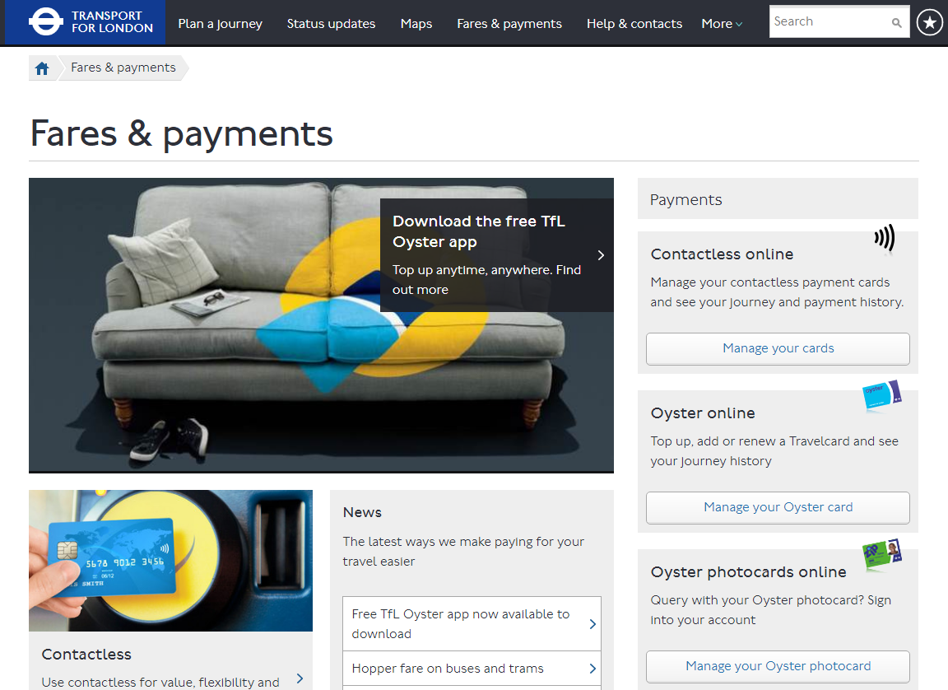
Transport for London Fare Purchases

Slide 42
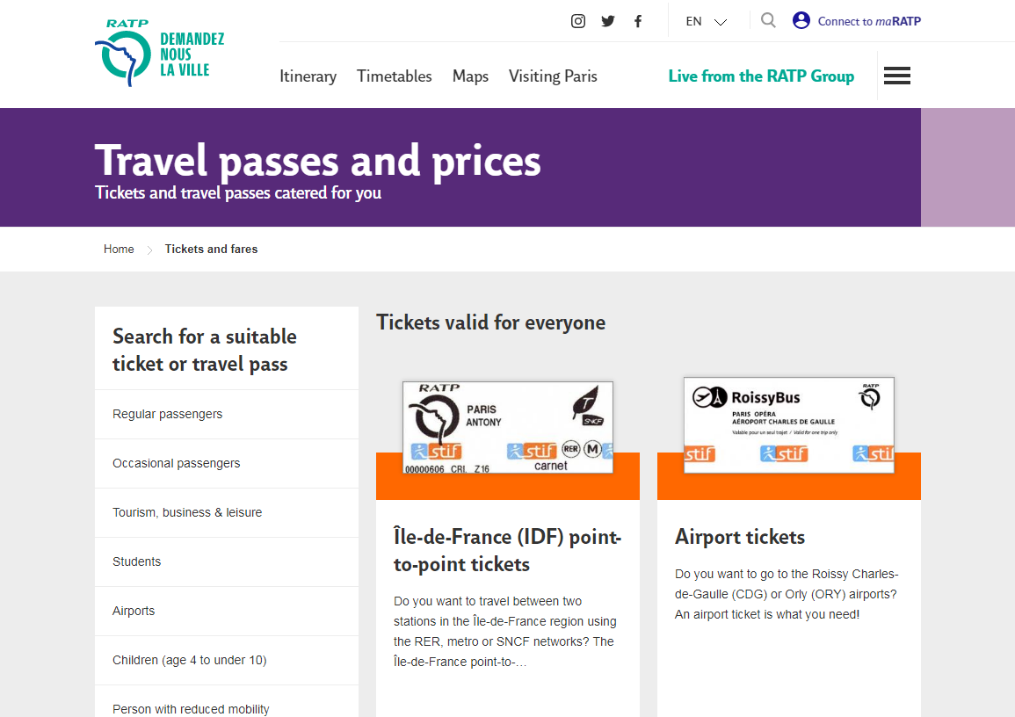
RATP Fare Purchases

Slide 43
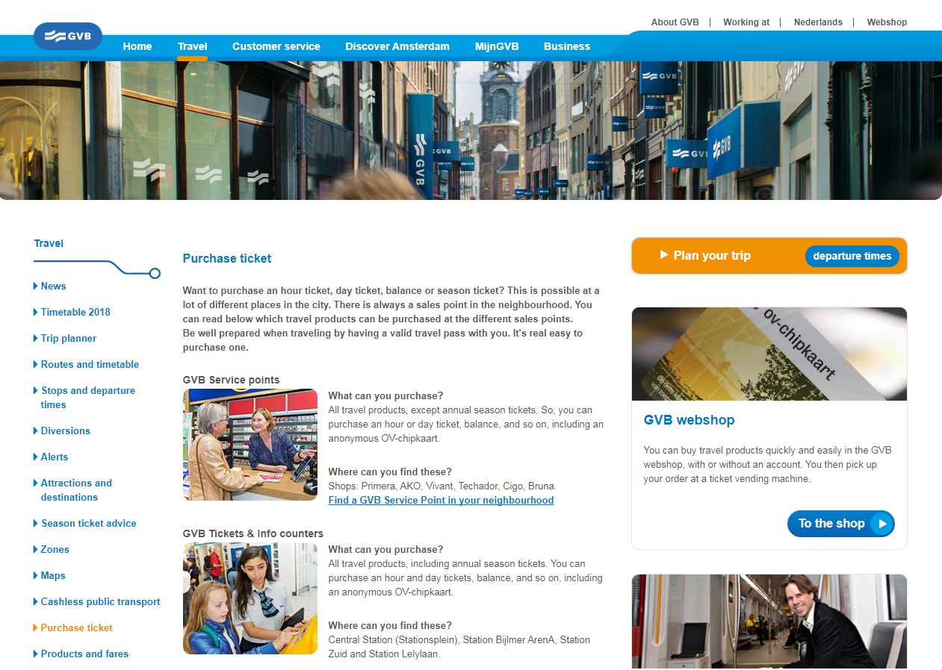
GVB Fare Purchases

Slide 44
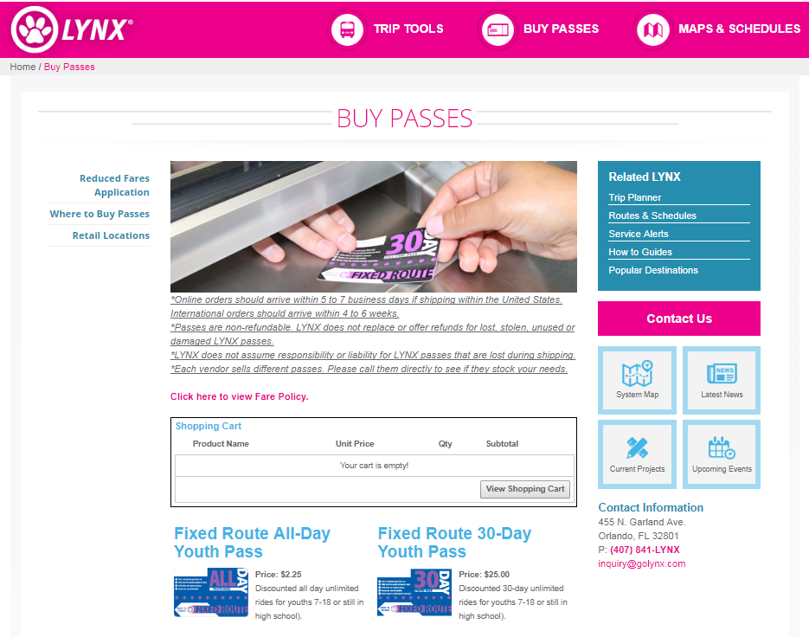
LYNX Fare Purchases

Slide 45
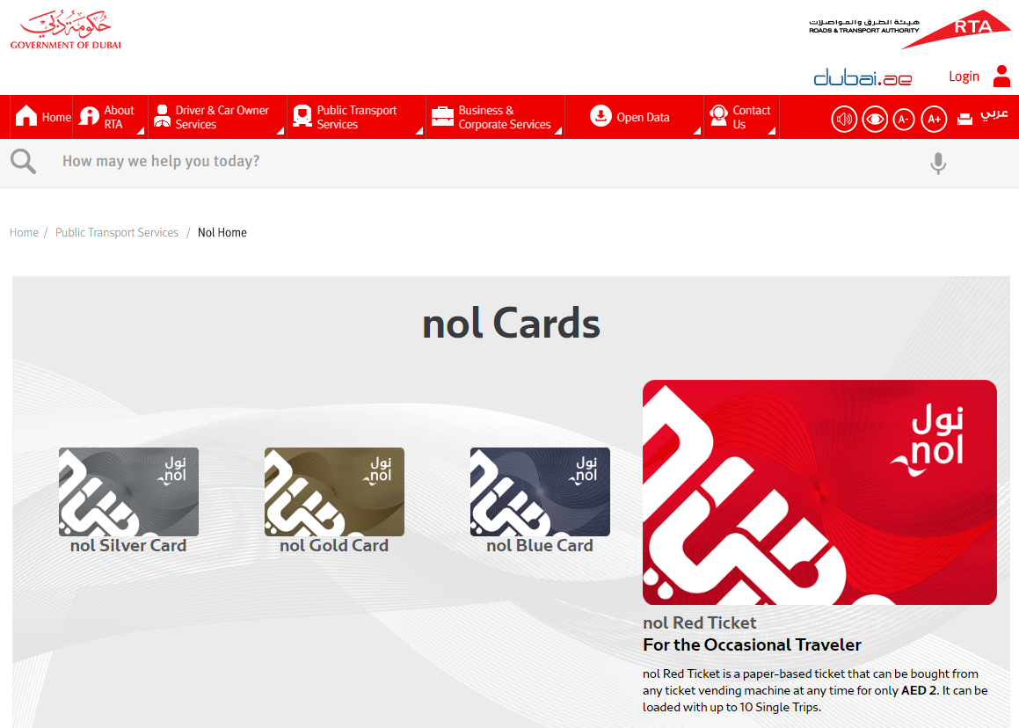
RTA Fare Purchases

Slide 46

Accessibility

Slide 47
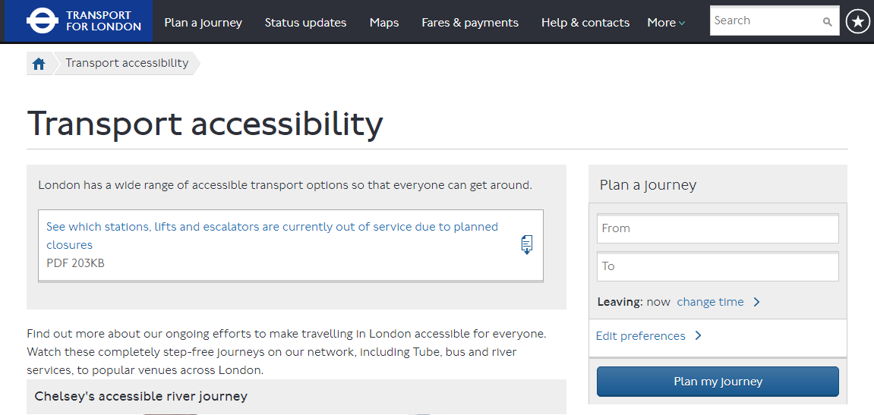
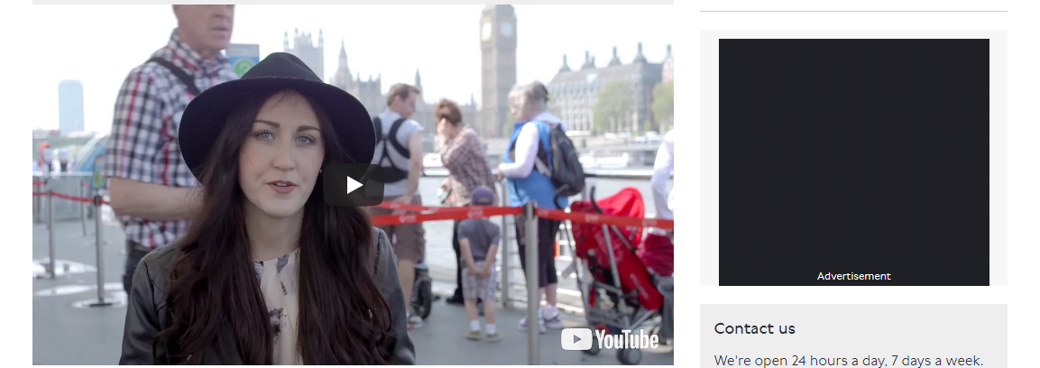
Transport for London Accessibility

Slide 48
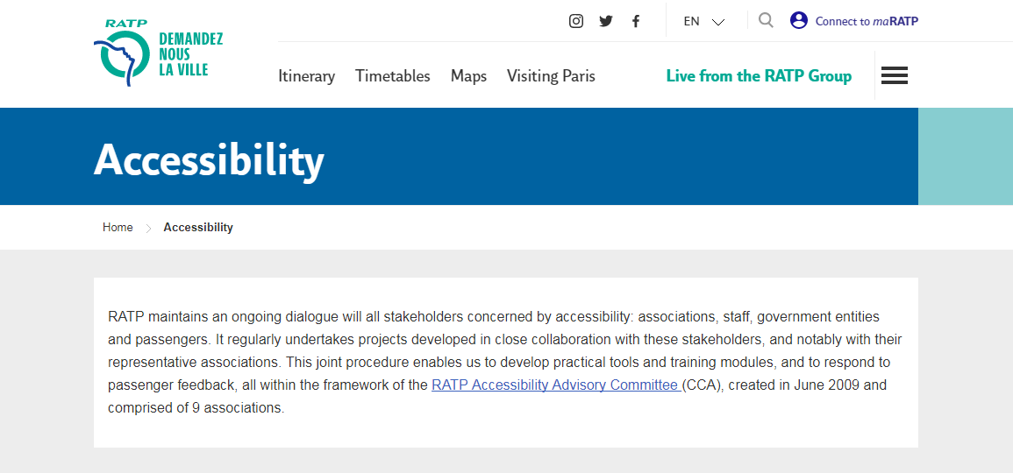
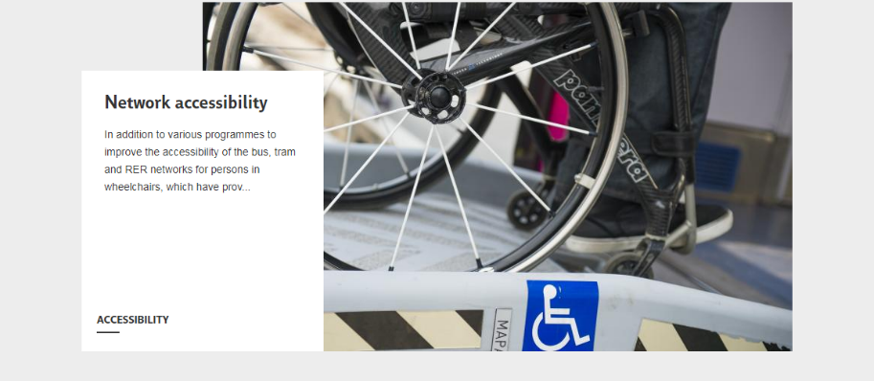
RATP Accessibility

Slide 49
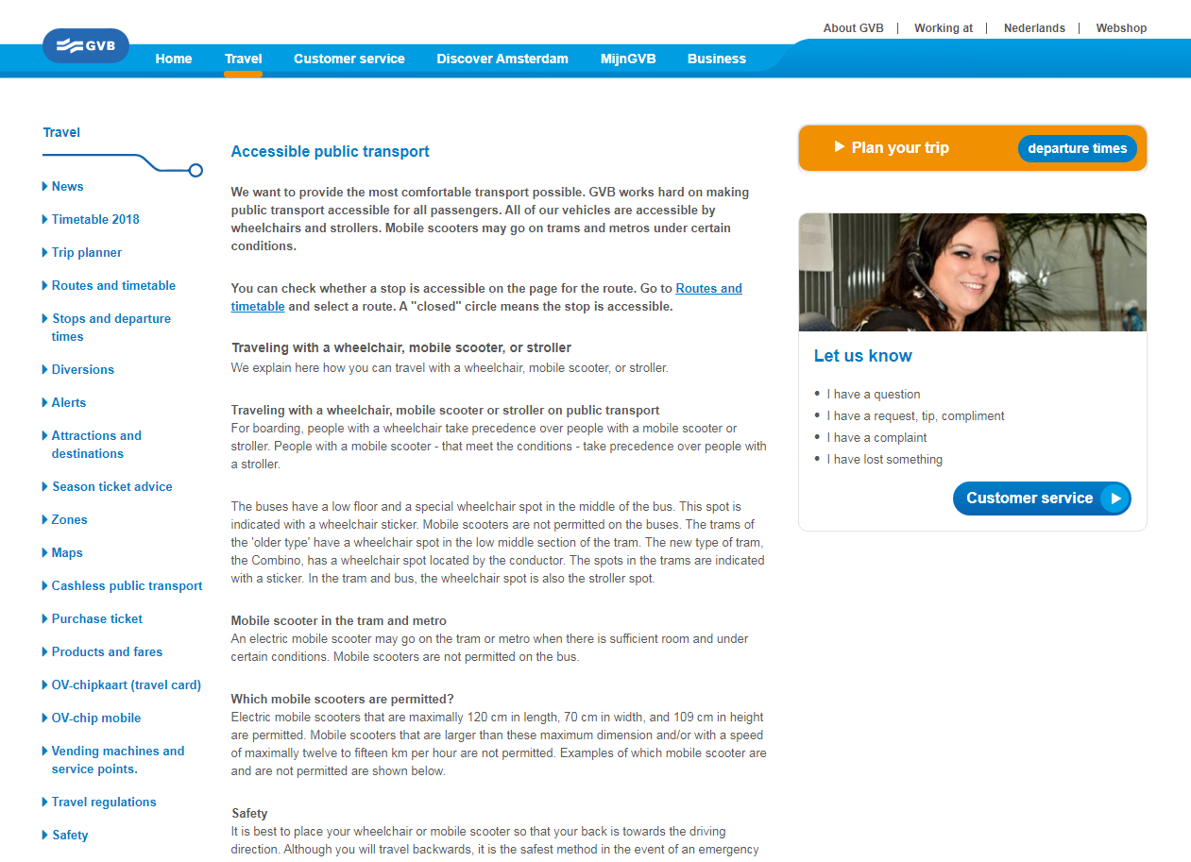
GVB Accessibility

Slide 50
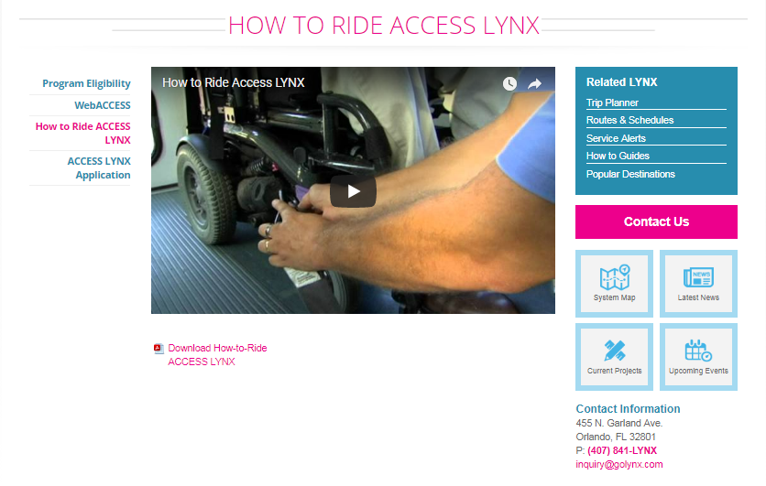
LYNX Accessibility

Slide 51

Tourist Information

Slide 52
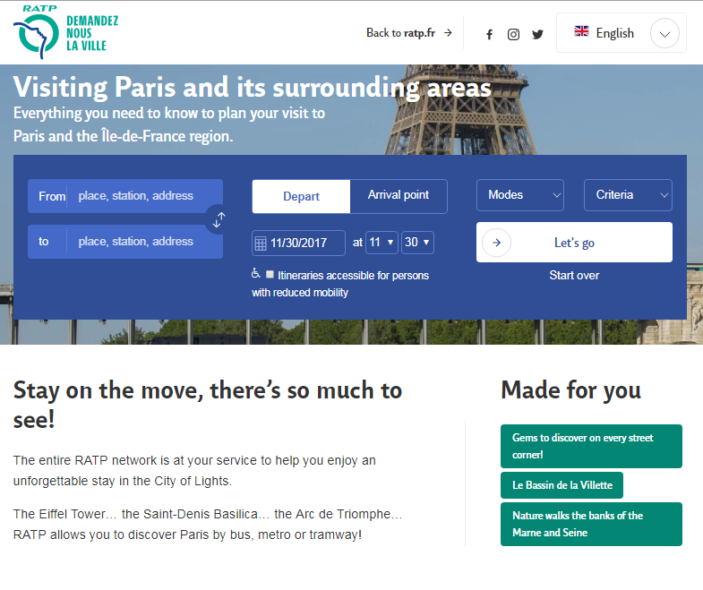
RATP Tourist Information

Slide 53
Push Communications

Slide 54
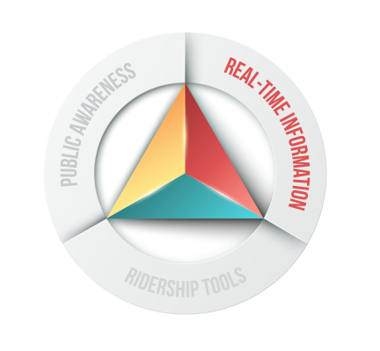
E-Newsletters &
Email Alerts

Slide 55
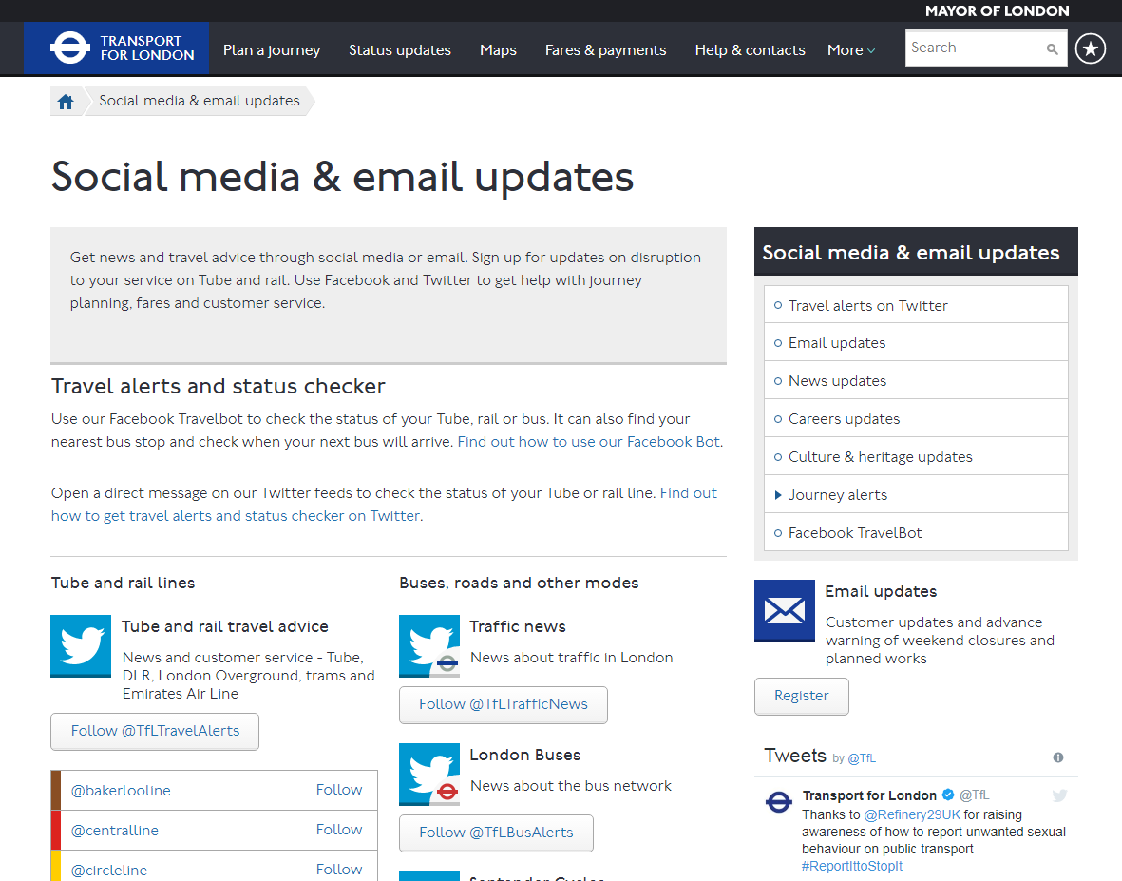
London eNewsletters & Email Alerts

Slide 56
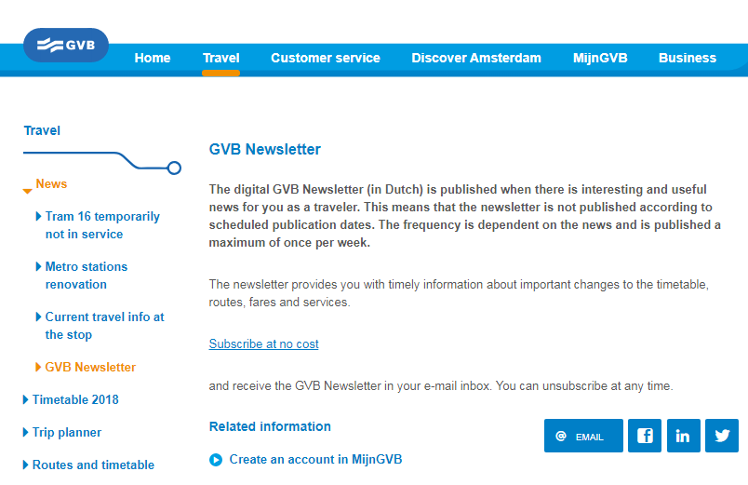
GVB eNewsletters & Email Alerts

Slide 57
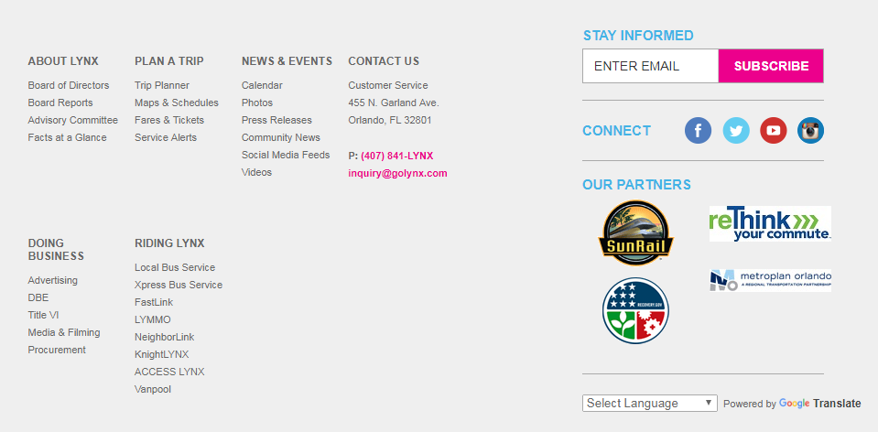
LYNX eNewsletters & Email Alerts

Slide 58






Social Media

Slide 59
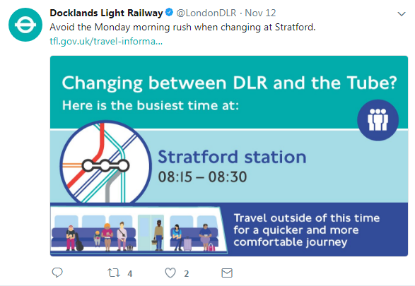

London Social Media

Slide 60


London Social Media

Slide 61


LYNX Social Media

Slide 62


RTA Social Media

Slide 63
Partnerships

Slide 64
Tourism Industry

Slide 65

RTA & Tourism Industry

Slide 66


RTA & Tourism Industry

Slide 67

RTA & Tourism Industry

Slide 68
Earned Media

Slide 69

London Earned Media

Slide 70

London Earned Media

Slide 71

RTA Earned Media

Slide 72
Mobile Applications & Real-Time Data

Slide 73



London Mobile App

Slide 74



RATP Mobile App

Slide 75

GVB Mobile App

Slide 76


LYNX Mobile App

Slide 77
Paid Media

Slide 78
Metrics & Measurement
Overall success
  Ridership numbers
  Revenue
Public Awareness
  Focus groups
  Opinion surveys
  News media monitoring
Ridership Tools
  Google Analytics
  Online feedback
Real-time Information
  Google Analytics (mobile app)
  Social media monitoring

Slide 79
Gap Analysis

Slide 80


eNewsletter Best Practice
Develop stories that are +/- 200 words with professional visuals for each story (photos or graphics) with no more than five stories per issue
Include links to website tools
Newsletter content should also have a home on the website and be easily sharable via social media
Share newsletter articles via owned social media

Slide 81
Social Media Best Practice
Create a unified social media presence with one Qatar public transport account on each social network
Create a social media editorial calendar and plan content in advance
Secure resources for imagery and content
Share less time-dependent news (news releases, marketing messages, etc.) via Facebook and Instagram
Develop a real-time alert system for Twitter

Slide 82


B2B Best Practice
Create or contract with a B2B outreach specialist to develop a full-scale B2B outreach program
Workplace public transport rider/customer recruitment presentations
Exhibits at workplace events (health fairs, employee picnics, building lobbies during morning/afternoon rush, etc.)
Public transport training program

Slide 83
On-line Newsroom Best Practice
Create an on-line newsroom on the unified public transport website
  Hard news: impactful stories that are up-to-the-minute and require immediate reporting
  Soft news: features and human interest stories, and marketing pieces
The newsroom should be full multimedia
Create a way for reporters to receive push notifications (emails) from the newsroom when new content is added

Slide 84
Mobile App Best Practice
Create one mobile application with multiple tools for riders
  Trip Planning
  Fare Purchasing
  Real-time Arrival/Departure Information
  Safety, Security and System Alerts
  Tourism

Slide 85
Performance Metrics
Qatar Ministry of Transport and Communications (MoTC)
Public bus ridership in Qatar has risen by 40% between 2015 and 2018 according the MoTC
MoTC attributes this to “significant enhancement works” carried out by the ministry “to boost the performance efficiency of the public bus service and increase ridership, in co-ordination with Mowasalat (Karwa).”

Slide 86

For More Information:
Thank you!
Greg Nixon
Senior Consultant
407.571.6775 office
gregnixon@global-5.com
www.global-5.com

