Slide 1
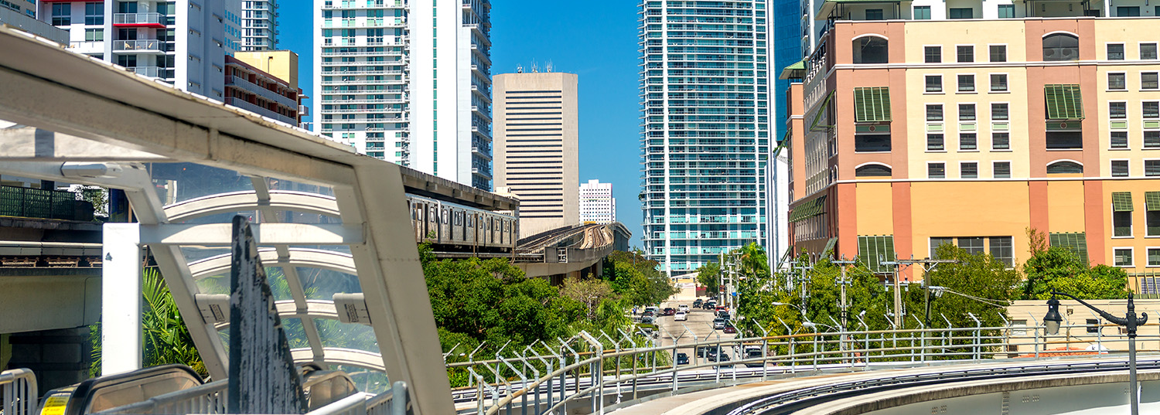
Working with your Elected Officials and Maximizing your Legislative Message
2019 FPTA/CTD Annual Conference
Wednesday, September 18, 2019

Slide 2
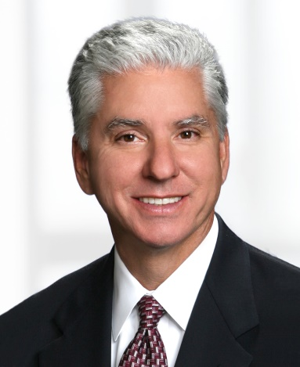
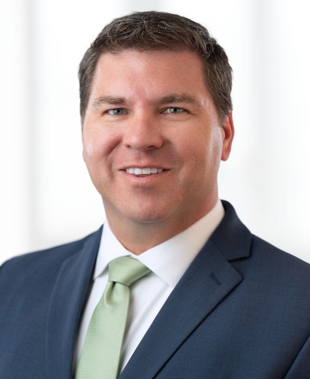
Presenters
J. Keith Arnold, Ph.D.
Senior Principal, Florida Government Relations
keith.arnold@bipc.com | Tallahassee, FL | 850-681-4280
Keith brings decades of government and government relations experience to our Florida team. During his 16-year tenure in the Florida House of Representatives, Keith held variety of chairmanships, including Chair of the Tourism and Cultural Affairs Committee and Chair of the Postsecondary Education Committee. He now works with clients on a broad range of issues including transportation.
Terrence Heubert
Principal, Federal Government Relations
terrence.heubert@bipc.com | Washington, D.C. | 202-452-6041
Terry has been advocating for a variety of interests in Washington, D.C. for over 15 years, focusing mainly on transportation and infrastructure work. He has long-standing experience working with the federal government and has represented clients from across the country, including transportation-related companies, local governments, transit systems, airports and ports.

Slide 3
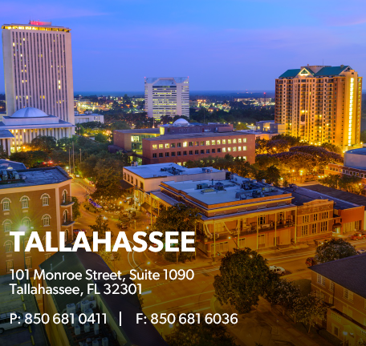

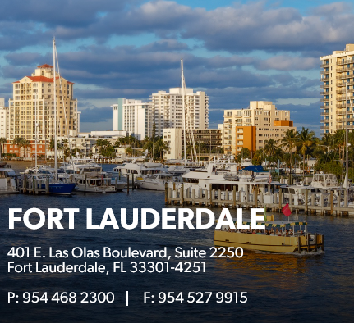
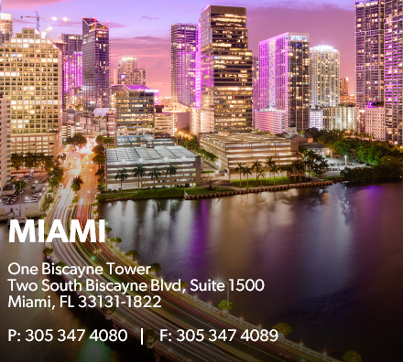
Our Florida Coverage
450 Attorneys and Government Relations Professionals firm-wide
9 Lobbyists in Florida Focused on a Range of Industries
Dedicated Federal Team in Washington, D.C.

Slide 4
Florida: The Main Players in Transit
Senate Appropriations Subcommittee on Transportation, Tourism, and Economic Development
Senator Travis Hutson, Chair (Flagler, Putnam, St. Johns, Volusia)
Senator Perry Thurston, Vice Chair (Broward)
Senator Jeff Brandes (Pinellas)
Senator Tom Lee (Hillsborough, Pasco, Polk)
Senator Keith Perry (Alachua, Marion, Putnam)
Senator Wilton Simpson (Citrus, Hernando, Pasco)
Senator Annette Taddeo (Miami Dade)
Senator Victor Torres (Orange, Osceola)
House Transportation & Tourism Appropriations Subcommittee
Rep. Jay Trumbull, Chair (Bay County)
Rep. Brad Drake, Vice Chair (Bay, Holmes, Jackson, Walton, Washington)
Rep. Barbara Watson (Miami Dade)
Rep. Dan Daley (Broward)
Rep. Bobby DuBose (Broward)
Rep. Elizabeth Fetterhoff (Volusia)
Rep. Joe Geller (Broward, Miami Dade)
Rep. Blaise Ingoglia (Hernando)
Rep. Tom Leek (Volusia)
Rep. Anthony Rodriguez (Miami Dade)
Rep. David Smith (Seminole)
Rep. Cyndi Stevenson (St. Johns)

Slide 5
Federal: The Main Players in Transit
House Transportation & Infrastructure Committee
Peter DeFazio (D-OR), Chair
Sam Graves (R-MO), Ranking Member
Eleanor Holmes Norton (D-DC), Chair, Highways & Transit Subcommittee; Rodney Davis (R-IL), Ranking Member
Florida Representation
  Frederica Wilson (D-Miami), Highways & Transit Subcommittee Member
  Debbie Mucarsel-Powell (D-South FL & the Keys)
  Daniel Webster (R-Leesburg), Highways & Transit Subcommittee Member
  Ross Spano (R-Lakeland), Highways & Transit Subcommittee Member
Senate Banking, Housing and Urban Affairs Committee
Mike Crapo (R-ID), Chairman
Sherrod Brown (D-OH), Ranking Member
David Perdue (R-GA), Chairman, Housing, Transportation, and Community Development Subcommittee; Robert Menendez (D-NJ), Ranking Member
Key Appropriators in the Florida Delegation
House
Mario Diaz-Balart (R-Doral), Ranking Member, THUD
Debbie Wasserman Schultz (D-Sunrise)
Lois Frankel (D-Boca Raton)
Charlie Crist (D-St. Petersburg)
John Rutherford (R-Jacksonville), THUD Member
Senate
Marco Rubio (R-FL)

Slide 6
Interacting with Officials
Know the Rules
Florida gift laws make it difficult to interact with elected officials outside of their office and official duties
Social and casual interactions with Florida elected officials are limited because of a prohibition of campaign contributions from public entities
On the federal level, congressional Members and their staffs cannot accept gifts of $50 or more and all gifts from the same source must total less than $100 in the same calendar year
For Federal agencies, ethics rules restrict the solicitation and receipt of gifts by Executive Branch employees where gifts are from prohibited sources or result from the employee’s official position
Interact in a Smart Way
Identify individuals in your organization who have personal relationships with lawmakers to gain access
Schedule individual meetings with lawmakers in their district offices for more substantive discussions
Invite officials to special events including the opening of a facility or a tour

Slide 7
Playing the Ground Game: Getting Funding
Prioritize Your Efforts
Work with Membership Organizations – FPTA
  FPTA’s Tallahassee Legislative Day
Work with a Contract Lobbyist
  Deliver messages specific to your organization
Leverage Competitive Grants
  Schedule project visits
  Secure letters of recommendation
  Recent Examples:
  Pinellas Suncoast Transit Authority – $100K software technology grant for vehicle integration
  Jacksonville Transportation Authority – $399K grant to develop software connecting medical scheduling and transit vehicles
Educate County Commissioners
  Convey a sense of urgency around transit issues
  Drive home that transit is a priority and provides an economic benefit

Slide 8
Key Messages to Convey to Elected Officials
Public Transportation is Good for Florida Businesses
$1 invested in public transportation = $4 generated in economic returns
Traffic congestion is bad for business
Transit provides a more reliable employee base and better access to labor pools
Public Transportation is a Smart Environmental Choice
Transit strategies reduce greenhouse gasses and save 37 million metric tons of carbon dioxide annually
Cuts down on the air pollution that can cause asthma in children
Public Transportation Improves Quality of Life
Florida has the second largest amount of congested urban areas in the U.S. behind California
Automobile travel is one of Florida’s most expensive public health issues
  Traffic accidents are a leading cause of fatalities
  Ground-based mass transit is 150 times safer
Source: Florida Public Transportation Association

Slide 9
Questions

Slide 10
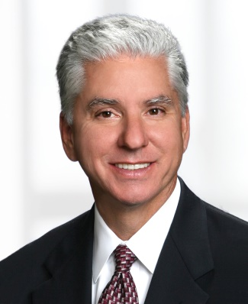

Thank you
J. Keith Arnold
Terrence Heubert
717-237-4861
keith.arnold@bipc.com
Tallahassee, FL
202-452-6041
terrence.heubert@bipc.com
Washington, D.C.

