Slide 1

FPTA/CTD Annual Conference and EXPO
Florida Automated Transit and Shared Use Network (ATSUN)
Shared Mobility Session
Monday September 16, 2019
Victoria Perk, CUTR Transit Research Program
Steve Holmes, Vice President Southeast Region, UZURV
Annie Arguello, Program Manager, FDOT District 1 Commute Connector
Bonnie Epstein, Senior Planner, PSTA

Slide 2
The Adaptive Transportation Network For Communities of Health
Steve Holmes
Vice President, Southeast Region
September 15, 2019

Slide 3
UZURV
“Higher Level of Care”
Active ride monitoring & oversight
Door-to-door rider assistance
Specialized driver pools
With FTA compliant & credentialed drivers
“Favorite Driver”

Slide 4
Adaptive TNC & Mobility Platform
Connect people to independent drivers and wheelchair accessible vehicles.
Independent drivers and wheelchair accessible vehicles provide on-demand or prearranged rides.
People access healthcare, jobs, education & other life-sustaining services.

Slide 5
Adaptive TNC & Mobility Platform
Focus
Providing safe, reliable and accessible rides
Serving the speciality needs of people & organizations

Slide 6
UZURV Mobility Platform
UZURV 360
Wheelchair Accessible Vehicles (WAV)
Lyft

Slide 7
Mobility Platform - UZURV 360
Door-to-door . . . non-stop . . . ambulatory rides
Credentialed independent drivers
  CPR
  First Aid
  Disability Sensitivity
  HIPAA
FTA Drug and Alcohol
Local and national criminal background checks

Slide 8
Mobility Platform - WAV
Integration of locally-based Wheelchair Accessible Vehicle providers
Non-ambulatory rides
Operations Team
  Schedules rides
  Provides oversight of rides

Slide 9
Mobility Platform - Lyft
Direct integration with Lyft
Curb-to-curb rides
Operations Team provides oversight of rides

Slide 10
UZURV Programs
ADA Paratransit Premium (Rider-Choice)
ADA Paratransit Supplemental (Overflow)
Non-Emergency Medical Transportation
  Medicaid
  Non-Medicaid
Human Services Transportation

Slide 11




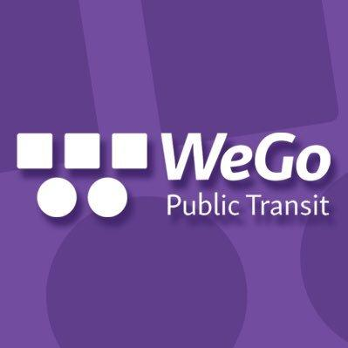




Customers
Jacksonville Transportation Authority
Launched April, 2019
Premium ADA service
Municipal ADA transportation
FTA Compliant
American Cancer Society
Launched 6 state October 2017
Expanded to 19 states February, 2018
Using UZURV and Lyft with a system integration
25,000 rides executed in 2018
Lynx—Orlando
Launched June 2019
ADA Supplemental Service
Web Self-Service reservations
FTA Compliant
Commission for the Transportation Disadvantaged
Launched January 2019
Human Services Transportation
Call Center
Rider Training
Nashville WeGo
Launched February 2018
Awarded Multi-year contract September
Premium ADA and Supplemental Service
FTA Compliant
Phoenix
Launched November 2018
Batch loaded, Custom integration
Trapeze
FTA Compliant
Greater Richmond Transit Company
Launched August 2017
Over 30,000 ADA rides
Call Center
Model for municipal transit
Central Ohio Transit Authority
Launched May 2019
Web Self-Service reservations
FTA Compliant
City of Greensboro Transit
Launched January 2019
Municipal ADA Supplemental Service

Slide 12
Jacksonville Transportation Authority
Launched April 2019
Premium (rider-choice) ADA service
Reservations - Call center
FTA compliant drivers
On-Time Performance
  < 15 minutes
  98.69% August

Slide 13
Central Florida Regional Transit Authority
Launched June 2019
ADA Supplemental Service
Reservations: Web Self-Service batch upload
FTA compliant drivers
On-Time Performance
  < 15 minutes
  97.04% August

Slide 14
American Cancer Society
Launched October 2017
NEMT Service
Reservations: Web Self-Service
Uses UZURV 360 & Lyft drivers
On-Time Performance
  < 15 minutes
  98.34%
> 25,000 rides

Slide 15
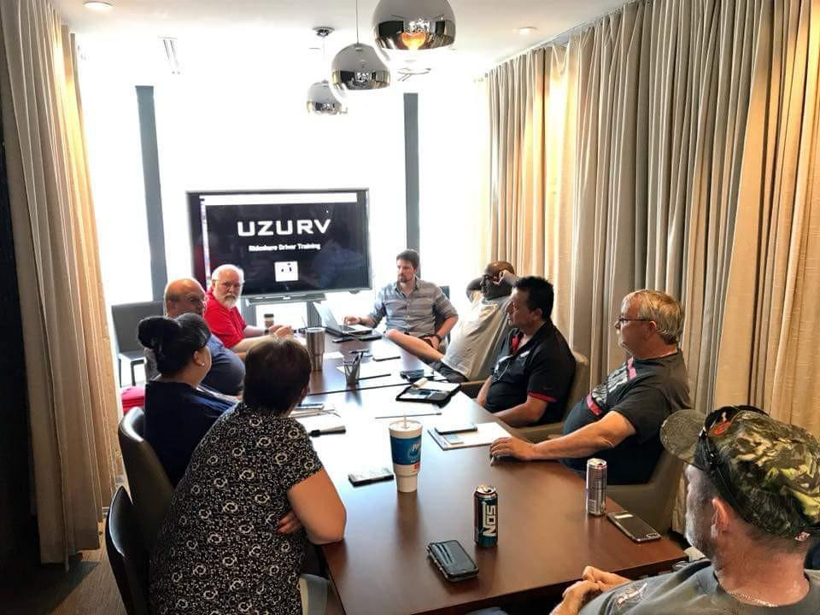
The Adaptive Transportation Network For Communities of Health
Steve Holmes
Vice President, Southeast Region
September 15, 2019

Slide 16



Slide 17


Who We Are

Slide 18
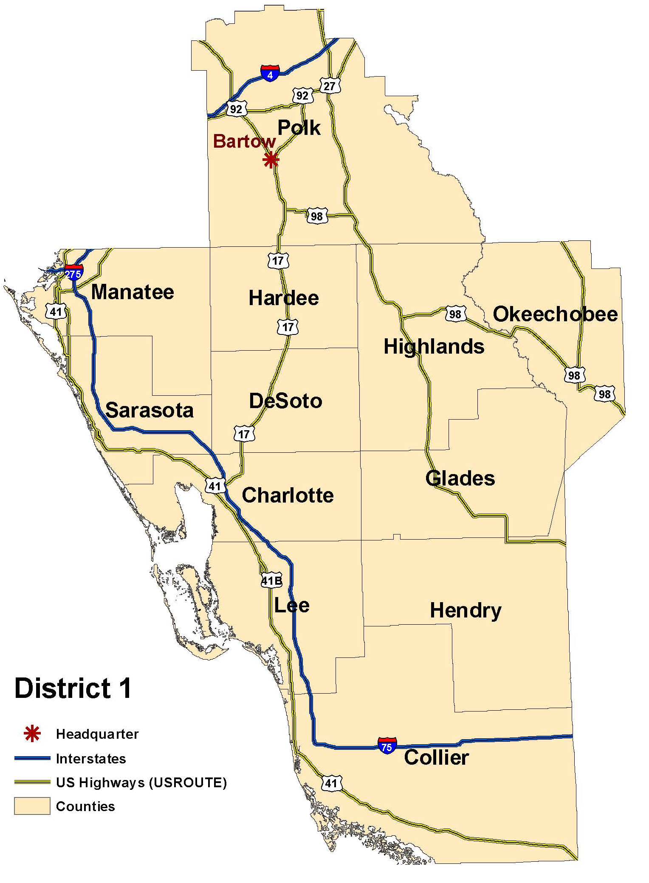

Who We Are
Commute Connector is a program of the Florida Department of Transportation
We serve 12 counties in southwestern Florida
Focus on improving shared mobility across the region through planning, promotions and development of commute options
  Expand access to jobs
  Reduce congestion
  Strengthen partnerships

Slide 19
What We Do

Slide 20


What We Do
Increase vehicle occupancy
  Ridesharing (carpooling/vanpooling), transit, biking and walking
Shift demand away from peak hours
  Compressed work weeks
  Telecommuting
Target efforts to employers to affect mode choice for work trips

Slide 21
Program Features

Slide 22
Core Services
Ridematching
Transit Training
Bike/Ped Safety
Park & Ride Program
Commuter Call Center
Employer Services
Incentives

Slide 23
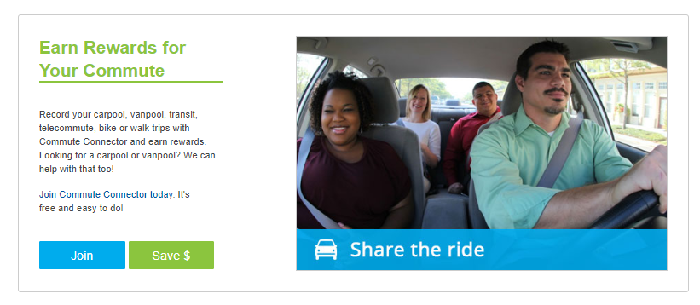
Commuter Platform
Launch: June 2019
Total members: 11,150
Ready-to-go incentives and rewards
Native mobile apps for iOS and Android

Slide 24
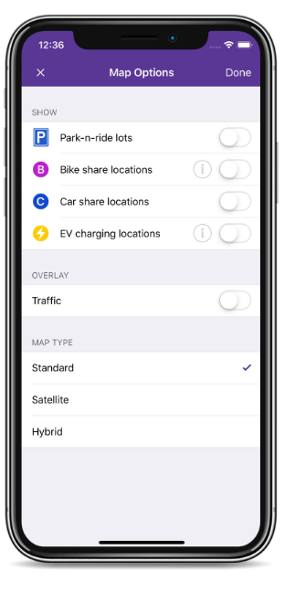
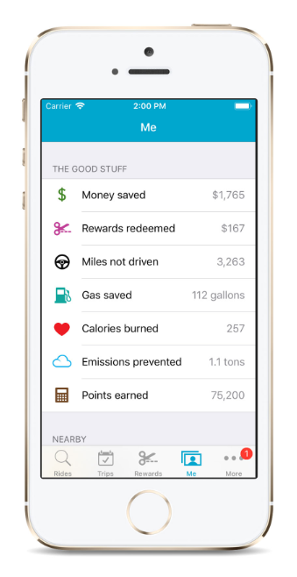



Commuter Platform
How it works
Find a carpool or transit option
Record your commute trips
Earn points and rewards
Rewards & Engagement
Dashboard – Personal impacts & savings
Rewards – Mobile coupons & raffle prizes
Results – Individual & company-wide metrics

Slide 25
Next Step

Slide 26
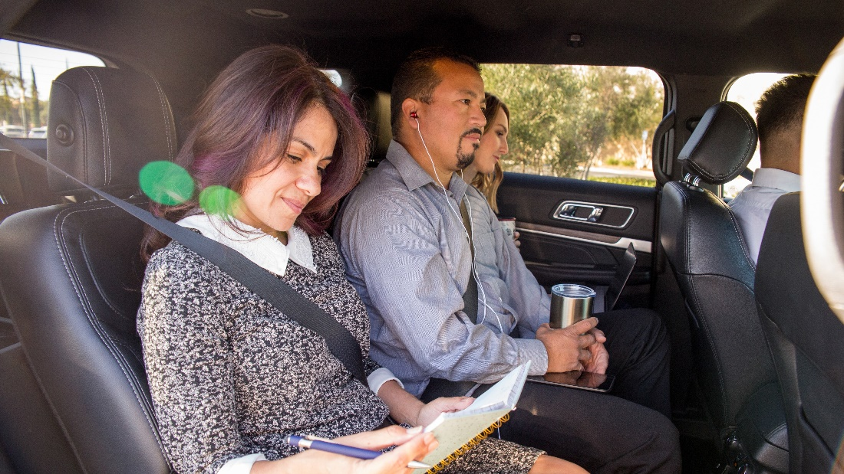
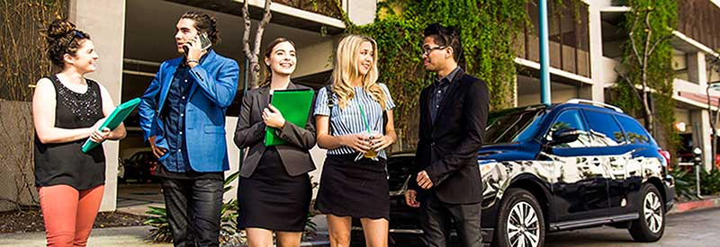
Regional Vanpool Program
Expand access to jobs
Improve mobility

Slide 27


Annie Arguello
Program Manager
Annie@CommuteConnector.com
A Program of the Florida Department of Transportation
CommuteConnector.com
866-585-RIDE (7433)

Slide 28
PSTA Mobility on Demand Programs
FPTA/CTD Annual Conference
Shared Mobility Session
Orlando, FL
Bonnie Epstein, Senior Planner
September 16, 2019

Slide 29
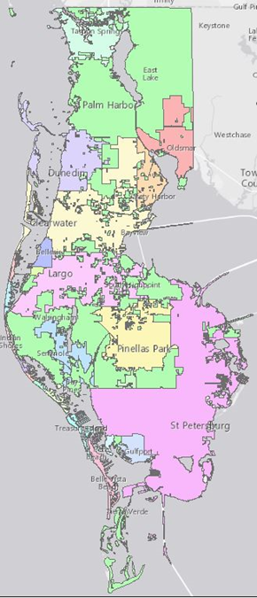

PSTA and Pinellas County
Population of 949,827 (2015)
Median age of 46
24 municipalities – 22 served by PSTA
Top business sectors are health services, tourism services, manufacturing, and financial services
41 bus routes
12 million trips in FY18

Slide 30
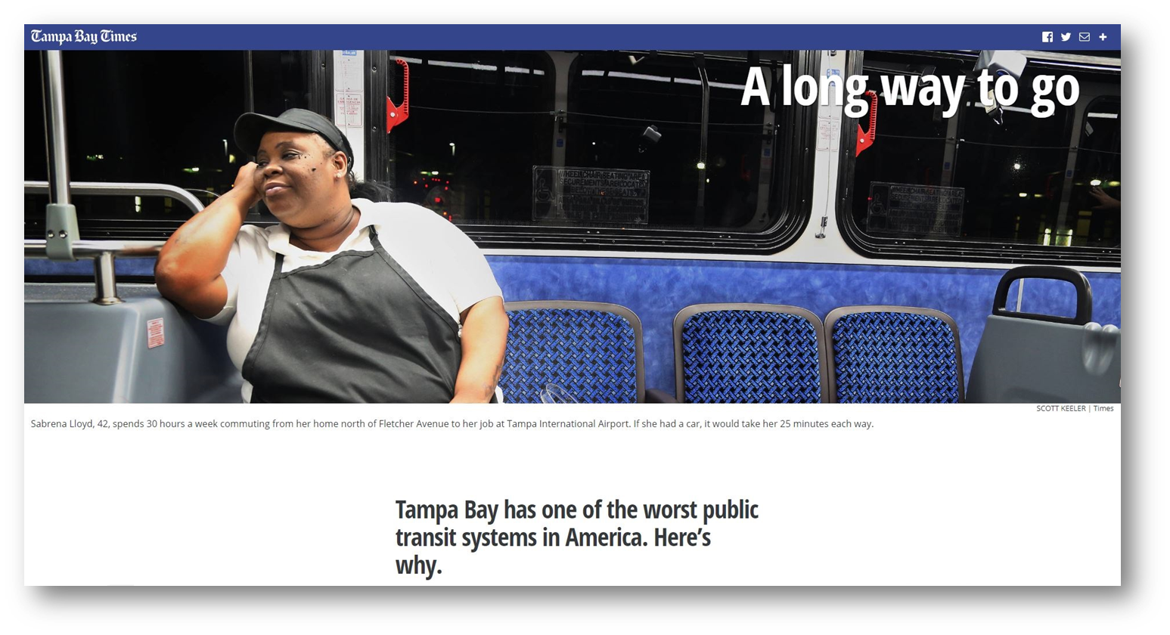
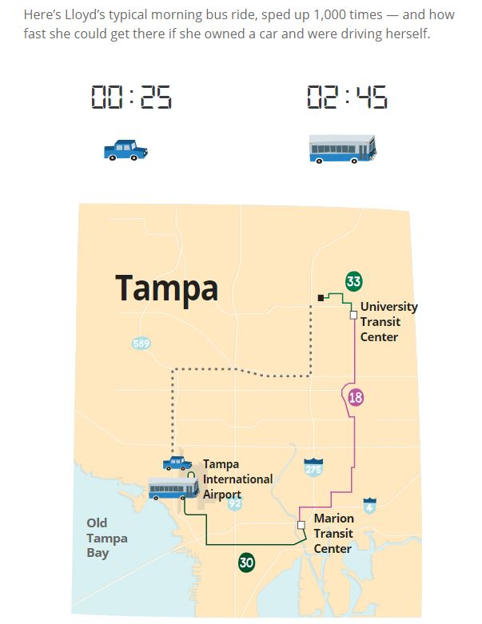







PSTA

Slide 31
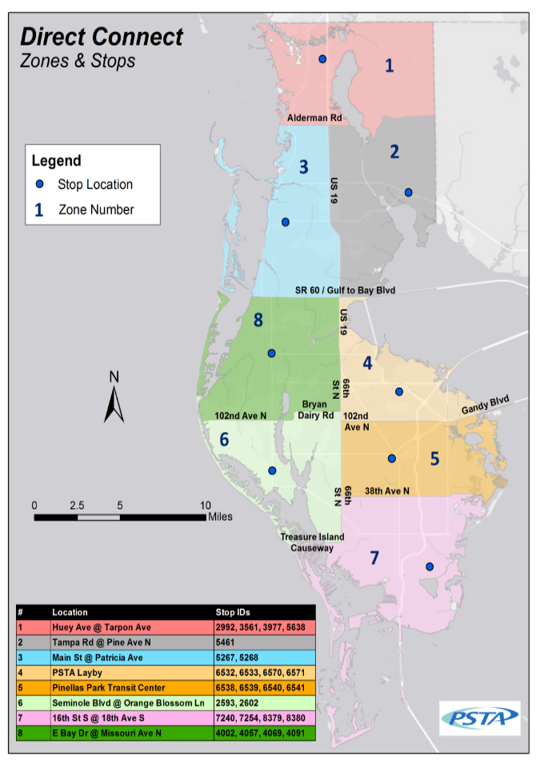
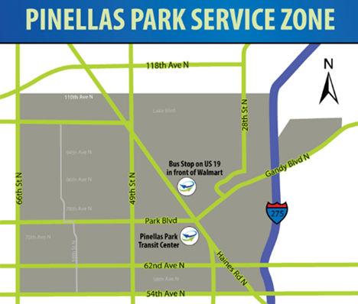



Direct Connect Service
First/Last mile connection to the PSTA fixed route system
Use Uber app or call to get ride within 20 minutes
Trip must begin or end at designated bus stops which connect riders to multiple PSTA fixed routes
2 zone pilot begins Feb 2016
County wide expansion began January 2017
Notes:
Service must remain within the pilot boundary

Slide 32
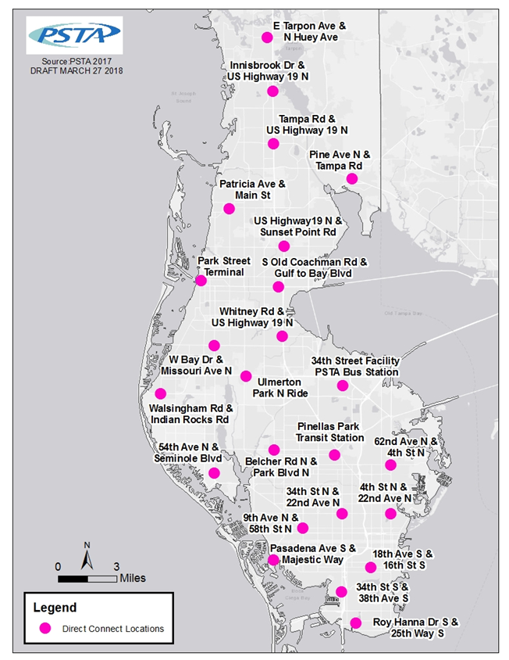
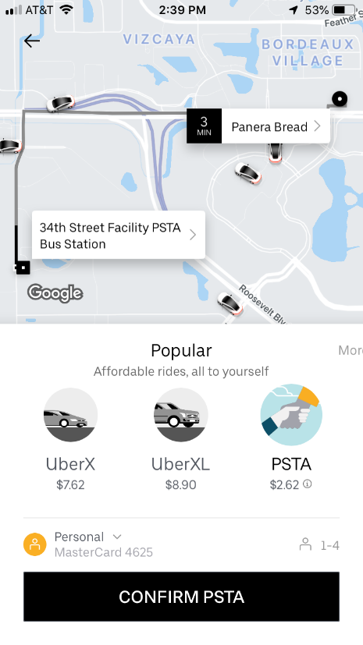
Direct Connect Expansion 2018
Focus on adding direct connect stops to core/frequent routes
Expand to 24 locations throughout the county
Remove zone boundaries
$25/ trip for Wheelchair Service

Slide 33
Direct Connect Expansion 2018 Ridership

Slide 34
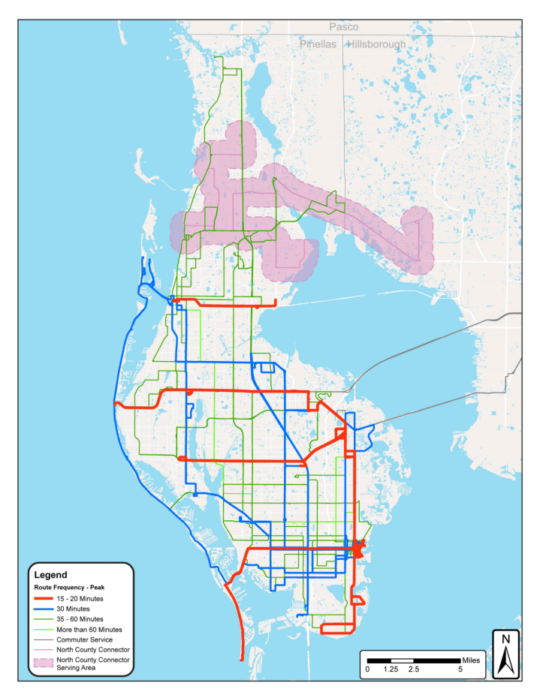
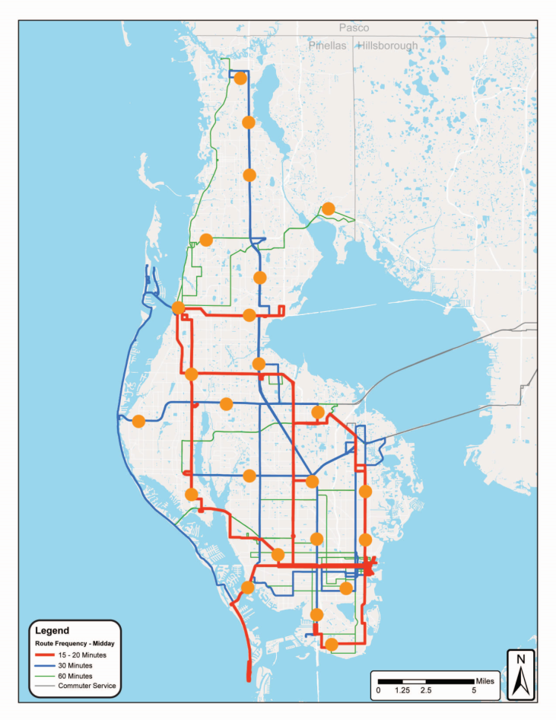
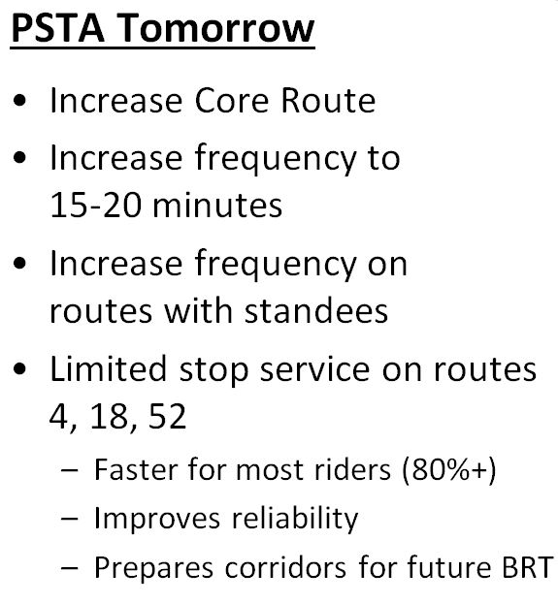
Direct Connect Moving Forward
PSTA Today
50% Core/
50% Coverage
PSTA Tomorrow
64% Core/
36% Coverage
Direct Connect
1st/last mile service

Slide 35

Transportation Disadvantaged (TD) Pilot
State TD Commission Mobility Enhancement Grant began August 2016
  Using the Direct Connect model to get low wage 2nd & 3rd shifters to/from work when buses are not available, as well as urgent day trips
  Prove replicability to other counties in Florida

Slide 36

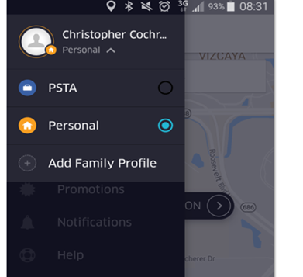
TD Late Shift
  Riders must be registered TD customer and purchase the TD monthly bus pass
  Riders must have a job that ends or begins between 10 pm and 6am
  Riders choose between Uber, United Taxi, and Care Ride
  Once approved, riders received up to 25 trips per month to or from work between 10pm and 6am.

Slide 37
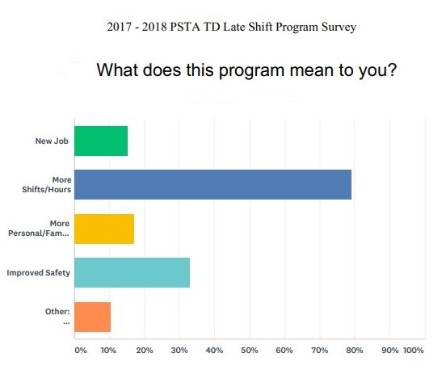
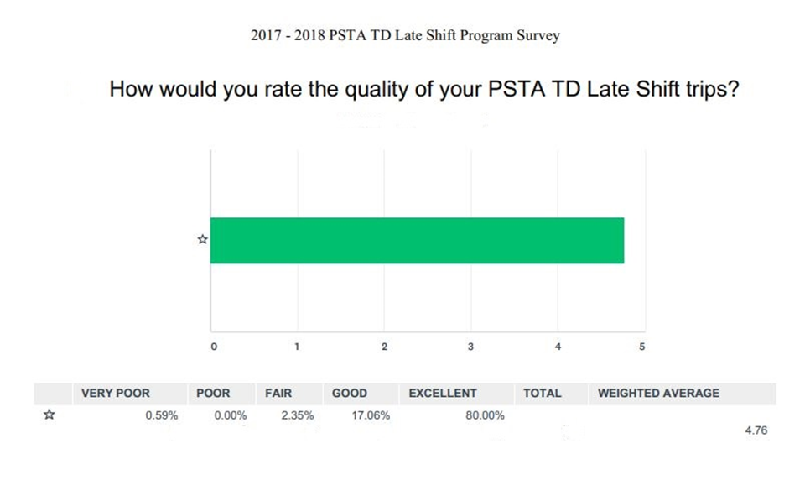
TD Late Shift Successes
Improved economic position of participants
Improved safety
Improved reliability and pick up time
“I don’t have to walk home in the dark anymore.”
“It has been really helpful to me not having a care and all and when I work late after the buses stop running and sometimes I get stranded. Thank you for this program it really helps a lot.”
“Allowed me to work late shifts”
Notes:
From PSTA perspective – higher
Lessons learned – Some of the goals of the late shift program were based on experience with Direct Connect. Turns out to be a different market which affected popularity and demand; also geographical area whole county versus constrained = longer trips and higher trip costs

Slide 38
TD Late Shift Ridership

Slide 39
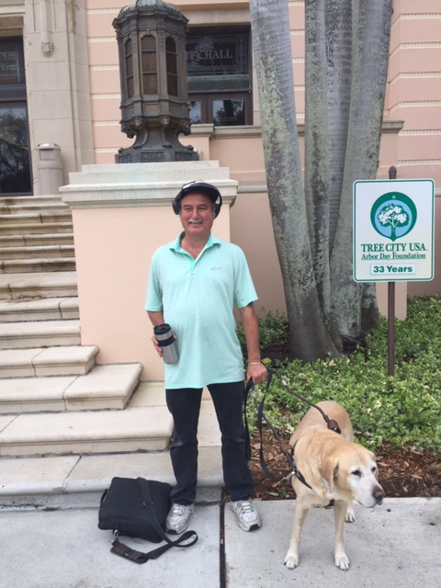
Mobility on Demand
Provide On Demand Rides to ADA clients using multiple providers – Lyft, United Taxi, Wheelchair Transport, Liberty Wheelchair - through the Goin integrated platform
Funded by innovative Mobility on Demand Sandbox grant from the FTA
This grant programs supports new approaches to traditional service

Slide 40
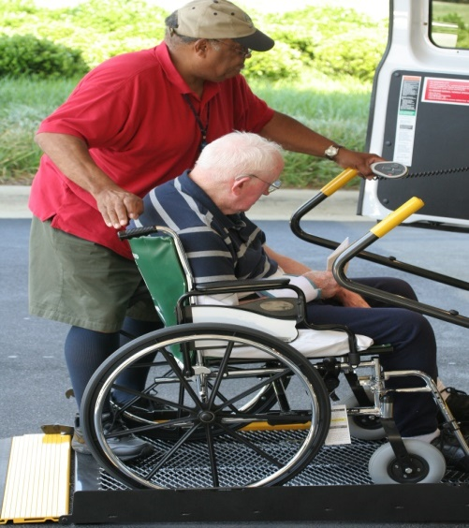
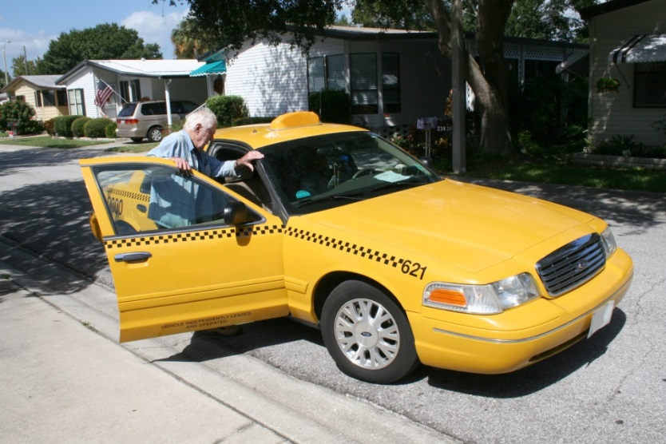
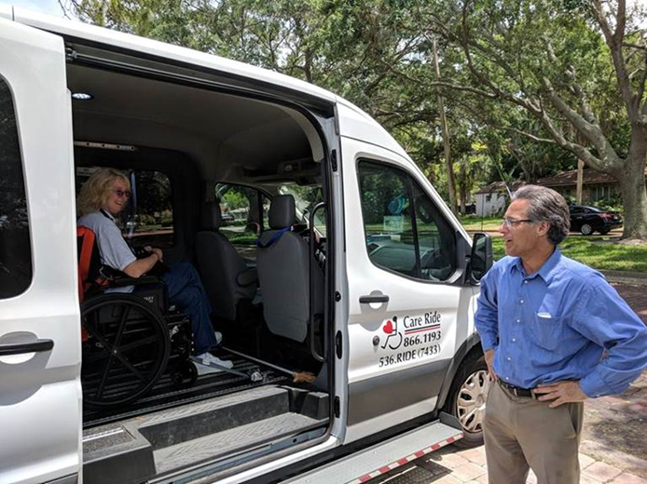
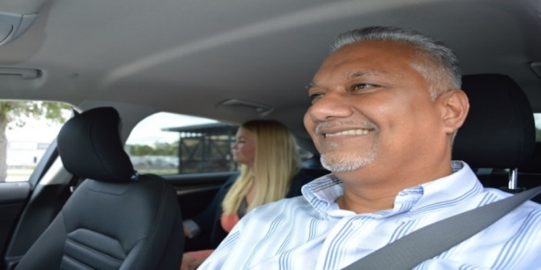
Mobility on Demand
Capitalize on success with other TNC programs by partnering with Lyft, United Taxi, and Care Ride.
Piloting with a portion of PSTA’s eligible paratransit customers – now open to all ADA customers
Real-time trips to work,
school, medical, and shopping areas
MOD improves mobility for our customers while being cost efficient

Slide 41
Mobility on Demand Ridership

Slide 42
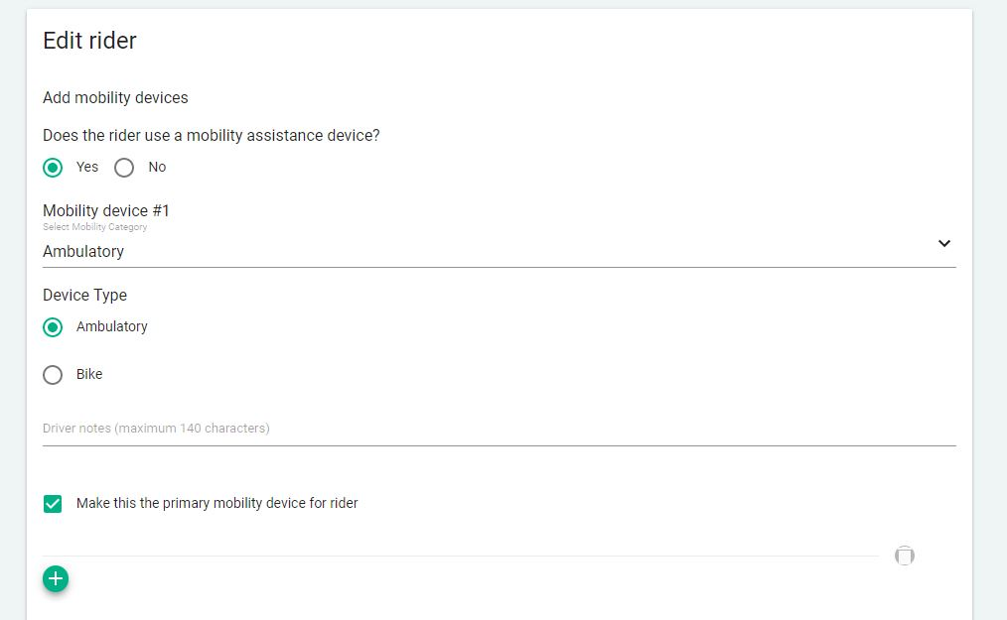
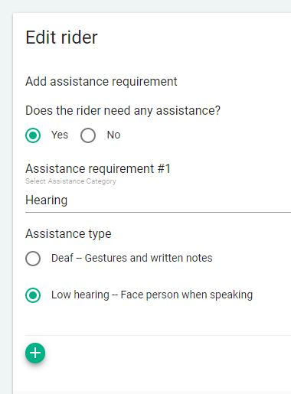
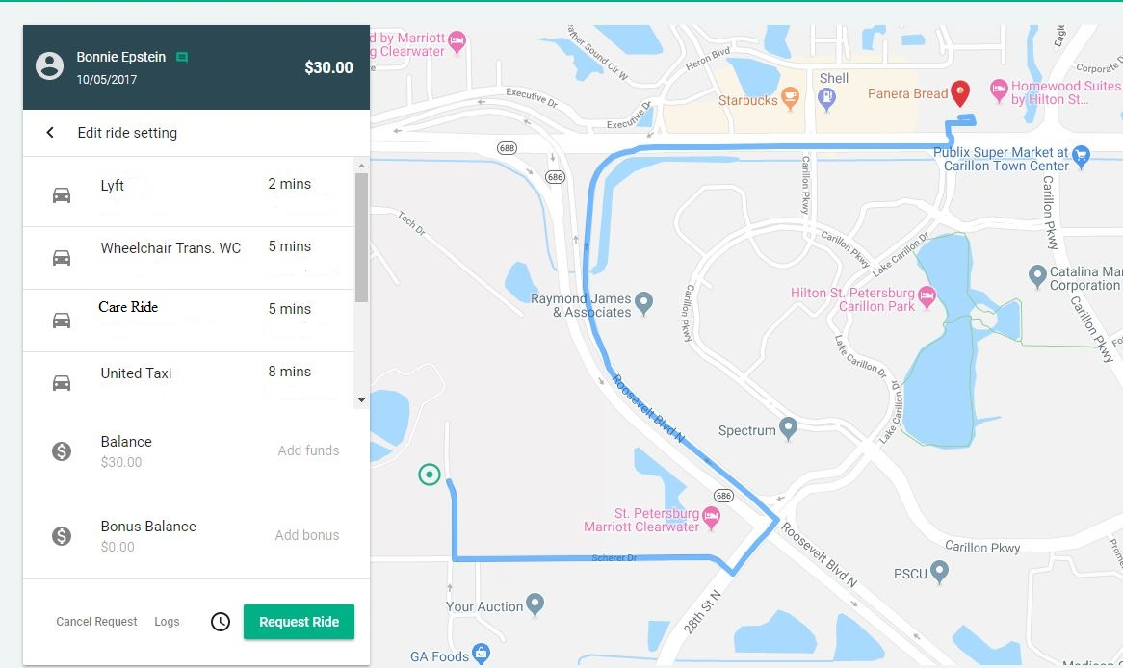
Mobility on Demand

Slide 43

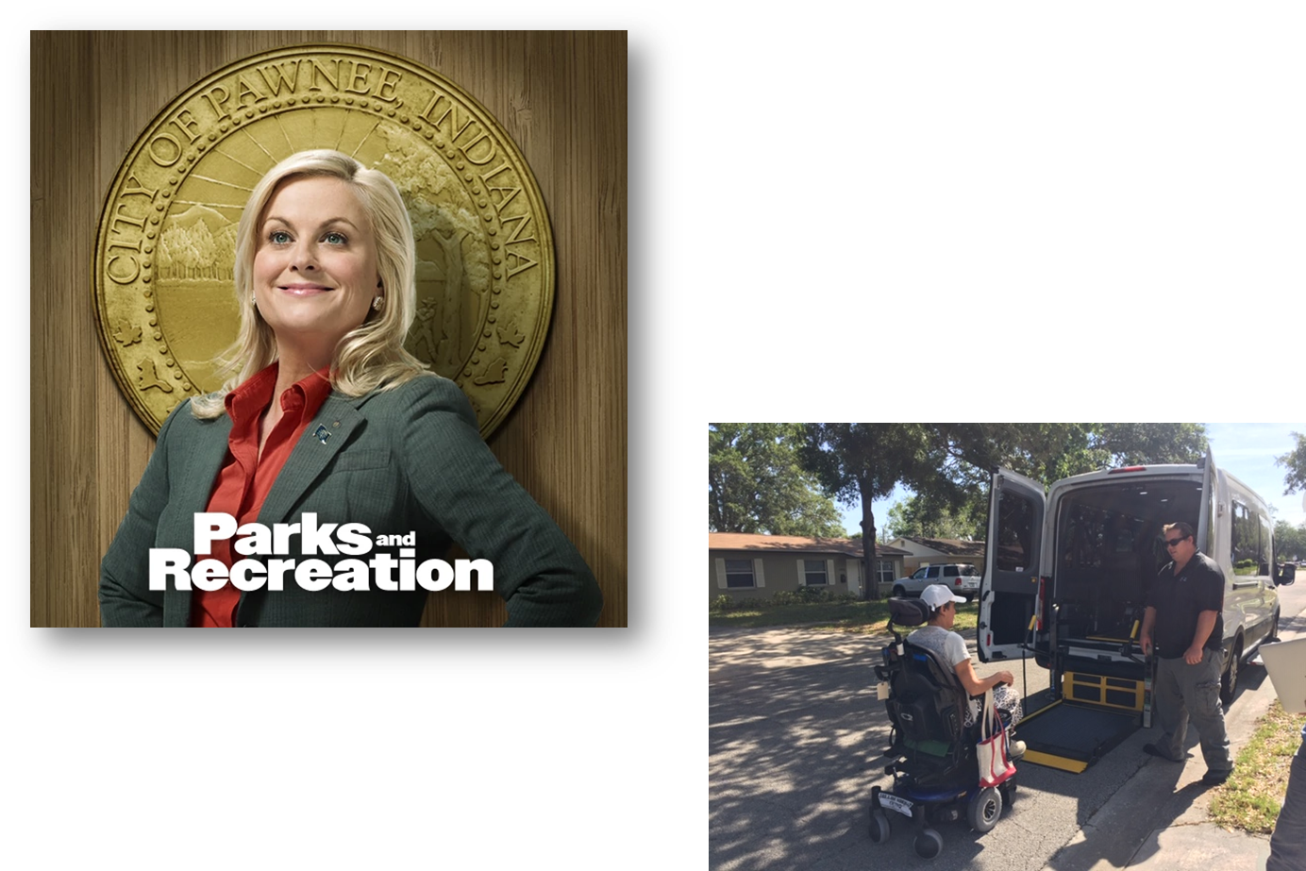






PSTA

