Slide 1

Part 673 – Public Transportation Agency Safety Plan (PTASP) and Chapter 14-90, FAC
A Discussion – FPTA/CTD Annual Conference
October 15, 2018

Slide 2
Outline
49 CFR Part 673 PTASP Requirements
Discussion of Relevant Chapter 14-90 Sections
Chapter 14-90 Potential Modifications

Slide 3
PTASP and SMS

Slide 4
PTASP Applicability and Requirements
Applicability
Applies to operators of transit systems that received FTA Section 5307 funds
Deferred applicability for operators receiving Section 5310 and/or Section 5311
PTASP
Safety Management Systems
Safety Performance Targets
Employee Reporting Program
Requirements

Slide 5
PTASP Administration
Must be developed, certified and implemented by July 20, 2020
Approved by Accountable Executive AND Board of Directors
Annual Review/Update and Certification
Compliance with Public Transportation Safety Program/National Safety Plan
Must Assign Chief Safety Officer
Records associated with plan must be kept for three years

Slide 6
PTASP Development
Small Bus 5307 Recipients
State DOT must develop plan*
May choose to develop their own
Only implement Safety Performance Monitoring Measurement
Large Bus 5307
Must incorporate all SMS elements
Use Safety Plan Template for Bus Transit

Slide 7
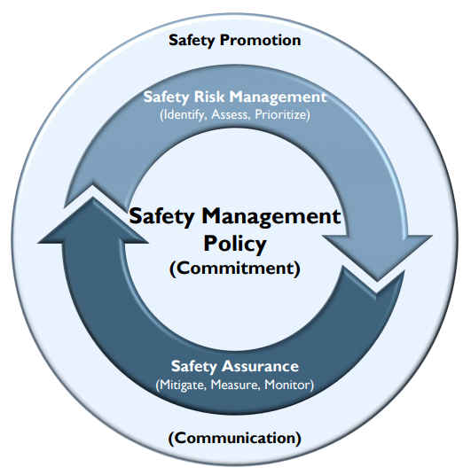
SMS – The Basis/Foundation for the PTASP
Safety Management Policy
Safety Risk Management
Safety Assurance
Safety Promotion

Slide 8
Safety Management Policy
Written Safety Policy – Includes:
Safety objectives for agency
Employee reporting system
Organizational accountabilities/ responsibilities
Accountable Executive
Key Staff Responsible
Chief Safety Officer
Agency Leadership

Slide 9
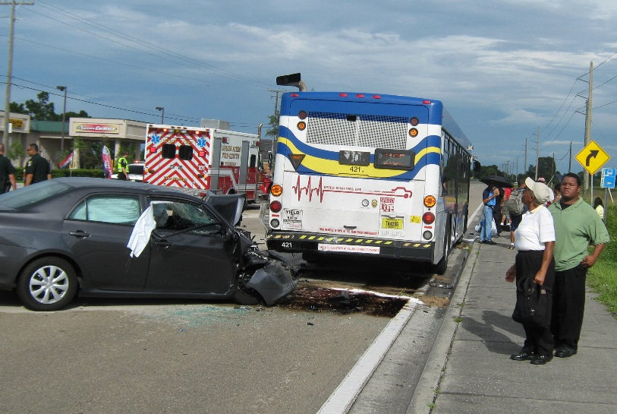
Safety Risk Management
Establish a PROCESS for:
Identifying Safety Hazards
Prioritizing Safety Hazards Based on Level of Risk
Assessing Safety Risks Associated with Hazards
Implementing Safety Risk Mitigations

Slide 10
Safety Assurance
Safety Performance Monitoring and Measurement
  Establish Safety Performance Measures/Targets
  Monitor compliance – operations and maintenance procedures
  Identify mitigations that may be ineffective, inappropriate, or not implemented as intended
  Conduct investigations of safety events to identify causal factors
  Monitor safety-related information
Establish Activities for:

Slide 11
Minimum Safety Performance Measures & Targets
Injuries
Total amount and rate per total revenue miles
Fatalities
Safety Events
System Reliability
Mean distance between major mechanical failures
Total amount and rate per total vehicle revenue miles
Total amount and rate per total vehicle revenue miles

Slide 12
Safety Assurance – Large Bus & Rail Systems
Management of Change
Identify and assess changes that may introduce new hazards or impact safety performance
Continuous Improvement
Assess safety performance and correct safety deficiencies
Establish Activities for:

Slide 13
Safety Promotion
Safety Training
Comprehensive – for agency employees/contractors directly responsible for safety
Agency Communication
Communicate agency’s safety policies, safety performance throughout the agency

Slide 14
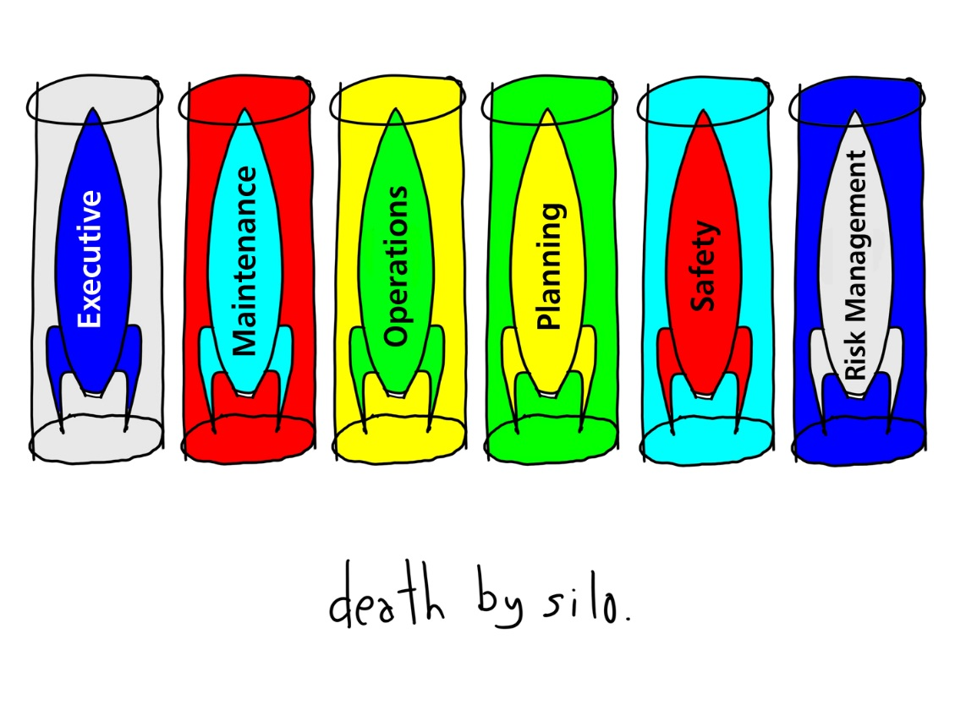
PTASP “MUST HAVES”
AGENCY-WIDE SMS processes – risk management, safety assurance, and safety promotion
Continuous process for risk assessment, management, mitigation, re-assessment
Change management process
Non-punitive employee reporting program

Slide 15

SMS Processes Must Include
Management
Operations
Maintenance
Safety
Human Resources
Risk Management
Procurement
Marketing
Union

Slide 16
Chapter 14-90, FAC

Slide 17
Current 14-90 Elements
Bus Transit System Operational Standards
  System Safety Program Plan
  Security Program Plan
  Criteria and procedures for the selection, qualification and training of all drivers
  Maintenance plan and procedures for preventive and routine maintenance
  Event investigation

Slide 18
Current 14-90 Elements
Medical Examinations for Bus Transit System Drivers
Operational and Driving Requirements
  Driver hours
  Fitness for duty
  Operation of transit bus
  Pre-trip/daily inspections

Slide 19
Current 14-90 Elements
Vehicle Equipment Standards and Procurement Criteria
Bus Safety Inspections
Certification
Safety and Security Inspections and Reviews

Slide 20
Chapter 14-90 – Potential Modifications
System Safety Program Plan
Hours of service
Driver qualifications/selection and training
Medical examinations
Vehicle operations
Safety inspections
Event investigation
Mandatory event data reporting system
Safety and security reviews

Slide 21

Discussion

Slide 22
Upcoming Training – FTA
Bus Guidance and Template – October 18, 2018 @ 2:00 PM
Bus Guidance and Template – November 1, 2018 @ 2:00 PM
Registration: www.transit.dot.gov/PTASP
SMS Awareness (eLearning) – on demand at tsi.dot.gov
SMS Safety Assurance – virtual live training: 11/29/2018, 1/16/2019, and 2/21/2019 (other 2019 dates are available)
Registration: https://tsi-dot.csod.com/client/tsi-dot/default.aspx

Slide 23
Resources
www.transit.dot.gov/PTASP (archived webinars may also be accessed via this site)
PTASP Final Rule
SMS Guidance
National Public Transportation Safety Plan
Chapter 14-90, FAC

