Slide 1
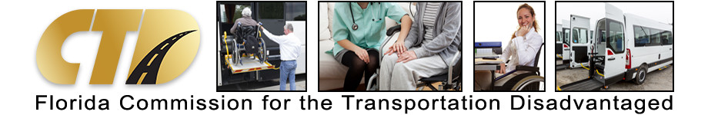

CTD Business Meeting
June 24, 2022

Slide 2

Please Stand for the Pledge of Allegiance

Slide 3

Meeting Rules
This is a public meeting under Florida’s Government in the Sunshine Act.
This meeting is being recorded.
All audio and phone lines are muted.
Speakers that submitted a public comment form will be selected first.
Webinar speakers will be unmuted when called on by the meeting facilitator.
Phone participants will be instructed on unmuting their phone lines.
All speakers during public input will be limited to 5 minutes.

Slide 4

Public Comments
Speakers will be called on in the order requests are received.
Comments are limited to agenda items only.
All speakers are limited to five minutes per public comment.

Slide 5

Approval of Minutes
The Commission convened a virtual business meeting on March 22, 2022, and an in-person business meeting in Stuart, Florida, on May 24, 2022.
The minutes from both meetings are included in the CTD Business Meeting Packet for June 24, 2022.

Slide 6
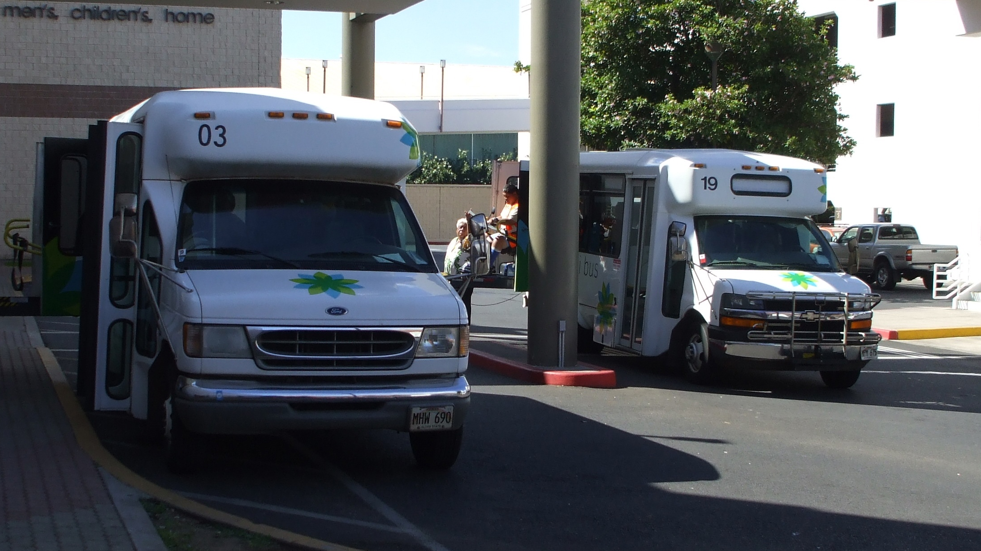
Approval of Grant Awards for Fiscal Year 2022-23

Slide 7
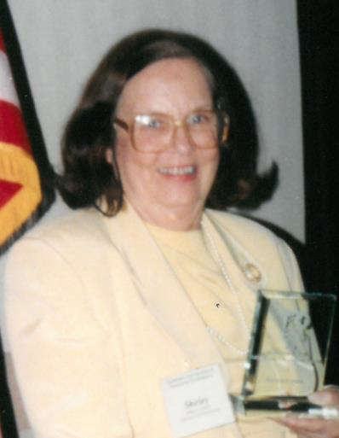
Shirley Conroy Rural Area Capital Assistance Grant
FDOT authorizes the transfer of $1.4 million to the TD Trust Fund to assist rural areas with the purchase of capital equipment.
CTD announced the opportunity to apply for the FY22-23 Shirley Conroy Grant on April 18, with a deadline of May 20, 2022.
Nineteen applications were received, requesting a total of $2.3 million in grant funding.
The review subcommittee met on June 14, 2022, and recommended approving 10 projects at $1,034,688.

Slide 8
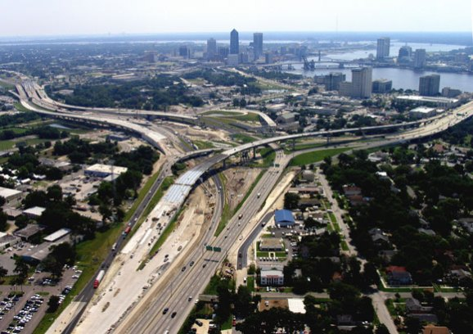
Innovative Services Development (ISD) Grant Program
Originally funded under the M-CORES Program (2019-2021) to support access to TD, cross-county, fixed-route connections.
Funding was repealed under M-CORES (one year), then was re-appropriated $4M for FY22-23 (July 1, 2022 – June 30, 2023).
Competitive funding based on evidence of need (supporting one or more goals) to “test” a new service to address a demand.
A CTC of a single service area can apply for up to $750,000; CTC(s) serving multiple service areas can apply for up to $1.5M.

Slide 9
ISD Grant Review Subcommittee Objectives
Review Each Application
Evaluate and Rank Each Proposal
Recommend Funding

Slide 10

How Did We Determine “Innovative”?
A project must demonstrate a new or improved way of delivering TD services that “enhance an eligible rider’s mobility.”
“New” can be measured by verifying that the service is not funded under the Trip & Equipment (T&E) Grant, such as:
Contracting with a TNC or non-traditional provider
Creating new cross-county or after-hours services, currently unavailable under local TD program.
ISD funds shall NOT supplant existing T&E Grant: simply providing more trips is not “innovative”.
“Improved” can include targeting an underserved population, enhancing on-time performance, increasing access to fixed route.

Slide 11
Recommended Projects
County | Project | Funding Request
Bay | Corridor Connector | $286,074
Hernando | Veterans Service/Connector | $135,000
Indian River/St. Lucie | Advantage Ride Program | $1,350,000
Leon | TNC Pilot Project | $252,298
Martin | Dialysis Patient Access Project | $675,000
Monroe | Extension of Miami-Dade Service | $93,870
Pinellas/Hillsborough/Pasco | Regional Pilot/Weekend, After-Hours, Same-Day On-Demand | $1,343,610
Wakulla/Leon | iEnable On-Demand Pilot | $1,015,951
TOTAL Funding Request |  | $5,151,803
Remaining Balance |  | -$1,151,803

Slide 12
Adjustment Recommendation
Counties | Recommendation | Adjusted Amount
Wakulla/Leon | Reduce iEnable Project to the amount it received FY20-21 for a similar project in Escambia and Santa Rosa Counties | $313,688
Pinellas/Hillsborough/Pasco | Reduce Tampa Bay project to an even million-dollar amount. | $1,000,000
Indian River/St. Lucie | Allocate remaining funding to Advantage Ride, which is the strongest proposal of the three. | $1,244,070

Slide 13
Projects Not Recommended
County | Project | Funding Request
DeSoto/Hardee/Highlands/ Okeechobee | Dialysis/Cancer Treatment | $225,000
Flagler | Dialysis Treatment Project | $419,510
Lafayette | Big Bend Technical College Service | $38,716
TOTAL Funding Request |  | -$683,226
Remaining Balance (with Adjustments) |  | $0
A special thank you to the applicants on this list – without them, this program would not be truly competitive. The subcommittee appreciates the intention behind each of these projects, but their proposals need improvement in articulating how they can be considered “new” or “added value” to the TD Program. CTD will provide technical assistance to grant applicants in FY22-23 to help improve future proposals, including the three projects that were not recommended for this year.

Slide 14
Additional Considerations
All projects must demonstrate an “innovative human service”:
  A proposal does not have to provide a “new” project or serve a new population to be considered “innovative” (e.g., Martin County’s Dialysis Patient project).
  How does the project add value to the current TD services provided in the area?
Improvement is needed in developing budgets and estimates across all applications to justify funding requests.
Most projects have strong objectives (i.e., increased access to TD), but need to differentiate these services from those funded by other sources.
Data analyses is critical to effectively evaluate proposals – approved projects should have performance measures tied to invoice data (i.e., trips, unduplicated passengers, destinations, etc.) to improve accountability.
Projects utilizing TNCs should require “scheduled pick-up/drop-off times” on invoice to measure on-time performance.

Slide 15
Additional Considerations
Future applications should include clear, concise goals:
  Projects can support multiple goals but should have a singular objective. Example: Monroe Extended Service meets two ISD goals (cross-county and increased access) but offers one service (morning trips into Miami-Dade County).
  Conversely, Hernando and the Tampa Bay proposals have too many objectives, which present challenges in the evaluation process.
Rejected proposals should explore other funding sources, such as FDOT or CareerSource (e.g., Lafayette’s access to Big Bend Technical College).
Service rates should be carefully examined to measure cost-effectiveness of approved projects.
Some projects appear reliant on contracted services, such as Tampa Bay and Wakulla Counties, raising concerns about managing service demands.

Slide 16
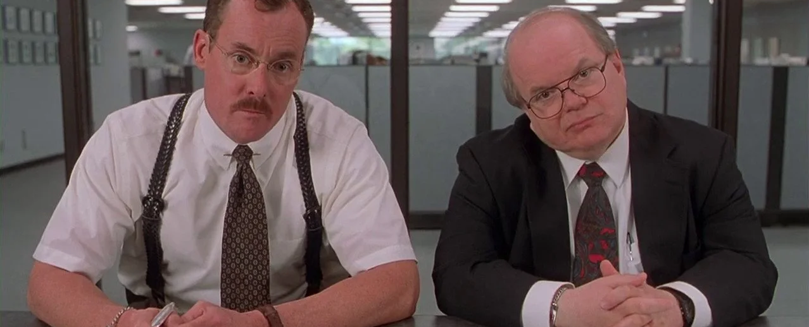
Performance Considerations
CTD will continue to analyze T&E and ISD Grant data as part of the application review process.
Performance measures should be tied to ISD Grant invoice:
If data are not included on the template (e.g., surveys), the recipient should submit as part of their reimbursement.
Projects should include “scheduled time” to measure on-time performance and TNC utilization.
Grant recipients should present performance outcomes at CTD Business Meeting or Subcommittee Workshop.

Slide 17

Subcommittee and Priorities for FY 22-23

Slide 18
Committee Structure
Executive “Energy” Committee (Chair Tellez) – Provides oversight and guidance to Executive Director
Grants Committees (Chairs TBD) – Reviews and recommends proposals submitted to the ISD and Shirley Conroy Grant Programs.
Rider & Stakeholder Relations Subcommittee (Chair Gray) – Collaborates with advocates to promote awareness of the TD Program.
Awards Achievement Subcommittee (Chair TBA) – Reviews nominations and approves the CTD Annual Achievement Awards Banquet.

Slide 19
Workgroup Structure
Annual Operating Report (AOR) Redesign Workgroup (Chair Knight) – Review the data collection of AOR performance data and recommend changes to improve the validation process.
Planning Grant Improvement Workgroup (Chair Elwell) – Assess the current structure of the Planning Grant and make recommendations to improve the performance and collaboration of the activities of the Designated Official Planning Agencies.

Slide 20

Executive Director Report
New Fiscal Year Resolution – Measure progress of Executive Director/CTD Team growth in knowledge, skills, and leadership.
2022 Vision Summit Summary Document (June 30, 2022)
Discussion on CTD Policy pertaining to ADA Paratransit Services (CTD Business Meeting on August 29, 2022).
Anticipated Stakeholder Workshops and Events for FY22-23:
  AOR Redesign (Summer 2022)
  Planning Grant Improvement Plan (Fall 2022)
  Annual Training and Best Practices Conference (August 30-31)
  Public Transportation and TD Day at the Capitol (March 16, 2023)
  Various Educational Workshops, such as the Funding Formula, Rate Model, ISD Grant, etc. (throughout the year)
ISD Grant Performance Report (June 30, 2022)

Slide 21

Commissioner & Advisor Reports

Slide 22
Public Comments and Closing Remarks
Next CTD Business Meeting: August 29, 2022 at 2:00pm

