Slide 1
CTD Rules Development Workshop
October 12, 2020

Slide 2
Objectives of the Public Workshop
Provide an overview of the 2020 Trip & Equipment (T&E) Grant Allocation Study;
Present proposed changes to the T&E allocation methodology in Rule 41-2, F.A.C.; and
Gather input on proposed rule language prior to CTD Business Meeting on October 28, 2020

Slide 3
Meeting Rules
This is a public meeting under Florida’s Government in the Sunshine Act.
This meeting is being recorded.
All audio and phone lines are muted.
Speakers that submitted a public comment form will be selected first.
Webinar speakers can unmute their line when called by the meeting facilitator.
Phone participants will be instructed on unmuting their phone lines.
All speakers during public input will be limited to 5 minutes.

Slide 4
Webinar Tutorial

Slide 5
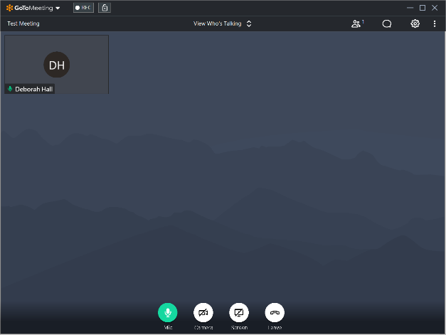
Your GoToMeeting Screen Controls
Located at the bottom, center of the meeting screen.
Mic - Mute and unmute your microphone.
Camera - Turn Web Camera On and Off.
Screen - Share Your Screen if you are a Presenter.
Leave - Leave the Meeting
Notes:
Good morning everyone, I am Debbie Hall and I’ve been asked to provide some instructions that may be helpful to you during this GoToMeeting session.
Dial-In Attendees - If you used the toll-free number to dial in, please note that you will need to press *2 to unmute your line. We ask that you send a Chat if you would like to speak or you may wait until we have the Q&A at the end of the meeting.
This slide shows one of the control panels that is located at the bottom center of your screen. It includes buttons for your Microphone, Camera, Screen and a Leave button. If you are not seeing these four buttons, move your mouse around the screen, and you should then see it at the bottom center.
The Mic button will glow red when your microphone is muted. The microphone button will glow green when you are unmuted.
The Camera button is used to turn on or turn off your camera. The button will have a line through it when it is turned off. You can turn your camera off if you are not speaking to help performance.
The Screen button should only be used if you are a presenter.
When you are ready to Leave the meeting, just click on the green Phone button and you will end your meeting session.

Slide 6
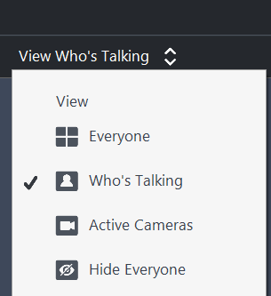
More Screen Controls
Webcams
Notes:
The second slide shows other screen controls that are available to you.
At the top center of the screen, is the Webcams View which has four options. If you click the toggle button you can choose to see Everyone that has joined the meeting, you can choose to see only those who are talking, you can choose to see all Active Cameras, or you can Hide Everyone.
The People Icon – This icon will display the names or telephone number of all attendees in the meeting.
The Chat icon is available to everyone who joined the meeting using the meeting link. If you have a question during the meeting, we ask you use the Chat feature. Be sure to select Chat then select a specific person from the drop-down link in the bottom right; or you may send a chat to Everyone. Someone will be monitoring the Chat log and will answer your question using the Chat feature; or you may ask the question during the Question & Answer period at the end of the meeting.
Settings Icon can help you troubleshoot audio problems with your laptop. It can help you to test your microphone and your speakers to ensure they are working properly.
We ask that everyone please be aware that all attendees will be automatically muted upon joining or dialing in to the meeting.

Slide 7
Overview of T&E Funding Methodology
Understanding the Current Rule and Practice

Slide 8
Trip & Equipment Grant
Allocation methodology established in Rule 41-2.014(5), F.A.C.
Consists of two components:
Base Funding – Based on a county’s equivalent allocation in FY1999-00.
Formula Funding – Based on four variables that equally weight demand and performance of transportation disadvantaged services in a county:
Total Population (demand)
Total Geographic Square Miles (demand)
Total Annual Operating Report (AOR) Trips (performance)
Total AOR Vehicle Miles (performance)
Funds are disbursed to the county’s Community Transportation Coordinators (“grant applicant”) after TD services are rendered.

Slide 9
Base Funding - Rule 41-2.014(5)(a) and (b), F.A.C.
(a) In order to maintain system and service stability, the Commission’s Fiscal Year 99/00 Allocation of Trip and Equipment Grant Funds, dated 02/99, incorporated herein by reference, shall be the base allocation for each subsequent year’s distribution for trip and equipment related grant funds. No county shall receive less than the base allocation unless the Commission’s five year cash-flow forecast falls below the Fiscal Year 99/00 levels allocated to the trip and equipment grant related program.
(b) If the level of funding available for distribution to the trip and equipment grant program falls below the base as stated in paragraph 41-2.014(5)(a), F.A.C., a proportionate adjustment to the base allocation will be made. Such adjustment will be based on the five year cash-flow forecast of the Commission, and each county’s share of the Fiscal Year 99/00 trip and equipment related grant allocation.

Slide 10
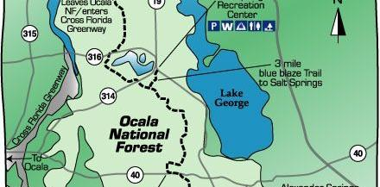
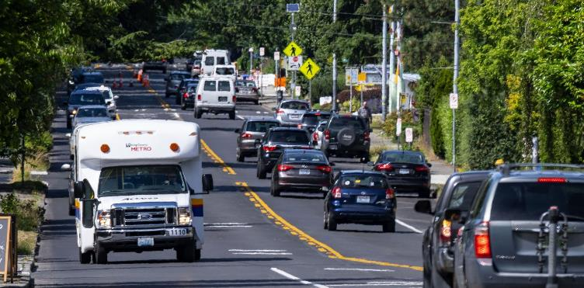
Formula Funding – Rule 41-2.014(5)(c) and (d), F.A.C.
(c) Allocation of additional trip and equipment grant funds above the amount used in the base allocation will be allocated to eligible applicants based on a comparative ranking of all eligible applicants in each of the following four categories:
The applicant’s total county area in square miles as a percentage of the total square miles of all eligible applicants.
Total system passenger trips provided as a percentage of all eligible applicant trips reported.
Total system vehicle miles traveled as a percentage of all eligible applicants vehicle miles traveled and reported.
Total county population as a percentage of the total population of all eligible applicants.
(d) Each category will represent one fourth of the trip related grant funds.

Slide 11
The Role of the AOR within the Formula Funding
Rule 41-2.007(6), F.A.C. – “Each Community Transportation Coordinator shall by September 15 of each year report required operating statistics to the Commission. The operational statistics will be compiled into a report by the Commission and utilized as a part of the analysis of the Community Transportation Coordinator’s performance evaluation and the trip and equipment grant distribution. The Community Transportation Coordinator’s report shall be reviewed by the Coordinating Board with a copy provided to the Metropolitan Planning Organization or Designated Official Planning Agency.”
Rule 41-2.014(5)(e), F.A.C. – “The latest required operational statistics report which is submitted by September 15 of each year will be used for obtaining the applicant’s coordinated vehicle miles and coordinated passenger trips data. For purpose of this section, coordinated vehicle miles or passenger trips shall not include those services provided through an approved transportation alternative.”

Slide 12
Applying the Current Methodology: Alachua County
The allocations represent amounts that were appropriated in FY2019-20, prior to “hold harmless” funding that was applied in November 2019.

Slide 13
Calculating Current Formula Funding: Alachua County
Statewide Formula Funding: $30,047,495.93*
Share of Square Miles: [($7,511,873.98*902/54,157)
Share of Total Population: +($7,511,873.98*259,865/20,278,447)
Share of AOR Trips: +($7,511,873.98*88,740/22,514,853)
Share of AOR Miles: +($7,511,873.98*1,129,073/99,057,595)]
Alachua Total: =$336,604.54
$7.5 million represents 25% of the $30 million in total statewide Formula funding for FY2019-20.

Slide 14
Effective Current Total Distributions: Alachua County

Slide 15
T&E Grant Allocation Study
Findings & Recommendations

Slide 16
Study Objectives
Conducted an in-depth analysis of data used within the current allocation methodology
01
Facilitated stakeholder workshops to gather input on funding models for future consideration
02
Published a final report that recommends changes to the funding methodology to be implemented in rule by July 1, 2021.
03

Slide 17
Issues with Current Methodology
Base Funding:
Static amounts from over 20 years ago. Meant to provide stability/predictability of funding but comprises less and less of counties’ overall funding over time as total funding increases.
Formula Funding:
Total Population (demand)
Includes populations not even potentially TD eligible. TD population is a subset of the total population.
Total Geographic Square Miles (demand)
Not strongly correlated with or predictive of travel demand. Many square miles of land do not have roads.
Total Annual Operating Report (AOR) Trips and Miles (performance)
Serious concerns about integrity of data. Also, majority of trips/miles reported are funded not by Trip & Equipment Grant dollars but by other programs. This results in CTCs’ performance outside of the T&E program having greater weight in determining T&E allocation amounts compared to performance within the program.

Slide 18
Recommendation 1: Proposed New Variables/Datasets
Study proposed the use of more precise estimates or measures:
TD Population (Demand) – Using American Community Survey 5-year data, allocate funds more directly to county residents eligible to be served by TD program.
Centerline Miles (CLM) (Demand) – As an alternative to square miles, allocate funds to a county’s total miles of public roads using data from the Federal Highway Administration.
T&E Grant Funded Services (Performance) – Instead of AOR systemwide trips/miles, allocate funds only for TD non-sponsored services (trips, miles, bus passes) using T&E invoice data.
Base Funding – Add the Base as a variable within the Formula and allocate funds based on a percent of a county’s previous year allocation (instead of the amount from FY1999-00).

Slide 19
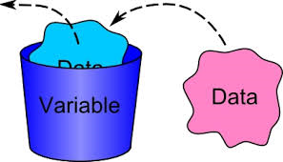
Tallying New Variables/Datasets
New variables counted similar to current methodology—whatever the variable is, it’s just the county’s statewide share for that variable:
TD Population (Demand) – Similar to current use of total population, every person is counted equally at 1.0 weight.
Centerline Miles (CLM) (Demand) – Similar to current use of square miles, every mile of roads is counted equally at 1.0 weight.
T&E Grant Funded Services (Performance) – Rather than count every trip and mile equally, weight based on relative cost of service type.
Base Funding – Every dollar from most recent year’s allocation counted equally at 1.0 weight.

Slide 20
More on Weighting within Variables
The study assigned different weights to datasets within each of the variables, with “1.0” as the standard value.
Demand Variables – Both TD population and CLM datasets are weighted equally at 1.0
Performance Variable – The T&E invoice data are weighted at an amount relative to the unit cost (or rate) of an ambulatory trip:
A wheelchair trip, for example, is weighted at 1.7 because it is reimbursed 1.7 times the cost of an ambulatory trip.
Miles are weighted at 0.1 the amount for an equivalent type of trip, so that each additional mile in a trip adds 0.1 to the total for the trip.
Bus passes are weighted significantly higher than their average rates to incentivize use when available and appropriate.

Slide 21
Recommendations 2 and 3: Proposed Weights for Variables
Recommendation 2 – Rather than weight the new variables equally (25% each), the study recommended greater weight be given to the base (60%) and performance (30%) to promote year-over-year stability while incentivizing cost-effective services.
Recommendation 3 – In response to requests made during public workshops, the study recommended the base be given greater weight (80%) for the first year (FY 2021-22) to help “phase-in” the new methodology.
Variable | Year 1 | Year 2 | Year 3
TD Population | 2.5% | 5% | 5%
CLM | 2.5% | 5% | 5%
T&E Services | 15% | 30% | 30%
Base | 80% | 60% | 60%

Slide 22
Applying Proposed Methodology Alachua County
Using Alachua County as an example again, the following table provides the weighted totals within each proposed variable under the new methodology:
COUNTY | WEIGHTED TOTALS BY VARIABLE
 | INHERENT DEMAND |  | PERFORMANCE | BASE FUNDING
 | TD Population | Centerline Miles | T&E Invoiced Trips | 2019-20 Allocation
Alachua | 96,121 | 1,820,154 | 44,483.050 | $650,821.00
STATEWIDE | 7,589,002 | 1,123,099,224 | 5,643,204.900 | $56,538,360.24

Slide 23
Calculating Statewide Shares Alachua County
Once the weighted totals for each variable are tallied, a statewide share for each county by variable can be calculated. For Alachua County, its share can be calculated as follows:
Share of TD Population: (96,121/7,589,002) = 1.27%
Share of Centerline Miles: (1,820,154/123,099,224) = 1.48%
Share of T&E Services: (44,483.050/5,643,204.900) = 0.79%
Share of Base: ($650,821/$56,538,360.24) = 1.15%

Slide 24
Calculating Alachua County’s Share under New Formula
With statewide shares calculated for each county and weights assigned to each variable, it then becomes possible to calculate each county’s share of the total amount appropriated for the T&E Grant (allocation factor) under the new formula. Taking Alachua County as an example again:
Proposed Variable: Year 1 Year 2 Year 3
Share of TD Population: (1.27%*2.5%) (1.27%*5%) (1.27%*5%)
Share of CLM: +(1.48%*2.5%) +(1.48%*5%) +(1.48%*5%)
Share of T&E Services: +(0.79%*15%) +(0.79%*30%) +(0.79%*30%)
Share of Base: +(1.15%*80%) +(1.15%*60%) +(1.15%*60%)
Allocation Factor =1.11% =1.06% =1.06%

Slide 25
Allocation Amounts for Alachua County Under Each Model
Finally, after calculating the allocation factor under each year’s model, it becomes possible to determine the allocation amount for each county. Using Alachua County as the example:
*Years 1, 2, and 3 assume total funding equal to current year appropriation.
Proposed Variable | Year 1 | Year 2 Projected | Year 3 Projected | FY2019-20 (Pre-”Hold Harmless”) | FY2018-19
TD Population | $17,959.02 | $35,918.03 | $35,918.03
CLM | $20,965.33 | $41,930.66 | $41,930.66
T&E Services | $67,060.83 | $134,121.66 | $134,121.66
Base | $522,296.68 | $391,722.51 | $391,722.51
Total Allocation | $628,281.86 | $603,692.87 | $603,692.87 | $650,820.54 | $605,854.51

Slide 26
Additional Recommendations
RECOMMENDATION 4 – When developing rule language, CTD should allow for flexibility in determining the year of data used in each variable in case of a state of emergency that would adversely impact allocations. For example, CTD could use 2018-19 invoice data to allocate funding for performance in response to the impact on COVID 19 in Fiscal Years 2019-20 and 2020-21.
RECOMMENDATION 5 –In addition to implementing a new formula that prioritizes performance, CTD should examine its policies and procedures pertaining to the reimbursement of grant funds to ensure they align with the intent of the new methodology

Slide 27
For More Information
The full report and all information related to the study can be accessed at: https://ctdallocationstudy.com/

Slide 28
Proposed Rule Language
Rule 41-2.014 and 41-2.007, F.A.C.

Slide 29
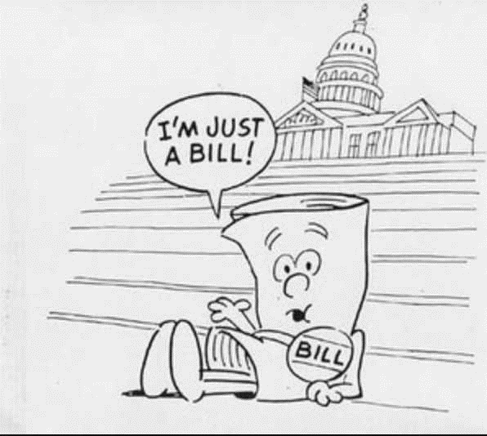
Authority
Commission has statutory authority to develop rules to implement the Transportation Disadvantaged program (s. 427.013(10), F.S.).
2020 Legislature appropriated $4.5 million in nonrecurring funding to keep allocations stable until new methodology is codified in rule in Fiscal Year 2020-2021.

Slide 30
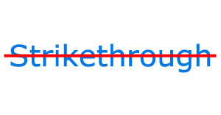
Proposed Strikethroughs
Base funding, as a separate component to the funding methodology (Rule 41-2.014(a) and (b), F.A.C.).
Current variables – total geographic square miles, total system (AOR) passenger trips, total system (AOR) vehicle miles, total population (Rule 41-2.014(c)1-4, F.A.C.).
Weighting each variable at one-fourth (25%) of the formula funding (Rule 41-2.014(d), F.A.C.)
Use of the most recent AOR in determining formula funding based on total system passenger trips and vehicle miles (Rule 41-2.014(e), F.A.C.).
The requirement for grant applicants to submit their funding requests by October 1 of each year (Rule 41-2.014(8), F.A.C.)

Slide 31
Additional Strikethroughs
Rule 41-2.007(6), F.A.C. – “Each Community Transportation Coordinator shall by September 15 of each year report required operating statistics to the Commission. The operational statistics will be compiled into a report by the Commission and utilized as a part of the analysis of the Community Transportation Coordinator’s performance evaluation and the trip and equipment grant distribution. The Community Transportation Coordinator’s report shall be reviewed by the Coordinating Board with a copy provided to the Metropolitan Planning Organization or Designated Official Planning Agency.”

Slide 32
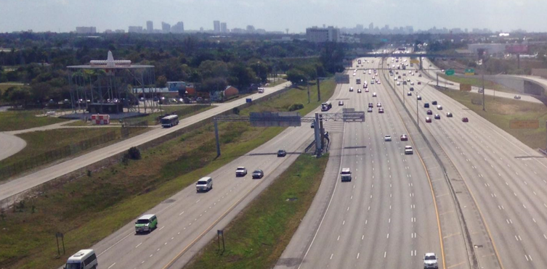
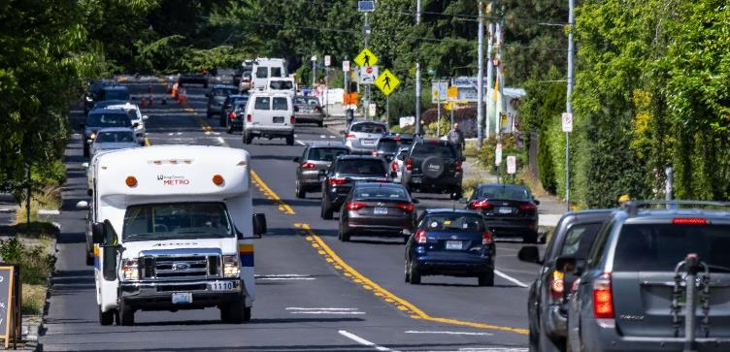
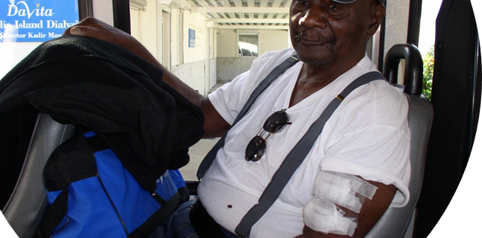
Proposed New Methodology: Recommendation 1
Rule 41-2.014(5)(a) “Allocation of trip and equipment grant funds shall be based on a comparative ranking of all eligible applicants in each of the following categories:
The county’s total transportation disadvantaged population as a percentage of the state’s total transportation disadvantaged eligible population, based on the U.S. Census Bureau American Community Survey 5-Year Population Estimates.
The county’s total centerline miles of public roads as a percentage of the state’s total centerline miles of public roads, based on public mileage data reported by the Federal Highway Administration.
The county’s total transportation disadvantaged services provided by trip and equipment grant funds as a percentage of the state’s total transportation disadvantaged services provided by trip and equipment grant funds, as reported on the invoices submitted by applicants for reimbursement under the trip and equipment grant program.
The county’s total allocated amount of trip and equipment grant funds as a percentage of the state’s total allocated amount of trip and equipment grant funds, based on allocated amounts from the previous fiscal year.”

Slide 33
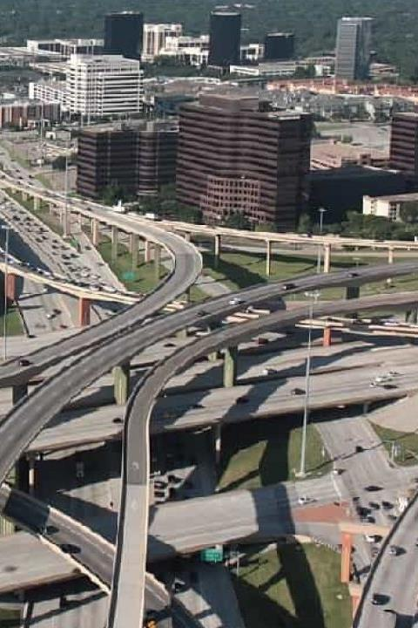
Proposed “Phase-In” Weighting of Variables: Recommendation 3
Rule 41-2.014(5)(b) “For the 2021-2022 fiscal year, each category shall represent the following percentages of the state’s total allocated amount for the trip and equipment grant program:
2.5% based on the state’s total transportation disadvantaged eligible population.
2.5% based on the state’s total centerline miles of public roads.
15% based on the state’s total transportation disadvantaged services provided by trip and equipment grant fund.
80% based on the state’s total allocated amount from the 2020-2021 fiscal year.”

Slide 34
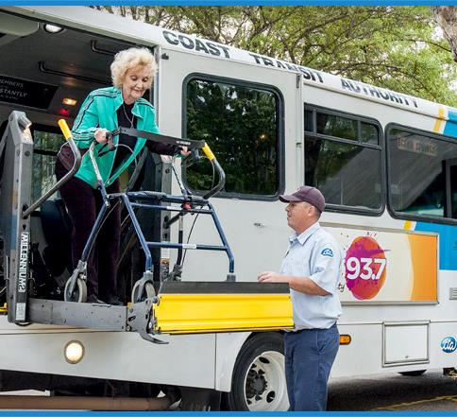
Proposed New Weighting of Variables: Recommendation 2
Rule 41-2.014(5)(c) “For the 2022-23 fiscal year and each fiscal thereafter, each category shall represent the following percentages of the state’s total allocated amount for the trip and equipment grant program:
5% based on the state’s total transportation disadvantaged eligible population.
5% based on the state’s total centerline miles of public roads.
30% based on the state’s total transportation disadvantaged services provided by trip and equipment grant fund.
60% based on the state’s total allocated amount from the 2020-2021 fiscal year.”

Slide 35
Proposed New Weighting of Datasets within Variables: Recommendations 1 and 2
Rule 41-2.014(5)(d) “The Commission, in calculating allocated amounts, shall weigh each dataset described in subsection (5)(a) as follows:
Every person identified within the state’s transportation disadvantaged population shall be weighted equally.
Every centerline mile of the state’s public roads shall be weighted equally.
Each trip and mile provided by trip and equipment grant funds shall be weighted relative to the unit cost at which they are reimbursed. Each bus pass purchased with trip and equipment grant funds shall be weighted higher than the unit cost at which they are reimbursed in order to incentivize their use in service asreas where a fixed-route system is available.”

Slide 36
Proposed Flexibility in Determining Year of Data: Recommendation 4
Rule 41-2.014(5)(e) “Fund allocations pursuant to subparagraph (5)(a) of this rule shall be administered each fiscal year based on available data from the previous year or applicable period as determined by the Commission.”

Slide 37
Public Comments
Speakers will be called on in the order requests are received.
Comments are limited to proposed rule language and allocation study.
All speakers are limited to five minutes per public comment.
Participants may also submit feedback to David Darm at: David.Darm@dot.state.fl.us

