Slide 1
AOR Study

Slide 2
Background
CTD collects aggregated (summarized) data from CTCs on TD services from state fiscal year.
CTD contracted with Thomas Howell Ferguson (THF) to help facilitate study to improve the verification and analysis of AOR data.
THF presented report in September, recommended CTD test collection of disaggregated data.
THF has developed prototype website for collecting test data from counties.

Slide 3
AOR study recommendations (from last year)
For the upcoming AOR submissions in 2023, the Commission should continue with the current processes and methods it has in place and collect the same information as it has in recent years.
The Commission should develop a detailed plan to test run the additional collection of individual trip level data, as well as individual bus pass level data, from CTCs as part of the 2023 AOR submission cycle. This planned test run for collecting data on individual trips and bus passes should function separately from the existing processes referenced in Recommendation 1 and not be integrated within them.
As part of the detailed plan in Recommendation 2, the Commission should conduct a comprehensive and thorough review of its legal options and authorities pertaining to the collection of data on individual trips and bus passes. The review should especially focus on the collection of potentially sensitive information, including potential personally identifiable details such as names or addresses. By proactively exploring its legal options and authorities for collecting specific details, the Commission can ensure that its data collection practices align with legal requirements, protect privacy rights, and build a strong foundation for the ethical and responsible use of disaggregated data.

Slide 4
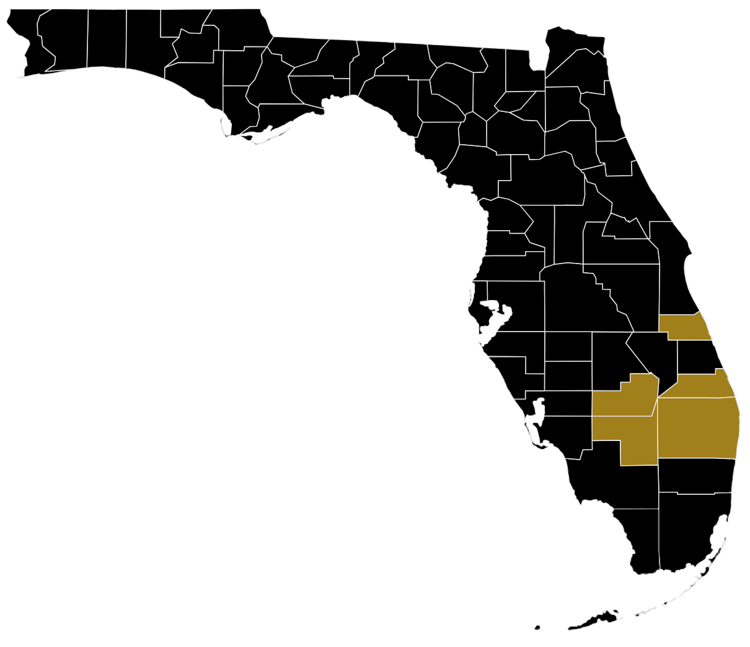
Initial Participating Counties
Glades
Hendry
Indian River
Martin
Palm Beach

Slide 5
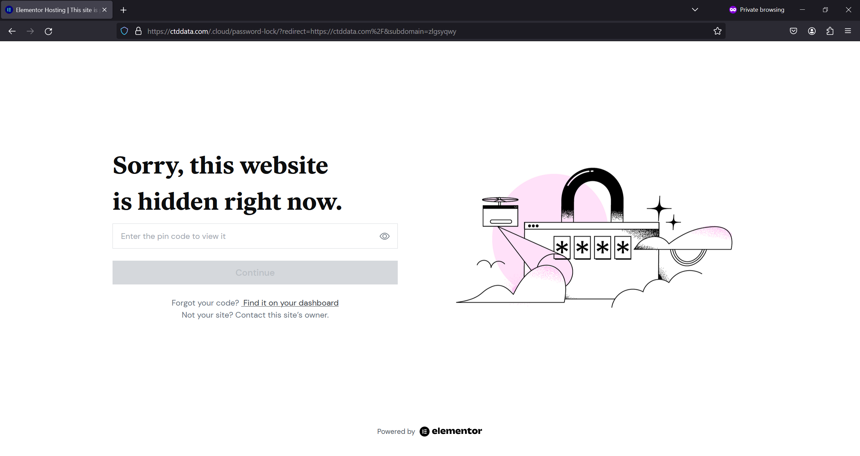
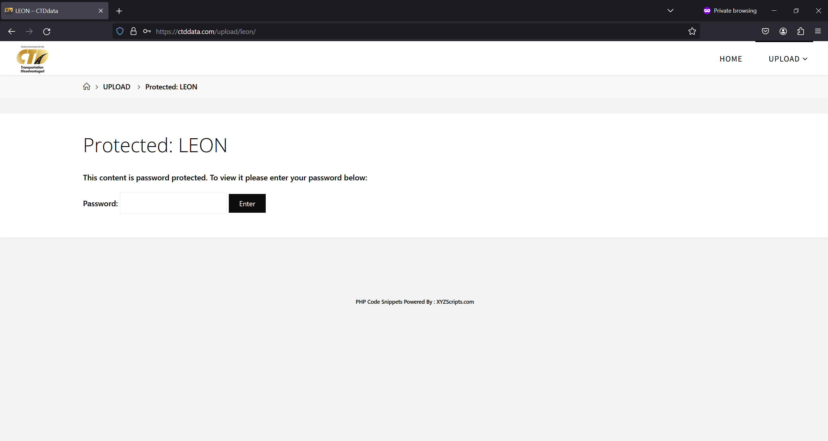
Site Security
Site PIN
Page Password

Slide 6
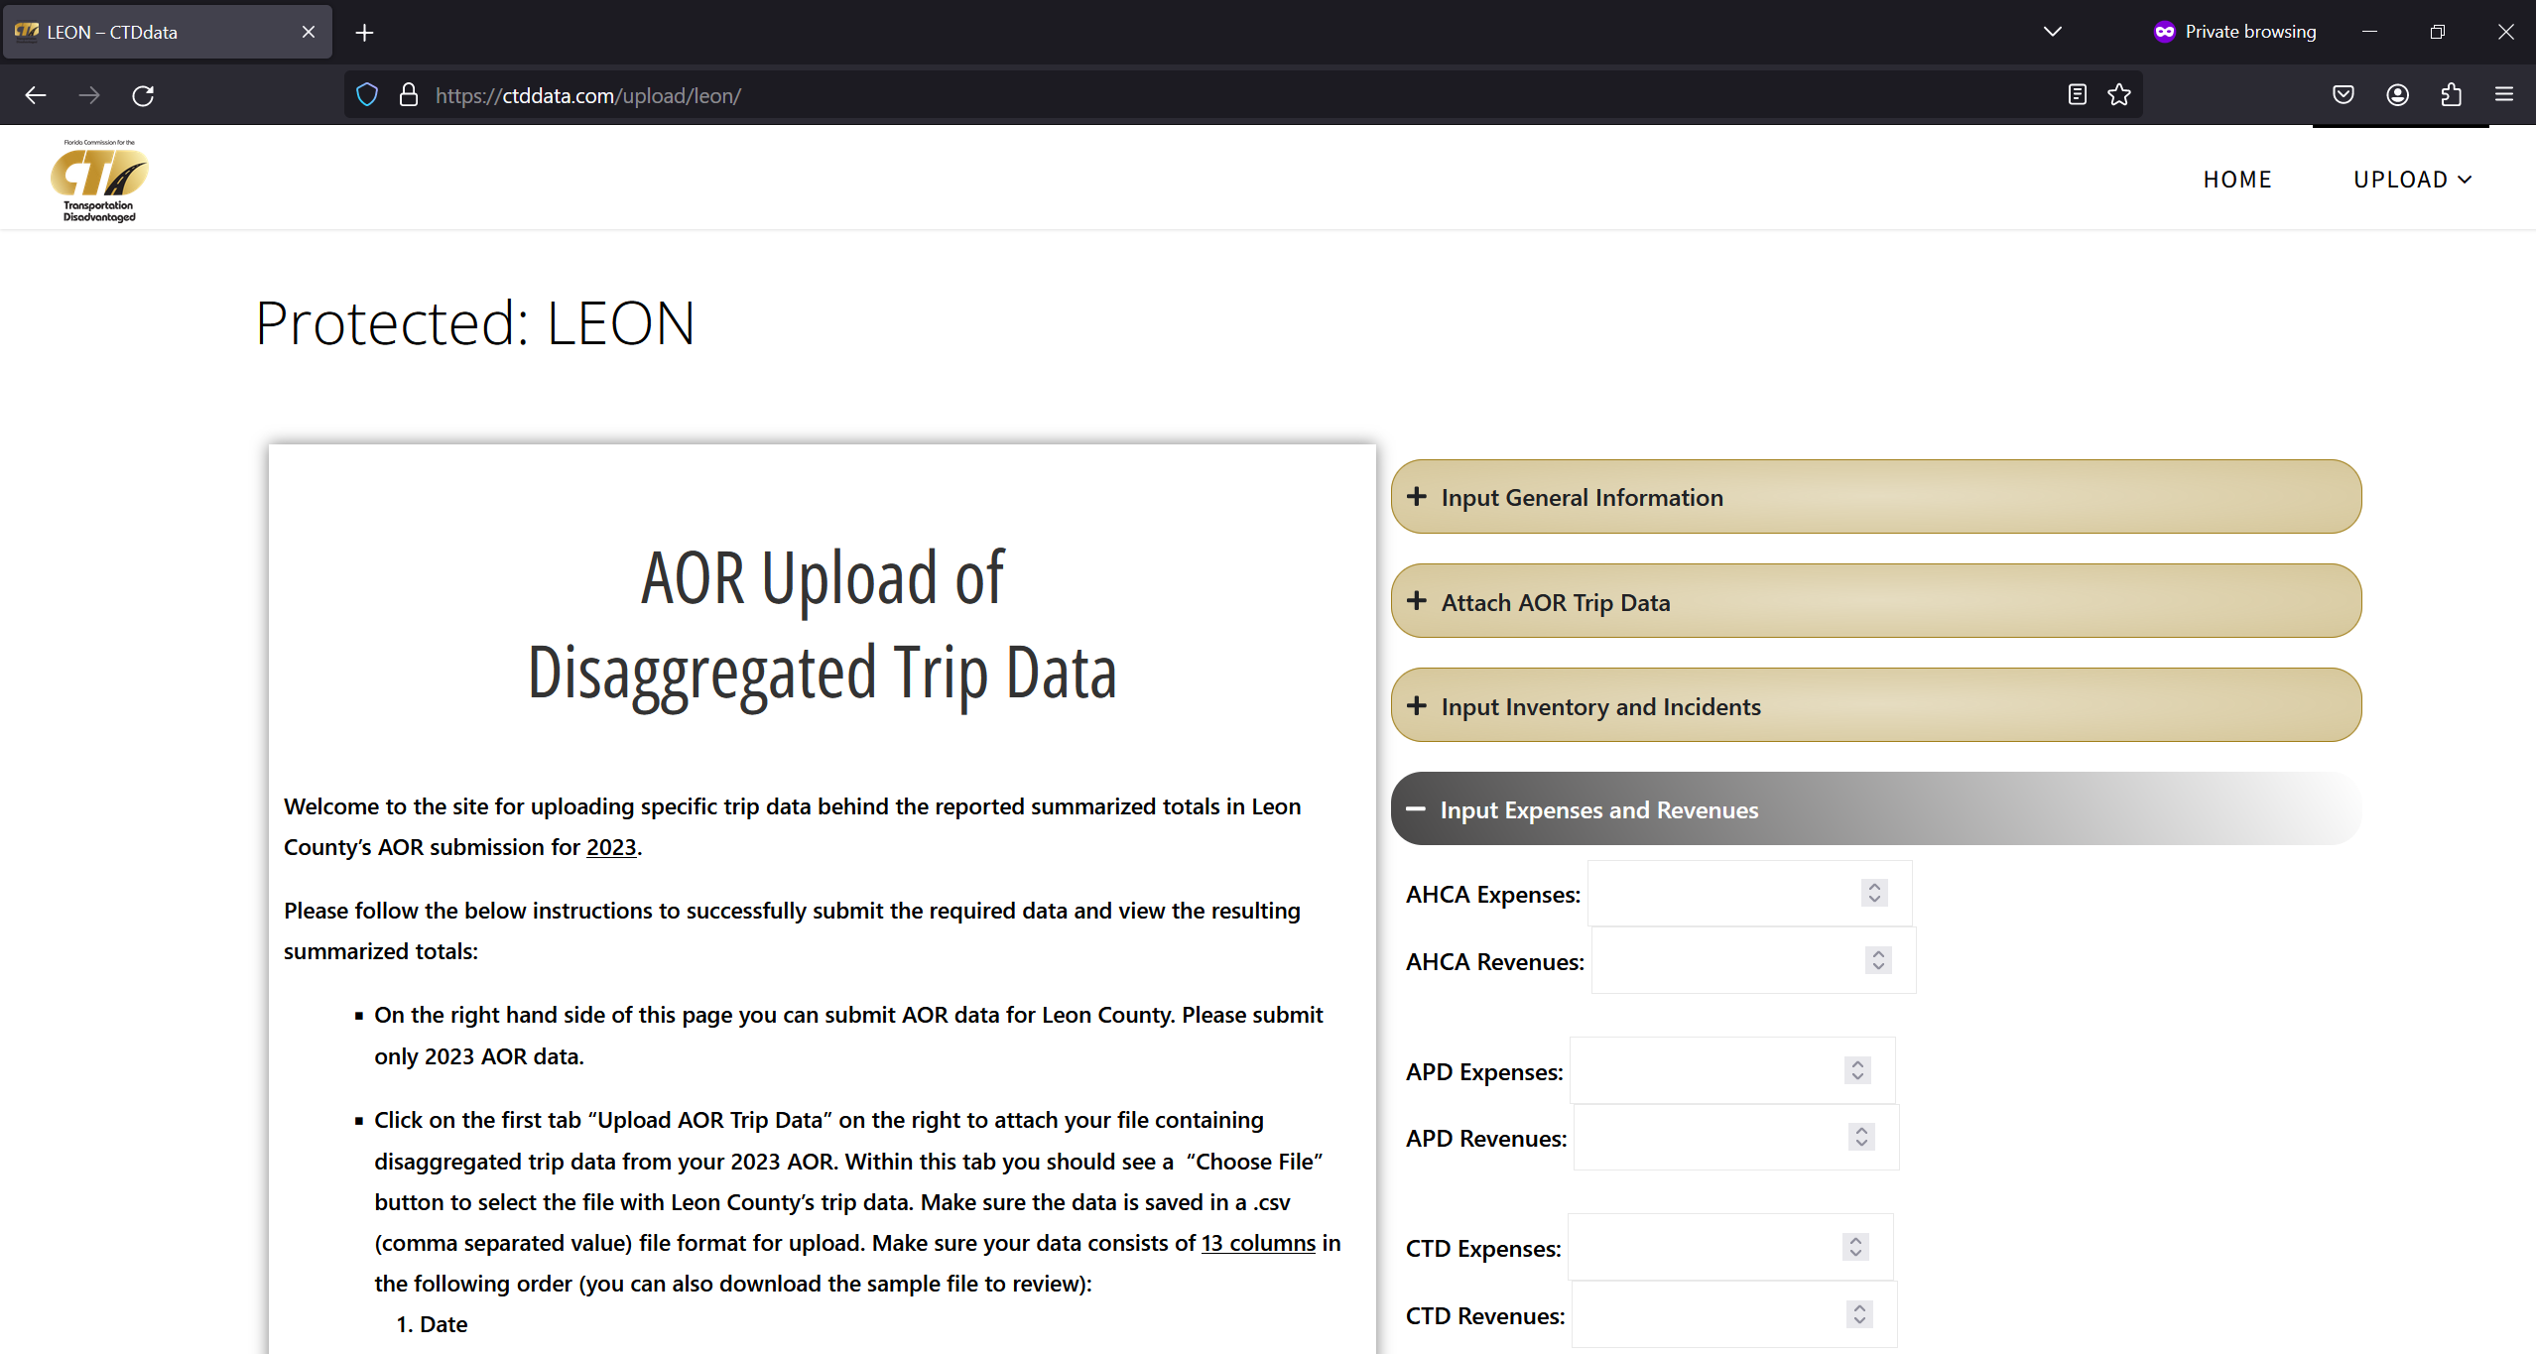
Data Uploading
After entering the site PIN and the page-specific password, CTC uploads the following data:
General Information
AOR Trip Data
Inventory and Incidents
Expenses and Revenues

Slide 7
Data Storage
Data is uploaded to secure server
Data is then exported to a text file that is stored offline
Data is removed from online server and County-specific web page is taken down

Slide 8
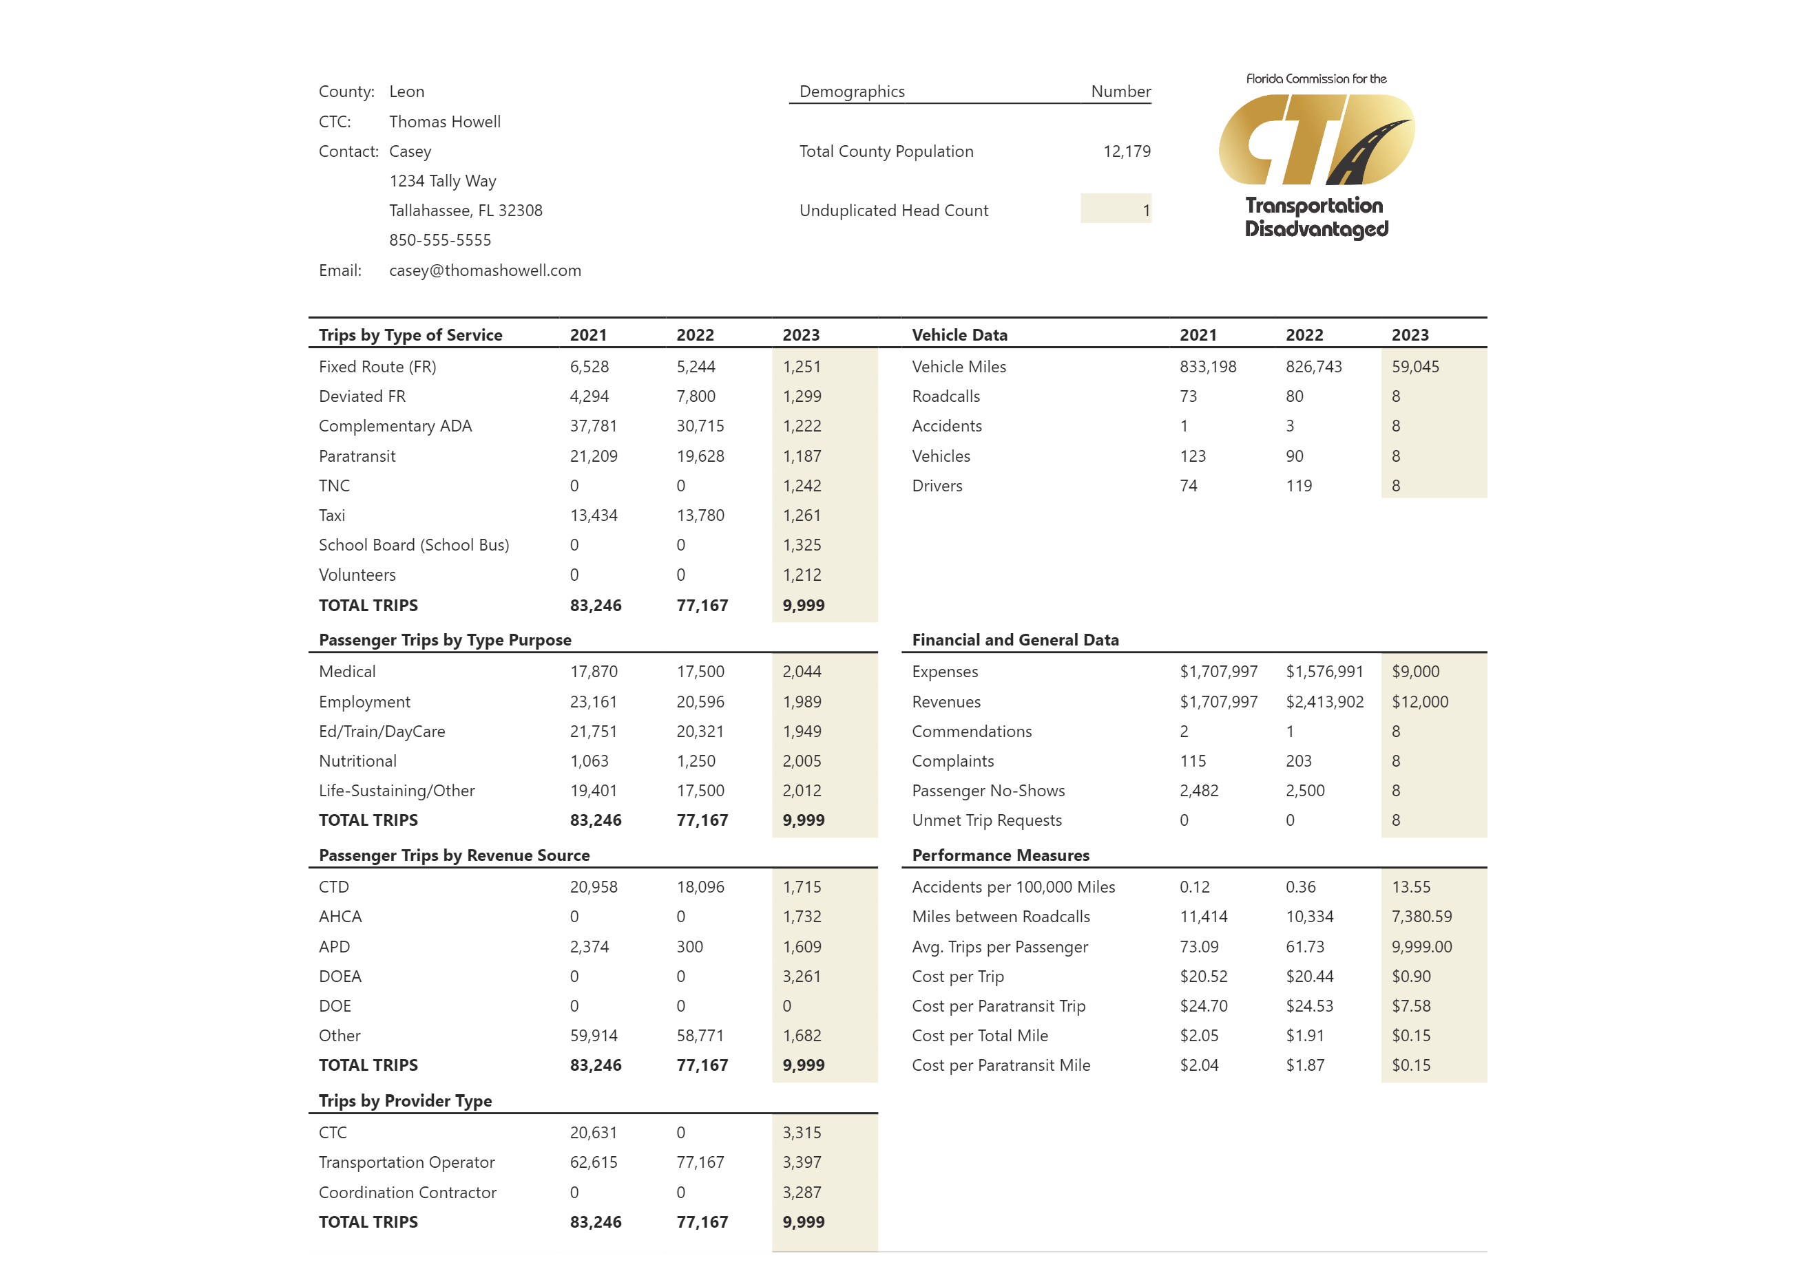
Data Analysis

Slide 9
Next Steps
Collect disaggregated data from more CTCs
(April 15th – May 15th)
CTCs can reach out to THF if they are interested in participating. Site PIN and county-specific password will be provided.
Analyze data collected in a report to be presented at next Commission Meeting in June

