Slide 1
Commission Business Meeting
September 15, 2023

Slide 2
Please Stand for the Pledge of Allegiance

Slide 3
Meeting Rules
This is a public meeting under Florida’s Government in the Sunshine Act.
This meeting is being recorded.
All audio and phone lines are muted.
Speakers that submitted a public comment form will be selected first.
Speakers must unmute their line when called on by the chair (press *6 if participating by phone).
Public comments are limited to 5 minutes. Please state your name, organization, and county of residence.

Slide 4
Public Comments
Speakers will be called on in the order requests are received.
Comments are limited to agenda items only.
All speakers are limited to five minutes per public comment.

Slide 5
Approval of Minutes
The Commission convened a business meeting in Punta Gorda on June 15, 2023.
The minutes from this meeting are attached to the meeting packet for this meeting.

Slide 6
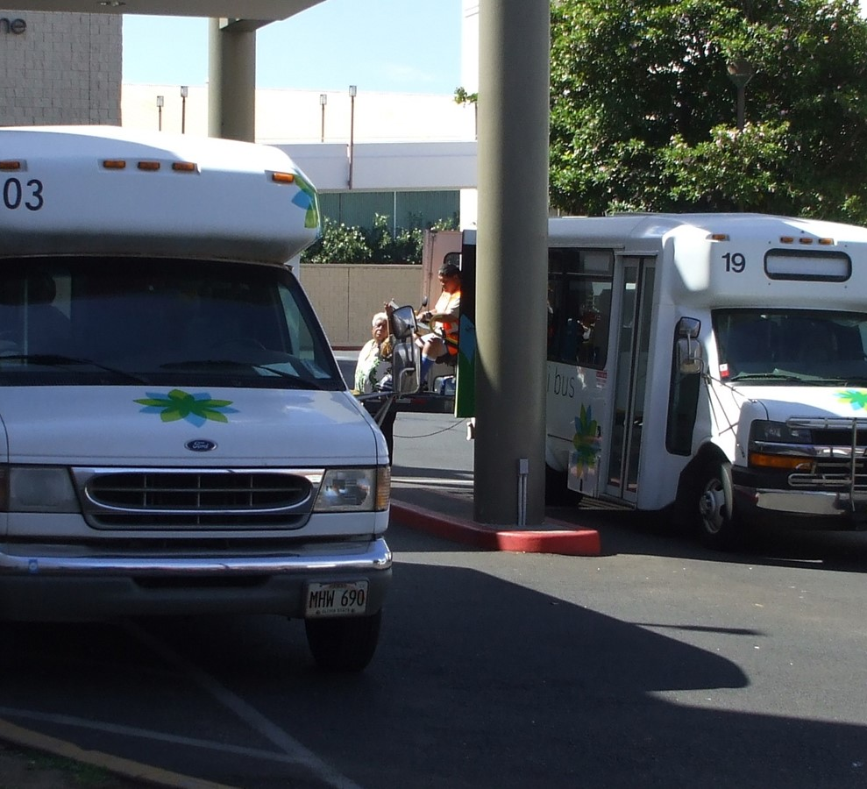
Shirley Conroy Grant FY 2023-24
Each year, FDOT transfers $1.4M for the CTD to award competitive grants to CTCs for the purchase of capital equipment.
In FY2022-23, five agencies (CTCs) who were awarded vehicles were unable to purchase their vehicles due to supply shortages and state contract issues.
CTD released applications on June 12, with a deadline to submit on July 28, 2023:
Seventeen applications were received, requesting a total of $3.3M.
The five agencies mentioned above resubmitted applications for vehicles. The subcommittee prioritized these agencies to receive first consideration.
Fourteen requested vehicles; five requested other capital (e.g., software, video recording).
Subcommittee recommends 11 projects ($1.4M), with a focus on vehicle replacement purchases now that vehicle contracts have been finalized.

Slide 7
Recommended Projects for Approval for FY 2023-24
Previous Year Projects | New Projects
Columbia/Hamilton/Suwannee for one 23’ cutaway vehicle – $153,729 | Alachua for one 23’ cutaway vehicle – $136,074.60
Dixie for one 23’ cutaway – $140,703 | Baker for seven computers/dual monitors (w/ software) – $13,700
Gulf for two 26’ cutaways (w/ option to designate one for Franklin) – $322,512 | DeSoto/Hardee/Highlands/Okeechobee for one wheelchair accessible minivan – $64,749
Okaloosa for two 22’ cutaways – $219,686.40 | Jackson for one copier (w/ remaining balance) – $4,638
Union for one 23’ cutaway – $140,703 | Levy for one 23’ cutaway – $160,000
 | Monroe for one minivan – $43,505

Slide 8
Approval of Annual Regulatory Plan for 2023-24
Each year, the Commission reviews and approves an annual regulatory plan as part of its rulemaking responsibilities pursuant to s. 427.013(10), F.S.
The 2023-24 Annual Regulatory Plan is included in the Commission Meeting Packet.
There are no updates to the prior year Regulatory Plan.

Slide 9
Executive Director Performance Review from FY2022-23
The CTD appoints an executive director, who serves “under the direction, supervision, and control of the commission” (s. 427.012(7), FS). David Darm has served in this role since July 2019.
On July 24, 2023, the Executive Committee convened to approve a process for the CTD to conduct an annual evaluation of the director. The minutes were included in the packet for this business meeting.
An evaluation form and instructions were provided to all commissioners in August. The completed evaluations were included the packet for this meeting.
Director Darm scored an average of 4.2 out of 5 points on his evaluation. Areas of high performance included: keeping commissioners informed and assisting chairs with responsibilities; demonstrating knowledge of the TD program and public policy; and representing the CTD before the public.
This evaluation is presented as an action item for Commission approval.

Slide 10
Employee Recognition
Kyle Mills – 5 Years of Service with FDOT
Theresa Joaceus – 10 Years of Service with the State of Florida
Elmer Melendez – 15 Years of Service with FDOT
Sheri Powers – 15 Years of Service with FDOT
Cecile Del Moral – 30 Years of Service with the State of Florida
John Irvine – 30 Years of Service with FDOT

Slide 11
Fiscal Year 2023-24 Goals
Goal 1 – Fill all CTD staff positions, implement salary raises, and adjust position descriptions as needed to better align employee strengths w/ program needs.
Goal 2 – Develop Statewide Five-Year Transportation Disadvantaged Plan pursuant to s. 427.013(15), F.S.
Goal 3 – Fill all CTD board seats and improve agency engagement.
Goal 4 – Test run the collection of disaggregated data as part of the AOR (contingent on CTD approval).
Goal 5 – Assess Quality Assurance review process and identify changes needed to improve program performance.

Slide 12
FY 2023-24 Budget Update
Expense Budget:
$64,380,102
Expense Item | Amount
Salary & Benefits | $1,197,434
OPS | $21,546
Expenses | $238,522
Contracted Services | $557,738
Lease | $3,830
Grants & Aides | $62,356,668
Admin Fee | $4,364

Slide 13
Commissioner & Advisor Reports

Slide 14
Public Comments and Closing Remarks
Next CTD Business Meeting: December 14, 2023 (Virtual)
TD Day at the Florida Capitol: January 18, 2024 (Tentative)

