Slide 1
Annual Operating Report (AOR) Study
CTD Business Meeting
September 15th, 2023
Notes:
Commissioner Renee Knight will provide an introduction

Slide 2
Background on AOR
Each year, CTD collects data on transportation operations related to serving the TD population.
The data is reported by Community Transportation Coordinators (CTCs) to CTD
Data includes trip totals across the TD system and other operational indicators from the previous state fiscal year.
CTD compiles AOR data within its Annual Performance Report (APR), submitted to the Governor and Legislature each year.
Annual
CTCs
System
Report
Notes:
Commissioner Knight presents

Slide 3



Project analysis slide 3
Study Purpose and Objectives
The Commission for the Transportation Disadvantaged (CTD) is conducting a study to improve the accuracy and analyses of performance data reported in the AOR
Objective 1:
ASSESS
Objective 1:
ASSESS
Objective 2:
VERIFY
Objective 3:
ANALYZE
The CTD will examine the current role of the AOR, including the process used to collect and report performance data each fiscal year. This will help identify both the strengths of the current system and the areas in need of future improvement.
The CTD will explore ways AOR data can be used to evaluate coordination of TD services. For purposes of this study, “coordination” is defined as the services being delivered directly by CTCs (in addition to what are funded by the T&E Grant), including paratransit trips and bus pass programs serving TD riders.
The CTD will examine the current role of the AOR, including the process used to collect and report performance data each fiscal year. This will help identify both the strengths of the current system and the areas in need of future improvement.
The CTD will identify strategies that can assist CTCs in reporting accurate and consistent data within the AOR. This is critical to the third objective of performing analyses and capturing accurate service trends year-over-year.
Notes:
Commissioner Knight presents

Slide 4
Study Deliverables
Established advisory workgroup in November 2022, which was chaired by Commissioner Knight and consisted of representatives of three state agencies, two CTCs, and one planning agency.
CTD facilitated a virtual public workshop on May 25, 2023, where THF presented an alternative approach of collecting data for future report considerations.
CTD launched a temporary webpage in June and encouraged CTCs to test uploading raw (disaggregated) data and provide feedback to Executive Director David Darm.
THF presented draft report to CTD in June and advisory workgroup met to discuss in July.
THF presented the final report to CTD on August 23, 2023.

Slide 5
Project analysis slide 3
Study Recommendations
Recommendation 1: For the upcoming AOR submissions in 2023, the Commission should continue with the current processes and methods it has in place and collect the same information as it has in recent years.
Recommendation 2: The Commission should develop a detailed plan to test run the additional collection of individual trip level data, as well as individual bus pass level data, from CTCs as part of the 2023 AOR submission cycle. This planned test run for collecting data on individual trips and bus passes should function separately from the existing processes referenced in Recommendation 1 and not be integrated within them.
Objective 1:
ASSESS
The CTD will examine the current role of the AOR, including the process used to collect and report performance data each fiscal year. This will help identify both the strengths of the current system and the areas in need of future improvement.
Recommendation 3: As part off the detailed plan in Recommendation 2, the Commission should conduct a comprehensive and thorough review of its legal options and authorities pertaining to the collection of data on individual trips and bus passes. The review should especially focus on the collection of potentially sensitive information, including potential personally identifiable details such as names or addresses. By proactively exploring its legal options and authorities for collecting specific detail, the Commission can ensure that its data collection practices align with legal requirements, protect privacy rights, and build a strong foundation for the ethical and responsible use of disaggregated data.
Notes:
Commissioner Knight presents

Slide 6
Why does CTD collect AOR data? Statute
“CTD must submit an annual report to the Governor, Speaker of the House, and President of the Senate by January 1st of each year (427.013(12)).”
CTCs must “collect annual operating data” and submit to the CTD (427.0155(2)).
CTD must “compile all available information on the transportation operations for and needs of the transportation disadvantaged in the state” (427.013(1)).
The Annual Performance Report (APR) currently satisfies this statute
Annual
CTCs
System
Report

Slide 7
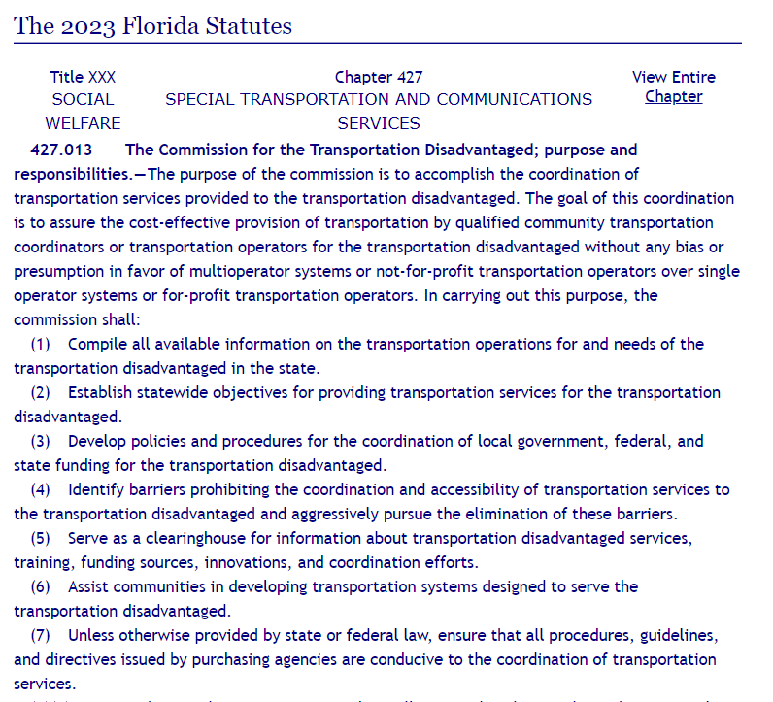
Why does CTD collect AOR data? Statute

Slide 8
Statute requires the AOR, but is flexible
“The very first directive given to CTD in carrying out its statutory purpose . . . is to ‘Compile all available information on the transportation operations for and needs of the transportation disadvantaged in the state . . . CTD exercises considerable self-determination in what it collects through the AOR.”
A Study of the Annual Operating Report and the Data Used to Create It. Florida Commission for the Transportation Disadvantaged. June 30, 2023. pp. 4-5

Slide 9
Study Purpose and Objectives
The Commission for the Transportation Disadvantaged (CTD) is conducting a study to improve the accuracy and analyses of performance data reported in the AOR
Objective 1:
ASSESS
Objective 1:
ASSESS
Objective 2:
VERIFY
Objective 3:
ANALYZE
The CTD will examine the current role of the AOR, including the process used to collect and report performance data each fiscal year. This will help identify both the strengths of the current system and the areas in need of future improvement.
The CTD will explore ways AOR data can be used to evaluate coordination of TD services. For purposes of this study, “coordination” is defined as the services being delivered directly by CTCs (in addition to what are funded by the T&E Grant), including paratransit trips and bus pass programs serving TD riders.
The CTD will examine the current role of the AOR, including the process used to collect and report performance data each fiscal year. This will help identify both the strengths of the current system and the areas in need of future improvement.
The CTD will identify strategies that can assist CTCs in reporting accurate and consistent data within the AOR. This is critical to the third objective of performing analyses and capturing accurate service trends year-over-year.

Slide 10
Major Categories of AOR Form Submissions
3
CTC Trips
Contains annual totals of one-way passenger trips provided to TD riders
2
4
CTC Coordinated System
Contains a listing of the CTC’s transportation operators and coordination contractors
CTC Inventory
Contains data on vehicles and drivers associated with the coordinated system’s operations
1
AOR
5
CTC Organization
Contains basic information about the CTC (name, address, etc.)
CTC Finances
Contains data on revenues and expenses associated with the coordinated system’s operations

Slide 11
Major Categories of AOR Form Submissions
3
CTC Trips
Contains annual totals of one-way passenger trips provided to TD riders
2
4
CTC Coordinated System
Contains a listing of the CTC’s transportation operators and coordination contractors
CTC Inventory
Contains data on vehicles and drivers associated with the coordinated system’s operations
1
5
CTC Organization
Contains basic information about the CTC (name, address, etc.)
CTC Finances
Contains data on revenues and expenses associated with the coordinated system’s operations

Slide 12
Major Categories of AOR Form Submissions
1
2
3
4
5
CTC Organization
Contains basic information about the CTC (name, address, etc.)
CTC Coordinated System
Contains a listing of the CTC’s transportation operators and coordination contractors
CTC Trips
Contains annual totals of one-way passenger trips provided to TD riders
CTC Inventory
Contains data on vehicles and drivers associated with the coordinated system’s operations
CTC Finances
Contains data on revenues and expenses associated with the coordinated system’s operations
Basic information
Information on services provided
Information on resources used to provide services
The current AOR provides comprehensive breadth of information

Slide 13
Focus on performance data
3
CTC Trips
Contains annual totals of one-way passenger trips provided to TD riders
Annual totals of trips are broken down by:
Service Type
Provider Type
Funding (Revenue) Source
Passenger Type
Trip Purpose
The current AOR does not provide as much depth of information

Slide 14
Aggregated vs Disaggregated Data
Analogy with Education data…
3
CTC Trips
Contains annual totals of one-way passenger trips provided to TD riders
Annual totals of trips are broken down by:
Service Type
Provider Type
Funding (Revenue) Source
Passenger Type
Trip Purpose
But the AOR only collects the high-level annual totals—it does not collect more detailed data on trips such as records of individual trips

Slide 15
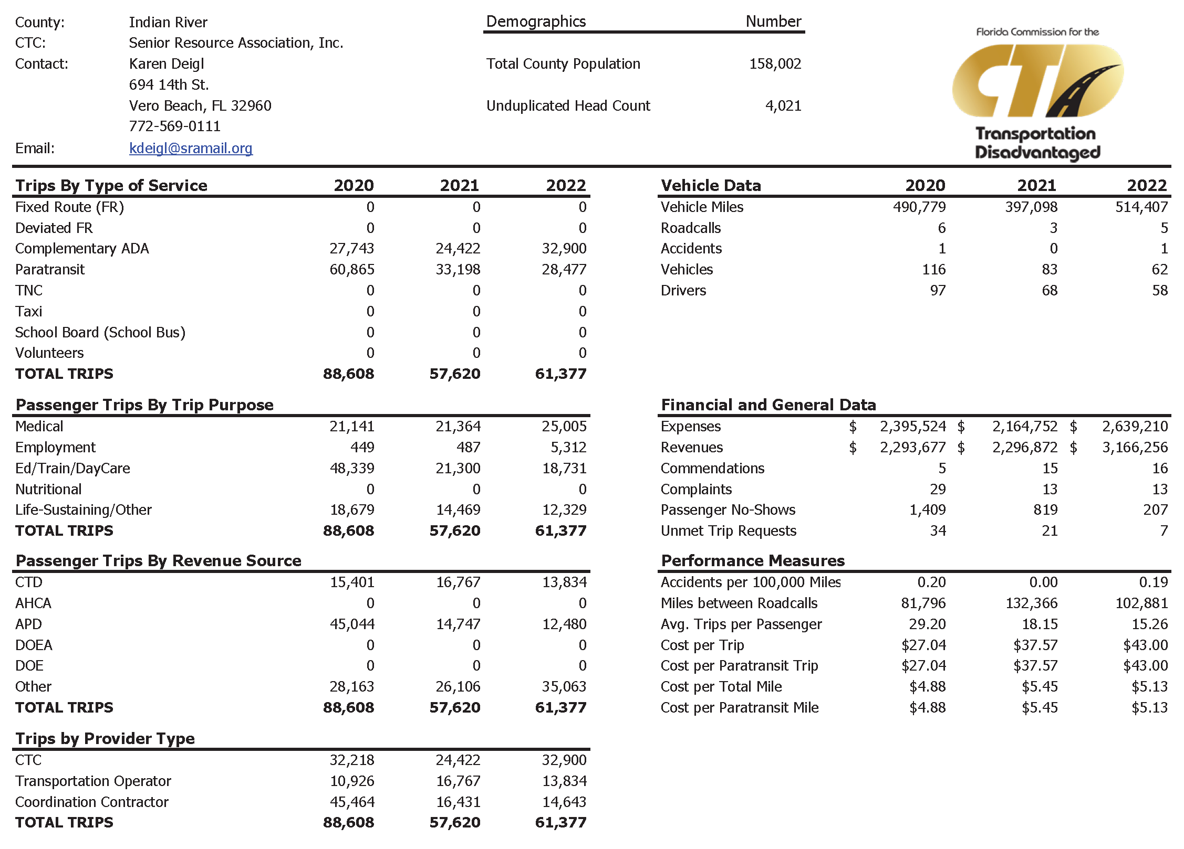
Project analysis slide 2
Indian River 2021-2022 AOR (Example)
The AOR collects aggregated trip data by fields such as “Trip Purpose” and “Revenue Source”, among others.
Aggregated data is just a set of calculations on top of raw data that exists at a more granular level. In this sense, data submitted by CTC’s in the AOR is more analysis than it is pure data.
Aggregated data represents a summary of disaggregated data. In this case, 61,377 individual trips (the disaggregated data) are aggregated (summarized) by:
  Type of Service
  Trip Purpose
  Revenue Source
  Provider Type

Slide 16
Project analysis slide 3
Study Purpose and Objectives
The Commission for the Transportation Disadvantaged (CTD) is conducting a study to improve the accuracy and analyses of performance data reported in the AOR
Objective 1:
ASSESS
Objective 1:
ASSESS
Objective 2:
VERIFY
Objective 3:
ANALYZE
The CTD will examine the current role of the AOR, including the process used to collect and report performance data each fiscal year. This will help identify both the strengths of the current system and the areas in need of future improvement.
The CTD will explore ways AOR data can be used to evaluate coordination of TD services. For purposes of this study, “coordination” is defined as the services being delivered directly by CTCs (in addition to what are funded by the T&E Grant), including paratransit trips and bus pass programs serving TD riders.
The CTD will examine the current role of the AOR, including the process used to collect and report performance data each fiscal year. This will help identify both the strengths of the current system and the areas in need of future improvement.
The CTD will identify strategies that can assist CTCs in reporting accurate and consistent data within the AOR. This is critical to the third objective of performing analyses and capturing accurate service trends year-over-year.

Slide 17
Project analysis slide 2
Indian River 2021-2022 AOR
The only figures that can be verified for accuracy within the AOR itself are the summary totals against one another. But there is no audit trail for these summarized totals.
there is no audit trail

Slide 18
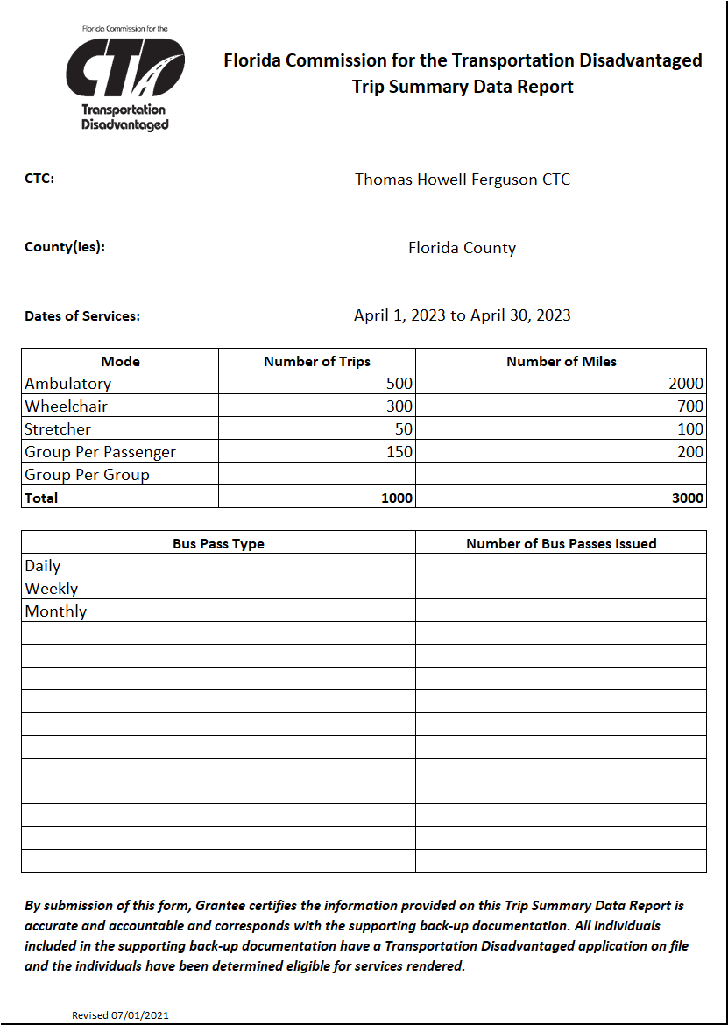
Project analysis slide 2
Using CTD Invoices as Analogy
no audit trail...
audit trail...

Slide 19
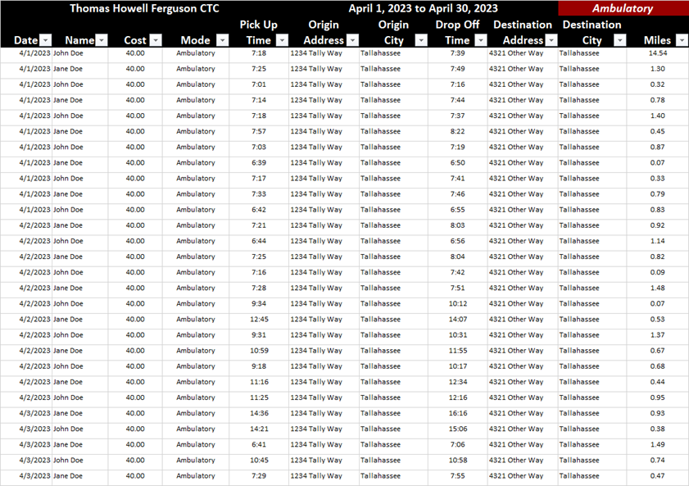
Project analysis slide 2
Using CTD Invoices as Analogy
“The Trip Summary Data Report provides a summary of the invoice back-up documentation. This report must be submitted with the invoice and detailed back-up documentation in order for the invoice to be processed by the Commission. Data provided on this form must match data provided on the back-up documentation.”
COMMISSION FOR THE TRANSPORTATION DISADVANTAGED INVOICING PROCEDURES FOR THE PROVISION OF TRANSPORTATION AND CAPITAL EQUIPMENT. July 1, 2017. p. 6

Slide 20
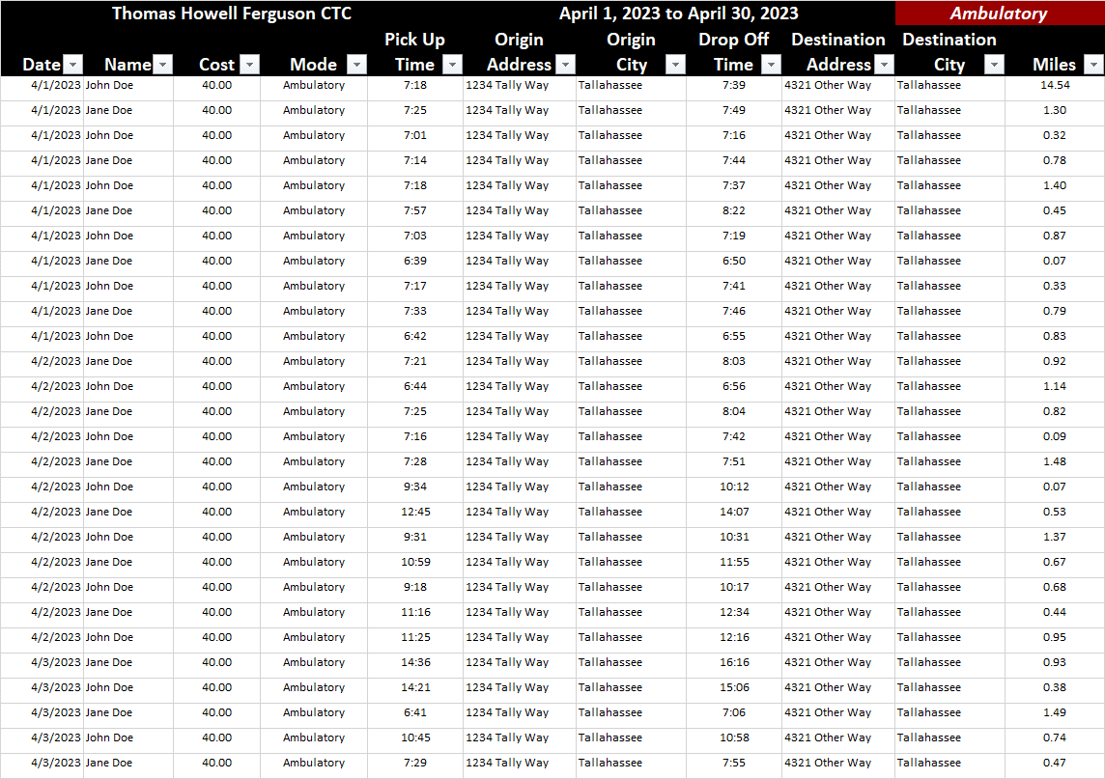
Using CTD Invoices as Analogy
“The Grantee must provide the following supporting documentation for reimbursement which identifies specific trips designated as eligible for the Transportation Disadvantaged Trust Fund. The Grantee shall provide sufficient documentation for each cost or claims for reimbursement to allow an audit trail to ensure that the services rendered or costs incurred were for those that were provided.”
COMMISSION FOR THE TRANSPORTATION DISADVANTAGED INVOICING PROCEDURES FOR THE PROVISION OF TRANSPORTATION AND CAPITAL EQUIPMENT. July 1, 2017. p. 8
supporting
documentation
identifies
specific trips
to allow an
audit trail

Slide 21
AOR History with T&E Grant Funding
Prior to FY21-22, CTD Trip & Equipment (T&E) Grant funding was allocated based on total trips and miles in the AOR, including coordination contractors and third-party agencies.
In 2020, a CTD study identified concerns with inconsistencies in gathering and reporting AOR data from 60 different sources.
As a result, the CTD removed the AOR from the funding methodology and replaced it with invoice data collected through the T&E Grant.
The study recommended re-evaluating the role of the AOR in measuring the performance of the broader Coordinated TD System.
The AOR remains a statutory requirement for CTCs and is compiled in the CTD's Annual Performance Report.

Slide 22
Project analysis slide 3
Study Purpose and Objectives
The Commission for the Transportation Disadvantaged (CTD) is conducting a study to improve the accuracy and analyses of performance data reported in the AOR
Objective 1:
ASSESS
Objective 1:
ASSESS
Objective 2:
VERIFY
Objective 3:
ANALYZE
The CTD will examine the current role of the AOR, including the process used to collect and report performance data each fiscal year. This will help identify both the strengths of the current system and the areas in need of future improvement.
The CTD will explore ways AOR data can be used to evaluate coordination of TD services. For purposes of this study, “coordination” is defined as the services being delivered directly by CTCs (in addition to what are funded by the T&E Grant), including paratransit trips and bus pass programs serving TD riders.
The CTD will examine the current role of the AOR, including the process used to collect and report performance data each fiscal year. This will help identify both the strengths of the current system and the areas in need of future improvement.
The CTD will identify strategies that can assist CTCs in reporting accurate and consistent data within the AOR. This is critical to the third objective of performing analyses and capturing accurate service trends year-over-year.

Slide 23
Project analysis slide 2
Indian River 2021-2022 AOR (Example)
This aggregated format can tell us how many CTD trips there are (13,834) and how many trips were for the purpose of employment (5,312). But it can’t tell us how many CTD trips were for the purpose of employment.

Slide 24
Project analysis slide 2
Aggregated vs Disaggregated Data
An example strength of the AOR’s aggregated form of data is how (in Indian River’s case in 2021-2022) it is immediately apparent how many trips were funded by CTD (13,834 trips) and how many trips there were for the purpose of employment (5,312 trips).
Trip Purpose
61,377 Total Trips
Medical
25,005 Trips
Employment
5,312 Trips
Ed/Train/DayCare
18,731Trips
Life-Sustaining/Other
12,329 Trips
Revenue Source
61,377 Total Trips
CTD
13,834 Trips
APD
12,480 Trips
Other
35,063 Trips
An example weakness of the AOR’s lack of disaggregation of data is how (again, in Indian River’s case) it is impossible to determine how many CTD trips were for the purpose of employment. Data is aggregated by Funding Source and by Trip Purpose, but not disaggregated by any combination of the two.
Revenue Source
61,377 Total Trips
CTD
13,834 Trips
APD
12,480 Trips
Other
35,063 Trips
Medical
?
Employment
?
Ed/Train/DayCare
?
Life-Sustaining/Other
?

Slide 25
Project analysis slide 2
Aggregated vs Disaggregated Data
An example strength of the AOR’s aggregated form of data is how (in Indian River’s case in 2021-2022) it is immediately apparent how many trips were funded by CTD (13,834 trips) and how many trips there were for the purpose of employment (5,312 trips).
Trip Purpose
61,377 Total Trips
Medical
25,005 Trips
Employment
5,312 Trips
Ed/Train/DayCare
18,731Trips
Life-Sustaining/Other
12,329 Trips
Revenue Source
61,377 Total Trips
CTD
13,834 Trips
APD
12,480 Trips
Other
35,063 Trips
With the individual trip level AOR data provided by Indian River, Thomas Howell Ferguson was able to answer this particular question of how many CTD trips were for the purpose of employment, as well as others like it.
Revenue Source
61,377 Total Trips
CTD
13,834 Trips
APD
12,480 Trips
Other
35,063 Trips
Medical
4,522
Employment
3,117
Ed/Train/DayCare
2,288
Life-Sustaining/Other
3,907

Slide 26
Project analysis slide 3
Study Recommendations
Recommendation 1: For the upcoming AOR submissions in 2023, the Commission should continue with the current processes and methods it has in place and collect the same information as it has in recent years.
Recommendation 2: The Commission should develop a detailed plan to test run the additional collection of individual trip level data, as well as individual bus pass level data, from CTCs as part of the 2023 AOR submission cycle. This planned test run for collecting data on individual trips and bus passes should function separately from the existing processes referenced in Recommendation 1 and not be integrated within them.
Objective 1:
ASSESS
The CTD will examine the current role of the AOR, including the process used to collect and report performance data each fiscal year. This will help identify both the strengths of the current system and the areas in need of future improvement.
Recommendation 3: As part off the detailed plan in Recommendation 2, the Commission should conduct a comprehensive and thorough review of its legal options and authorities pertaining to the collection of data on individual trips and bus passes. The review should especially focus on the collection of potentially sensitive information, including potential personally identifiable details such as names or addresses. By proactively exploring its legal options and authorities for collecting specific detail, the Commission can ensure that its data collection practices align with legal requirements, protect privacy rights, and build a strong foundation for the ethical and responsible use of disaggregated data.

