Slide 1
FY2023-24 Innovation and Service Development Project Year-in-Review

Slide 2
DIRECT COMPARISION:
July-March FY2022-23 ISD Project vs. July-March FY2023-24 ISD Project
Trips Provided
On-Time Performance
Ridership
Avg. Miles per Trip
Avg. Minutes per Trip

Slide 3
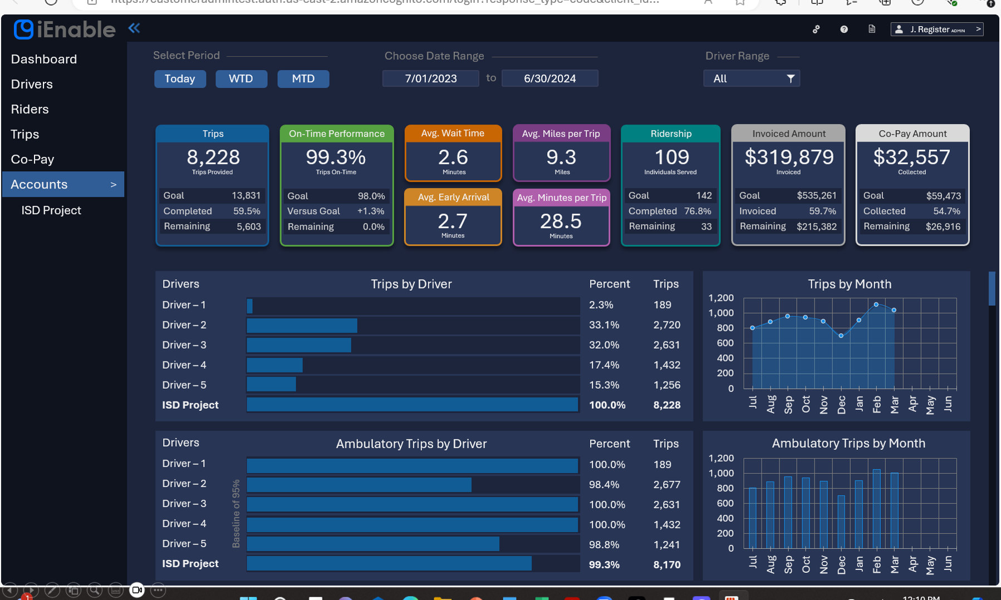

Slide 4
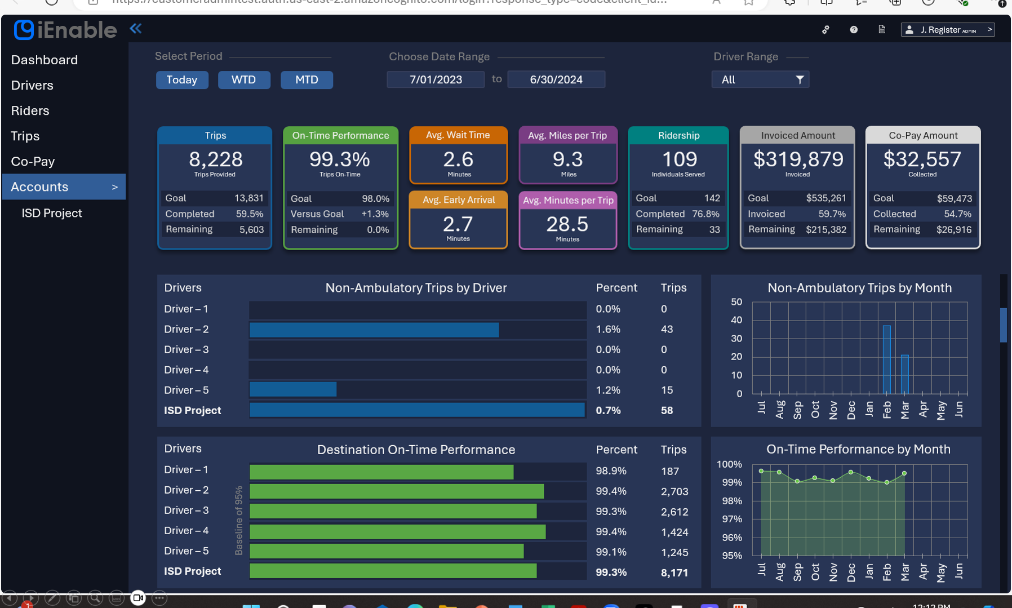

Slide 5
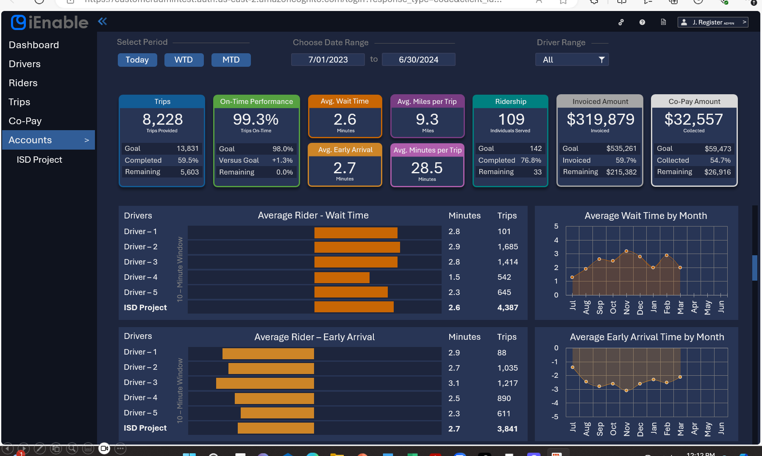

Slide 6
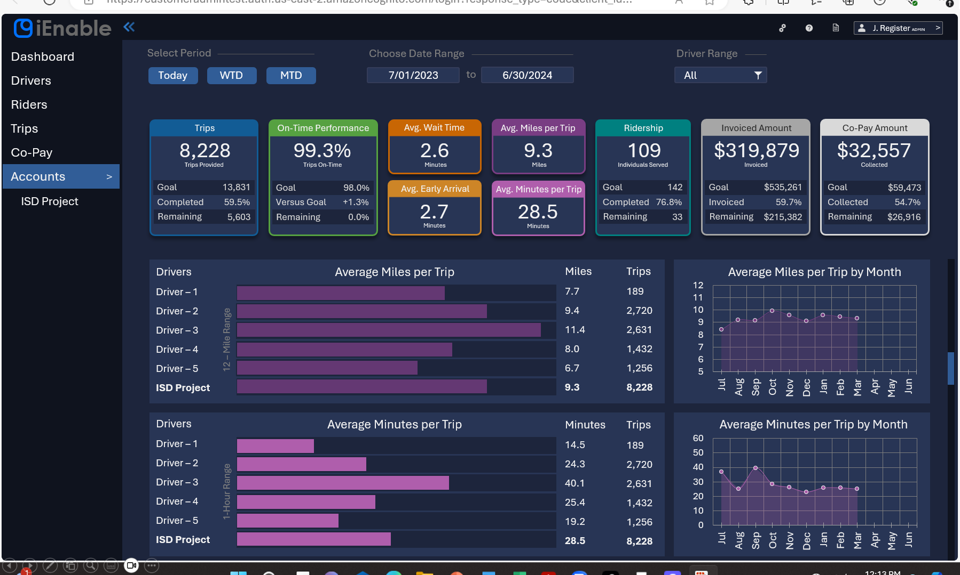

Slide 7
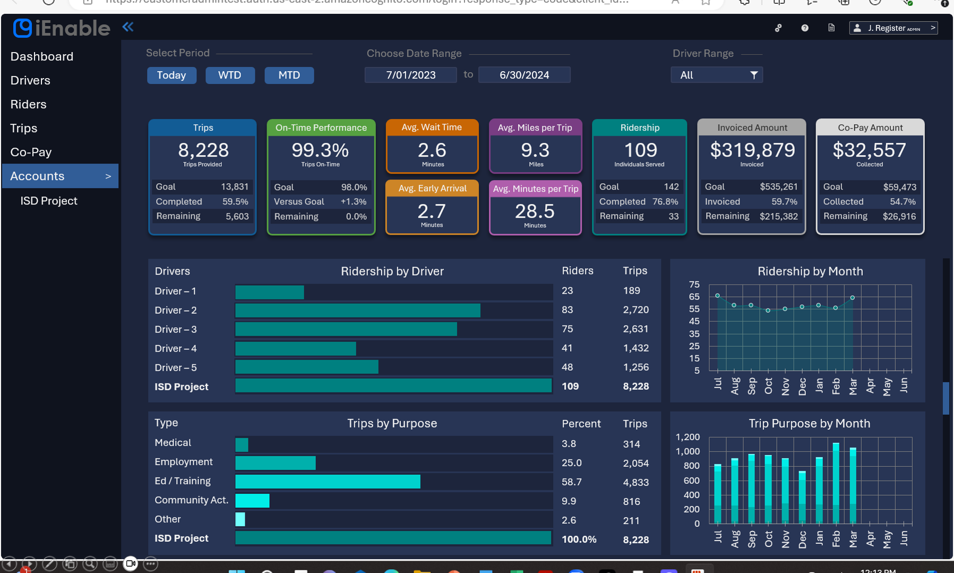

Slide 8
