Slide 1
Pinellas, Pasco, Hillsborough Regional ISD 2023-24 Grant Update
April 24, 2024
Ross Silvers, Mobility Services

Slide 2
PSTA and Pinellas County, FL
Population near 1,000,000
Median age of 46
42 bus routes, 11.66 million Trips FY19
Top 10 Lowest funded transit agencies
Top 10 Most Dangerous for Pedestrians
Service economy = low pay, high turnover, shift ends when work is done, 24/7
Sunset Hours on most buses, advance reservation TD paratransit inflexible
¼ of all bus riders are using TD fare
If 2nd or 3rd shift, bus one way only
Wheelchair & Taxi companies priority is on servicing contracts v. on-demand
Notes:
Location
Mid size agency
We’ve been working with taxis and TNCs since 2016 for first/last mile and overnight trips
Our median age is higher than FL, higher than US

Slide 3
Regional Needs: One Metro Area
Pre-Existing Services
PSTA’s Two Express Buses to Downtown Tampa, but most service jobs are long bus ride from there
Pasco buses serve PSTA’s Tarpon Springs transfer center, but these Pasco routes are not where most Pasco residents live.
Paratransit cross-county vehicle transfers are hard to coordinate due to heavy traffic, weather
Prior Pilots Demonstrated Demand
CTD’s prior TD Tampa Bay pilot had high demand in these 3 counties, with great interest in resumption
Current CTD TD Tampa Bay grant
Cross-County On-Demand Rides Monday – Saturday
In-County Urgent Rides Evenings & Saturdays (Pasco & Hillsborough)
Late Shift (Pinellas)

Slide 4
TD Tampa Bay Service
Providers
Lyft, Uber, United Taxi, Wheelchair Transport
GoGo (Grandparent) added
Trip requests taken live by phone or in app
Fares/Costs
Cross-County $6, Urgent $3, Early/Late $9/month
Response Time
Ambulatory response time = Under 20 mins
Wheelchair response time = 37 min on average

Slide 5
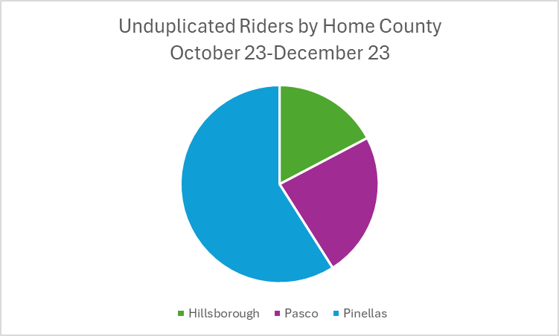
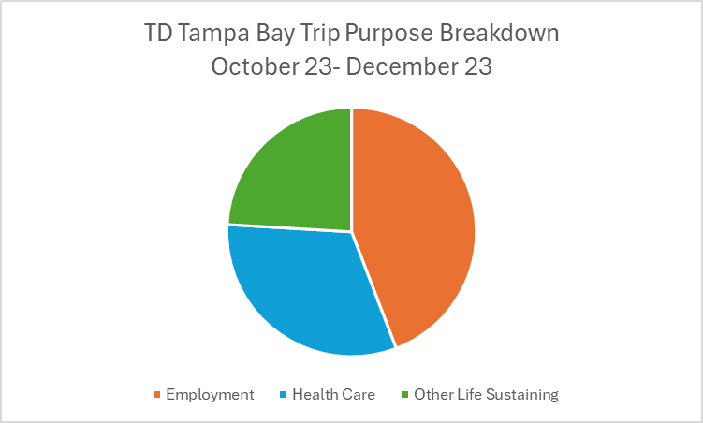
Progress Report
Most Recent Data (YTD as of 12/31/23)
Over 1,800 TD riders (Goal = 2,100) took nearly 10,000 rides (Goal = 25,000 rides)
9,153 Cross-County Rides were provided
Just under 900 Early/Late & Urgent Rides
98% of rides had Response Time of less than 20 minutes (Goal = 90%)
Customer Survey Results
93% reported positive satisfaction rating (Goal = 90%)
95% reported positive satisfaction for safety
93% reported positive satisfaction for vehicle accessibility and cleanliness
Notes:
Location
Mid size agency
We’ve been working with taxis and TNCs since 2016 for first/last mile and overnight trips
Our median age is higher than FL, higher than US

Slide 6
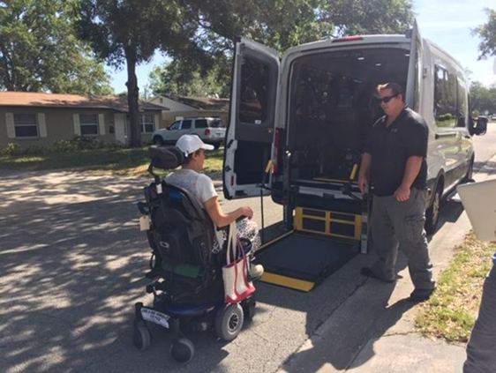
Lessons Learned & Challenges
Everyone Wants TD Tampa Bay cross-county rides, but not all actually use it.
Wait List since Fall when exceeded grant allocation
Three Services under TD Tampa Bay is confusing for TD clients, staff, and providers; it is a challenge for, coordination, communication, and documentation
Cross-County and Early/Late have been most in-demand
Next year’s ISD application will be one TD Tampa Bay service, expanding to Sundays & overnight for top priority trips.

Slide 7
Contact Information
Ross Silvers
ADA & Community Relations Officer
Phone – 727-540-1844
Email – rsilvers@psta.net
Pinellas Suncoast Transit Authority
Saint Petersburg, FL

