Slide 1
Middle Keys Transportation
Maureen Dunleavy, LMHC,
Regional Senior Vice President
“Connecting the Keys”

Slide 2
Agenda
Transportation of the Disadvantaged Innovative Service Development Grant (ISD)
Provided by: Middle Keys Transportation at the Guidance/Care Center
Need – “Connecting the Keys”
Project Proposal and Overview
Results
Lessons Learned

Slide 3
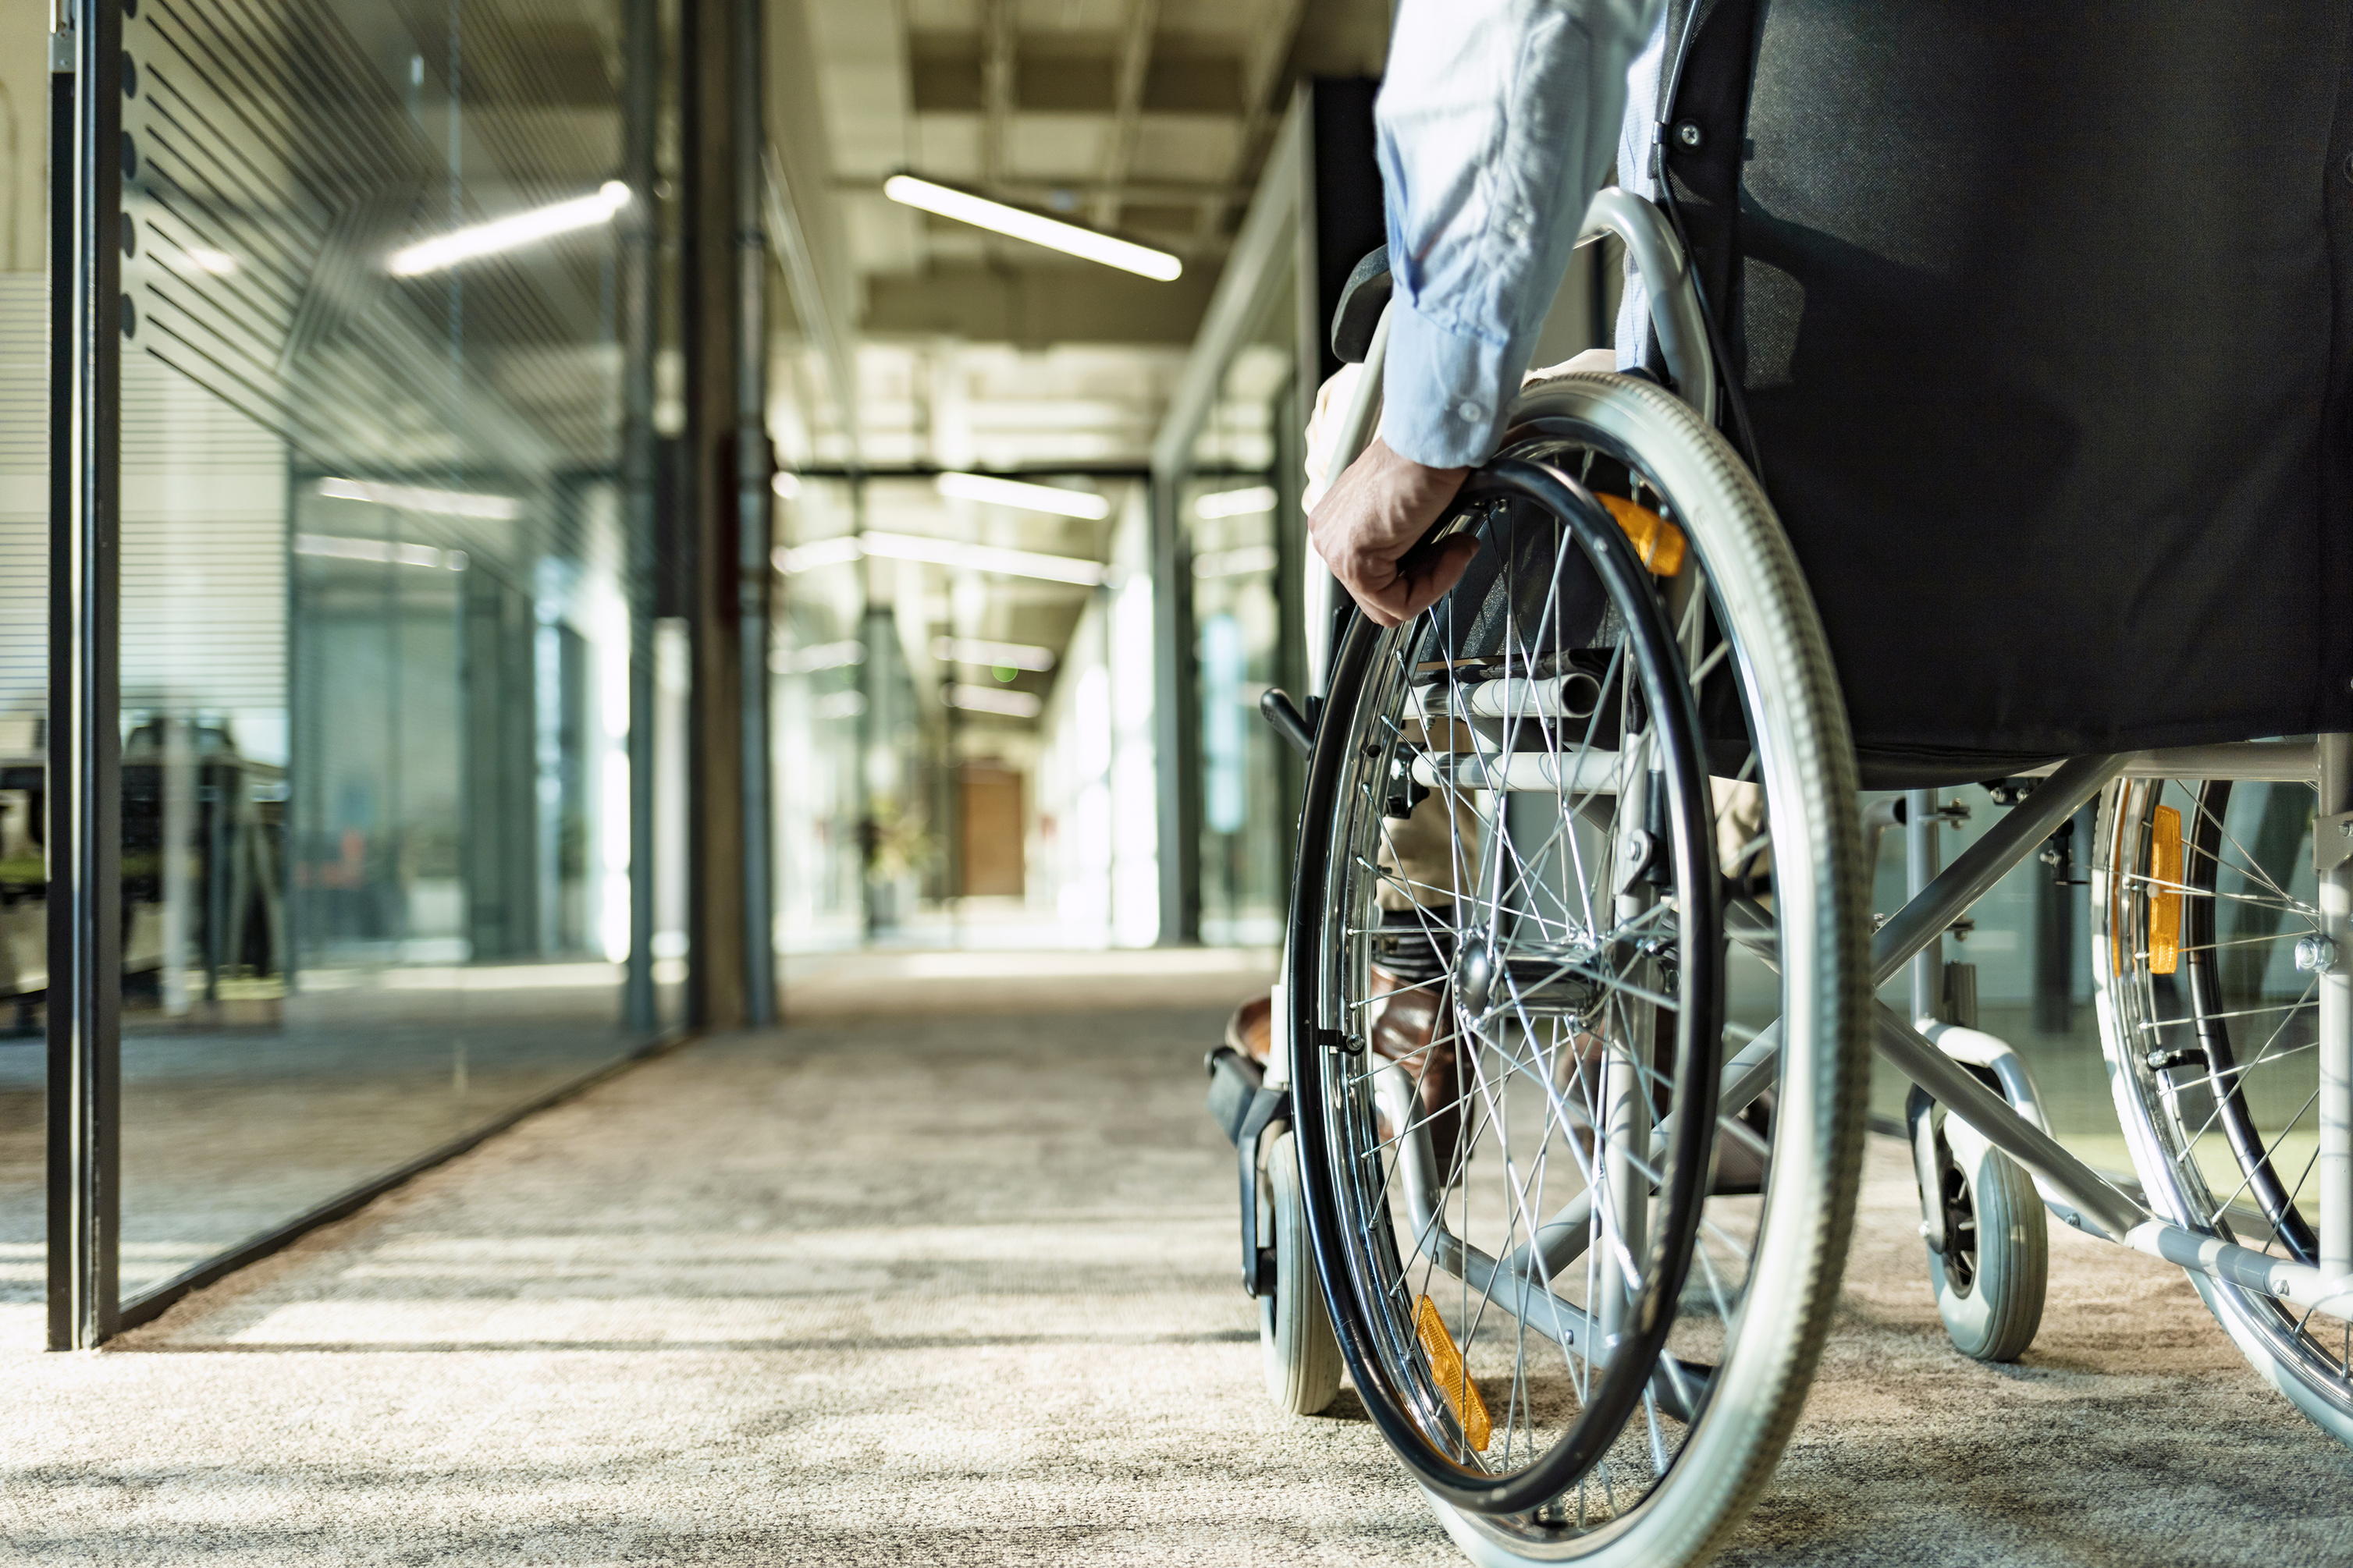
Introduction The Guidance/Care Center (GCC) operates Middle Keys Transportation services and is the designated Community Transportation Coordinator (CTC) for Monroe County. The CTC is responsible for administering a countywide system of transportation for all Monroe citizens who are transportation disadvantaged.

Slide 4
Need
“Connecting the Keys” to services on the Mainland
Middle Keys Transportation’s seven bus service provides 4,000 trips totaling 110,000 miles throughout Monroe County
to the Transportation Disadvantaged (elderly, disabled, low income)
for medical appointments, shopping, day care, entertainment and employment.
Operates Lower Keys through Upper Keys Monday to Friday (excluding major holidays)
with originally only ONE trip per week to Miami Dade when driver was available;
with ISD we now provide 4 trips/2 days a week with dedicated Driver
Service limitations –
Lack of Local Medical Providers- Cancer Center in Key West closed 2023
Ballooning fuel, insurance and repair costs and global supply chain issues
Quicker deterioration of vehicles due to be surrounding by salt air.
Rising Cost of Living in Florida Keys

Slide 5
Need
“Connecting the Keys” to services on the Mainland
Service limitations
Lack of Local Medical Providers/Services – residents are referred to: Miami Veterans Medical Center, University of Miami Health System, Bascom Palmer Eye Institutes, Mount Sinai Medical Center Cardiology, Baptist Medical Center Kendall – Center for Eye Excellence, Miami Cancer Institute, Miami
Cardio Vascular Institute, South Miami Hospital and Jackson Memorial
Lack of out of county transportation services
Geography of Monroe County
57% of residents in Monroe County have no access to public transportation
Two-lane Highway for 113 Miles with 45 mph speed zones. Variables: Accidents, Construction, Utility Work
Limited appointment window for out of county transportation due to extended travel time and parameters set for driver availability

Slide 6
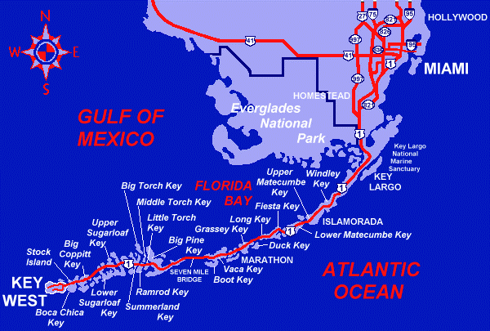
Geography
City | Mile Marker | Miles from Miami | Minimal Travel Time (no delays) | Round Trip | Minimal Round Trip (no delays)
Key West | 0-8 | 159 | 3 hrs. 42 Min | 318 | 7.25 hrs
Big Pine | 9-39 | 128 | 2 hrs 49 min | 256 | 6 hrs
Marathon | 40-65 | 111 | 2 hrs 26 min | 222 | 5 hrs
Islamorada | 66-88 | 76 | 1 hr 42 min | 152 | 3.75 hrs
Key Largo | 89-110 | 58 | 1 hr 15 min | 116 | 2.5 hrs
Accidents or other roadway obstacles can result in traffic congestion and additional wait time of several hours
Pickups scheduled at 8 am for Appointments scheduled between 12-4 ONLY

Slide 7
PROJECT PROPOSAL AND OVERVIEW
Established two (2) early-morning multi-rider door to door trips per week to Miami-Dade
Added a dedicated driver and an additional Trip 2 days per week
Morning Service Hours expanded to pickups in Lower Keys as early as 3:30 AM for 8 AM-12PM appointments Clients requiring additional time for their appointments can return on the normal afternoon route 12-4 pm
Vehicles are ADA-compliant and equipped with mobility devices for riders in wheelchairs or disabled. Drivers are trained to provide assistance
Process: Client Application and eligibility. Call for reservation line 48 hours prior. Client will receive a confirmation call 24 hrs in advance with Pickup time and service drop off.
Client outcomes – 1) less restrictive appointment times – less wait for doctor 2) Residents will not incur lodging expenses for early morning surgery schedules 3) Extended time will allow providers to complete long treatments in 1 visit vs. 2 4) Door to door eases coordination with transport services and missed rides 5) Affordable roundtrip $10 per person fee. Will not be denied for inability to pay

Slide 8
ISD Results (data based on 2 quarters July- December 2023)
Total number of trips - As of 12/31/23 we have invoiced $48,007 for 91 trips and 9148 miles
Providing 2 daily trips to Miami 2 days a week (Tuesdays and Thursdays) totaling
8 trips per week. Mostly medical trips have been provided. There were 3 trips that
were non-medical.
Unduplicated Passenger Head Count (goal 45). Unduplicated year to date is 49 clients.
With time left for this grant we have exceeded our goal.
Performance Indicators –
Average service hours per day total – 6.24 hours
Average Vehicle miles per day total – 240 miles
Average Passenger miles per day total – 285.81miles
Average wait time per trip – 2 hours 40 minutes.
On-time performance percentage – 96%

Slide 9
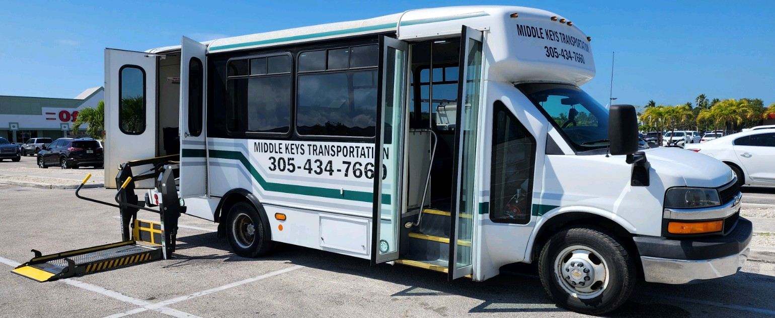
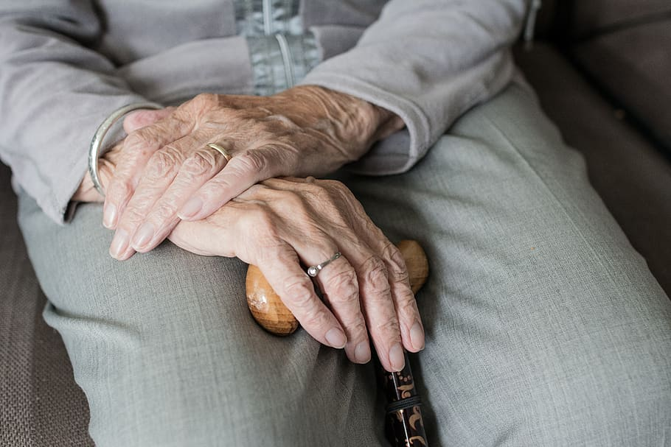
“ I have lived in KW for 40+ years and fortunately have not had a need for transportation help. I now am in that position as I go to Miami every 6 weeks for an eye condition where I cannot see well enough to drive home after treatment. I had to resort to staying overnight in hotels, pay for cabs, meals for two days as well as gas and the wear and tear on my older car. It was becoming financially intolerable. Then my provider told me about Middle Keys Transport and after coordinator Katrina sent me an application and my Retina doctor signed off, I was approved. Being thankful is an understatement! What a great service you provide and what wonderful drivers. I have used the transportation shuttle twice now and the driver comes from Marathon and picks up KW and Lower Keys riders at their door early morning. Drivers are so helpful and will answer questions or stop if someone needs to. I feel safe riding with them. The driver gets everyone where needed and returns us all home door to door the same day. How wonderful this service is and thank you for the professionalism of your staff! This is an important service and I am truly grateful!”
Typical Testimonial (over 90% favorable goal met)

Slide 10
Thank You
This has been a very worthwhile project critical to our
community.
Maureen Dunleavy, Regional Sr. Vice President
maureen.dunleavy@westcare.com
www.guidancecarecenter.org

