Slide 1
Transportation Network Company Pilot Program
April 23, 2024

Slide 2
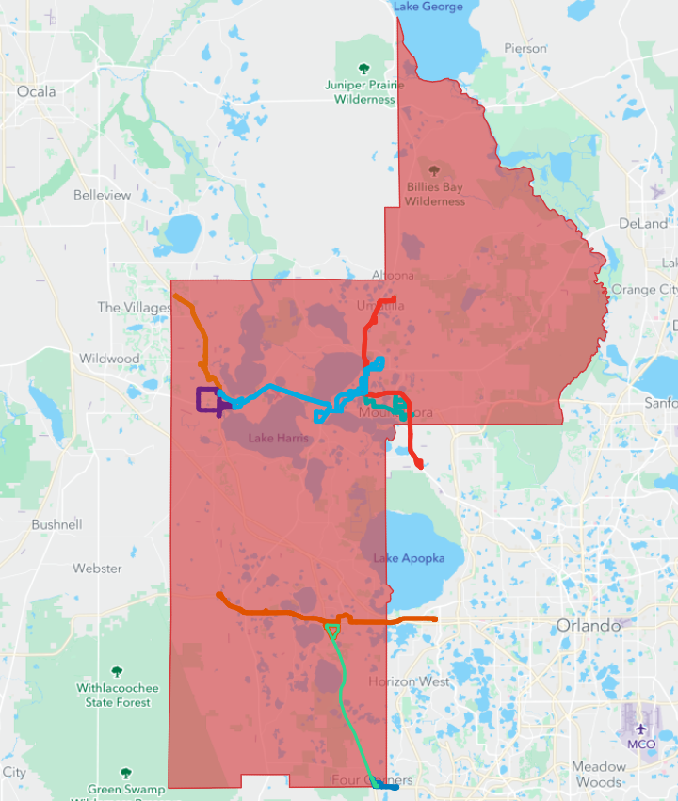
Facts
Lake County:
1,157 Square Miles
18.9% Water
North to South = 65 Miles
LakeXpress:
Monday to Friday, 6a-7p
Lake County Connection:
Monday to Friday, 6a-7p
Saturday, Dialysis Only

Slide 3
Systemwide Concerns
Lake County Residents
No Evening Transit Services
No Weekend Transit Services
30-Minute Average Work Commute
Lake County Transit
Increased Paratransit Trips
Increased Expenses
Lack of Bus Operators
Lack of Transit Network
Fixed Route Customers
Hourly Headways
Lack of Connectivity
First/Last Mile
Travel Time
Paratransit Customers
No Same Services
No Same Day Changes
On-Time Performance Levels
Travel Time

Slide 4
Project Goals
Supplement Paratransit Program
Provide Eligible Paratransit Customers with Options
Same Day Service
Evening Transit Services
Weekend Transit Services
Reduced Customer Wait Time
Reduced Customer Travel Time
Reduced Trip Costs
Increased On-Time Performance
Increased Customer Satisfaction

Slide 5
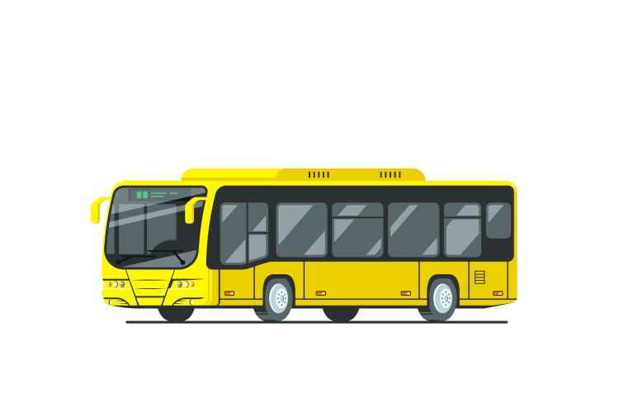
Obvious Solutions
Hire More Operators and Staff
Buy More Buses
Print More Money

Slide 6
Transportation Network Companies
Apply & Receive ISD Grant Funding
Contract with TNCs
Develop Policies, Procedures, Marketing, and Promotional Items
Customers “Opt-In” to the Program
LCT Authorizes the Customer
Customer Downloads App and Registers
Customer Makes Reservation / Confirms Fare
Customer Takes Trip
TNC Invoices LCT
Evaluate the Project for Continuation / Enhancement

Slide 7
Timelines
Action Planned Actual
CTD Approves ISD Award Recommendations < 07/01/2023 08/28/2023
“Authorization to Accept Grant Award” 08/2023 10/24/2023
Grant Execution 09/2023 11/29/2023
Procurement Process / Discussions 09/2023 09/2023 to Present
Project Policy & Procedure Development / Marketing 09/2023 Pending Contract
Project Start Date 10/01/2023 Pending Contract

Slide 8
Current Status
Contracting
Policies, Procedures, Marketing
Enrolling (Opting-In) Eligible Customers
Service Provision

Slide 9
Moving Forward
Implement Year One Pilot Project
Apply for Year Two Pilot Project Funding
Share Lessons Learned
Develop Project Outline (Living Document)
Start the Procurement Process EARLY
ITB?
RFP?
Piggybacking?
Year One – Plan for less than 12-months of operating
Project Size
Trip Volume
Available Project Funding

Slide 10
Questions?
Bill Hearndon
Bill.Hearndon@LakeCountyFL.gov
(352) 323-5733

