Slide 1
Heartland Community Transportation Coordinator
Respect Individuals | Collaborate to Innovate | Deliver Value | Align with Clients | Act with Integrity

Slide 2
2023-2024 ISD GRANT UPDATES

Slide 3
Ambulatory vs. Non-Ambulatory Rider Metrics

Slide 4
ISD GRANT FUNDS USED PER MONTH

Slide 5
MTM CTC Service updates:
Same Day or Next Day program for Highlands County has given the riders a new opportunity to meet those unexpected changes or challenges on their day-to-day life.
MTM / Contractors are keeping the momentum moving forward this year by adding more Para-Transit drivers and better reporting technologies.
Highlands County clients have the ability to call in the same day or the day before and request a trip instead of the normal policy of up to 2 weeks in advance for local appointments.
This Grant has assisted various clients to get to their life-saving medical treatments like dialysis, to their employment, as well as nutritional trips to the grocery store and food banks. Educational trips have also increased in the past year, as well using the ISD grant.
Communication is KEY! Informing new and existing clients of the Same Day Next Day program to continue to increase ridership

Slide 6
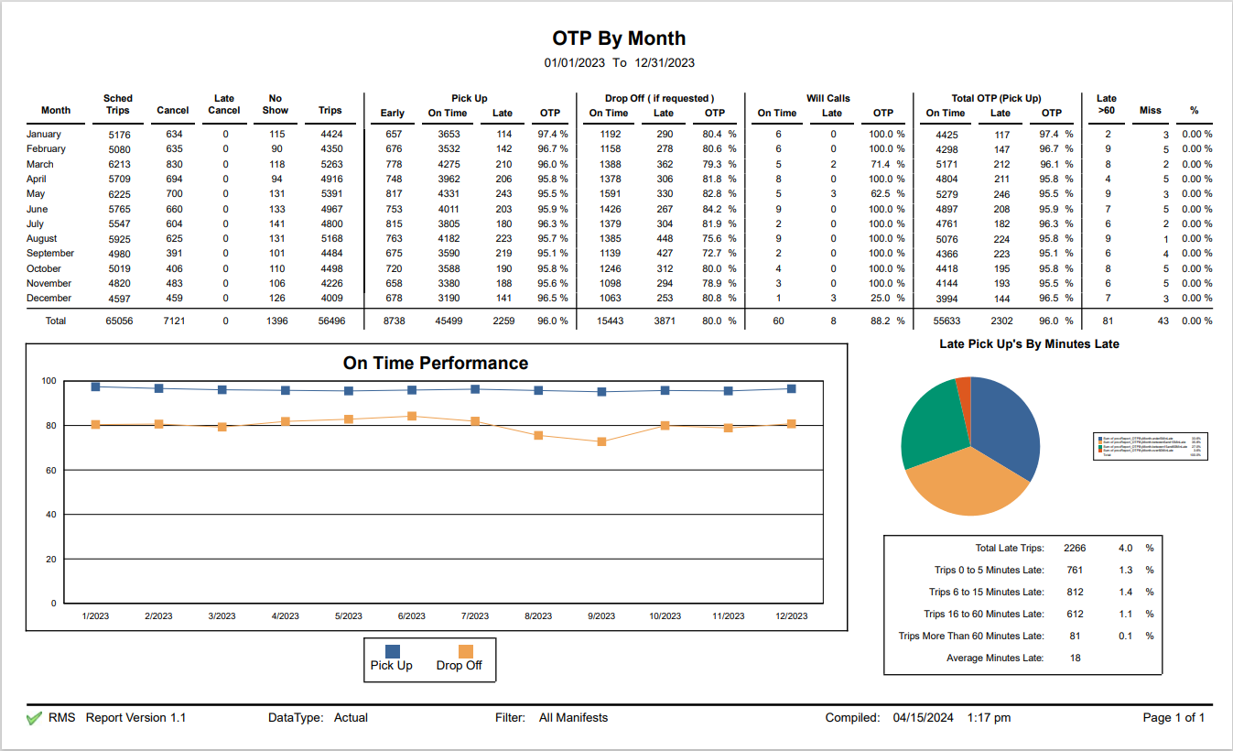

Slide 7
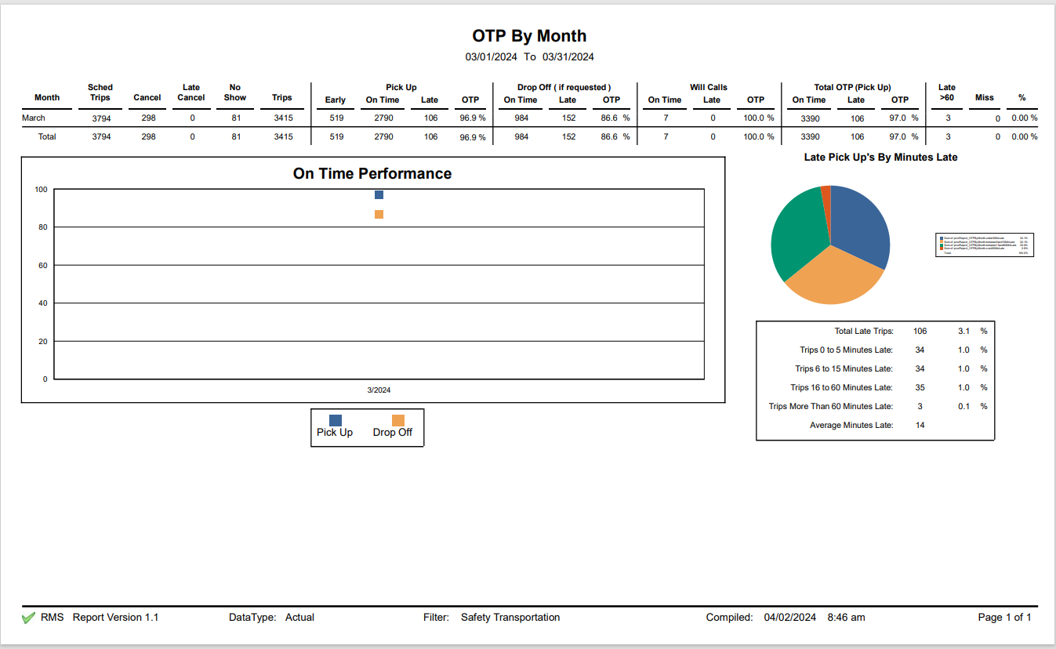

Slide 8
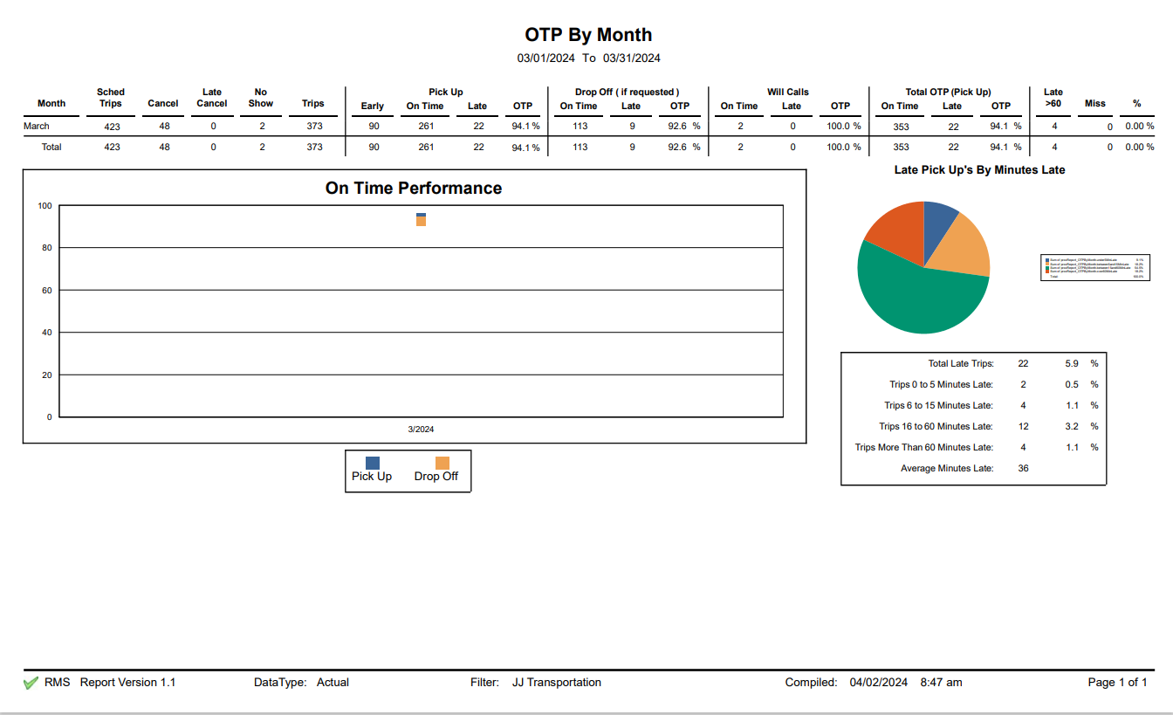

Slide 10
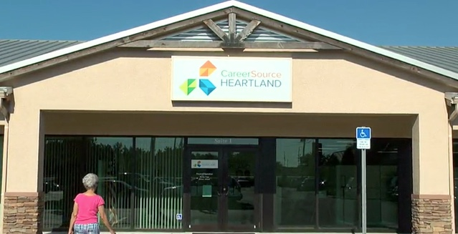
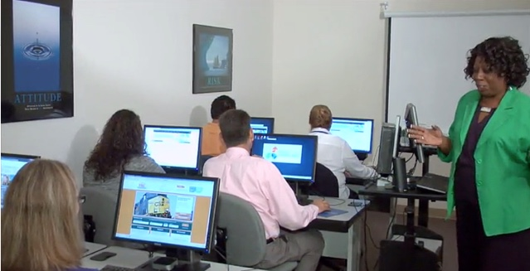
Career Source Heartland
5901 US Hwy 27 South Suite 1 Sebring , FL

Slide 11
Fresenius Kidney Care Sebring

