Slide 1
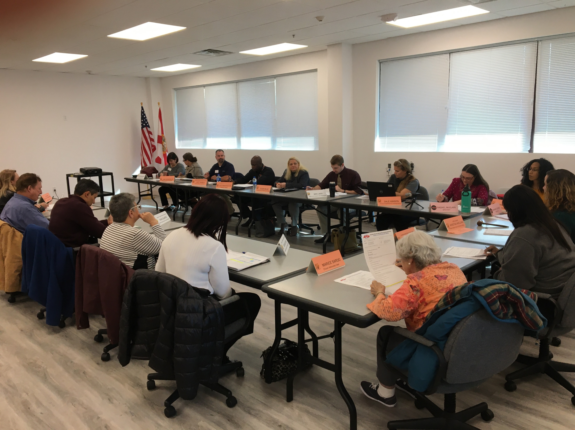
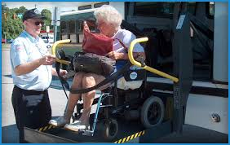
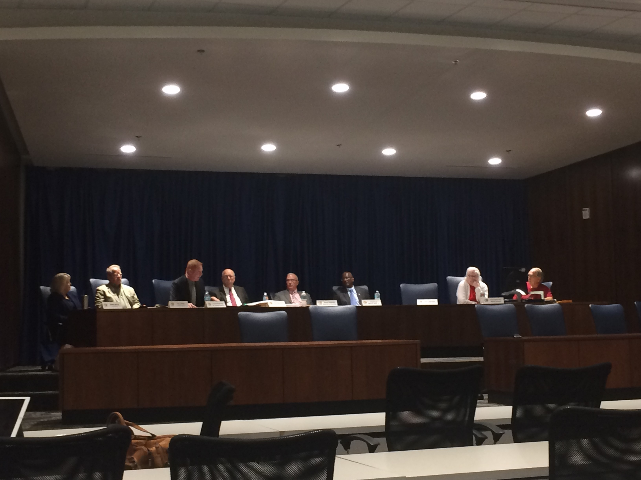
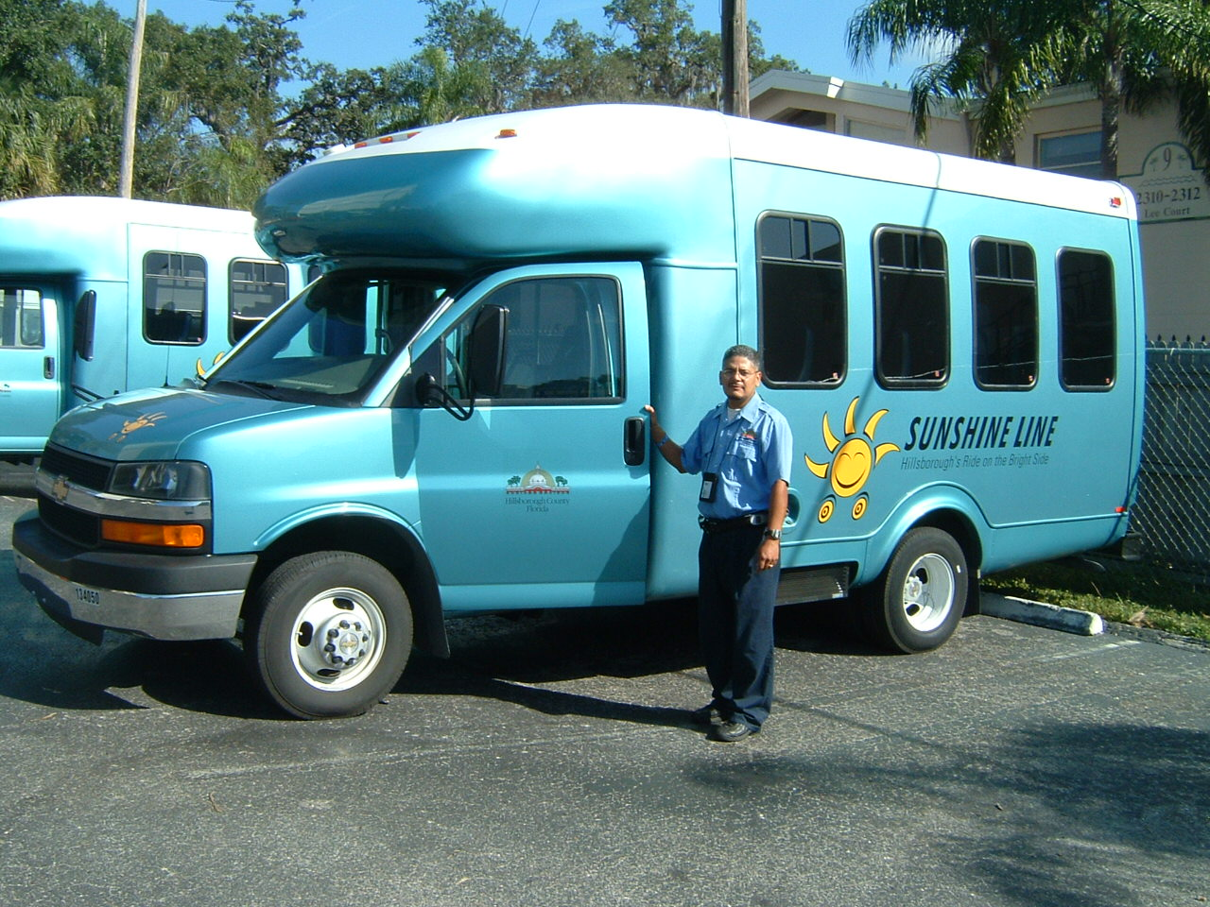
TD 101 An Overview of the Transportation Disadvantaged Program
Updated:
February 13, 2024
Notes:
Presented by the Florida Commission for the Transportation Disadvantaged (CTD).

Slide 2
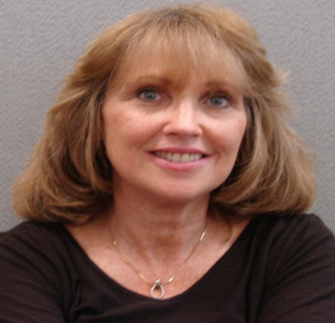
Who Are Our Customers?
Notes:
Steve Jobs (the late CEO of Apple) once said: “You’ve got to start with the customer experience and work backwards to the technology. You can’t start with the technology and try to figure out where you are going to try to sell it.” This is also a good way to approach the transportation challenges facing our customers: we must first understand their barriers, needs, and options available in their community before we examine the transportation systems. With this in mind, let’s start with our customer’s experiences, then work backwards to the transportation…

Slide 3
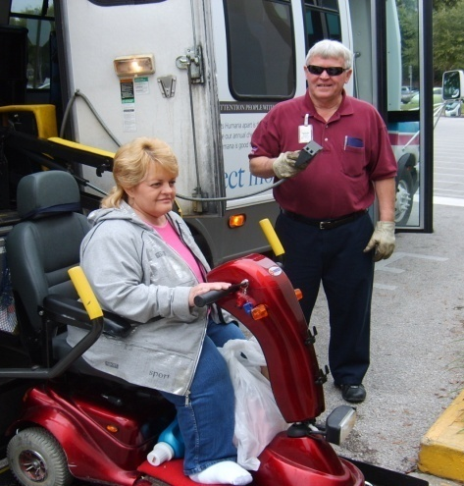
Individuals Who…
Are “Transportation Disadvantaged” due to disability, age or income;
Rely on others to access health care, employment, education, and other activities in their community; and
Have limited transportation options to participate in these activities.
Notes:
Chapter 427, Florida Statutes, defines the “Transportation Disadvantaged” as older adults, individuals with disabilities, persons with low-income, or at-risk children who are unable to transport themselves or purchase transportation. They are dependent upon others to obtain access to health care, employment, education, shopping, social and other life-sustaining activities. Some of these individuals may have access to limited transportation options in their community. For example, if enrolled in Medicaid, they may have transportation to medical appointments, but not necessarily options to access grocery shopping or employment.

Slide 4
^{TD Program Foundation}
The “Three-Legged Stool” of Coordination
In 1979, Legislature created the program to be “fully responsive to the needs” of this population.
Legislature created CTD and TD Trust Fund in 1989.
The purpose was to “coordinate” transportation services in each county in Florida.
Implemented by three primary entities at local level:
Community Transportation Coordinator (CTC) – Oversees the delivery of TD services in designated county or multi-county area.
Planning Agency (Planner) – Coordinates planning activities for local TD program.
Local Coordinating Board (LCB) – Represents stakeholders and advises on the delivery of TD services.
CTD also works with state/local partners or “purchasing agencies” to coordinate funding for these services.
Commission for the Transportation Disadvantaged (CTD)
Planner
LCB
CTC
Notes:
The TD Program was created by the Florida Legislature in 1979, with the goal to establish a Coordinated Transportation System “fully responsive to the needs” of the TD population. The Legislature recognized that the availability of public transportation (i.e., fixed bus route) services were limited to large metropolitan communities and not generally conducive to the needs of persons with disabilities and older adults. Further, there were a variety of programs and human service agencies that were providing transportation to certain activities, but they were not effectively coordinated across the state. Thus, Florida spent the next ten years (1979 – 1989) building a coordinated transportation system, culminating with the creation of a statewide commission and dedicated trust fund.
The CTD serves as the statewide policy board that oversees the coordination of TD services in every county of the state (discussed further in Slides 6-8). The program is implemented at the local level by three primary entities. The CTC is designed by the CTD to deliver and/or contract the TD services in a county or multi-county area. The Planner is a Metropolitan Planning Organization (MPO) or similar agency responsible for coordinating the planning activities for the local TD program, including staffing and appointing members to the LCB. And the LCB is made up of stakeholders of the TD program (rider advocates, state agencies, human service providers, and elected officials) that advise the CTC and Planning on the delivery of the TD services in their designated area. The CTD also works with state and local partners, including FDOT, to coordinate funding and purchase trips through the Coordinated TD System.

Slide 5
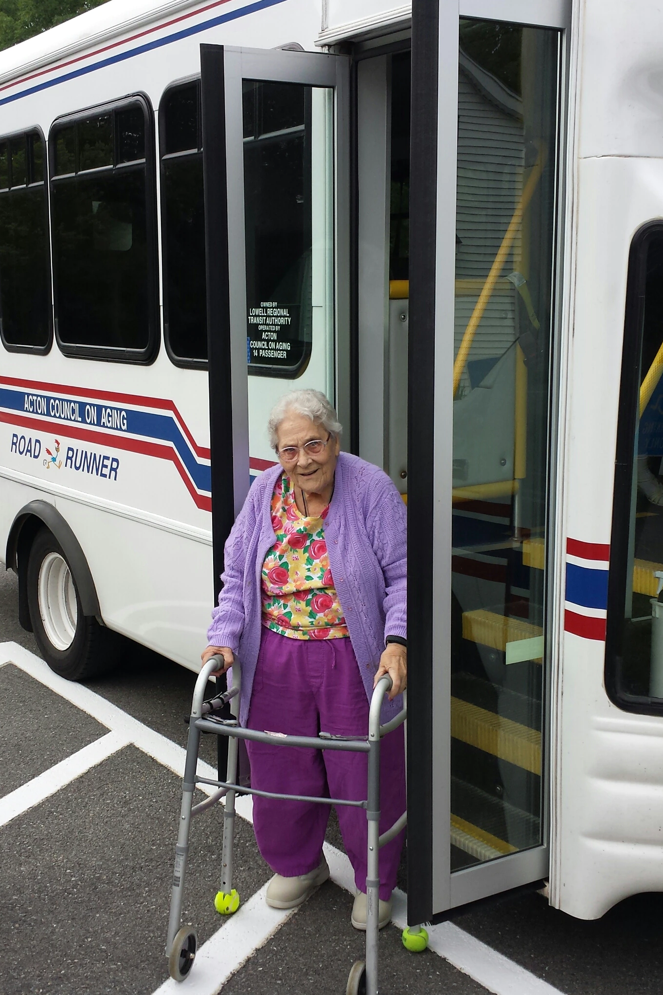
What is “Coordinated Transportation”?
“Coordination” is the arrangement of transportation “in a manner that is cost-effective, efficient, and reduces fragmentation and duplication of services” (s. 427.011, F.S.).
For example, an individual may have access to medical transportation through Medicaid but requires another funding source to access employment.
Paratransit (demand-response) trips that are not “sponsored” by any other agency or provided as an extension of the fixed-route system may be purchased under the TD Trust Fund.
If TD riders are physically able to access the fixed-route system, TD funds may be used to purchase bus passes (more cost-effective than paratransit services).
Notes:
The TD program is governed under Chapter 427, Florida Statutes. The term “coordination” is defined by statute as the arrangement of transportation in a manner that is cost-effective, efficient, and reduces duplication of services. The Legislature recognized that there was not enough money to meet all the needs of the TD population; thus, the State directed that the Commission and its partners coordinate with the various funding sources and human service agencies to deliver this transportation in the most cost-effective way possible. This is accomplished by first determining whether the individual meets the criteria of “transportation disadvantaged” (age, disability or income), which is performed by the CTC. Then the CTC is tasked with identifying what transportation options are available to the individual, including if the individual has a personal vehicle or family/friend to provide transportation, whether they can use public transit, or if they have another “sponsoring” agency that funds their trips to certain activities (such as Medicaid). If the CTC determines the individual has no other transportation option available to access a certain activity within its service area, the individual may qualify for “non-sponsored” TD services, which are funded under the TD Trust Fund.
Transportation purchased under the TD Trust Fund mostly consist of “demand-response” paratransit trips. These are usually scheduled between the rider and CTC and are provided door-to-door or curb-to-curb. If the individual has the physical/mental ability to access the fixed route but have income limits, the TD Trust Fund may be used to subsidize their fare to use the fixed route (also known as a “bus pass”).

Slide 6
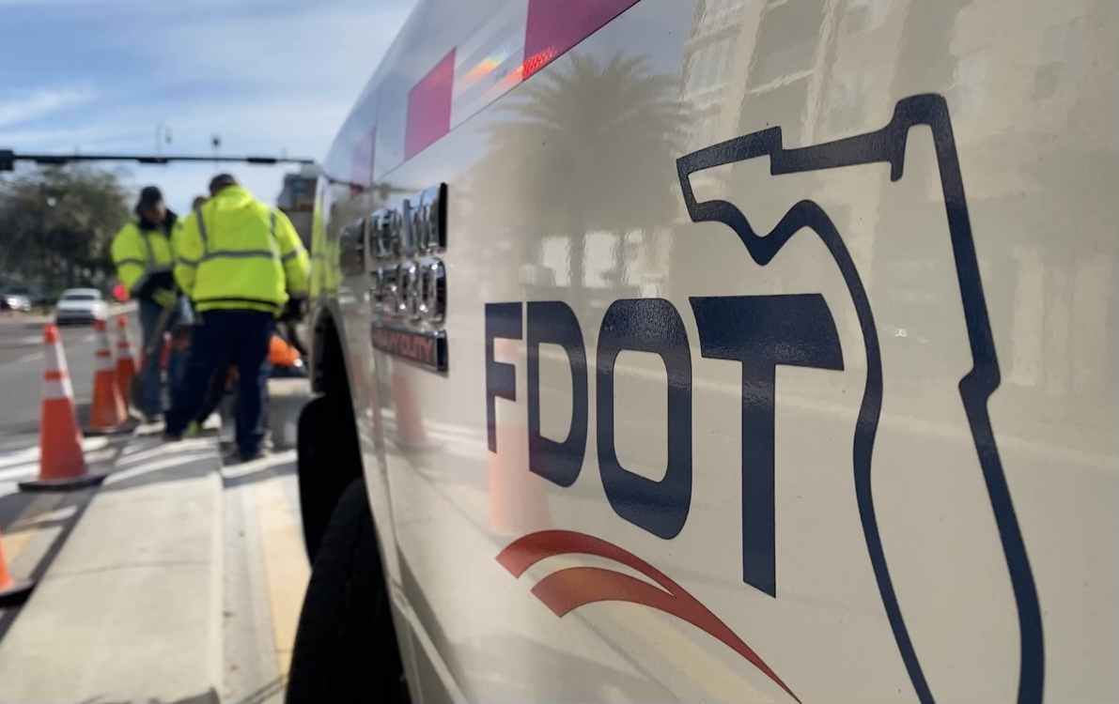
Who Are the System’s Players?
Notes:
Now that we’ve provided an overview of the Coordinated TD System, let’s examine the specific role and responsibilities of the Commission and our partners.

Slide 7
CTD Responsibilities
Independent state government agency, administratively housed within the Florida Department of Transportation (FDOT).
Consists of seven board members, appointed by the Governor, and eight (non-voting) advisors representing state agencies, including FDOT.
Administers the Transportation Disadvantaged Trust Fund and distributes funding through its grant programs.
Develops rules and policies governing the Coordinated System.
Approves and contracts with CTCs to support the delivery of TD services.
Designates the planning agency to implement program at local level, including staffing the Local Coordinating Boards.
Submits an annual performance report to the Governor and Legislature.
Notes:
The CTD is administratively housed within the Florida Dept of Transportation, but functions as an independent state agency that reports directly to the Governor. Currently, the Commission board is made up of seven voting members (all appointed by the Governor): five that represent the business community, two members with a disability who use the system, and at least one member who is 65 years of age or older. The board also consists of eight ex-officio (non-voting) advisors representing seven state agencies (including FDOT) and one local government (appointed by the Governor). The board meets at least four times a year and approves policies, reports, and the designation of entities responsible for delivering the TD services around the state. The Commission appoints and supervises the Executive Director and has a full-time staff of 13 individuals in Tallahassee.
The Commission administers the TD Trust Fund and distributes the funding each year appropriated by the Legislature through its grant programs (discussed further in the next two slides). The Commission implements its statutes under Rule 41-2, FAC, and develops policies that assist with the coordination of TD services. The CTD contracts with the CTCs and Planning Agencies and reviews/monitors activities funded under its grant programs. This includes “non-sponsored” trips funded under the TD Trust Fund (reported on a CTC’s invoice), the development of the TD Service Plan under the Planning Grant. Each year, CTCs are required to submit an Annual Operating Report (AOR) on trips and other operating data, which are then compiled within the Commission’s Annual Performance Report to the Governor and Legislature on January 1st.

Slide 8
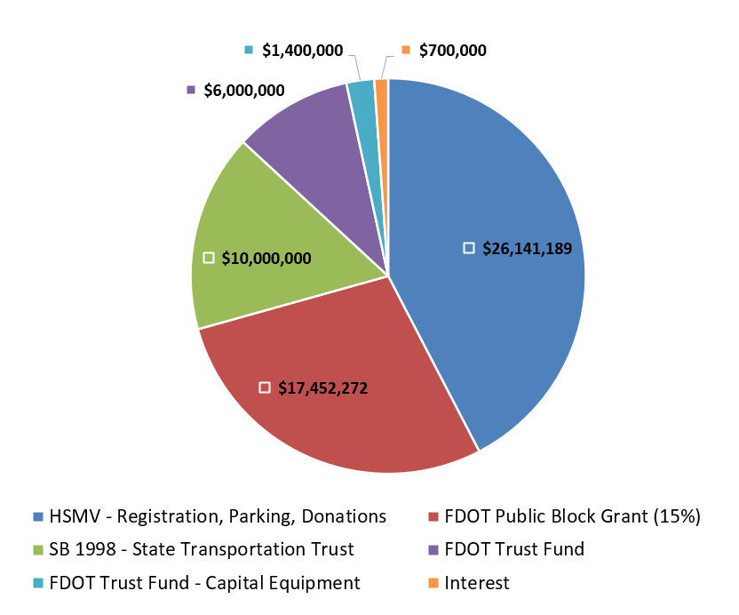
Transportation Disadvantaged Trust Fund Revenues FY23-24 $61,693,461
Notes:
The TD Trust Fund is established in Chapter 427.0159, FS, and consists entirely of state revenues (i.e., no federal dollars). The largest share of revenue comes from the $1.50 when Florida residents renew their vehicle registration. FDOT contributes 15% of its block grant to the TD Trust Fund as well as transfers $1.4 million each year to support the purchase of capital equipment (discussed on the next slide).

Slide 9
CTD Grant Programs
Trip & Equipment Grant – Annually allocates funding to 67 counties for CTCs to purchase trips, bus passes, and capital equipment.
Legislature appropriated $53 million for State Fiscal Year (FY) 2023-24
Planning Grant – Annually allocates approximately $1.8 million to support planning activities for local TD programs.
“Shirley Conroy” Rural Area Capital Assistance Grant – Competitive funding for CTCs to purchase capital equipment for TD services.
FDOT transfers $1.4 million each year for CTD to award funding.
Innovative Service Development Grant – Competitive funding for CTCs to test new services that increase access for TD riders, enhance cross-county mobility, or reduce barriers to fixed-route system.
CTD awarded $4.9 million for 12 projects for FY 2023-24
Notes:
Each year, the Commission receives legislative budget authority (through the General Appropriations Act) to distribute TD Trust Fund dollars through its four grant programs. The Trip & Equipment (T&E) Grant is a formula-based program that allocates funding to all 67 counties to deliver TD “non-sponsored” services for the state fiscal year (July 1 – June 30). After funding is allocated and grant agreements are executed for the fiscal year, the CTC will submit a monthly invoice of services rendered under the T&E Grant, which are then reimbursed after the Commission approves the invoice. Funding that is not spent by the end of the fiscal year are reverted to the TD Trust Fund and re-appropriated for a future year. The Planning Grant supports the activities performed by the Designated Official Planning Agencies of the TD program, including facilitating the quarterly LCB meetings and developing the TD Service Plan. The “Shirley Conroy” Grant is a competitive program for CTCs to purchase capital equipment (e.g., vehicles, technology) in service to the TD population. FDOT transfers $1.4 million for the Shirley Conroy Grant and has a representative on the review subcommittee that recommends projects for approval each year. And the Innovative Service Development (ISD) Grant is a competitive program for CTCs to test new services that accomplish one of three goals: 1) increase access to TD services (such as targeting an underserved population or expanding service hours) not provided under the T&E Grant; 2) expand cross-county or regional mobility options; and/or 3) reduce barriers to access the fixed route system (if available). The ISD Grant is the newest program and has evolved over the years with different levels of funding: this year, the Commission awarded $4.9 million for 12 projects.

Slide 10
Planning Agency Responsibilities
May be an MPO, regional planning council, or other local organization performing planning activities for a service area.
Assists the CTC and LCB to implement local TD program.
Staffs and appoints members to the LCB.
Facilitates the procurement of the CTC and recommends approval by the CTD.
Works with CTC and LCB in developing the TD Service Plan.
Reviews the CTC’s Annual Operating Report and submits to the LCB each year.
Notes:
The Commission designates and contracts with planning agencies to help administer the TD program at the local level. The planner assists the CTC and LCB in developing the TD Service Plan, which identifies the needs of the service area. It also facilitates a procurement process to recommend an entity to serve as the CTC for the designated service area.

Slide 11
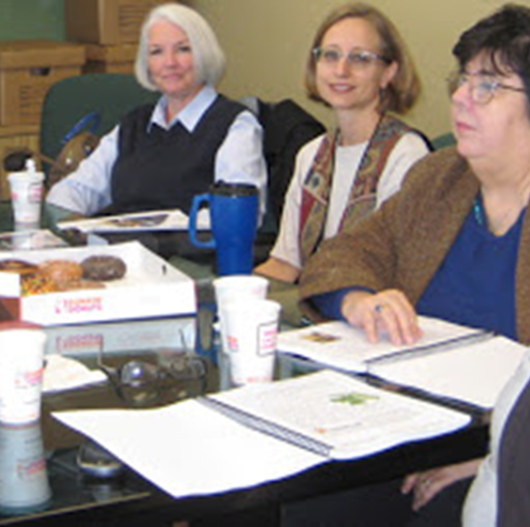
LCB Responsibilities
Represents local stakeholders of the TD program, including:
Local elected officials (LCB Chair)
Purchasing agencies (FDOT, Agency for Persons with Disabilities, etc.)
Transportation provider organizations
Rider advocates
Assists in establishing eligibility guidelines and trip priorities.
Assists CTC and Planner with developing the TD Service Plan.
Evaluates the performance of the CTC.
Appoints a grievance committee.
Notes:
The Local Coordinating Board serves in an advisory capacity to the CTC and Commission. The board members are made up of stakeholders impacted by the program, including advocates and their families, state agencies, and transportation service organizations. The LCB is chaired by a local elected official.

Slide 12
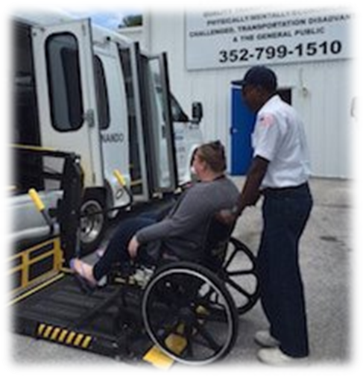
CTC Responsibilities
May be a transit agency, non-profit organization, for-profit company, or local governmental entity.
Provides and/or contracts with transportation companies to deliver trips to TD customers in county or multi-county area.
Determines rider eligibility based on state and local guidelines.
Invoices agencies for trips “purchased” for TD customers.
Assists LCB in developing the TD Service Plan.
Submits performance data to the CTD, compiled within the Annual Operating Report (AOR).
Notes:
The CTC arranges transportation services to the TD population in its designated service (county or multi-county) area. It could be a transit agency, county government, not-for-profit or private company. The CTC can provide direct services or contract with transportation operators to deliver the services. The CTC is reimbursed by the Commission for the delivery of “non-sponsored” trips funded under the TD Trust Fund.

Slide 13
Partnering Agencies
State agencies that serve as advisors to the CTD and voting members to the LCB, including:
FDOT
Agency for Persons with Disabilities (APD)
Agency for Health Care Administration (Medicaid)
Department of Elder Affairs (DOEA)
Purchase trips or support the transportation operations that serve segments of the TD population.
Assist communities in designing transportation systems that meet the needs of TD customers.
Ensure their rules, procedures and guidelines are supportive of the TD population.
Notes:
The Commission also works with state and local governmental entities to purchase transportation for their clients through the Coordinated System.

Slide 14
Data on TD Program
Notes:
We will now discuss some of the performance reported through the Coordinated TD System.

Slide 15
Coordinated Transportation Services in FY22-23 (AOR)
Ridership – Approximately 11.6 million trips were provided to nearly 193,000 riders within the TD population.
Trips by Purpose – 4 million (35%) of all reported trips supported life-sustaining activities and 2.5 million (22%) trips supported medical activities.
Trips by Service Type – 6.6 million (57%) of all reported trips were delivered by the fixed-route system and the remaining 5 million (43%) were paratransit trips.
203,814 of reported trips were delivered by Taxicab or Transportation Network Companies (TNCs), such as Uber and Lyft.
Notes:
This data represents a macro-level view of all coordinated transportation services for the TD population.

Slide 16
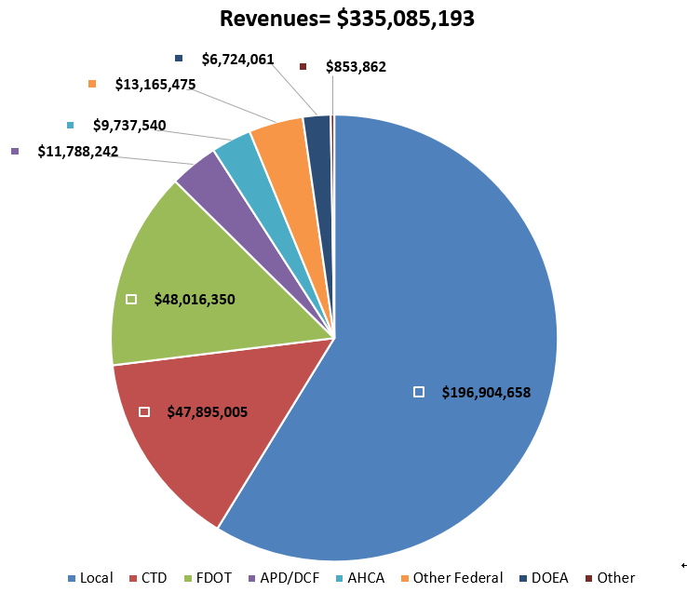
Coordinated System Reported Revenues FY22-23
Notes:
This chart represents the reported revenues to the Coordinated System. Note that the largest funder is local government (58.8%).

Slide 17
Statewide TD “Non-Sponsored” Paratransit Trips
Notes:
Drilling down into the programmatic level, this chart represents the total trips that were funded under the TD Trust Fund for the last four years.

Slide 18
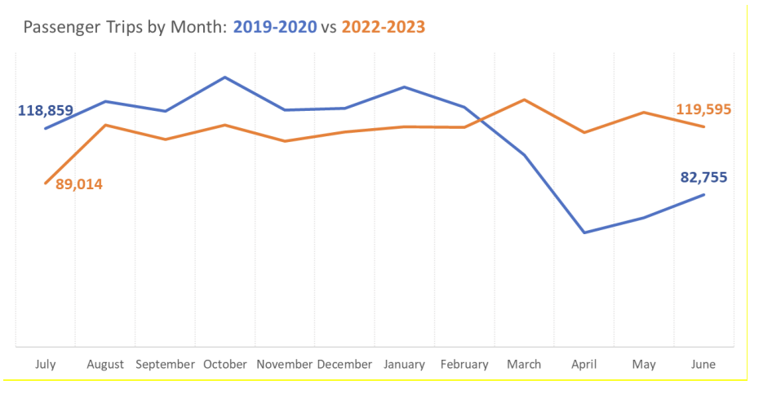
Before and After COVID-19 Pandemic
Notes:
The impact of the COVID-19 pandemic began in March 2020, where the state experienced a substantial decrease in paratransit services. Over the next three years, the services gradually increased and reached their pre-COVID levels by FY 2022-23.

Slide 19
What Can You Do?
Notes:
In conclusion, we would like to share about some upcoming events for 2024 and ways you can get involved to support the Transportation Disadvantaged program.

Slide 20
CTD Priorities & Events for 2024
Fill all vacant seats on Commission board
Develop Five-Year Transportation Disadvantaged Plan (s. 427.013(15), FS), solicit stakeholder input throughout process
Improve accuracy and analyses of performance data reported to CTD, Governor, Legislature, and stakeholders
Continue funding Innovative Service Development Grant program
Upcoming CTD meetings: March 20 (Polk County), June 5 (Tampa), Sept 23 (West Palm Beach), and Dec 11 (Virtual)
Annual Training Conference and Expo – Sept 23-25, 2024 (West Palm Beach)
Notes:
The Commission board meets at least on a quarterly basis. Our next meeting will be in Polk County on March 20. The Commission will also co-host a two-day workshop with the Florida Public Transportation Association (FPTA), where stakeholders can acquire training and learn about best practices within the field. This year’s workshop will be held in West Palm Beach, September 23-25. We hope to have new board members appointed by this event. In addition to these events, the Commission will hold business meetings and training workshops throughout the year – please visit our website (provided on the following slide) for more details about these events.
We’d also like to highlight some initiatives for the next year. For the 2024 Florida Session, we are requesting an increase of $5 million in legislative budget authority to continue funding ($4 million) for our Innovative Service Development Grant as well as modest increases to our other grant programs. One of our top priorities is to develop the five-year Transportation Disadvantaged Plan that is required in our statute. We are in the search for a vendor that can assist us in developing the plan and facilitating discussions with stakeholders throughout the year. We look forward to partnering with our state and county partners on this important initiative. In addition to the five-year plan, the Commission is currently examining ways to improve our data reporting and analyses of coordinated TD services within the AOR. Finally, we will be examining ways to streamline and improve our quality assurance review process of CTCs and Planning Agencies.

Slide 21
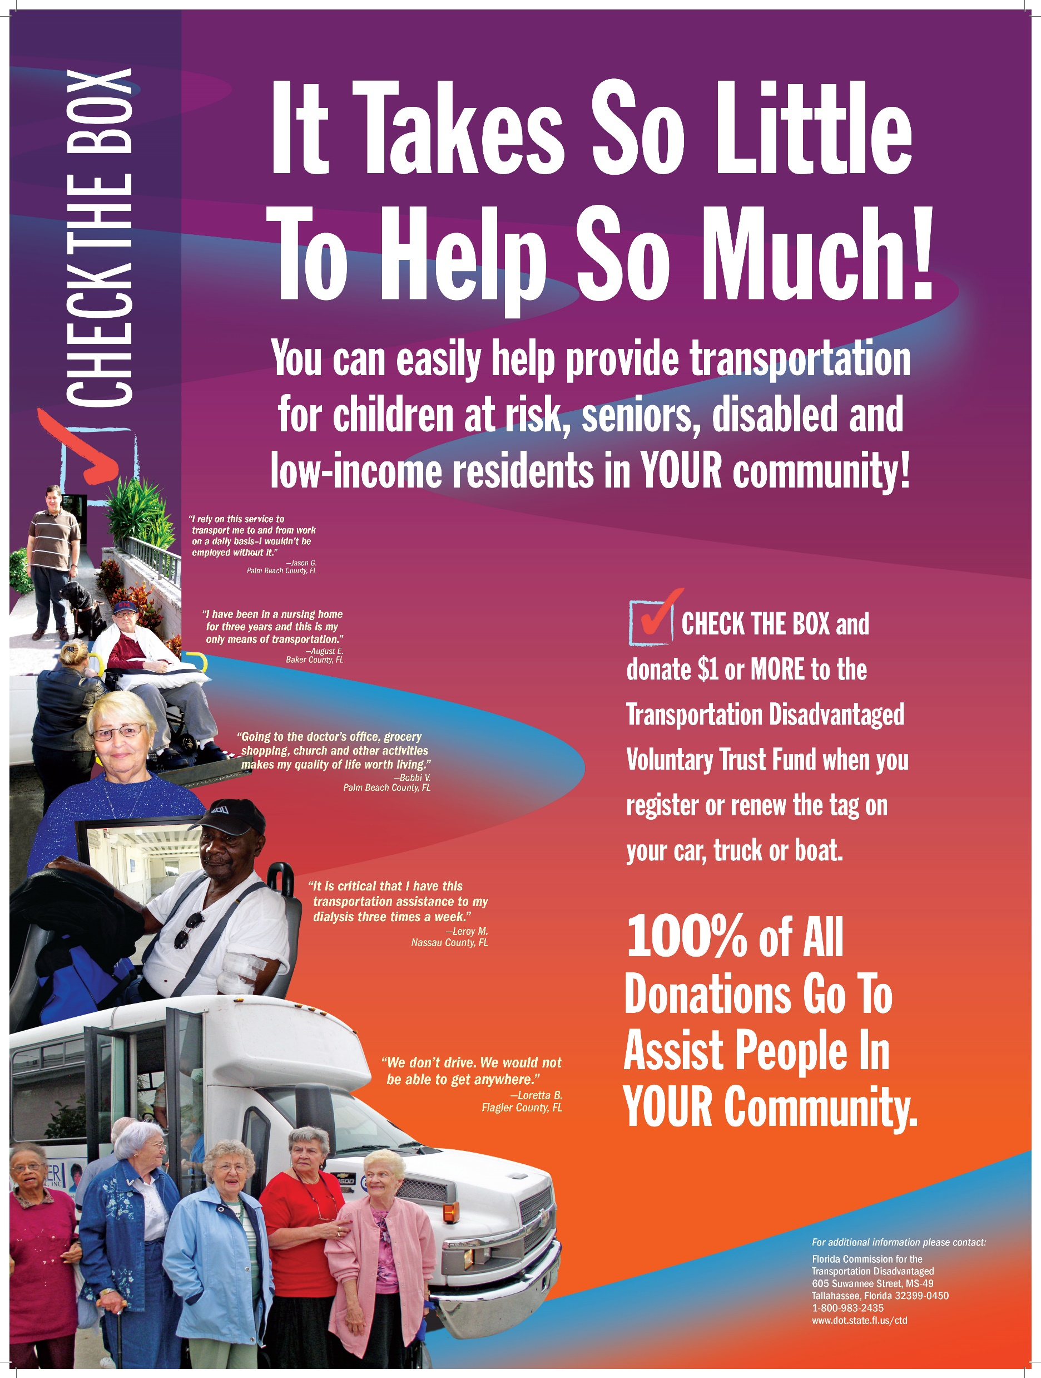
How You Can Serve Our Customers
Be a voice for riders and your community on the LCB.
Donate a dollar or more to the TD Trust Fund when renewing your auto tags.
Inform elected officials and other local leaders about the importance of the TD program.
Work with CTC and other partners to identify areas of need in the community.
Notes:
For those who are interested in learning more about our program, we encourage you to attend our business meetings held around the state as well as our Local Coordinating Board meetings. In addition to the contribution made by renewing your vehicle registration, you can also donate an additional dollar or more to the TD Trust Fund, which will go directly to the county’s TD program. We encourage you to communicate with your CTC and Planner to identify other areas where there is need for greater coordination. To learn more about our program, you can visit our website or contact our office (as provided on this slide).

Slide 22
For More Info…
Visit CTD website at: Florida Commission for the Transportation Disadvantaged - Home (fdot.gov)
Or contact David Darm, CTD Executive Director, at: (850) 688-2953 or David.Darm@dot.state.fl.us
Notes:
Thank you

