Slide 1
MANDATORY PRE-BID MEETING
June 15, 2009
Florida Department of Transportation
District 7 Auditorium
9:00 am

Slide 2
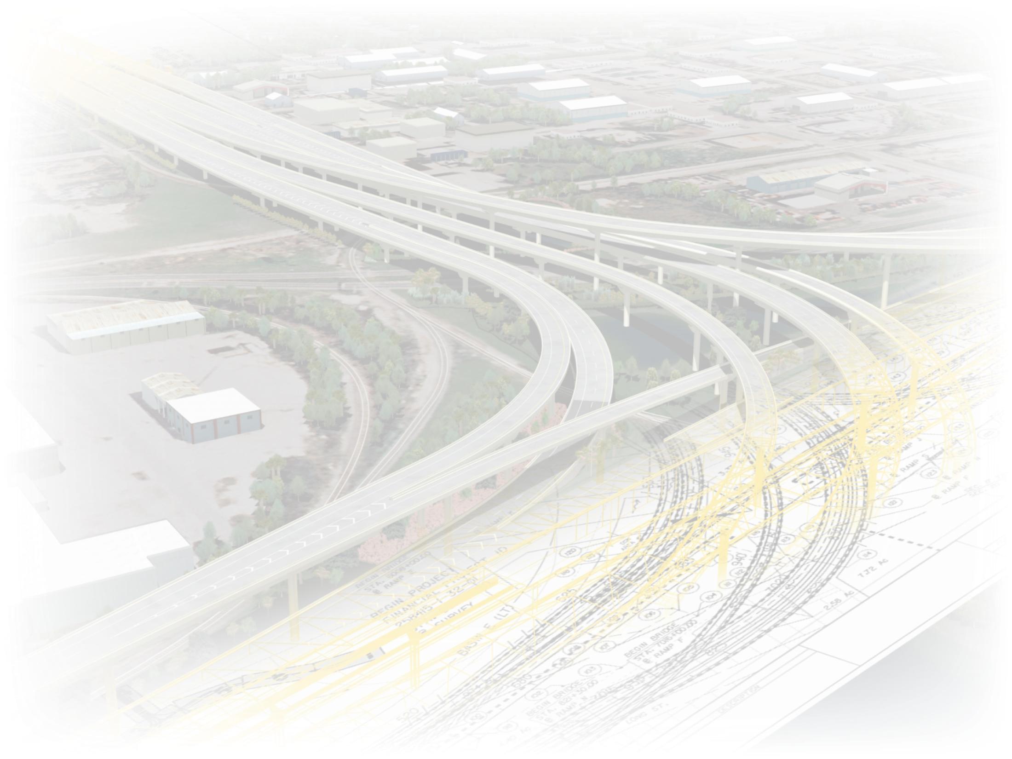
Opening Remarks
Welcome
Goals
Overview of Today’s Meeting
Project Description
FDOT Hierarchy
Key Stakeholders
Funding
Introduction to Project Details (EOR’s)
Notes:
Good morning. Welcome. My name is Conrad Campbell and on behalf of the Department and District Seven I would like to thank you for your interest in this key and monumental project in District Seven.
You are aware of the comments that were made at our Industry Forum held in May.
This project is one of two of it’s kind, and is key in fulfilling our commitment to the Federal Government and to the citizens of Florida when it comes to our use of ARRA (stimulus) funds.
To that end, our goals for this meeting are simple. This morning we intend to disseminate information about this complex project in order to help our contractor submit accurate bids. Ultimately we expect to successfully let and award this project come September 16, 2009.
You can see from the slide on the screen I have a few opening remarks and pieces of information and then I intend to hand-off the Funding/Financing portion of the presentation to Scott Collister, our Director of Transportation Development. After Director Collister gives his portion of the presentation I will introduce the Engineer’s of Record who, along with their staff, will be sharing the project details with us. After they present Richard Frank, our interstate construction project manager, will be discussing several other key topics.
I will wrap up the meeting with some brief comments about bid questions and opening the floor for your comments.
In order to keep everything moving, I will ask that you keep all of your questions until the end of the presentation.
There is a volume of information that will be presented at this meeting today – it is important that you get an overview of the project and its key features, the PowerPoint presentation will be available for download from the Contracts Administration internet website.
Also the meeting is being recorded today and a transcript will be provided to all in attendance.

Slide 3
Welcome
Pre-Bid Meeting Goals
House Keeping
Proposal forms (bid packages) will be issued only to attendees of the mandatory pre-bid conference.
Introductions
Questions & Answers – Please hold until the end.
Notes:
3
As a reminder, please be absolutely sure you have signed in. The sign-in sheet will be transmitted to Tallahassee this afternoon and bid packages will be issued only to attendees of this mandatory pre-bid conference.
Introductions – Name and Firm you are representing.
Thank you.
Once again please save your questions until the Q&A time at the end.

Slide 4
Project Description
Financial Project Numbers
25841515201 (*) Lead FIN
25841525201
25841535201
25841515601 Utilities (UHWCA)
25841515602 Utilities (UHWCA)
25841525601 Utilities (UHWCA)
25841525602 Utilities (UHWCA)
A + B
Letting Date: 09/16/09
Max Number of Days: 1713
Acquisition Time: 120 DAYS
Notes:
There are several project numbers that comprise this project. The ‘Lead’ project number is the dash one project and there are several utility components to this project also.
This is an A+B project with a maximum number of days being 1713 days.

Slide 5
Project Description
Maximum Budget Specification
For the purpose of bidding, the Department has established a maximum budget of $446,192,015.…For this contract, the Department will reject as non-responsive any bid in which the contractor submits a bid in excess of the maximum budget amount shown above.
Concerns regarding the Department's maximum budget arise, submit a letter of budget concern to Scott Collister, P.E., CPCM, Director of Transportation Development, District Seven, Florida DOT, Fax Number (813) 975-4853 by 8/3/2009.
Notes:
This project along with several others we have been letting recently has a ‘Maximum Budget’ specification as part of the contract.
This limiting amount is $446,192,015 – all bids over this amount will be rejected and if there are concerns regarding the amount, these should be directed to Scott Collister (his information is provided in on the slide and bid solicitation notice).

Slide 6
FDOT Hierarchy
Don Skelton, PE
District Secretary
Organization
Jim Moulton PE
Director of Transportation Operations
Scott Collister PE
Director of Transportation Development
Brian McKishnie PE District Construction Engineer
Margaret Smith PE
District Consultant Project Management Engineer
Patrick Stanford PE
Resident Engineer
CCEI/Interstate Construction
Adam Perez PE
Interstate Program Manager
Richard Frank
Interstate Construction
Project Manager
Engineers Of Record
Project CCEI
Notes:
This slide is just a brief overview of some of the key personnel within District Seven, some of whom will be presenting today.

Slide 7
Key Stakeholders
Other Agencies/Entities
FDOT (Turnpike)
FHWA
THEA
City of Tampa
Hillsborough County
Port of Tampa
Local Communities & Businesses
Palmetto Beach
Ybor City
Notes:
This project touches many local entities, not to mention two DOT districts (D7 and the Turnpike). Needless to say a significant amount of coordination has occurred between the Department and these entities already – you’ll see from subsequent presentations today – but also coordination will have to continue to occur to insure our key stake holders are not impacted negatively.
***Spot for the Port of Tampa

Slide 8
Funding
Project Financial Plan, including at a minimum:
All financial elements to finance the project as proposed.
Provision for all project costs.
Project Sources and Uses of Funds.
Audited Financial Statements for the most recent two (2) fiscal years. Required financial statements shall include:
Opinion Letter (Auditor’s Report)
Balance Sheet
Income Statement
Statement of Changes in Cash Flow
Footnotes
If financial statements are not prepared in accordance with U.S. Generally Accepted Accounting Principles (GAAP)
A letter from a CPA must be included to address how conversion to GAAP would be impacted.

Slide 9
Funding
If audited financials are not available,
Provide unaudited financial statements prepared in accordance with GAAP, certified as true, correct and complete by the Chief Financial Officer.
Interim Financial Statements must be submitted for each party of the Build-Finance Team providing financial support to the project.
Prepared in accordance with GAAP and certified by the entity’s Chief Financial Officer for the period since the last Audited Financial Statement.
Interim Financial Statements through the most recent completed fiscal quarter should be provided.
Letter of Commitment or Credit from Financial Institution.
If using debt financing as a source of funds or guarantee, a preliminary Letter of Commitment or Credit from the financial institution, must be submitted as part of the Financial Proposal
Final Letter of Commitment or Credit/Statement of No Change or updated firm commitment letter submitted prior to award of contract.
The Letter of Commitment or Credit should be specific to the project and meet the amount required as identified in the Project Financial Plan.

Slide 10
Funding
Chief Financial Officer Attestation
Required for accuracy and completeness of all financial information.
Ownership and Organizational structure
Required of all project entities, including financial relationships with other entities included or involved in project delivery.
Bonding company affidavit
Certifies contractor has the financial means and capacity to bond 100% payment and performance for the face amount of $250,000,000 for the project.
As appropriate
Any and all financial warranties, bonds, sureties, certifications and other commitments for the financial security of the project.

Slide 11
Funding
Cash Availability Schedule
Project Number: 258415-1-52
Fiscal Year | July 1 | October 1 | January 1 | April 1 | Total
2009 | $0 | $0 | $0 | $0 | $0
2010 | $91,380,329 | $0 | $0 | $0 | $91,380,329
2011 | $0 | $0 | $0 | $0 | $0
2012 | $0 | $0 | $0 | $0 | $0
2013 | $80,000,001 | $137,513 | $1,673,611 | $4,992,191 | $86,803,316
2014 | $8,175,854 | $11,315,499 | $15,348,747 | $18,000,089 | $52,840,189
2015 | $19,582,298 | $21,881,937 | $23,096,191 | $22,024,368 | $86,584,794
2016 | $21,225,113 | $20,068,409 | $17,673,127 | $14,517,948 | $73,484,597
2017 | $12,862,606 | $10,081,074 | $7,519,252 | $9,650,466 | $40,113,398
2018 | $3,236,978 | $2,095,439 | $1,285,115 | $3,353,932 | $9,971,464
Total | $236,463,179 | $65,579,871 | $66,596,043 | $72,538,994 | $441,178,087

Slide 12
Funding
Cash Availability Schedule
Project Number: 258415-1-56
Fiscal Year | July 1 | October 1 | January 1 | April 1 | Total
2009 | $0 | $0 | $0 | $0 | $0
2010 | $0 | $0 | $0 | $0 | $0
2011 | $0 | $0 | $0 | $0 | $0
2012 | $0 | $0 | $0 | $0 | $0
2013 | $0 | $4,072 | $49,561 | $147,836 | $201,469
2014 | $242,124 | $332,684 | $425,171 | $445,379 | $1,445,358
2015 | $436,271 | $450,654 | $431,685 | $387,907 | $1,706,517
2016 | $369,639 | $326,796 | $267,101 | $199,656 | $1,163,192
2017 | $161,464 | $104,528 | $64,106 | $167,294 | $497,392
2018 | $0 | $0 | $0 | $0 | $0
Total | $1,209,498 | $1,218,734 | $1,237,624 | $1,348,072 | $5,013,928

Slide 13
Project Details
Overview
Engineer of Record
Robert Szatynski, PE FPID: 258415-2
Joe Garrity, PE FPID: 258415-1 and 258415-3

Slide 14
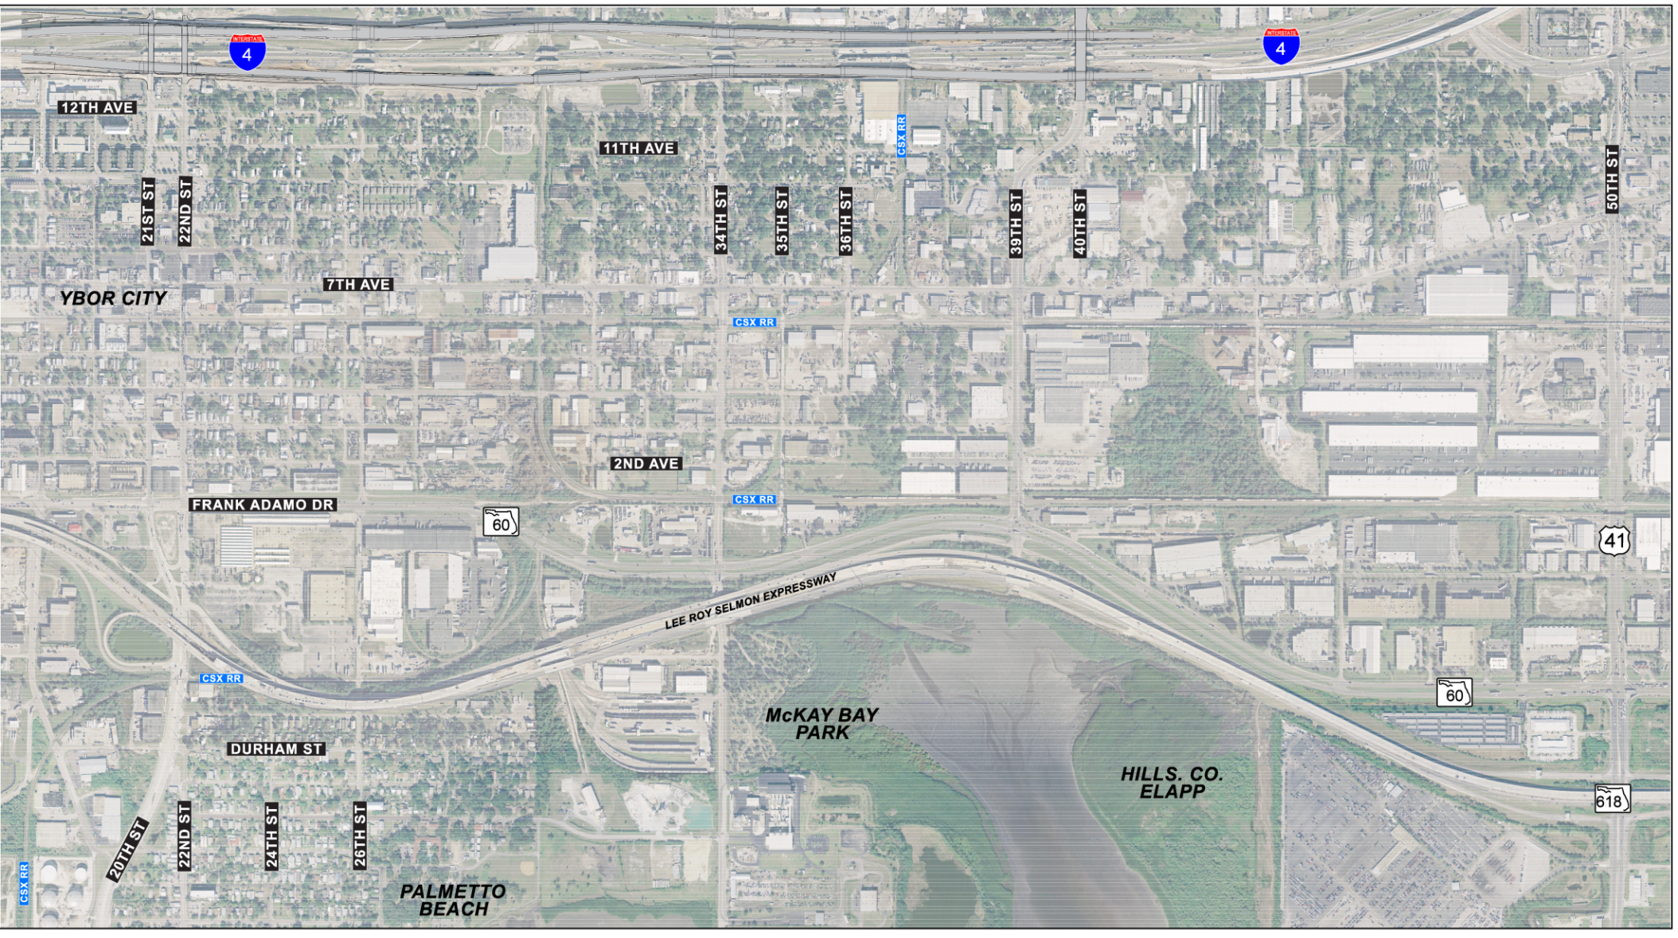
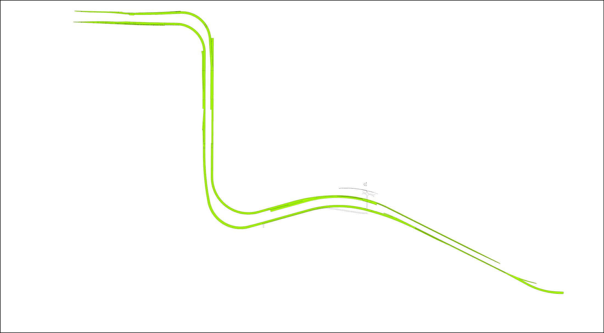
Project Details
Primary Movements
“S” Movement
“Z” Movement
“T” Movement

Slide 15
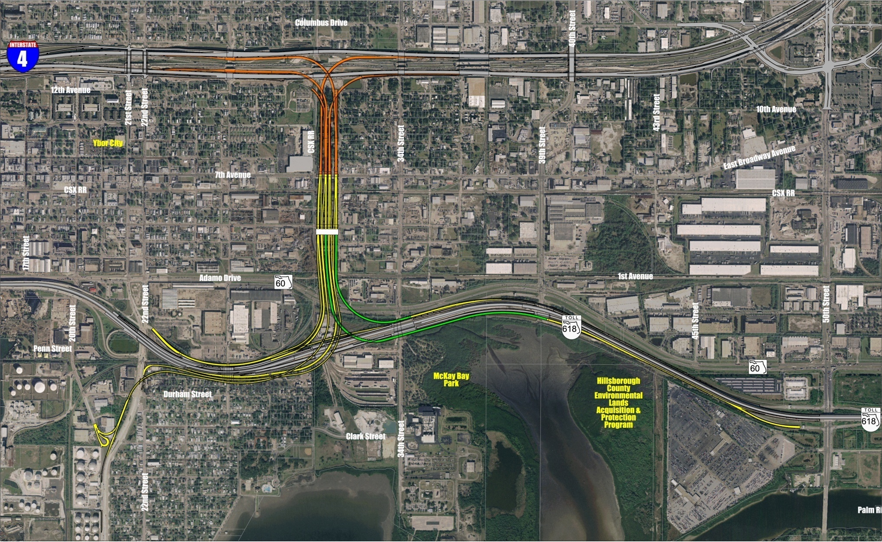
Project Details
Overview of FPID Packages
Toll Gantry
FPID: 258415-1
FPID: 258415-2
FPID: 258415-3

Slide 16
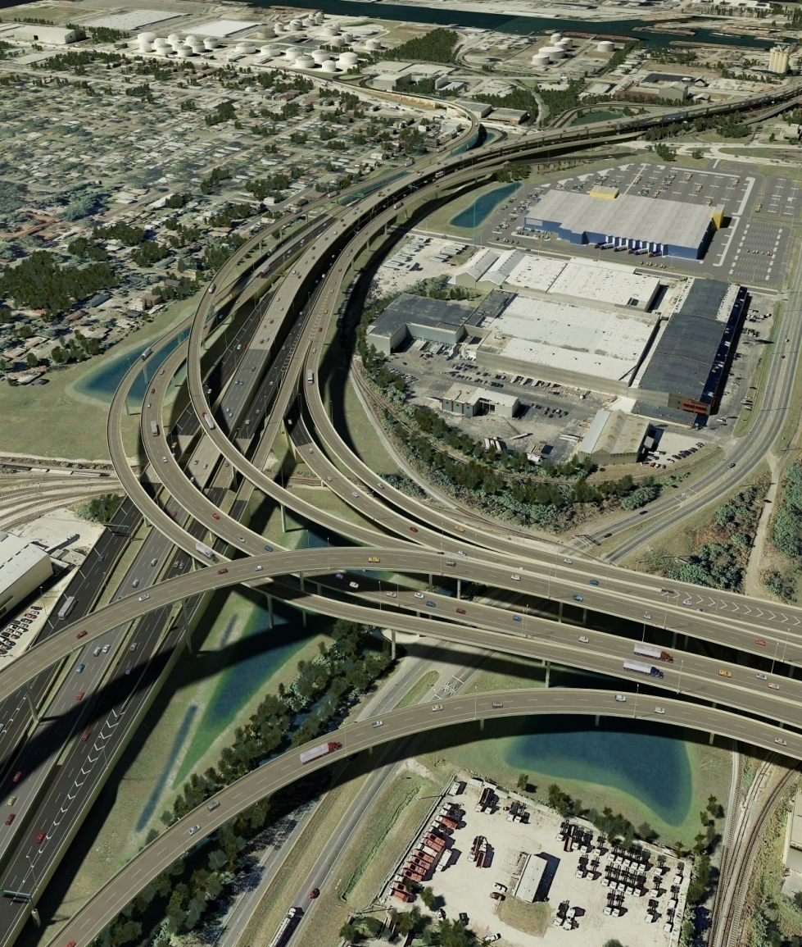
Project Details
Overview of FPID Packages
Core Project
Bid Alternatives
Construction Highlights
Toll Gantry
Deck Panel Replacement
Hazardous Materials
Utilities
CSX Coordination
Aesthetics
Traffic Control Phasing

Slide 17
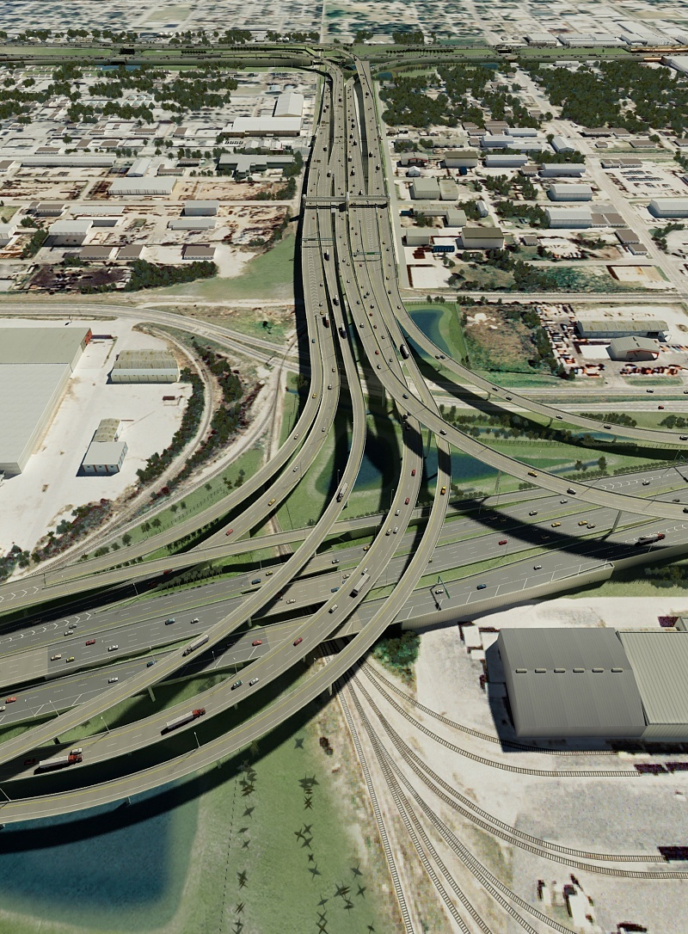
Project Details
Core Project
Architecture Plans
Signing
Signals
ITS
Landscape Plans
McKay Bay Bridge
Deck Panel Bridges
I-4 over 26th Street Bridges
Notes:
17

Slide 18
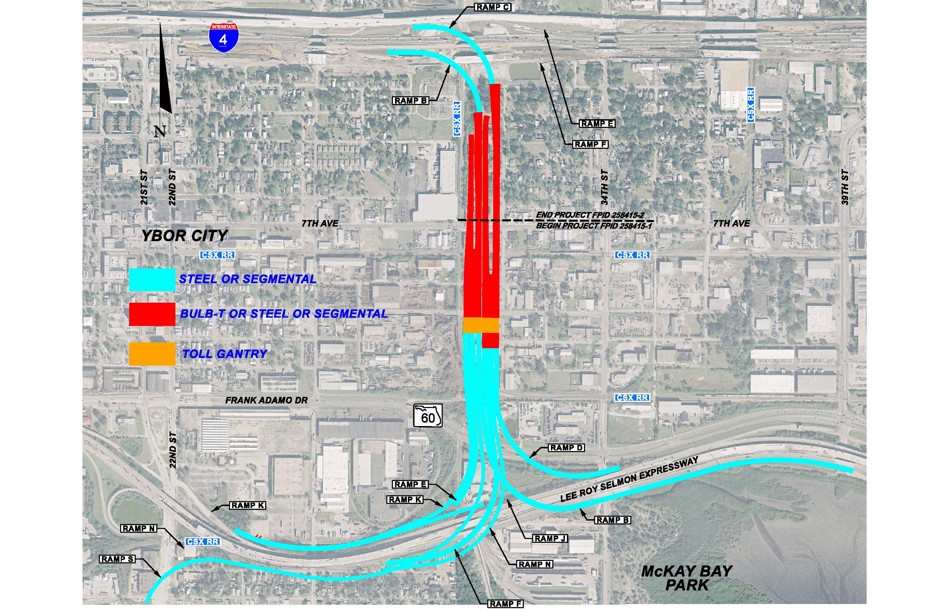
Project Details
Bid Alternatives
Bid Alternative 1: Core + AA1 Steel Girder Bridges
Bid Alternative 2: Core + AA2 Segmental Concrete Bridges
Bid Alternative 3: Core + AA3 Steel Girder Bridges with Bulb T Alternate
Bid Alternative 4: Core + AA4 Segmental Concrete Bridges with Bulb T Alternate
Notes:
18

Slide 19
Project Details
Bid Alternatives
Notes:
19

Slide 20
Project Details
Factoids
19473 Drawings Were Needed to Produce The Four Bid Alternatives. Double that when you include the computation books and double it again when you include the geotechnical and structures calculation reports.
FDOT District 7’s Highest Profile Project and Highest Priority.
FDOT’s Standard Specification Book has 926 Pages. The Supplemental Specification for the Connector is 1446 pages.
Notes:
20

Slide 21
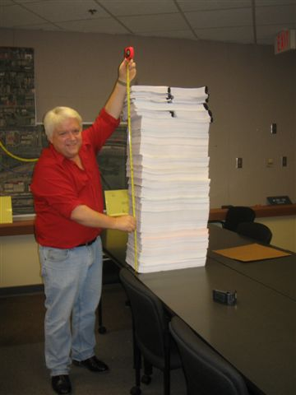
Project Details
Factoids
The Plans Single Stacked Measures 8 feet high. Double Sided (as shown) 4 feet High.
Notes:
21

Slide 22
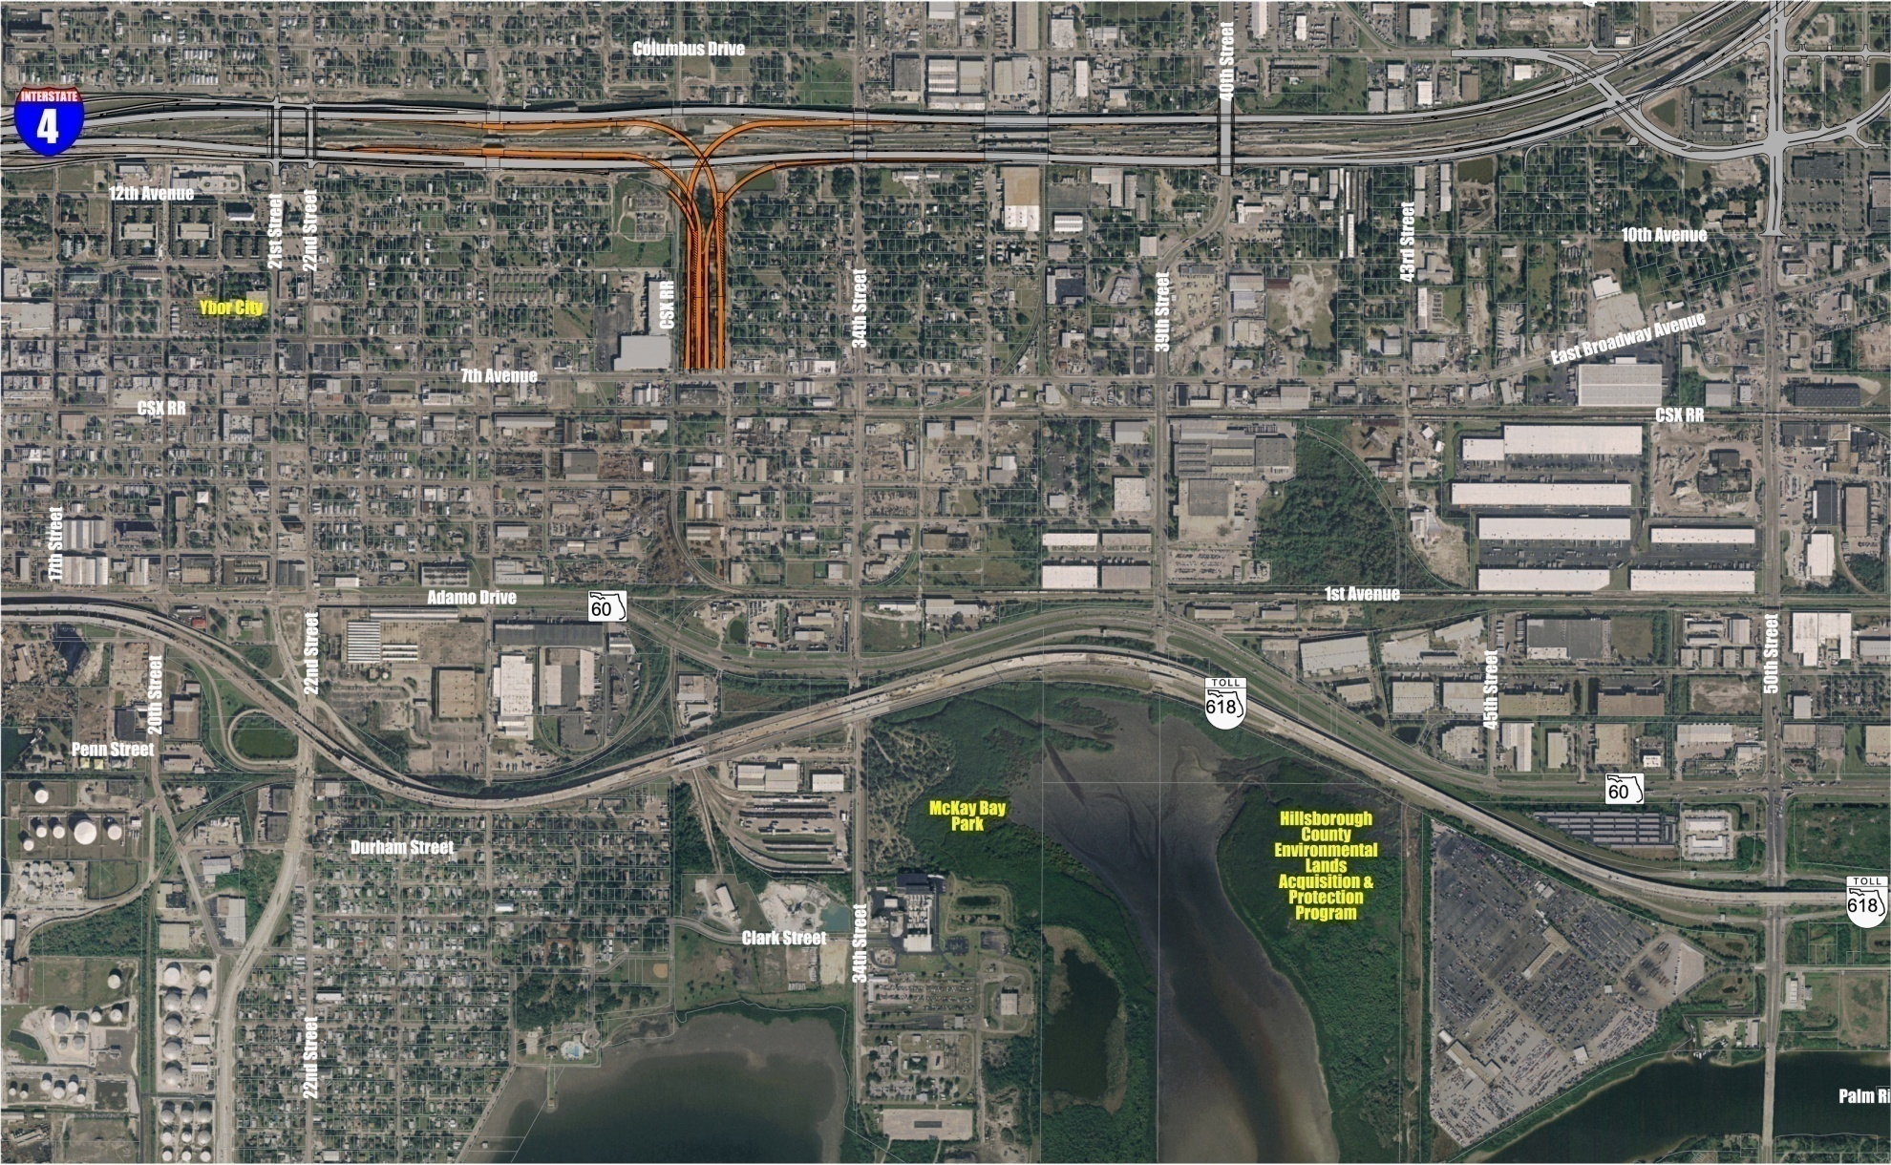
Project Details
Project Map 258415-2
FPID: 258415-2
Notes:
22

Slide 23
Project Details
Major Work Items (North Section)
Segmental Bridges
Steel Box Bridges
AASHTO Girder Bridges
Bulb T Bridges
MSE walls
Miscellaneous Structures
Drilled Shaft Foundation
Lighting
Signing and Marking
Landscaping
Drainage
TCP
Utilities
Notes:
23

Slide 24
Project Details
North Section (Major Design Issues)
Connections to I-4
Structural Challenges
Relocation of ITS
features
Sensitive Grading
Landscaping & Pond
Construction
Aesthetics and
Restoration
TCP & RR
Coordination etc. (combined with south section)
Notes:
24

Slide 25
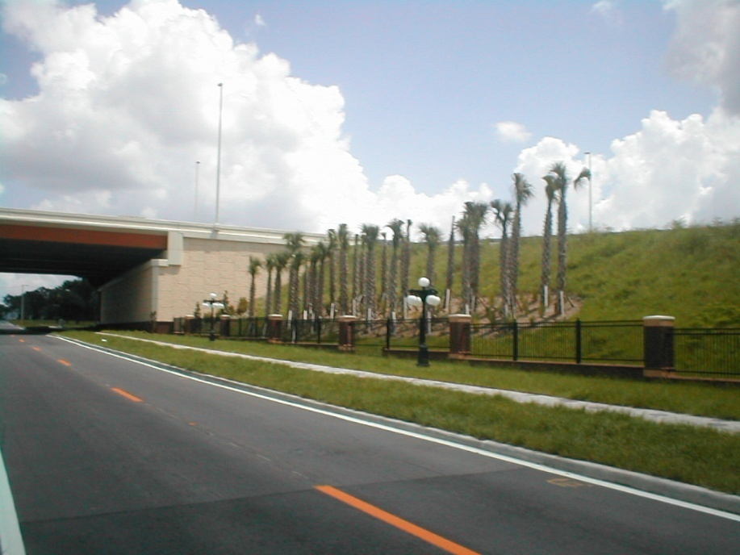
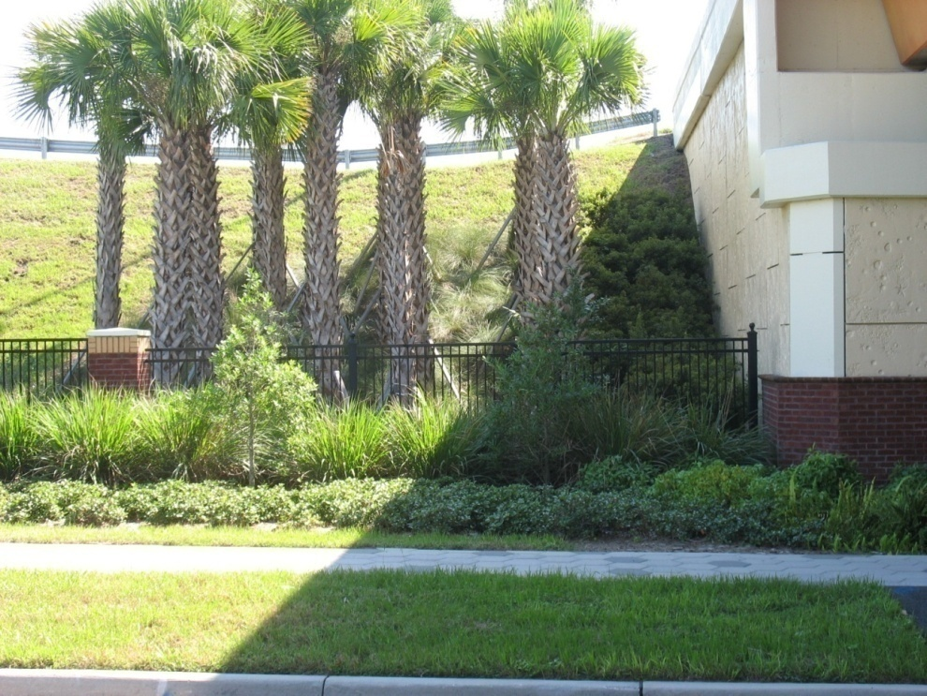
Project Details
Aesthetics and Restoration
Restore Landscape & Hardscape Elements @ 26th Street
Landscape Establishment Period
Notes:
25

Slide 26
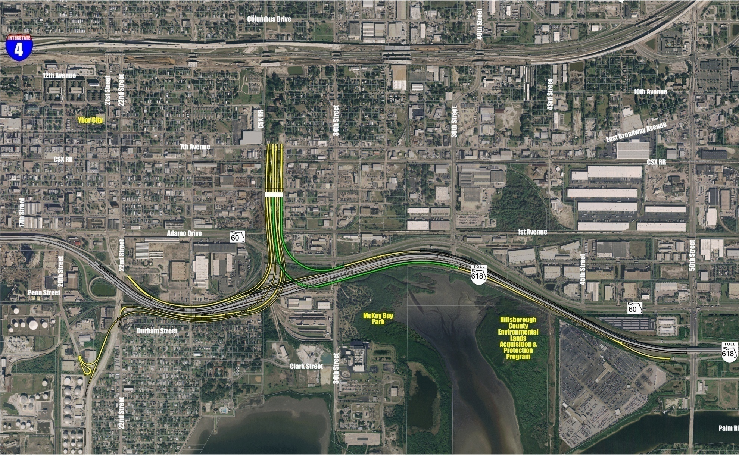
Project Details
Project Map 258415-1 and 258415-3
Toll Gantry
FPID: 258415-1
FPID: 258415-3

Slide 27
Project Details
Major Work Items (South Section)
Segmental Bridges
Steel Box Bridges
AASHTO Girder Bridges
Deck Panel Replacement
Bulb T Bridges
Pre-stressed Concrete Beam Bridge (34th Street)
AASHTO Girder / Steel Plate Mix (22nd Street Viaduct)
Bridge Widening (22nd Street Viaduct)
3 Concrete Box Culvert Extensions
Notes:
27

Slide 28
Project Details
Major Work Items (South Section)
Drilled Shafts
Major Sign Structures
Retaining Walls
Toll Gantry
Lighting
Signing and Marking
Signalization
ITS
Architecture
UWHCA – Water and Sewer
Notes:
28

Slide 29
Project Details
Major Work Items (South Section)
Retention Ponds
Channel Reconstruction
Extensive Storm Sewer
Roadway Embankment
Asphalt and Concrete Pavement
Slope Pavement
SR 618 Traffic Control
Temporary and Permanent Barrier Wall
Shared Use Path
Notes:
29

Slide 30
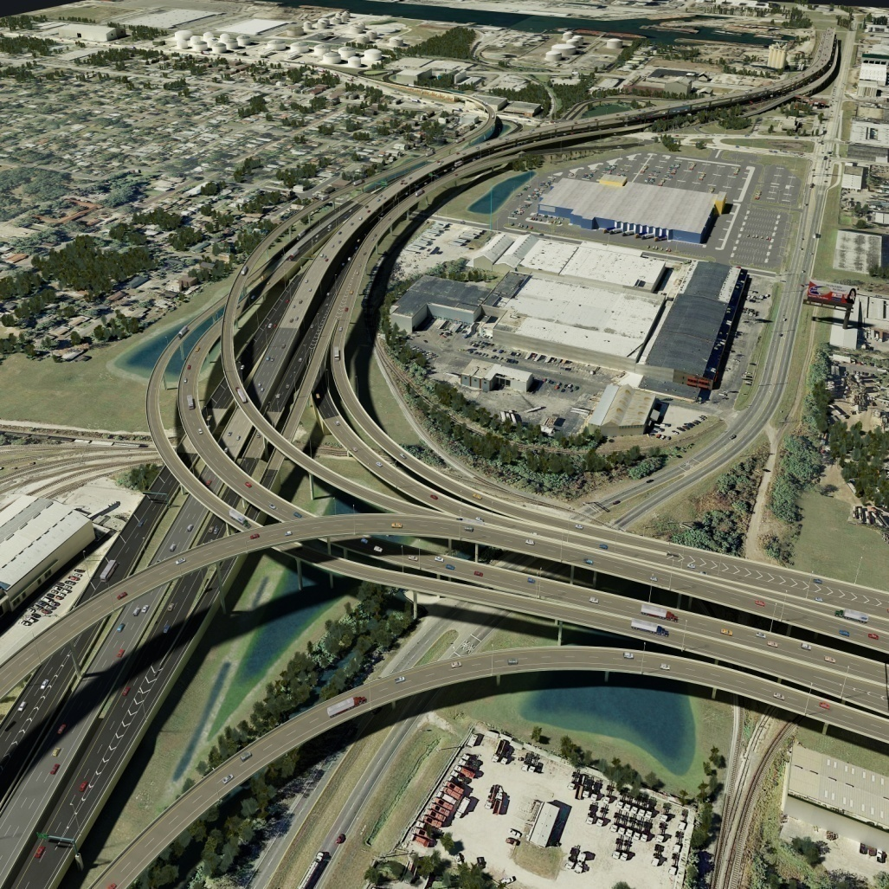
Project Details
Major Structure –Buy America Provisions
Consider domestic steel availability and required ordering lead times for all permanent steel products.
Notes:
30

Slide 31
Project Details
Major Structure – Aesthetic Treatments
Aesthetic requirements do not allow altering the bridge superstructure type for the steel box girder and segmental box girder bridges.
Notes:
31

Slide 32
Project Details
Major Structure – Steel Box Bridges
Completed units and partially completed units supported by piers and temporary towers have been analyzed and designed to provide adequate resistance for a design hurricane wind event. During the hurricane season, as determined by the national hurricane center, the contractor shall have all materials, labor and equipment available on site to install required temporary bracing (see scheme note 7) and to complete construction stages such that the falsework towers are not required to provide stability to the structural steel framework. Disengage all falsework towers 24 hours prior to a hurricane wind event striking the project area. after the national hurricane center issues an all clear, the contractor shall reinstall the falsework and jack girders to their proper elevation prior to installation of next stage.
Notes:
32

Slide 33
Project Details
Major Structure – Segmental Bridges
Bridges erected by balanced cantilever method have not been designed for span by span gantry loads.
Notes:
33

Slide 34
Project Details
Major Structures – South Section
Deck Panel Replacement Bridges:
Stay-in-Place forms are not allowed
Contractor must survey the elevations of the existing girders after the deck slab has been removed and calculate any elevation changes required.
Notes:
34

Slide 35
Project Details
22nd Street
Deck Panels
26th Street
34th Street
CSX RR
39th Street
Notes:
35

Slide 36
Project Details
Major Structure – Bulb T Bridges
Bulb-T bridges were not designed to carry any gantry loads for segmental construction.
Notes:
36

Slide 37
Project Details
Major Structure – Walls
Special care must be taken when installing and removing temporary walls in the median of S.R. 618. Buried temporary walls or other construction debris may be encountered. The Reversible Lanes remediation piers may be in close proximity.
Where sheet pile is to be installed within 20 feet of an existing mechanically stabilized earth (MSE) wall, sheet pile installation and removal shall be completed by non-vibratory equipment.
Notes:
37

Slide 38
Project Details
Major Structure – Geotechnical
There are restrictions on vibratory installation of drilled shaft casing adjacent to existing structures. These restrictions are located in the plan notes. For construction of drilled shafts located 9 feet or less (clear distance) from existing MSE walls, oscillation or other non-vibratory installation and removal of steel casing will be required. Vibration of steel casing is prohibited.
Certain existing structures will require pre- and post-condition surveys, settlement monitoring, and vibration monitoring.
The Contractor shall ensure drilled shaft operations do not affect the performance of nearby critical temporary walls.
Notes:
38

Slide 39
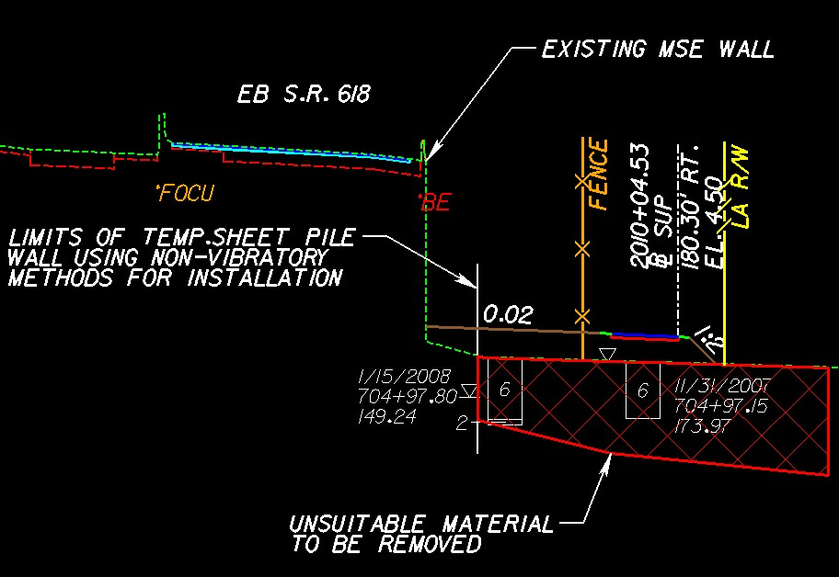
Project Details
Major Structure – Muck Excavation
Notes:
39

Slide 40
Project Details
Roadway
For the Deck Panel Replacement Bridges, the existing 7 inch deck surface will be replaced with a 8 ½” deck thickness to meet Current Standards.
Concrete Pavement within the Toll Gantry Walled Section utilizes a Fiber-Reinforced Concrete Pavement with the Asphalt Base Option. Loop Detectors will be installed in the pavement for the Toll Gantry through coordination with FTE.
Special sleeper (moment) slab designs have been proposed for the roadways with concrete shoulders adjacent to MSE walls.
Notes:
40

Slide 41
Project Details
Drainage
All the proposed and existing ponds can be used for de-watering and flood control purposes. However, this does not alleviate the contractor of the conditions of the Environmental Resource Permits.
The Contractor must ensure all the downstream pipes have been de-silted in order to have smooth flow of storm water to the outfall.
Drainage is significantly different for all four options largely due to pier placement differences and differences in where pipes exit the pier column or footer.
Notes:
41

Slide 42
Project Details
Drainage
There are differences in inlet pan depths and configuration between the alternatives due to structural considerations.
A special design has been developed for pipes entering and exiting the Toll Gantry earth area between 3rd and 4th Avenues due to the expected wall settlement.
Any existing ponds to remain that are disturbed by construction activities will require being returned to their preconstruction state.
Notes:
42

Slide 43
Project Details
CSX Railroad Coordination - General
Connector Ramps to be constructed over 23 tracks Including:SY-Line;A-Line;and Extension of Hooker’s Point Spur
10 Railroad Grade Separation Agreements Approved
1 - at-Grade Crossing Agreement – Approval Pending
7 - Storm Sewer Pipeline Agreements – Approval Pending
4 - Water Mains Pipeline Agreements – Approval Pending.
11 – ITS Wire Line Agreements – Approval Pending
FDOT will Pay CSX under Separate Contract
Notes:
43

Slide 44
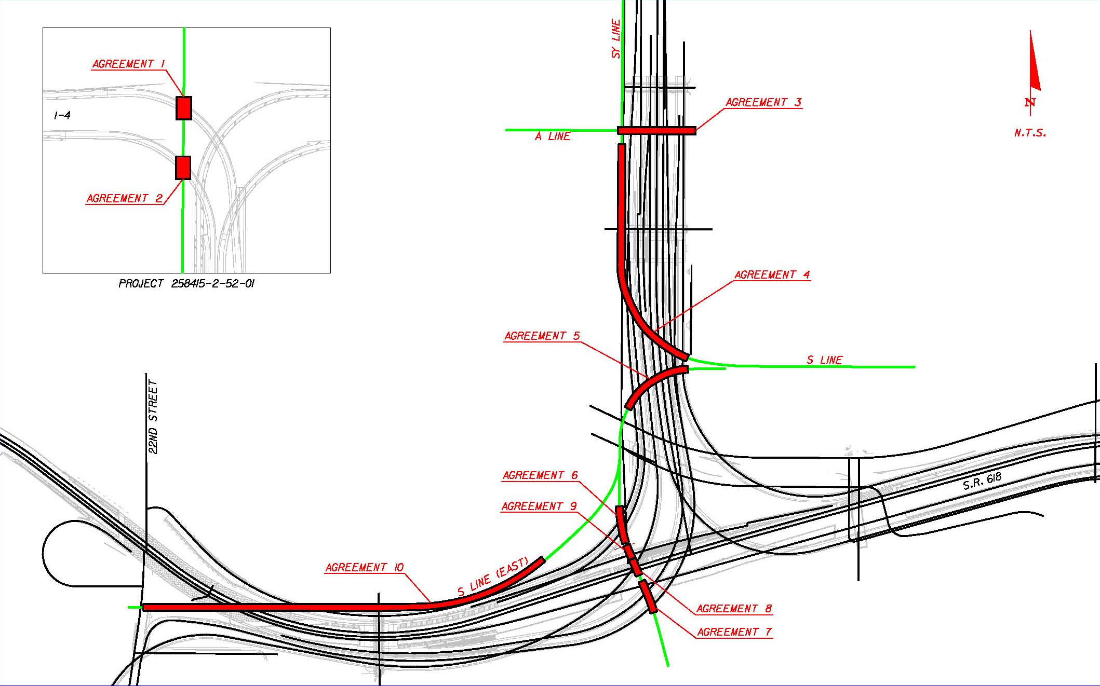
Project Details
CSX Railroad Coordination
Notes:
44

Slide 45
Project Details
CSX Railroad Coordination - Flaggers
It Takes 45 to 60 days to obtain project Flaggers (CSX union requirement)
CSX will provide utility inspectors per requirement during underground installations whenever the contractor is on CSX right of way.
Erection over railroad will require CSX CEI engineers to be present (see general notes)
Contractor will be responsible for any temporary railroad crossings. (access will be via 4th & 7th avenues, SY-line grade crossings)
One additional at-Grade Crossing Agreement is Currently Pending (Hooker’s Point Spur)
Notes:
45

Slide 46
Project Details
CSX Railroad Coordination - Clearances
23 - Foot Minimum Vertical Clearance when trains are passing the Work Zone.
The Contractor may Work within 10 feet of the Centerline of Track with CSX Flaggers Approval.
Notes:
46

Slide 47
Project Details
THEA ITS Facilities
The Tampa Hillsborough Expressway Authority (THEA) maintains a 96-strand fiber optic cable along SR 618 (Selmon Expressway) that controls the slip ramp gates, cameras, and variable and changeable message signs along the Reversible Expressway Lanes (REL).
The Contractor must protect this fiber optic trunk at all times during any construction activities adjacent to or near its location.
Notes:
47

Slide 48
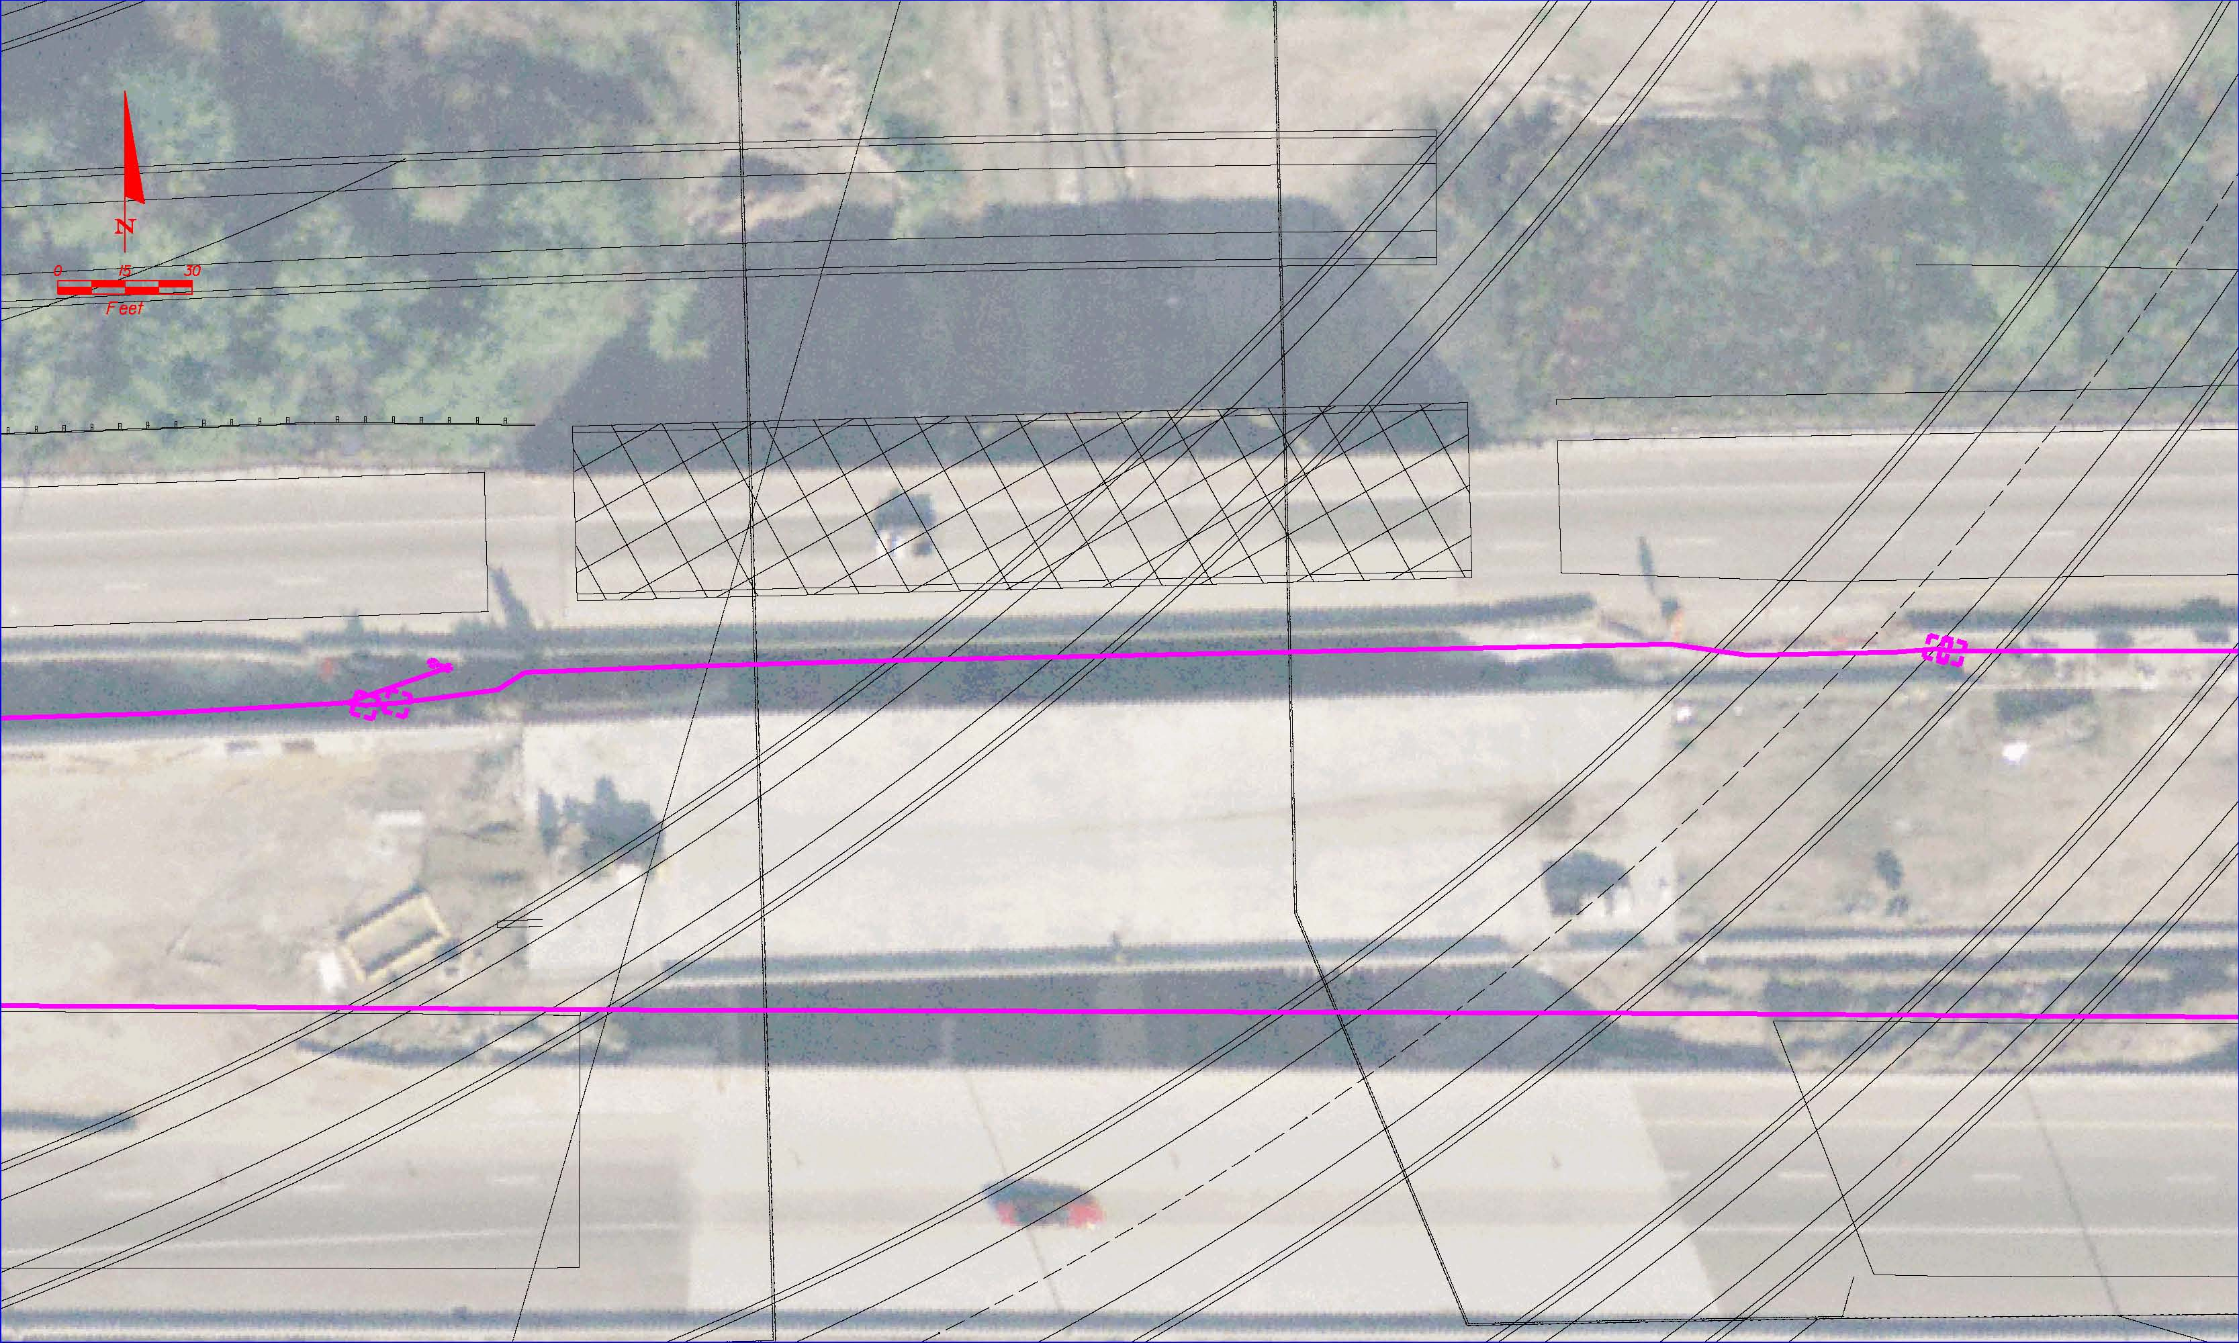
Project Details
THEA ITS Facilities
See ITS Plans for Locations
CSX
Lee Roy Selmon Expressway
Notes:
48

Slide 49
Project Details
Utilities
TAMPA ELECTRIC (TECO)
DISTRIBUTION
TRANSMISSION
PEOPLE’S GAS
TAMPA WATER DEPT.
TAMPA WASTEWATER DEPT.
CENTRAL FLORIDA PIPELINE
VERIZON FLORIDA
SPRINT
BRIGHTHOUSE NETWORKS
LEVEL 3 COMMUNICATIONS
MCI WORLDCOM
FPL FIBERNET
FIBER LIGHT
P.E.A., INC.
GLOBAL CROSSING TELECOMMUNICATIONS, INC.
HILLSBOROUGH COUNTY TRAFFIC SERVICE UNIT
ITC DELTA COM
QWEST COMMUNICATIONS
PROGRESS TELECOM
XO COMMUNICATIONS
Notes:
49

Slide 50
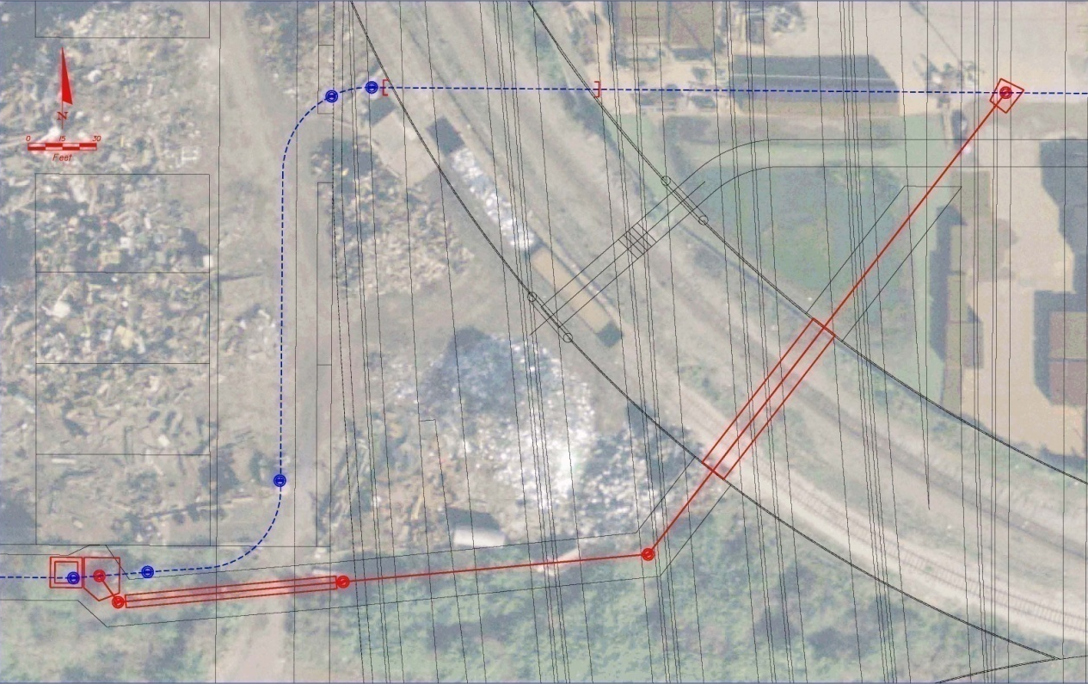
Project Details
Utilities – Performing Ongoing Relocations
TECO Peoples
Gas
Bright House
Central Florida
Pipeline
Qwest
Communications
42” Sanitary Sewer from 31st Street to south of Trademark Metals Recycling
Trademark
Metals
Recycling
Notes:
50

Slide 51
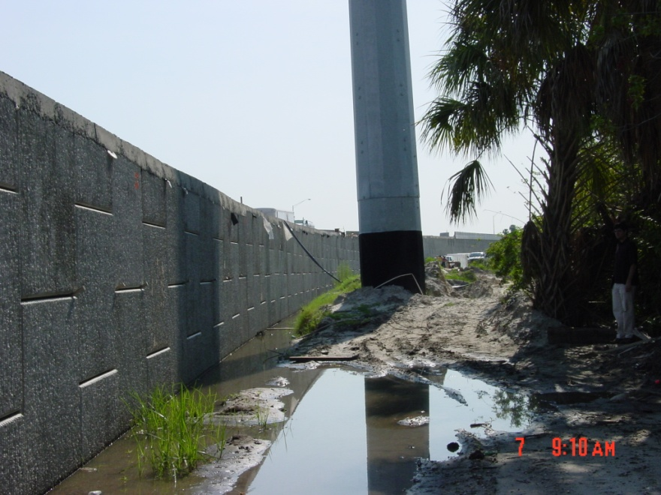
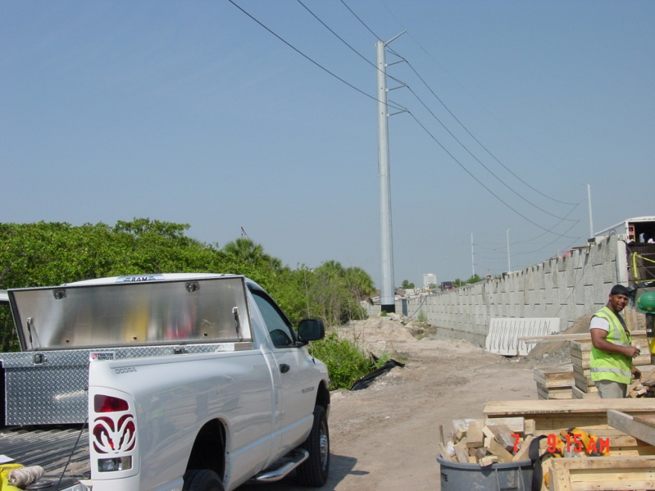
Project Details
Utilities
Owner Relocations During Construction
TECO Distribution
TECO Transmission
Fiber Light, LLC
TECO Peoples Gas
Verizon
Central Florida Pipeline
Notes:
51

Slide 52
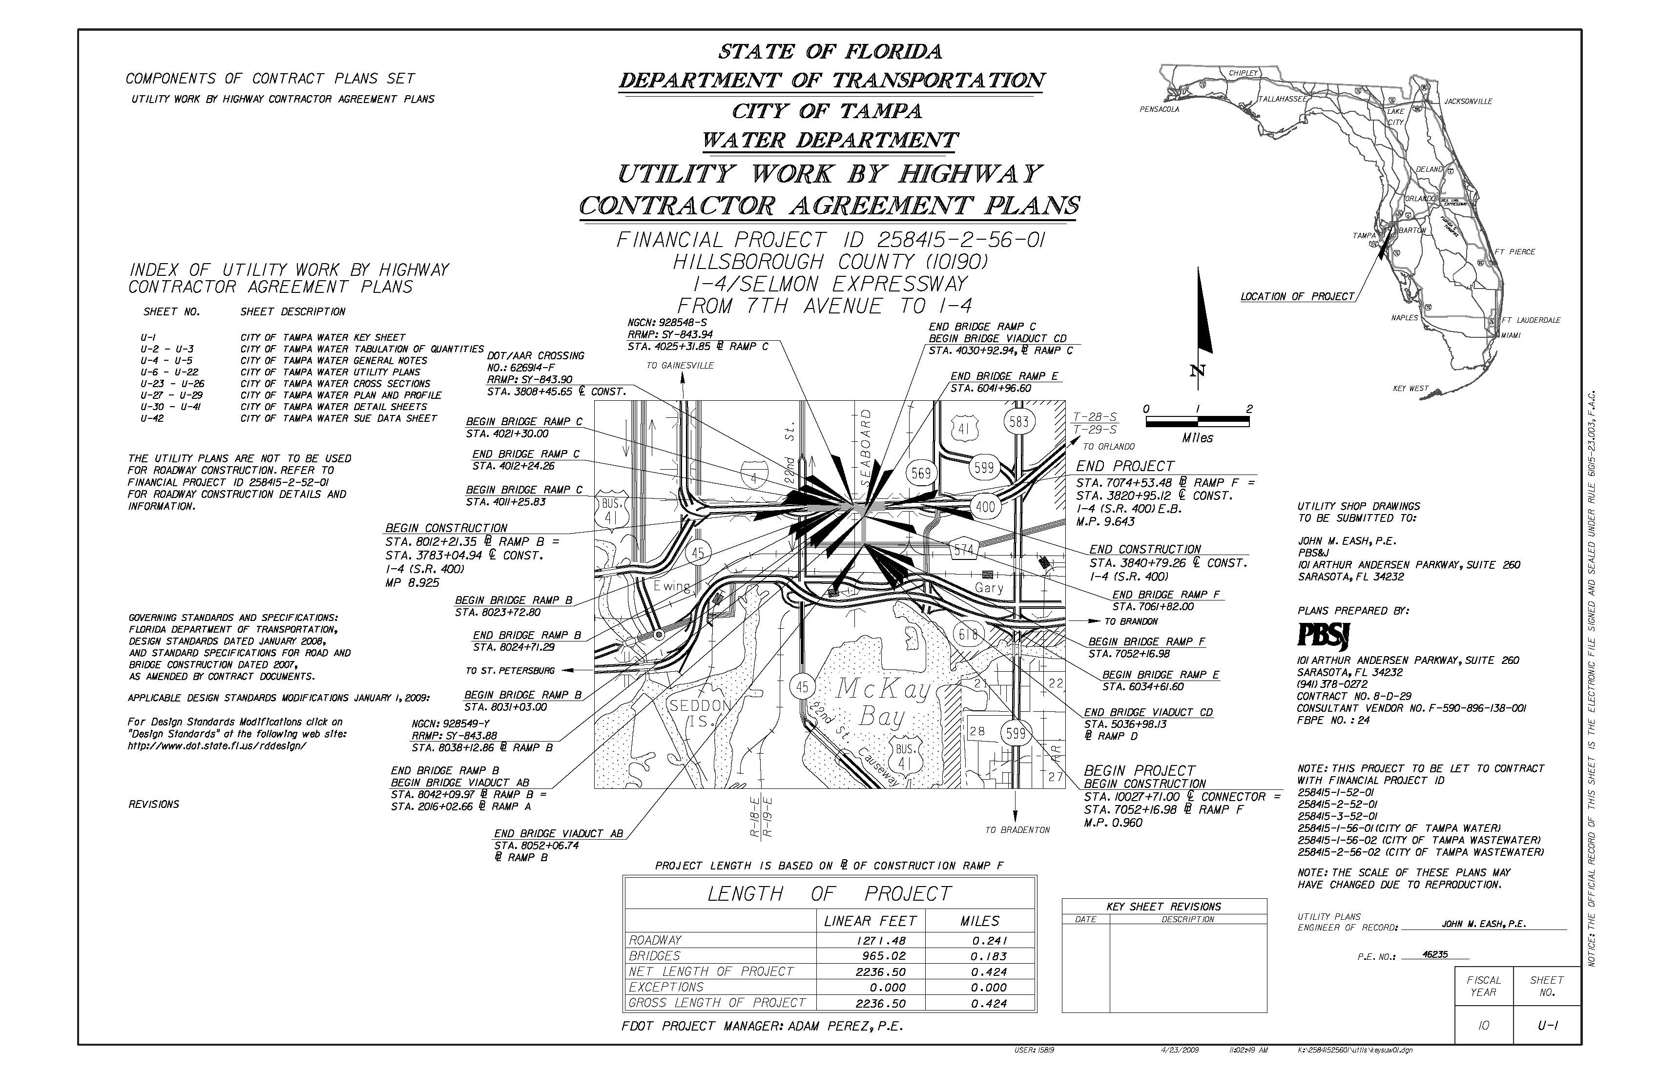
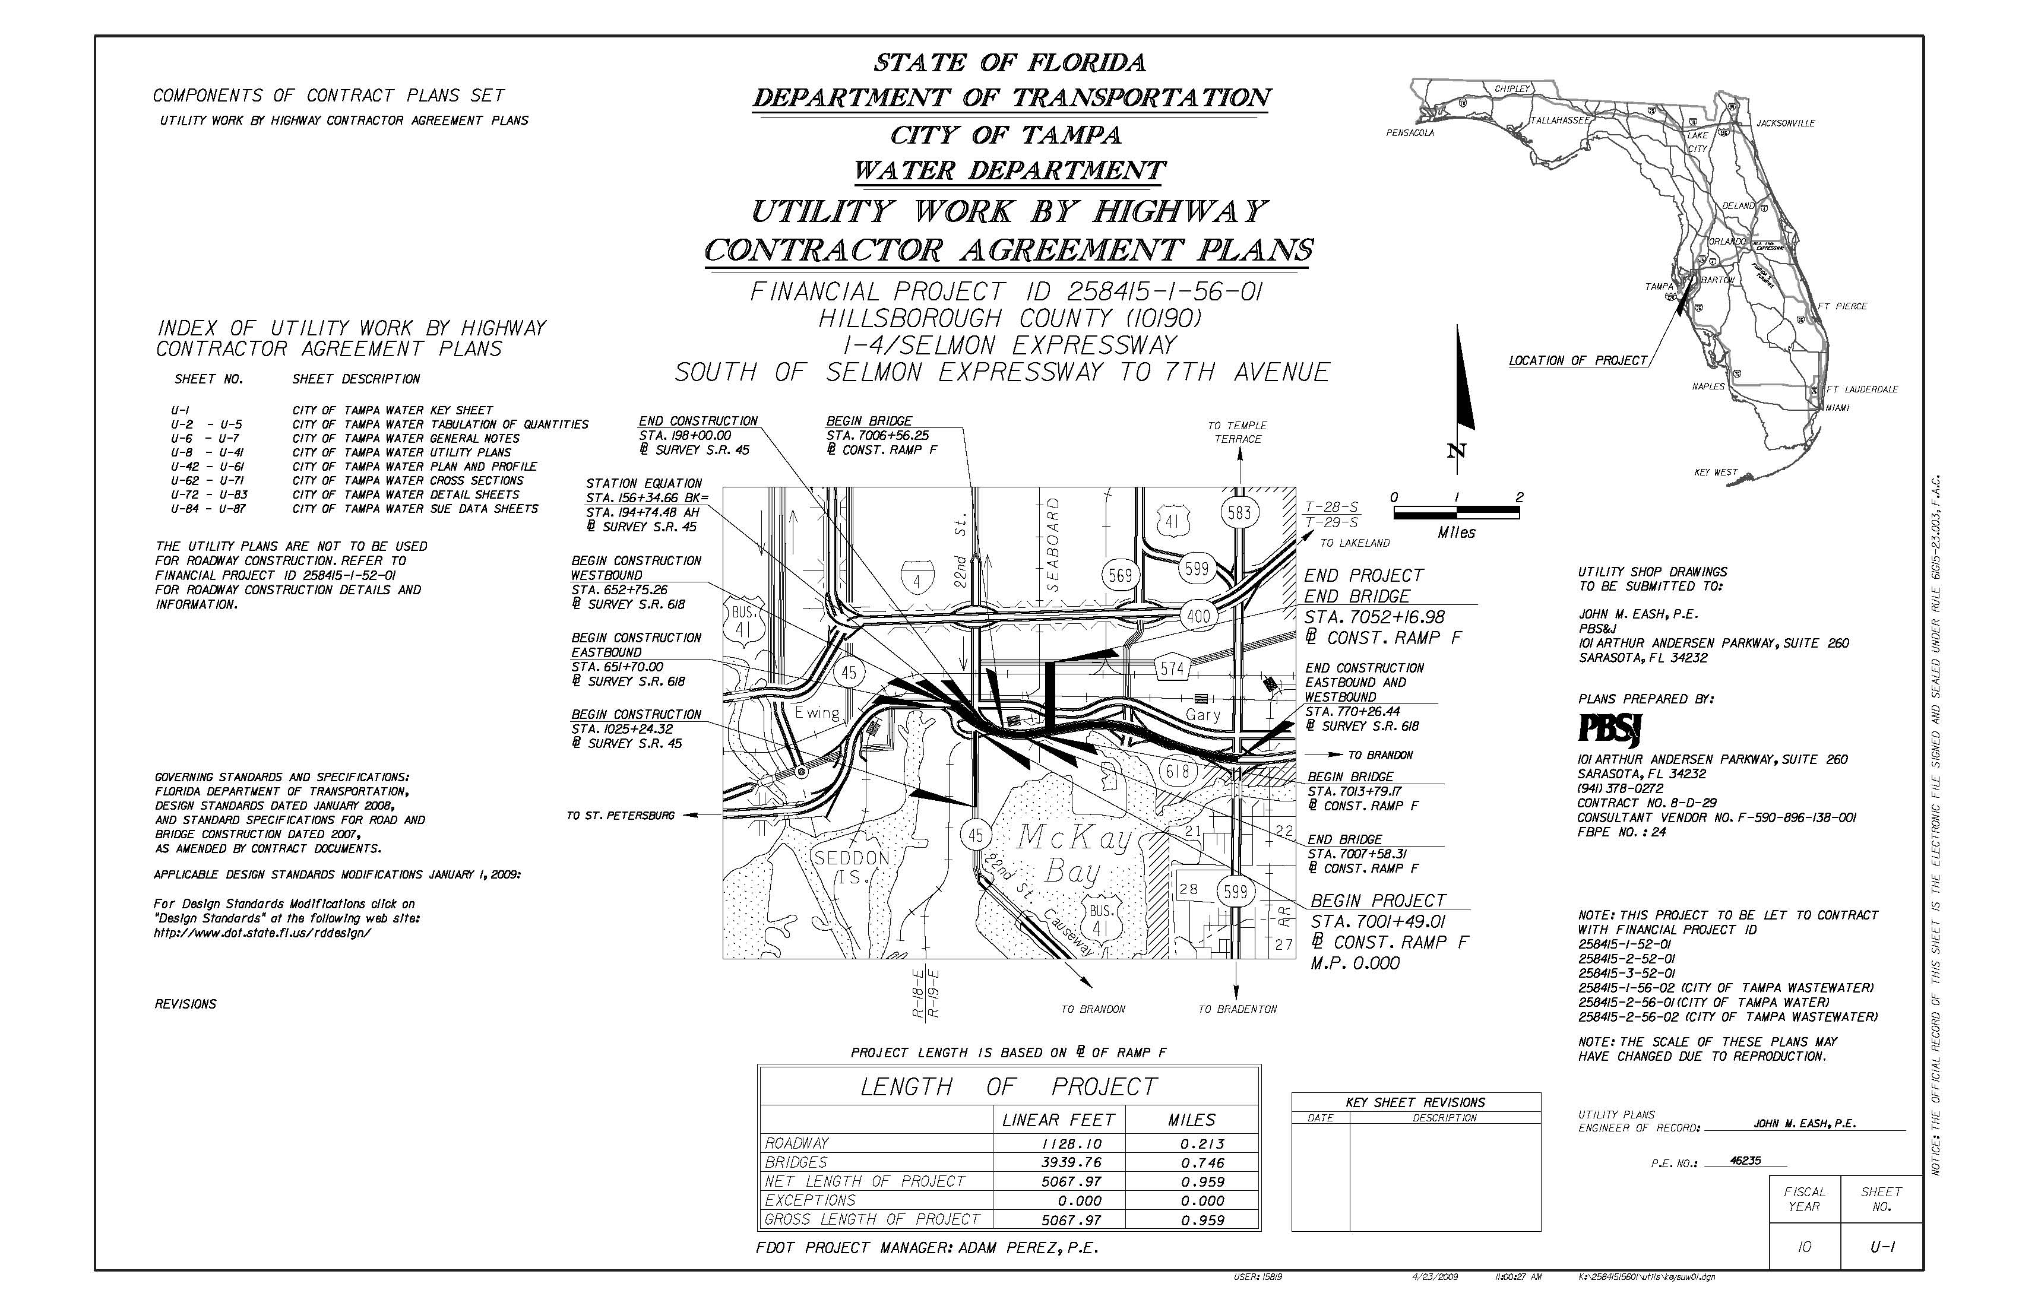
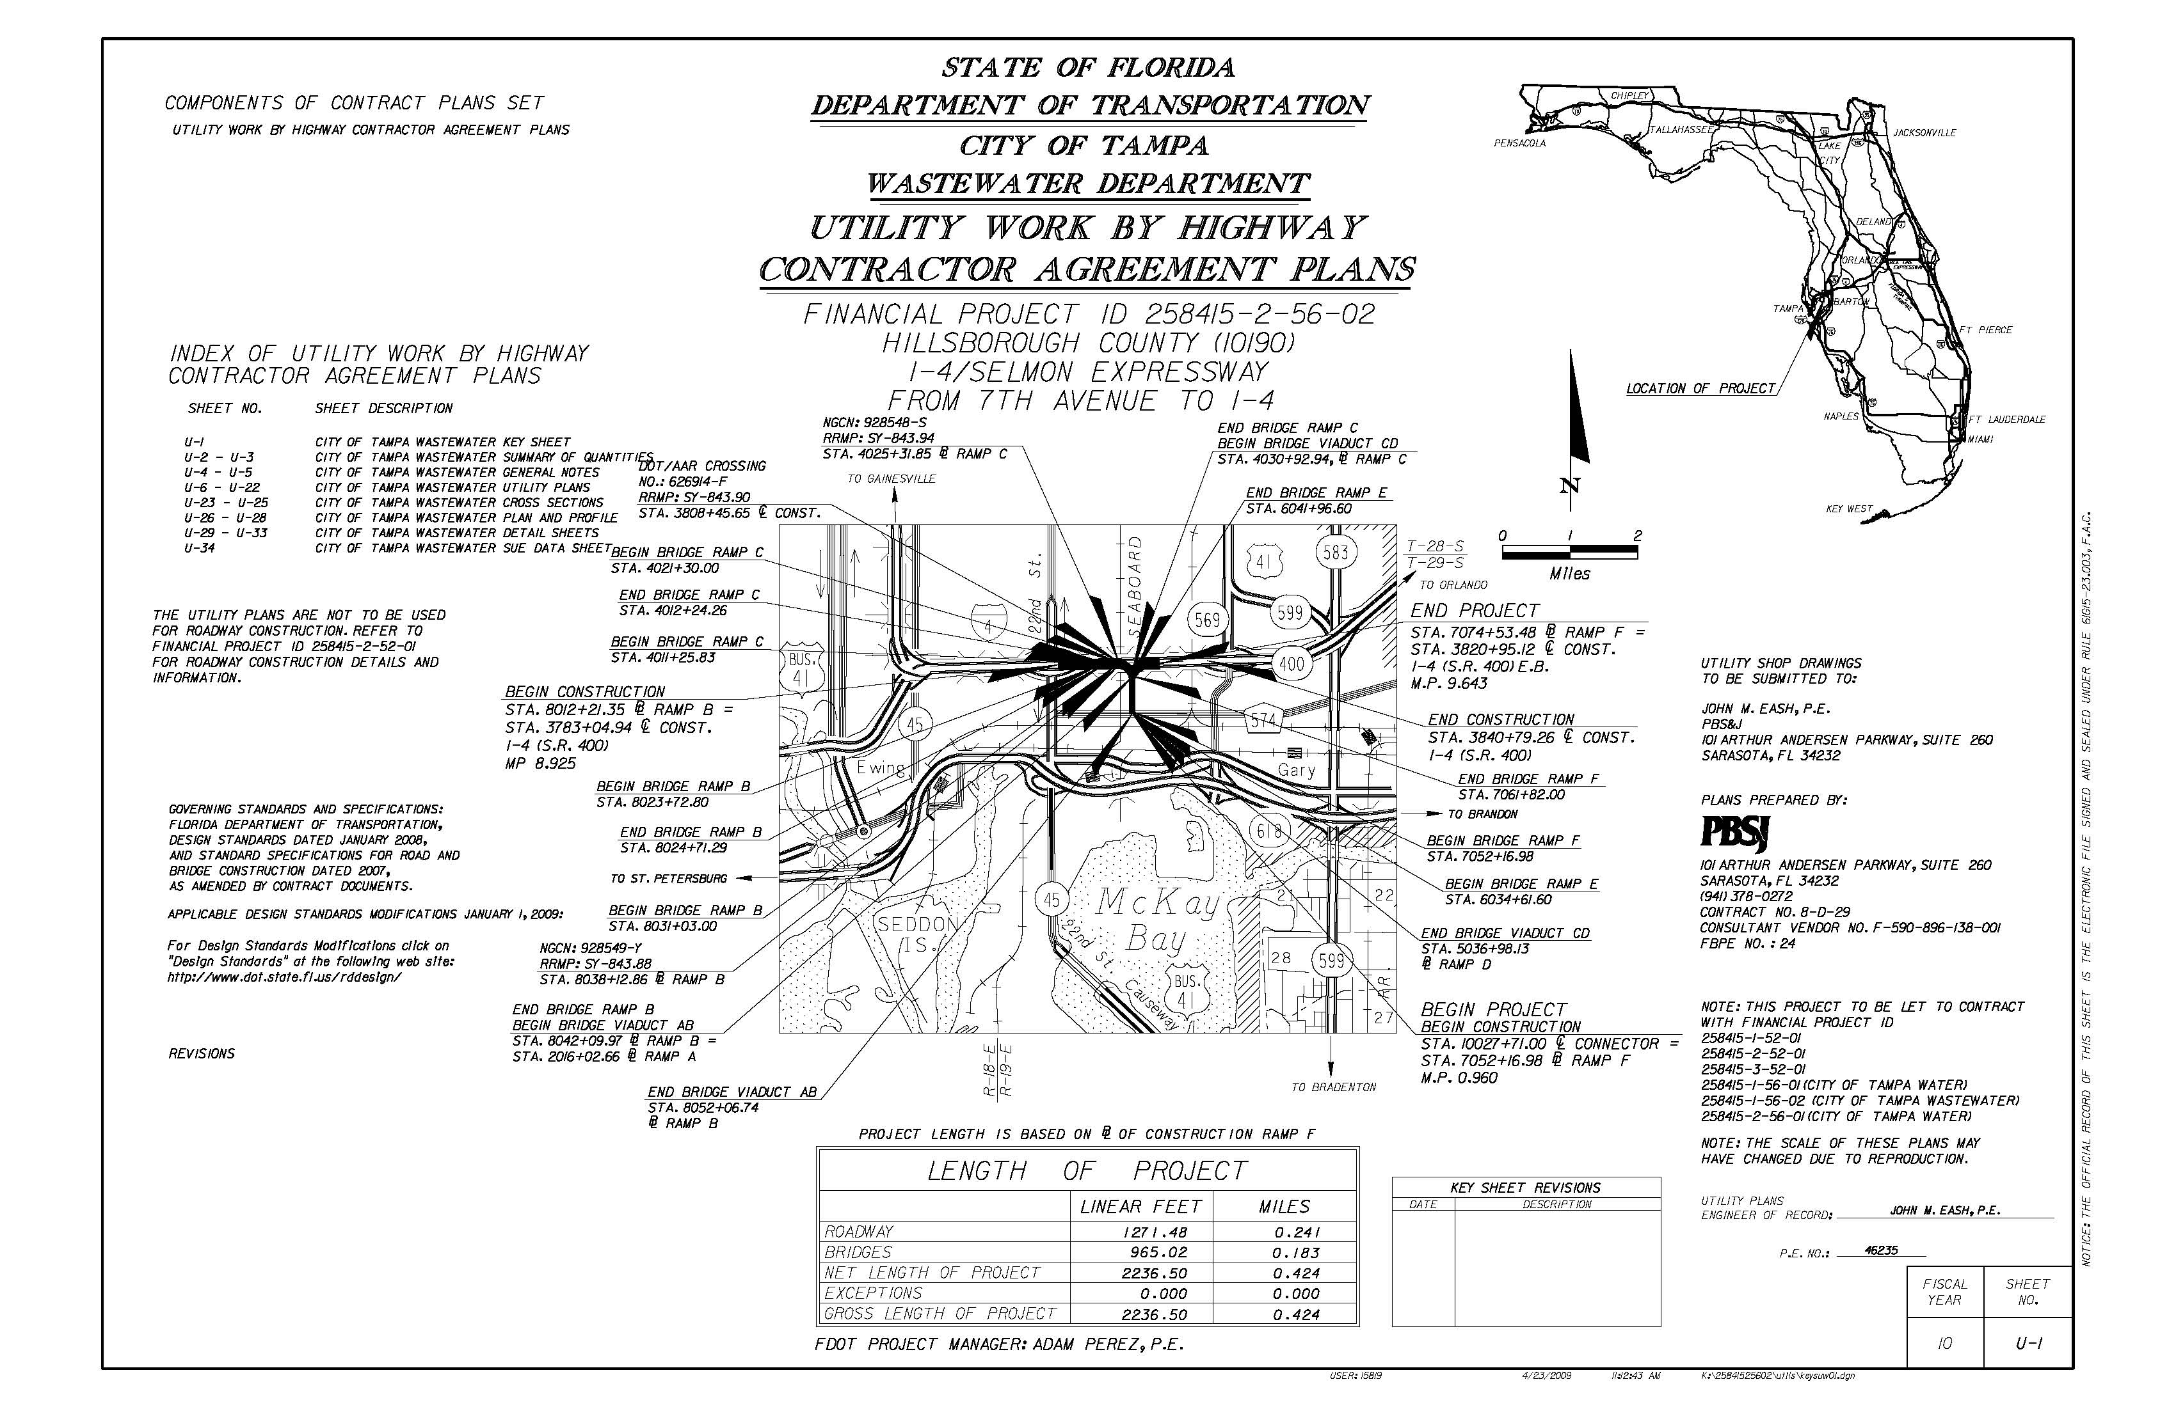
Project Details
Utilities
Utility Work by Highway Contractor Agreements (UWHCA)
City of Tampa Water
Size: 2” to 24”
Lengths: 8’ to 747’
City of Tampa Wastewater
Size: 4” to 36”
Lengths: 20’ to 390’
Notes:
52

Slide 53
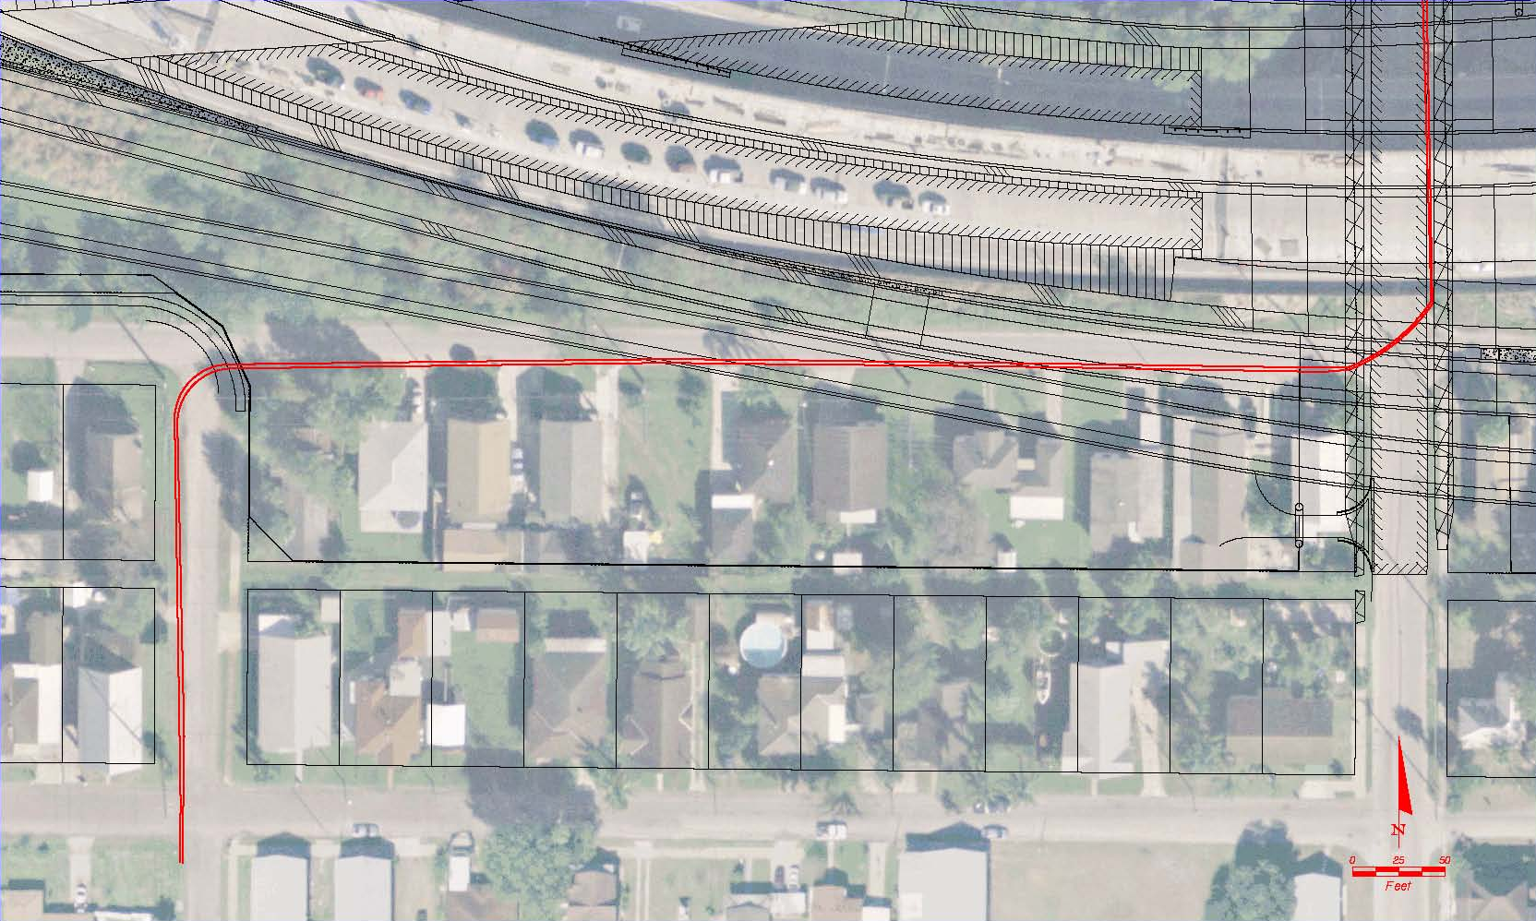
Project Details
Utilities
Utility Awareness – TECO Transmission
Two buried oil encased 69 kilovolt transmission lines in the Long Street right-of-way from 24th Street to 26th Street, and along 26th Street from Long Street north to the CSXT railroad crossing. These lines are to remain in place and are to be protected.
Long Street
26th Street
24th Street
Durham Street
Notes:
53

Slide 54
Project Details
Utilities
CAUTION: This utility has a BURIED, OIL FILLED, double barrel, 69KV line from 24th Street up to 26th Street. They power 3 substations, and if hit, cannot be replaced for 12 months.
CAREFUL COORDINATION is necessary during the installation of drainage for the proposed pond, pond construction, and bridge drill shafts installation near the 69KV line.
The Contractor MUST contact TECO Transmission per the plans before attempting to work around these lines. A meeting must be set up with TECO to discuss the specific details of these lines.
Notes:
54

Slide 55
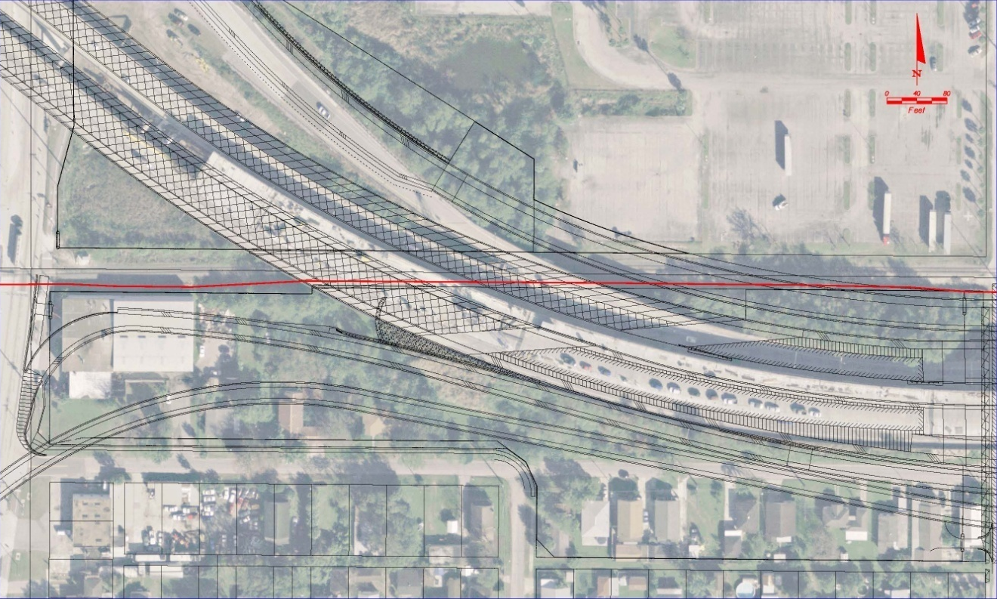
Project Details
Utilities
Utility Awareness – Central Florida Pipeline
The contractor cannot work within 10 feet of the Central Florida 10" pipeline without a Kinder Morgan representative on site. The contractor cannot dig with any mechanical equipment within 2 feet of the pipeline. The contractor must hand dig within 2 feet of the pipeline.
22nd Street
Long Street
24th Street
Notes:
55

Slide 56
Project Details
Utilities – Central Florida Pipeline
This utility will adjust their lines if necessary, but they must be given 60 days notice if it is major. Refer to notes in the plans.
They are located within an easement, so the Contractor will have to sign documentation to enter into this easement.
Close coordination regarding proposed drainage crossing is imperative for this utility.
Notes:
56

Slide 57
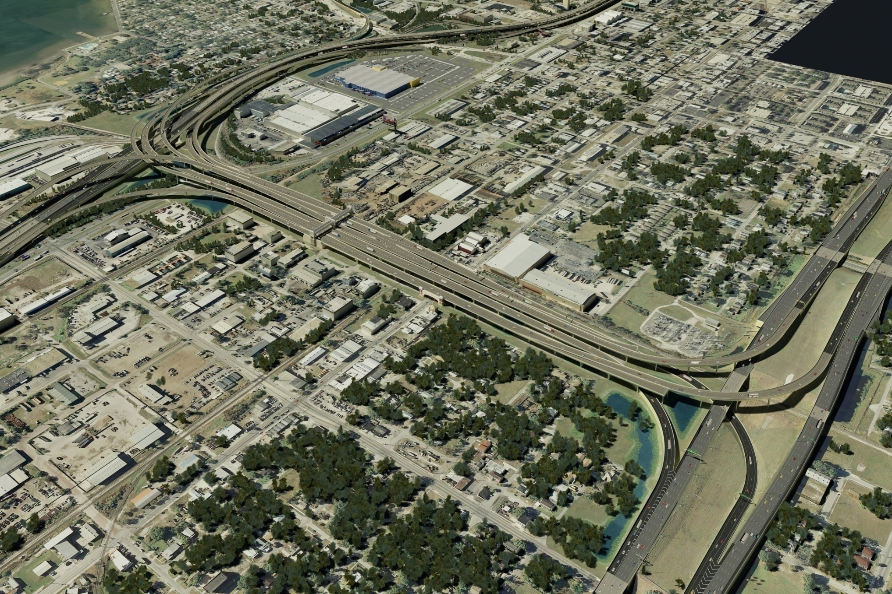
Project Details
TCP Overview
I-4/Lee Roy Selmon Expressway Interchange

Slide 58
Project Details
TCP Overview cont’d
Contract Duration = 1713 days
Flexibility in Traffic Control Staging
Refer to Special Phasing Notes under 258415-1
Coordinate staging between 258415-1 and 258415-2
Complete non-traffic related construction outside of the TCP work zones

Slide 59
Project Details
TCP Overview cont’d
Phasing is based on:
Addressing concerns of Managing Agencies
Meeting milestones in each phase
Utilizing existing structures and ramps for temporary diversions
Providing constructability for different structure types based on the erection control schemes
Ensuring that all surfaces are at final grade at the completion of the project

Slide 60
Project Details
TCP Lane Closures
FACILITY | LANE CLOSURE | RESTRICTED HOURS
S.R. 400 (EB) | SINGLE | 6:30AM – 8PM
S.R. 400 (EB) | DOUBLE | 6AM – 10:30PM
S.R. 400 (WB) | SINGLE | 6AM – 8PM
S.R. 618 (EB/WB/REV) | SINGLE | 6AM – 10AM, 4PM – 8PM
S.R. 60 (EB/WB) | SINGLE | 7AM – 10AM, 3PM – 7PM
S.R. 45 (NB/SB) | SINGLE | 7AM – 9AM, 4PM – 7PM
SIDESTREETS | SINGLE | 7AM – 9AM, 4PM – 7PM

Slide 61
Project Details
TCP Extended Lane and Ramp Closures
FACILITY | PHASE / STAGE | CLOSURE DURATION
S.R. 618 WESTBOUND | PHASE 1, STAGE 1 | 180 CALENDAR DAYS
S.R. 618 WESTBOUND | PHASE 1, STAGE 2 | 150 CALENDAR DAYS
S.R. 618 WESTBOUND | PHASE 1, STAGE 3 | 160 CALENDAR DAYS
S.R. 618 WESTBOUND | PHASE 1, STAGE 4 | 40 CALENDAR DAYS
S.R. 618 EASTBOUND AND EB 22ND ST. ENTRANCE RAMP | PHASE 2, STAGE 1 | 180 CALENDAR DAYS
S.R. 618 EASTBOUND | PHASE 2, STAGE 2 | 120 CALENDAR DAYS
S.R. 618 EB 50TH ST. EXIT RAMP | PHASE 3, STAGE 4 | 45 CALENDAR DAYS
S.R. 45 NORTHBOUND | PHASE 1 (ALL STAGES) | 530 CALENDAR DAYS
S.R. 45 NORTHBOUND | PHASE 2 (ALL STAGES) | 360 CALENDAR DAYS
S.R. 45 NORTHBOUND | PHASE 4, STAGE 1 | 420 CALENDAR DAYS
S.R. 45 SOUTHBOUND | PHASE 1 (ALL STAGES) | 530 CALENDAR DAYS
S.R. 45 SOUTHBOUND | PHASE 2 (ALL STAGES) | 360 CALENDAR DAYS
S.R. 45 SOUTHBOUND | PHASE 4 (ALL STAGES) | 470 CALENDAR DAYS

Slide 62
Project Details
TCP Extended Lane and Ramp Closures cont’d
Damage Recovery Special Provision
See TCP Project Specific Notes – 258415-1-52-01
Unit cost will be assessed if all lanes are not opened to traffic during times shown in TCP
First 30 minutes and under $10,000
Each additional 30 minute period or portion thereof $5,000
Not to exceed $38,000 in a 24-hour period

Slide 63
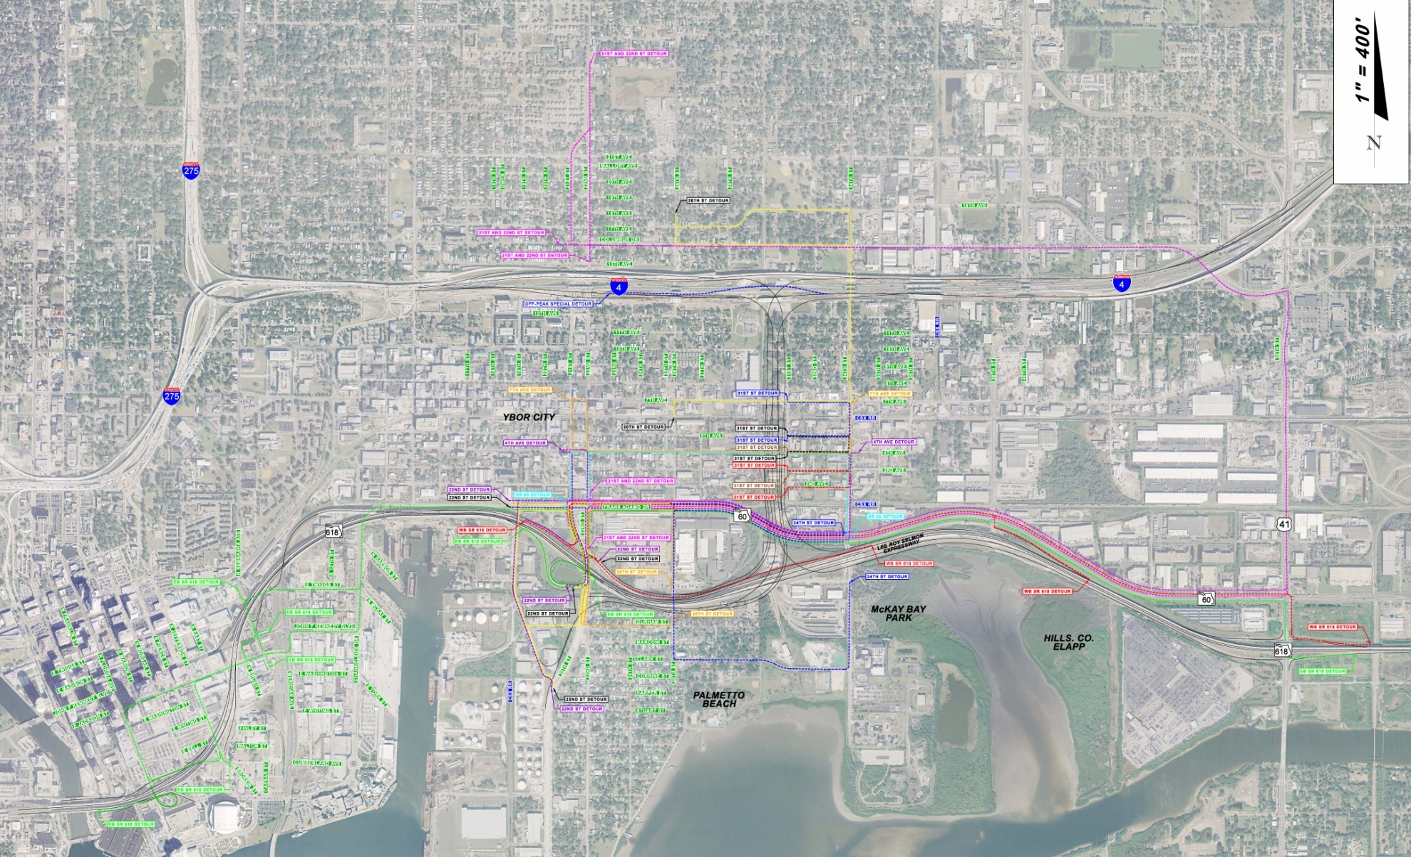
Project Details
TCP Detours: Night-time or Extended Ramp Closures

Slide 64
Project Details
TCP Miscellaneous
Existing 39th Street Toll Plaza
Existing Toll Plaza at Entrance Ramp must be removed prior to Phase 3, Stage 1
Requires coordination with THEA
See TCP Project Specific Notes – 258415-1-52-01
Existing WB SR 618 39th Street Exit and Entrance Ramps
Existing ramp pavement cannot be removed until the Diversion is no longer needed after Phase 3, Stage 1

Slide 65
Project Details
TCP Miscellaneous cont’d
Palmetto Beach Community Restrictions
Located south of SR 618 between SR 45 and CSX
Installation of any piling and bridge demolition activities are restricted from 9 PM – 7 AM
See TCP Project Specific Notes – 258415-1-52-01

Slide 66
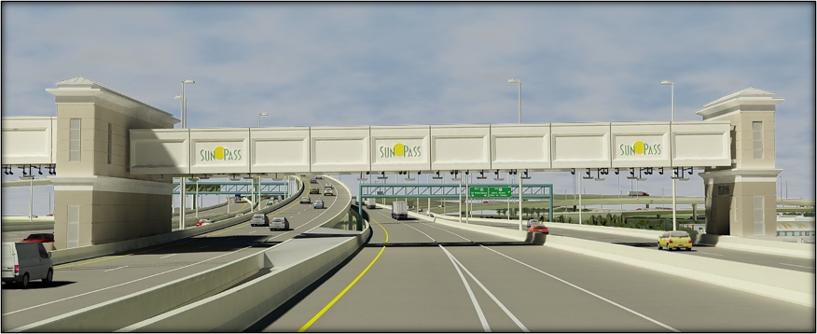
Project Details
Toll Gantry
Lump sum pay item under Toll Plaza w/ drilled shafts bid separately
Stained precast concrete panels on a primarily cast-in-place concrete framework
FRP aesthetic panel cladding attached to two single span steel Vierendeel trusses with maintenance/equipment cores
Translucent polycarbonate panel roof System at towers and metal roof at equipment bldg.
Southbound Gantry Span

Slide 67
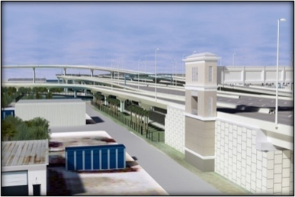
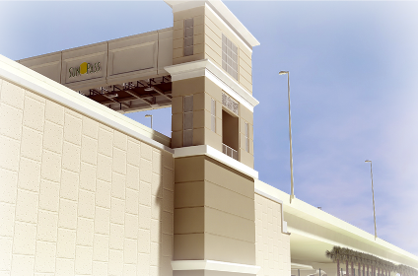
Project Details
Toll Gantry
Metal access ladders and grating for maintenance and inspection
ROW and CSX proximity (West side)
Contractor responsible for acquiring all building permits, inspections, and compliance with Florida Product Approval submittals
All fees for permits and required inspections shall be borne by the contractor and considered incidental to the task being performed
Incorporates significant electrical work and utility connections
Contractor shall coordinate fiber trunk coming from I-4, connections at Toll Gantry, and others as specified
Special care shall be taken regarding casting aesthetic reveals at tower bases
Bird’s-Eye View of East Tower
Ground View of West Tower

Slide 68
Project Details
Toll Gantry
The Contractor shall be fully aware of all contents of the drawings and specifications as they relate to elements such as:
Toll equipment/ITS (FTE coordination)
Rolling Shutters (post FTE approval)
Shutter sills (post FTE approval)
CCTV/Security (FTE coordination)
SunPass Signs
FRP Panels
Precast Concrete Panels – coordination and sequencing of truss fabrication and placement, installation of windows, doors, and roofs.
Toll Gantry - Drive Through Animation

Slide 69
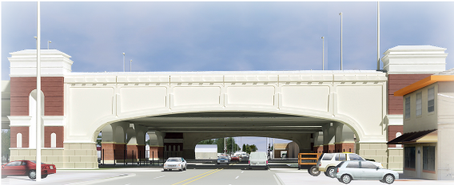
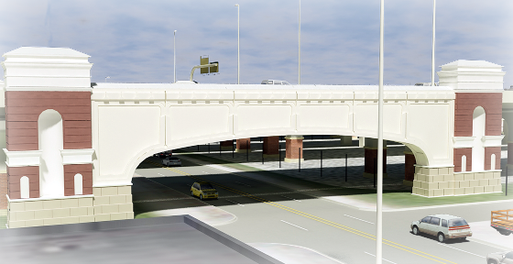
Project Details
7th Avenue Gateways
Lump sum pay item under Architecture Building w/ drilled shafts bid separately
Stained precast concrete panels on a structural steel framework
FRP aesthetic panel cladding attached to single span metal box trusses
Translucent Polycarbonate Panel Roof System
Metal access ladders and grating for maintenance and inspection
ROW and CSX proximity
Westbound approach on 7th Avenue
Northwest view

Slide 70
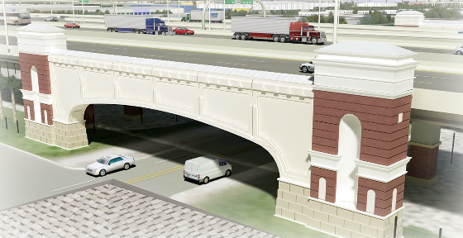
Project Details
7th Avenue Gateways
Contractor responsible for acquiring all building permits, inspections, and compliance with Florida Product Approval submittals
All fees for permits and required inspections shall be borne by the contractor and considered incidental to the task being performed
Incorporates electrical work and utility connections
7th Avenue Gateway - Southwest view

Slide 71
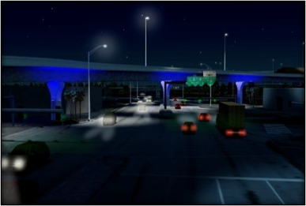
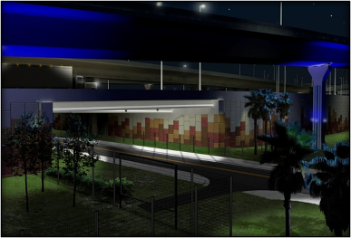
Project Details
Aesthetic Lighting
Lump sum pay item under Architectural Work
Certain specified piers shall receive the aesthetic up-lighting
Contractor shall coordinate installation of conduits and junction boxes with drainage pipes embedded within the bridge piers
Final color specification and fixture aiming shall be coordinated with equipment manufacturer, EOR and the Department
References can be found in the architecture, structures, and lighting plans
22nd Street
26th Street

Slide 72
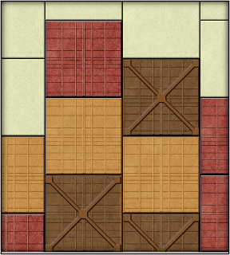
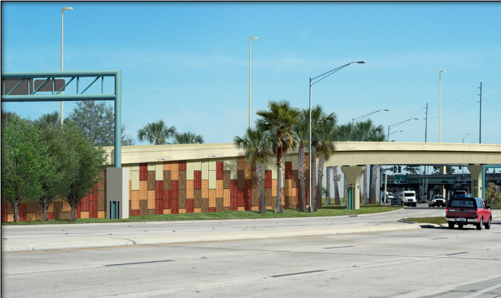
Project Details
Aesthetic Wall Treatments and Lighting
Permanent retaining walls have various surface finishes, depending on location:
Smooth Finish
Fractured Finish
Shell pattern matching project FPID 258401-1-52-01
Three Custom MSE Wall Textures (“Shipping Container” pattern)
The aesthetic light fixture attached to the wall coping is only located on the walls containing custom MSE wall textures or graphics

Slide 73
Project Details
Pier Rustications – General
There are three main Column Treatment designs:
North / I-4
Connector (Ybor Pier Rustication)
South / Selmon Expressway
Exposed portions of pedestals for overhead sign structures receive column rustications and a stain/sealer coating system in accordance with the stain/sealer TSP. Colors for the stain/sealer coating system are shown in the TSP.
With the exception of Pier 9-3, all piers south of the Toll Gantry for the Steel Box Girder and Segmental bridges receive column rustications.

Slide 74
Project Details
Pier Rustications – Toll Gantry North to 7th Avenue
The Rustications are a manufactured architectural precast panel that includes an embedded brick system. The integrated design components of each precast panel include:
Cap (sand blast finish, stained)
Façade (embedded brick system)
Pedestal (sand blast finish, stained)
Attachment of the precast concrete panels to the structural piers is to be completed after construction of the pier. Approved alternative methods of attachment can be utilized if approved by the Engineer.
For the bridges north of the Toll Gantry, a special architectural treatment (“Ybor City Treatment”) is required for exterior pier columns and pier columns along 7th Avenue.

Slide 75
Project Details
Contamination Impacts
National Emission Standard for Hazardous Air Pollutants (NESHAP) Notifications
258415-1, General Notes
Written notification required by the Contractor for contamination sites
258415-1, Contamination Notes
258415-2, Contamination Notes
Notes:
75
The Contractor will be required to perform NESHAP (National Emission Standard for Hazardous Air Pollutants) notifications for renovations and/or demolitions of any structure as well as providing a certificate affirming that no asbestos containing material was used in the construction of the project.
-See Segment 1, Sheet 3, General Note Items 13 & 14
Various written notification procedures are required by the Contractor pertaining to known contamination sites and when unexpected contamination are encountered.
-See Segment 1, Sheet 4, Contamination Note Items 1,2,3 & 4
-Segment 2, Sheet 24, Contamination Note Items 1,2,3 & 4

Slide 76
Project Details
Contamination Impacts
A level staging area shall be provided for use by the District Remediation Contractor (DRC).
258415-1, Contamination Notes
258415-2, Contamination Notes
Contractor working in more than one area of known contamination shall work where DRC is working.
258415-1, Contamination Notes
258415-2, Contamination Notes
Notes:
76
The Contractor shall provide a level staging area for the sole use of the DRC (District Remediation Contractor) within close proximity of the dewatering discharge points.
-See Segment 1, Sheet 4, Contamination Note Item 2b
-See Segment 2, Sheet 24, Contamination Note Item 2b
Per approved schedule, if the Contractor is required to work in more than one area of known contamination, the Contractor shall work on parcels where the DRC is already working. Written notification procedures also apply.
-See Segment 1, Sheet 4, Contamination Note Item 3
-See Segment 2, Sheet 24, Contamination Note Item 3

Slide 77
Project Details
Contamination Impacts
Backfill for contaminated soil removal will be provided by DRC.
258415-1, Contamination Notes
258415-2, Contamination Notes
Slurry used on contaminated sites cannot be used on clean sites.
Notes:
77
The DRC will provide backfill for areas of contaminated soil removal. It will be the responsibility of the Contractor to perform compaction activities for these areas unless, under the discretion of the Engineer, the Contractor is directed to do otherwise.
-See Segment 1, Sheet 4, Contamination Note Item 5
-See Segment 2, Sheet 24, Contamination Note Item 5
Contractor can reuse slurry within contaminated areas but not use slurry from contaminated areas in clean areas.

Slide 78
Project Details
Contamination Impacts
Contaminated sites require the DRC to provide groundwater treatment and soil support services during construction.
258415-1, Contamination Notes
258415-2, Contamination Notes
Some Contaminated sites may no longer require soil screening for petroleum compounds (using a vapor analyzer) during construction.
Notes:
78
There are multiple known contaminated sites that require the DRC to perform groundwater and/or soil support services during construction activities. Soil screening performed by the DRC will not be physical screening but rather screening with an OVA/FID monitor. (Organic Vapor Analyzer/Flame Ionization Detector)
-See Segment 1, Sheet 4, Contamination Note Item 6
-See Segment 2, Sheet 24, Contamination Note Item 6
Due to remediation efforts, some identified contaminated sites may no longer need soil screening for petroleum compounds using an OVA/FID during construction.

Slide 79
Project Details
Contamination Impacts
The Contractor must obtain their own NPDES (National Pollutant Discharge Elimination System) permit.
There are established permitted dewatering discharge locations for the sole use of the DRC. The Contractor must maintain these sewer lines and access to the discharge locations for the DRC’s use.
258415-1, Contamination Notes
258415-2, Contamination Notes
Some DRC remediation activities will continue beyond letting date.
Notes:
79
The Contractor is responsible for obtaining their own NPDES (National Pollutant Discharge Elimination System) permit and to discharge water from uncontaminated sites. To follow FDEP’s (Florida Department of Environmental Protection’s) regulations, the Contractor cannot utilize the DRC’s treatment system to discharge water from uncontaminated sites. The DRC has obtained City of Tampa dewatering discharge permits. These permits specify locations which are for the sole use of the DRC to discharge into. Some sanitary sewer lines connected to these discharge locations are to be abandoned. As a result, for all sanitary sewer connections listed in the contamination notes, the Contractor must maintain these sewer lines and access to the discharge location, for the DRC’s use throughout the construction phase of the project.
-See Segment 1, Sheet 4, Contamination Note Item 7
-See Segment 2, Sheet 24, Contamination Note Item 7
Due to certain circumstances, there are some areas that remediation activities by the DRC may still be ongoing beyond the actual letting date. This may also include the 42” sanitary sewer installation discussed in this pre-bid presentation.

Slide 80
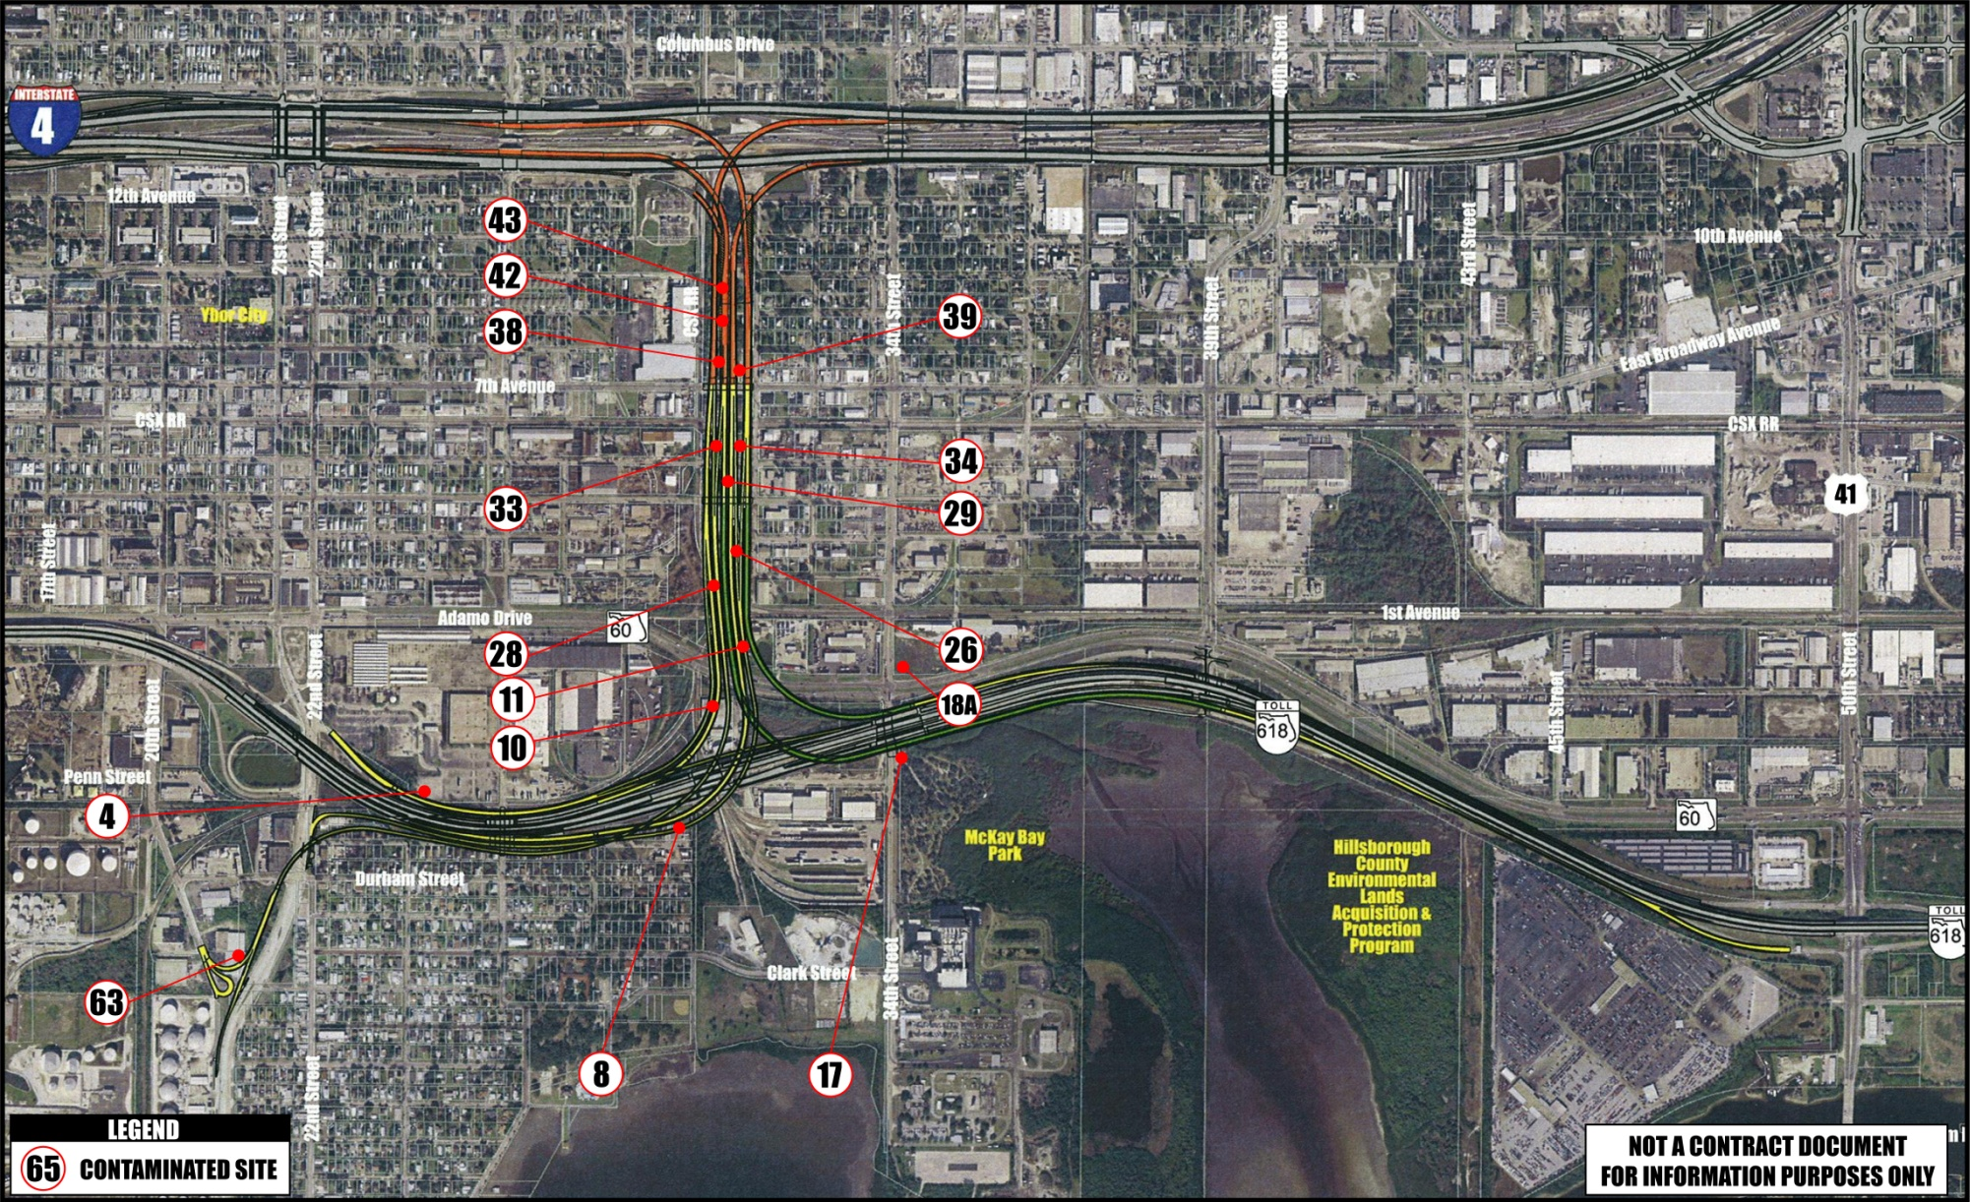
Project Details
Sites with Future Construction Issues
Notes:
80

Slide 81
Other Project Requirements
A+B Alternative Contracting
Engineer’s Field Office
Pedestrian Access
Diamond Grinding

Slide 82
Other Project Requirements
Adjacent/Concurrent Projects
THEA Deck Panel Replacement
21st/22nd Street Resurfacing
Box Culvert X-3 and Drainage Basin
City of Tampa Permits
Building Permits

Slide 83
Other Project Requirements
Bid Questions
Direct all questions to the Department by posting them to the Department’s website at the following URL address: www2.dot.state.fl.us/construction/bidquestionmain.asp
Questions posted before 5:00 P.M. (EST) on the 21st calendar day prior to the bid opening will be responded to.
Take responsibility to review and be familiar with all questions and responses posted to this website up through 2 business days prior to the bid opening and to make any necessary adjustments in the proposal accordingly.
Notes:
Direct all questions to the Department by posting them to the Department’s website at the following URL address: www2.dot.state.fl.us/construction/bidquestionmain.asp
Questions posted before 5:00 P.M. (EST) on the 21st calendar day prior to the bid opening will be responded to.
Contractor’s are responsible to review and be familiar with all questions and responses posted to this website up through 2 business days prior to the bid opening and to make the necessary adjustments to their bids.

Slide 84
Other Project Requirements
Bid Questions (Cont.)
Please submit your bid questions individually: By submitting one question per entry, time for response should be minimized.
Please be very clear on the sheet location of the question. Please included the FIN Number (for the particular project you are commenting on), Alternate description and number, and the sheet number.
Notes:
I’d like to share a few helpful tips about the submission of bid questions:
Please submit your bid questions individually: By submitting one question per entry, time for response should be minimized. Sometimes several questions get submitted as one entry – this complicates the response since we are forced to respond to all the questions at one time. If the questions are submitted separately we can prioritize our responses. Etc.
Please be very clear on the sheet location of the question. Please included the FIN Number (for the particular project you are commenting on), Alternate description and number, and the sheet number.
These plans represent a large volume of plan sheets. It would expedite our responses if you would identify clearly which plan sheet you are referring to in your question – which plan set, MOT, lighting, etc.,

Slide 85
Questions & Answers
I-4/Lee Roy Selmon Expressway Interchange
Visit www.myTBI.com
Notes:
Thank you for your time and patience.
I will open the floor for some questions. There are microphones available for you. I will ask that you clearly state your name and the firm you are representing prior to stating your question.
I will ask our presenters to respond, however if we are unable to respond today without looking into the plans/contract, we will get back to you with a response. We will take your question down and post a response via the bid question website.
Thank you for coming and for your interest. We look forward to a successful letting and award come September.
Thank you the meeting is adjourned.

