Slide 1
May 27, 2009

Slide 2
Agenda
Introduction
Project Overview
Agency Coordination
Contract Process
DBE
Finance Plan
Project Description
Questions & Answers
Visit www.myUS19.com

Slide 3
Introduction
Project Overview
Roadway Reconstruction: US19: 6-lane controlled access typical section Frontage Roads: One-way, two-lane typical sections
Right of Way Typically 200’ wide
Grade Separated Intersections: Belleair Road Seville Boulevard State Road 60
FPID 256881-1-52-01 North of Whitney Road to South of Seville Boulevard – 1.6 Miles
FPID 256881-2-52-01 South of Seville Boulevard to North of State Road 60) – 1.2 Miles

Slide 4
Introduction
Agency Coordination
City of Clearwater
City of Largo
Pinellas County
Pinellas Suncoast Transit Authority (PSTA)
Southwest Florida Water Management District (SWFWMD)
US Army Corp of Engineers (USACE)
Notes:
4

Slide 5
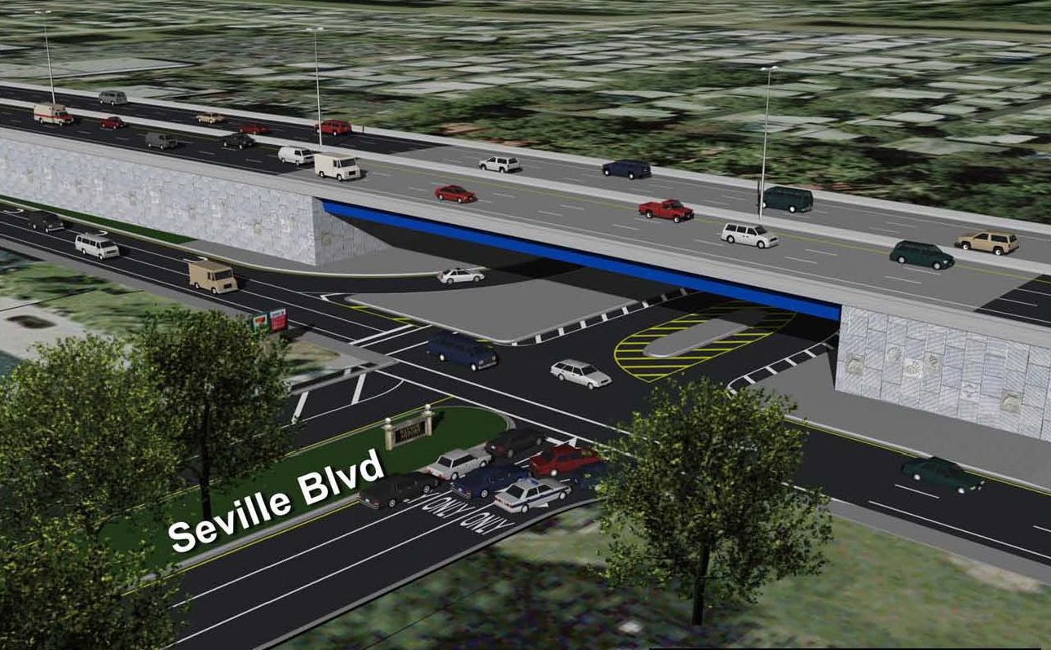
Contract Process
Qualification
Work Class
Major Bridge – Curved Steel Girders
Bidding Capacity
Bidding Capacity will be needed to cover the entire budget estimate for the project

Slide 6
Contract Process
Qualification – Joint Ventures (JV)
All parties in the JV must be prequalified
At least one party in the JV must be
prequalified in the required work class
Each party in the JV must have the bidding capacity to cover the % of the project budget that equals their % in the JV
The Declaration of Joint Venture Form must be completed and submitted for approval

Slide 7
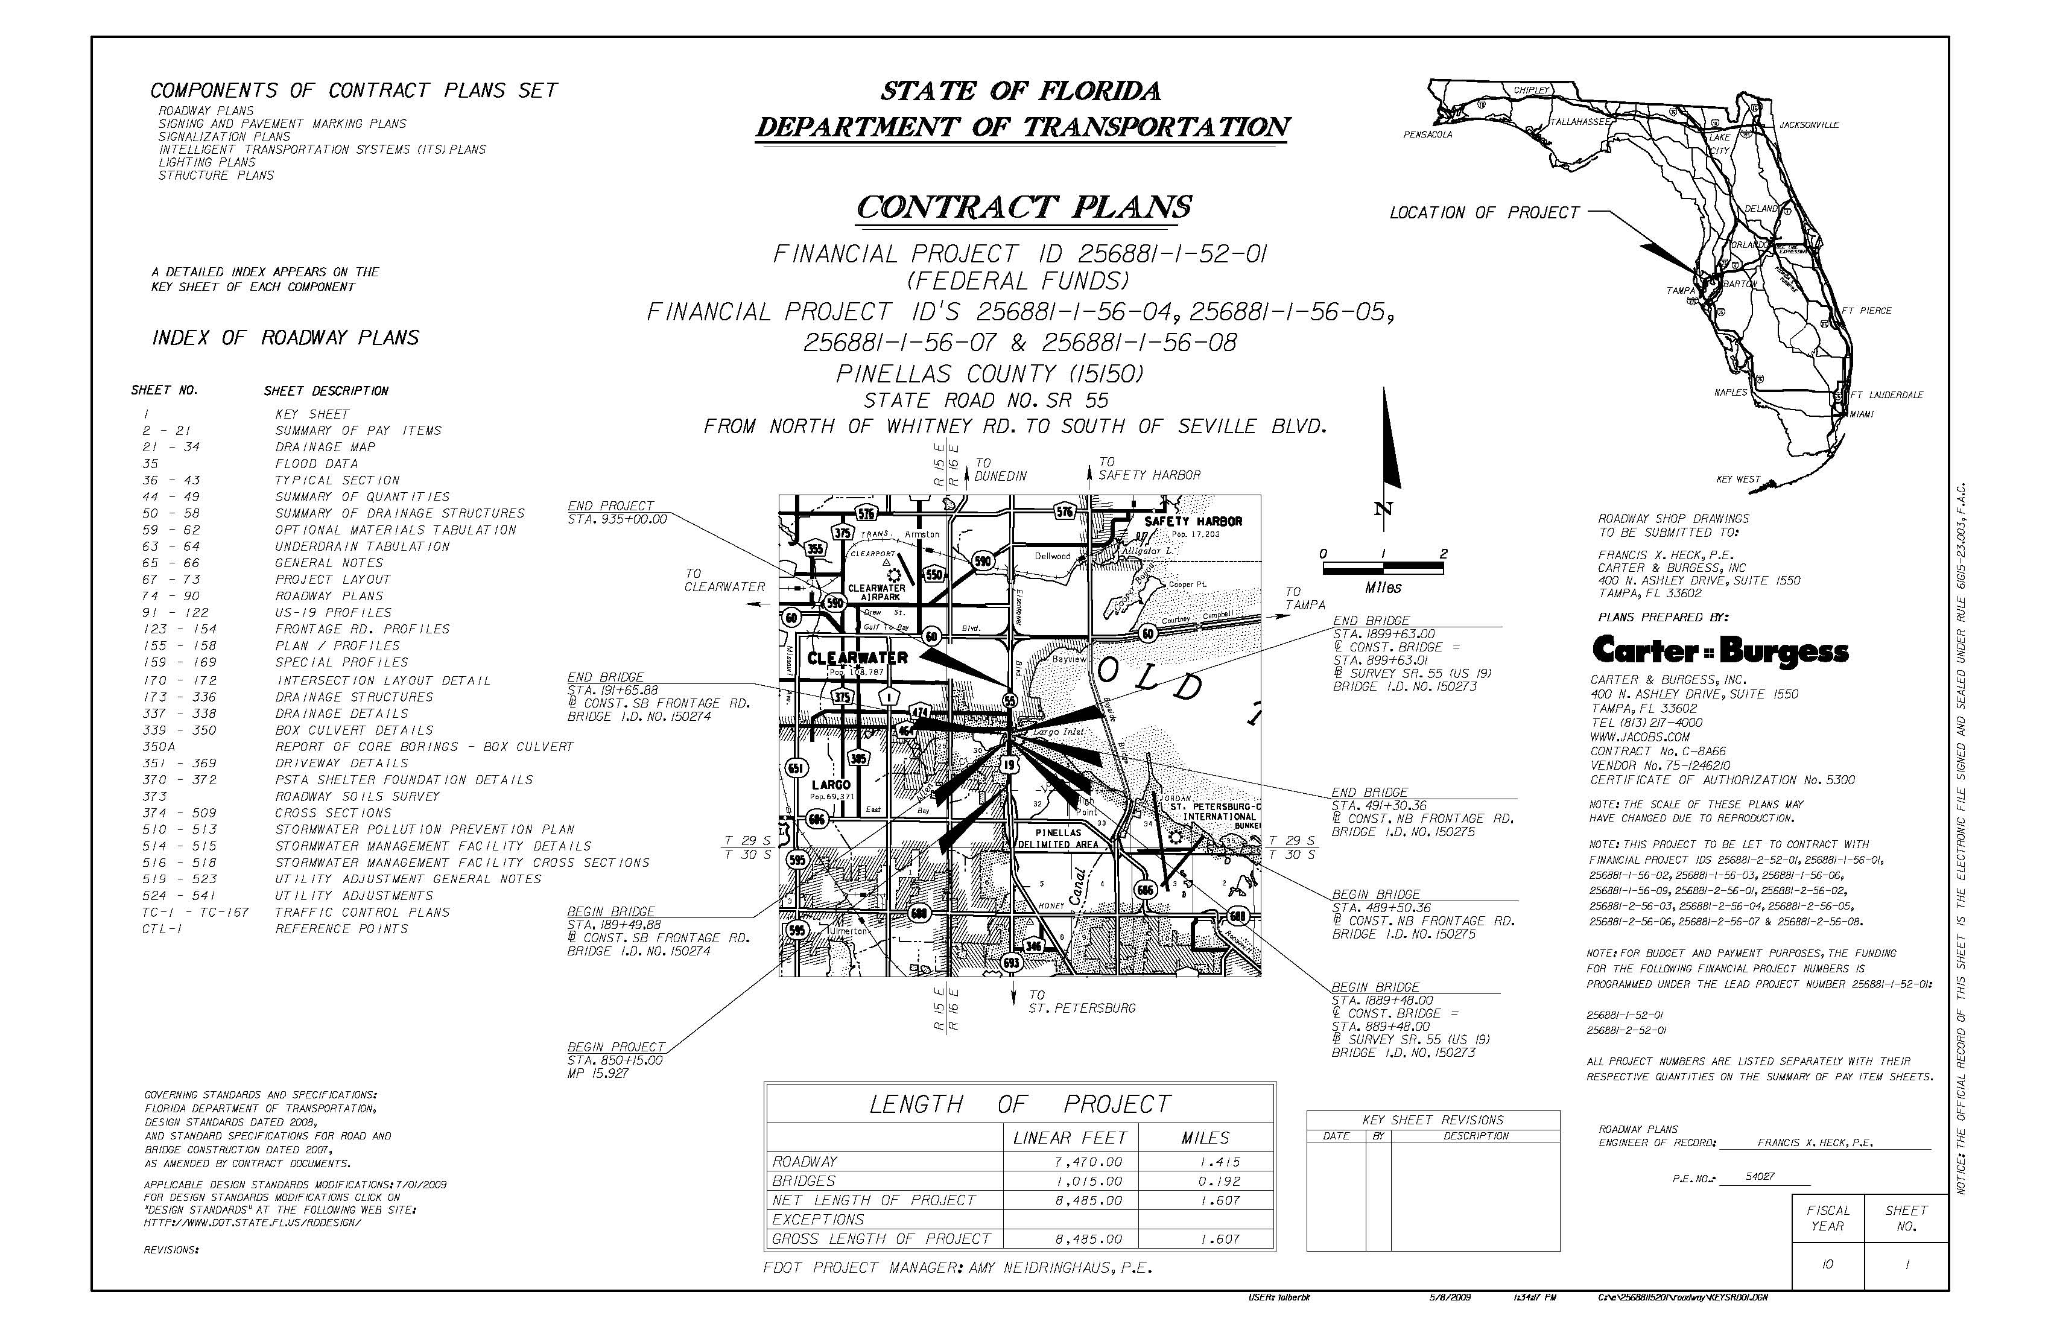
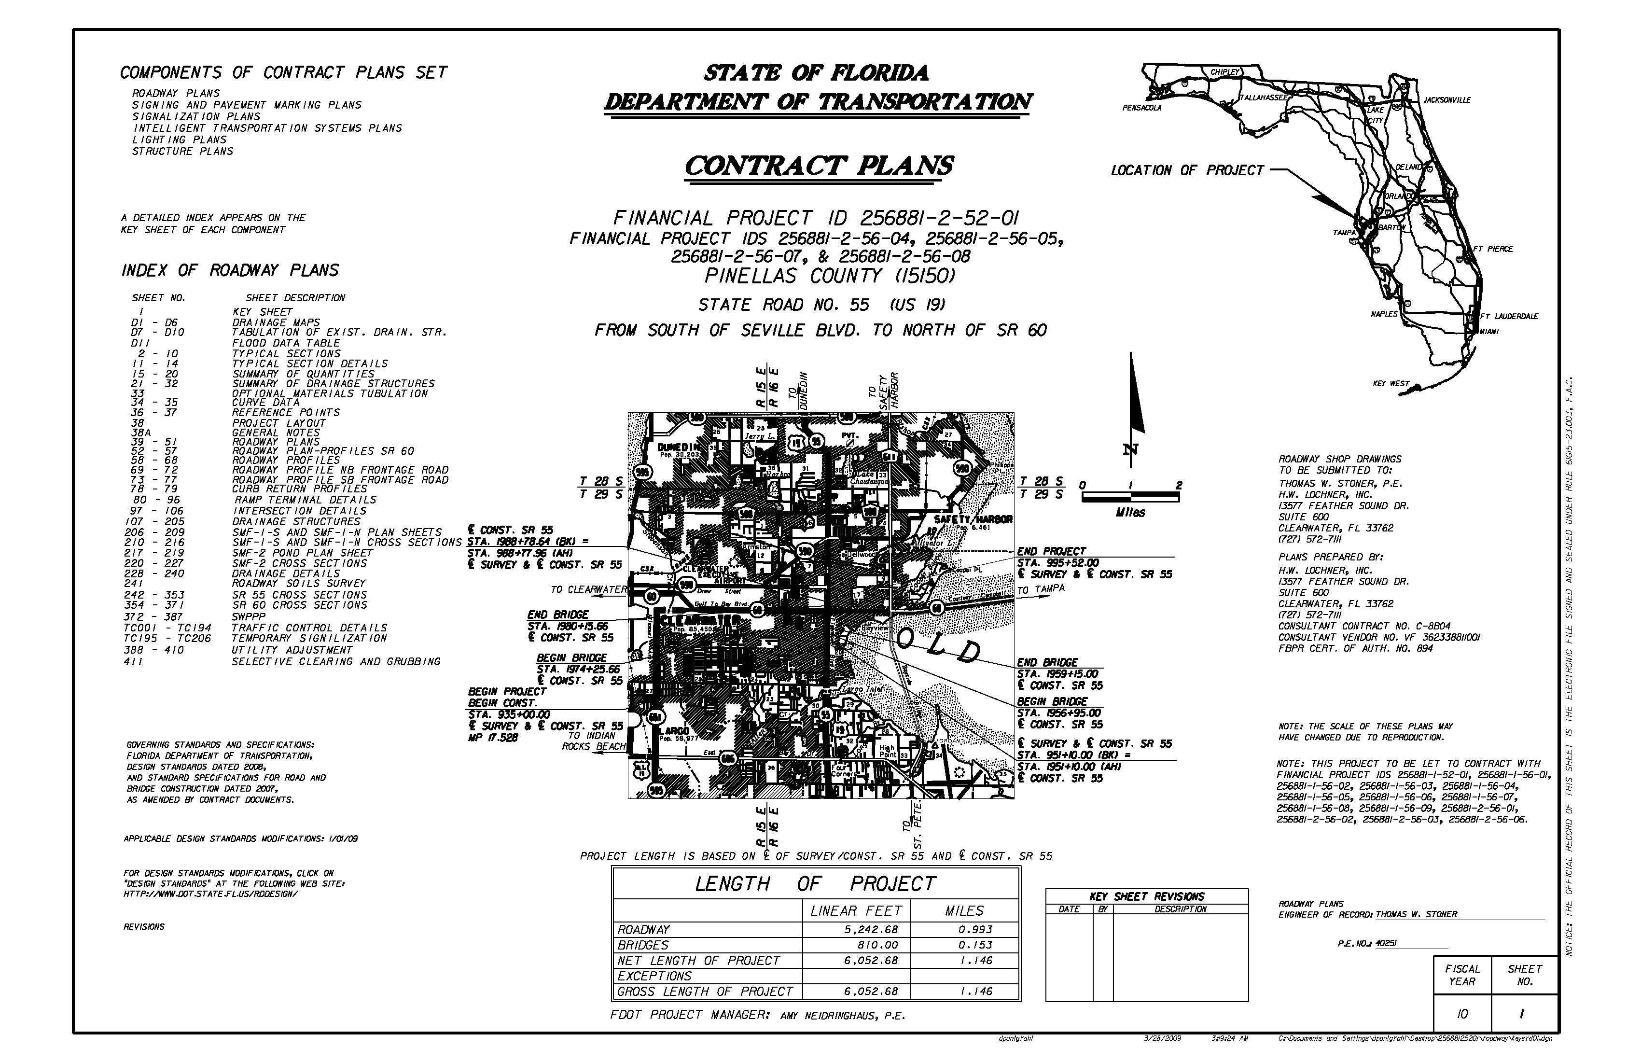
Contract Process
Bid Documents
Advertisement Date June 3, 2009
Deadline for submission of questions
July 1, 2009 – 10:00 am Local Time

Slide 8
Contract Process
Financial Plan and Bid Submittal
All Documents will be submitted to:
Contracts Administration Office
Florida Department of Transportation
605 Suwannee Street, MS – 55
Tallahassee, FL 32399
The Financial Plan
5 Hard copied and 5 digital copies
Bid is submitted via Bid Express

Slide 9
Contract Process
Opening – Review – Award
Bid totals for each bid submitted will be read aloud for those present and available at 4:00 PM in Tallahassee on the day of the letting, or on the Contracts Administration website at: www.dot.state.fl.us/cc-admin.
Anyone needing special accommodations under the Americans with Disabilities Act of 1990 should send an e-mail to: contracts.admin@dot.state.fl.us or call telephone number (850) 414-4000.
Special accommodation requests under the Americans with Disabilities Act should be made at least seven days prior to the public meeting.

Slide 10
Contract Process
Advertisement Bid Solicitation Notice
Date | Event
May 27, 2009 | Contractor Information Forum - USF
June 3, 2009 | Advertisement Date
--- | No Mandatory Pre-Bid Meeting
July 1, 2009 | Deadline for submission of questions - 10:00 am Local Time
July 22, 2009 | Bid/Price Proposal and Financial Plan Proposal due before by 2:00 p.m. local time. All Documents will be submitted to: Contracts Administration Office, Florida Department of Transportation, 605 Suwannee Street, MS – 55, Tallahassee, FL 32399. The Financial Plan 5 Hard copied and 5 digital copies. Bid/Price Proposal will be submitted to the Department using the Expedite Proposal file by using the internet. (Bid Express)
TBD | Anticipated Award Date
TBD | Anticipated Execution Date

Slide 11
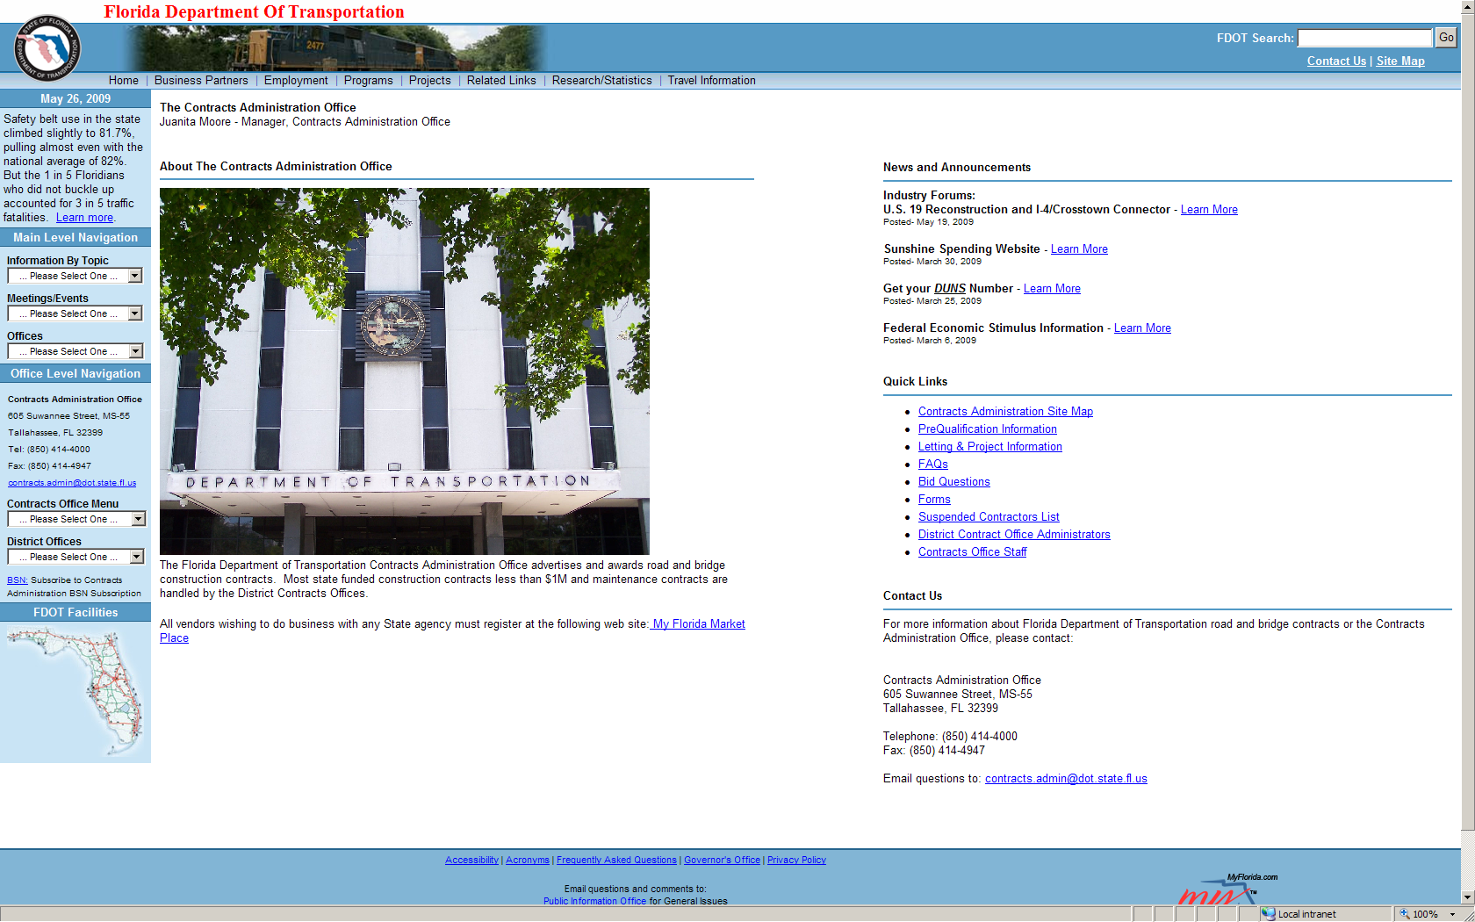
Contract Process
Contracts Administration Website
http://www.dot.state.fl.us/cc-admin/

Slide 12
Contract Process
DBE Participation
Objective – 8.1%
Assistance - Blackmon Roberts Group
Lakeland Office Miami Office
902 South Florida Avenue 4000 Ponce De Leon Blvd Suite 205 Suite 470 Lakeland, FL 33803 Coral Gables, FL 33145
(P) 863.802.1280 (P) 305.762.5836
(F) 863.802.1290 (F) 305.777.0449
Introductions

Slide 13
Contract Process
Project Financial Plan, including at a minimum:
All financial elements to finance the project as proposed.
Provision for all project costs.
Project Sources and Uses of Funds.
Audited Financial Statements for the most recent two (2) fiscal years. Required financial statements shall include:
Opinion Letter (Auditor’s Report)
Balance Sheet
Income Statement
Statement of Changes in Cash Flow
Footnotes
If financial statements are not prepared in accordance with U.S. Generally Accepted Accounting Principles (GAAP)
A letter from a CPA must be included to address how conversion to GAAP would be impacted.

Slide 14
Contract Process
If audited financials are not available,
Provide unaudited financial statements prepared in accordance with GAAP, certified as true, correct and complete by the Chief Financial Officer.
Interim Financial Statements must be submitted for each party of the Build-Finance Team providing financial support to the project.
Prepared in accordance with GAAP and certified by the entity’s Chief Financial Officer for the period since the last Audited Financial Statement.
Interim Financial Statements through the most recent completed fiscal quarter should be provided.
Letter of Commitment or Credit from Financial Institution.
If using debt financing as a source of funds or guarantee, a preliminary Letter of Commitment or Credit from the financial institution, must be submitted as part of the Financial Proposal
Final Letter of Commitment or Credit/Statement of No Change or updated firm commitment letter submitted prior to award of contract.
The Letter of Commitment or Credit should be specific to the project and meet the amount required as identified in the Project Financial Plan.

Slide 15
Contract Process
Chief Financial Officer Attestation
Required for accuracy and completeness of all financial information.
Ownership and Organizational structure
Required of all project entities, including financial relationships with other entities included or involved in project delivery.
Bonding company affidavit
Certifies contractor has the financial means and capacity to bond 100% payment and performance for the face amount of $80,000,000 for the project.
As appropriate
Any and all financial warranties, bonds, sureties, certifications and other commitments for the financial security of the project.

Slide 16
DRAFT - Contract Process - DRAFT
Cash Availability Schedule
Project Number: 256881-1-52
Fiscal Year | FPID |  |  |  | Total
 | July 1 | October 1 | January 1 | April 1
2009 | $0 | $0 | $0 | $0 | $0
2010 | $41,888,641 | $0 | $0 | $0 | $41,888,641
2011 | $0 | $0 | $0 | $0 | $0
2012 | $0 | $10,061 | $533,781 | $2,472,869 | $3,016,711
2013 | $4,393,250 | $6,269,202 | $7,882,263 | $9,332,910 | $27,877,625
2014 | $10,060,573 | $9,708,991 | $9,871,563 | $9,448,405 | $39,089,532
2015 | $7,771,674 | $6,774,264 | $5,438,312 | $4,074,500 | $24,058,750
2016 | $2,904,151 | $1,941,485 | $1,305,195 | $3,229,052 | $9,379,883
Total | $67,018,289 | $24,704,003 | $25,031,114 | $28,557,736 | $145,311,142

Slide 17
DRAFT - Contract Process - DRAFT
Cash Availability Schedule
Project Number: 256881-1-56 (All Local Funds)
Fiscal Year | FPID |  |  |  | Total
 | July 1 | October 1 | January 1 | April 1
2009 | $0 | $0 | $0 | $0 | $0
2010 | $5,052,927 | $0 | $0 | $0 | $5,052,927
2011 | $0 | $0 | $0 | $0 | $0
2012 | $0 | $0 | $0 | $0 | $0
2013 | $0 | $0 | $0 | $0 | $0
2014 | $0 | $0 | $0 | $0 | $0
2015 | $0 | $0 | $0 | $0 | $0
2016 | $0 | $0 | $0 | $0 | $0
Total | $5,052,927 | $0 | $0 | $0 | $5,052,927

Slide 18
DRAFT - Contract Process - DRAFT
Cash Availability Schedule
Project Number: 256881-1-56-02
Fiscal Year | FPID |  |  |  | Total
 | July 1 | October 1 | January 1 | April 1
2009 | $0 | $0 | $0 | $0 | $0
2010 | $0 | $0 | $0 | $0 | $0
2011 | $0 | $0 | $0 | $0 | $0
2012 | $0 | $0 | $0 | $0 | $0
2013 | $0 | $2,779,211 | $0 | $0 | $2,779,211
2014 | $0 | $0 | $0 | $0 | $0
2015 | $0 | $0 | $0 | $0 | $0
2016 | $0 | $0 | $0 | $0 | $0
Total | $0 | $2,779,211 | $0 | $0 | $2,779,211

Slide 19
DRAFT - Contract Process - DRAFT
Cash Availability Schedule
Project Number: 256881-1-56-03
Fiscal Year | FPID |  |  |  | Total
 | July 1 | October 1 | January 1 | April 1
2009 | $0 | $0 | $0 | $0 | $0
2010 | $900,000 | $0 | $0 | $0 | $900,000
2011 | $0 | $0 | $0 | $0 | $0
2012 | $0 | $1,146,783 | $0 | $0 | $1,146,783
2013 | $0 | $1,146,783 | $0 | $0 | $1,146,783
2014 | $0 | $1,146,783 | $0 | $0 | $1,146,783
2015 | $0 | $0 | $0 | $0 | $0
2016 | $0 | $0 | $0 | $0 | $0
Total | $900,000 | $3,440,349 | $0 | $0 | $4,340,349

Slide 20
DRAFT - Contract Process - DRAFT
Cash Availability Schedule
Project Number: 256881-1-56-22
Fiscal Year | FPID |  |  |  | Total
 | July 1 | October 1 | January 1 | April 1
2009 | $0 | $0 | $0 | $0 | $0
2010 | $0 | $0 | $0 | $0 | $0
2011 | $0 | $0 | $0 | $0 | $0
2012 | $0 | $0 | $0 | $0 | $0
2013 | $0 | $2,487,952 | $0 | $0 | $2,487,952
2014 | $0 | $0 | $0 | $0 | $0
2015 | $0 | $0 | $0 | $0 | $0
2016 | $0 | $0 | $0 | $0 | $0
Total | $0 | $2,487,952 | $0 | $0 | $2,487,952

Slide 21
DRAFT - Contract Process - DRAFT
Cash Availability Schedule
Project Number: 256881-1-56-23
Fiscal Year | FPID |  |  |  | Total
 | July 1 | October 1 | January 1 | April 1
2009 | $0 | $0 | $0 | $0 | $0
2010 | $500,000 | $0 | $0 | $0 | $500,000
2011 | $0 | $0 | $0 | $0 | $0
2012 | $0 | $623,886 | $0 | $0 | $623,886
2013 | $0 | $623,887 | $0 | $0 | $623,887
2014 | $0 | $623,887 | $0 | $0 | $623,887
2015 | $0 | $0 | $0 | $0 | $0
2016 | $0 | $0 | $0 | $0 | $0
Total | $500,000 | $1,871,660 | $0 | $0 | $2,371,660

Slide 22
Project Description
Overview of Roadway Improvements
Overview of FPID Packages
Roadway Projects
Utility Work by Highway Contractor Agreement (UWHCA)
Permits
Construction Focus/Highlights
Traffic Control Phasing
R/W Constraints
Driveway Connections
Utility Relocations
Temporary Critical Sheet Pile Wall
Contamination Sites

Slide 23
Project Description
Roadway Component Plans
Signing and Pavement Markings
Signalization
Intelligent Transportation Systems (ITS) Plans
Lighting Plans
Structure Plans
UWHCA Plans: Utility Additions and Relocations
UWS: Utility Removals
Utility Work by Highway Contractor

Slide 24
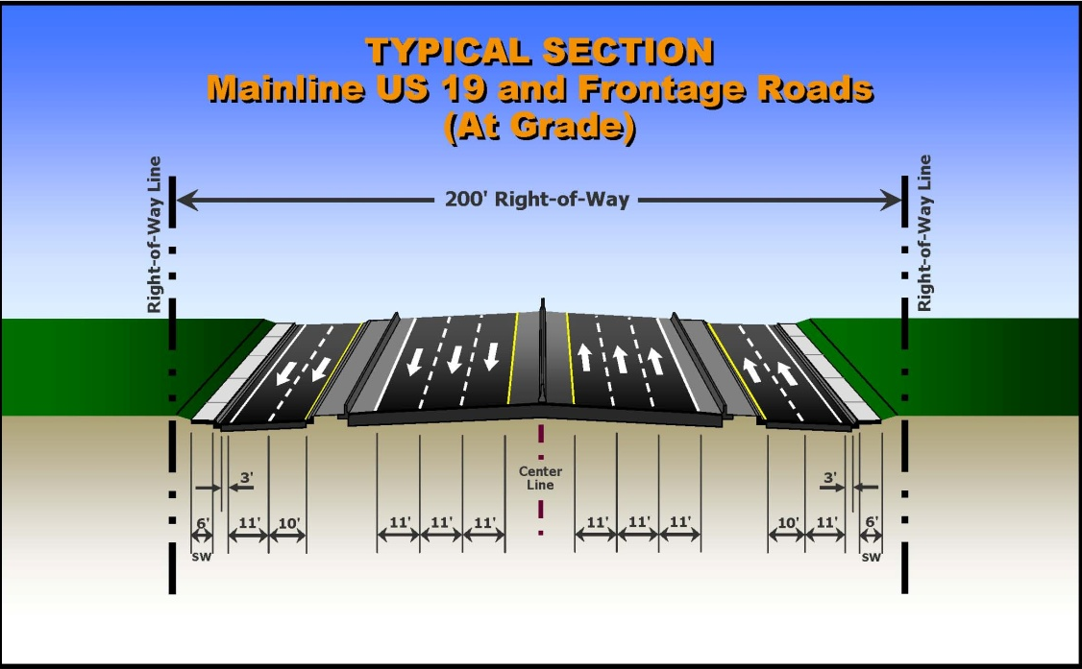
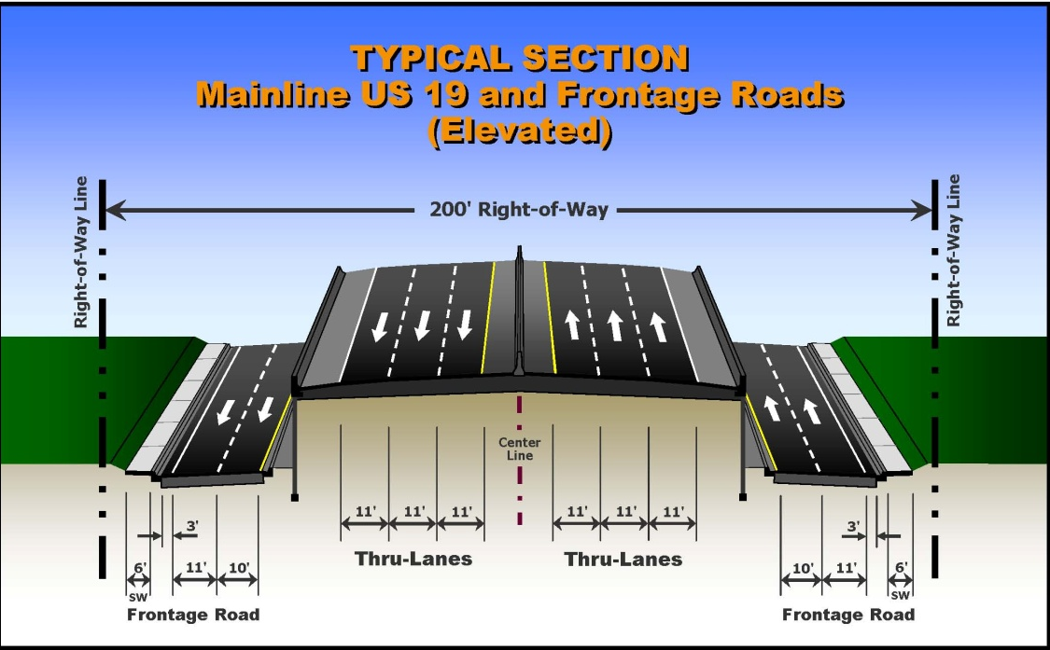
Project Description
Typical Sections

Slide 25
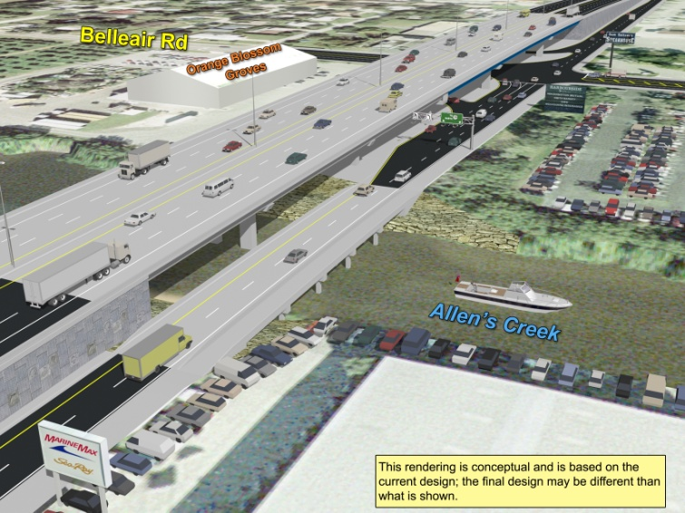
Project Description
Grade Separated Intersections
Belleair Road / Allens Creek
State Road 60
Seville Boulevard

Slide 26
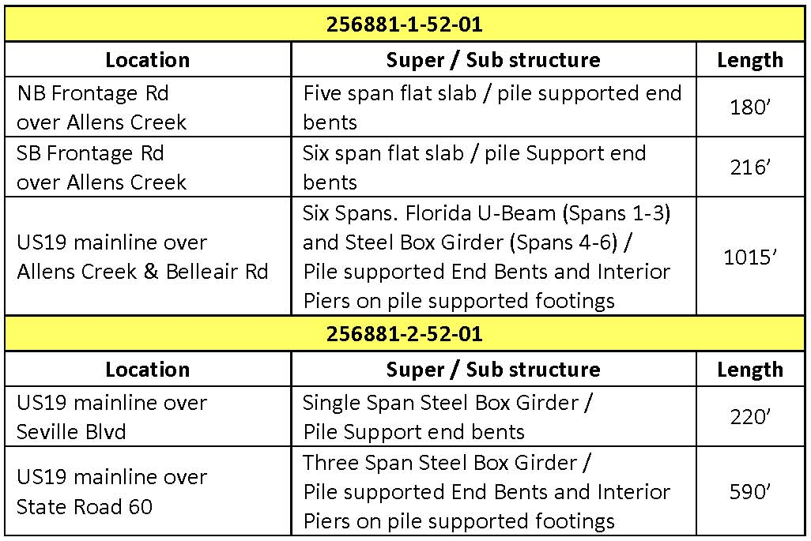
Project Description
Bridge Structures

Slide 27
Project Description
Overview of FPID Packages
FPID 256881-1-52-01 North of Whitney Road to south of Seville Blvd.
FPID 256881-2-52-01 South of Seville Blvd. to north of State Road 60
FPID: 256881-1
FPID: 256881-2

Slide 28
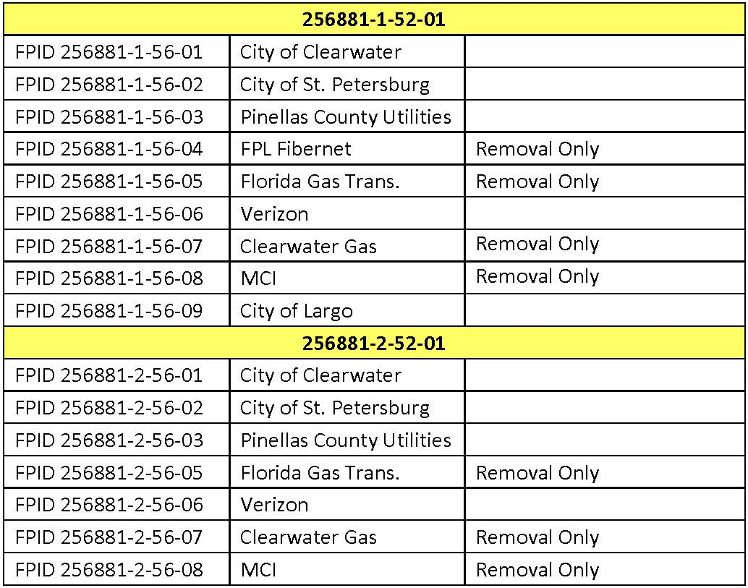
Project Description
Utility Work by Highway Contractor (UWHCA)
UWHCA on both projects:
N. of Whitney Rd to S. of Seville Blvd. (FPID 256881-1-52-01)
S. of Seville Blvd. to N. of SR 60 (FPID 256881-2-52-01)

Slide 29
Project Description
Joint Project Agreements (JPA)
City of Clearwater
Box Culvert (replace existing cross drain)
Imperial Cove and Bay Cove Apartments
(right turn lane)
Pinellas County
Wide sidewalk
North side of Belleair Road
South side of Haines-Bayshore Road

Slide 30
Project Description
Specification Package
13 TSPs:
One Signalization
One structures
One survey
Two drainage
Eight utility

Slide 31
Project Description
Permits
SWFWMD :
Separate permits for 256881-1-52-01 and 256881-2-52-01 projects (Permit Issue date: Sept 2005 Expiration Date: Sept 2010)
USACE:
Joint permit for 256881-1-52-01 and 256881-2-52-01 projects (Permit Issue date: Feb 2009 Expiration Date: Feb 2014)
Pinellas County:
Right of Way Use Permit
Tropic Hills Stormwater Outfall Project,
COC Project No. 99-0018-EN,
have included 0.05 acres of surface water impacts, associated
with filling in the ditch, in their permit applications for
SWFWMD and ACOE.

Slide 32
Project Description
Traffic Control Plan
TCP phases sequenced between 256881-1 and 256881-2 projects
Equal construction efforts/focus on both projects concurrently
ITS is to be maintained continuously throughout construction
PSTA related notes located in the 256881-1 plans only
ADA guidelines and pedestrian traffic must be maintained
Temporary Critical Sheetwalls
Drainage Features
Utility removals and relocations
Removal of Existing Walls and Earthwork

Slide 33
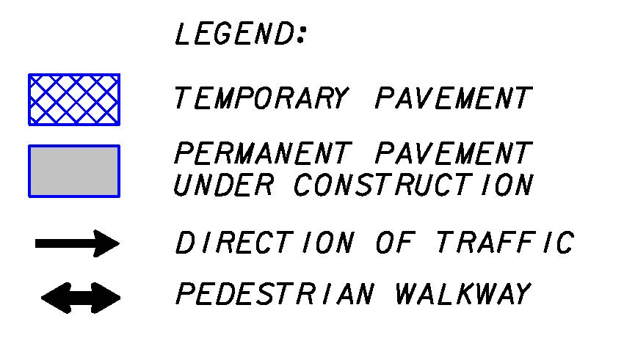
Project Description
Traffic Control Plan

Slide 34
Project Description
Traffic Control Plan

Slide 35
Project Description
Traffic Control Plan

Slide 36
Project Description
Traffic Control Plan

Slide 37
Project Description
Construction Focus / Highlights
MAINTAIN ALL WORK ACTIVITIES WITHIN FDOT R/W (JPA work also within easements and other public R/W)
ANY AGREEMENTS FOR CONTRACT WORK OUTSIDE FDOT R/W
MUST BE IN WRITING AND SIGNED BY THE PROPERTY OWNERS
Driveways
Maintain access
Connections within FDOT R/W
ADA compliant
Utility Adjustments and Relocations
Advance relocations
Concurrent relocations
Progress Energy needs to be relocated twice in area of Sound Barrier Wall (256881-2 only)

Slide 38
Project Description
Construction Focus / Highlights
UWHCA
Temporary Critical Sheet Walls
Progress Energy: Hot Oil Line to remain
Pre-drilling of piles required at Allens Creek
Construction of drilled shaft foundations near R/W (casings required)
Earthwork at existing retaining walls
Contamination Notes specific to project limits

Slide 39
Project Description
Utilities Owners
PROGRESS ENERGY
HOT OIL
TRANSMISSION
DISTRIBUTION
CITY OF CLEARWATER
LIGHTING
UTILITIES
CITY OF ST. PETERSBURG
PINELLAS COUNTY UTILITIES
TRAFFIC
UTILITIES
FPL FIBERNET
FLORIDA GAS TRANSMISSION
CLEARWATER GAS
MCI WORLDCOM
CITY OF LARGO
BRIGHTHOUSE NETWORKS
KNOLOGY BROADBAND OF FLA
TELCOV (FORMERLY KMC) LEVEL (3) COMMUNICATIONS
FIBERLIGHT (XSPEDIUS)
FDOT ITS
FDOT LIGHTING
VERIZON
Notes:
39

Slide 40
Project Description
Utilities – Relocations To Be Started Prior to Construction
Progress Energy – Distribution
Verizon
Clearwater Gas
Joint Bore under Allen’s Creek completed prior to construction.
Progress Energy
Brighthouse Networks
Knology
Verizon
FPL Fibernet
Level 3
Notes:
40

Slide 41
Project Description
Utilities
Utility Work by Highway Contractor Agreement (UWHCA)
Notes:
41

Slide 42
Project Description
Utilities
Utility Awareness – Progress Energy Hot Oil
Construction in vicinity of hot oil line to be closely monitored by PE representatives
Sheet piling in vicinity of hot oil line to be performed by non-vibratory method
Utility Awareness – Water main Construction
Sequence construction to avoid concurrent shutdown of transmission water mains
City of St. Petersburg 48” WM
Pinellas County 42” WM

Slide 43
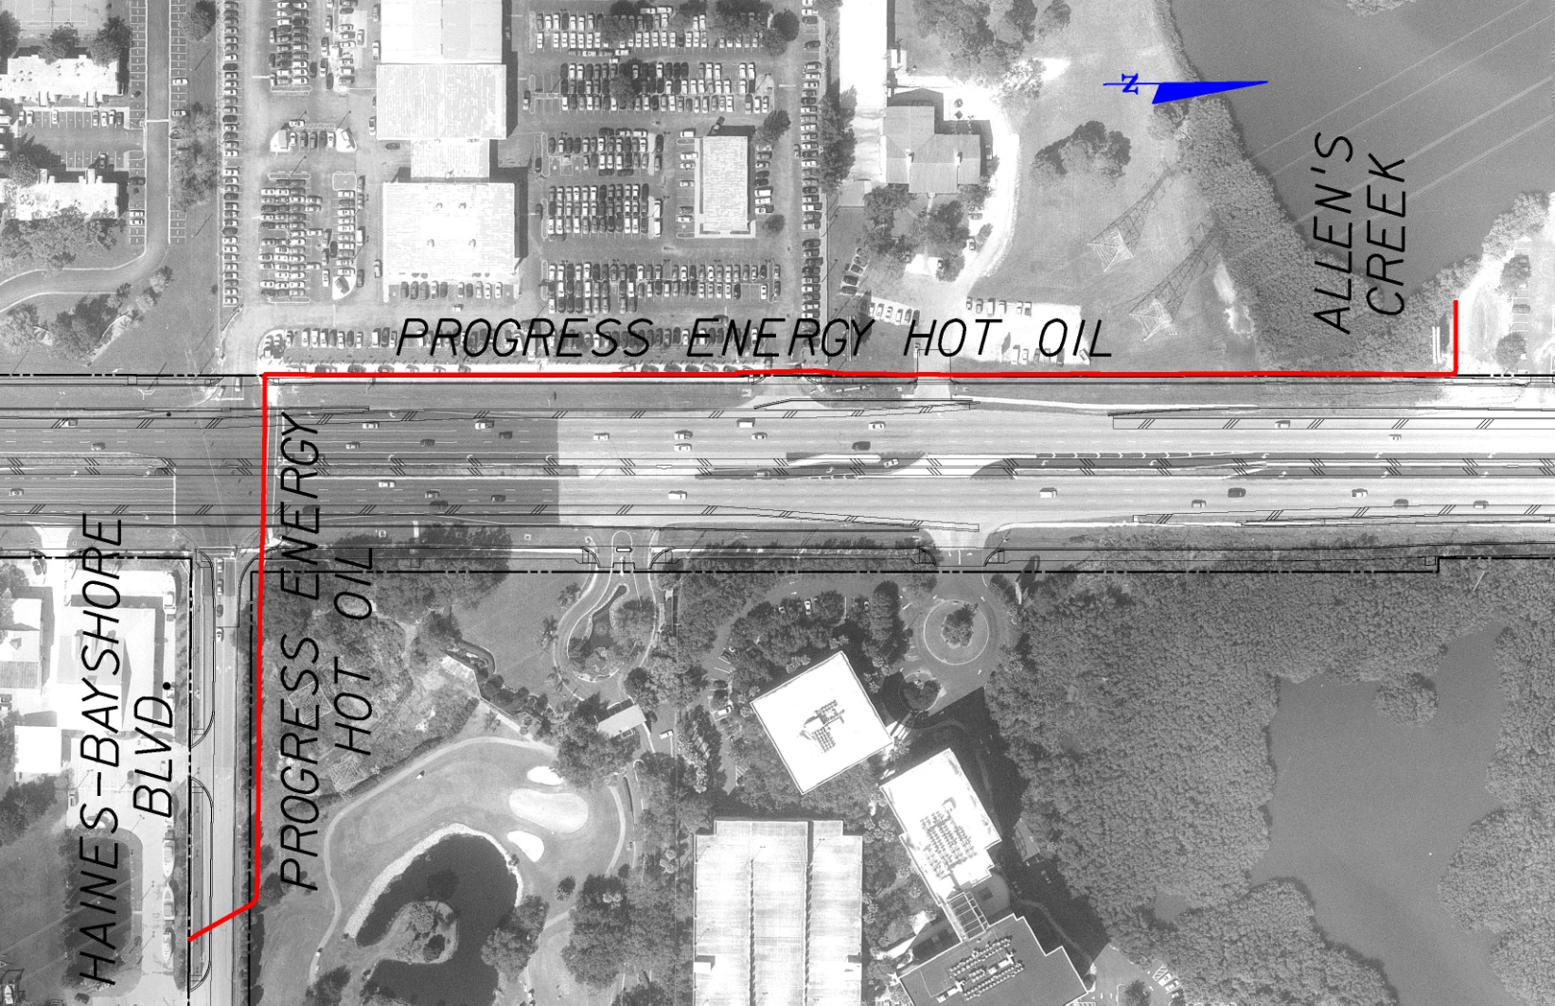
Project Description
Utilities
Utility Awareness – Progress Energy Hot Oil
Notes:
43

Slide 44
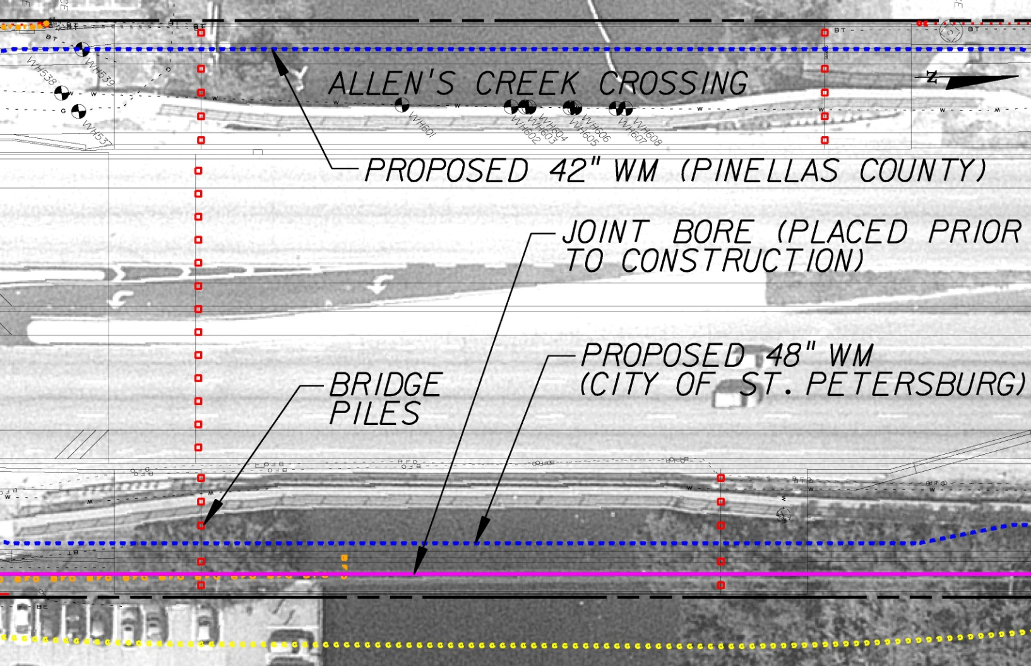
Project Description
Utilities
Utility Awareness – Allens Creek Crossing

Slide 45
Project Description
Utilities
Utility Awareness – Temporary Critical Sheet Pile Wall
To protect travelling public and adjacent properties
Splicing required to avoid overhead electric
Vibratory restrictions in sensitive areas (PE Hot Oil)
Limited clearance between right-of-way and utilities
Contractor to locate existing transverse utilities and lag around during placement of sheet pile wall
Driveways to be constructed in phases in areas of sheet pile walls
Approx. 489,880 sf of temporary critical sheet pile wall

Slide 46
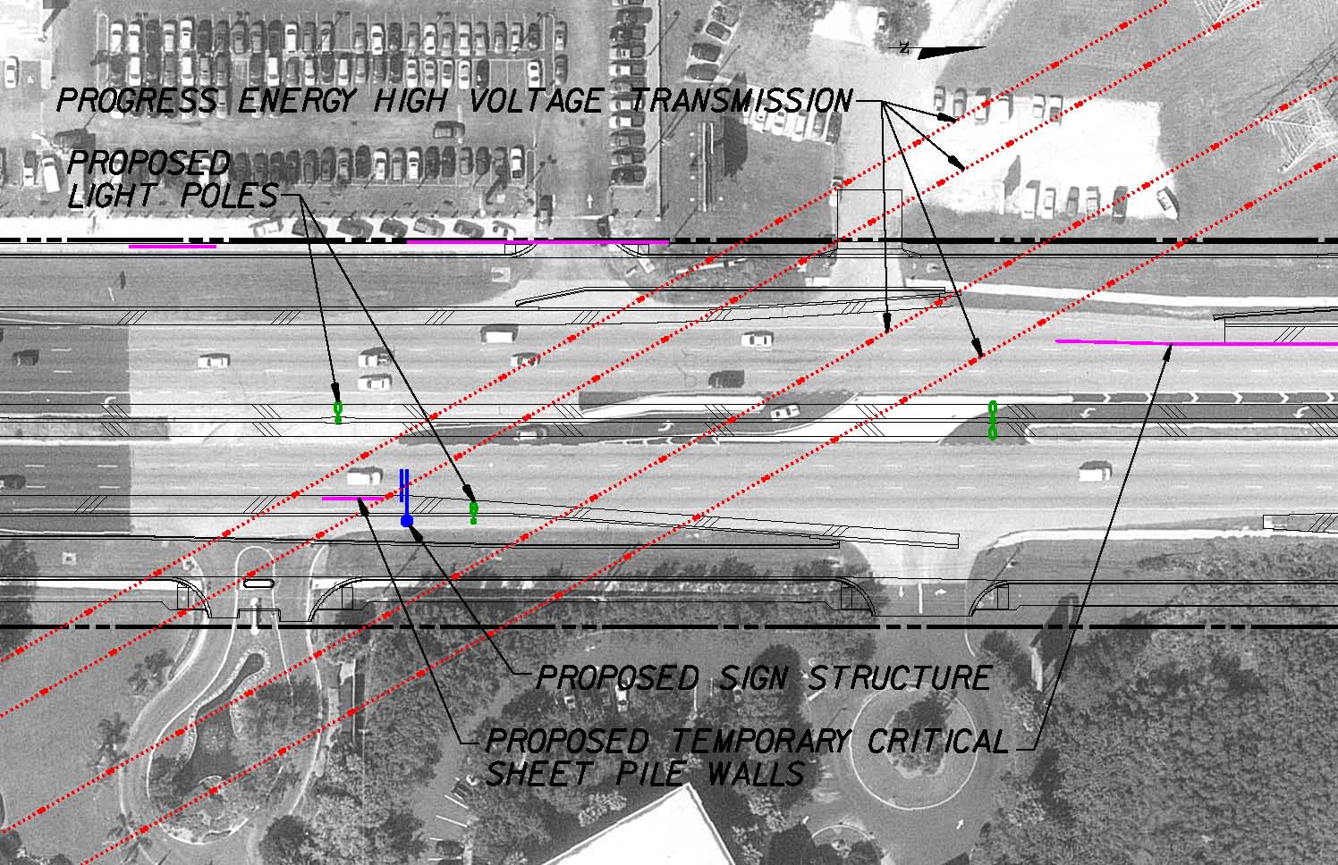
Project Description
Utilities
Utility Awareness – PE High Voltage Transmission

Slide 47
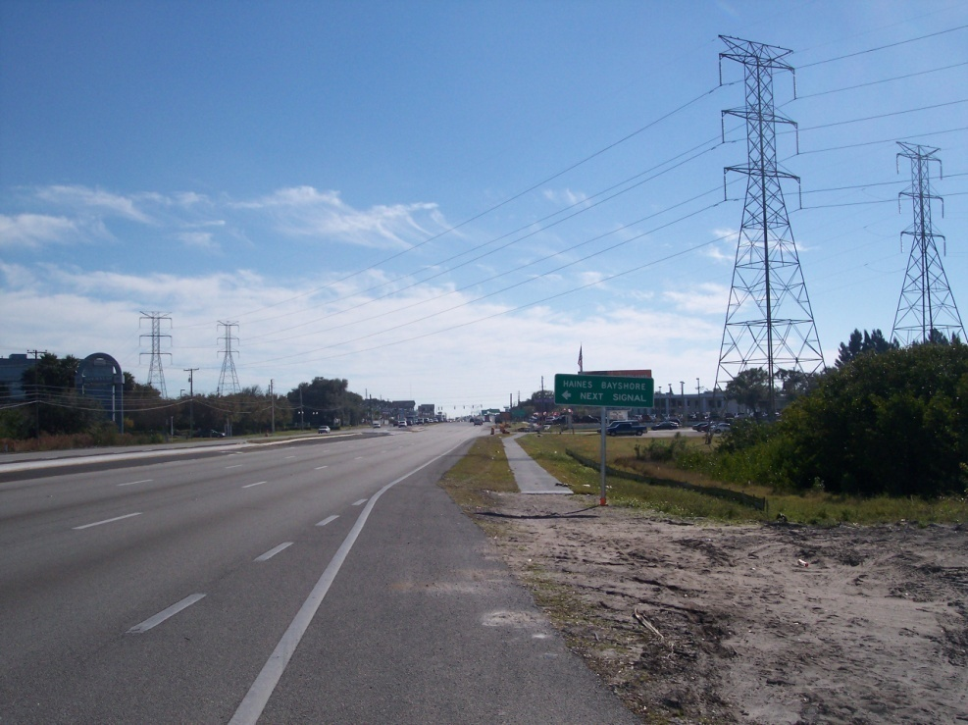
Project Description
Utilities
Utility Awareness – PE High Voltage Transmission

Slide 48
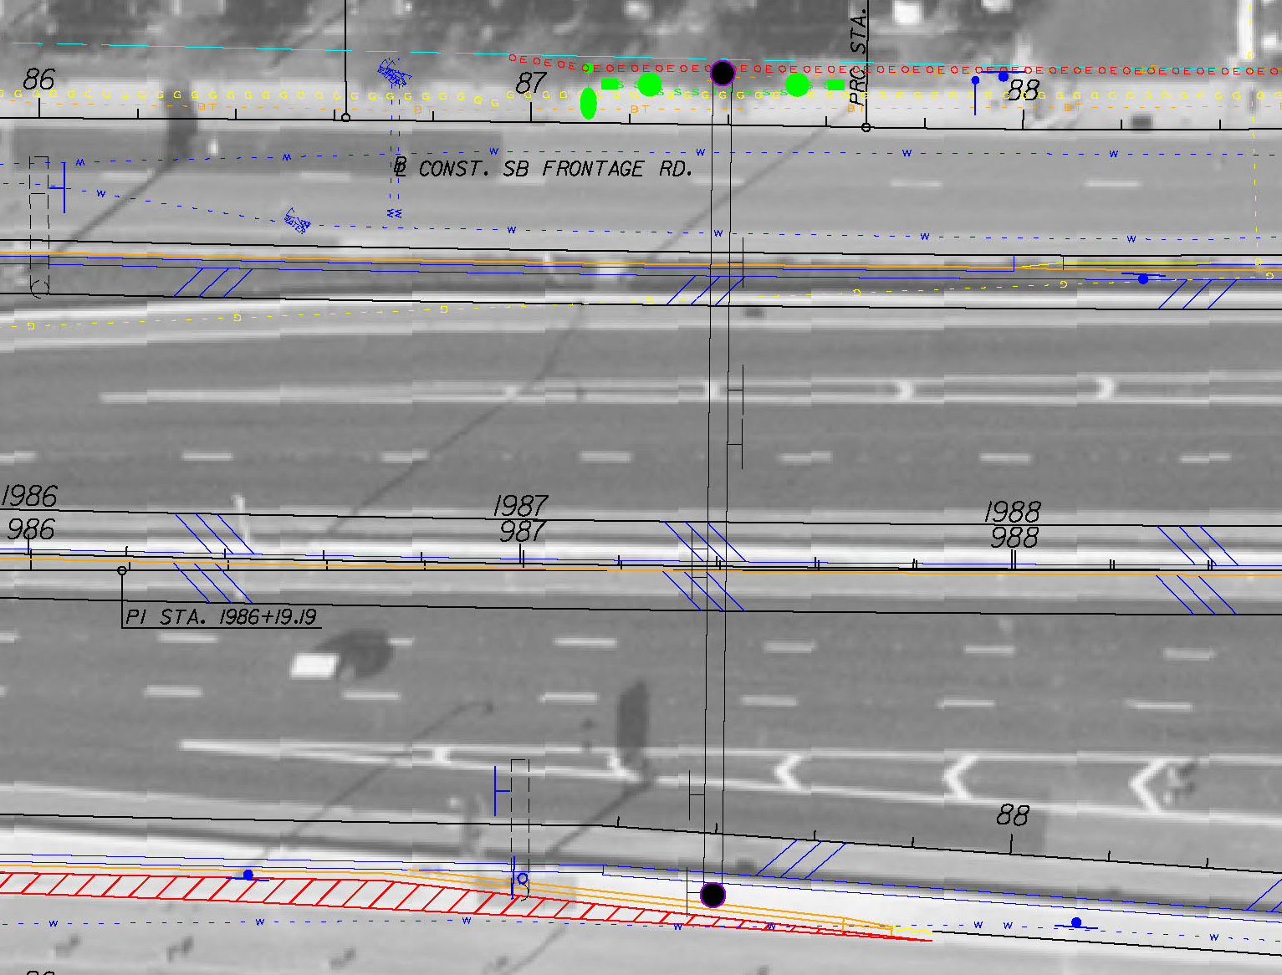
Project Description
Utilities
Utility Awareness – Drilled Shaft Foundations
DRILLED SHAFT WITH CASING
DRILLED SHAFT WITH CASING

Slide 49
Project Description
Utilities
Utility Awareness – Temporary Critical Sheet Pile Wall

Slide 50
Project Description
Contamination Sites
Harberston Swanston, Inc 17116 North US19 SB Frontage Road Sta. 157+50 to Sta. 161+00
Orange Blossom Groves 18200 North US19 SB Frontage Road Sta. 191+80 to Sta. 196+50
Hess Station 2577 Harn Blvd. Sta. 224+00 to Sta. 228+50
Circle K, 17218 North US19 SB Frontage Road Sta. 161+00 to Sta. 163+50
Allied Discount Tires 18300 North US19 SB Frontage Road Sta. 195+00 to Sta. 199+50
ABC Cleaners
2579 Harn Blvd. Sta. 926+60 to Sta. 928+00
FPID: 256881-1
FPID: 256881-2
Angel Properties
2575 Gulf To Bay Blvd.
SB Frontage Road
Sta. 269+60 to Sta. 273+00
Sweethearts
20866 US19 North
SB Frontage Road
Sta. 82+40 to Sta. 84+00

Slide 51
Questions & Answers
Questions & Answers

Slide 52
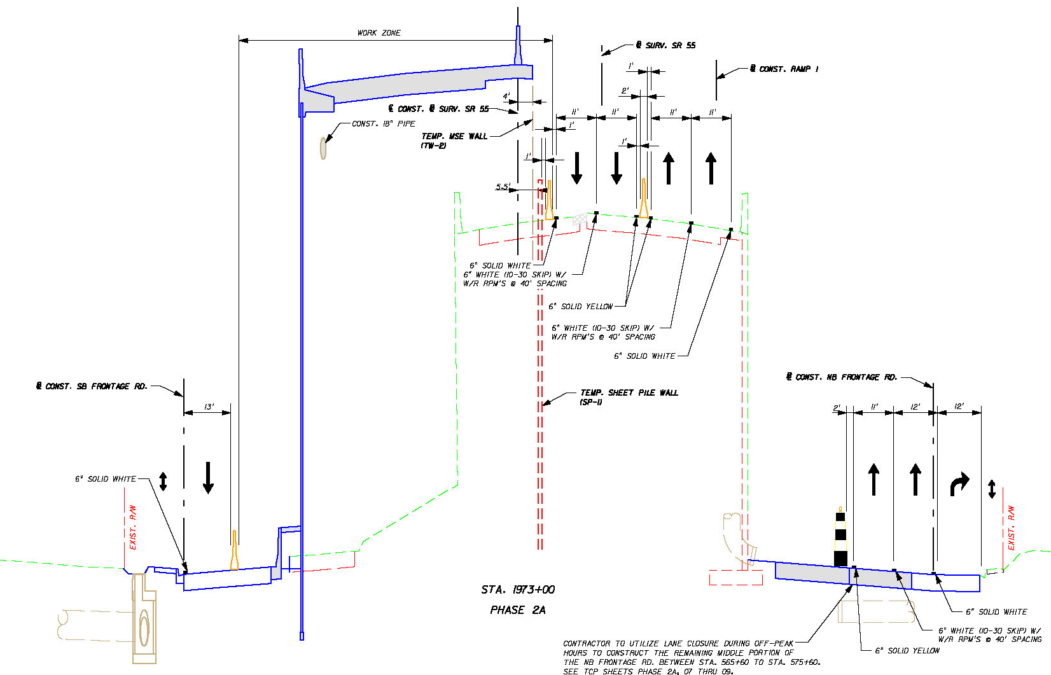
Project Description
Traffic Control Plan

Slide 53
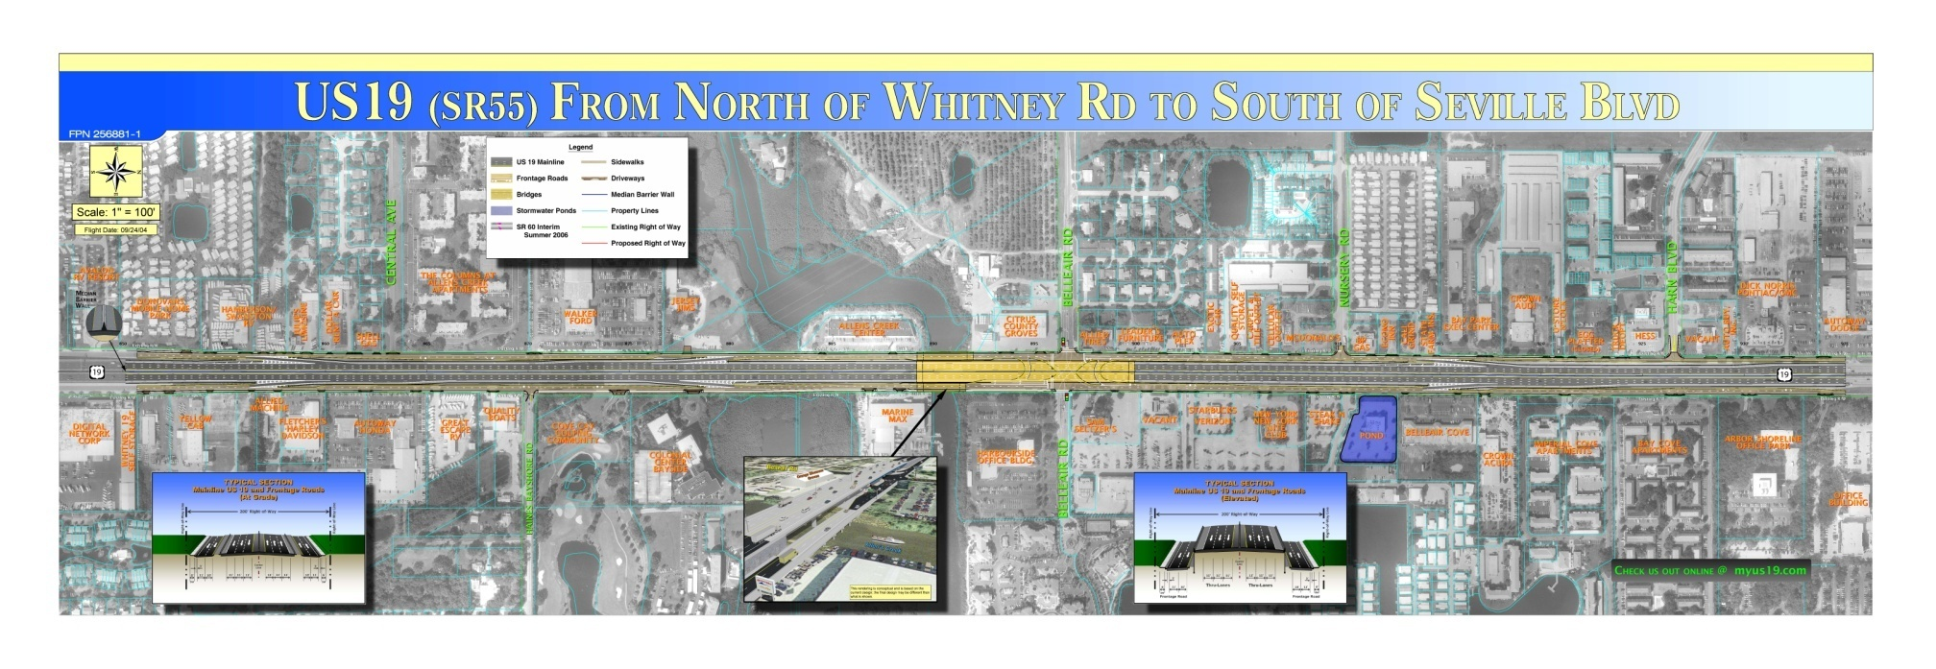
Project Description
Overview of FPID Packages
FPID 256881-1-52-01 North of Whitney Road to South of Seville Boulevard – 1.6 Miles

Slide 54
Project Description
Overview of FPID Packages
FPID 256881-2-52-01 South of Seville Boulevard to North of State Road 60) – 1.2 Miles

